Slide 1
Trustworthy research collaboration starts with trustworthy access
The AARC handbook: a practical guide to federated identity management for research infrastructures
Maarten Kremers, SURF
ISGC 2026
Taipei, 20th March 2026
https://aarc-community.org/aarc-tree-project/
Notes:
Good morning, and thank you for being here. At ISGC, we are talking about trustworthy infrastructures, secure collaboration, and the conditions that make (open( science actually work. One of those conditions is access: who can use which services, under what conditions, and with what level of trust. When access is fragmented or ad hoc, collaboration becomes slower, harder to scale, and more difficult to secure. Today I want to introduce the AARC Handbook not as another architecture document, but as a practical guide for communities and infrastructures that need to make this work in the real world.

Slide 2
The problem everyone recognises
Too many accounts and passwords
Manual onboarding for guests and collaborators
Unclear permissions and roles
Security and policy handled too late
Researchers confused, operators overloaded
This is not only a login problem
Notes:
Even if you do not work in identity management, these symptoms are probably familiar. A service begins with local users. Then external collaborators join. Then project partners from other institutions, sometimes from other countries. Soon there are separate accounts, manual approval steps, spreadsheet-based workarounds, unclear permissions, and pressure on support teams. Researchers experience friction, operators experience complexity, and security or compliance questions often arrive only after the service is already in use. So the problem is not only authentication. The real challenge is managing trust, roles, and access across organisational boundaries.

Slide 3
What federated identity management actually means
Home Organisation
Research community / infrastructure
Service
Identity comes from a trusted source
Community adds roles, groups, or project context
Service decides access
Not just login — also trust and access decisions
Notes:
So what do we actually mean by federated identity management? In simple terms, it means that a user can access a service using an identity from an organisation that the service trusts, instead of every service creating separate local accounts for everyone. But that is only part of the story. Research communities often need to add more context: is this person part of the project, do they belong to a group, are they a PI, a student, a guest, or an operator? So federation is not just about proving who somebody is. It is about combining trusted identity with community context so that services can make sensible access decisions.

Slide 4
Why this is harder than it looks
Identity
who is this person, consistently?
Authorisation
what are they allowed to do?
Interoperability
how do systems work together?
Policy & trust
security, data protection, responsibilities
Notes:
This is where reality becomes more complicated. It is one thing to say “use federated identity”; it is another to make it work well. You need to represent identities consistently. You need an authorisation model that reflects real community roles. You need services and components to interoperate. And you need to handle security, privacy, and governance questions in a way that is defensible and sustainable. In other words, this is not only a technical integration issue. It is a combination of technical, operational, and policy challenges. That is exactly why many communities need guidance that goes beyond standards documents.

Slide 5
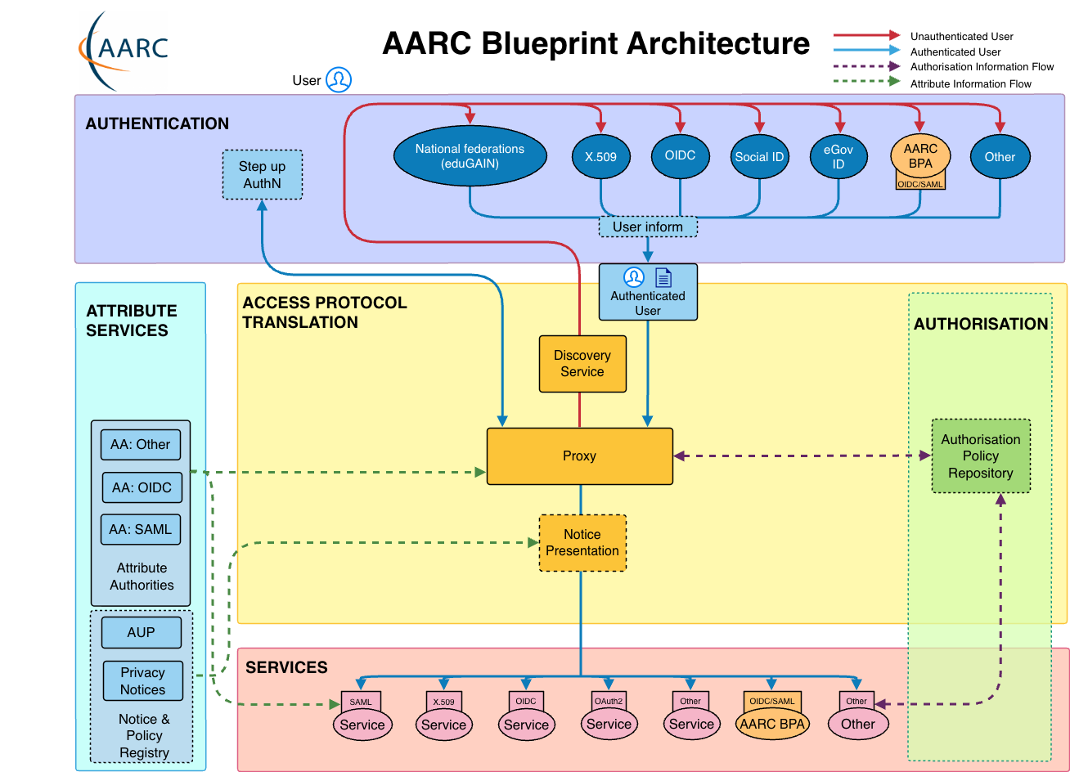
The AARC Handbook: a practical guide
What is it?
Who is it for?
•
Practical guide
•
Research Community Management
•
Introductory, but not simplistic
•
AAI Implementors and Operators
•
Funding Agencies
•
Bridges technical, policy, and community needs
•
All / General audience
What does it contain?
•
Why research AAIs matter
•
Implementation choices, including buy vs build
•
Policy and interoperability guidance
•
Software, services, glossary, FAQs, and examples
Notes:
The AARC Handbook is intended as a practical introductory guide to federated identity management for research infrastructures and their communities. What I like about it is that it is not written only for identity specialists. It is written for several audiences, including research community management, AAI implementors and operators, funding agencies, and also a broader general audience. It explains why research AAIs matter, outlines implementation choices such as buy versus build, and points to software, services, and practical examples. So rather than asking every community to reinvent the same understanding from scratch, it gives them a shared starting point.

Slide 6
Questions the Handbook helps you answer
Do we need to build our own AAI, or can we use a hosted solution?
How do we support external collaborators safely?
How do we connect identity, roles, and access decisions?
What policy and data protection questions do we need to address?
How do we make choices that will still scale later?
The Handbook is useful because it
helps communities ask the right questions
Notes:
This slide shows the kinds of questions the Handbook helps people answer. That is important, because many communities do not start with a technology choice; they start with uncertainty. Do we build something ourselves? Can we use a hosted solution? How do we support external collaborators safely? What policy and data protection questions do we need to think about? The Handbook helps communities ask the right questions early, before short-term decisions turn into long-term constraints.

Slide 7
There is no one-size-fits-all path
Hosted / managed path
Self-hosted / proxy path
•
Faster to start
•
More control and flexibility
•
Lower operational burden
•
Better for more complex requirements
•
Good for communities with limited IAM capacity
•
Greater technical and policy responsibility
Choose based on scale, risk, resources, and sustainability
Notes:
One of the most useful messages in the Handbook is that there is no universal implementation pattern. Different communities have different capacities, risks, and requirements. For some, a hosted or managed solution is clearly the best option because it reduces operational burden and speeds up adoption. For others, more local control may be necessary because of integration complexity, policy constraints, or infrastructure-specific needs. The important point is that the choice should be deliberate, and that communities should think not only about deployment, but also about operations, maintenance, and long-term interoperability.

Slide 8
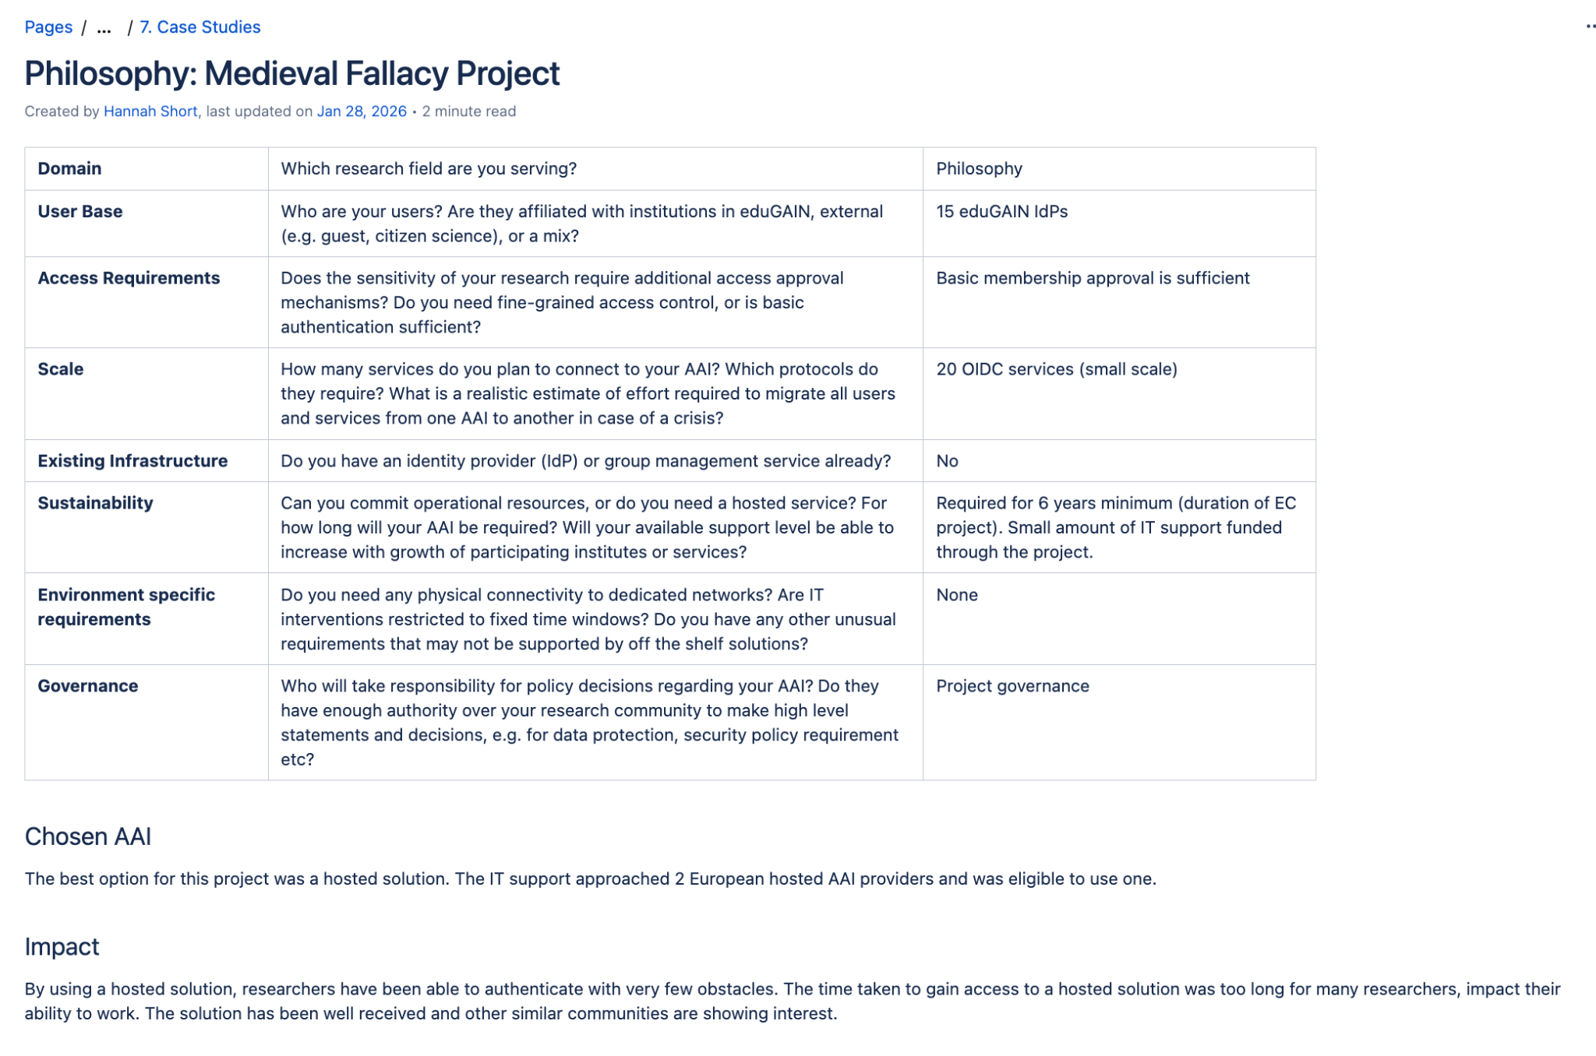
Early examples from the Handbook
Case Study in Astronomy and Particle Physics: CERN laboratory
Case Study in Social Sciences and Humanities: Philosophy: Medieval Fallacy project
more use case editors welcome!
Notes:
These examples show that research communities do not all look the same. One example comes from a very large and well-known research environment, and another from a much smaller humanities project. The point is not that these two cases cover the full landscape. The point is that the Handbook is designed to capture practical implementation experience in a reusable format. Even with a small number of examples today, it already shows the value of turning real-world experience into something other communities can learn from.

Slide 9

A simple starting point for your community
Map who needs access, to which services, and who you trust to vouch for them.
Choose a path that matches your capacity
Use the Handbook to align technical, policy, and operational decisions
Better access decisions make collaboration faster, safer, and easier to scale.
Visit
https://wiki.geant.org/spaces/AARC/pages/1278607380/AARC+Handbook
Notes:
So the key message I want to leave with you is this: trustworthy research collaboration depends on trustworthy and scalable access. The AARC Handbook is meant to help communities and infrastructures make better decisions about that, without requiring everyone to become an identity specialist first. It gives you a shared language, practical choices, policy guidance, and examples. You do not need to solve everything at once. A good starting point is to map who needs access, to which services, and who you trust to vouch for them, then choose an approach that fits your capacity and maturity.

Slide 10
Many thanks to all of the editors of the handbook:
Hannah Short, Sally Chambers, Michael Kurzmeier
and all the contributors
maarten.kremers@surf.nl
Notes:
Thank you. I’d be very happy to discuss whether this Handbook could help your community, your service, or your infrastructure.

