Slide 1

Integrating AI into
Data-Center Operations
Dr Marco Lorusso, INFN-CNAF

Slide 2
Context
The increasing complexity and scale of modern data centers generate operational environments where the ability to detect anomalies, predict failures, and improve resource usage is becoming critically important.
Recent advances in machine learning and artificial intelligence offer powerful techniques for extracting actionable insights from heterogeneous monitoring data
In this contribution, we explore an AI-driven approac that can be applied to a specific large-scale computing facility hosted at INFN-CNAF in Bologna.

Slide 3
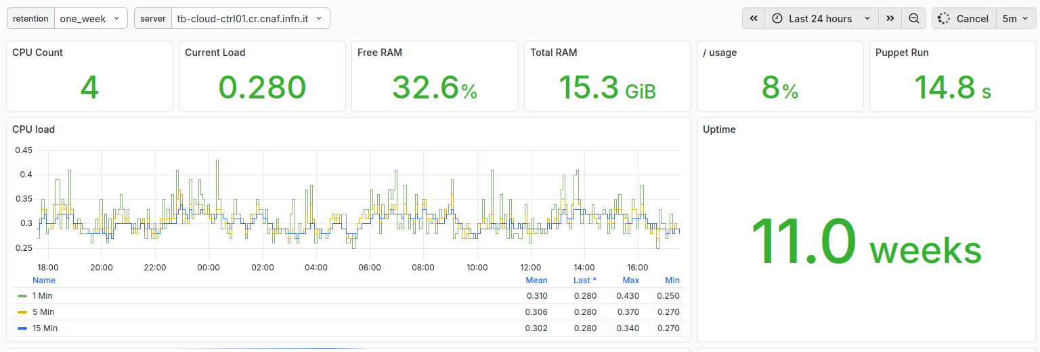
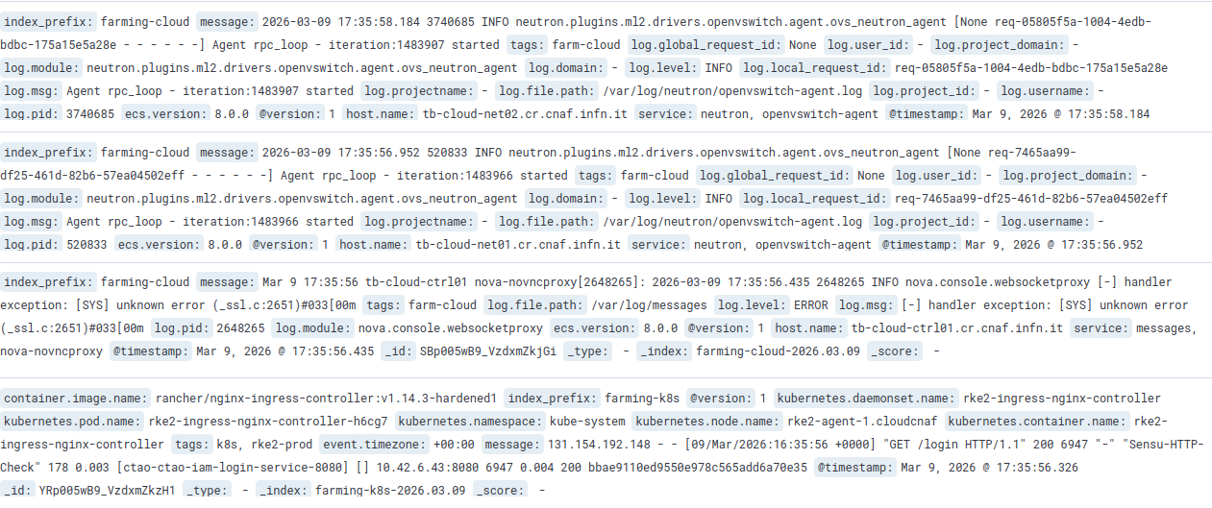
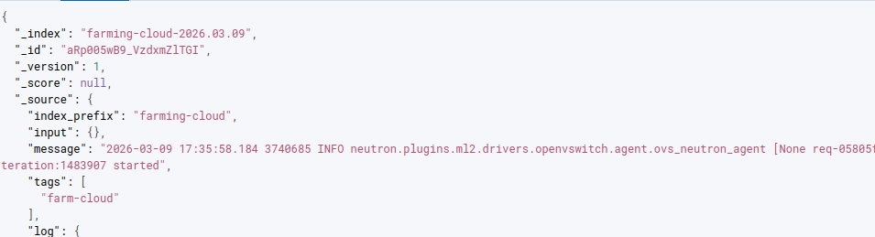
Data Complexity
Multiple Data sources
  Logs, metrics, monitoring data, and system outputs
Heterogeneous formats
  Structured (JSON), semi-structured (logs), and time-series metrics
Large data volumes
  High and continuously growing data amounts
Processing Complexity

Slide 4
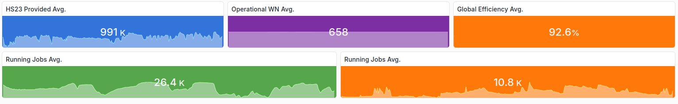
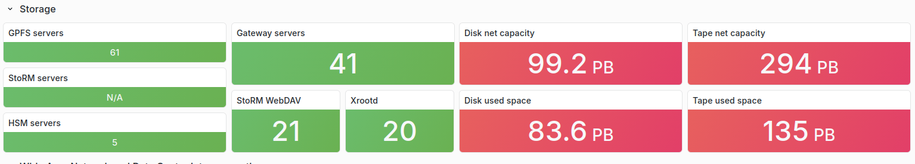
Data Complexity @ CNAF
Large-Scale Infrastructure @ CNAF
  CERN Tier-1 data center with large computing and storage capacity
High Data Volume
  Petabyte-scale storage and thousands of running jobs
  Metrics, logs, and monitoring data from hosts and services
Analytical Challenge
  Large and diverse datasets require novel approaches for analysis

Slide 5
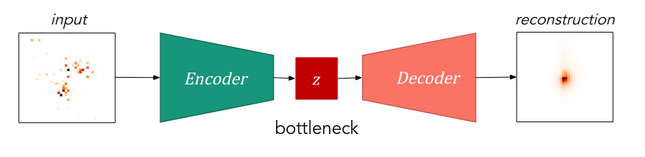
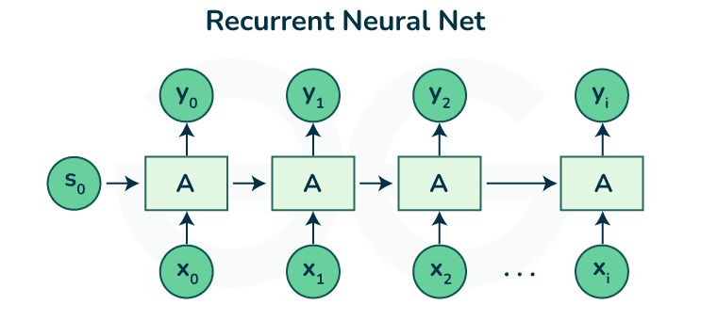
Different ML Approaches for AD
Autoencoder: trained to reconstruct their inputs:
  The encoder compress the input into a smaller latent space.
  The decoder reconstructs from the compressed representation.
Recurrent Neural Network: designed for processing sequential data
  the output of a neuron at one time step is fed back as input at the next time step
Transformer: based on the multi-head attention mechanism:
  designed to model relationships between elements in a set or sequence.

Slide 6
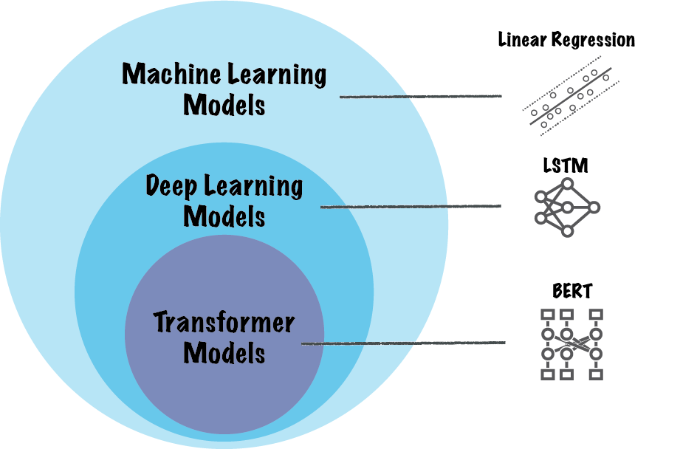
Transformer
Traditional ML models often impose fixed structural assumptions, such as locality or sequential processing;
Transformers instead rely on attention mechanisms to learn relationships directly from the data;
  hosts in a distributed system do not have a meaningful spatial ordering;
Self-attention allows each element in an input representation to interact with all other elements;
  The model learns which elements of the inputs are relevant to each other, enabling flexible modeling of complex interaction patterns.

Slide 7
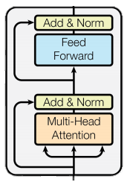
Transformer Architecture
Latent Space
A typical Transformer layer consists of two main components:
Self-attention:
  exchanges information between elements
Feed-forward transformation:
  independently refines each element's representation
attn = tf.keras.layers.MultiHeadAttention(num_heads,key_dim= lat_dim // num_heads, name = "multiheadattention")(e,e)
ee = tf.keras.layers.Add(name = "attn_resid")([e,attn])
ee = tf.keras.layers.LayerNormalization(name = "attn_ln")(ee)
ffn = tf.keras.layers.Dense(lat_dim * ff_trans_dens, activation = // "relu", name = "ffn1")(ee)
ffn = tf.keras.layers.Dense(lat_dim, activation = "relu", name = // "ffn1")(ffn)
eee = tf.keras.layers.Add(name = "ffn_resid")([ee,ffn])
eee = tf.keras.layers.LayerNormalization(name = "fnn_ln")(eee)
Inputs after Conv1D

Slide 8
Data Overview
Operational telemetry collected from services managed by the CNAF Farming Group, which operates the computing clusters supporting distributed scientific workloads and large-scale data processing.
The data is a multivariate time series across multiple hosts, which include:
CPU usage and load
memory utilization and disk I/O statistics
process-level resource metrics

Slide 9
Data Preparation and Processing
Raw Telemetry JSON Logs
Starting from multi-gigabyte JSON logs with redundant structure
For Anomaly Detection data must be processed to:
  Isolate informative system-level metric
  Remove noisy and low-signal process-level measurements
  Remove missing values and inconsistent reporting intervals
The resulting Dataset contains:
  4086 (check number) time snapshots for 304 compute nodes with 36 system-level metrics each = a timeseries with ~11k features each step. (~44M input values)
Metric Selection & Structural Reduction
ML-Ready Tensors
H x T x Metric

Slide 10
Signal injection
Data coming from nodes in production
  Real anomalies are rare
To evaluate the detection method, anomalies are synthetically injected into validation data by simulating realistic events affecting random hosts and metrics:
  CPU usage spikes
  Sustained workload shifts
  Disk I/O bursts
  Memory leaks
  Node outages
  Abnormal process behaviour

Slide 11
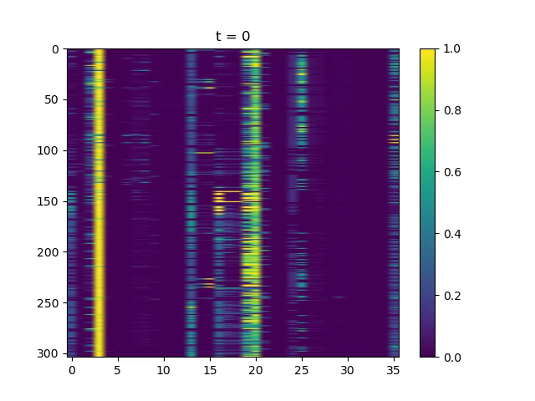
Training v Test dataset
Time series with anomalies
Time series without anomalies

Slide 12
Model Architecture
Input representation: telemetry windows arranged as time steps × hosts × features;
Encoder:
  Per-host temporal Conv1D layers extract short-term patterns
  Global max pooling produces a compact host representation
Cross-host modeling:
  Host embeddings processed with multi-head self-attention
  Residual and feed-forward layers refine the contextual representation
  A global latent vector summarizes the system state
Decoder:
  Host embeddings expanded and passed through temporal Conv1D layers
  Reconstructs the original telemetry window

Slide 13
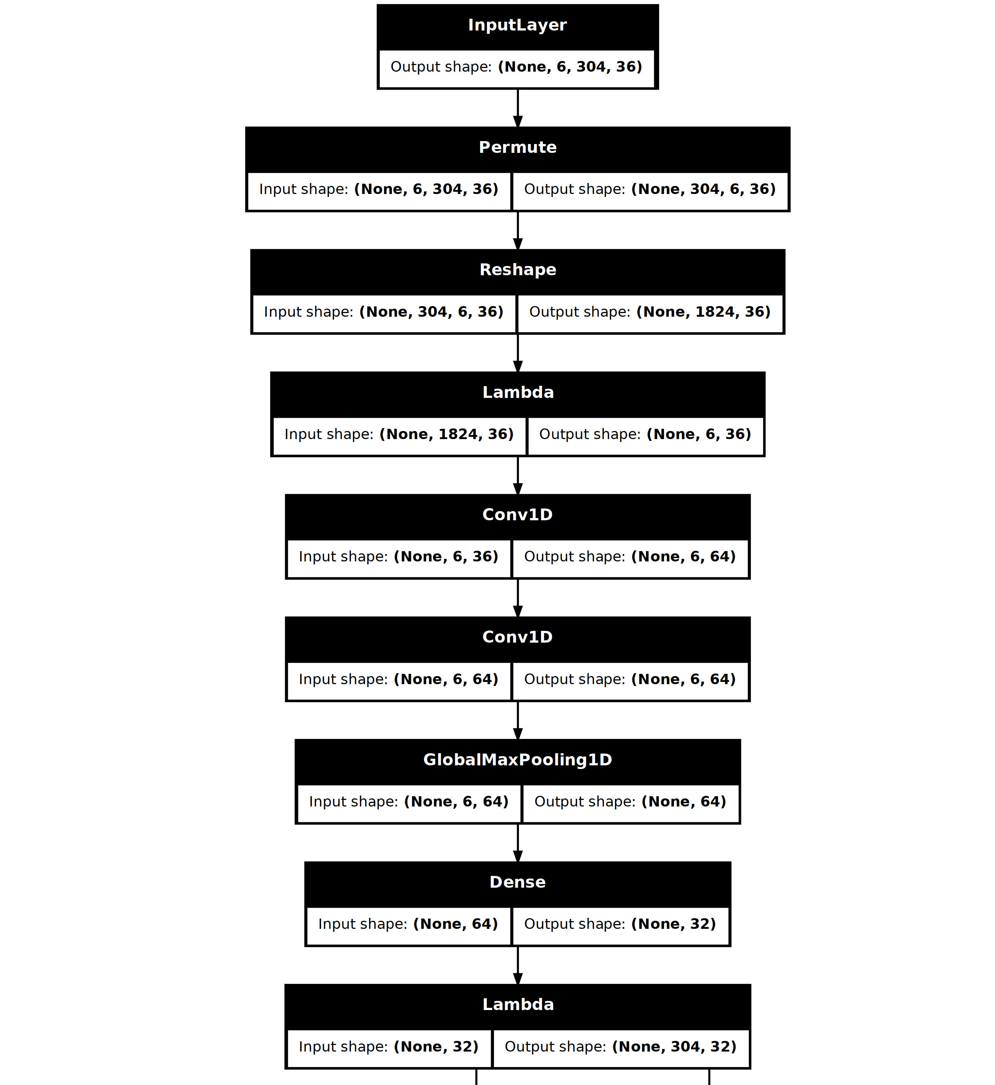
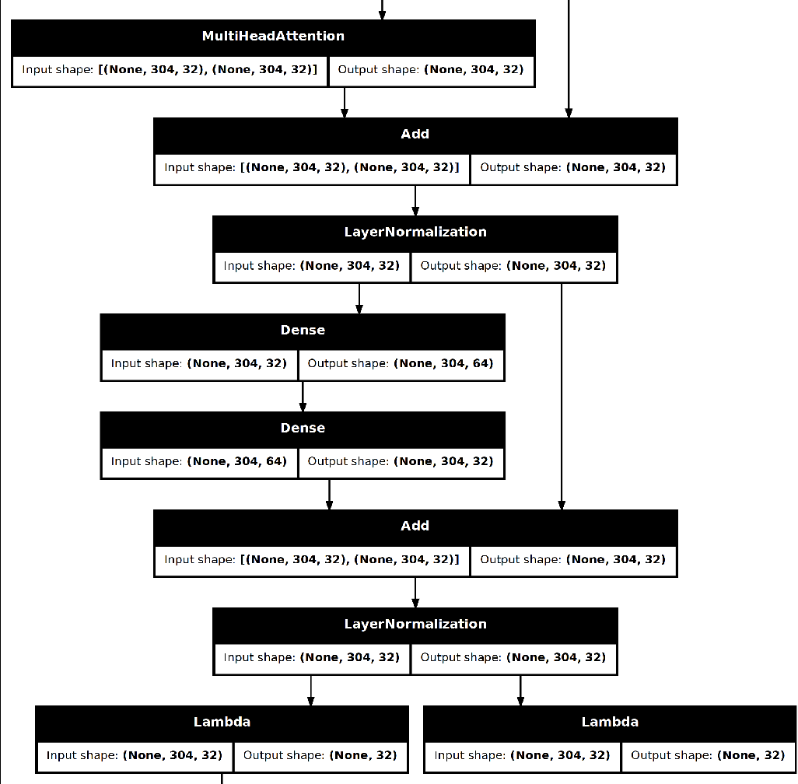
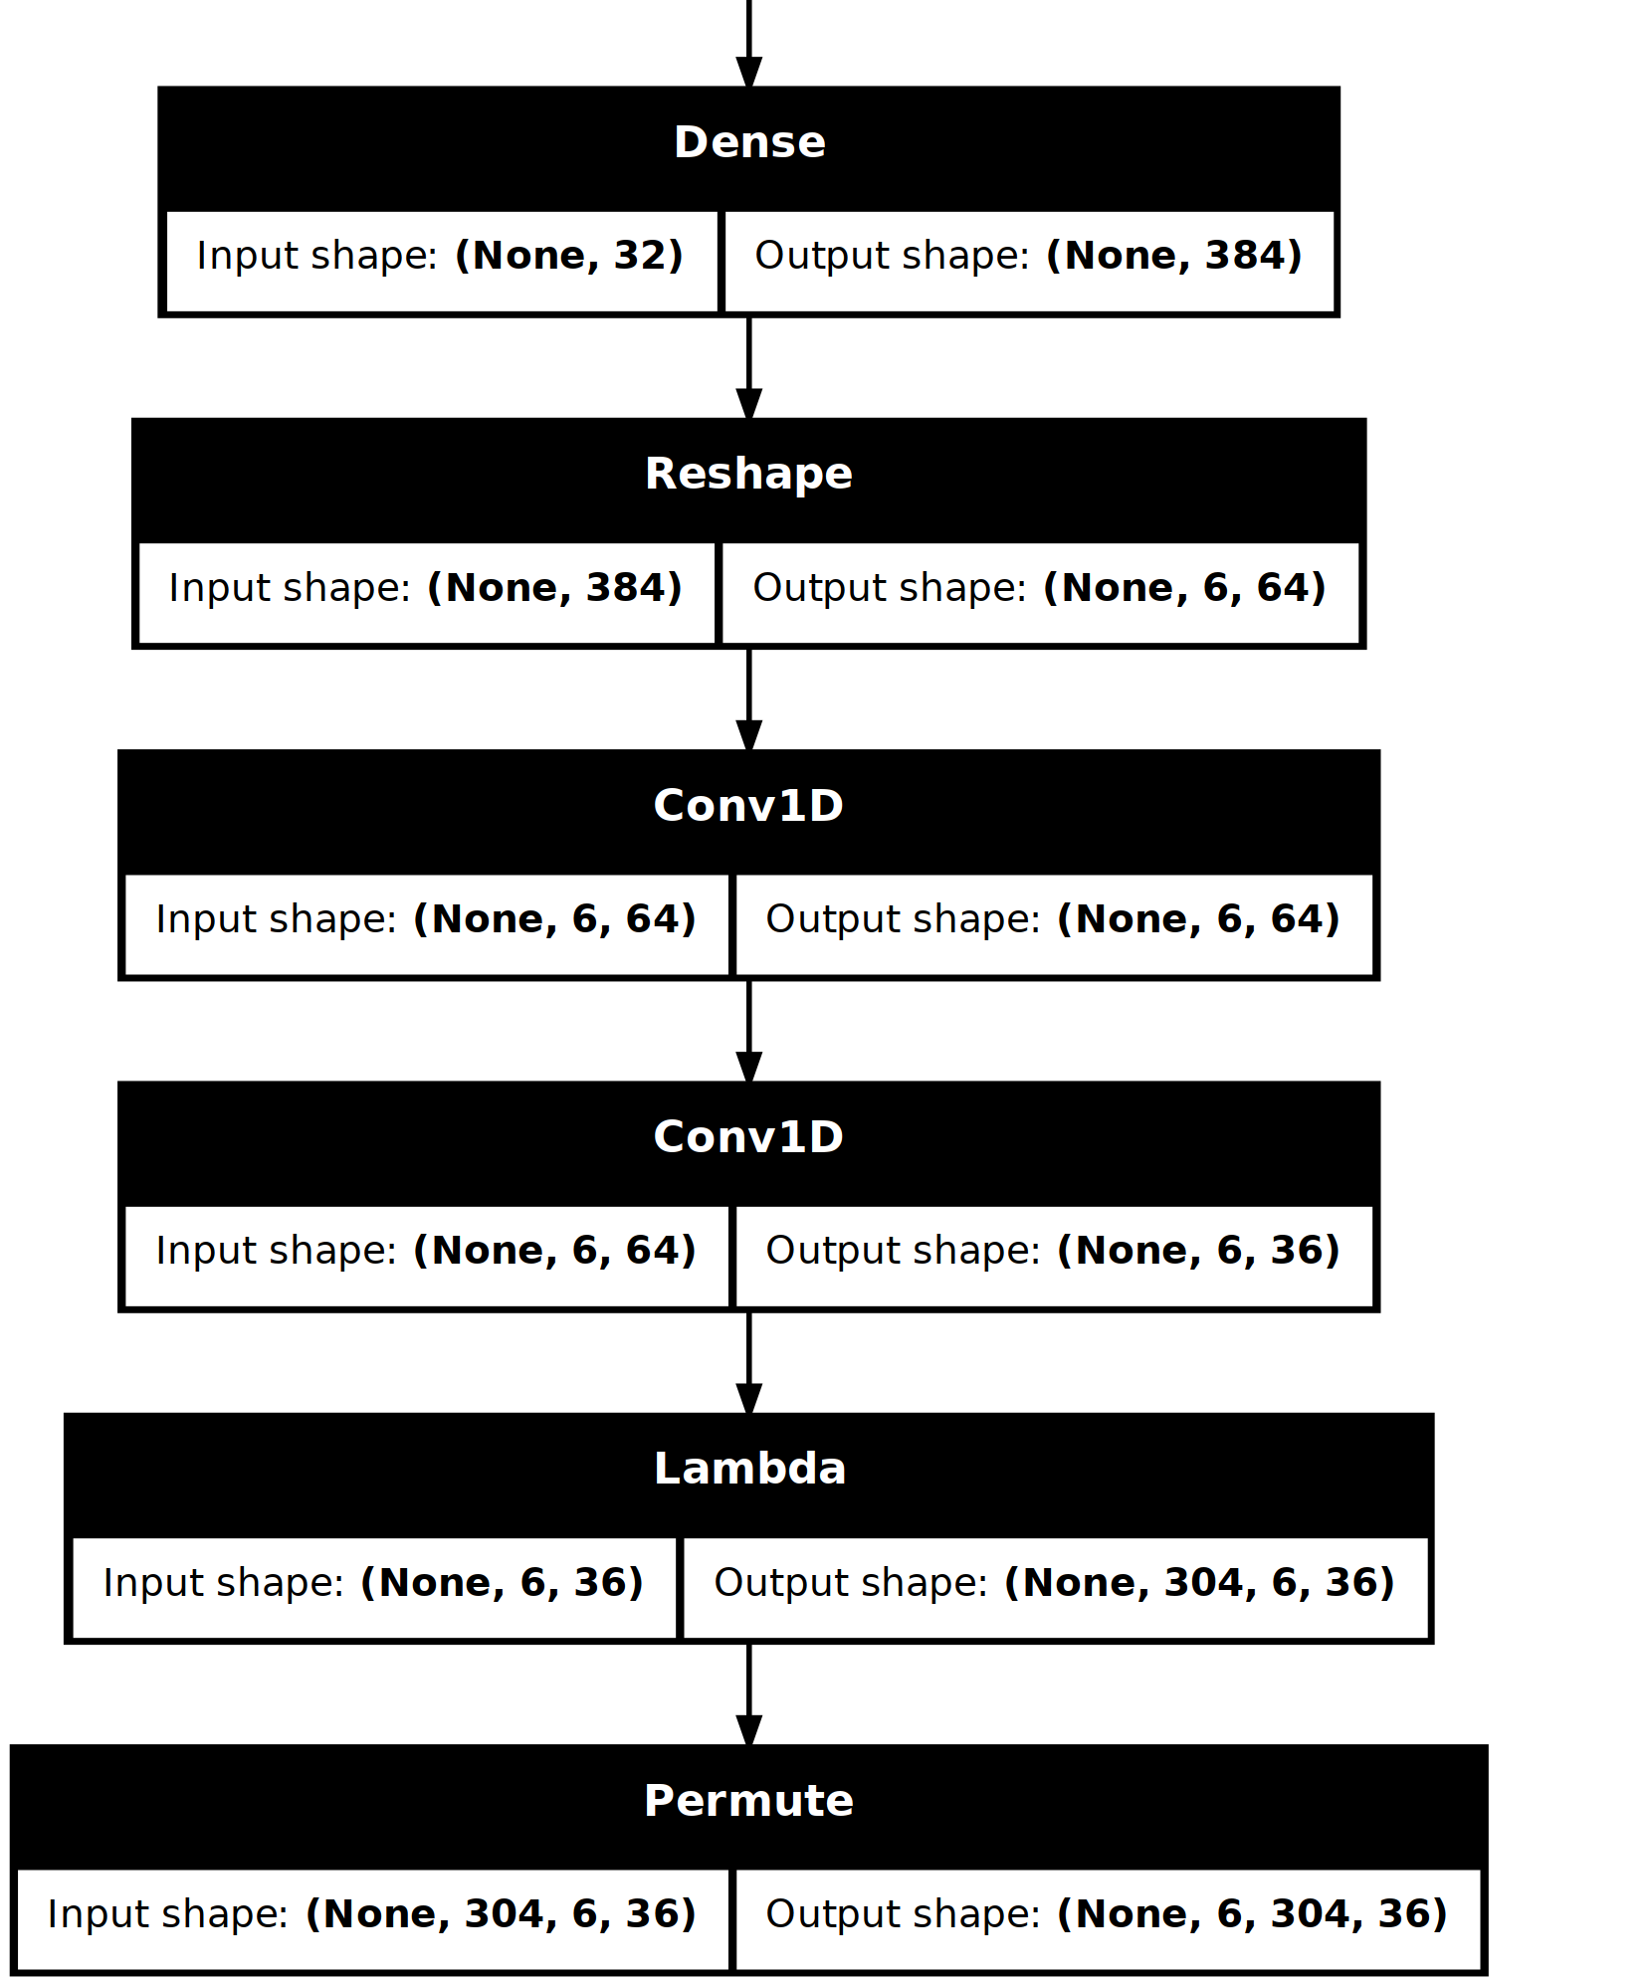
Model Architecture
# parameters: 87,524

Slide 14
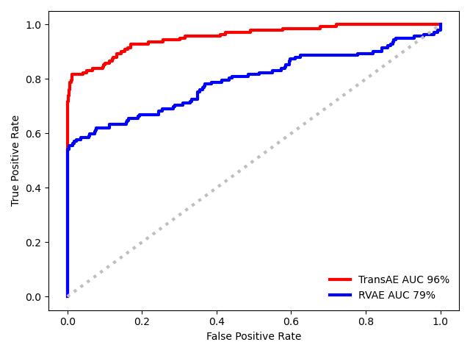
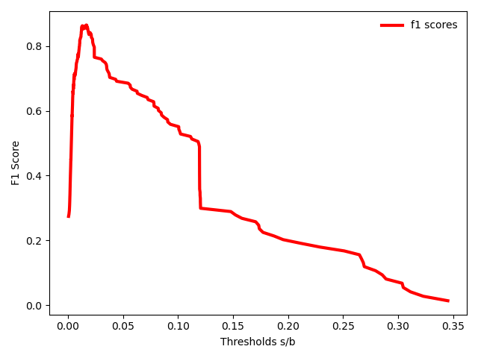

Results
Injected anomalies provide controlled ground truth labels.
Anomaly score:
  Compute reconstruction error per host
  Final score = average error of the top-k most anomalous hosts
This allows quantitative evaluation of the anomaly detection model, e.g. using a ROC curve, its AUC and F1-score:
  $F1=\frac{\text{2} \text{×} \text{TP}}{\text{2 }\text{×} \text{TP}\text{ + }\text{FP}\text{ + }\text{FN}}$

Slide 15
Conclusion
Autoencoders provide a powerful tool for unsupervised anomaly detection in multivariate telemetry;
Attention mechanisms enable modeling dependencies between hosts, allowing to detect cluster-wide behaviour;
Future Directions:
Improve model robustness by incorporating additional feature engineering;
Create more complex and generalized architectures for modeling temporal and cross-host dependencies;
Develop a dedicate data pipeline for ingestion and preprocessing, enabling systematic experimentation and facilitating deployment in the future.

Slide 16
