Slide 1
Supercomputing, Databases and Data Ecosystems: The Best of Three Worlds for Efficient Data-Driven Workflows
Stephan Hachinger

Slide 2
EXA4MIND Consortium / Project: Who we are.

Slide 3

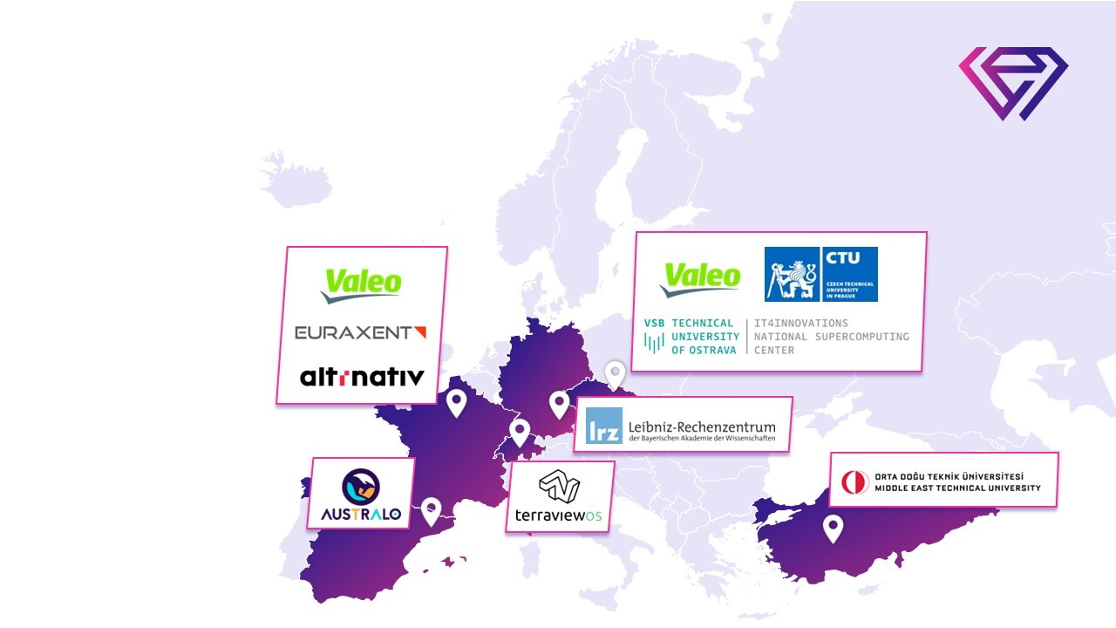

EXA4MIND consortium “Extreme Data Analytics for Mining Data Spaces”
10 partners, 6 countries, 40 months
EU contribution: € 4.9M
Overall budget: € 6M
Coordinator Jan Martinovič (IT4I)
Science & Co-Design Coordinator Stephan Hachinger (LRZ)

Slide 4
What and why?

Slide 5
A fast gap analysis...
Big Data Analytics – Hot Topic Since Years
… yields great results with AI and database technology; yields more with more computing power.
Notes:
4 Use Cases Science (Molecular Dynamics), Industry (Automotive) SME (Smart Agriculture, Mining Public Data)
Data harmonization and then… demanding analytics
Extreme Data Database (EDD) with DBMS-oriented and distributed-data store solutions
Advanced Query and Indexing System (AQIS) to find and filter data: fast, consistent, general
Staging and workflow automation to use Supercomputing centres for Analytics & AI
Data access, publication & staging to connect our EDD to European Data Spaces, EUDAT, EOSC

Slide 6
A fast gap analysis...
Big Data Analytics – Hot Topic Since Years
… yields great results with AI and database technology; yields more with more computing power.
Excellent Supercomputing Facilities with HPC, Cloud, GPU and Quantum Systems
… do simulations and complex workflows but not so much work on Databases & Extreme Data Analytics.
Notes:
4 Use Cases Science (Molecular Dynamics), Industry (Automotive) SME (Smart Agriculture, Mining Public Data)
Data harmonization and then… demanding analytics
Extreme Data Database (EDD) with DBMS-oriented and distributed-data store solutions
Advanced Query and Indexing System (AQIS) to find and filter data: fast, consistent, general
Staging and workflow automation to use Supercomputing centres for Analytics & AI
Data access, publication & staging to connect our EDD to European Data Spaces, EUDAT, EOSC

Slide 7
A fast gap analysis...
Big Data Analytics – Hot Topic Since Years
… yields great results with AI and database technology; yields more with more computing power.
Excellent Supercomputing Facilities with HPC, Cloud, GPU and Quantum Systems
European Data Spaces,
EOSC and EUDAT
… do simulations and complex workflows but not so much work on Databases & Extreme Data Analytics.
… can do great research data management but rarely address general Big/Extreme Data.
Notes:
4 Use Cases Science (Molecular Dynamics), Industry (Automotive) SME (Smart Agriculture, Mining Public Data)
Data harmonization and then… demanding analytics
Extreme Data Database (EDD) with DBMS-oriented and distributed-data store solutions
Advanced Query and Indexing System (AQIS) to find and filter data: fast, consistent, general
Staging and workflow automation to use Supercomputing centres for Analytics & AI
Data access, publication & staging to connect our EDD to European Data Spaces, EUDAT, EOSC

Slide 8
A fast gap analysis...
Big Data Analytics – Hot Topic Since Years
✘
✘
… yields great results with AI and database technology; yields more with more computing power.
✘
Excellent Supercomputing Facilities with HPC, Cloud, GPU and Quantum Systems
European Data Spaces,
EOSC and EUDAT
… do simulations and complex workflows but not so much work on Databases & Extreme Data Analytics.
… can do great research data management but rarely address general Big/Extreme Data.
Notes:
4 Use Cases Science (Molecular Dynamics), Industry (Automotive) SME (Smart Agriculture, Mining Public Data)
Data harmonization and then… demanding analytics
Extreme Data Database (EDD) with DBMS-oriented and distributed-data store solutions
Advanced Query and Indexing System (AQIS) to find and filter data: fast, consistent, general
Staging and workflow automation to use Supercomputing centres for Analytics & AI
Data access, publication & staging to connect our EDD to European Data Spaces, EUDAT, EOSC

Slide 9
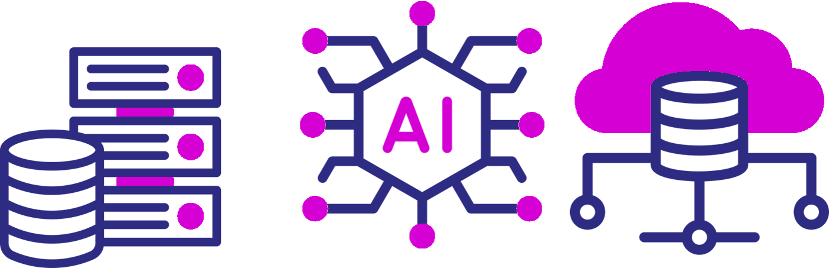


... motivating EXA4MIND
Supercomputing
Computational
Workflows
EU Data Ecosystems
Notes:
4 Use Cases Science (Molecular Dynamics), Industry (Automotive) SME (Smart Agriculture, Mining Public Data)
Data harmonization and then… demanding analytics
Extreme Data Database (EDD) with DBMS-oriented and distributed-data store solutions
Advanced Query and Indexing System (AQIS) to find and filter data: fast, consistent, general
Staging and workflow automation to use Supercomputing centres for Analytics & AI
Data access, publication & staging to connect our EDD to European Data Spaces, EUDAT, EOSC

Slide 10






... motivating EXA4MIND
DBMS & Object Stores
Advanced Queries
Analytics
Supercomputing
Computational
Workflows
EU Data Ecosystems
Notes:
4 Use Cases Science (Molecular Dynamics), Industry (Automotive) SME (Smart Agriculture, Mining Public Data)
Data harmonization and then… demanding analytics
Extreme Data Database (EDD) with DBMS-oriented and distributed-data store solutions
Advanced Query and Indexing System (AQIS) to find and filter data: fast, consistent, general
Staging and workflow automation to use Supercomputing centres for Analytics & AI
Data access, publication & staging to connect our EDD to European Data Spaces, EUDAT, EOSC

Slide 11



... motivating EXA4MIND
DBMS & Object Stores
Advanced Queries
Analytics
Supercomputing
Computational
Workflows
EU Data Ecosystems
Notes:
4 Use Cases Science (Molecular Dynamics), Industry (Automotive) SME (Smart Agriculture, Mining Public Data)
Data harmonization and then… demanding analytics
Extreme Data Database (EDD) with DBMS-oriented and distributed-data store solutions
Advanced Query and Indexing System (AQIS) to find and filter data: fast, consistent, general
Staging and workflow automation to use Supercomputing centres for Analytics & AI
Data access, publication & staging to connect our EDD to European Data Spaces, EUDAT, EOSC

Slide 12
What do we provide?

Slide 13
Tested concepts & boilerplates to set up your Extreme Data / computing workflows with the best data backends and data-sharing possibilities.

Slide 14
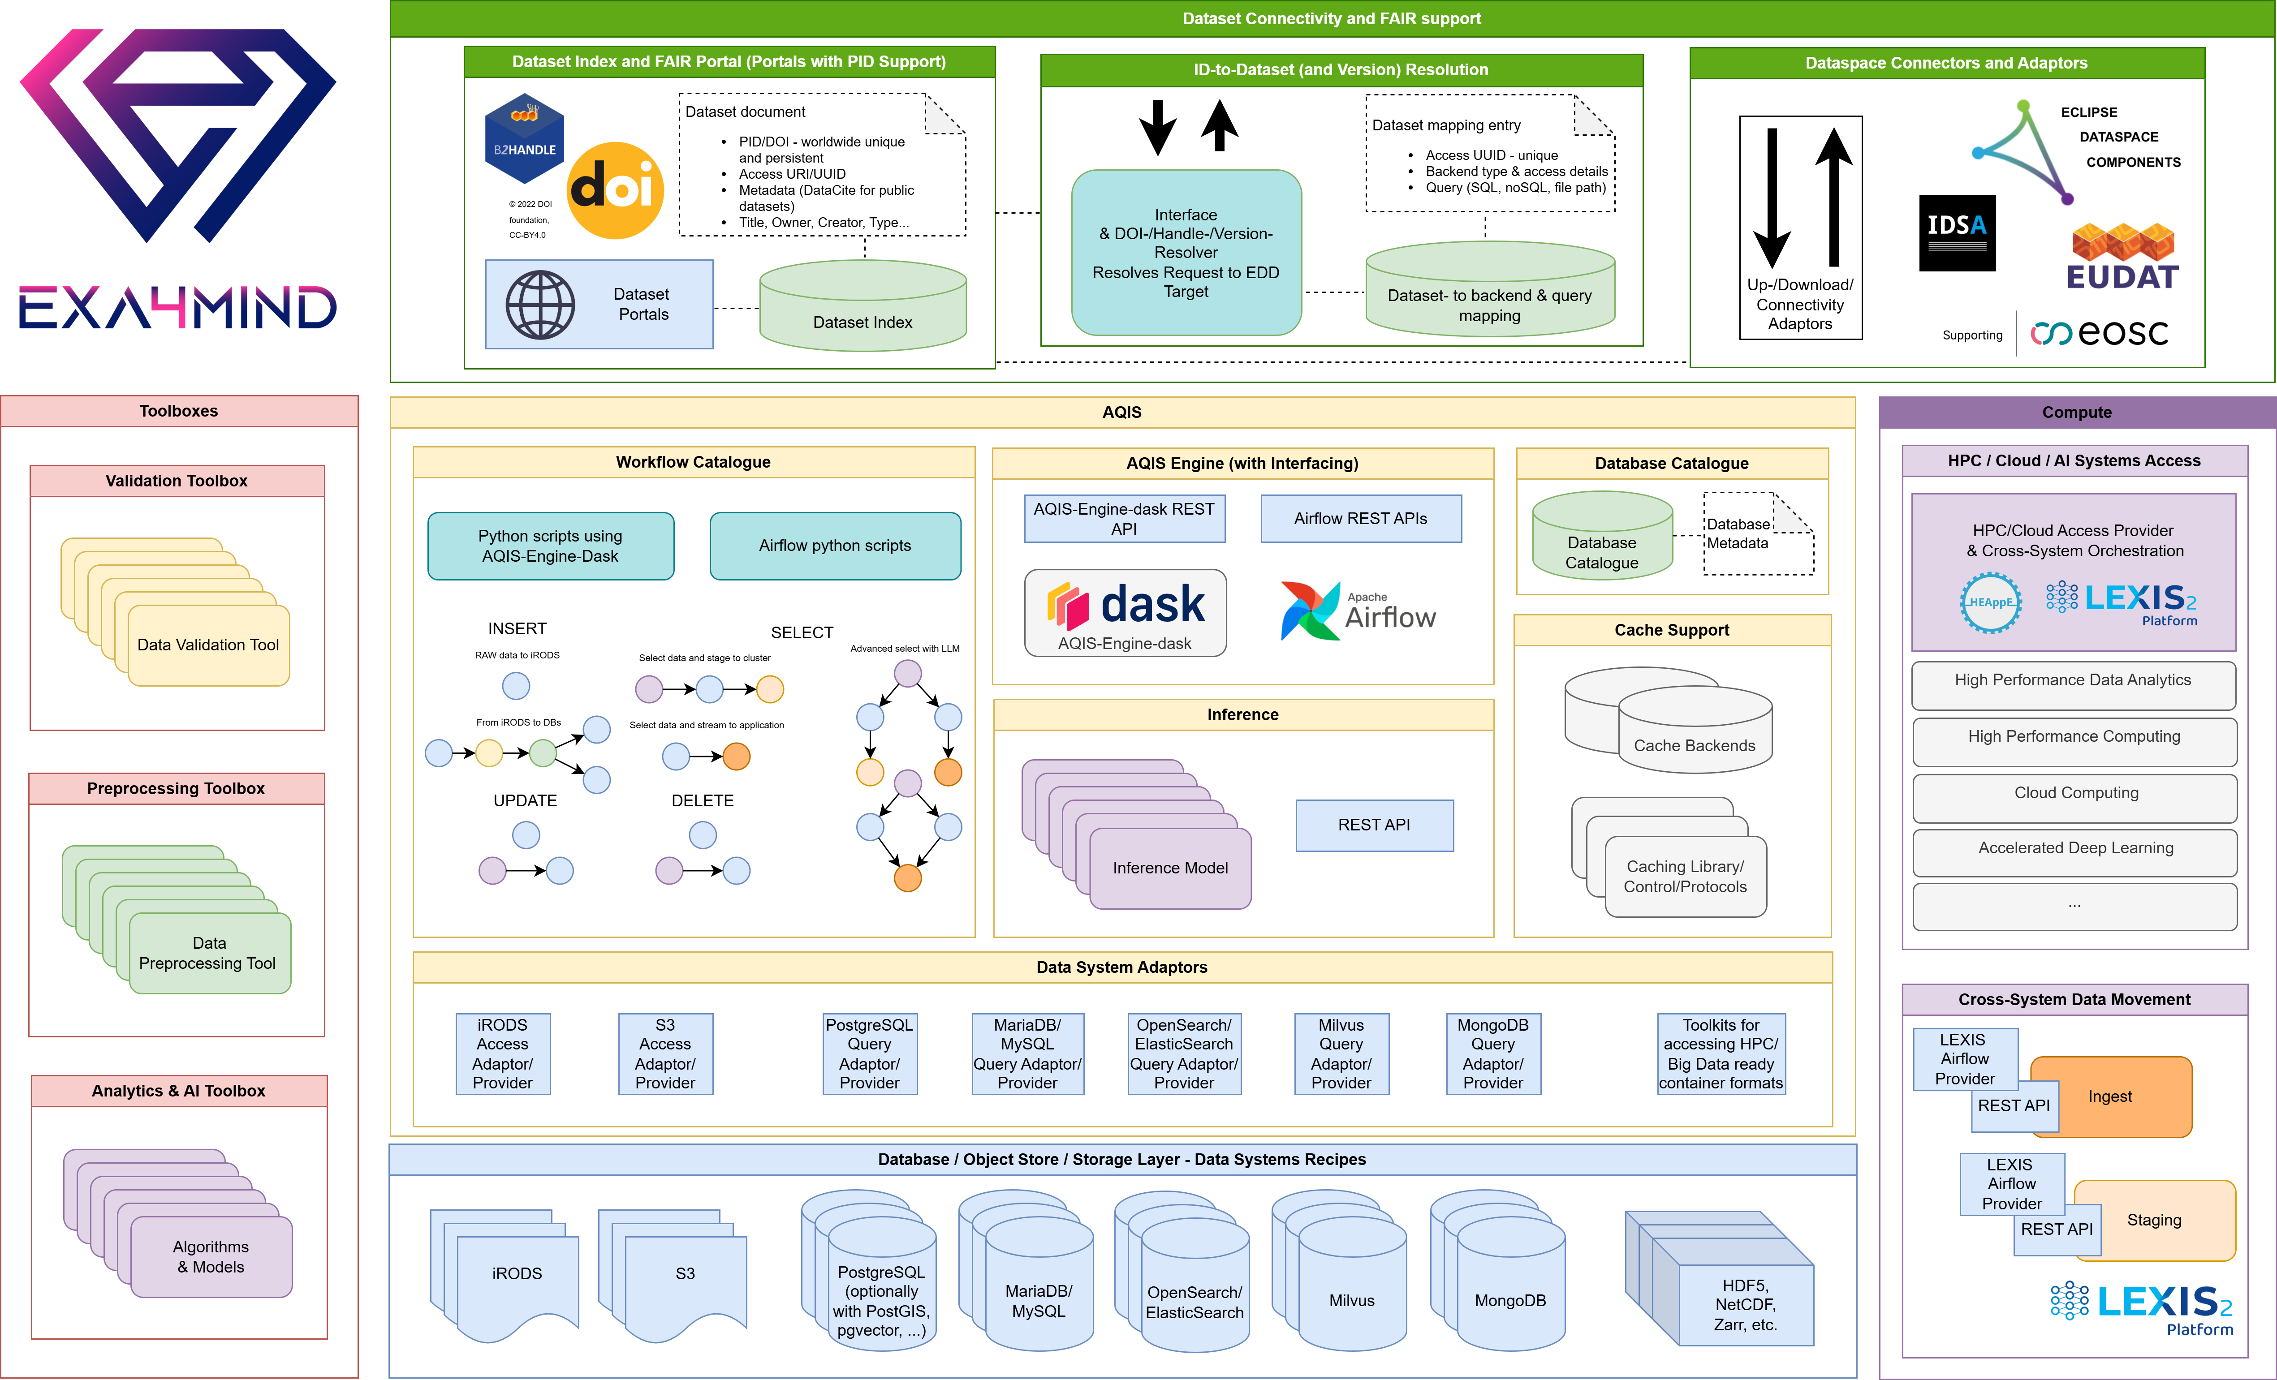

Slide 15
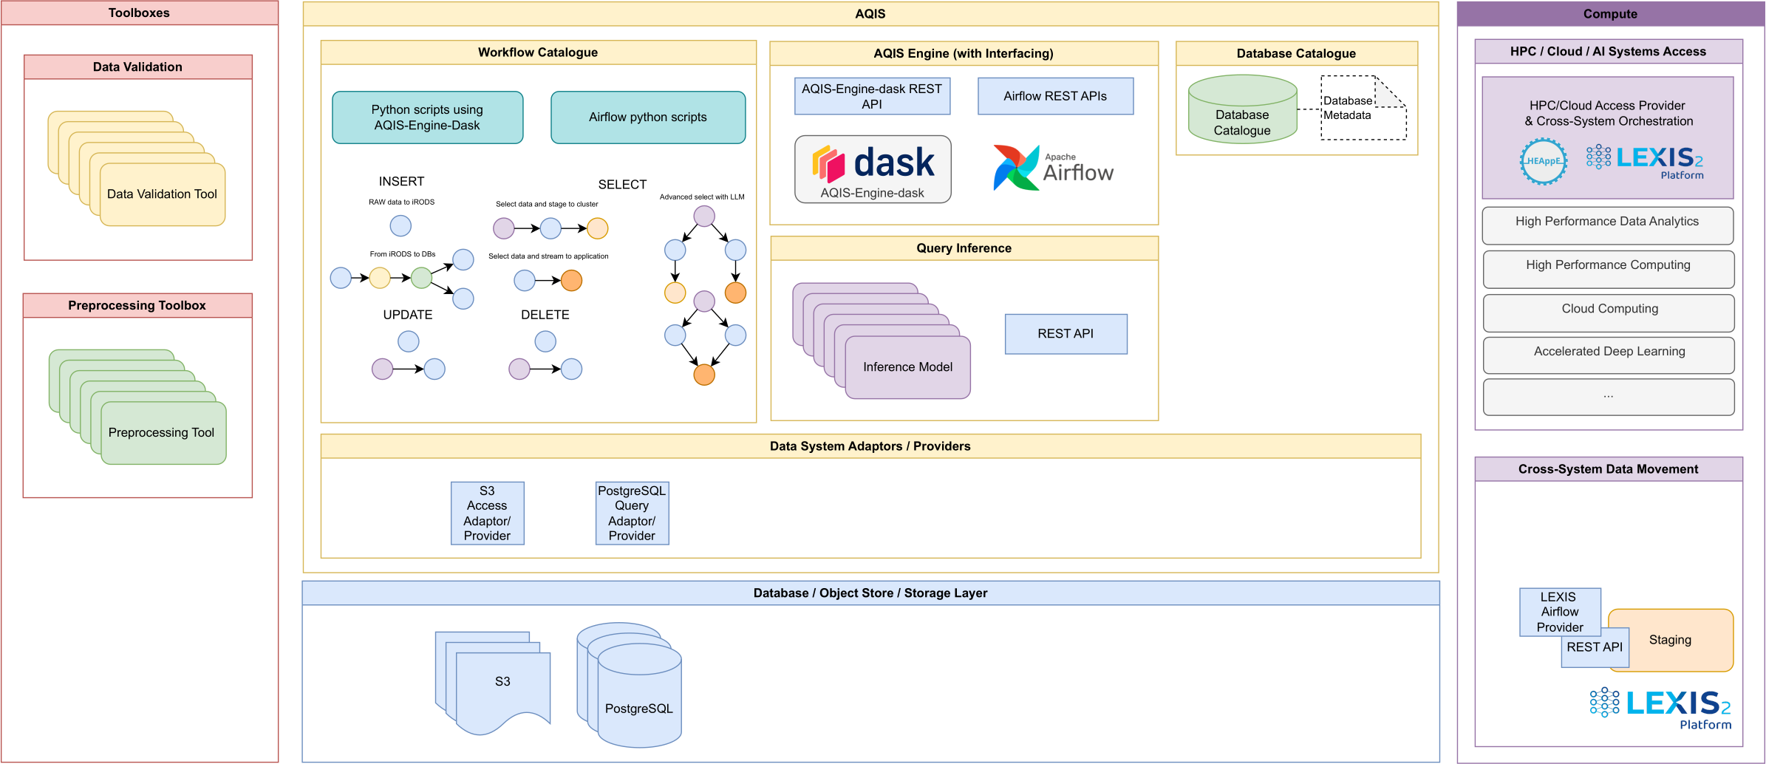
A „flexibly-deployable platform“: selecting modular parts & instantiating them to implement …

Slide 16
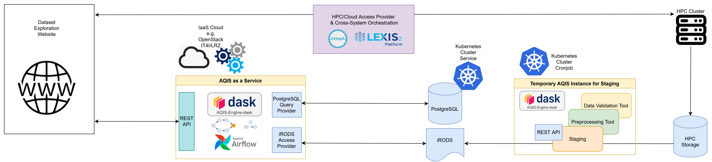
... as an example ...
... a website where engineers can explore simulation data & trigger more HPC simulations.

Slide 17




Application cases within the project
SCIENTIFIC – Molecular simulations WP4
INDUSTRY – Automotive Car Sensor Recordings WP5
ADAMS4SIMS, an innovative Automated Data Mining System for Systematic Improvement of Molecular Simulations accuracy and predictability will combine services and on-/offline data sources.
Advanced Driver Assistance Systems (ADAS) need Extreme Data annotation, search and analytics. Methods, AI models and framework are co-developed in EXA4MIND.
Data: 0.1-1 PB range
Data: 1-100 PB range
SME – Smart farming / viticulture WP6
SME – Health WP6
Easy and quick ingestion of large amounts of agriculture focused data, as well as efficient and space-saving re-distribution of computed/ingested (meta-)data.
Demonstration of viability of Extreme Data Database (EDD) for Extreme Data processing use cases with health and societal datasets, based on direct user interaction.
Data: 0.01-1 PB range
Data: 0.01-0.1 PB range
Notes:
WP5 Industry use case is about Advanced Driver Assistance Systems Validation data processing and understanding.

Slide 18
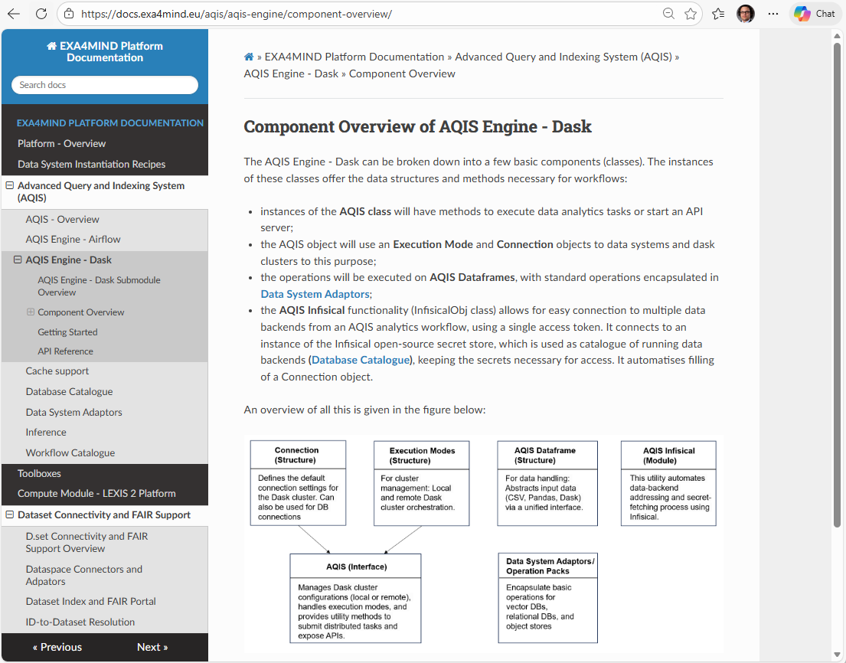
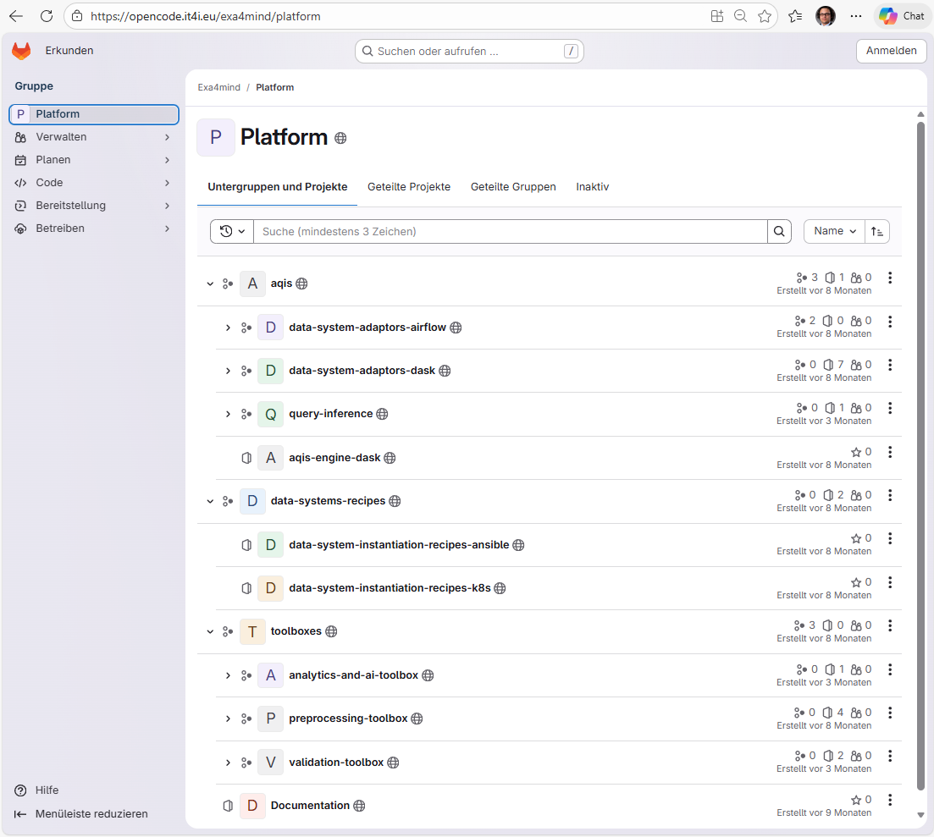
Platform releases
opencode.it4i.eu/exa4mind
docs.exa4mind.eu

Slide 19
Are you serious – do you really wanna use such stuff on HPC?

Slide 20
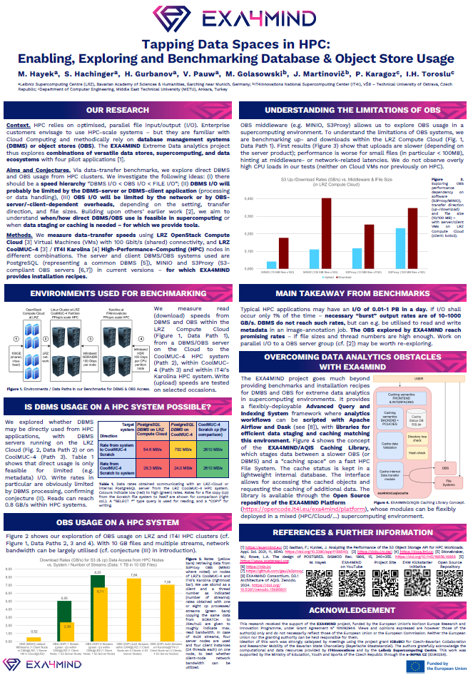
Yes, we are serious about understanding a wealth of data backends ☺
Why diversify data backends at supercomputing centres?
More and more customers want it (used to Cloud/Business world maybe)
Databases can have advantages, e.g.: - Data indexing for fast access - Vector databases for similarity search
Object stores can have advantages: - Data sharing functionalities - Codes can stay the same as in Cloud Poster: Hayek et al, SC Asia ‘26

Slide 21
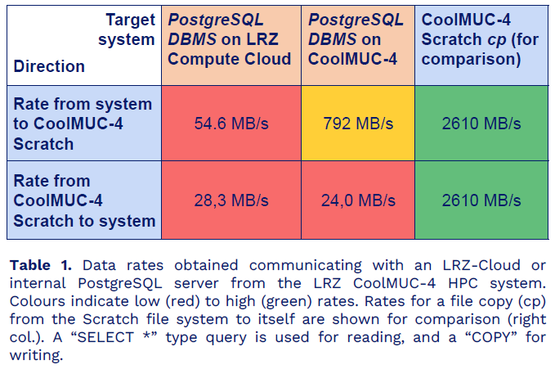
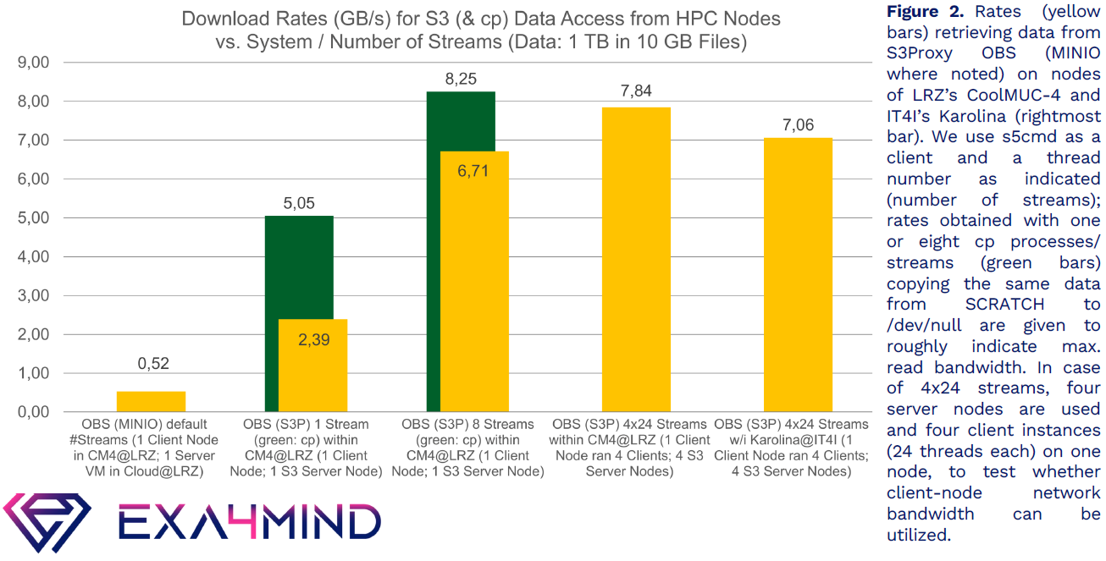
Benchmarking of DBMS and OBS on HPC clusters

Slide 22
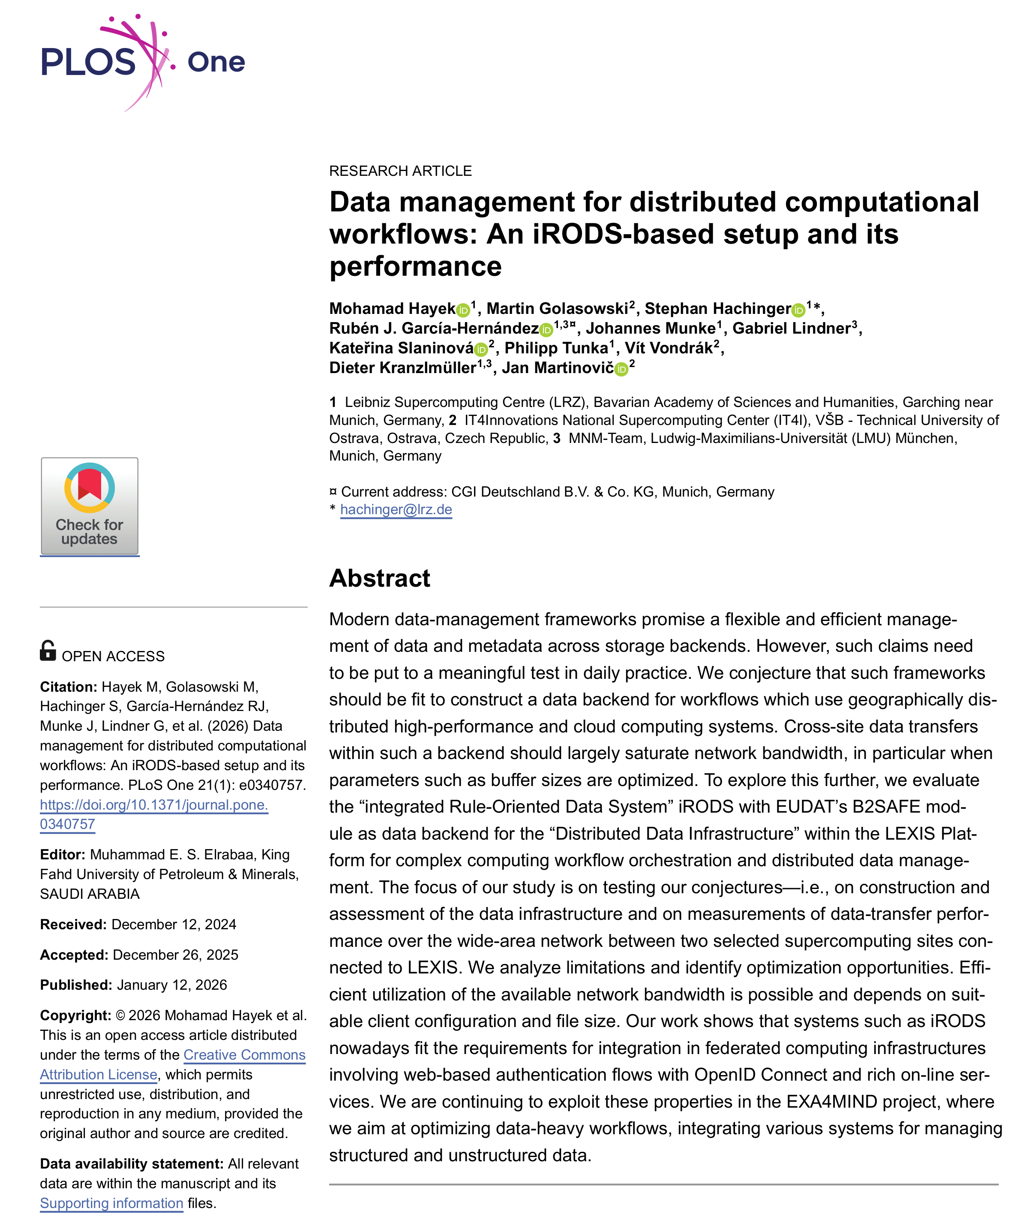
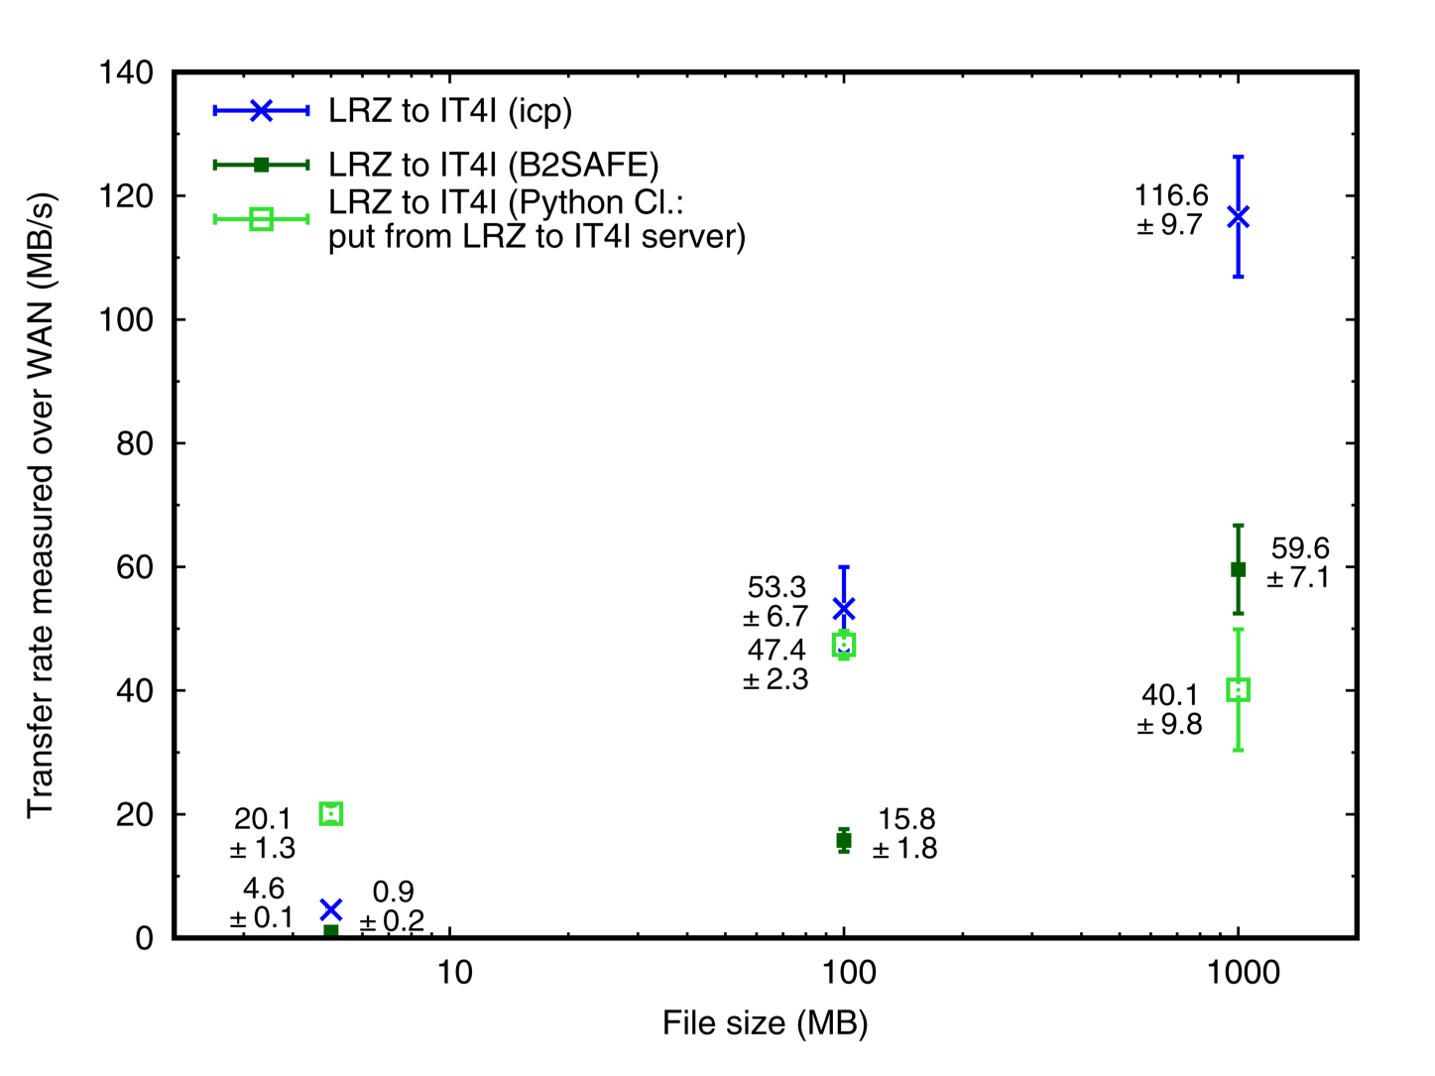
Object stores for warm data enable federation & sharing
cf. iperf3 in tested env: 140-180 MB/s
For going HPC, EXA4MIND has staging tools

Slide 23
Some speed tests, is that all you show?

Slide 24
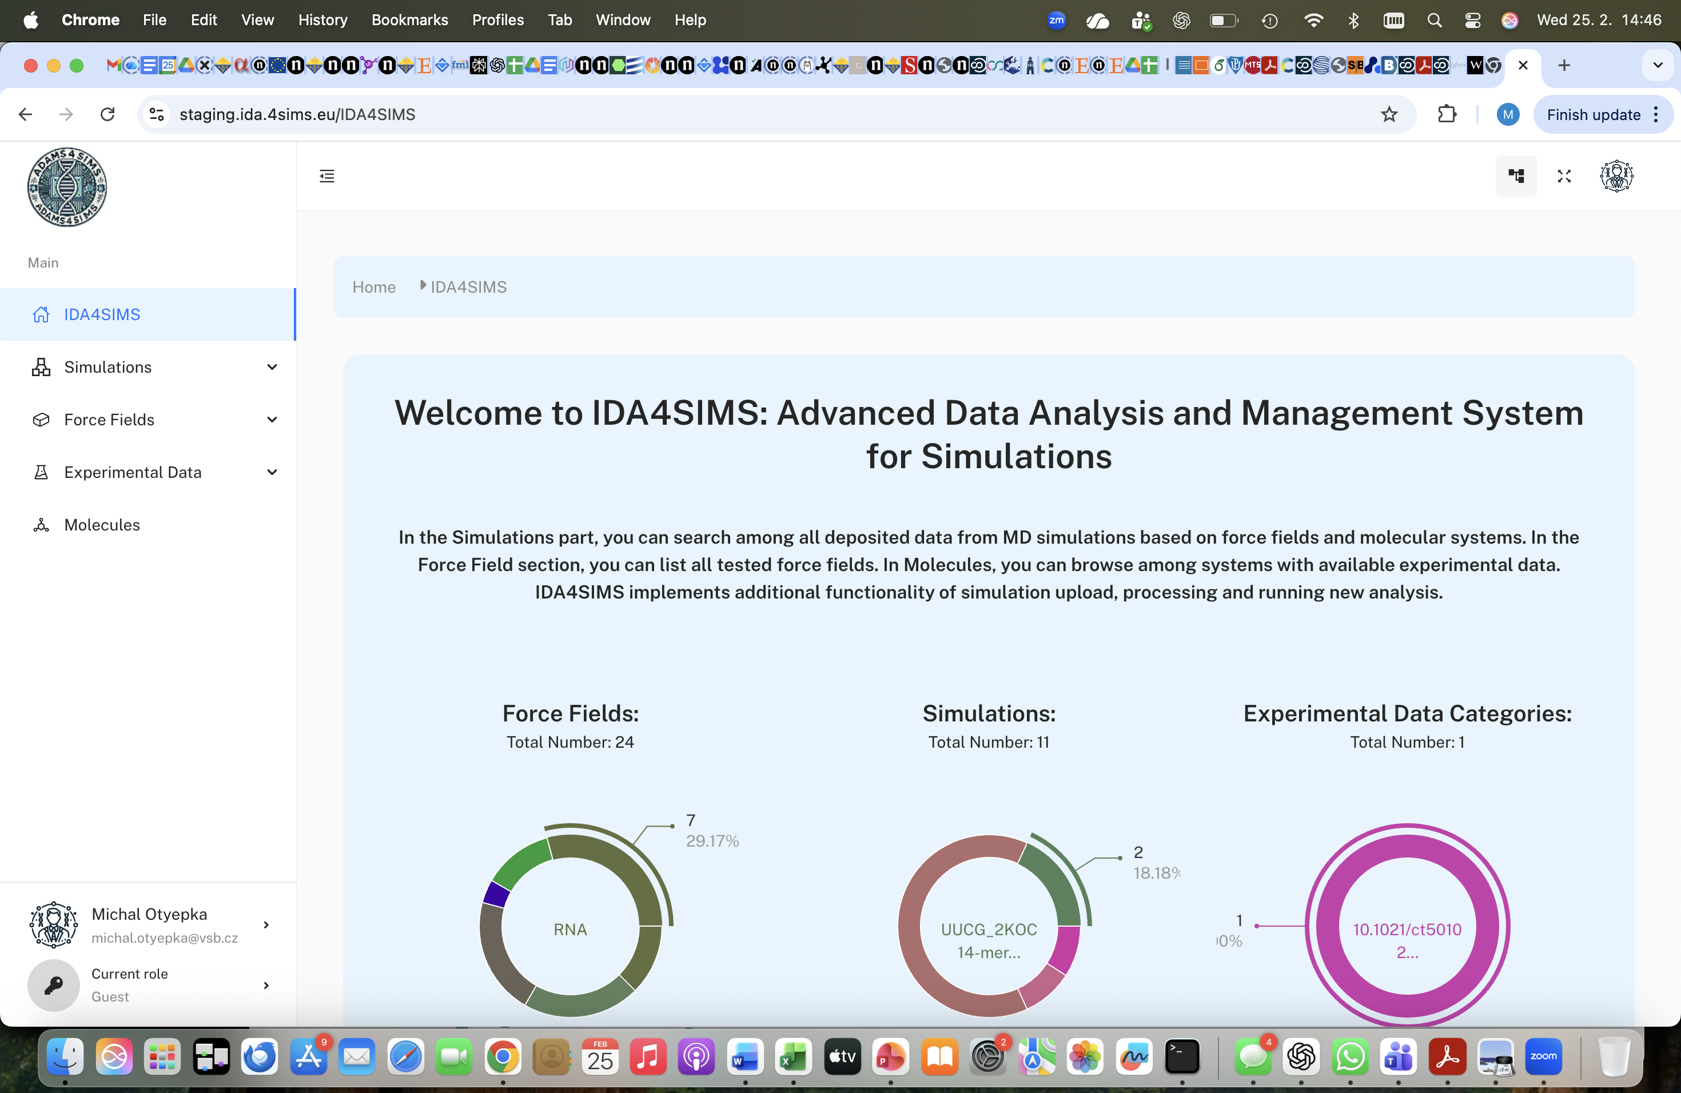
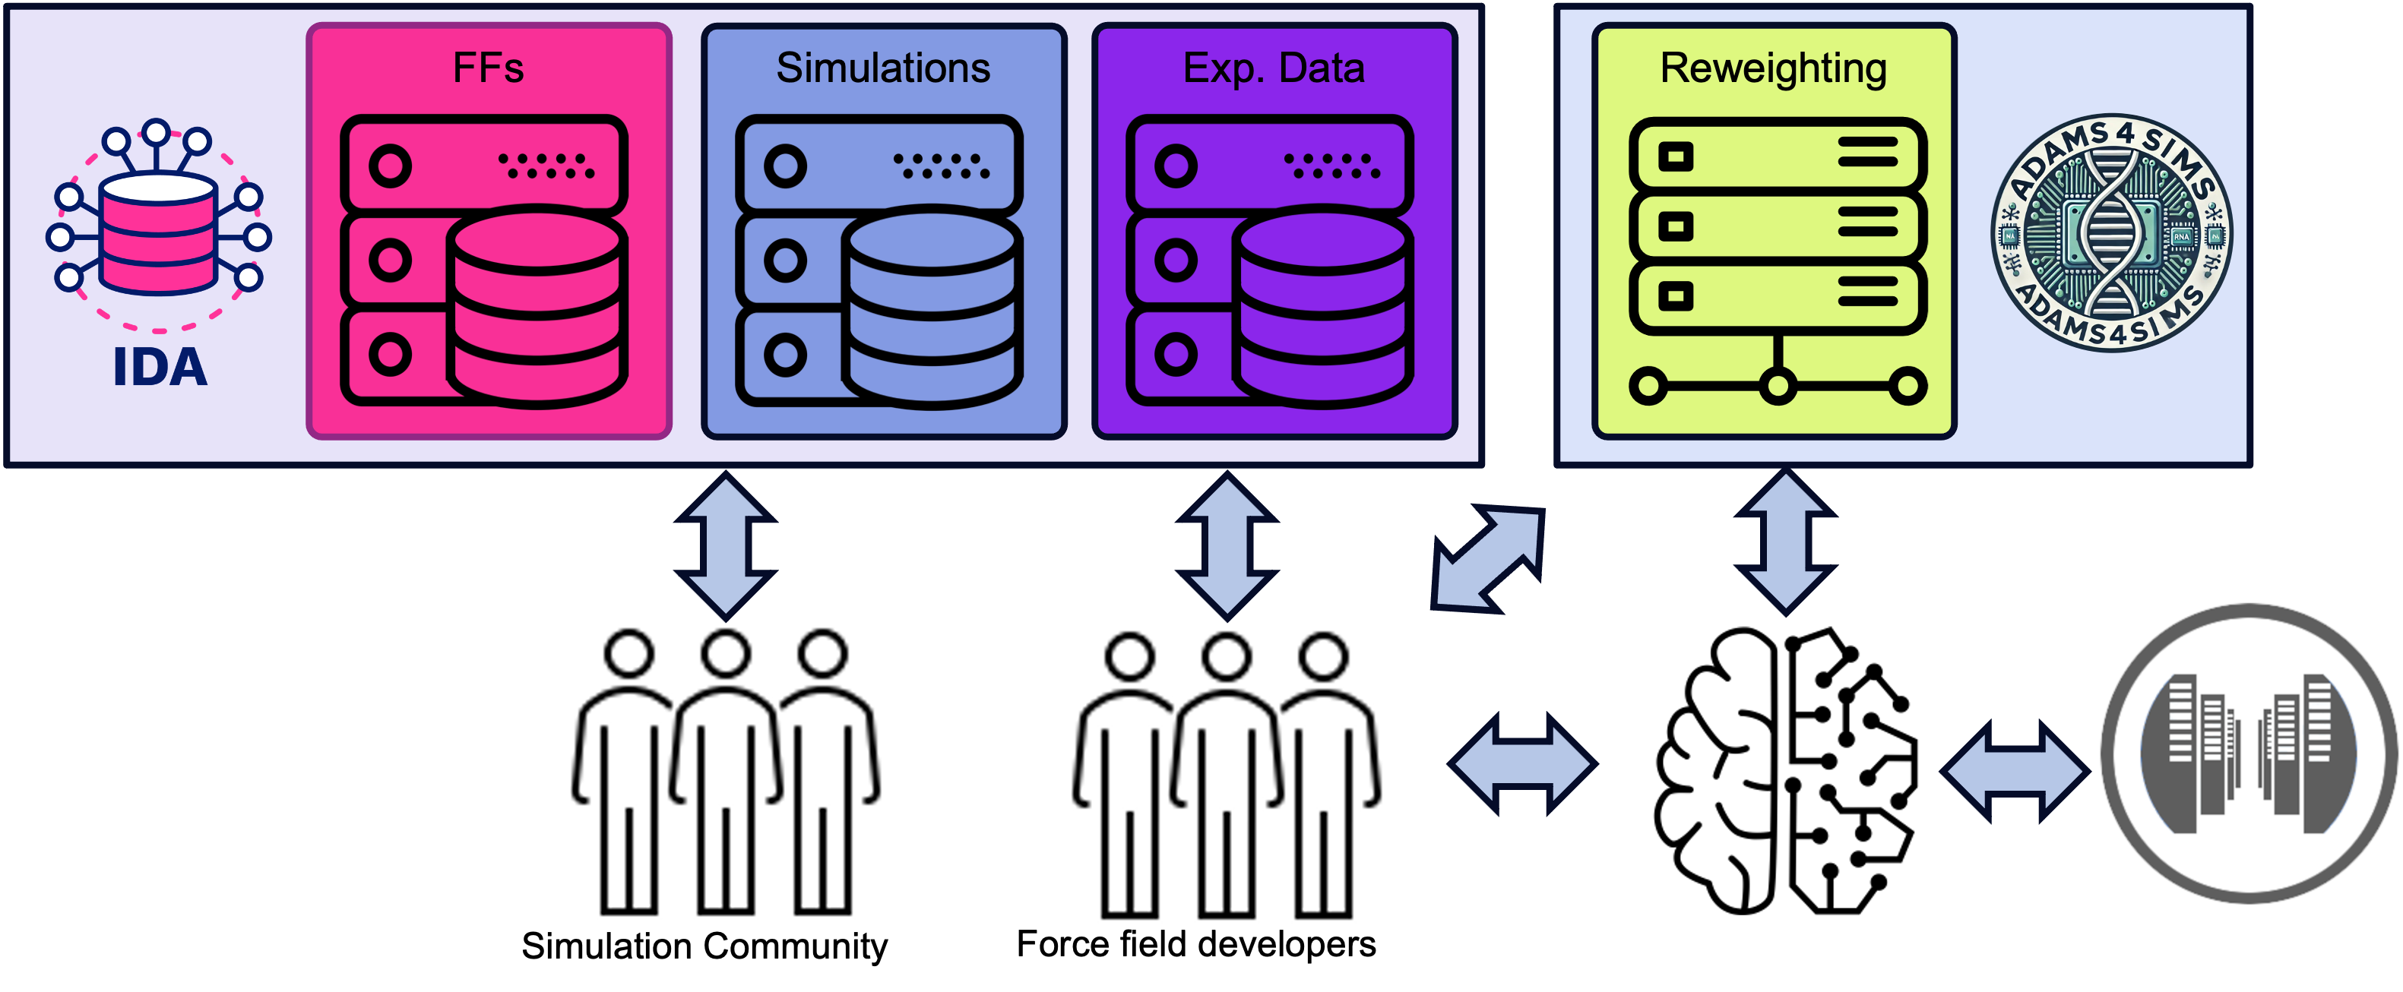
ADAMS/IDA4SIMS – a molecular dynamics platform for comparing simulations to experiments and improving them

Slide 25
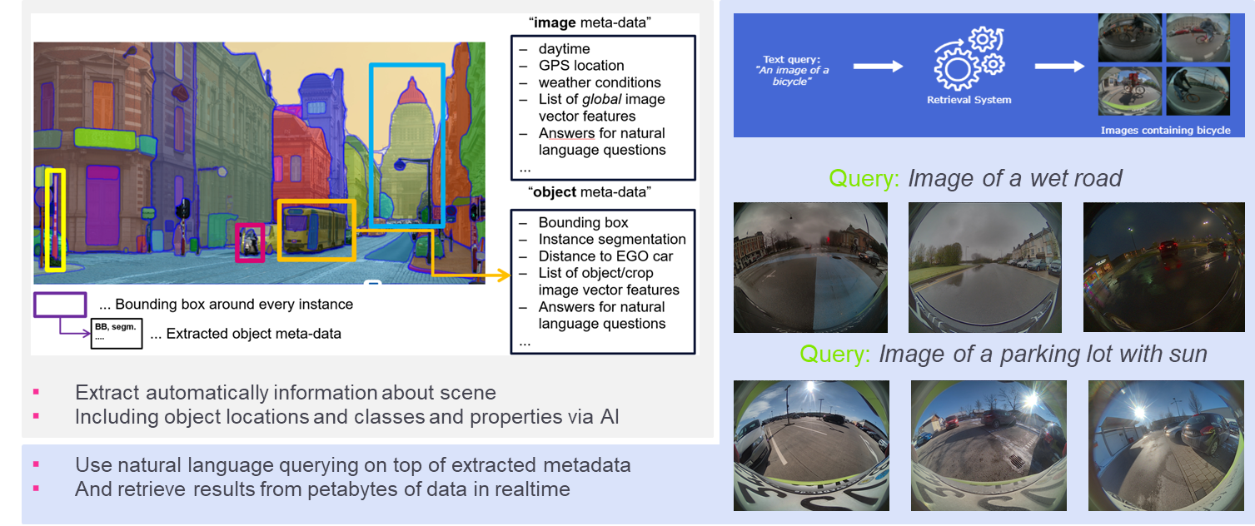

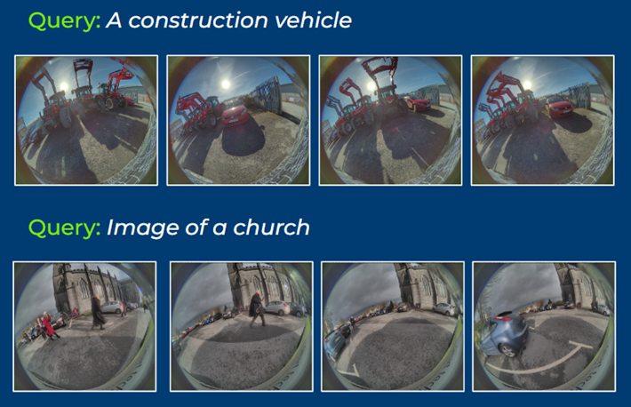
Self-driving cars
Workflows on HPC for image segmentation, annotation, ...
(Natural language) query capabilities for system validation
EXA4MIND also helps with data transfer from test vehicles and company systems to HPC cluster

Slide 26
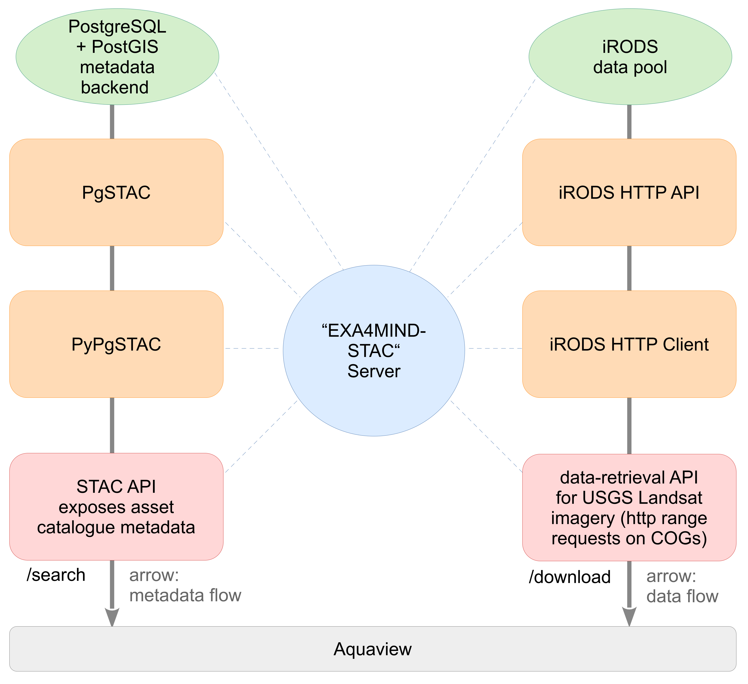
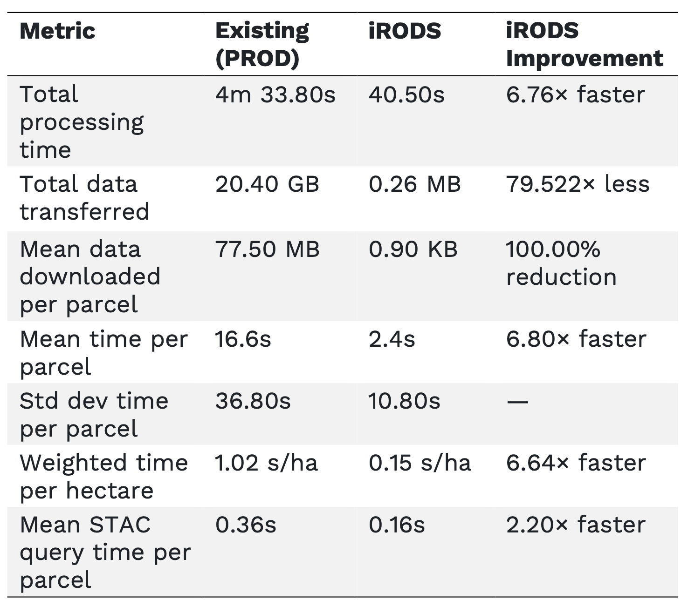
Smart viticulture
Aquaview: Soil moisture prediction from satellite and weather data
EXA4MIND: satellite-data cache (iRODS + STAC) with Cloud-Optimised GeoTIFFs. More: Friday @EnvComp Workshop.

Slide 27
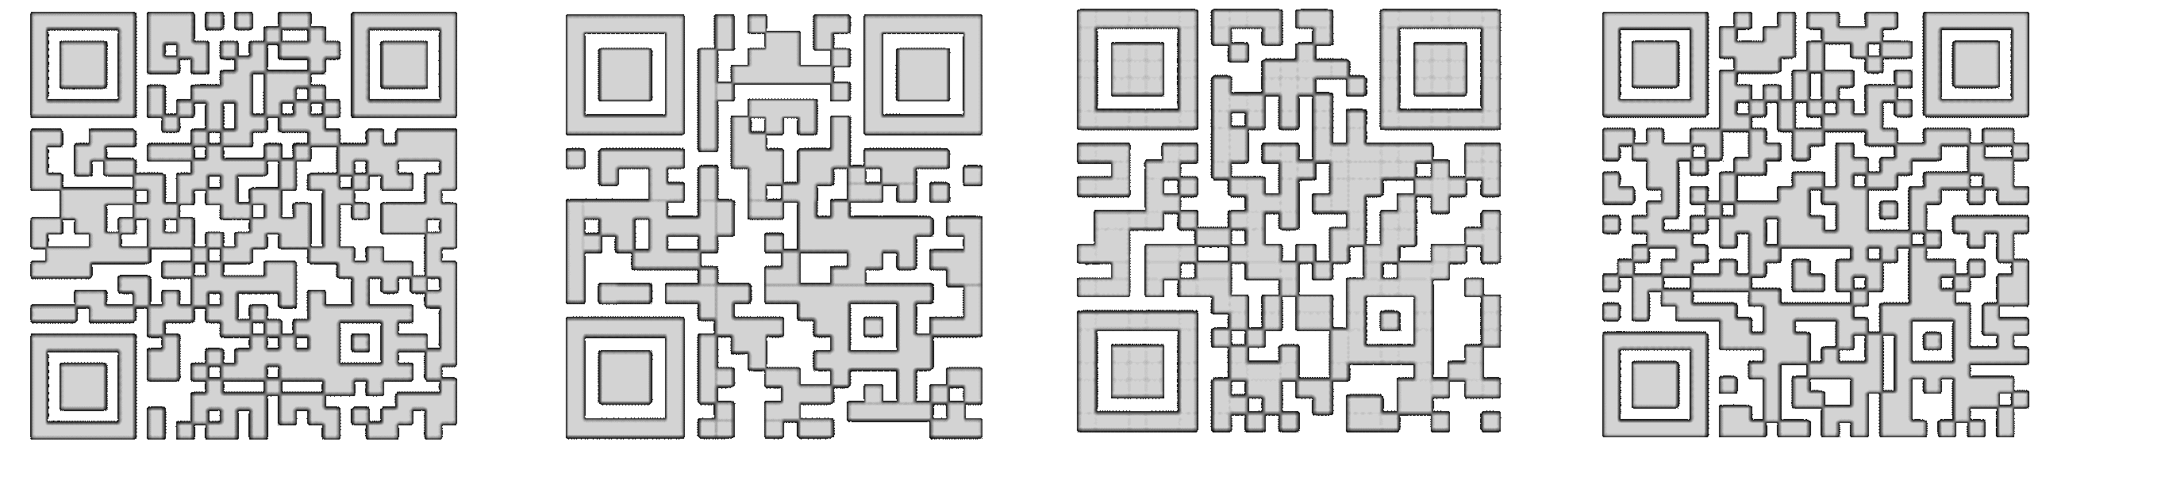
Thanks for your attention – please test our modules!

