Slide 1


Quantum reservoir computing on Pasqal neutral atoms platform
Simone Angelozzi PhD Quantum Tech Eng
S.Angelozzi@soton.ac.uk
Simone Gasperini
Daniele Bonacorsi

Slide 2
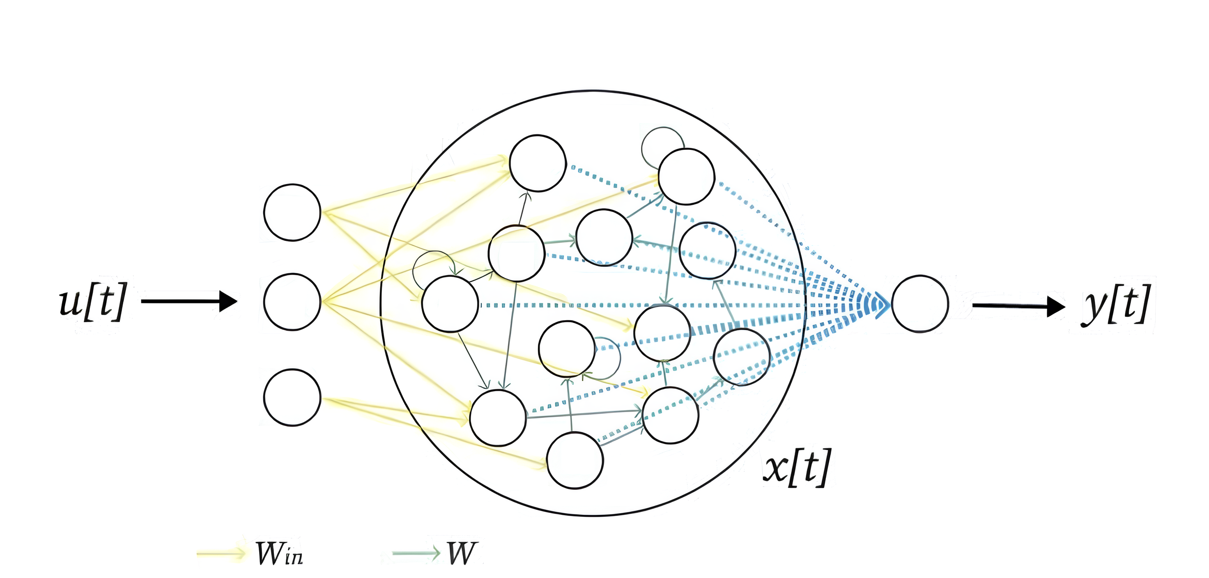
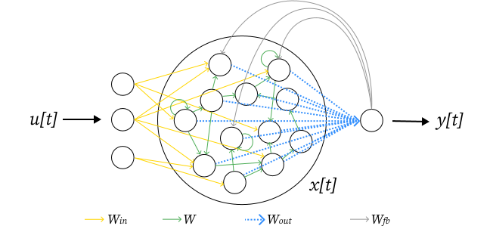
Overview
Intro to QML
  Why QML?
  VQA issues.
Reservoir Computing
  Classical reservoir.
  Neutral atom QRC.
  Pasqal platform.
Classification task
  Data and methodology.
  Global encoding.
  Local encoding.
  Results comparison.
Prespectives
  Contributions.
  Future directions.
  Literature.

Slide 3
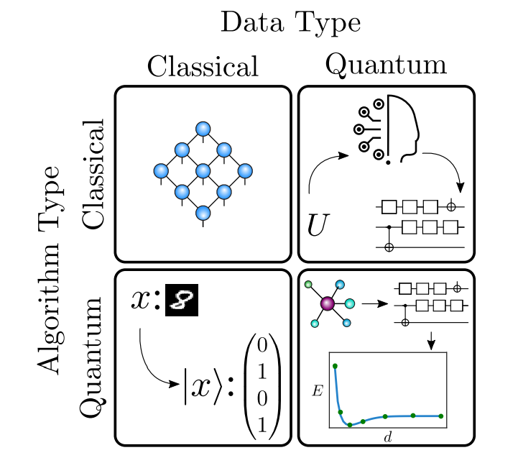
Quantum Machine Learning
Machine learning success data-based.
With QC expected speed-up of linear algebra subroutines.
QML with classical data.
[Nat. Comput. Sci. 2, 567 (2022)]
1

Slide 4
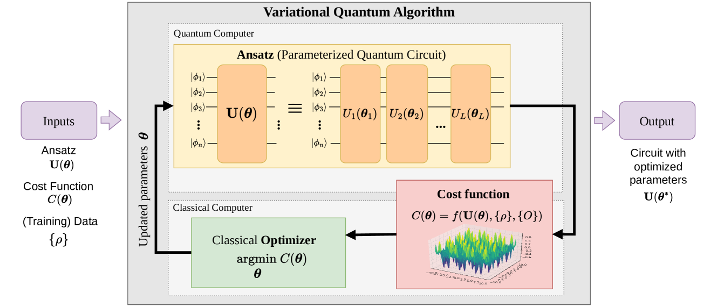
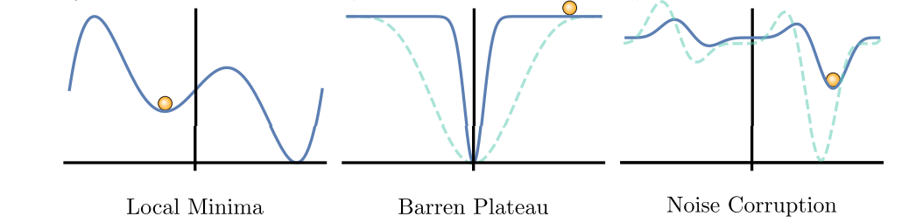
Variational Quantum Algorithm
Variational Quantum Algorithm inspired by classical NN.
Dominate theoretical/numerical explorations.
[arXiv: 2407.06421]
Major issues
  Costly gradient estimation and optimization loop.
  Trainability: size and noise lead to barren plateaus.
[Nat. Comput. Sci. 2, 567 (2022)]
2

Slide 5
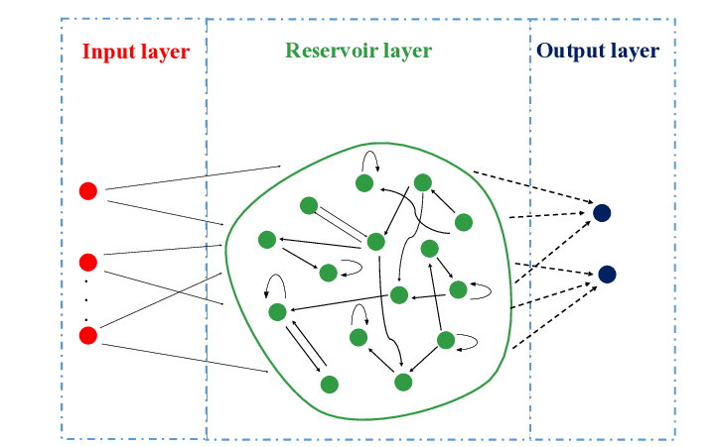
Reservoir Computing
Dynamical system as a feature map
Fixed internal structure
Output layer is the only trained component
Classical or Quantum reservoir
[arXiv: 1907.09504]
3

Slide 6
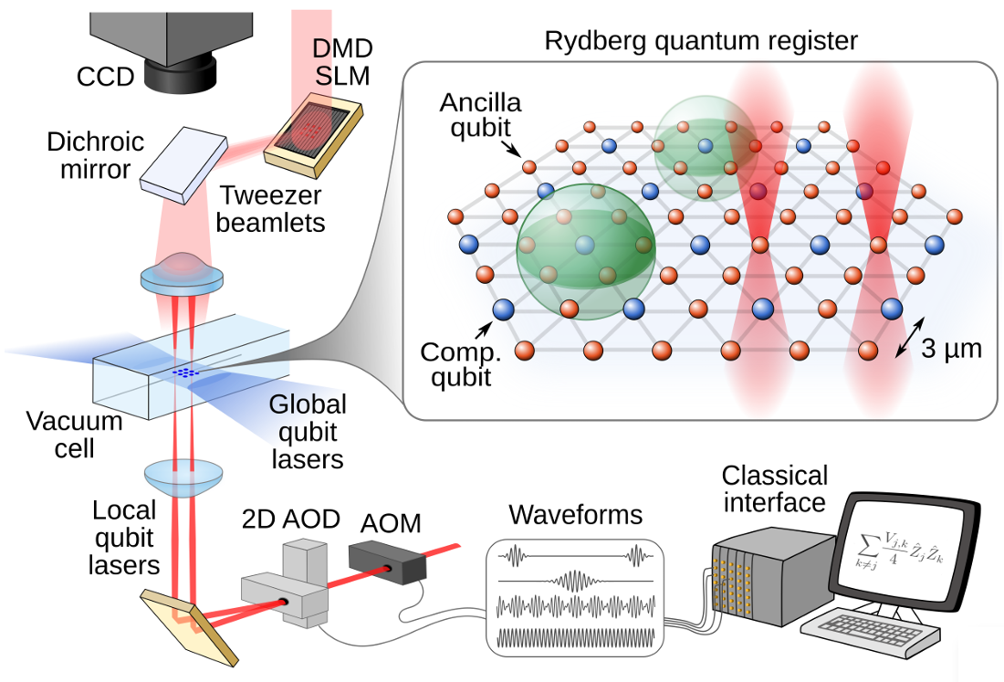
Neutral Atom Quantum Computing
Qubits: ground and Rydberg states of Rubidium atoms
Control: optical tweezers for initialization and qubit addressing
Interaction: Rydberg blockade mechanism
Readout: state-dependent fluorescence
[AVS Quantum Sci. 3, 023501 (2021)]
4

Slide 7
VQA
QRC
Hybrid structure: quantum circuit + classical optimizer
Variational internal structure: costly training of parameter
Training bottleneck: Barren Plateau
Hybrid structure: input, quantum evolution, classical postprocessing
Fixed internal structure: no parameter update
No variational optimization: avoids Barren Plateau
VQA = Variational Quantum Algorithms
QRC = Quantum Reservoir Computing
5

Slide 8
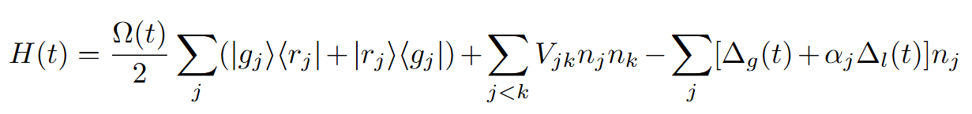
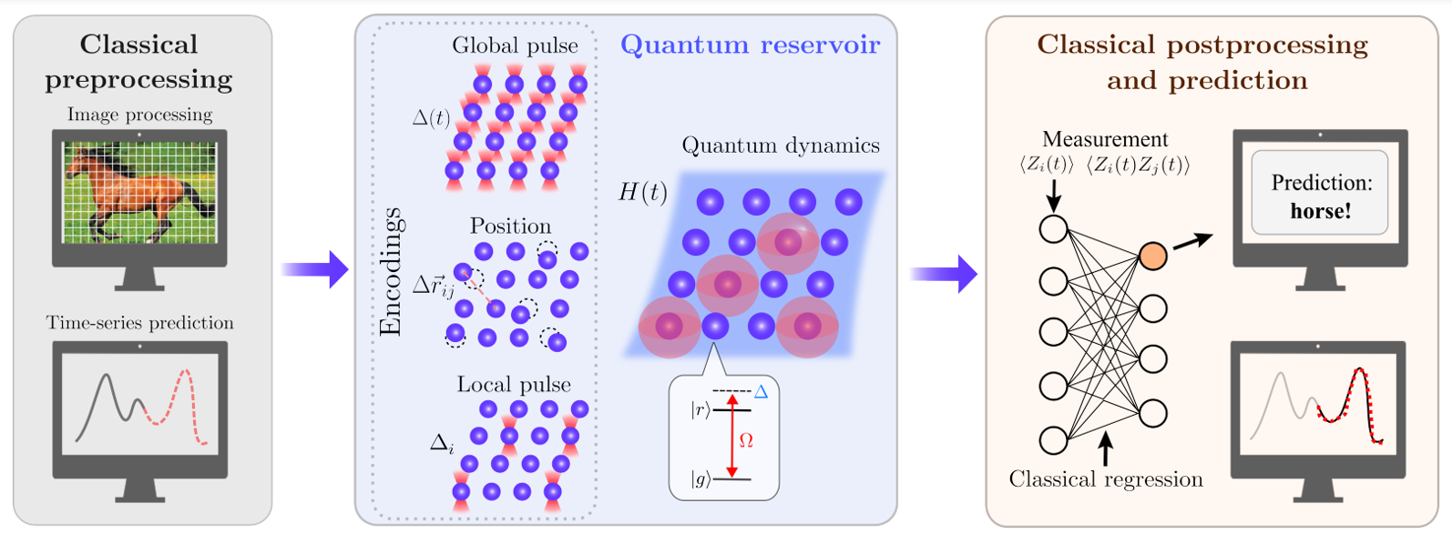
Quantum Reservoir Computing Algorithm
[arXiv:2407.02553]
6

Slide 9
Quantum Reservoir Computing Algorithm
[arXiv:2407.02553]
6

Slide 10
Quantum Reservoir Computing Algorithm
[arXiv:2407.02553]
6

Slide 11
Quantum Reservoir Computing Algorithm
[arXiv:2407.02553]
6

Slide 12
Quantum Reservoir Computing Algorithm
[arXiv:2407.02553]
6

Slide 13
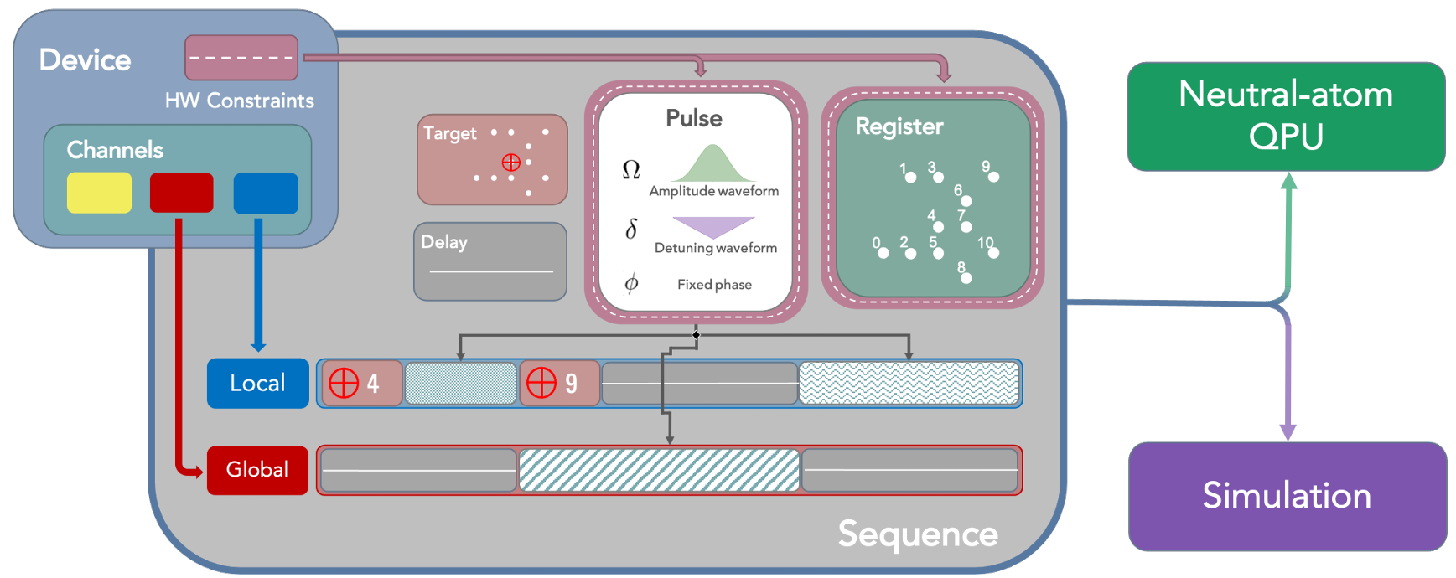
Implementation on Pasqal Platform
Pasqal: neutral atoms quantum hardware provider
[Quantum 6, 629 (2022)]
7

Slide 14
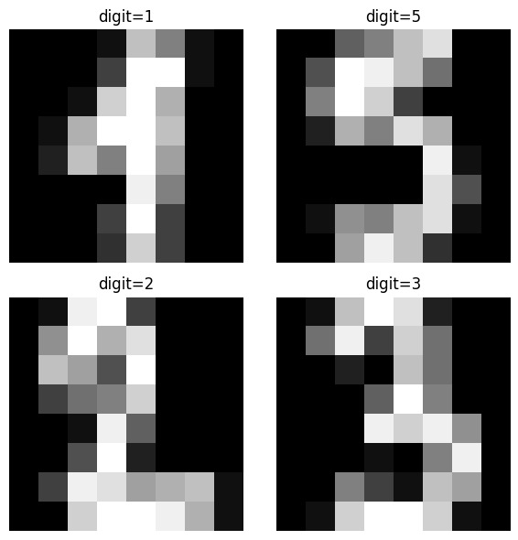
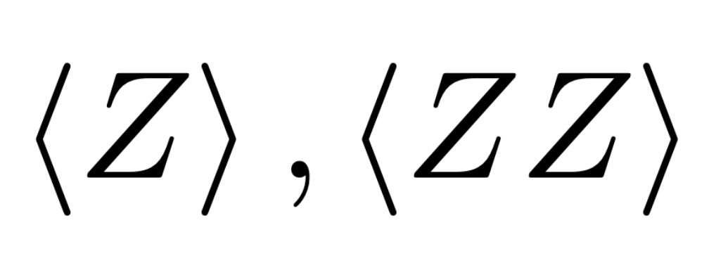
Data and Methodology
Dataset: MNIST, 1797 images, 8x8 pixels, values [0,15]
Pre-processing:
  PCA: 5 principal components
  Normalization [0,1]
  Train/test split: 70%/30%
Quantum Reservoir design:
  Linear chain of 5 atoms
  Observables:
Post-processing:
  Hyperparameter tuning
  Logistic regression
  Comparison quantum and classical baseline
MNIST = Modified National Institute of Standards and Technology
PCA = Principal Component Analysis
8

Slide 15
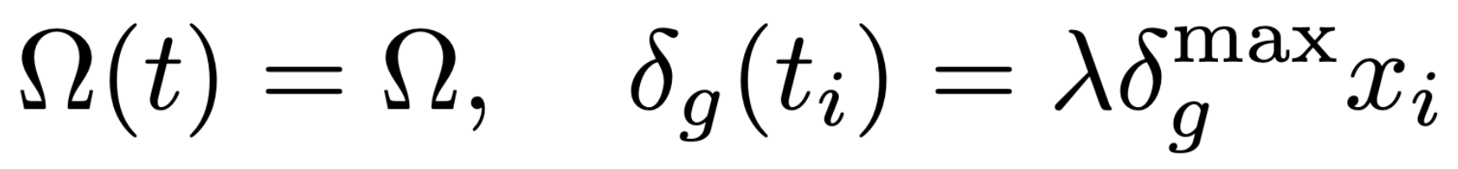
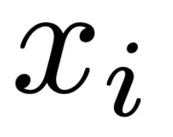
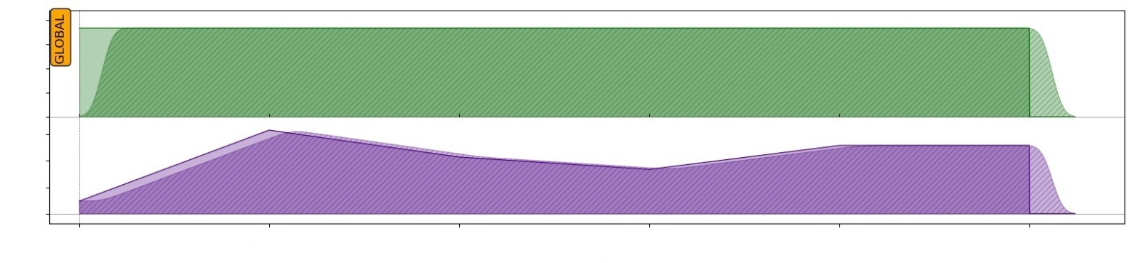


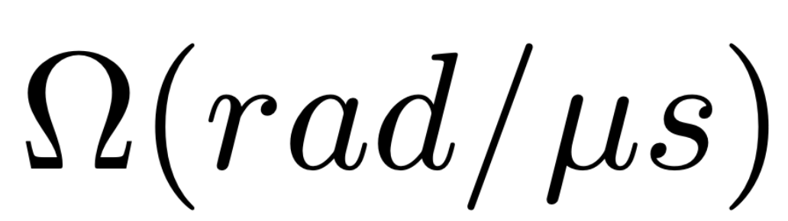





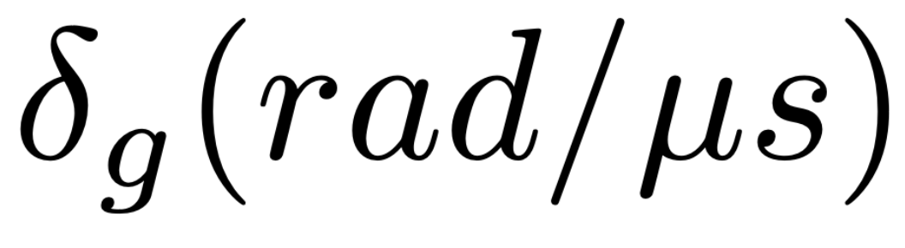






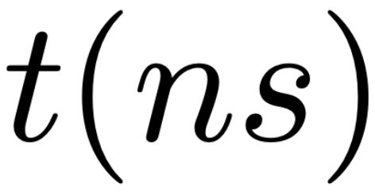
Global Encoding
Mapping features in global detunings
Customized sequence for each input
Embeddings collected at different time steps
9

Slide 16
Global Encoding
Mapping features in global detunings
Customized sequence for each input
Embeddings collected at different time steps
9

Slide 17
Global Encoding
Mapping features in global detunings
Customized sequence for each input
Embeddings collected at different time steps
9

Slide 18
Global Encoding
Mapping features in global detunings
Customized sequence for each input
Embeddings collected at different time steps
9

Slide 19
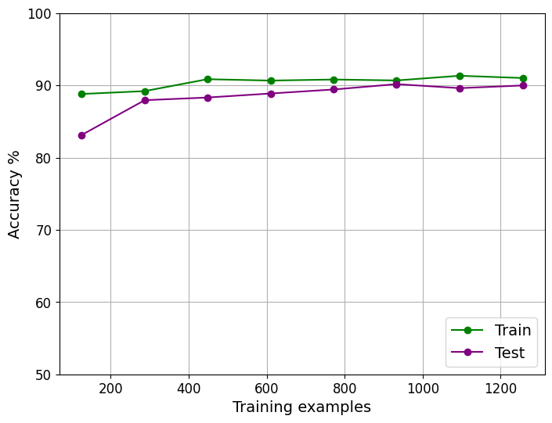
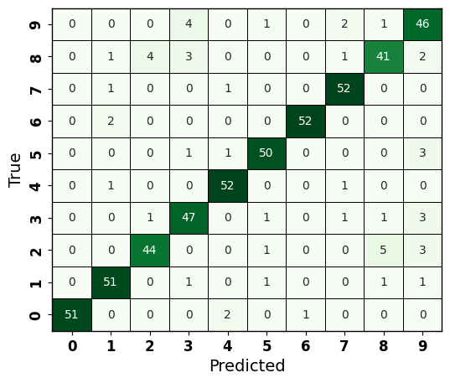
Global Encoding: results
Learning curve
Confusion matrix
10

Slide 20
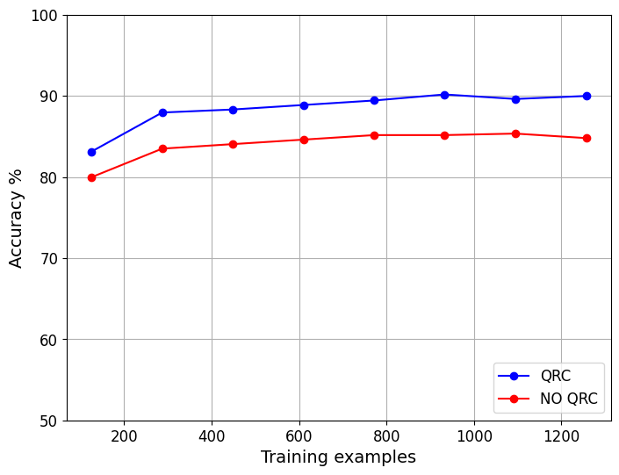
Global Encoding: results
Top performance:
  Global encoding 90.2% test accuracy
  Classical 85.1% test accuracy
Consistent advantage
More separable features: QRC extracts non-linear correlations
11

Slide 21
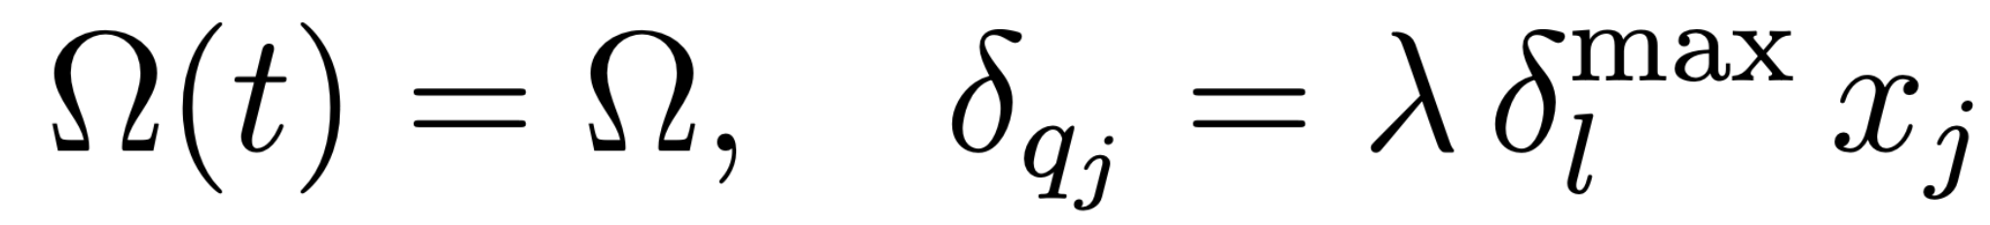
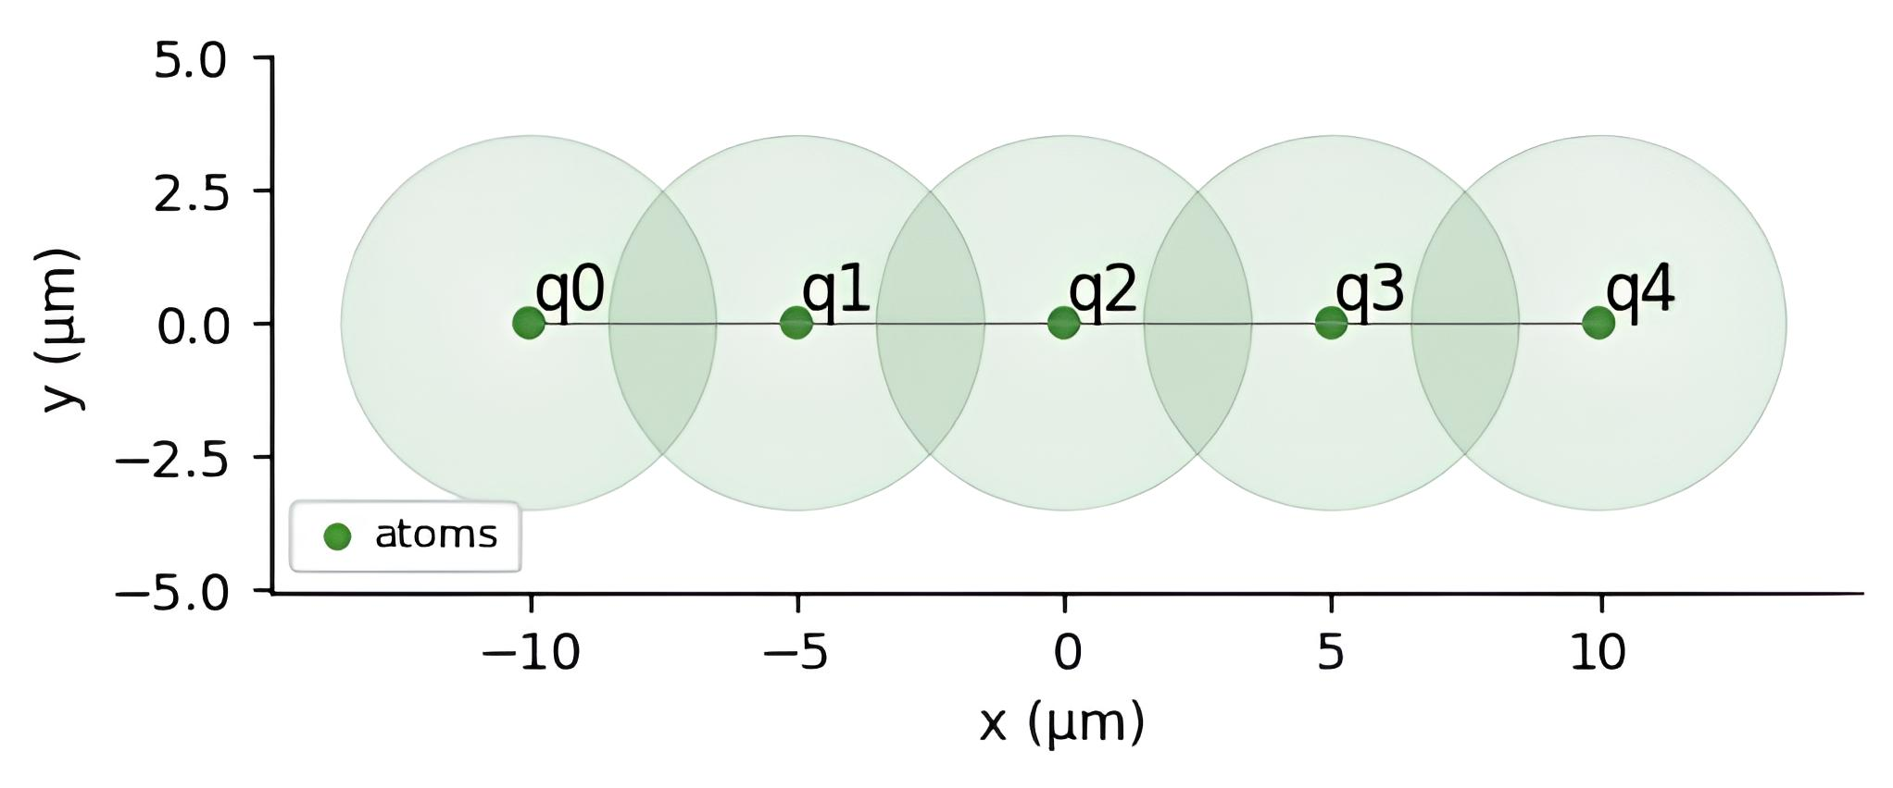
Local Encoding
Mapping features in local detunings
Custom sequence per input vector and feature
Embeddings collected at each time steps
12

Slide 22
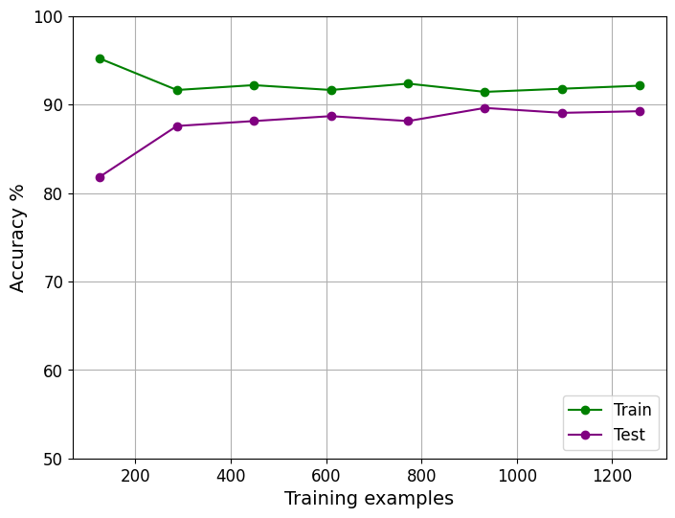
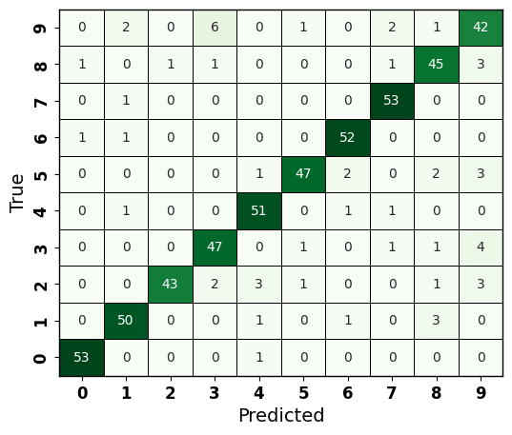
Local Encoding: results
Learning curve
Confusion matrix
13

Slide 23
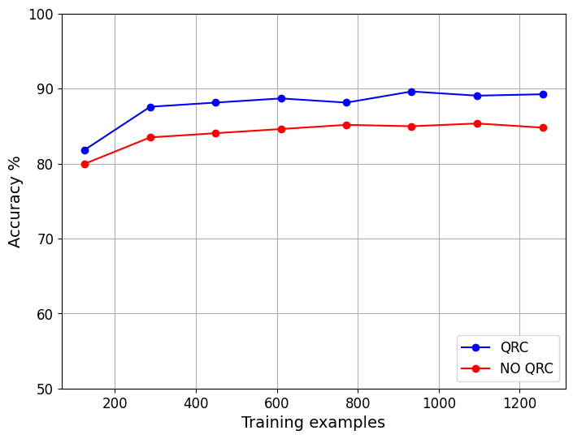
Local Encoding: results
Top performance:
  Local encoding 89.6% test accuracy
  Classical 85.1% test accuracy
Consistent advantage
Encoding-independent benefit
14

Slide 24
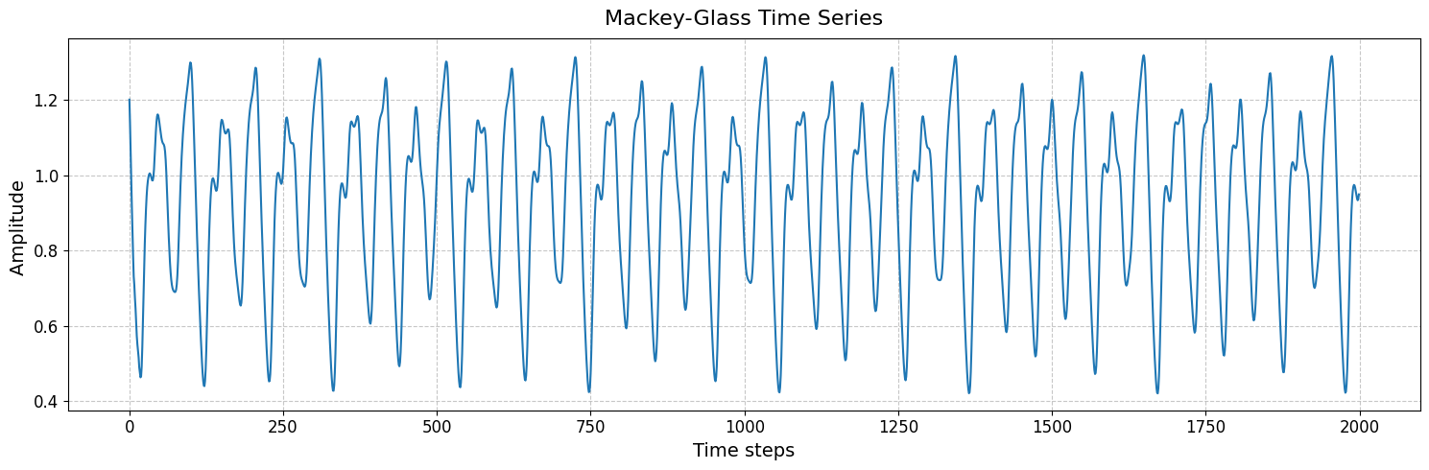
Future work
Time series predicition of chaotic systems
16 input data
70 output
15

Slide 25
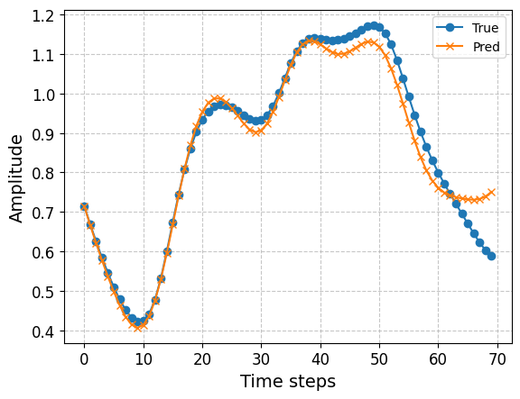
Future work
Time series predicition of chaotic systems
16 input data
70 output
15

Slide 26
Conclusions
Contributions:
Implemented and tested QRC on Pasqal neutral-atom platform.
Classically emulated the algorithm with different encoding strategies.
Achieved 5% improvement with global and local encoding over classical pipeline.
Future directions:
Scale up the reservoir: increase qubit count and dimension.
Execution on real hardware: submit sequence and extract embeddings from measured bit-strings.
Benchmarking time series prediction: compare model against top classical.
16

Slide 27
Recommended Literature
Quantum reservoir computing
Mujal et al. “ Opportunities in Quantum Reservoir Computing and Extreme Learning Machines”, Adv. Quantum Technol. 4, 2100027 (2021)
Domingo. “Classical and quantum reservoir computing: development and applications in machine learning.” arXiv:2310.07455(2023)
Quantum chemistry applications
Beaulieu, et al. “Robust Quantum Reservoir Computing for Molecular Property Prediction.” J. Chem. Inf. Model. 65, 8475 (2025)
Kawai & Nakagawa, "Predicting excited states from ground state wavefunction by supervised quantum machine learning", Mach. Learn.: Sci. Technol. 1, 045027 (2020)
17

Slide 28
Thank you
for your attention!
Any questions?

Slide 29
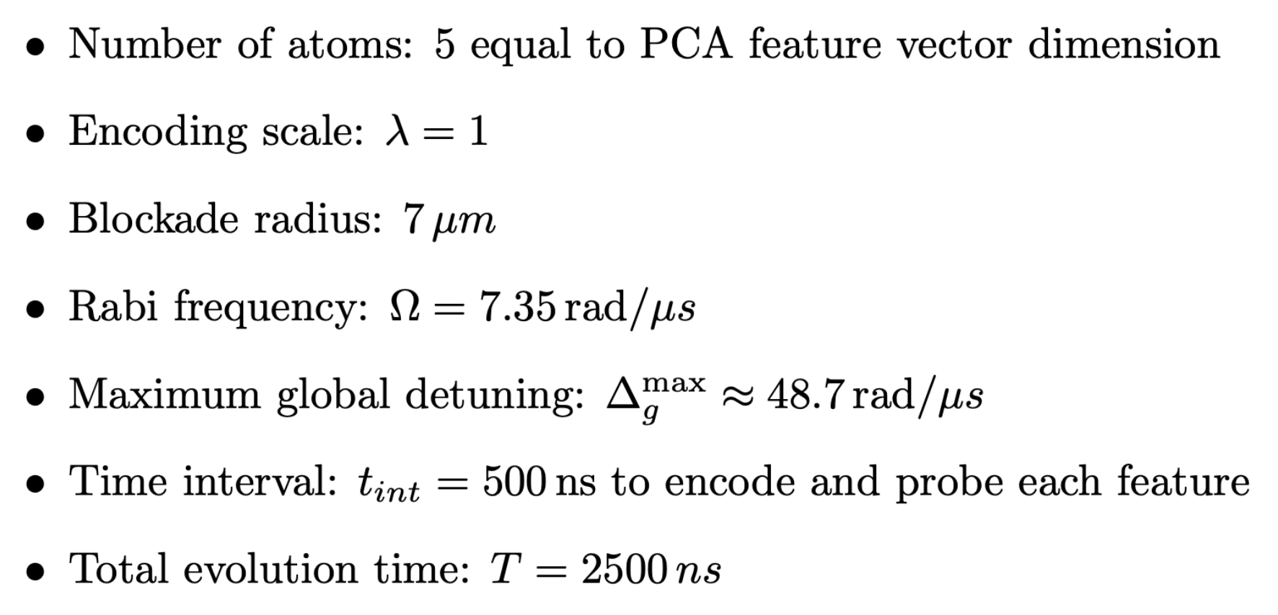
Simulation parameters – Global encoding

Slide 30
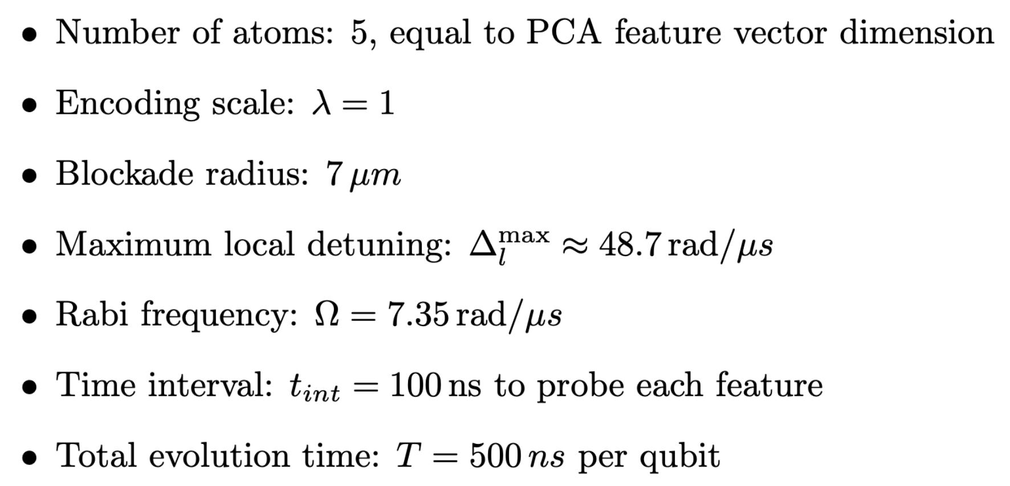
Simulation parameters – Local encoding

Slide 31
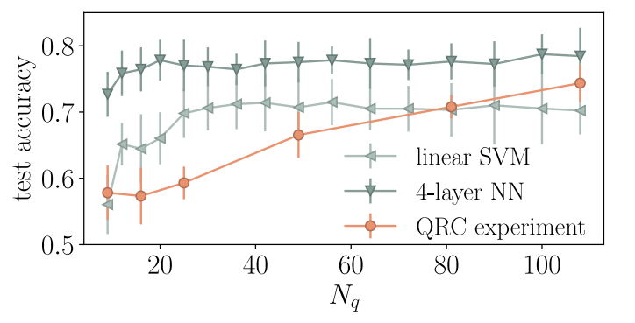
Scaling up
Tomato disease task. 2D position encoding. Test accuracy increase with qubits.
[arXiv:2407.02553]

