Slide 1
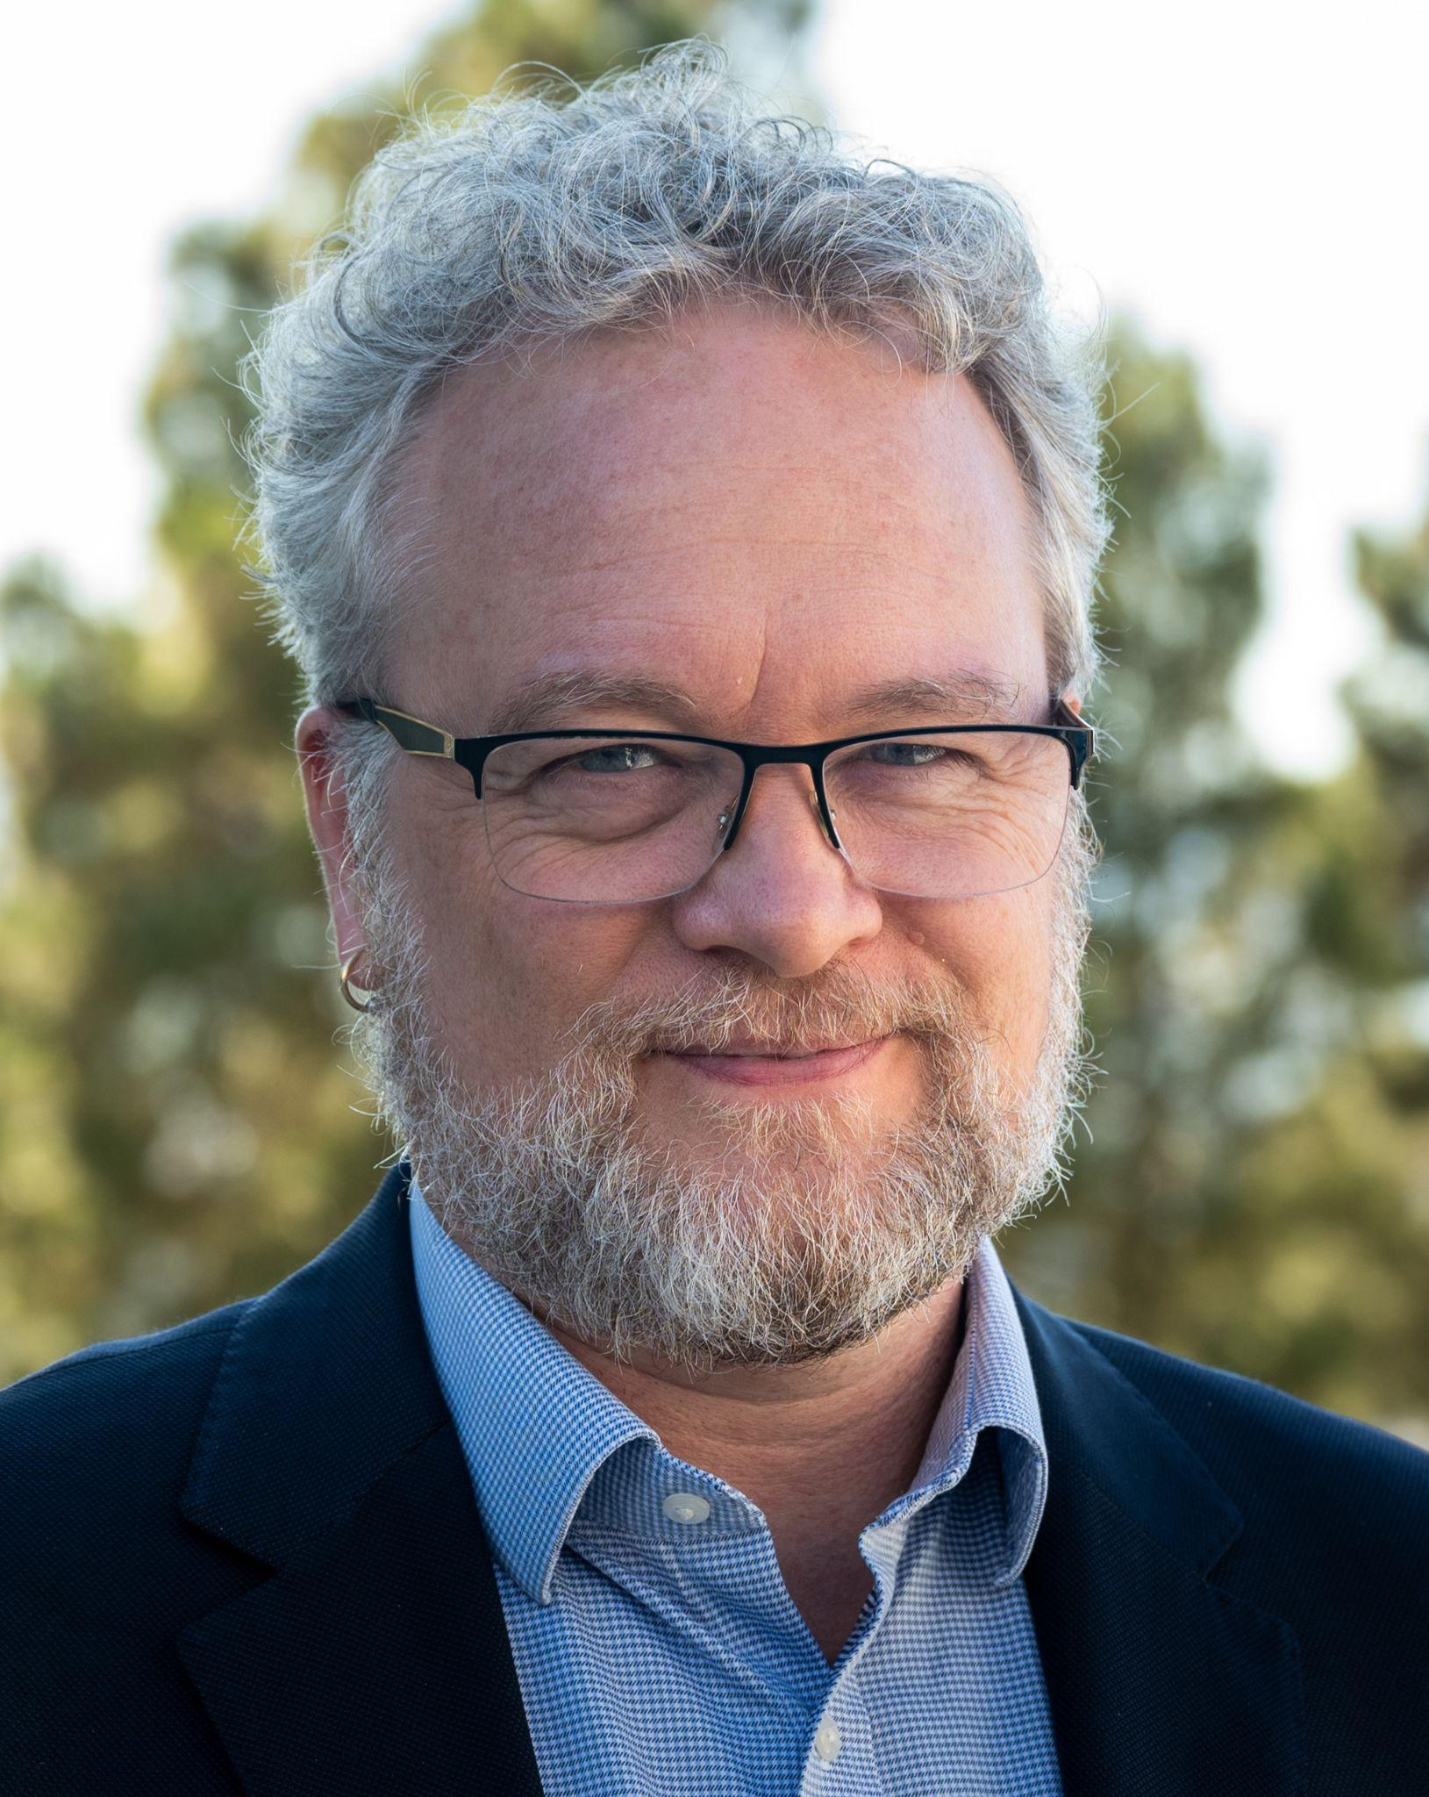
Performant Perimeter Security:
A Foundation for Data Intensive Science
Eli Dart
Network Engineer, Science Engagement
dart@es.net
ISGC 2026
Taipei, Taiwan
19 March 2026

Slide 2
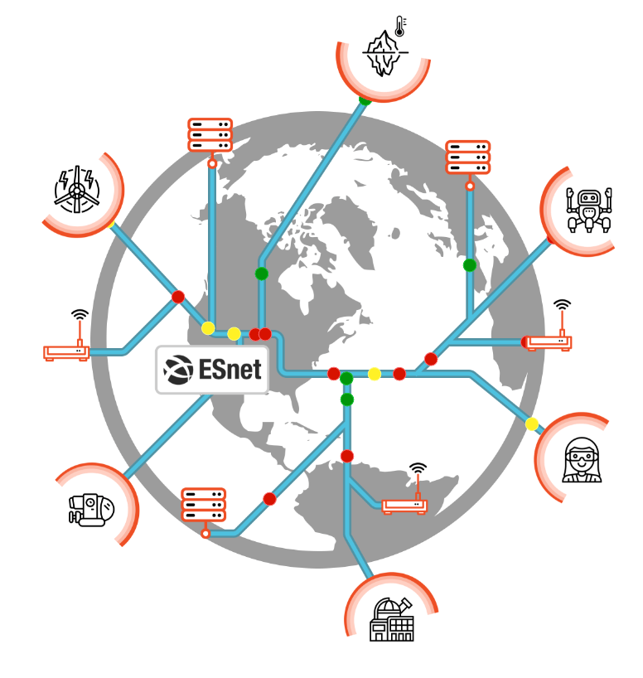
Our World Is Data-Centric
Many, many scientific discoveries are impossible without data analysis
Modern science relies on computing, data, storage, all interconnected using fast networks
ESnet even thinks of itself as a “data circulatory system”

Slide 3
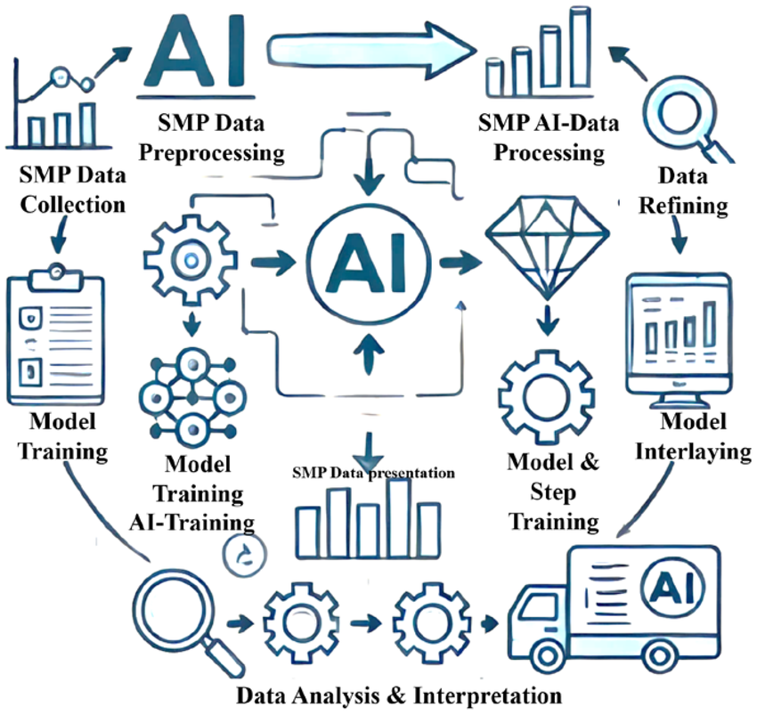
Most People Want Semantic Reasoning
Think about high level analysis instead of low level data sets
This is where the value is
This is where the discoveries are
However, in order for this to be possible, the low level stuff has to work
Image: Olawumi, Mattew & Oladapo, Bankole & Olugbade, Temitope & Omigbodun, Francis & Olawade, David. (2024). AI-Driven Data Analysis of Quantifying Environmental Impact and Efficiency of Shape Memory Polymers. Biomimetics. 9. 490. 10.3390/biomimetics9080490.

Slide 4
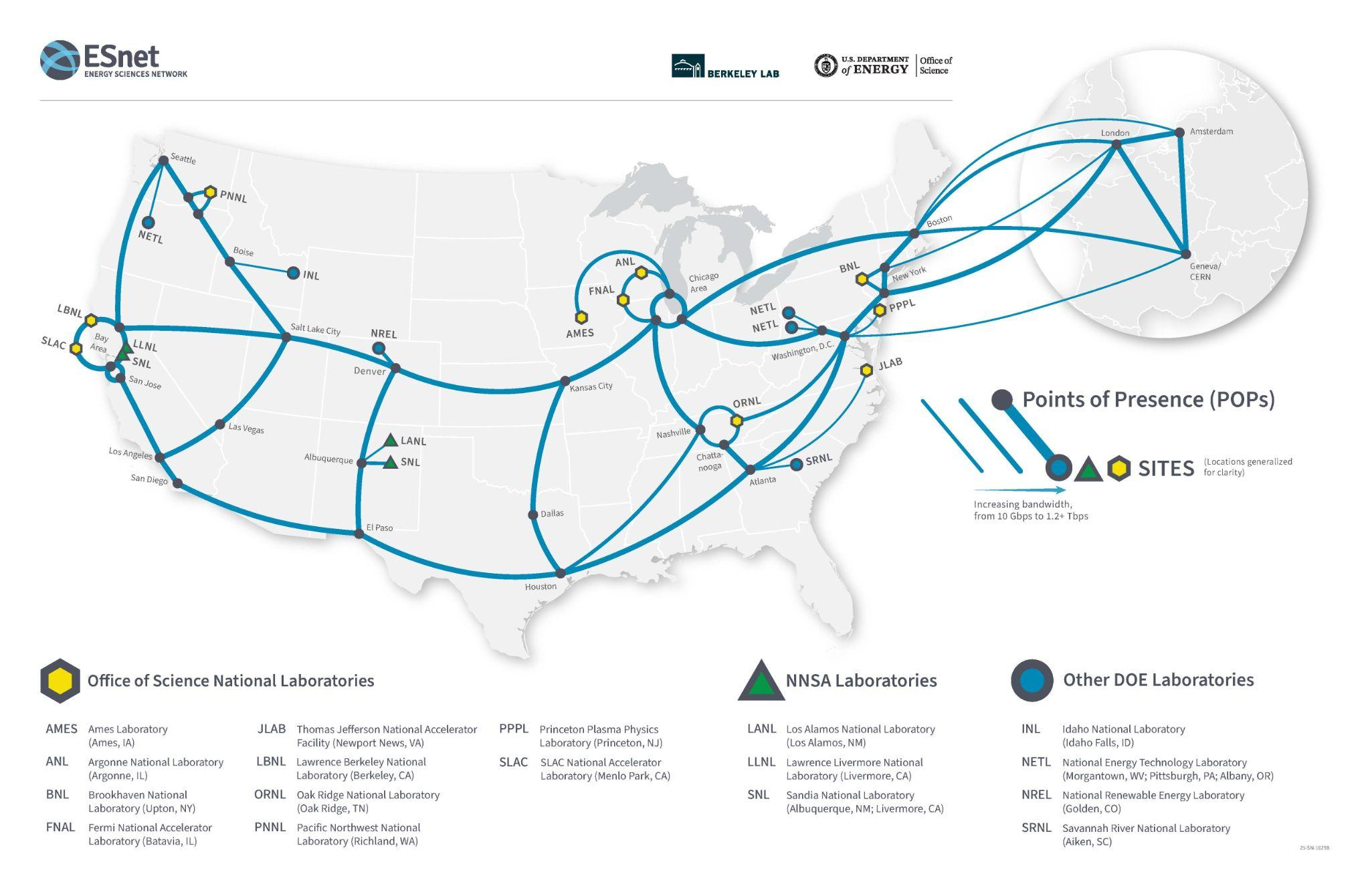
Data Infrastructure Under The Semantics
ESnet supports the DOE scientific research ecosystem.
Interconnects all US national labs and user facilities
Provides reliable, high-performance connectivity to global research collaborations, the Cloud, and the larger Internet.
Notes:
In short: ESnet is a high-performance, high-speed network that serves as the “data circulatory system” for the DOE scientific research ecosystem, connecting the 17 national labs and 28 other user facilities (soon to include the High Performance Data Facility), plus CERN in Switzerland.
This map just shows ESnet’s US and European backbone. It also peers with more than 270 research and commercial networks, transmitting data traffic all over the globe.
ESnet's vision is that scientific progress will be completely unconstrained by geography — the physical location of instruments, people, computational resources, or data should not matter.

Slide 5
Science Needs More Than Just The Network
Computing and storage
HPC center, institute
cloud, personal device
Code (workflow, analysis, …)
All of these things exist somewhere in physical space
All of these things located in the network topology
It’s great to be able to reason at a higher level
But then all the lower level stuff has to work!
Science workflows are multi-domain in the general case
Data and workflows cross network boundaries

Slide 6
What is Perimeter Security?
Network perimeter: boundary between zones of control
Each organization has its zone of control
Hardware owned by the organization
Network topology under the control of the organization
Connection of the network to the outside world
Cloud complicates this, but the network perimeter still exists
This is a necessary construct
ZeroTrust doesn’t change it
On-premise assets are “inside” the perimeter, the rest of the Internet is “outside” the perimeter
We can think of perimeter security as the policies and technologies that defend on-premise assets from network-based attacks

Slide 7
Science Crosses the Perimeter
Science collaborations are inherently multi-domain
Labs, Universities, Cloud, etc.
Data must move between sites and resources
Science mission requires that high performance science traffic moves between and across zones of control
Data, computing, storage, instruments, researchers
All are at different locations in the network topology
Key point: high performance data flows have a concrete location in the network topology
Virtualization, cloud, workflows, etc. all hide physical performance characteristics, but that doesn’t change them
If we want workflows to perform, we have to have a performant physical path for the data

Slide 8
Security and Performance In Conflict
The organization must defend its perimeter
Huge liability risk
Operational/availability risk
This MUST happen, so it WILL happen!
We can choose how it happens, but not whether it happens
Science requires performance
In order to meet the science mission, we must find a way to make data flows performant
Because perimeter security must exist, performance must exist in the context of perimeter security
Find a way to run high performance workflows across the perimeter

Slide 9
High Performance, Safely
This is both a technical issue and a sociological issue
The technical solutions must be technically sound
However, policy is critical, and there are multiple related but separate aspects to perimeter policy
Which hosts/systems are allowed to exchange data?
Which applications and protocols are permitted?
Which technologies are used to enforce policy?
The answers to these questions determine whether high performance data applications can use your perimeter
And: can your scientists run high performance workflows at your site, using your computing, instruments, and storage?

Slide 10
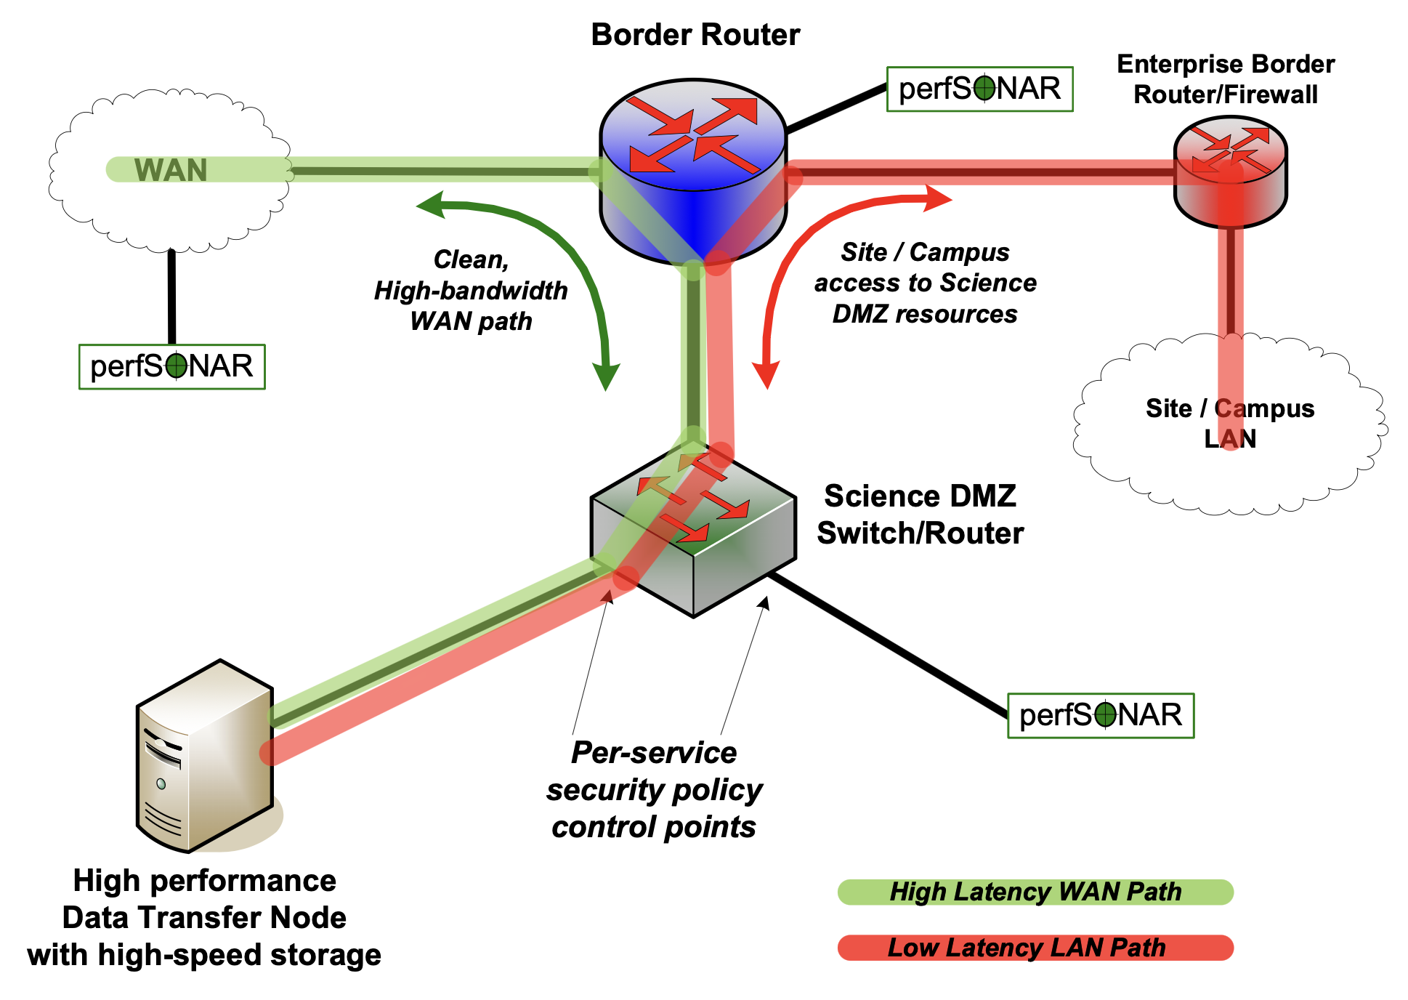
Best Practice: Science DMZ
The answer is the science dmz model.
Separate high performance science traffic from enterprise traffic
Build the science data perimeter using performant technologies
If we can do this, we can scale up data performance to match the data scale

Slide 11
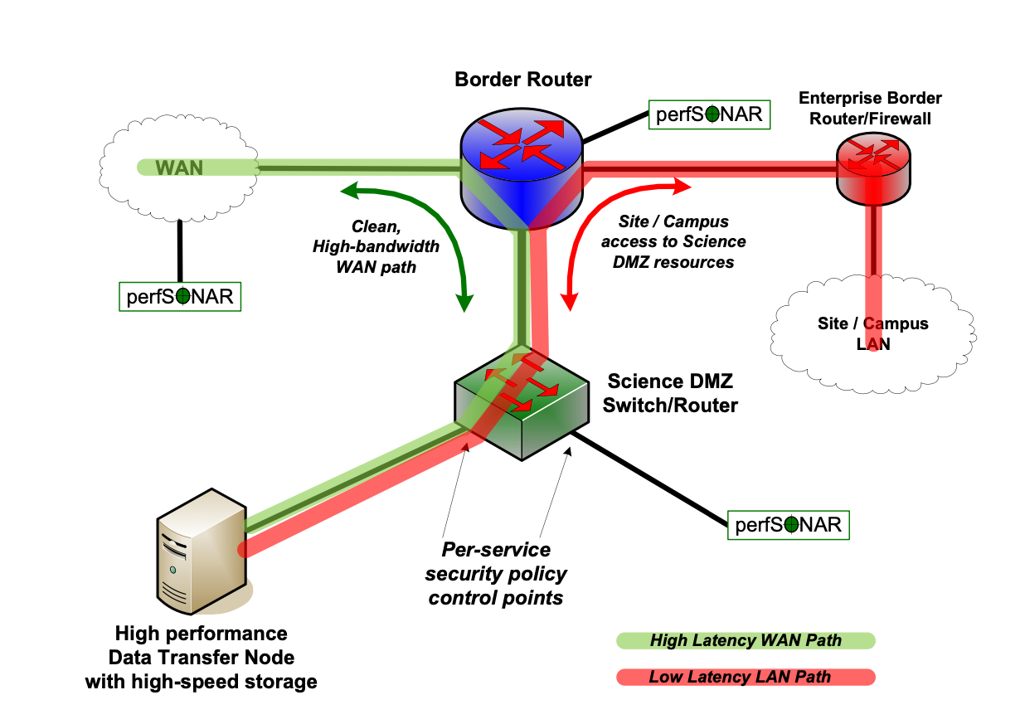
Limitation Is An Enabler
Only approved services in the Science DMZ
Services that can be secured with stateless firewalls
Complexity is the enemy
Allows space for performant security
Control vs. Data can be handled separately
Enterprise firewall is fine for control messages, auth, etc.
Need Science DMZ for high performance data

Slide 12
Lessons Learned Over Time
Enterprise security team will try to eliminate Science DMZ
“The firewall is faster now”
“The DMZ isn’t secure because it doesn’t have a firewall, so we will put in a firewall to make it secure”
Multiple variations of this
Workflows change over time
You may not know about the changes in advance
Science need drives mission
Architecture must accommodate changes needed by science
Must find a way to make performance persistent
Then, users can rely on it

Slide 13
Lessons Learned Over Time (2)
Most users won’t ask for help
They just suffer in silence or change to fit limitations
Many “know” that things can’t be better
Proving a negative is hard
Very difficult to find evidence that users would be doing better if they could
Answer: build it right, and teach users to use it
The results can be impressive

Slide 14
A Note About Data Locality
I hear a lot of people say “don’t move the data”
“Just move the compute to the data!”
Of course! Do that if you can. But there are often difficulties
Open access data, closed access computing
Code execution is often tightly controlled
Scientist often doesn’t have permission to run analysis next to the existing data store → need to move the data
Specific hardware required
Specialized systems, computing scale, other requirements
Move the data to the specific system
I don’t have to pay to run on my local system
More creativity if I run there
I have to move the data to my cluster
Therefore, we must support data movement in the general case

Slide 15
What is Possible?
I’m going to go through a few real-world examples
High performance data workflows across the perimeter
Multiple Science DMZ design pattern examples
First examples: file transfer using DTNs
Classical use of Science DMZ
Transfer files or objects from one storage system to another
Valuable if data needed at remote location for some time
Many, many workflows do this
Basic portal or cluster/HPC implementation of Science DMZ

Slide 16
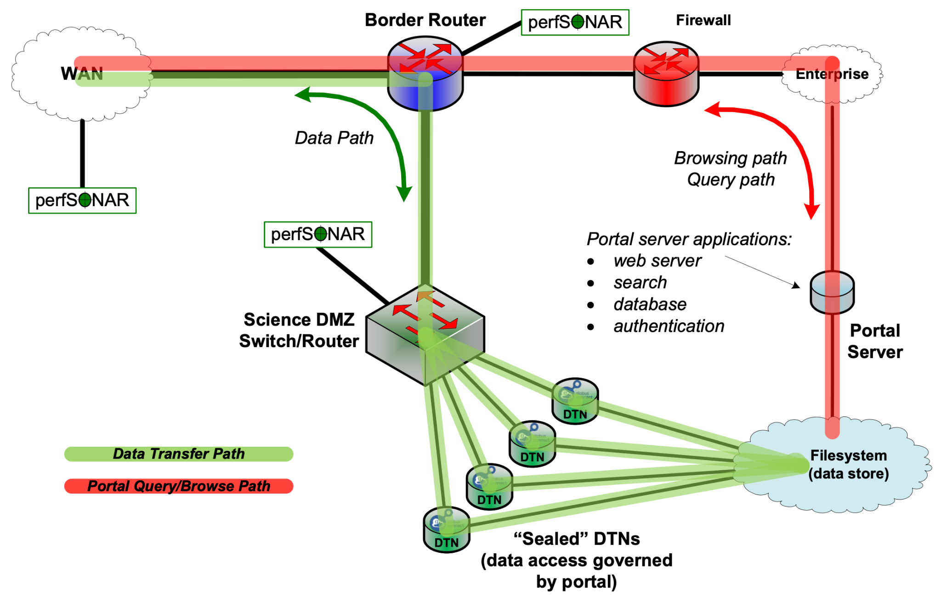
Portal Design Pattern

Slide 17
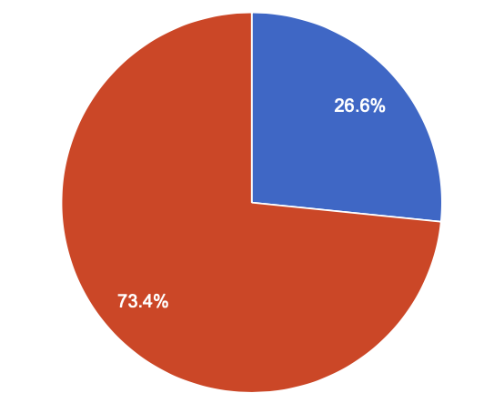
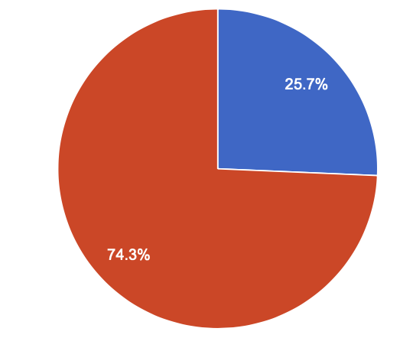

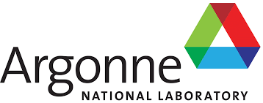

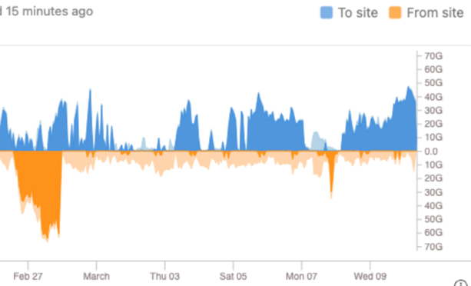

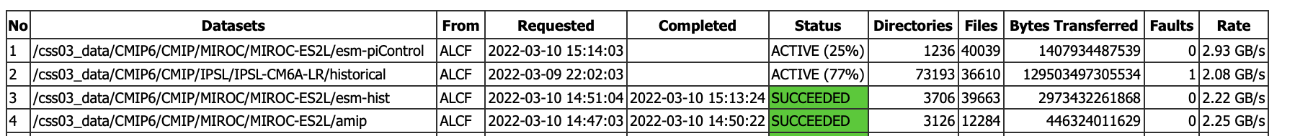

Replication: Globus used to move 7.4 petabytes of data from Livermore to Argonne and Oak Ridge Labs
4 to 6 GB/s
1.5 GB/s
17,347,671 directories and 28,907,532 files
From February 12 to May 4, 2022
To ALCF
To OLCF
Slide credit: Ian Foster, ANL
Shown: Status as of March 10, 2022

Slide 18
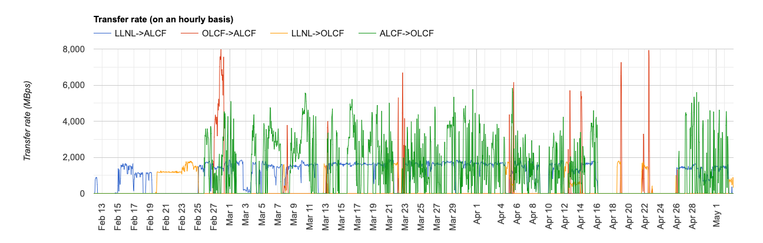
Replication: Transfer Strategy
Keep the slow part busy
Sync between the fast systems
Fail over during maintenance windows
Note performance differences
Outbound from LLNL much slower
Sync between ALCF and OLCF is fast

Slide 19
Portal Data Replication: Discussion
Data portal infrastructure already had DTNs in place
All the replication team had to do was use them
If they had had to use the portal web server, the task would have been impossible
New use for the DTNs, very valuable to have them there

Slide 20
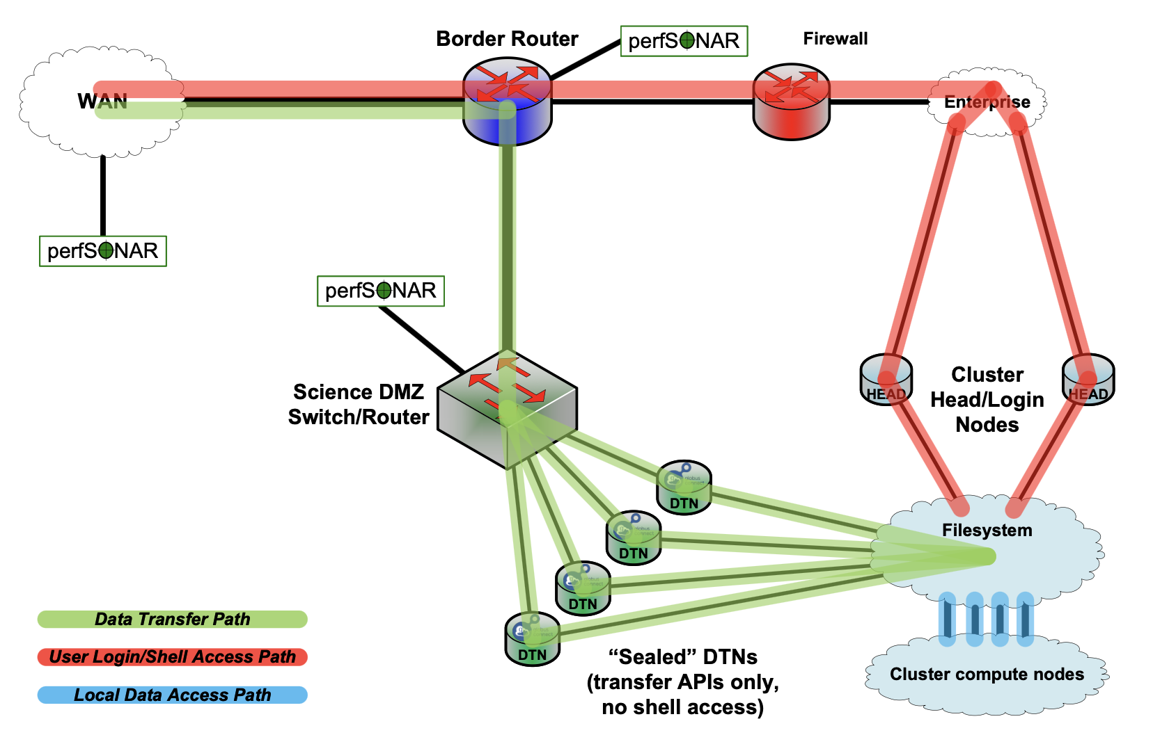
HPC/Cluster Design Pattern

Slide 21
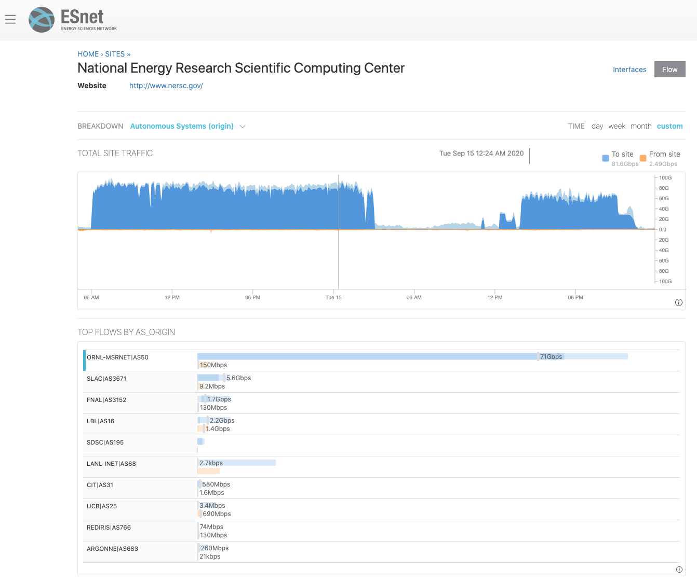

Slide 22
Large Scale Data Transfer
Two Globus transfers from OLCF to NERSC were started by the same user (presumably for the same project – DESI – which is dark energy/cosmology) within 40 minutes of each other.
One transfer was ~350k files, ~296TB
Other transfer was ~1.8M files, ~472TB
Data transfer rate peaks over 80Gbps
Total transfer volume ~768TB
Total wall clock time ~39 hours
Current tools (Filesystems, DTNs, Globus) handle petascale data sets easily

Slide 23
Small job (296TB)
OLCF Globus endpoint pause (scheduled maintenance)
Big job (472TB)
Total volume in two jobs: 768TB

Slide 24
Key Points
Sophisticated tools bring multiple benefits
Both transfers experienced random data corruption (multiple checksum failures) which was automatically corrected by Globus (data set is ¾ of a petabyte….a lot can happen with that much data)
User had to expend zero effort to find and fix the corrupted files
OLCF endpoint paused for a workday for normal scheduled maintenance, and transfer resumed after maintenance concluded
OLCF staff did not have to worry about the user when planning maintenance
User had to expend zero effort to work around HPC facility maintenance
Easy to use tools with automated fault recovery reduce human effort
Large scale data transfer is a key enabler for scientific productivity
Benefits of large-scale HPC allocation brought back to collaborators
Normal, routine operations – no magic

Slide 25
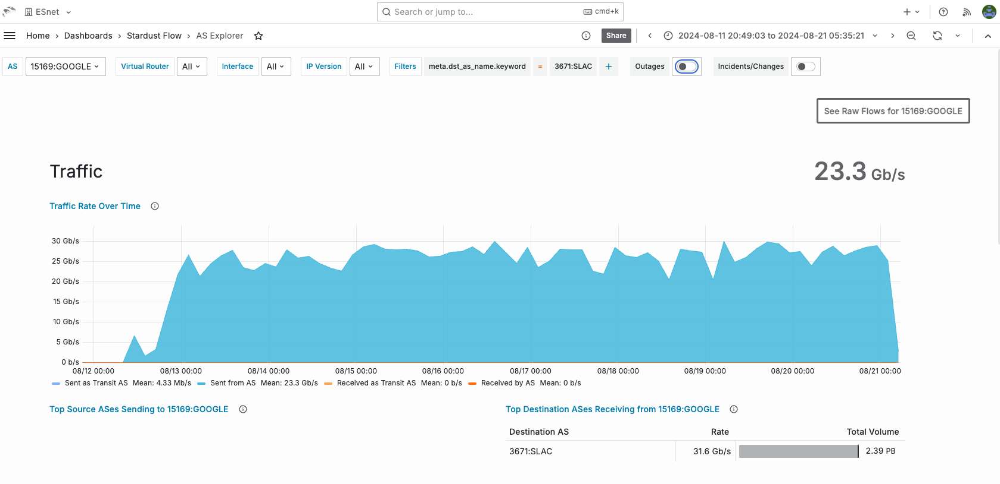
Large Scale Replication From Cloud
Notes:
Cloud to science institution

Slide 26
Large Scale Replication From Cloud
Rubin/LSST project at SLAC
Large scale data replication
250M files
Over 2.3PB
Approx. 8.5 days
Six DTNs at SLAC
K8 environment
Google Cloud Storage Transfer application
Traffic traversed three Squid proxies at SLAC

Slide 27
Google to SLAC Replication - Key Points
Petascale data transfer from cloud works!
Small number of DTNs can achieve good performance
Containers are viable for high performance applications, including I/O intensive

Slide 28
File Transfer: Discussion
When the infrastructure is already in place, users just use it
Nobody has to ask permission
No complex config for users to do
No need to debug the end to end path before using it
Users can concentrate on the workflow
Simple protocols, high performance
Simple policy: Support DTN driven data transfers
Simple protocols: Globus, cloud-native object access, etc.
Safe to operate when secured with performant technologies, in keeping with Science DMZ

Slide 29
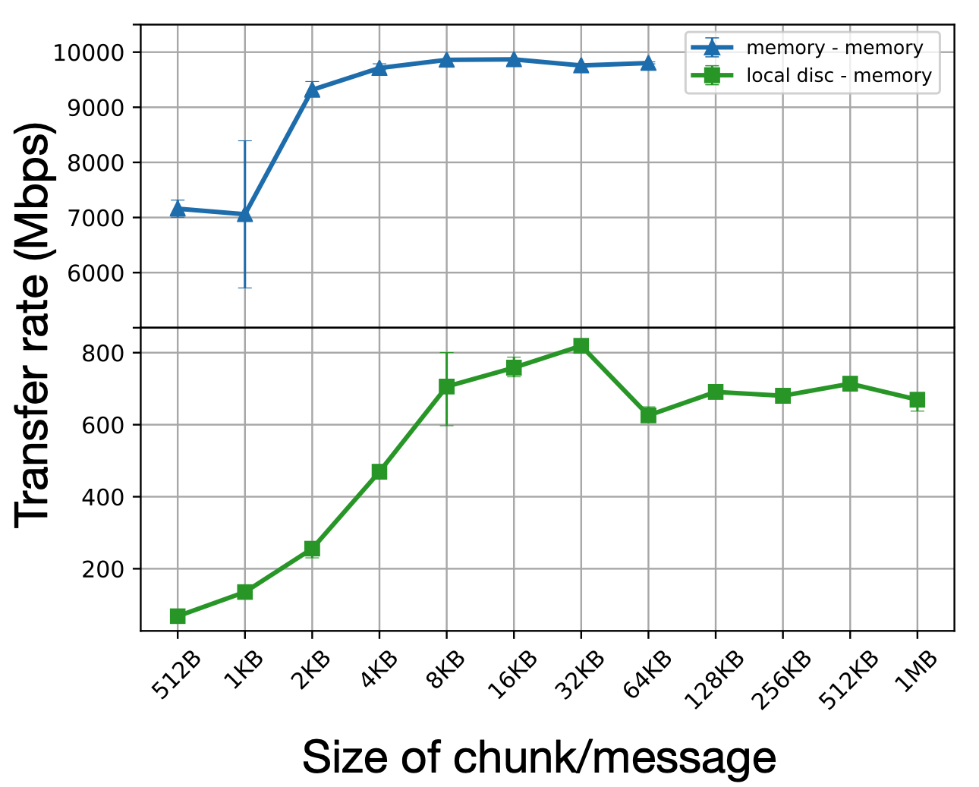
Storage Becoming A Limitation
In many cases, storage I/O is now the bottleneck
Answer: streaming
One or both ends of the data transfer is volatile
Instrument
Memory
Removes storage limitations from the workflow
Image: Raj Kettimuthu, ANL

Slide 30
Stream From Site Storage To Cloud
Workflow reads from site storage into cloud analysis job
No local storage in the cloud environment
Compute job analyzes the data and then drops it
Need the data again? Fetch it again!
No cloud storage costs
High performance perimeter required for success
Packet loss or other network issues reduce compute performance
Easy to do with Science DMZ
Two examples follow

Slide 31
Analysis in Cloud: Vera Rubin Observatory
Two parts to Rubin workflow
Acquisition + alerting
Data comes from the telescope in Chile to SLAC in USA
World’s largest digital camera on telescope in Chile
Data path traverses many networks, including ESnet
Prompt analysis and alert generation at SLAC
Multinational networking collaboration required to get the data to SLAC
Alerts sent to scientific community
User analysis
Data releases distributed from SLAC to scientists
Jupyter analysis environment for users in Google Cloud
Cloud job reads data from SLAC into Jupyter notebook
Collaboration will scale this up as data accumulates

Slide 32
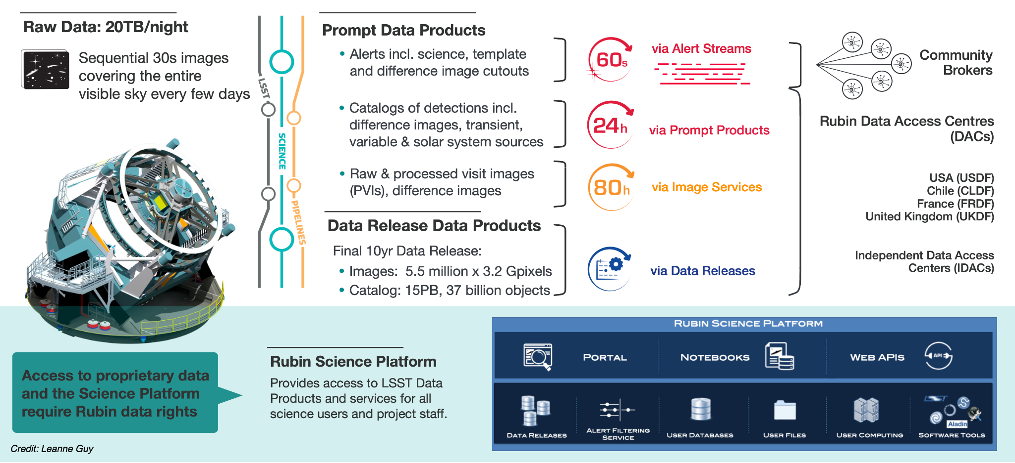
Rubin Data Management System includes both making data and serving data to users
Notes:
Rubin services are deployed via kubernetes - “configuration as code”
Makes it easier to deploy in different places
RSP is running in at least 6 locations: IDF, NCSA, Summit, FrDF, UKDF and SLAC
RSP users live in a Rubin-controlled containerized bubble
Catalogue access is via a TAP service (no direct querying of Qserv)
Traffic load is not seen as large; access SLAC’s Qserv from cloud RSP (and Chile’s)
Most Rubin data will be in object stores
Access is via url - will be signed and timed to limit to data rights holders
Can access SLAC’s archive from the Cloud if users need more than Coadds
100 Gb/s link between SLAC and Google today

Slide 33
Training and Inference in Commercial Cloud
DUNE collaboration
ML based data reduction
Near-real-time inferencing classifiers supporting neutrino physics workflows.
Hybrid workflow
Data and CPU computing at FNAL
GPUs in Google
Impossible without high performance perimeter
Works great if you do have high performance perimeter

Slide 34
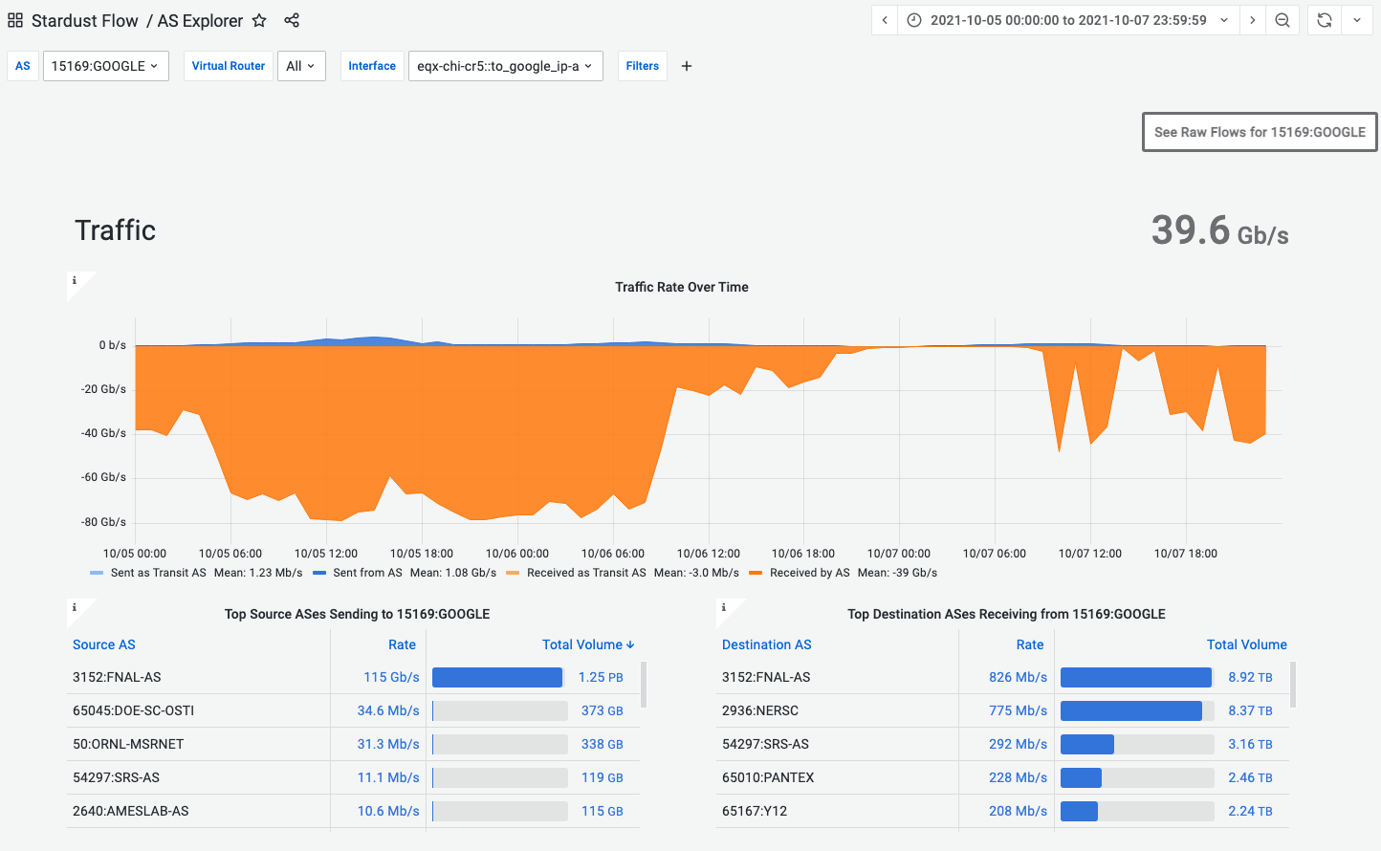

Data From Lab to Cloud For Inference
~80Gbps for hours at a time
Over 1PB moved in ~30 hours
No need to replicate the data first (no file transfer workflow)
No in-cloud storage costs

Slide 35
Site to Cloud Streaming: Discussion
Data storage and servers are on infrastructure owned by the community/collaboration
Storage systems with DTNs
POSIX or object store, doesn’t matter
Analysis/compute clients in the cloud fetch the data directly
No copying to cloud storage first
Just read the data in from remote storage, analyze it
Site perimeter design: DTNs for outbound data
Simple security policy (address and port filters)
Safe to operate with performant security technologies
Science workflow requires high performance
Scaling enterprise firewalls to support this is difficult and expensive
No added benefit from enterprise firewalls (just address/port)

Slide 36
Stream From Cloud To HPC
These workflows go in the other direction
Data comes from the cloud, across the perimeter, and into a running analysis job on a supercomputer
Can be many many nodes on both sides
Bandwidth can get quite large
Not limited by HPC storage I/O
No need to wait for data replication
Workflow can go faster than the DTN cluster

Slide 37
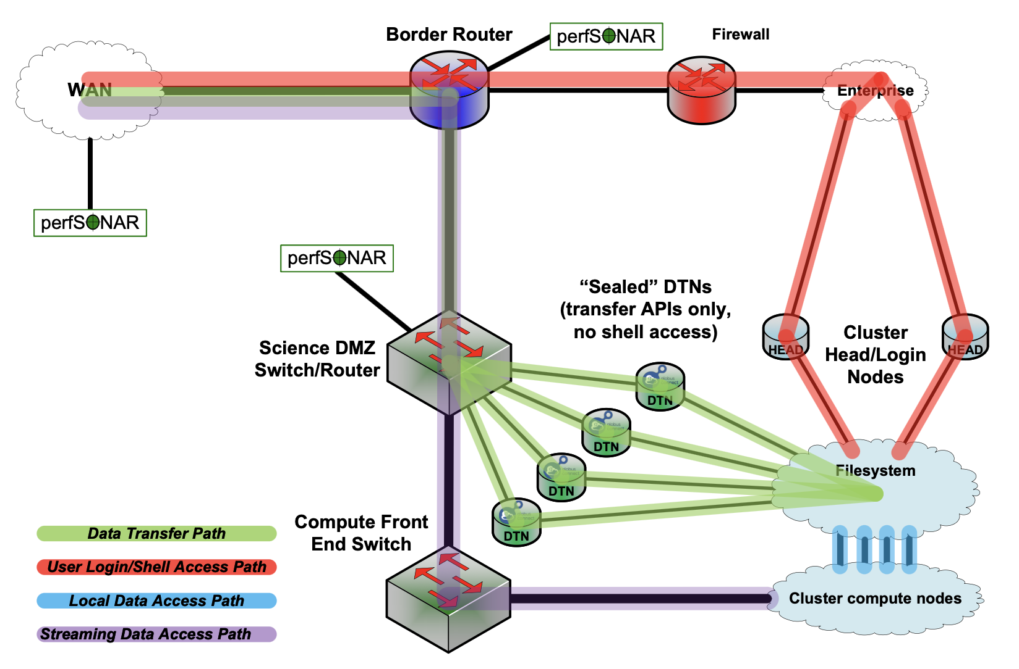

Slide 38
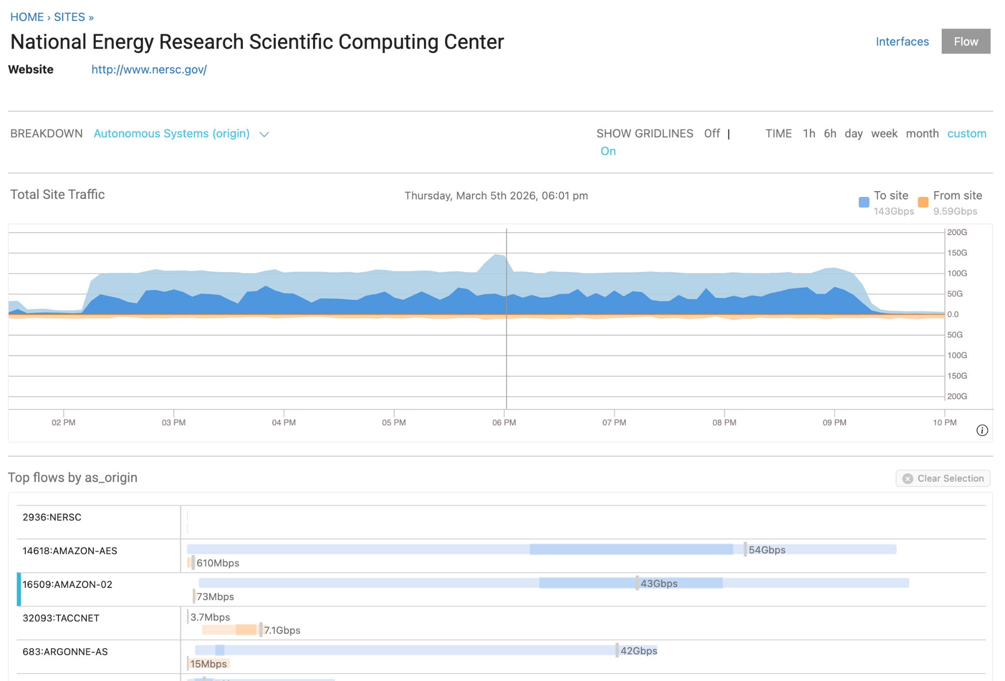
Direct Transfer to Compute: Amazon to NERSC
Data set in commercial cloud
Weather forecasting code
No replication before job launch
Direct ingest by compute job takes pressure off the HPC facility storage system

Slide 39
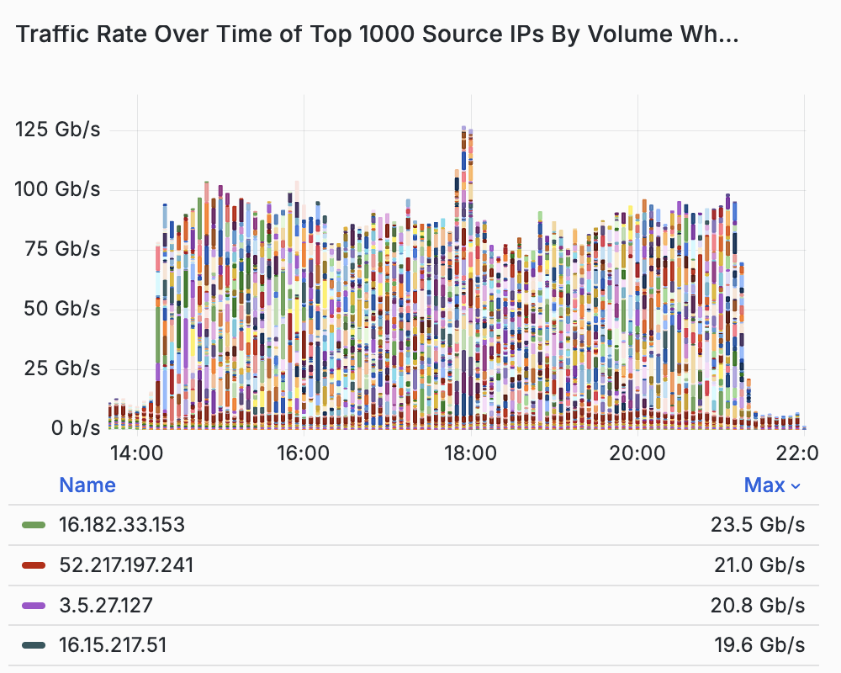
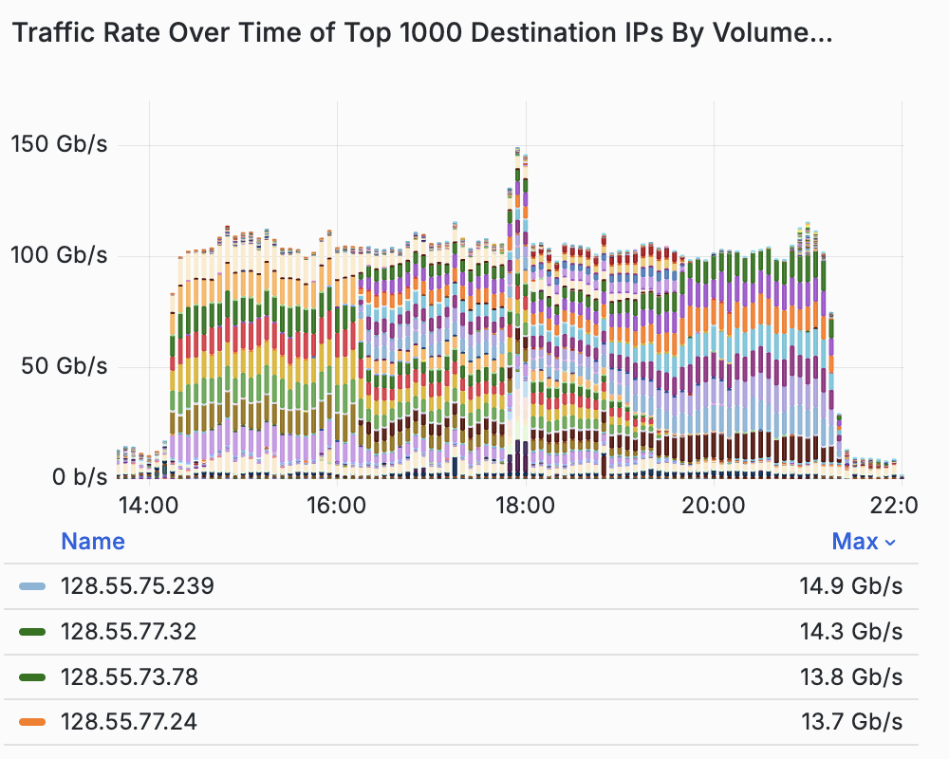
Many cloud servers to a few compute nodes

Slide 40
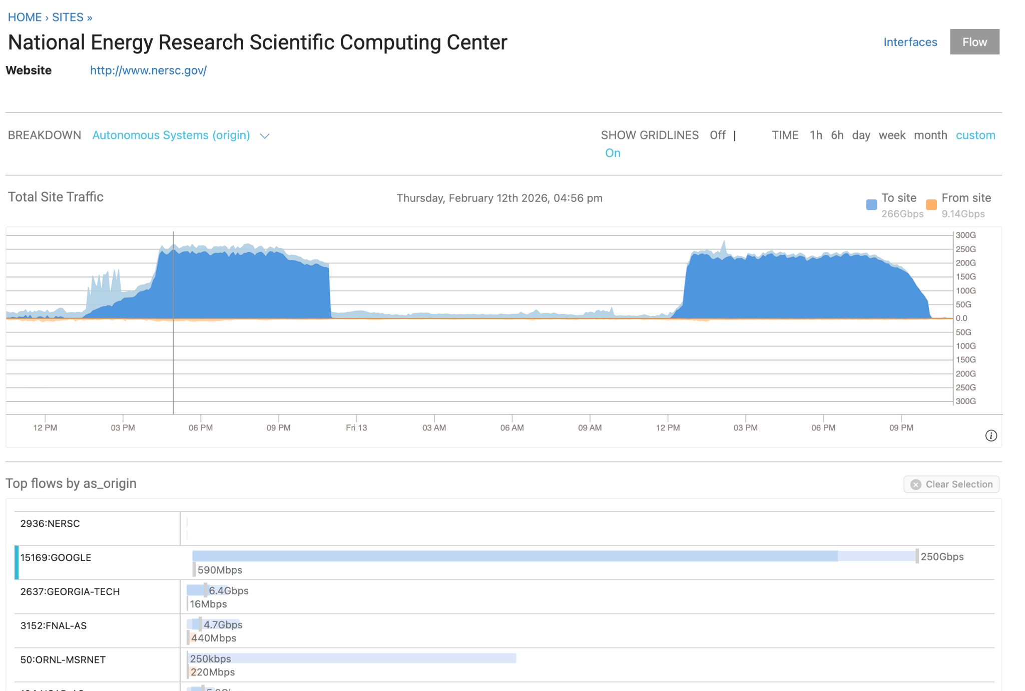
Direct Transfer to Compute: Google to NERSC
Large (over 5PB) public data set in commercial cloud
ECMWF ERA5
AI-ready
ML-accelerated earth system model application
Direct data ingest into running code

Slide 41
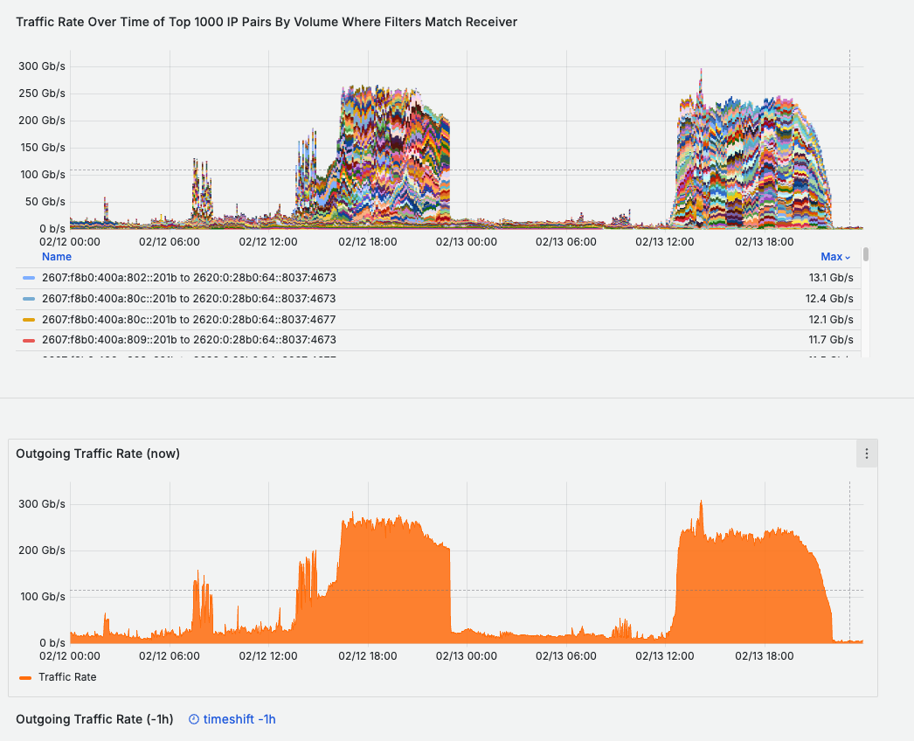
Flow statistics: massively parallel
Host breakdown:
Many, many parallel streams in these transfers
Many cloud hosts delivering over 10Gbps
User was able to just launch the job and move forward.
No special setup
No debug before use

Slide 42
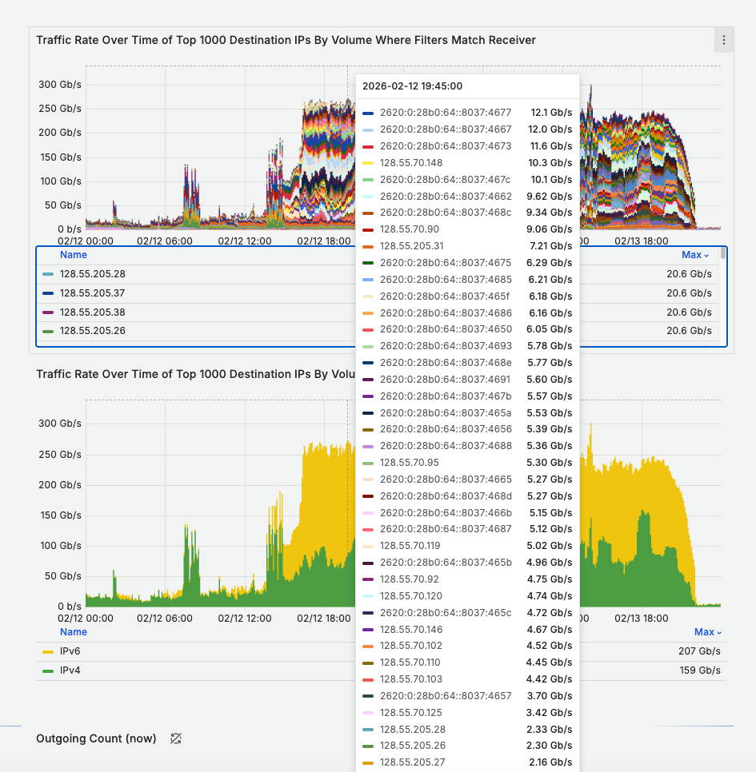
IPv6 Works!
A lot of this transfer occurred over IPv6
It was already set up and configured - no need for user to care
IPv6 is real now, even in commercial cloud environments

Slide 43
Evolution Of Data-Intensive Science
Science DMZ enabled high performance file transfer
DTNs
Performant tools
Now, we are running into the limitations of storage
File transfer before job launch increases friction
Storage layer is slow and expensive
New workflows drive ever higher performance across network boundaries
But this only works if the perimeter is performant

Slide 44
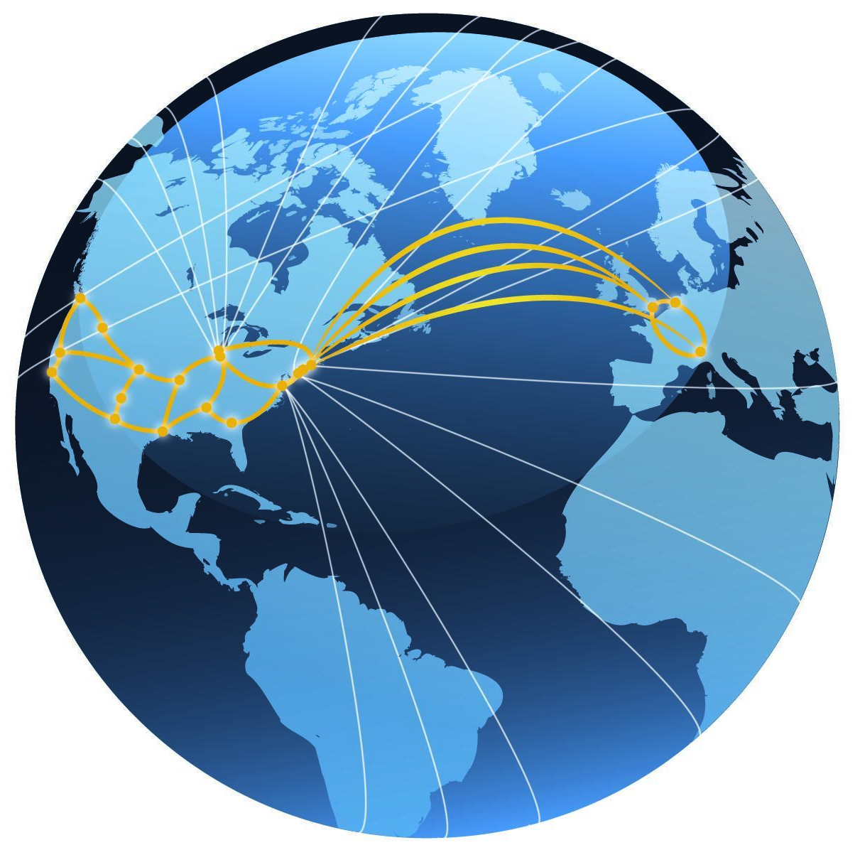
In conclusion – ESnet’s vision:
Scientific progress will be completely unconstrained by the physical location of instruments, people, computational resources, or data.

Slide 45
Thanks!
Eli Dart
dart@es.net
https://my.es.net/
https://www.es.net/
https://fasterdata.es.net/

Slide 46
Thanks!
Eli Dart
dart@es.net
https://my.es.net/
https://www.es.net/
https://fasterdata.es.net/

