Slide 1
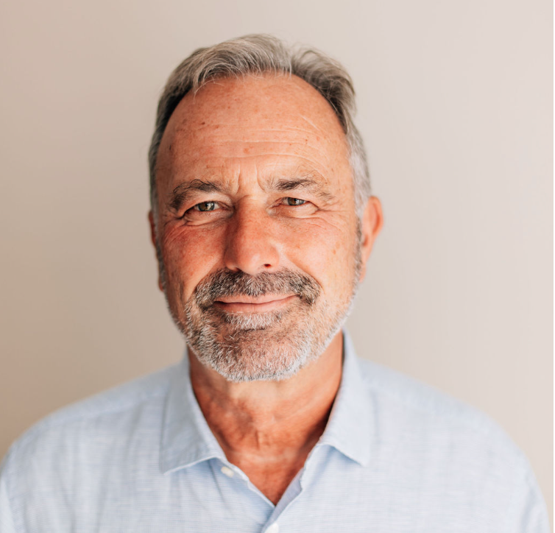

The Internet of FAIR data and Services
Barend Mons Taipe 2026

Slide 2
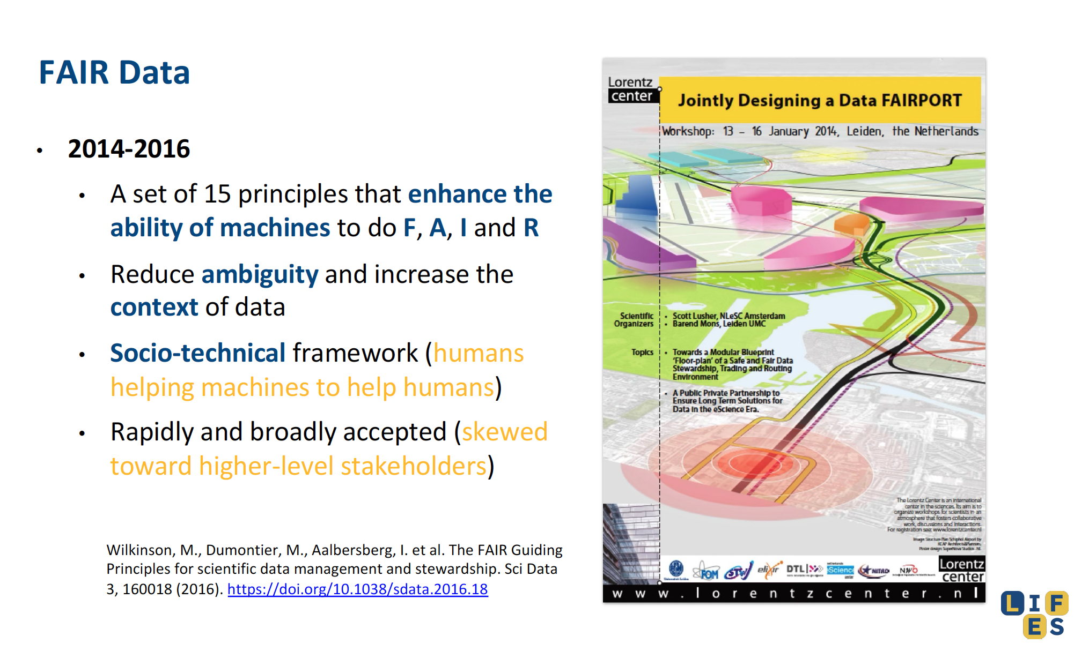

Slide 3
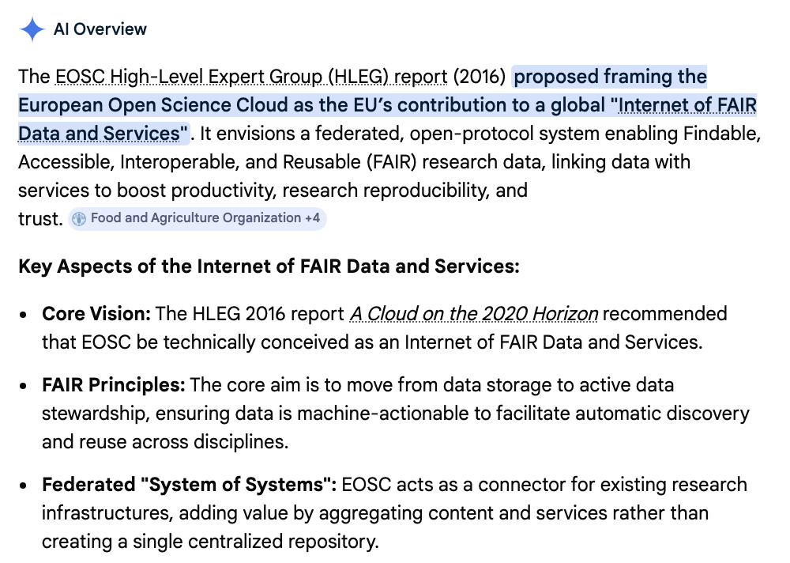
The end of data sharing?

Slide 4
Findable
Accessible
Interoperable
Reusable
Fully
AI
Ready
FAIR
The Machine Knows what I mean

Slide 5
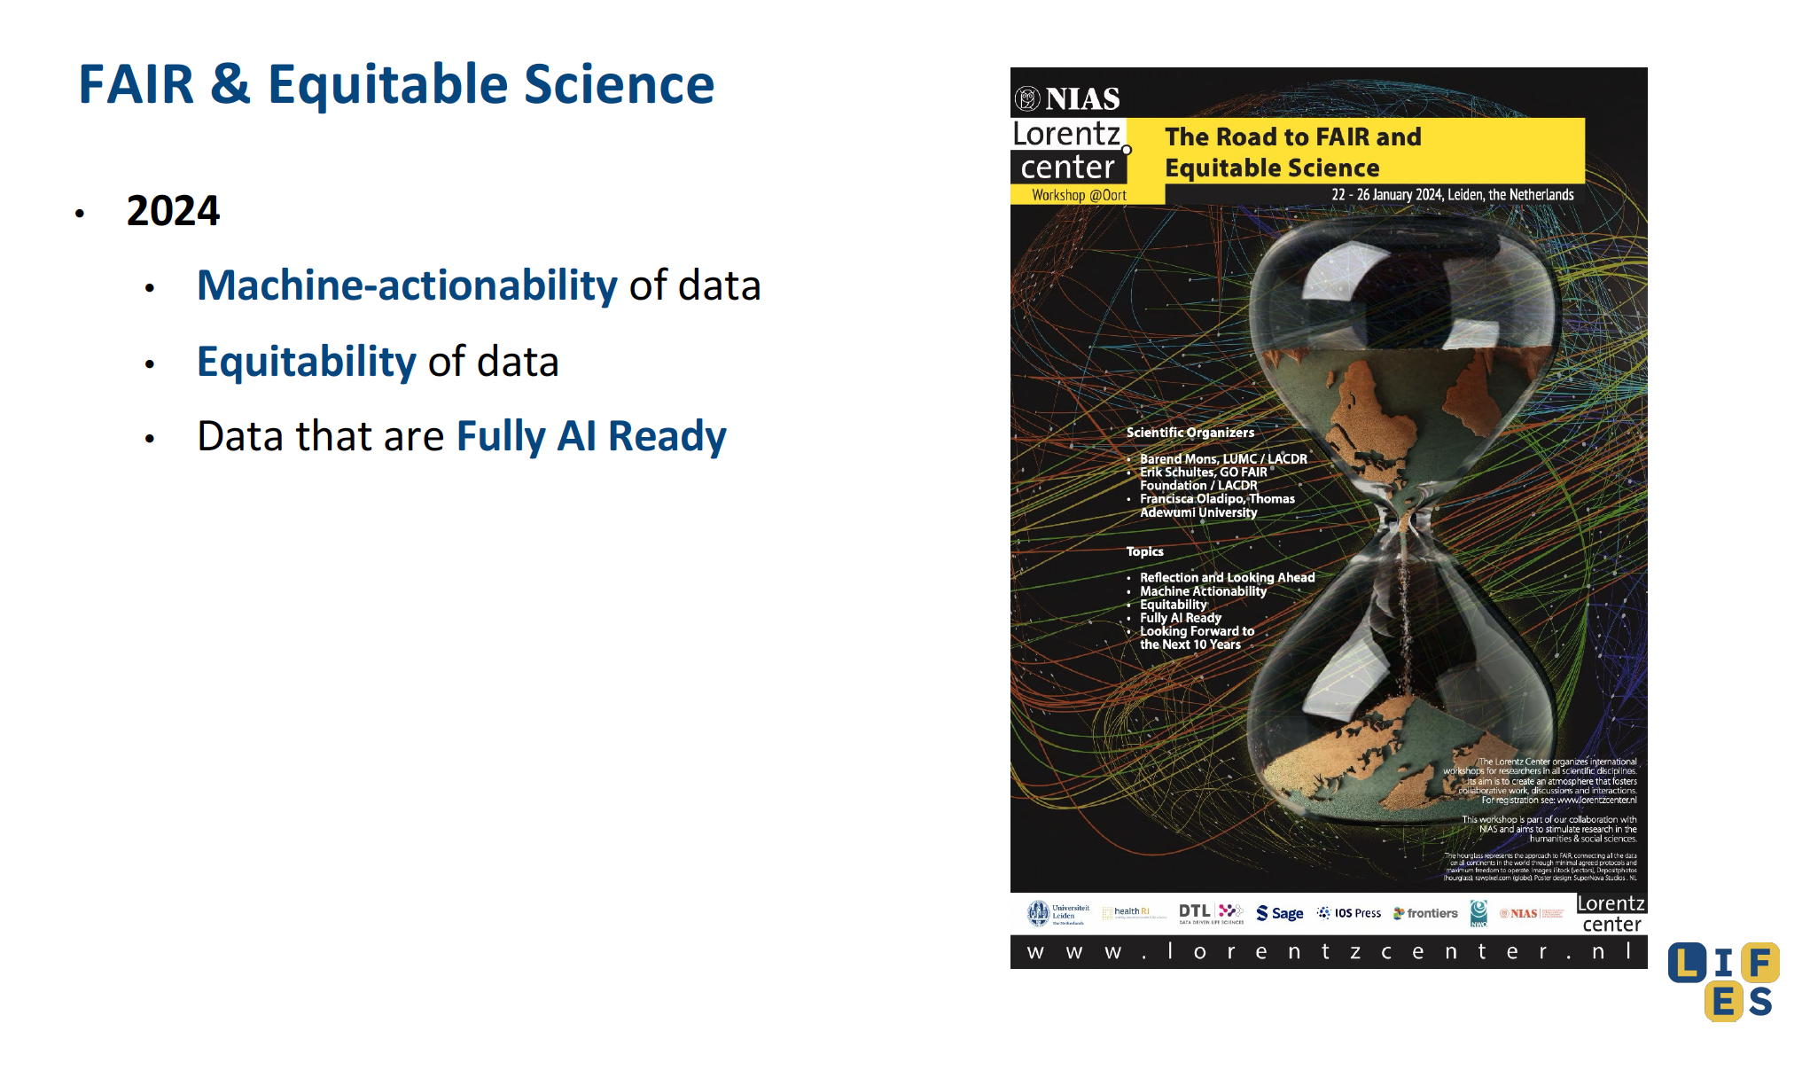
20 K citations later…..

Slide 6
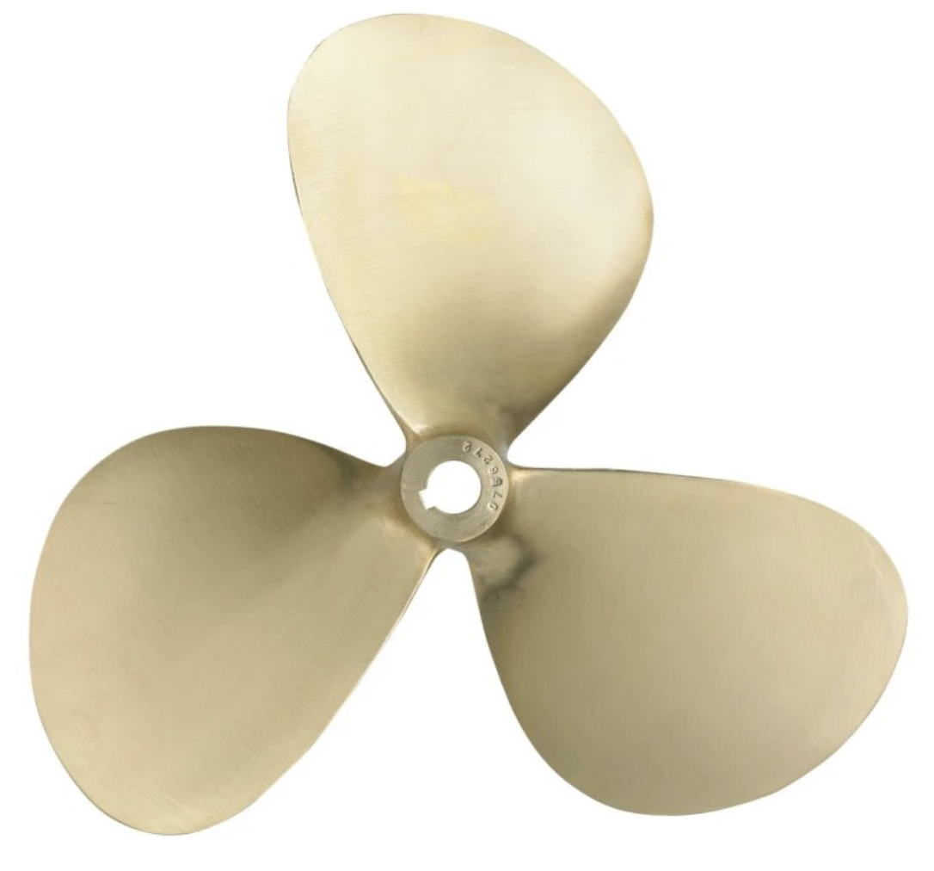
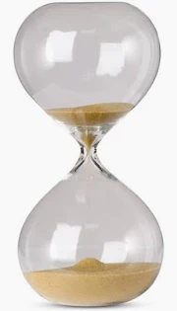


The LIFES vision on the IFDS ecosystem
Data
Applications
FTO
Compute
FTO
INFRA
Algorithms

Slide 7
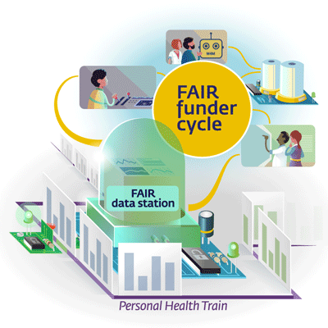
The end of data sharing
Data
Visiting
The Dawn of data Visiting

Slide 8
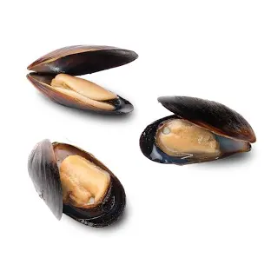

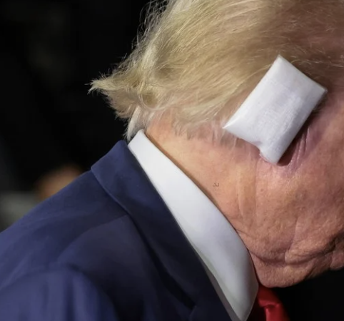
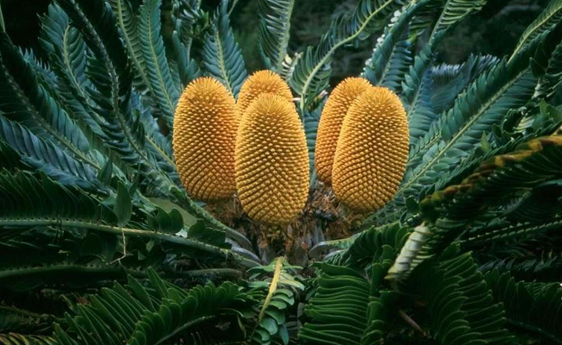
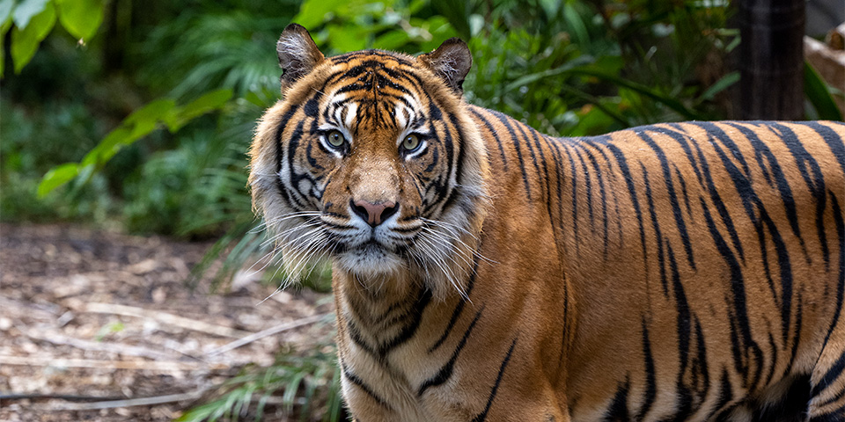
1. Privacy

Slide 9
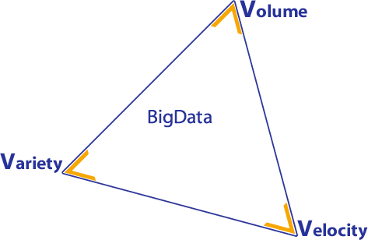
2. Size
The Explicitome (LS)
10¹⁴ assertions
of the type S-P-O
?

Slide 10
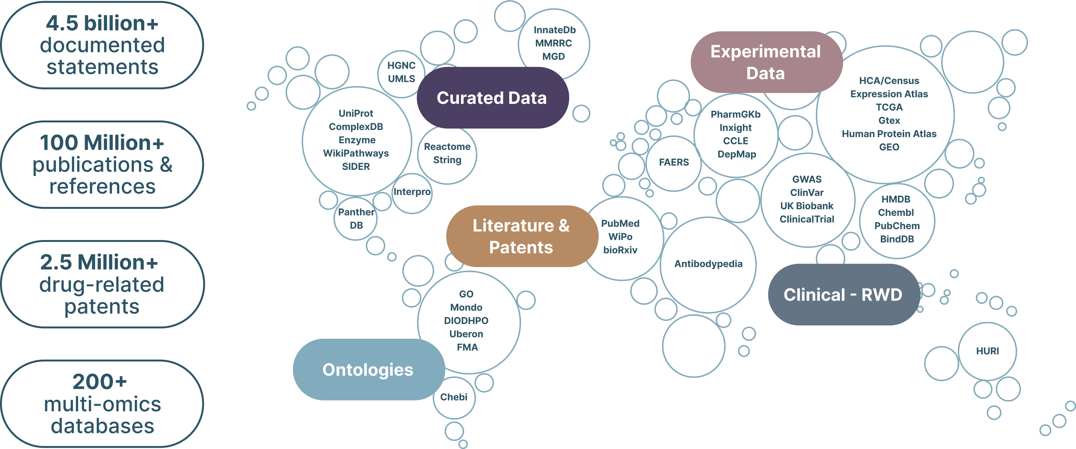
3. Complexity
Data types (with example source)
Clinical Trials (clinicaltrials.gov)
Diseases (Clinvar)
Phenotypes (GWAS)
Drug (InXIght)
Targets (Chembl)
Genes (HGNC)
Genomics (ENSEMBL)
Metabolomics (HMDB)
Microbiome (HMP)
Adverse Effect Reporting (Sider)
Pharmacogenomics (PharmGKB)
Single cell expression/scRNA (Human Cell Atlas)
Proteins (Uniprot)
Proteomics (HPA)
RNA (miRbase)
Structural Data (PdB)
Systems biology (Intact)
Toxicity (InXight)
Transcriptomics (Expression Atlas)
Cell lines (CCLE)
Animal Models (MGD)
Antibodies (AntibodyPedia)
Please do not distribute outside your organization © Euretos 2025

Slide 11
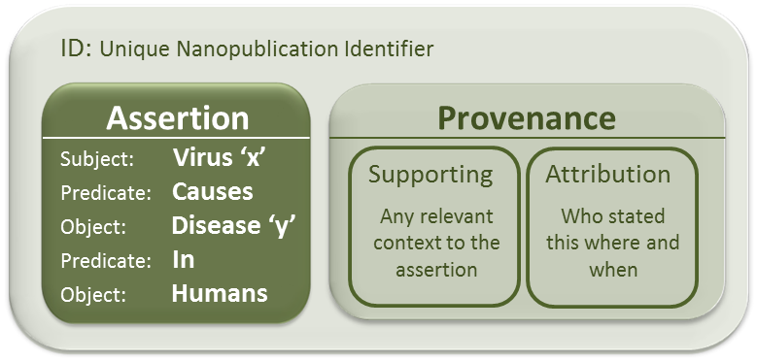
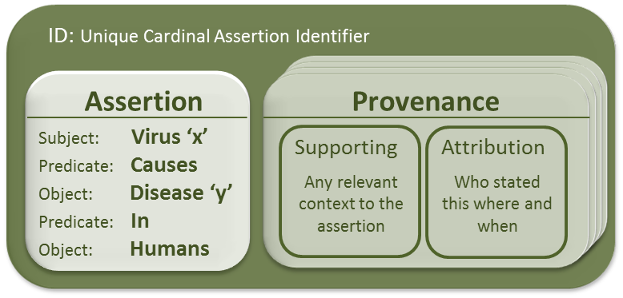
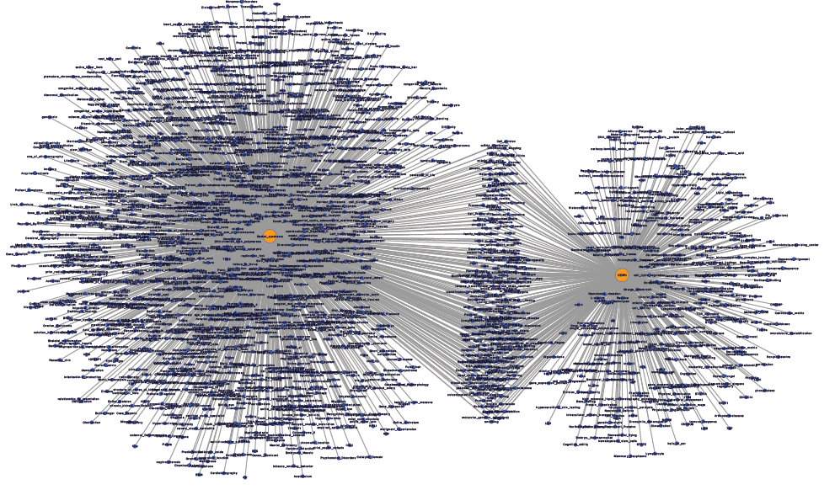
zipping the explicitome
All Assertions:10¹⁴
n identical
assertions
‘n’ different
provenances
Cardinal Assertions: <10¹¹
Knowlets: <10⁶
Notes:
A basic overview of information zipping

Slide 12
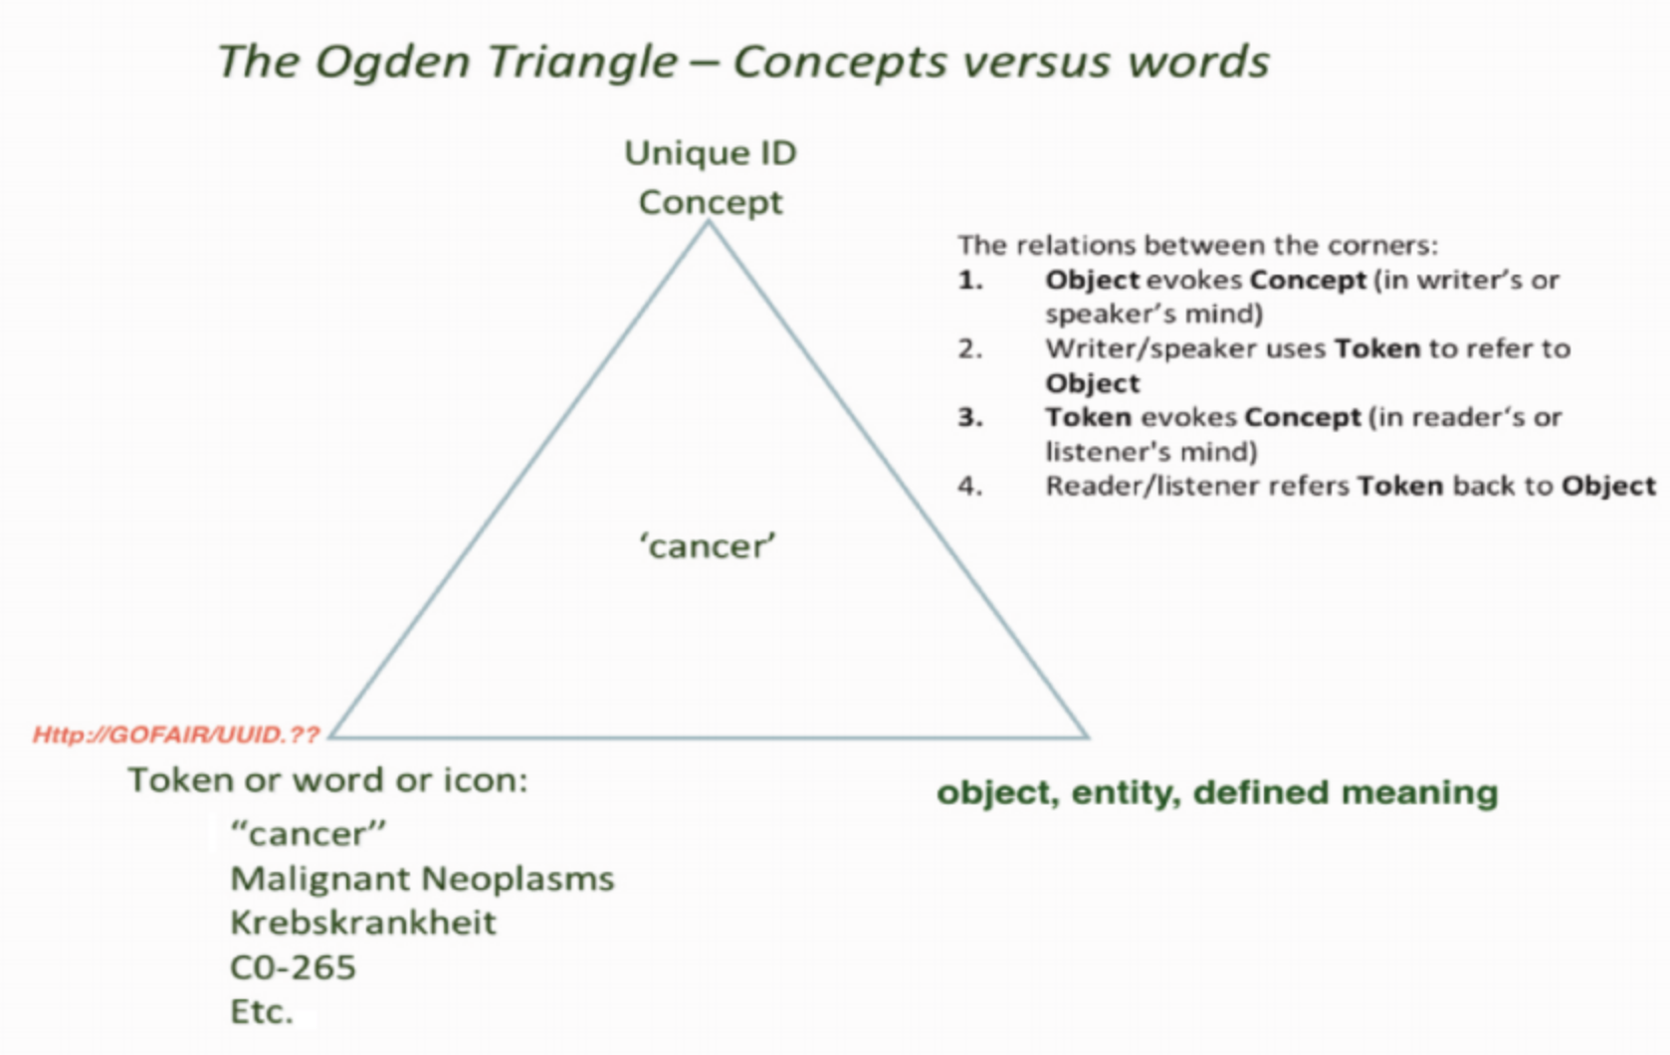


Slide 13
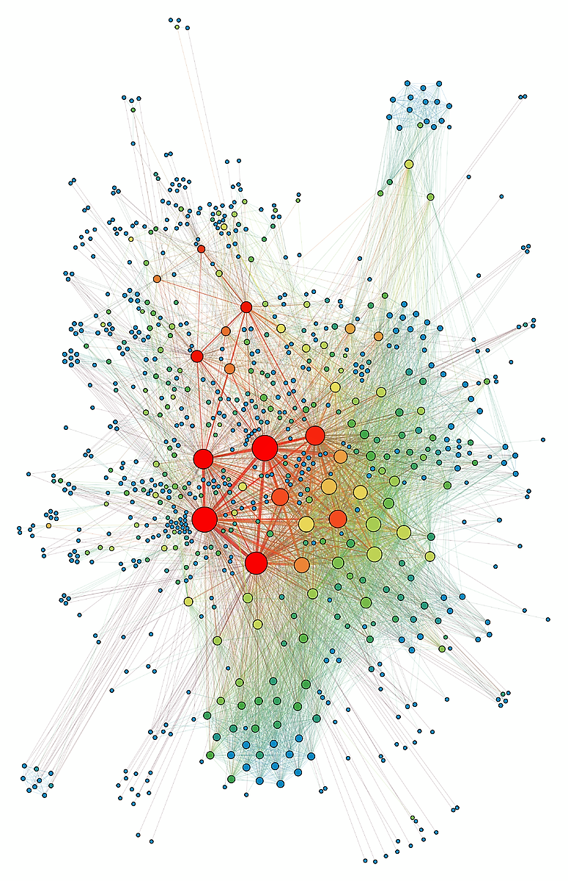
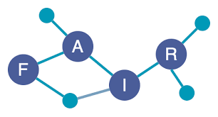
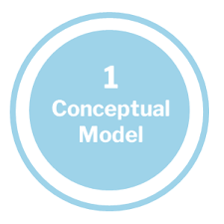
LLM is not AI
It’s all hallucination, but we only call it that when we notice it’s wrong. The problem is, large language models are so good at what they do that what they make up looks right most of the time. And that makes trusting them hard.

Slide 14
LLM is not AI
Hybrid Intelligence support is what scientists are waiting for !

Slide 15
Member
Powered by curated, FAIR data
The Disease Atlas is powered by one of the world's largest collections of literature, patents, experimental, clinical & real-world patient data integrated into a vast, FAIR biological knowledge graph
Please do not distribute outside your organization © Euretos 2025

Slide 16
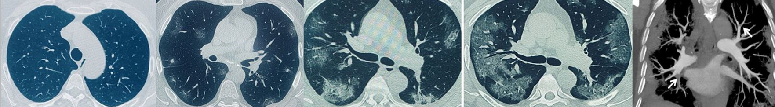
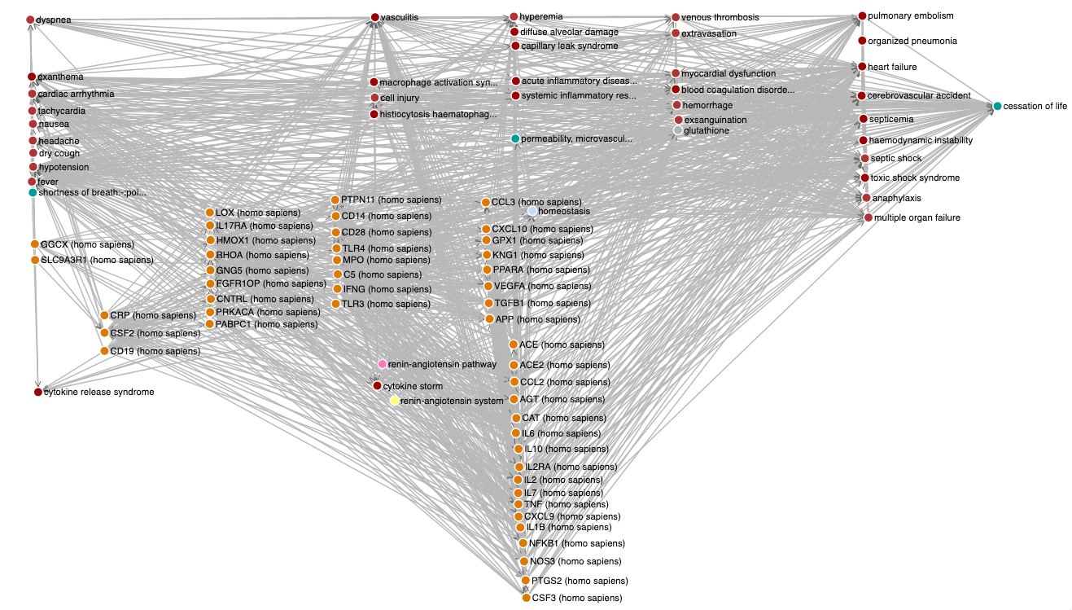
Use case 5: Existing Drugs for COVID ?
I
II
III
IV
V
EK > hypotesis

Slide 17
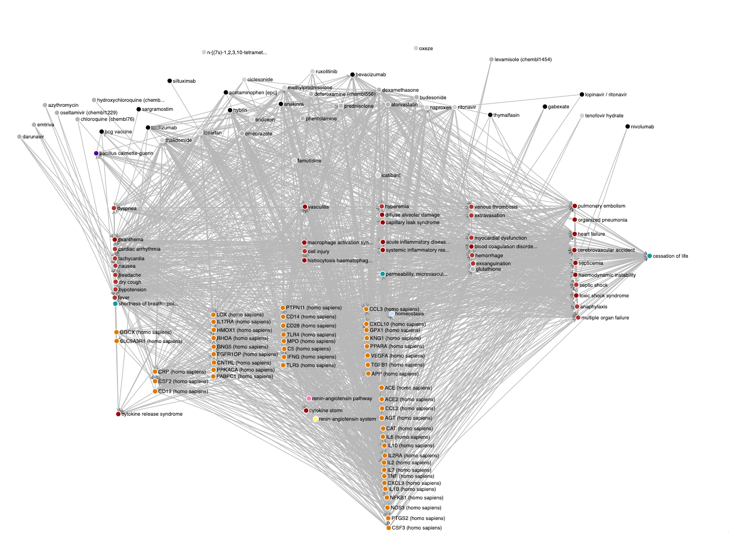
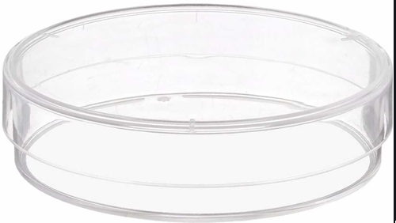
Machine-Assisted Science

Slide 18
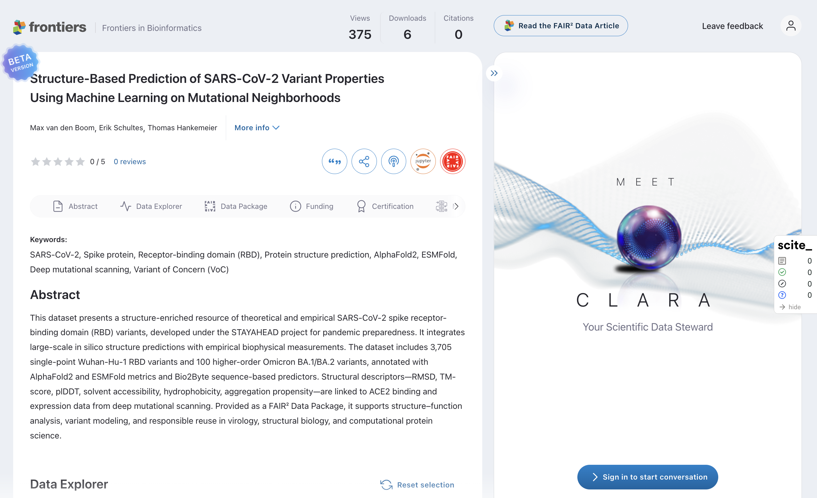
Member

Slide 19
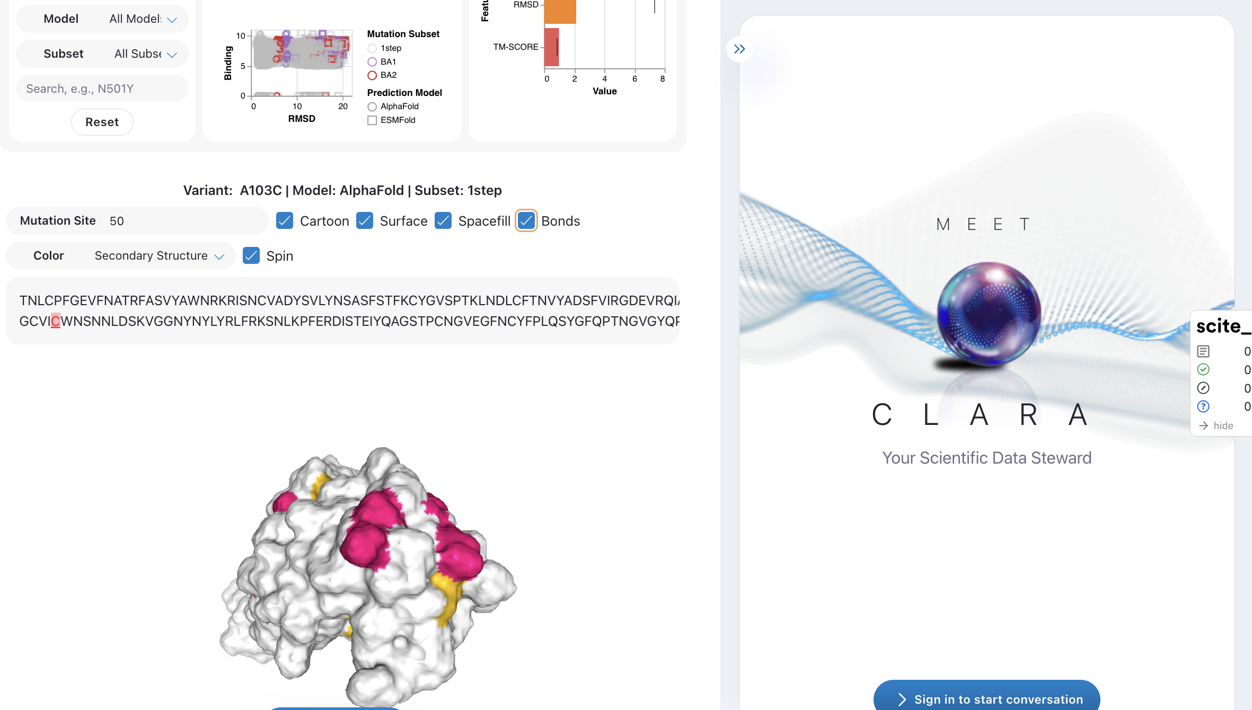

Slide 20

AI infrastructure for institutional-grade startup evaluation and discovery

Slide 21

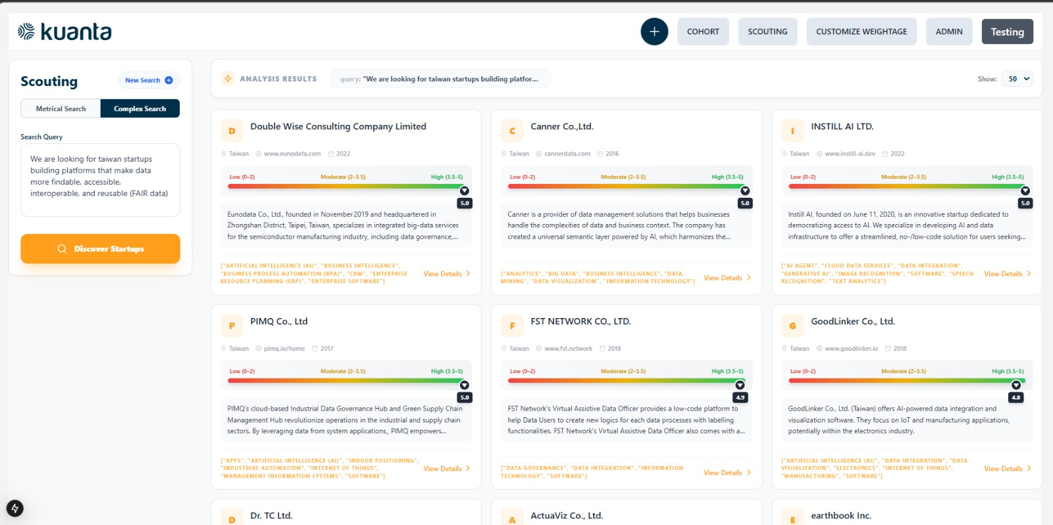
Taiwan - 10,580 active startups (after 2016)
Complex search: Top 50 Fair, accessible, interoperable data

Slide 22
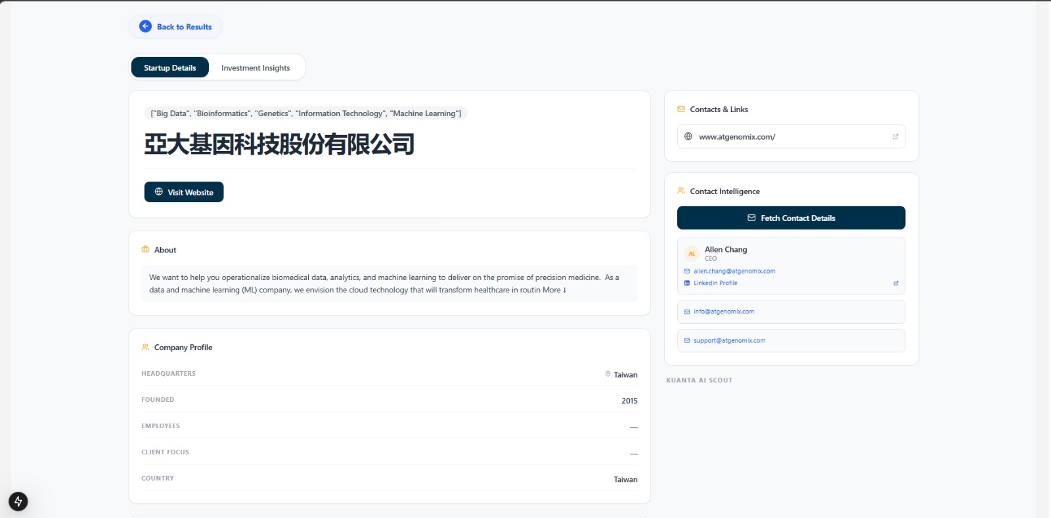
Taiwan - 10,580 active startups (after 2016)
Startup details: description (operationalizing biomedical data e.g. genetics), founder contact

Slide 23

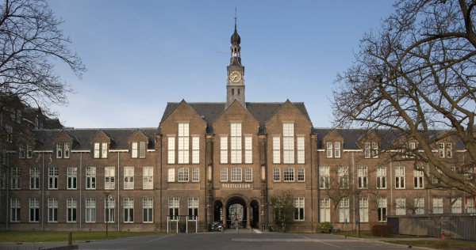
LIFES offices
Based in Leiden in the monumental Poortgebouw
Central location for face 2 face meetings
20 minutes from Schiphol by train
Planning to move to 17th century Pesthuys building in 2025 (events will be hosted there in 2024)

Slide 24
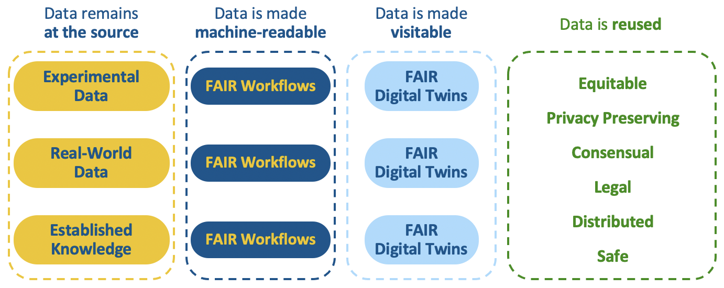







Slide 25
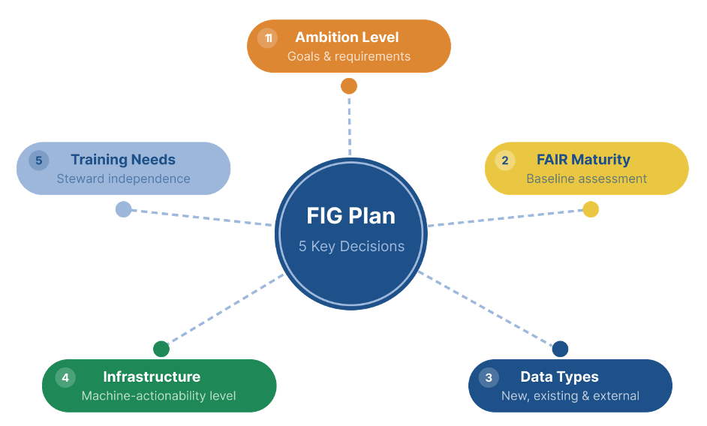

Slide 26
Usage level
FAIR metadata
Machine use
Machine interaction
FAIR Metadata
External use
Usage & access rights
Machine interaction
Internal use
Intrinsic & provenance
Usage & access rights
Personal use
Intrinsic & provenance
(meta)
DATA
Rich (non-FAIR) metadata
Data
Data elements
+
Metadata
FAIR metadata
(at data element level)
FIPs, semantics, models
FAIR Data Point (findability), access control
FAIR Data Station (machine actionability)
FAIR enablers

Slide 27
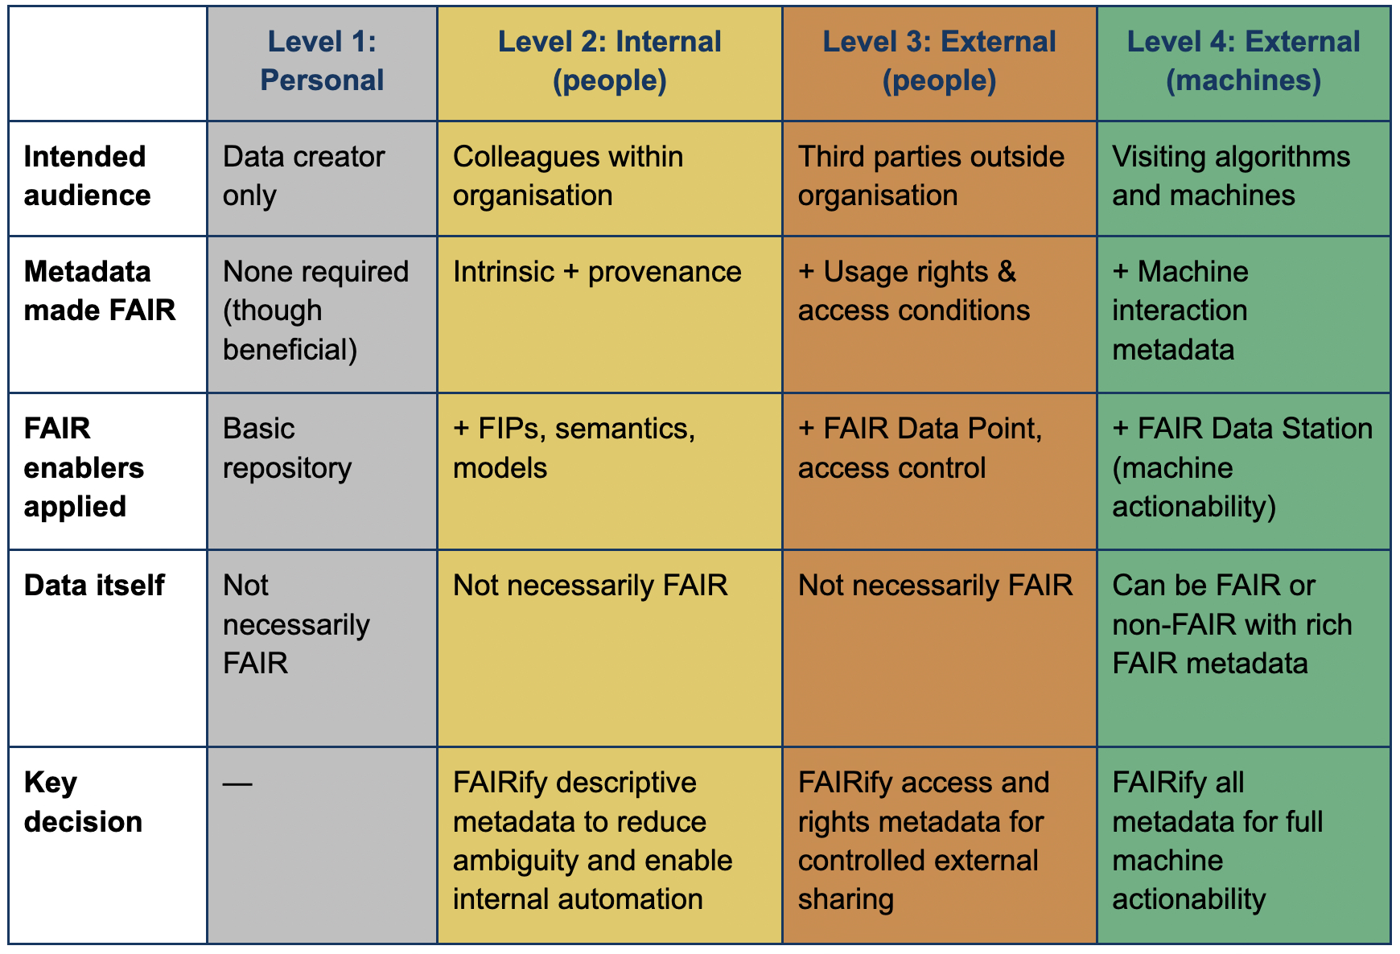

Slide 28
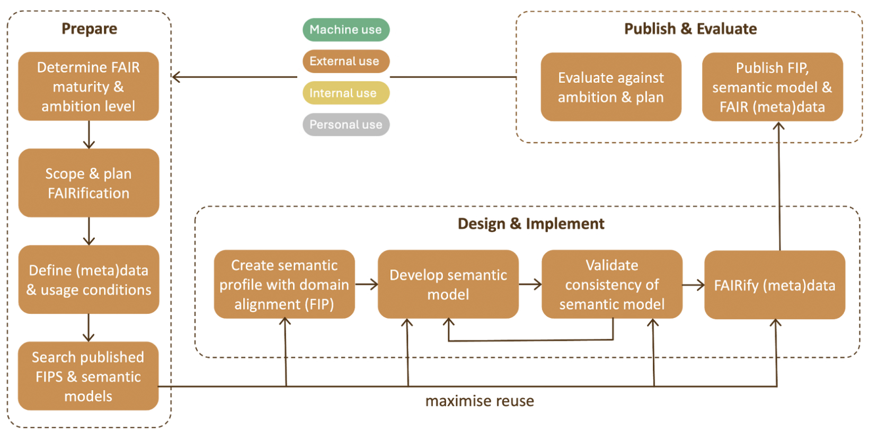
The expert data workflow: mostly with Recognised Expert Communities

Slide 29
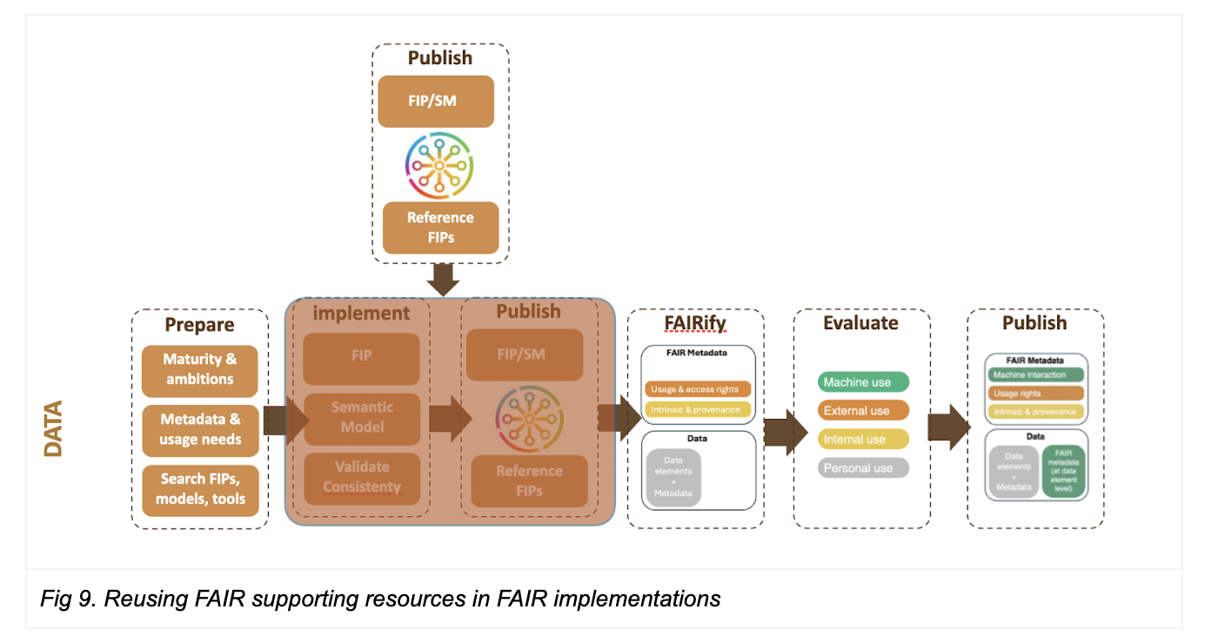
The shortened data workflow: mostly with novice users

Slide 30
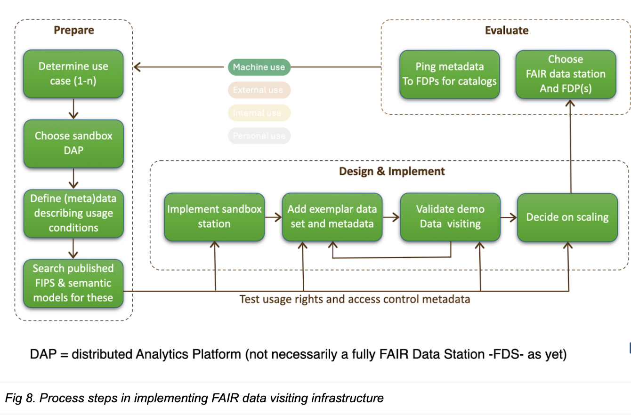

Slide 31




































Supply
DATA
STATIONS
Demand
TRAINING
Demand

Slide 32
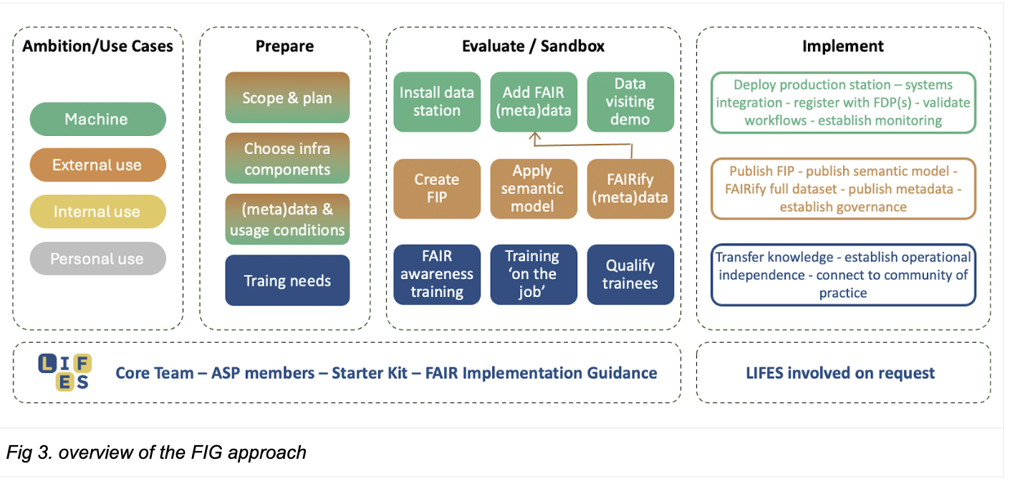

Slide 33
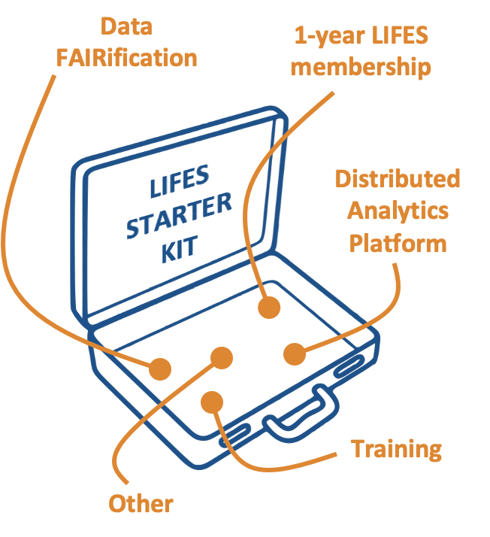


Starter Kit Participants
Member
4LifeSupport – EHDS mini pilot
42 Hills – Swarm learning pilot
DesciLabs - DeSci Publish platform
FAIR Solutions – FAIR value event
GO FAIR Foundation – FAIR Awareness eLearning
LinkSight – Data sharing platform pilot
Senscience – FAIR Data publishing
TIB – AIsistant research lifecycle
University of Twente – Semantic model extraction
SureSync – Data Station proof of value (next nw meeting)
Codevence – FAIR Wizard

Slide 34


Domain specific and RECommended Starter Kits
LSH
Immunology
Agriculture
Earth Sciences
Biodiversity
Cultural Heritage
Regional
…………………

Slide 35
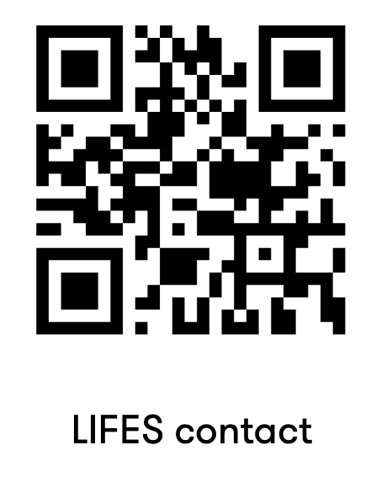
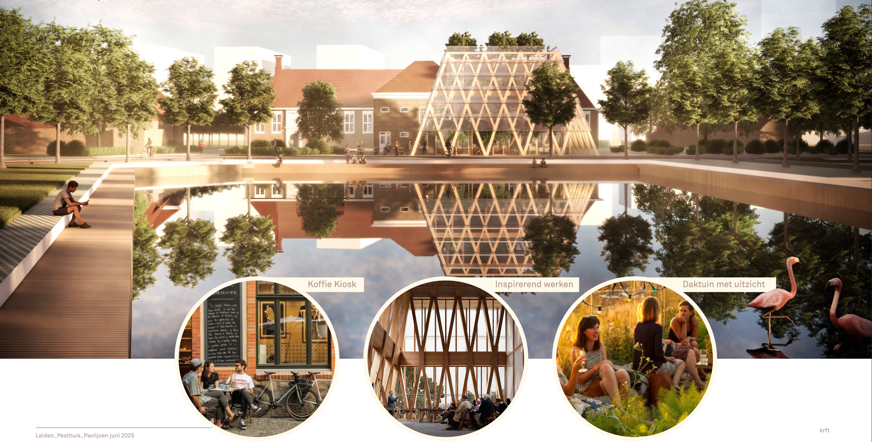
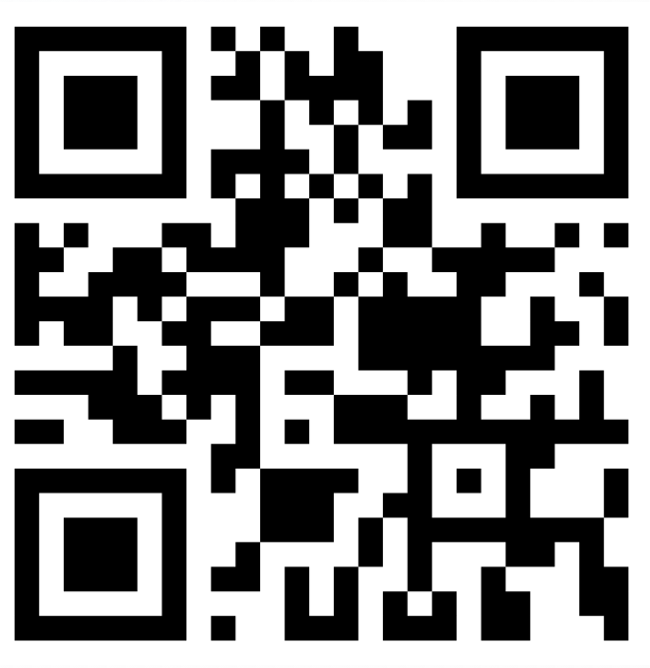
Immediate Opportunity: Join LIFES with a presence (postal address in Leiden)
Connect
Implement
Innovate
Prof. Barend Mons
Barend.mons@lifes.institute
+31-624879779

Slide 36
Thank You and FAIRwell
References
https://link.springer.com/article/10.1186/1471-2105-6-142
https://link.springer.com/article/10.1186/gb-2008-9-s2-s7
https://www.nature.com/articles/ng0411-281
https://journals.plos.org/plosone/article?id=10.1371/journal.pone.0007894
https://asistdl.onlinelibrary.wiley.com/doi/abs/10.1002/asi.10392
https://academic.oup.com/bioinformatics/article/21/9/2049/409019

