Slide 1

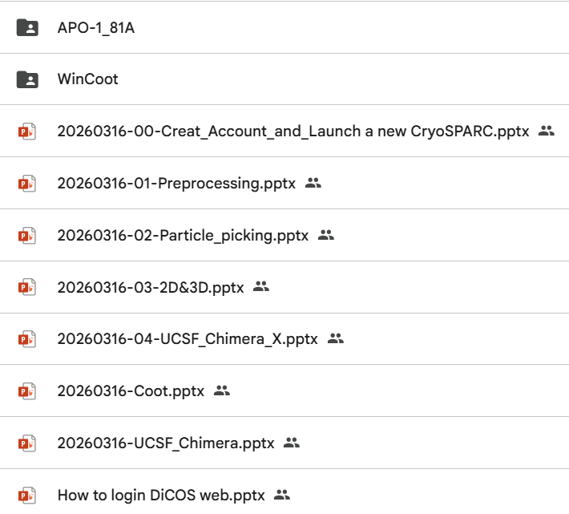

https://reurl.cc/M2Z5ym

Slide 2
Launch a new CryoSPARC
Dr. Chun-Hsiung Wang
2026/03/16

Slide 3
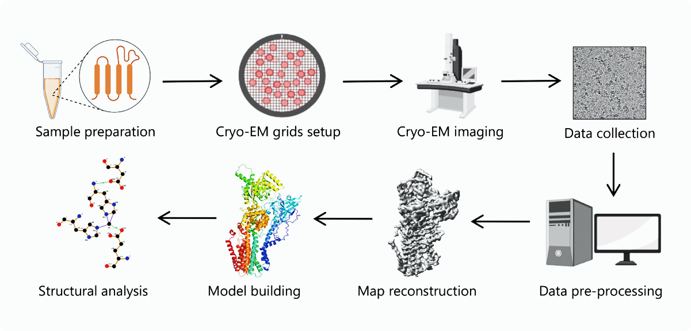
The workflow for
Cryo-EM single particle analysis
ASCEM
ASGC (DiCOS)
Zhu, K. F. et al., Military Med Res 10, 10 (2023)

Slide 4

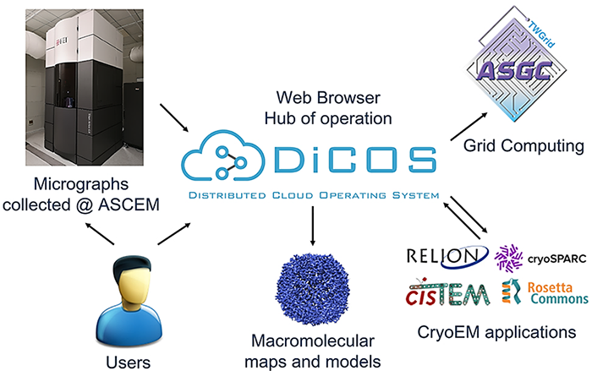
SCALE (SCientific computing and big data AnaLytics corE facility)
原 ASGC (AS Grid Computing Facility)

Slide 5
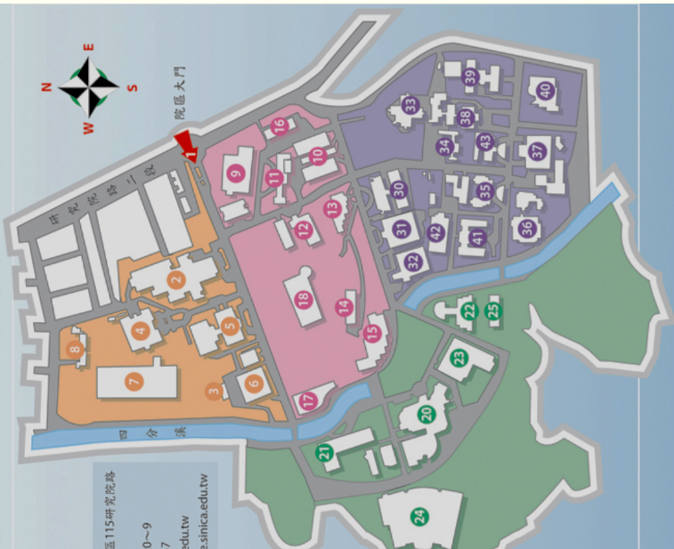
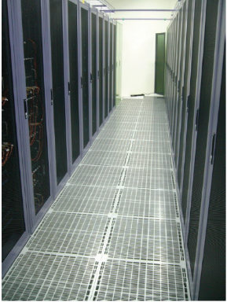
SCALE (SCientific computing and big data AnaLytics corE facility)
原 ASGC (AS Grid Computing Facility)
Resources:
Disk storage
CPU cores
GPU cores
  GTX 1080Ti
  GTX 3090Ti
  Telsa p100
  Telsa v100
ASGC
10Gb speed
ASCEM
IBC

Slide 6
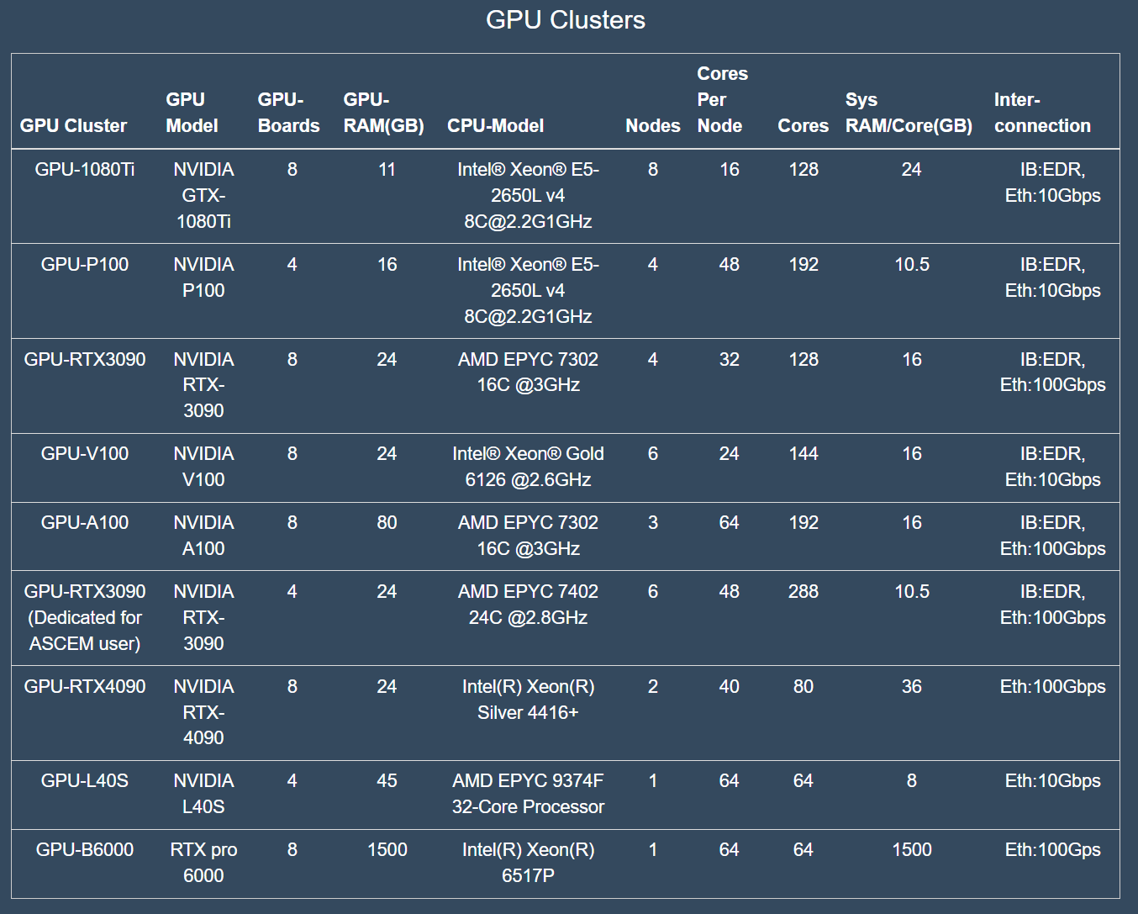

Slide 7
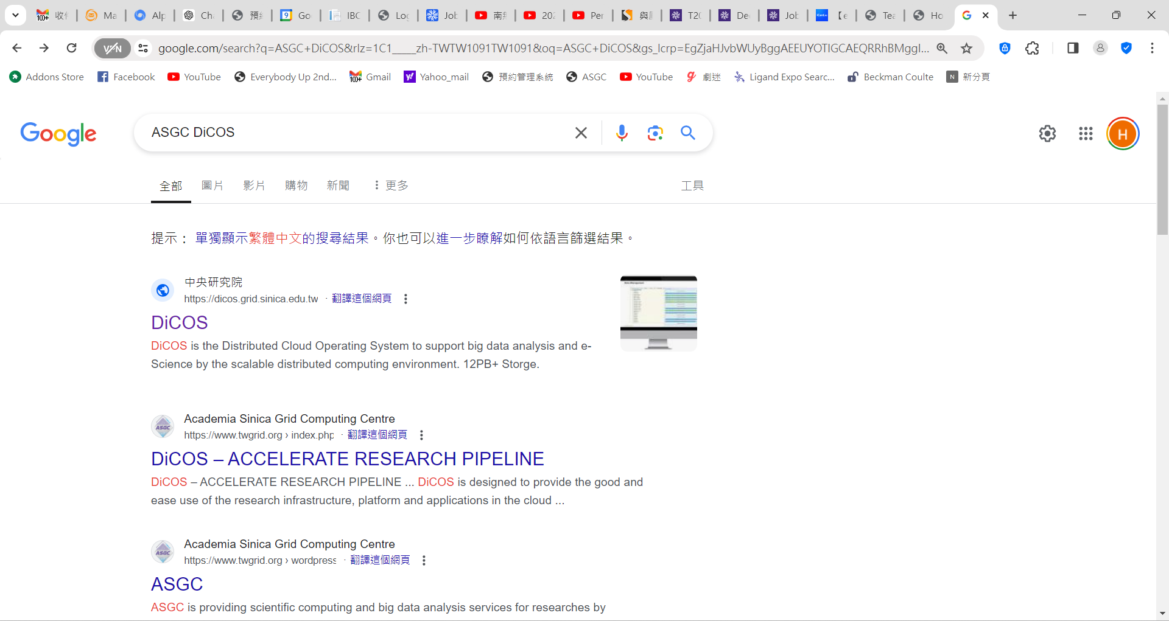
Apply for a ASGC DiCOS account
(Distributed Cloud Operating System)

Slide 8
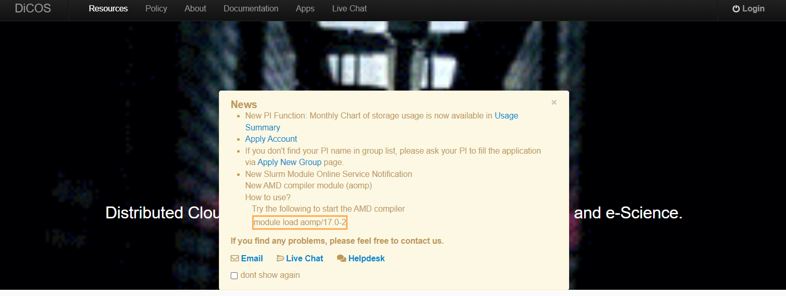
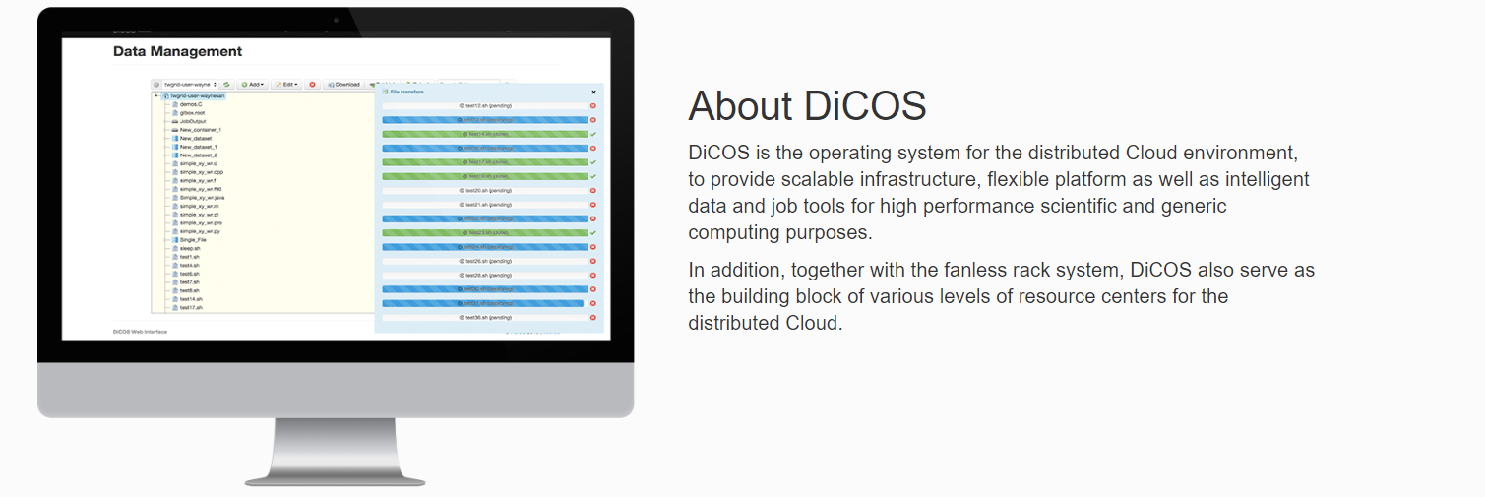
Apply for a ASGC DiCOS account
(Distributed Cloud Operating System)

Slide 9
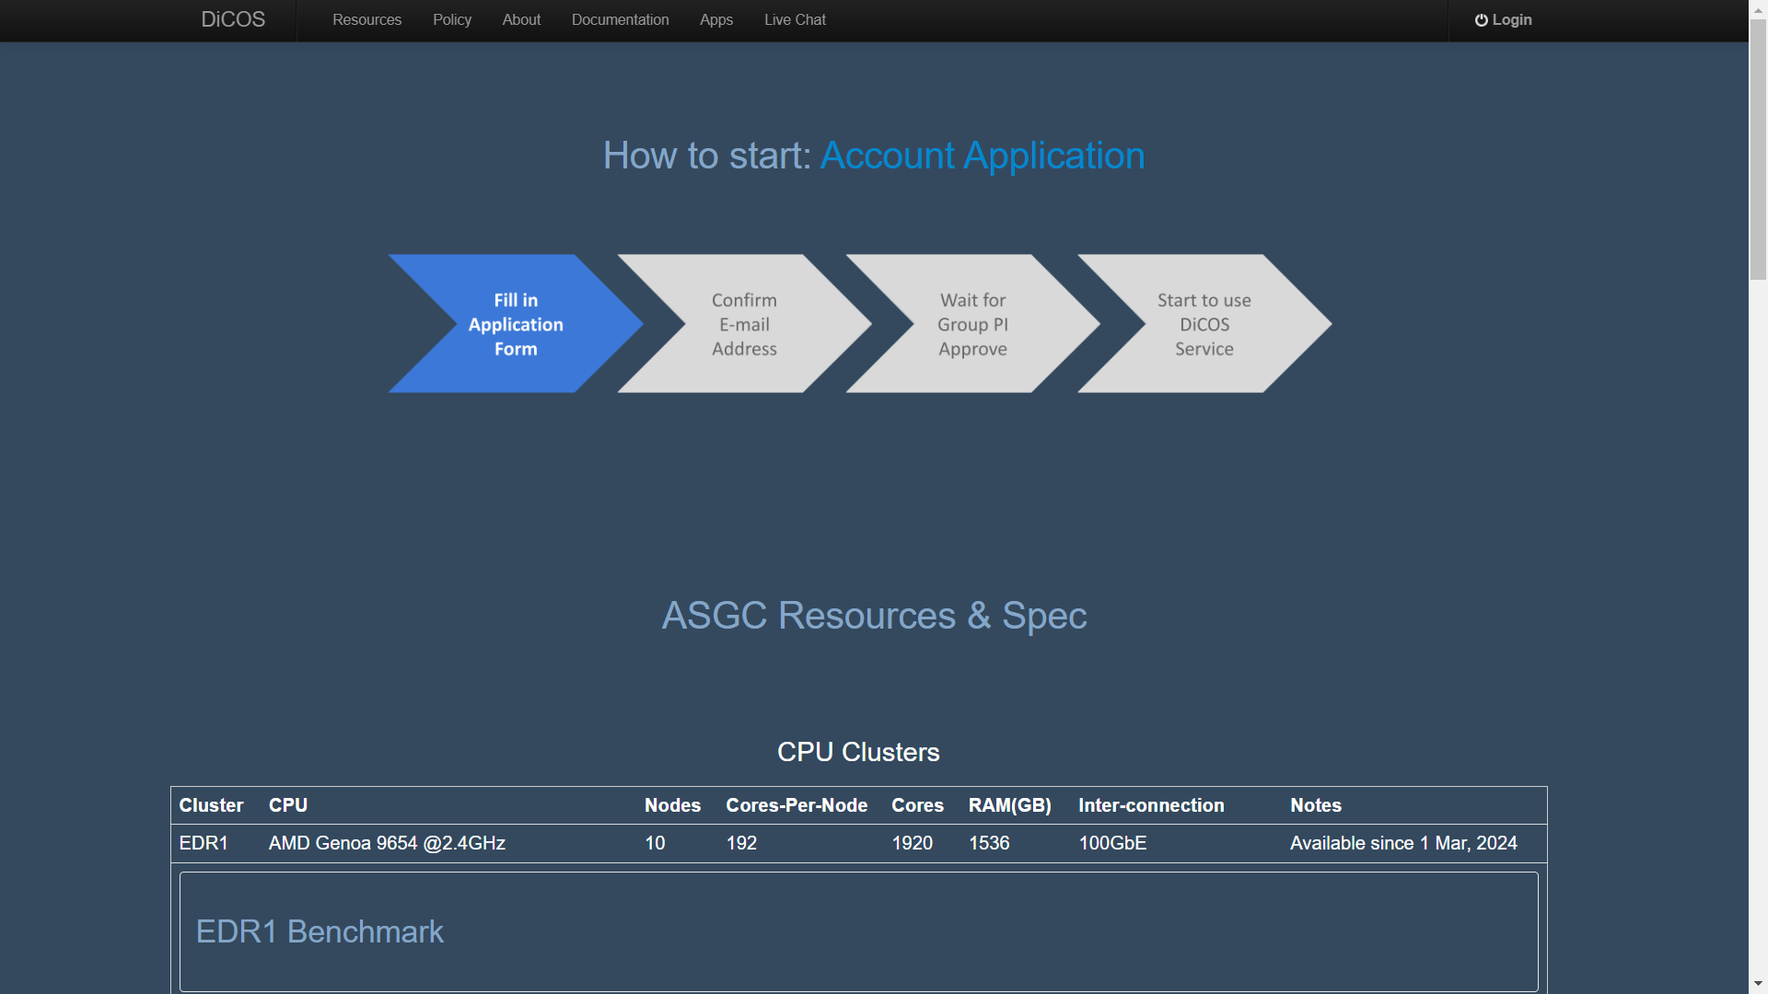
Apply for a ASGC DiCOS account
(Distributed Cloud Operating System)
https://dicos.grid.sinica.edu.tw/resources

Slide 10
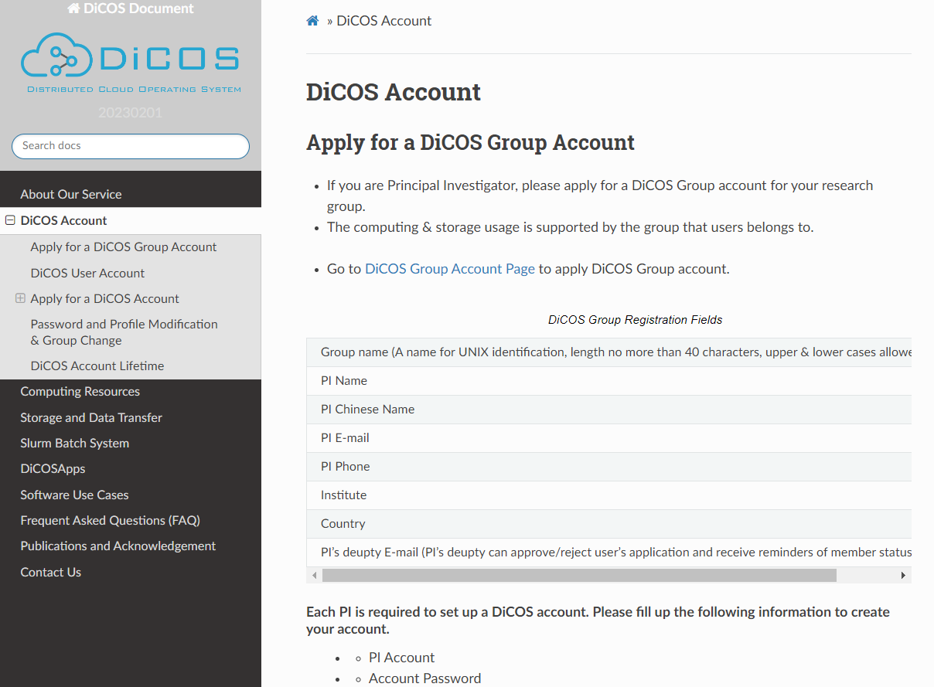
Apply for a DiCOS account
(Group Account)

Slide 11
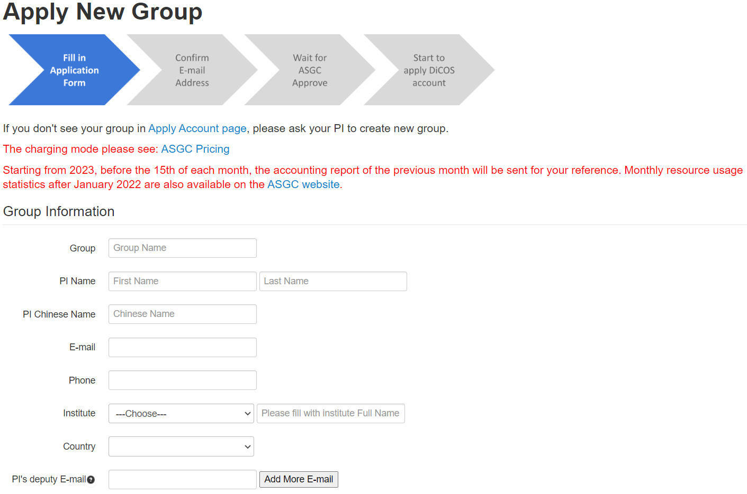
Apply for a DiCOS account
(Group Account)

Slide 12
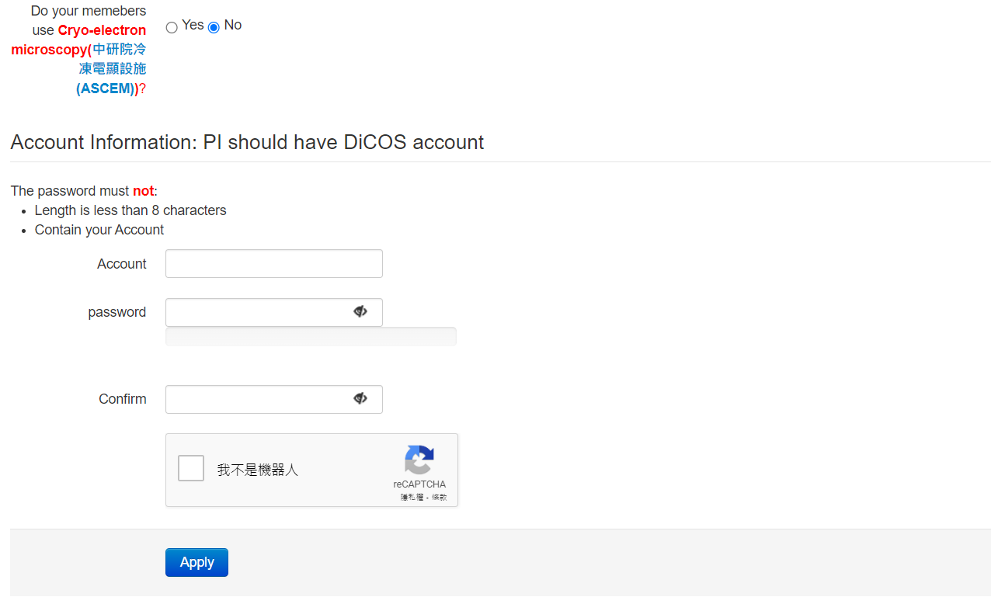
Apply for a DiCOS account
(Group Account)

Slide 13
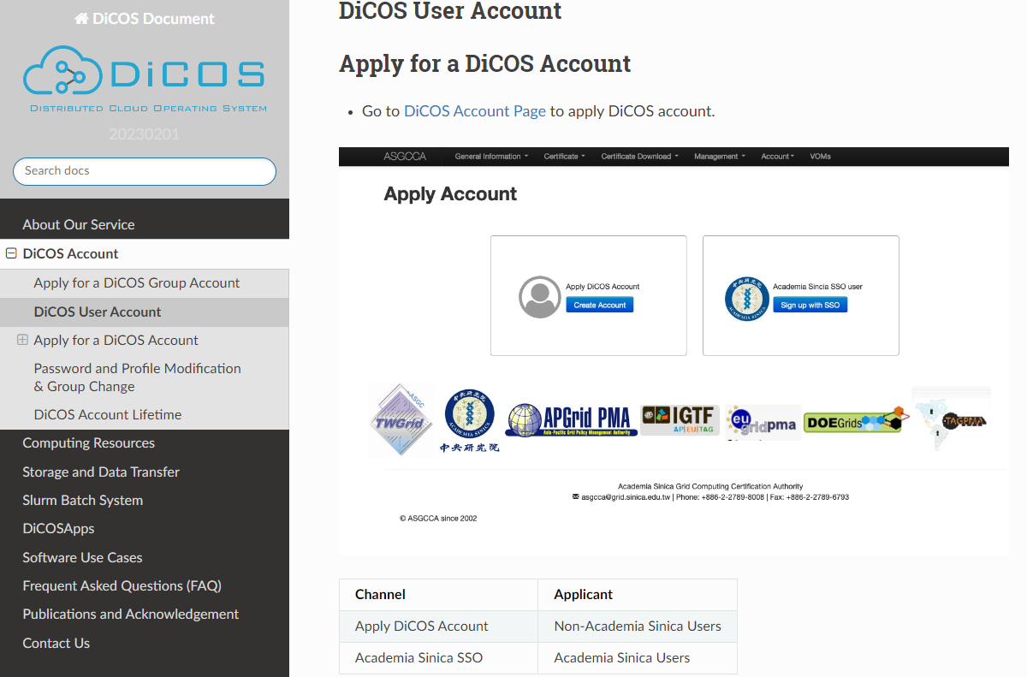
Apply for a DiCOS account
(User Account)

Slide 14
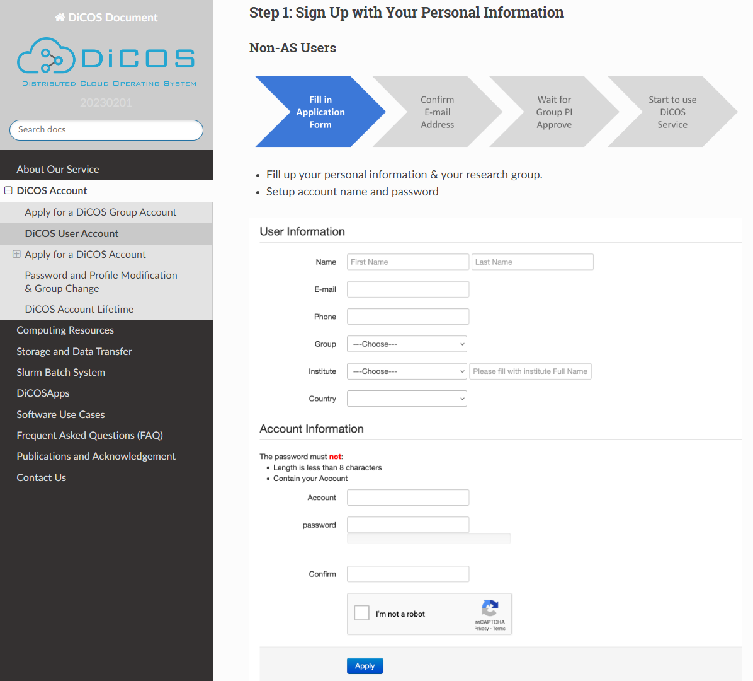
Apply for a DiCOS account
(User Account)

Slide 15
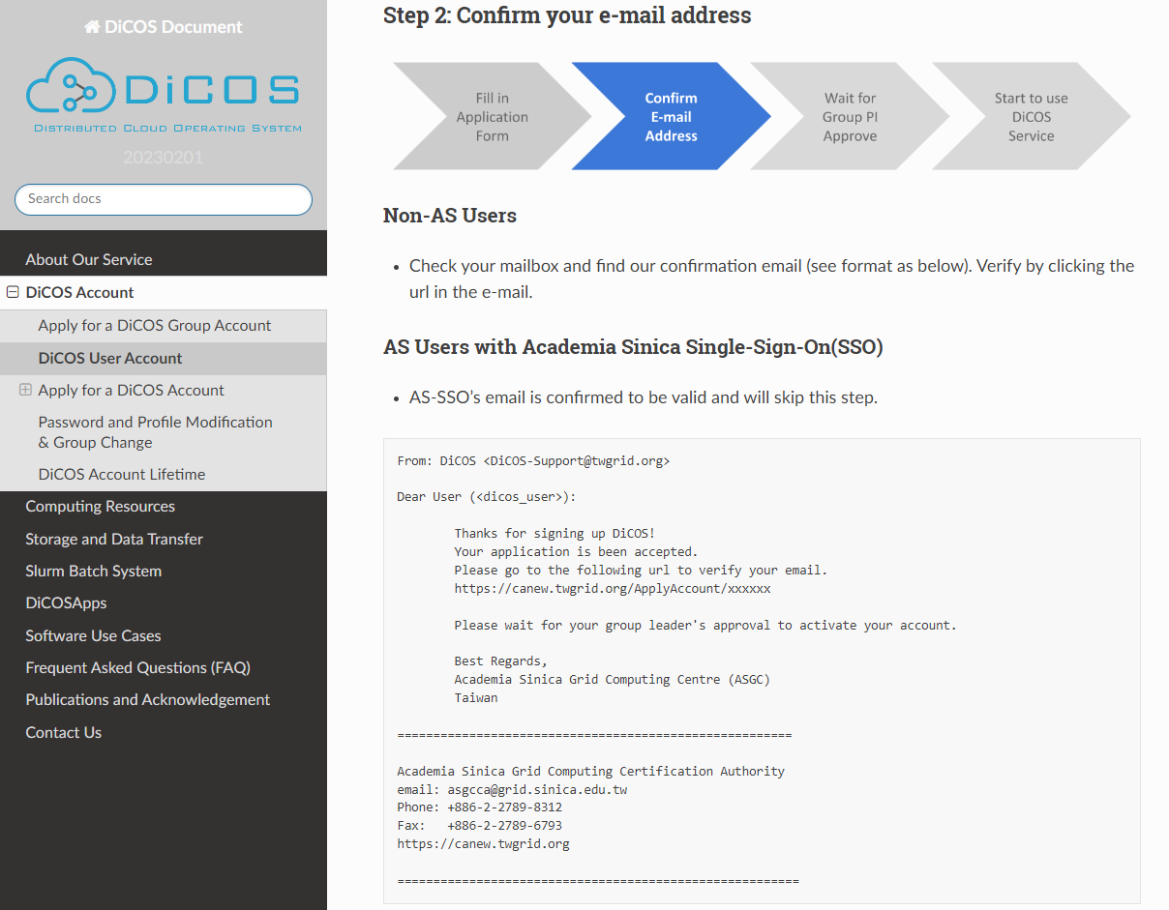
Apply for a DiCOS account
(User Account)

Slide 16
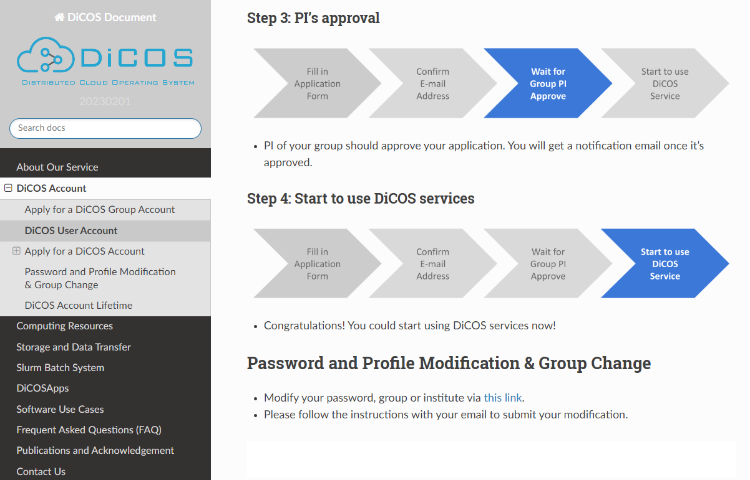
Apply for a DiCOS account
(User Account)

Slide 17
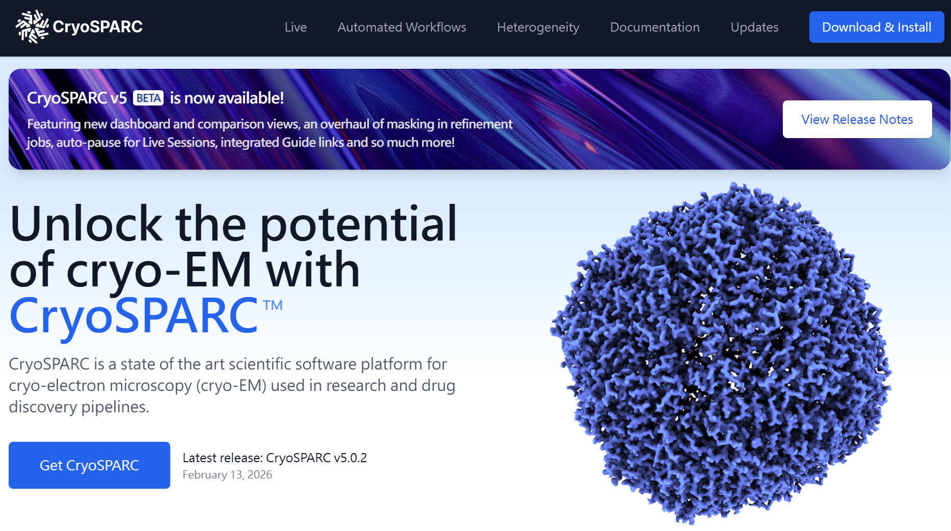
Apply for a cryoSPARC license
(https://cryosparc.com/)

Slide 18
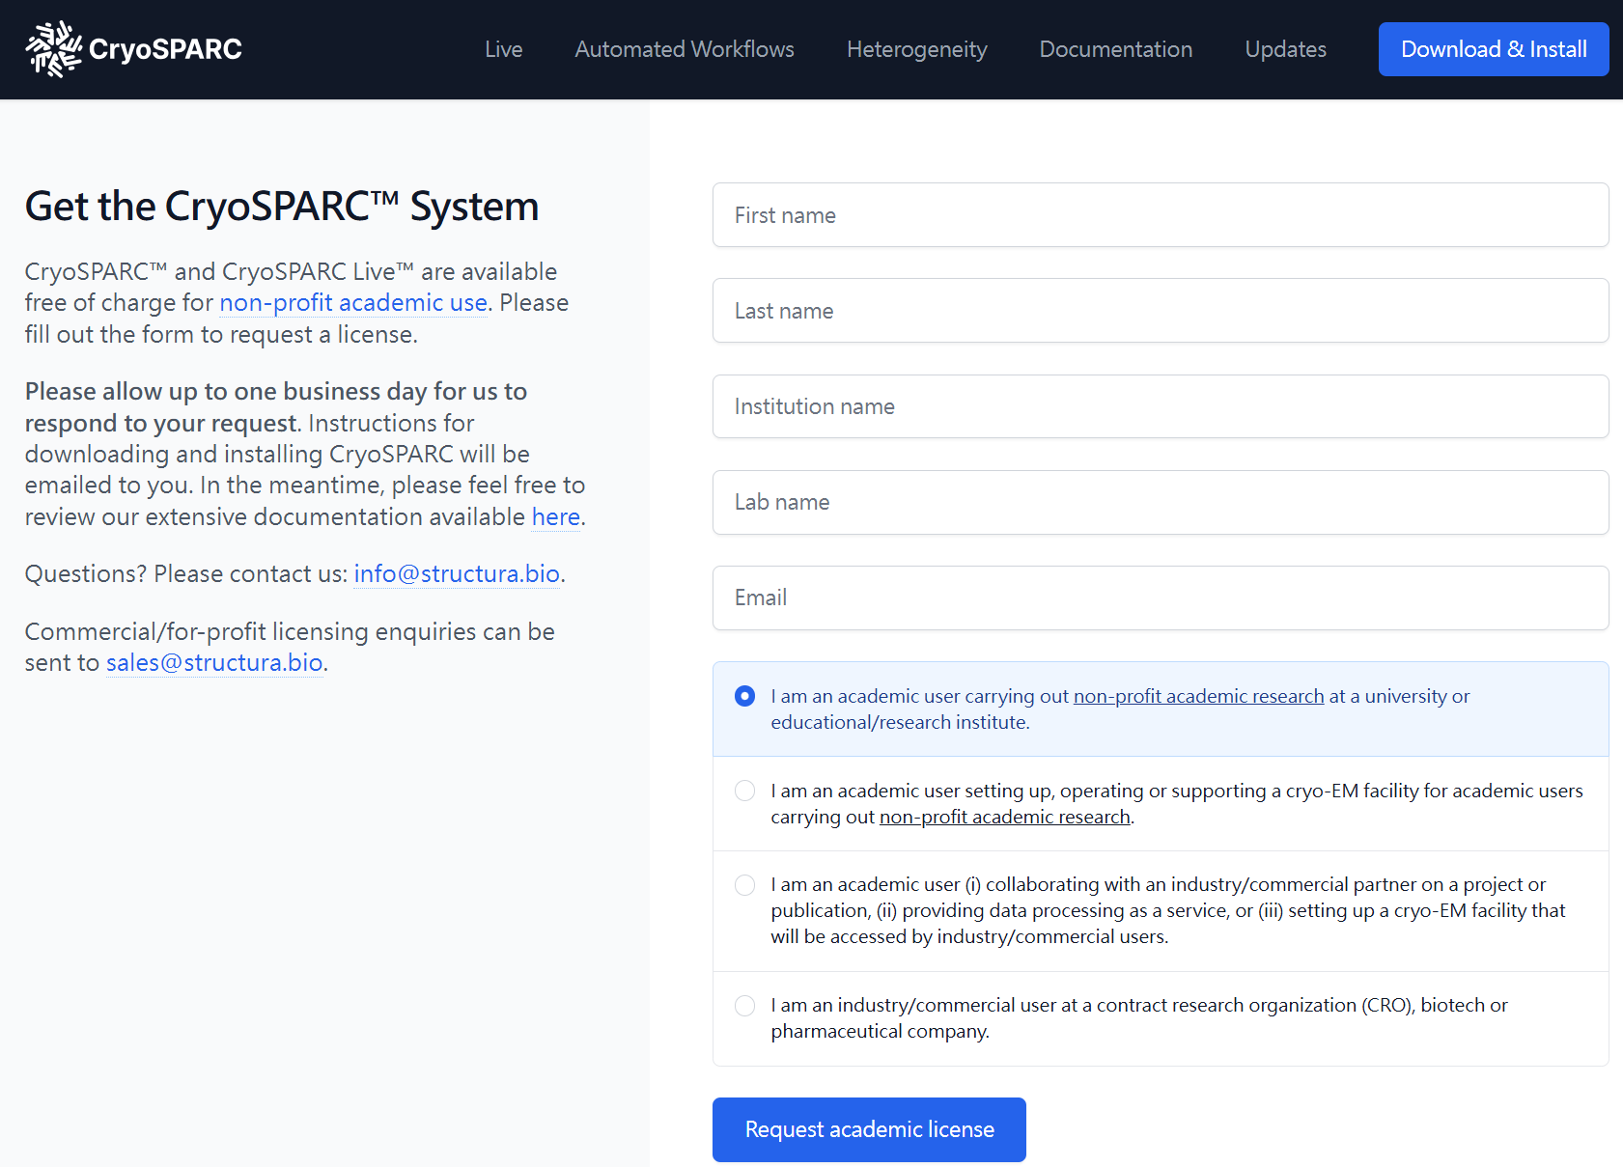
Apply for a cryoSPARC license
(https://cryosparc.com/)

Slide 19
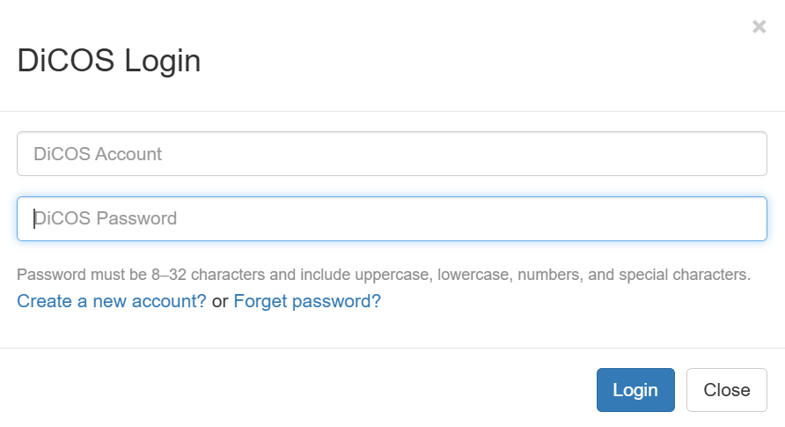
Login DiCOS &
Launch a new CryoSPARC
 3
 1
 2

Slide 20
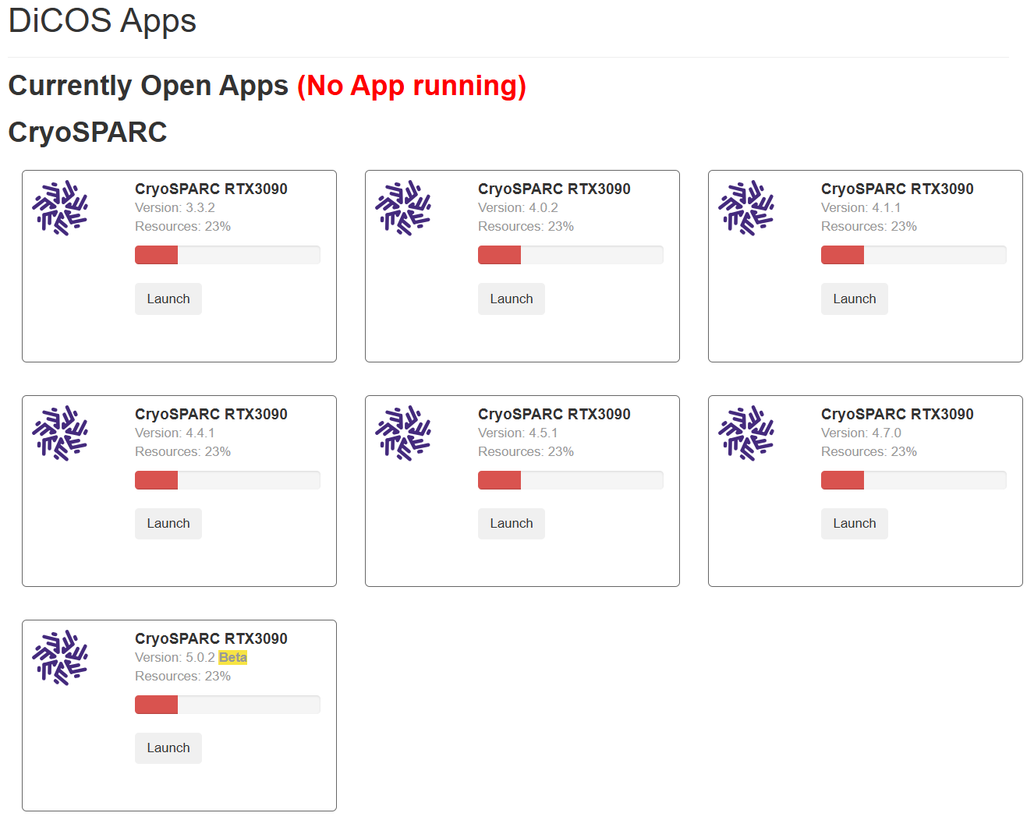
Launch a new CryoSPARC
 1

Slide 21
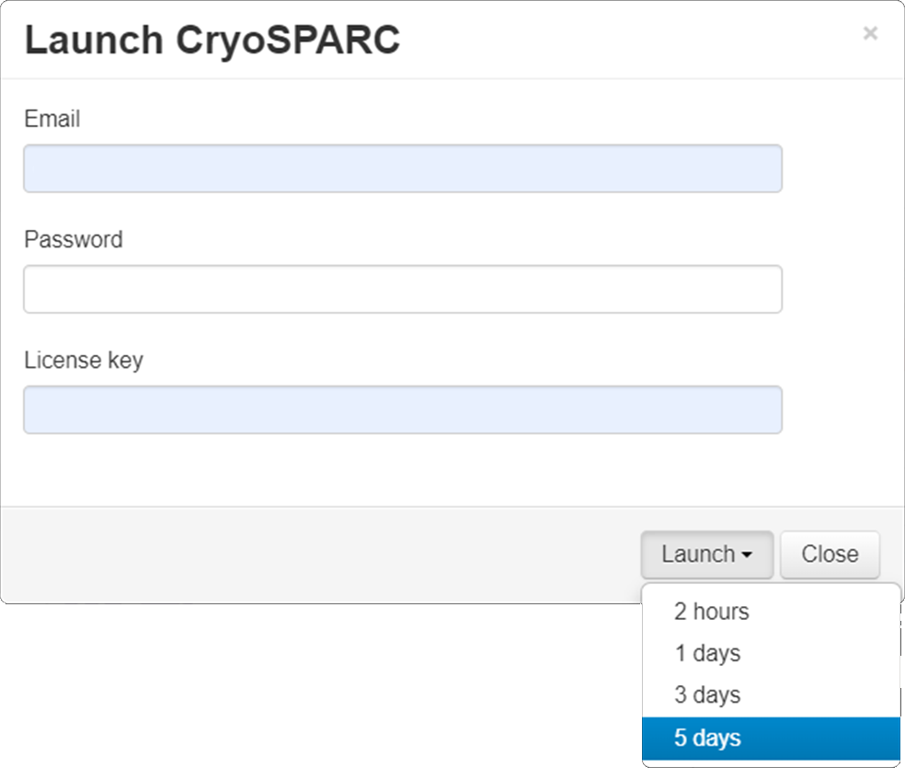
Launch a new CryoSPARC
 1
user@gmail.com
 2
1234
 3
123f4f56-f7f8-90f1-2f3f-f45678901ff2
 4
 5

Slide 22
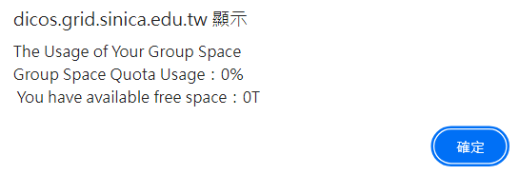
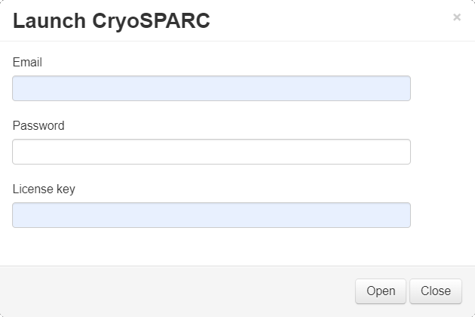
Launch a new CryoSPARC
 1
user@gmail.com
1234
123f4f56-f7f8-90f1-2f3f-f45678901ff2
 2

Slide 23
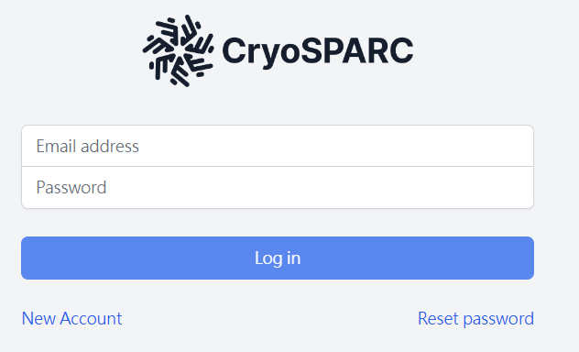
Launch a new CryoSPARC
 1
user@gmail.com
 2
1234
 3

Slide 24
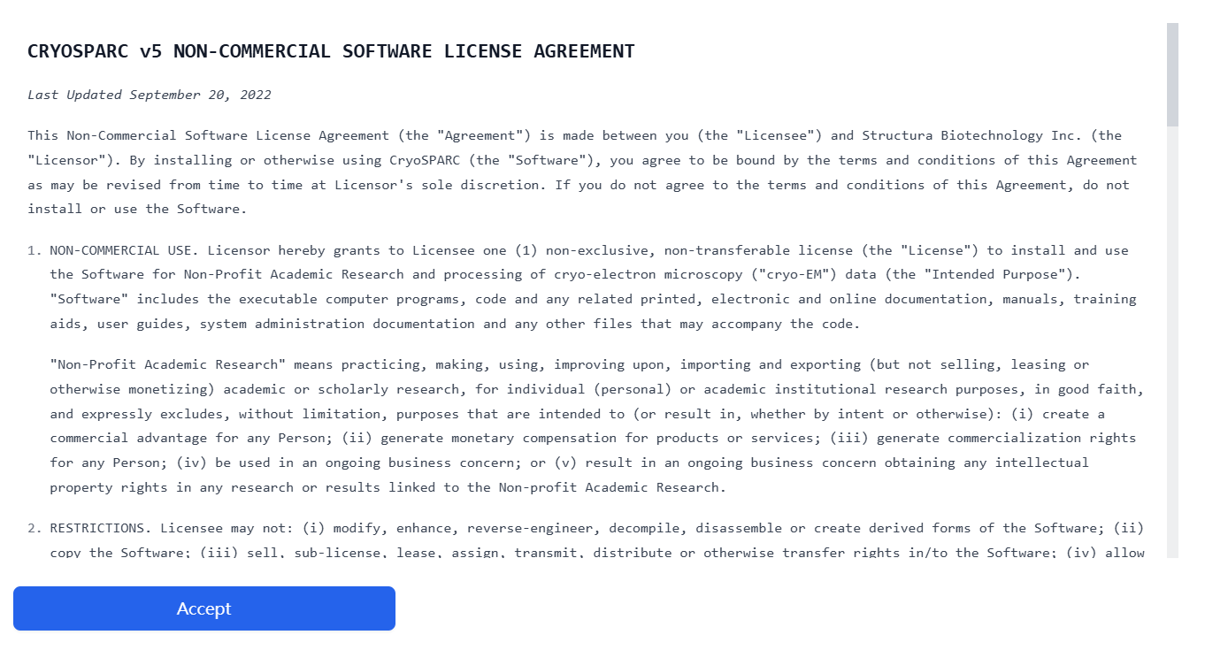
Launch a new CryoSPARC
 1
(Acceptance is needed only during the initial login.)

Slide 25
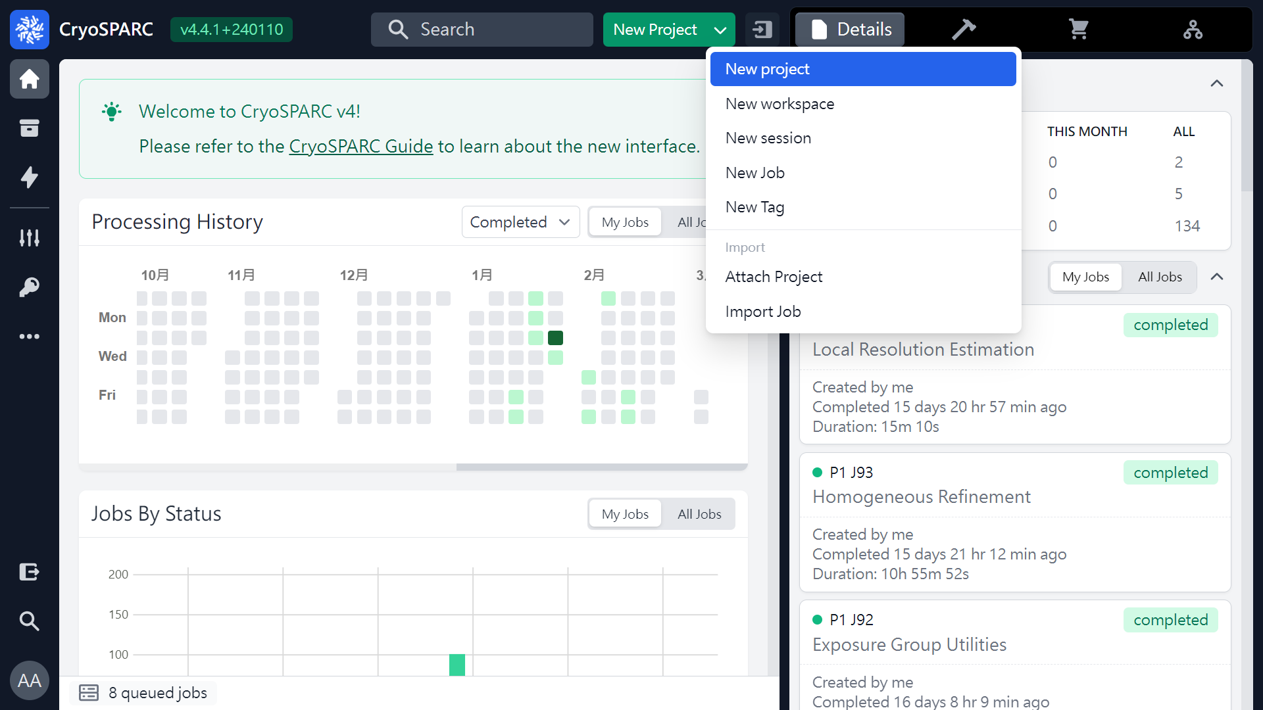
Launch a new CryoSPARC

Slide 26
Thank you !

