Slide 1
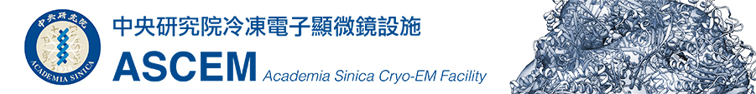
CryoSPARC
01-Preprocessing
Dr. Chun-Hsiung Wang
王俊雄
2026/03/16

Slide 2
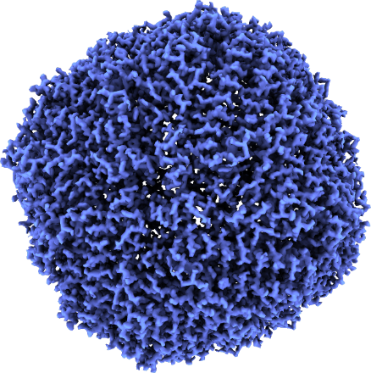
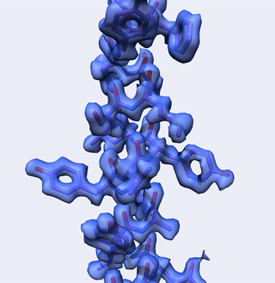


What is cryoSPARC?
(Cryo-EM Single Particle Ab-Initio Reconstruction and Classification) is a High Performance Computing (HPC) software solution for complete processing of single-particle cryo-electron microscopy (cryo-EM) data.
(ref: cryoSPARC website. https://cryosparc.com/)

Slide 3
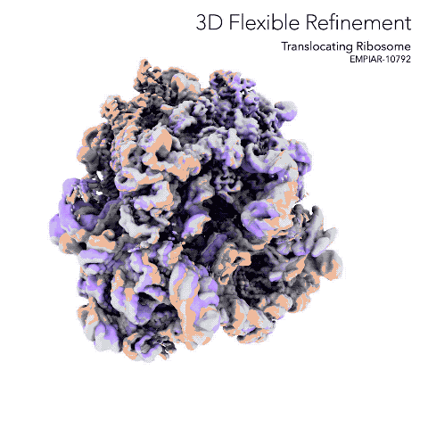
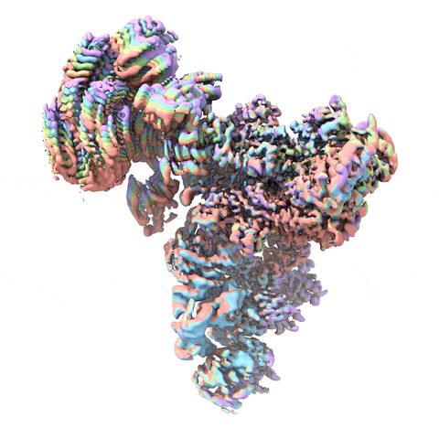
What is cryoSPARC?
CryoSPARC is useful for solving cryo-EM structures of
Membrane proteins
Small particles
Complexes
Viruses
Flexible molecules
Cryo-EM data
Phase plate data
Negative stain data
(ref: cryoSPARC website. https://cryosparc.com/)

Slide 4
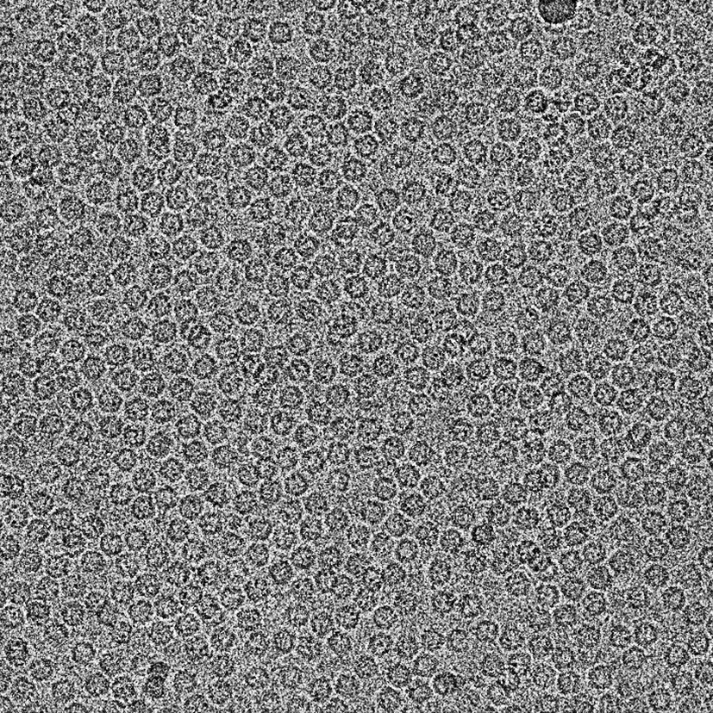
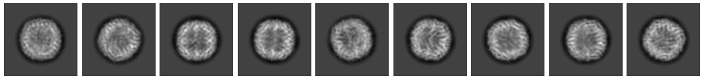
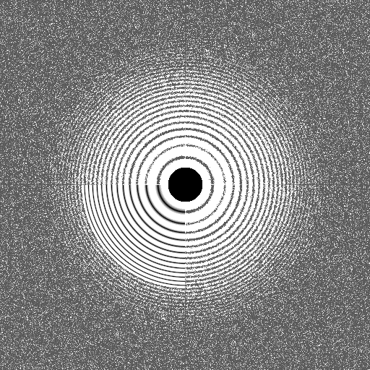
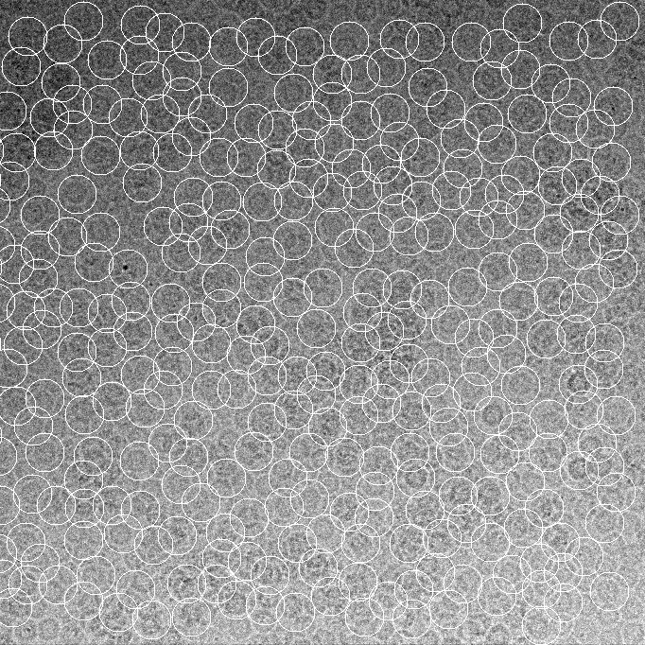
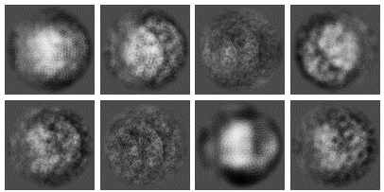
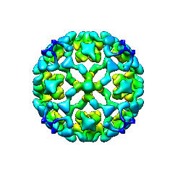
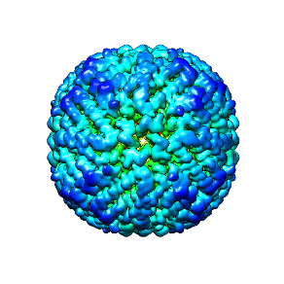
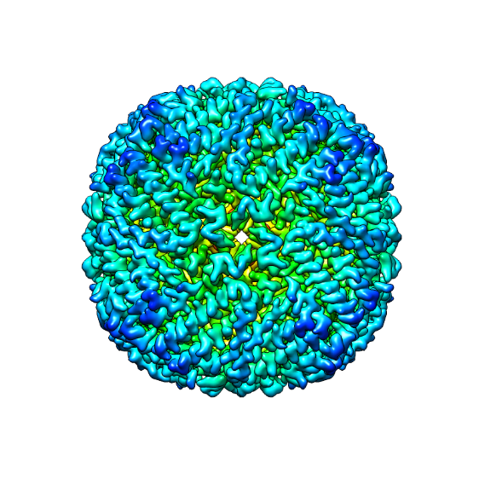
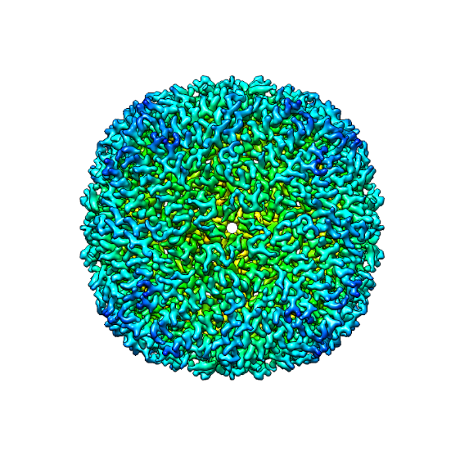
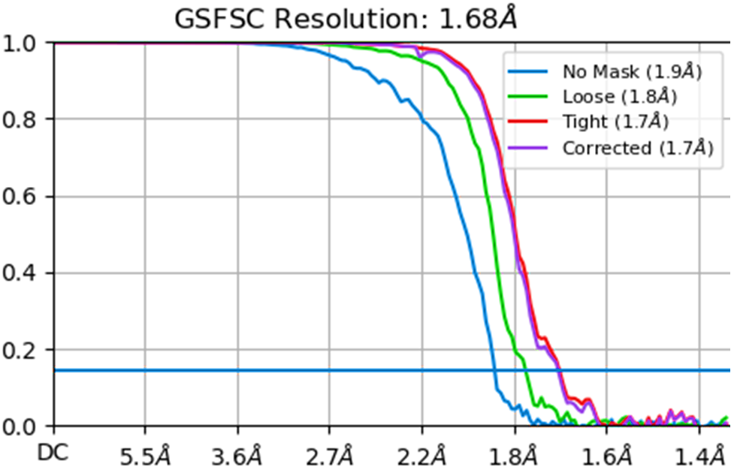
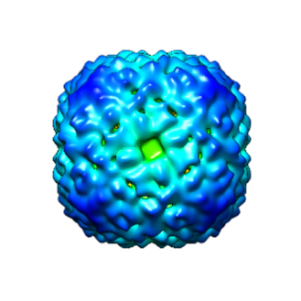
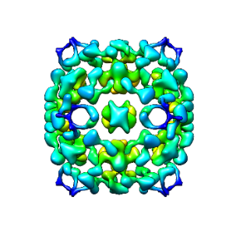
The workflow for
Cryo-EM single particle analysis
Motion correction
CTF estimation
Particle picking
2D classification
O
X
3D classification
3D refinement
Post-processing
Resolution (FSC)
X
X
X

Slide 5
Workflow of single particle analysis using cryoSPARC
Import Dataset
Ab-initio 3D Classification
Movies
Motion corrected
Micrographs
Motion Correction
Heterogeneous Refinement
3D
Pre-
process
CTF Estimation
Homogeneous Refinement
Micrograph Curation
Non-uniform Refinement
or
Particle Picking
Local Refinement
Advanced
3D
or
Particle picking
Particle Curation
3D class, 3D Var, 3D Flex
Particle Extraction
Post-processing & Sharpening
2D
2D Classification
Final Structures

Slide 6
Diagram of Projects, Workspaces and Jobs
Project 01
(Protein A)
Projects 02
(Protein B)
Workspace 01
(dataset 01, pH, temperature)
Workspace 02
(dataset 02, pH, temperature)
Workspace 01
(pH)
Job 01 (Import movies)
Job 01
Job 01
Job 02 (Motion correction)
Job 02
Job 02
Job 03 (CTF estimation)
Job 03
Job 04 (Micrograph Curation )

Slide 7
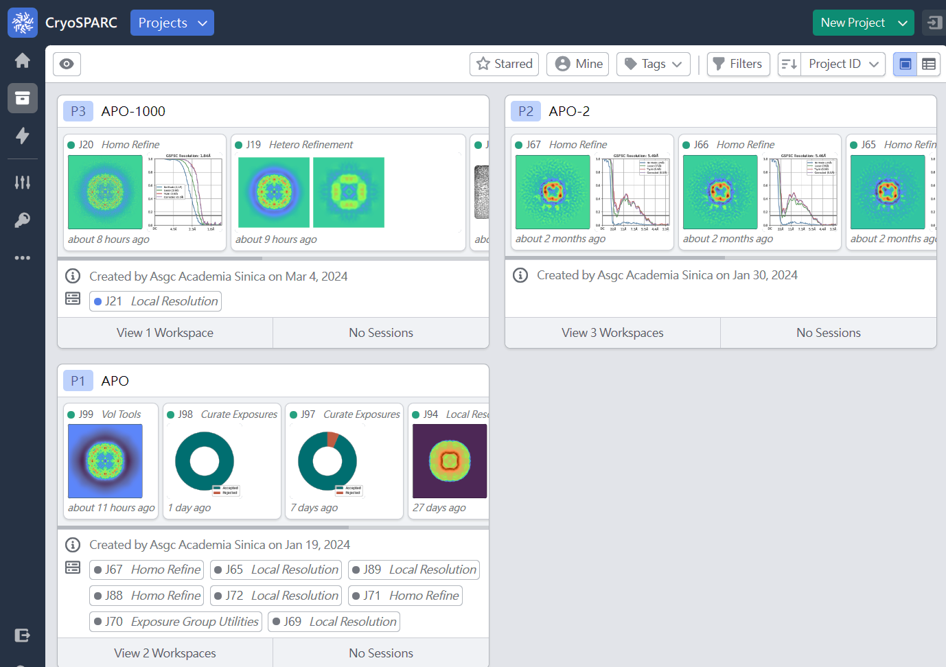
Diagram of Projects, Workspaces and Jobs
Projects
P3 (Project 3)
P2 (Project 2)
P1 (Project 1)

(ref: cryoSPARC website. https://cryosparc.com/)

Slide 8
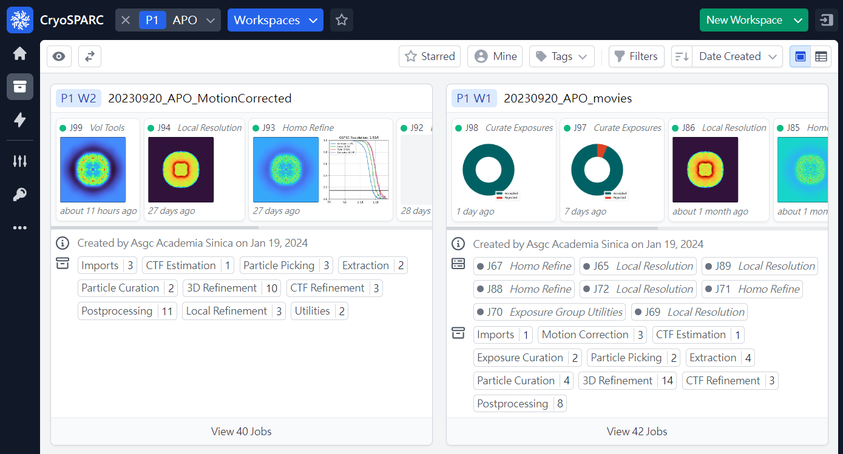
Diagram of Projects, Workspaces and Jobs
Project 1
Workspaces
P1 W2 (Project 1 / Workspace 2)
P1 W1 (Project 1 / Workspace 1)
J99, J94, J93 … (Job)

(ref: cryoSPARC website. https://cryosparc.com/)

Slide 9
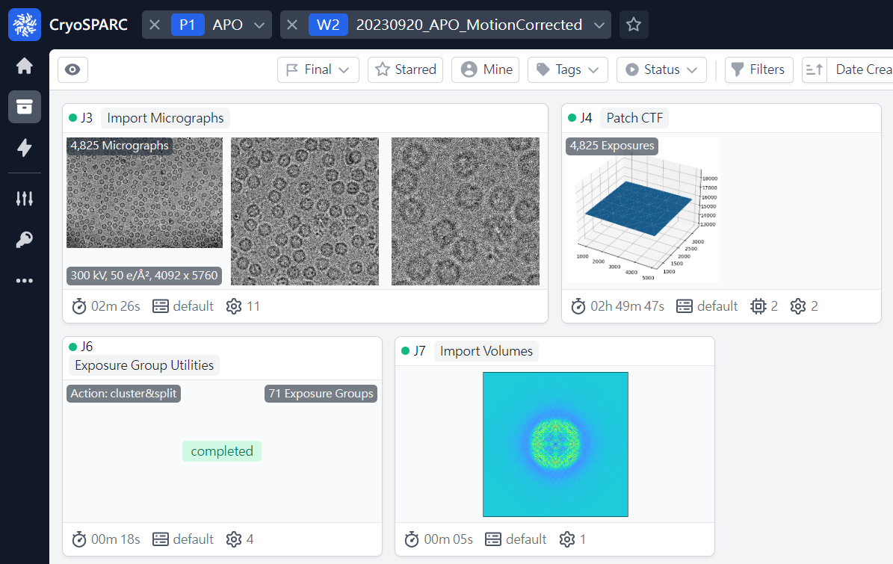
Diagram of Projects, Workspaces and Jobs
Project 1
Workspace 1

J3 (Job 3)
J4 (Job 4)
J6 (Job 6)
J7 (Job 7)
Jobs
(ref: cryoSPARC website. https://cryosparc.com/)

Slide 10
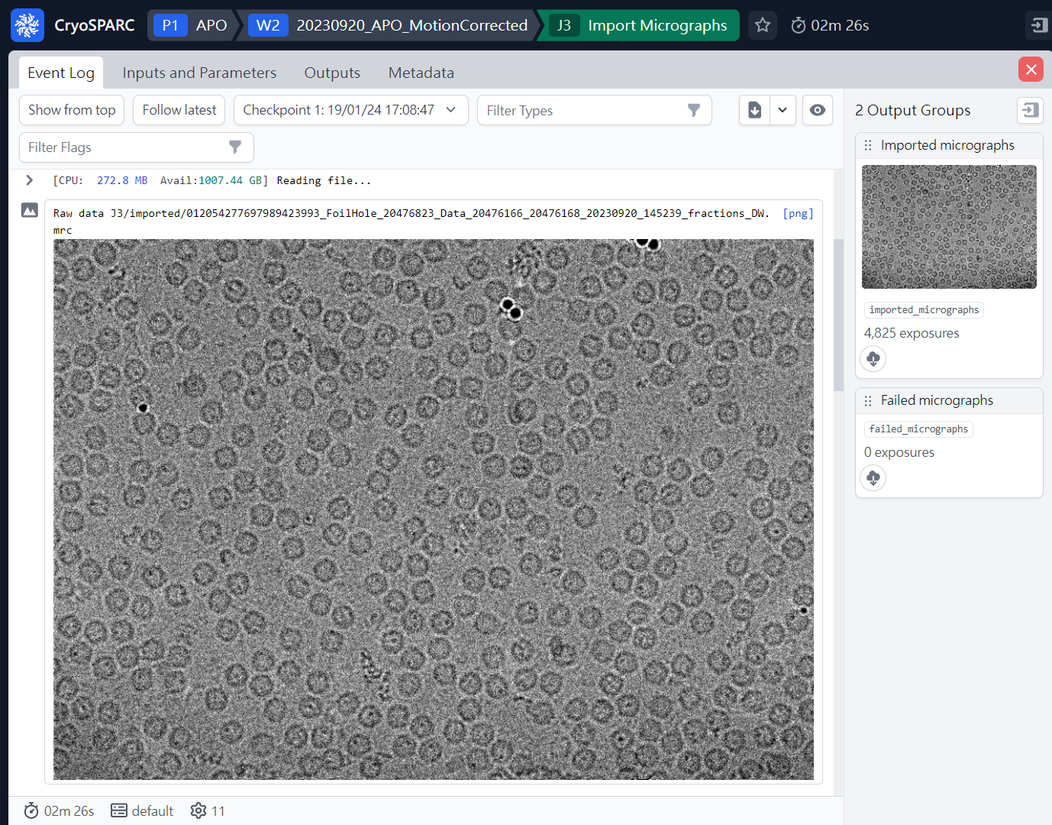
Diagram of Projects, Workspaces and Jobs
Project 1
Workspace 2
Job3
P1
W2
J3

(ref: cryoSPARC website. https://cryosparc.com/)

Slide 11
Diagram of Projects, Workspaces and Jobs
Project 01
(Protein A)
Projects 02
(Protein B)
Workspace 01
(dataset 01, pH, temperature)
Workspace 02
(dataset 02, pH, temperature)
Workspace 01
(pH)
Job 01 (Import movies)
Job 01
Job 01
Job 02 (Motion correction)
Job 02
Job 02
Job 03 (CTF estimation)
Job 03
Job 04 (Micrograph Curation )

Slide 12
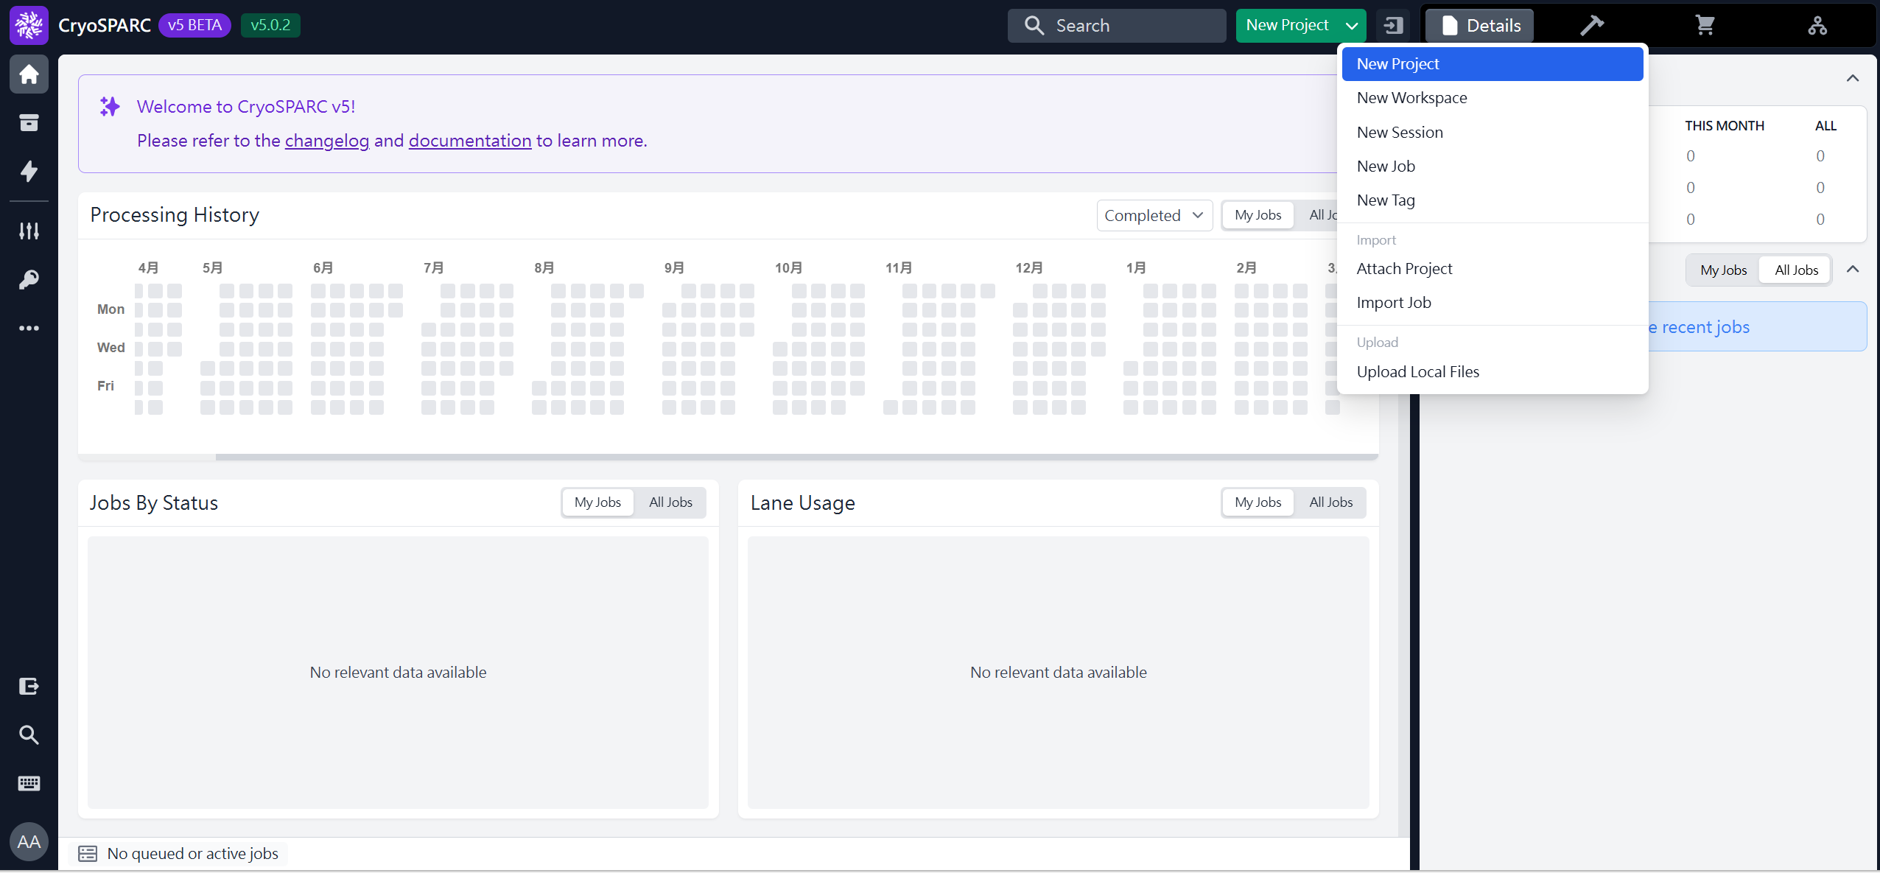
Create New Project
 1
 2
(ref: cryoSPARC website. https://cryosparc.com/)

Slide 13
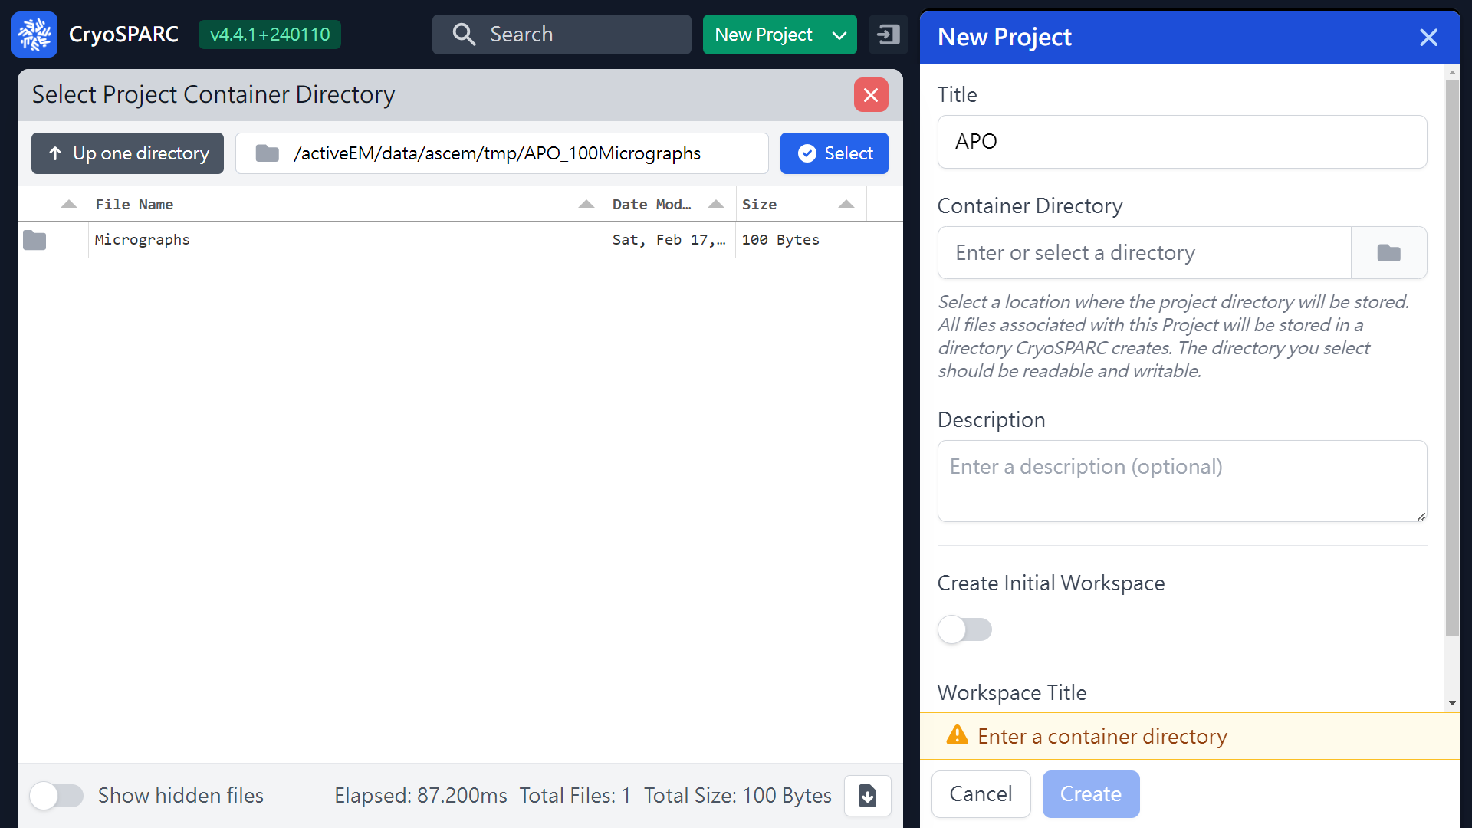
Create New Project
 5
 6
 3
 1
 2
 4
/activeEM/data/group_folder/
user_folder/
/activeEM/ascem_workshop/dicosbio01
(ref: cryoSPARC website. https://cryosparc.com/)

Slide 14
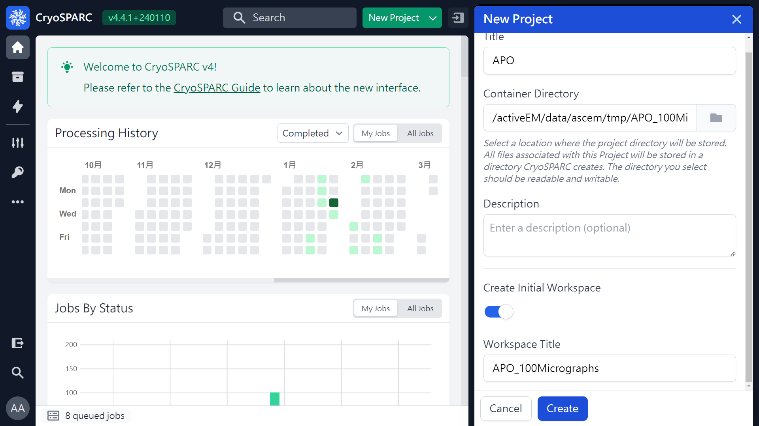
Create Initial Workspace
 1
APO_100Micrographs
 2
 3
(ref: cryoSPARC website. https://cryosparc.com/)

Slide 15
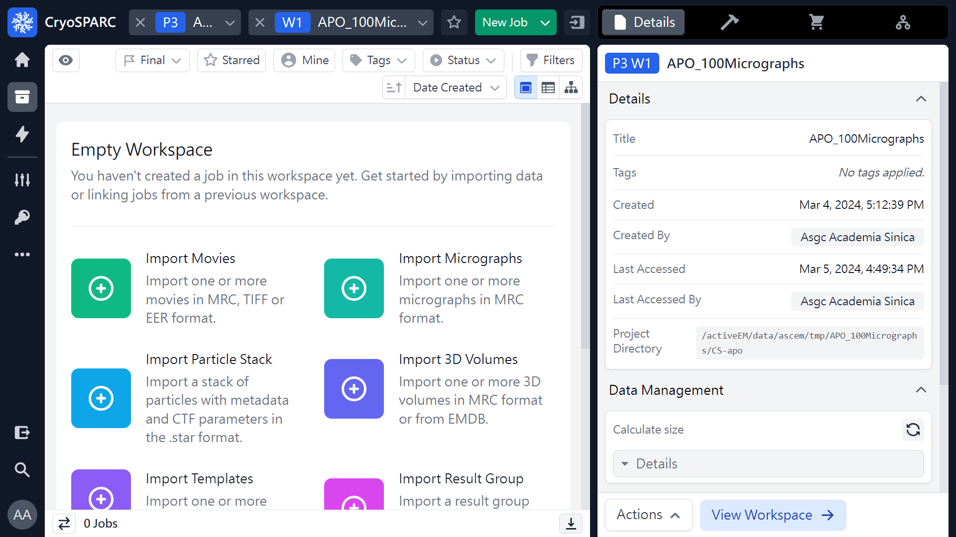
Create Initial Workspace (Diagram of Projects, Workspaces and Jobs)
Project 3
Workspace 1
Jobs
 Add Jobs
P3
W1
 Add Jobs
(ref: cryoSPARC website. https://cryosparc.com/)

Slide 16
Import Micrographs
Project 3
Workspace 1
Jobs
 1
(ref: cryoSPARC website. https://cryosparc.com/)

Slide 17
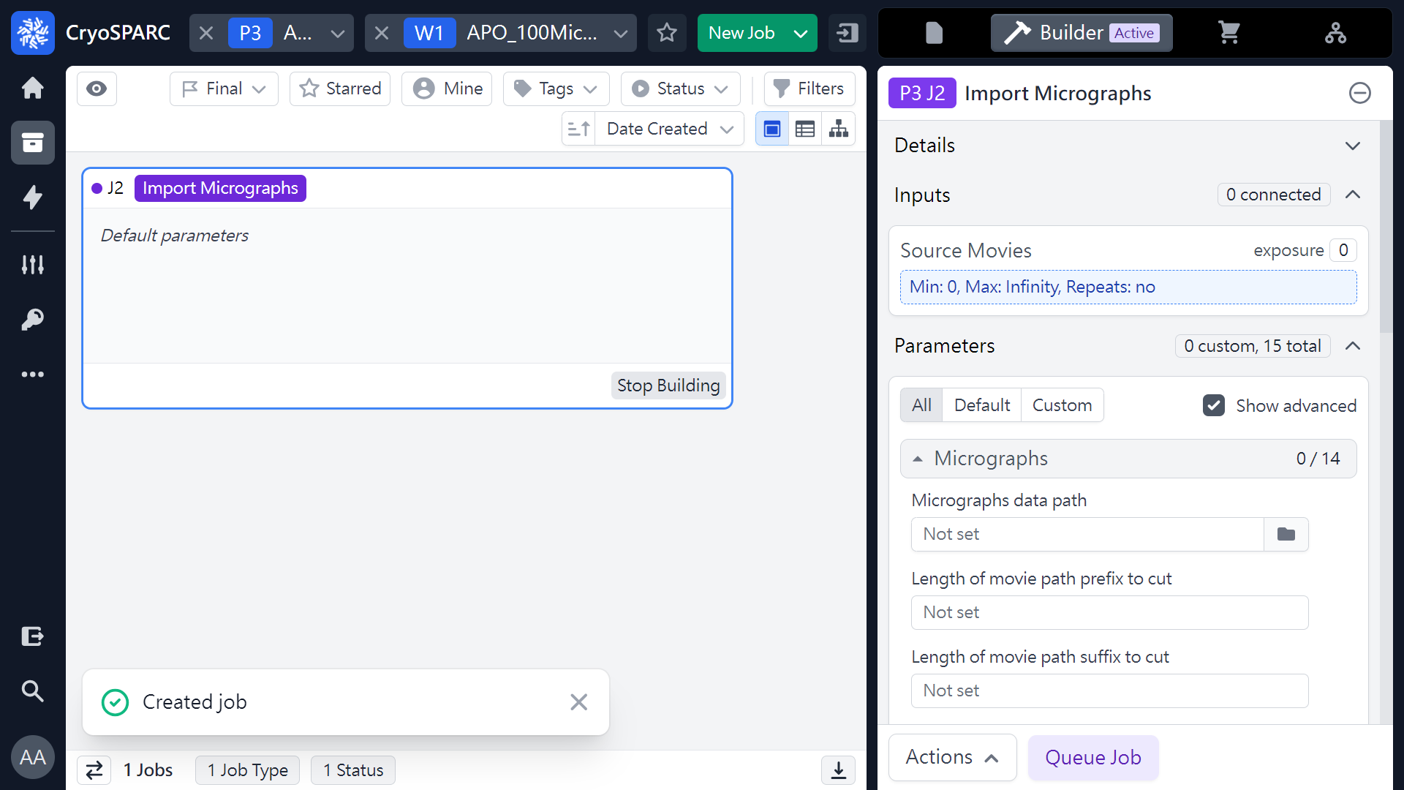
Import Micrographs
 1
(ref: cryoSPARC website. https://cryosparc.com/)

Slide 18
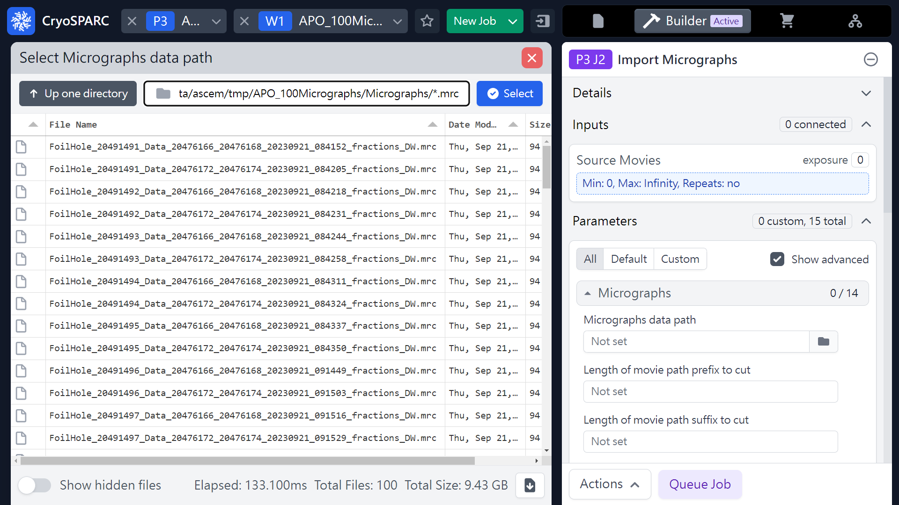
Import Micrographs
 4 (add *mrc)
 5
 2
 3
/activeEM/data/group_folder/
user_folder/Micrographs_folder/*.mrc
/activeEM/ascem_workshop/Hands_on_tutorial/Micrographs/*.mrc
 1
/activeEM/Hands_on_tutorial/Micrographs/*.mrc
(ref: cryoSPARC website. https://cryosparc.com/)

Slide 19
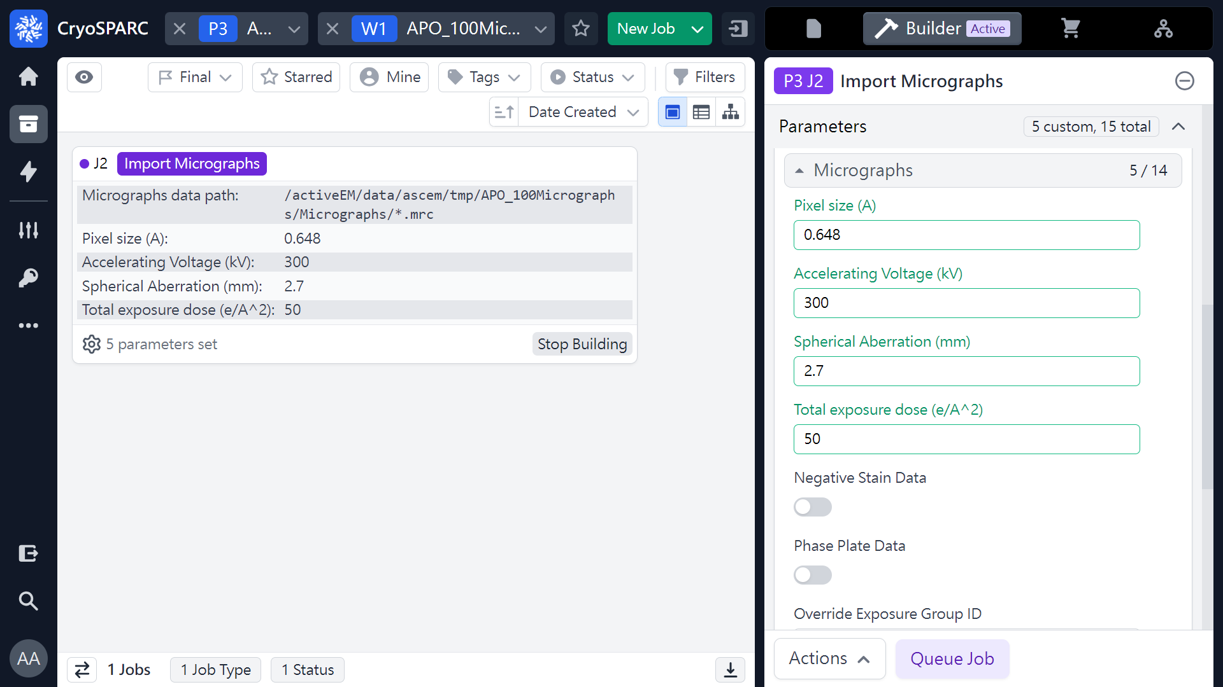
Import Micrographs
Imaging Parameters
Apix: 0.648 Å/pixel
Voltage: 300 keV
Cs: 2.7 mm
Frame number: 60 frames
Frame does: 0.8 e-/Å²
Total does 50 e-/Å²
(0.833 e-/Å² x 60 frames)
0.648
 1
300
 2
2.7
 3
50
 4
 5
(ref: cryoSPARC website. https://cryosparc.com/)

Slide 20
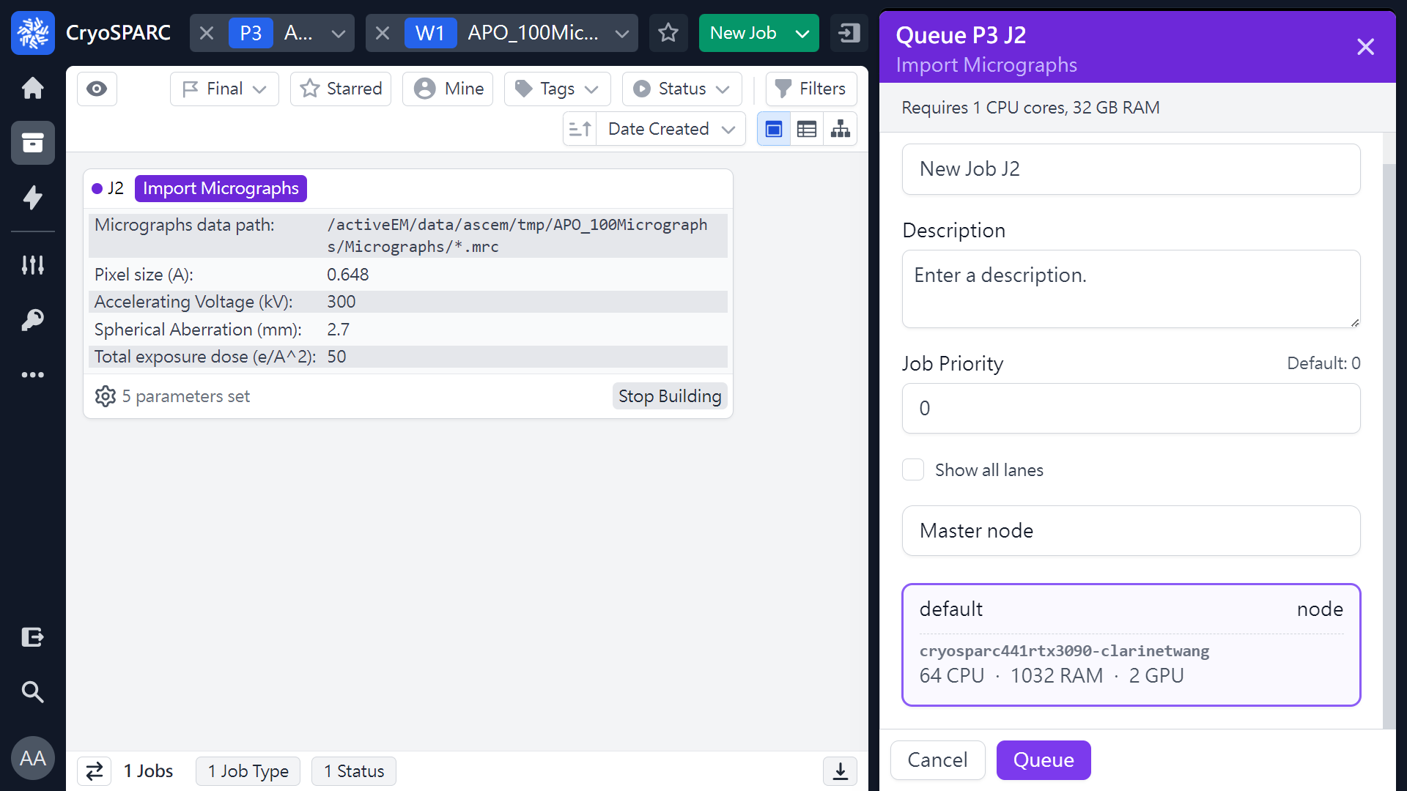
Import Micrographs
 1
(ref: cryoSPARC website. https://cryosparc.com/)

Slide 21
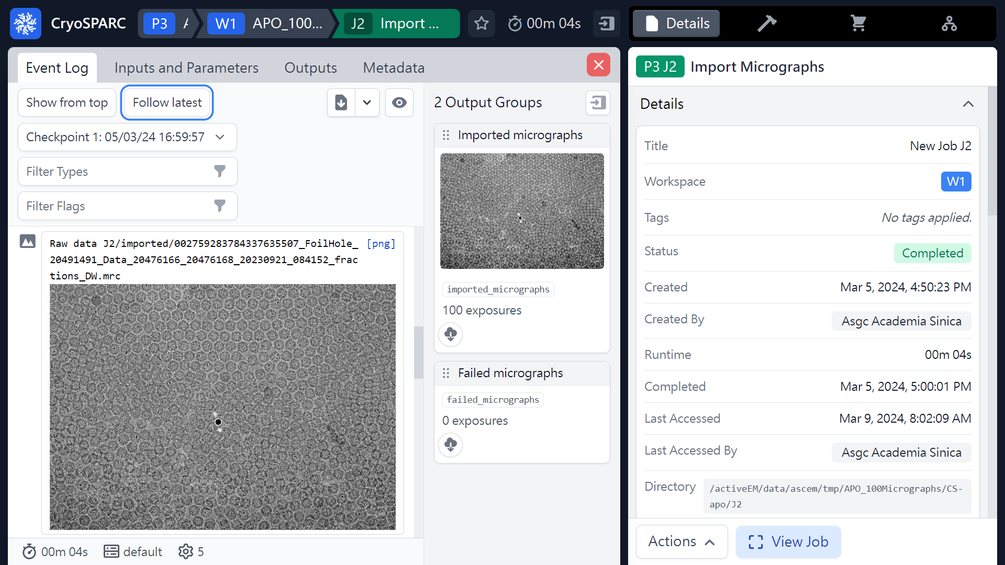
Import Micrographs (Results)
100 Micrographs
(ref: cryoSPARC website. https://cryosparc.com/)

Slide 22
Workflow of single particle analysis using cryoSPARC
Import Dataset
Ab-initio 3D Classification
Movies
Motion corrected
Micrographs
Motion Correction
Heterogeneous Refinement
3D
Pre-
process
CTF Estimation
Homogeneous Refinement
Micrograph Curation
Non-uniform Refinement
or
Particle Picking
Local Refinement
Advanced
3D
or
Particle picking
Particle Curation
3D class, 3D Var, 3D Flex
Particle Extraction
Post-processing & Sharpening
2D
2D Classification
Final Structures

Slide 23
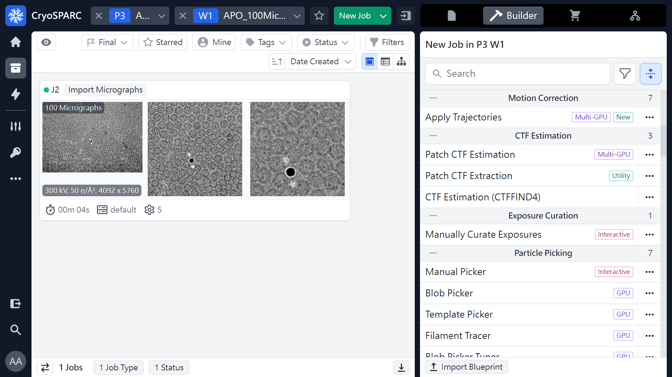
Patch CTF estimation
 1
 2
(ref: cryoSPARC website. https://cryosparc.com/)

Slide 24
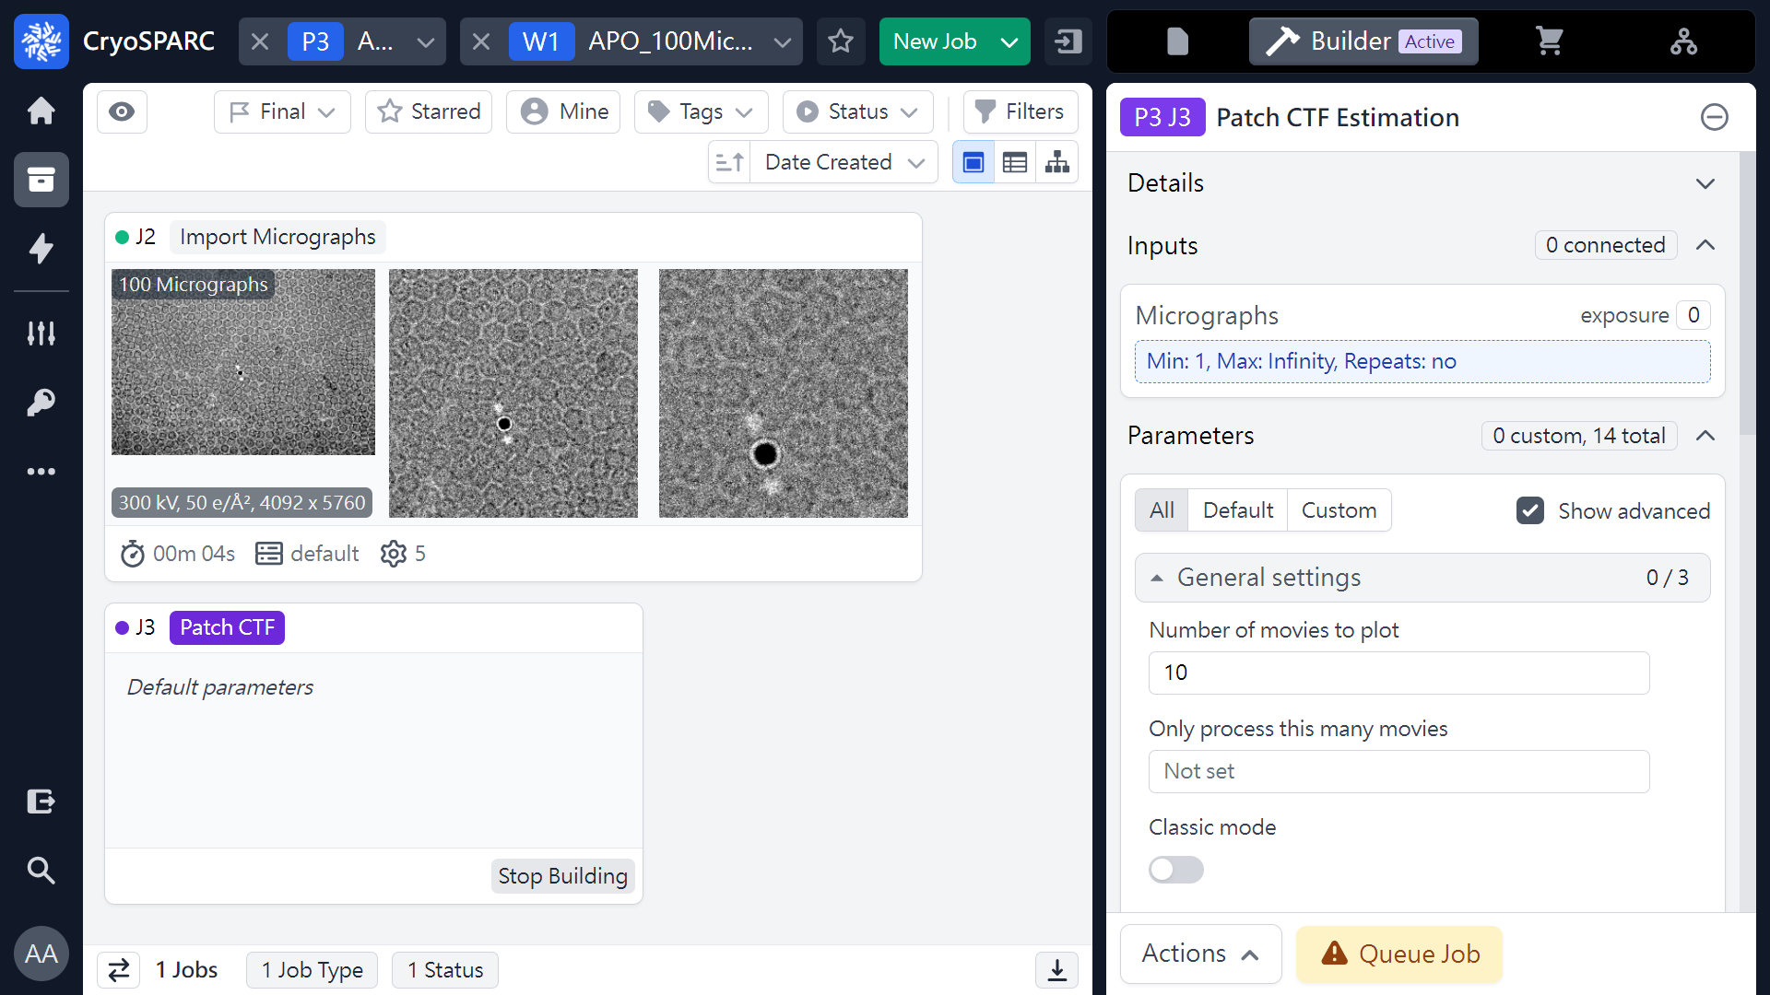
Patch CTF estimation
 1
(ref: cryoSPARC website. https://cryosparc.com/)

Slide 25
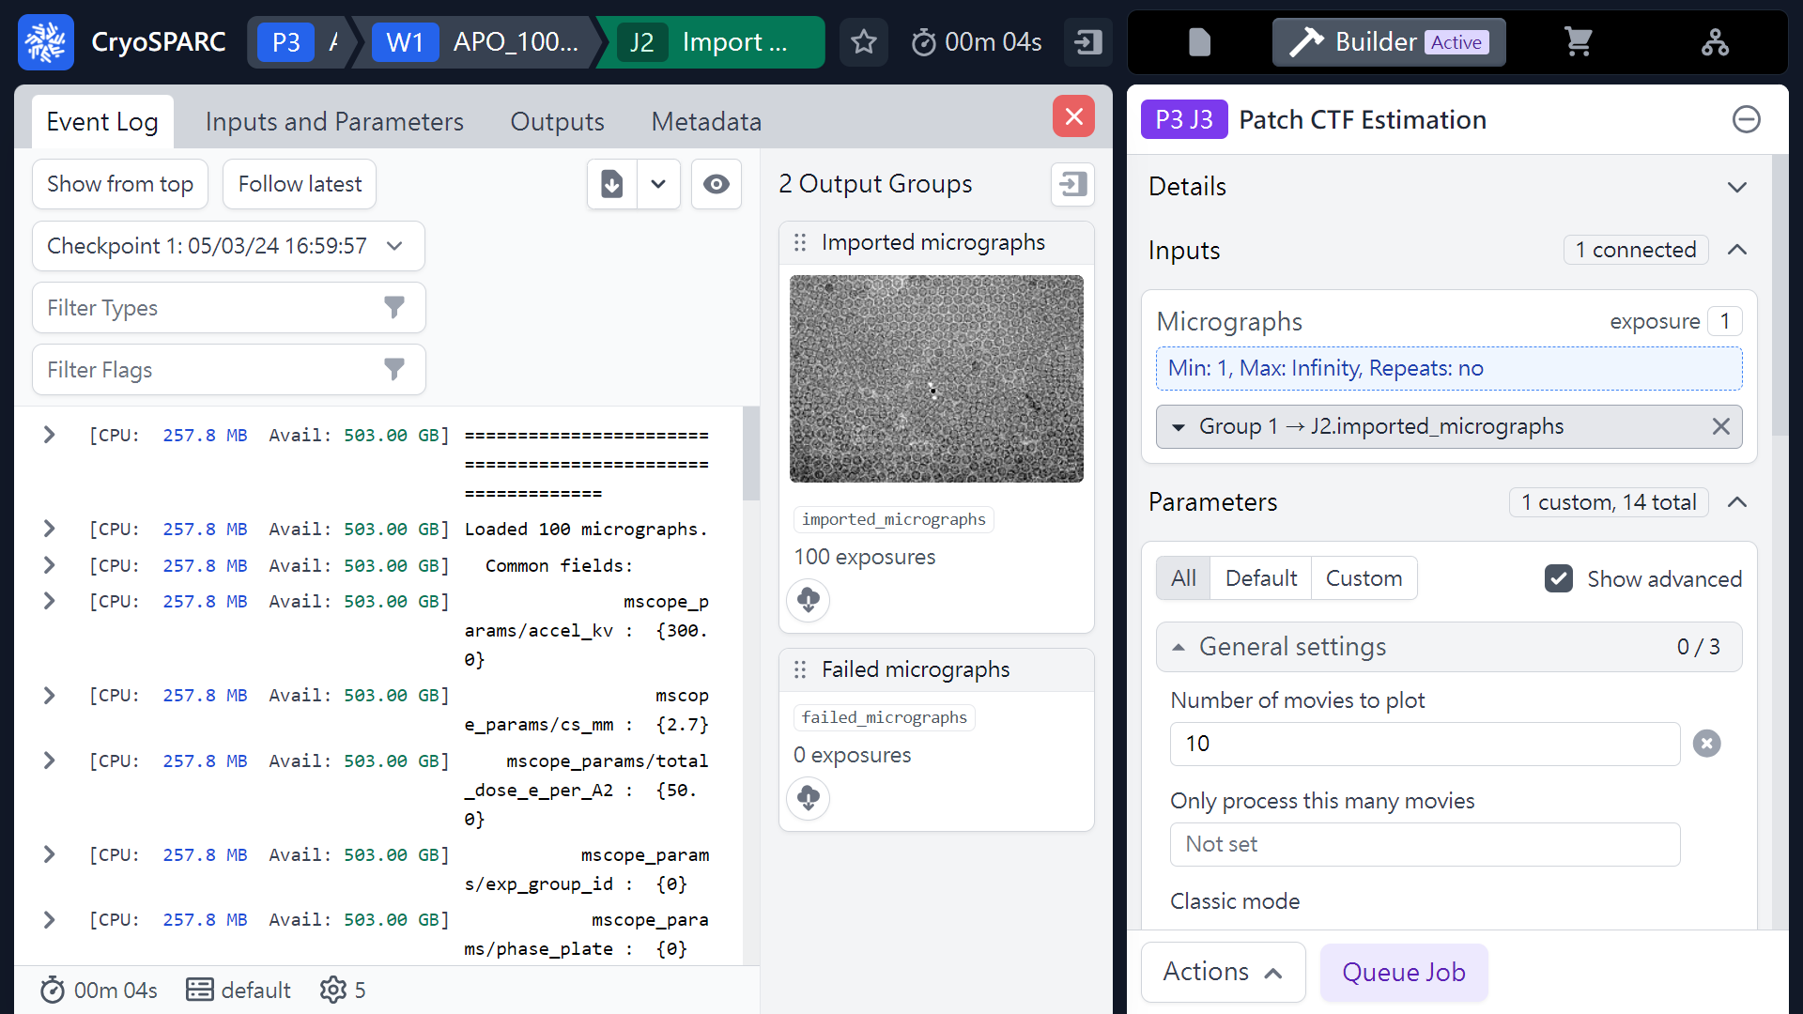
Patch CTF estimation
Imported micrographs
Micrographs
 1
Mouse left click
(Hold & Drag)
 2
(ref: cryoSPARC website. https://cryosparc.com/)

Slide 26
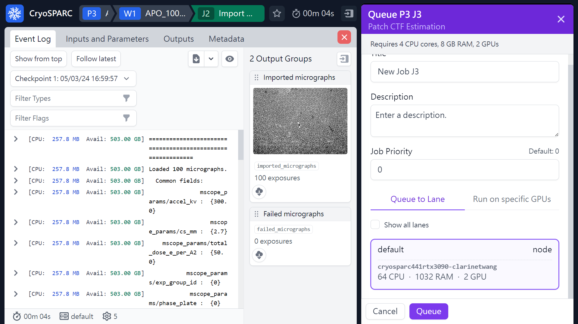
Patch CTF estimation
 2
 1
(ref: cryoSPARC website. https://cryosparc.com/)

Slide 27
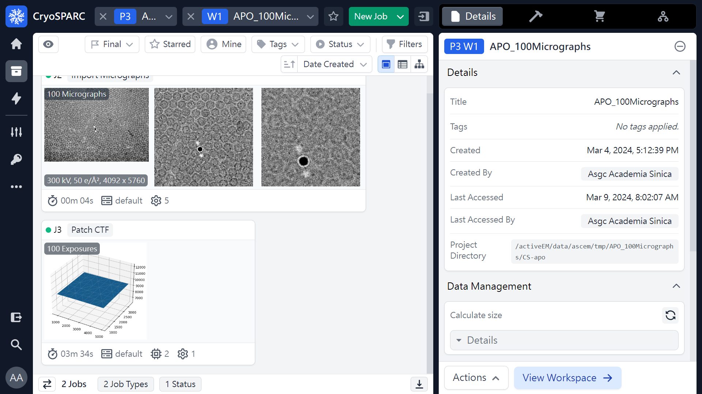
Patch CTF estimation
 1
(ref: cryoSPARC website. https://cryosparc.com/)

Slide 28
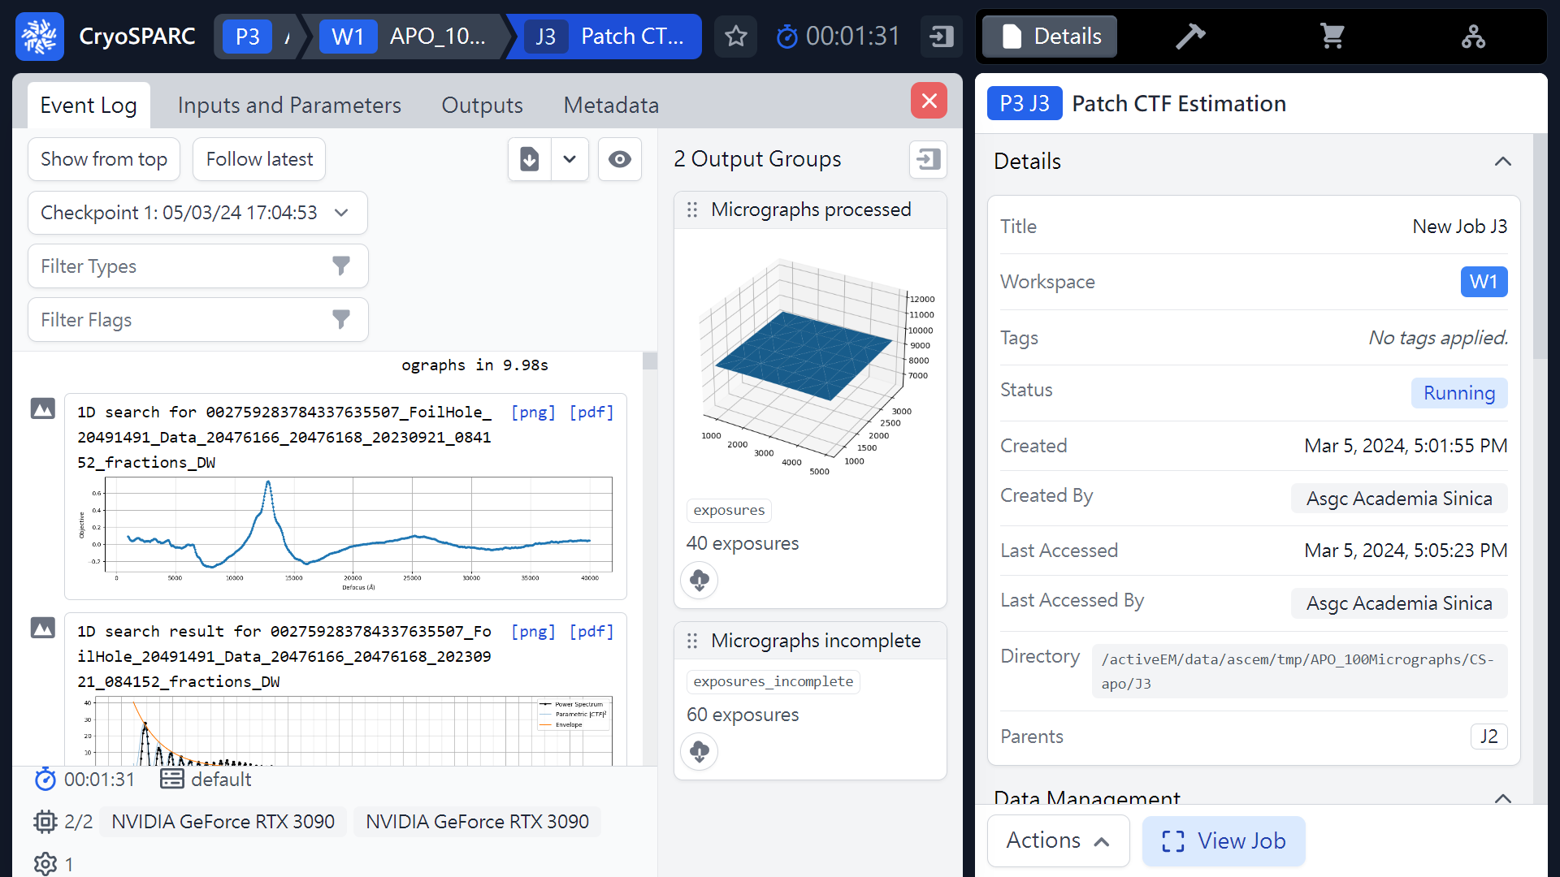
Patch CTF estimation (Results)
 1
 2
Defocus
(ref: cryoSPARC website. https://cryosparc.com/)

Slide 29
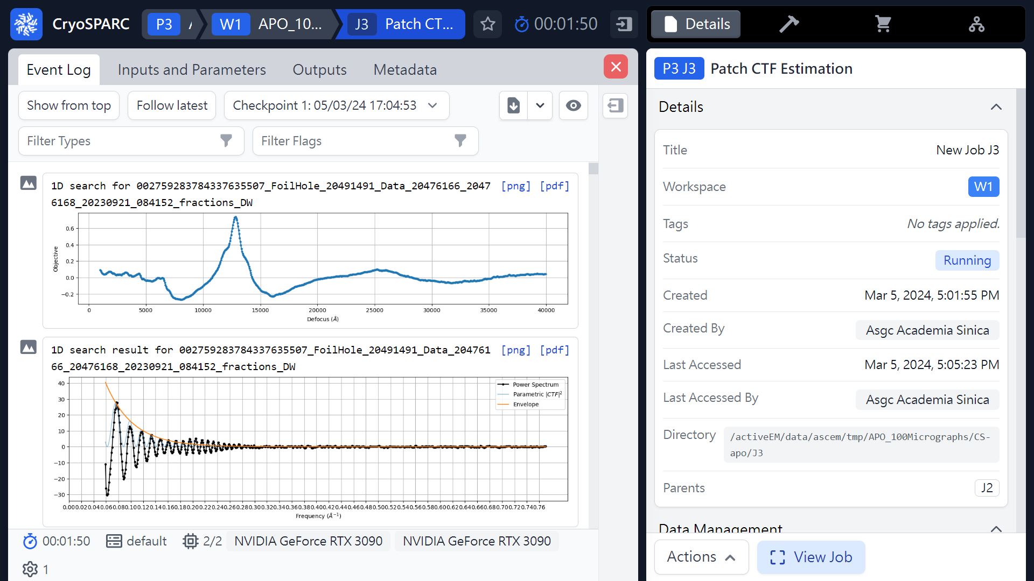
Patch CTF estimation (Results)
Defocus:
around -1.26 um
1D FFT
(ref: cryoSPARC website. https://cryosparc.com/)

Slide 30
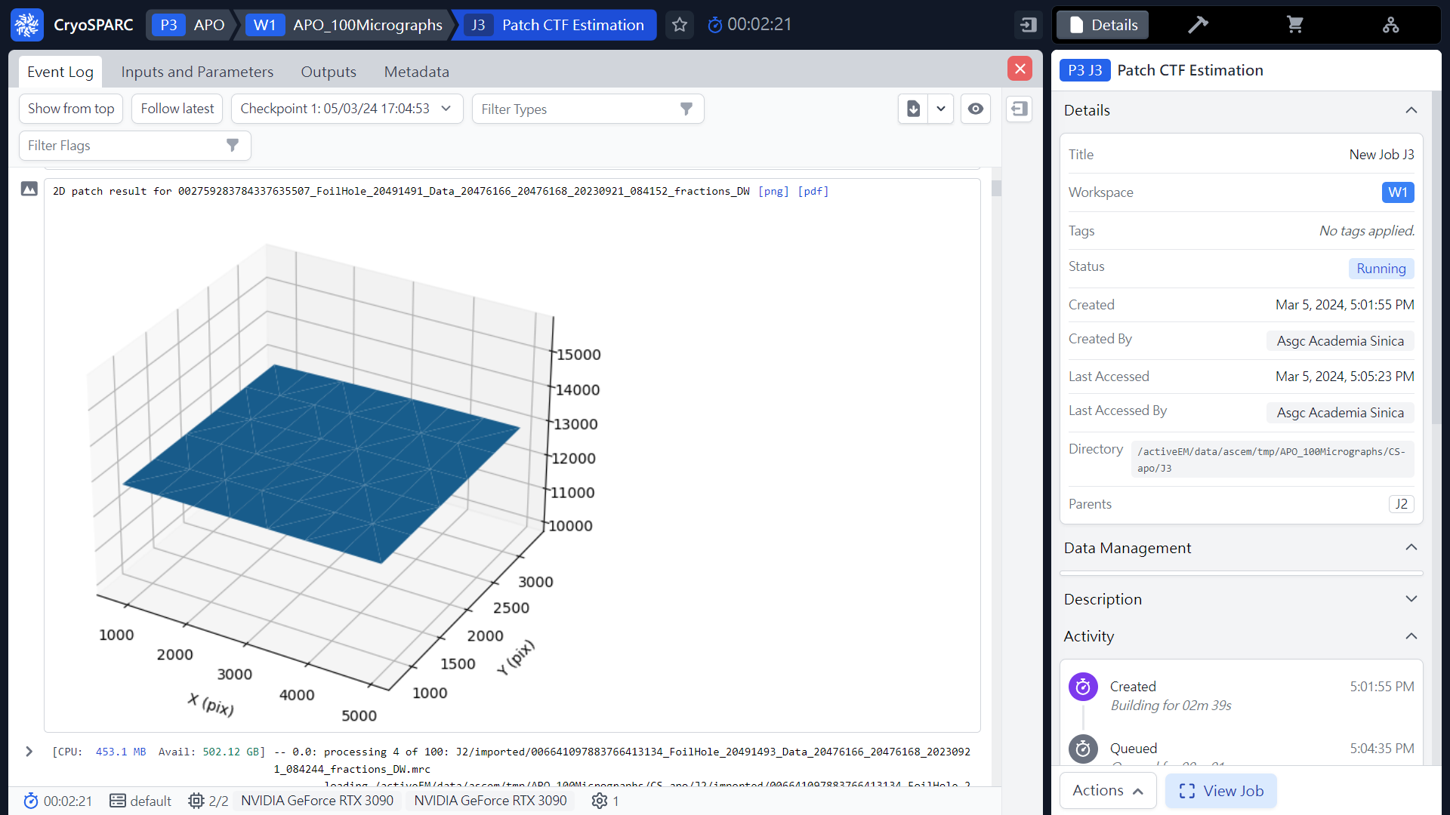
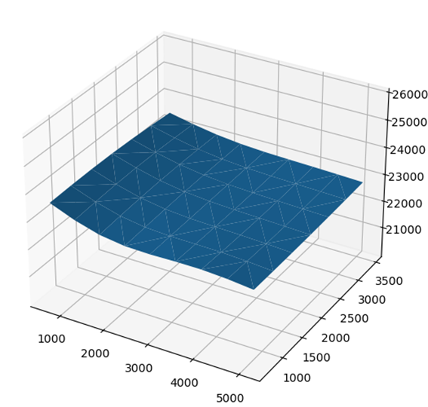
Patch CTF estimation (Results)
Patch results
(Defocus)
(ref: cryoSPARC website. https://cryosparc.com/)

Slide 31
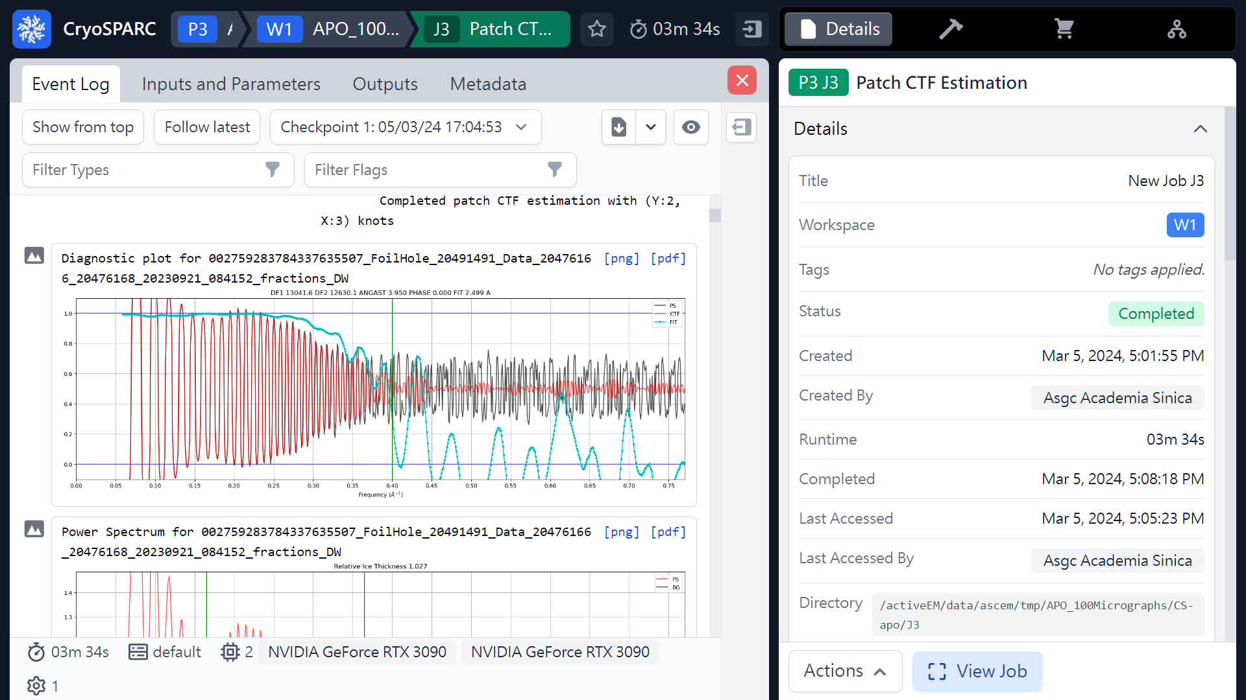
Patch CTF estimation (Results)
Max fit resolution
2.499Å
(ref: cryoSPARC website. https://cryosparc.com/)

Slide 32
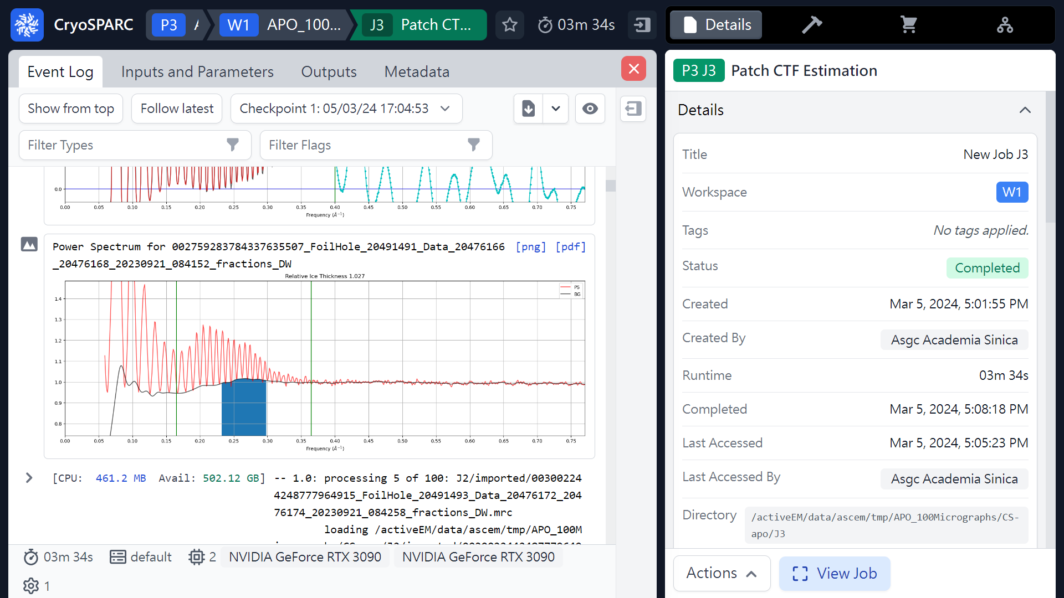
Patch CTF estimation (Results)
Relative Ice Thickness
1.027
(ref: cryoSPARC website. https://cryosparc.com/)

Slide 33
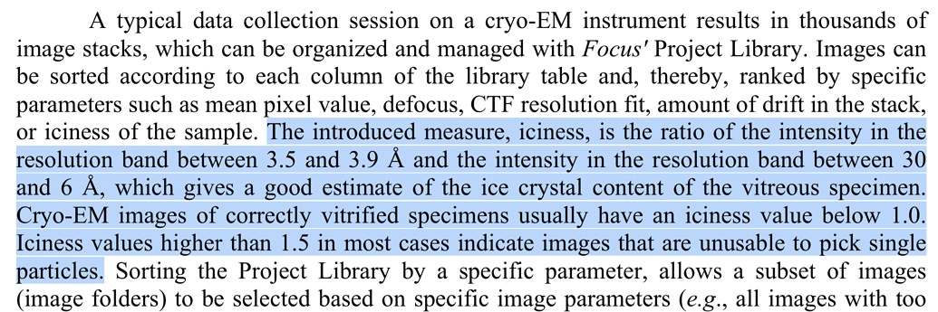
Relative Ice Thickness
(in cryoSPARC)
Intensity (3.5 Å ~ 3.9Å)
Intensity (30 Å ~ 6 Å)
Relative Ice Thickness =
Good: < 1.0 (vitreous ice)
Bad: > 1.5 (most case unusable to pick single particle)
https://www.biorxiv.org/content/biorxiv/early/2017/03/17/105452.full.pdf

Slide 34
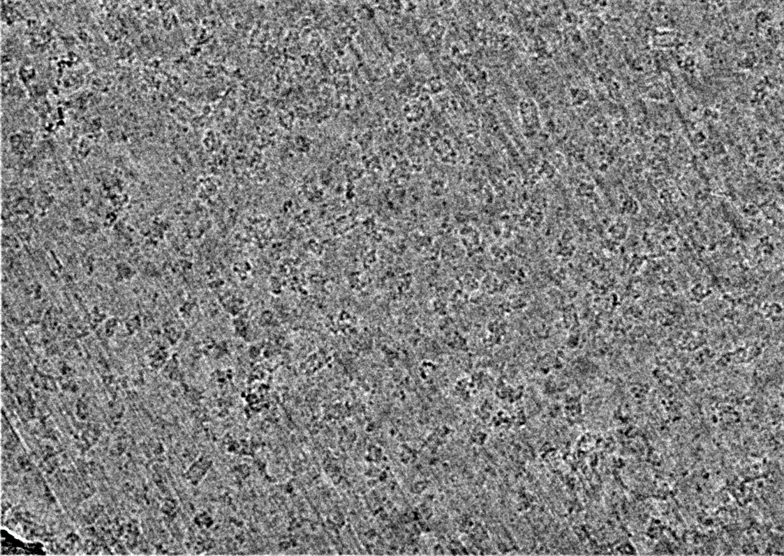
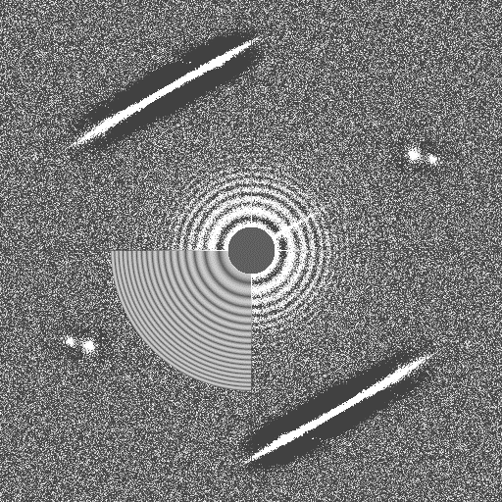
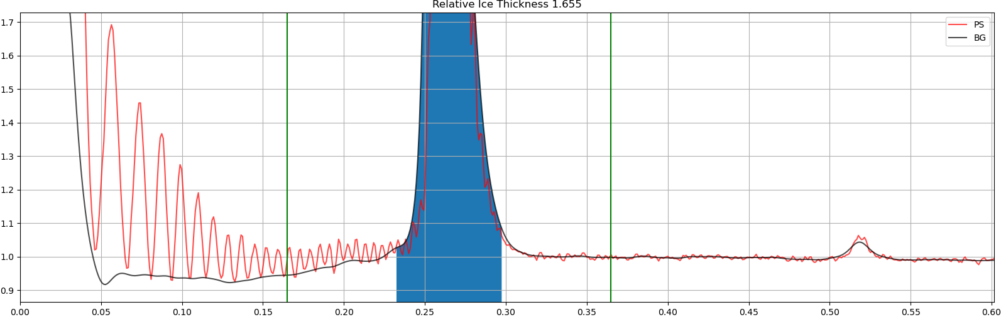
Relative Ice Thickness
(1.655 (> 1.5))
Micrographs
2D FFT
1D FFT
Intensity (3.5 Å ~ 3.9Å)
Intensity (30 Å ~ 6 Å)
Relative Ice Thickness =

Slide 35
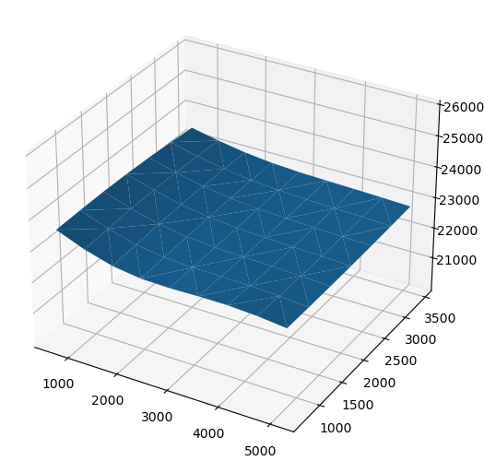
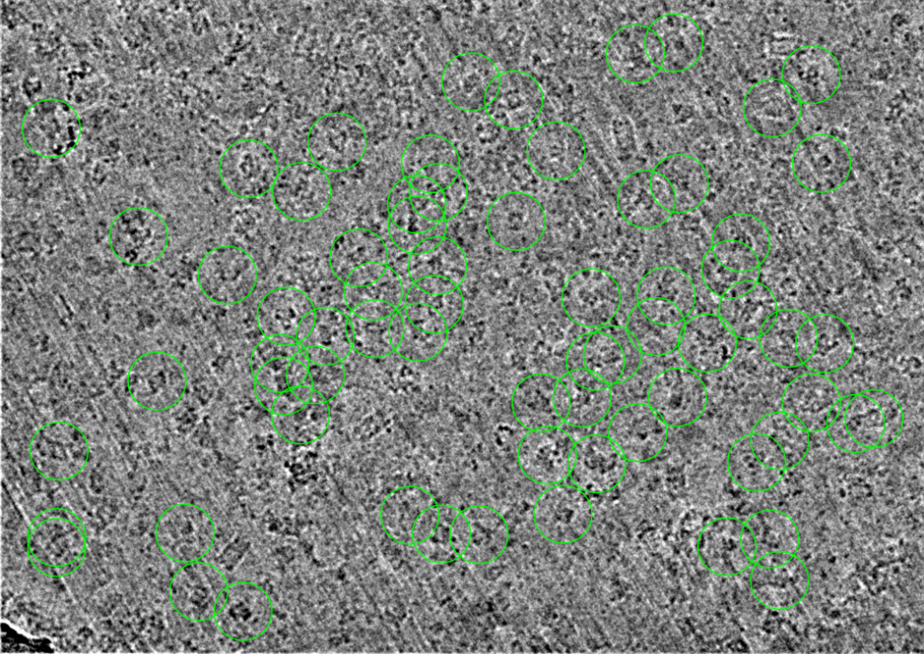
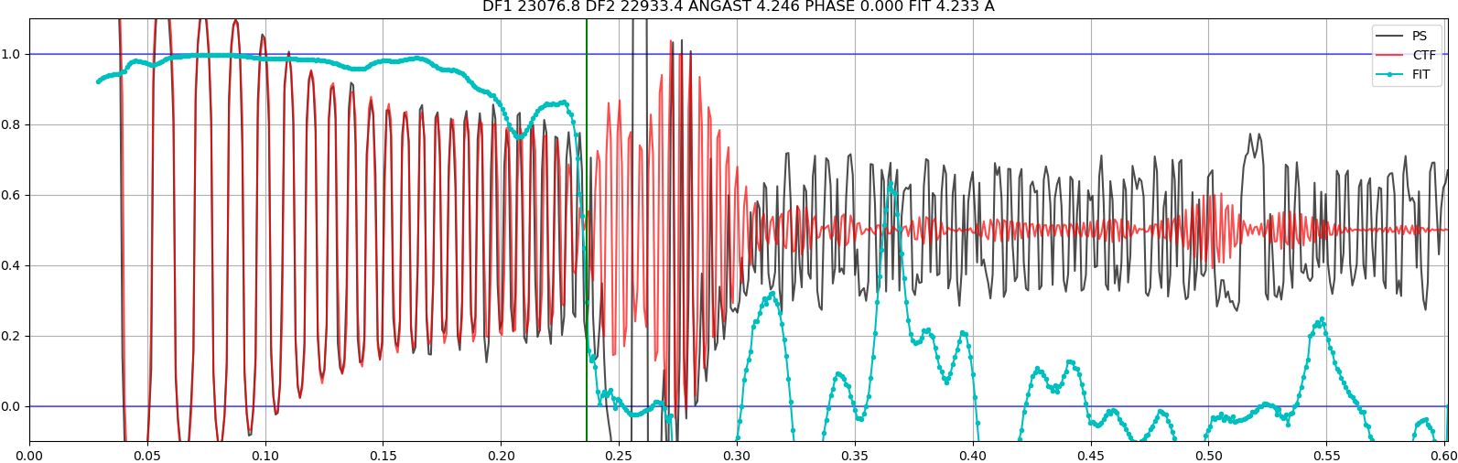
Relative Ice Thickness
(CTF fit resolution: 4.233Å)
Particle picking
Patch CTF
1D FFT

Slide 36
Workflow of single particle analysis using cryoSPARC
Import Dataset
Ab-initio 3D Classification
Movies
Motion corrected
Micrographs
Motion Correction
Heterogeneous Refinement
3D
Pre-
process
CTF Estimation
Homogeneous Refinement
Micrograph Curation
Non-uniform Refinement
or
Particle Picking
Local Refinement
Advanced
3D
or
Particle picking
Particle Curation
3D class, 3D Var, 3D Flex
Particle Extraction
Post-processing & Sharpening
2D
2D Classification
Final Structures

Slide 37
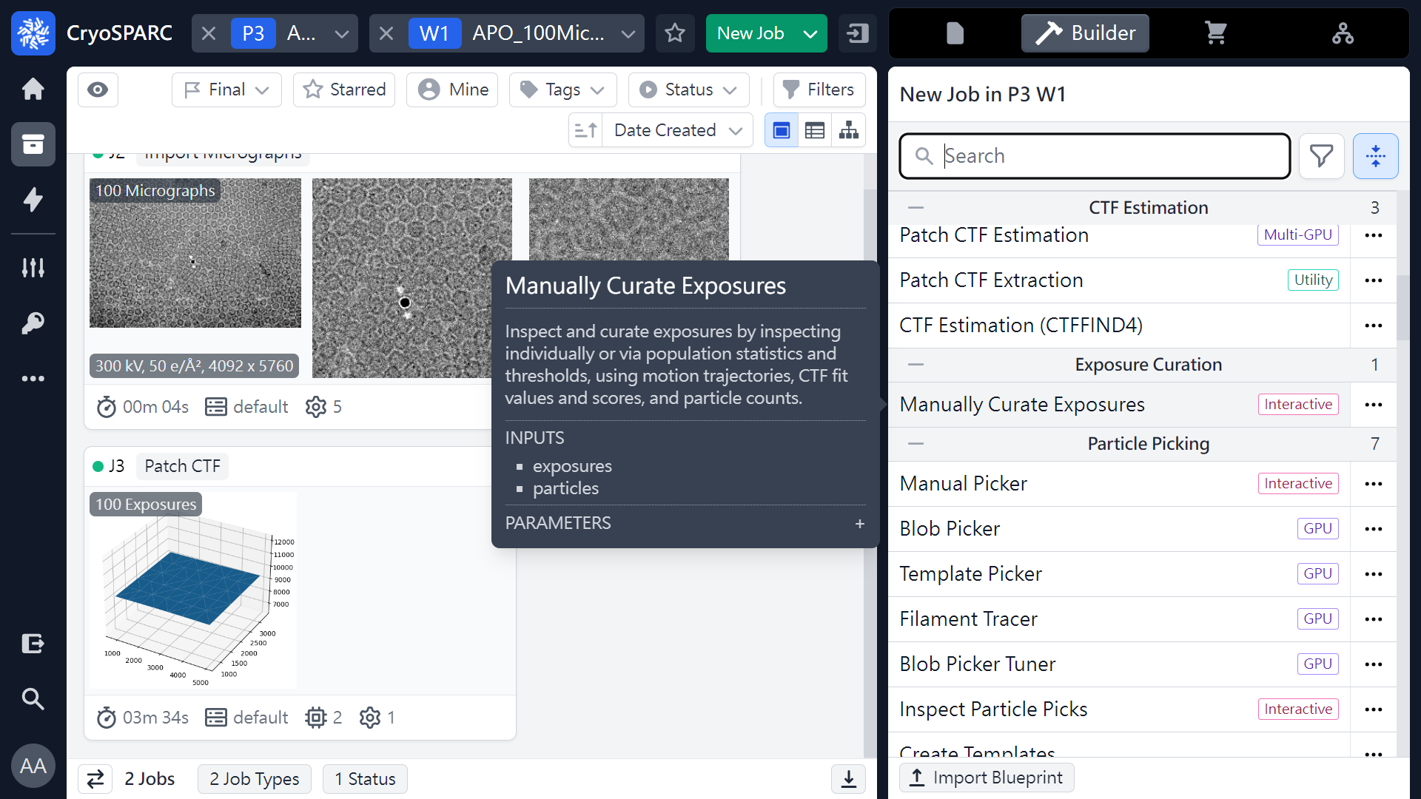
Manually Curate Exposures
 1
 2
(ref: cryoSPARC website. https://cryosparc.com/)

Slide 38
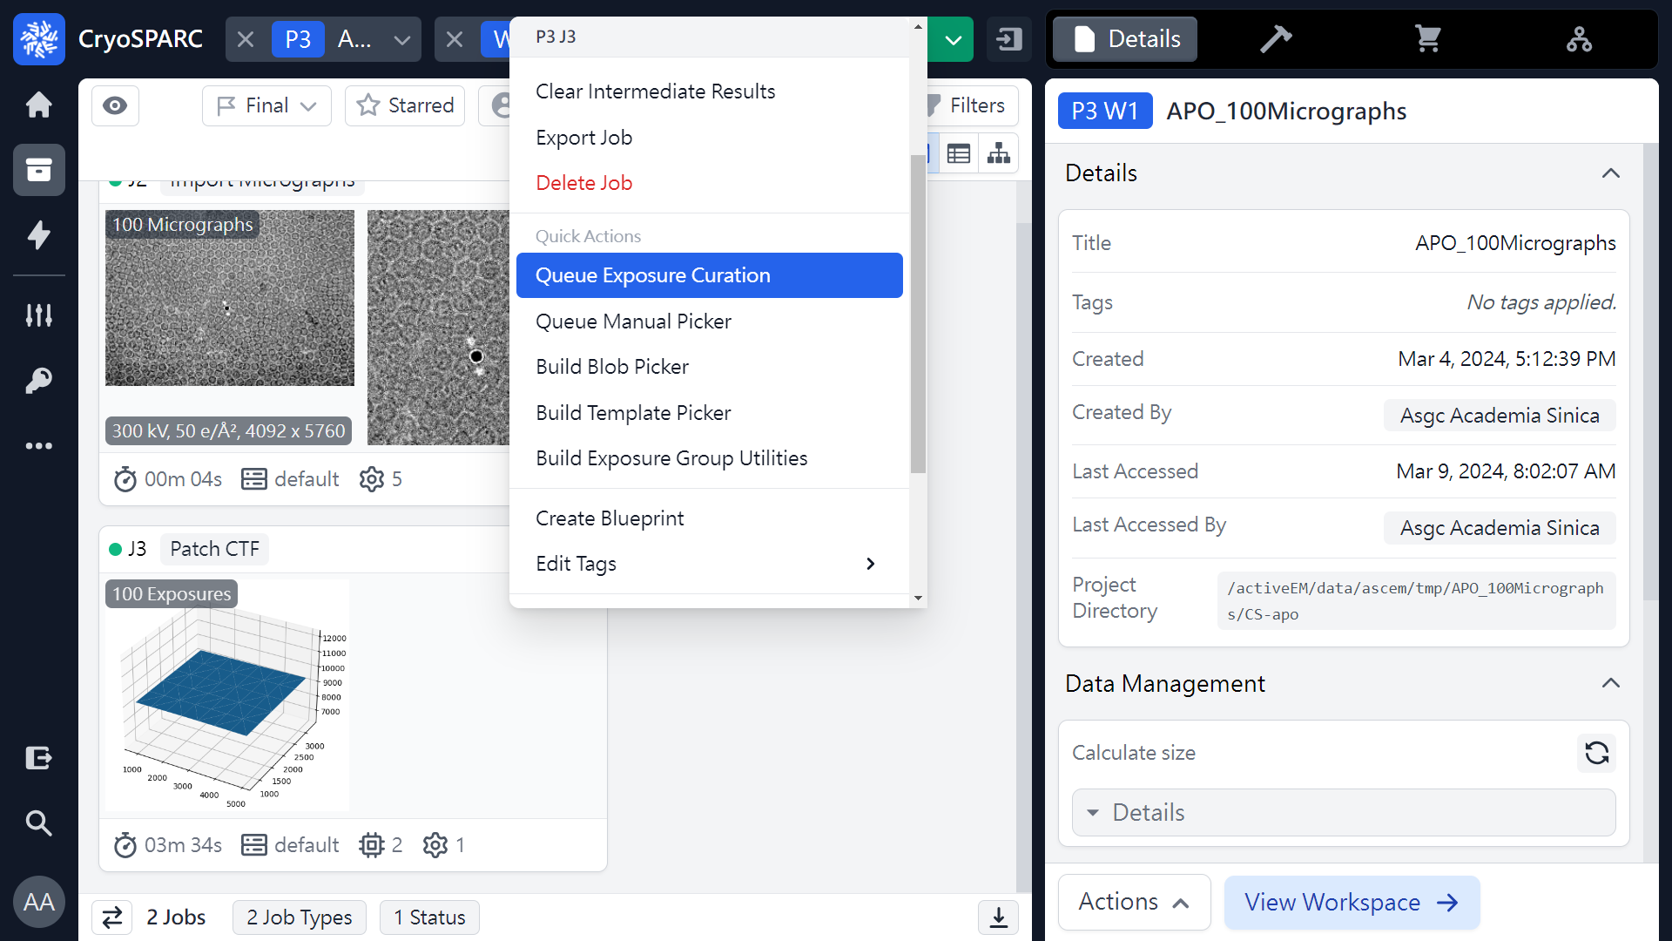
Manually Curate Exposures
 1
(ref: cryoSPARC website. https://cryosparc.com/)

Slide 39

Manually Curate Exposures
 1
(ref: cryoSPARC website. https://cryosparc.com/)

Slide 40

Manually Curate Exposures
Mouse left click
(Hold & Drag)
 1
(ref: cryoSPARC website. https://cryosparc.com/)

Slide 41

Manually Curate Exposures
 1
(ref: cryoSPARC website. https://cryosparc.com/)

Slide 42

Manually Curate Exposures
 2
 1
(ref: cryoSPARC website. https://cryosparc.com/)

Slide 43

Manually Curate Exposures
 1
(ref: cryoSPARC website. https://cryosparc.com/)

Slide 44

Manually Curate Exposures (Thresholds)
 1
Index
 2
(ref: cryoSPARC website. https://cryosparc.com/)

Slide 45

Manually Curate Exposures (Thresholds)
Average defocus (Å)
 1
(ref: cryoSPARC website. https://cryosparc.com/)

Slide 46

Manually Curate Exposures (Thresholds)
Astigmatism (Å)
 1
(ref: cryoSPARC website. https://cryosparc.com/)

Slide 47

Manually Curate Exposures (Thresholds)
CTF fit resolution (Å)
 1
(ref: cryoSPARC website. https://cryosparc.com/)

Slide 48

Manually Curate Exposures (Thresholds)
Relative Ice Thickness
 1
(ref: cryoSPARC website. https://cryosparc.com/)

Slide 49

Manually Curate Exposures (Micrographs)
 1
 2
(ref: cryoSPARC website. https://cryosparc.com/)

Slide 50

Manually Curate Exposures (Diagnostics)
 1
 2
(ref: cryoSPARC website. https://cryosparc.com/)

Slide 51

Manually Curate Exposures (Diagnostics)
 1
(ref: cryoSPARC website. https://cryosparc.com/)

Slide 52

Manually Curate Exposures (Diagnostics)
Sort by DF Avg
 1
 2
(ref: cryoSPARC website. https://cryosparc.com/)

Slide 53

Manually Curate Exposures (Select Thresholds)
 1
 2
Average defocus (Å)
(ref: cryoSPARC website. https://cryosparc.com/)

Slide 54

Manually Curate Exposures (Select Thresholds)
CTF fit resolution (Å)
 1
(ref: cryoSPARC website. https://cryosparc.com/)

Slide 55

Manually Curate Exposures (Select Thresholds)
CTF fit resolution (Å)
 1
5 or 7 …
 2
(ref: cryoSPARC website. https://cryosparc.com/)

Slide 56

Manually Curate Exposures (Select Thresholds)
Accepted: 96, Rejected: 4
CTF fit resolution (Å)
5
(ref: cryoSPARC website. https://cryosparc.com/)

Slide 57

Manually Curate Exposures (Select Thresholds)
Relative Ice Thickness
 1
1.04 …
 2
(ref: cryoSPARC website. https://cryosparc.com/)

Slide 58

Manually Curate Exposures (Select Thresholds)
 1
Accepted: 94, Rejected: 6
Relative Ice Thickness
1.04
(ref: cryoSPARC website. https://cryosparc.com/)

Slide 59

Manually Curate Exposures (Results)
Average defocus: 7918.461 Å (~ -0.792 um)
94
6
(ref: cryoSPARC website. https://cryosparc.com/)

Slide 60

Manually Curate Exposures (Results)
Average astigmatism: 405.410Å
(ref: cryoSPARC website. https://cryosparc.com/)

Slide 61

Manually Curate Exposures (Results)
Average CTF fit resolution: 3.825Å
(ref: cryoSPARC website. https://cryosparc.com/)

Slide 62
Workflow of single particle analysis using cryoSPARC
Import Dataset
Ab-initio 3D Classification
Movies
Motion corrected
Micrographs
Motion Correction
Heterogeneous Refinement
3D
Pre-
process
CTF Estimation
Homogeneous Refinement
Micrograph Curation
Non-uniform Refinement
or
Particle Picking
Local Refinement
Advanced
3D
or
Particle picking
Particle Curation
3D class, 3D Var, 3D Flex
Particle Extraction
Post-processing & Sharpening
2D
2D Classification
Final Structures

Slide 63
Thank you !

