Slide 1

CryoSPARC
02-Particle_picking
Dr. Chun-Hsiung Wang
王俊雄
2026/03/16

Slide 2
Workflow of single particle analysis using cryoSPARC
Import Dataset
Ab-initio 3D Classification
Movies
Motion corrected
Micrographs
Motion Correction
Heterogeneous Refinement
3D
Pre-
process
CTF Estimation
Homogeneous Refinement
Micrograph Curation
Non-uniform Refinement
or
Particle Picking
Local Refinement
Advanced
3D
or
Particle picking
Particle Curation
3D class, 3D Var, 3D Flex
Particle Extraction
Post-processing & Sharpening
2D
2D Classification
Final Structures

Slide 3





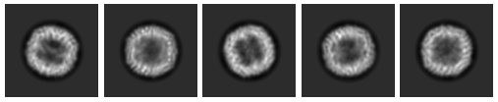
Particle Picking
Manual picking
(Coordinates & Particles)
Blob picking
(Coordinates)
Template picking
(Coordinates)
Particle Curation
(Coordinates)
Particle Curation
(Coordinates)
Particle Extraction
(Particles)
Particle Extraction
(Particles)
2D Classification
2D Classification
2D Classification
(2D Templates)
3D reconstruction

Slide 4
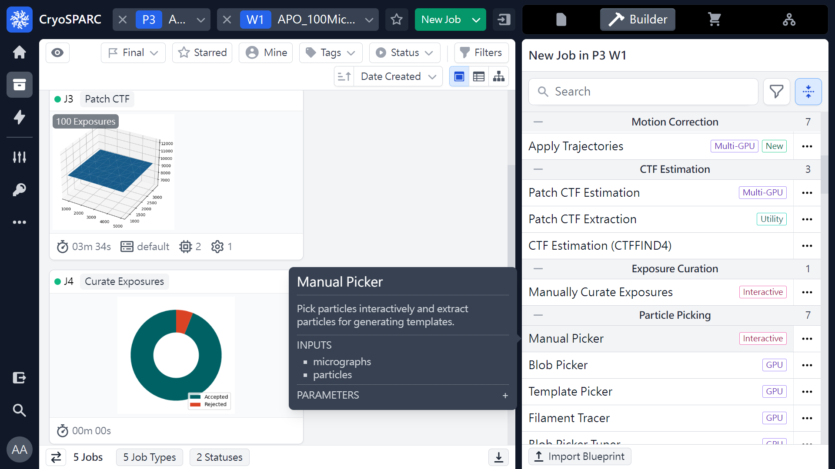
Manually Picker
 1
 2
(ref: cryoSPARC website. https://cryosparc.com/)

Slide 5
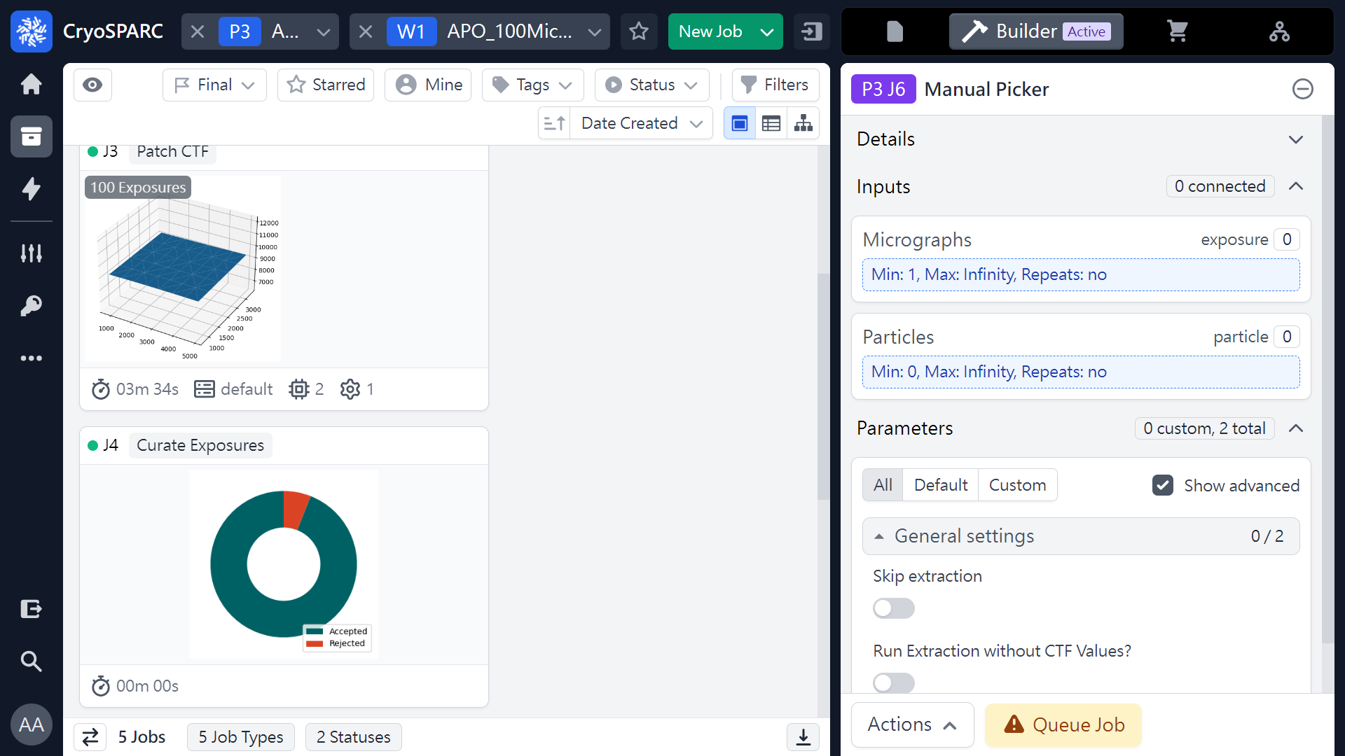
Manually Picker
or 
 1
(ref: cryoSPARC website. https://cryosparc.com/)

Slide 6
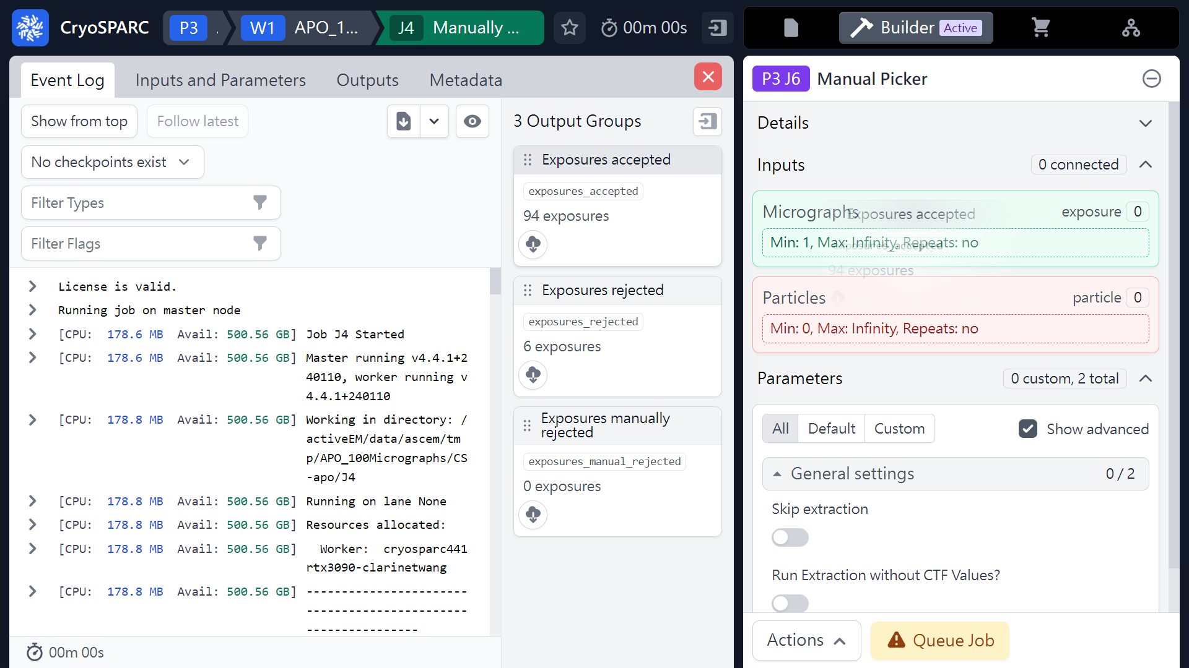
Manually Picker
(From curate exposures)
Mouse left click
(Hold & Drag)
 1
(ref: cryoSPARC website. https://cryosparc.com/)

Slide 7
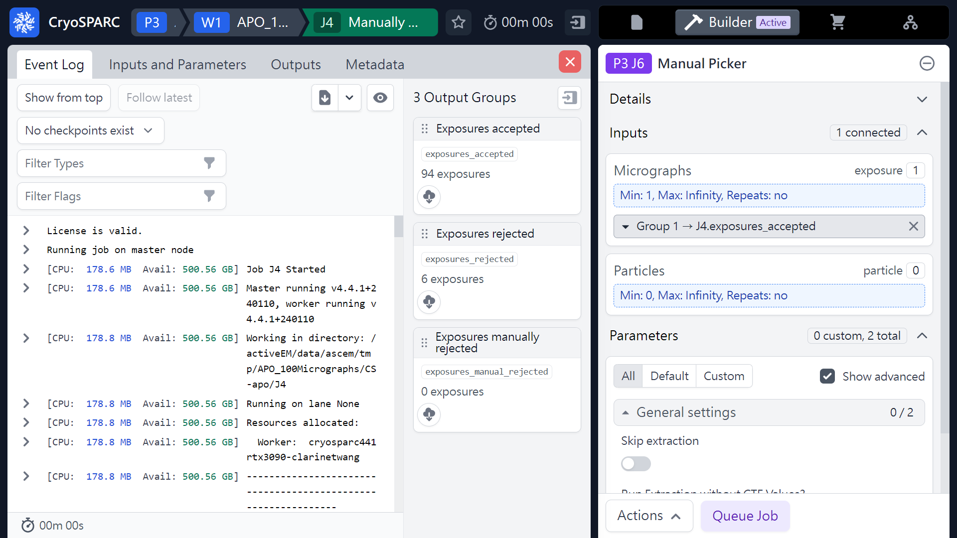
Manually Picker
(From curate exposures)
 1
(ref: cryoSPARC website. https://cryosparc.com/)

Slide 8
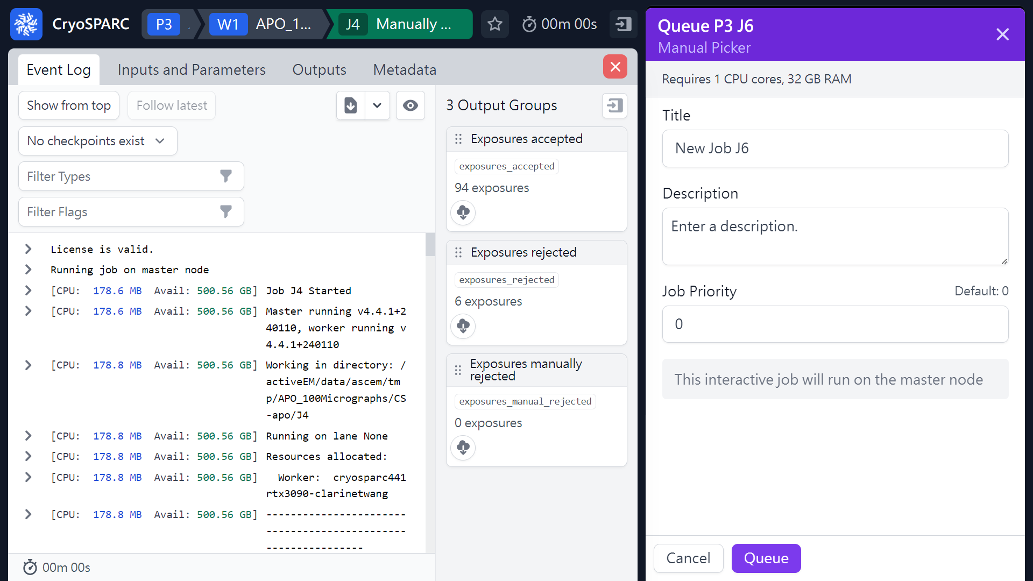
Manually Picker
(From curate exposures)
 2
 1
(ref: cryoSPARC website. https://cryosparc.com/)

Slide 9
Manually Picker
(From Patch CTF)
 1
or 
(ref: cryoSPARC website. https://cryosparc.com/)

Slide 10
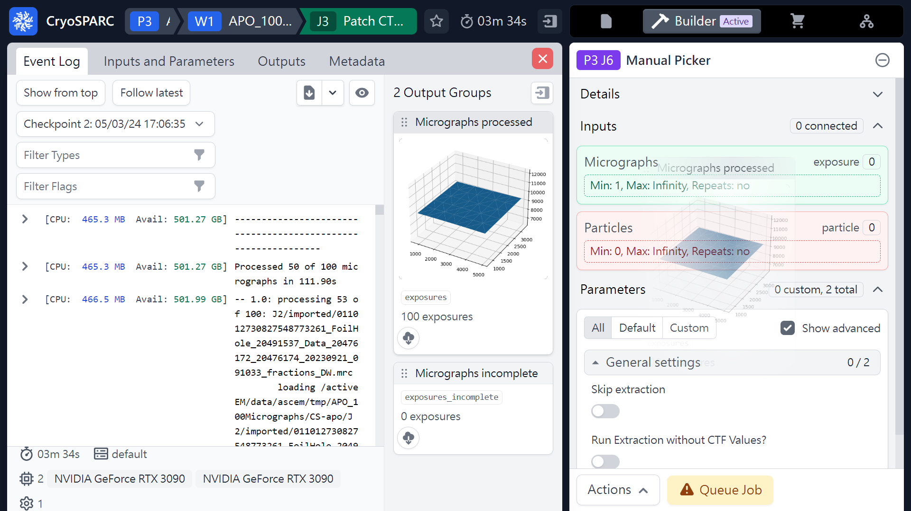
Manually Picker
(From Patch CTF)
Mouse left click
(Hold & Drag)
 1
(ref: cryoSPARC website. https://cryosparc.com/)

Slide 11
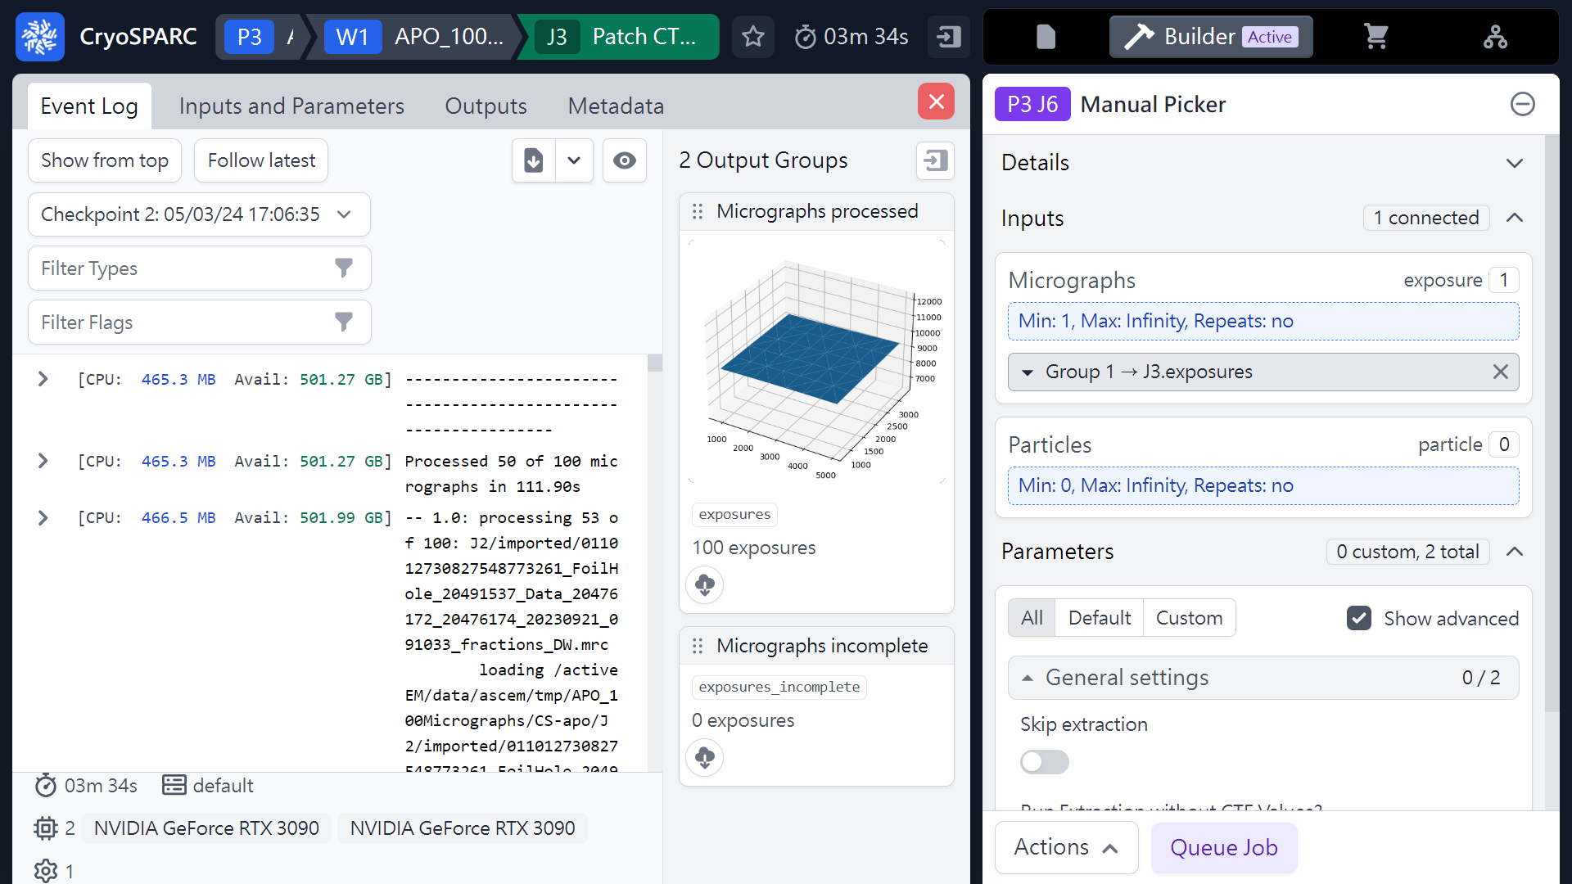
Manually Picker
(From Patch CTF)
 1
(ref: cryoSPARC website. https://cryosparc.com/)

Slide 12
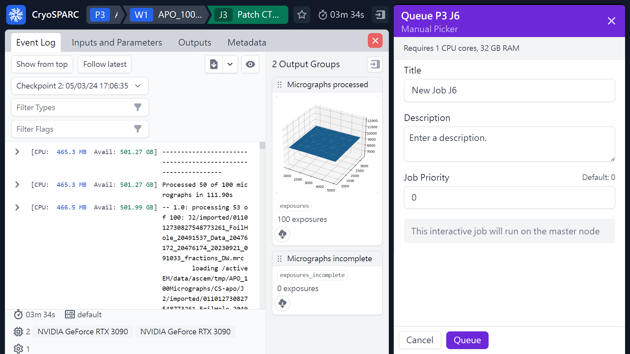
Manually Picker
(From Patch CTF)
 2
 1
(ref: cryoSPARC website. https://cryosparc.com/)

Slide 13
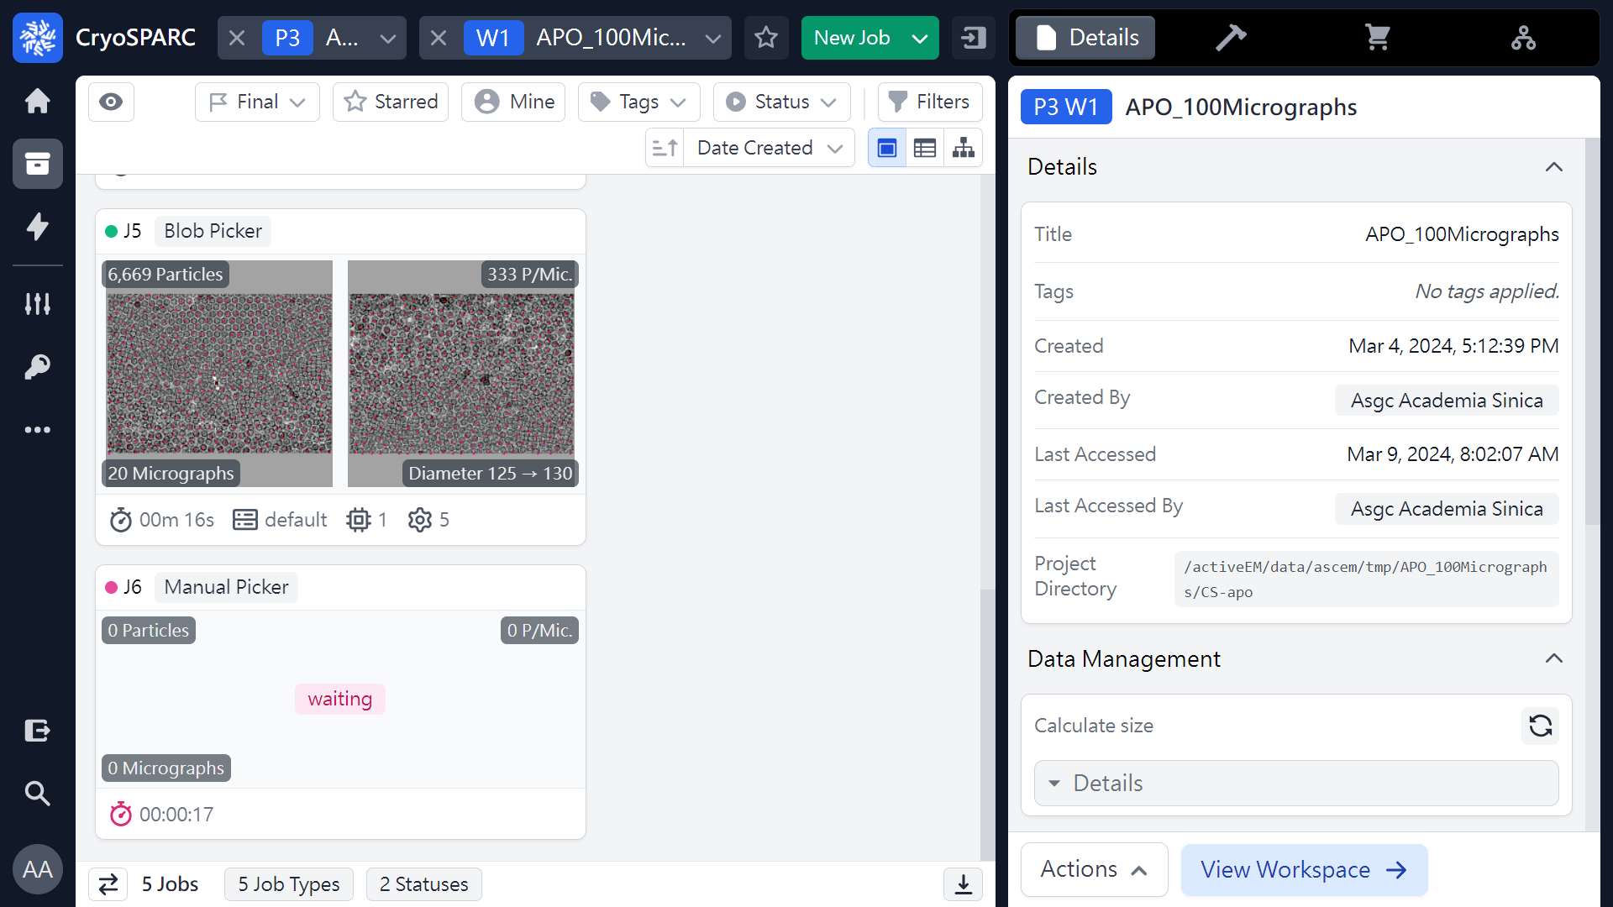
Manually Picker
(Pick Coordinates & Extract Particles)
 1
(ref: cryoSPARC website. https://cryosparc.com/)

Slide 14
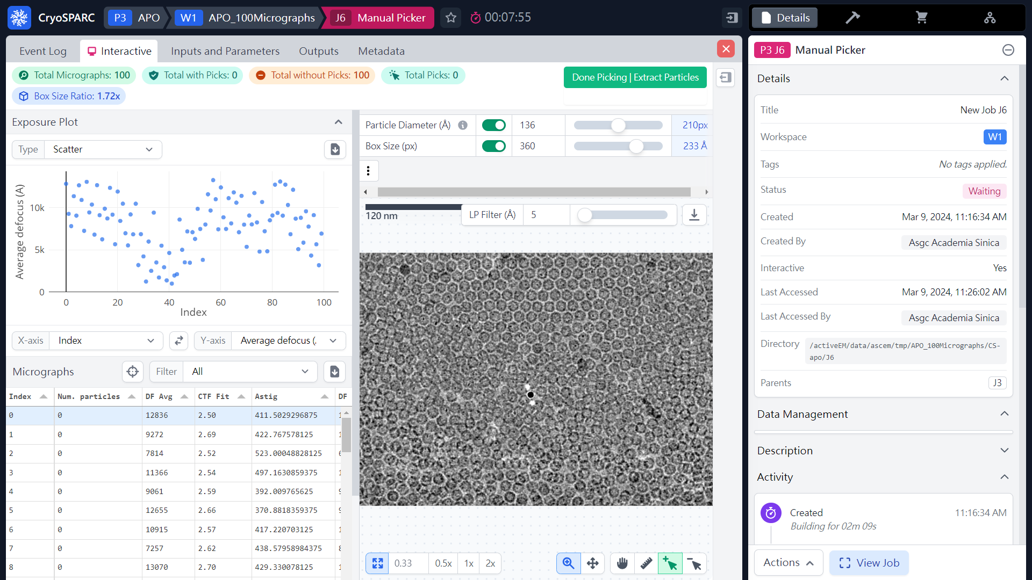
Manually Picker
(Pick Coordinates & Extract Particles)
Mouse scrolling to
zoom in and out
 1
 2
(ref: cryoSPARC website. https://cryosparc.com/)

Slide 15
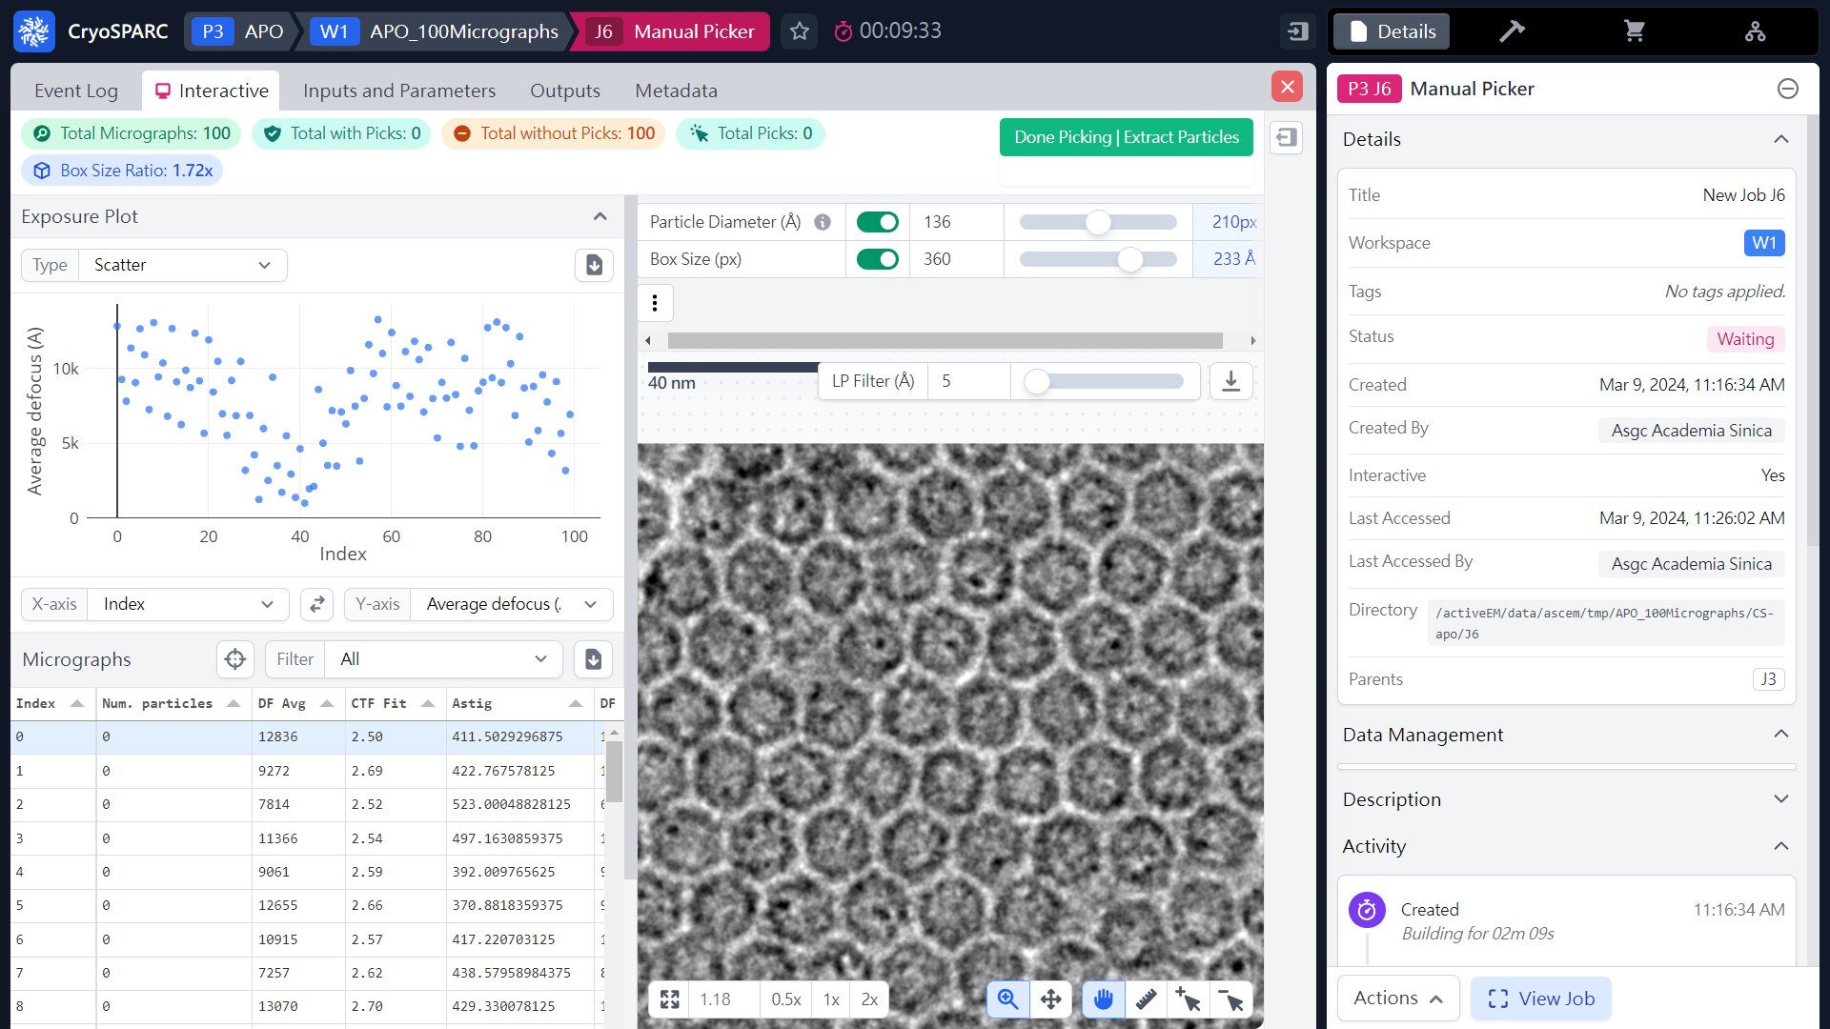
Manually Picker
(Pick Coordinates & Extract Particles)
 1
(ref: cryoSPARC website. https://cryosparc.com/)

Slide 16
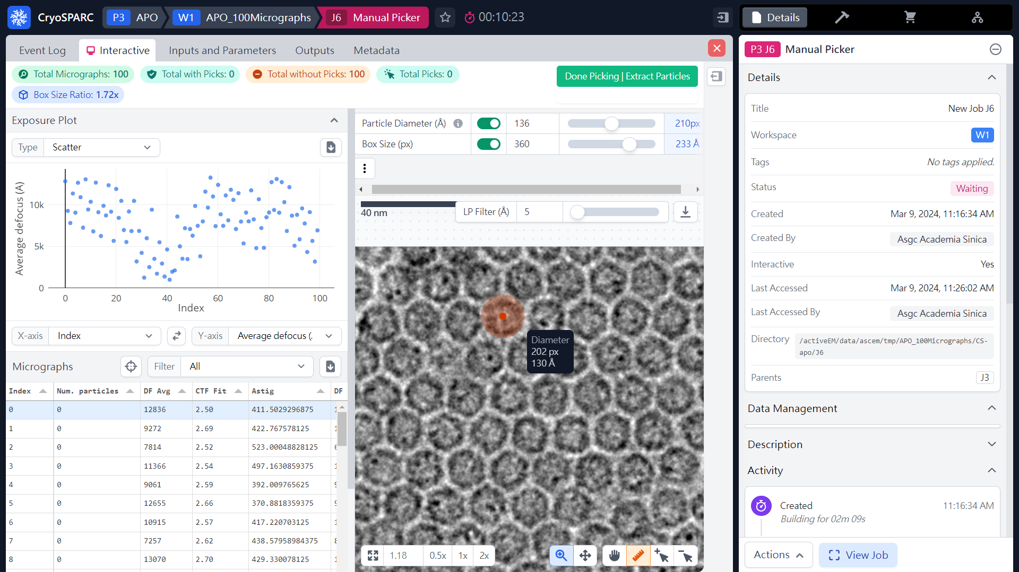
Manually Picker
(Pick Coordinates & Extract Particles)
 2
Mouse Left click and drag
 1
(ref: cryoSPARC website. https://cryosparc.com/)

Slide 17
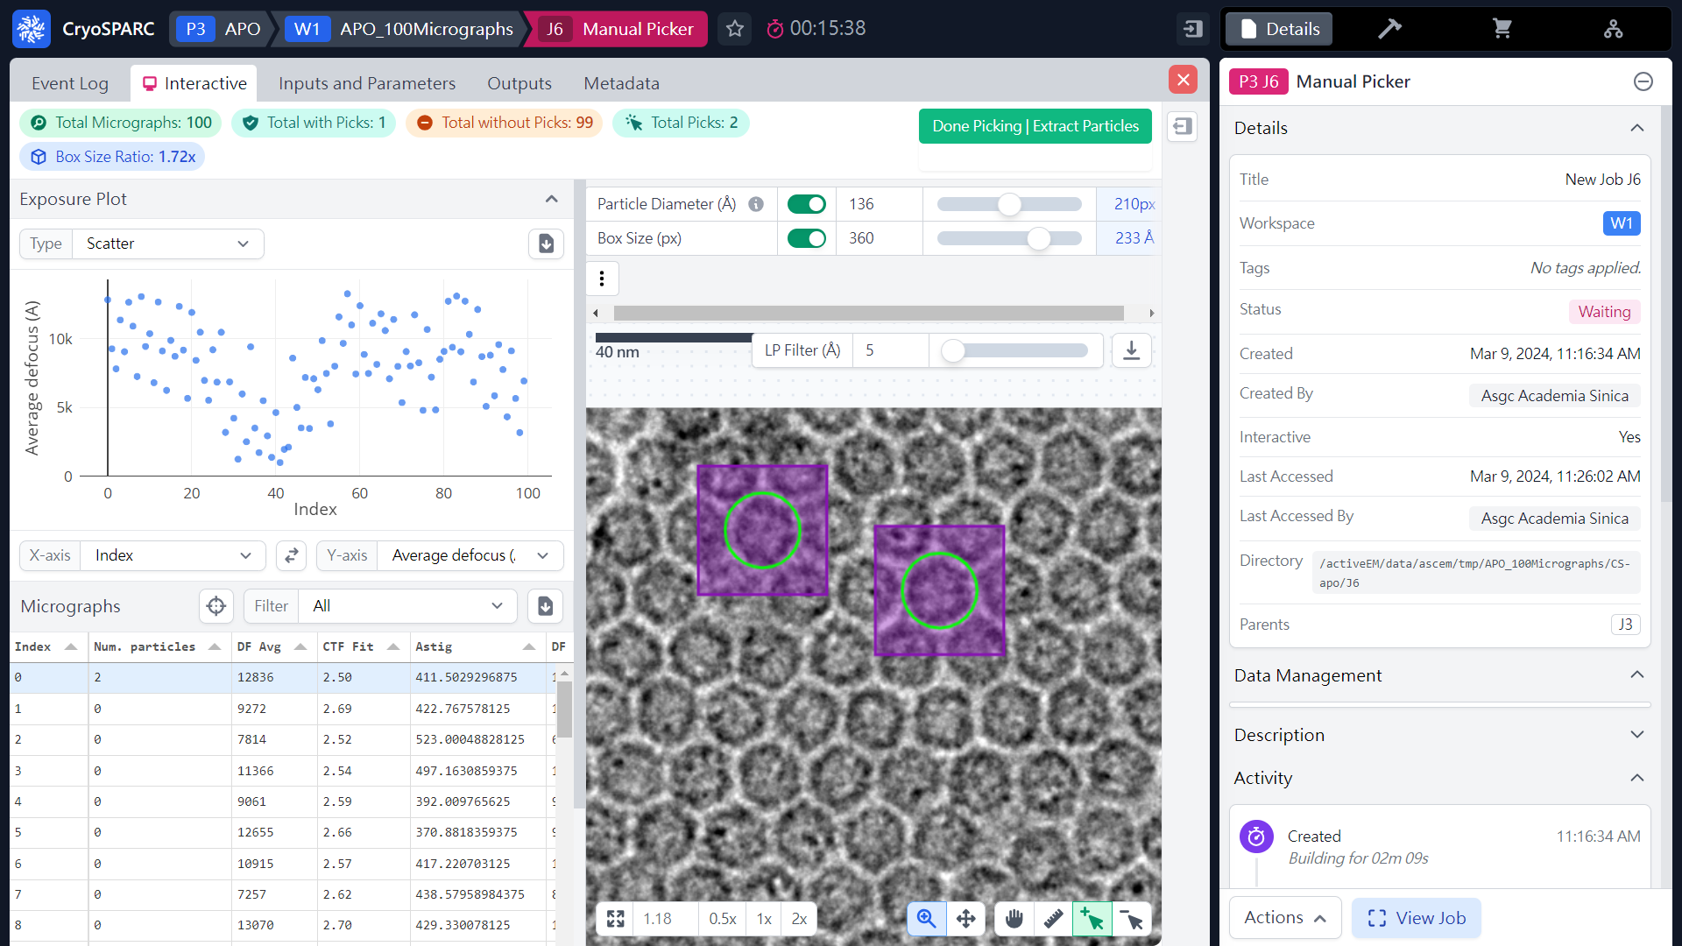
Manually Picker
(Pick Coordinates & Extract Particles)
 2
 4
 3
 1
(ref: cryoSPARC website. https://cryosparc.com/)

Slide 18
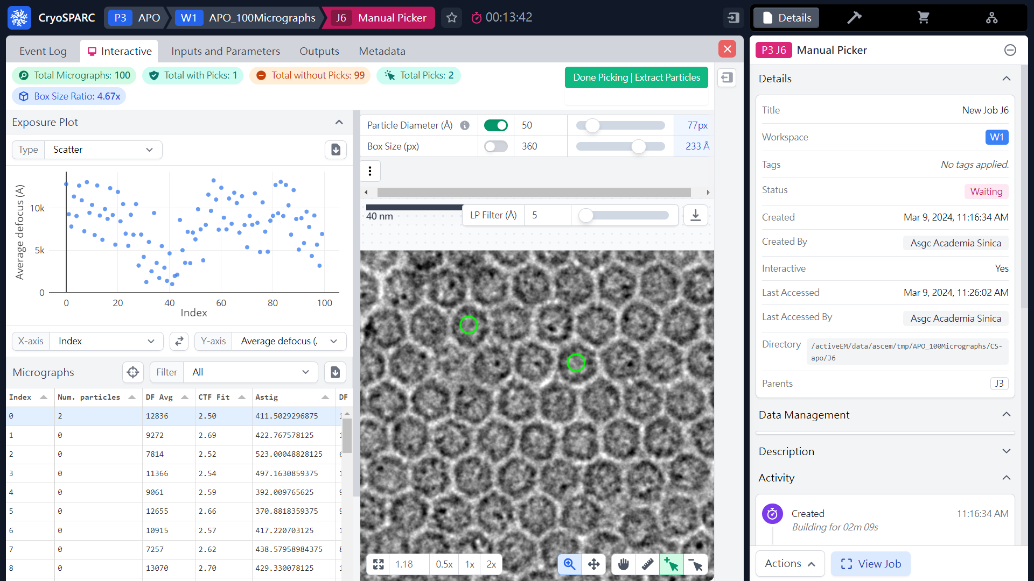
Manually Picker
(Pick Coordinates & Extract Particles)
 1
(ref: cryoSPARC website. https://cryosparc.com/)

Slide 19

Manually Picker
(Pick Coordinates & Extract Particles)
 2
 1
(ref: cryoSPARC website. https://cryosparc.com/)

Slide 20
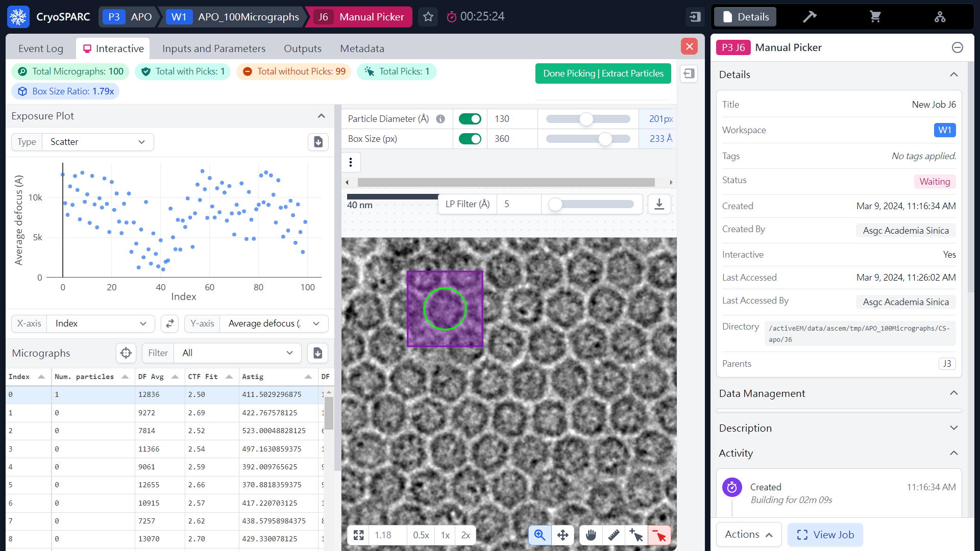
Manually Picker
(Pick Coordinates & Extract Particles)
(ref: cryoSPARC website. https://cryosparc.com/)

Slide 21
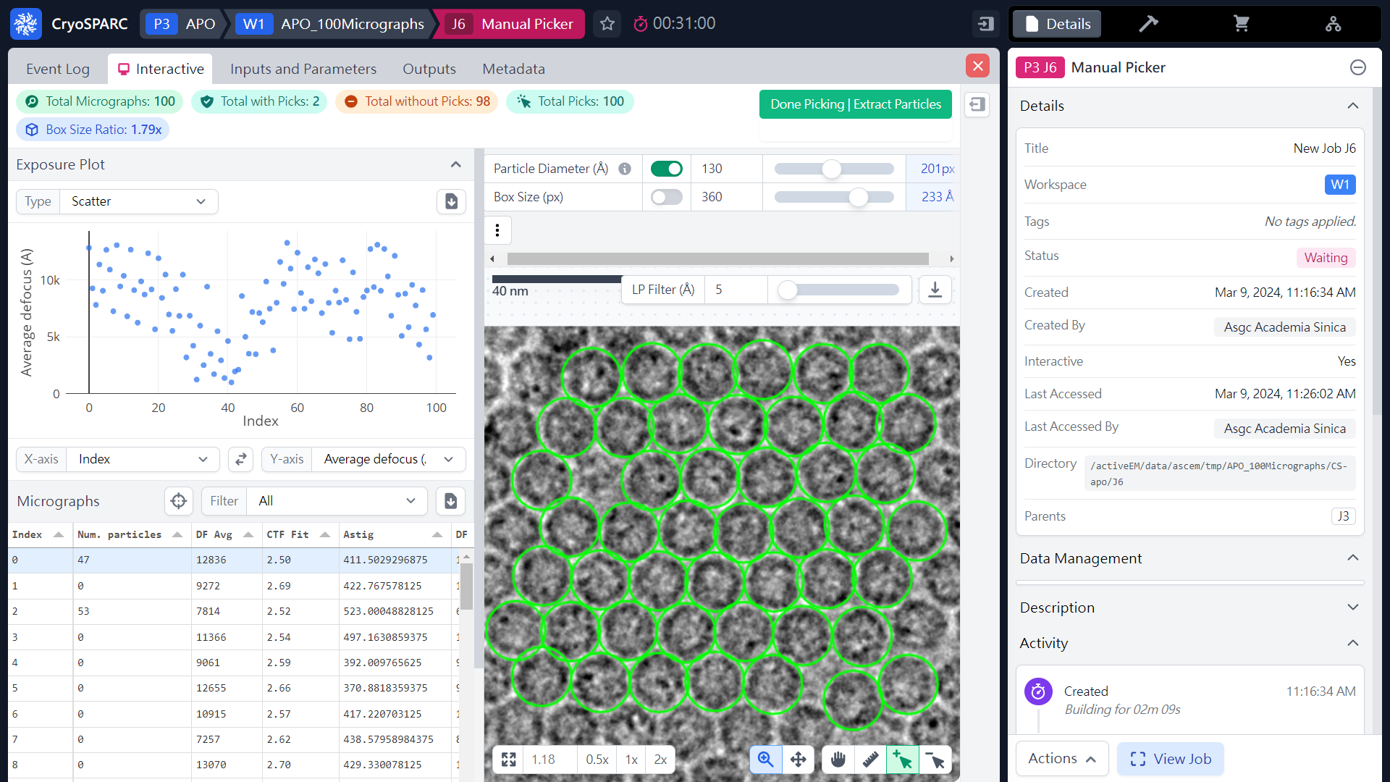
Manually Picker
(Pick Coordinates & Extract Particles)
 3
 4
 1
 2
(ref: cryoSPARC website. https://cryosparc.com/)

Slide 22
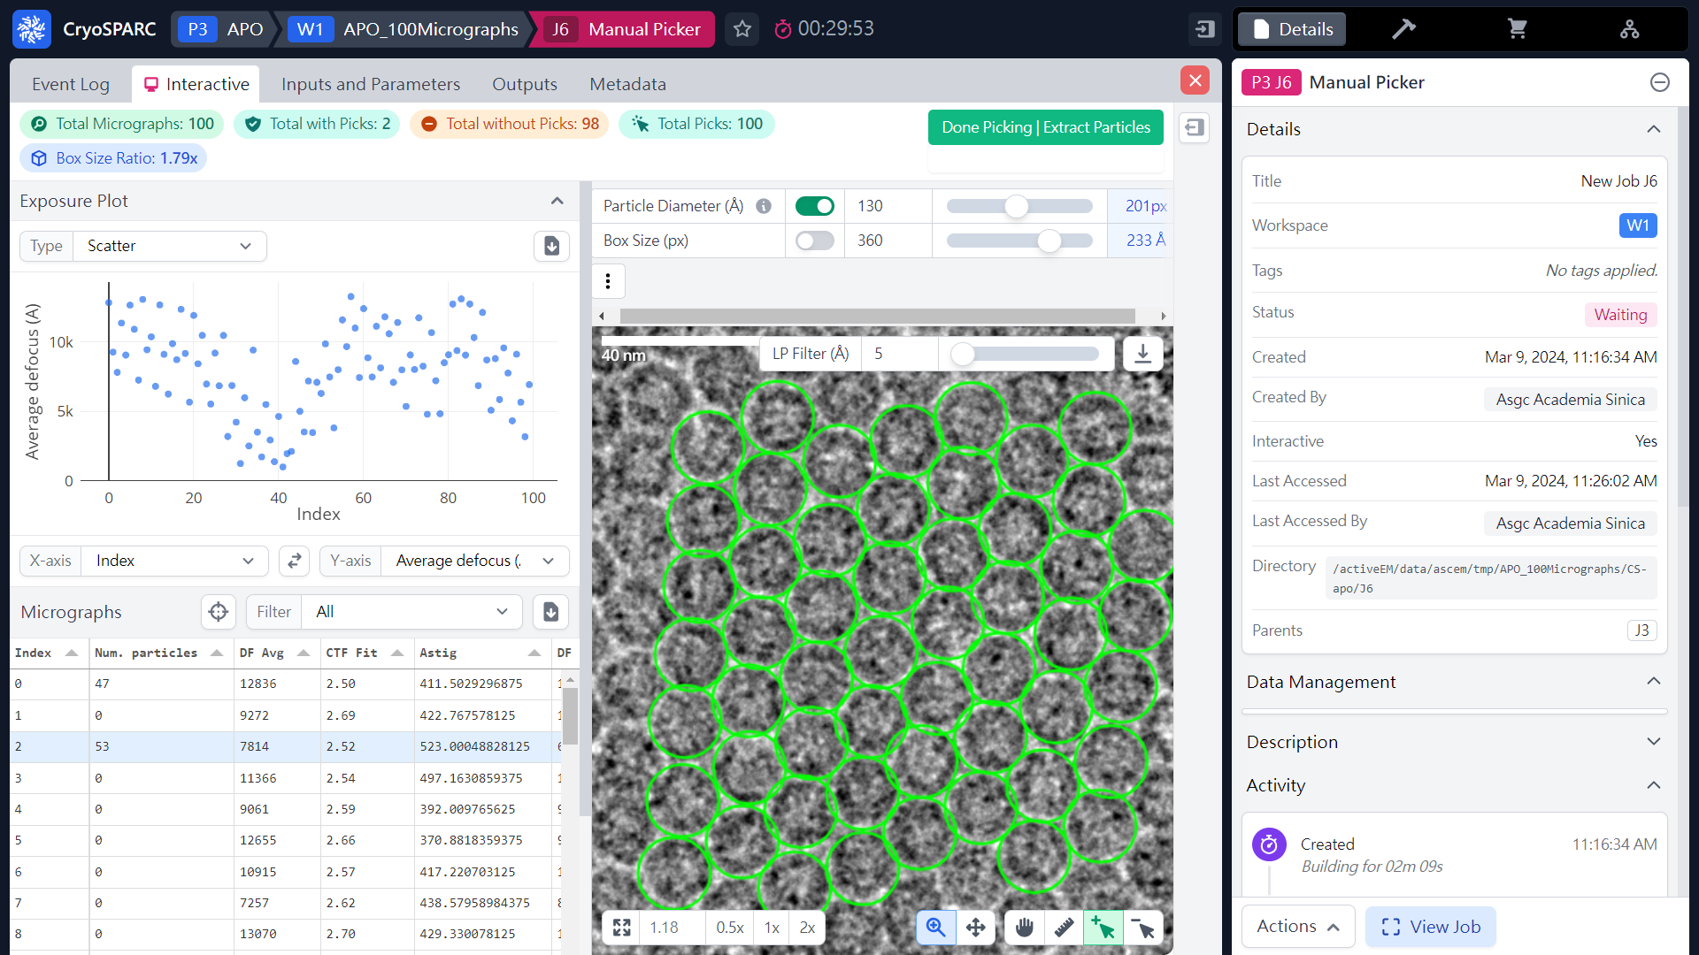
Manually Picker
(Pick Coordinates & Extract Particles)
100 particles
 3
 2
 1
(ref: cryoSPARC website. https://cryosparc.com/)

Slide 23
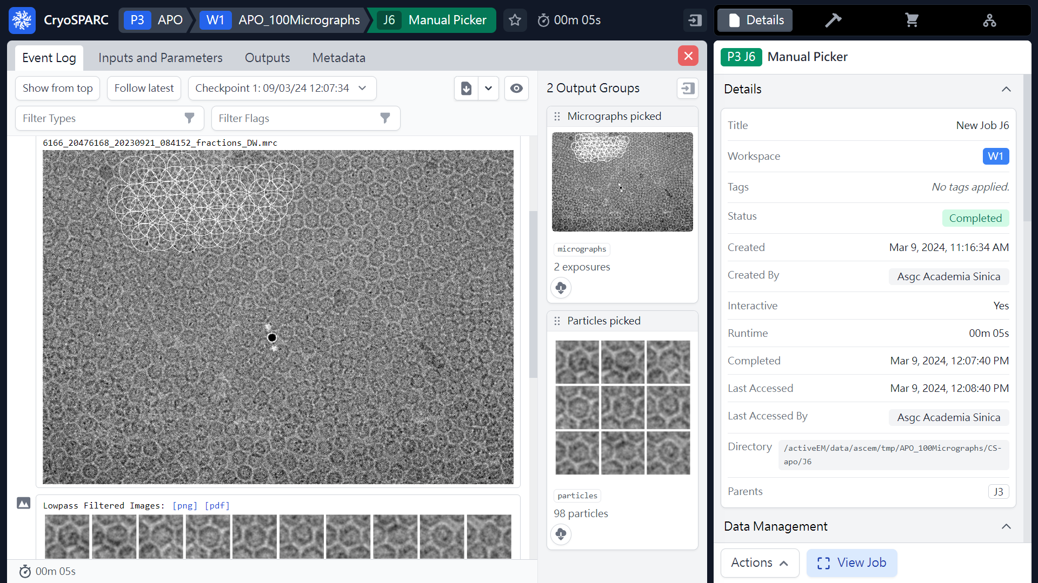
Manually Picker
(Pick Coordinates & Extract Particles)
98 particles
(ref: cryoSPARC website. https://cryosparc.com/)

Slide 24
Particle Picking
Manual picking
(Coordinates & Particles)
Blob picking
(Coordinates)
Template picking
(Coordinates)
Particle Curation
(Coordinates)
Particle Curation
(Coordinates)
Particle Extraction
(Particles)
Particle Extraction
(Particles)
2D Classification
2D Classification
2D Classification
(2D Templates)
3D reconstruction

Slide 25
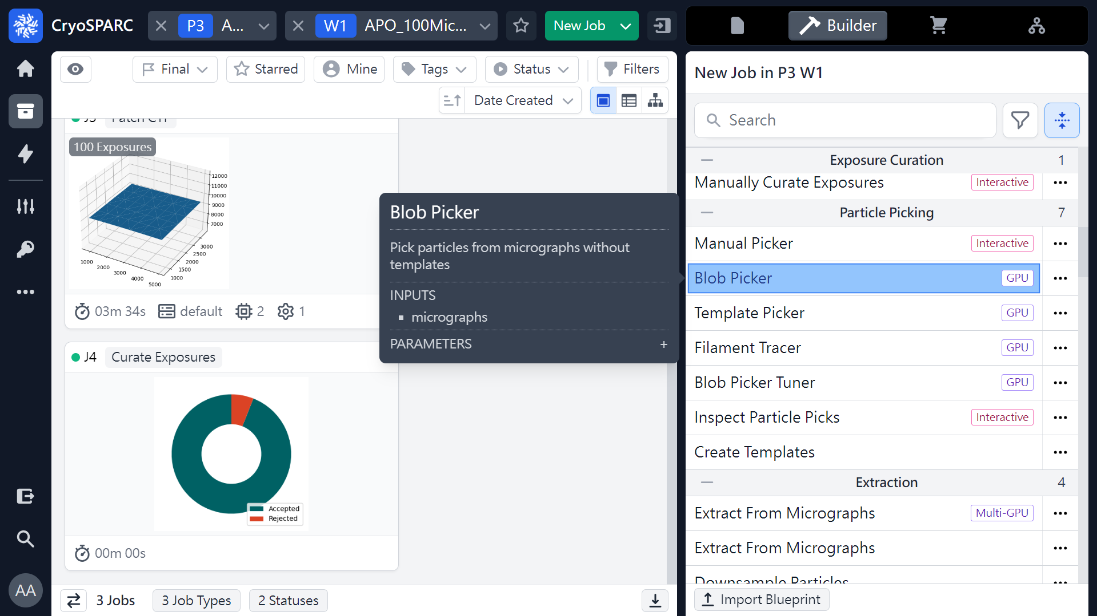
Blob Picker
(Pick Coordinates)
 1
(ref: cryoSPARC website. https://cryosparc.com/)

Slide 26
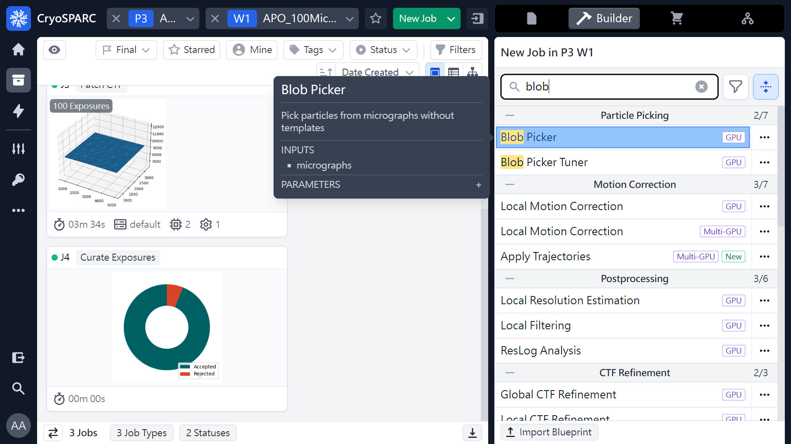
Blob Picker
(Pick Coordinates)
 1
 2
(ref: cryoSPARC website. https://cryosparc.com/)

Slide 27
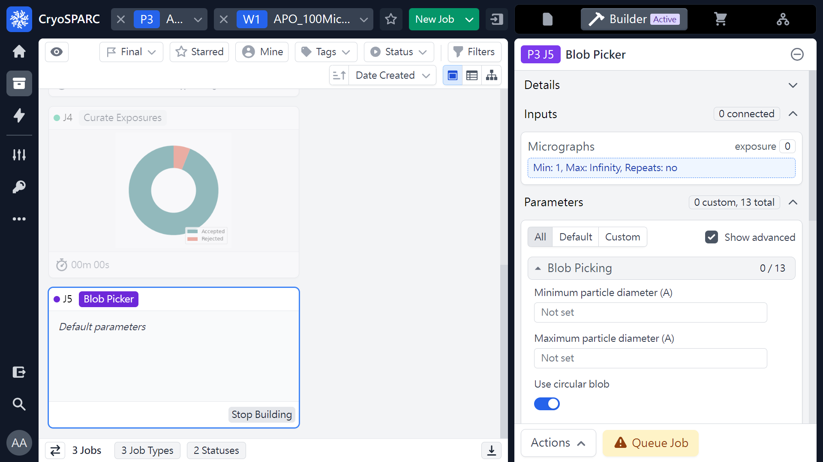
Blob Picker
(Pick Coordinates)
 1
(ref: cryoSPARC website. https://cryosparc.com/)

Slide 28
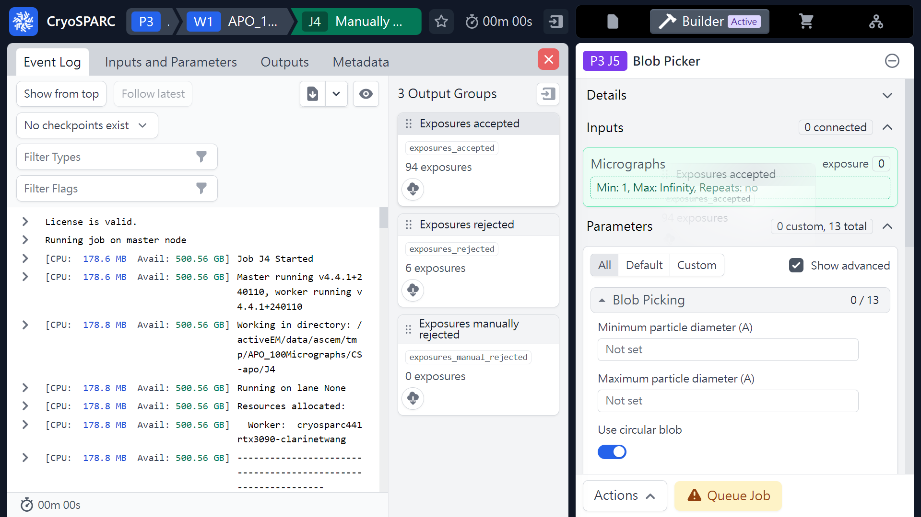
Blob Picker
(Pick Coordinates)
Mouse left click
(Hold & Drag)
 1
(ref: cryoSPARC website. https://cryosparc.com/)

Slide 29
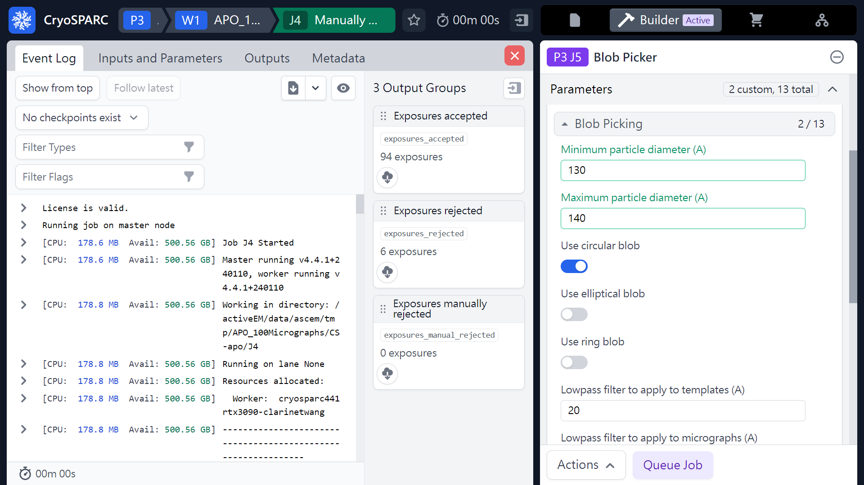

Blob Picker
(Pick Coordinates)
 1
(ref: cryoSPARC website. https://cryosparc.com/)

Slide 30
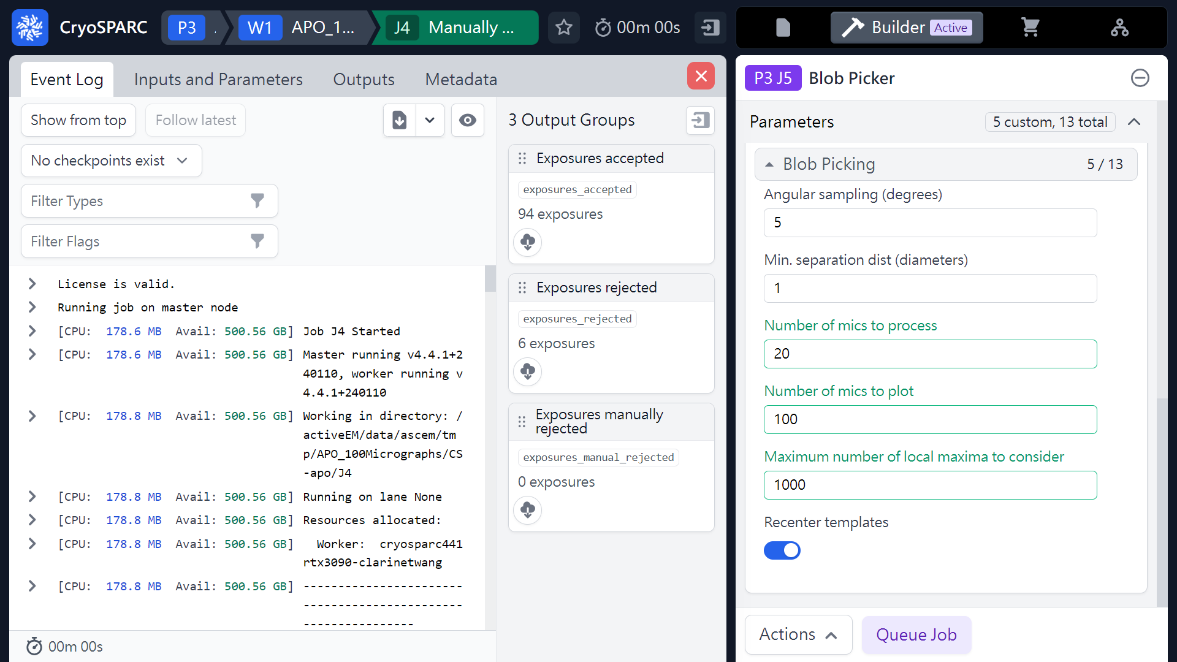
Blob Picker
(Pick Coordinates)
 1
(ref: cryoSPARC website. https://cryosparc.com/)

Slide 31
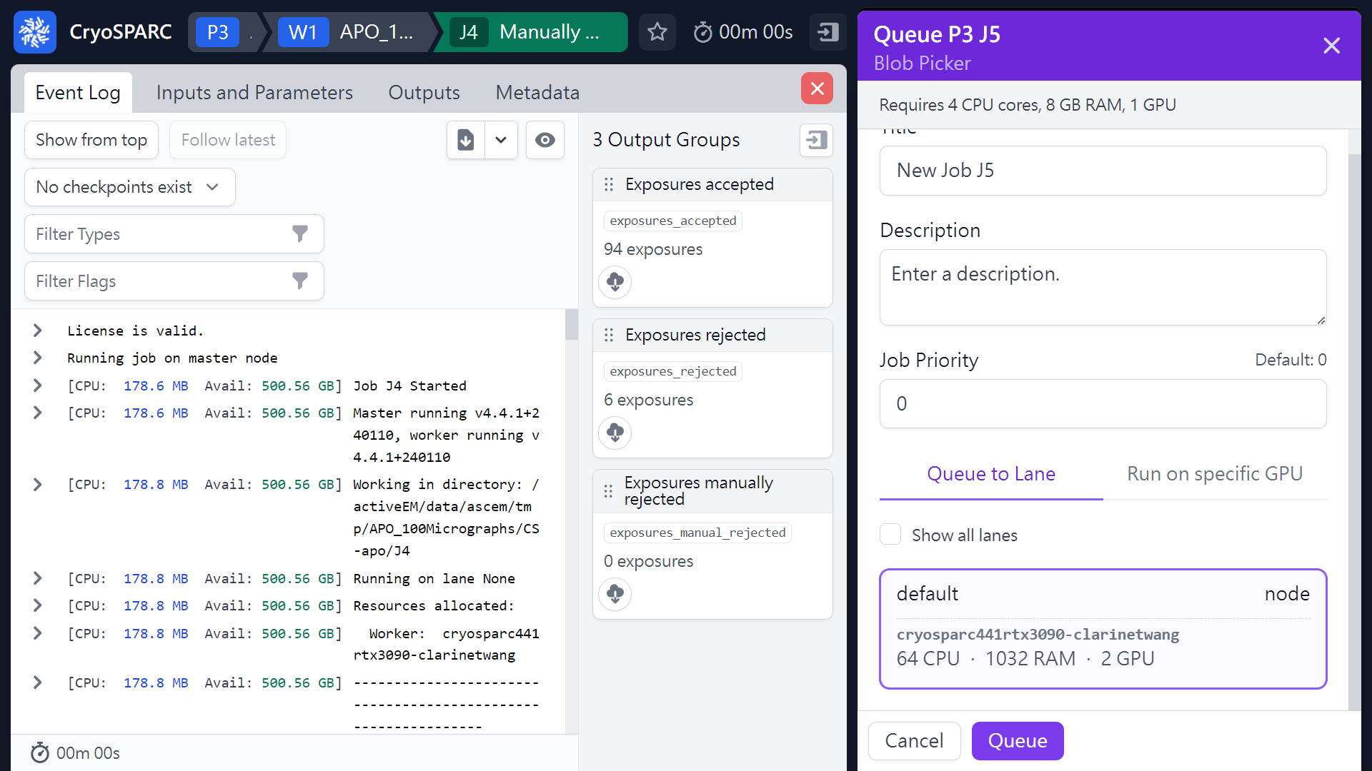
Blob Picker
(Pick Coordinates)
 1
(ref: cryoSPARC website. https://cryosparc.com/)

Slide 32
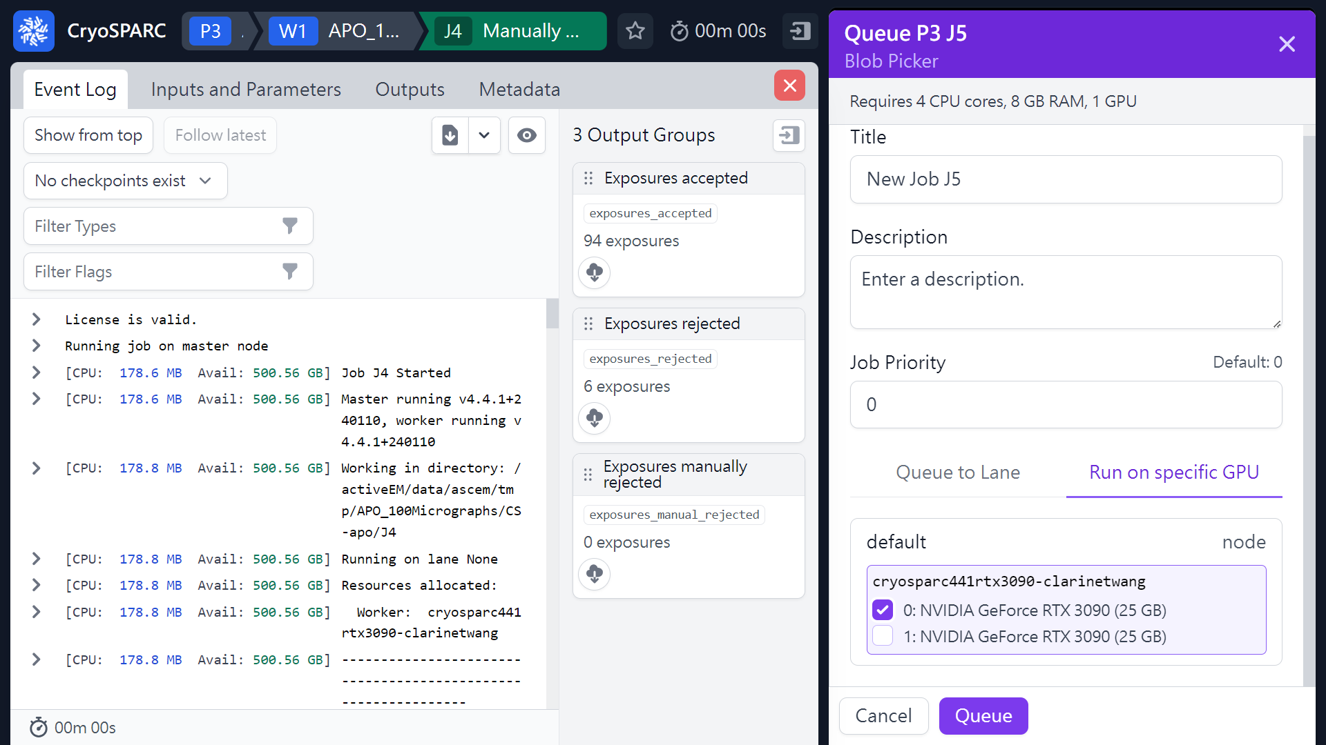
Blob Picker
(Pick Coordinates)
 4
 1
 2
 3
(ref: cryoSPARC website. https://cryosparc.com/)

Slide 33
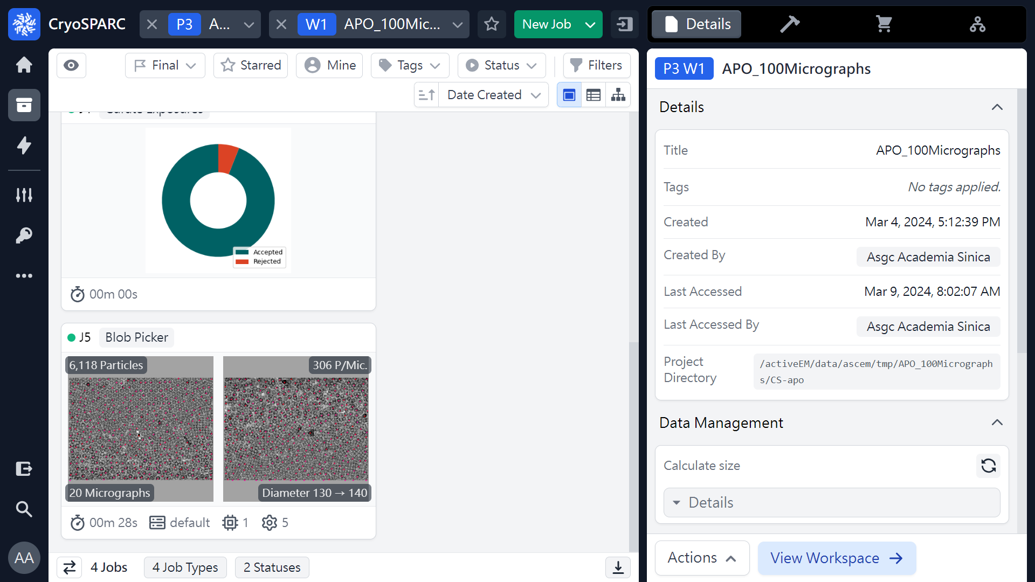
Blob Picker
(Pick Coordinates)
 1
(ref: cryoSPARC website. https://cryosparc.com/)

Slide 34
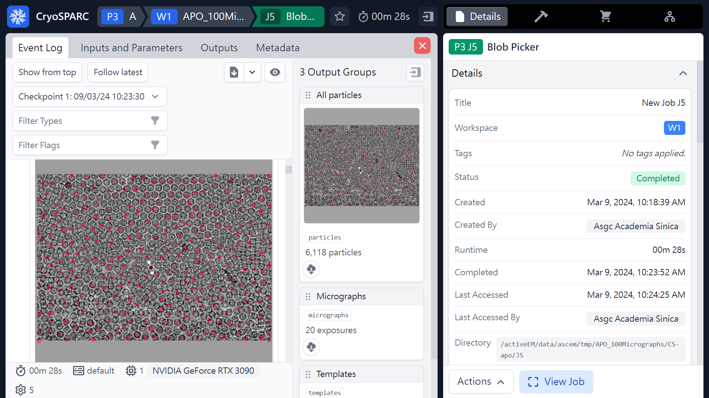
Blob Picker
(Pick Coordinates)
 1
(ref: cryoSPARC website. https://cryosparc.com/)

Slide 35
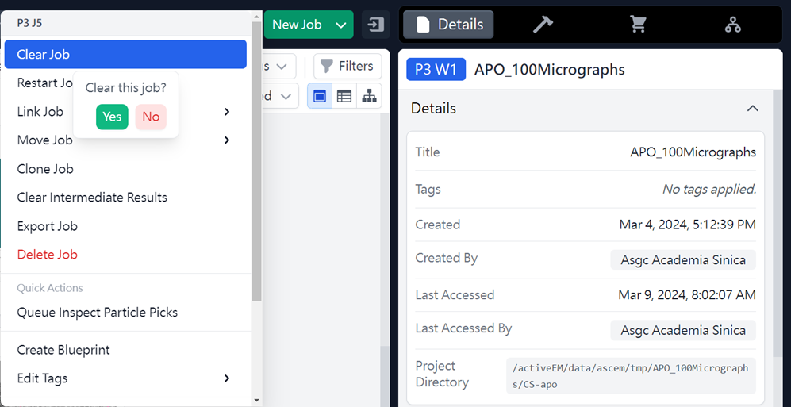
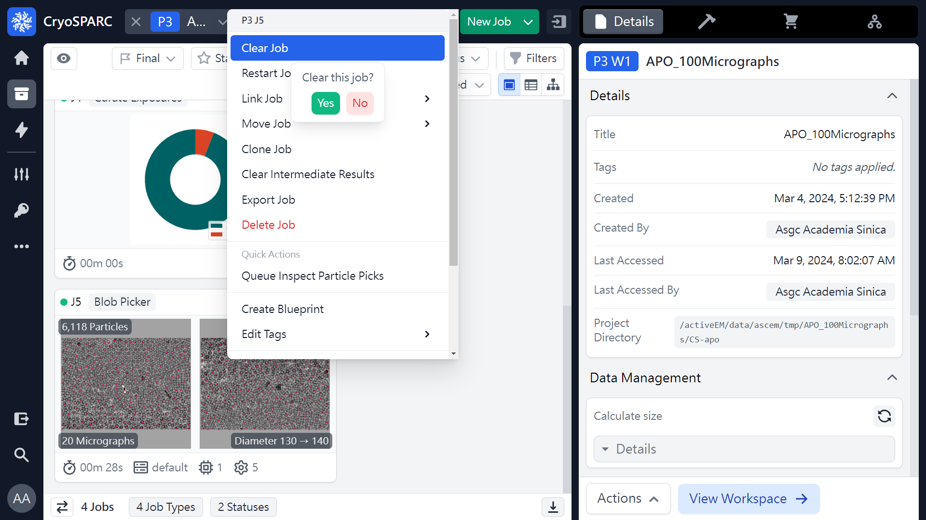
Blob Picker (clear job)
(Pick Coordinates)
 2
 3
 1
Mouse right click
(ref: cryoSPARC website. https://cryosparc.com/)

Slide 36
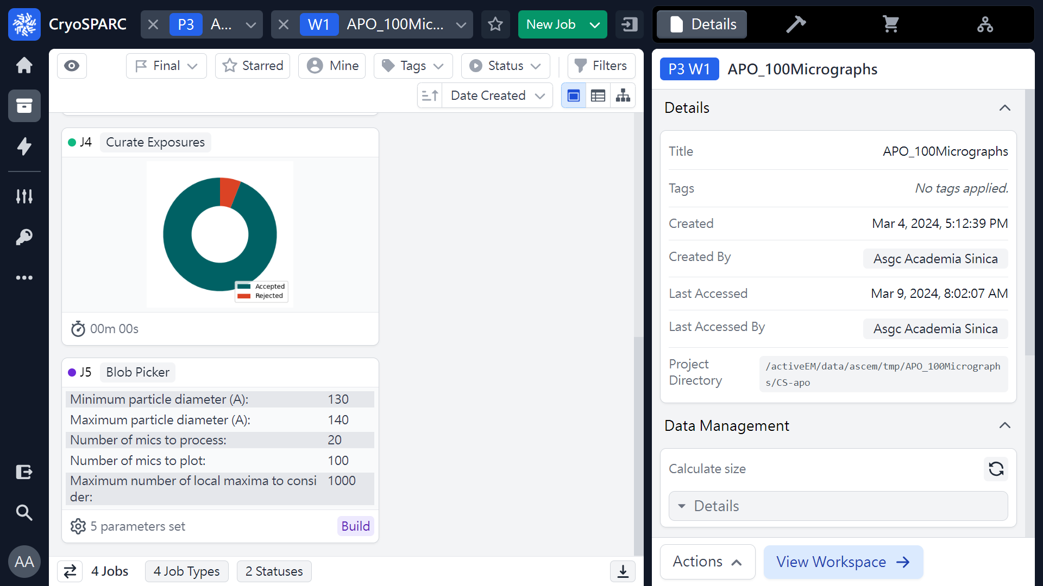
Blob Picker (re-build job)
(Pick Coordinates)
 1
(ref: cryoSPARC website. https://cryosparc.com/)

Slide 37
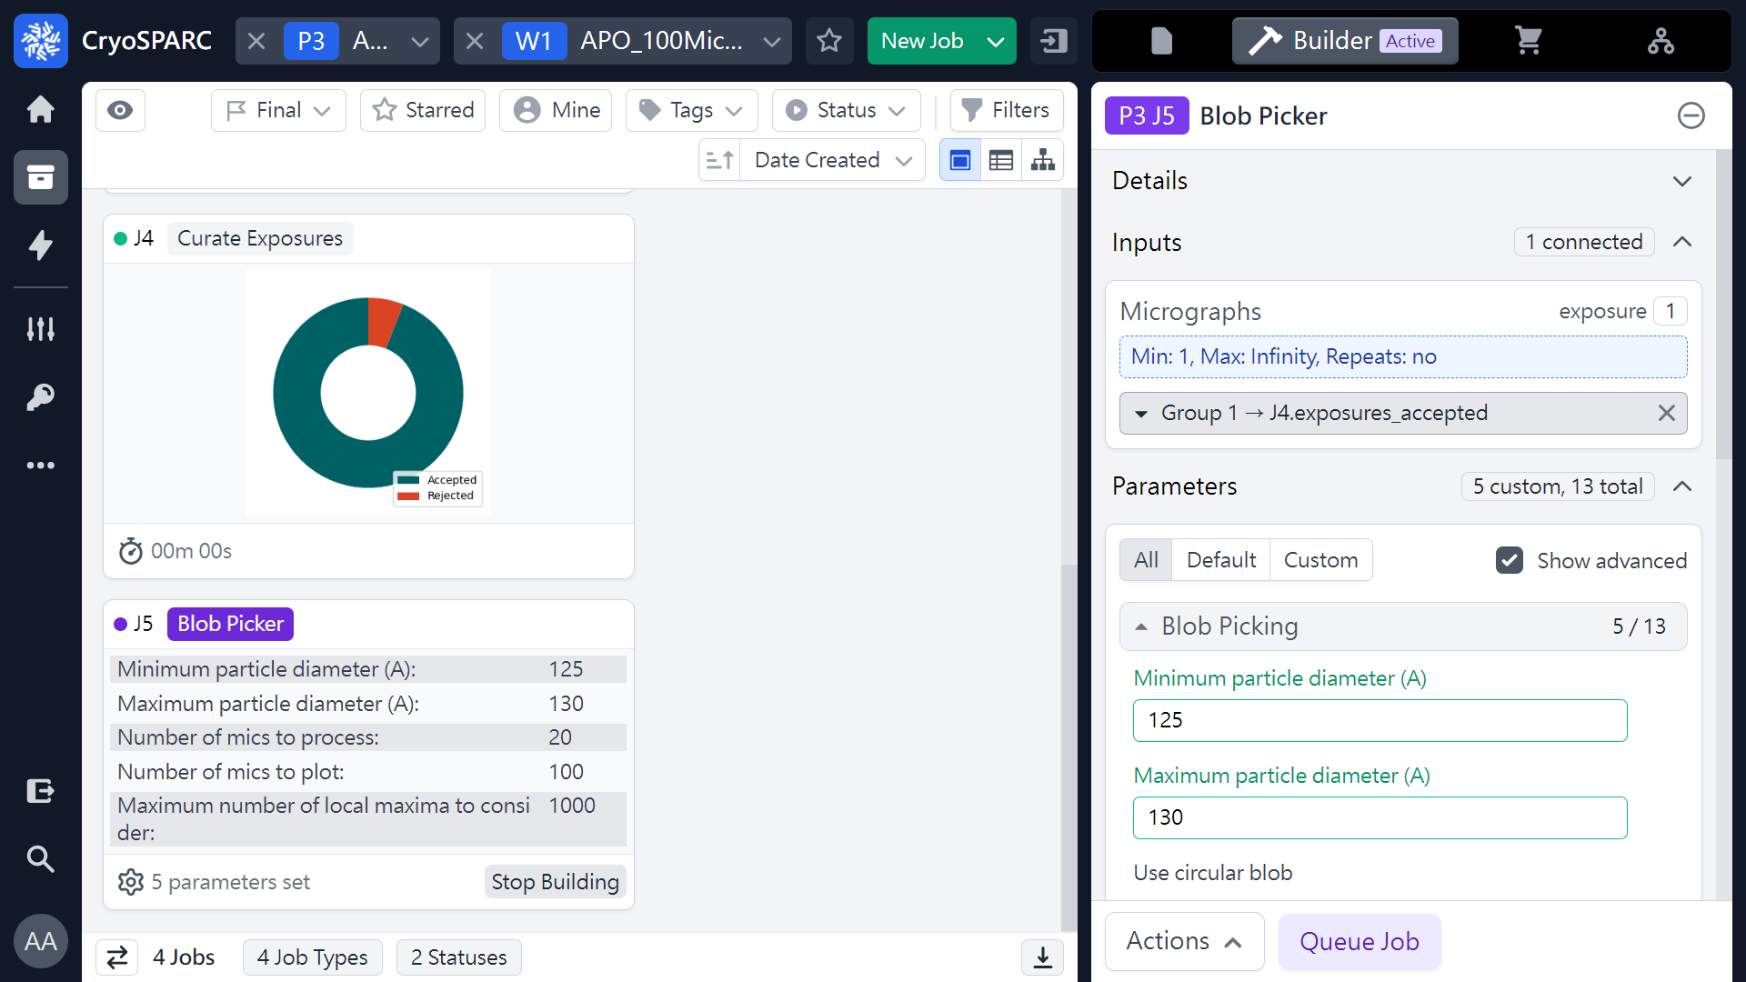
Blob Picker (re-build job)
(Pick Coordinates)
130 → 125
 1
140 → 130
 2
(ref: cryoSPARC website. https://cryosparc.com/)

Slide 38
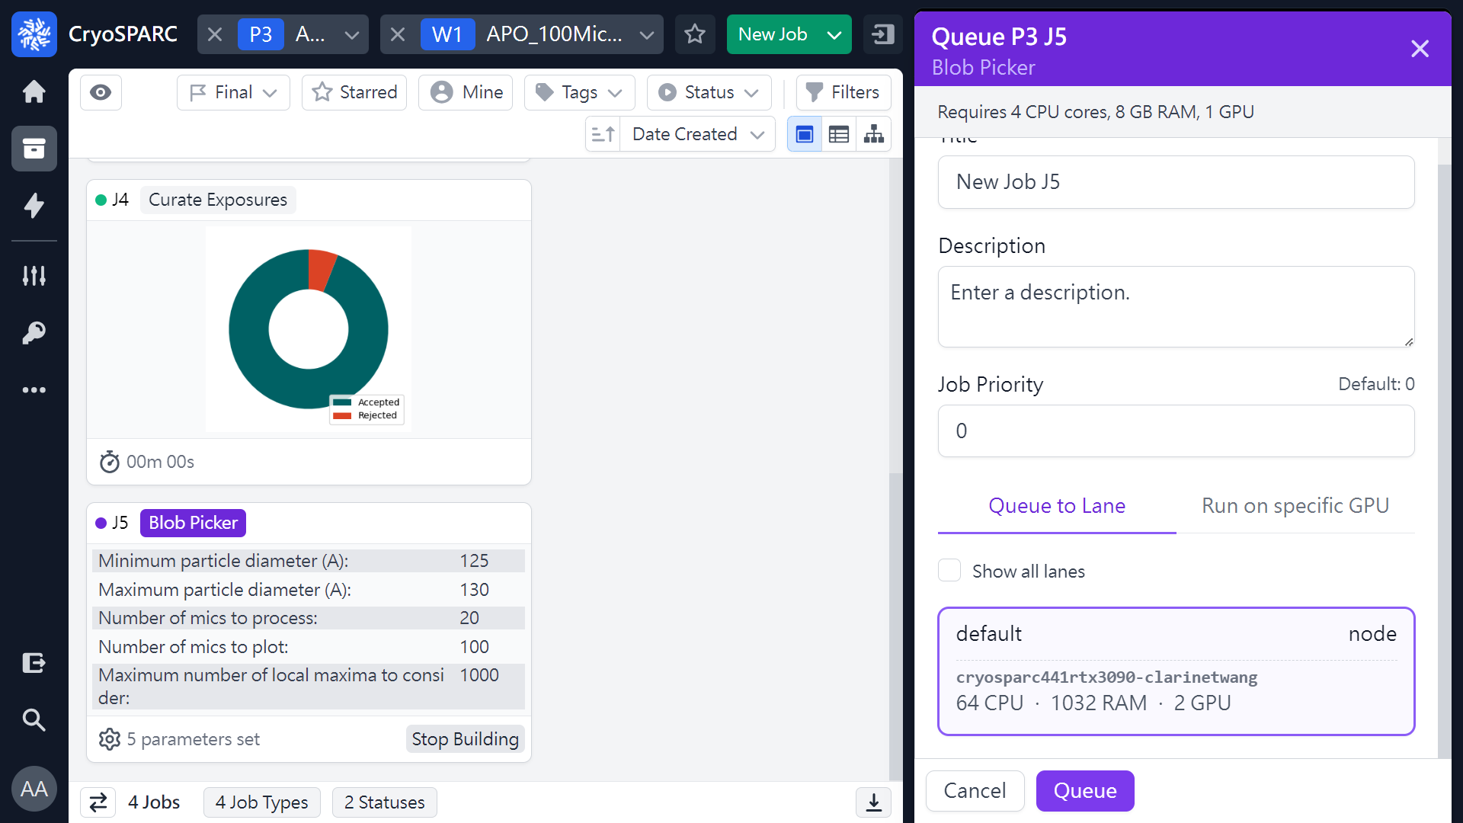
Blob Picker (re-build job)
(Pick Coordinates)
 1
(ref: cryoSPARC website. https://cryosparc.com/)

Slide 39
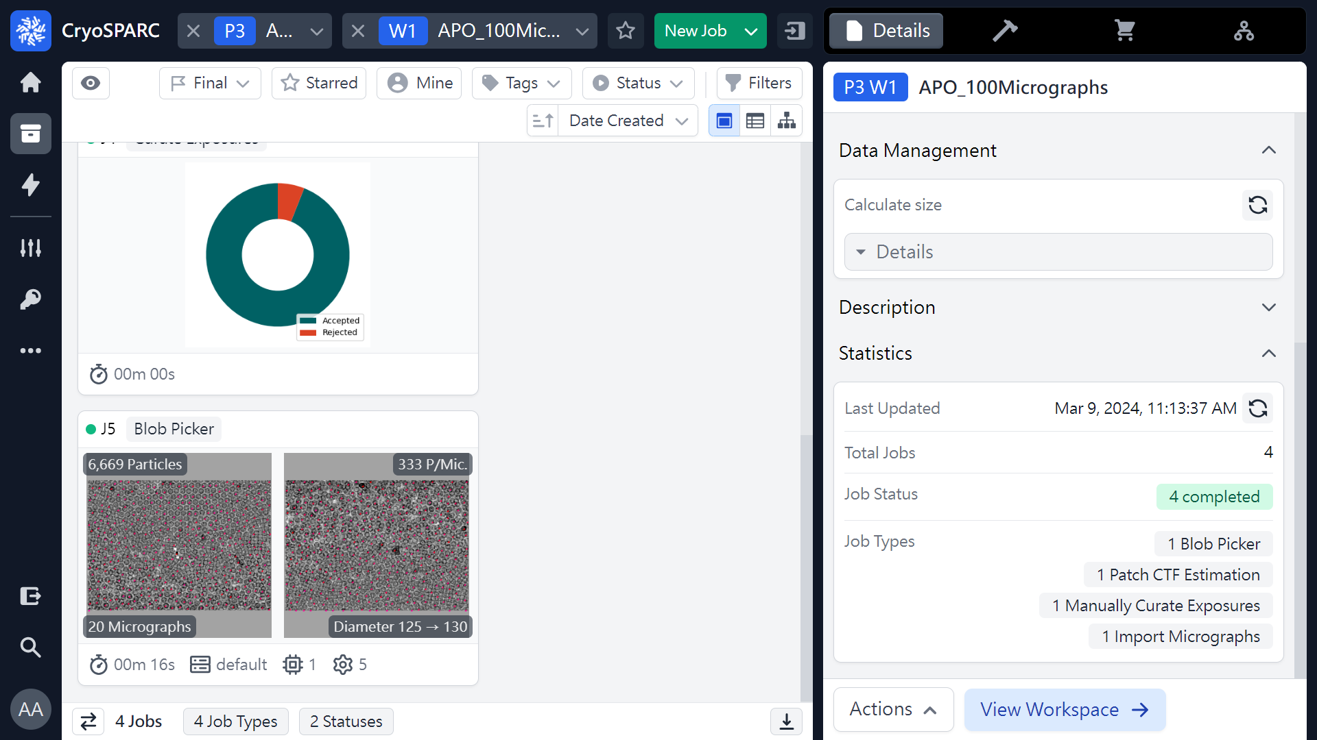
Blob Picker (re-build job)
(Pick Coordinates)
 1
(ref: cryoSPARC website. https://cryosparc.com/)

Slide 40

Blob Picker (re-build job)
(Pick Coordinates)
 1
(ref: cryoSPARC website. https://cryosparc.com/)

Slide 41
Workflow of single particle analysis using cryoSPARC
Import Dataset
Ab-initio 3D Classification
Movies
Motion corrected
Micrographs
Motion Correction
Heterogeneous Refinement
3D
Pre-
process
CTF Estimation
Homogeneous Refinement
Micrograph Curation
Non-uniform Refinement
or
Particle Picking
Local Refinement
Advanced
3D
or
Particle picking
Particle Curation
3D class, 3D Var, 3D Flex
Particle Extraction
Post-processing & Sharpening
2D
2D Classification
Final Structures

Slide 42
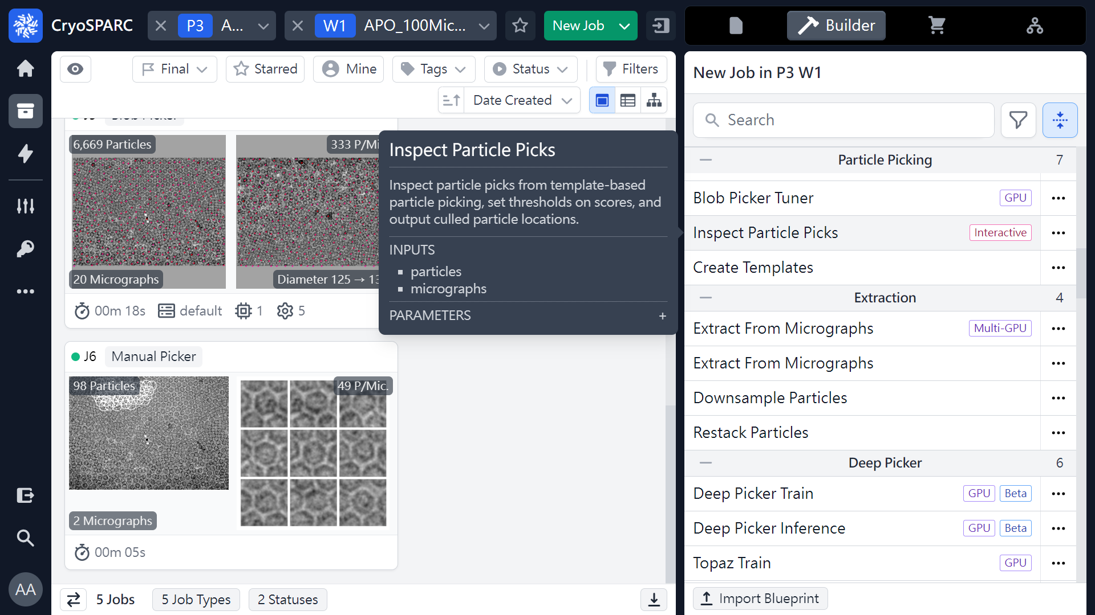
Inspect Particle Picks
(Coordinates)
 1
 2
(ref: cryoSPARC website. https://cryosparc.com/)

Slide 43
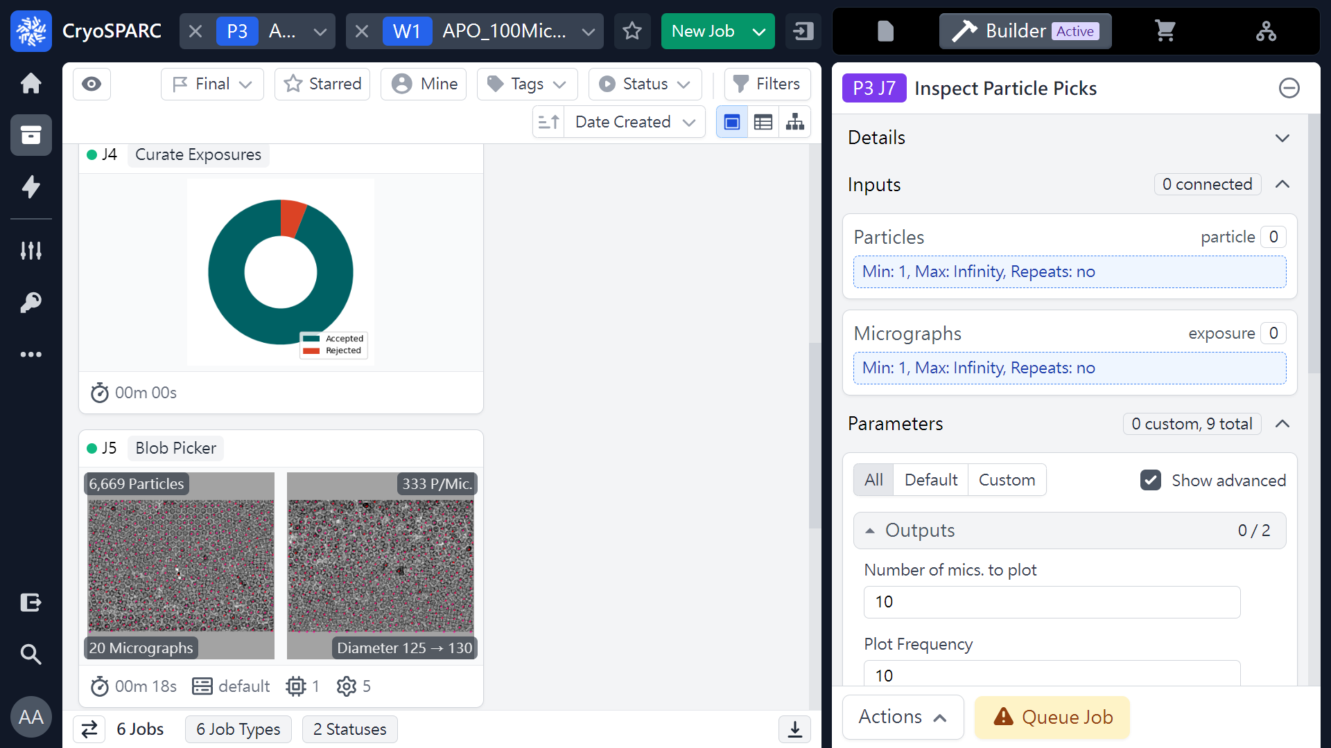
Inspect Particle Picks
(Coordinates)
 1
(ref: cryoSPARC website. https://cryosparc.com/)

Slide 44
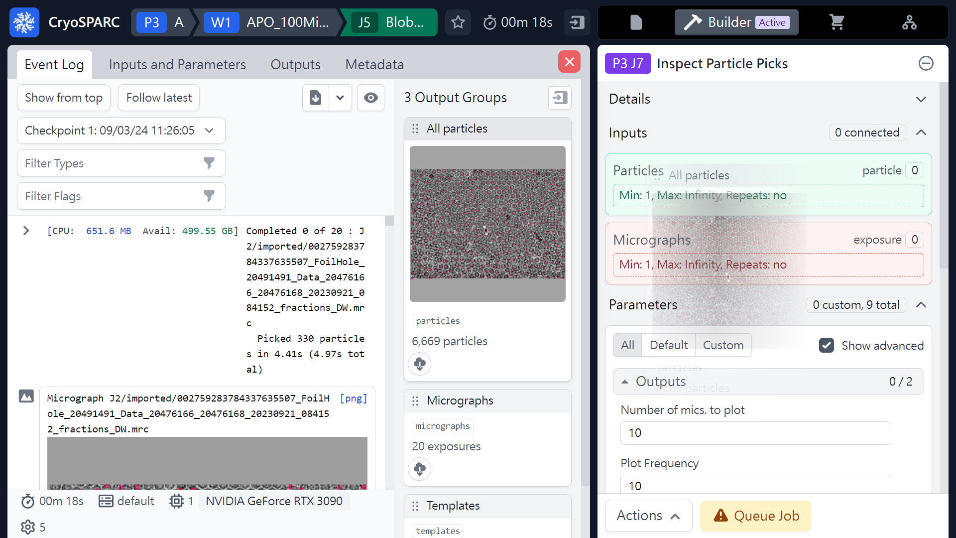
Inspect Particle Picks
(Coordinates)
Mouse left click
(Hold & Drag)
 1
(ref: cryoSPARC website. https://cryosparc.com/)

Slide 45
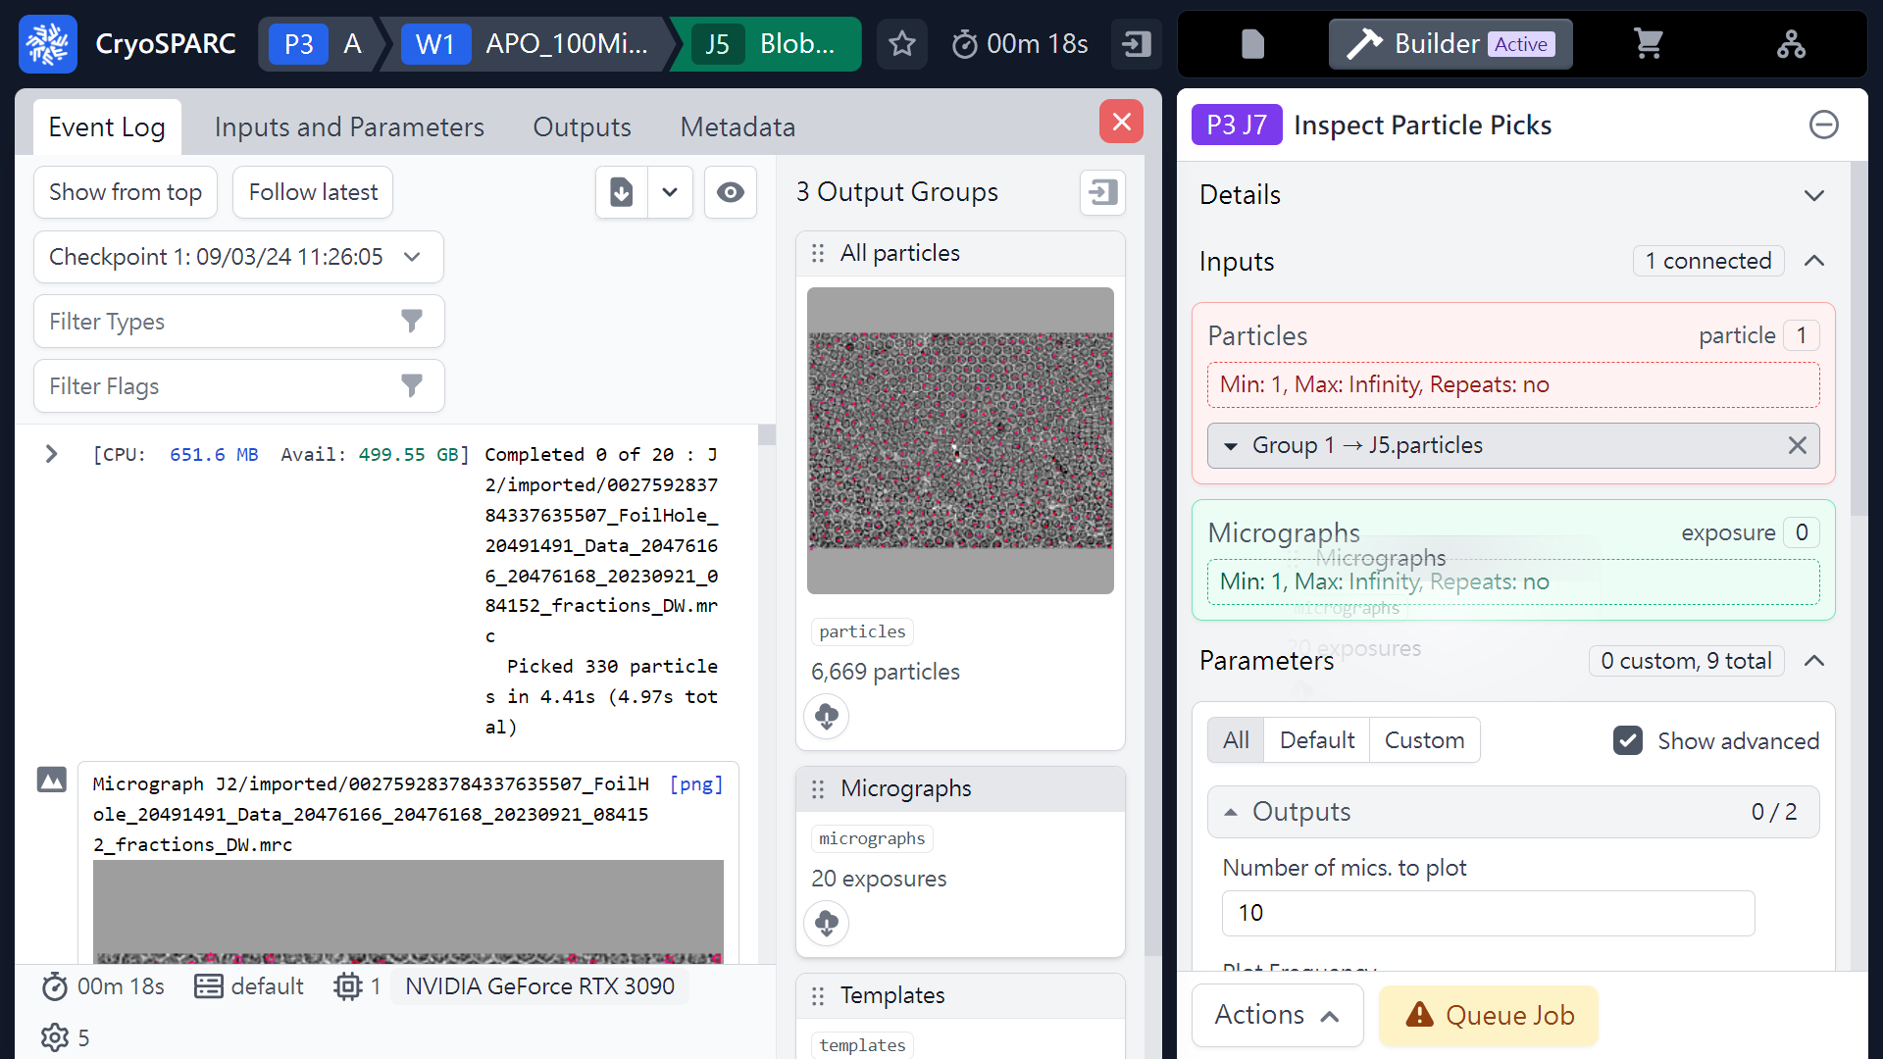
Inspect Particle Picks
(Coordinates)
Mouse left click
(Hold & Drag)
 1
(ref: cryoSPARC website. https://cryosparc.com/)

Slide 46
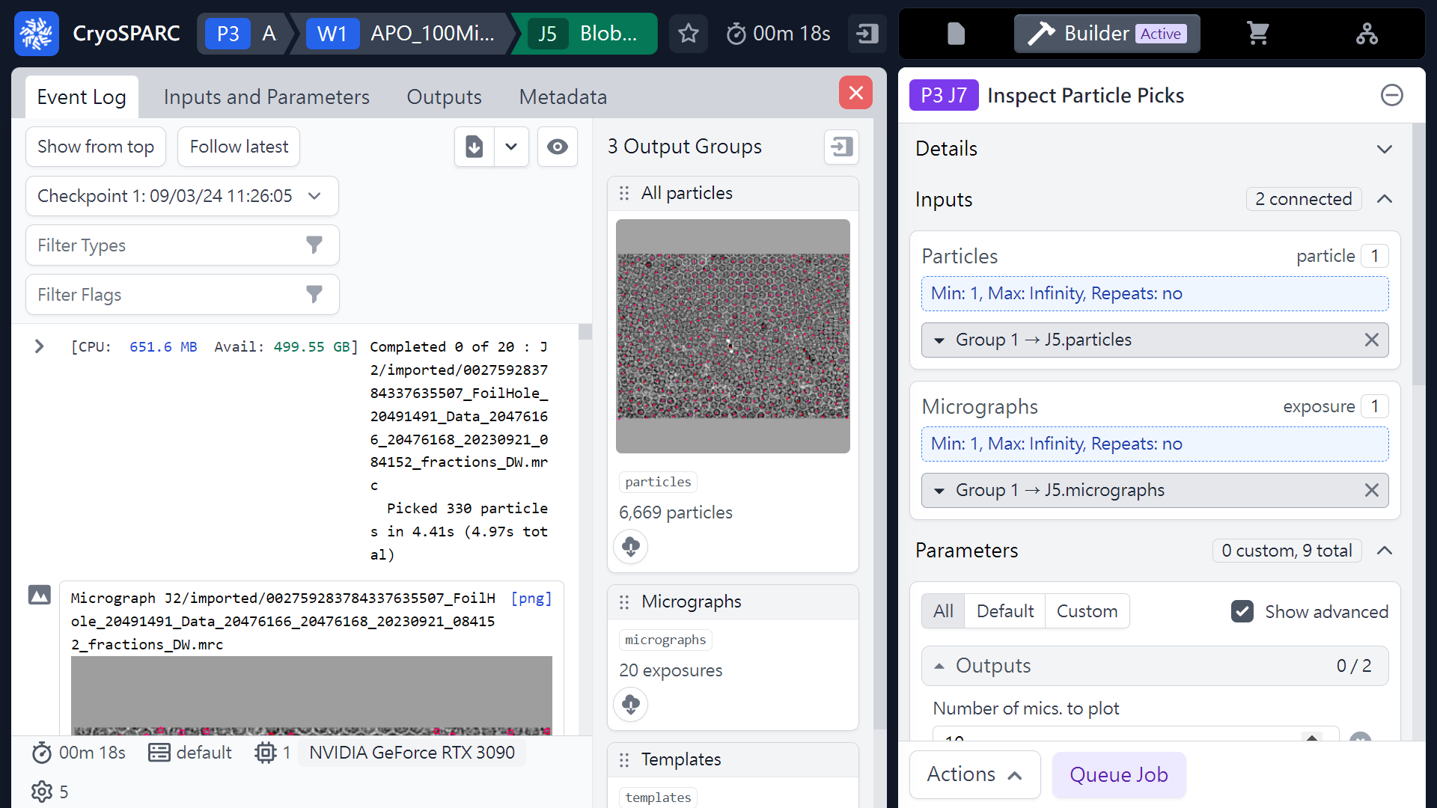
Inspect Particle Picks
(Coordinates)
 1
(ref: cryoSPARC website. https://cryosparc.com/)

Slide 47
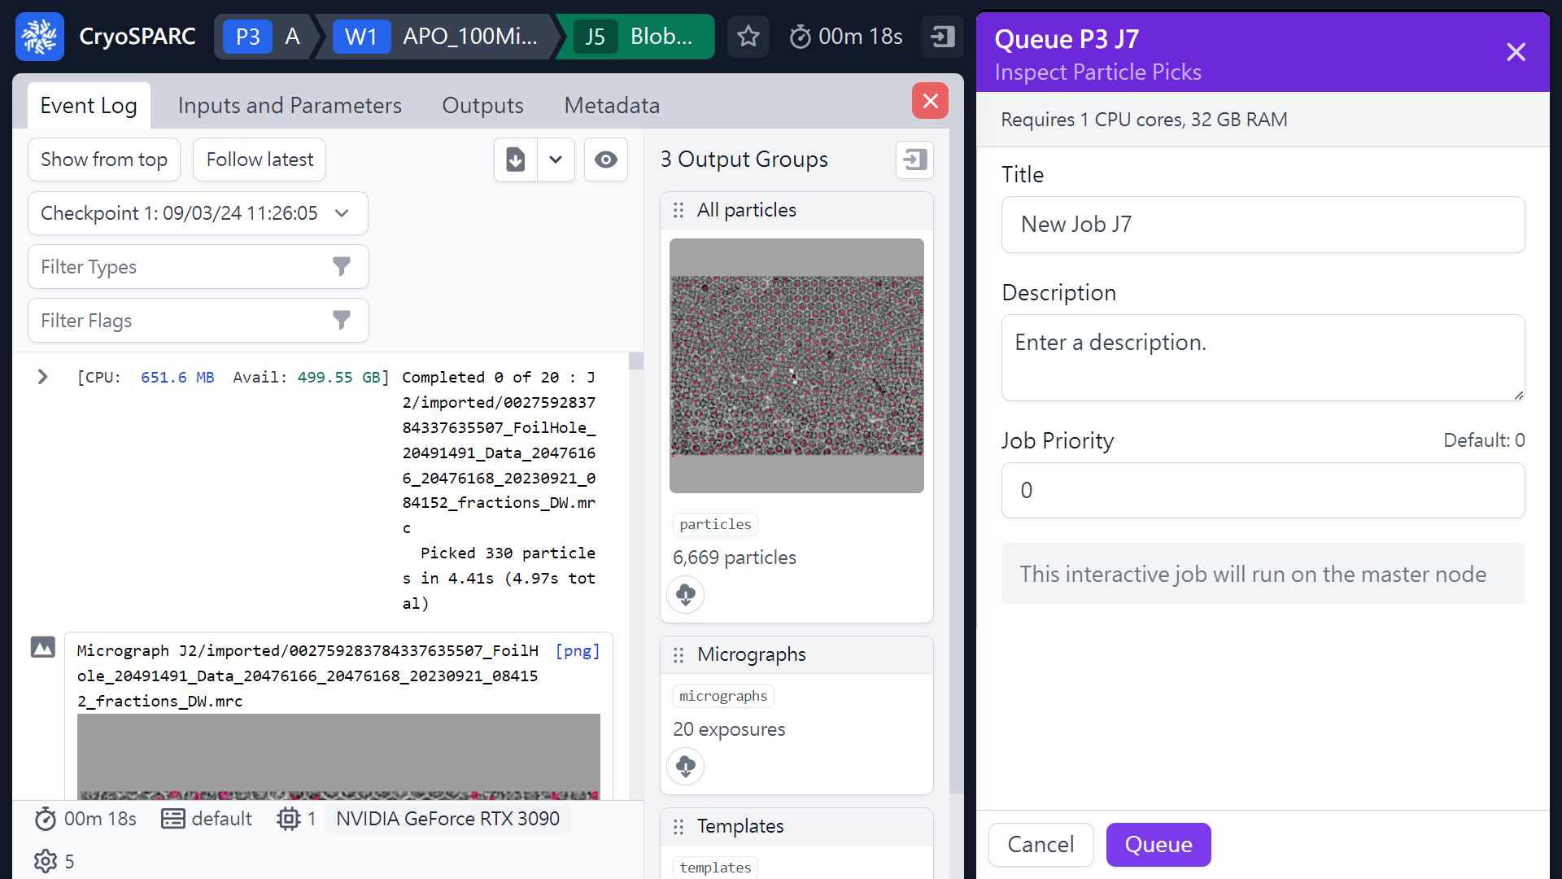
Inspect Particle Picks
(Coordinates)
 2
 1
(ref: cryoSPARC website. https://cryosparc.com/)

Slide 48
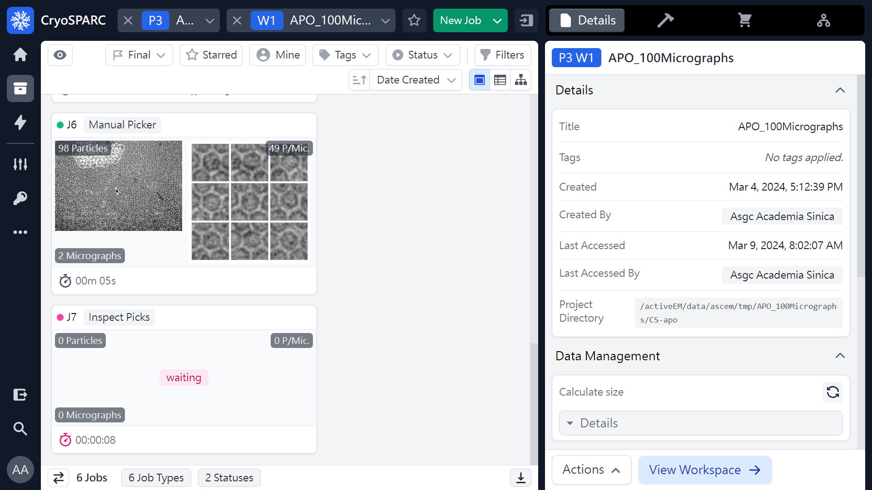
Inspect Particle Picks
(Coordinates)
 1
(ref: cryoSPARC website. https://cryosparc.com/)

Slide 49
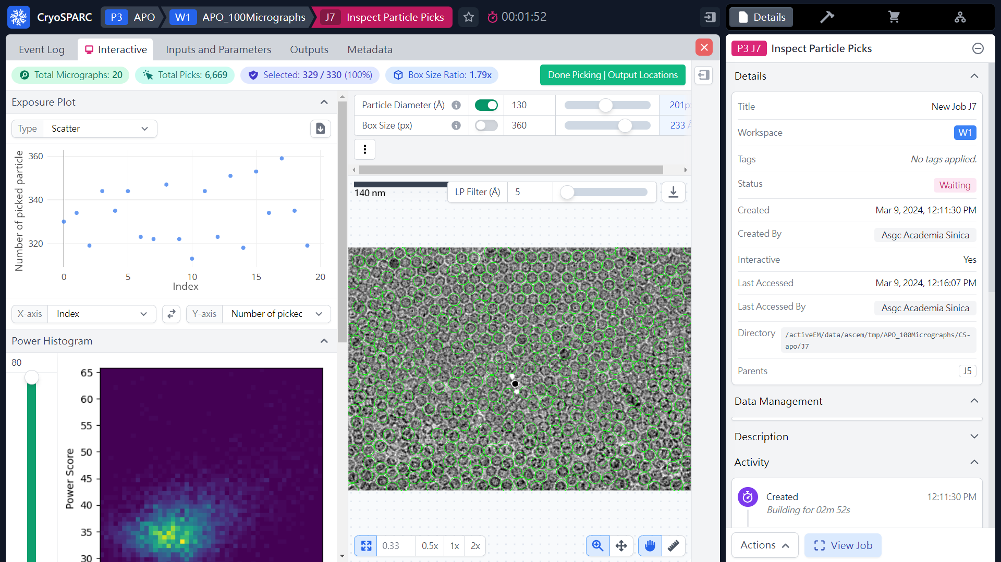
Inspect Particle Picks
(Coordinates)
(ref: cryoSPARC website. https://cryosparc.com/)

Slide 50
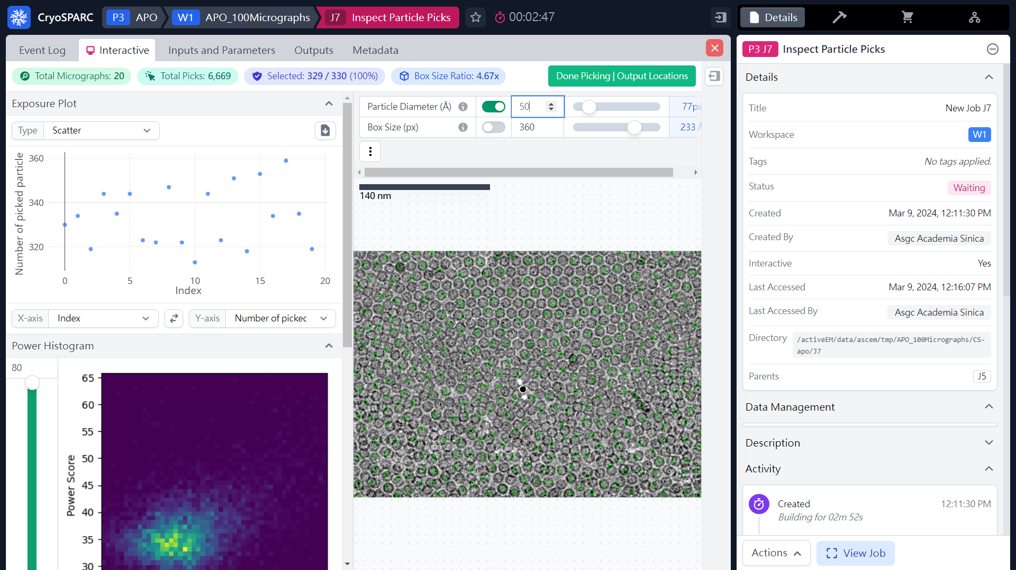
Inspect Particle Picks
(Coordinates)
 1
(ref: cryoSPARC website. https://cryosparc.com/)

Slide 51
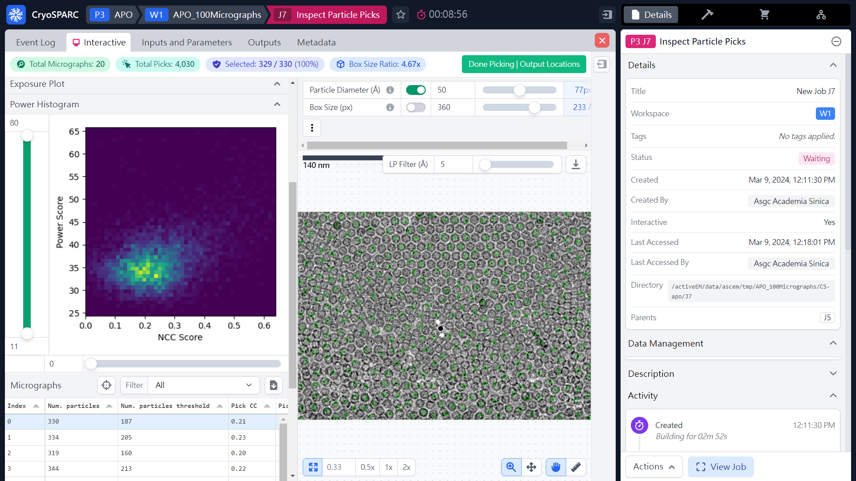
Inspect Particle Picks
(Coordinates)
(ref: cryoSPARC website. https://cryosparc.com/)

Slide 52

Inspect Particle Picks
(Coordinates)
0 → 0.2
 1
(ref: cryoSPARC website. https://cryosparc.com/)

Slide 53
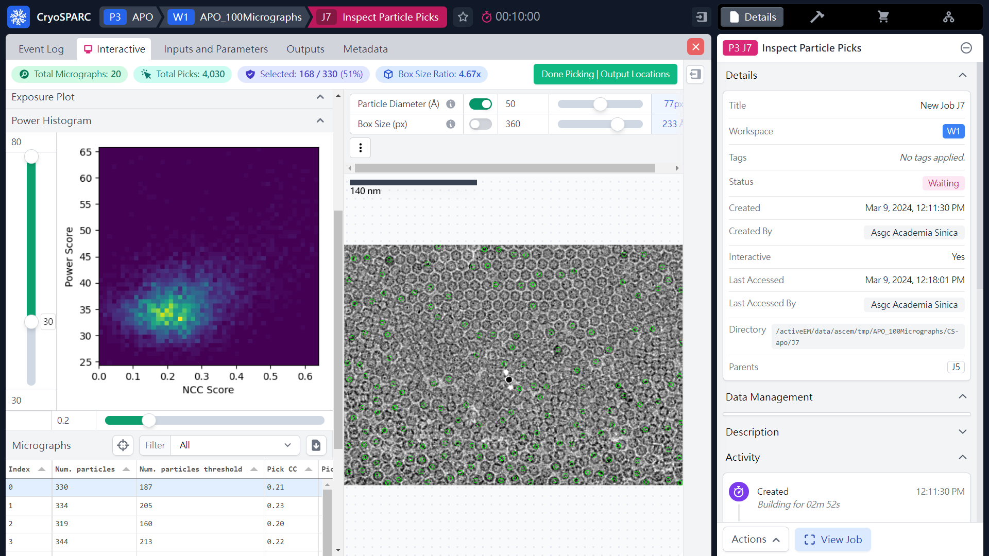
Inspect Particle Picks
(Coordinates)
 1
11 → 30
(ref: cryoSPARC website. https://cryosparc.com/)

Slide 54

Inspect Particle Picks
(Coordinates)
80 → 36
 1
11 → 30
(ref: cryoSPARC website. https://cryosparc.com/)

Slide 55
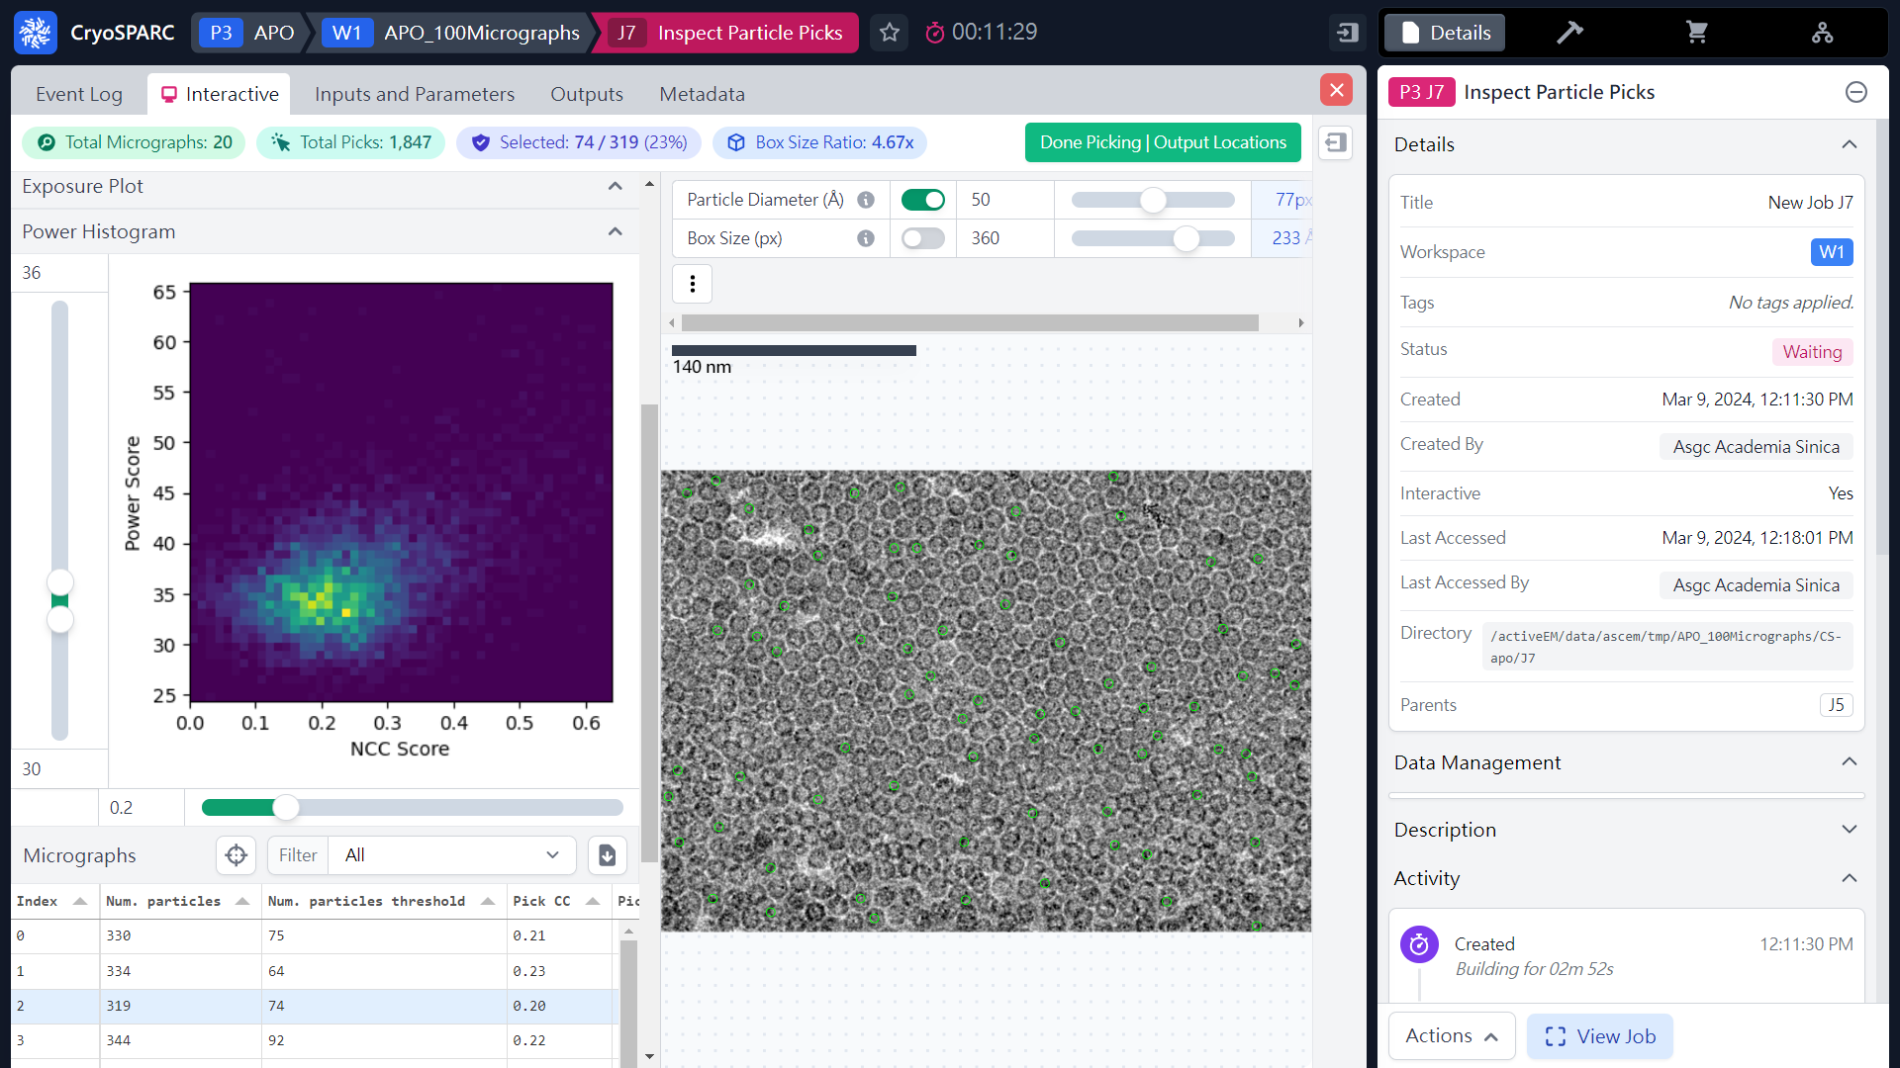
Inspect Particle Picks
(Coordinates)
 2
 1
(ref: cryoSPARC website. https://cryosparc.com/)

Slide 56
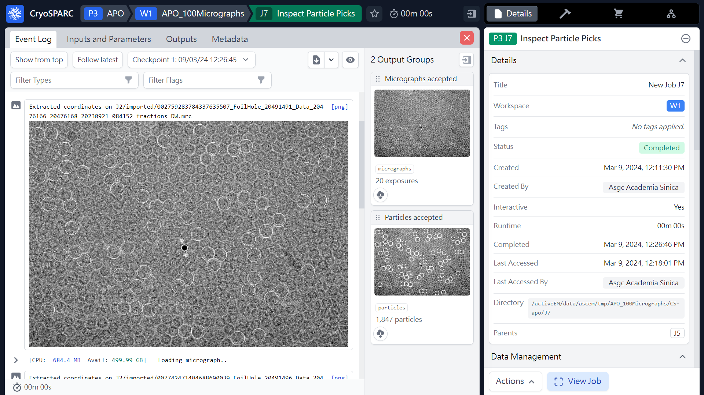
Inspect Particle Picks
(Coordinates)
 1
20 exposures
1,847 particles
(ref: cryoSPARC website. https://cryosparc.com/)

Slide 57
Workflow of single particle analysis using cryoSPARC
Import Dataset
Ab-initio 3D Classification
Movies
Motion corrected
Micrographs
Motion Correction
Heterogeneous Refinement
3D
Pre-
process
CTF Estimation
Homogeneous Refinement
Micrograph Curation
Non-uniform Refinement
or
Particle Picking
Local Refinement
Advanced
3D
or
Particle picking
Particle Curation
3D class, 3D Var, 3D Flex
Particle Extraction
Post-processing & Sharpening
2D
2D Classification
Final Structures

Slide 58
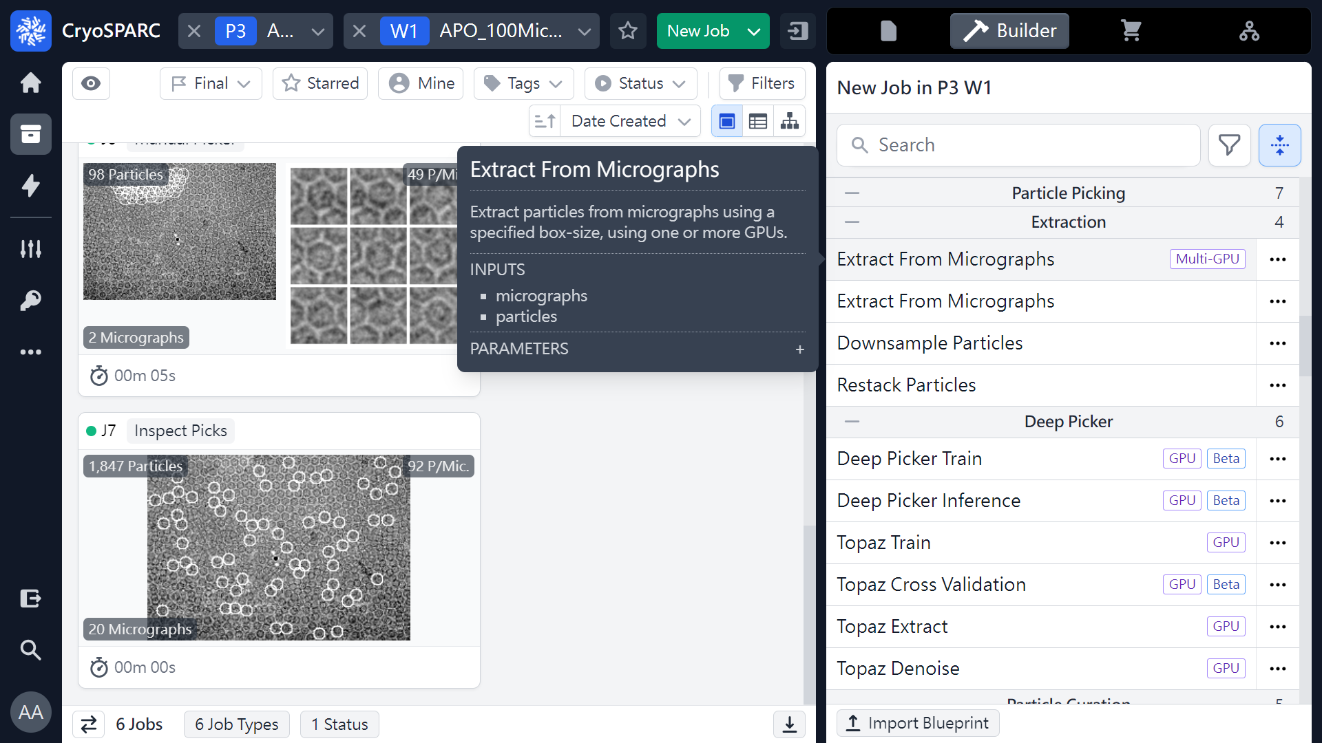
Extract From Micrographs
(Extract Particles)
 1
 2
 3
(ref: cryoSPARC website. https://cryosparc.com/)

Slide 59
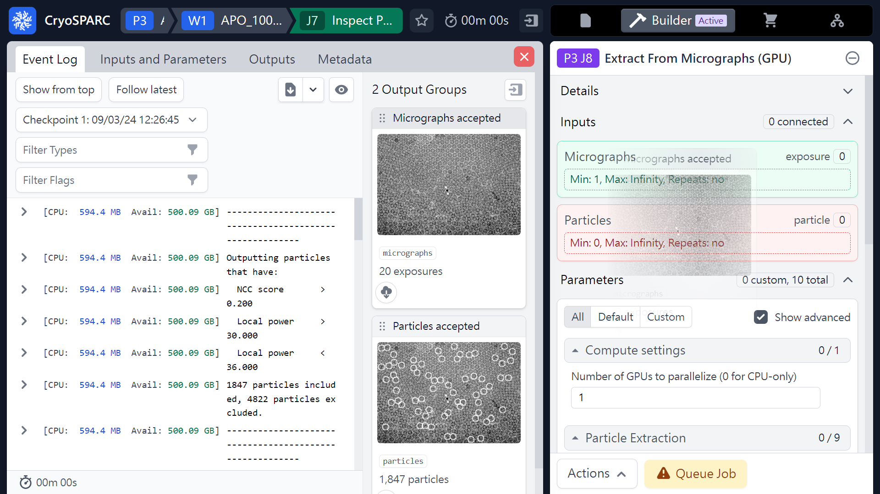
Extract From Micrographs
(Extract Particles)
Mouse left click
(Hold & Drag)
 1
(ref: cryoSPARC website. https://cryosparc.com/)

Slide 60

Extract From Micrographs
(Extract Particles)
Mouse left click
(Hold & Drag)
 1
(ref: cryoSPARC website. https://cryosparc.com/)

Slide 61

Extract From Micrographs
(Extract Particles)
 1
 2
 3
(ref: cryoSPARC website. https://cryosparc.com/)

Slide 62

Extract From Micrographs
(Extract Particles)
 2
 1
(ref: cryoSPARC website. https://cryosparc.com/)

Slide 63

Extract From Micrographs
(Extract Particles)
 1
(ref: cryoSPARC website. https://cryosparc.com/)

Slide 64

Extract From Micrographs
(Extract Particles)
 1
20 exposures
1,579 particles
(ref: cryoSPARC website. https://cryosparc.com/)

Slide 65
Workflow of single particle analysis using cryoSPARC
Import Dataset
Ab-initio 3D Classification
Movies
Motion corrected
Micrographs
Motion Correction
Heterogeneous Refinement
3D
Pre-
process
CTF Estimation
Homogeneous Refinement
Micrograph Curation
Non-uniform Refinement
or
Particle Picking
Local Refinement
Advanced
3D
or
Particle picking
Particle Curation
3D class, 3D Var, 3D Flex
Particle Extraction
Post-processing & Sharpening
2D
2D Classification
Final Structures

Slide 66

2D Classification
 1
 2
(ref: cryoSPARC website. https://cryosparc.com/)

Slide 67

2D Classification
(Parameters)
 1
(ref: cryoSPARC website. https://cryosparc.com/)

Slide 68

2D Classification
(Parameters)
Mouse left click
(Hold & Drag)
 1
(ref: cryoSPARC website. https://cryosparc.com/)

Slide 69

2D Classification
(Parameters)
50 or 100 …
 1
(ref: cryoSPARC website. https://cryosparc.com/)

Slide 70

2D Classification
(Parameters)
 1
(ref: cryoSPARC website. https://cryosparc.com/)

Slide 71

2D Classification
(Parameters)
 1
 2
(ref: cryoSPARC website. https://cryosparc.com/)

Slide 72

2D Classification
(Parameters)
 1
(ref: cryoSPARC website. https://cryosparc.com/)

Slide 73

2D Classification
(Job finished)
 1
(ref: cryoSPARC website. https://cryosparc.com/)

Slide 74

2D Classification
(Results)
 1
(ref: cryoSPARC website. https://cryosparc.com/)

Slide 75

2D Classification
(For Small Particles)
 1
2D
(ref: cryoSPARC website. https://cryosparc.com/)

Slide 76

Select 2D Classes
 1
 2
(ref: cryoSPARC website. https://cryosparc.com/)

Slide 77

Select 2D Classes
 1
(ref: cryoSPARC website. https://cryosparc.com/)

Slide 78

Select 2D Classes
Mouse left click
(Hold & Drag)
 1
(ref: cryoSPARC website. https://cryosparc.com/)

Slide 79

Select 2D Classes
Mouse left click
(Hold & Drag)
 1
(ref: cryoSPARC website. https://cryosparc.com/)

Slide 80

Select 2D Classes
 1
(ref: cryoSPARC website. https://cryosparc.com/)

Slide 81

Select 2D Classes
 2
 1
(ref: cryoSPARC website. https://cryosparc.com/)

Slide 82

Select 2D Classes
 1
(ref: cryoSPARC website. https://cryosparc.com/)

Slide 83

Select 2D Classes
 1
(ref: cryoSPARC website. https://cryosparc.com/)

Slide 84

Select 2D Classes
 1
(ref: cryoSPARC website. https://cryosparc.com/)

Slide 85

Select 2D Classes
 1
(ref: cryoSPARC website. https://cryosparc.com/)

Slide 86

Select 2D Classes
 1
 3
 2
(ref: cryoSPARC website. https://cryosparc.com/)

Slide 87

Select 2D Classes
Selected
3 classes
374 particles
3 templates
Excluded 47 classes
(ref: cryoSPARC website. https://cryosparc.com/)

Slide 88
Particle Picking
Manual picking
(Coordinates & Particles)
Blob picking
(Coordinates)
Template picking
(Coordinates)
Particle Curation
(Coordinates)
Particle Curation
(Coordinates)
Particle Extraction
(Particles)
Particle Extraction
(Particles)
2D Classification
2D Classification
2D Classification
(2D Templates)
3D reconstruction

Slide 89
Workflow of single particle analysis using cryoSPARC
Import Dataset
Ab-initio 3D Classification
Movies
Motion corrected
Micrographs
Motion Correction
Heterogeneous Refinement
3D
Pre-
process
CTF Estimation
Homogeneous Refinement
Micrograph Curation
Non-uniform Refinement
or
Particle Picking
Local Refinement
Advanced
3D
or
Particle picking
Particle Curation
3D class, 3D Var, 3D Flex
Particle Extraction
Post-processing & Sharpening
2D
2D Classification
Final Structures

Slide 90

Template Picker
(Coordinates)
 1
 2
(ref: cryoSPARC website. https://cryosparc.com/)

Slide 91

Template Picker
(Coordinates)
 1
(ref: cryoSPARC website. https://cryosparc.com/)

Slide 92

Template Picker
(Coordinates)
 2
Mouse left click
(Hold & Drag)
 1
(ref: cryoSPARC website. https://cryosparc.com/)

Slide 93

Template Picker
(Coordinates)
 1
(ref: cryoSPARC website. https://cryosparc.com/)

Slide 94

Template Picker
(Coordinates)
Mouse left click
(Hold & Drag)
 1
(ref: cryoSPARC website. https://cryosparc.com/)

Slide 95

Template Picker
(Coordinates)
 1
(ref: cryoSPARC website. https://cryosparc.com/)

Slide 96

Template Picker
(Coordinates)
 1
 2
(ref: cryoSPARC website. https://cryosparc.com/)

Slide 97

Template Picker
(Coordinates)
 2
 1
(ref: cryoSPARC website. https://cryosparc.com/)

Slide 98

Template Picker
(Coordinates)
 1
(ref: cryoSPARC website. https://cryosparc.com/)

Slide 99

Template Picker
(Coordinates)
 1
Blob picker
(ref: cryoSPARC website. https://cryosparc.com/)

Slide 100
Workflow of single particle analysis using cryoSPARC
Import Dataset
Ab-initio 3D Classification
Movies
Motion corrected
Micrographs
Motion Correction
Heterogeneous Refinement
3D
Pre-
process
CTF Estimation
Homogeneous Refinement
Micrograph Curation
Non-uniform Refinement
or
Particle Picking
Local Refinement
Advanced
3D
or
Particle picking
Particle Curation
3D class, 3D Var, 3D Flex
Particle Extraction
Post-processing & Sharpening
2D
2D Classification
Final Structures

Slide 101

Inspect Particle Picks
(Coordinates)
or 
 2
 1
Mouse right click
(ref: cryoSPARC website. https://cryosparc.com/)

Slide 102

Inspect Particle Picks
(Coordinates)
 1
(ref: cryoSPARC website. https://cryosparc.com/)

Slide 103

Inspect Particle Picks
(Coordinates)
 4
 3
 1
 2
(ref: cryoSPARC website. https://cryosparc.com/)

Slide 104

Inspect Particle Picks
(Coordinates)
 1
94 exposures
65,984 particles
(ref: cryoSPARC website. https://cryosparc.com/)

Slide 105
Workflow of single particle analysis using cryoSPARC
Import Dataset
Ab-initio 3D Classification
Movies
Motion corrected
Micrographs
Motion Correction
Heterogeneous Refinement
3D
Pre-
process
CTF Estimation
Homogeneous Refinement
Micrograph Curation
Non-uniform Refinement
or
Particle Picking
Local Refinement
Advanced
3D
or
Particle picking
Particle Curation
3D class, 3D Var, 3D Flex
Particle Extraction
Post-processing & Sharpening
2D
2D Classification
Final Structures

Slide 106

Extract From Micrographs
(Extract Particles)
or 
 2
 1
Mouse right click
(ref: cryoSPARC website. https://cryosparc.com/)

Slide 107

Extract From Micrographs
(Extract Particles)
 1
(ref: cryoSPARC website. https://cryosparc.com/)

Slide 108

Extract From Micrographs
(Extract Particles)
 1
 2
(ref: cryoSPARC website. https://cryosparc.com/)

Slide 109

Extract From Micrographs
(Extract Particles)
 1
(ref: cryoSPARC website. https://cryosparc.com/)

Slide 110

Extract From Micrographs
(Extract Particles)
(ref: cryoSPARC website. https://cryosparc.com/)

Slide 111
Workflow of single particle analysis using cryoSPARC
Import Dataset
Ab-initio 3D Classification
Movies
Motion corrected
Micrographs
Motion Correction
Heterogeneous Refinement
3D
Pre-
process
CTF Estimation
Homogeneous Refinement
Micrograph Curation
Non-uniform Refinement
or
Particle Picking
Local Refinement
Advanced
3D
or
Particle picking
Particle Curation
3D class, 3D Var, 3D Flex
Particle Extraction
Post-processing & Sharpening
2D
2D Classification
Final Structures

Slide 112
Particle Picking
Manual picking
(Coordinates & Particles)
Blob picking
(Coordinates)
Template picking
(Coordinates)
Particle Curation
(Coordinates)
Particle Curation
(Coordinates)
Particle Extraction
(Particles)
Particle Extraction
(Particles)
2D Classification
2D Classification
2D Classification
(2D Templates)
3D reconstruction

Slide 113
Thank you !

