Slide 1
Helical reconstruction
Chih-Hsuan Lee, IBMS, AS
March 16, 2026

Slide 2
Outlines
A brief overview of helices and helical processing
A walkthrough of helical reconstruction

Slide 3
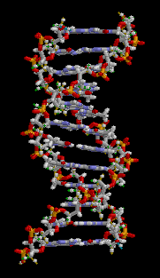
Many Biological Specimens have helical symmetry
DNA
α-Helix
Viruses (TMV)
Actin filaments
Myosin filaments
Microtubules
Bacterial Flagella

Slide 4
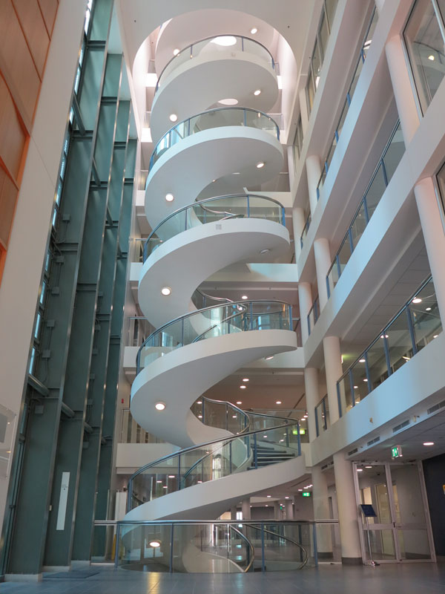
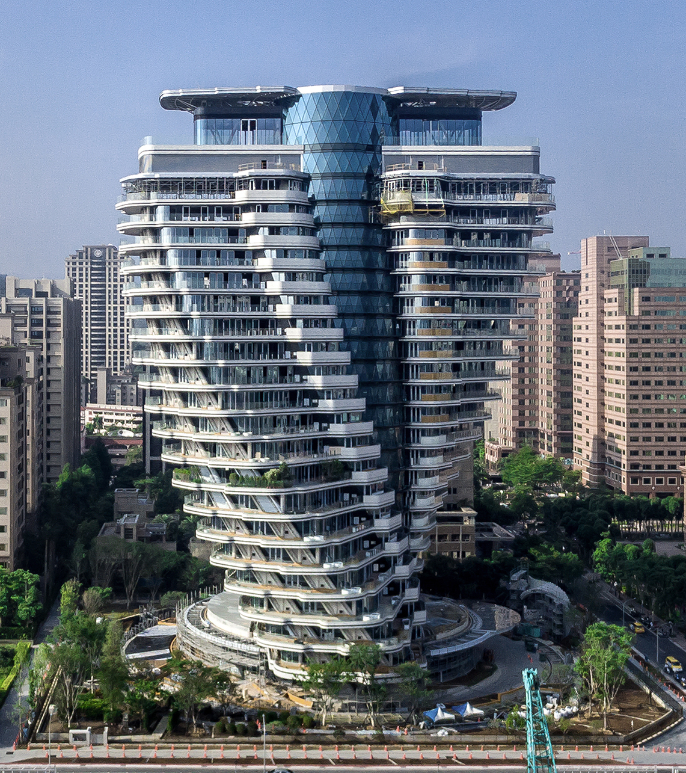

Slide 5
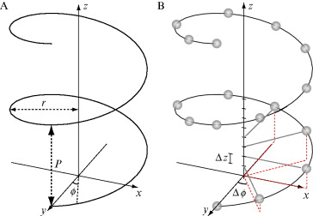

Helical symmetry
Helical pitch, P (Å),
number-of-subunits-per-full-turn, n, hand h∈{+1,−1}
Helical rise Δz (Å), and twist Δϕ (º)
$$∆φ=\frac{360° h}{n}; ∆z=\frac{P}{n}$$
Ex:
TMV, 49 subunits in 3 turns
F-actin, 13 subunits in 6 turns

Slide 6
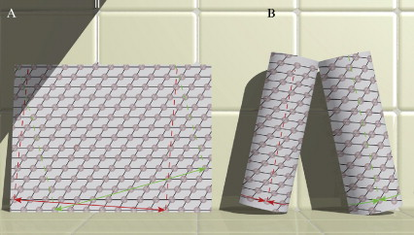
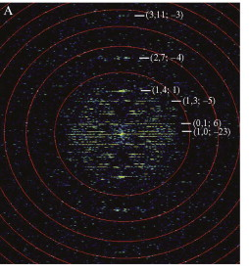
Fourier transform of a helical assembly
Relationship between 2D lattice and helical assembly
2D Fourier Transform
A single view contains all the necessary info for 3D
Bessel function: cylindrical harmonic
Fourier Bessel analysis
(Diaz et al. Methods in Enzymology 2010)

Slide 7
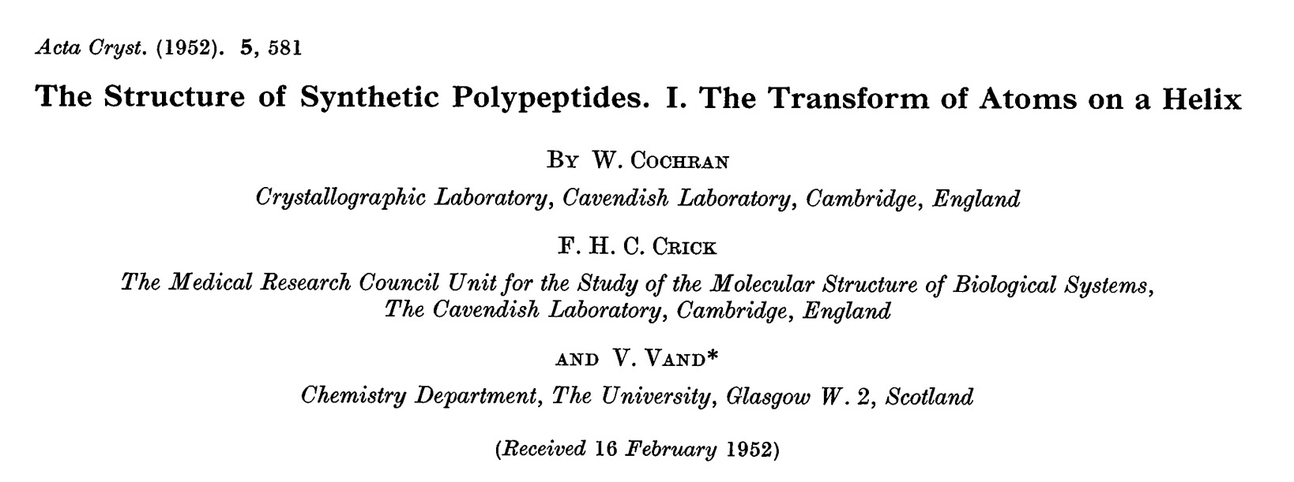

Slide 8
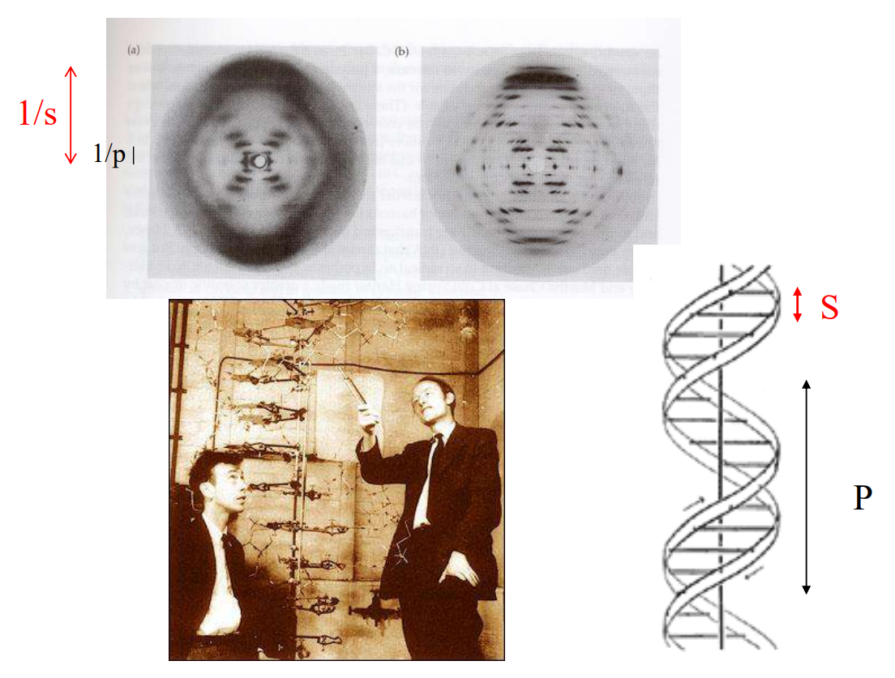
DNA double helix

Slide 9
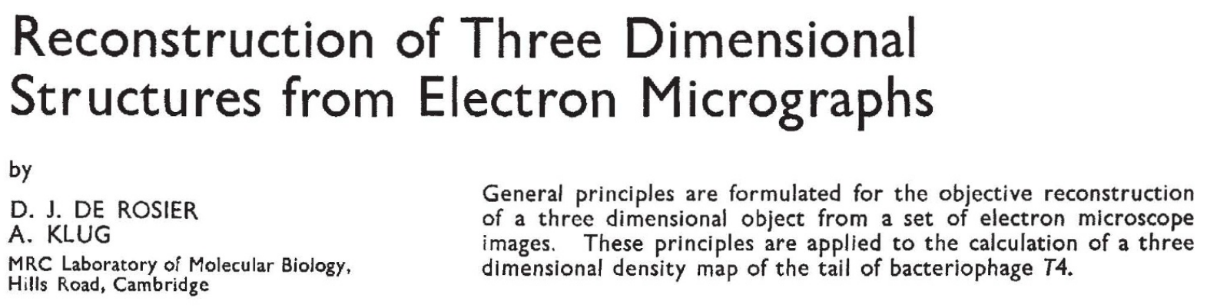
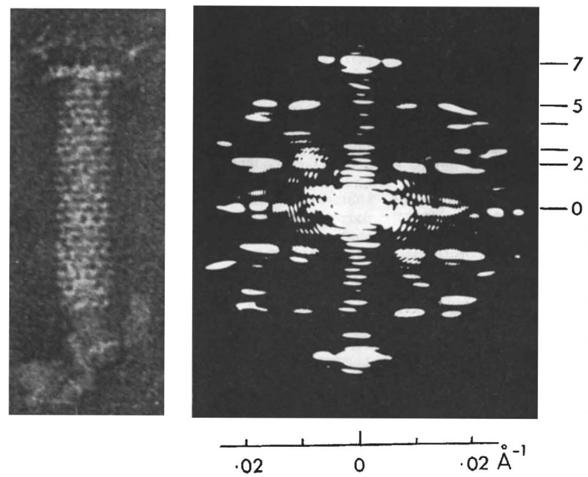
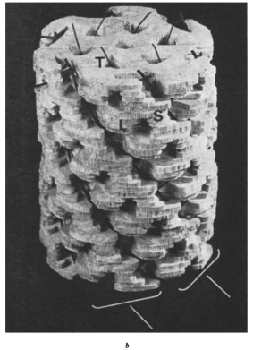
Fourier Bessel method for helical reconstruction
Limitions:
1. Laborious
2. Small inaccuracies in indexing
lead to incorrect structures!
3. Requires strict helical symmetry
4. Requires flat straight helices

Slide 10
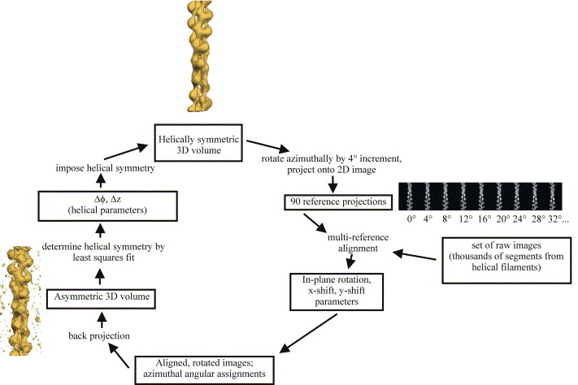
Iterative Helical Real Space Reconstruction (IHRSR)
- A reference model is required (featureless
cylinders or simulated helical lattices)
- Helical parameters (twist and rise) are
refined during the reconstruction
- Initial guess of twist and rise is important.

Slide 11
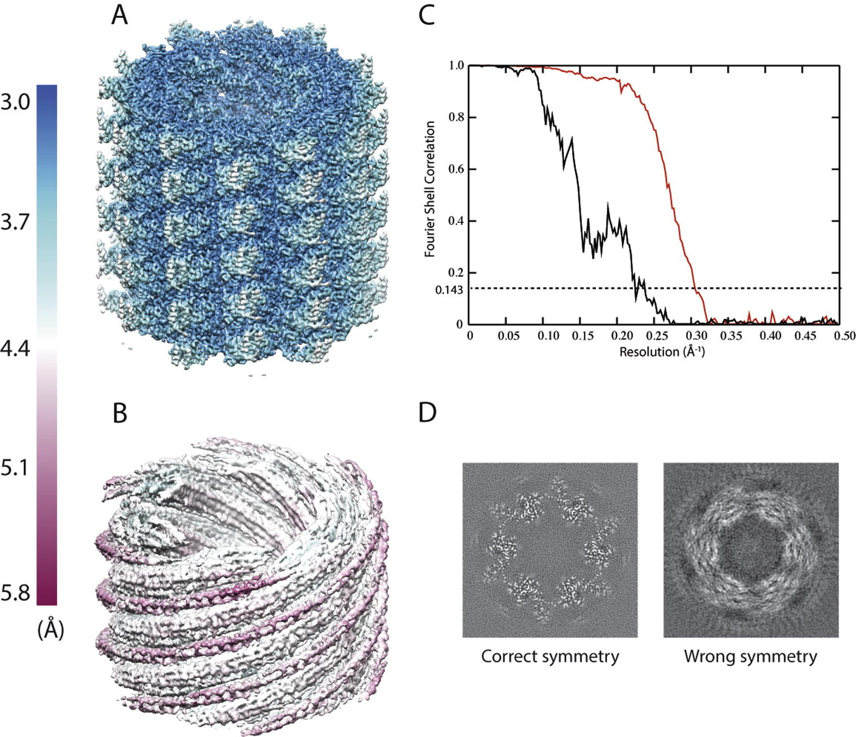
Potential pitfalls
- Is your map has protein-like feature
- FSC
- Noise
(He & Scheres., J Struct Biol 2017)

Slide 12
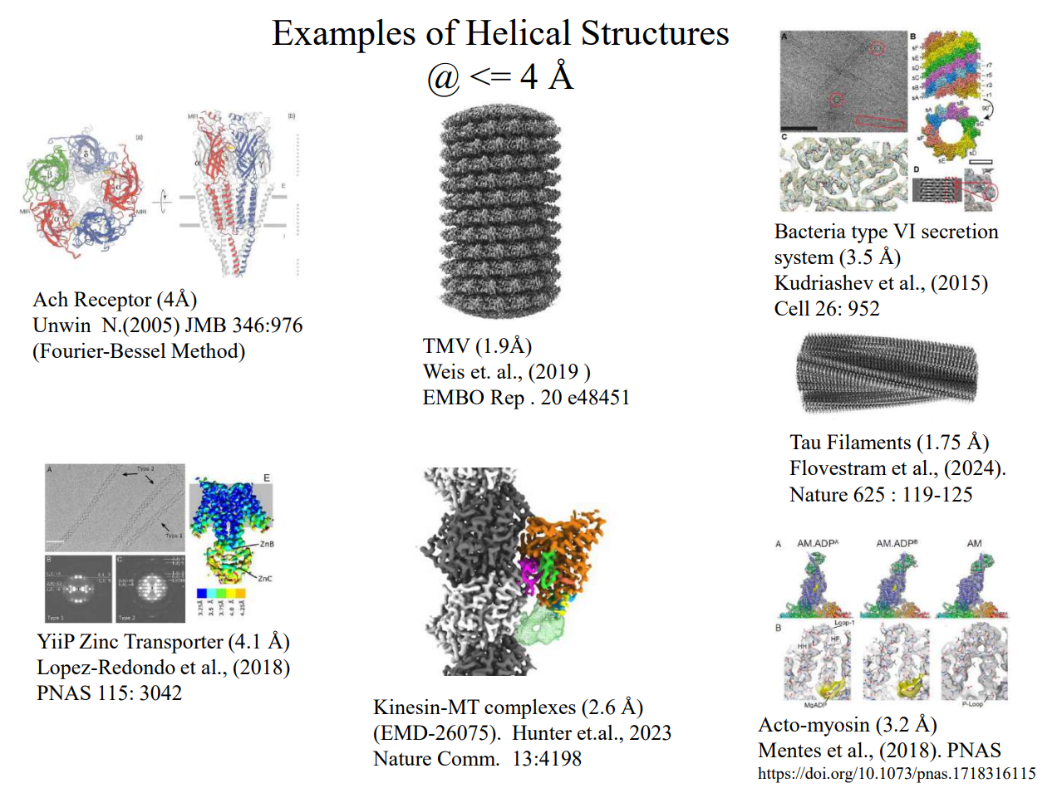

Slide 13
Software for Helical Reconstruction
Fourier-Bessel
- MRC Package
- Brandeis
- Phoelix & Suprim
- Unwin’s routines
- Toyoshima’s routines
- Ruby-Helix
- EMIP
Single-particle-like IHRSR
- FREALIGN
- IHRSR
- SPRING
- RELION (933/2449 in EMDB)
- cryoSPARC

Slide 14
Helical Reconstruction Workflow
- Preprocessing (Motion correction, CTF estimation)
- Pick filaments: EMAN2, RELION (Manual)
topaz, crYOLO (Automatic)
- Particles extractions
- 2D Classification
- Initial model: Custom
- Determine helical parameters (twist, rise): Custom
- 3D refinement
- Model building

Slide 15
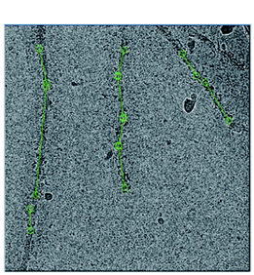
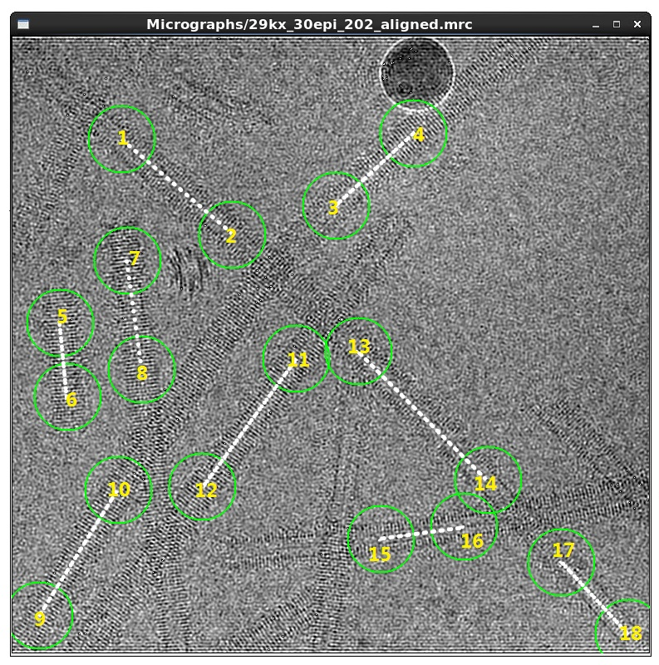
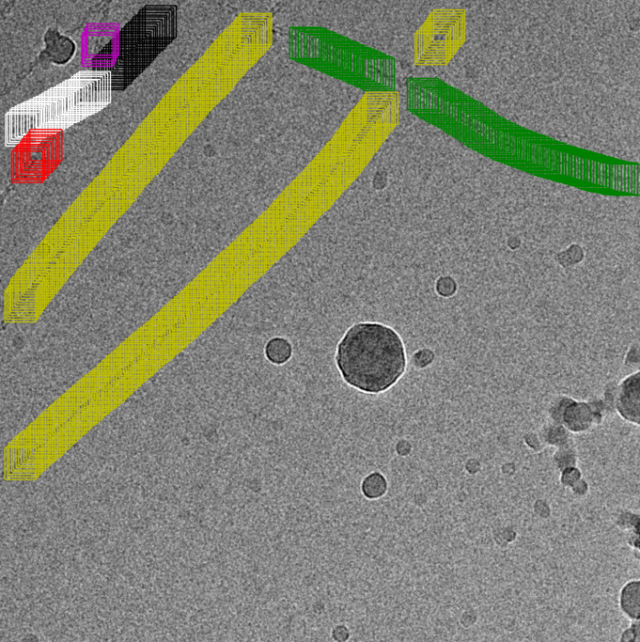
Filament picking
Manually picking
Automatics: Topaz
Automatics: cyYOLO
Manual: pick straight filaments, avoid junction
Automatic: try to tuning parameter, train your own model

Slide 16
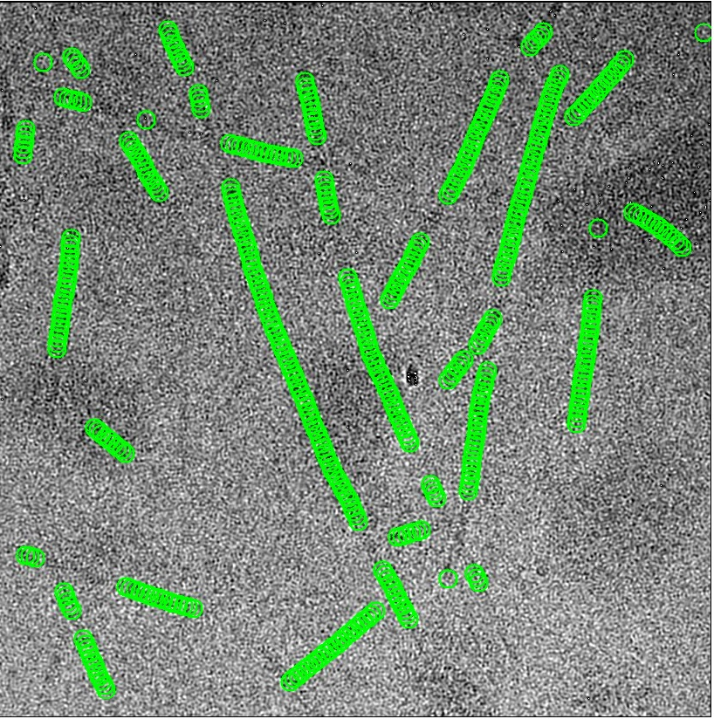
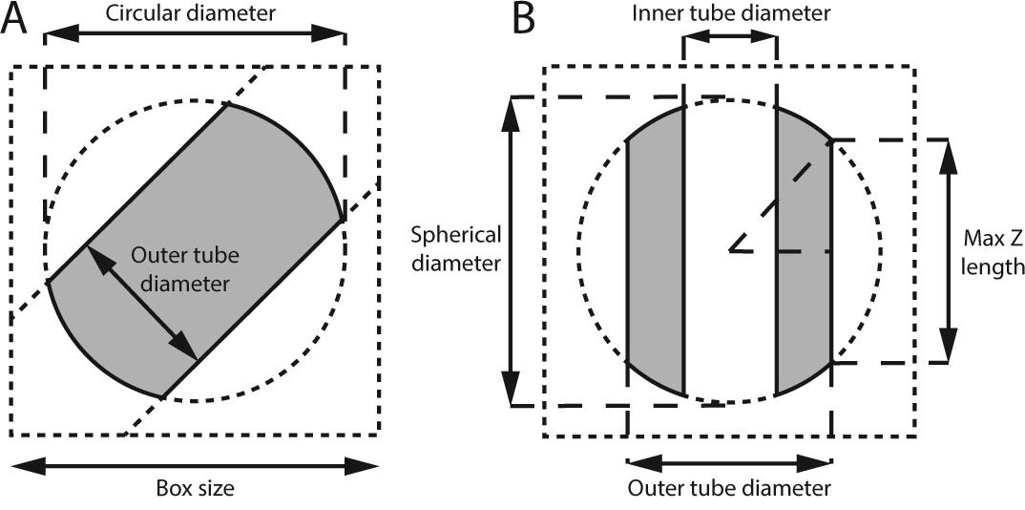
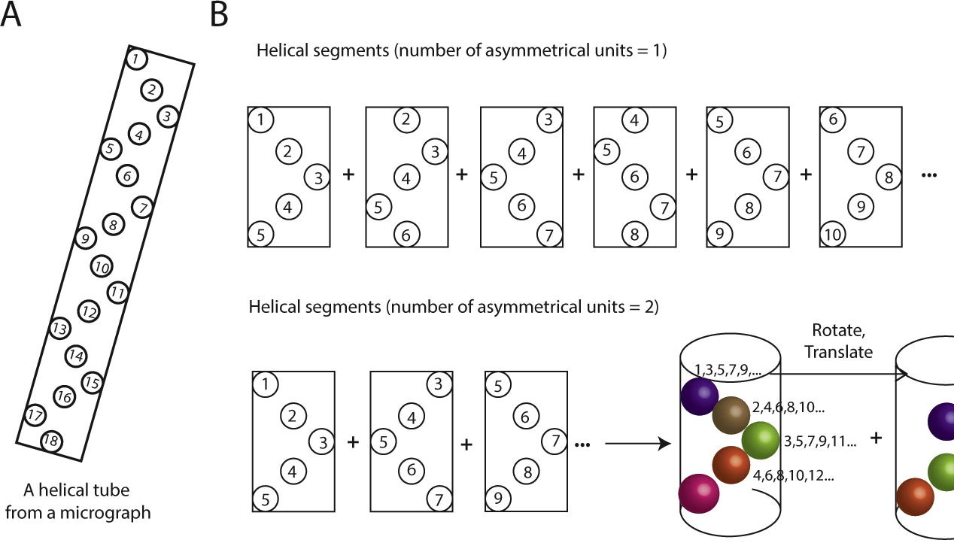
Particle Extraction
Things to keep in mind:
Overlapping distance between box

Slide 17
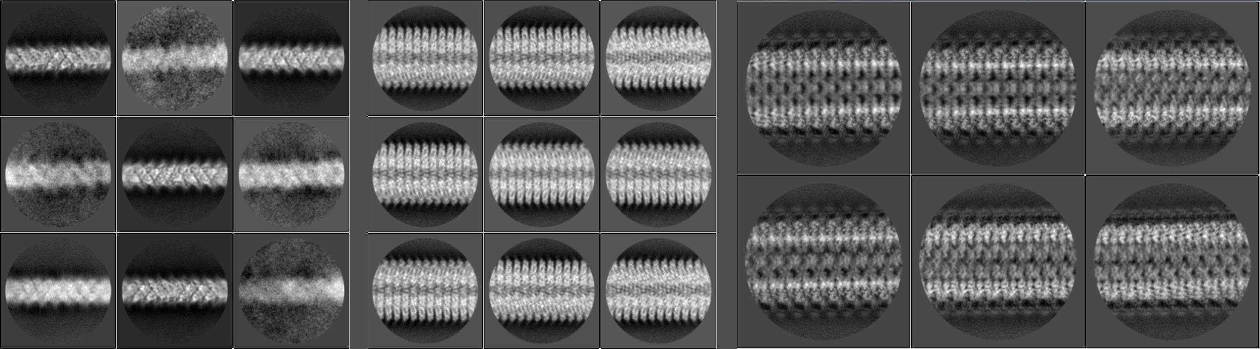
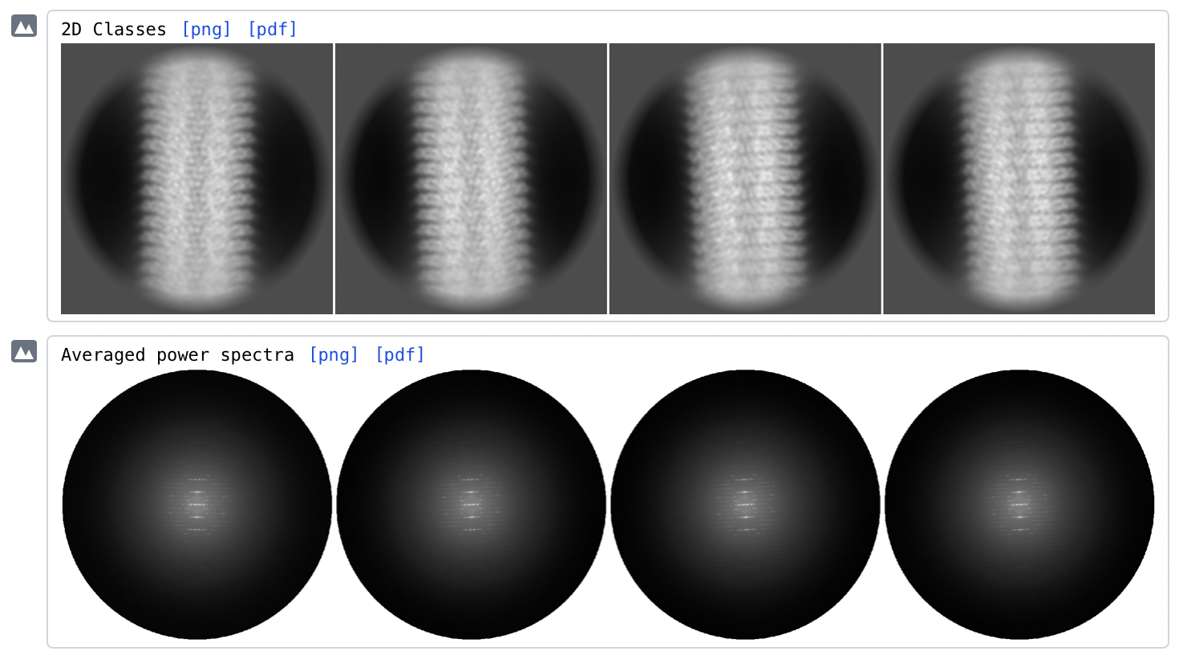
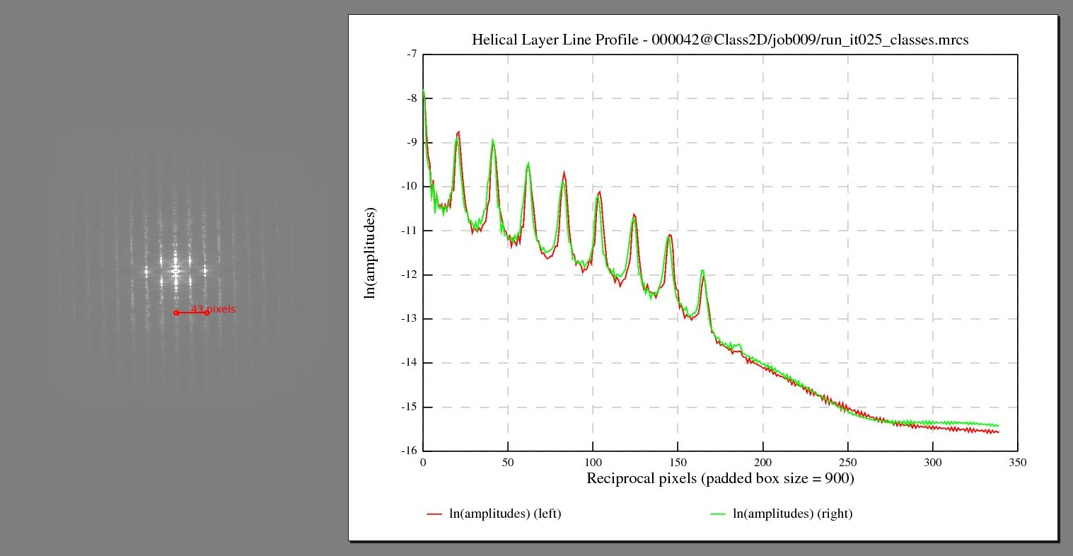
2D Classification
- Try to tune T value in RELION
- Ignore CTF first peak
- Calculation of layer lines or averaged power spectra
- Determine helical rise and twist
- http://rico.ibs.fr/helixplorer/

Slide 18
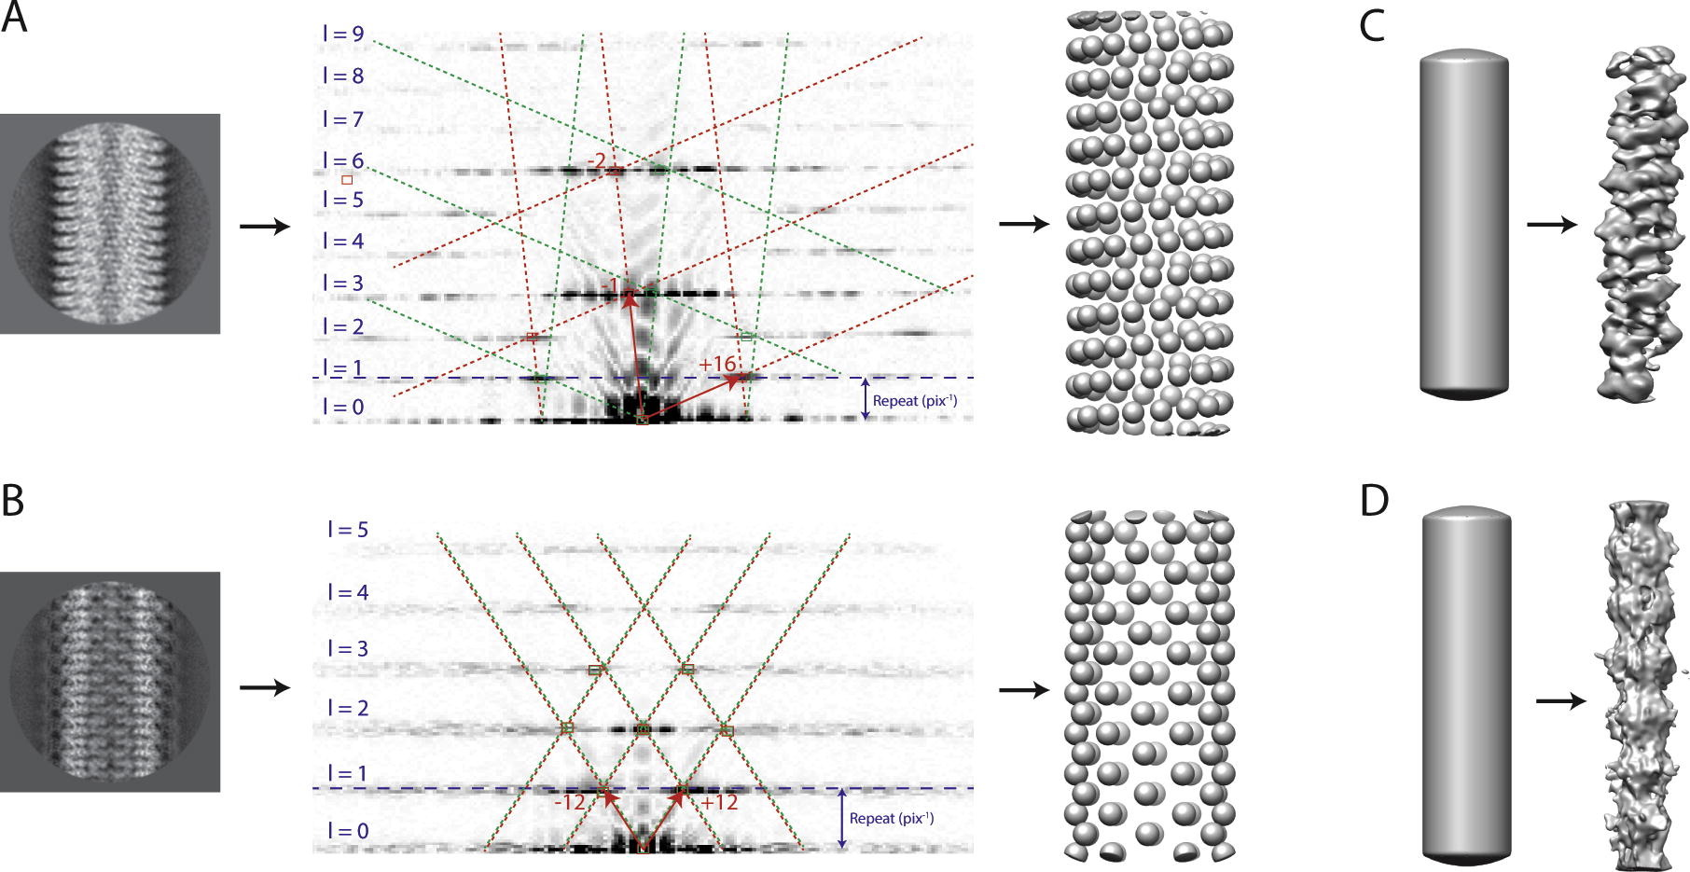
Initial model
Featureless cylinder:
- helical width
Simulated helical lattices
- helical twist and rise are known
For some case, you need to test different
kind of initial models

Slide 19
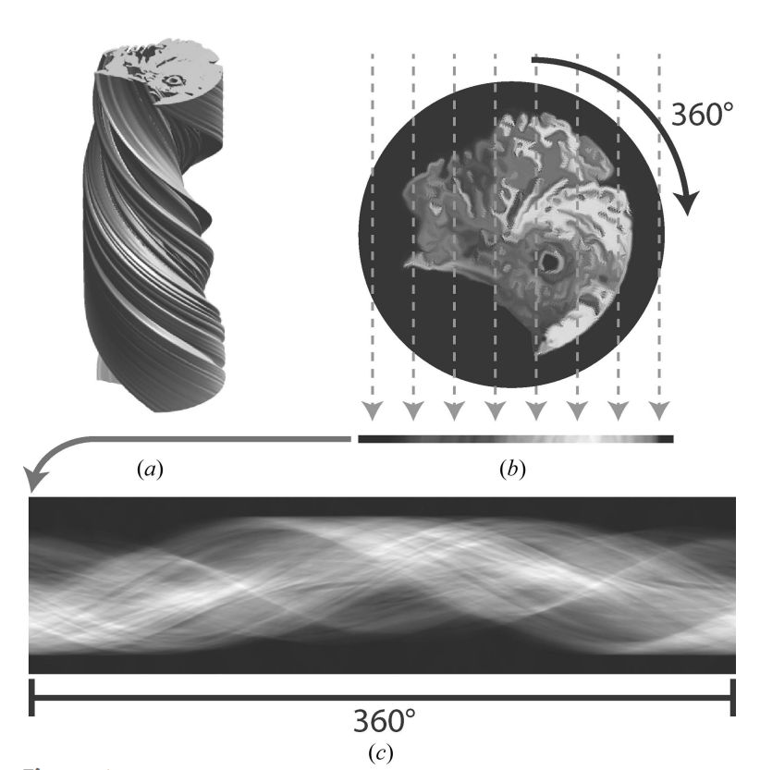
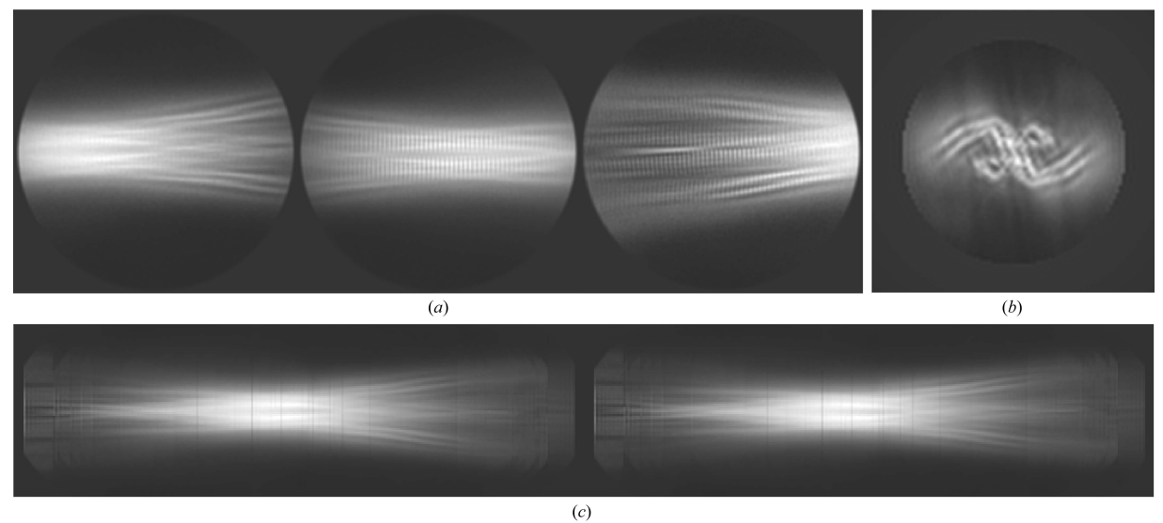
Initial model: amyloid fibril
- Making a sinogram by put together 2D class averages
- Build initial model from sinogram
- Classify different kinds of filaments and estimate patch distance
(Scheres, 2020)

Slide 20
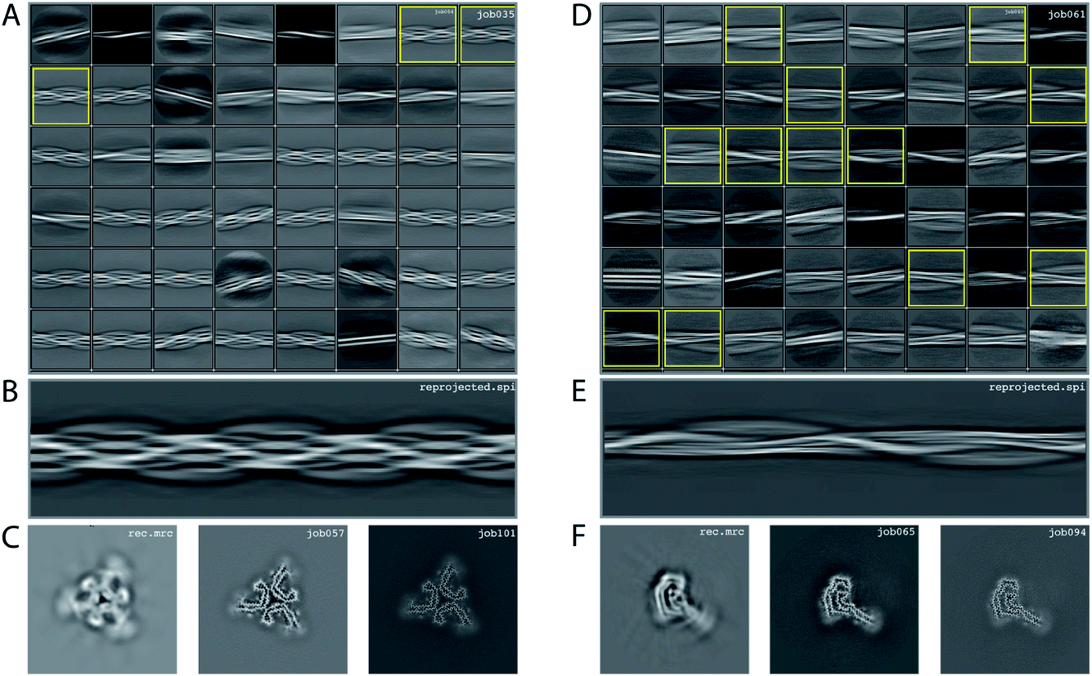
(Lövestam 2022)

Slide 21
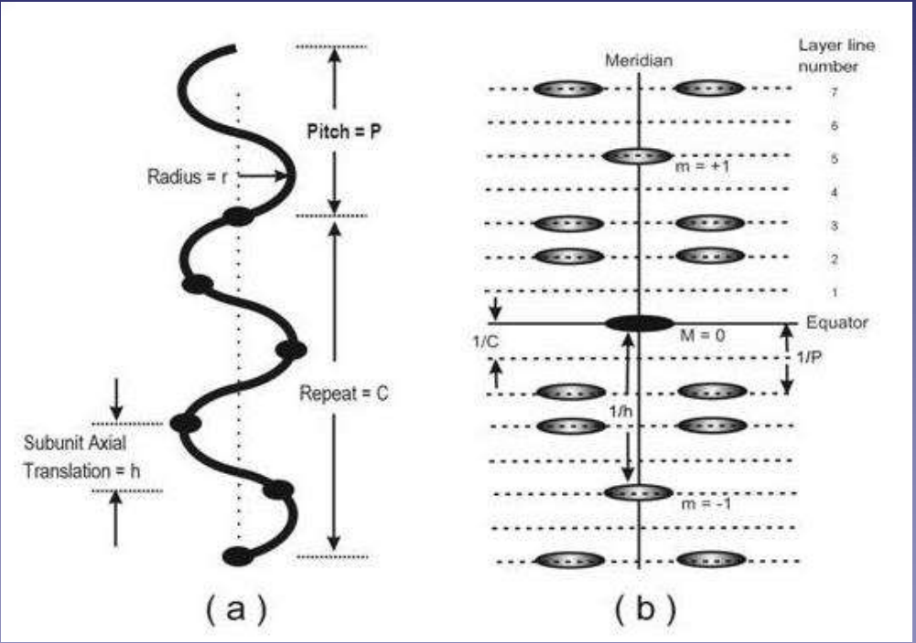
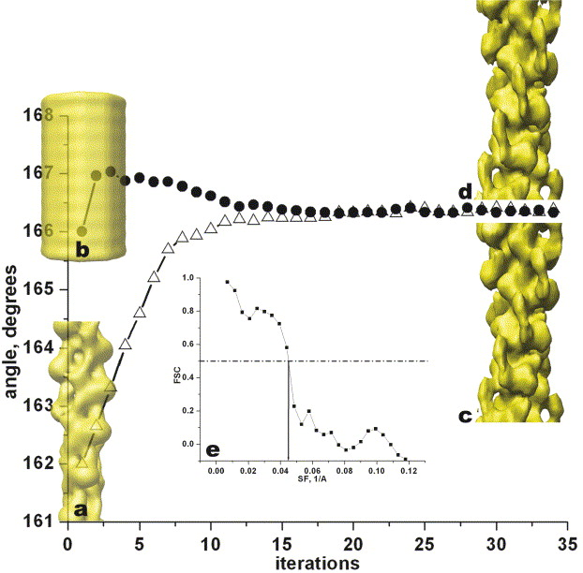
3D Reconstruction
- Determine helical twist and rise:
provided by literature, indexing power spectra,
mass-per-length by TMV
- Try different helical twist and rise combinations
- Try different kind of initial model
- Check whether helical parameter and map converge
- Check the map by visual inspection

Slide 22
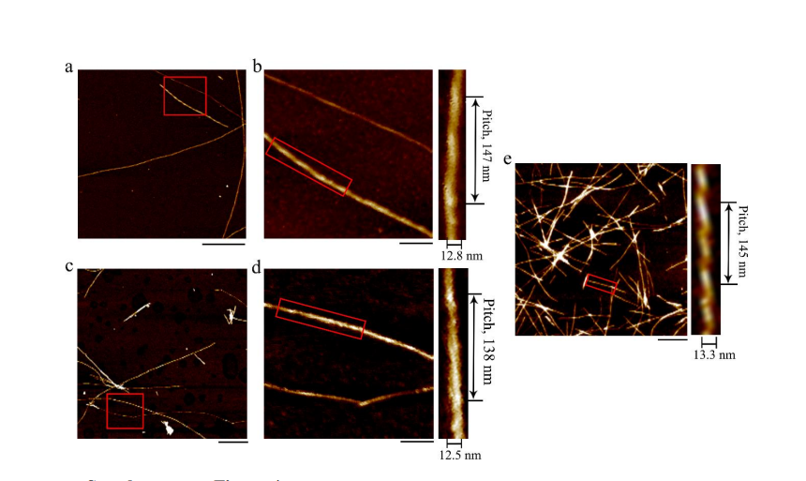
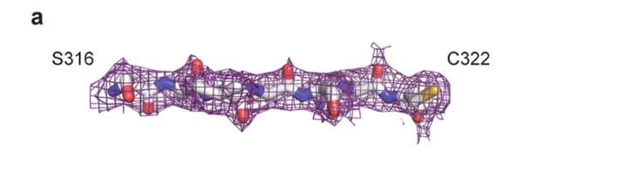
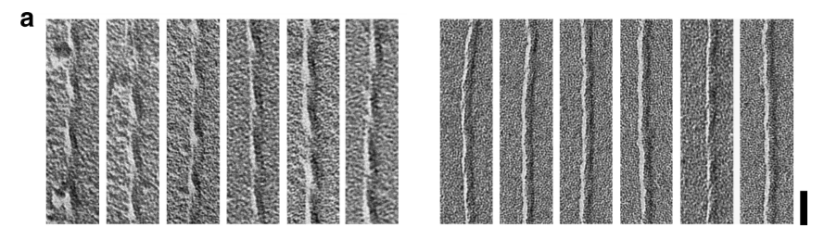
Handedness
- a-helix is right handed
- AFM
- Negative staining metal shadowing
- Check carbonyl group density

Slide 23
Questions?

