Slide 1

CryoSPARC
03-2D & 3D classification
Dr. Chun-Hsiung Wang
王俊雄
2026/03/16

Slide 2
Workflow of single particle analysis using cryoSPARC
Import Dataset
Ab-initio 3D Classification
Movies
Motion corrected
Micrographs
Motion Correction
Heterogeneous Refinement
3D
Pre-
process
CTF Estimation
Homogeneous Refinement
Micrograph Curation
Non-uniform Refinement
or
Particle Picking
Local Refinement
Advanced
3D
or
Particle picking
Particle Curation
3D class, 3D Var, 3D Flex
Particle Extraction
Post-processing & Sharpening
2D
2D Classification
Final Structures

Slide 3
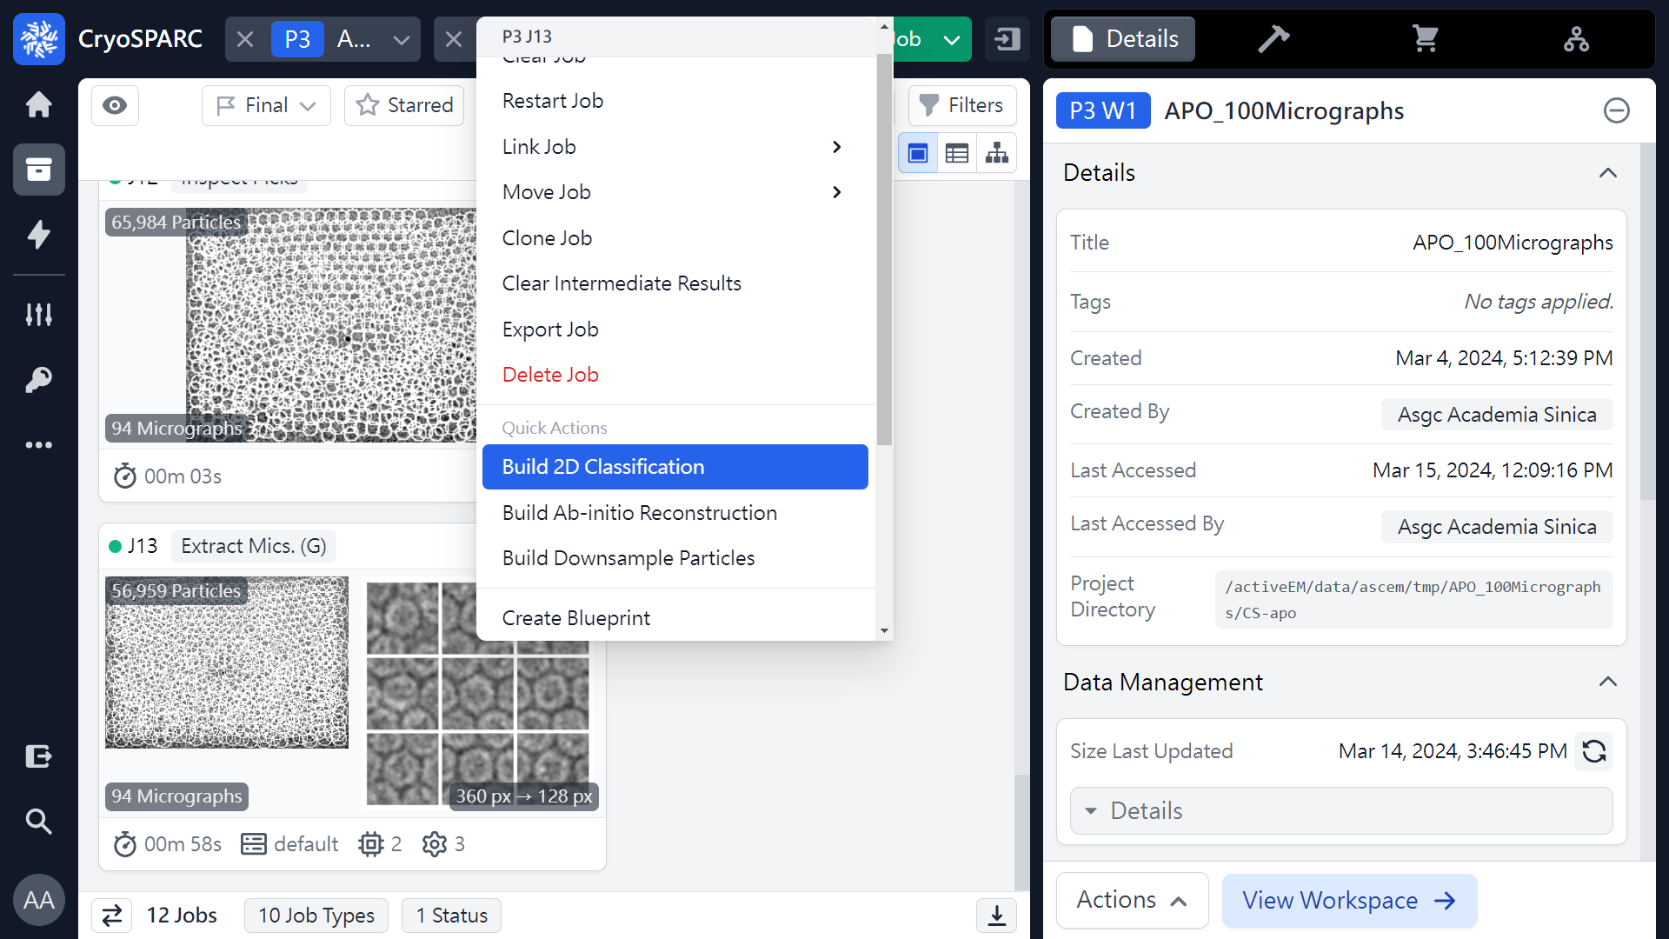
2D classification
or 
 2
 1
Mouse right click
(ref: cryoSPARC website. https://cryosparc.com/)

Slide 4
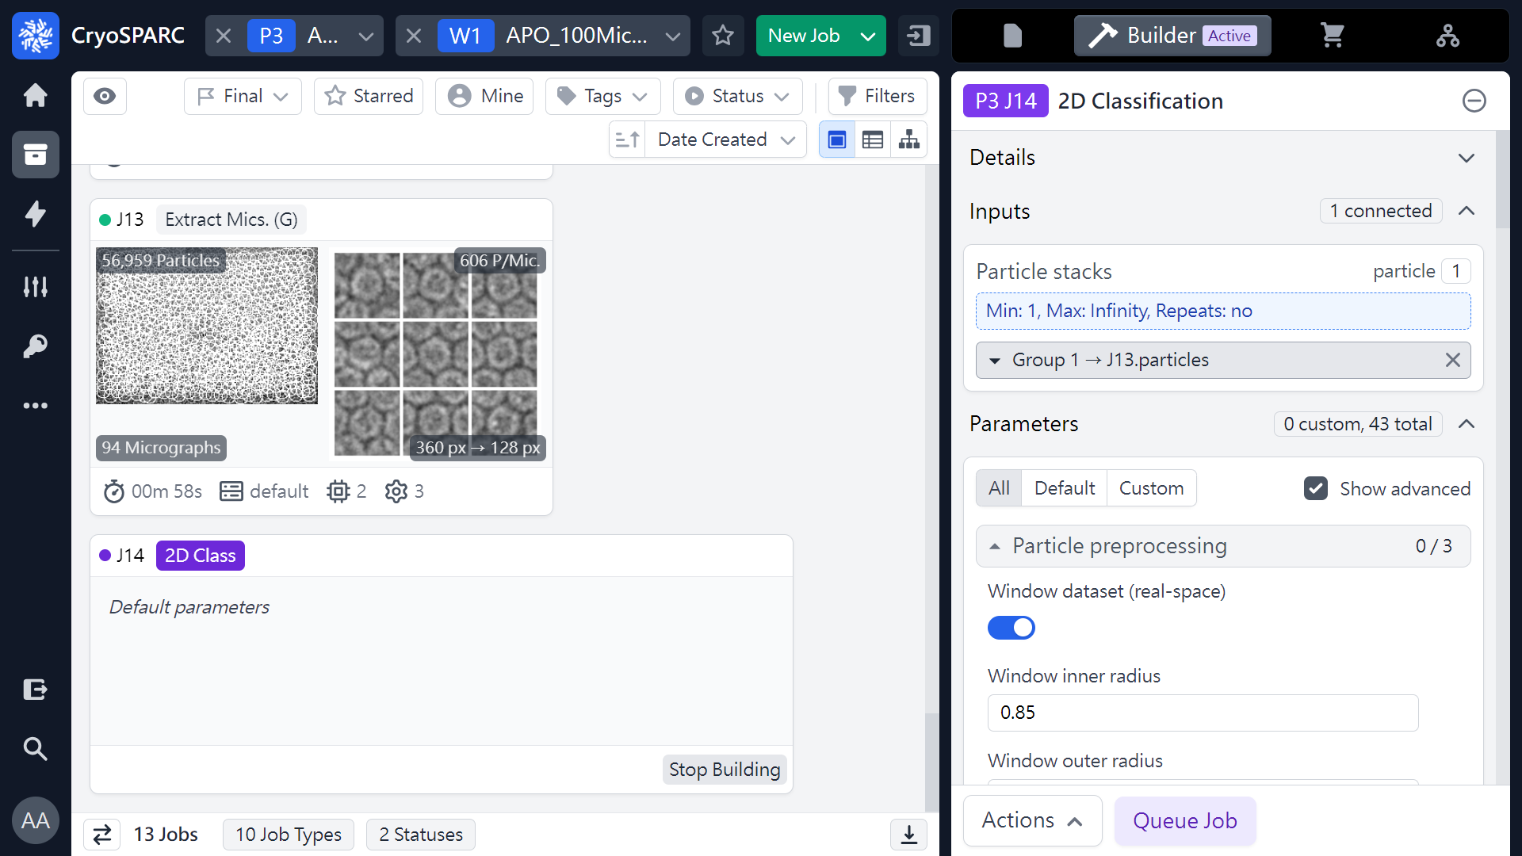
2D classification (Parameters)
(ref: cryoSPARC website. https://cryosparc.com/)

Slide 5
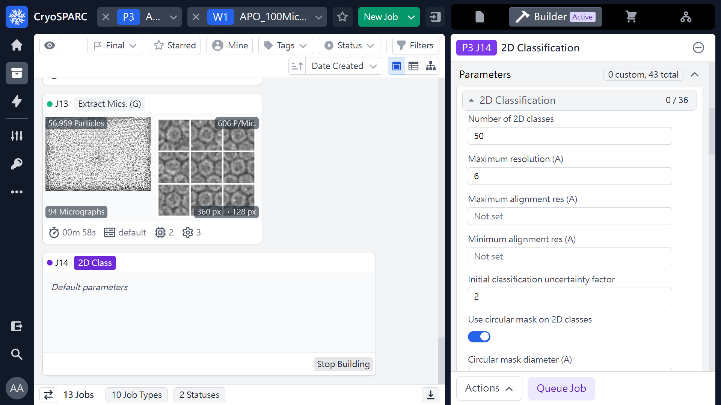
2D classification (Parameters)
(ref: cryoSPARC website. https://cryosparc.com/)

Slide 6
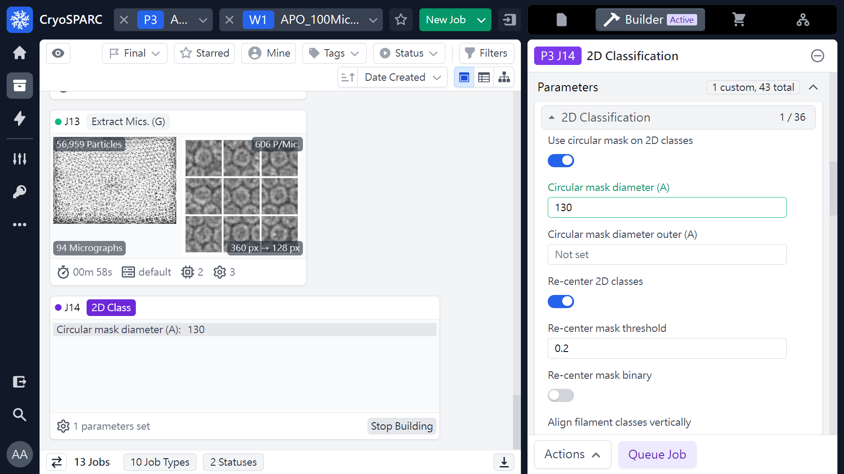
2D classification (Parameters)
 1
(ref: cryoSPARC website. https://cryosparc.com/)

Slide 7
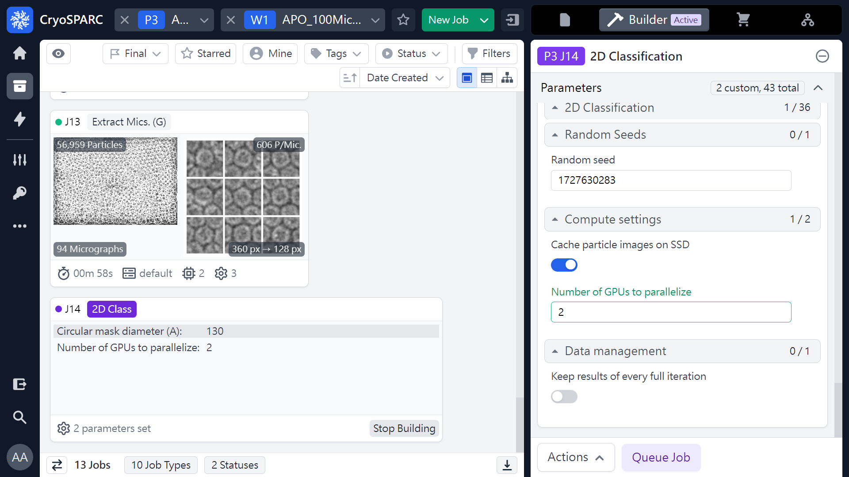
2D classification (Parameters)
 1
 2
(ref: cryoSPARC website. https://cryosparc.com/)

Slide 8
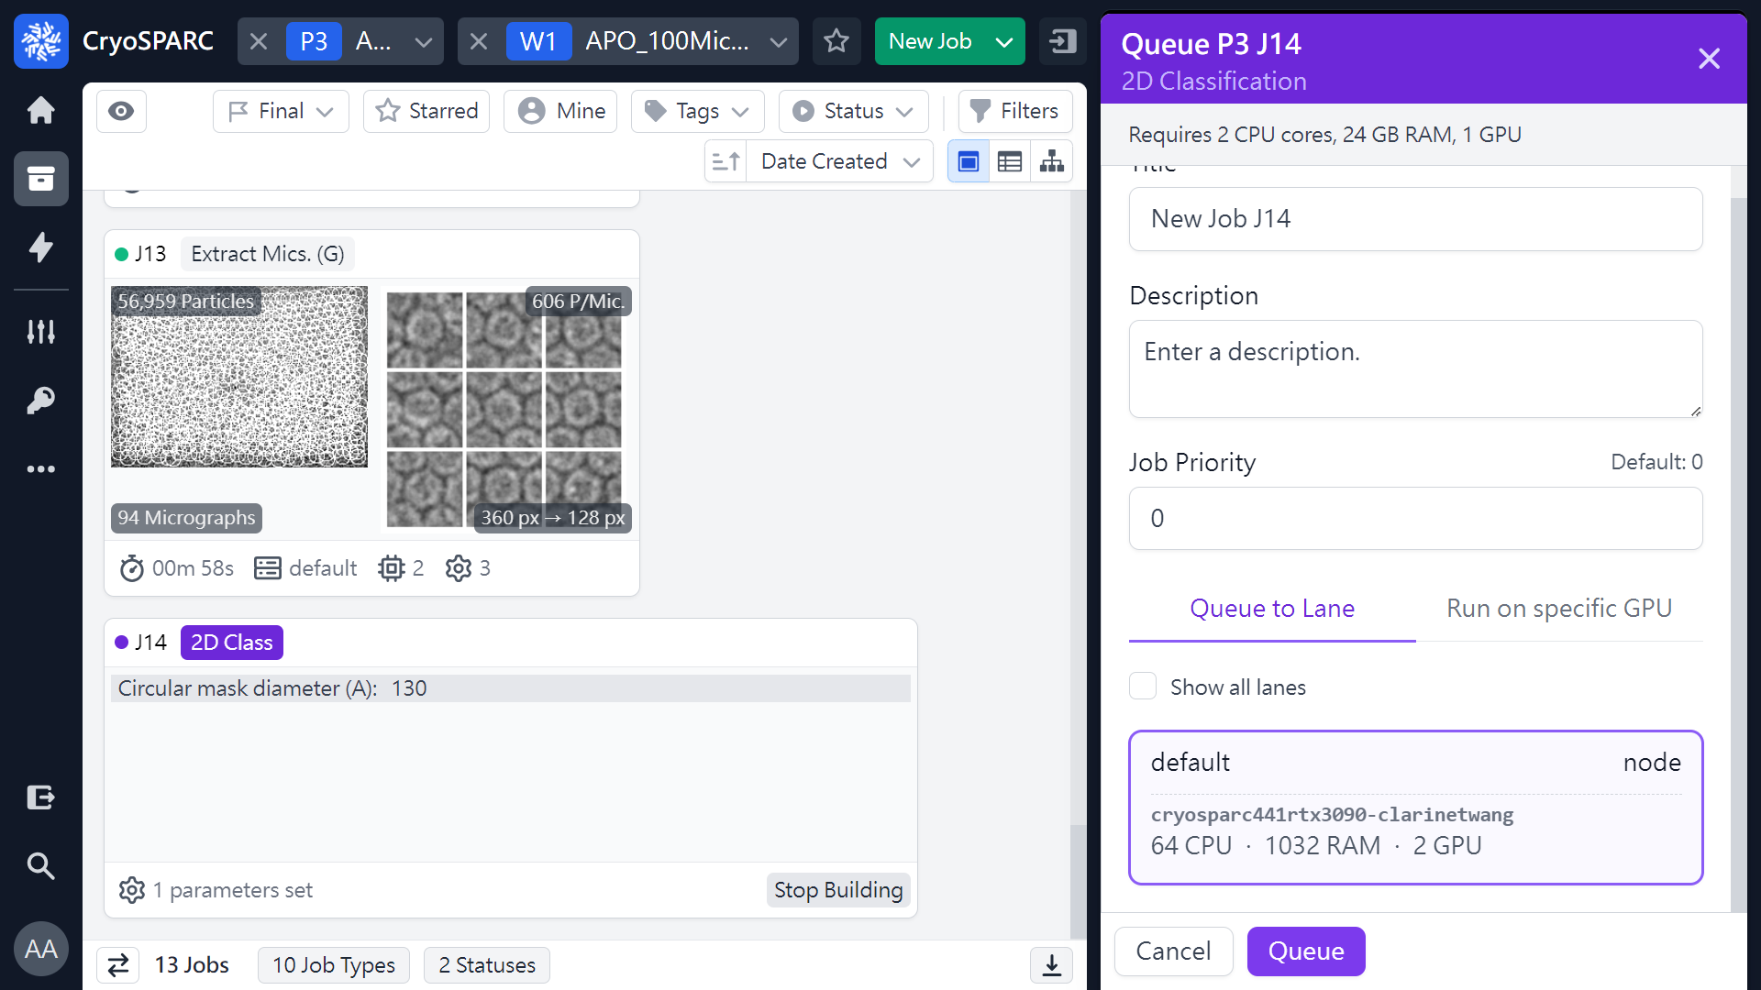
2D classification (Parameters)
 1
(ref: cryoSPARC website. https://cryosparc.com/)

Slide 9
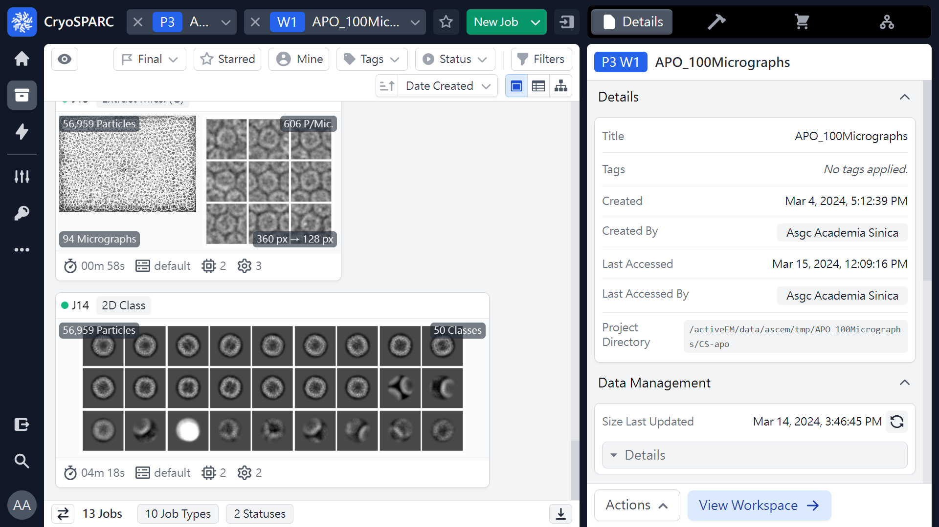
2D classification (Job finished)
 1
(ref: cryoSPARC website. https://cryosparc.com/)

Slide 10
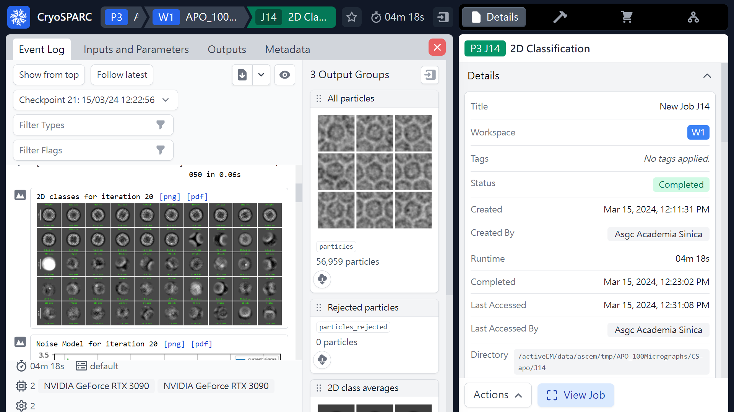
2D classification (Results)
 1
(ref: cryoSPARC website. https://cryosparc.com/)

Slide 11
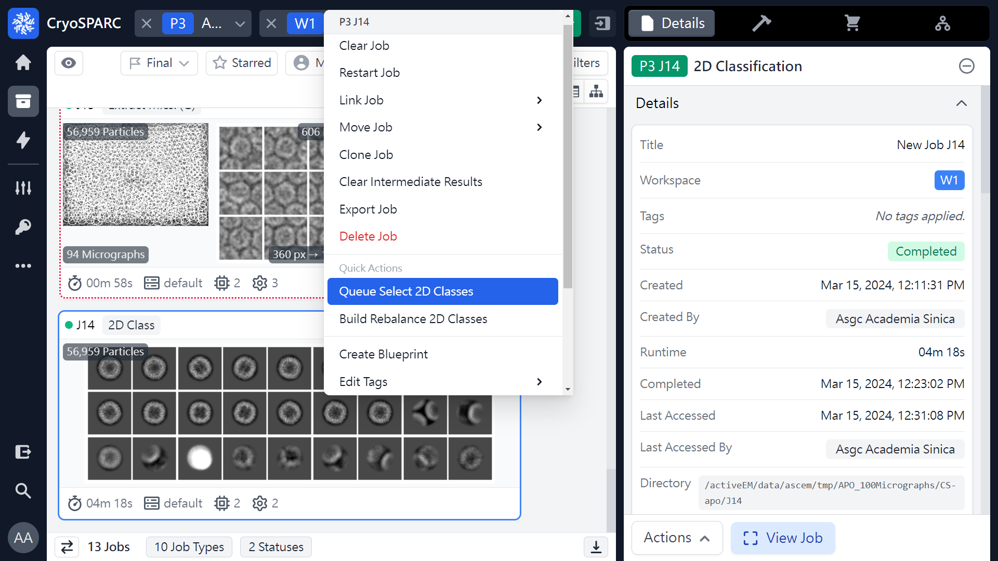
Select 2D Classes
or 
 2
 1
Mouse right click
(ref: cryoSPARC website. https://cryosparc.com/)

Slide 12
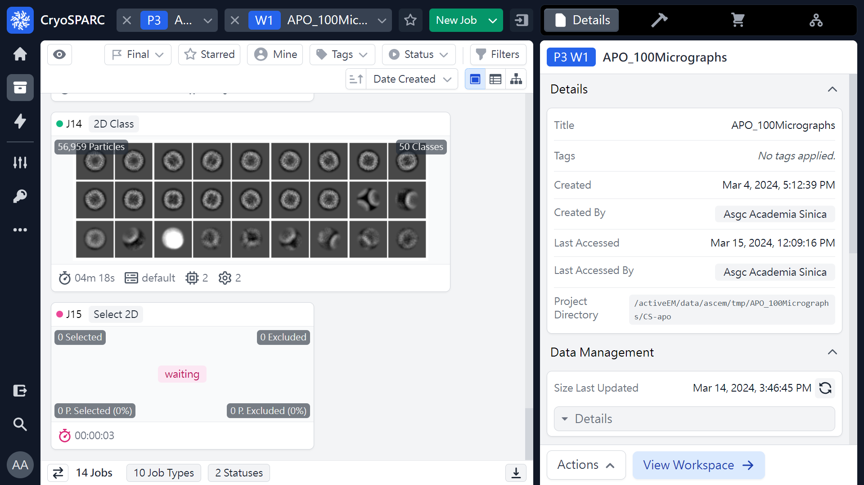
Select 2D Classes
 1
(ref: cryoSPARC website. https://cryosparc.com/)

Slide 13
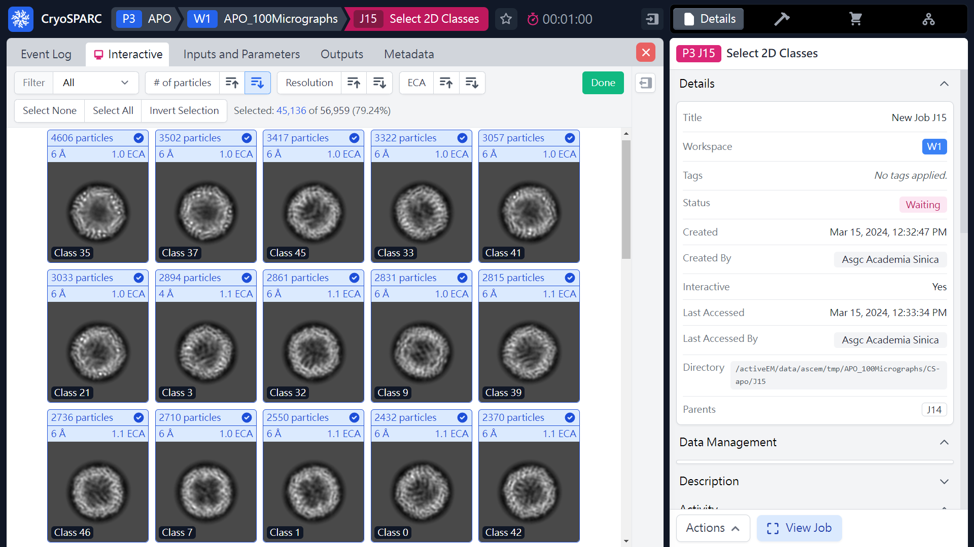
Select 2D Classes
 1
(ref: cryoSPARC website. https://cryosparc.com/)

Slide 14
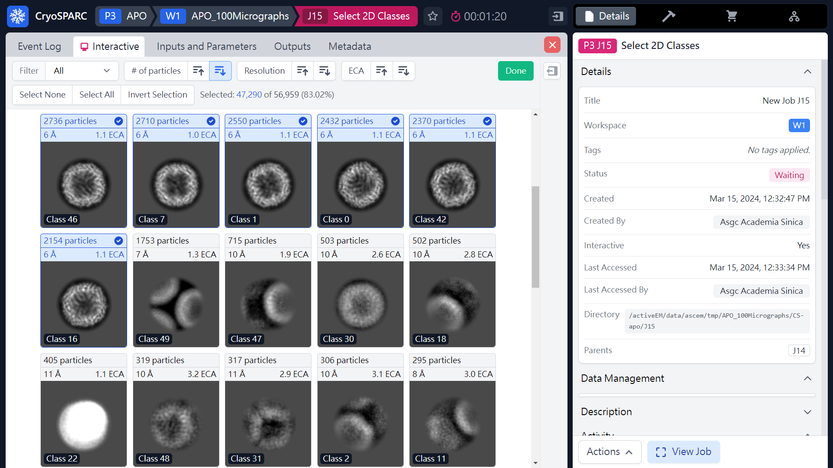
Select 2D Classes
 2
 1
(ref: cryoSPARC website. https://cryosparc.com/)

Slide 15
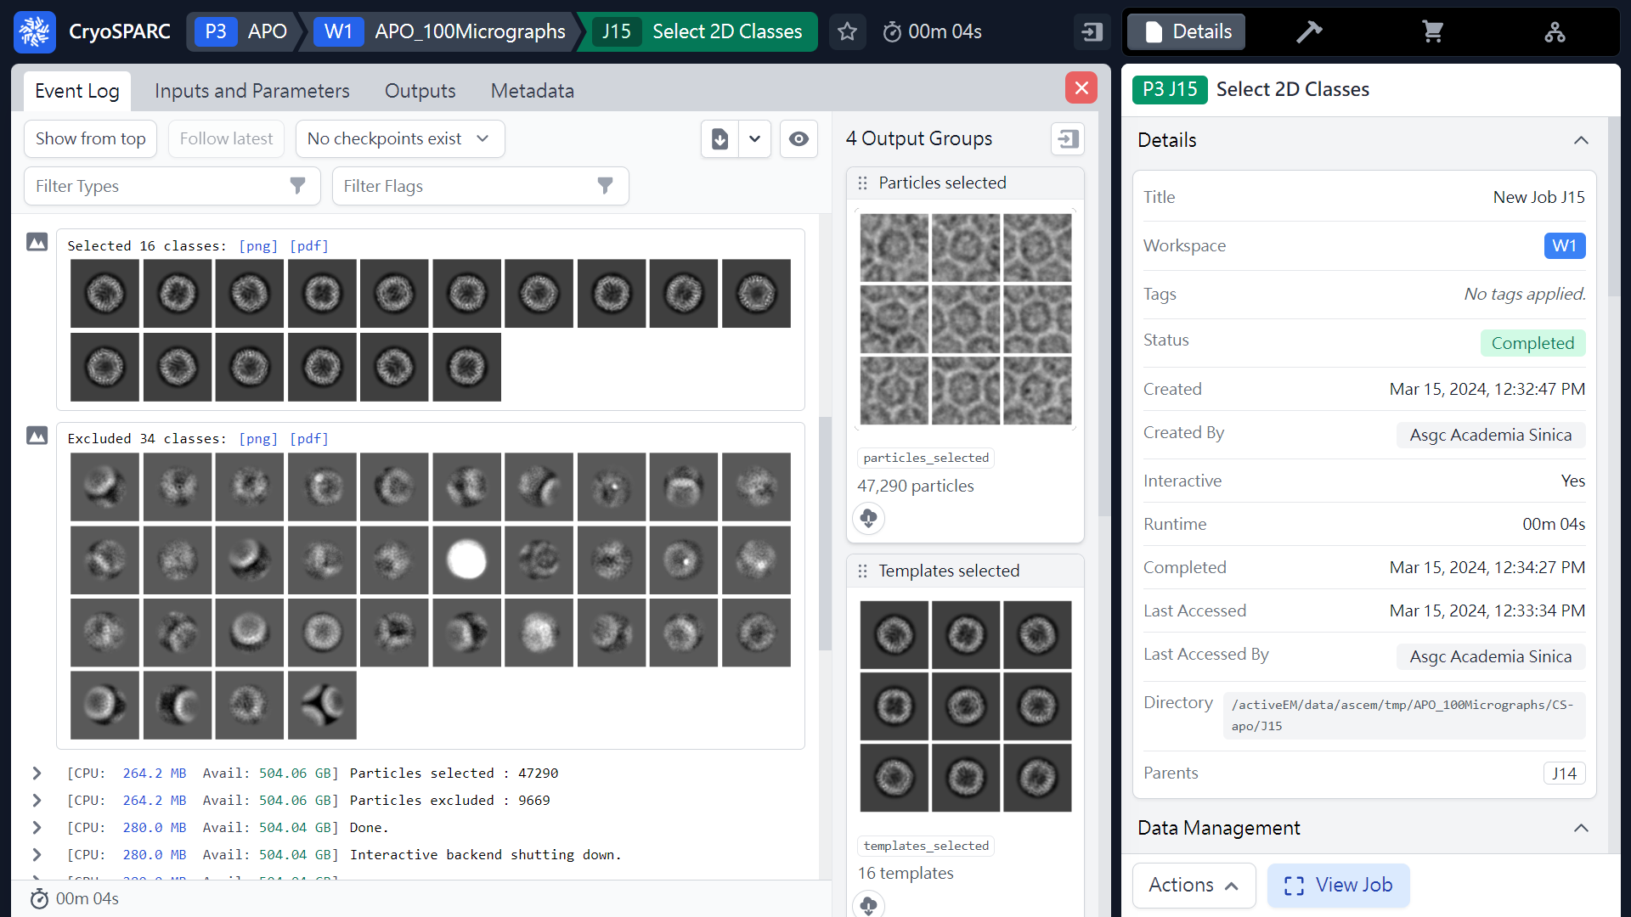
Select 2D Classes (Results)
 1
Selected 16 classes
47,290 particles
Exclude 34 classes
16 templates
(ref: cryoSPARC website. https://cryosparc.com/)

Slide 16
Workflow of single particle analysis using cryoSPARC
Import Dataset
Ab-initio 3D Classification
Movies
Motion corrected
Micrographs
Motion Correction
Heterogeneous Refinement
3D
Pre-
process
CTF Estimation
Homogeneous Refinement
Micrograph Curation
Non-uniform Refinement
or
Particle Picking
Local Refinement
Advanced
3D
or
Particle picking
Particle Curation
3D class, 3D Var, 3D Flex
Particle Extraction
Post-processing & Sharpening
2D
2D Classification
Final Structures

Slide 17
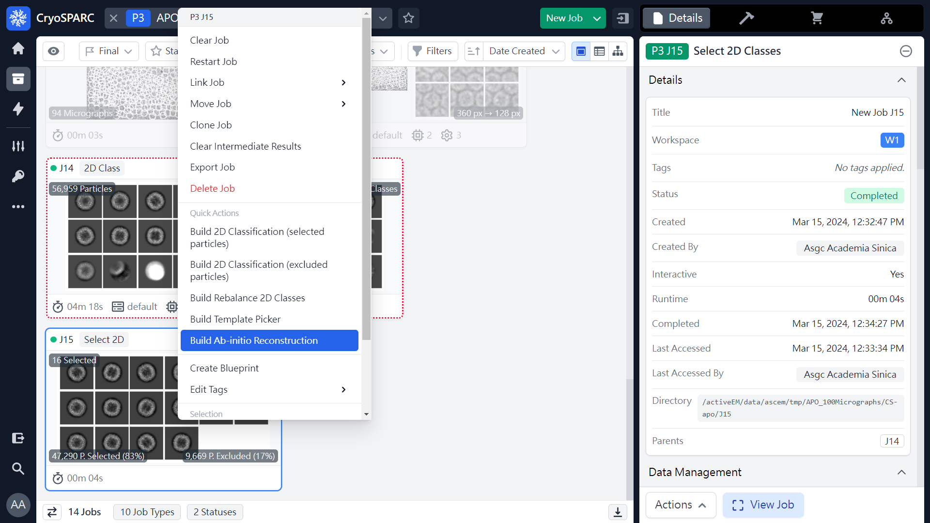
Ab-initio Reconstruction
or 
 2
 1
Mouse right click
(ref: cryoSPARC website. https://cryosparc.com/)

Slide 18
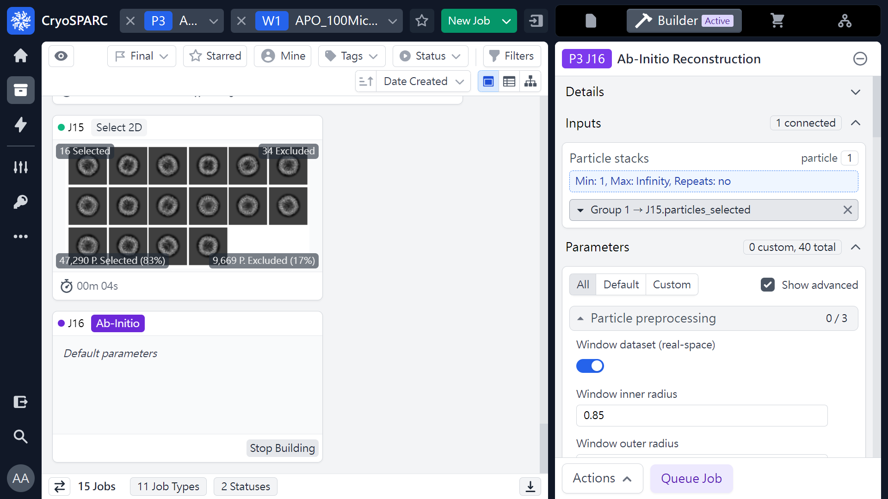
Ab-initio Reconstruction (Parameters)
(ref: cryoSPARC website. https://cryosparc.com/)

Slide 19
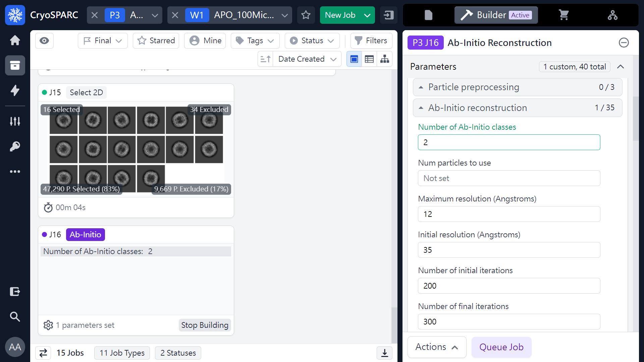
Ab-initio Reconstruction (Parameters)
 1
(ref: cryoSPARC website. https://cryosparc.com/)

Slide 20
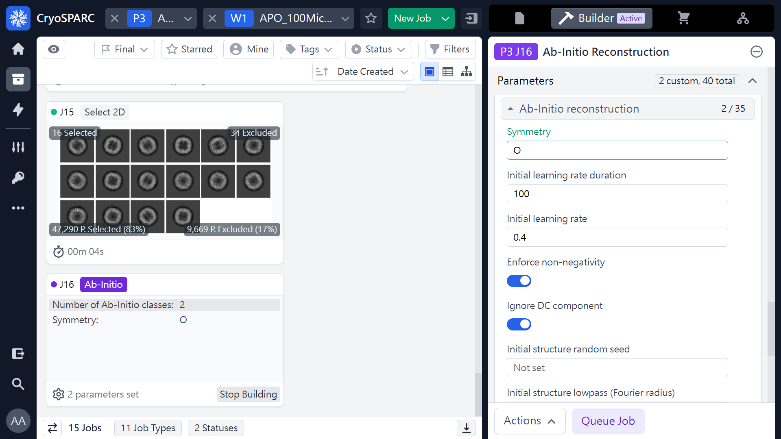
Ab-initio Reconstruction (Parameters)
 1
 2
(ref: cryoSPARC website. https://cryosparc.com/)

Slide 21
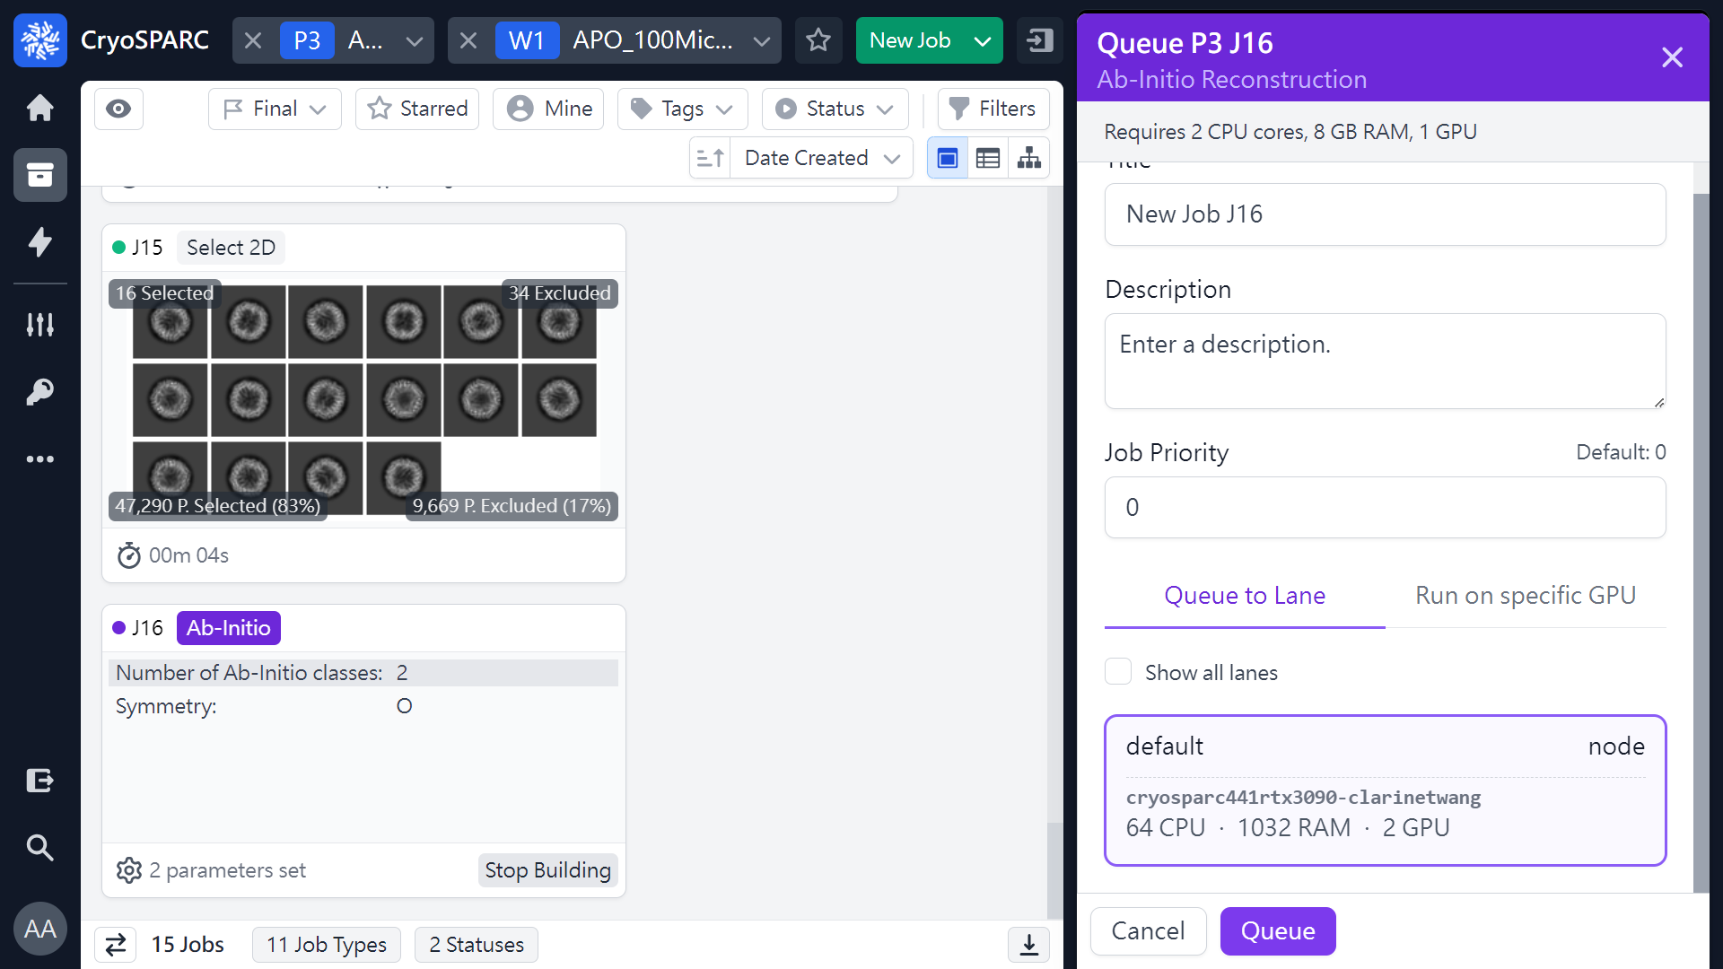
Ab-initio Reconstruction (Parameters)
 1
(ref: cryoSPARC website. https://cryosparc.com/)

Slide 22
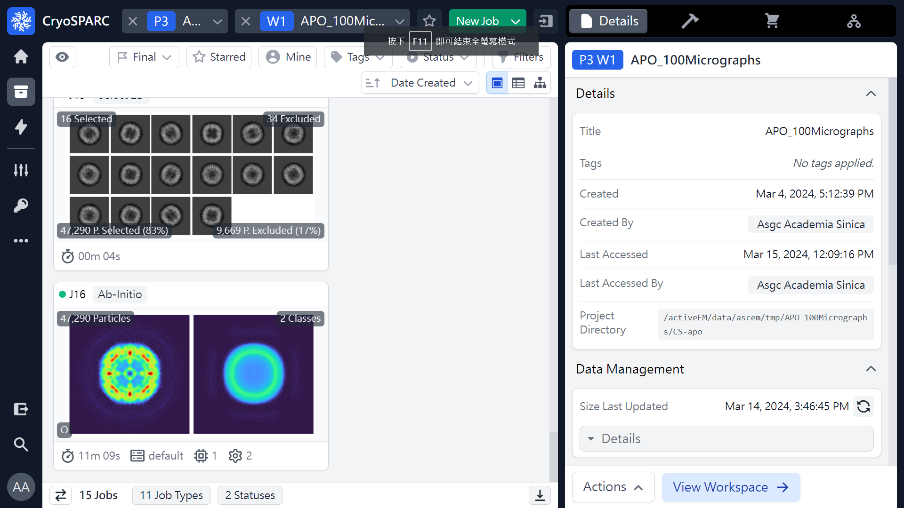
Ab-initio Reconstruction (Job finished)
 1
(ref: cryoSPARC website. https://cryosparc.com/)

Slide 23
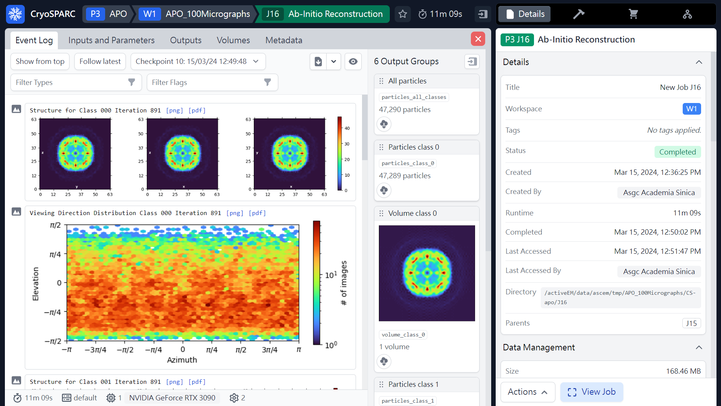
Ab-initio Reconstruction (Results)
Class 000
47,289 particles
Volume_class_0
(ref: cryoSPARC website. https://cryosparc.com/)

Slide 24
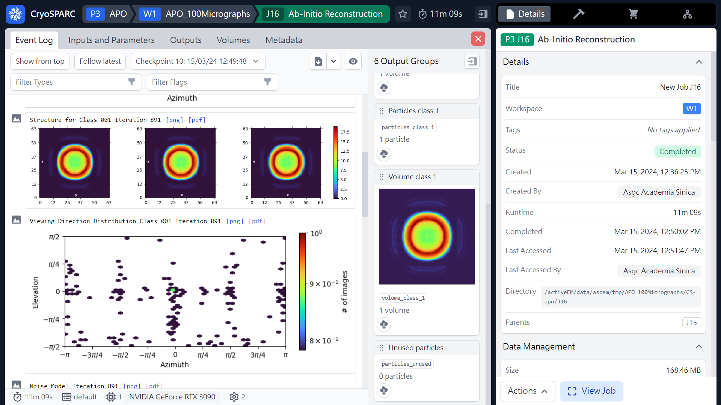
Ab-initio Reconstruction (Results)
Class 001
1 particles
Volume_class_1
(ref: cryoSPARC website. https://cryosparc.com/)

Slide 25
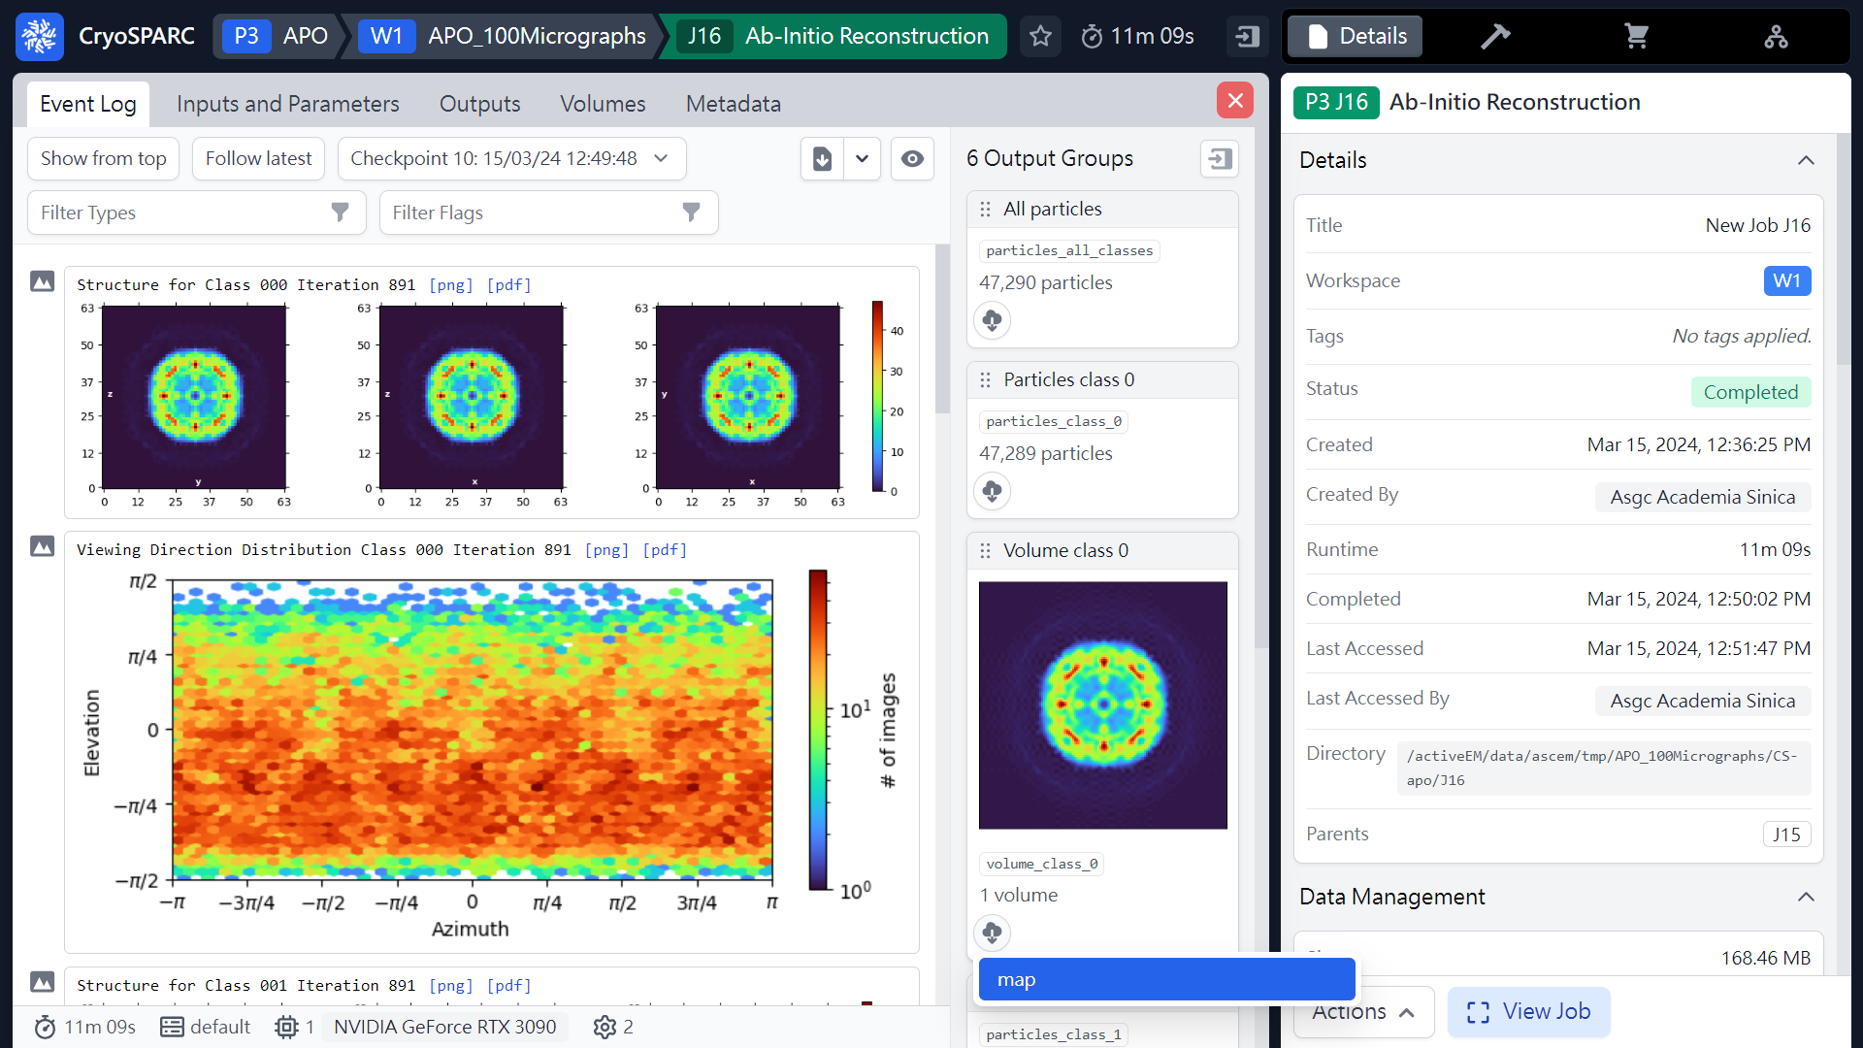
Ab-initio Reconstruction (Download maps)
 3
 1
2
Download map
(ref: cryoSPARC website. https://cryosparc.com/)

Slide 26
Workflow of single particle analysis using cryoSPARC
Import Dataset
Ab-initio 3D Classification
Movies
Motion corrected
Micrographs
Motion Correction
Heterogeneous Refinement
3D
Pre-
process
CTF Estimation
Homogeneous Refinement
Micrograph Curation
Non-uniform Refinement
or
Particle Picking
Local Refinement
Advanced
3D
or
Particle picking
Particle Curation
3D class, 3D Var, 3D Flex
Particle Extraction
Post-processing & Sharpening
2D
2D Classification
Final Structures

Slide 27
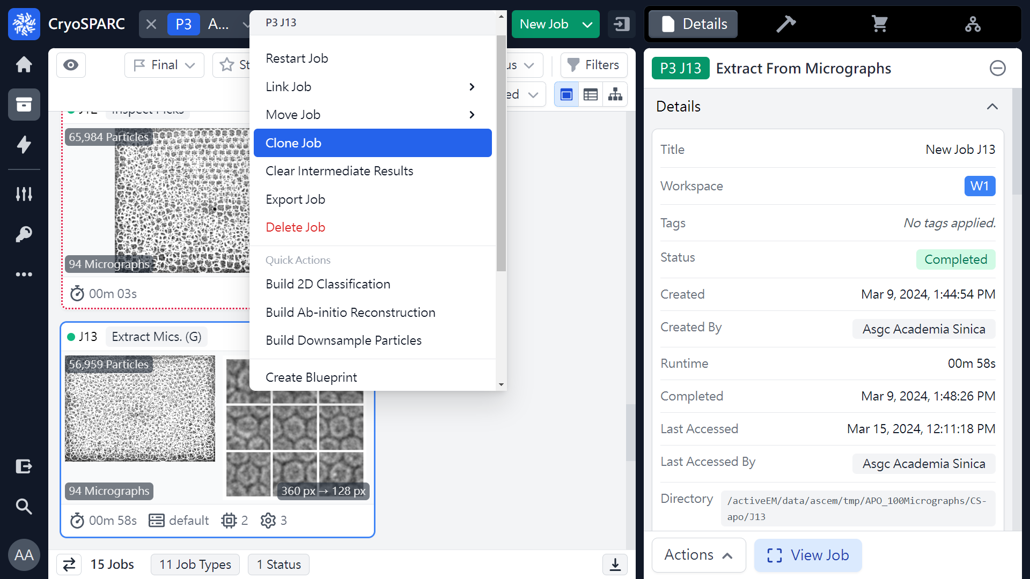
Extract From Micrographs (Clone Job)
or 
 2
 1
Mouse right click
(ref: cryoSPARC website. https://cryosparc.com/)

Slide 28
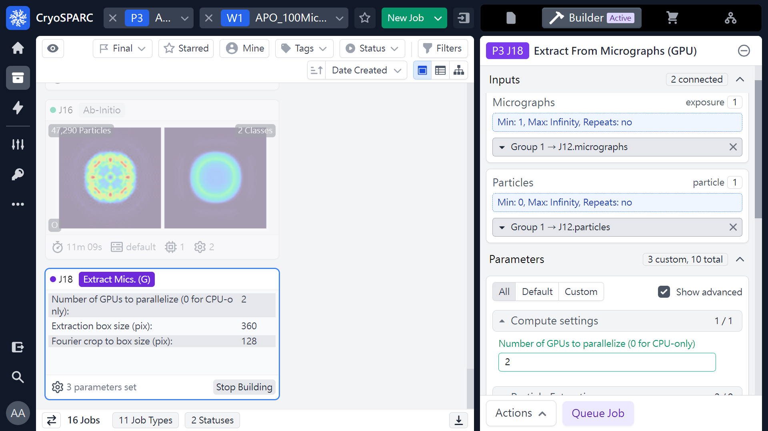
Extract From Micrographs (Parameters)
 1
(ref: cryoSPARC website. https://cryosparc.com/)

Slide 29
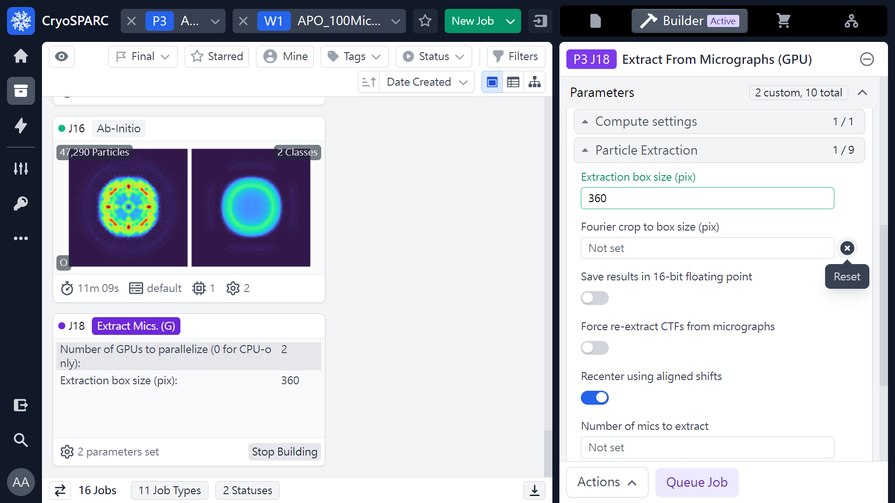
Extract From Micrographs (Parameters)
 1
 2
(ref: cryoSPARC website. https://cryosparc.com/)

Slide 30
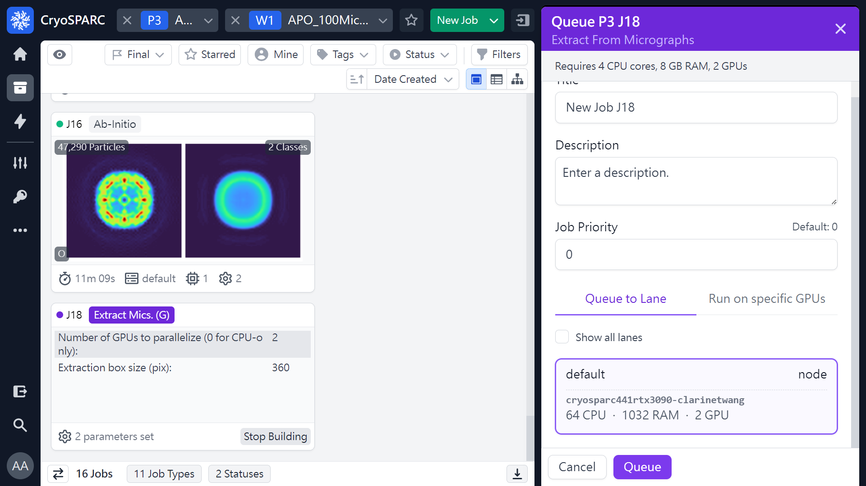
Extract From Micrographs (Parameters)
 1
(ref: cryoSPARC website. https://cryosparc.com/)

Slide 31
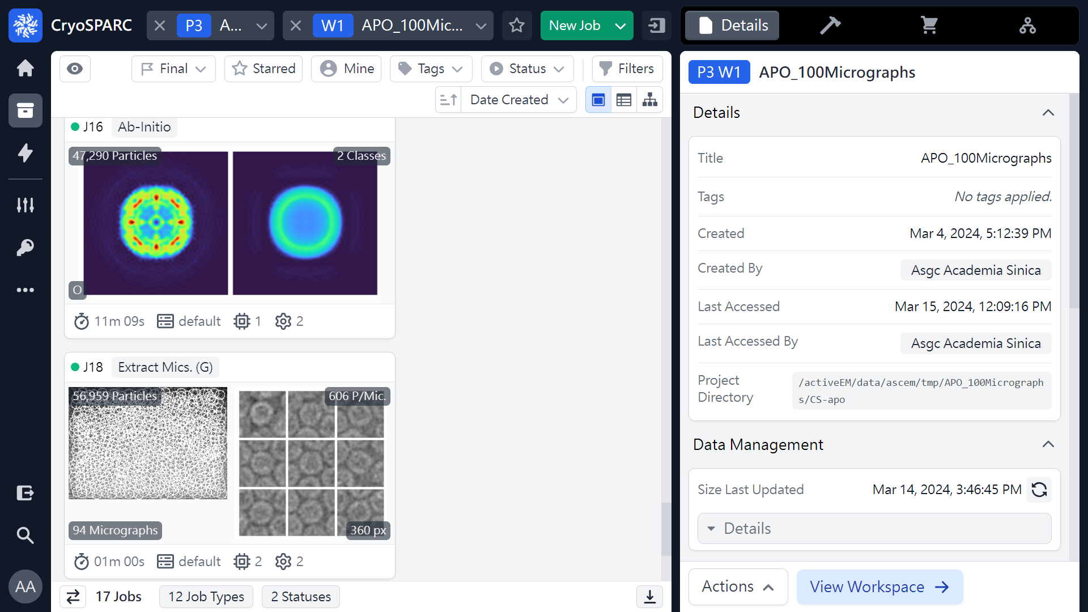
Extract From Micrographs (Job finished)
56,959 particles
(ref: cryoSPARC website. https://cryosparc.com/)

Slide 32
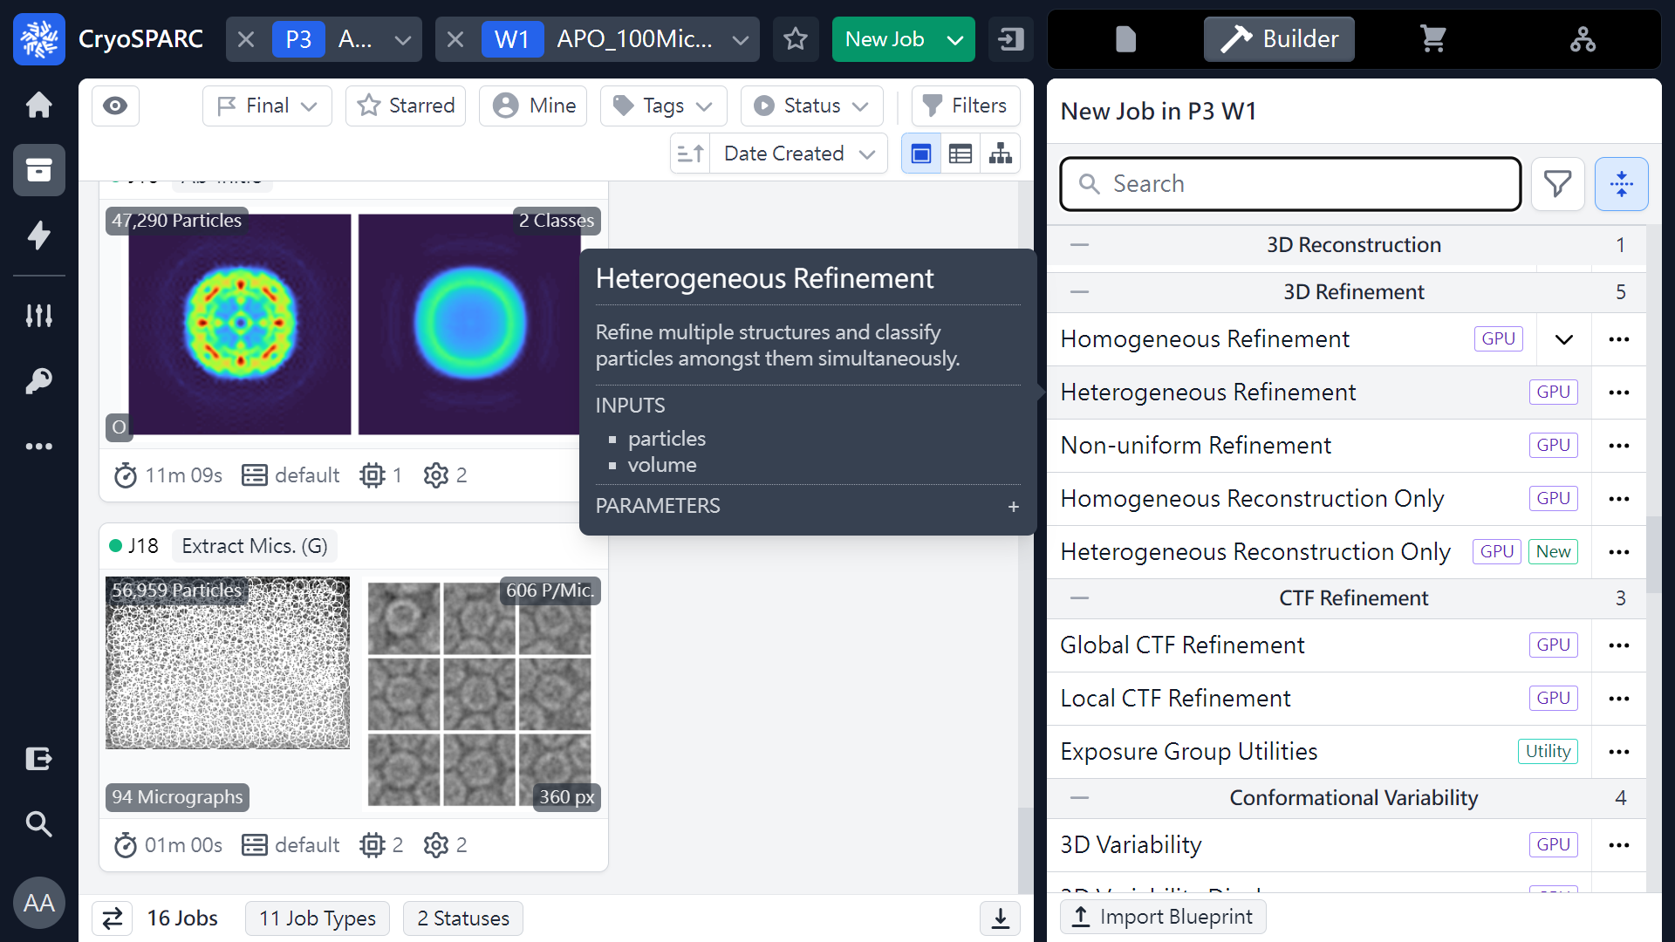
Heterogeneous refinement
 1
 2
(ref: cryoSPARC website. https://cryosparc.com/)

Slide 33
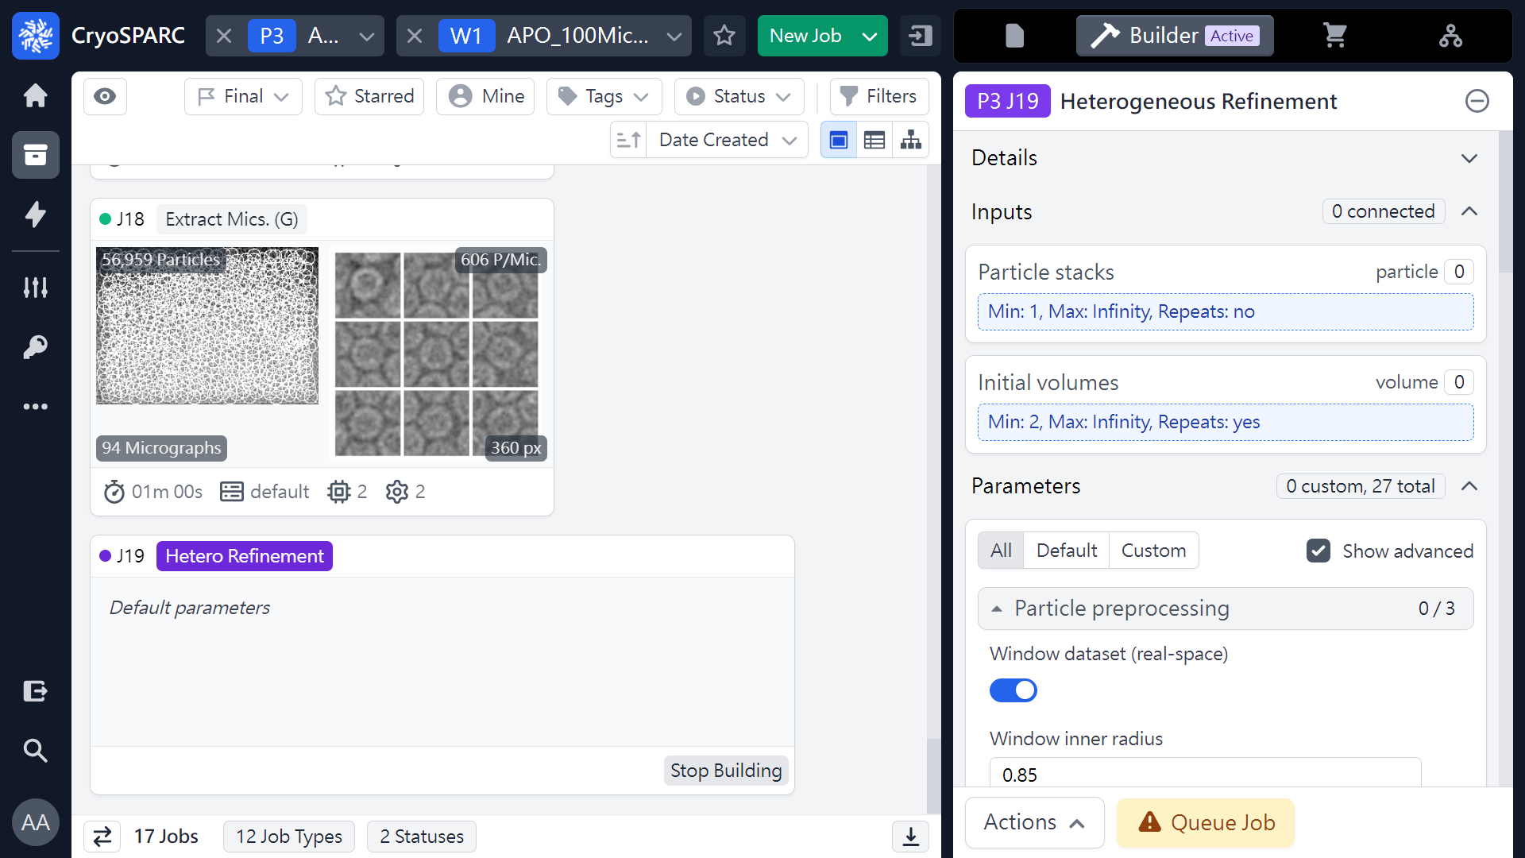
Heterogeneous refinement (Parameters)
 1
56,959 particles
(ref: cryoSPARC website. https://cryosparc.com/)

Slide 34
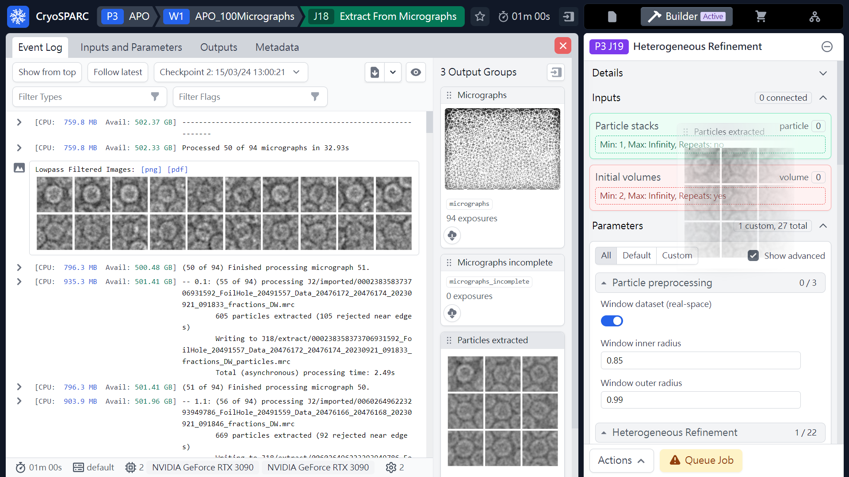
Heterogeneous refinement (Parameters)
 2
 1
Mouse left click
(Hold & Drag)
(ref: cryoSPARC website. https://cryosparc.com/)

Slide 35
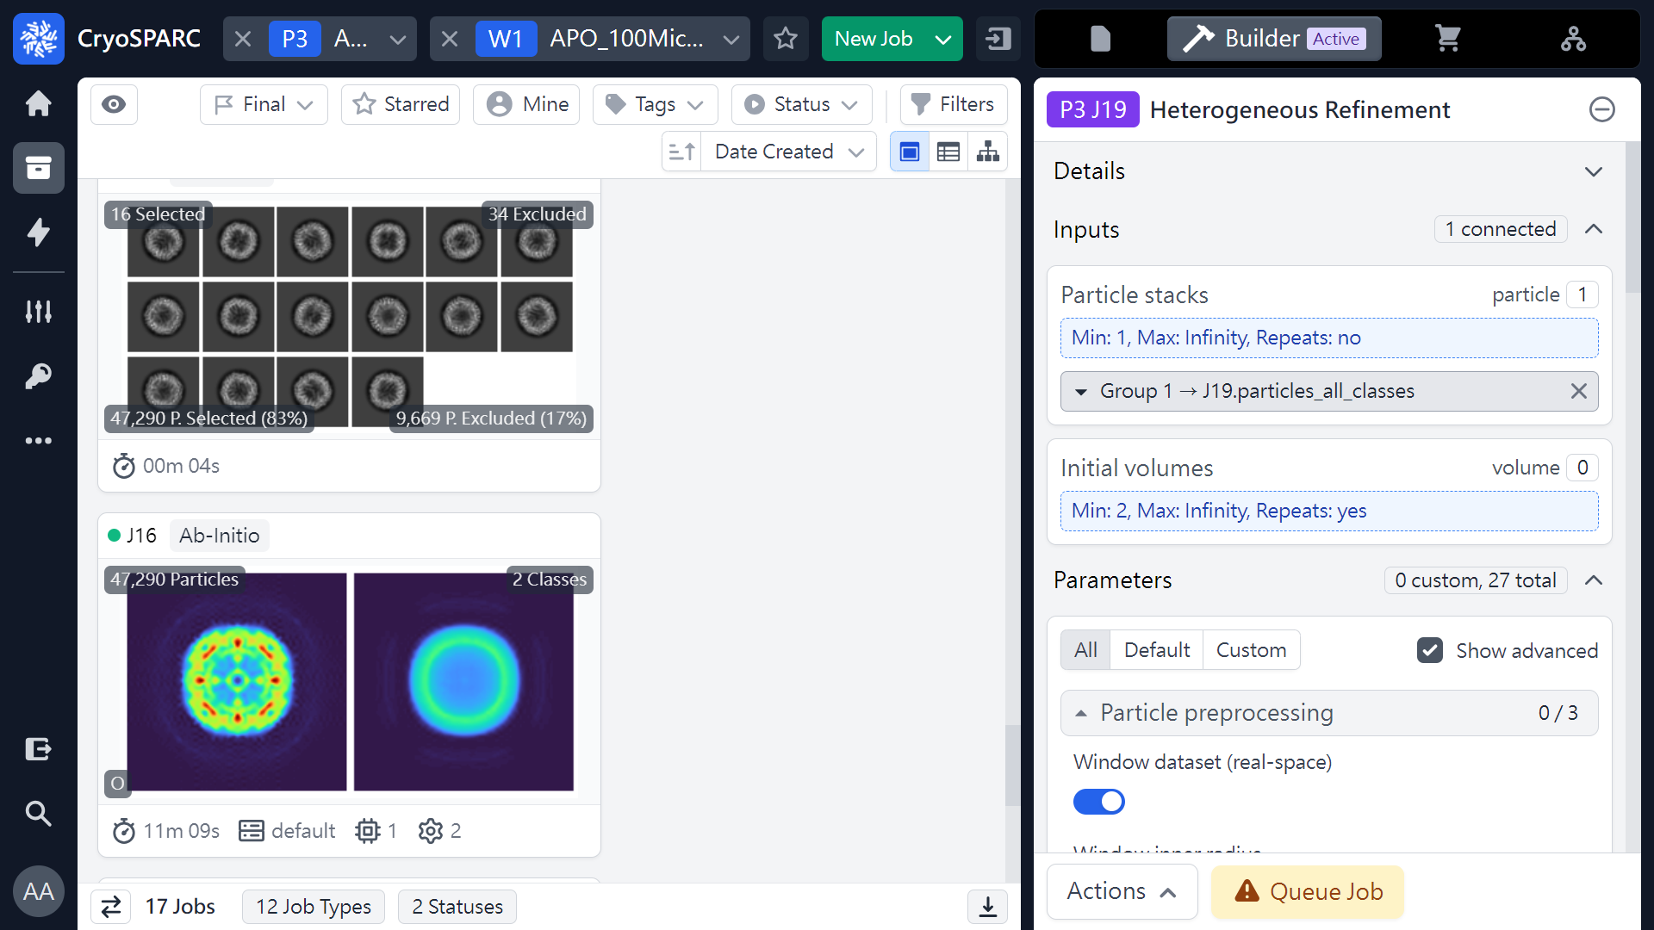
Heterogeneous refinement (Parameters)
 1
(ref: cryoSPARC website. https://cryosparc.com/)

Slide 36
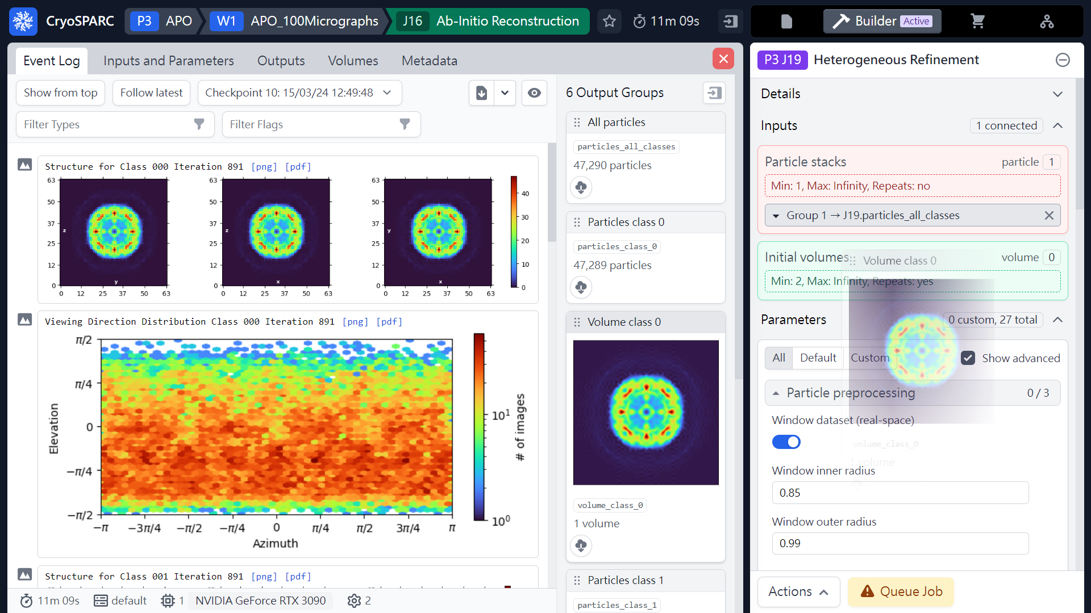
Heterogeneous refinement (Parameters)
Volume class 0
Mouse left click
(Hold & Drag)
 1
(ref: cryoSPARC website. https://cryosparc.com/)

Slide 37
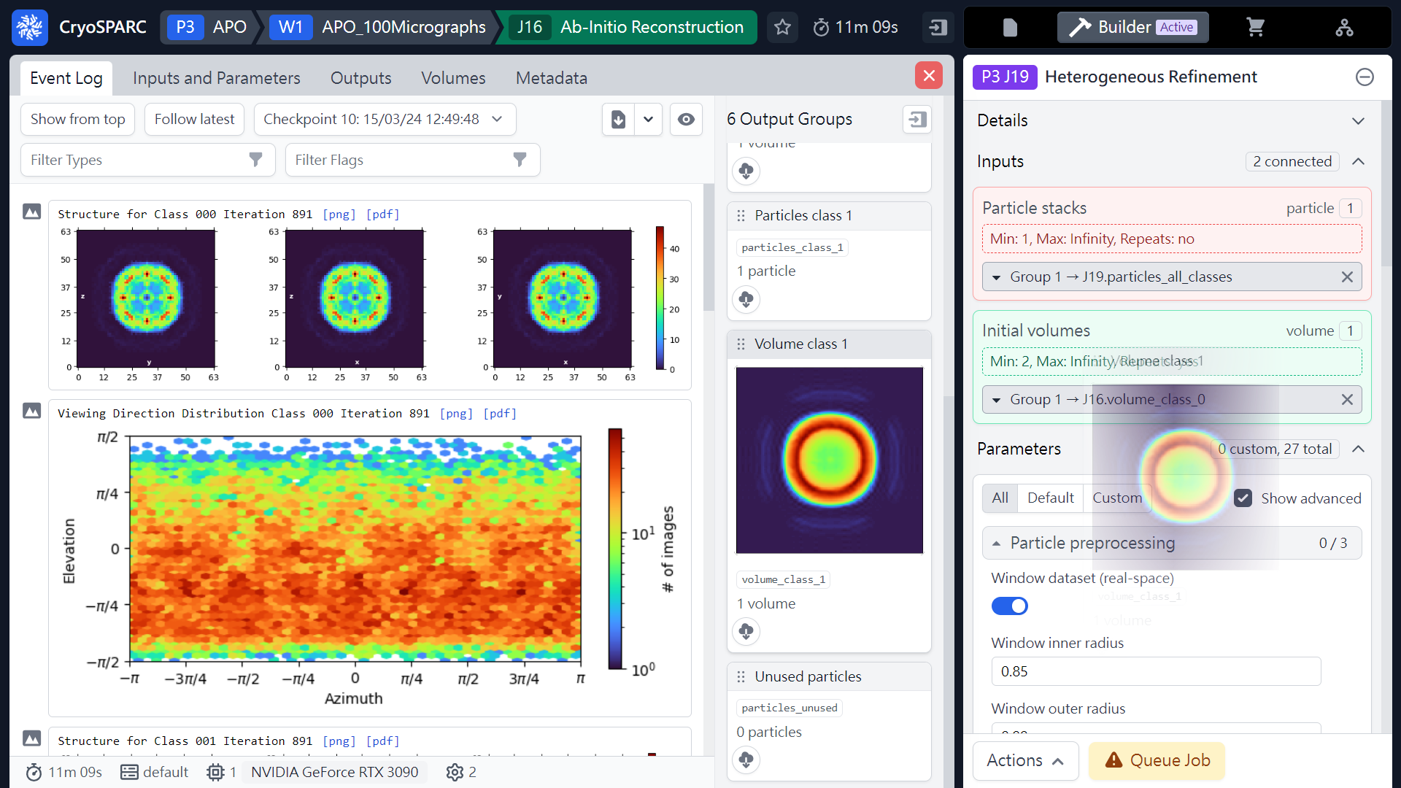
Heterogeneous refinement (Parameters)
Volume class 1
Mouse left click
(Hold & Drag)
 1
(ref: cryoSPARC website. https://cryosparc.com/)

Slide 38
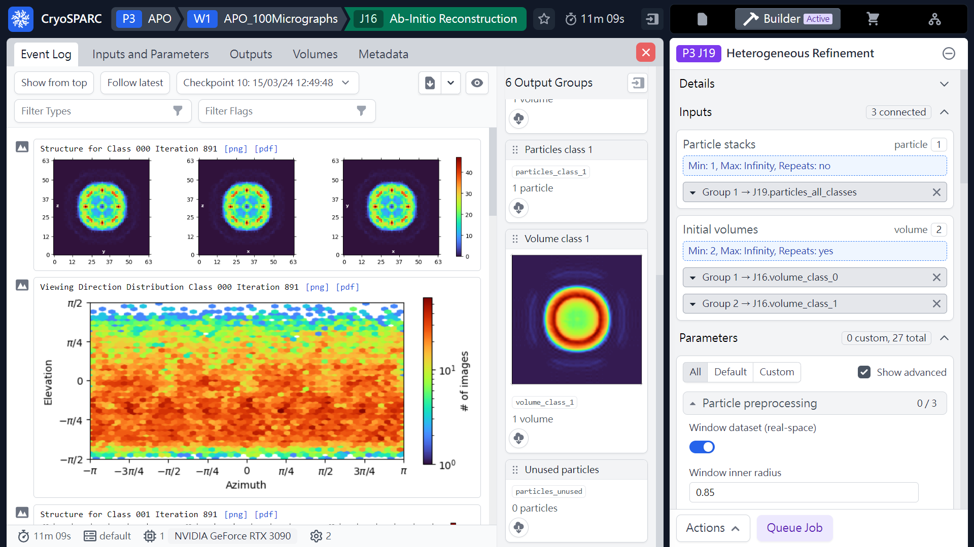
Heterogeneous refinement (Parameters)
(ref: cryoSPARC website. https://cryosparc.com/)

Slide 39

Heterogeneous refinement (Parameters)
 1
 2
(ref: cryoSPARC website. https://cryosparc.com/)

Slide 40
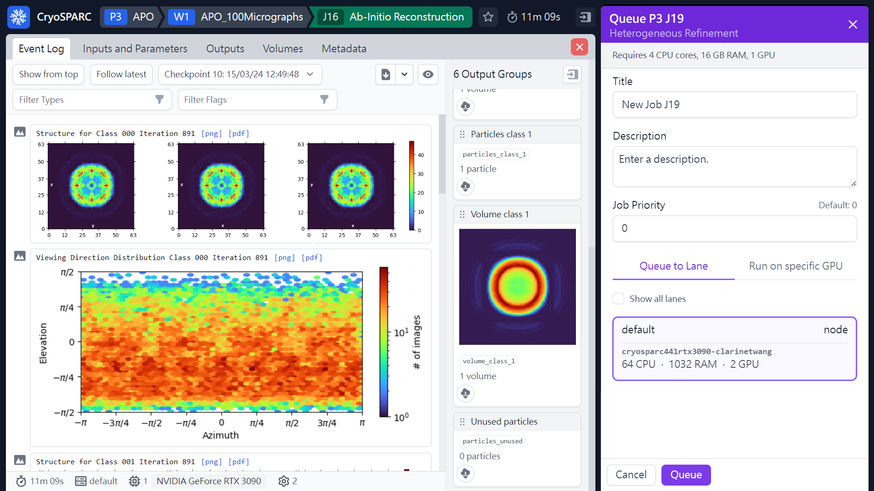
Heterogeneous refinement (Parameters)
 2
 1
(ref: cryoSPARC website. https://cryosparc.com/)

Slide 41
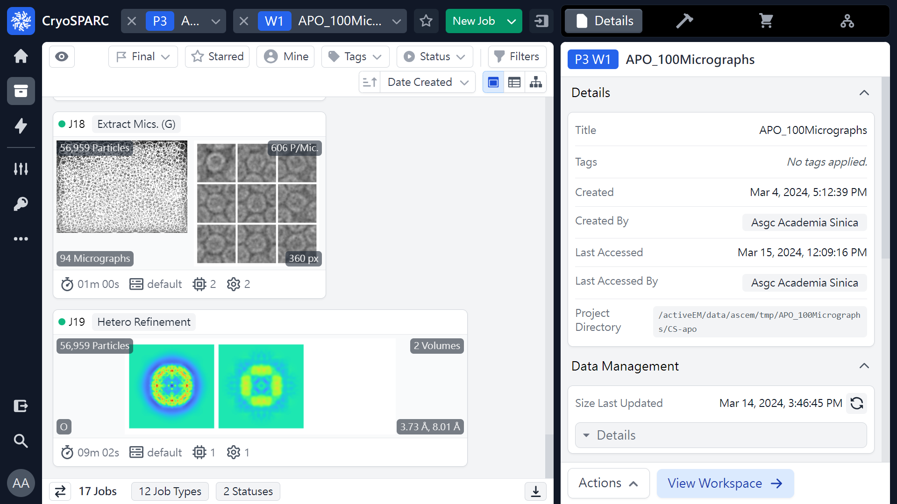
Heterogeneous refinement (Job finished)
 1
(ref: cryoSPARC website. https://cryosparc.com/)

Slide 42
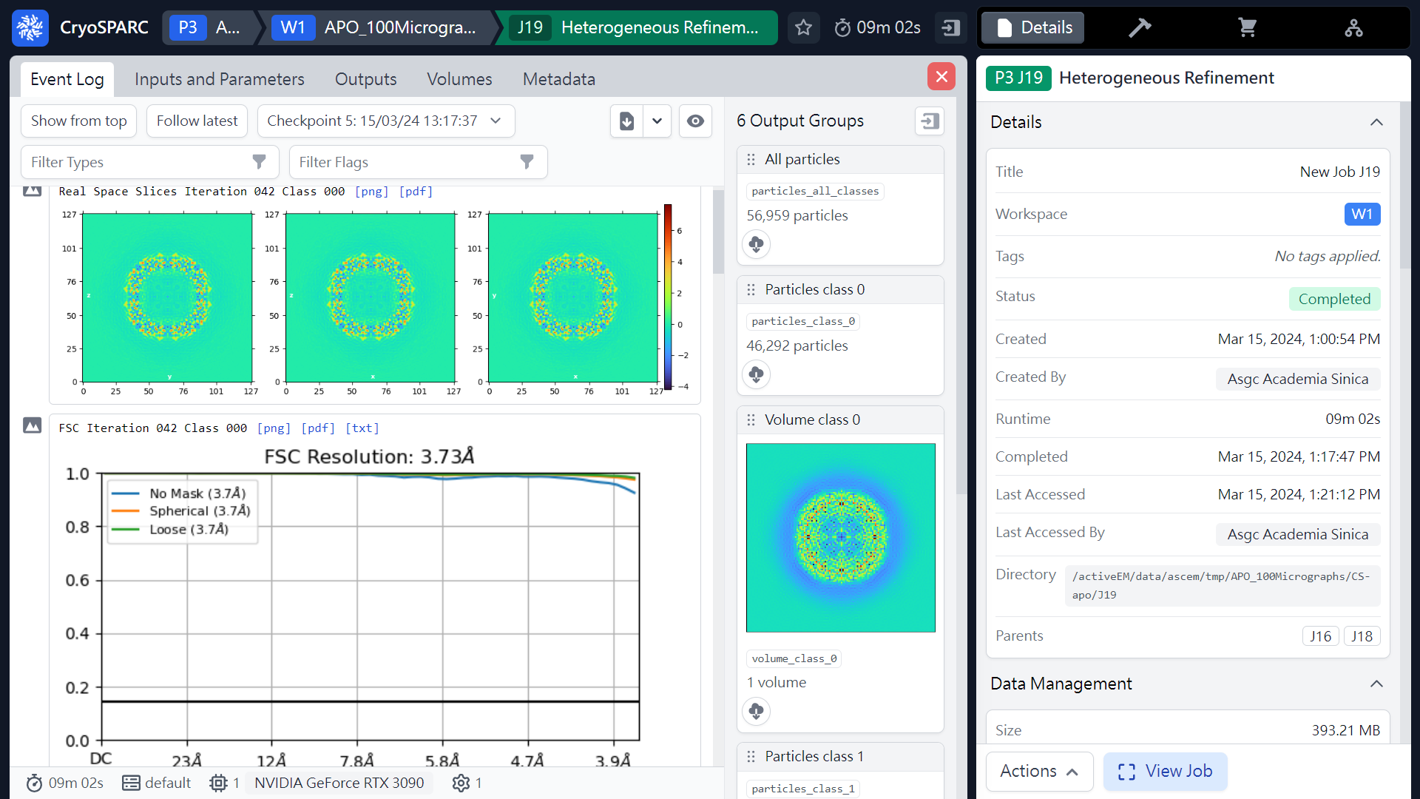
Heterogeneous refinement (Results)
Class 000
46,292 particles
Volume_class_0
(ref: cryoSPARC website. https://cryosparc.com/)

Slide 43
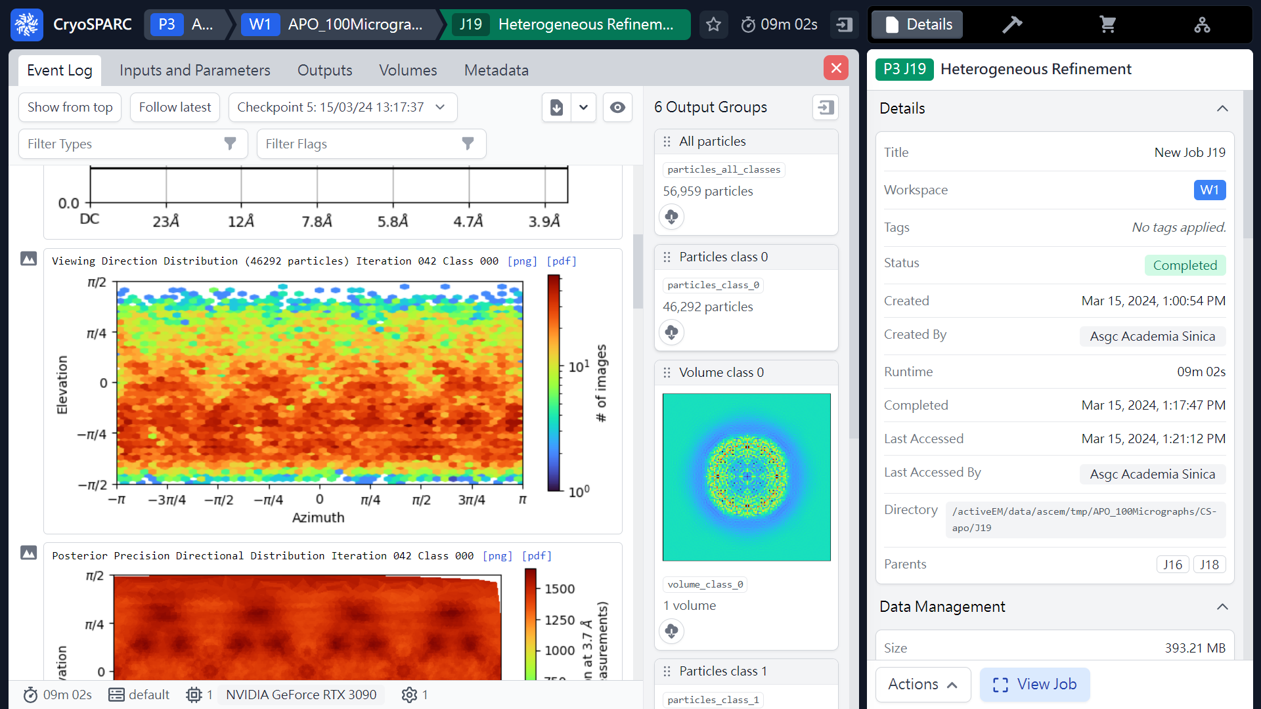
Heterogeneous refinement (Results)
Class 000
(ref: cryoSPARC website. https://cryosparc.com/)

Slide 44
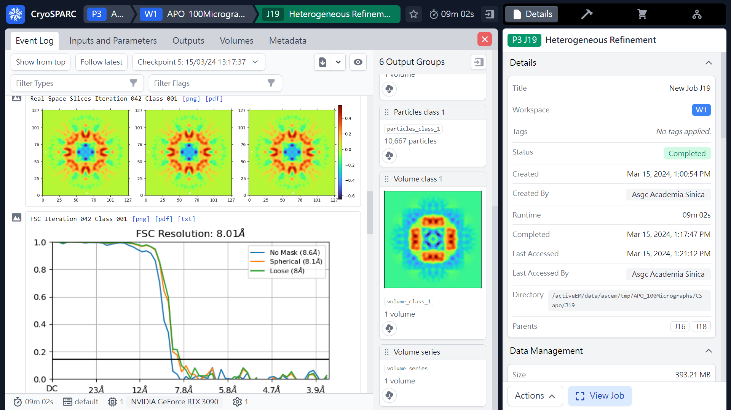
Heterogeneous refinement (Results)
Class 001
10,667 particles
Volume_class_1
(ref: cryoSPARC website. https://cryosparc.com/)

Slide 45
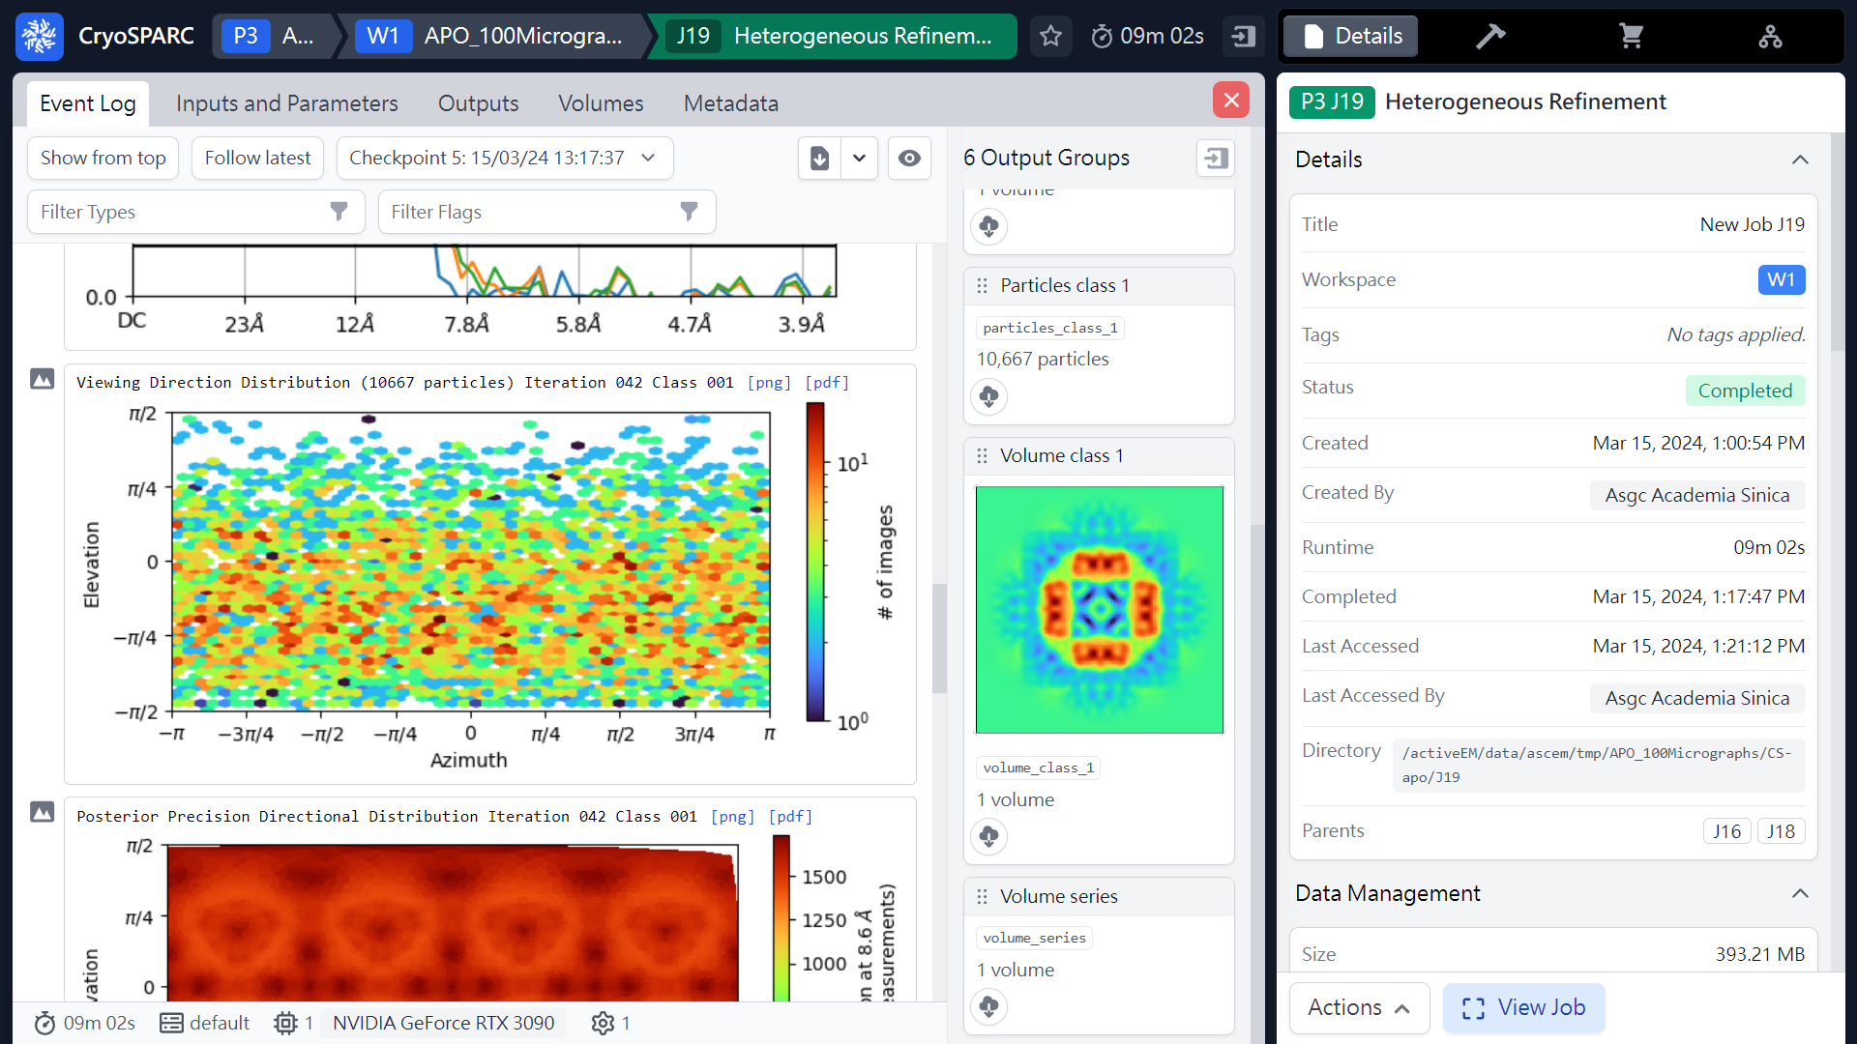
Heterogeneous refinement (Results)
Class 001
(ref: cryoSPARC website. https://cryosparc.com/)

Slide 46
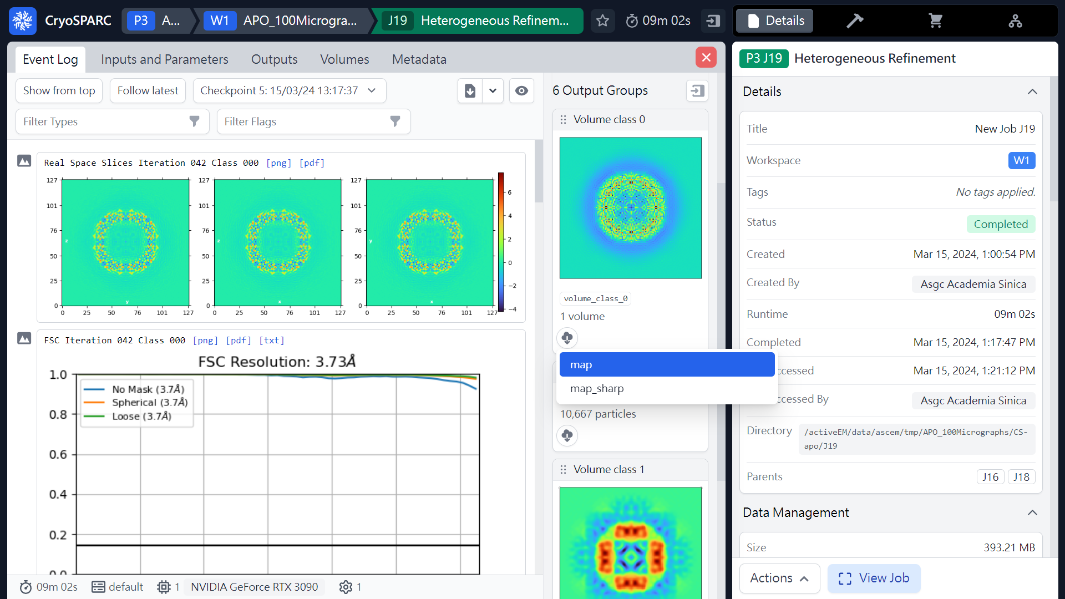
Heterogeneous refinement (Download maps)
 3
 1
 2
(ref: cryoSPARC website. https://cryosparc.com/)

Slide 47
Workflow of single particle analysis using cryoSPARC
Import Dataset
Ab-initio 3D Classification
Movies
Motion corrected
Micrographs
Motion Correction
Heterogeneous Refinement
3D
Pre-
process
CTF Estimation
Homogeneous Refinement
Micrograph Curation
Non-uniform Refinement
or
Particle Picking
Local Refinement
Advanced
3D
or
Particle picking
Particle Curation
3D class, 3D Var, 3D Flex
Particle Extraction
Post-processing & Sharpening
2D
2D Classification
Final Structures

Slide 48
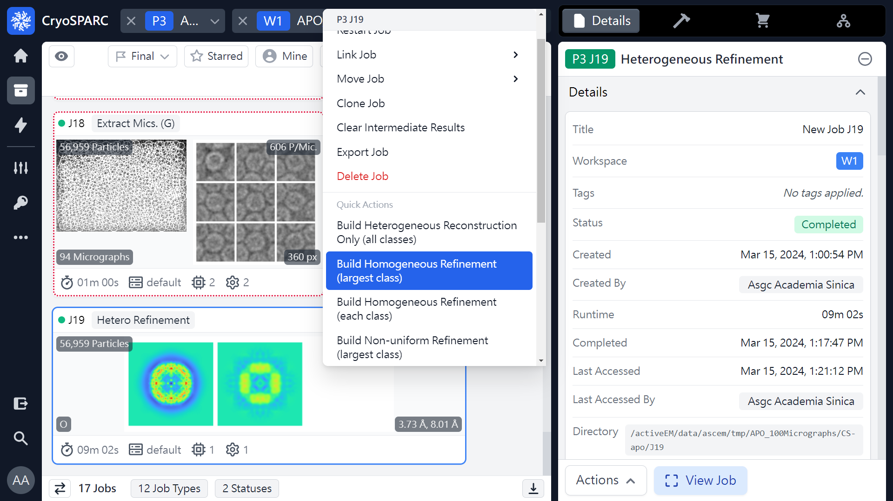
Homogeneous refinement
or 
 2
 2
or 
 1
Mouse right click
(ref: cryoSPARC website. https://cryosparc.com/)

Slide 49
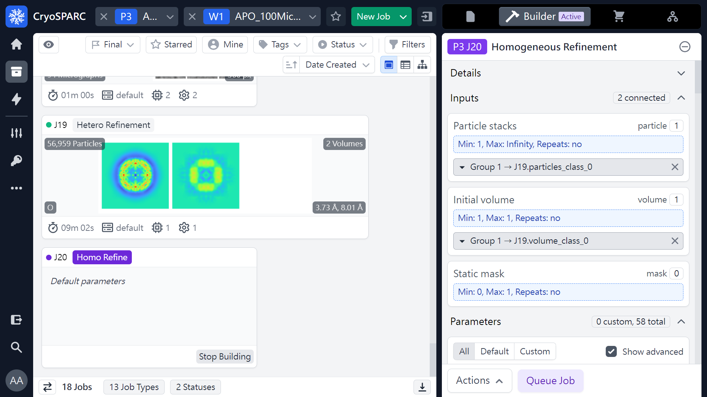
Homogeneous refinement (Parameters)
(ref: cryoSPARC website. https://cryosparc.com/)

Slide 50
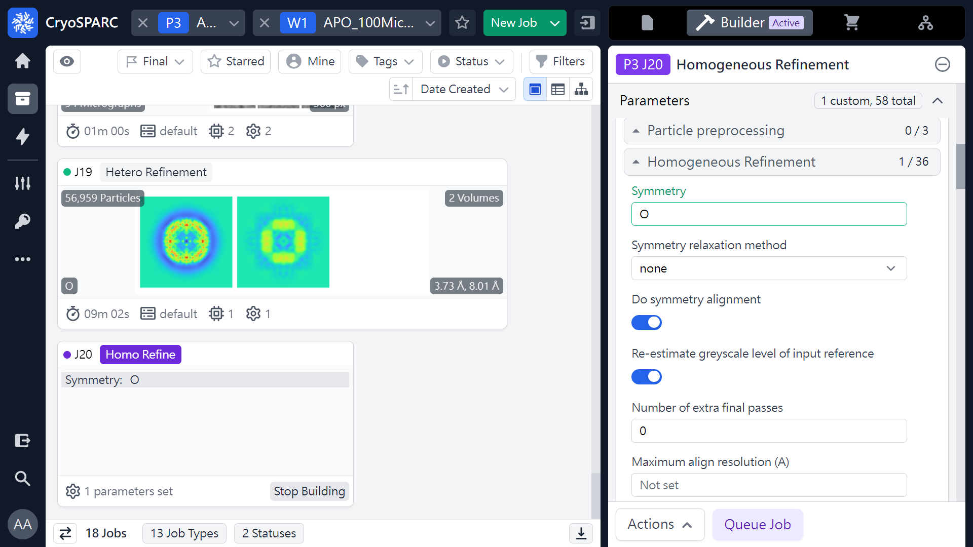
Homogeneous refinement (Parameters)
 1
(ref: cryoSPARC website. https://cryosparc.com/)

Slide 51
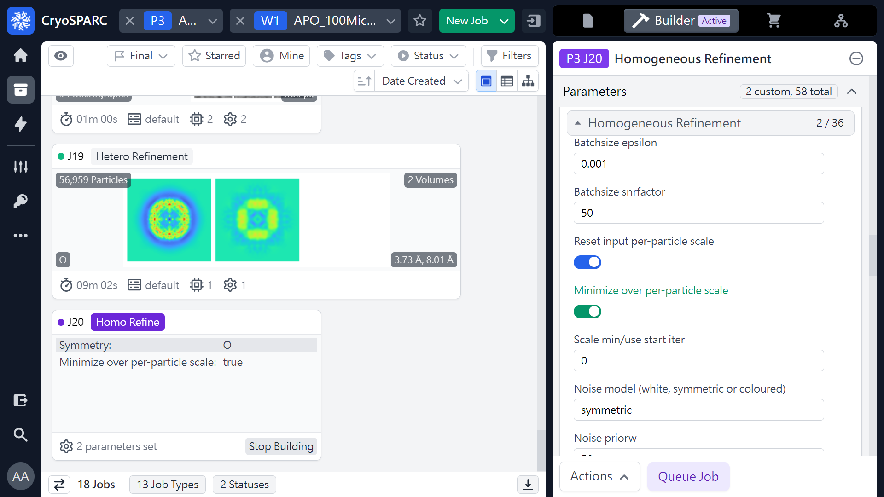
Homogeneous refinement (Parameters)
 1
(ref: cryoSPARC website. https://cryosparc.com/)

Slide 52
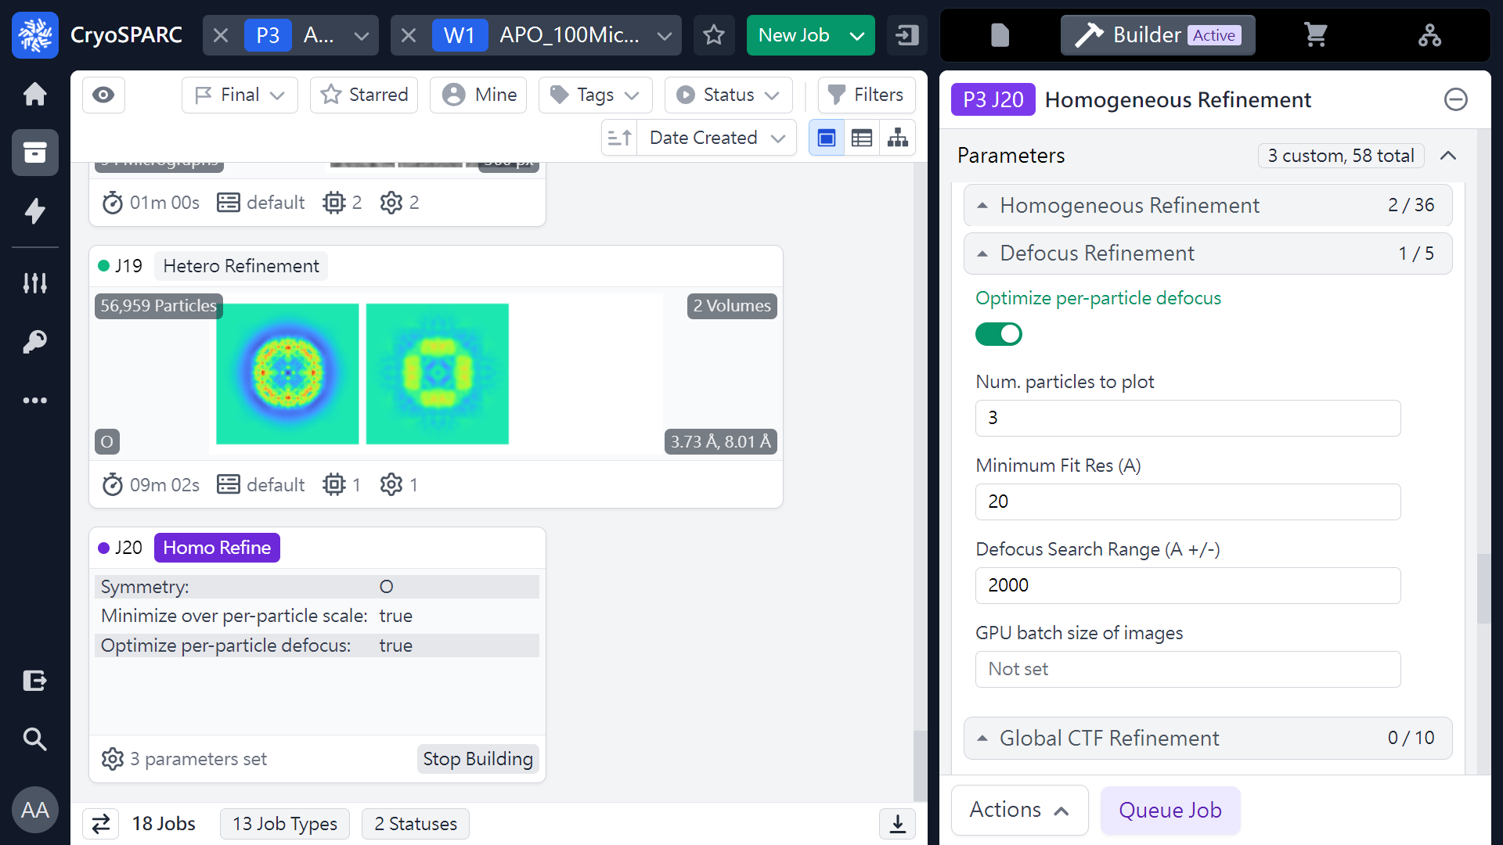
Homogeneous refinement (Parameters)
 1
(ref: cryoSPARC website. https://cryosparc.com/)

Slide 53

Homogeneous refinement (Parameters)
 1
 2
(ref: cryoSPARC website. https://cryosparc.com/)

Slide 54
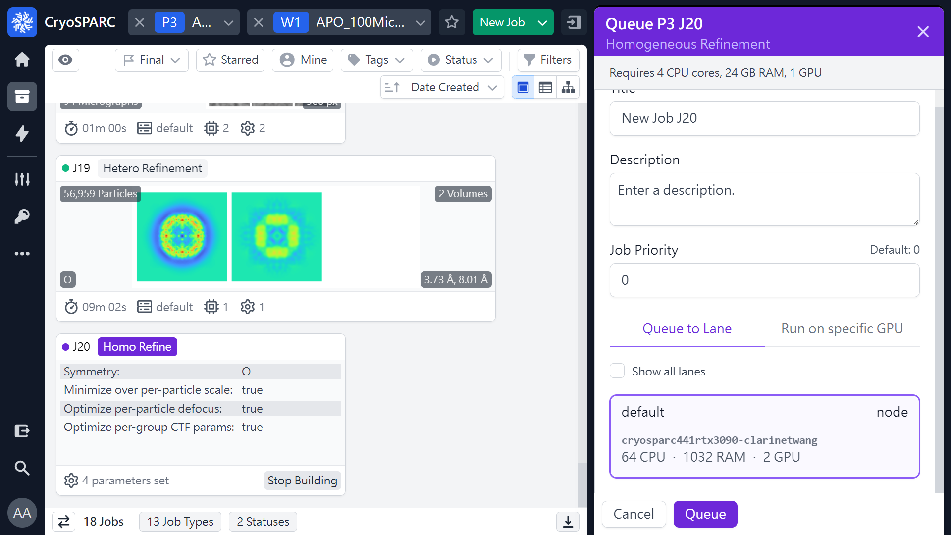
Homogeneous refinement (Parameters)
 1
(ref: cryoSPARC website. https://cryosparc.com/)

Slide 55
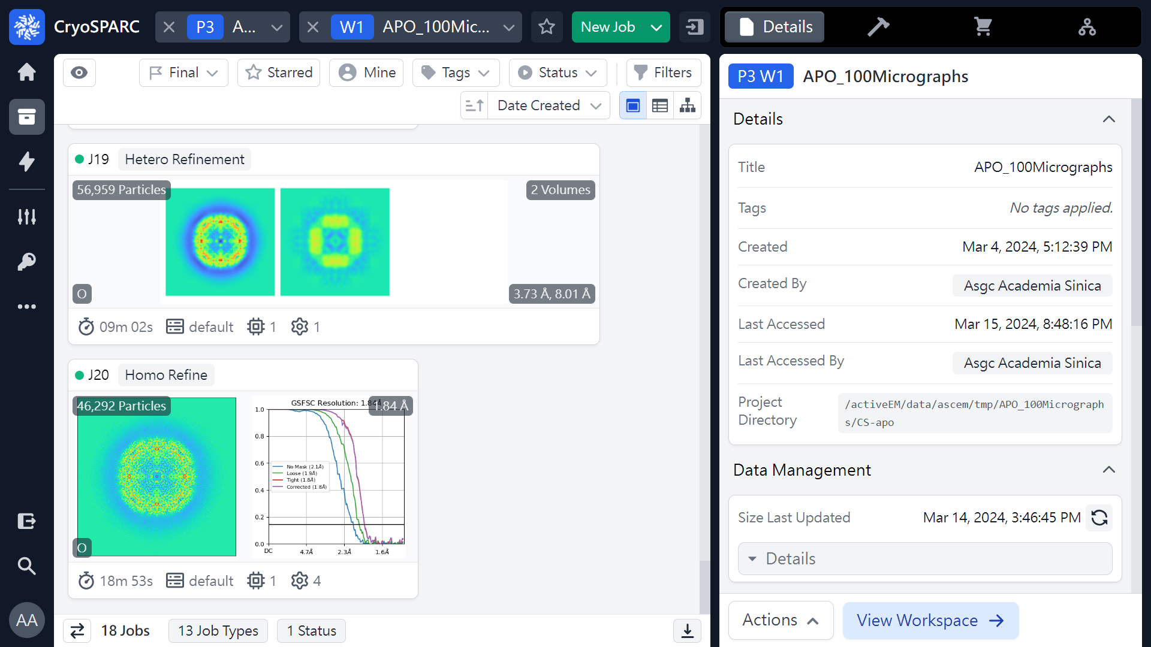
Homogeneous refinement (Job finished)
 1
(ref: cryoSPARC website. https://cryosparc.com/)

Slide 56
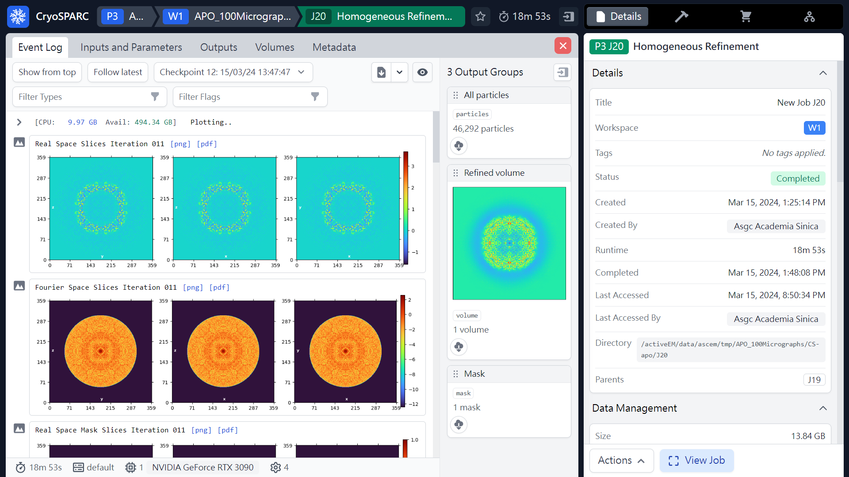
Homogeneous refinement (Results)
46,292 particles
(ref: cryoSPARC website. https://cryosparc.com/)

Slide 57
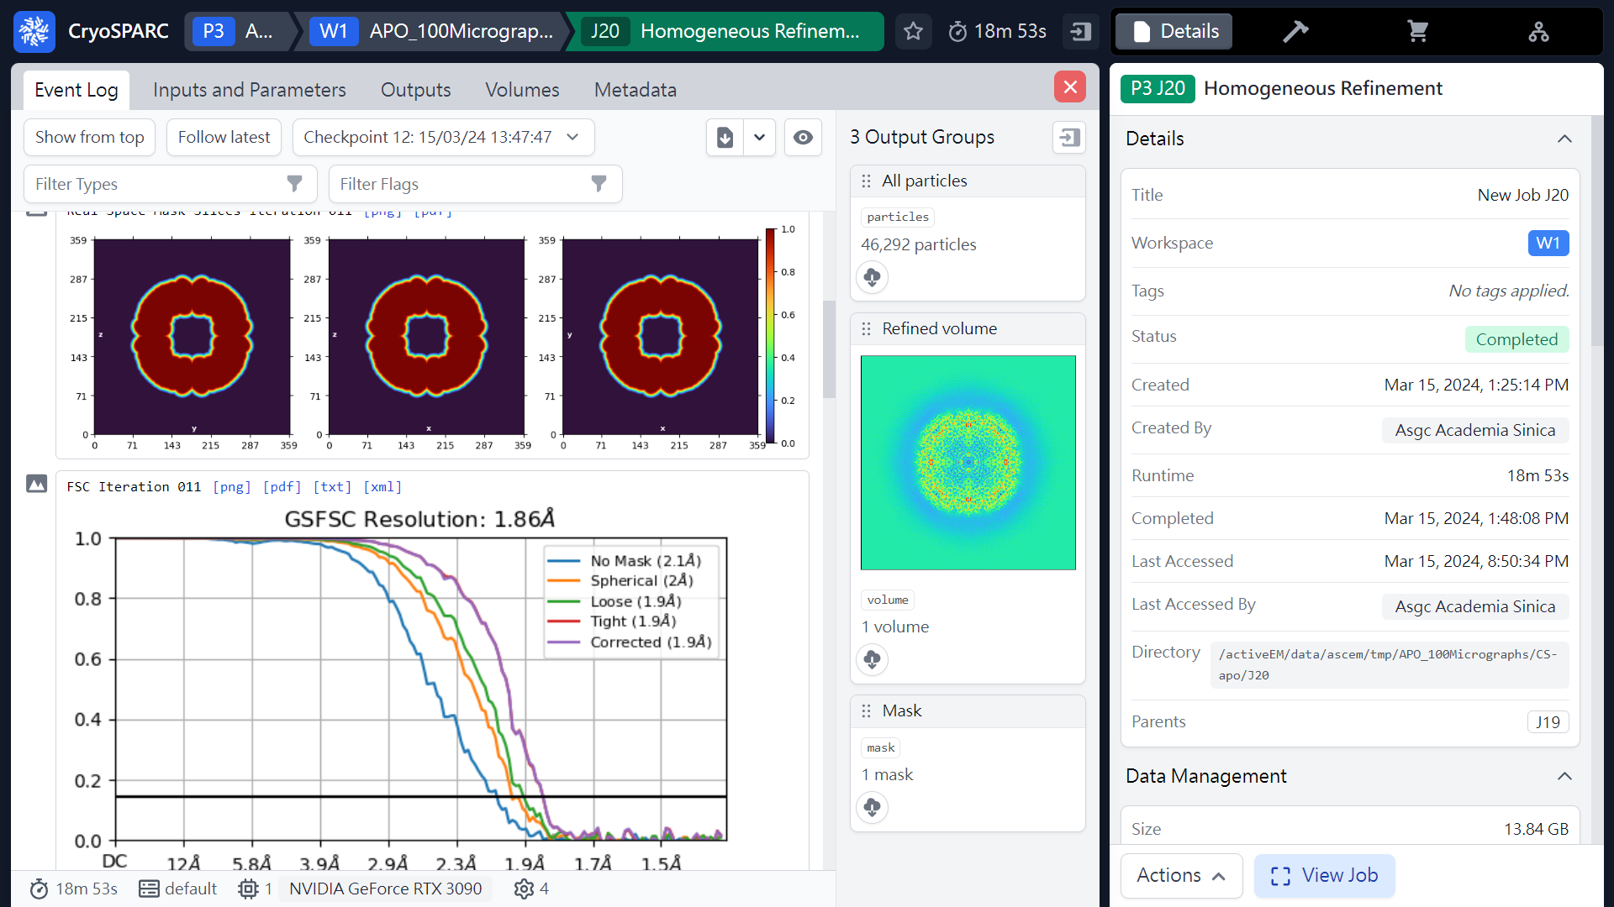
Homogeneous refinement (Results)
(ref: cryoSPARC website. https://cryosparc.com/)

Slide 58

Homogeneous refinement (Results)
(ref: cryoSPARC website. https://cryosparc.com/)

Slide 59

Homogeneous refinement (Results)
(ref: cryoSPARC website. https://cryosparc.com/)

Slide 60

Homogeneous refinement (Results)
(ref: cryoSPARC website. https://cryosparc.com/)

Slide 61

Homogeneous refinement (Download maps)
 3
 2
 1
(ref: cryoSPARC website. https://cryosparc.com/)

Slide 62

Local resolution estimation
or 
 2
 1
Mouse right click
(ref: cryoSPARC website. https://cryosparc.com/)

Slide 63

Local resolution estimation (Parameters)
 1
(ref: cryoSPARC website. https://cryosparc.com/)

Slide 64

Local resolution estimation (Parameters)
 1
(ref: cryoSPARC website. https://cryosparc.com/)

Slide 65

Local resolution estimation (Job finished)
 1
(ref: cryoSPARC website. https://cryosparc.com/)

Slide 66

Local resolution estimation (Results)
(ref: cryoSPARC website. https://cryosparc.com/)

Slide 67

Local resolution estimation (Results)
(ref: cryoSPARC website. https://cryosparc.com/)

Slide 68

Local resolution estimation (Results)
(ref: cryoSPARC website. https://cryosparc.com/)

Slide 69

Local resolution estimation (Results & Download maps)
 3
 1
 2
(ref: cryoSPARC website. https://cryosparc.com/)

Slide 70
Workflow of single particle analysis using cryoSPARC
Import Dataset
Ab-initio 3D Classification
Movies
Motion corrected
Micrographs
Motion Correction
Heterogeneous Refinement
3D
Pre-
process
CTF Estimation
Homogeneous Refinement
Micrograph Curation
Non-uniform Refinement
or
Particle Picking
Local Refinement
Advanced
3D
or
Particle picking
Particle Curation
3D class, 3D Var, 3D Flex
Particle Extraction
Post-processing & Sharpening
2D
2D Classification
Final Structures

Slide 71


Non-uniform Refinement
or 
 2
 1
Mouse right click
(ref: cryoSPARC website. https://cryosparc.com/)

Slide 72

Non-uniform Refinement (Parameters)
(ref: cryoSPARC website. https://cryosparc.com/)

Slide 73

Non-uniform Refinement (Parameters)
 1
(ref: cryoSPARC website. https://cryosparc.com/)

Slide 74

Non-uniform Refinement (Parameters)
 1
(ref: cryoSPARC website. https://cryosparc.com/)

Slide 75

Non-uniform Refinement (Parameters)
 1
(ref: cryoSPARC website. https://cryosparc.com/)

Slide 76

Non-uniform Refinement (Parameters)
 1
 2
(ref: cryoSPARC website. https://cryosparc.com/)

Slide 77

Non-uniform Refinement (Parameters)
 1
(ref: cryoSPARC website. https://cryosparc.com/)

Slide 78

Non-uniform Refinement (Job finished)
(ref: cryoSPARC website. https://cryosparc.com/)

Slide 79
Workflow of single particle analysis using cryoSPARC
Import Dataset
Ab-initio 3D Classification
Movies
Motion corrected
Micrographs
Motion Correction
Heterogeneous Refinement
3D
Pre-
process
CTF Estimation
Homogeneous Refinement
Micrograph Curation
Non-uniform Refinement
or
Particle Picking
Local Refinement
Advanced
3D
or
Particle picking
Particle Curation
3D class, 3D Var, 3D Flex
Particle Extraction
Post-processing & Sharpening
2D
2D Classification
Final Structures

Slide 80
Thank you !

