Slide 1

UCSF ChimeraX
Dr. Chun-Hsiung Wang
王俊雄
2026/03/16

Slide 2
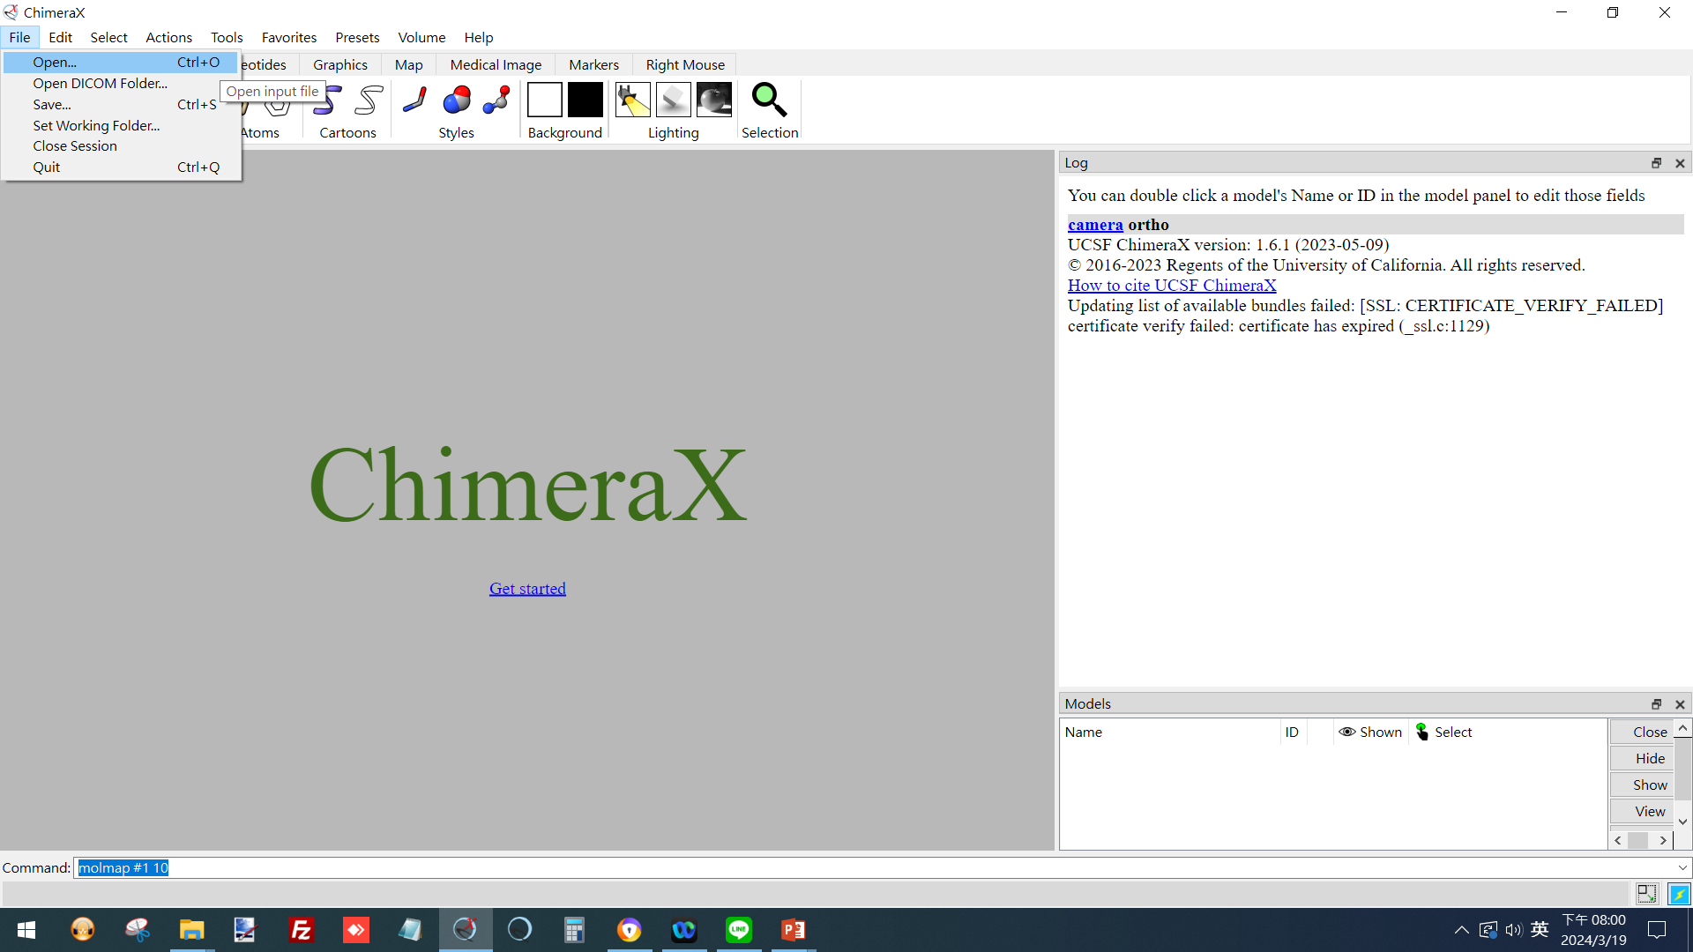
UCSF ChimeraX
(open map)
 1
(ref: UCSF ChimeraX website. https://www.cgl.ucsf.edu/chimerax/)

Slide 3
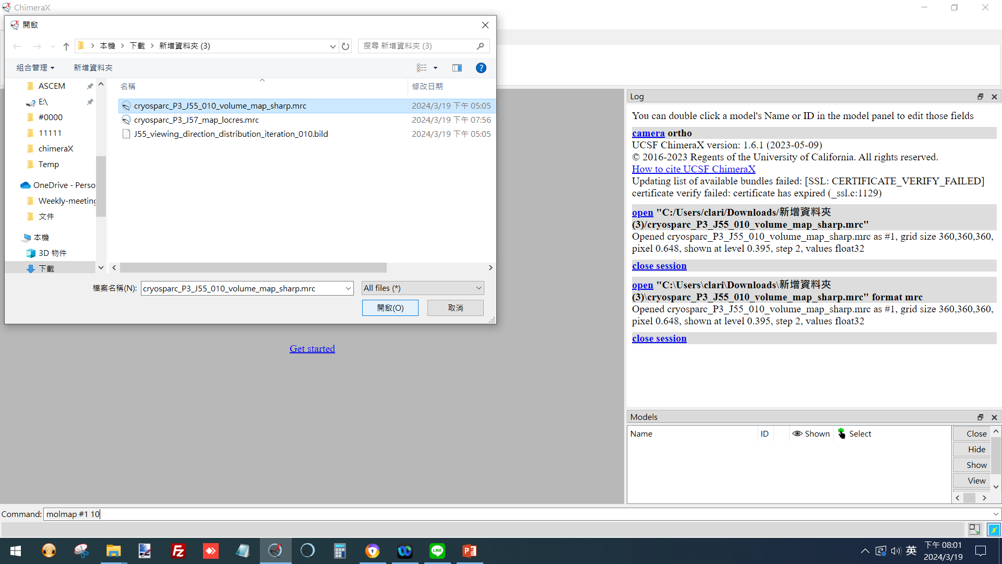
UCSF ChimeraX
(open map)
 1
 2
(ref: UCSF ChimeraX website. https://www.cgl.ucsf.edu/chimerax/)

Slide 4
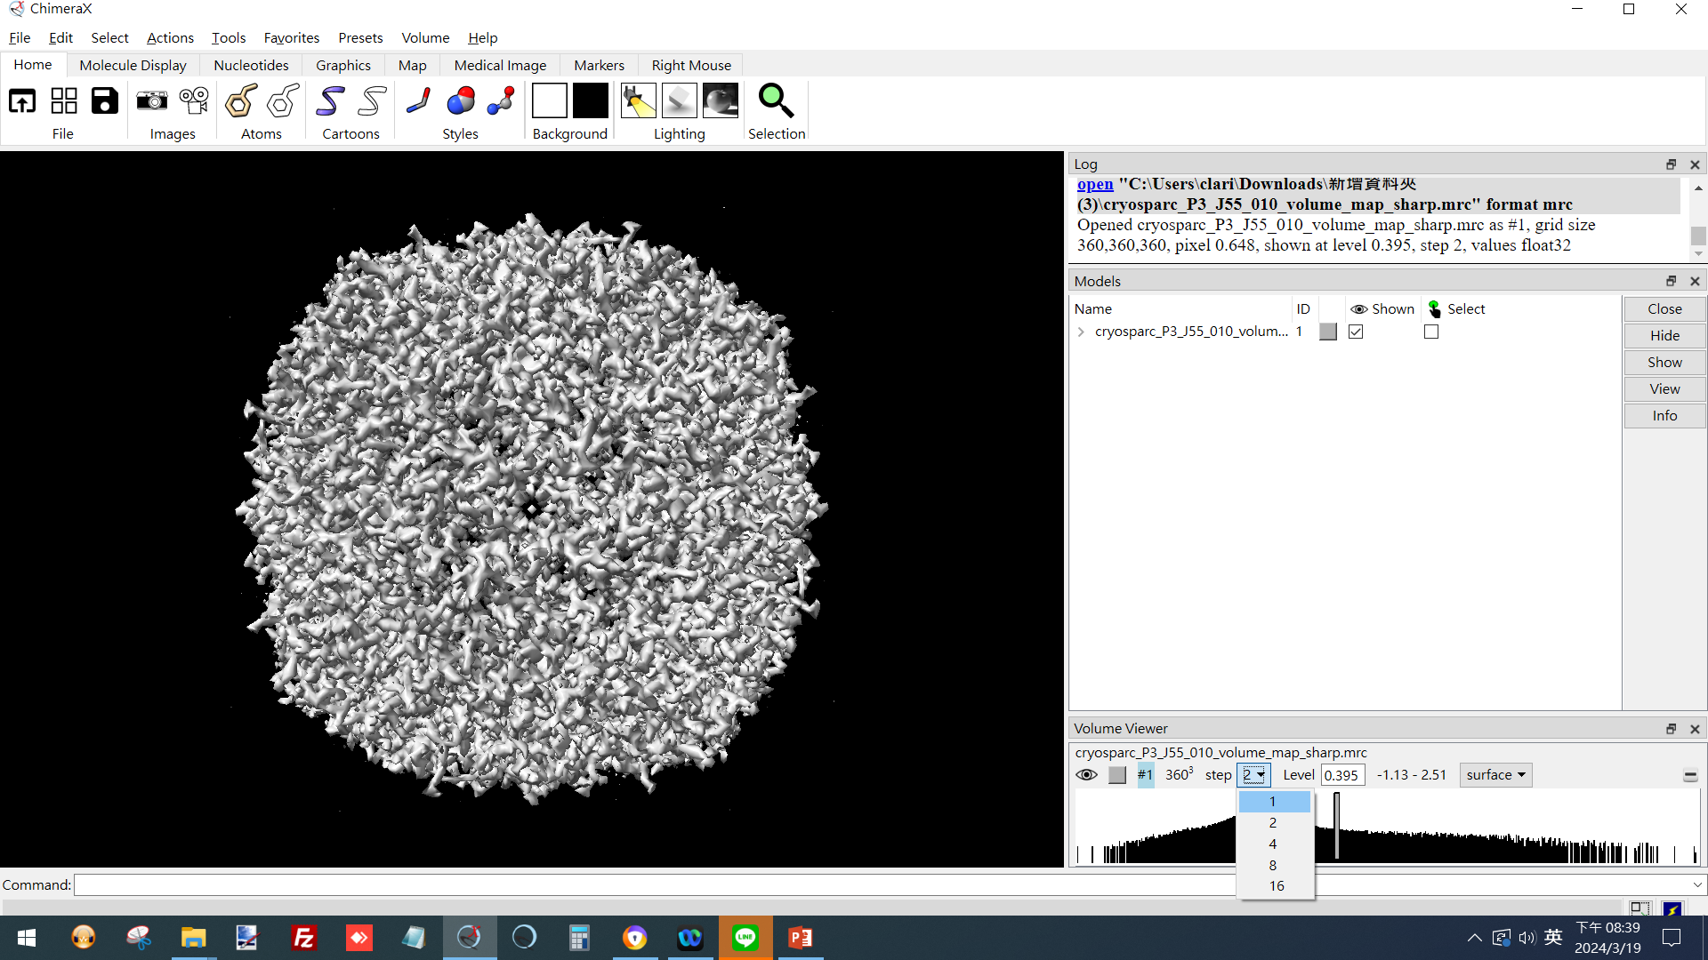
UCSF ChimeraX
(open map)
 1
(ref: UCSF ChimeraX website. https://www.cgl.ucsf.edu/chimerax/)

Slide 5
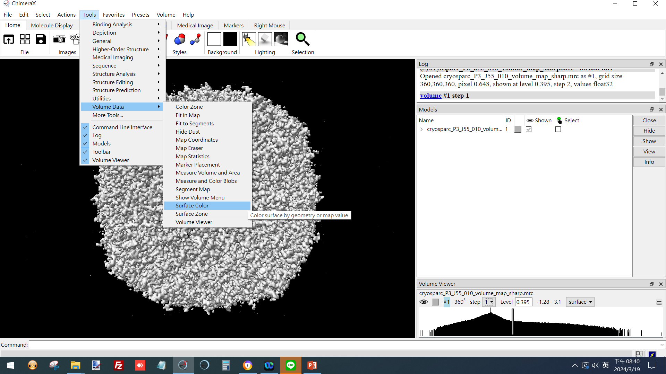
UCSF ChimeraX
(Color according to radius)
 1
 2
 3
(ref: UCSF ChimeraX website. https://www.cgl.ucsf.edu/chimerax/)

Slide 6
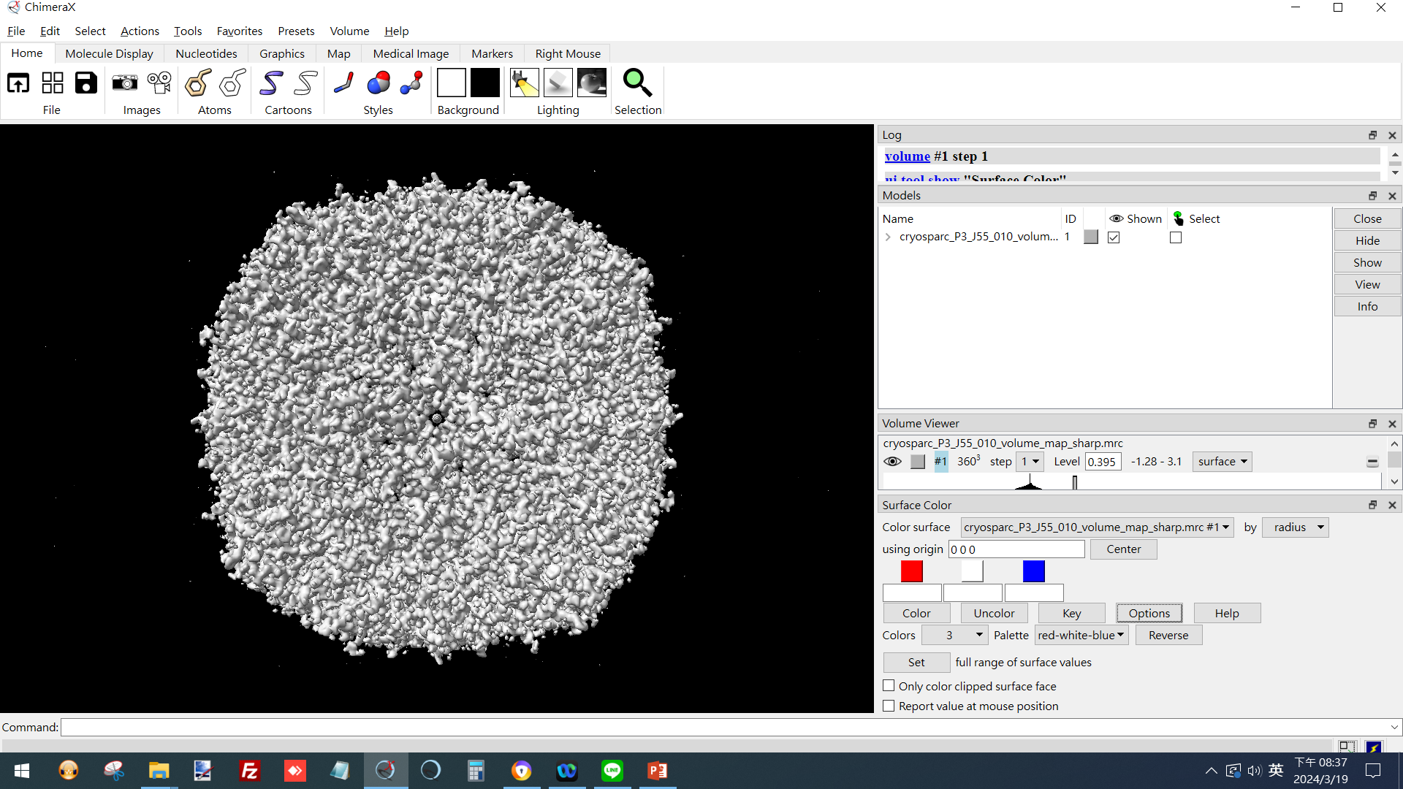
UCSF ChimeraX
(Color according to radius)
 1
 2
 3
(ref: UCSF ChimeraX website. https://www.cgl.ucsf.edu/chimerax/)

Slide 7
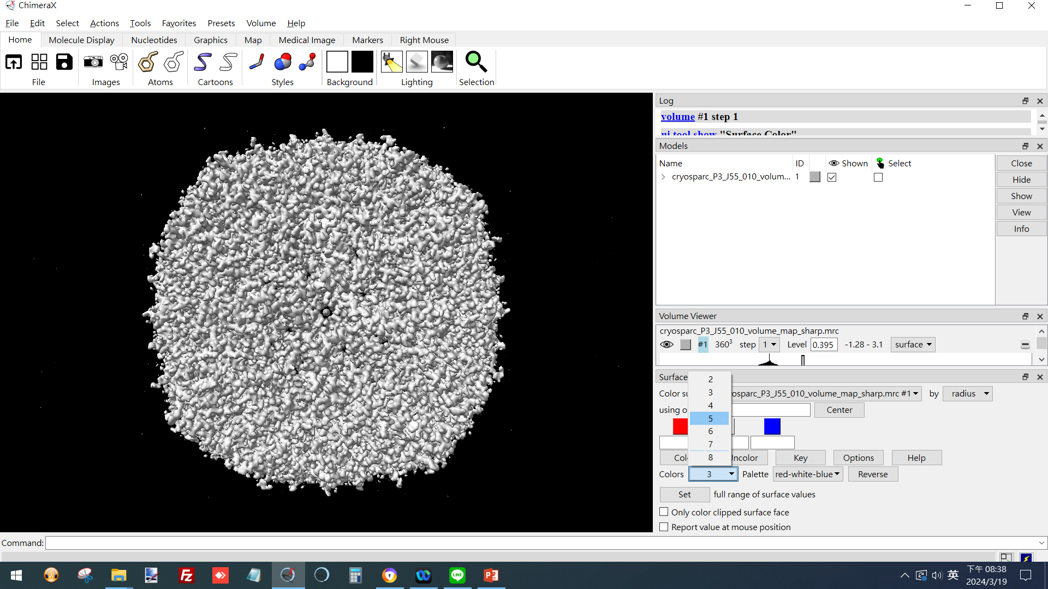
UCSF ChimeraX
(Color according to radius)
 2
 1
(ref: UCSF ChimeraX website. https://www.cgl.ucsf.edu/chimerax/)

Slide 8
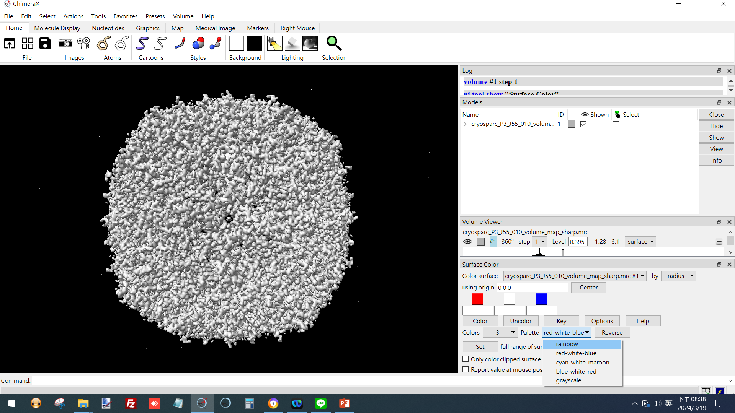
UCSF ChimeraX
(Color according to radius)
 1
(ref: UCSF ChimeraX website. https://www.cgl.ucsf.edu/chimerax/)

Slide 9
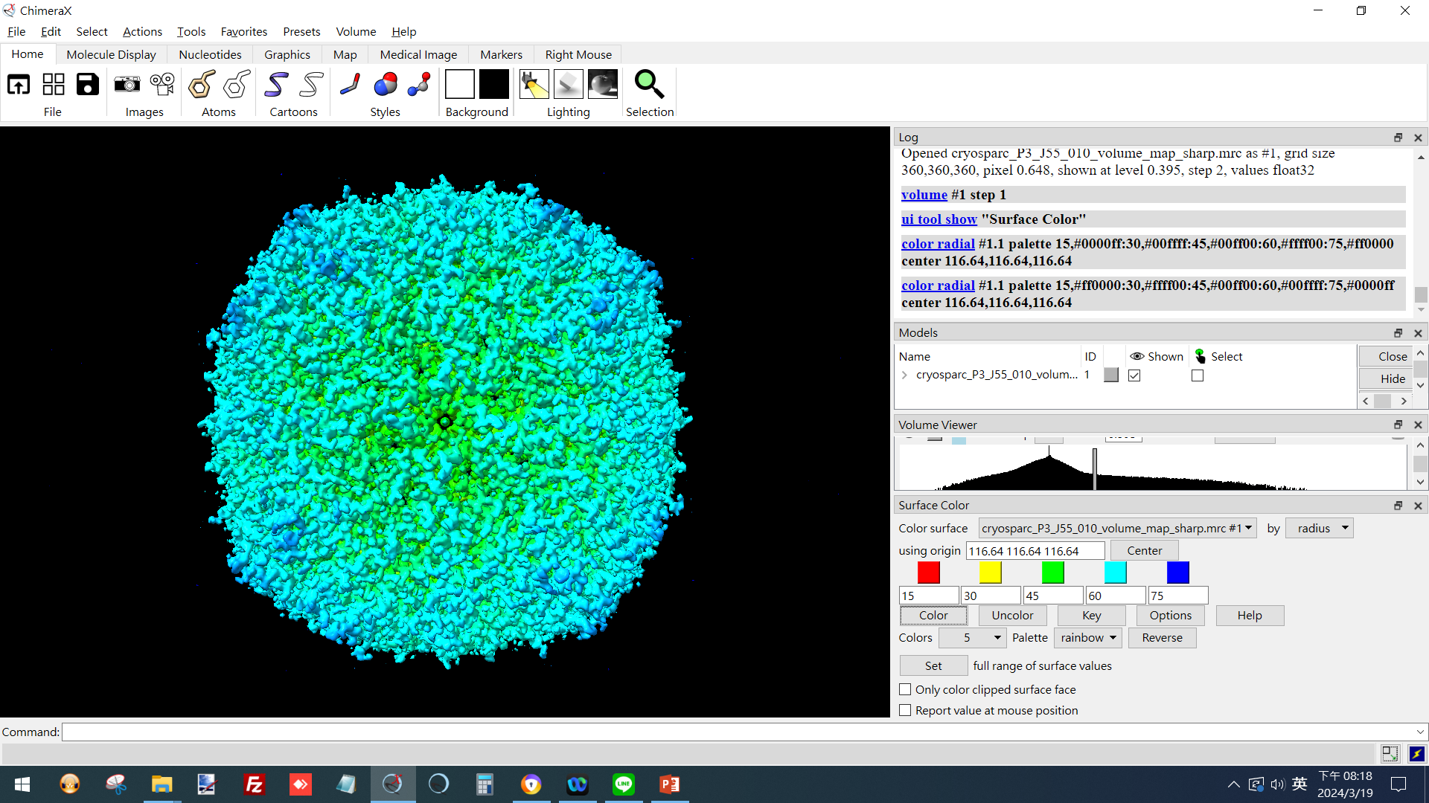
UCSF ChimeraX
(Color according to radius)
 1
 4
 2
 3
(ref: UCSF ChimeraX website. https://www.cgl.ucsf.edu/chimerax/)

Slide 10
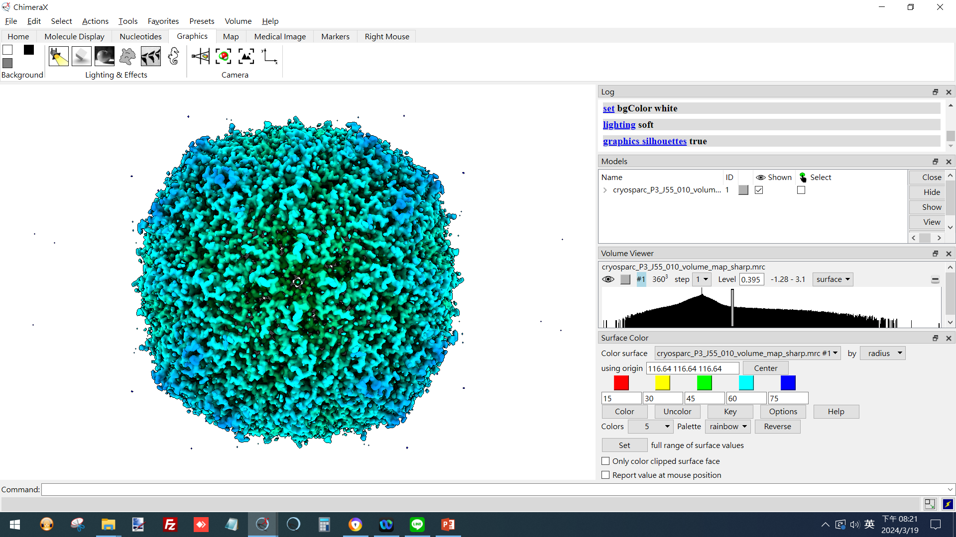
UCSF ChimeraX
(change display style)
 1
 2
 3
 4
(ref: UCSF ChimeraX website. https://www.cgl.ucsf.edu/chimerax/)

Slide 11

UCSF ChimeraX
(hide dusts, hide small volume)
 1
 2
(ref: UCSF ChimeraX website. https://www.cgl.ucsf.edu/chimerax/)

Slide 12
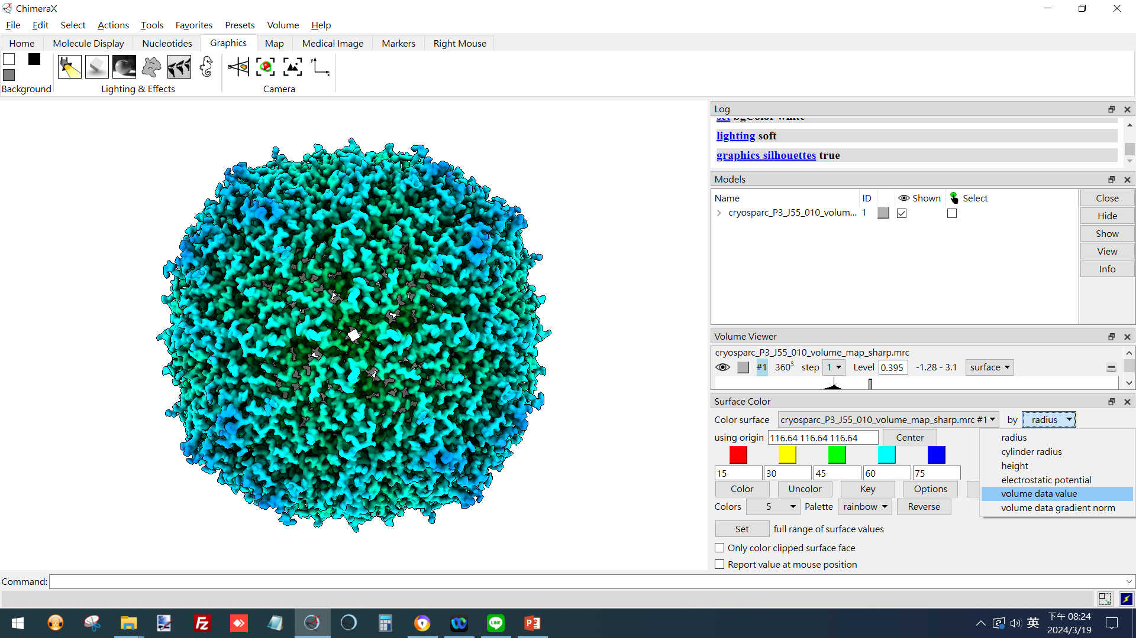
UCSF ChimeraX
(color according to local resolutions)
 1
 2
(ref: UCSF ChimeraX website. https://www.cgl.ucsf.edu/chimerax/)

Slide 13
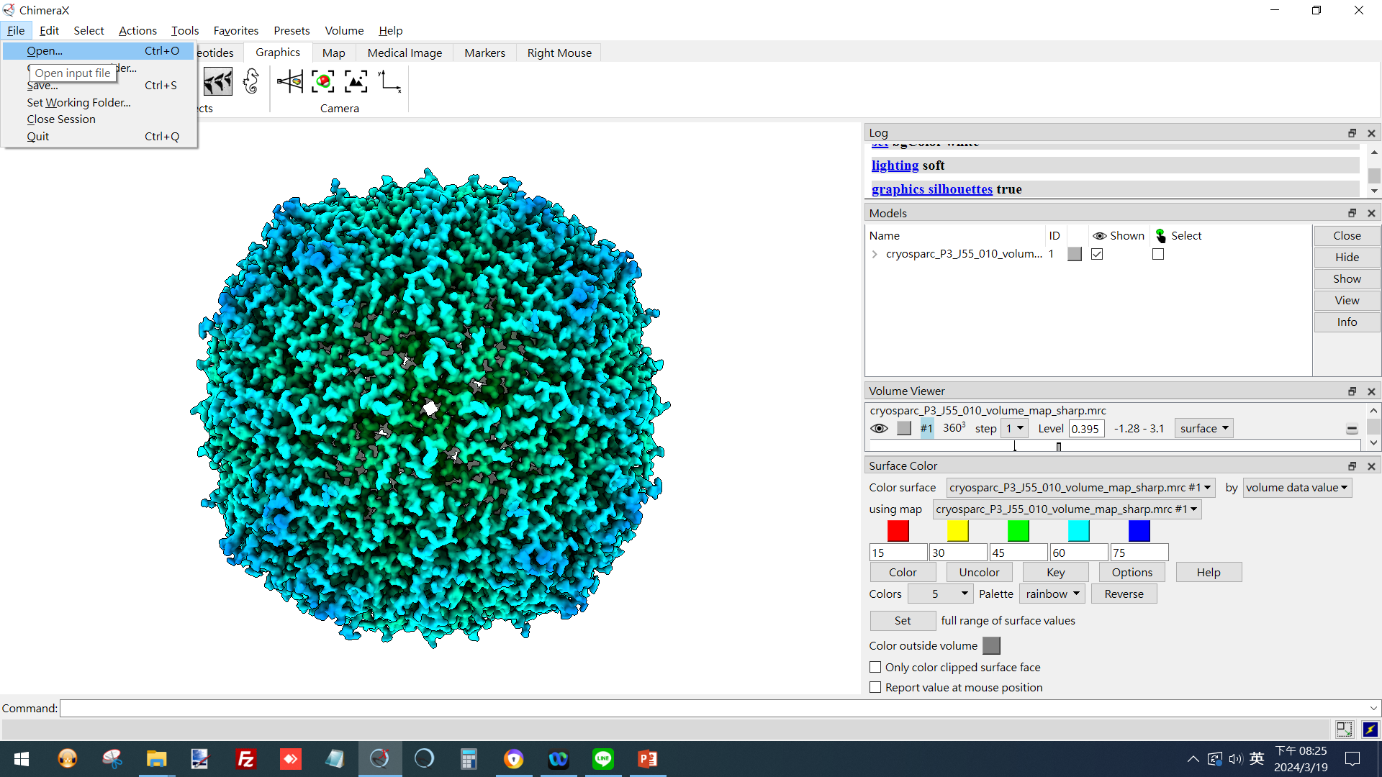
4
UCSF ChimeraX
(open cryoSPARC local resolution result)
 1
(ref: UCSF ChimeraX website. https://www.cgl.ucsf.edu/chimerax/)

Slide 14
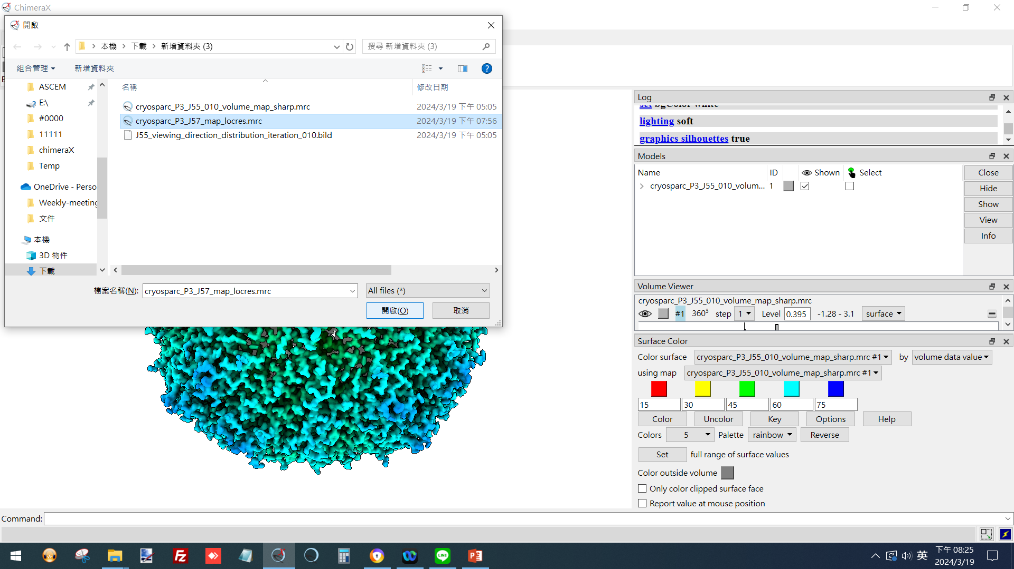
UCSF ChimeraX
(open cryoSPARC local resolution result)
 1
 2
(ref: UCSF ChimeraX website. https://www.cgl.ucsf.edu/chimerax/)

Slide 15
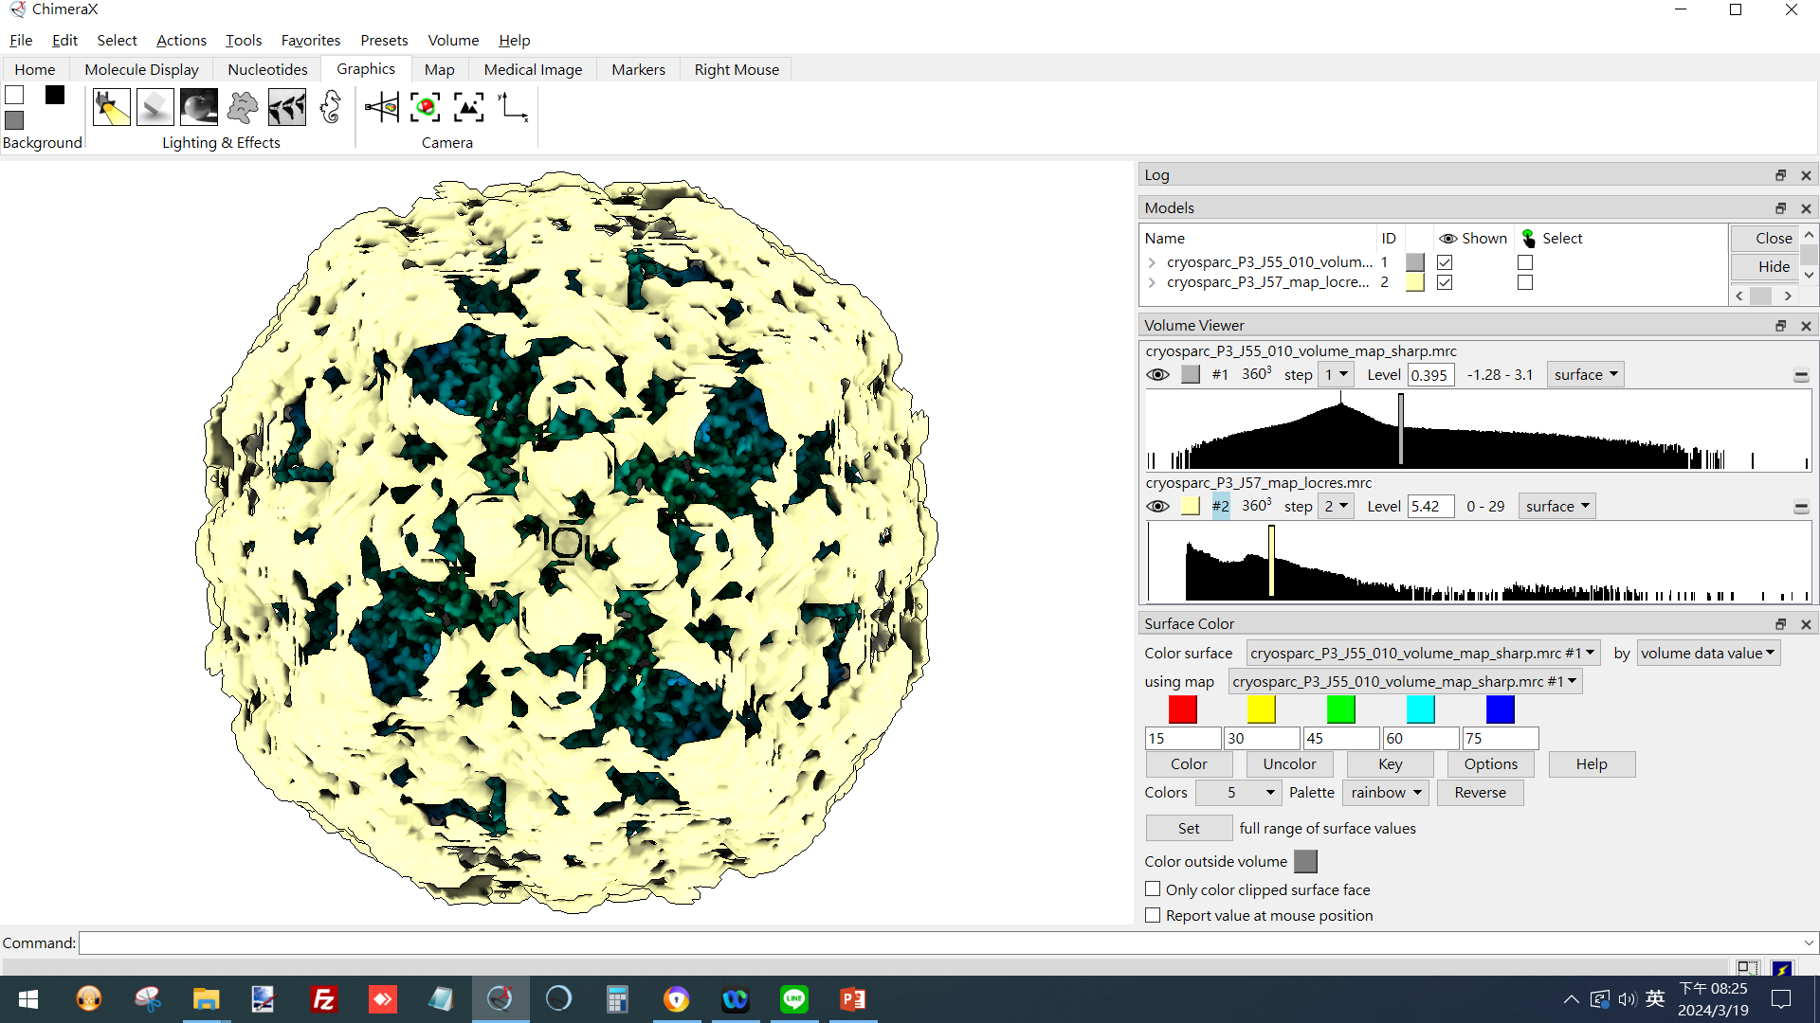
UCSF ChimeraX
(hide local resolution map)
 1
(ref: UCSF ChimeraX website. https://www.cgl.ucsf.edu/chimerax/)

Slide 16
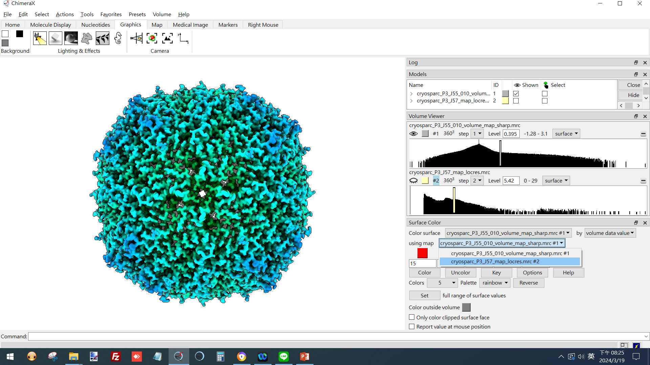
UCSF ChimeraX
(select local resolution map)
 1
(ref: UCSF ChimeraX website. https://www.cgl.ucsf.edu/chimerax/)

Slide 17
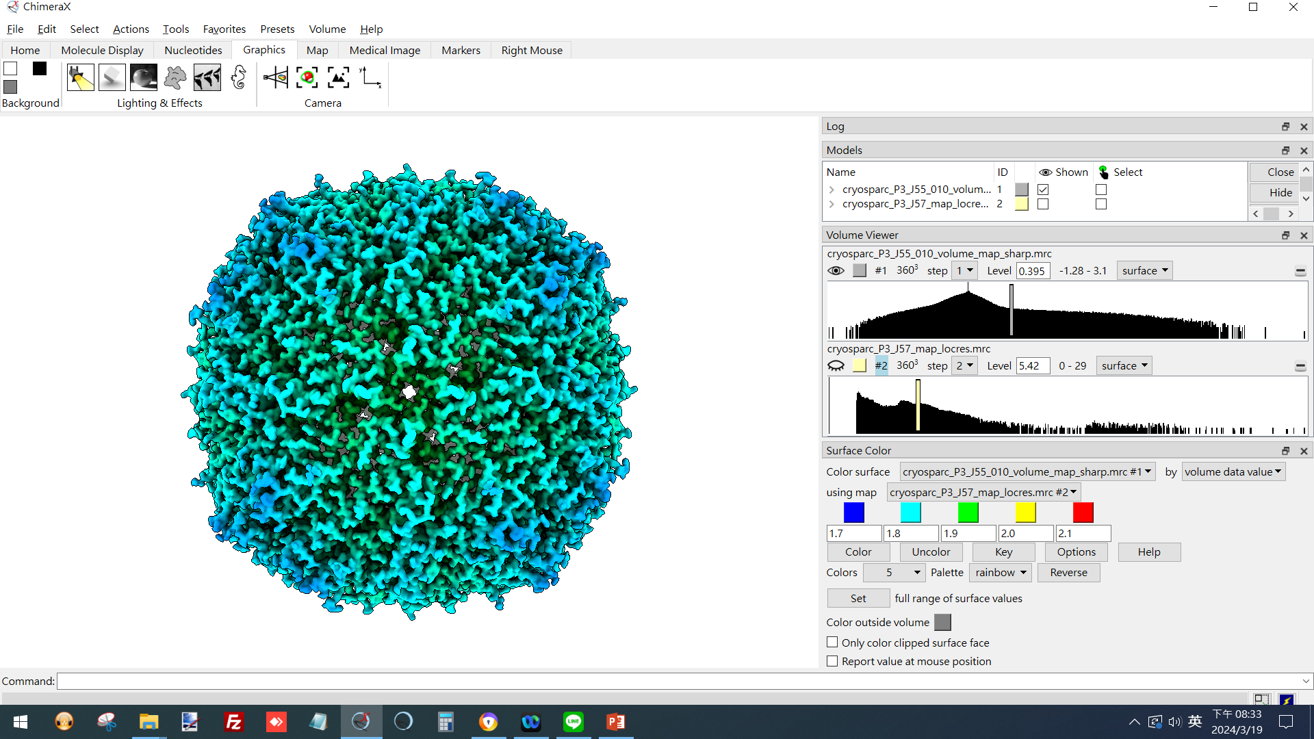
UCSF ChimeraX
(color according to local resolutions, rainbow)
1.7 1.8 1.9 2.0 2.1
 1
 3
 2
(ref: UCSF ChimeraX website. https://www.cgl.ucsf.edu/chimerax/)

Slide 18
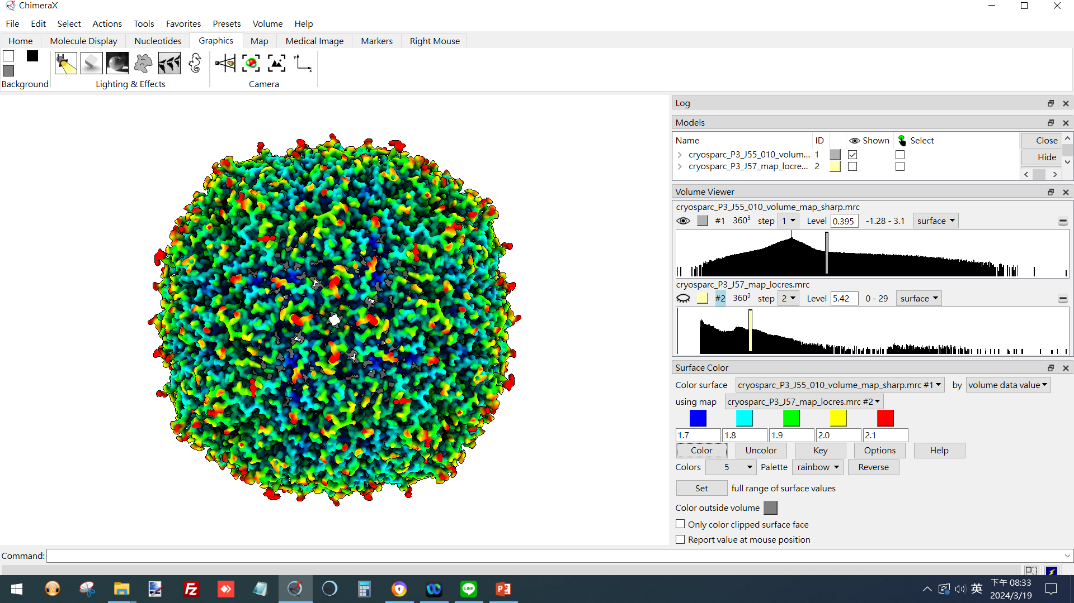
UCSF ChimeraX
(color according to local resolutions, rainbow)
(ref: UCSF ChimeraX website. https://www.cgl.ucsf.edu/chimerax/)

Slide 19
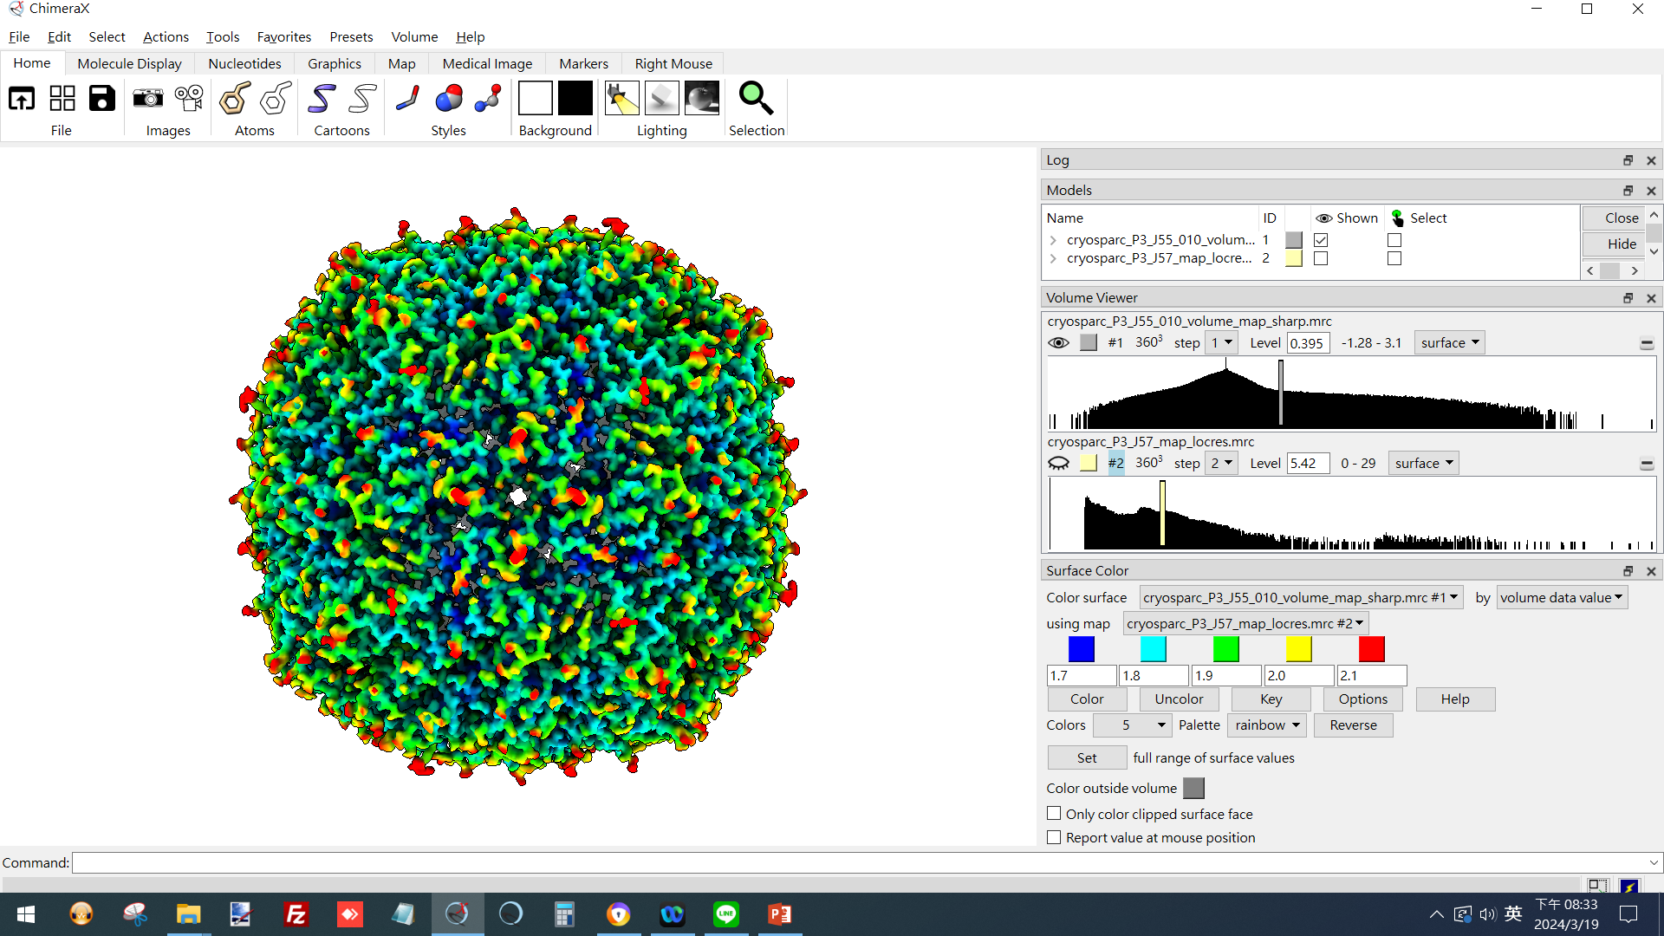
UCSF ChimeraX
(Export image to Desktop)
 1
 2
(ref: UCSF ChimeraX website. https://www.cgl.ucsf.edu/chimerax/)

Slide 20
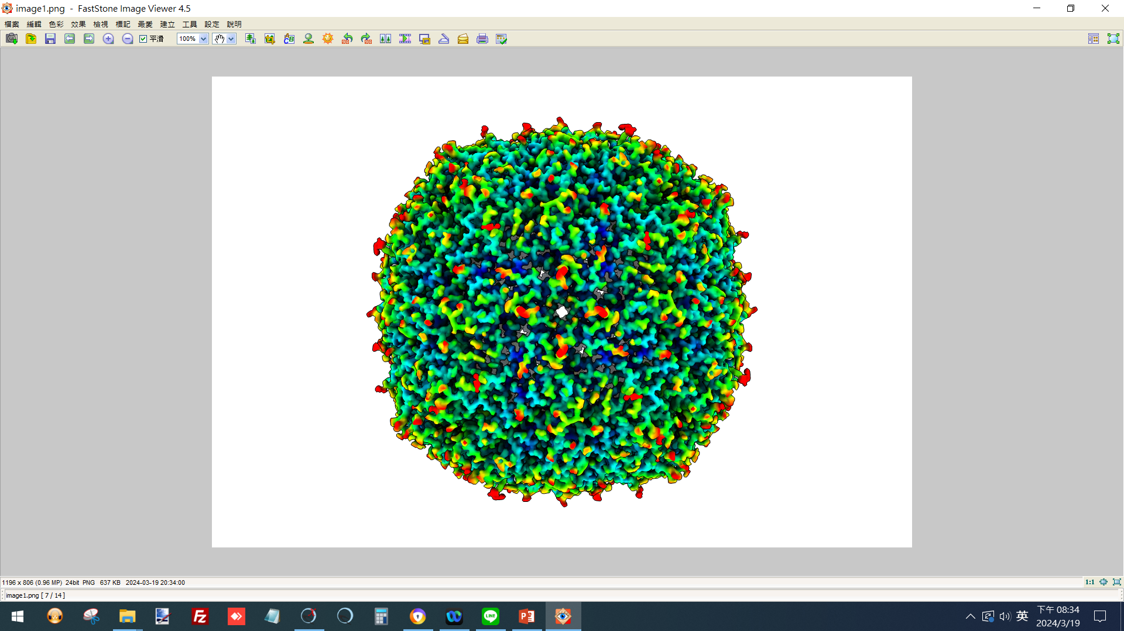
UCSF ChimeraX
(Exported image)
(ref: UCSF ChimeraX website. https://www.cgl.ucsf.edu/chimerax/)

Slide 21
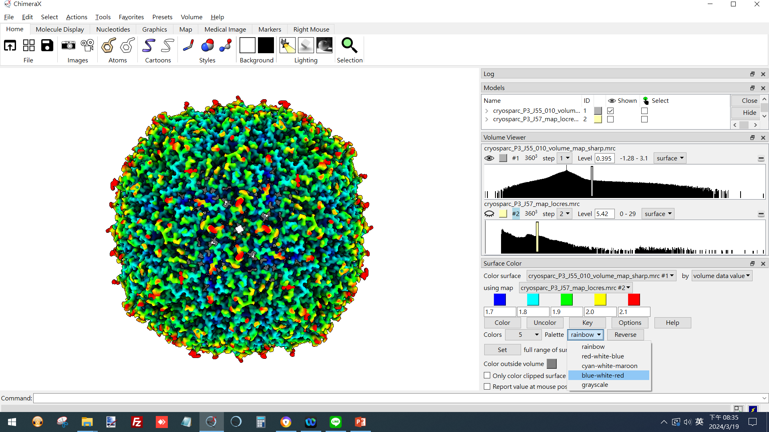
UCSF ChimeraX
(color according to local resolutions, blue-white-red)
 2
 1
(ref: UCSF ChimeraX website. https://www.cgl.ucsf.edu/chimerax/)

Slide 22
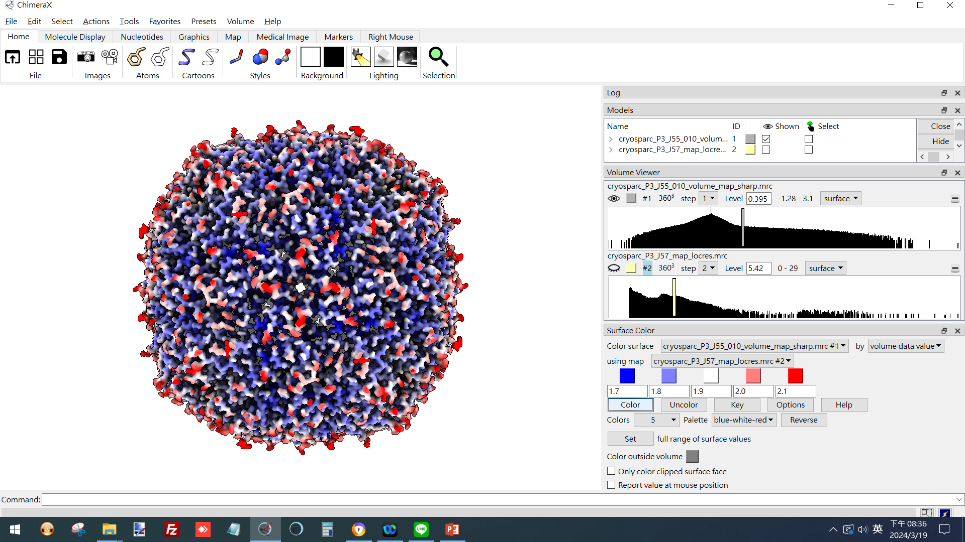
UCSF ChimeraX
(color according to local resolutions, blue-white-red)
 1
 2
(ref: UCSF ChimeraX website. https://www.cgl.ucsf.edu/chimerax/)

Slide 23
Thank you !

