Slide 1

Coot
Dr. Chun-Hsiung Wang
王俊雄
2026/03/16

Slide 2
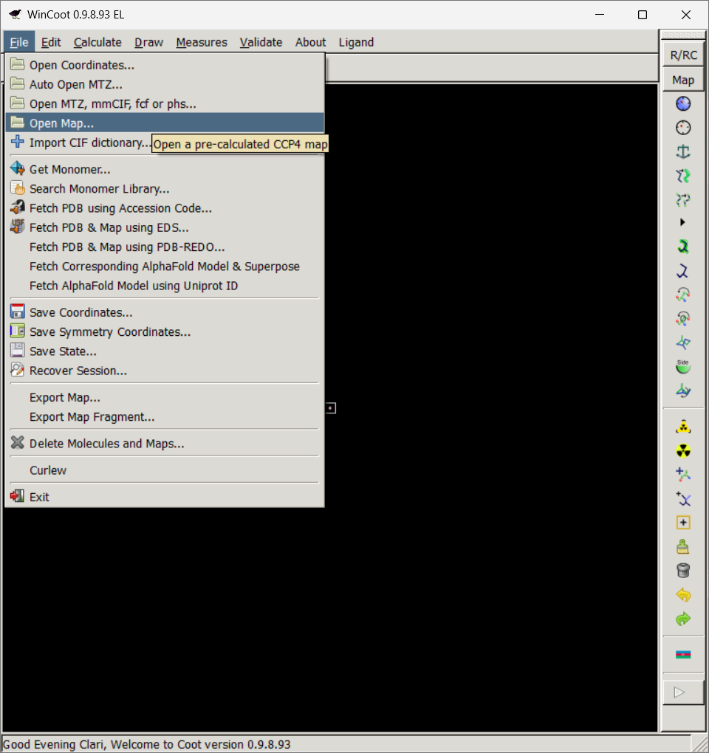
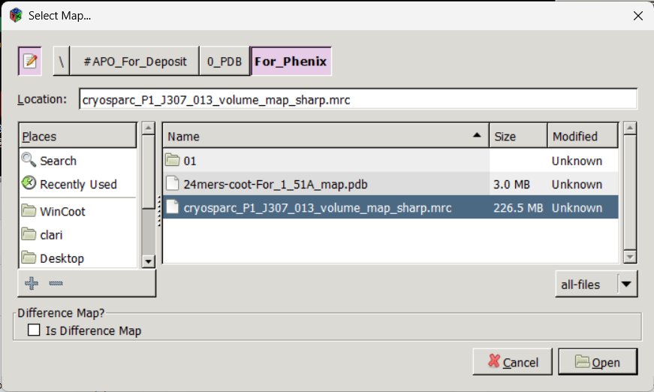
Coot
(open map)
 1
 2
 3
 4
 5

Slide 3
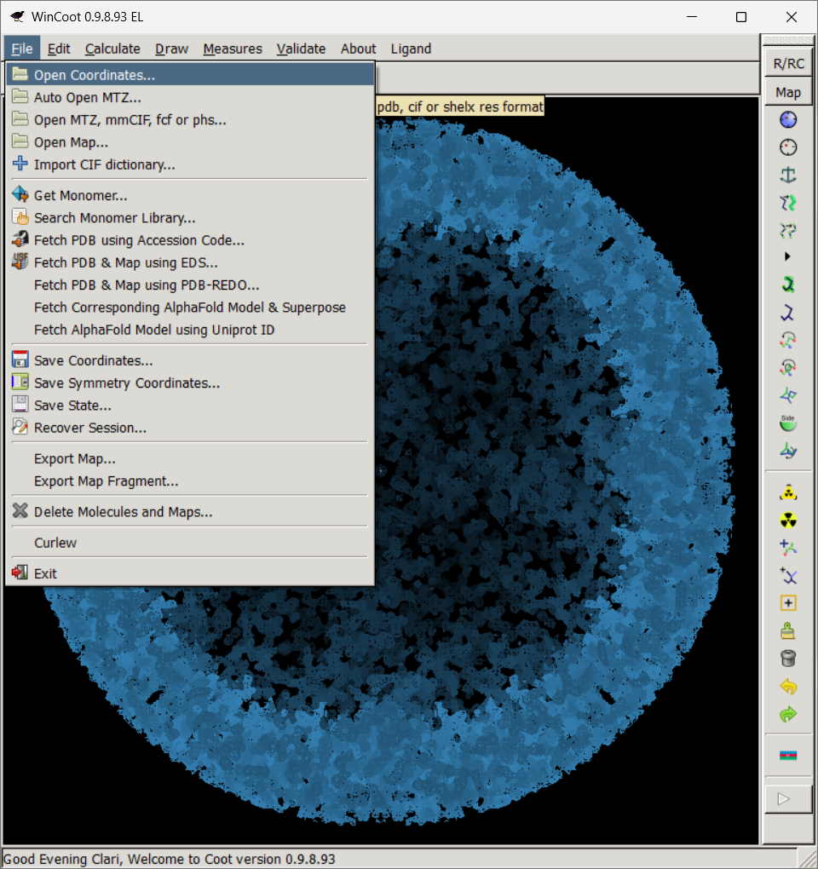
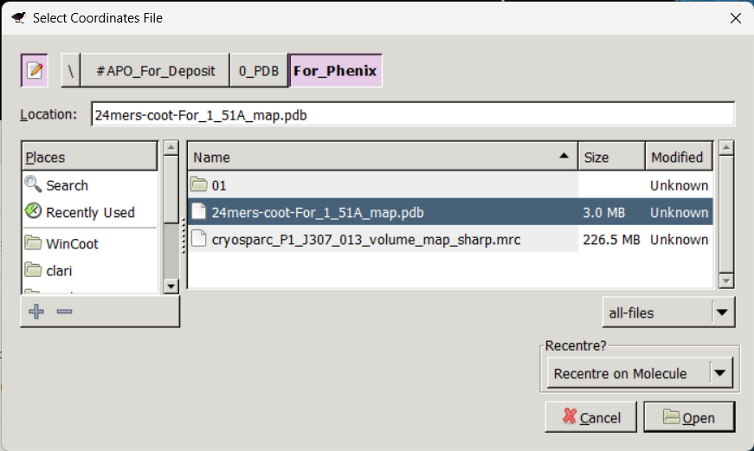
Coot
(open Coordinates)
 1
 2
 3
 4
 5

Slide 4
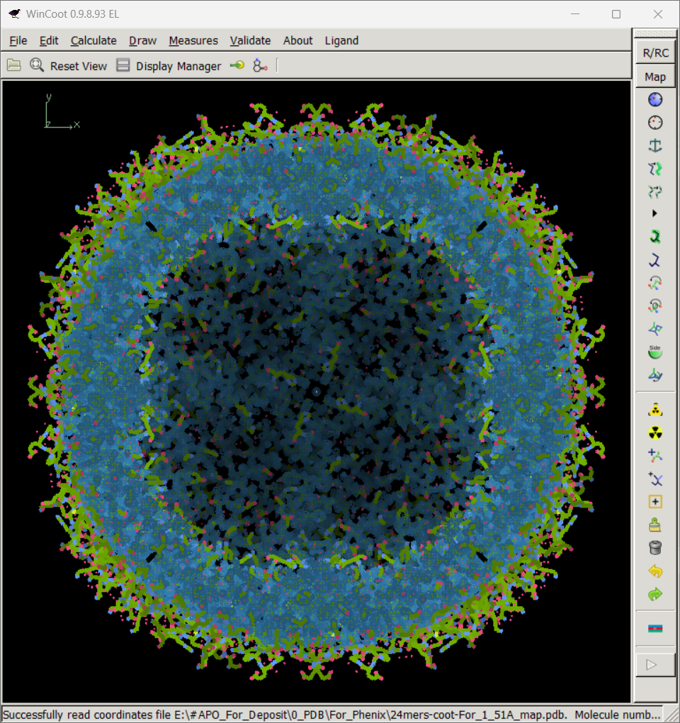
Coot
(Basic operation)
1. Mouse right bottom:
Hold and drag to
zoom in and zoom out
2. Mouse left bottom:
Hold and drag to
rotate the map/pdb
3. Mouse middle wheel:
To adjust the contour
of the map

Slide 5
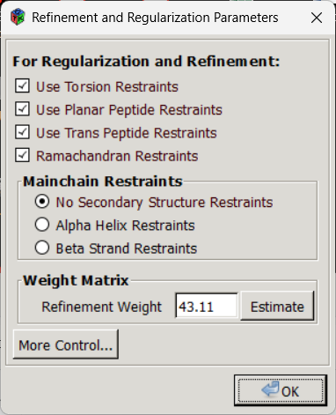
Coot
(Setting parameters-01)
 1
 2
 3
 4
Auto estimate
 5

Slide 6
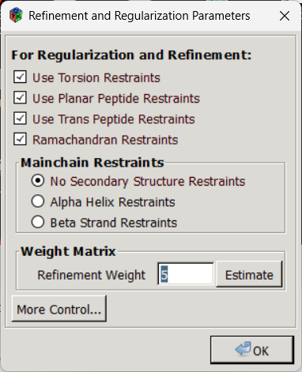
Coot
(Setting parameters-02)
Weight Matrix:
Larger value:
More weight given to
fitting the map.
Smaller value:
More weight given to
following the
geometry constraints.
 1
Manual key in
5

Slide 7
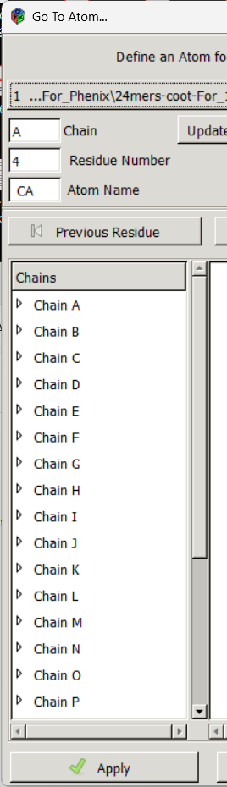
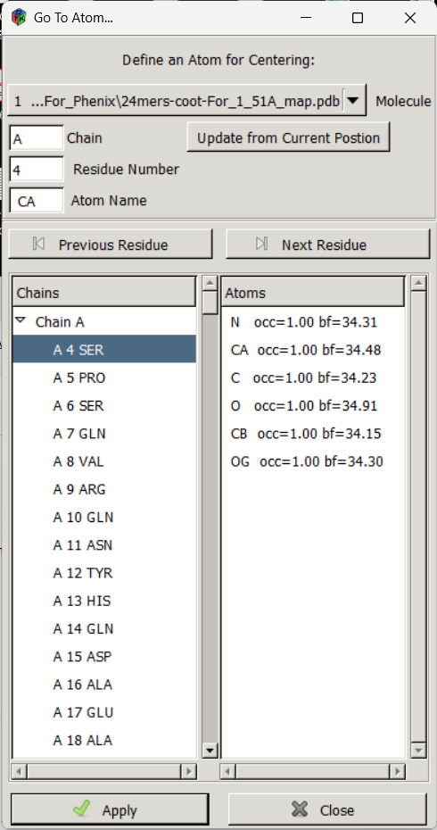
Coot
(Go to residue)
 1
 5
 4
 2
 3

Slide 8
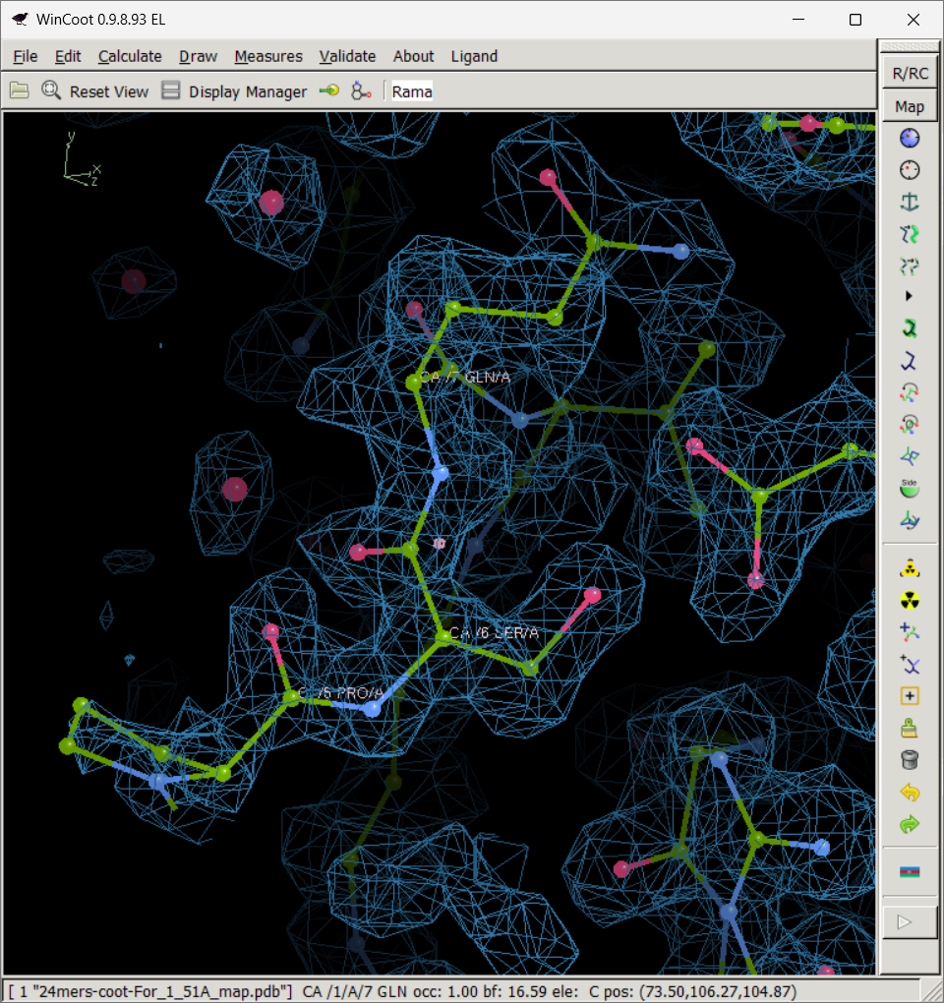
Coot (real space refinement-01)
Refine 3 residues together (residue 4~6)
 1
Refine 3 residues
together (residue 4~6).
You can also refine
more than 100 residues
together.
 3
 2

Slide 9
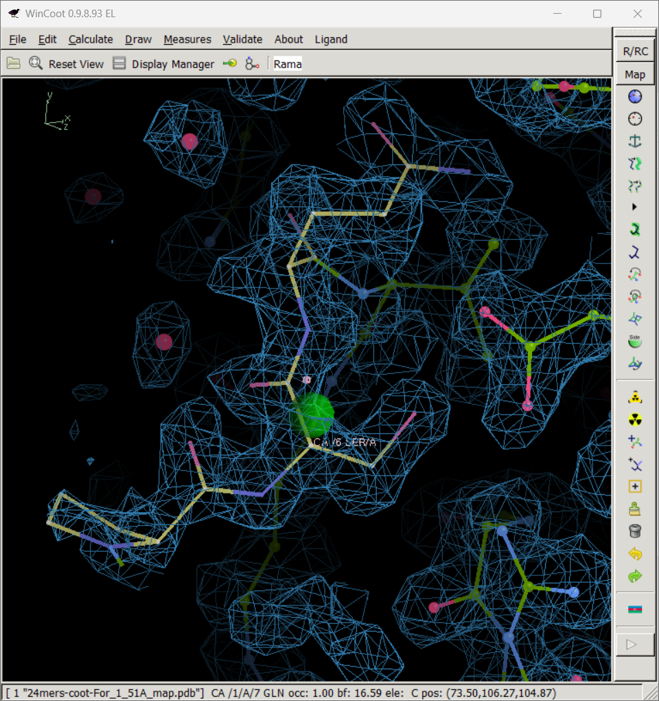
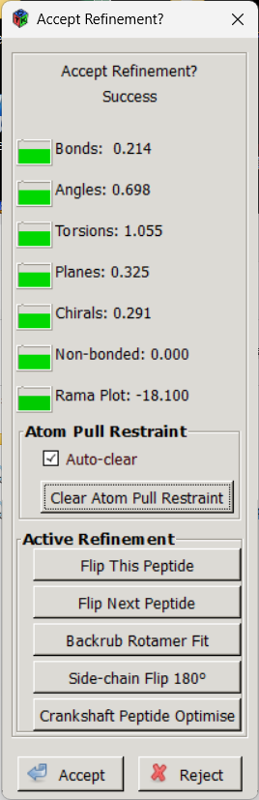
Coot (real space refinement-01)
Refine 3 residues together (residue 4~6)
 4

Slide 10
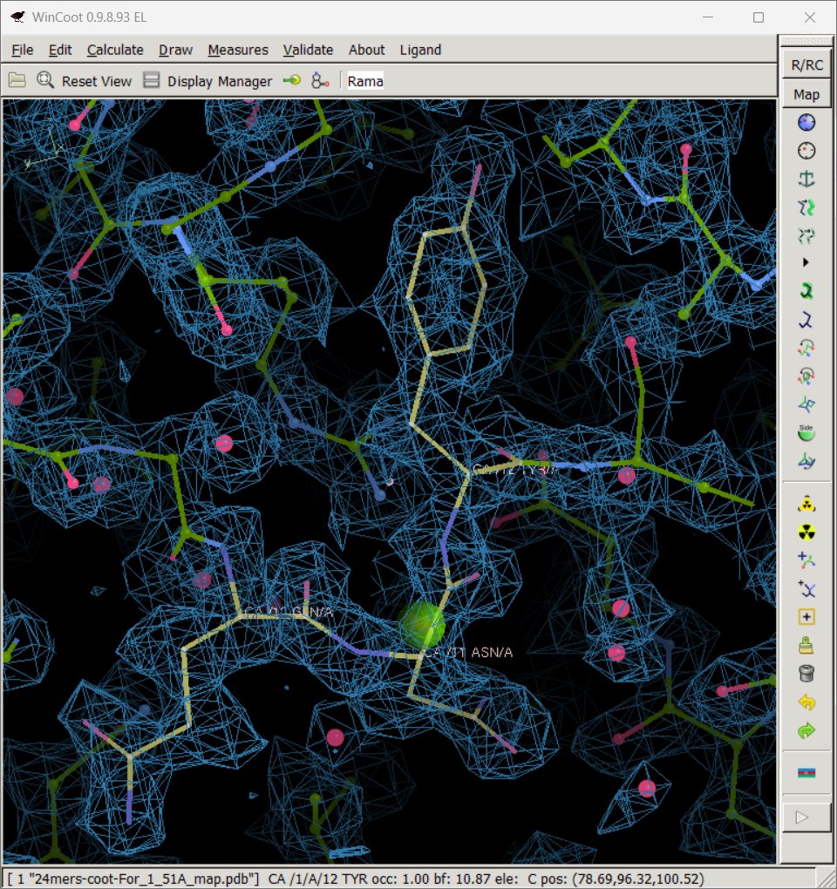

Coot (real space refinement-02)
Refine 3 residues together (residue 10~12)
 1
 3
 2
 4

Slide 11
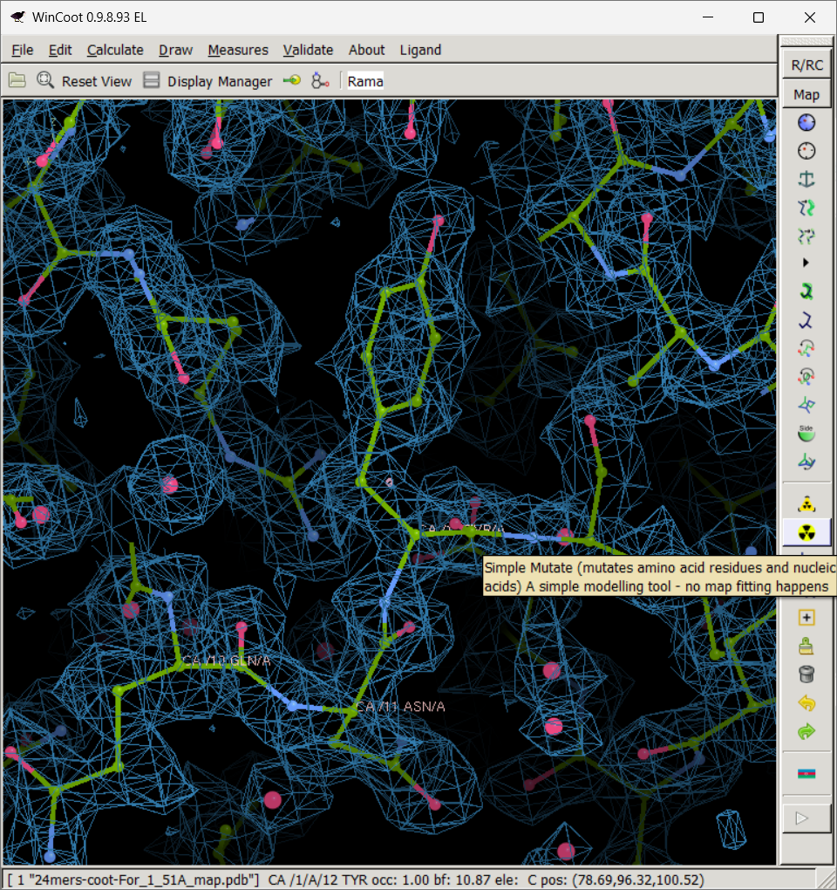
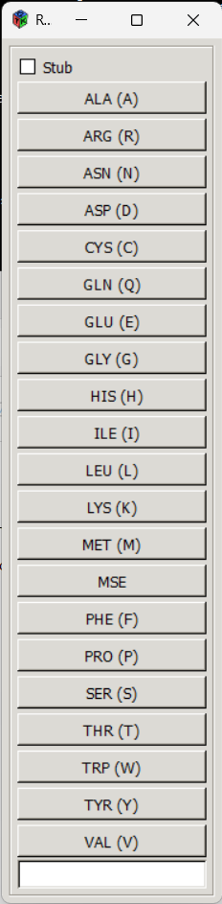
Coot (Point mutation)
(Residue 12 TYR(Y) → HIS(H) )
TYR
 3
 2
 1

Slide 12
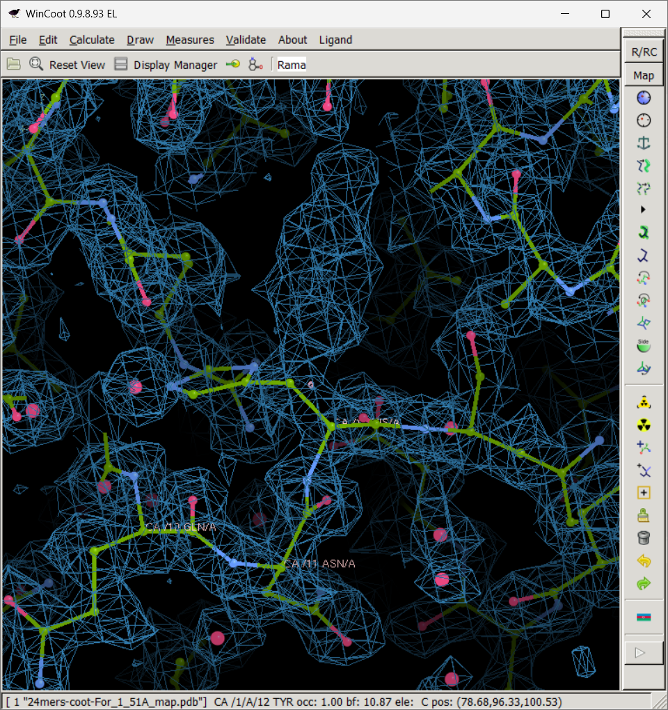
Coot (Point mutation)
(Residue 12 TYR(Y) → HIS(H) )
The model doesn't
fit into the map and
needs to be adjusted by
real space refinement.
HIS

Slide 13

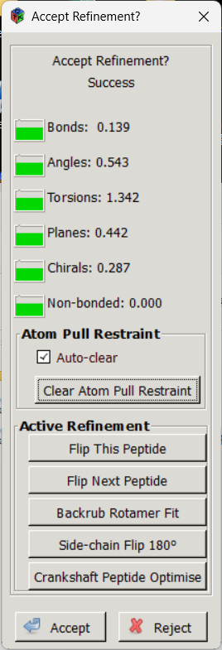
Coot (real space refinement)
(Point mutation: Residue TYR(Y) → HIS(H) )
 1
HIS
 2
 3

Slide 14
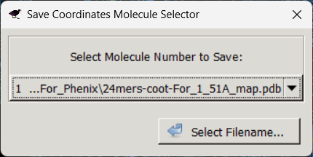
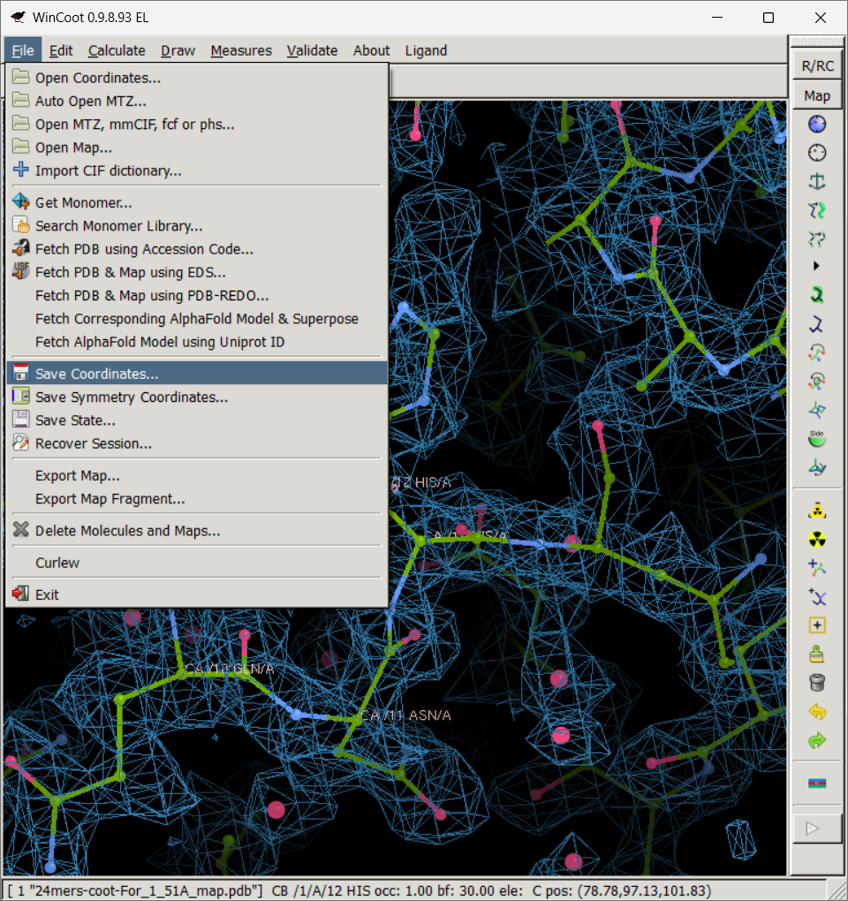
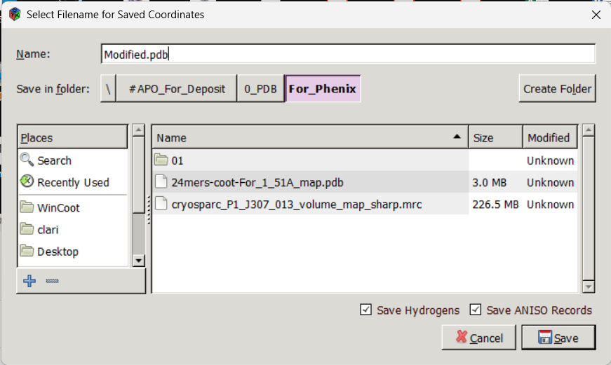
Coot
(Save Coordinates)
 1
 3
 2
 5
 4
 6

Slide 15
Thank you !

