Slide 1

UCSF Chimera
Dr. Chun-Hsiung Wang
王俊雄
2026/03/16

Slide 2
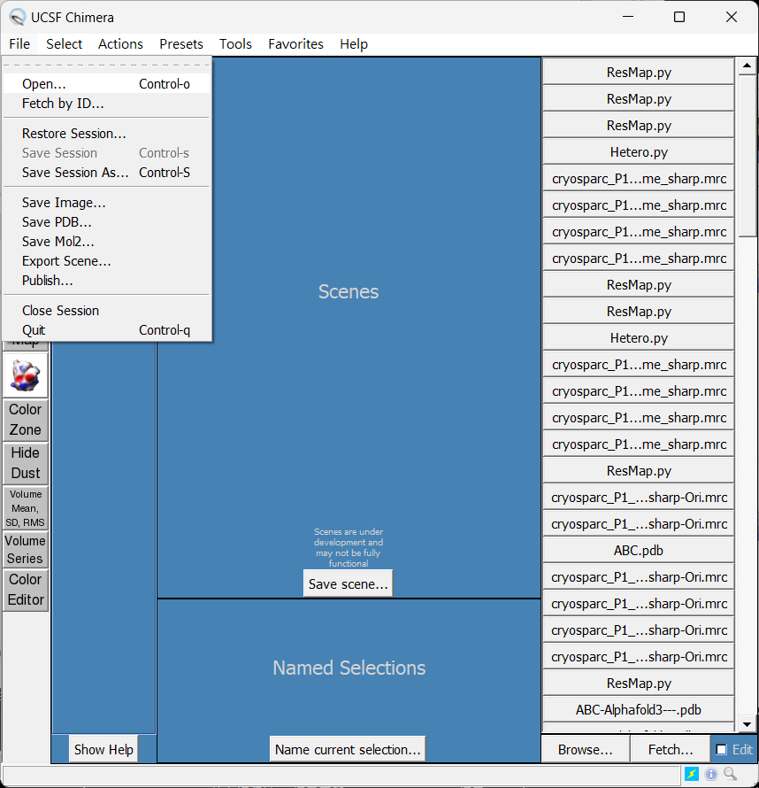
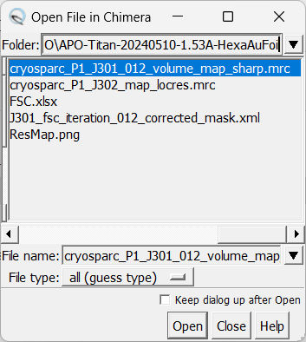
UCSF Chimera
(open map)
 1
 2
 3
(ref: UCSF Chimera website. www.rbvi.ucsf.edu/chimera/)

Slide 3
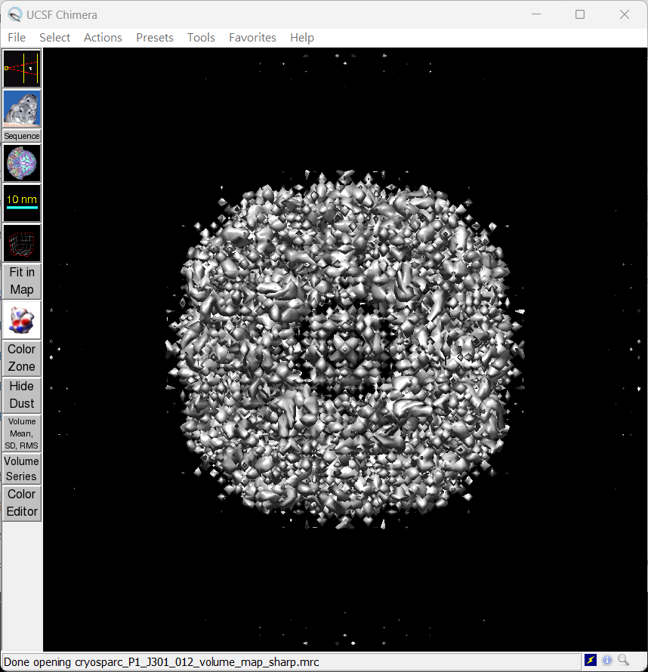
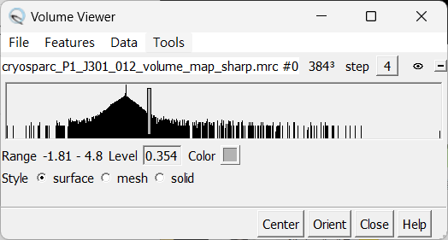
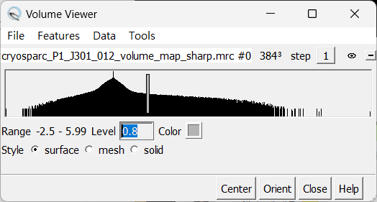
UCSF Chimera
(open map)
 1
 2
(ref: UCSF Chimera website. www.rbvi.ucsf.edu/chimera/)

Slide 4
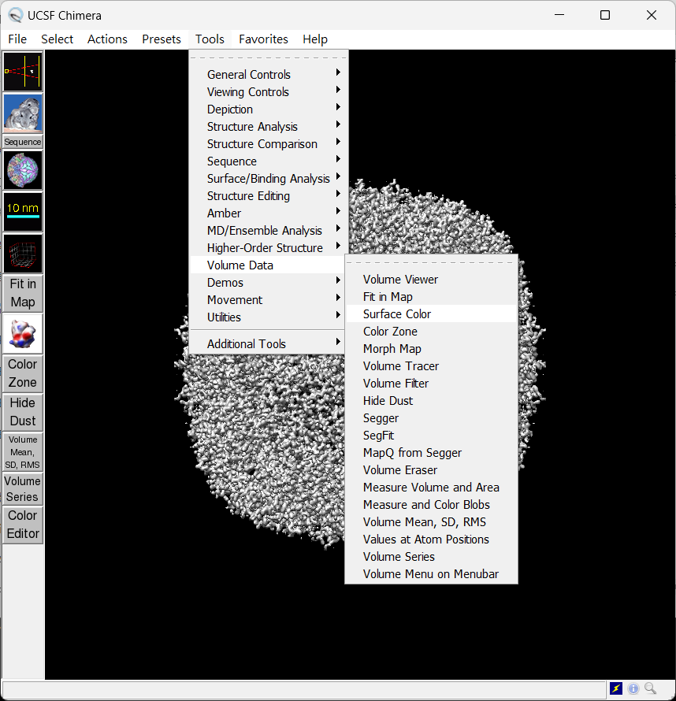
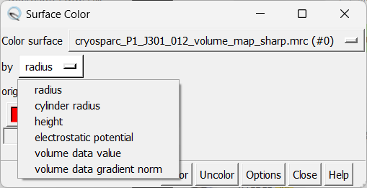
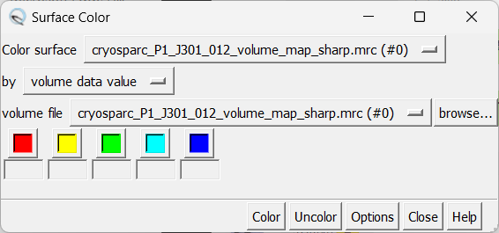
UCSF Chimera
(Color according to local resolution)
 1
 4
 2
 3
 5
(ref: UCSF Chimera website. www.rbvi.ucsf.edu/chimera/)

Slide 5
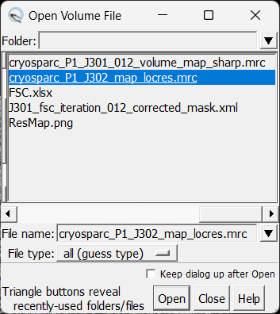
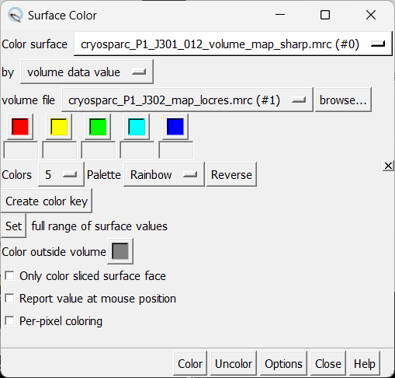
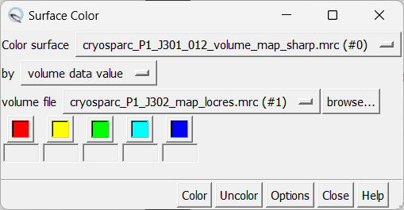
UCSF Chimera
(Color according to local resolution, Rainbow)
 1
 4
 2
 3
(ref: UCSF Chimera website. www.rbvi.ucsf.edu/chimera/)

Slide 6
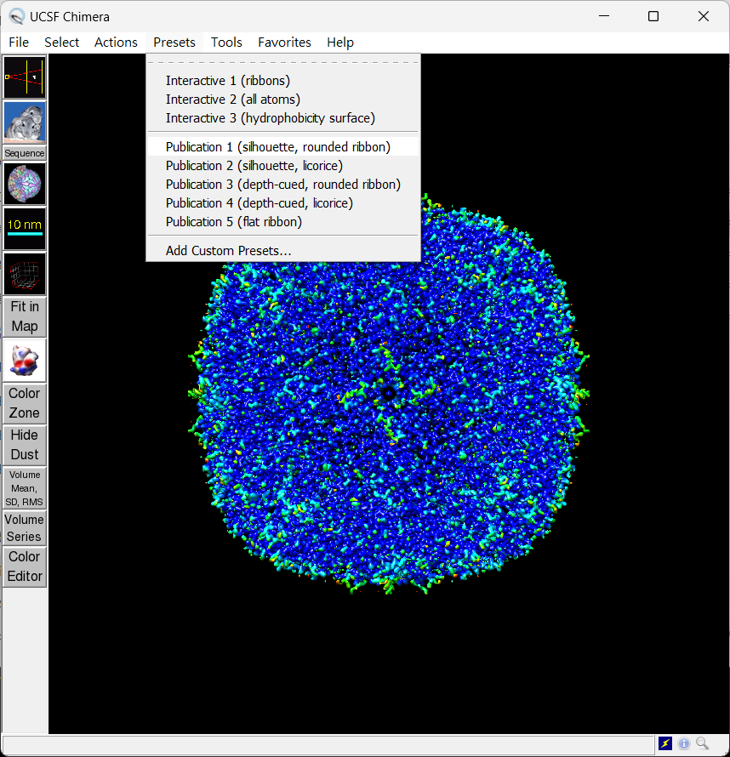
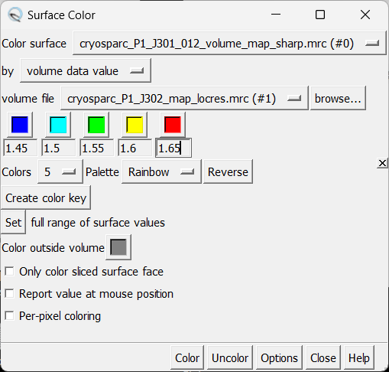
UCSF Chimera
(Color according to local resolution, change style)
 3
 1
 2
(ref: UCSF Chimera website. www.rbvi.ucsf.edu/chimera/)

Slide 7
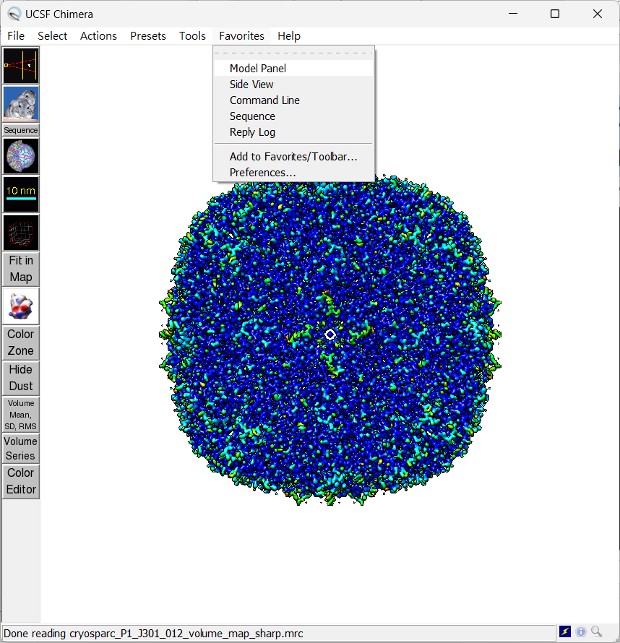
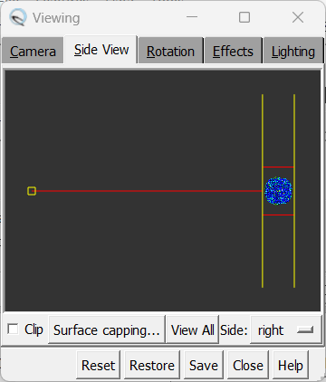
UCSF Chimera
(Color according to local resolution, View All)
 1
 2
(ref: UCSF Chimera website. www.rbvi.ucsf.edu/chimera/)

Slide 8
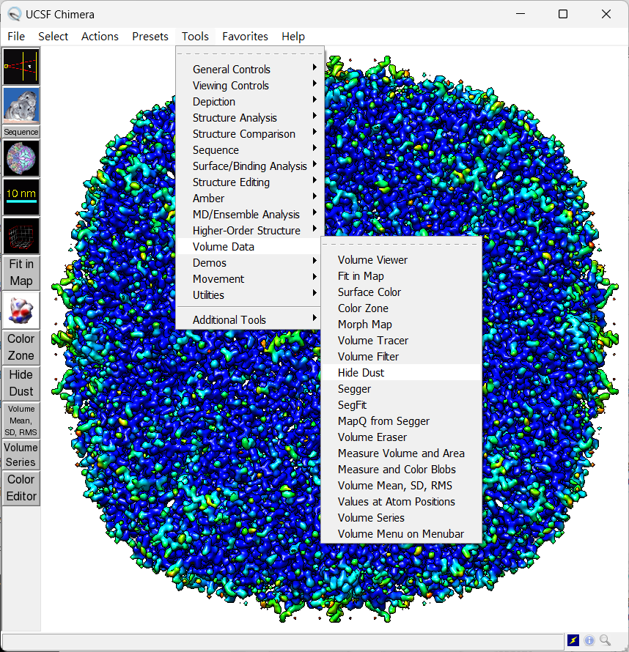
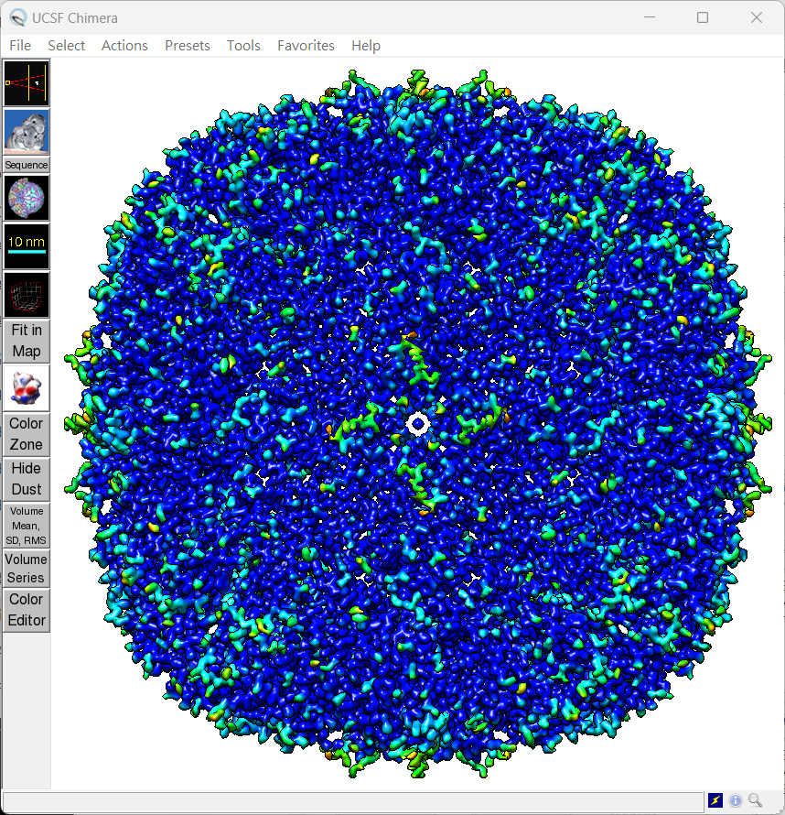
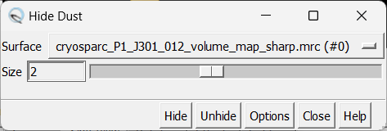
UCSF Chimera
(Color according to local resolution, Hide dust)
 1
 2
 3
 5
 4
(ref: UCSF Chimera website. www.rbvi.ucsf.edu/chimera/)

Slide 9
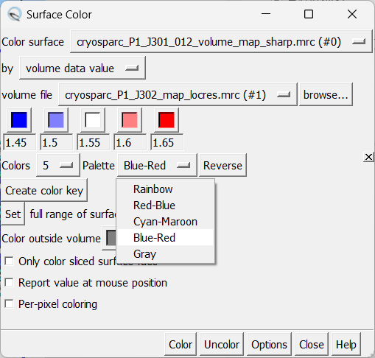
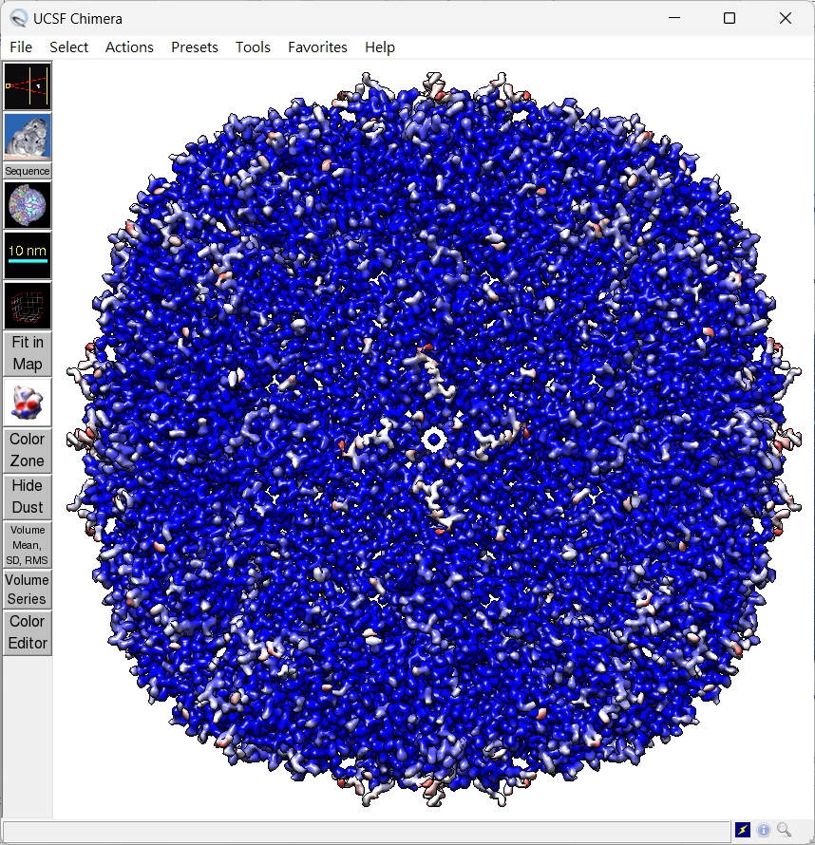
UCSF Chimera
(Color according to local resolution, Blue-Red)
 1
 2
(ref: UCSF Chimera website. www.rbvi.ucsf.edu/chimera/)

Slide 10
Thank you !

