Slide 1






Multifaceted molecular dynamics studies on the stability of type 1A polymorph of α-synuclein
Marina BOTNARI
TIGP-X program
LPCT, University of Lorraine
Metz, France
Thesis advisor:
Dr Thérèse MALLIAVIN
LPCT, CNRS, University of Lorraine
Metz, France
Thesis co-advisor:
Dr Jung-Hsin LIN
BioTReC, RCAS, Academia Sinica
Taipei, Taiwan
Taipei, Taiwan
Notes:
1. Good morning. I’m BOTNARI MARINA, a second-year PhD student at the University of Lorraine and part of the TIGP-X program in collaboration with Academia Sinica, working under the guidance of Drs. Thérèse MALLIAVIN and Jung-Hsin LIN.
2. Today I will present some progress I have made on this project over the past 6 months centered on the multifaceted molecular dynamics aspects of α-synuclein

Slide 2
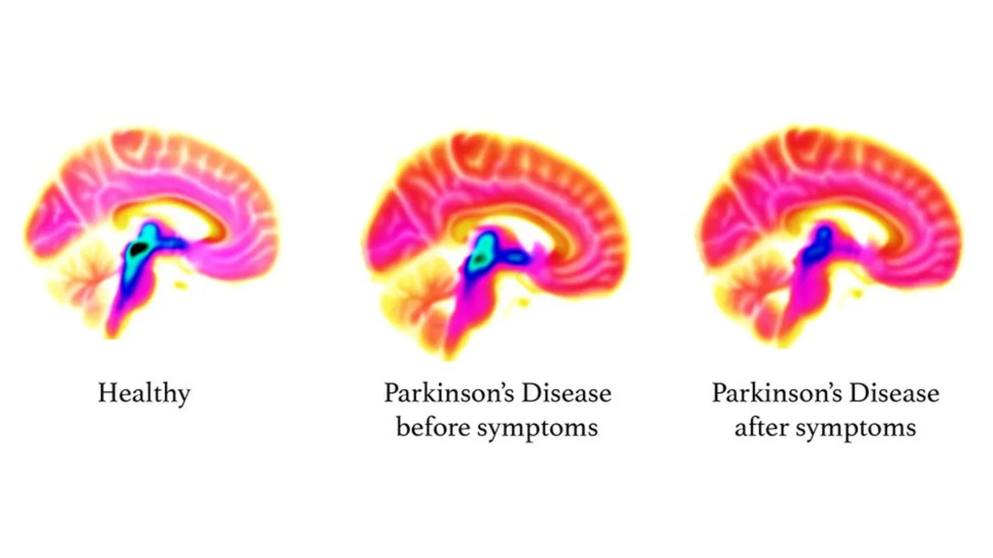
Multifaceted molecular dynamics studies on the stability of the type 1A polymorph of α synuclein
I. Parkinson’s Disease
Stage 1
Tremors on one side of the body
Stage 2
Speech abnormality
Stage 3
Postural instability
Stage 4
Stage 5
Limited movement
In need of assistance
Stiffness in posture
Mild clumsiness
Decreased blinking
Loss of facial expression on both sides
Hindered daily activities
Falls are common
Severe tremors
Stiffness
Dementia
Psychosis
Cognitive imapirment
^{[1]}
Fig 1. Serotonin levels (blue/black) in healthy and in diagnoses with Parkinson’s disease brains. Image retrieved on 13/03/2026 from https://www.bbc.com/news/health-48691633
Synucleinopathies: Parkinson’s Disease, Dementia with Lewy Bodies, Multiple System Atrophy
Abnormal accumulation of misfolded α-synuclein in neurons and glia
Progressive neurodegenerative disorder
No curative treatment
Notes:
To begin, I will introduce a pathology that is already well known to everyone: Parkinson’s Disease.
Together with Dementia with Lewy Bodies and Multiple System Atrophy it is characterised as a synucleinopathy, defined by the abnormal accumulation of misfolded α-synuclein protein in neurons and glia.
It is a progressive condition characterised by multiple stages, with each clinical phase marked by the onset of more severe symptoms, featuring cardinal motor dysfunction, postural instability, and often cognitive impairment, dementia, and psychosis.
To date, no curative treatment exists, and disease management remains largely palliative.
Therefore, a deeper understanding of α-synuclein behaviour may enable the development of therapeutic molecules targeting this protein.

Slide 3
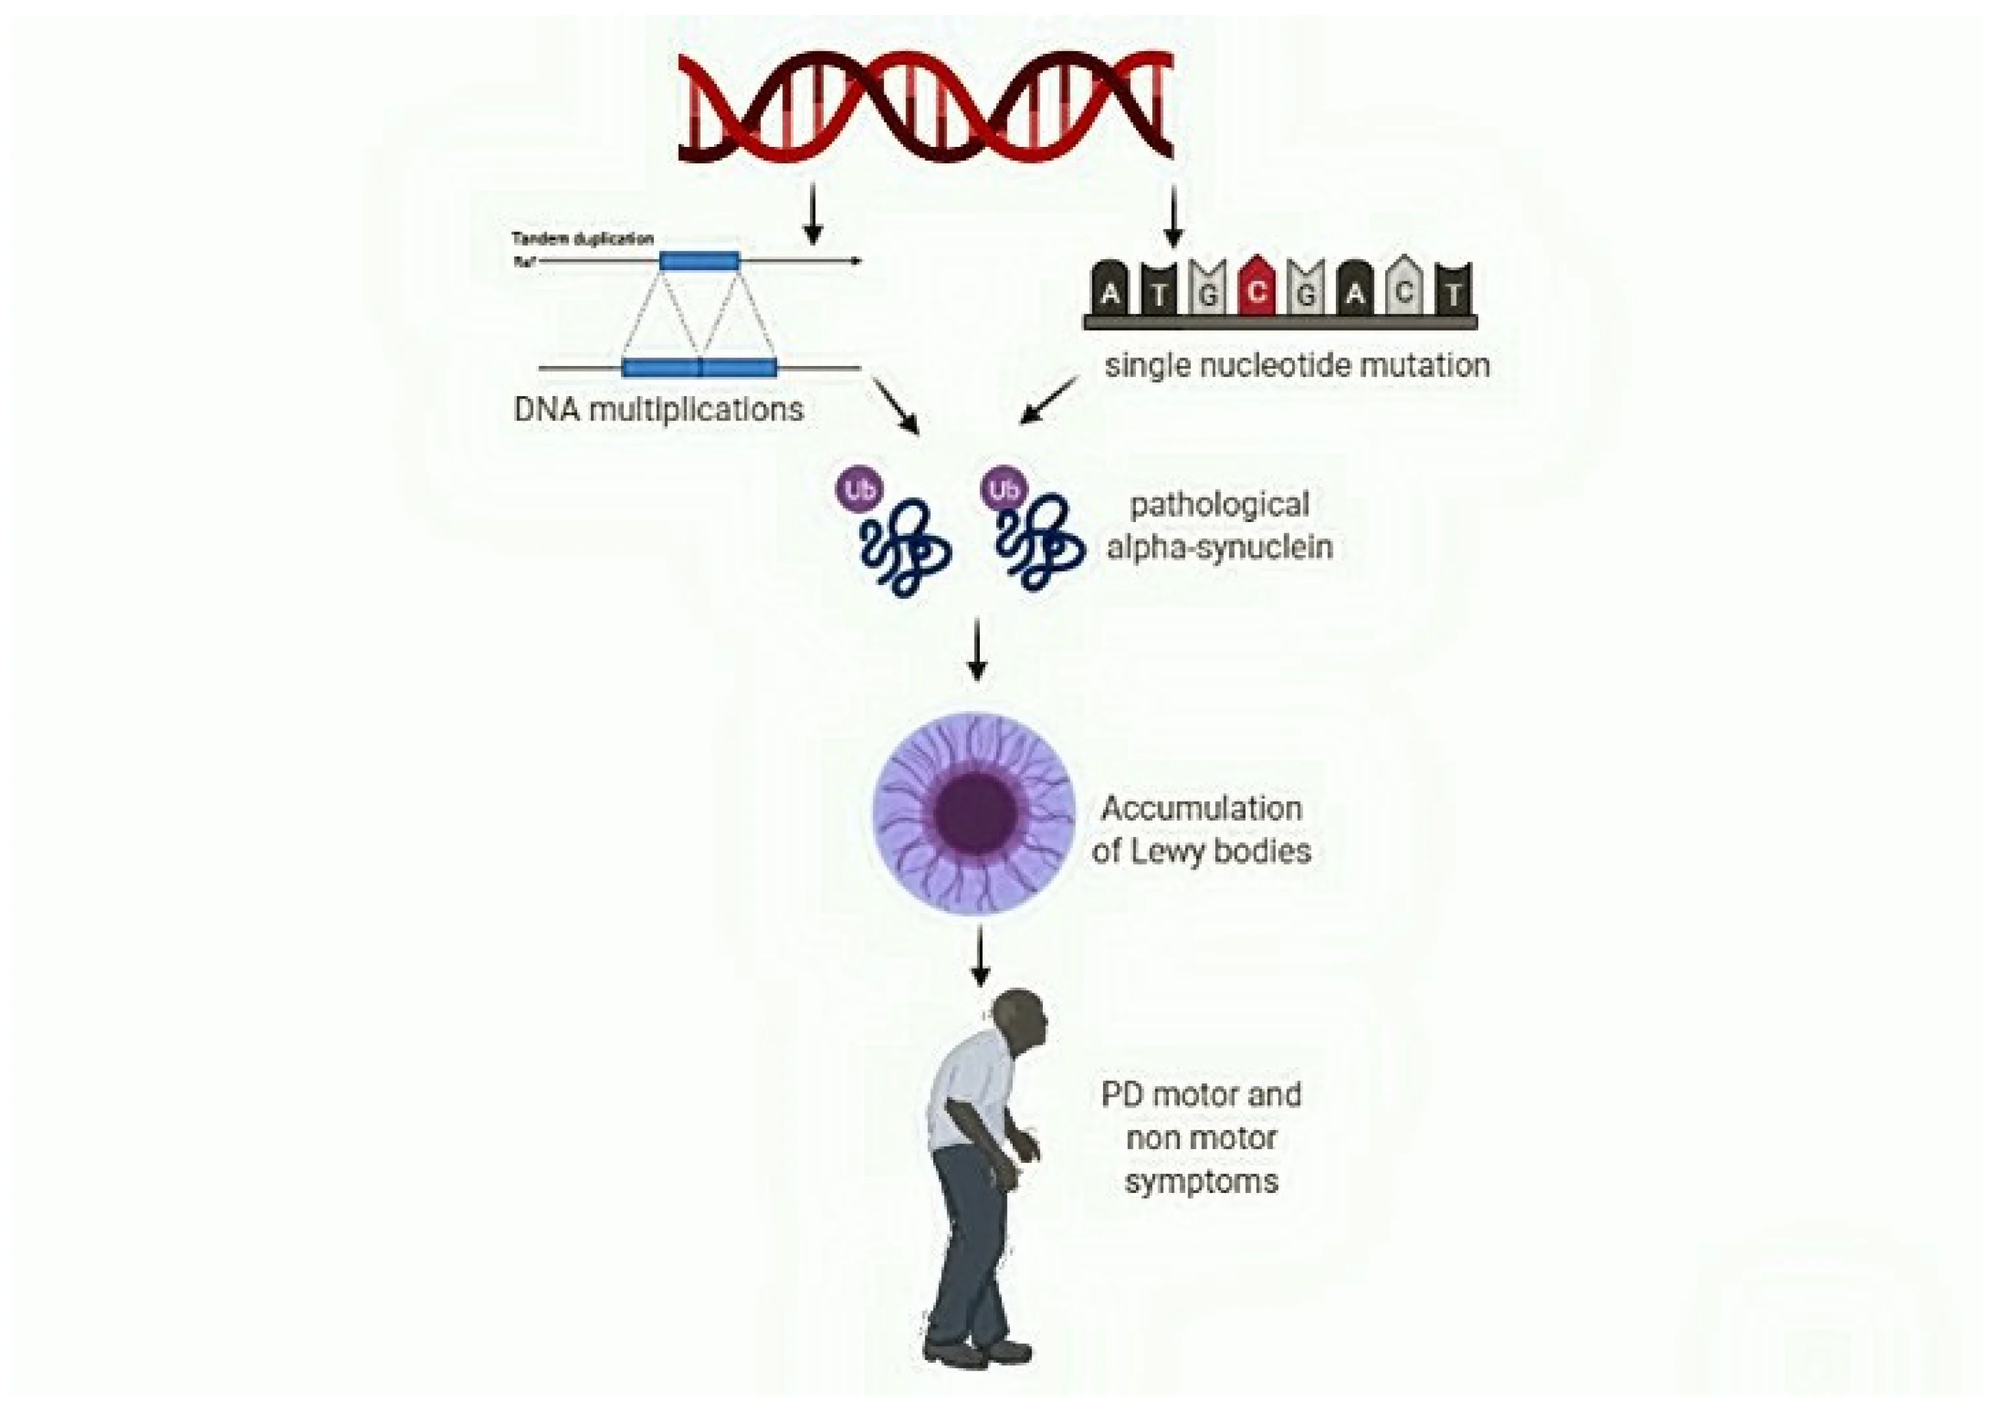
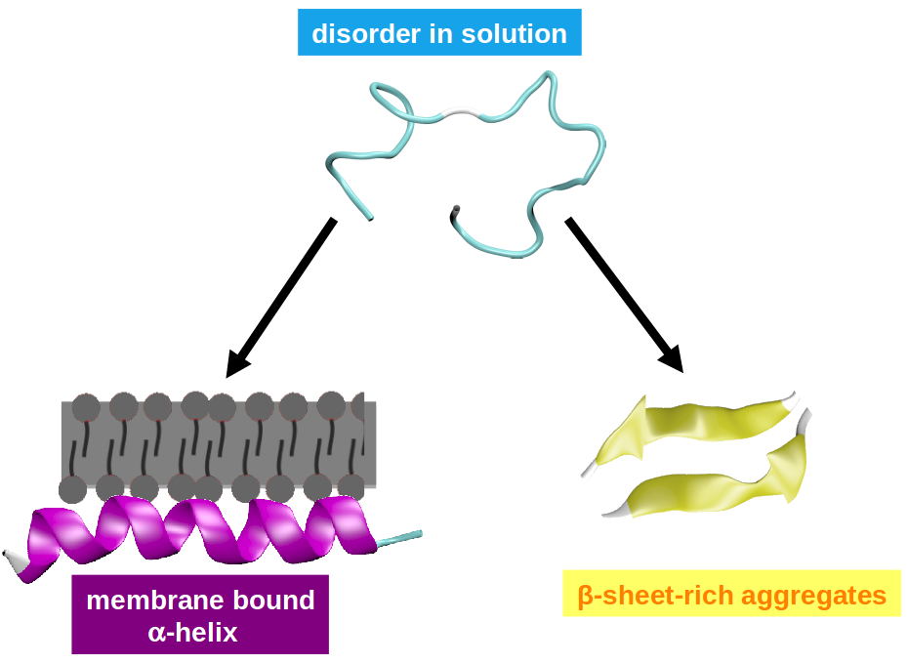
Multifaceted molecular dynamics studies on the stability of the type 1A polymorph of α synuclein
II. α-synuclein introduction
Small presynaptic 140aa neuronal protein
SNCA gene
Regulates neurotransmitter release
Physiological form: unfolded
Bound to phospholipid membranes: α-helix
Pathological: β-sheet motifs -> amyloid aggregates^{[2]}
-> onset of synucleinopathies
Fig 3. Secondary structure elements variation in α-synuclein in different conditions. Image retrieved on 13/03/2026 from https://www.chemie.uni-konstanz.de/ag-peter/research/research-projects/biological-and-bio-inspired-systems/intrinsically-disorderd-systems/alpha-synuclein/
Fig 2. The impact of SNCA variation in the development of non-motor symptoms in Parkinson’s disease. Image retrieved on 13/03/2026 from https://www.mdpi.com/2075-1729/11/8/804^{[2]}
Notes:
α-Synuclein is a small presynaptic neuronal protein encoded by the SNCA gene, composed of 140 amino acids.
It plays a key role in regulating neurotransmitter release.
In its physiological form, this is an intrinsically disordered protein.
It also adopts a helical structure and binds to phospholipid membranes.
However, in its pathological form, α-synuclein is prone to adopt β-sheet cross motifs instead, forming amyloid fibrils, mediating the onset of synucleinopathies.

Slide 4
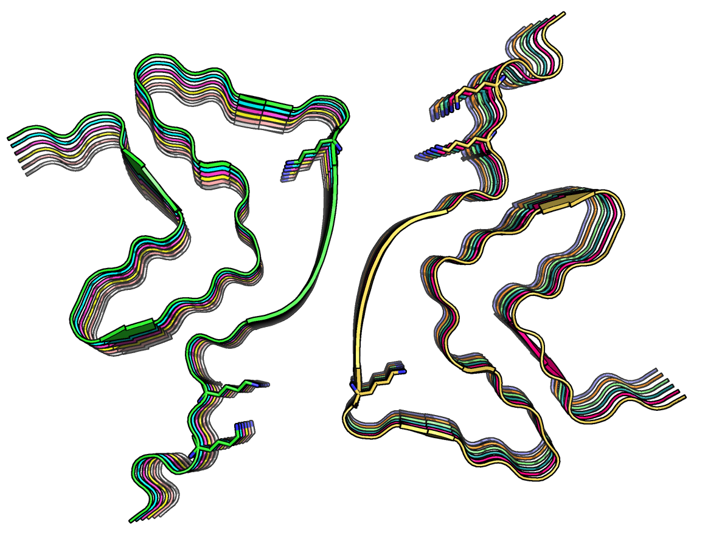
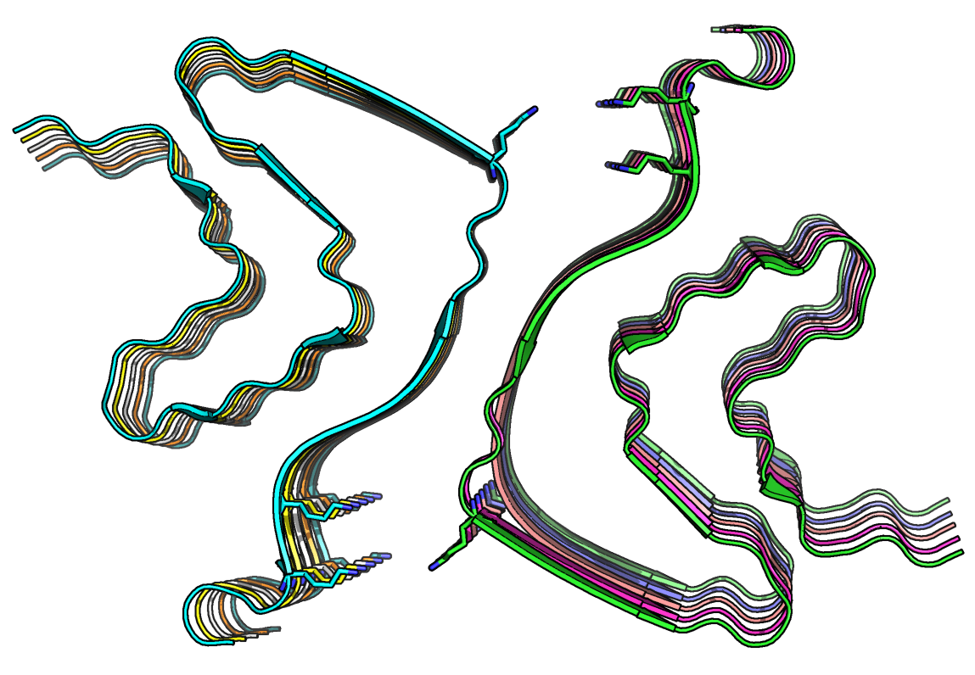
Multifaceted molecular dynamics studies on the stability of the type 1A polymorph of α synuclein
III. α-synuclein polymorphs
Aggregates:
6A6B (12 chains):
inward (no lysine triad)^{[4]}
6CU7 (10 chains):
outward (lysine triad)^{[5]}
60 amyloid structures (cryo-EM) at pH: 5.8 – 7.4^{[3]}
5 main polymorphic types, focusing on 1A type (pH 7.4)
Structural difference: orientation of the Lys⁵⁸ side chain
A
B
Lys⁴³
Lys⁴³
Lys⁵⁸
Lys⁴⁵
Lys⁴⁵
Lys⁵⁸
Lys⁴⁵
Lys⁵⁸
Lys⁴⁵
Lys⁵⁸
Lys⁴³
Lys⁴³
6A6B
6CU7
Fig 4. Structures of the two 1A polymorphs: (A) 6A6B with the Lys⁵⁸ side-chain oriented outwards, (B) 6CU7 with the Lys⁵⁸ sidechain oriented inwards . The red dashed circle denotes the formation of the Lys⁴³-Lys⁴⁵-Lys⁵⁸ triad. PyMOL representation ^{[6]}.
Notes:
Currently, approximately 60 α-synuclein amyloid structures have been resolved by cryo-EM at pH values ranging from 5.8 to 7.4 and classified into five main polymorphic types.
The present study focuses on two polymorphs belonging to type 1A (PDB codes 6A6B [3] and 6CU7 [4]).
Both structures are classified as aggregates.
The only reported structural difference they exhibit is the orientation of the Lys⁵⁸ side chain, which forms a lysine triad with Lys⁴³ and Lys⁴⁵ residues in the 6CU7 structure.

Slide 5
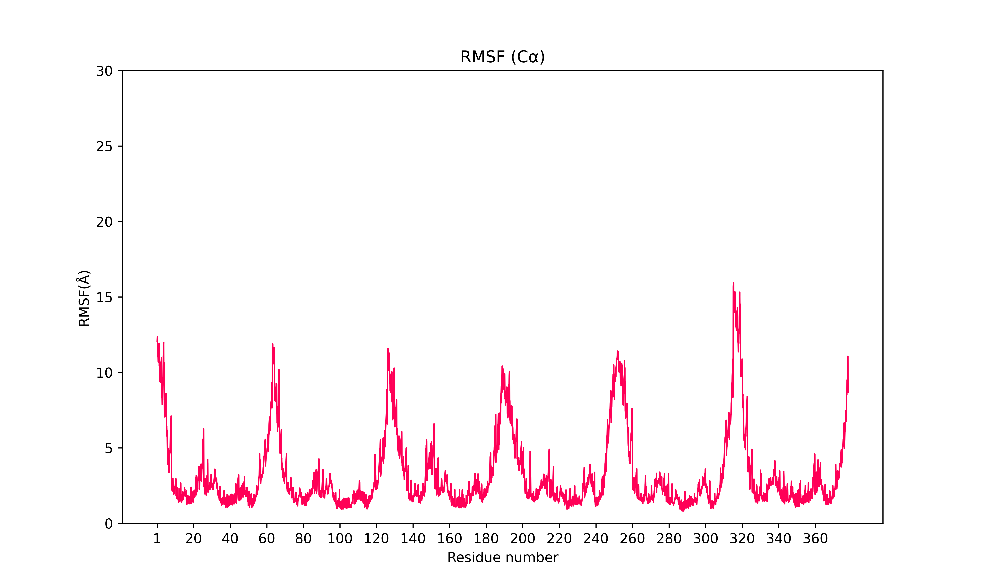
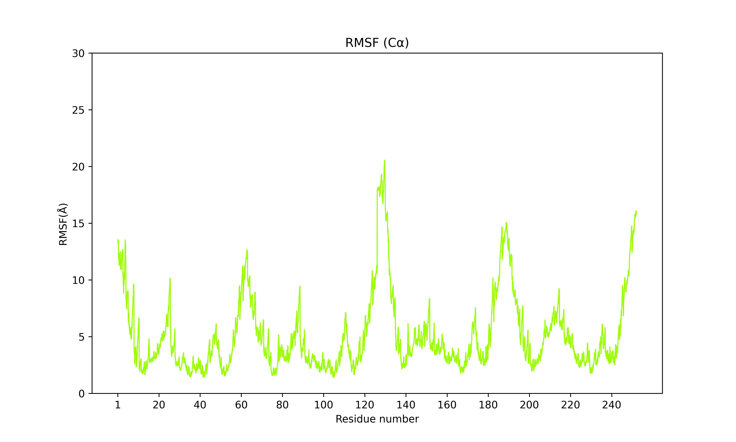
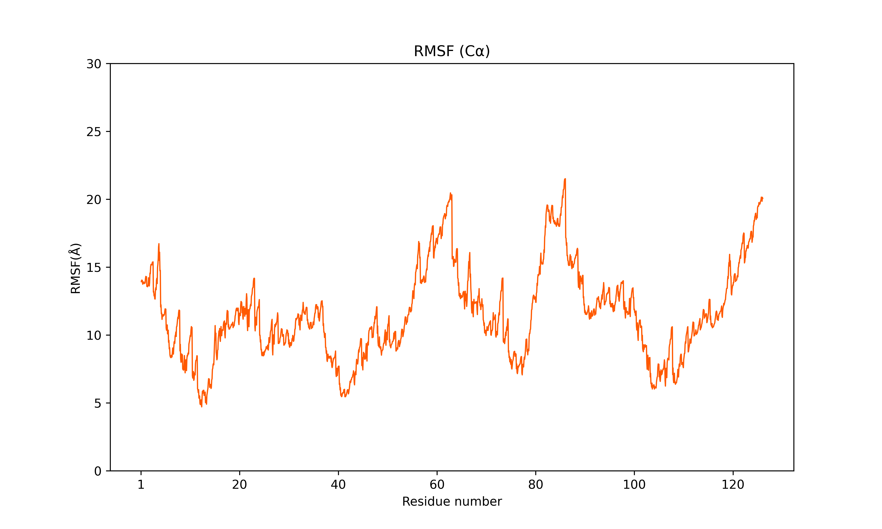
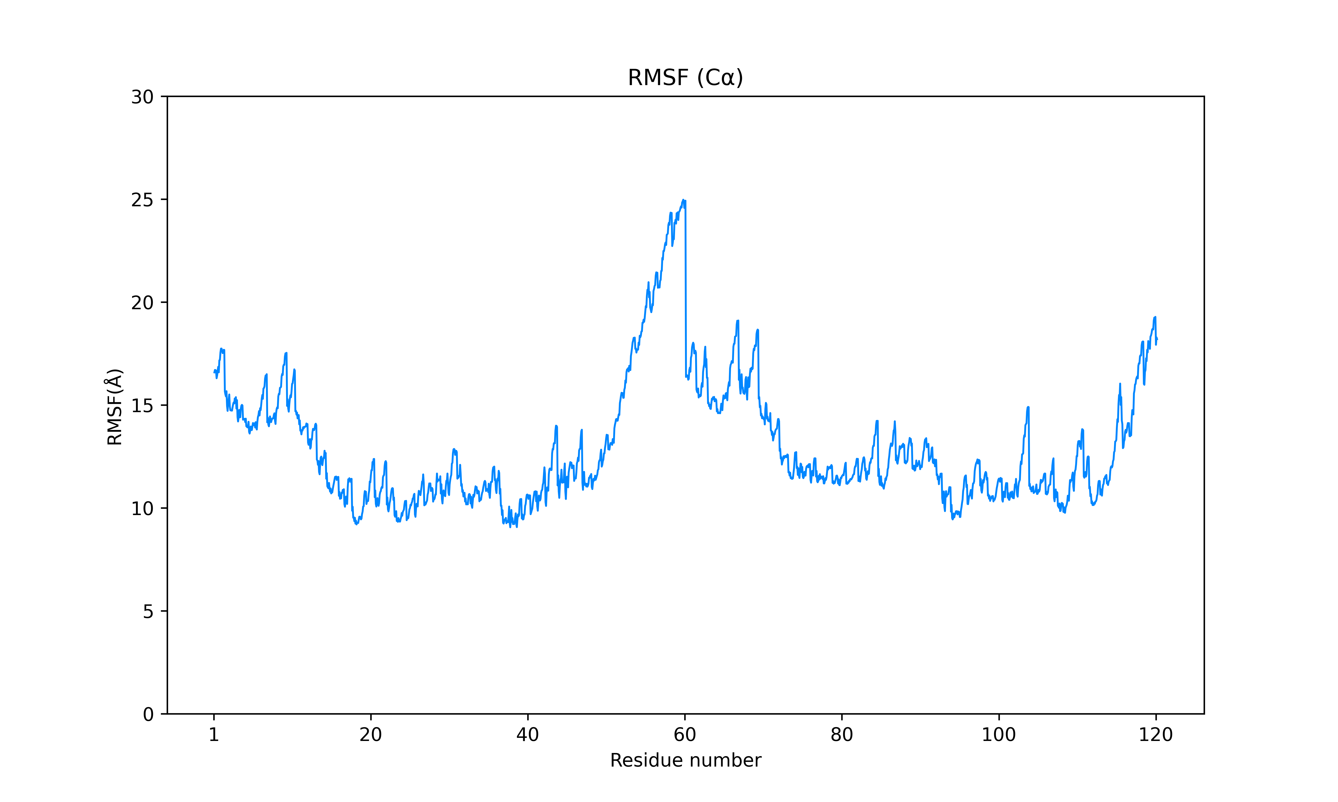
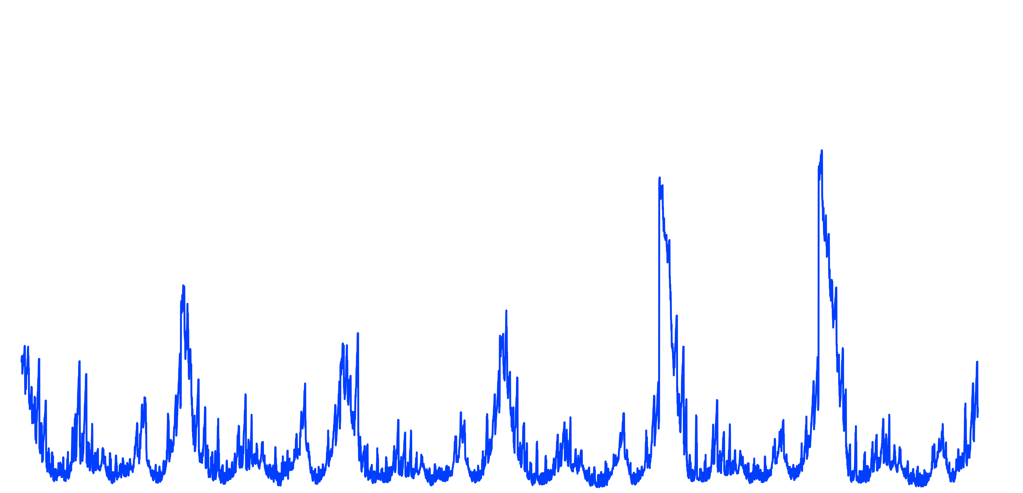
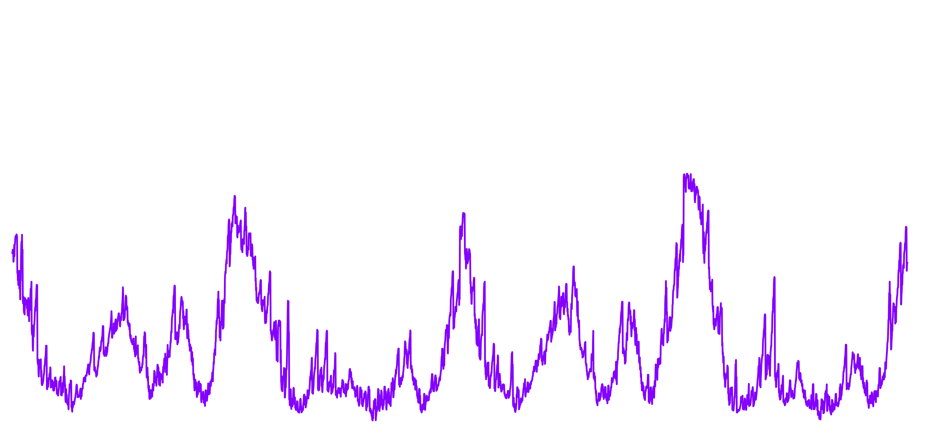
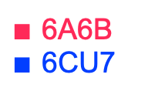
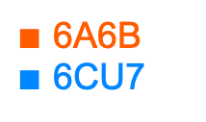
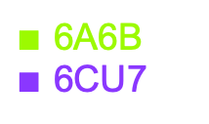
Multifaceted molecular dynamics studies on the stability of the type 1A polymorph of α synuclein
IV. α-synuclein stability and aggregation
Multiple systems: 12/10 -> 6, 4, and 2 chains per dimer
6 chains: fluctuations of N-, C-terminal regions, core (β-sheet) steady
4 chains: fluctuations of N-, C-terminal regions, core (β-sheet) steady
2 chains: high fluctuations overall
A
Chain 5
Chain 6
B
C
Chain 1
Chain 2
Chain 3
Chain 4
Chain 1
Chain 2
Chain 3
Chain 4
Chain 1
Chain 2
$∎$ 6A6B
$∎$ 6CU7
$∎$ 6A6B
$∎$ 6CU7
$∎$ 6A6B
$∎$ 6CU7
6-chain systems
4-chain systems
2-chain systems
Fig 5. Root Mean Square Fluctuation (RMSF) of two 1A polymorphs 6A6B and 6CU7 (HIE protonation state) in function of the number of chains per dimer: (A) 6-chain systems, (B) 4-chain systems, (C) 2-chain systems. The x-axis represents the number of residues per system, y-axis represents the fluctuation in Å compared to the reference structure. Figures generated from 100ns conventional Molecular Dynamics (cMD) simulations.
Notes:
A first condition to evaluate was amyloid stability in general.
As the deposited cryo-EM models correspond to aggregated forms containing 12 and 10 chains per dimer, respectively, they were truncated to generate dimers composed of 6, 4, and 2 total chains.
Root Mean Square Fluctuation analysis revealed that in the 6- and 4-chains systems, the fluctuating atoms were principally part of the N- and C-terminal disordered regions, while the core composed of β-sheet elements was mainly steady.
In contrast, the 2-chain system exhibited large fluctuations not only around the terminal domains, but inside the core as well.

Slide 6
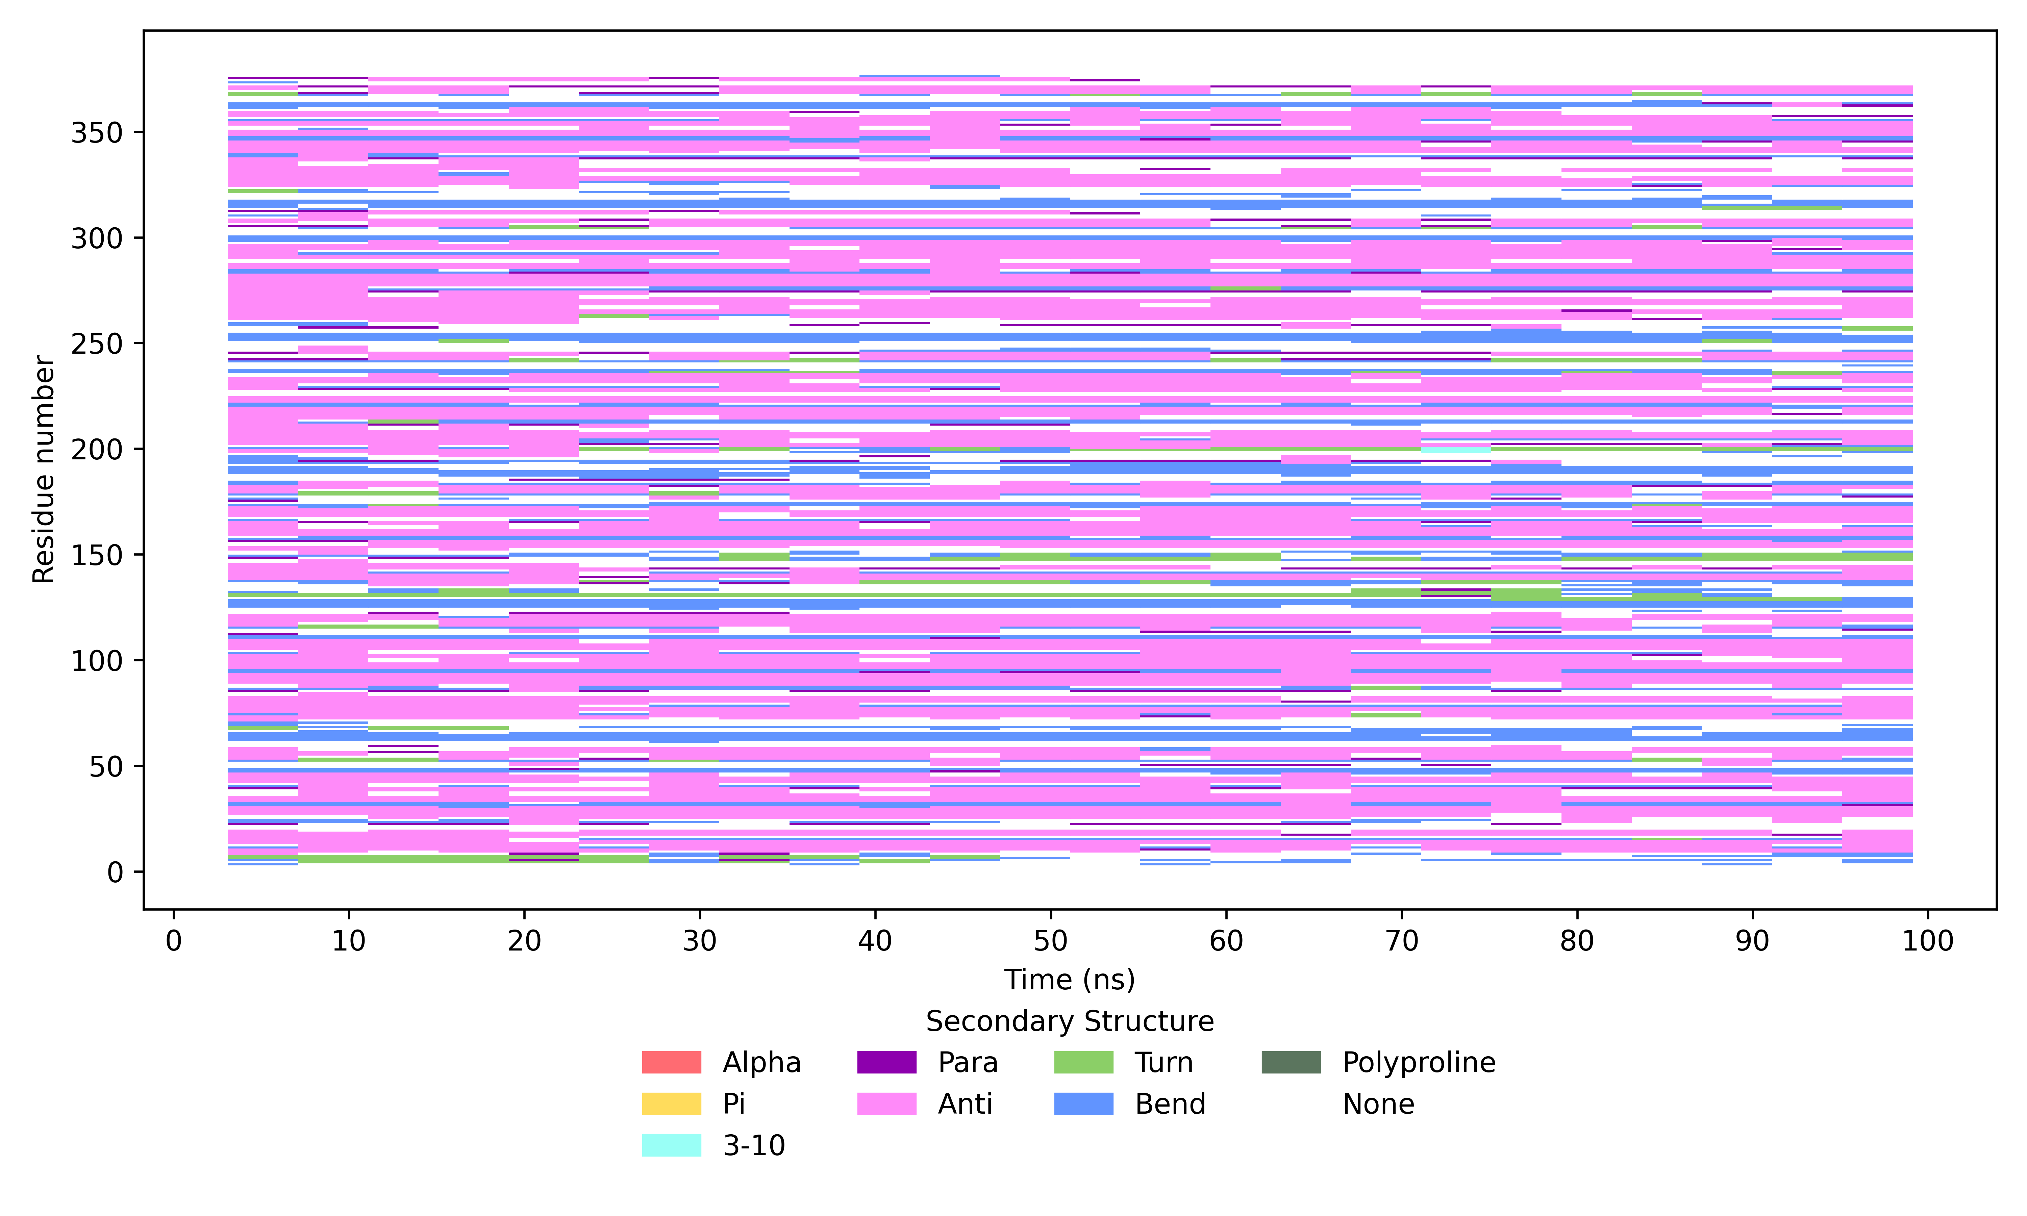
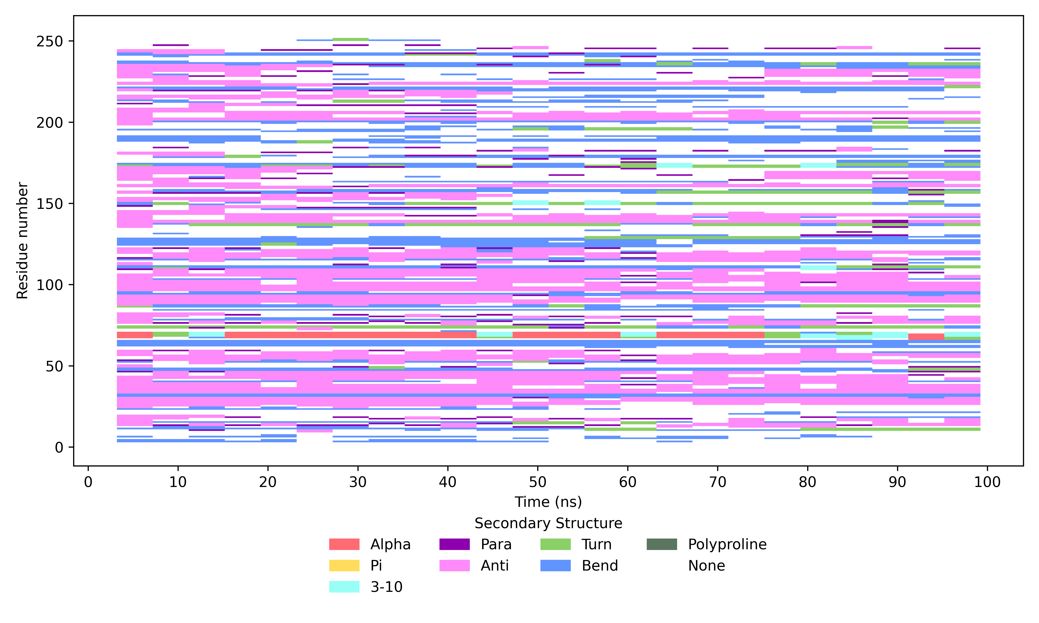
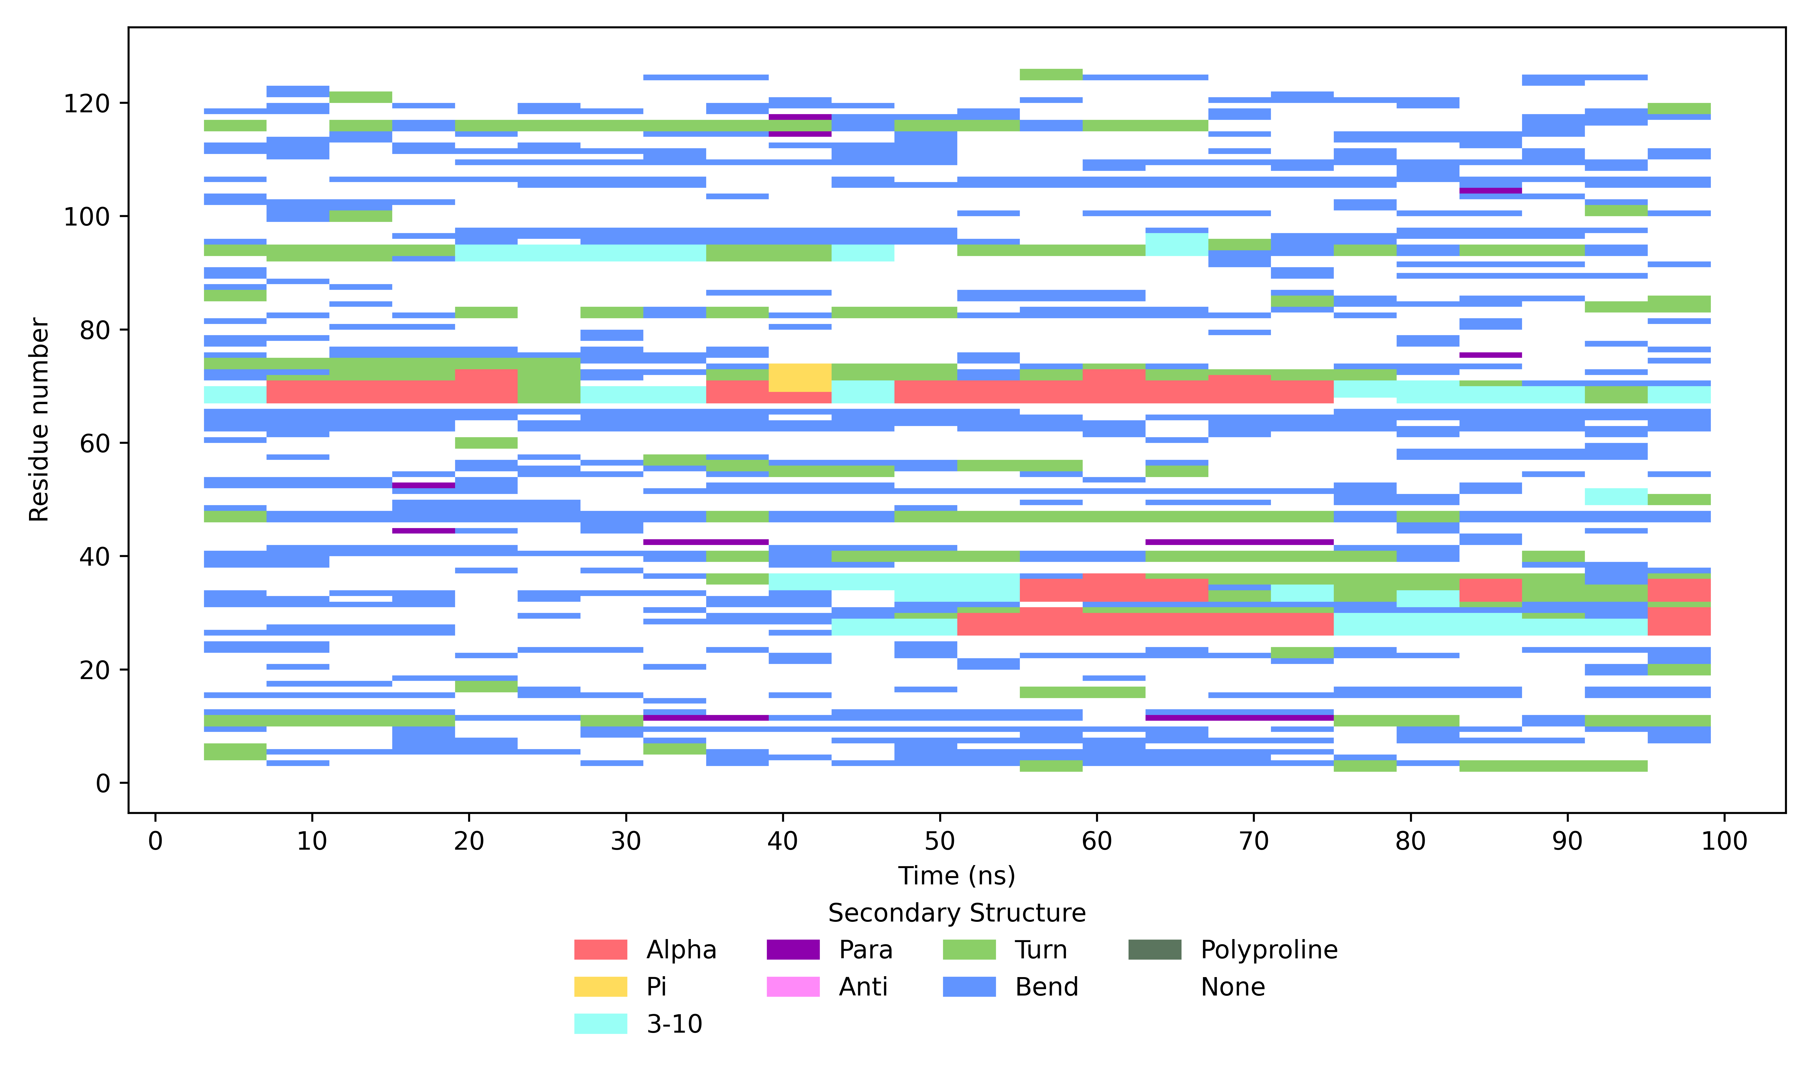
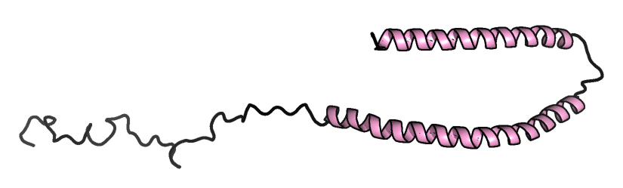
Multifaceted molecular dynamics studies on the stability of the type 1A polymorph of α synuclein
IV. α-synuclein stability and aggregation
A
B
C
c6
c4
c5
c2
c4
c3
c3
c2
c2
c1
c1
c1
6A6B: 6-chain system
6A6B: 4-chain system
6A6B: 2-chain system
Secondary Structure
$∎$ α-helix $∎$ $π$-helix $∎$ 3₁₀-helix $∎$ antiparallel β-strands $∎$ parallel β-strands $∎$ turn $∎$ bend $∎$ polyproline II $∎$ coil
Fig 6. Dictionary of Secondary Structure in Proteins (DSSP)^{[7]} analysis of two 1A polymorphs 6A6B and 6CU7 (HIE) in function of the number of chains per dimer: (A) 6-chain systems,
(B) 4-chain systems, (C) 2-chain systems. The x-axis represents the simulation time in ns, the y-axis represents the number of residues per system. Figures generated from 100ns conventional Molecular Dynamics (cMD) simulations.
N-term
6-chain system: conservation of β-sheet motifs
4-chain system: prolonged presence of β-sheet motifs
2-chain system: loss of β-sheet motifs (unfolding) +
transient α-helices
V3
V37
C-term
K45
T92
Fig 7. Human micelle-bound α-synuclein 1XQ8.
Notes:
DSSP analysis confirmed the prolonged presence of secondary structure elements, predominantly the β-sheet motif in pink characteristic of amyloids, throughout the simulation for the 4- and 6-chain conformations.
Meanwhile, the 2-chain systems showed a loss of β-sheet content, consistent with increased unfolding.
At the same time, we can observe the transient formation of α helices that may resemble those found in human micelle-bound α-synuclein

Slide 7
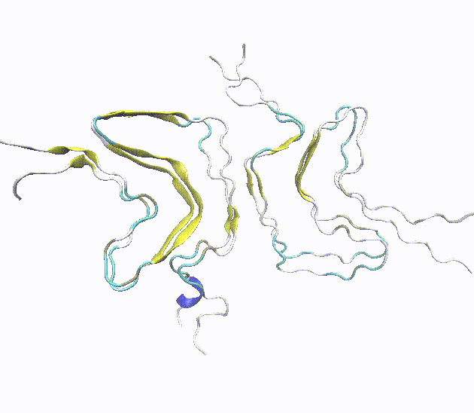
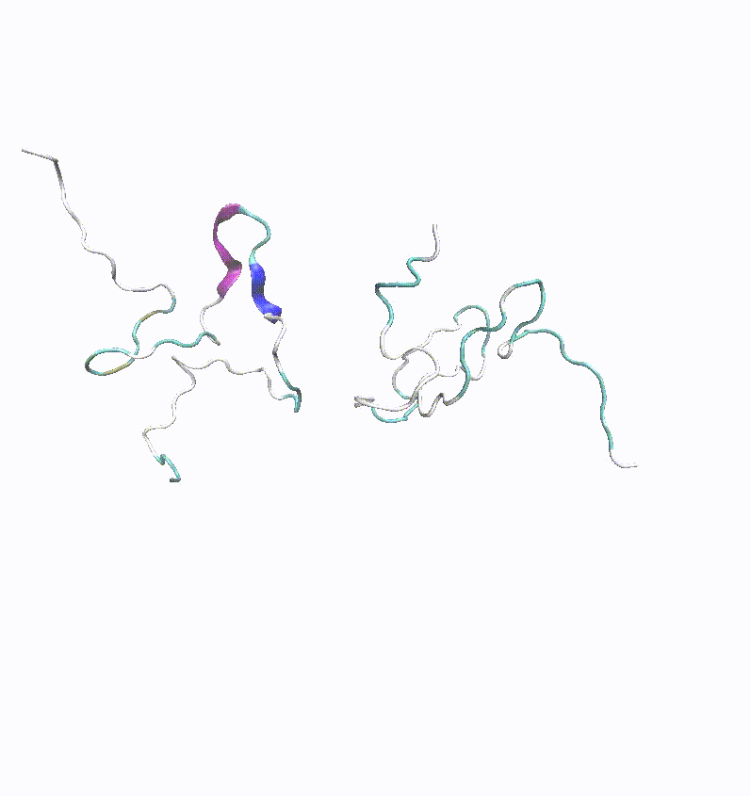
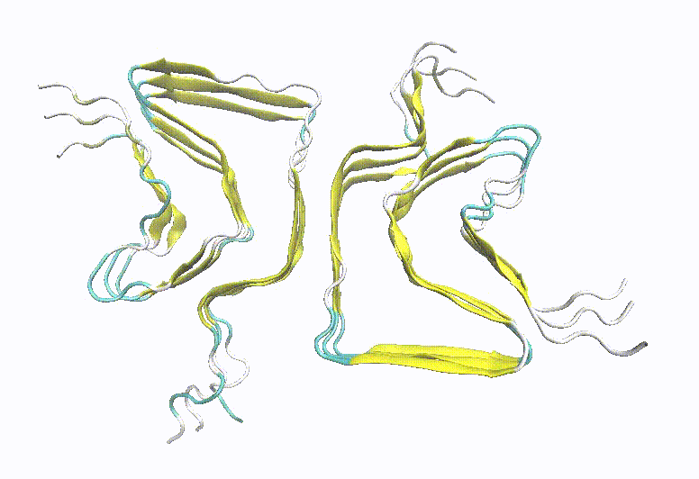
Multifaceted molecular dynamics studies on the stability of the type 1A polymorph of α synuclein
IV. α-synuclein stability and aggregation
A
B
C
6-chain system: great stablity +
close to reference
4-chain system:
good stability (exceptions)
2-chain system: loss of secondary structure elements -> disorder
Fig 8. Trajectory movies of the two 1A polymorphs 6A6B and 6CU7 (HIE) in function of the number of chains per dimer: (A) 6-chain systems, (B) 4-chain systems, (C) 2-chain systems. Movies generated from 100ns conventional Molecular Dynamics (cMD) simulations in Visual Molecular Dynamics (VMD)^{[8]}.
Multi-chain systems may require longer simulation or overcoming higher energy barrier to observe unfolding
Notes:
Visual inspection of the trajectories VMD confirmed that the 6-chain systems were very stable throughout the simulation and remained close to the reference structure.
The 4-chain systems exhibited great stability as well, with some exceptions, maintaining their β-sheet elements throughout most of the simulation.
In contrast, the 2-chain systems rapidly lost their secondary structure elements and became disordered during the simulation.
These observations suggest that the 2-chain systems have a higher propensity to revert to an unfolded state, whereas the multi-chain systems may require longer simulation times to exhibit similar behaviour or, more plausibly, require overcoming higher energy barriers.

Slide 8
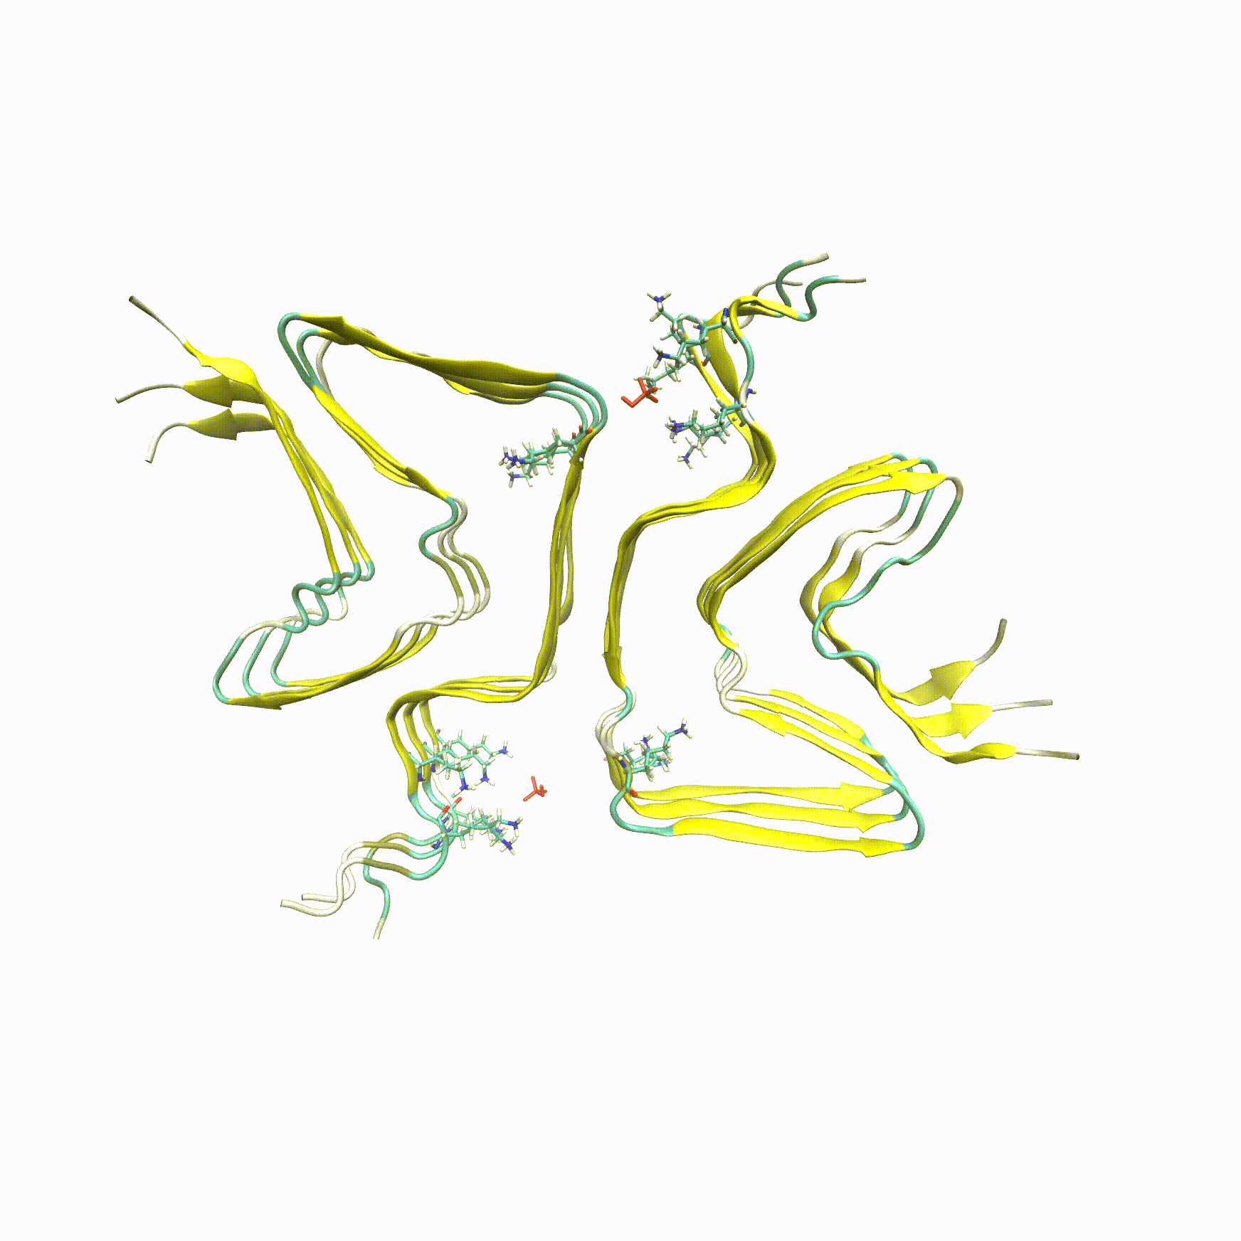
Multifaceted molecular dynamics studies on the stability of the type 1A polymorph of α synuclein
V. α-synuclein 6-chain unfolding
To probe aggregate destabilisation:
Simulated Annealing MD simulation
Maximum heating temperature: 800K
Loss of stabilising interactions
(not achievable in cMD)
Disrupted aggregation
K58 – T64
OBSERVATION 1:
The minimal amount of chains for a stable amyloid: 6
2-chain systems: appearance of
α-helices and coil elements
First parts to unfold in SAMD:
N-, C-terminal + K58-T64
K58 – T64
Fig 9. Trajectory movie of 1A polymorph 6A6B (HID protonation state of His⁵⁰) 6 chains. Movie generated from 100ns Simulated Annealing Molecular Dynamics (SAMD) simulations in Visual Molecular Dynamics (VMD)^{[8]}.
Notes:
To further probe aggregate destabilisation, an additional simulated annealing experiment was conducted for the 6-chain systems, with the maximum temperature increased to 800K.
In these simulations, visual inspection and other standard analysis reflected a loss of stabilising interactions and secondary structure elements which were not achievable with conventional MD simulations.
The structures had unfolded, indicating that heating the systems to 800K is sufficient disrupt aggregation.
As a first observation, the minimal number of chains needed for a stable amyloid is 6.
The rapid unfolding of the 2-chains systems led to the appearance of α-helices already described before in monomers
The first parts that unfolded in the SAMD simulation were the N-, C-terminal domains, and the segments between K58 and T64

Slide 9
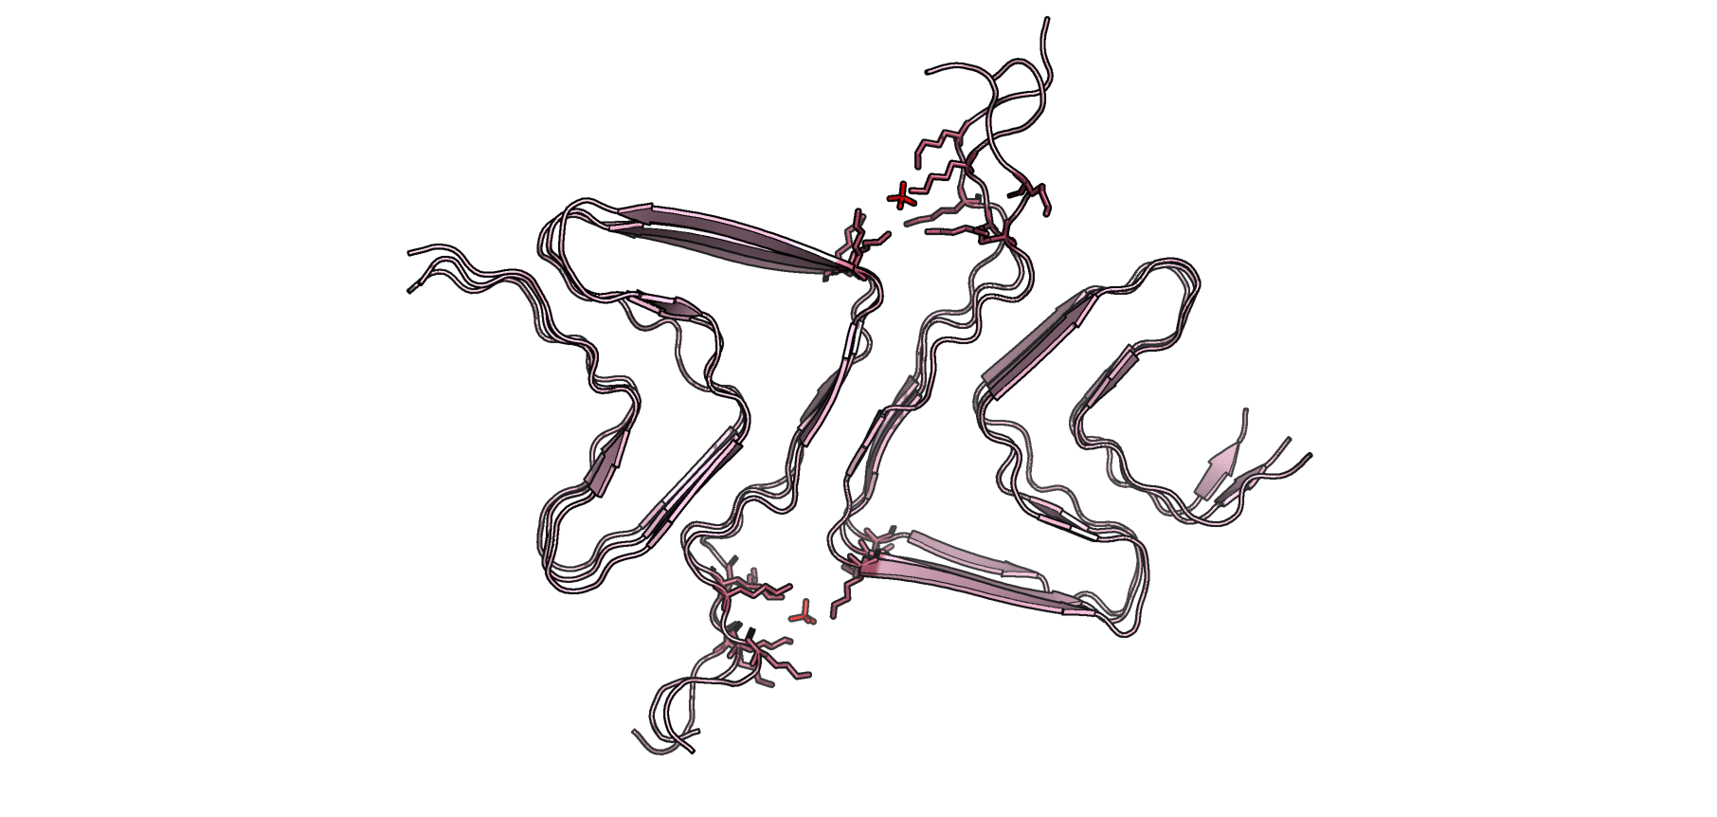
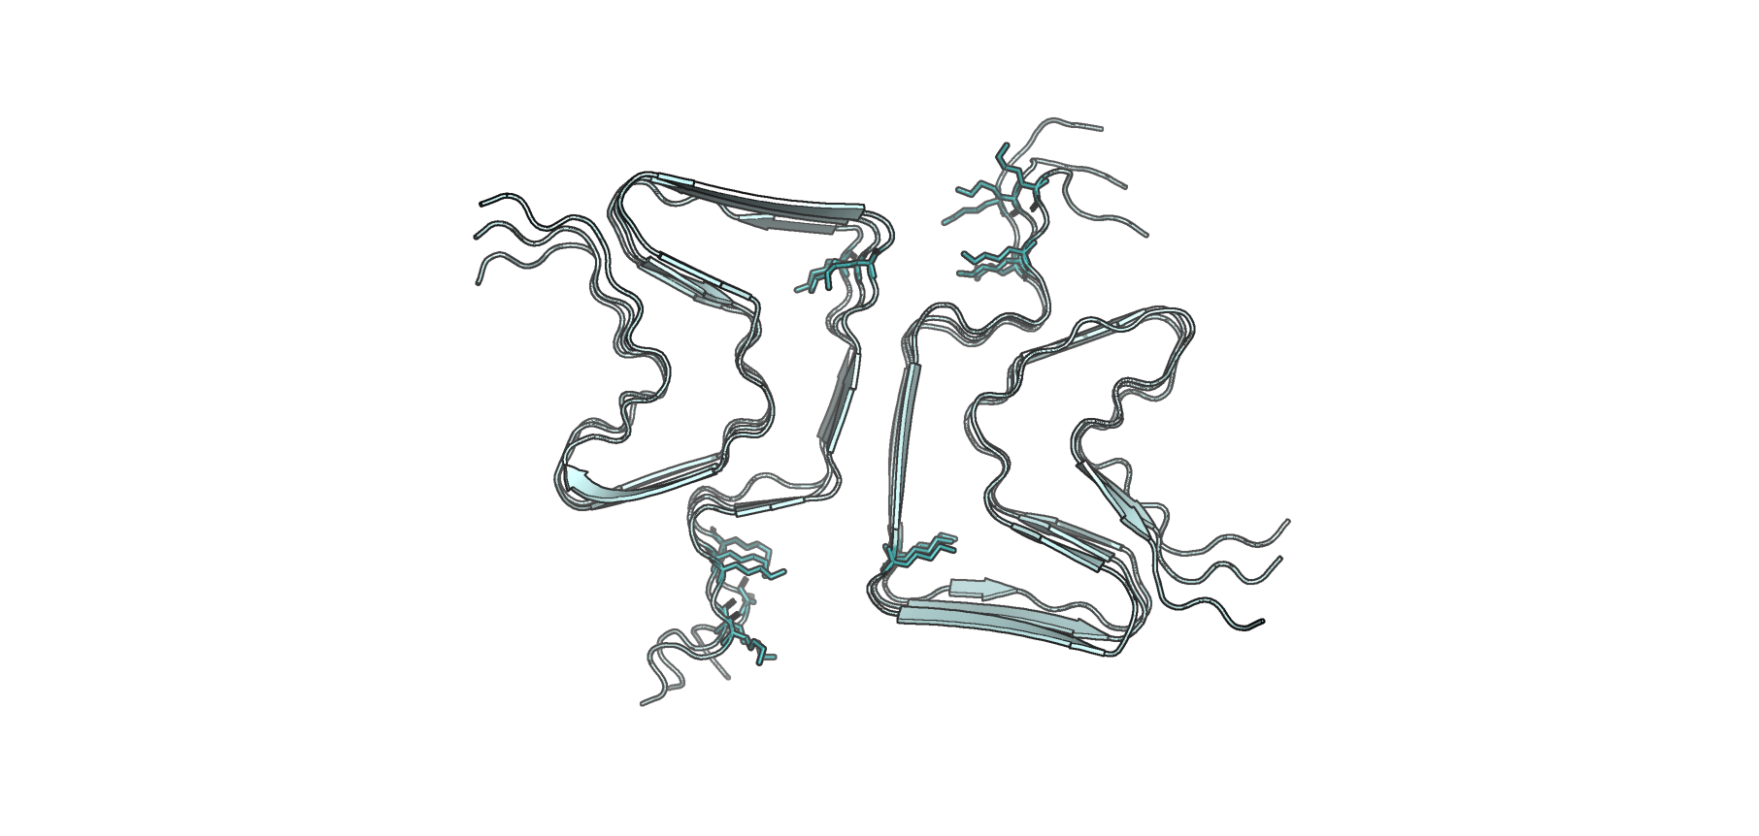
Multifaceted molecular dynamics studies on the stability of the type 1A polymorph of α synuclein
VI. LYS⁵⁸ side chain orientation
Umbrella Sampling MD simulation: measure the free energy needed to overcome the rotational barrier
6A6B: inward -> no lysine triad and 6CU7: outward -> lysine triad
Lysine triad: presence of electron density (possible phosphate ion)
Phosphate ions: center of mass of Lys^{43,45,58} N atoms
Trapped coordination state: F=10 kcal/mol distance restraints
Two buffer conditions: Saline + PBS^{[3]}
PO4⁻
Lys⁴³
A
Lys⁴³
B
Lys⁴⁵
Lys⁴⁵
Lys⁵⁸
Lys⁵⁸
Lys⁵⁸
Lys⁵⁸
Lys⁴⁵
Lys⁴⁵
Lys⁴³
Lys⁴³
PO4⁻
6A6B
6CU7
Fig 10. Structures of the two 1A polymorphs: (A) 6A6B with the Lys⁵⁸ side-chain oriented outwards in saline buffer, (B) 6CU7 with the Lys⁵⁸ sidechain oriented inwards in PBS environment. The red dashed circle denotes the formation of the Lys⁴³-Lys⁴⁵-Lys⁵⁸ triad. PyMOL representation. The red molecules represent the phosphate ions.
Notes:
To continue, the sole difference between these two structures is the orientation of Lys58 side chain.
Therefore, Umbrella Sampling (US) simulations were performed to calculate the free energy required to overcome the rotational barrier between the two conformations.
As mentioned before, the lysine triad in 6CU7 could be maintained by the presence of an electron density which might be a phosphate ion, hence simulations were performed in two buffer conditions: saline and phosphate-buffer saline.
Phosphate ions were positioned within the lysine triad at the center of mass of the lysine nitrogen atoms, Lys⁴³, Lys⁴⁵, and Lys⁵⁸.
Distance restraints with a force constant of 10kcal/mol were applied to maintain the phosphate ion in a trapped coordination state.

Slide 10
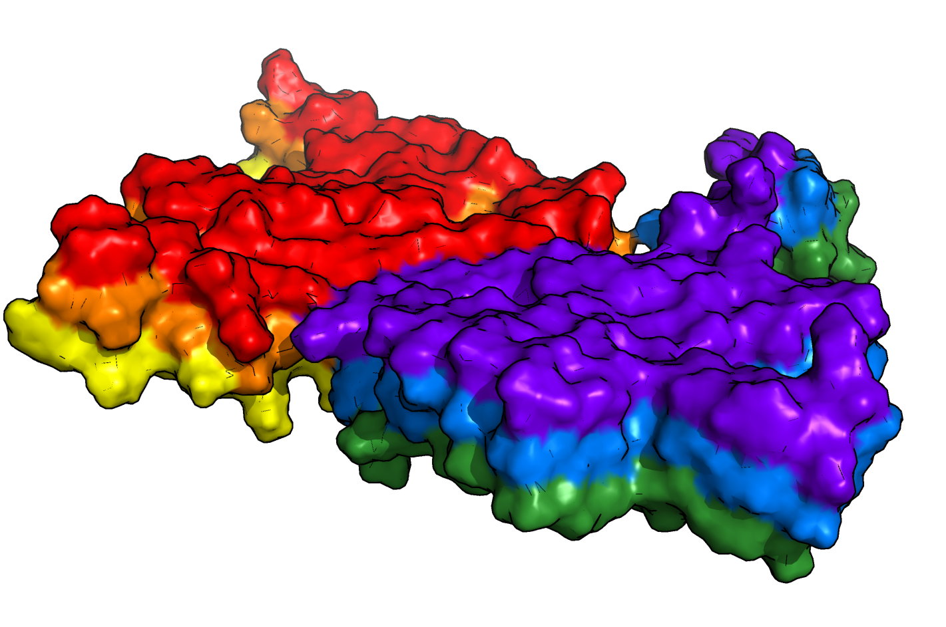
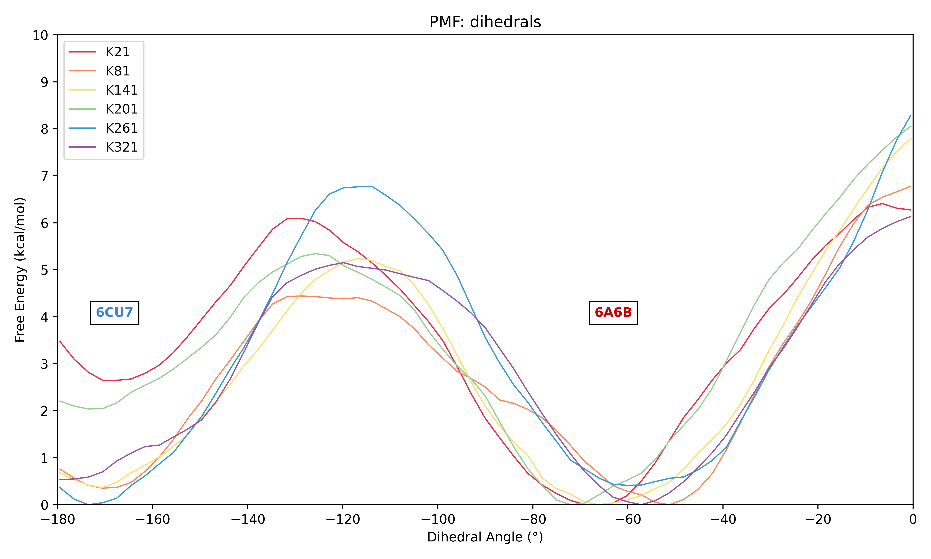
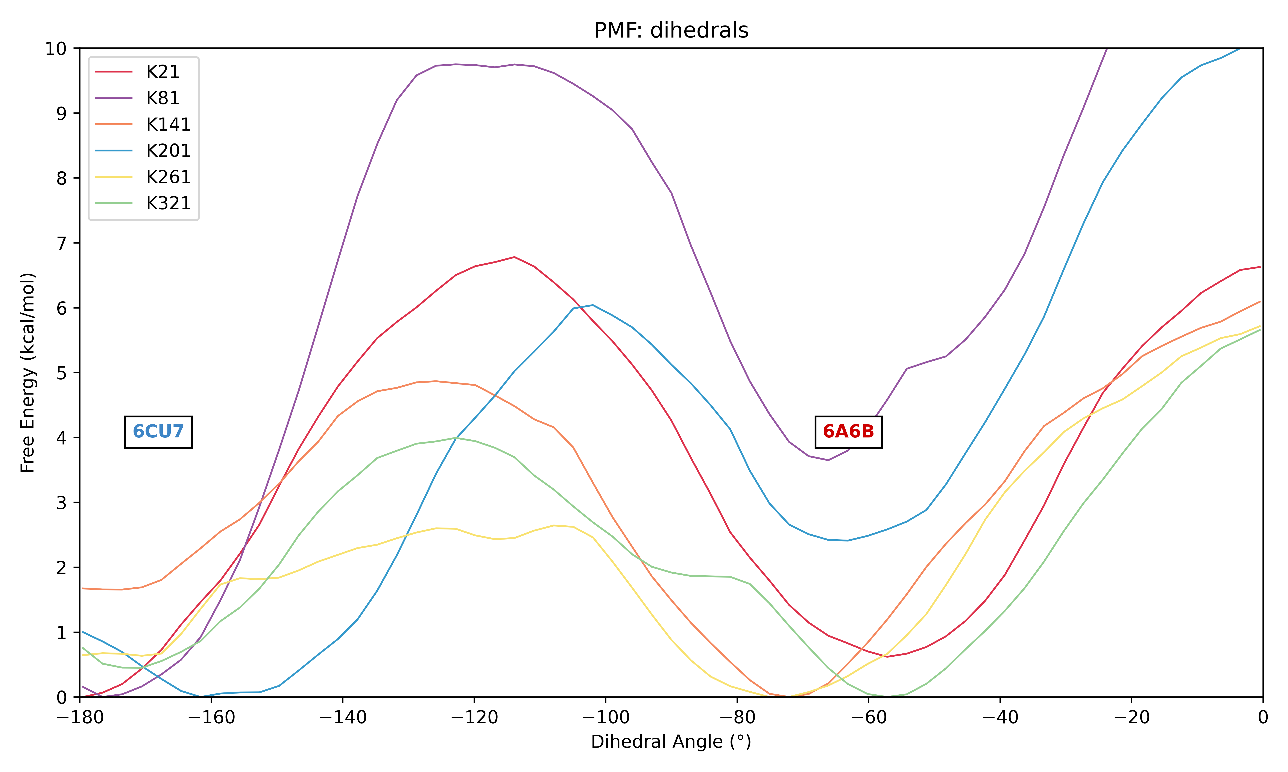
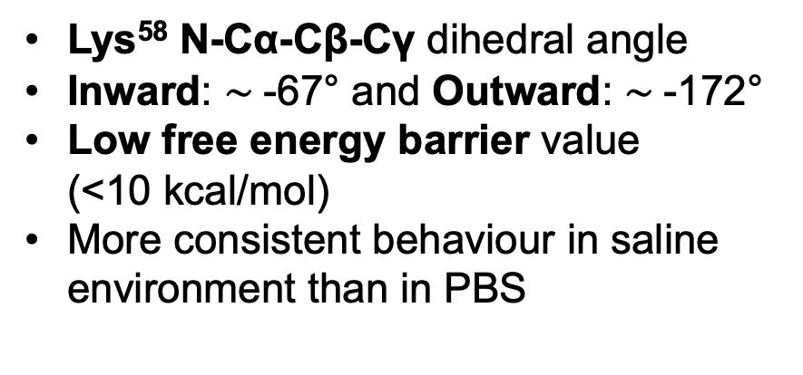


Multifaceted molecular dynamics studies on the stability of the type 1A polymorph of α synuclein
VI. LYS⁵⁸ side chain orientation
Lys⁵⁸ N-Cα-Cβ-Cγ dihedral angle
Inward: $\sim$-67° and Outward: $\sim$-172°
Low free energy barrier value
(<10 kcal/mol)
More consistent behaviour in saline environment than in PBS
Fig 11. Surface representation of 6CU7. The red and purple chains represent the upper part of the protein; orange and blue – middle, yellow and green – bottom part.
A
Saline
B
PBS
$∎$ K58 chain A
$∎$ K58 chain B
$∎$ K58 chain C
$∎$ K58 chain D
$∎$ K58 chain E
$∎$ K58 chain F
$∎$ K58 chain A
$∎$ K58 chain B
$∎$ K58 chain C
$∎$ K58 chain D
$∎$ K58 chain E
$∎$ K58 chain F
+ Lys triad
- Lys triad
+ Lys triad
- Lys triad
Fig 12. Relationship between Lys⁵⁸ side-chain free energy, chain position within the six-chain model, and buffer conditions. (A) systems simulated in saline buffer, (B) systems simulated in PBS. Each curve represents the Lys⁵⁸ residue from a distinct chain within the six-chain assembly. The x-axis represents the value of the dihedral angle in degrees, the y-axis represents the free energy in kcal/mol. Figures generated from Umbrella Sampling (USMD) simulations.
Notes:
Overall, the energy barrier to rotate Lys58 is low.
In saline buffer conditions, this side-chain orientation is preferentially stabilised in the 6A6B conformation, corresponding to the N-Cα-Cβ-Cγ dihedral angle of approximately -67° and to the absence of lysine triad.
Yet, in PBS, the top two chains demonstrate a higher energy barrier to be overcome, while the bottom two chains are characterised by a lower energy barrier.

Slide 11
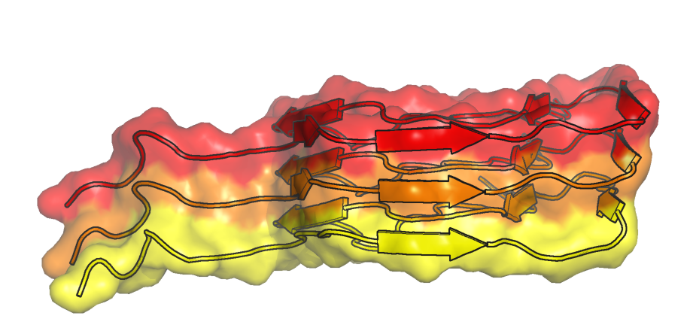
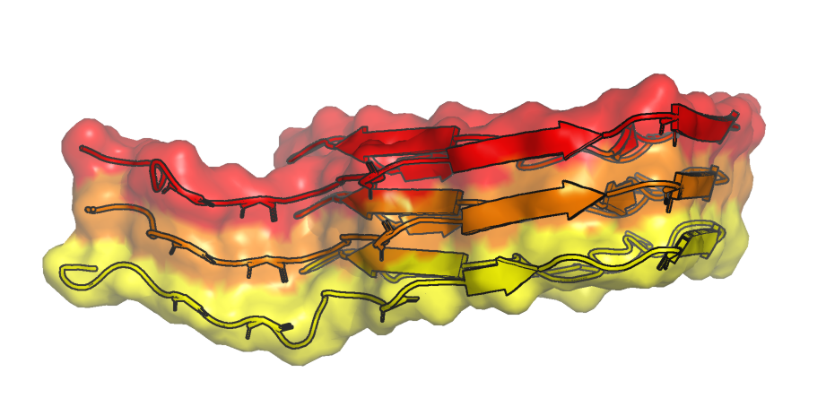
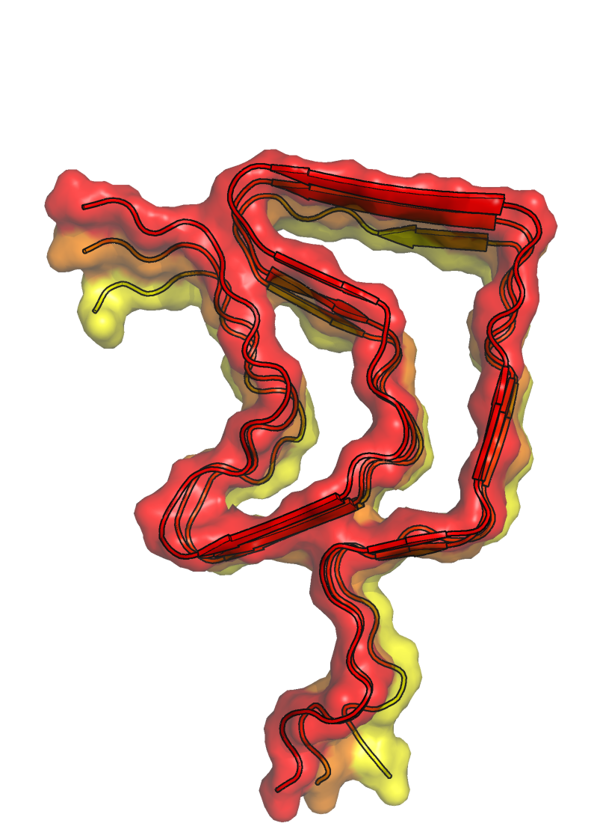
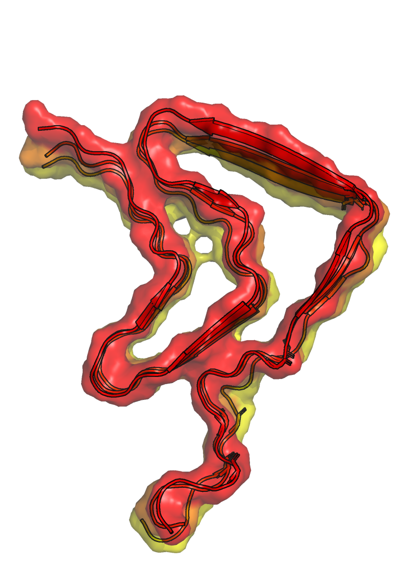
Multifaceted molecular dynamics studies on the stability of the type 1A polymorph of α synuclein
VI. LYS⁵⁸ side chain orientation
(I) 6A6B
(II) 6CU7
Saline environment: absence
of lysine triad favoured
PBS: lysine triad formation favoured
PBS: energy barrier higher for top chains in comparison to the bottom ones
Could be related to the orientation of other residues and/or interactions
A
B
OBSERVATION 2:
PBS stabilises better the lysine triad
Stability asymmetry: orientation
of other residues and other
interactions inside the dimers
Low energy barrier to rotate Lys⁵⁸
Fig 13. Backbone surface representation of the two type 1A polymorphs truncated to only one three-six chain monomer. The columns represent the structures: (I) 6A6B, and (II) 6CU7. The rows indicate the representation: (A) side representation, (B) top representation.
Notes:
This means that in PBS, lysine triad formation is slightly more favoured than its absence, depending on chain identity.
This asymmetry could be related to the orientation of other residues and to other interactions occurring inside the dimers.

Slide 12
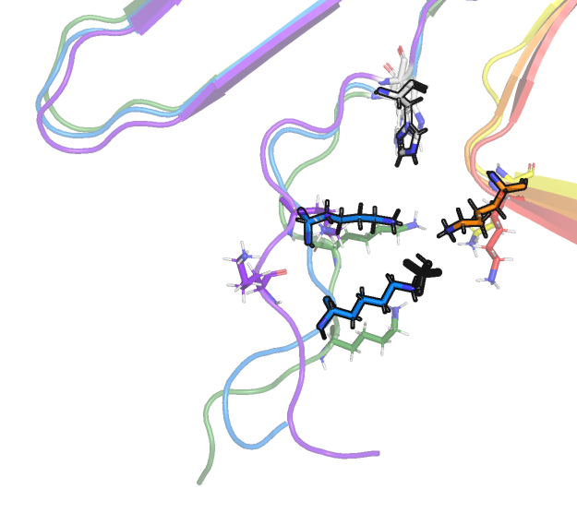
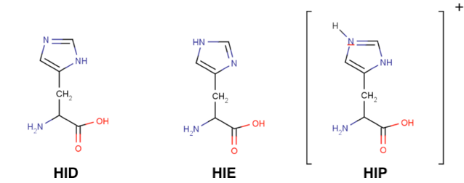
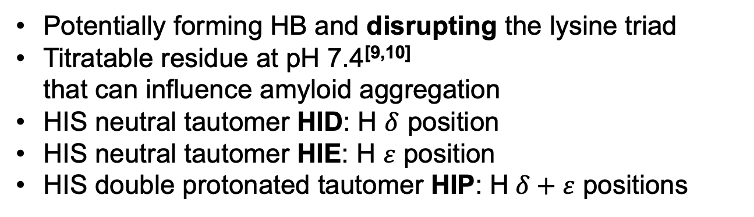
Multifaceted molecular dynamics studies on the stability of the type 1A polymorph of α synuclein
VII. HIS⁵⁰ protonation state
Potentially forming HB and disrupting the lysine triad
Titratable residue at pH 7.4^{[9,10]}
that can influence amyloid aggregation
HIS neutral tautomer HID: H $δ$ position
HIS neutral tautomer HIE: H $ε$ position
HIS double protonated tautomer HIP: H$δ+ε$ positions
His⁵⁰
Lys⁴⁵
Lys⁵⁸
A
B
C
Lys⁴³
Fig 14. Lysine triad Lys⁴³-Lys⁴⁵-Lys⁵⁸ formation and histidine His⁵⁰ stick representation in 6CU7 structure.
Fig 15. Histidine in three protonation states: (A) HID: neutral, H in $δ$ position, (B) HIE: neutral, H $ε$ position, (C) HIP: double protonated, H in$δ+ε$ positions. Image retrieved on 14/03/2026 from https://docs.bioexcel.eu/2020_06_09_online_ambertools4cp2k/03-prepPDB/index.html
Notes:
Now, depending on the pH and its protonation state, histidine could form stabilising hydrogen bonds with the lysines and perhaps disrupt the triad.
Thus, another aspect we wanted to evaluate was its protonation state.
As reported before, histidine is a titratable residue that can adopt different protonation states at physiological pH and may directly influence amyloid aggregation.
It can exist as a mixture of forms: either as a neutral tautomer, with the hydrogen being either in the delta or epsilon position, or as a doubly protonated tautomer, with hydrogens in both delta and epsilon positions.

Slide 13
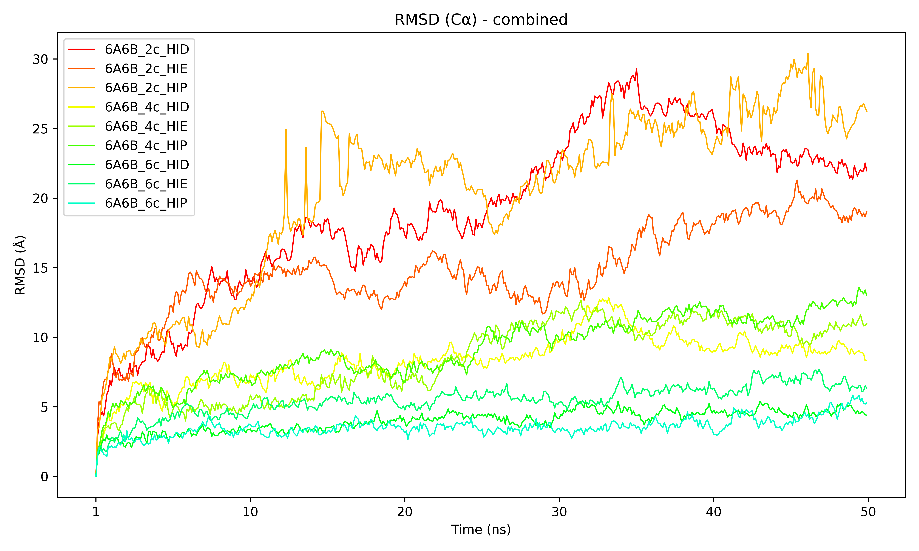
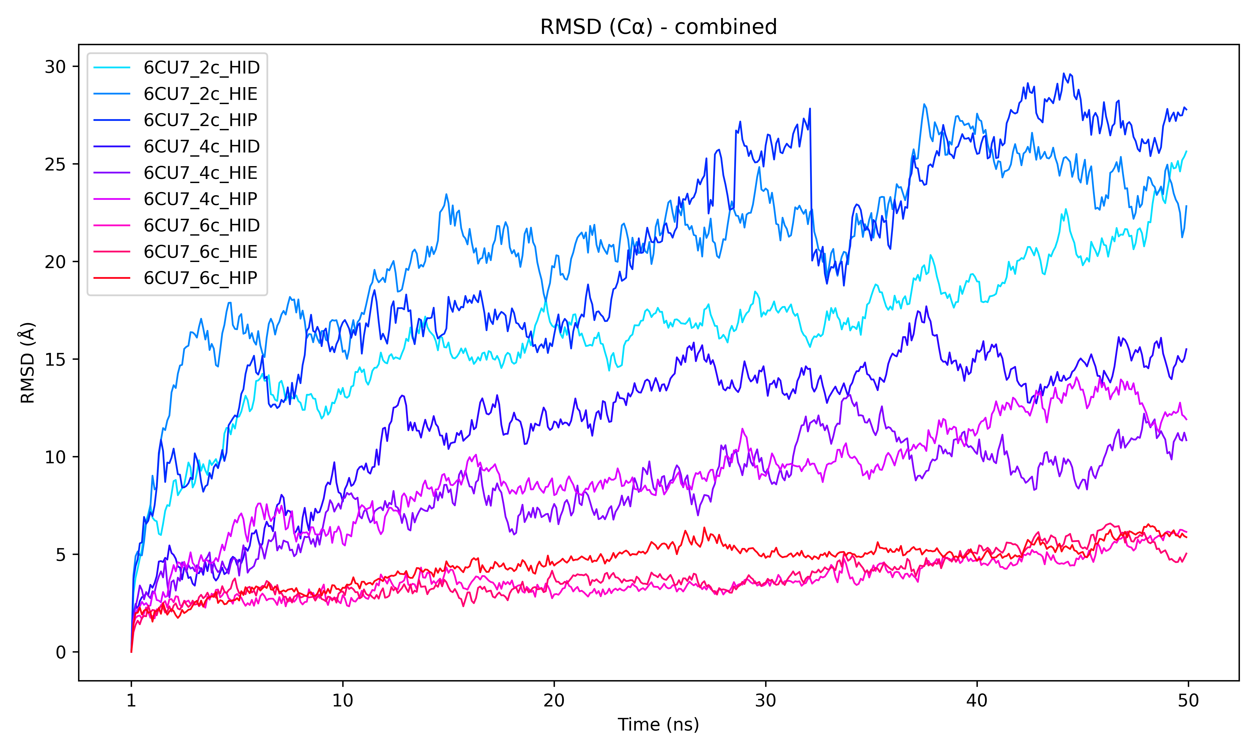
Multifaceted molecular dynamics studies on the stability of the type 1A polymorph of α synuclein
VII. HIS⁵⁰ protonation state
6-chain models with one His⁵⁰ per chain -> 6 His
HIS protonation states: HID/HIE/HIP
A
B
2 chains
2 chains
4 chains
4 chains
6 chains
6 chains
| | | | | | | | | | |
1 10 20 30 40 50 60 70 80 90 100
Time (ns)
| | | | | | | | | | |
1 10 20 30 40 50 60 70 80 90 100
Time (ns)
6A6B
6CU7
Fig 16. Root Mean Square Deviation (RMSD) of the two 1A polymorphs 6A6B and 6CU7 in function of the number of chains per dimer and depending on His⁵⁰ protonation state: HID/HIE/HIP: (A) 6A6B systems, (B) 6CU7 systems. The x-axis represents the simulation time in ns, the y-axis represents the deviation in Å from the reference structure. Figures generated from 100ns conventional Molecular Dynamics (cMD) simulations.
Possible greater effect on 6CU7 than 6A6B
No significant effect on protein dynamics or structural stability
Notes:
Since we employed the 6-chain models, 6 histidine residues were evaluated, one per chain.
RMSD revealed that It is possible that the protonation state has a slightly greater effect in the case of 6CU7 in comparison with 6A6B
However, at this stage, standard analyses revealed no significant effect of histidine protonation state on protein dynamics or structural stability.

Slide 14
Multifaceted molecular dynamics studies on the stability of the type 1A polymorph of α synuclein
VII. HIS⁵⁰ protonation state
A
B
System | Buffer | HIS⁵⁰ chain | Fraction of the time spent in this protonation state (%) |  |  | Buffer | Fraction of the time spent in this protonation state (%)
 |  |  | HID | HIE | HIP |  | HID | HIE | HIP
6A6B | Saline | Chain A | 5.09 | 94.15 | 0.75 | PBS | 27.13 | 56.91 | 15.96
 |  | Chain B | 31.69 | 32.68 | 35.63 |  | 27.27 | 72.65 | 0.08
 |  | Chain C | 3.09 | 82.34 | 14.58 |  | 1.23 | 95.82 | 2.95
 |  | Chain D | 7.51 | 76.29 | 16.20 |  | 7.40 | 72.50 | 20.11
 |  | Chain E | 13.42 | 81.88 | 4.70 |  | 15.55 | 58.58 | 25.87
 |  | Chain F | 11.20 | 68.51 | 20.29 |  | 9.11 | 73.94 | 16.95
 |  | Average | 12.0 | 72.64 | 15.36 |  | 14.62 | 71.73 | 13.65
System | Buffer | HIS⁵⁰ chain | Fraction of the time spent in this protonation state (%) |  |  | Buffer | Fraction of the time spent in this protonation state (%)
 |  |  | HID | HIE | HIP |  | HID | HIE | HIP
6CU7 | Saline | Chain A | 0.86 | 98.62 | 0.52 | PBS | 5.68 | 86.49 | 7.83
 |  | Chain B | 4.25 | 87.20 | 8.54 |  | 11.78 | 73.30 | 14.92
 |  | Chain C | 0.98 | 98.76 | 0.27 |  | 0.42 | 98.21 | 1.38
 |  | Chain D | 19.05 | 74.72 | 6.23 |  | 5.91 | 82.71 | 11.37
 |  | Chain E | 19.50 | 80.33 | 0.17 |  | 2.16 | 64.46 | 33.37
 |  | Chain F | 0.09 | 82.14 | 17.77 |  | 1.94 | 97.41 | 0.64
 |  | Average | 7.46 | 86.96 | 5.58 |  | 4.65 | 83.76 | 11.59
Tab 1. Overview the protonation state classification of His⁵⁰ in each of the six chains of the (A) 6A6B and (B) 6CU7 models under different buffer conditions (saline and PBS). Tables generated from 40ns constant pH Molecular Dynamics (cpHMD) simulations.
Constant pH MD simulation -> which protonation state?
Relative populations of each state quantified as % distributions over the simulation
His protonation state influenced by buffer conditions + local chain environment
Higher propensity of HID and HIP in 6A6B than 6CU7
HIE preference more observed in saline conditions
OBSERVATION 3
Overall, HIE is the preffered choice among both structures and both buffer conditions
Notes:
In consequence, constant pH MD simulations were performed to determine the most probable histidine protonation state.
In this simulation, the relative populations of each protonation state were quantified as percentage distributions over the course of the simulation.
As indicated by the results, histidine protonation states appear to be slightly influenced by buffer conditions, and potentially, by the local chain environment.
In the 6A6B system, in the absence of lysine triad, the histidine residues have a higher propensity to adopt the HID protonation state.
Notably, this behaviour is less pronounced in the 6CU7 system, where the lysine triad is present.
In general, the HIE state is the preferred choice among both structures and buffer conditions.

Slide 15
Multifaceted molecular dynamics studies on the stability of the type 1A polymorph of α synuclein
Conclusion
Amyloid stability influenced by number of protomers.
A 2-chain system triggers the loss of β-sheet motif in α-synuclein and formation of transient α-helix elements.
A 4- and 6-chain system becomes significantly more stable:
interlayer contacts (stabilising secondary structure elements).
Unfolding of 4- and 6-chain systems nontrivial.
A 800K temperature is enough to unfold a 6-chain system
Orientation of Lys⁵⁸ side-chain influenced by buffer and His⁵⁰ protonation state
Lysine triad formation is favoured in PBS environment
Lysine triad absence is favoured in saline environment
Low energy barrier for interconversion
HIE is the preffered protonation state of His⁵⁰
Mixture of conditions and MD protocols: some trends could be observed
Basis for future research on these polymorphs.
Notes:
In conclusion, amyloid stability is influenced by several factors, one of the most important being the number of protomers within the assembly.
Our results show that decreasing the number of chains increases protein solubility: the two-chain models rapidly lost the β-sheet elements and quickly adopted transient α-helices and coils as observed in other models, whereas the four-chain and, even more so, the six-chain models exhibited markedly higher stability.
This increased stability is likely related to both the number and persistence of hydrogen bonds, not only in terms of their total count but also through their role in stabilising β-sheet secondary structure elements, which are characteristic of amyloid aggregates.
Unfolding of these larger assemblies proved to be nontrivial, as they exhibited strong resistance to disordering.
Simulated annealing ultimately demonstrated that the amyloid assemblies could revert to disordered conformations when heated up to 800K.
The orientation of the Lys⁵⁸ side-chain, representing the sole structural difference between structures 6A6B and 6CU7, was found to be moderately influenced by both buffer conditions and histidine protonation state. In saline buffer, the absence of the lysine triad was slightly favoured.
In PBS conditions, the lysine triad formation was more favoured.
Nevertheless, the energy needed for structural interconversion is low.
Overall, given a mixture of conditions and MD protocols, some trends could be observed, and they serve as a basis for future research on these polymorphs.

Slide 16
Multifaceted molecular dynamics studies on the stability of the type 1A polymorph of α synuclein
References
[1] Stefanis L. (2012). α-Synuclein in Parkinson's disease. Cold Spring Harbor perspectives in medicine, 2(2), a009399. https://doi.org/10.1101/cshperspect.a009399
[2] Magistrelli, L., et al., (2021). The Impact of SNCA Variations and Its Product Alpha-Synuclein on Non-Motor Features of Parkinson’s Disease. Life, 11(8), 804. https://doi.org/10.3390/life11080804
[3] Frey, L., et al., (2024). On the pH-dependence of α-synuclein amyloid polymorphism and the role of secondary nucleation in seed-based amyloid propagation. eLife, 12, RP93562. https://doi.org/10.7554/eLife.93562
[4] Li, Y., et al., (2018). Amyloid fibril structure of α-synuclein determined by cryo-electron microscopy. Cell research, 28(9), 897–903. https://doi.org/10.1038/s41422-018-0075-x
[5] Li, B., et al., (2018). Cryo-EM of full-length α-synuclein reveals fibril polymorphs with a common structural kernel. Nature communications, 9(1), 3609. https://doi.org/10.1038/s41467-018-05971-2
[6] Schrödinger, L., & DeLano, W. (2020). PyMOL. Retrieved from http://www.pymol.org/pymol
[7] Kabsch, W., & Sander, C. (1983). Dictionary of protein secondary structure: pattern recognition of hydrogen-bonded and geometrical features. Biopolymers, 22(12), 2577–2637. https://doi.org/10.1002/bip.360221211
[8] Humphrey, W., et al., (1996). VMD: visual molecular dynamics. Journal of molecular graphics, 14(1), 33–28. https://doi.org/10.1016/0263-7855(96)00018-5
[9] Shi, H., et al., (2023) New Insights into the Structural and Binding Properties on Aβ Mature Fibrils Due to Histidine Protonation Behaviors. ACS Chem Neurosci. ;14(2):218-225. doi: https://doi.org/10.1021/acschemneuro.2c00487. Epub 2023 Jan 5. PMID: 36604946.
[10] Shi, H., et al., (2023). New Insights into the Structural and Binding Properties on Aβ Mature Fibrils Due to Histidine Protonation Behaviors. ACS chemical neuroscience, 14(2), 218–225. https://doi.org/10.1021/acschemneuro.2c00487

