Slide 1
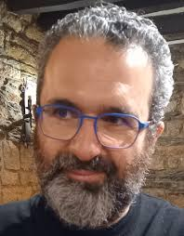
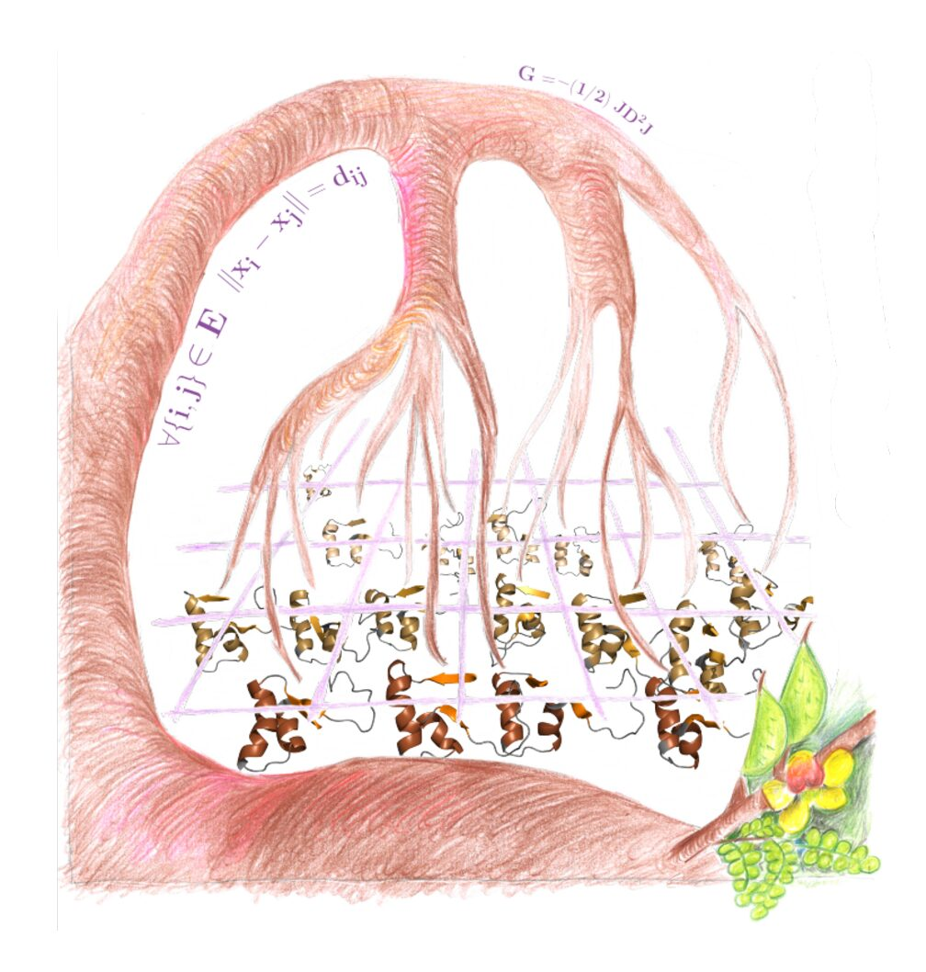
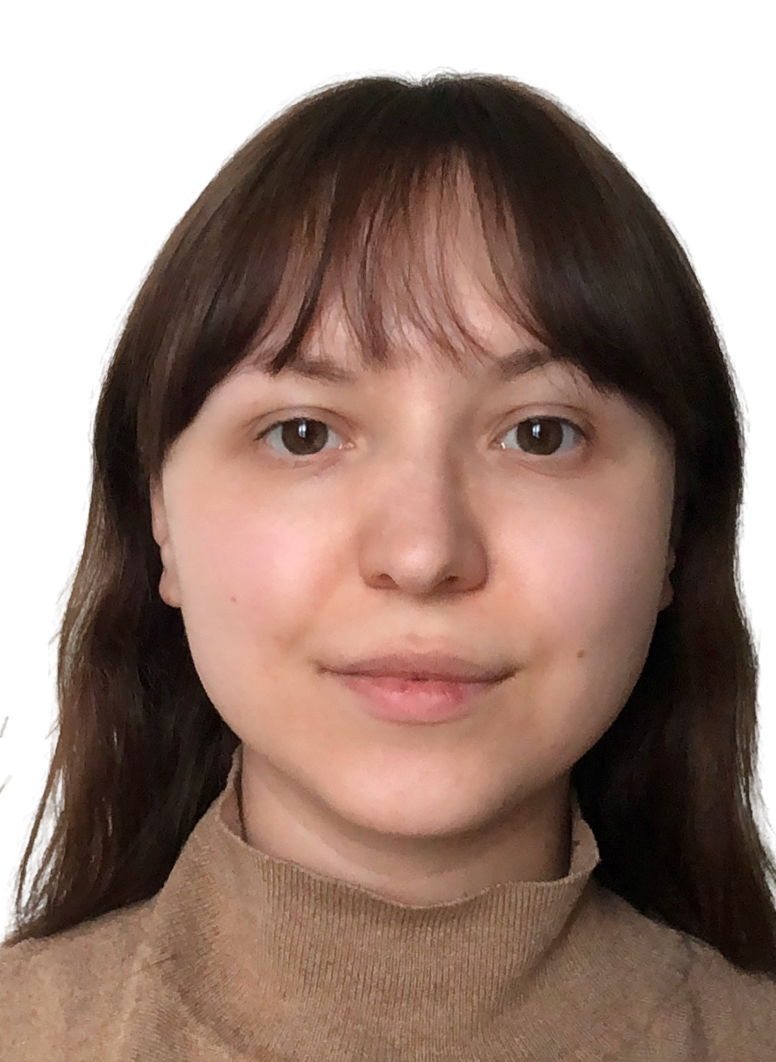

Novel Computational Approaches for Determining Protein Structures and Dynamics
Professor Antonio Mucherino, University of Rennes, France
From protein structure determination to abstract distance geometry in 1D: novel approaches
Mlle Marina Botnari, University of Lorraine, France
Multifaceted molecular dynamics studies on the stability of type 1A polymorph of α-synuclein
Professor Thérèse Malliavin, University of Lorraine, France
Experimental and in silico investigations of the conformational landscapes of intrinsically disordered proteins :
applying geometric approaches at various scales
https://gesp.cnrs.fr/

