Slide 1
The design and development of Vulnerability management system
Hao HU, Fazhi Qi, Chengcai Zhao, Manman Cheng
Computing Center, IHEP
ISGC 2019, Taipei

Slide 2
Outline
Motivation & background
Function modules design
Project progress
Summary & Future plan
ISGC 2019, Taipei

Slide 3
Background & Motivation
Facing network security problems/issues
99% of the network security problems are caused by the vulnerabilities
Lack of combination of security evaluation tools
Some tools/softwares are focusing on dedicated services
What we need is a software that composed of evaluation tools for all the services based on users’ requirement
Network inventory are usually incomplete, inaccurate and outdate
Since the network asset changing frequently and rapidly, blind spots are likely to arise, attackers could exploit those oversights to conceal their malicious activity
ISGC 2019, Taipei
Notes:
A vulnerability is a weakness in a system or device that can be exploited to allow unauthorized access, elevation of privileges or denial of service.

Slide 4
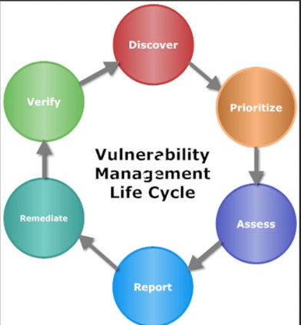
Background & Motivation
Even we have security evaluation every 3 months at IHEP, some problems still exist:
Scan results are not verified by the security team
Security team distributes the fixing tasks to the users manually
Vulnerabilities status are not tracked(left behind or fixed?)
What’ more?
Vulnerabilities knowledge database
Correlation analysis
Vulnerabilities trend
The vulnerability management and lifecycle tracking are important and necessary for the security team.
ISGC 2019, Taipei

Slide 5
function modules design

Slide 6
Design Principles
Easy to use
both for users and administrators
since end users/physicists are not security specialist
Scalability
easy to add new functional module
Multi Scanners/Engines should be supported (open source/ commercial security scanners) easily
High availability & high concurrency
Online services
For the network security team to do the assessment, thousands of hosts will be scanned at the same time
Least privilege & separation of duties
Security administrators can scan all the needed hosts
Normal users can only use it to scan his/her own hosts
ISGC 2019, Taipei

Slide 7
Function modules
Asset discovery
Asset management
Vulnerability detection
Vulnerability
handling and tracking
Asset database
(IP, port, service, user….)
Vulnerability database
(risk level, status..)
Vulnerability reports & visualization
ISGC 2019, Taipei

Slide 8
Asset discovery
Asset is the foundation of VM system, and all the security assessment objects come from assets list.
Build a list of every computing asset on the network and then build a database that vulnerability management solutions can use.
tasks:
Scan and detect to determine which hosts/services/ports are alive.
The detection need to be constant to make assets list refreshed.
Scanning Policy: every 30 Mins, a host/service/port is determined as unavailable only when it is not alive up to 3 times continuously.
Make sure that the user information imported from asset management system, e.g., ip address, user name, user email, department…
ISGC 2019, Taipei
Notes:
to determine which hosts are alive on the network, what services those hosts are offering and what ports those hosts are open.

Slide 9
Vulnerability detection
Contains detectors/scanners for kinds of vulnerabilities
Functions provided:
Form vulnerability detector for weak password in HTML pages
Web application vulnerability is detected by the response of a constructed request to that application
Port vulnerability is detected and analysis by the response of a customized request sending to an opening port
Weak password detection is carried out by verification of user password against a weak password list collected from internet.
System vulnerability is detected by performing CVE scanning
Credentialed Patch audit, Bash Shellshock Detection, …..
Easy to add more detectors/scanners in this function module
ISGC 2019, Taipei
Notes:
CVE: common vulnerabilities and exposures

Slide 10
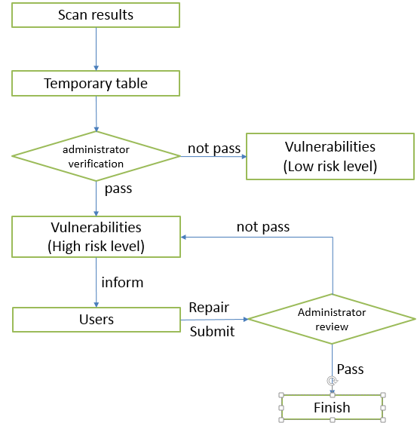
Vulnerability handling and tracking
Aimed at distributing and tracking the vulnerability until all the vulnerability tickets are closed.
Work flow
Scan results are parsed and formatted, then saved to a temporary table in database.
Notify the security administrator to verify the risk level for a detected vulnerability.
If a vulnerability is verified as a high/middle risk level, a ticket will be created to inform users to repair it.
After fixing, users need to submit tickets to administrator for review.
The administrator determine if the ticket should be closed or sent back to users to re-handle.
ISGC 2019, Taipei

Slide 11
Reports and visualization
By increasing visibility into the vulnerability status of the network at IHEP, security team can focus mitigation strategies accordingly.
Dashboards:
Top 10:
represents the proportion of the top 10 detected vulnerabilities by category .
Vulnerability status:
displays the count of vulnerabilities by status: new, active, fixed, re-opened.
Vulnerability trend:
shows the trend data about new detected vulnerabilities on the network.
ISGC 2019, Taipei
Notes:
Vulnerability Categories. Every vulnerability is mapped to a vulnerability category. This includes vulnerabilities, potential vulnerabilities and information gathered checks. Some vulnerability categories are platform-specific (for example Debian and SUSE) while others are more general (for example Database and Firewall)

Slide 12
Architecture
Asset discovery service
Vulnerability detection service
Permission control
Ticket
service
Visualization
Service layer
scan task
detection task
push
pull
message queue
DB server
Data access module
Middle layer
detection task
pull
detection result
push
Asset
scanner
Detector node 1
Detector node 2
Detector node 3
……
Module layer
Notes:
Congestion
Role based access control
Integrated with ihep unified authentication system

Slide 13
project progress

Slide 14
Development Environment
Programing Language:
JAVA, PYTHON
Operation system:
CentOS 6
Database:
MySQL 5.6
Web framework:
springboot+Vue.js, Nginx

Slide 15
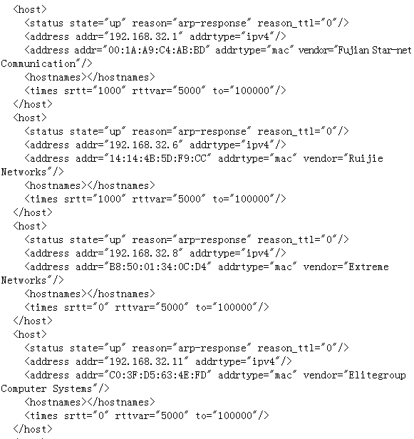
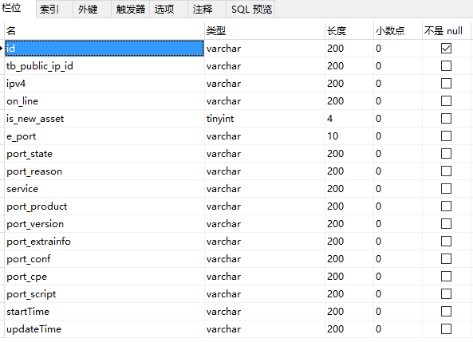
Asset discovery : host & service
Detect network asset( hosts/services/ports/OS/mac address) on IHEP network through passive scanning by IP range
Linked to network asset management system to get user information(name/email/department)
Tool: Nmap-- a free and open source utility for network discovery and security auditing
Nmap scan results → database schema
ISGC 2019, Taipei

Slide 16
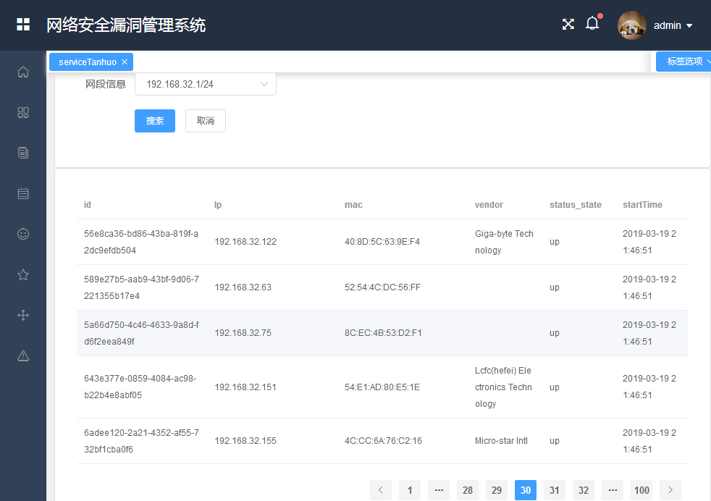
Examples of host discovery
Create a task to scan asset by ip range 192.168.32.1/24
command：nmap –T4 –sn 192.168.32.1/24
ISGC 2019, Taipei

Slide 17
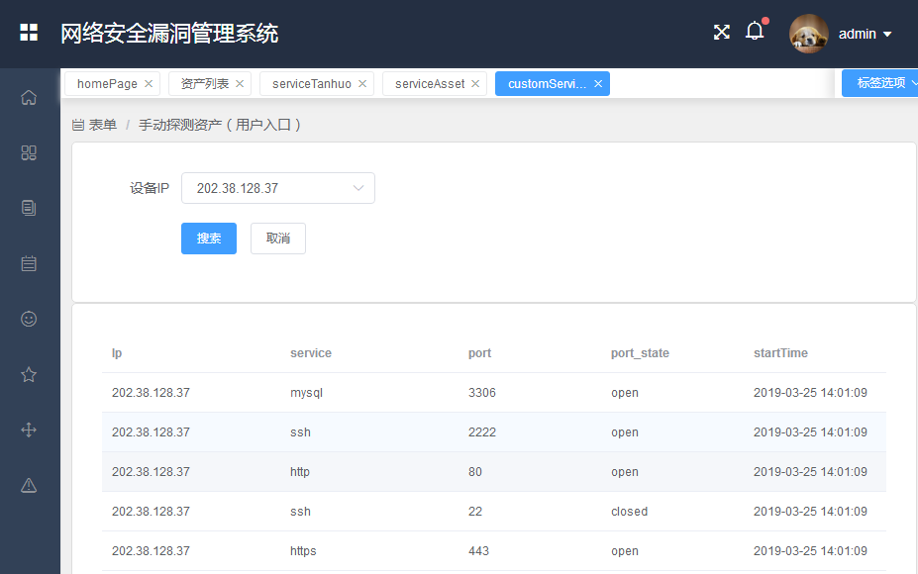
Examples of service discovery
Asset list: IP, service, port, port status.
ISGC 2019, Taipei

Slide 18
Vulnerability detection
Multi scanners supporting :
Nessus : popular and capable vulnerability scanners
NSFOCUS scanner(commercial): web service/host vulnerability
Scuba: a dedicated security software tool for database, such as weak passwords, known configuration risks, and missing patches on a range of database platforms.
Vulnerability/Leaks information storage:
Scanning name, scanner, scan strategy, IP, port, service, Risk level, description, suggested solution
Role based access control
Integrated with IHEP unified authentication/Oauth2.0
ISGC 2019, Taipei

Slide 19
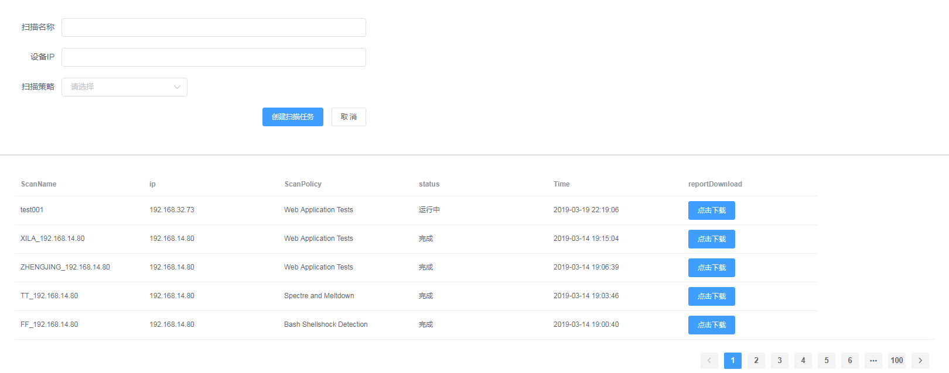
Examples of vulnerability detection
Create detection task
Task name
IP address range
Scan strategy(web application test,
Spectre and meltdown, bash shellshock
detection…)

Slide 20
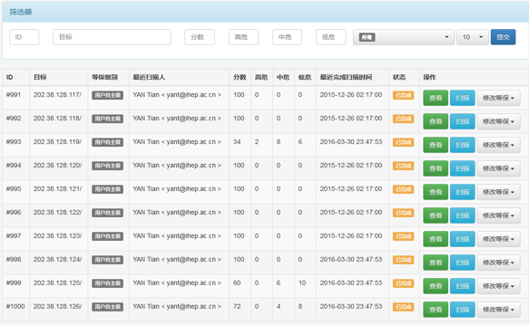
Examples of vulnerability detection

Slide 21
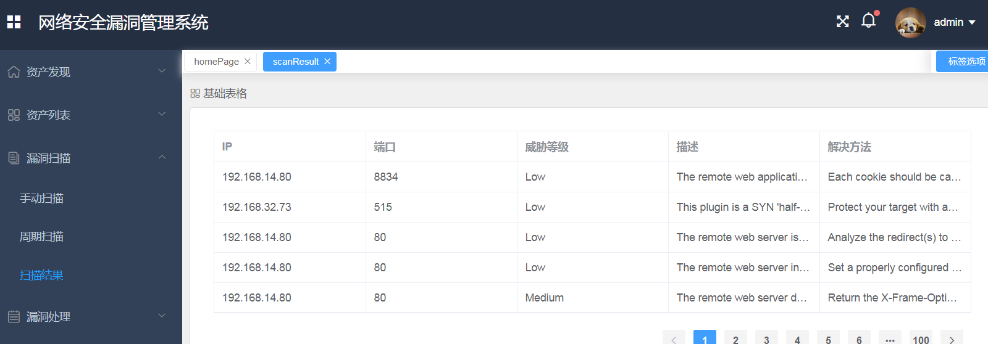
Examples of vulnerability detection

Slide 22
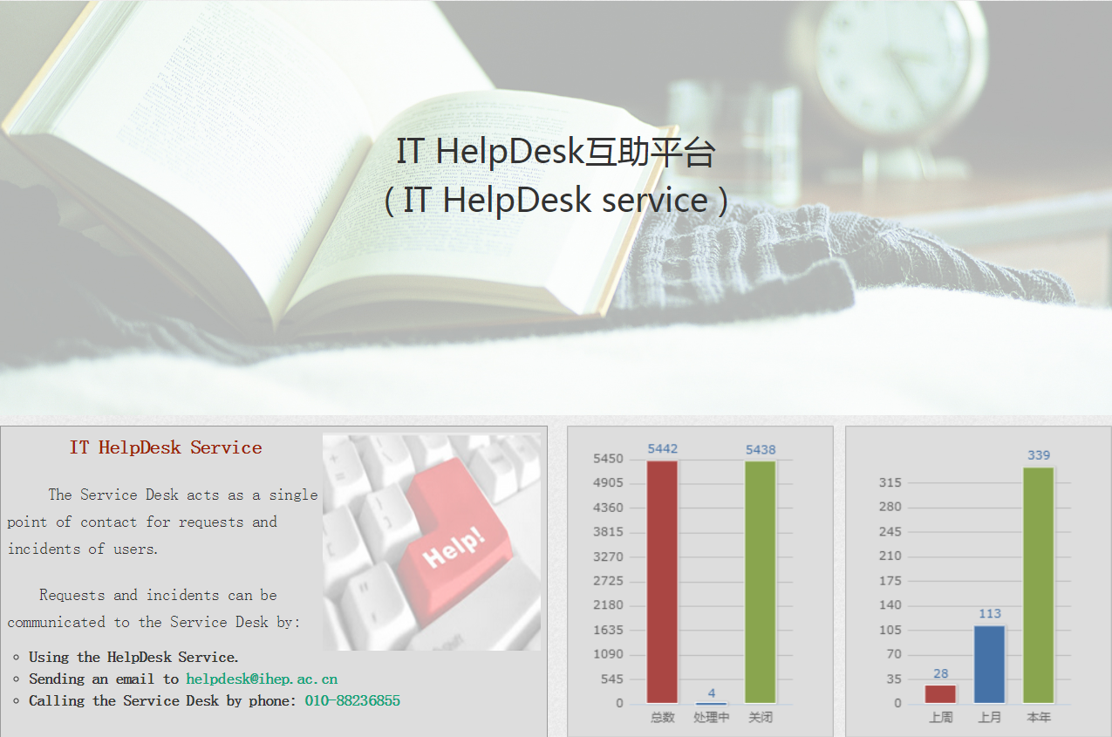
Vulnerability Tracking
Integated with IHEP ticket system(http://helpdesk.ihep.ac.cn)
A ticket will be created when a high risk vulnerabilty is found
ISGC 2019, Taipei

Slide 23
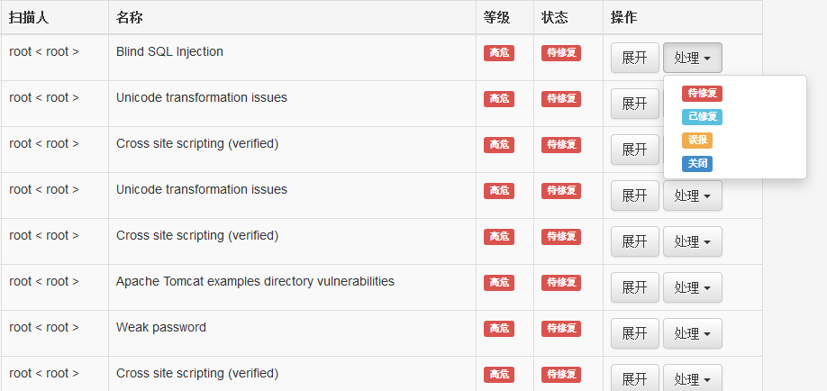
Examples of vulnerability tracking

Slide 24
Current Status
Assets discovery：Finished
Vulnerability detection: Partly finished
Batch detection is not supported
Multi-scanners are not available
Vulnerability tracking: Finished
Reports & visualization: Ongoing
ISGC 2019, Taipei

Slide 25
Summary & future plan
Motivated by the requirements of a easy-to-use vulnerability management system for both security team and normal users
Function modules of assets discovery, vulnerability detection and the vulnerability handling& tracking have been finished, reports visualization are under development
More vulnerability scanners will be added according to the needs in the future

Slide 26
Thank you for your attention!

