Slide 1

Orchestrating SDN High-Speed Network Flows for Secure Research Data Transfers
Sergio Rivera, C. Lowell Pike, Dr. James Griffioen,
Dr. Zongming Fei, Mami Hayashida
University of Kentucky

Slide 2
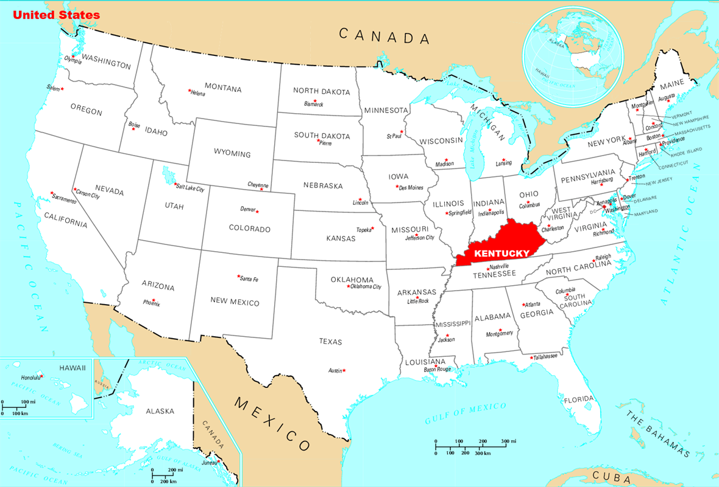
Where is Kentucky?

Slide 3
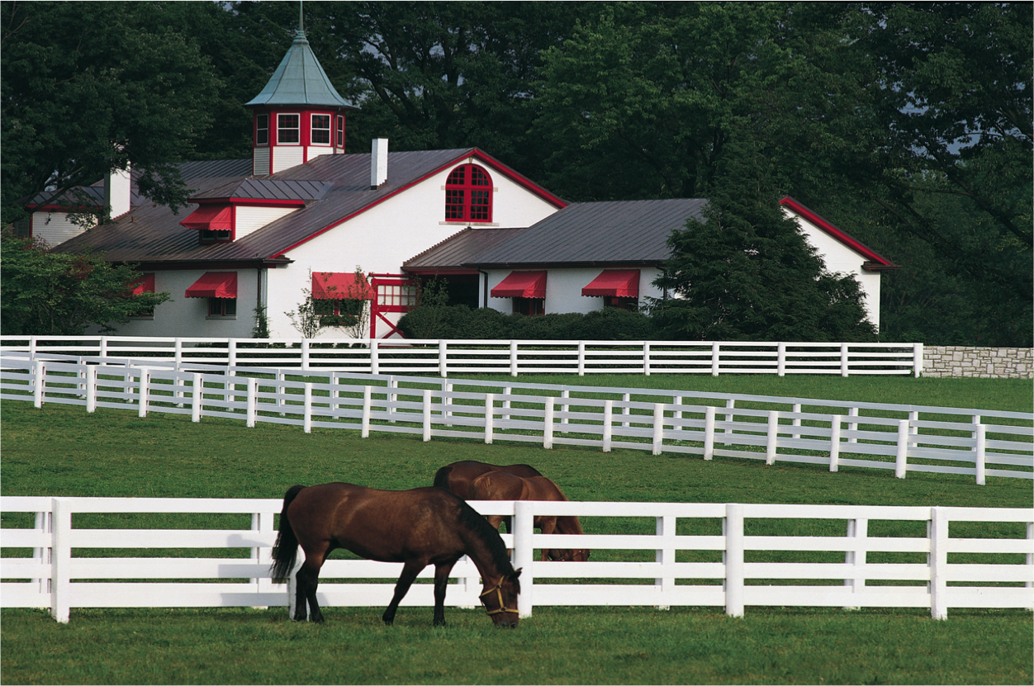
Horse Racing and Breeding

Slide 4

Bourbon Whiskey

Slide 5
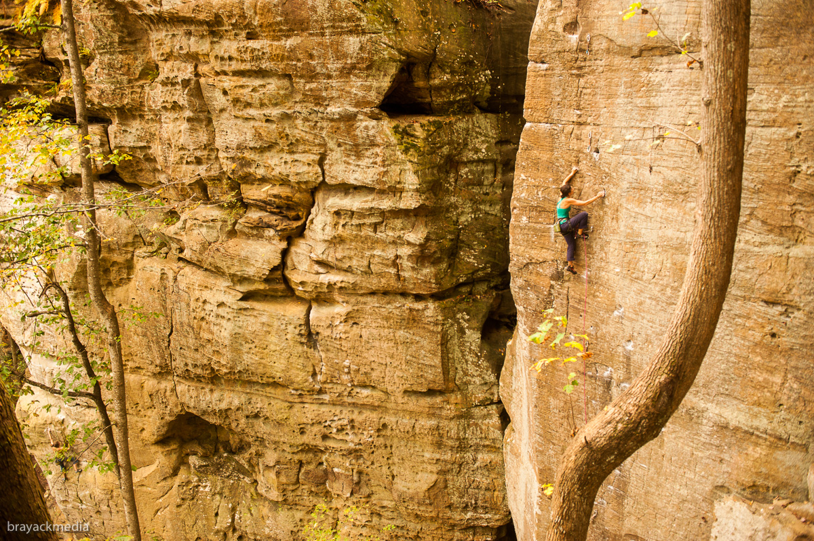
Red River Gorge

Slide 6
UK Research Computing Infrastructure
SuperComputing – OpenHPC, Singularity
Petabyte-scale Object Storage Clusters - Ceph
Cloud Virtualization Clusters - OpenStack
Machine Learning GPU Cluster
SDN-enabled Research Network - OpenFlow

Slide 7
Agenda
Big data woes on the campus network
An All-Campus Science DMZ using SDN
Orchestrating the All-Campus Science DMZ
Some results
Ongoing work

Slide 8
Big Data in Research
Large data sets are becoming increasingly prevalent in research.
  Machine Learning
  Data Mining
  Analytics
  Modeling
  Visualization
  Simulation
  …
Furthermore, researchers often need to move their large datasets between research sites and into and out of cloud storage.
Traditional campus networks are not designed to support pervasive big data usage.
Image Source: http://ohno.es/67076403.jpg

Slide 9



Typical Campus Network
Internet
Edge Router
Firewalls
Normal Flow Path
(100s of Mbps)
Middleboxes
Campus Core
Bldg
A
Bldg
B
Bldg
C
HPC

Slide 10
Typical Campus Network
Internet
Edge Router
Firewalls
Normal Flow Path
(100s of Mbps)
Middleboxes
Campus Core
Firewalls
Bldg
A
Bldg
B
Bldg
C
Middleboxes
HPC

Slide 11
Big Data Woes on Campus Network
Middleboxes
Competition: 45K students, faculty, staff
Refresh needed: older infrastructure
Backpressure: even with upgrades

Slide 12
Middleboxes
Packet inspecting/modifying devices scattered throughout the campus network.
Provide important services essential to a stable and secure campus network.
Impose intentional and unintentional bottlenecks in network performance.
Provided services include:
  Network Address Translation (NAT)
  Intrusion Detection (e.g., Deep Packet Inspection)
  Intrusion Prevention (e.g., Firewalls)
  Traffic Shaping/Quality of Service Enforcement
  Load Balancing
  Virtual Private Networks
  Content Caching
  Pre-network-access Authentication

Slide 13
Middleboxes
Provide important services that enforce policy and offer enhanced functionality.
Example middlebox services include:
  Network Address Translation (NAT)
  Traffic Shaping/QoS Enforcement
  Load Balancing
  Intrusion Detection/Prevention – and other types of DPI
  Firewalls
  VPN
  Caching Services/Proxies
  Wireless middleboxes
Middleboxes are placed strategically throughout the network, not just at the edge.
Because middleboxes operate on packets they pose a bottleneck to network performance.
Even if the network is upgraded to support high-speed connections, middleboxes can degrade or limit network throughput and/or latency.

Slide 14
How does one normally solve this problem?
Internet
Edge Router
Firewalls
Middleboxes
Campus Core
Bldg
A
Bldg
B
Bldg
C
HPC

Slide 15
Move Nodes Outside the Firewall
Internet
Edge Router
Firewalls
Middleboxes
Campus Core
Bldg
A
Bldg
B
Bldg
C
HPC

Slide 16
Move Nodes Outside the Firewall
Internet
Edge Router
Firewalls
Middleboxes
HPC
Campus Core
Bldg
A
Bldg
B
Bldg
C
HPC

Slide 17
Move Nodes Outside the Firewall
Internet
Edge Router
Firewalls
Middleboxes
HPC
Campus Core
Bldg
A
Bldg
B
Bldg
C

Slide 18
Campus Science DMZ
Internet
Edge Router
Firewalls
Middleboxes
HPC
Science DMZ
Campus Core
Bldg
A
Bldg
B
Bldg
C

Slide 19
Campus Science DMZ
Internet 2
Edge Router
Firewalls
Middleboxes
HPC
High Speed Flows
(Multiple Gbps)
Campus Core
Bldg
A
Bldg
B
Bldg
C

Slide 20
Standard Science DMZ Solution
Internet
Edge Router
Firewall
Middleboxes
Science
DMZ
Only Campus is Protected
Campus (Core) Network
Deploy a Science DMZ network connected to the network edge.
Move HPC machines to the Science DMZ network
Advantages:
  Traffic from HPC machines bypass middlebox bottlenecks
Disadvantages:
  Science DMZ machines are not protected by middleboxes.
  Campus (middlebox) policy enforcement is not applied to any traffic from Science DMZ machines. Even non-science flows (e.g., Netflix) bypass campus policy enforcement.
  Researchers must decide whether to connect their machines to the Science DMZ or the Campus Network.
HPC
Bldg
A
Bldg
B
Bldg
C

Slide 21
Standard Science DMZ Solution
Netflix
Internet
Edge Router
Firewall
Middleboxes
Science
DMZ
Campus (Core) Network
Deploy a Science DMZ network connected to the network edge.
Move HPC machines to the Science DMZ network
Advantages:
  Traffic from HPC machines bypass middlebox bottlenecks
Disadvantages:
  Science DMZ machines are not protected by middleboxes.
  Campus (middlebox) policy enforcement is not applied to any traffic from Science DMZ machines. Even non-science flows (e.g., Netflix) bypass campus policy enforcement.
  Researchers must decide whether to connect their machines to the Science DMZ or the Campus Network.
HPC
Bldg
A
Bldg
B
Bldg
C

Slide 22
Standard Science DMZ Solution
Internet
Edge Router
Slow Speeds to HPC
Firewall
Middleboxes
Science
DMZ
Campus (Core) Network
Deploy a Science DMZ network connected to the network edge.
Move HPC machines to the Science DMZ network
Advantages:
  Traffic from HPC machines bypass middlebox bottlenecks
Disadvantages:
  Science DMZ machines are not protected by middleboxes.
  Campus (middlebox) policy enforcement is not applied to any traffic from Science DMZ machines. Even non-science flows (e.g., Netflix) bypass campus policy enforcement.
  Researchers must decide whether to connect their machines to the Science DMZ or the Campus Network.
HPC
Bldg
A
Bldg
B
Bldg
C
?

Slide 23
Agenda
Big data woes on the campus network
Standard science DMZ solution
Brief SDN overview
A new DMZ approach
Some results

Slide 24
Developing an All-Campus Science DMZ
Internet
Edge Router
Firewalls
Middleboxes
Campus Core
Bldg
A
Bldg
B
Bldg
C
HPC

Slide 25
Developing an All-Campus Science DMZ
Internet
Edge Router
Firewalls
Middleboxes
Campus Core
Bldg
A
SDN Switch
SDN Switch
Bldg
B
Bldg
C
SDN Switch
HPC

Slide 26
Developing an All-Campus Science DMZ
Internet
Edge Router
Firewalls
Middleboxes
SDN Core
Campus Core
Bldg
A
SDN Switch
SDN Switch
Bldg
B
Bldg
C
SDN Switch
HPC

Slide 27
Developing an All-Campus Science DMZ
Internet
Edge Router
Firewalls
Middleboxes
SDN Controller Software
SDN Core
Campus Core
Bldg
A
SDN Switch
SDN Switch
Bldg
B
Bldg
C
SDN Switch
HPC

Slide 28
Developing an All-Campus Science DMZ
Internet
Edge Router
Firewalls
Middleboxes
SDN Core
Campus Core
Bldg
A
SDN Switch
SDN Switch
Bldg
B
Bldg
C
SDN Switch
HPC

Slide 29
University of Kentucky SDN Implementation
Use Normal rule for most traffic
Modify “VIP” traffic with OpenFlow rules
Avoid middle box bottlenecks for “VIP” traffic
Examples of “VIP” traffic:
Research data transfer to Internet2
Hostile traffic (drop)

Slide 30
Developing an All-Campus Science DMZ
Internet
Edge Router
Firewalls
Normal Flow Path
Middleboxes
SDN Core
Campus Core
Bldg
A
SDN Switch
SDN Switch
Bldg
B
Bldg
C
SDN Switch
HPC

Slide 31
Developing an All-Campus Science DMZ
Internet
Edge Router
Firewalls
Normal Flow Path
Middleboxes
SDN Core
Campus Core
High-speed Flow Path
Bldg
A
SDN Switch
SDN Switch
Bldg
B
Bldg
C
SDN Switch
HPC

Slide 32
Developing an All-Campus Science DMZ
Internet
Edge Router
Firewalls
Normal Flow Path
Middleboxes
All-Campus Science DMZ
Flows
(not machines)
join the DMZ.
SDN Core
Campus Core
High-speed Flow Path
Bldg
A
SDN Switch
SDN Switch
Bldg
B
Bldg
C
SDN Switch
HPC

Slide 33
Caveats
Being on the SDN network does not improve normal traffic.
By default, traffic still routes through the slow campus network
High-speed is only enabled for “privileged” flows
  Must obtain permission
  Rules must be inserted to activate the flow

Slide 34
Caveats
Being on the SDN network does not improve normal traffic.
By default, traffic still routes through the slow campus network
High-speed is only enabled for “privileged” flows
  Must obtain permission
  Rules must be inserted to activate the flow

Slide 35
Agenda
Big data woes on the campus network
An All-Campus Science DMZ using SDN
Orchestrating the All-Campus Science DMZ
Some results
Ongoing work

Slide 36
Orchestrating the All-Campus DMZ
“VIP Lanes”
Manage Trust
Discover topology information
Compute paths
Accept requests to enable “privileged flows”
Compute and insert SDN (OpenFlow) rules
Remove rules that are no longer needed
Ease of use

Slide 37
VIP Lanes
Network Administrator
Researchers
VIP Lanes
Server
(Auth N/Z and Web Server)
VIP Lanes
Graph DB
VIP Lanes
Path Service
App
VIP Lanes Wrapper
App
VIP Lanes
Monitoring Service
VIP Lanes
Relational
DB
LDAP
Service
Northbound Interface
Application
Data
OpenFlow Controller
VIP lanes
Software
(items in some
shade of blue)
Default Code
VIP Lanes Module
Southbound Interface
SDN Switch
SDN Switch
SDN Switch
See ICCCN 2017 VIP Lanes Paper

Slide 38
Authorization Questions
Who can authorize a VIP Lane(s)?
  A single authority? Multiple authorities?
  What is the authorization process?
When does authorization occur? When does instantiation occur?
  Instantaneously? Pre-authorized?,
What is the lifetime of a VIP Lane(s)?
  Months, days, hours, minutes?
Etc …

Slide 39
VIP Lanes Policy Exceptions
Flows space is arranged into a hierarchy
  Root = all flows
  Subnodes = strict subset of parent’s flows
  Flows defined by tuple (e.g., src/dst IP addrs and ports)
Trusted Users assigned to manage portions of the hierarchy
  Can instantiate a flow (i.e., create a policy exception)
  Can delegate control to other Trusted User
  Delegation defines a hierarchy of responsibility
See ICCCN 2017 VIP Lanes Paper

Slide 40
Example Policy Exception Tree
Src: *
Dst: *
Group: Campus IT
Src: 128.123.4.160/27
Dst: *
Group: CoE IT
Src: 128.123.123.0/24
Dst: *
Group: A&S IT
Src: 128.123.4.160/28
Dst: *
Group: CS Researchers
Src: 128.123.4.176/28
Dst: *
Group: ECE Researchers
Src: 128.123.4.160/29
Dst: *
Group: VIP Lanes
Src: 128.123.4.168/29
Dst: *
Group: GENI Research
Policy tree is created by users in a distributed way
(through a web server that maintains the policy tree).

Slide 41
Establishing/Managing Trust
(In an All-campus Science DMZ)
Authorized Bypass Flows: Authorized bypass traffic should be at the granularity of flows, as opposed to all Science DMZ traffic.
Trusted Users: Users (not machines) should be authenticated and trusted (i.e., trust should be traceable to people, not machines).
Limited Trust: User trust should be limited to a specific set of flows for a limited amount of time.
Distributed Trust Infrastructure: Trust decisions should not be made by a single entity (e.g., campus IT), but rather should be distributed in a controlled way among trusted users.
Dynamically Established Authorized Flows: Trusted users should be able to dynamically create authorized bypass flows.
Refinable Trust: If a flow’s characteristics cannot be known until the flow becomes active, trust should be refined to match the flow as soon as the flow appears.
Trust, but verify: Users could misuse privilege in unauthorized ways. Usage should be verified.
Backward Compatibility: Legacy applications should be able to make use of VIP Lanes without modification.

Slide 42
Scaling an All-Campus Science DMZ
Scaling the Science DMZ to the entire campus
  The number of machines is much larger
  The number of potential users is much larger
  The number of policies is much larger
    policies are per flow, not per machine
Scaling the decision-making processes
  Defining policies
  Authorizing Users
  Defining Trust relationships

Slide 43
VIPlanes Design Goals
Standard Traffic:
  By default, all traffic goes through the campus core and middleboxes
  Switches/Routers should be able to forward packets “normally”, (Implication: they must support standard routing/forwarding protocols)
Privileged Traffic:
  Create Control Software that can:
    Discover topology information
    Discover the placement/role of middleboxes
    Accept requests to enable “privileged flows” via a (REST) API
    Compute paths that by-pass middleboxes
    Compute SDN rules and insert them to “pick off” privileged flows
    Ensure rules remain in place for the duration of the flow
    Remove rules that are no longer needed
    Gracefully handle failures

Slide 44
VIP Lane
Authorization Concepts
Flow Space: Defines a set of flows that can traverse the network.
Flow Range: Defines a subset of flows in the Flow Space. Each Flow Range has associated User Group.
User Groups: A group of users (including both Admin Users and Standard Users).
Admin Users: Decide who can use a Flow Range.
Standard Users: Are allowed to instantiate flows in a Flow Range.
Flow Space Tree: Flow Ranges are arranged hierarchically with each child range being a strict subset of the parent flow range. Siblings must be unique (non-overlapping) flow ranges. This allows distributed user control of the flow space (with clear responsibility for each instantiated flow).
Flow Delegation: The act of creating a child flow range and associating it with a User Group. (Only Admin Users can do this.)
Flow Instantiation: The act of instantiating a single flow – i.e., installing OF rules in switches needed to forward traffic.
VIP Lanes Authorization: Enables users to originate privileged flows.

Slide 45
Example Policy Exception Tree
Src: *
Dst: *
Group: Campus IT
Control: user1
Use: user1, user2, user3
Control: user2
Use: user2, user3, user4
Src: 128.123.4.160/27
Dst: *
Group: CoE IT
Src: 128.123.123.0/24
Dst: *
Group: A&S IT
Control: user3
Use: user3, user5
Control: user6, user7
Use: user6, user7
Src: 128.123.4.160/28
Dst: *
Group: CS Researchers
Src: 128.123.4.176/28
Dst: *
Group: ECE Researchers
Control: user8
Use: user8
Src: 128.123.4.160/29
Dst: *
Group: VIP Lanes
Src: 128.123.4.168/29
Dst: *
Group: GENI Research
Control: user6
Use: user6, user9, user10, …
Control: user7
Use: user7, user9, user11, …

Slide 46
The SDN Control Software
(A.K.A. VIP Lanes)
Prereq:
  Switches/Routers must be configured to process packets “normally” by default
  Multiple ways to achieve this. Easy way is to insert a “normal” rule.
OpenFlow controller module
  Discover topology information and makes it available to VIPlanes services
  Accept requests to insert a set of rules comprising a flow
VIPlanes services
  Discover the placement/role of middleboxes
    Via topology discovery and config files
  Accept requests to enable “privileged flows”
    VIPlanes server authenticates/authorizes requests
  Compute paths that by-pass middleboxes
    Path computation service uses topo info to compute middlebox free paths
  Compute SDN rules and invokes controller to insert them to “pick off” privileged flows
    Path computation service and new controller module create and install rules
  Ensure rules remain in place for the duration of the flow
  Remove rules that are no longer needed
  Gracefully handle failures

Slide 47
Orchestrating the All-Campus DMZ
VIP Lanes
Manage Trust
Discover topology information
Compute paths
Accept requests to enable “privileged flows”
Compute and insert SDN (OpenFlow) rules
Remove rules that are no longer needed
Ease of use

Slide 48
Discover Topology Information
Controller pushes initial OpenFlow rules to every switch
Match
bddp
dhcp
arp
*
Action
forward to controller (topology discovery)
forward to controller & Normal (end node discovery)
forward to controller & Normal (end node discovery)
Normal

Slide 49
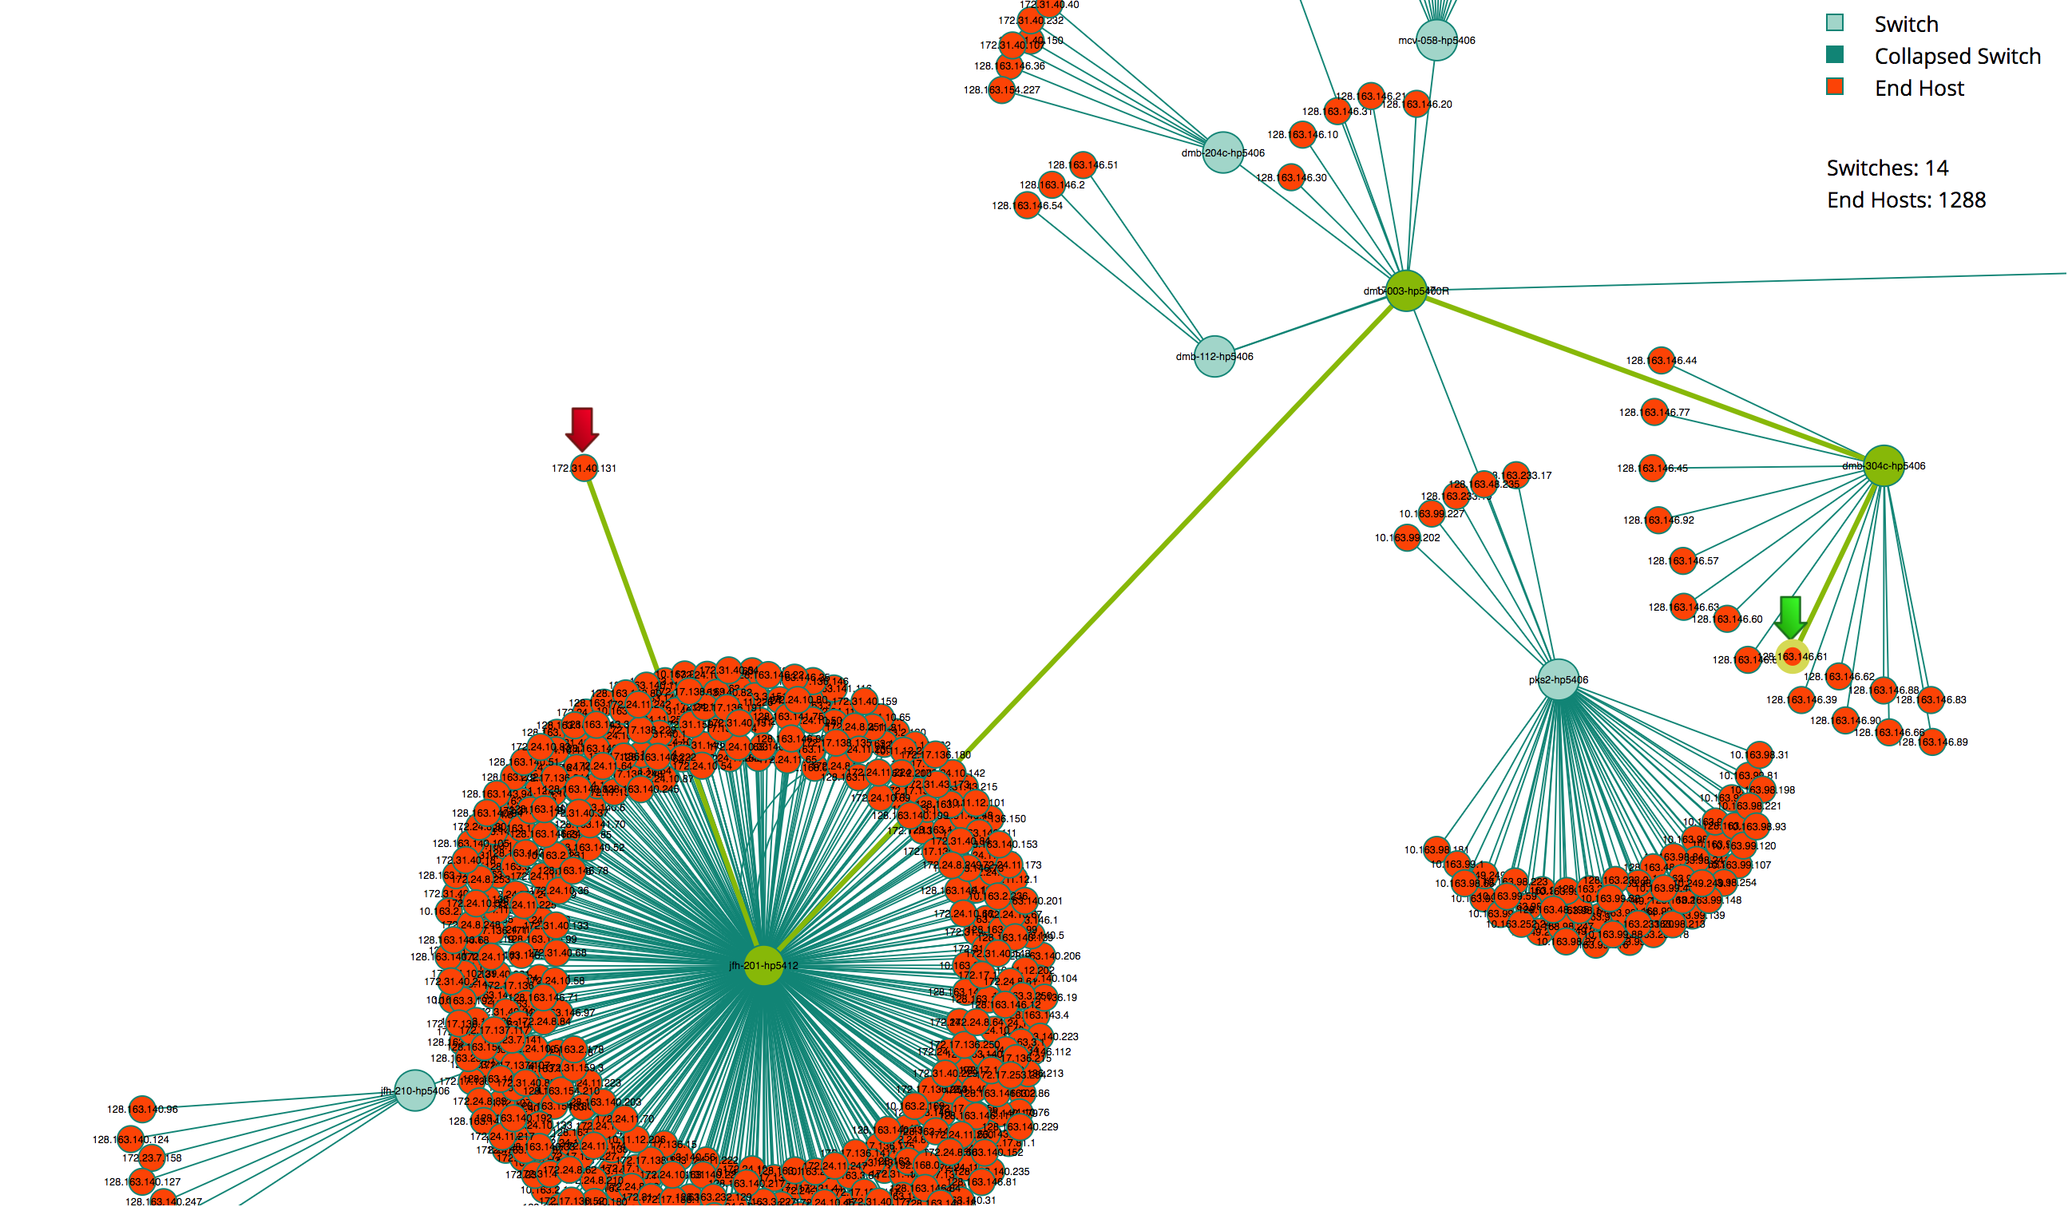

Slide 50
Orchestrating the All-Campus DMZ
VIP Lanes
Manage Trust
Discover topology information
Compute paths
Accept requests to enable “privileged flows”
Compute and insert SDN (OpenFlow) rules
Remove rules that are no longer needed
Ease of use

Slide 51
VIP Lanes
Network Administrator
Researchers
VIP Lanes
Server
(Auth N/Z and Web Server)
VIP Lanes
Graph DB
VIP Lanes
Path Service
App
VIP Lanes Wrapper
App
VIP Lanes
Monitoring Service
VIP Lanes
Relational
DB
LDAP
Service
Northbound Interface
Application
Data
OpenFlow Controller
VIP lanes
Software
(items in some
shade of blue)
Default Code
VIP Lanes Module
Southbound Interface
SDN Switch
SDN Switch
SDN Switch
See ICCCN 2017 VIP Lanes Paper

Slide 52
Insert OpenFlow Rules
Internet
Edge Router
Firewalls
Middleboxes
OpenFlow
Rule Match?
SDN Core
Campus Core
Bldg
A
SDN Switch
SDN Switch
Bldg
B
Bldg
C
SDN Switch
HPC

Slide 53
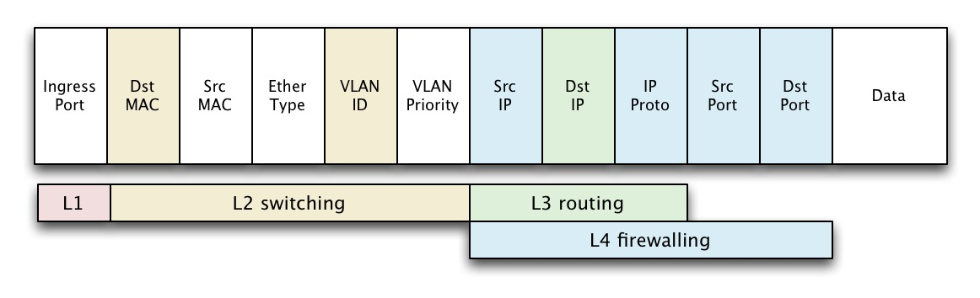
OpenFlow Rules : Match Packet then Take Actions
Match:
Actions:
Drop
Forward – to port, flood, to controller, normal…
Set – mac, vlan id, ip address…
Notes:
This is a sample Picture Right with Caption slide ideal for including a picture with a brief descriptive statement.
To Replace the Picture on this Sample Slide (this applies to all slides in this template that contain replaceable pictures)
Select the sample picture and press Delete. Click the icon inside the shape to open the Insert Picture dialog box. Navigate to the location where the picture is stored, select desired picture and click on the Insert button to fit the image proportionally within the shape.
Note: Do not right-click the image to change the picture inside the picture placeholder. This will change the frame size of the picture placeholder. Instead, follow the steps outlined above.
Tip: use the Crop tool to reposition a picture within a placeholder. From the Picture Tools Format tab on the ribbon, click the Crop button. Click and drag the picture within the placeholder to reposition. To scale the picture within the placeholder (while Crop is active), grab a round corner handle and drag to resize. Hold Shift key to constrain picture aspect ratio when resizing.

Slide 54
OpenFlow Rules : Match Packet then Take Actions
Match Research Flow?
Source IP
Destination IP
Ports (optional)
Actions:
Set – mac, vlan id
Forward – toward SDN Core port
Notes:
This is a sample Picture Right with Caption slide ideal for including a picture with a brief descriptive statement.
To Replace the Picture on this Sample Slide (this applies to all slides in this template that contain replaceable pictures)
Select the sample picture and press Delete. Click the icon inside the shape to open the Insert Picture dialog box. Navigate to the location where the picture is stored, select desired picture and click on the Insert button to fit the image proportionally within the shape.
Note: Do not right-click the image to change the picture inside the picture placeholder. This will change the frame size of the picture placeholder. Instead, follow the steps outlined above.
Tip: use the Crop tool to reposition a picture within a placeholder. From the Picture Tools Format tab on the ribbon, click the Crop button. Click and drag the picture within the placeholder to reposition. To scale the picture within the placeholder (while Crop is active), grab a round corner handle and drag to resize. Hold Shift key to constrain picture aspect ratio when resizing.

Slide 55
Orchestrating the All-Campus DMZ
VIP Lanes
Manage Trust
Discover topology information
Compute paths
Accept requests to enable “privileged flows”
Compute and insert SDN (OpenFlow) rules
Remove rules that are no longer needed
Ease of use

Slide 56
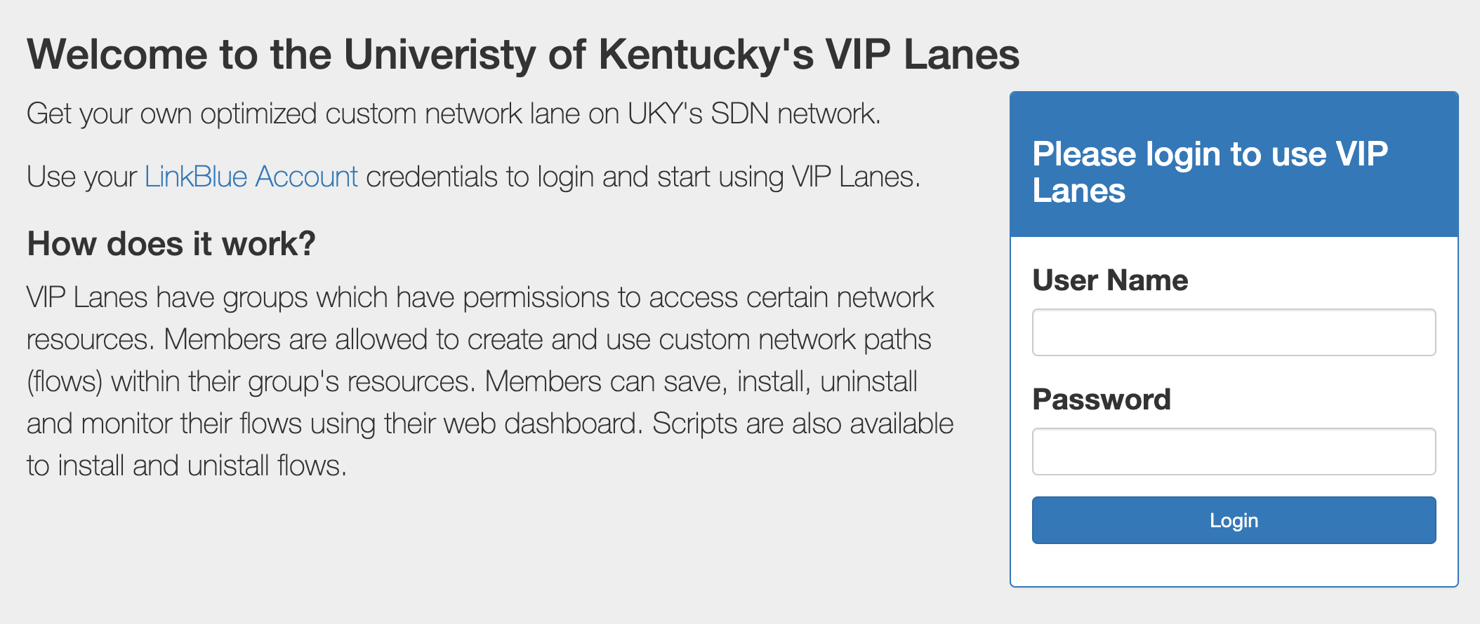

Slide 57
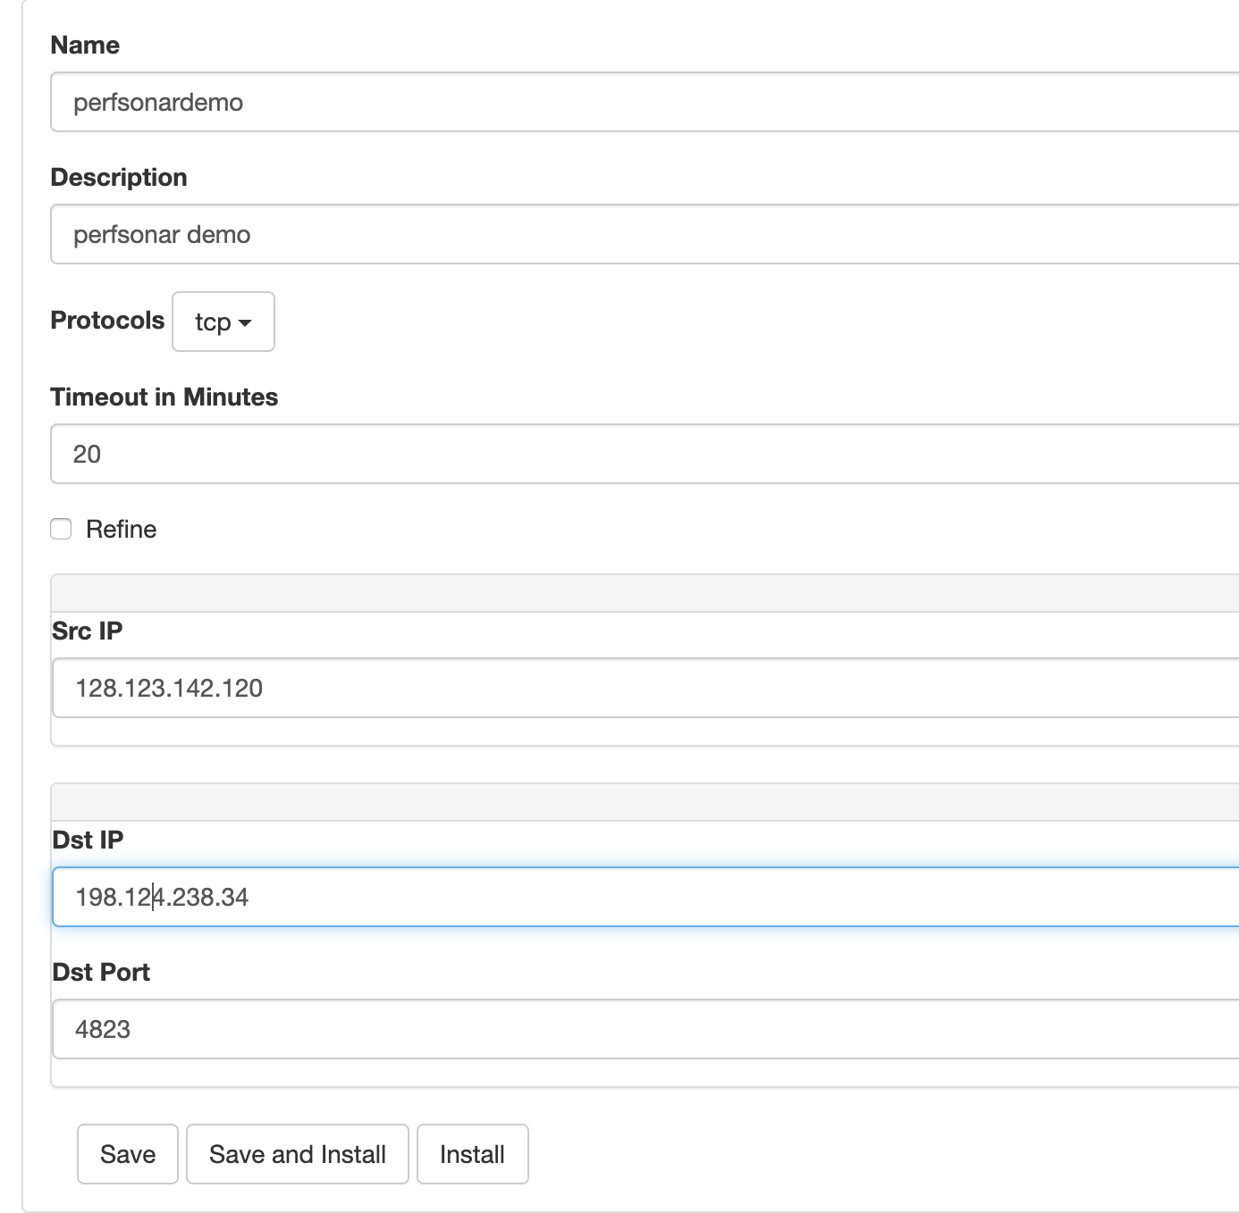

Slide 58
VIP Lanes Application Wrapper
Network Administrator
Researchers
VIP Lanes
Server
(Auth N/Z and Web Server)
VIP Lanes
Graph DB
VIP Lanes
Path Service
App
VIP Lanes Wrapper
App
VIP Lanes
Monitoring Service
VIP Lanes
Relational
DB
LDAP
Service
Northbound Interface
Application
Data
OpenFlow Controller
VIP lanes
Software
(items in some
shade of blue)
Default Code
VIP Lanes Module
Southbound Interface
See ICCCN 2017 VIP Lanes Paper
SDN Switch
SDN Switch
SDN Switch

Slide 59
VIP Lanes Application Wrapper
#scp bigdata.dat storage.state.edu:
Intercept socket connect with Linux LD_PRELOAD module
Sleep connect request
Contact VipLanes API to set up flow
Unsleep call to real socket connect routine

Slide 60
Agenda
Big data woes on the campus network
An All-Campus Science DMZ using SDN
Orchestrating the All-Campus Science DMZ
Some results
Ongoing work

Slide 61
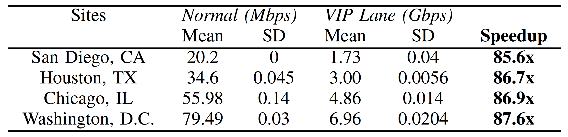
Internet Performance Results
Mbps
Gbps
See ICCCN 2017 VIP Lanes Paper

Slide 62
Agenda
Big data woes on the campus network
An All-Campus Science DMZ using SDN
Orchestrating the All-Campus Science DMZ
Some results
Ongoing work

Slide 63
Modifying Flows without OpenFlow
P4
IP policy routing
BGP

Slide 64
Acknowledgements
Current and Past Principle Investigators
James Griffioen
Cody Bumgardner
Zongming Fei
Ken Calvert
Brian Nichols
Vince Kellen
Funding Agencies
This work is supported, in part, by the National Science Foundation under NSF grants OCI-1246332, ACI-1541380, and ACI-1541426.
Infrastructure and Software Developers
Matthew Moseley
Sergio Rivera
Mami Hayashida
Charles Carpenter
Yongwook Song
Hussamuddin Nasir
Andrew Groenewold
Peter Oostema
Aruba VAN Support
Shaun Wackerly

Slide 65
Thanks
Questions?

