Slide 1
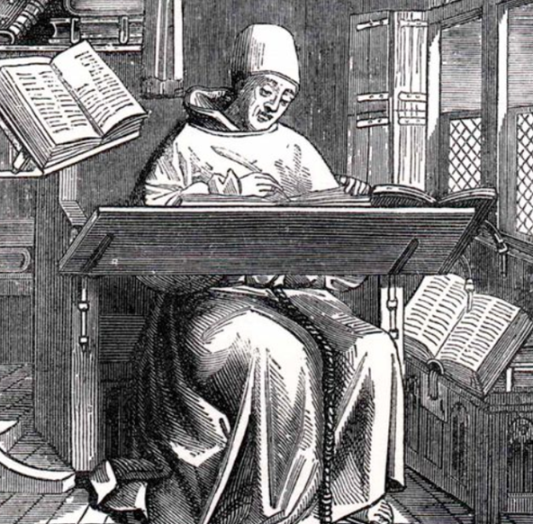
International Symposium on Grids and Clouds (ISGC) 2019. Efficient and Safe Processing of Findable, Accessible, Interoperable and Re-usable Open Data.
ECAI Workshop: Infrastructures Supporting Historical Text Projects, Atlas of Maritime Buddhism, Cultural Mapping, and Metadata for Big Data.
Session 1: A New Understanding of Bibliography
Bibliography and Learning
Michael Buckland
Univ of California, Berkeley
Academia Sinica, Taiwan.
March 31, 2019

Slide 2
Part 1: What Bibliography Does
Bibliography originally writing copies of books.
In 17th century became describing books.
Features of bibliographical describing:
Listing: Inclusion within scope.
Describing.
Discovery, finding, retrieving, selecting, display using element(s) of descriptions.
Linking: Relationships from elements of description that are related semantically or syntactically, graph.
Discovery and linking powers depend on descriptions.
Material bibliography (description of the physical book)
Intellectual bibliography (characterization of narrative).

Slide 3
Francis Bacon, 1561-1626.
Part 2: Learning
“For knowledge itself is power” (1597).
“Human knowledge and human power meet in one; for where the cause is not known the effect cannot be produced.”
Power is the ability to cause an effect and if you do not know how to do that you lack power.
May need other resources to effect a change (time, materials, tools, cooperation), but knowledge is needed.
More knowledge, more power. Less knowledge, less power. So enabling learning gives power.
Documents and, so, access to documents give power!

Slide 4
Jakob von Uexküll (1864-1944) Biosemiotics
Organisms experience life in terms of species-specific, spatio-temporal, 'self-in-world' subjective reference frame that he called a “surrounding world” (Umwelt).
Selective perception within conscious environment.
Cannot or do not notice much that is irrelevant.

Slide 5
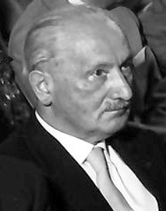
Martin Heidegger (1889-1976): Being
What does it mean for someone to be?
We are thrown into the world and must cope.
Life (“being there,” Dasein) is characterized by care (concern, worry, Sorge). One is "always already" concerned with a practically engaged and concernful mode of being-in-the-world.
Learning is central to being, to life.
With cultural resources, incl. language and technology.
“Truth” is unconcealment.

Slide 6
Hans-Georg Gadamer, 1900-2002 Hermeneutics.
Hermeneutics, once the study of texts, is now more broadly the nature of human interpretation and understanding.
We interpret based on our prior understanding (prejudices).
Interpretation of a text is a fusion of one’s “horizon of understanding” and the “horizon of a text”.
Problems if these horizons do not match.

Slide 7
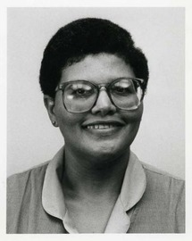
Elfreda Chatman 1943-2002
Hermeneutic “horizon” is similar to Elfreda Chatman’s “small [information] worlds.”
Our daily lives are based on only a small part of a larger world.

Slide 8
Part 3: Conditions For Learning (Living, Power) Significant things in the environment need:
1 - Evidence must exist (or be recoverable, substitute, surrogate).
2 - Be perceptible: within one’s “horizon”, accessible.
3 - Noticed.
4 - Interpreted. Made sense of.
5 - Trusted, sufficiently believed, unconcealed.
6 - Reaction, response.
7 - Economy of expected effort-effectiveness, expected cost, expected benefit, and alternative options.

Slide 9
Processes for Learning
Conditions for learning | Corresponding Processes
Exist | Preservation: Creation, conservation, substitution, reconstruction.
Perceptible | Revealing, providing access.
Awareness | Noticing, alerting services.
Interpreted | Establish relationship(s)
Trust | Verification, unconcealment, provenance, corroboration.
Responses | Action – or none.
Economy | Evaluation of costs and benefits.

Slide 10
Processes for Learning
Conditions for learning | Related Processes | Bibliographical Services
Exist | Preservation. | [Stewardship]
Perceptible | Revealing | Listing, inclusion (1)
Awareness | Noticing, alerting | Discovery: Selection, finding, selecting (3)
Interpreted | Relate | Description, links (2, 4)
Trust | Unconcealment | Description, links (2, 4)
Responses | (In)action | [Tools for cognitive work]
Economy | Evaluation | [? Reveal alternatives]

Slide 11
Summary
Being (living) is always already learning.
Living depends on perceiving and interpreting evidence (media).
Bibliography lists, describes, finds evidence.
Bibliography mediates media!
Thank-you!

