Slide 1
Federating pools – from Clusters to Grids
Greg Thain

Slide 2
Agenda
Overview of the Condor-CE
basis for GlideinWMS and OSG
What’s a CE
Why we need one
Past history
Possible future work

Slide 3
First, some terminonlogy
CE “Compute Element”
SE “Storage Element”
WN “Worker Node:

Slide 4
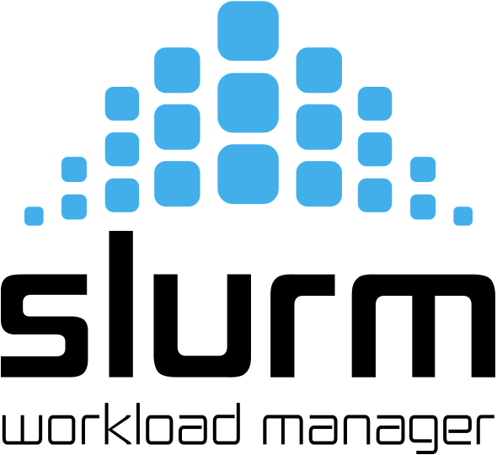
The Problem
You have many pools, all different
Different batch systems
Different policy
Want to use all of them
Job sender shouldn’t need to
know about site differences

Slide 5
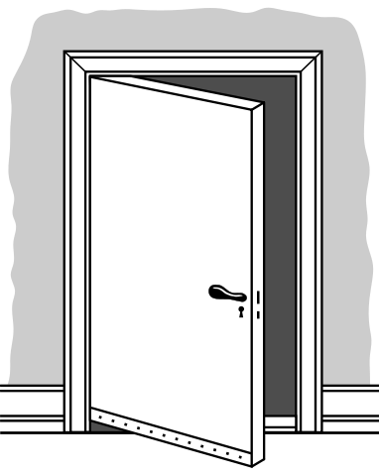
Solution: A common “Door”
Door translates common requests into
site-specific requests
Door applies site-specific
policy to common job
Door added to sites
Site A
Site B
Site C

Slide 6
Solution: A common “Door”
Job
Job
Job
Job

Slide 7
Door Principles
Need powerful transformations
Need to hide site dependencies
Want language to be declarative
Terse, Analyzable, Usable
Need all work to be Manageable

Slide 8
Focus on non-functional requirements
Doors must be
Scalable
Manageable
Accountable
Secureable
Extensible

Slide 9
Fundamental Principle
“Submit locally, Run Globally”
Same job description, local or grid
Global grid is not a separate system,
it extends the existing system

Slide 10
The 2000s solution to Doors
Globus GRAM
In 2017, Globus announced dropping support for GRAM
Required new implementation
Allow us to learn from lessons of GRAM

Slide 11
GRAM lessons learned
GRAM imperative, not declarative
Adaptation provided by perl scripts
Modified by every local site
Upgrade nightmares
Scalability problems
Accounting and manageability problems

Slide 12
HTCondor to the rescue
With HTCondor tools described yesterday…
Condor-C
Job Router
We built Condor-CE with existing parts

Slide 14
One Logical job, in many places
Job1
Job1
Changes here
Reflected here

Slide 15
Condor power on both sides
Job1
Job1
Schedd here
Full condor pool here

Slide 16
All is not well: source routing
Which route?
Remote
Pool
Local
Pool
Remote
Pool

Slide 17
Wait while idle…
Remote
Pool
Local
Pool
Remote
Pool

Slide 18
Solution: Late binding
Remote
Pool
Local
Pool
Pilots, not jobs
Remote
Pool

Slide 19
Factory submission
Remote
Pool
Local
Pool
Pilots, not jobs
Remote
Pool

Slide 20
Future work…

Slide 21
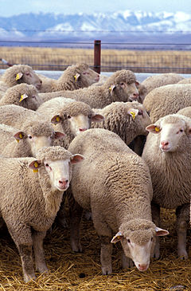
Pets vs Livestock
Names
Identity
Love
Quantity
Fungibility

Slide 22
kubernetes
Kubernetes
Could be just another grid type
allows interesting possibilities
Runs containers
Runs as root
Provisions its own network

Slide 23
Conclusion
Condor-CE allows us to build grids
Built on years of experience in months

