Slide 1
The XDC project
Daniele Cesini
INFN
daniele.cesini<at>extreme-datacloud.eu

Slide 2
Outline
XDC introduction and objectives
The XDC-1/Pulsar Release: the first year achievements
Next Steps && Conclusion

Slide 3
XDC
The eXtreme DataCloud is a software development and integration project
Develops scalable technologies for federating storage resources and managing data in highly distributed computing environments
Focus on efficient, policy driven and Quality of Service based DM
The targeted platforms are the current and next generation e-Infrastructures deployed in Europe
European Open Science Cloud (EOSC)
The e-infrastructures used by the represented communities
Addresses the EINFRA-21-2017 (b)-2: “Computing e-infrastructure with extreme large datasets”
Deal with heterogeneous datasets
Bring to TRL8 and include in a unified service catalogue services and prototype at least at TRL6

Slide 4
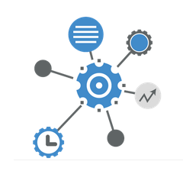
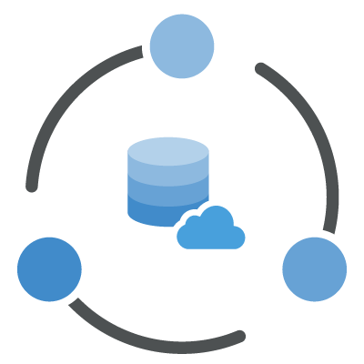
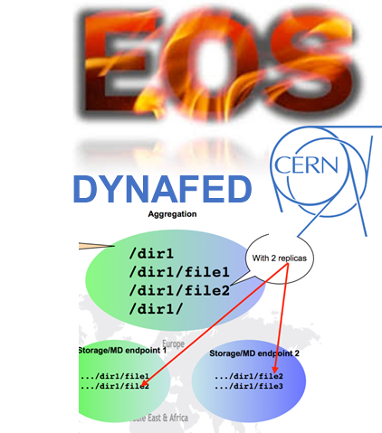
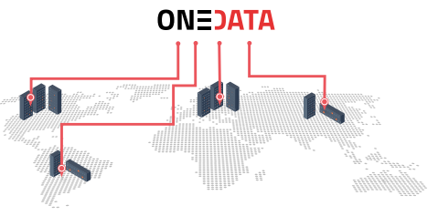
The Approach
Improve already existing, production quality Data Management services
By adding missing functionalities requested by research communities
Based mainly on technologies provided by the partners and by the INDIGO-Datacloud project
Must be coherently harmonized in the European e-Infrastructures
FTS
INDIGO PaaS Orchestrator
INDIGO CDMI Server

Slide 5
XDC Approach
The partners owning/involved in each of the tools are the main developers for that solution in XDC
We always aim to push back the code in the main development tree on the original projects
This widely increase the sustainability of the services
Upstream repositories
XDC new features

Slide 6
XDC standards and protocols
We always rely on standard and widely adopted protocols for services-to-services and for user-to-services interaction
Functionalities | Standards
Access/transport | http/webdav, gridftp, etc
Metadata | RDF, JSON
Orchestrating services | TOSCA, Ansible
Application sw distribution | Docker
AAI | OpenIDConnect, X509
Storage QoS | SNIA CDMI
Inter process communication | REST APIs, SSE, Message bus
This concretely opens the possibility to interact with external services
At the infrastructure level we provide few reference implementations
others services/initiative are implementing the same functionalities using same standard/protocols

Slide 7
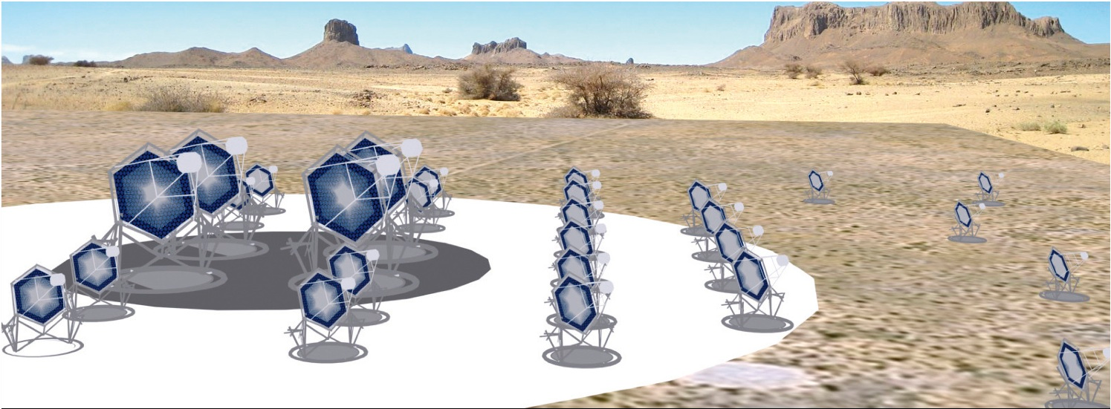
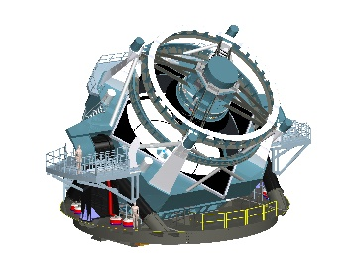
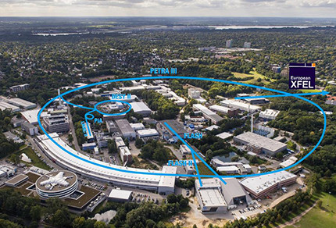
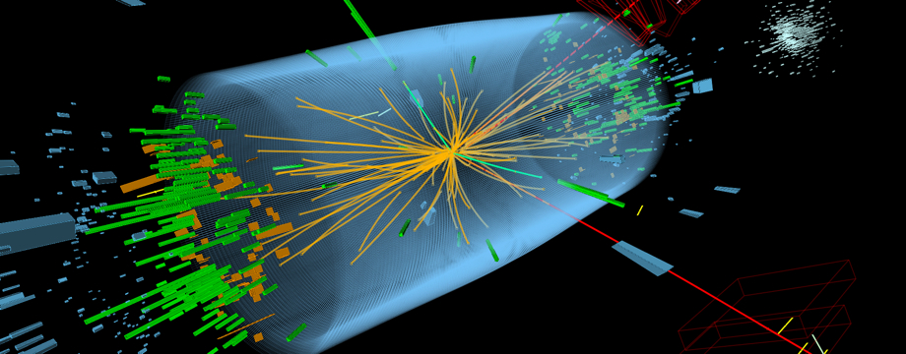
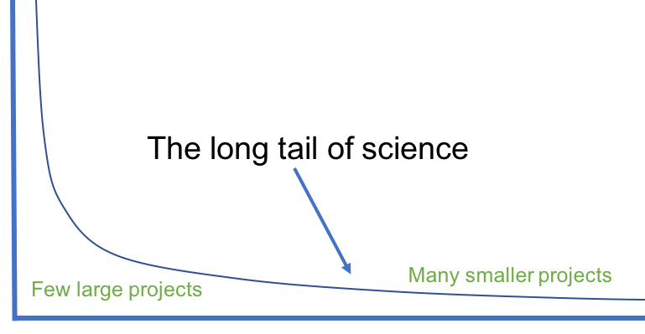
A User Driven Project

Slide 8
XDC Topics
Intelligent & Automated Dataset Distribution
Orchestration to realize a policy-driven data management
Data distribution policies based on Quality of Service (i.e. disks vs tape vs SSD) supporting geographical distributed resources (cross-sites)
Data lifecycle management
Data pre-processing during ingestion
Metadata management
Data management based on storage events
Smart caching
Transparent access to remote data without the need of a-priori copy
To support dynamic inclusion of diskless sites
To improve efficiency in multi-site storage systems and storage federations (i.e. Datalakes)
Sensitive data handling
secure storage and encryption

Slide 9
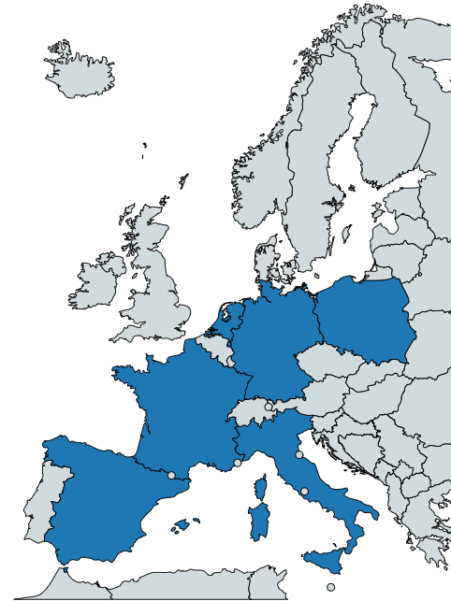
XDC Consortium
ID | Partner | Country | Represented Community | Tools and system
1 | INFN (Lead) | IT | HEP/WLCG | INDIGO-Orchestrator
2 | DESY | DE | Research with Photons (XFEL) | dCache
3 | CERN | CH | HEP/WLCG | EOS, DYNAFED, FTS, RUCIO
4 | AGH | PL |  | ONEDATA
5 | ECRIN | [ERIC] | Medical data
6 | UC | ES | Lifewatch
7 | CNRS | FR | Astro [CTA and LSST]
8 | EGI.eu | NL | EGI communities
8 partners, 7 countries
6 research communities represented + EGI
XDC Total Budget: 3.07Meuros

Slide 10
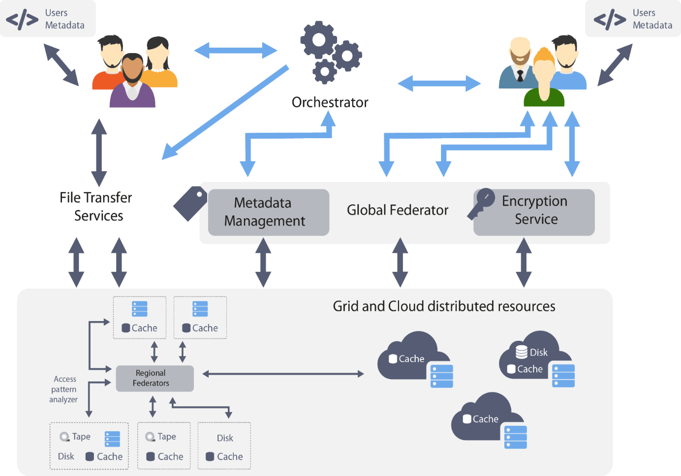
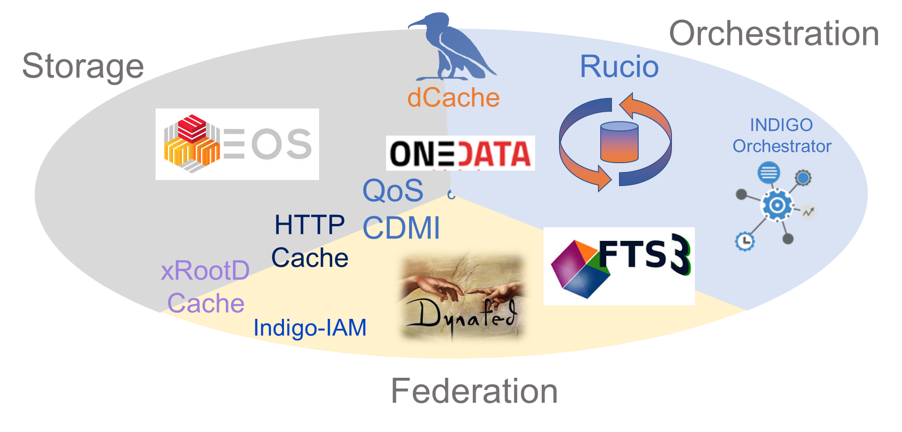
General Architecture Definition
XDC acts at all the e-infrastructure levels
Storage systems at sites
Federations of storage systems
regional and global
High level orchestration
User experience
The “toolbox” was mapped in those levels to define the general architecture
Taking into account the user requirements
The XDC Toolbox

Slide 11
XDC General Architecture

Slide 12
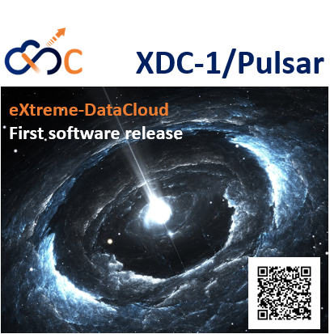
First XDC Release
Involved tools
CachingOnDemand
dCache
Dynafed
EOS
Key technical highlights
OpenIDConnect support for token based authentication
New QoS types integration and support in dCache, FTS, GFAL
Orchestrator integration with other components
Performance improvements in Onedata
Support for groups and roles in Onedata
EOS-dCache integration
Caching systems instantiation
Storage events notification in dCache
EOS caching with XCache for geographic deployment
EOS external storage adoption
FTS,GFAL
Onedata
PaaS Orchestrator plugin
TOSCA types & templates plugin
https://releases.extreme-datacloud.eu/en/latest/releases/pulsar/index.html

Slide 13
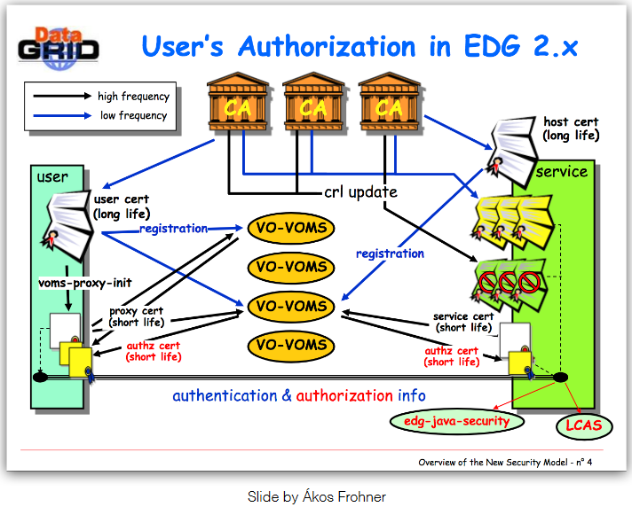
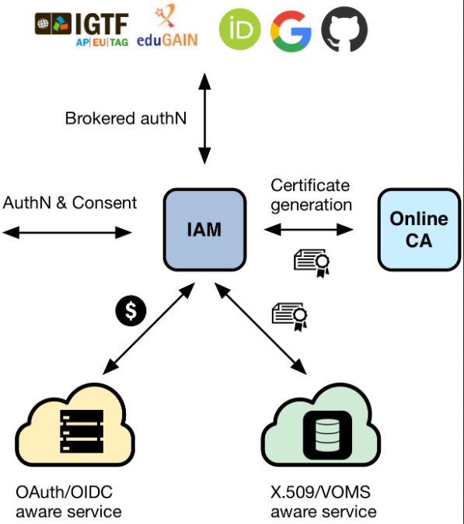
First XDC Release
Key technical highlights
OpenIDConnect support for token based authentication
new QoS types integration and support in dCache, FTS, GFAL
Orchestrator integration with other components
Performance improvements in Onedata
Support for groups and roles in Onedata
EOS-dCache integration
Caching systems instantiation
Storage events notification in dCache
EOS caching with XCache for geographic deployment
EOS external storage adoption
Slide by Akos Frohner ~2003
Slide by Andrea Ceccanti CHEP2018

Slide 14
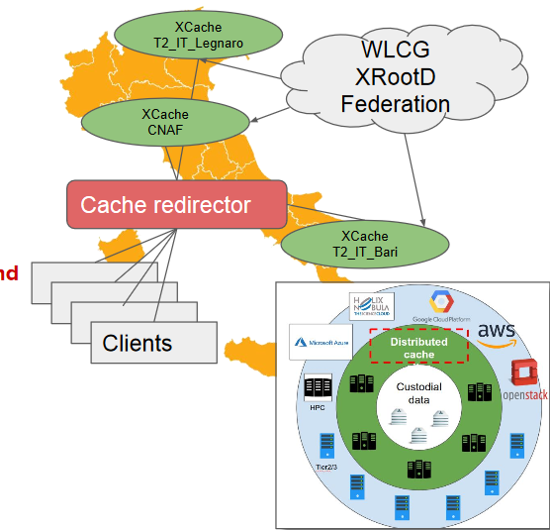
First XDC Release
Key technical highlights
OpenIDConnect support for token based authentication
new QoS types integration and support in dCache, FTS, GFAL
Orchestrator integration with other components
Performance improvements in Onedata
Support for groups and roles in Onedata
EOS-dCache integration
Caching systems instantiation
Storage events notification in dCache
EOS caching with XCache for geographic deployment
EOS external storage adoption
Deployment of Geo-distributed caches
Network of unmanaged storage for hot data
On-demand cache resources
Slide © Diego Ciangottini
Based on xRootD/xCache
See D.Ciangottini talk on “Integration of the Italian cache federation within CMS computing model”:
https://indico4.twgrid.org/indico/event/8/session/23/contribution/45

Slide 15
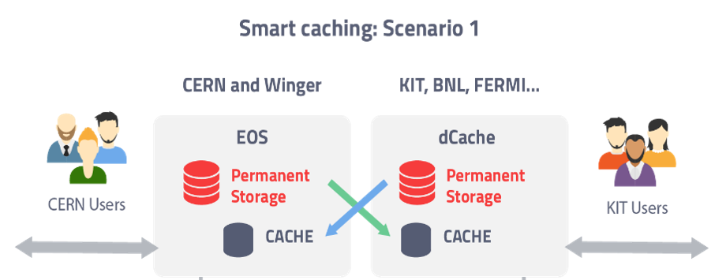
First XDC Release
Key technical highlights
OpenIDConnect support for token based authentication
new QoS types integration and support in dCache, FTS, GFAL
Orchestrator integration with other components
Performance improvements in Onedata
Support for groups and roles in Onedata
EOS-dCache integration
Caching systems instantiation
Storage events notification in dCache
EOS caching with XCache for geographic deployment
EOS external storage adoption

Slide 16
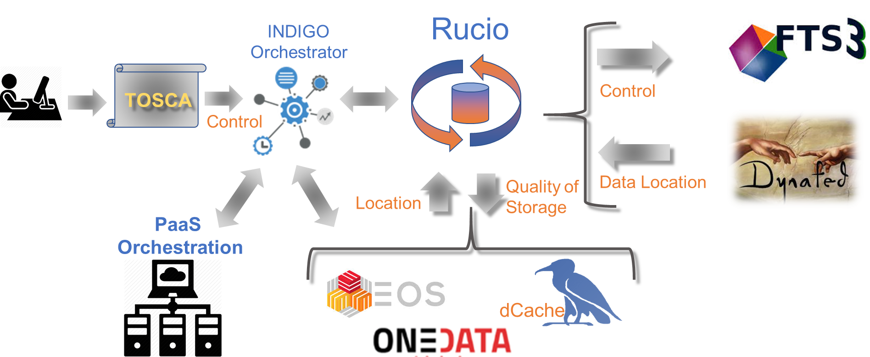
First XDC Release
Key technical highlights
OpenIDConnect support for token based authentication
new QoS types integration and support in dCache, FTS, GFAL
Orchestrator integration with other components
Performance improvements in Onedata
Support for groups and roles in Onedata
EOS-dCache integration
Caching systems instantiation
Storage events notification in dCache
EOS caching with XCache for geographic deployment
EOS external storage adoption

Slide 17
First XDC Release
Key technical highlights
OpenIDConnect support for token based authentication
new QoS types integration and support in dCache, FTS, GFAL
Orchestrator integration with other components
Performance improvements in Onedata
Support for groups and roles in Onedata
EOS-dCache integration
Caching systems instantiation
Storage events notification in dCache
EOS caching with XCache for geographic deployment
EOS external storage adoption

Slide 18
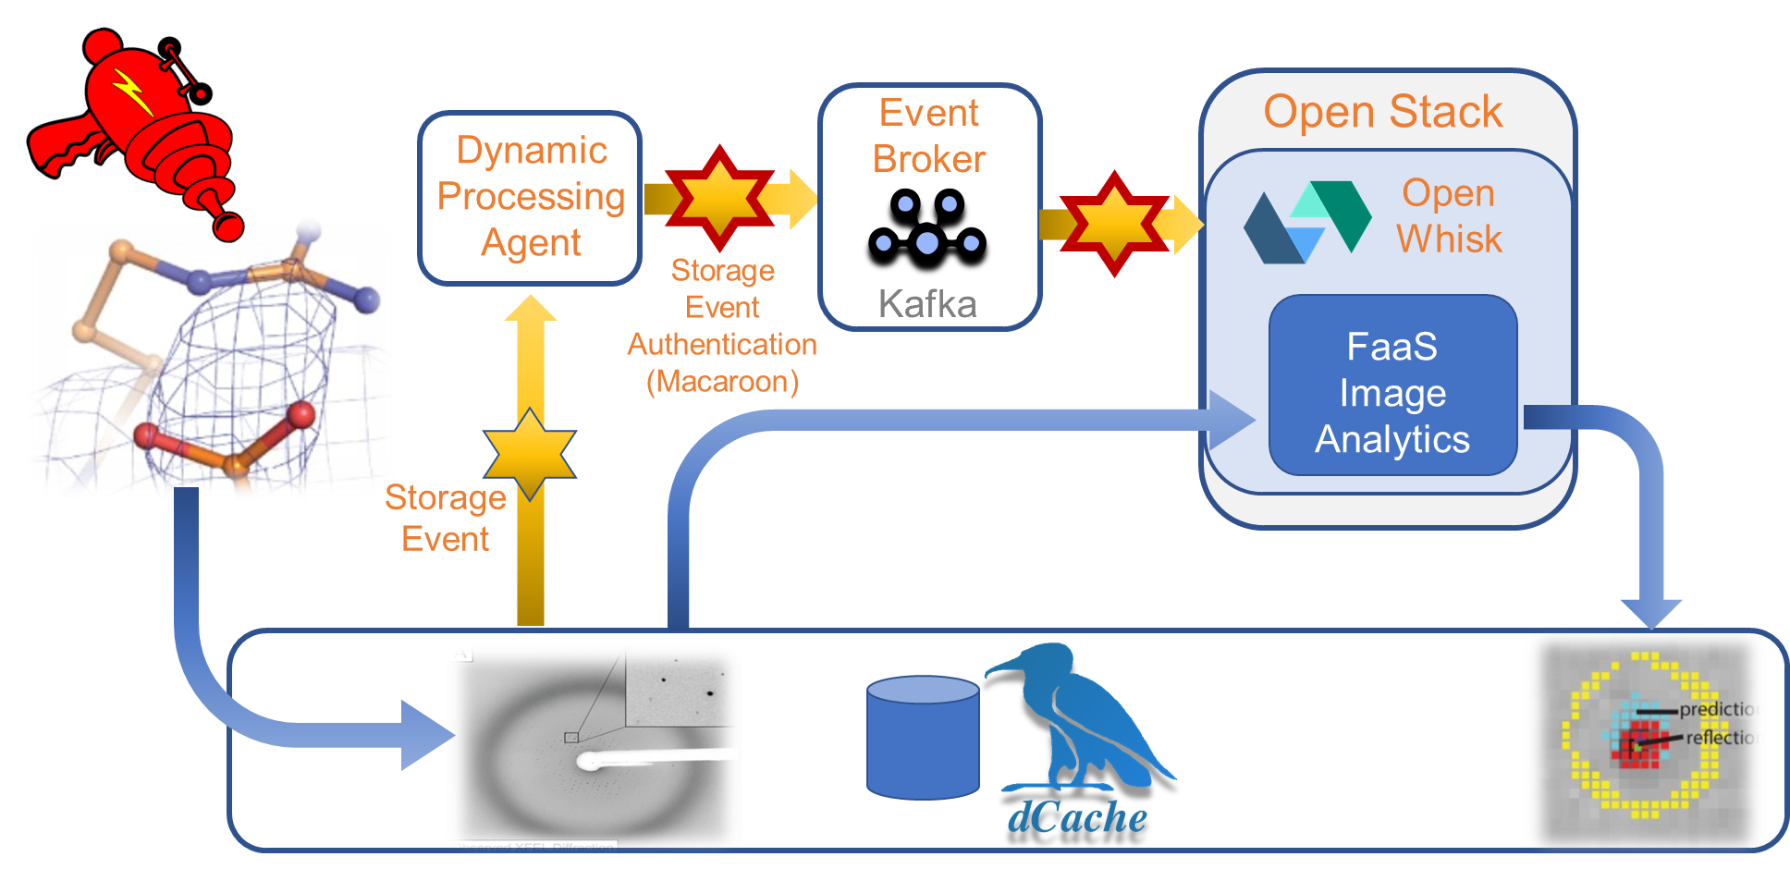
XFEL Use Case in XDC
The XFEL UseCase is driving the developments on storage events notifications support
A reference implementation is done using dCache as backend
Refer to the Patrick’s presentation on Wednesday
https://indico4.twgrid.org/indico/event/8/session/15/contribution/9
© Patrick’s Fuhrmann

Slide 19
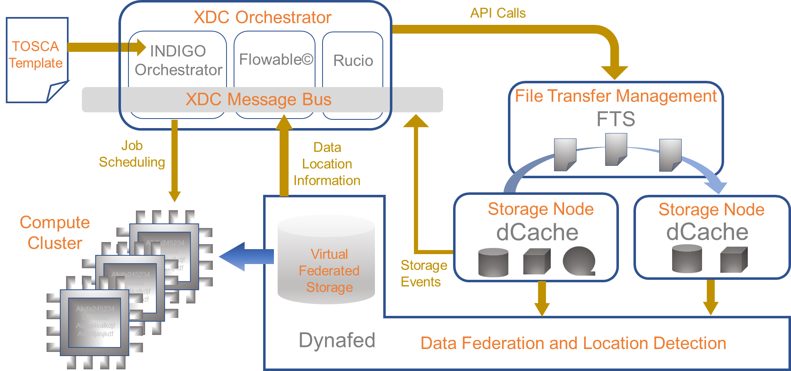
XFEL Use Case in XDC
The XFEL UseCase is driving the developments on storage events notifications support
A reference implementation is done using dCache as backend
Refer to the Patrick’s presentation on Wednesday: https://indico4.twgrid.org/indico/event/8/session/15/contribution/9
© Patrick’s Fuhrmann

Slide 20
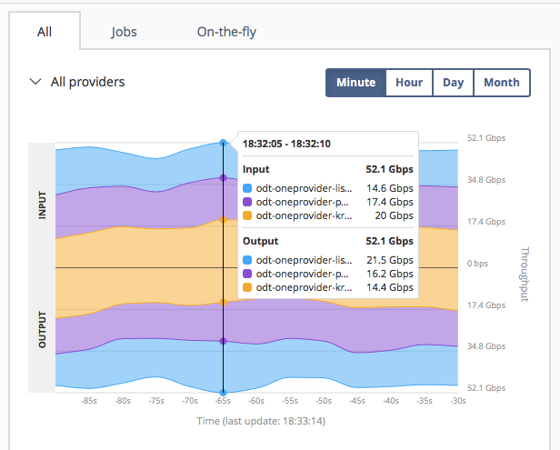
First XDC Release
Key technical highlights
OpenIDConnect support for token based authentication
new QoS types integration and support in dCache, FTS, GFAL
Orchestrator integration with other components
Performance improvements in Onedata
Support for groups and roles in Onedata
EOS-dCache integration
Caching systems instantiation
Storage events notification in dCache
EOS caching with XCache for geographic deployment
EOS external storage adoption
Onedata Transparent POSIX File System
Processing transparently cached data - 37GBytes/sec
Data Migration at combined
Throughput 56 Gbit/s
Data Transfer Mesh
3 Oneproviders connected by 20+Gbit/s links
Transfer data between all them
Single VM Node per Provider
Linear scalability

Slide 21
Metadata support in ONEDATA
Redesigned and re-implemented internal map reduce system for large scale indices based on single collections
Performance improvements in metadata management subsystem
Interface for external logic depending on metadata streams
Event based streams interfaces optimized and extended filtering options
Integration attributes with POSIX API (xattr command works from command line)

Slide 22
CTA Use Case Workflow in XDC
Canary Island ,
DL0/Bulk Archive x
Reconst
Calib
Online Process
Chile ,
Online Process
DL3 / High level data
20PB/yr
Max 500 files/s
Scientist Interface

Slide 23
CTA Use Case Workflow in XDC
Canary Island ,
DL0/Bulk Archive x
Reconst
Calib
Online Process
Chile ,
Online Process
DL3 / High level data
Scientist Interface

Slide 24
CTA Use Case Workflow in XDC
File System
Query by LFN
File
Generator
ingest
Metadata
Query by Metadata
Restquery
preprocessing
CTA HDF5 Extraction

Slide 25
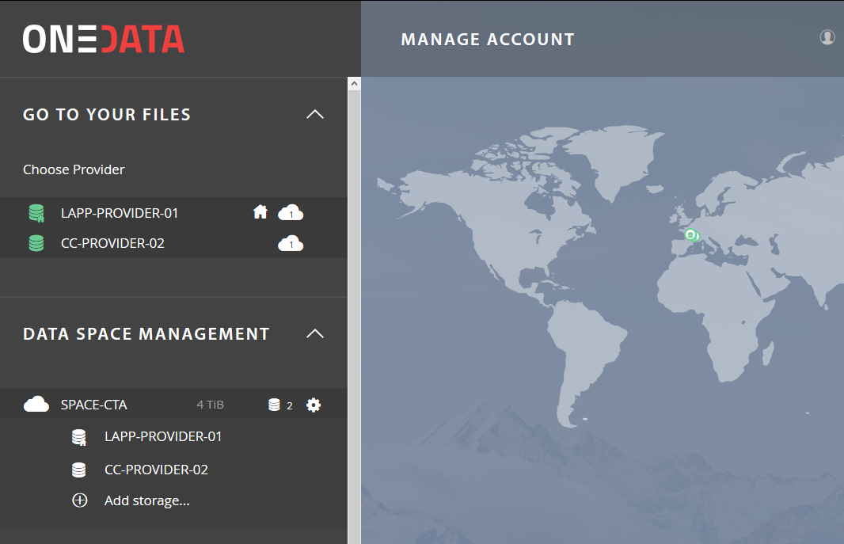
CTA Use Case Workflow in XDC
File System
Query by LFN
File
Generator
ingest
Metadata
Query by Metadata
Restquery
preprocessing
SPACE-CTA
LAPP-PROVIDER
CC-PROVIDER-02
CTA HDF5 Extraction
POSIX
40TB
S3
4TB
POSIX
6TB

Slide 26
CTA Use Case Workflow in XDC
File System
Query by LFN
File
Generator
ingest
Metadata
Query by Metadata
Restquery
preprocessing
SPACE-CTA
LAPP-PROVIDER
CC-PROVIDER-02
CTA HDF5 Extraction
POSIX
40TB
S3
4TB
POSIX
6TB

Slide 27
CTA Use Case Workflow in XDC
File System
Query by LFN
File
Generator
ingest
Metadata
Query by Metadata
Restquery
SPACE-CTA
preprocessing
LAPP-PROVIDER
CC-PROVIDER-02
CTA HDF5 Extraction
POSIX
40TB
S3
4TB
POSIX
6TB

Slide 28
CTA Use Case Workflow in XDC
File System
Query by LFN
File
Generator
ingest
All needed functionalities released with XDC-1/Pulsar
Now working on scalability
See demo at the EOSC-HUB week on next 12th April
Training on the INDIGO/DEEP/XDC Services
Metadata
Query by Metadata
Restquery
SPACE-CTA
preprocessing
LAPP-PROVIDER
CC-PROVIDER-02
CTA HDF5 Extraction
POSIX
40TB
S3
4TB
POSIX
6TB

Slide 29
LifeWatch Use Case in XDC

Slide 30
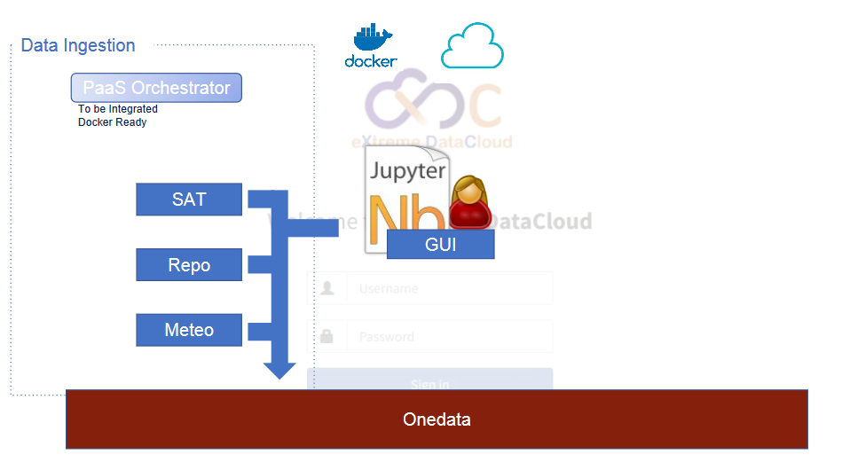
LifeWatch Use Case in XDC

Slide 31
LifeWatch Use Case in XDC

Slide 32
XDC Main Releases
A second major release is foreseen before the end of the project
XDC Message bus implementation
full orchestration
finalize integration of RUCIO
secure storage in Onedata
finalize the ECRIN Use Case
complete caching reference workflows with HTTP based systems
Jan 2018
May 2019
Sep 2019
Nov 2019
Oct 2019
Apr 2020
Jul 2020
Sep 2020
XDC products can be downloaded from XDC repositories or from each components upstream repositories after they have been pushed back

Slide 33
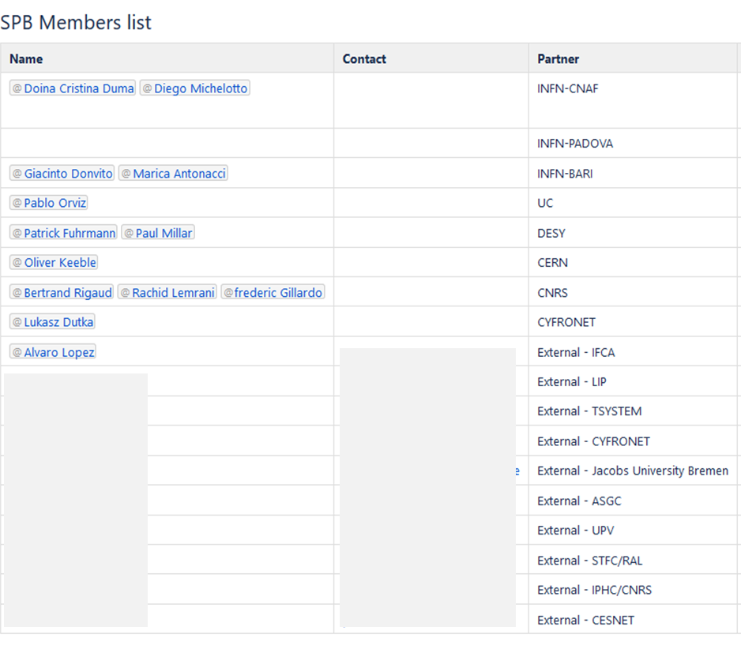
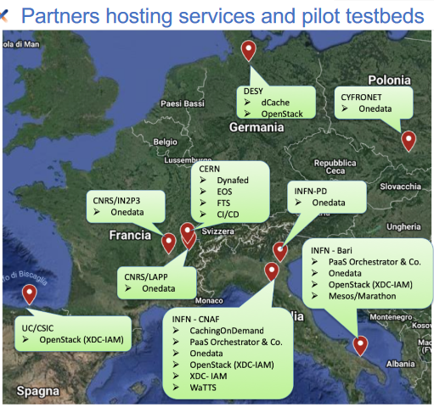
Service Provider Board
Service Provider Board
Composed of Service Providers part of the XDC consortium
Invited Service Providers
Ensure that project services will be deployable smoothly to existing production e-Infrastructures
Facilitate EOSC-HUB adoption
XDC Pilot Testbed
ToR available at: https://nextcloud.extreme-datacloud.eu/f/2252

Slide 34
Conclusion
XDC is adding new functionalities to already existing, production quality, data management services
XDC-1/Pulsar was released in January 2019
A step towards the complete implementation of the defined architecture
Research communities can already start implementing their use cases using Pulsar
A second release is foreseen by next October
Scalability verification is in progress and will be one of the core activities in 2019
XDC consortium members will act as service providers to facilitate the uptake of the XDC services by the EOSC communities
We are involving external service providers to increase the uptake of new user communities

Slide 35
XDC Contacts
Website: www.extreme-datacloud.eu
@XtremeDataCloud on Twitter
Mailing list: info<at>extreme-datacloud.eu

