Slide 1
A Blueprint of
Log Based Monitoring and Diagnosing Framework in Large Distributed Environments
Yining ZHAO
Computer Network Information Center,
Chinese Academy of Sciences
ISGC2019
Taipei, Apr 3rd 2019

Slide 2
Contents
Large Distributed Environments
Common Steps of Log Processing
CNGrid Practices
Conclusion

Slide 3
Large Distributed Environments

Slide 4
Large Distributed Environments
Distributed Systems are kept expanding
Heterogeneous devices and clusters
Many spots where potential anomalies may happen
  hardware
  software
  privileges
  user operation
  network
  ......

Slide 5
Security in Distributed Environments
Firewalls and network security policies
User authentication and authorization
Data access control
Secure data transfer protocol
Proper running of programs and applications
Leak discovering and patching
Trouble locating and shooting
General status monitoring and warning
Log processing and analyzing
......

Slide 6
Common Steps of Log Processing

Slide 7
Log Data Processing in Distributed Systems
Aims
  checking running status
  discovering anomalies
  handling problems
Common major steps
  log selection
  log classification
  analysis methods
  result feedback
Data Selection
Log Classification
Log Classification
Log Analysis
Log Analysis
...
Log Analysis
Result
Result
Result
Result Feedback

Slide 8

Major Steps 1: Log Selection
Need to choose which logs to be analyzed
  too many different logs in large environments
  only part of logs are useful for analyses
Largely depend on human experiences
  to consider the aim of log analyses
  the necessity of logs and difficulty of analyses
Network Logs
OS Logs
Software Logs
Data Access Records
Hardware Status
User Action Records
Interface Logs

Slide 9
Major Steps 2: Log Classification
To define log types and classification method
  classified log types are essential for log analyses
Classifying by: variables or non-variables
  variables: classifying logs by time, usernames, IPs, thread IDs, etc.
    to sort event chains that happened to variables
    logs containing only variables have to choose this approach
  non-variables: classifying logs by meanings
    to understand what happened and the frequencies
    fit for logs written in natural languages, especially logs that have no explicit variables
  may take a mixed approach when necessary

Slide 10

Major Steps 3: Analysis Methods
Aim: to discover hidden information from logs
  anomalies or frequent patterns
Methods: Data Mining, Machine Learning, etc.
  supervised vs. unsupervised
Design and implement on your needs
  shows your own capabilities

Slide 11
Major Steps 4: Result Feedback
Aim:
  result representing and applying to the environment
    results produced by machines are not easily understood by humans
    need to be manually converted to be applied
Methods:
  visualization to display
  solve problems in the environment according to analyzed results
  provide pertinent services to different users

Slide 12
CNGrid Practices

Slide 13
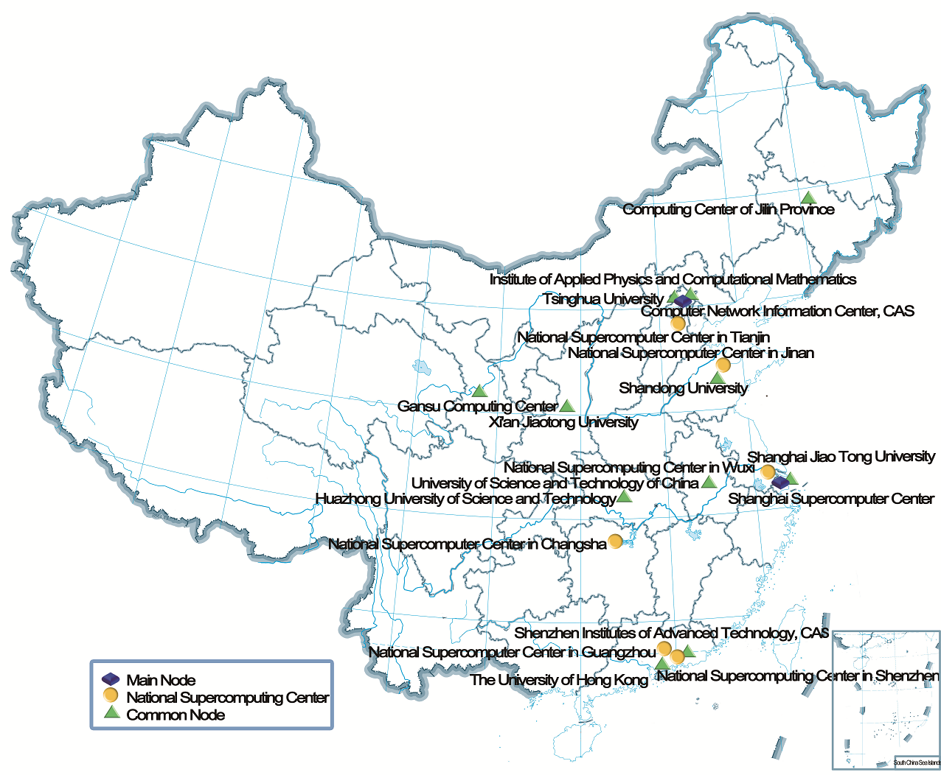
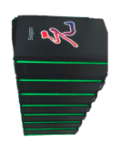
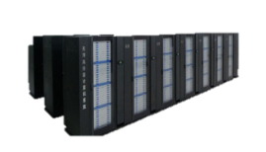
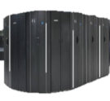
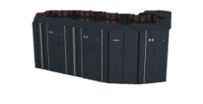
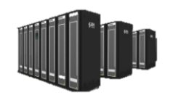

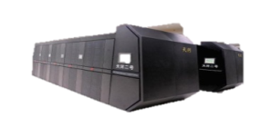
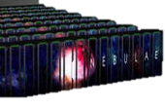
CNGrid
Scientific HPC Environment
19 nodes
260PF + 203PB
2 Operation Centers
Beijing / Hefei

Slide 14



CNGrid
SCE: core middleware in CNGrid
  developed by CNIC
  task scheduler and service provider
Command Line Users
Webpage Users
Community Developers
Client
Portal
SCEAPI
SCE
Scheduler
Message Bus
Data Processor

Slide 15
Log Selection and Classification
Logs | Classification Approach | Analysis orientations
syslog | Non-variable | Abnormal log flow detecting Invasion detecting Anomaly predicting
user ops | Variable | User behavior featuring
cluster status | Variable | General monitoring Performance analysis
application logs & interface logs | Mixed | Workflow modeling

Slide 16
Log Processing and Analyzing Framework in CNGrid
Log Classification Algorithms
Abnormal Log Flow Detection Method
Log Association Analyzing Method
User Behavior Featuring Method
Log Flow Monitoring System
Anomaly and Failure Predicting System
User Behavior Anomaly Detection
Monitoring Data
…
Environment Diagnosing Method
Environment Diagnosis Report

Slide 17
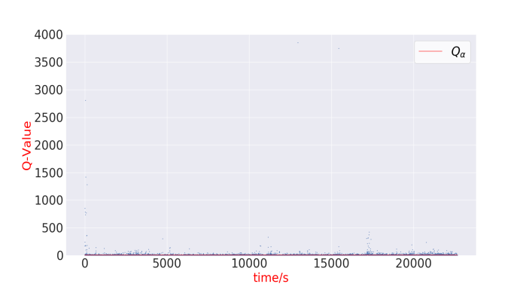
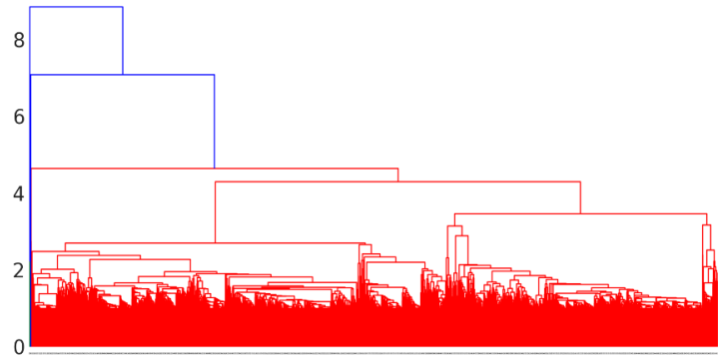
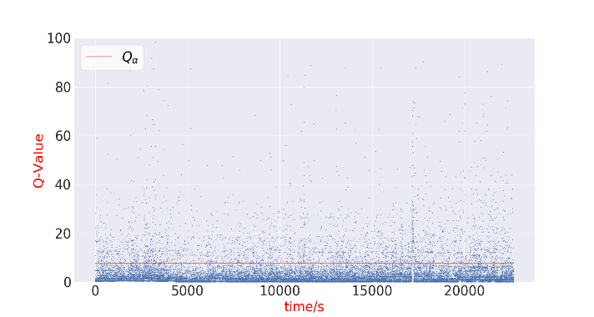
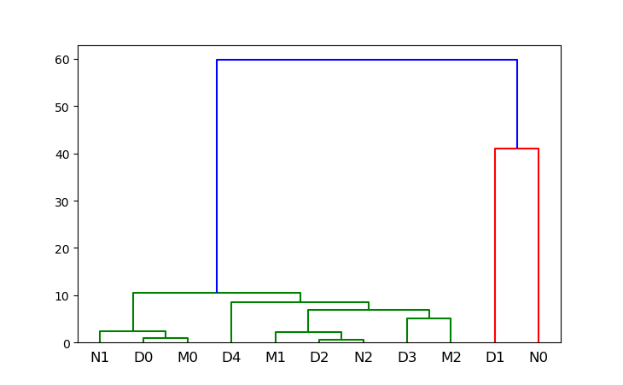
Abnormal Log Flow Detection
Aims: To detect anomalies from log flow in real-time
  sudden and great increase/decrease for certain log types
Method used: PCA and Clustering Algorithms
Issues to be considered
  different flow features in different time period (daytime, evening, night)

Slide 18
Abnormal Log Flow Detection
Real-time abnormal log flow detecting system

Slide 19
Log Association and Anomaly Prediction
Aims: predicting potential anomalies according to preceding events
Methods used: association algorithms and LSTM
  analyzing associations among log types
  defining abnormal log types, making prediction and early warning

Slide 20
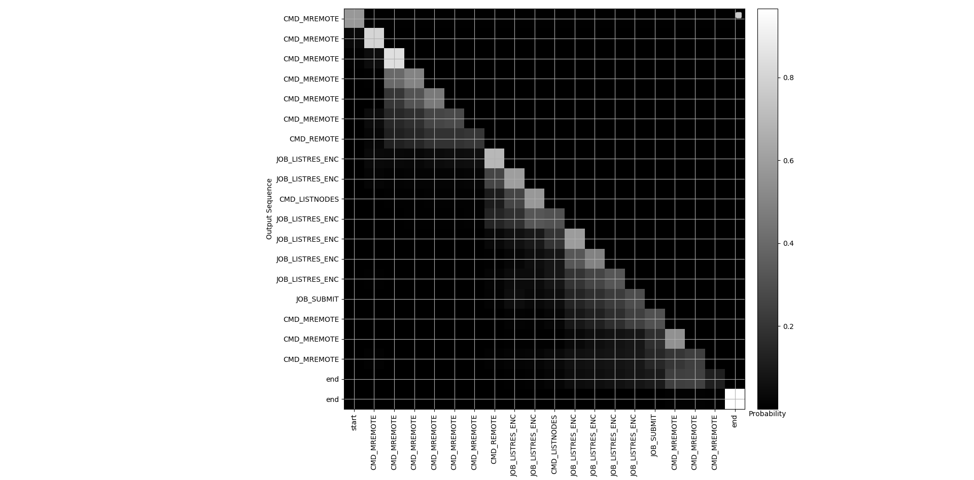
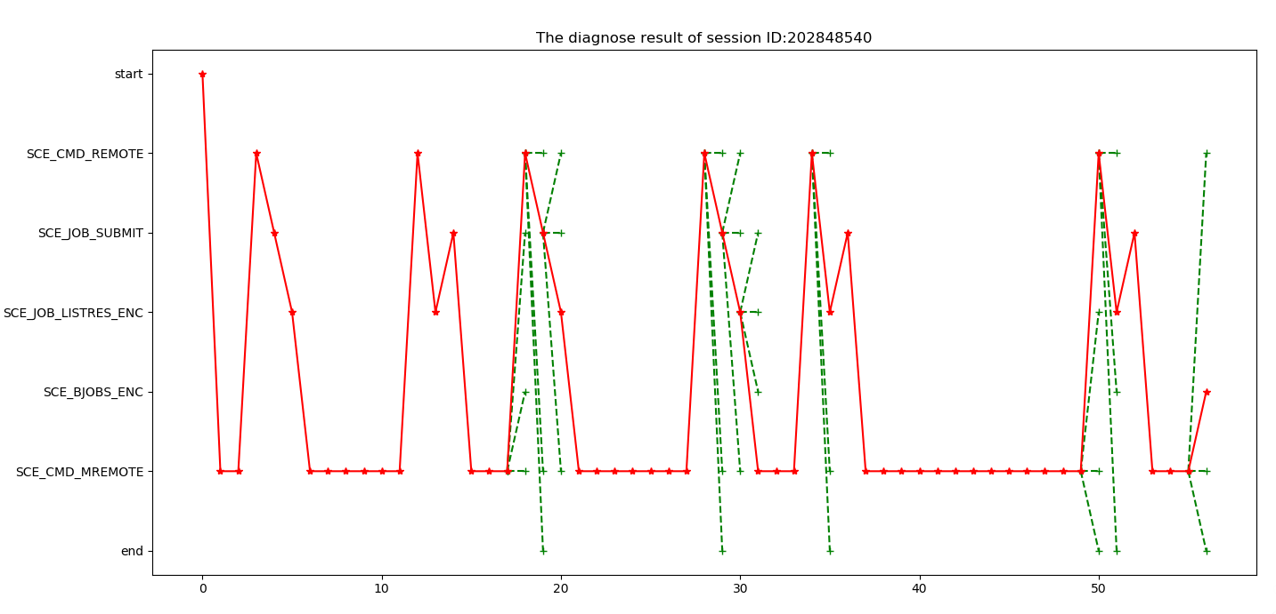
User Behavior Featuring
Aims: mining features and regular patterns of user behaviors, predicting user operations and distinguishing malicious users
Methods used: LSTM + Attention mechanism
  obtaining user sessions from log records as the input of LSTM
  involving Attention mechanism to weight the effect of previous user operations
  using the built models to predict and distinguish user behaviors

Slide 21
Environment Diagnosis
Aims: integrating results from analyses and generating general environment diagnosis
Methods used: quantization and visualization
  Quantization interface
    producing a value and weight
    for each analysis result
    integrating an overall value to
    represent health level
    for the environment
  Visualization displaying
    using colors and shapes to better
    display analyses results
    combine together to produce
    the environment diagnosis report

Slide 22
Conclusion

Slide 23
Conclusion
Log Processing: everybody has his own way...
Common major steps
  log selection
  log classification
  analysis methods
  result feedback
Log Processing and Analyzing Framework in CNGrid
  various analyses
  general environment diagnosis
  under construction and more analyses to be added

Slide 24
Thank you!

