Slide 1
An Introduction to Using HTCondor
ISGC 2019 Taipei, Taiwan
Todd Tannenbaum
Center for High Throughput Computing
University of Wisconsin-Madison

Slide 2
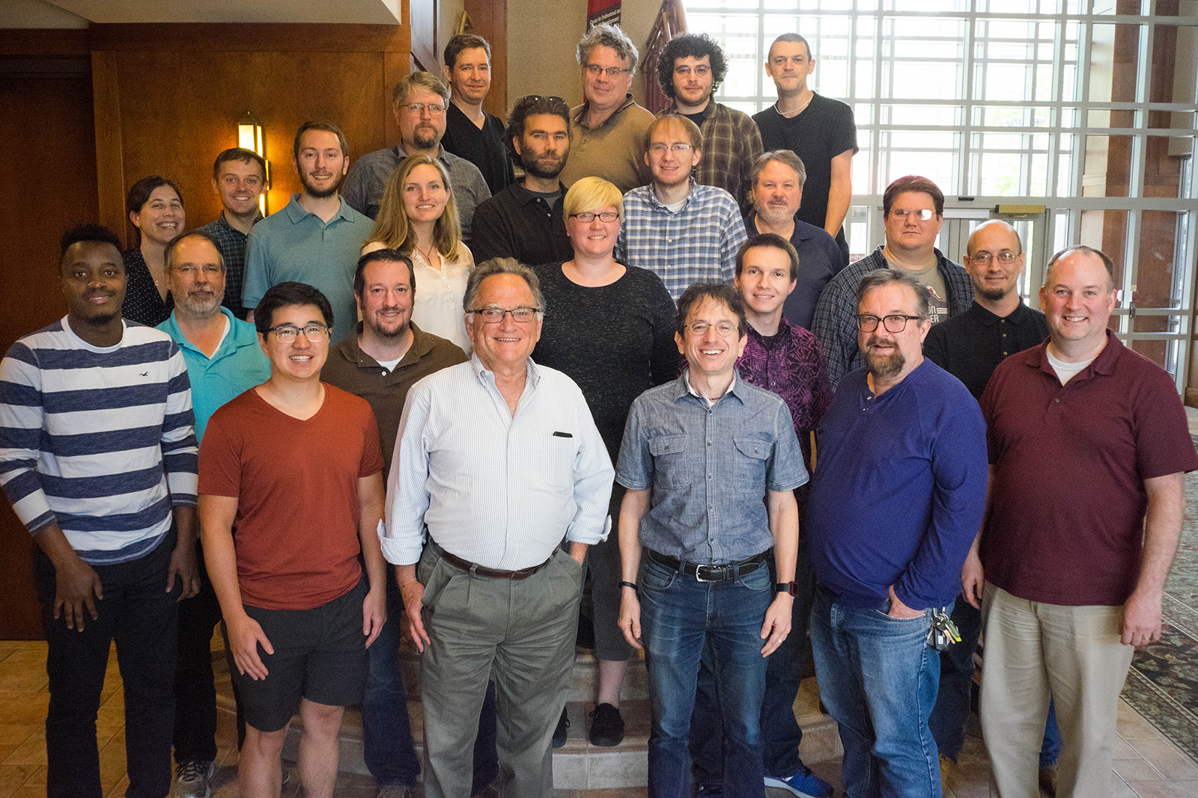
University of Wisconsin-Madison Center for High Throughput Computing

Slide 3
Introduction

Slide 4
What is HTCondor?
Software that schedules and runs computing tasks on computers
HTCONDOR

Slide 5
How It Works
Submit tasks to a queue (on a submit point)
HTCondor schedules them to run on computers (execute points)
execute
submit
execute
execute

Slide 6
Single Computer
execute
execute
submit
execute

Slide 7
Multiple Computers
execute
submit
execute
execute

Slide 8
Why HTCondor?
HTCondor manages and runs work on your behalf
Schedule tasks on a single computer to not overwhelm the computer
Schedule tasks on a group* of computers (which may/may not be directly accessible to the user)
Schedule tasks submitted by multiple users on one or more computers
*in HTCondor-speak, a “pool”

Slide 9
Why HTCondor, cont
Open source software to enable distributed High Throughput Computing (HTC)
Full featured, mature production system (1M+ LOC)
Widely deployed
Used in production at hundreds of universities, government labs, commercial companies to manage compute clusters in science, engineering, finance, …
Components used to federate compute clusters into campus grids and wide-area computing grids, e.g. Open Science Grid, WLCG, …

Slide 10
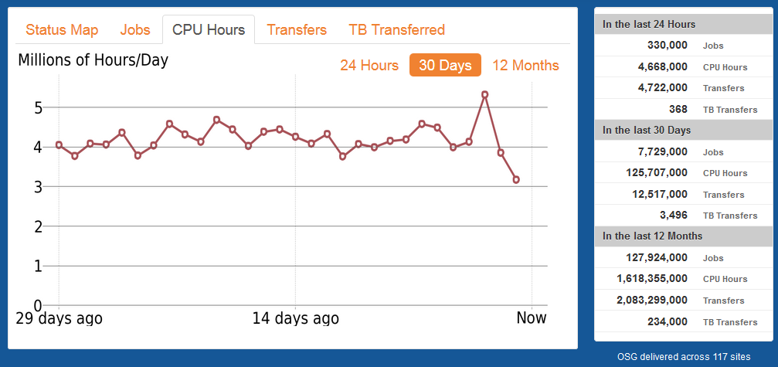
Open Science Grid
https://gracc.opensciencegrid.org/
http://display.opensciencegrid.org

Slide 11
CMS Global Pool
Dynamic cluster, ~200k - 250k cores pulled in from sites worldwide

Slide 12
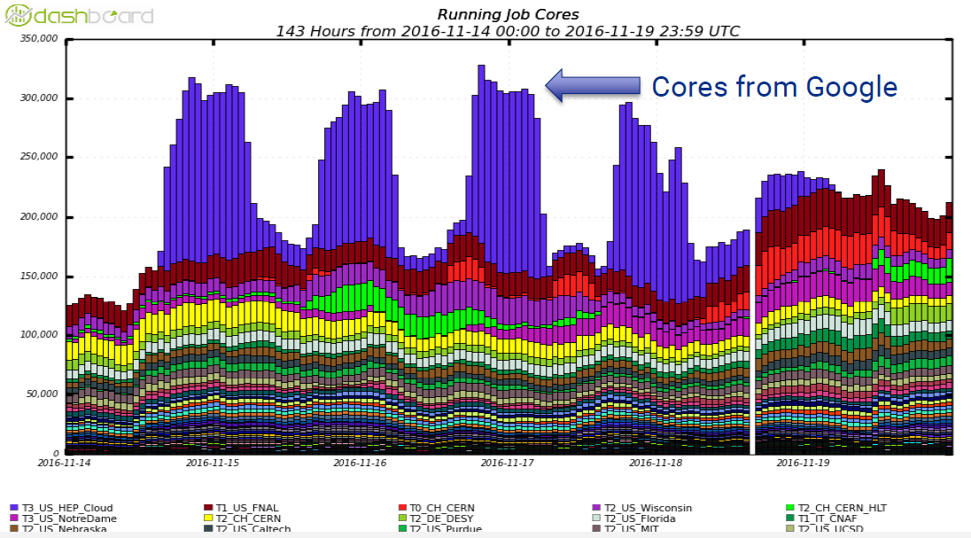
Bursting into Google Cloud @ SC16

Slide 13
User-Focused Tutorial
For the purposes of this tutorial, we are assuming that someone else has set up HTCondor on a computer/computers to create a HTCondor “pool”.
The focus of this talk is an introduction on how to get started running computational work on this system.

Slide 14
Running a Job with HTCondor

Slide 15
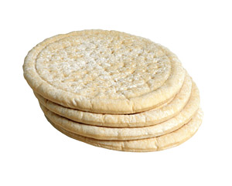
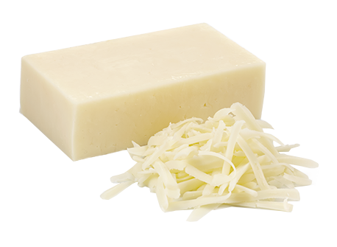
Jobs
A single computing task is called a “job”
Three main pieces of a job are the input, executable (program) and output
Executable must be runnable from the command line without any interactive input

Slide 16
Job Example
For our example, we will be using an imaginary program called “compare_states”, which compares two data files and produces a single output file.
wi.dat
compare_
states
wi.dat.out
us.dat
$ compare_states wi.dat us.dat wi.dat.out

Slide 17
File Transfer
What about files? Can use a shared file system, chirp, or file transfer mechanism.
Our example will use HTCondor’s file transfer :
Submit
Execute
(submit_dir)/
input files
executable
(execute_dir)/
output files

Slide 18
Job Translation
Submit file: communicates everything about your job(s) to HTCondor
executable = compare_states
arguments = wi.dat us.dat wi.dat.out
should_transfer_files = YES
transfer_input_files = us.dat, wi.dat
when_to_transfer_output = ON_EXIT
log = job.log
output = job.out
error = job.err
request_cpus = 1
request_disk = 20MB
request_memory = 20MB
queue 1

Slide 19
Submit File
job.submit
executable = compare_states
arguments = wi.dat us.dat wi.dat.out
should_transfer_files = YES
transfer_input_files = us.dat, wi.dat
when_to_transfer_output = ON_EXIT
log = job.log
output = job.out
error = job.err
request_cpus = 1
request_disk = 20MB
request_memory = 20MB
queue 1

Slide 20
Submit File
job.submit
List your executable and any arguments it takes.
Arguments are any options passed to the executable from the command line.
executable = compare_states
arguments = wi.dat us.dat wi.dat.out
should_transfer_files = YES
transfer_input_files = us.dat, wi.dat
when_to_transfer_output = ON_EXIT
log = job.log
output = job.out
error = job.err
request_cpus = 1
request_disk = 20MB
request_memory = 20MB
queue 1
compare_
states
$ compare_states wi.dat us.dat wi.dat.out

Slide 21
Submit File
job.submit
Indicate your input files.
executable = compare_states
arguments = wi.dat us.dat wi.dat.out
should_transfer_files = YES
transfer_input_files = us.dat, wi.dat
when_to_transfer_output = ON_EXIT
log = job.log
output = job.out
error = job.err
request_cpus = 1
request_disk = 20MB
request_memory = 20MB
queue 1
wi.dat
us.dat

Slide 22
Submit File
job.submit
HTCondor will transfer back all new and changed files (usually output) from the job.
executable = compare_states
arguments = wi.dat us.dat wi.dat.out
should_transfer_files = YES
transfer_input_files = us.dat, wi.dat
when_to_transfer_output = ON_EXIT
log = job.log
output = job.out
error = job.err
request_cpus = 1
request_disk = 20MB
request_memory = 20MB
queue 1
wi.dat.out

Slide 23
Submit File
job.submit
log: file created by HTCondor to track job progress
output/error: captures stdout and stderr
executable = compare_states
arguments = wi.dat us.dat wi.dat.out
should_transfer_files = YES
transfer_input_files = us.dat, wi.dat
when_to_transfer_output = ON_EXIT
log = job.log
output = job.out
error = job.err
request_cpus = 1
request_disk = 20MB
request_memory = 20MB
queue 1

Slide 24
Submit File
job.submit
Request the appropriate resources for your job to run.
queue: keyword indicating “create a job.”
executable = compare_states
arguments = wi.dat us.dat wi.dat.out
should_transfer_files = YES
transfer_input_files = us.dat, wi.dat
when_to_transfer_output = ON_EXIT
log = job.log
output = job.out
error = job.err
request_cpus = 1
request_disk = 20MB
request_memory = 20MB
queue 1

Slide 25
Submitting and Monitoring
To submit a job/jobs:
condor_submit submit_file_name
To monitor submitted jobs, use:
condor_q
$ condor_submit job.submit
Submitting job(s).
1 job(s) submitted to cluster 128.
$ condor_q
-- Schedd: submit-5.chtc.wisc.edu : <128.104.101.92:9618?... @ 05/01/17 10:35:54
OWNER BATCH_NAME SUBMITTED DONE RUN IDLE TOTAL JOB_IDS
alice CMD: compare_states 5/9 11:05 _ _ 1 1 128.0
1 jobs; 0 completed, 0 removed, 1 idle, 0 running, 0 held, 0 suspended
HTCondor Manual: condor_submit
HTCondor Manual: condor_q

Slide 26
More about condor_q
By default condor_q shows:
user’s job only (as of 8.6)
jobs summarized in “batches” (as of 8.6)
Constrain with username, ClusterId or full JobId, which will be denoted [U/C/J] in the following slides
$ condor_q
-- Schedd: submit-5.chtc.wisc.edu : <128.104.101.92:9618?... @ 05/01/17 10:35:54
OWNER BATCH_NAME SUBMITTED DONE RUN IDLE TOTAL JOB_IDS
alice CMD: compare_states 5/9 11:05 _ _ 1 1 128.0
1 jobs; 0 completed, 0 removed, 1 idle, 0 running, 0 held, 0 suspended
JobId = ClusterId .ProcId

Slide 27
More about condor_q
To see individual job information, use:
condor_q -nobatch
We will use the -nobatch option in the following slides to see extra detail about what is happening with a job
$ condor_q -nobatch
-- Schedd: submit-5.chtc.wisc.edu : <128.104.101.92:9618?...
ID OWNER SUBMITTED RUN_TIME ST PRI SIZE CMD
128.0 alice 5/9 11:09 0+00:00:00 I 0 0.0 compare_states wi.dat us.dat
1 jobs; 0 completed, 0 removed, 1 idle, 0 running, 0 held, 0 suspended

Slide 28
Job Idle
$ condor_q - nobatch
-- Schedd: submit-5.chtc.wisc.edu : <128.104.101.92:9618?...
ID OWNER SUBMITTED RUN_TIME ST PRI SIZE CMD
128.0 alice 5/9 11:09 0+00:00:00 I 0 0.0 compare_states wi.dat us.dat
1 jobs; 0 completed, 0 removed, 1 idle, 0 running, 0 held, 0 suspended
Submit Node
(submit_dir)/
job.submit
compare_states
wi.dat
us.dat
job.log
job.out
job.err

Slide 29
Job Starts by doing File Transfer
$ condor_q -nobatch
-- Schedd: submit-5.chtc.wisc.edu : <128.104.101.92:9618?...
ID OWNER SUBMITTED RUN_TIME ST PRI SIZE CMD
128.0 alice 5/9 11:09 0+00:00:00 < 0 0.0 compare_states wi.dat us.dat w
1 jobs; 0 completed, 0 removed, 0 idle, 1 running, 0 held, 0 suspended
Submit Node
Execute Node
(submit_dir)/
job.submit
compare_states
wi.dat
us.dat
job.log
job.out
job.err
(execute_dir)/
compare_states
wi.dat
us.dat

Slide 30
Job Running
$ condor_q -nobatch
-- Schedd: submit-5.chtc.wisc.edu : <128.104.101.92:9618?...
ID OWNER SUBMITTED RUN_TIME ST PRI SIZE CMD
128.0 alice 5/9 11:09 0+00:01:08 R 0 0.0 compare_states wi.dat us.dat
1 jobs; 0 completed, 0 removed, 0 idle, 1 running, 0 held, 0 suspended
Submit Node
Execute Node
(submit_dir)/
job.submit
compare_states
wi.dat
us.dat
job.log
job.out
job.err
(execute_dir)/
compare_states
wi.dat
us.dat
stderr
stdout
wi.dat.out

Slide 31
Job Completes
$ condor_q -nobatch
-- Schedd: submit-5.chtc.wisc.edu : <128.104.101.92:9618?...
ID OWNER SUBMITTED RUN_TIME ST PRI SIZE CMD
128 alice 5/9 11:09 0+00:02:02 > 0 0.0 compare_states wi.dat us.dat
1 jobs; 0 completed, 0 removed, 0 idle, 1 running, 0 held, 0 suspended
Submit Node
Execute Node
(submit_dir)/
job.submit
compare_states
wi.dat
us.dat
job.log
job.out
job.err
(execute_dir)/
compare_states
wi.dat
us.dat
stderr
stdout
wi.dat.out
stderr
stdout
wi.dat.out

Slide 32
Job Completes (cont.)
$ condor_q -nobatch
-- Schedd: submit-5.chtc.wisc.edu : <128.104.101.92:9618?...
ID OWNER SUBMITTED RUN_TIME ST PRI SIZE CMD
0 jobs; 0 completed, 0 removed, 0 idle, 0 running, 0 held, 0 suspended
Submit Node
(submit_dir)/
job.submit
compare_states
wi.dat
us.dat
job.log
job.out
job.err
wi.dat.out

Slide 33
Log File
000 (128.000.000) 05/09 11:09:08 Job submitted from host: <128.104.101.92&sock=6423_b881_3>
...
001 (128.000.000) 05/09 11:10:46 Job executing on host: <128.104.101.128:9618&sock=5053_3126_3>
...
006 (128.000.000) 05/09 11:10:54 Image size of job updated: 220
1 - MemoryUsage of job (MB)
220 - ResidentSetSize of job (KB)
...
005 (128.000.000) 05/09 11:12:48 Job terminated.
(1) Normal termination (return value 0)
Usr 0 00:00:00, Sys 0 00:00:00 - Run Remote Usage
Usr 0 00:00:00, Sys 0 00:00:00 - Run Local Usage
Usr 0 00:00:00, Sys 0 00:00:00 - Total Remote Usage
Usr 0 00:00:00, Sys 0 00:00:00 - Total Local Usage
0 - Run Bytes Sent By Job
33 - Run Bytes Received By Job
0 - Total Bytes Sent By Job
33 - Total Bytes Received By Job
Partitionable Resources : Usage Request Allocated
Cpus : 1 1
Disk (KB) : 14 20480 17203728
Memory (MB) : 1 20 20

Slide 34
Job States
transfer
executable
and input to
execute
node
transfer
output
back to
submit node
Idle
(I)
Running (R)
Completed
(C)
condor_
submit
in the queue
leaving the queue

Slide 35
Assumptions
Aspects of your submit file may be dictated by infrastructure and configuration
For example: file transfer
previous example assumed files would need to be transferred between submit/execute
not the case with a shared file system
should_transfer_files = YES
should_transfer_files = NO
Notes:
Talk to your sys admin!

Slide 36
Shared file system
If a system has a shared file system, where file transfer is not enabled, the submit directory and execute directory are the same.
Submit
Execute
Submit
Execute
shared_dir/
input
executable
output

Slide 37
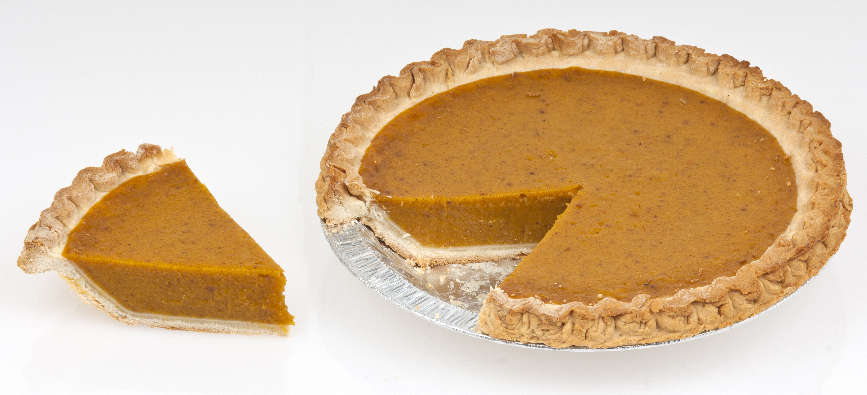
Resource Request
Jobs are nearly always using a part of a computer, not the whole thing
Very important to request appropriate resources (memory, cpus, disk) for a job
whole computer
your request

Slide 38
Resource Assumptions
Even if your system has default CPU, memory and disk requests, these may be too small!
Important to run test jobs and use the log file to request the right amount of resources:
requesting too little: causes problems for your and other jobs; jobs might by held by HTCondor
requesting too much: jobs will match to fewer “slots”

Slide 39
Job Matching and Class Ad Attributes

Slide 40
The Central Manager
HTCondor matches jobs with computers via a “central manager”.
execute
submit
central manager
execute
execute

Slide 41
Class Ads
HTCondor stores a list of information about each job and each computer.
This information is stored as a “Class Ad”
Class Ads have the format:
AttributeName = value
can be a boolean, number, string, expression
HTCondor Manual: Appendix A: Class Ad Attributes

Slide 42
Job Class Ad
RequestCpus = 1
Err = "job.err"
WhenToTransferOutput = "ON_EXIT"
TargetType = "Machine"
Cmd = "/home/alice/tests/compare_states"
JobUniverse = 5
Iwd = "/home/alice/tests/htcondor_week"
RequestDisk = 20480
NumJobStarts = 0
WantRemoteIO = true
OnExitRemove = true
TransferInput = "us.dat,wi.dat"
MyType = "Job"
Out = "job.out"
UserLog = "/home/alice/tests/job.log"
RequestMemory = 20
...
...
executable = compare_states
arguments = wi.dat us.dat wi.dat.out
should_transfer_files = YES
transfer_input_files = us.dat, wi.dat
when_to_transfer_output = ON_EXIT
log = job.log
output = job.out
error = job.err
request_cpus = 1
request_disk = 20MB
request_memory = 20MB
queue 1
=
+
HTCondor configuration*
*Configuring HTCondor will be covered by Greg Thain later today

Slide 43
Computer “Machine” Class Ad
HasFileTransfer = true
DynamicSlot = true
TotalSlotDisk = 4300218.0
TargetType = "Job"
TotalSlotMemory = 2048
Mips = 17902
Memory = 2048
UtsnameSysname = "Linux"
MAX_PREEMPT = ( 3600 * 72 )
Requirements = ( START ) && ( IsValidCheckpointPlatform ) && ( WithinResourceLimits )
OpSysMajorVer = 6
TotalMemory = 9889
HasGluster = true
OpSysName = "SL"
HasDocker = true
...
=
+
HTCondor configuration

Slide 44
Job Matching
On a regular basis, the central manager reviews Job and Machine Class Ads and matches jobs to computers.
execute
submit
central manager
execute
execute

Slide 45
Job Execution
(Then the submit and execute points communicate directly.)
execute
submit
central manager
execute
execute

Slide 46
Class Ads for People
Class Ads also provide lots of useful information about jobs and computers to HTCondor users and administrators

Slide 47
Finding Job Attributes
Use the “long” option for condor_q condor_q -l JobId
$ condor_q -l 128.0
WhenToTransferOutput = "ON_EXIT"
TargetType = "Machine"
Cmd = "/home/alice/tests/htcondor_week/compare_states"
JobUniverse = 5
Iwd = "/home/alice/tests/htcondor_week"
RequestDisk = 20480
NumJobStarts = 0
WantRemoteIO = true
OnExitRemove = true
TransferInput = "us.dat,wi.dat"
MyType = "Job”
UserLog = "/home/alice/tests/htcondor_week/job.log"
RequestMemory = 20
...

Slide 48
Some Useful Job Attributes
UserLog: location of job log
Iwd: Initial Working Directory (i.e. submission directory) on submit node
MemoryUsage: maximum memory the job has used
RemoteHost: where the job is running
BatchName: attribute to label job batches
...and more

Slide 49
Selectively display specific attributes
Use the “auto-format” option:
condor_q [U/C/J] -af Attribute1 Attribute2 ...
$ condor_q -af ClusterId ProcId RemoteHost MemoryUsage
17315225 116 slot1_1@e092.chtc.wisc.edu 1709
17315225 118 slot1_2@e093.chtc.wisc.edu 1709
17315225 137 slot1_8@e125.chtc.wisc.edu 1709
17315225 139 slot1_7@e121.chtc.wisc.edu 1709
18050961 0 slot1_5@c025.chtc.wisc.edu 196
18050963 0 slot1_3@atlas10.chtc.wisc.edu 269
18050964 0 slot1_25@e348.chtc.wisc.edu 245
18050965 0 slot1_23@e305.chtc.wisc.edu 196
18050971 0 slot1_6@e176.chtc.wisc.edu 220

Slide 50
Other Displays
See the whole queue (all users, all jobs)
condor_q -all
$ condor_q -all
-- Schedd: submit-5.chtc.wisc.edu : <128.104.101.92:9618?...
OWNER BATCH_NAME SUBMITTED DONE RUN IDLE HOLD TOTAL JOB_IDS
alice DAG: 128 5/9 02:52 982 2 _ _ 1000 18888976.0 ...
bob DAG: 139 5/9 09:21 _ 1 89 _ 180 18910071.0 ...
alice DAG: 219 5/9 10:31 1 997 2 _ 1000 18911030.0 ...
bob DAG: 226 5/9 10:51 10 _ 1 _ 44 18913051.0
bob CMD: ce.sh 5/9 10:55 _ _ _ 2 _ 18913029.0 ...
alice CMD: sb 5/9 10:57 _ 2 998 _ _ 18913030.0-999

Slide 51
condor_q Reminder
Default output is batched jobs
Batches can be grouped manually using the JobBatchName attribute in a submit file:
Otherwise HTCondor groups jobs automatically
To see individual jobs, use:
condor_q -nobatch
+JobBatchName = “CoolJobs”

Slide 52
Class Ads for Computers
as condor_q is to jobs, condor_status is to computers (or “machines”)
$ condor_status
Name OpSys Arch State Activity LoadAv Mem Actvty
slot1@c001.chtc.wisc.edu LINUX X86_64 Unclaimed Idle 0.000 673 25+01
slot1_1@c001.chtc.wisc.edu LINUX X86_64 Claimed Busy 1.000 2048 0+01
slot1_2@c001.chtc.wisc.edu LINUX X86_64 Claimed Busy 1.000 2048 0+01
slot1_3@c001.chtc.wisc.edu LINUX X86_64 Claimed Busy 1.000 2048 0+00
slot1_4@c001.chtc.wisc.edu LINUX X86_64 Claimed Busy 1.000 2048 0+14
slot1_5@c001.chtc.wisc.edu LINUX X86_64 Claimed Busy 1.000 1024 0+01
slot1@c002.chtc.wisc.edu LINUX X86_64 Unclaimed Idle 1.000 2693 19+19
slot1_1@c002.chtc.wisc.edu LINUX X86_64 Claimed Busy 1.000 2048 0+04
slot1_2@c002.chtc.wisc.edu LINUX X86_64 Claimed Busy 1.000 2048 0+01
slot1_3@c002.chtc.wisc.edu LINUX X86_64 Claimed Busy 0.990 2048 0+02
slot1@c004.chtc.wisc.edu LINUX X86_64 Unclaimed Idle 0.010 645 25+05
slot1_1@c004.chtc.wisc.edu LINUX X86_64 Claimed Busy 1.000 2048 0+01
Total Owner Claimed Unclaimed Matched Preempting Backfill Drain
X86_64/LINUX 10962 0 10340 613 0 0 0 9
X86_64/WINDOWS 2 2 0 0 0 0 0 0
Total 10964 2 10340 613 0 0 0 9
HTCondor Manual: condor_status

Slide 53
Machine Attributes
Use same options as condor_q:
condor_status -l Slot/Machine
condor_status [Machine] -af Attribute1 Attribute2 ...
$ condor_status -l slot1_1@c001.chtc.wisc.edu
HasFileTransfer = true
COLLECTOR_HOST_STRING = "cm.chtc.wisc.edu”
TargetType = "Job”
TotalTimeClaimedBusy = 43334c001.chtc.wisc.edu
UtsnameNodename = ""
Mips = 17902
MAX_PREEMPT = ( 3600 * ( 72 - 68 * ( WantGlidein =?= true ) ) )
Requirements = ( START ) && ( IsValidCheckpointPlatform ) && ( WithinResourceLimits )
State = "Claimed"
OpSysMajorVer = 6
OpSysName = "SL”
...

Slide 54
Machine Attributes
To summarize, use the “-compact” option
condor_status -compact
$ condor_q -compact
Machine Platform Slots Cpus Gpus TotalGb FreCpu FreeGb CpuLoad ST
e007.chtc.wisc.edu x64/SL6 8 8 23.46 0 0.00 1.24 Cb
e008.chtc.wisc.edu x64/SL6 8 8 23.46 0 0.46 0.97 Cb
e009.chtc.wisc.edu x64/SL6 11 16 23.46 5 0.00 0.81 **
e010.chtc.wisc.edu x64/SL6 8 8 23.46 0 4.46 0.76 Cb
matlab-build-1.chtc.wisc.edu x64/SL6 1 12 23.45 11 13.45 0.00 **
matlab-build-5.chtc.wisc.edu x64/SL6 0 24 23.45 24 23.45 0.04 Ui
mem1.chtc.wisc.edu x64/SL6 24 80 1009.67 8 0.17 0.60 **
Total Owner Claimed Unclaimed Matched Preempting Backfill Drain
x64/SL6 10416 0 9984 427 0 0 0 5
x64/WinVista 2 2 0 0 0 0 0 0
Total 10418 2 9984 427 0 0 0 5

Slide 55
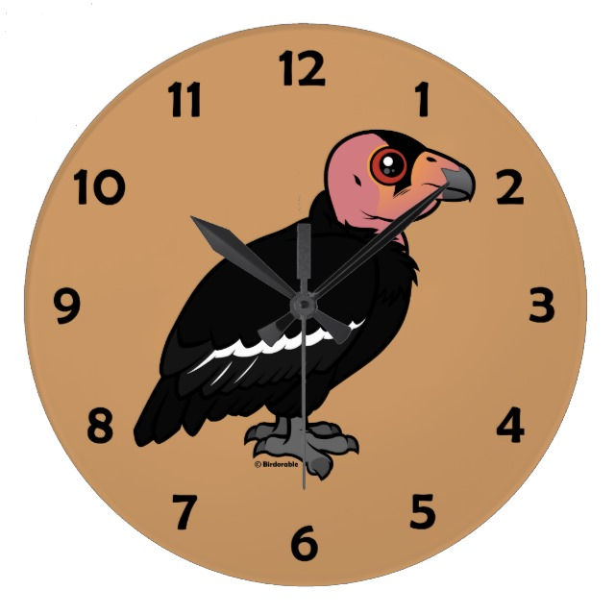
(60 second) Pause
Questions so far?

Slide 56
Submitting Multiple Jobs with HTCondor

Slide 57
Many Jobs, One Submit File
HTCondor has built-in ways to submit multiple independent jobs with one submit file

Slide 58
Advantages
Run many independent jobs...
analyze multiple data files
test parameter or input combinations
and more!
...without having to:
start each job individually
create separate submit files for each job

Slide 59
Multiple, Numbered, Input Files
job.submit
(submit_dir)/
executable = analyze.exe
arguments = file.in file.out
transfer_input_files = file.in
log = job.log
output = job.out
error = job.err
queue
analyze.exe
file0.in
file1.in
file2.in
job.submit
Goal: create 3 jobs that each analyze a different input file.

Slide 60
Multiple Jobs, No Variation
job.submit
(submit_dir)/
executable = analyze.exe
arguments = file0.in file0.out
transfer_input_files = file.in
log = job.log
output = job.out
error = job.err
queue 3
analyze.exe
file0.in
file1.in
file2.in
job.submit
This file generates 3 jobs, but doesn’t use multiple inputs and will overwrite outputs

Slide 61
Automatic Variables
ClusterId
ProcId
Each job’s ClusterId and ProcId numbers are saved as job attributes
They can be accessed inside the submit file using:
$(ClusterId)
$(ProcId)
128
0
queue N
128
1
128
2
...
...
128
N-1

Slide 62
Job Variation
job.submit
(submit_dir)/
executable = analyze.exe
arguments = file0.in file0.out
transfer_input_files = file0.in
log = job.log
output = job.out
error = job.err
queue
analyze.exe
file0.in
file1.in
file2.in
job.submit
How to uniquely identify each job (filenames, log/out/err names)?

Slide 63
Using $(ProcId)
job.submit
executable = analyze.exe
arguments = file$(ProcId).in file$(ProcId).out
should_transfer_files = YES
transfer_input_files = file$(ProcId).in
when_to_transfer_output = ON_EXIT
log = job_$(ClusterId).log
output = job_$(ClusterId)_$(ProcId).out
error = job_$(ClusterId)_$(ProcId).err
queue 3
Use the $(ClusterId), $(ProcId) variables to provide unique values to jobs.*
* May also see $(Cluster), $(Process) in documentation

Slide 64
Organizing Jobs
12181445_0.err 16058473_0.err 17381628_0.err 18159900_0.err 5175744_0.err 7266263_0.err
12181445_0.log 16058473_0.log 17381628_0.log 18159900_0.log 5175744_0.log 7266263_0.log
12181445_0.out 16058473_0.out 17381628_0.out 18159900_0.out 5175744_0.out 7266263_0.out
13609567_0.err 16060330_0.err 17381640_0.err 3446080_0.err 5176204_0.err 7266267_0.err
13609567_0.log 16060330_0.log 17381640_0.log 3446080_0.log 5176204_0.log 7266267_0.log
13609567_0.out 16060330_0.out 17381640_0.out 3446080_0.out 5176204_0.out 7266267_0.out
13612268_0.err 16254074_0.err 17381665_0.err 3446306_0.err 5295132_0.err 7937420_0.err
13612268_0.log 16254074_0.log 17381665_0.log 3446306_0.log 5295132_0.log 7937420_0.log
13612268_0.out 16254074_0.out 17381665_0.out 3446306_0.out 5295132_0.out 7937420_0.out
13630381_0.err 17134215_0.err 17381676_0.err 4347054_0.err 5318339_0.err 8779997_0.err
13630381_0.log 17134215_0.log 17381676_0.log 4347054_0.log 5318339_0.log 8779997_0.log
13630381_0.out 17134215_0.out 17381676_0.out 4347054_0.out 5318339_0.out 8779997_0.out
Notes:
Will talk more on ways to submit lots of jobs, but first a relevant strategy on approaches to organize all these files.

Slide 65
Shared Files
HTCondor can transfer an entire directory or all the contents of a directory
transfer whole directory
transfer contents only
Useful for jobs with many shared files; transfer a directory of files instead of listing files individually
(submit_dir)/
job.submit
shared/
reference.db
parse.py
analyze.py
cleanup.py
links.config
transfer_input_files = shared
transfer_input_files = shared/
Notes:
Strategy one

Slide 66
Organize Files in Sub-Directories
Create sub-directories* and use paths in the submit file to separate input, error, log, and output files.
output
error
input
log
* must be created before the job is submitted
Notes:
Strategy two…

Slide 67
Use Paths for File Type
(submit_dir)/
file0.out
file1.out
file2.out
log/
job0.log
job1.log
job2.log
job.submit
analyze.exe
input/
file0.in
file1.in
file2.in
err/
job0.err
job1.err
job2.err
job.submit
executable = analyze.exe
arguments = file$(Process).in file$(ProcId).out
transfer_input_files = input/file$(ProcId).in
log = log/job$(ProcId).log
error = err/job$(ProcId).err
queue 3

Slide 68
InitialDir
Change the submission directory for each job using initialdir
Allows the user to organize job files into separate directories.
Use the same name for all input/output files
Useful for jobs with lots of output files
job0
job1
job2
job3
job4
Notes:
Alternatively, strategy three…

Slide 69
Separate Jobs with InitialDir
(submit_dir)/
job0/
file.in
job.log
job.err
file.out
job1/
file.in
job.log
job.err
file.out
job.submit
analyze.exe
job2/
file.in
job.log
job.err
file.out
job.submit
executable = analyze.exe
initialdir = job$(ProcId)
arguments = file.in file.out
transfer_input_files = file.in
log = job.log
error = job.err
queue 3
Executable should be in the directory with the submit file, *not* in the individual job directories

Slide 70
Other Submission Methods
What if your input files/directories aren’t numbered from 0 - (N-1)?
There are other ways to submit many jobs!

Slide 71
Submitting Multiple Jobs
Replacing single job inputs
with a variable of choice
executable = compare_states
arguments = wi.dat us.dat wi.dat.out
transfer_input_files = us.dat, wi.dat
queue 1
executable = compare_states
arguments = $(infile) us.dat $(infile).out
transfer_input_files = us.dat, $(infile)
queue ...
Notes:
First identify the values that need to vary across each run instance

Slide 72
Possible Queue Statements
multiple “queue” statements
matching ... pattern
in ... list
from ... file
infile = wi.dat
queue 1
infile = ca.dat
queue 1
infile = ia.dat
queue 1
queue infile matching *.dat
queue infile in (wi.dat ca.dat ia.dat)
queue infile from state_list.txt
wi.dat
ca.dat
ia.dat
state_list.txt

Slide 73
Possible Queue Statements
multiple “queue” statements
matching ... pattern
in ... list
from ... file
infile = wi.dat
queue 1
infile = ca.dat
queue 1
infile = ia.dat
queue 1
Not Recommended
queue infile matching *.dat
queue infile in (wi.dat ca.dat ia.dat)
queue infile from state_list.txt
wi.dat
ca.dat
ia.dat
state_list.txt

Slide 74
Queue Statement Comparison
multiple queue statements | Not recommended. Can be useful when submitting job batches where a single (non-file/argument) characteristic is changing
matching .. pattern | Natural nested looping, minimal programming, use optional “files” and “dirs” keywords to only match files or directories Requires good naming conventions,
in .. list | Supports multiple variables, all information contained in a single file, reproducible Harder to automate submit file creation
from .. file | Supports multiple variables, highly modular (easy to use one submit file for many job batches), reproducible Additional file needed

Slide 75
Using Multiple Variables
Both the “from” and “in” syntax support using multiple variables from a list.
job.submit
job_list.txt
executable = compare_states
arguments = -year $(option) -input $(file)
should_transfer_files = YES
when_to_transfer_output = ON_EXIT
transfer_input_files = $(file)
queue file,option from job_list.txt
wi.dat, 2010
wi.dat, 2015
ca.dat, 2010
ca.dat, 2015
ia.dat, 2010
ia.dat, 2015
HTCondor Manual: submit file options

Slide 76
Other Features
Match only files or directories:
Submit multiple jobs with same input data
Use other automatic variables: $(Step)
queue input matching files *.dat
queue directory matching dirs job*
queue 10 input matching files *.dat
arguments = -i $(input) -rep $(Step)
queue 10 input matching files *.dat

Slide 77
Testing and Troubleshooting
Notes:
Now we have submitted lots of jobs, and Murphy's Law says that things can go wrong.

Slide 78
What Can Go Wrong?
Jobs can go wrong “internally”:
something happens after the executable begins to run
Jobs can go wrong from HTCondor’s perspective:
A job can’t be started at all,
Uses too much memory,
Has a badly formatted executable,
And more...

Slide 79
Reviewing Failed Jobs
A job’s log, output and error files can provide valuable information for troubleshooting
Log | Output | Error
When jobs were submitted, started, and stopped Resources used Exit status Where job ran Interruption reasons | Any “print” or “display” information from your program | Captured by the operating system

Slide 80
Reviewing Jobs
To review a large group of jobs at once, use condor_history
As condor_q is to the present, condor_history is to the past
$ condor_history alice
ID OWNER SUBMITTED RUN_TIME ST COMPLETED CMD
189.1012 alice 5/11 09:52 0+00:07:37 C 5/11 16:00 /home/alice
189.1002 alice 5/11 09:52 0+00:08:03 C 5/11 16:00 /home/alice
189.1081 alice 5/11 09:52 0+00:03:16 C 5/11 16:00 /home/alice
189.944 alice 5/11 09:52 0+00:11:15 C 5/11 16:00 /home/alice
189.659 alice 5/11 09:52 0+00:26:56 C 5/11 16:00 /home/alice
189.653 alice 5/11 09:52 0+00:27:07 C 5/11 16:00 /home/alice
189.1040 alice 5/11 09:52 0+00:05:15 C 5/11 15:59 /home/alice
189.1003 alice 5/11 09:52 0+00:07:38 C 5/11 15:59 /home/alice
189.962 alice 5/11 09:52 0+00:09:36 C 5/11 15:59 /home/alice
189.961 alice 5/11 09:52 0+00:09:43 C 5/11 15:59 /home/alice
189.898 alice 5/11 09:52 0+00:13:47 C 5/11 15:59 /home/alice
HTCondor Manual: condor_history

Slide 81
“Live” Troubleshooting
To log in to a job where it is running, use:
condor_ssh_to_job JobId
$ condor_ssh_to_job 128.0
Welcome to slot1_31@e395.chtc.wisc.edu!
Your condor job is running with pid(s) 3954839.
HTCondor Manual: condor_ssh_to_job

Slide 82
Held Jobs
HTCondor will put your job on hold if there’s something YOU need to fix.
A job that goes on hold is interrupted (all
progress is lost) and kept from running
again, but remains
in the queue in the
“H” state.

Slide 83
Diagnosing Holds
If HTCondor puts a job on hold, it provides a hold reason, which can be viewed with:
condor_q -hold [ -wide]
$ condor_q -hold -af HoldReason
Error from slot1_1@wid-003.chtc.wisc.edu: Job has gone over
memory limit of 2048 megabytes.
Error from slot1_20@e098.chtc.wisc.edu: SHADOW at
128.104.101.92 failed to send file(s) to <128.104.101.98:35110>: error
reading from /home/alice/script.py: (errno 2) No such file or directory;
STARTER failed to receive file(s) from <128.104.101.92:9618>
Error from slot1_11@e138.chtc.wisc.edu: STARTER
at 128.104.101.138 failed to send file(s) to <128.104.101.92:9618>; SHADOW at
128.104.101.92 failed to write to file /home/alice/Test_18925319_16.err:
(errno 122) Disk quota exceeded
Error from slot1_38@e270.chtc.wisc.edu: Failed
to execute '/var/lib/condor/execute/slot1/dir_2471876/condor_exec.exe' with
arguments 2: (errno=2: 'No such file or directory')

Slide 84
Common Hold Reasons
Job has used more memory than requested
Incorrect path to files that need to be transferred
Badly formatted bash scripts (have Windows instead of Unix line endings)
Submit directory is over quota
The admin has put your job on hold

Slide 85
Fixing Holds
Job attributes can be edited while jobs are in the queue using:
condor_qedit [U/C/J] Attribute Value
If a job has been fixed and can run again, release it with:
condor_release [U/C/J]
$ condor_qedit 128.0 RequestMemory 3072
Set attribute ”RequestMemory".
$ condor_release 128.0
Job 18933774.0 released
HTCondor Manual: condor_qedit
HTCondor Manual: condor_release

Slide 86
Holding or Removing Jobs
If you know your job has a problem and it hasn’t yet completed, you can:
Place it on hold yourself, with condor_hold [U/C/J]
Remove it from the queue, using condor_rm [U/C/J]
$ condor_hold bob
All jobs of user ”bob" have been held
$ condor_hold 128
All jobs in cluster 128 have been held
$ condor_hold 128.0
Job 128.0 held
HTCondor Manual: condor_hold
HTCondor Manual: condor_rm

Slide 87
Job States, Revisited
Idle
(I)
Running (R)
Completed
(C)
condor_
submit
in the queue
leaving the queue
Notes:
So to recap this, lets revisit our diagram from before…

Slide 88
Job States, Revisited
Idle
(I)
Running (R)
Completed
(C)
condor_
submit
condor_hold, or HTCondor puts
a job on hold
condor_release
Held
(H)
in the queue
leaving the queue

Slide 89
Job States, Revisited*
Idle
(I)
Running (R)
Completed
(C)
condor_
submit
condor_hold, or job error
condor_release
Removed
(X)
condor_rm
Held
(H)
in the queue
leaving the queue
*not comprehensive

Slide 90
Use Cases and HTCondor Features

Slide 91
Interactive Jobs
An interactive job proceeds like a normal batch job, but opens a bash session into the job’s execution directory instead of running an executable.
condor_submit -i submit_file
Useful for testing and troubleshooting
$ condor_submit -i interactive.submit
Submitting job(s).
1 job(s) submitted to cluster 18980881.
Waiting for job to start...
Welcome to slot1_9@e184.chtc.wisc.edu!

Slide 92
Output Handling
Only transfer back specific files from the job’s execution using transfer_ouput_files
transfer_output_files = results-final.dat
(submit_dir)/
(execute_dir)/
condor_exec.exe
results-tmp-01.dat
results-tmp-02.dat
results-tmp-03.dat
results-tmp-04.dat
results-tmp-05.dat
results-final.dat

Slide 93
condor_chirp
What if you want to only read part of a file?
What if you want to write records into an output file?
Use condor_chirp !
http://htcondor.org/manual/current/condor_chirp.html
(can also edit job classad or add entries to
the job event log file)

Slide 94
Self-Checkpointing
By default, a job that is interrupted will start from the beginning if it is restarted.
It is possible to implement self-checkpointing, which will allow a job to restart from a saved state if interrupted.
Self-checkpointing is useful for very long jobs, and being able to run on opportunistic resources.

Slide 95
Self-Checkpointing How-To
Edit executable:
Atomically save intermediate states to a checkpoint file
Always check for a checkpoint file when starting
Add HTCondor option that a) saves all intermediate/output files from the interrupted job and b) transfers them to the job when HTCondor runs it again
when_to_transfer_output = ON_EXIT_OR_EVICT

Slide 96
Job Universes
HTCondor has different “universes” for running specialized job types
HTCondor Manual: Choosing an HTCondor Universe
Vanilla (default)
good for most software
HTCondor Manual: Vanilla Universe
Set in the submit
file using:
universe = vanilla

Slide 97
Other Universes
Standard
Built for code (C, fortran) that can be statically compiled with condor_compile
HTCondor Manual: Standard Universe
Java
Built-in Java support
HTCondor Manual: Java Applications
Local
Run jobs on the submit node
HTCondor Manual: Local Universe

Slide 98
Grid Universe
Reliable, durable submission of a job to a remote scheduler
Popular way to send pilot jobs (used by glideinWMS), key component of HTCondor-CE
Supports many “back end” types:
HTCondor
PBS
LSF
Grid Engine
Google Compute Engine
Amazon AWS
OpenStack
Cream
NorduGrid ARC
BOINC
Globus: GT2, GT5
UNICORE
Notes:
98

Slide 99
Other Universes (cont.)
Docker
Run jobs inside a Docker container
HTCondor Manual: Docker Universe Applications
VM
Run jobs inside a virtual machine
HTCondor Manual: Virtual Machine Applications
Parallel
Used for coordinating jobs across multiple servers (e.g. MPI code)
Not necessary for single server multi-core jobs
HTCondor Manual: Parallel Applications

Slide 100
Multi-CPU and GPU Computing
Jobs that use multiple cores on a single computer can be run in the vanilla universe (parallel universe not needed):
If there are computers with GPUs, request them with:
request_cpus = 16
request_gpus = 1

Slide 101
Docker Universe
universe = docker
executable = /bin/my_executable
Executable comes either from submit machine or image
NOT FROM execute machine

Slide 102
Docker Universe
universe = docker
executable = /bin/my_executable
docker_image =deb7_and_HEP_stack
Image is the name of the docker image stored on execute machine

Slide 103
Docker Universe
universe = docker
executable = /bin/my_executable
docker_image =deb7_and_HEP_stack
transfer_input_files = some_input
HTCondor can transfer input files from submit machine into container
(same with output in reverse)

Slide 104
Docker Universe
universe = docker
executable = /bin/my_executable
arguments = arg1
docker_image = deb7_and_HEP_stack
transfer_input_files = some_input
output = out
error = err
log = log
queue

Slide 105
Automation

Slide 106
Automation
After job submission, HTCondor manages jobs based on its configuration
You can use options that will customize job management even further
These options can
automate when
jobs are started,
stopped, and removed.

Slide 107
Retries
Problem: a small number of jobs fail with a known error code; if they run again, they complete successfully.
Solution: If the job exits with the error code, leave it in the queue to run again
max_retries = 3

Slide 108
Retries, cont.
Can also combine with
success_exit_code = < Integer >
retry_until = < Integer | Expression >
executable = foo.exe
max_retries = 5
retry_until = ExitCode >= 0
queue

Slide 109
Automatically Hold Jobs
Problem: Your job should run in 2 hours or less, but a few jobs “hang” randomly and run for days
Solution: Put jobs on hold if they run for over 2 hours, using a periodic_hold statement
job is running
periodic_hold = (JobStatus == 2) &&
((CurrentTime - EnteredCurrentStatus) > (60 * 60 * 2))
How long the job has been running, in seconds
2 hours

Slide 110
Automatically Release Jobs
Problem (related to previous): A few jobs are being held for running long; they will complete if they run again.
Solution: automatically release those held jobs with a periodic_release option, up to 5 times
job is held
periodic_release = (JobStatus == 5) &&
(HoldReason == 3) && (NumJobStarts < 5)
job was put on hold by periodic_hold
job has started running less than 5 times

Slide 111
Automatically Remove Jobs
Problem: Jobs are repetitively failing
Solution: Remove jobs from the queue using a periodic_remove statement
periodic_remove = (NumJobsStarts > 5)
job has started running more than 5 times

Slide 112
Automatic Memory Increase
Putting all these pieces together, the following lines will:
request a default amount of memory (2GB)
put the job on hold if it is exceeded
release the the job with an increased memory request
request_memory = ifthenelse(isUndefined(MemoryUsage), 2048,(MemoryUsage * 3/2), 2048)
periodic_hold = (MemoryUsage >= ((RequestMemory) * 5/4 )) && (JobStatus == 2)
periodic_release = (CurrentTime - EnteredCurrentStatus) > 180) && (NumJobStarts < 5) && (HoldReasonCode == 3)

Slide 113
Relevant Job Attributes
CurrentTime: current time
EnteredCurrentStatus: time of last status change
ExitCode: the exit code from the job
HoldReasonCode: number corresponding to a hold reason
NumJobStarts: how many times the job has gone from idle to running
JobStatus: number indicating idle, running, held, etc.
MemoryUsage: how much memory the job has used
HTCondor Manual: Appendix A: JobStatus and HoldReason Codes

Slide 114
General User Commands
condor_submit Submit new Jobs
condor_status View Pool Status
condor_q View Job Queue
condor_q -analyze Why job/machines fail to match?
condor_ssh_to_job Create ssh session to active job
condor_submit -i Submit interactive job
condor_hold / release Hold a job, or release a held job
condor_run Submit and block
condor_rm Remove Jobs
condor_prio Intra-User Job Prios
condor_history Completed Job Info
condor_submit_dag Submit new DAG workflow
condor_chirp Access files/ad from active job

Slide 115
Describing Workflows with DAGMan

Slide 116
Workflows
Problem: Want to submit jobs in a particular order, with dependencies between groups of jobs
Solution: Write a DAG
download
split
1
2
3
...
N
combine

Slide 117
DAG = ”directed acyclic graph”
topological ordering of vertices (“nodes”) is established by directional connections (“edges”)
“acyclic” aspect requires a start and end, with no looped repetition
can contain cyclic subcomponents, covered in later slides for workflows
Wikimedia Commons
wikipedia.org/wiki/Directed_acyclic_graph

Slide 118
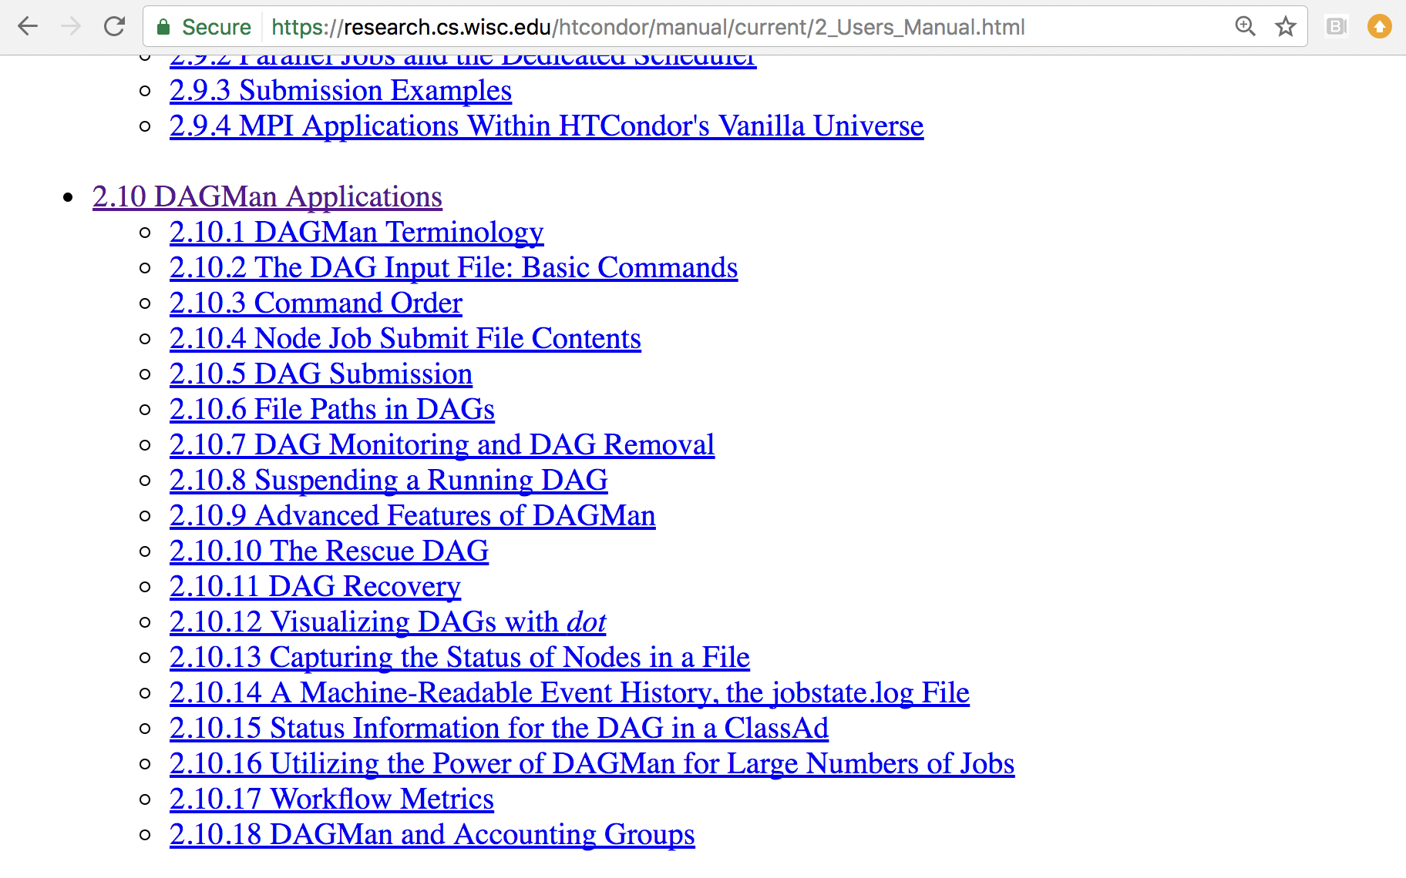
DAGMan in the HTCondor Manual

Slide 119
Simple Example for this Tutorial
The DAG input file will communicate the “nodes” and directional “edges” of the DAG
A
B1
B2
B3
...
BN
C
HTCondor Manual: DAGMan Applications > DAG Input File

Slide 120
Basic DAG input file: JOB nodes, PARENT-CHILD edges
A
my.dag
JOB A A.sub
JOB B1 B1.sub
JOB B2 B2.sub
JOB B3 B3.sub
JOB C C.sub
PARENT A CHILD B1 B2 B3
PARENT B1 B2 B3 CHILD C
B1
B2
B3
...
BN
Node names are used by various DAG features to modify their execution by DAG Manager.
C
HTCondor Manual: DAGMan Applications > DAG Input File

Slide 121
Endless Workflow Possibilities
Wikimedia Commons
https://confluence.pegasus.isi.edu/display/pegasus/WorkflowGenerator

Slide 122
Endless Workflow Possibilities
https://confluence.pegasus.isi.edu

Slide 123
Submitting and Monitoring a DAGMan Workflow

Slide 124
Basic DAG input file: JOB nodes, PARENT-CHILD edges
A
my.dag
JOB A A.sub
JOB B1 B1.sub
JOB B2 B2.sub
JOB B3 B3.sub
JOB C C.sub
PARENT A CHILD B1 B2 B3
PARENT B1 B2 B3 CHILD C
B1
B2
B3
...
BN
C
HTCondor Manual: DAGMan Applications > DAG Input File

Slide 125
Submitting a DAG to the queue
Submission command:
condor_submit_dag dag_file
$ condor_submit_dag my.dag
------------------------------------------------------------------
File for submitting this DAG to HTCondor : mydag.dag.condor.sub
Log of DAGMan debugging messages : mydag.dag.dagman.out
Log of HTCondor library output : mydag.dag.lib.out
Log of HTCondor library error messages : mydag.dag.lib.err
Log of the life of condor_dagman itself : mydag.dag.dagman.log
Submitting job(s).
1 job(s) submitted to cluster 87274940.
------------------------------------------------------------------
HTCondor Manual: DAGMan > DAG Submission

Slide 126
Jobs are automatically submitted by the DAGMan job
Seconds later, node A is submitted:
$ condor_q
-- Schedd: submit-3.chtc.wisc.edu : <128.104.100.44:9618?... OWNER BATCH_NAME SUBMITTED DONE RUN IDLE TOTAL JOB_IDS
alice my.dag+128 4/30 18:08 _ _ 1 5 129.0
2 jobs; 0 completed, 0 removed, 1 idle, 1 running, 0 held, 0 suspended
$ condor_q -nobatch
-- Schedd: submit-3.chtc.wisc.edu : <128.104.100.44:9618?...
ID OWNER SUBMITTED RUN_TIME ST PRI SIZE CMD
128.0 alice 4/30 18:08 0+00:00:36 R 0 0.3 condor_dagman
129.0 alice 4/30 18:08 0+00:00:00 I 0 0.3 A_split.sh
2 jobs; 0 completed, 0 removed, 1 idle, 1 running, 0 held, 0 suspended
HTCondor Manual: DAGMan > DAG Submission

Slide 127
Jobs are automatically submitted by the DAGMan job
After A completes, B1-3 are submitted
$ condor_q
-- Schedd: submit-3.chtc.wisc.edu : <128.104.100.44:9618?... OWNER BATCH_NAME SUBMITTED DONE RUN IDLE TOTAL JOB_IDS
alice my.dag+128 4/30 8:08 1 _ 3 5 129.0...132.0
4 jobs; 0 completed, 0 removed, 3 idle, 1 running, 0 held, 0 suspended
$ condor_q -nobatch
-- Schedd: submit-3.chtc.wisc.edu : <128.104.100.44:9618?...
ID OWNER SUBMITTED RUN_TIME ST PRI SIZE CMD
128.0 alice 4/30 18:08 0+00:20:36 R 0 0.3 condor_dagman
130.0 alice 4/30 18:18 0+00:00:00 I 0 0.3 B_run.sh
131.0 alice 4/30 18:18 0+00:00:00 I 0 0.3 B_run.sh
132.0 alice 4/30 18:18 0+00:00:00 I 0 0.3 B_run.sh
4 jobs; 0 completed, 0 removed, 3 idle, 1 running, 0 held, 0 suspended
HTCondor Manual: DAGMan > DAG Submission

Slide 128
Jobs are automatically submitted by the DAGMan job
After B1-3 complete, node C is submitted
$ condor_q
-- Schedd: submit-3.chtc.wisc.edu : <128.104.100.44:9618?... OWNER BATCH_NAME SUBMITTED DONE RUN IDLE TOTAL JOB_IDS
alice my.dag+128 4/30 8:08 4 _ 1 5 129.0...133.0
2 jobs; 0 completed, 0 removed, 1 idle, 1 running, 0 held, 0 suspended
$ condor_q -nobatch
-- Schedd: submit-3.chtc.wisc.edu : <128.104.100.44:9618?...
ID OWNER SUBMITTED RUN_TIME ST PRI SIZE CMD
128.0 alice 4/30 18:08 0+00:46:36 R 0 0.3 condor_dagman
133.0 alice 4/30 18:54 0+00:00:00 I 0 0.3 C_combine.sh
2 jobs; 0 completed, 0 removed, 1 idle, 1 running, 0 held, 0 suspended
HTCondor Manual: DAGMan > DAG Submission

Slide 129
Status files are Created at the time of DAG submission
(dag_dir)/
A.sub B1.sub B2.sub
B3.sub C.sub (other job files)
my.dag my.dag.condor.sub my.dag.dagman.log
my.dag.dagman.out my.dag.lib.err my.dag.lib.out
my.dag.nodes.log
*.condor.sub and *.dagman.log describe the queued DAGMan job process, as for all queued jobs
*.dagman.out has detailed logging (look to first for errors)
*.lib.err/out contain std err/out for the DAGMan job process
*.nodes.log is a combined log of all jobs within the DAG
DAGMan > DAG Monitoring and DAG Removal

Slide 130
Removing a DAG from the queue
Remove the DAGMan job in order to stop and remove the entire DAG:
condor_rm dagman_jobID
Creates a rescue file so that only incomplete or unsuccessful NODES are repeated upon resubmission
$ condor_q
-- Schedd: submit-3.chtc.wisc.edu : <128.104.100.44:9618?... OWNER BATCH_NAME SUBMITTED DONE RUN IDLE TOTAL JOB_IDS
alice my.dag+128 4/30 8:08 4 _ 1 6 129.0...133.0
2 jobs; 0 completed, 0 removed, 1 idle, 1 running, 0 held, 0 suspended
$ condor_rm 128
All jobs in cluster 128 have been marked for removal
DAGMan > DAG Monitoring and DAG Removal
DAGMan > The Rescue DAG

Slide 131
Removal of a DAG results in a rescue file
(dag_dir)/
A.sub B1.sub B2.sub B3.sub C.sub (other job files)
my.dag my.dag.condor.sub my.dag.dagman.log
my.dag.dagman.out my.dag.lib.err my.dag.lib.out
my.dag.metrics my.dag.nodes.log my.dag.rescue001
Named dag_file.rescue001
increments if more rescue DAG files are created
Records which NODES have completed successfully
does not contain the actual DAG structure
DAGMan > DAG Monitoring and DAG Removal
DAGMan > The Rescue DAG

Slide 132
Rescue Files For Resuming a Failed DAG
A rescue file is created when:
a node fails, and after DAGMan advances through any other possible nodes
the DAG is removed from the queue (or aborted; covered later)
the DAG is halted and not unhalted (covered later)
Resubmission uses the rescue file (if it exists) when the original DAG file is resubmitted
override: condor_submit_dag dag_file -f
DAGMan > The Rescue DAG

Slide 133
Node Failures Result in DAG Failure
If a node JOB fails (non-zero exit code)
DAGMan continues to run other JOB nodes until it can no longer make progress
Example at right:
B2 fails
Other B* jobs continue
DAG fails and exits after B* and before node C
A
B1
B2
B3
...
BN
C
DAGMan > The Rescue DAG

Slide 134
Resolving held node jobs
$ condor_q -nobatch
-- Schedd: submit-3.chtc.wisc.edu : <128.104.100.44:9618?...
ID OWNER SUBMITTED RUN_TIME ST PRI SIZE CMD
128.0 alice 4/30 18:08 0+00:20:36 R 0 0.3 condor_dagman
130.0 alice 4/30 18:18 0+00:00:00 H 0 0.3 B_run.sh
131.0 alice 4/30 18:18 0+00:00:00 H 0 0.3 B_run.sh
132.0 alice 4/30 18:18 0+00:00:00 H 0 0.3 B_run.sh
4 jobs; 0 completed, 0 removed, 0 idle, 1 running, 3 held, 0 suspended
Look at the hold reason (in the job log, or with ‘condor_q -hold’)
Fix the issue and release the jobs (condor_release) -OR- remove the entire DAG, resolve, then resubmit the DAG
HTCondor Manual: DAGMan > DAG Submission

Slide 135
DAG Completion
(dag_dir)/
A.sub B1.sub B2.sub
B3.sub C.sub (other job files)
my.dag my.dag.condor.sub my.dag.dagman.log
my.dag.dagman.out my.dag.lib.err my.dag.lib.out
my.dag.nodes.log my.dag.dagman.metrics
*.dagman.metrics is a summary of events and outcomes
*.dagman.log will note the completion of the DAGMan job
*.dagman.out has detailed logging (look to first for errors)
DAGMan > DAG Monitoring and DAG Removal

Slide 136
Beyond the Basic DAG: Some Node-level Modifiers

Slide 137
PRE and POST scripts run on the submit server, as part of the node
my.dag
A
JOB A A.sub
SCRIPT POST A sort.sh
JOB B1 B1.sub
JOB B2 B2.sub
JOB B3 B3.sub
JOB C C.sub
SCRIPT PRE C tar_it.sh
PARENT A CHILD B1 B2 B3
PARENT B1 B2 B3 CHILD C
POST script
B1
B2
B3
...
BN
PRE script
Use sparingly for lightweight work; otherwise include work in node jobs
C
HTCondor Manual: DAGMan Applications > DAG Input File

Slide 138
RETRY failed nodes to overcome transient errors
Retry a node up to N times if the exit code is non-zero:
RETRY node_name N
See also: retry except for a particular exit code (UNLESS-EXIT), or retry scripts (DEFER)
Note: Unnecessary for nodes (jobs) that can use max_retries in the submit file
Example:
JOB A A.sub
RETRY A 5
JOB B B.sub
PARENT A CHILD B
DAGMan Applications > Advanced Features > Retrying
DAGMan Applications > DAG Input File > SCRIPT

Slide 139
RETRY applies to whole node, including PRE/POST scripts
PRE and POST scripts are included in retries
RETRY of a node with a POST script uses the exit code from the POST script (not from the job)
POST script can do more to determine node success, perhaps by examining JOB output
Example:
SCRIPT PRE A download.sh
JOB A A.sub
SCRIPT POST A checkA.sh
RETRY A 5
DAGMan Applications > Advanced Features > Retrying
DAGMan Applications > DAG Input File > SCRIPT

Slide 140
SCRIPT Arguments and Argument Variables
JOB A A.sub
SCRIPT POST A checkA.sh my.out $RETURN
RETRY A 5
$JOB: node name
$JOBID: cluster.proc
$RETURN: exit code of the node
$PRE_SCRIPT_RETURN: exit code of PRE script
$RETRY: current retry count
(more variables described in the manual)
DAGMan Applications > DAG Input File > SCRIPT
DAGMan Applications > Advanced Features > Retrying

Slide 141
Modular Organization and Control of DAG Components
Splices and SubDags
Node Throttling
Node Priorities
Lots more in the Manual…

Slide 142
Additional Resources
Nice HTCondor FAQs, examples, and documentation from our friends in Canary Islands:
https://is.gd/TjRvY8
Email list:
http://htcondor.org/mail-lists/
HTCondor HOWTO Recipes has FAQ on job submission
http://wiki.htcondor.org/index.cgi/wiki?p=HowToAdminRecipes

Slide 143
Thank You! Questions?

Slide 144
ADDITIONAL DAGMAN SLIDES

Slide 145
Submit File Templates via VARS
VARS line defines node-specific values that are passed into submit file variables
VARS node_name var1=“value” [var2=“value”]
Allows a single submit file shared by all B jobs, rather than one submit file for each JOB.
my.dag
B.sub
JOB B1 B.sub
VARS B1 data=”B1” opt=“10”
JOB B2 B.sub
VARS B2 data=“B2” opt=“12”
JOB B3 B.sub
VARS B3 data=“B3” opt=“14”
…
InitialDir = $(data)
arguments = $(data).csv $(opt)
…
queue
DAGMan Applications > Advanced Features > Variable Values

Slide 146
SPLICE groups of nodes to simplify lengthy DAG files
my.dag
A
JOB A A.sub
SPLICE B B.spl
JOB C C.sub
PARENT A CHILD B
PARENT B CHILD C
B1
B2
B3
...
BN
B.spl
JOB B1 B1.sub
JOB B2 B2.sub
…
JOB BN BN.sub
C
DAGMan Applications > Advanced Features > DAG Splicing

Slide 147
Use nested SPLICEs with DIR for repeating workflow components
my.dag
A
JOB A A.sub DIR A
SPLICE B B.spl DIR B
JOB C C.sub DIR C
PARENT A CHILD B
PARENT B CHILD C
B.spl
B1
B2
BN
B.spl
SPLICE B1 ../inner.spl DIR B1
SPLICE B2 ../inner.spl DIR B2
…
SPLICE BN ../inner.spl DIR BN
1
1
1
...
2
2
2
inner.spl
JOB 1 ../1.sub
JOB 2 ../2.sub
PARENT 1 CHILD 2
C
DAGMan Applications > Advanced Features > DAG Splicing

Slide 148
Use nested SPLICEs with DIR for repeating workflow components
my.dag
(dag_dir)/
JOB A A.sub DIR A
SPLICE B B.spl DIR B
JOB C C.sub DIR C
PARENT A CHILD B
PARENT B CHILD C
my.dag
A/ A.sub (A job files)
B/ B.spl inner.spl
1.sub 2.sub
B1/ (1-2 job files)
B2/ (1-2 job files)
…
BN/ (1-2 job files)
C/ C.sub (C job files)
B.spl
SPLICE B1 ../inner.spl DIR B1
SPLICE B2 ../inner.spl DIR B2
…
SPLICE BN ../inner.spl DIR BN
inner.spl
JOB 1 ../1.sub
JOB 2 ../2.sub
PARENT 1 CHILD 2
DAGMan Applications > Advanced Features > DAG Splicing

Slide 149
More on SPLICE Behavior
Upon submission of the outer DAG, nodes in the SPLICE(s) are added by DAGMan into the overall DAG structure.
A single DAGMan job is queued with single set of status files.
Great for gradually testing and building up a large DAG (since a SPLICE file can be submitted by itself, as a complete DAG).
SPLICE lines are not treated like nodes.
no PRE/POST scripts or RETRIES (though this may change)
DAGMan Applications > Advanced Features > DAG Splicing

Slide 150
What if some DAG components can’t be known at submit time?
A
If N can only be determined as part of the work of A …
B1
B2
B3
...
BN
C

Slide 151
A SUBDAG within a DAG
my.dag
A
JOB A A.sub
SUBDAG EXTERNAL B B.dag
JOB C C.sub
PARENT A CHILD B
PARENT B CHILD C
B1
B2
B3
...
BN
B.dag (written by A)
JOB B1 B1.sub
JOB B2 B2.sub
…
JOB BN BN.sub
C
DAGMan Applications > Advanced Features > DAG Within a DAG

Slide 152
More on SUBDAG Behavior
WARNING: SUBDAGs should only be used (over SPLICES) when absolutely necessary!
Each SUBDAG EXTERNAL has it’s own DAGMan job running in the queue.
SUBDAGs are nodes (can have PRE/POST scripts, retries, etc.)
A SUBDAG is not submitted until prior nodes in the outer DAG have completed.
DAGMan Applications > Advanced Features > DAG Within a DAG

Slide 153
Use a SUBDAG to achieve Cyclic Components within a DAG
A
POST script determines whether another iteration is necessary; if so, exits non-zero
RETRY applies to entire SUBDAG, which may include multiple, sequential nodes
my.dag
B
JOB A A.sub
SUBDAG EXTERNAL B B.dag
SCRIPT POST B iterateB.sh
RETRY B 1000
JOB C C.sub
PARENT A CHILD B
PARENT B CHILD C
POST script
RETRY
C
DAGMan Applications > Advanced Features > DAG Within a DAG

Slide 154
DAG-level Control

Slide 155
Pause a running DAG with hold/release
Hold the DAGMan job process:
condor_hold dagman_jobID
Pauses the DAG
No new node jobs submitted
Queued node jobs continue to run (including SUBDAGs), but no PRE/POST scripts
DAGMan jobs remains in the queue until released (condor_release) or removed
DAGMan > Suspending a Running DAG

Slide 156
Pause a DAG with a halt file
Create a file named DAG_file.halt in the same directory as the submitted DAG file
Pauses the DAG
No new node jobs submitted
Queued node jobs, SUBDAGs, and POST scripts continue to run, but not PRE scripts
DAGMan resumes after the file is deleted
If not deleted, the DAG creates rescue DAG file and exits after all queued jobs have completed
DAGMan > Suspending a Running DAG
DAGMan > The Rescue DAG

Slide 157
Throttle job nodes of large DAGs via DAG-level configuration
If a DAG has many (thousands or more) jobs, performance of the submit server and queue can be assured by limiting:
Number of jobs in the queue
Number of jobs idle (waiting to run)
Number of PRE or POST scripts running
Limits can be specified in a DAG-specific CONFIG file (recommended) or as arguments to condor_submit_dag
DAGMan > Advanced Features > Configuration Specific to a DAG

Slide 158
DAG-specific throttling via a CONFIG file
my.dag
A
JOB A A.sub
SPLICE B B.dag
JOB C C.sub
PARENT A CHILD B
PARENT B CHILD C
CONFIG my.dag.config
B1
B2
B3
...
BN
my.dag.config
DAGMAN_MAX_JOBS_SUBMITTED = 1000
DAGMAN_MAX_JOBS_IDLE = 100
DAGMAN_MAX_PRE_SCRIPTS = 4
DAGMAN_MAX_POST_SCRIPTS = 4
C
DAGMan > Advanced Features > Configuration Specific to a DAG

Slide 159
Other DAGMan Features

Slide 160
Other DAGMan Features: Node-Level Controls
Set the PRIORITY of JOB nodes with:
PRIORITY node_name priority_value
Use a PRE_SKIP to skip a node and mark it as successful, if the PRE script exits with a specific exit code:
PRE_SKIP node_name exit_code
DAGMan Applications > Advanced Features > Setting Priorities
DAGMan Applications > The DAG Input File > PRE_SKIP

Slide 161
Other DAGMan Features: Modular Control
Append NOOP to a JOB definition so that its JOB process isn’t run by DAGMan
Test DAG structure without running jobs (node-level)
Simplify combinatorial PARENT-CHILD statements (modular)
Communicate DAG features separately with INCLUDE
e.g. separate file for JOB nodes and for VARS definitions, as part of the same DAG
Define a CATEGORY to throttle only a specific subset of jobs
DAGMan Applications > The DAG Input File > JOB
DAGMan Applications > Advanced Features > INCLUDE
DAGMan Applications > Advanced > Throttling by Category

Slide 162
Other DAGMan Features: DAG-Level Controls
Replace the node_name with ALL_NODES to apply a DAG feature to all nodes of the DAG
Abort the entire DAG if a specific node exits with a specific exit code:
ABORT-DAG-ON node_name exit_code
Define a FINAL node that will always run, even in the event of DAG failure (to clean up, perhaps).
FINAL node_name submit_file
DAGMan Applications > Advanced > ALL_NODES
DAGMan Applications > Advanced > Stopping the Entire DAG
DAGMan Applications > Advanced > FINAL Node

