Slide 1
HTCondor Administration Basics
Greg Thain
Center for High Throughput Computing

Slide 2
Overview
HTCondor Architecture Overview
Configuration and other surprises
Setting up a personal condor
Setting up distributed condor
Minor topics

Slide 3
Three roles in a HTCondor pool:
Execute machines, that do the work
  Also called worker node, startd
Submit machine, that schedule the work
  Also called schedd, but not head node
Central Manager, db and provisioner
  Also called matchmaker

Slide 4
Machine may have > 1 role
Many possible configurations
Several common ones
Depends on performance, size, etc.

Slide 5
All roles on one machine:
Personal Condor
Submit
Execute
Central manager

Slide 6
A Small Pool
Submit
Central Manager
Execute Machines

Slide 7
A Large Pool
Submit machines
Central Manager
Execute Machines

Slide 8
Roles determined by daemons
Daemons, or services, determine roles
Much admin work:
  Deciding what daemons are/are not doing

Slide 9
The condor_master
Every condor machine needs a master
Like “systemd”, or “init”
Starts daemons, restarts crashed daemons
Tunes machine for condor
condor_on/off talk to master

Slide 10
The submit side
Submit side managed by 1 condor_schedd process
And one shadow per running job
  condor_shadow process
The Schedd is a database
Submit points can be performance bottleneck
Usually a one to a handful per pool

Slide 11
Process View
condor_master
(pid: 1740)
condor_procd
shared_port
fork/exec
“Condor Kernel”
condor_schedd
condor_q
condor_submit
“Tools”
fork/exec
condor_shadow
condor_shadow
condor_shadow
“Condor Userspace”

Slide 12
In the Beginning…
universe = vanilla
executable = compute
request_memory = 70M
arguments = $(ProcID)
should_transfer_input = yes
output = out.$(ProcID)
error = error.$(ProcId)
+IsVerySpecialJob = true
Queue
HTCondor Submit file

Slide 13
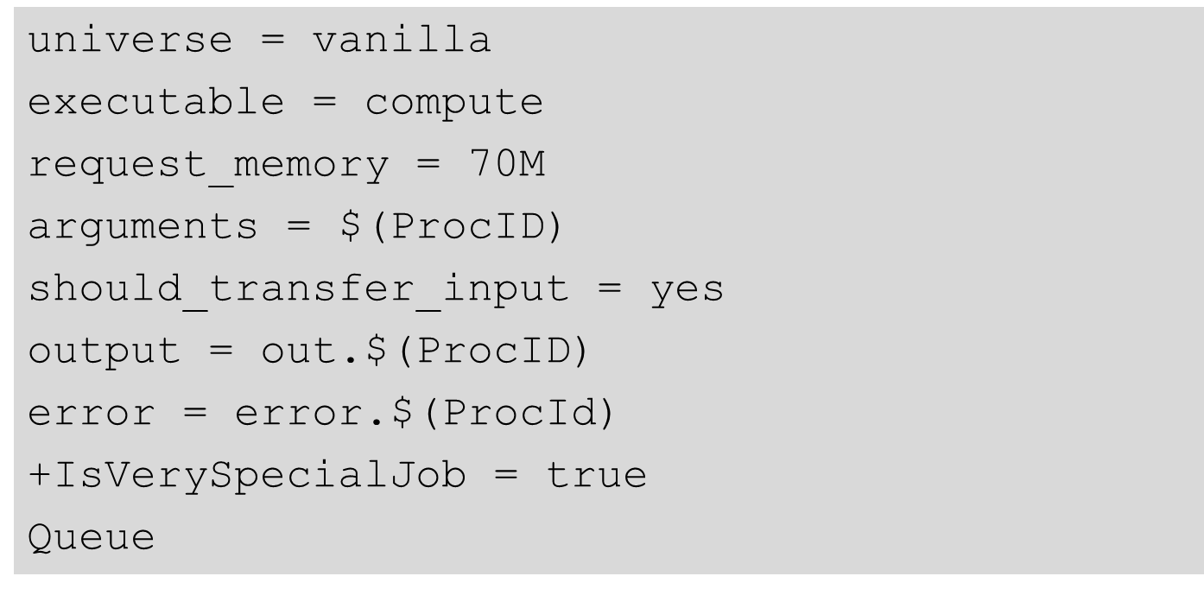
From submit to schedd
JobUniverse = 5
Cmd = “compute”
Args = “0”
RequestMemory = 70000000
Requirements = Opsys == “Li..
DiskUsage = 0
Output = “out.0”
IsVerySpecialJob = true
condor_submit submit_file
Submit file in, Job classad out
Sends to schedd
man condor_submit for full details
Other ways to talk to schedd: Python bindings,DAGman

Slide 14
Condor_schedd holds all jobs
JobUniverse = 5
Owner = “gthain”
JobStatus = 1
NumJobStarts = 5
Cmd = “compute”
Args = “0”
RequestMemory = 70000000
Requirements = Opsys == “Li..
DiskUsage = 0
Output = “out.0”
IsVerySpecialJob = true
  One pool, Many schedds
  condor_submit –name
  chooses
  Owner Attribute:
  need authentication
  Schedd also called “q”
  not actually a queue

Slide 15
Condor_schedd has all jobs
In memory (big)
  condor_q expensive
And on disk
  Fsync’s often
Attributes in manual
condor_q -l job.id
  e.g. condor_q -l 5.0
JobUniverse = 5
Owner = “gthain”
JobStatus = 1
NumJobStarts = 5
Cmd = “compute”
Args = “0”
RequestMemory = 70000000
Requirements = Opsys == “Li..
DiskUsage = 0
Output = “out.0”
IsVerySpecialJob = true

Slide 16
What if I don’t like those Attributes?
Write a wrapper to condor_submit
SUBMIT_ATTRS
condor_qedit
+Notation
Schedd transforms

Slide 17
The Execute Side
Primarily managed by
condor_startd process
With one condor_starter
per running job
Sandboxes the jobs
Usually many per pool
(support 10s of thousands)

Slide 18
Process View: Execute
condor_master
(pid: 1740)
condor_procd
fork/exec
“Condor Kernel”
condor_startd
condor_status -direct
“Tools”
condor_starter
condor_starter
condor_starter
“Condor Userspace”
Job
Job
Job

Slide 19
Startd also has a classad
Condor creates it
  From interrogating the machine
  And the config file
  And sends it to the collector
condor_status [-l]
  Shows the ad
condor_status –direct daemon
  Goes to the startd

Slide 20
Condor_status –l machine
OpSys = "LINUX“
CustomGregAttribute = “BLUE”
OpSysAndVer = "RedHat6"
TotalDisk = 12349004
Requirements = ( START )
UidDomain = “cheesee.cs.wisc.edu"
Arch = "X86_64"
StartdIpAddr = "<128.105.14.141:36713>"
RecentDaemonCoreDutyCycle = 0.000021
Disk = 12349004
Name = "slot1@chevre.cs.wisc.edu"
State = "Unclaimed"
Start = true
Cpus = 32
Memory = 81920

Slide 21
One Startd, Many slots
HTCondor treats multicore as independent slots
Slots: static vs. partitionable
Startd can be configured to:
  Only run jobs based on machine state
  Only run jobs based on Resources (GPUs)
  Preempt or Evict jobs based on policy
  …

Slide 22
3 types of slots
Static (e.g. the usual kind)
Partitionable (e.g. leftovers)
Dynamic (usableable ones)
  Dynamically created
  But once created, static

Slide 23
The “Middle” side
There’s also a “Middle”, the Central Manager:
  A condor_negotiator
    Provisions machines to schedds
  A condor_collector
    Central nameservice: like LDAP
    condor_status queries this
Not the bottleneck you may think: stateless

Slide 24
Process View: Central Manager
condor_master
(pid: 1740)
“Condor Kernel”
condor_procd
fork/exec
condor_collector
condor_negotiator
condor_userprio
“Tools”

Slide 25
Responsibilities of CM
Pool-wide scheduling policy resides here
Scheduling of one user vs another
Definition of groups of users
Definition of preemption
Whole talk on this – later in this session

Slide 26
Defrag daemon
Optional, but usually on the central manager
  One daemon defragments whole pool
Scan pool, try to fully defrag some startds
Only looks at partitionable machines
Admin picks some % of pool that can be “whole”

Slide 27
On to configuration…

Slide 28
Configuration File
(Almost)all configure is in files, “root” CONDOR_CONFIG env var
/etc/condor/condor_config
This file points to others
All daemons share same configuration
Might want to share between all machines (NFS, automated copies, puppet, etc)
Notes:
All daemons on same machine share configuration

Slide 29
Configuration File Syntax
# I’m a comment!
CREATE_CORE_FILES=TRUE
MAX_JOBS_RUNNING = 50
# HTCondor ignores case:
log=/var/log/condor
# Long entries:
collector_host=condor.cs.wisc.edu,\
secondary.cs.wisc.edu

Slide 30
Metaknobs
One metaknob controls other knobs
use ROLE : Personal

Slide 31
Other Configuration Files
LOCAL_CONFIG_FILE
  Comma separated, processed in order
  LOCAL_CONFIG_FILE = \
  /var/condor/config.local,\
  /shared/condor/config.$(OPSYS)
LOCAL_CONFIG_DIR
  Files processed IN LEXIGRAPHIC ORDER
  LOCAL_CONFIG_DIR = \
  /etc/condor/config.d

Slide 32
Configuration File Macros
You reference other macros (settings) with:
  A = $(B)
  SCHEDD = $(SBIN)/condor_schedd
Can create additional macros for organizational purposes

Slide 33
Configuration File Macros
Can append to macros:
  A=abc
  A=$(A),def
Don’t let macros recursively define each other!
  A=$(B)
  B=$(A)

Slide 34
Configuration File Macros
Later macros in a file overwrite earlier ones
  B will evaluate to 2:
  A=1
  B=$(A)
  A=2

Slide 35
Config file defaults
CONDOR_CONFIG “root” config file:
  /etc/condor/condor_config
Local config file:
  /etc/condor/condor_config.local
Config directory
  /etc/condor/config.d

Slide 36
Config file recommendations
For “system” condor, use default
  Global config file read-only
    /etc/condor/condor_config
  All changes in config.d small snippets
    /etc/condor/config.d/05some_example
  All files begin with 2 digit numbers
Personal condors elsewhere

Slide 37
condor_config_val
condor_config_val [-v] <KNOB_NAME>
  Queries config files
condor_config_val -dump
Notes:
-dump includes defaults

Slide 38
Environment overrides
export _condor_KNOB_NAME=value
  Over rules all others (so be careful)

Slide 39
condor_reconfig
Daemons long-lived
  Only re-read config files on condor_reconfig command
  Some knobs don’t obey re-config, require restart
    DAEMON_LIST, NETWORK_INTERFACE
condor_restart

Slide 40
Got all that?

Slide 41
Quick Review of Daemons
condor_master: runs on all machine, always
condor_schedd: runs on submit machine
condor_shadow: one per job
condor_startd: runs on execute machine
condor_starter: one per job
condor_negotiator/condor_collector: one/pool
Notes:
Also responsibilities of each daemon

Slide 42
Common config parameters
CONDOR_HOST
  String that tells daemon where CM is
LOG
  Directory that holds log files

Slide 43
Condor Log files
Defaults to /var/log/condor
Separate log file for each daemon
Except Starter, one per slot
  StarterLog.slot1 or StarterLog.slot1_1
Useful for debugging and developers

Slide 44
Configuration of Submit side
Not much policy to be configured in schedd
Mainly scalability and security
MAX_JOBS_RUNNING
JOB_START_DELAY
MAX_CONCURRENT_DOWNLOADS
MAX_JOBS_SUBMITTED

Slide 45
More Submit config
SCHEDD_TRANSFORMS
START_LOCAL_UNIVERSE
SUBMIT_REQUIREMENTS

Slide 46
Configuration of startd
Mostly policy, whole talk on this later
Several directory parameters
EXECUTE – where the sandbox is
CLAIM_WORKLIFE
  How long to reuse a claim for different jobs
MaxJobRetirementTime
Notes:
Turn on GPUs

Slide 47
Static slots by default
Each slot gets equal resources
$ condor_status
Name OpSys Arch State Activity LoadAv Mem Ac
slot1@chevre.cs.wisc.edu LINUX X86_64 Unclaimed Idle 0.000 20480 3+
slot2@chevre.cs.wisc.edu LINUX X86_64 Unclaimed Idle 0.000 20480 3+
slot3@chevre.cs.wisc.edu LINUX X86_64 Unclaimed Idle 0.000 20480 3+
slot4@chevre.cs.wisc.edu LINUX X86_64 Unclaimed Idle 0.000 20480 3+
slot5@chevre.cs.wisc.edu LINUX X86_64 Unclaimed Idle 0.000 20480

Slide 48
How to configure pslots
NUM_SLOTS = 1
NUM_SLOTS_TYPE_1 = 1
SLOT_TYPE_1 = cpus=100%
SLOT_TYPE_1_PARTITIONABLE = true

Slide 49
pslot slots by default
One slot gets “leftovers”
$ condor_status
Name OpSys Arch State Activity Mem
slot1@chevre.cs.wisc.edu LINUX X86_64 Unclaimed Idle 20480
Slot1_1@chevre.cs.wisc.edu LINUX X86_64 Claimed Busy 10243
Slot1_2@chevre.cs.wisc.edu LINUX X86_64 Claimed Busy 20480

Slide 50
Configuration of Central Manager
Mostly about fair share, whole talk about it

Slide 51
Condor Installation Basics

Slide 52
Let’s Install HTCondor
With native packages
wget http://research.cs.wisc.edu/htcondor/yum/repo.d/htcondor-stable-rhel6.repo
wget http://research.cs.wisc.edu/htcondor/yum/RPM-GPG-KEY-HTCondor
rpm –import RPM_GPG-KEY-HTCondor
Yum install htcondor

Slide 53
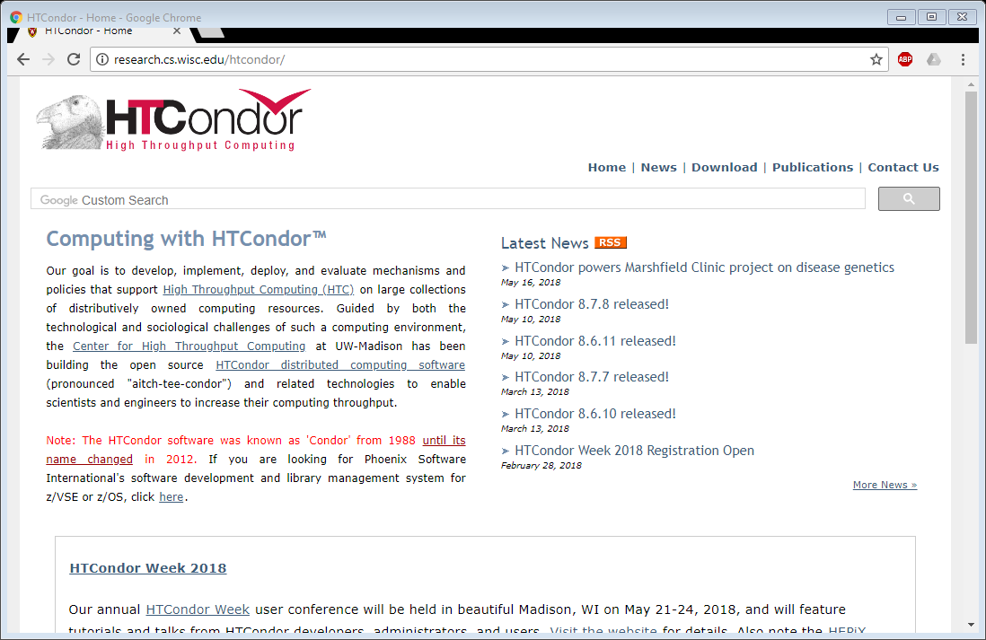
http://htcondorproject.org

Slide 54
Version Number Scheme
Major.minor.release
  If minor is even (a.b.c): Stable series
    Very stable, mostly bug fixes
    Current: 8.8
    Examples: 8.8.2, 8.8.1
  If minor is odd (a.b.c): Developer series
    New features, may have some bugs
    Current: 8.9
    Examples: 8.9.1

Slide 55
The Guarantee
All minor releases in a stable series interoperate
  E.g. can have pool with 8.6.0, 8.6.5, etc.
  But not WITHIN A MACHINE:
    Only across machines
The Reality:We work hard to do better
    8.4 with 8.2 with 8.5, etc.
    Part of HTC ideal: can never upgrade in lock-step

Slide 56
Let’s Make a Pool
First need to configure HTCondor
1100+ knobs and parameters!
Don’t need to set all of them…

Slide 57
Default file locations
BIN = /usr/bin
SBIN = /usr/sbin
LOG = /var/condor/log
SPOOL = /var/lib/condor/spool
EXECUTE = /var/lib/condor/execute
CONDOR_CONFIG=/etc/condor/condor_config

Slide 58
Let’s make a pool!
“Personal Condor”
  All on one machine:
    submit side IS execute side
  Jobs always run
Use defaults where ever possible
Very handy for debugging and learning

Slide 59
Minimum knob settings
  Role
  What daemons run on this machine
CONDOR_HOST
  Where the central manager is
Security settings
  Who can do what to whom?
Notes:
What’s a metaknob

Slide 60
Other interesting knobs
LOG = /var/log/condor
Where daemons write debugging info
SPOOL = /var/spool/condor
Where the schedd stores jobs and data
EXECUTE = /var/condor/execute
Where the startd runs jobs

Slide 61
Minimum knobs for personal Condor
In /etc/condor/config.d/50PC.config
# All daemons local
Use ROLE : Personal
CONDOR_HOST = localhost
ALLOW_WRITE = localhost

Slide 62
Does it Work?
$ condor_status
Error: communication error
CEDAR:6001:Failed to connect to <128.105.14.141:4210>
$ condor_submit
ERROR: Can't find address of local schedd
$ condor_q
Error:
Extra Info: You probably saw this error because the condor_schedd is not running on the machine you are trying to query…

Slide 63
Checking…
$ ps auxww | grep [Cc]ondor
$

Slide 64
Starting Condor
condor_master –f
service start condor

Slide 65
$ ps auxww | grep [Cc]ondor
$
condor 19534 50380 Ss 11:19 0:00 condor_master
root 19535 21692 S 11:19 0:00 condor_procd -A …
condor 19557 69656 Ss 11:19 0:00 condor_collector -f
condor 19559 51272 Ss 11:19 0:00 condor_startd -f
condor 19560 71012 Ss 11:19 0:00 condor_schedd -f
condor 19561 50888 Ss 11:19 0:00 condor_negotiator -f
Notice the UID of the daemons
Notes:
condor_procd: explain

Slide 66
Quick test to see it works
$ condor_status
# Wait a few minutes…
$ condor_status
Name OpSys Arch State Activity LoadAv Mem
slot1@chevre.cs.wi LINUX X86_64 Unclaimed Idle 0.190 20480
slot2@chevre.cs.wi LINUX X86_64 Unclaimed Idle 0.000 20480
slot3@chevre.cs.wi LINUX X86_64 Unclaimed Idle 0.000 20480
slot4@chevre.cs.wi LINUX X86_64 Unclaimed Idle 0.000 20480
-bash-4.1$ condor_q
-- Submitter: gthain@chevre.cs.wisc.edu : <128.105.14.141:35019> : chevre.cs.wisc.edu
ID OWNER SUBMITTED RUN_TIME ST PRI SIZE CMD
0 jobs; 0 completed, 0 removed, 0 idle, 0 running, 0 held, 0 suspended
$ condor_restart # just to be sure…

Slide 67
Some Useful Startd Knobs
NUM_CPUS = X
  How many cores condor thinks there are
MEMORY = M
  How much memory (in Mb) there is
STARTD_CRON_...
  Set of knobs to run scripts and insert attributes into startd ad (See Manual for full details).

Slide 68
Brief Diversion into daemon logs
Each daemon logs mysterious info to file
$(LOG)/DaemonNameLog
Default:
  /var/log/condor/SchedLog
  /var/log/condor/MatchLog
  /var/log/condor/StarterLog.slotX
Experts-only view of condor

Slide 69
Let’s make a “real” pool
Distributed machines makes it hard
  Different policies on each machines
  Different owners
  Scale

Slide 70
Most Simple Distributed Pool
Requirements:
  No firewall
  Full DNS everywhere (forward and backward)
  We’ve got root on all machines
HTCondor doesn’t require any of these
  (but easier with them)

Slide 71
What UID should jobs run as?
Three Options (all require root):
  Nobody UID
    Safest from the machine’s perspective
  The submitting User
    Most useful from the user’s perspective
    May be required if shared filesystem exists
  A “Slot User”
    Bespoke UID per slot
    Good combination of isolation and utility

Slide 72
UID_DOMAIN SETTINGS
UID_DOMAIN = \ same_string_on_submit
TRUST_UID_DOMAIN = true
SOFT_UID_DOMAIN = true
If UID_DOMAINs match, jobs run as user, otherwise “nobody”

Slide 73
Slot User
SLOT1_USER = slot1
SLOT2_USER = slot2
…
STARTER_ALOW_RUNAS_OWNER = false
EXECUTE_LOGIN_IS_DEDICATED=true
Job will run as slotX Unix user

Slide 74
FILESYSTEM_DOMAIN
HTCondor can work with NFS
  But how does it know what nodes have it?
WhenSubmitter & Execute nodes share
  FILESYSTEM_DOMAIN values
      e.g FILESYSTEM_DOMAIN = domain.name
Or, submit file can always transfer with
  should_transfer_files = yes
If jobs always idle, first thing to check

Slide 75
3 Separate machines
Central Manager
Execute Machine
Submit Machine

Slide 76
Central Manager
Use ROLE : CentralManager
CONDOR_HOST = cm.cs.wisc.edu
ALLOW_WRITE = *.cs.wisc.edu

Slide 77
Submit Machine
Use ROLE : submit
CONDOR_HOST = cm.cs.wisc.edu
ALLOW_WRITE = *.cs.wisc.edu
UID_DOMAIN = cs.wisc.edu
FILESYSTEM_DOMAIN = cs.wisc.edu

Slide 78
Execute Machine
Use ROLE : Execute
CONDOR_HOST = cm.cs.wisc.edu
ALLOW_WRITE = *.cs.wisc.edu
UID_DOMAIN = cs.wisc.edu
FILESYSTEM_DOMAIN = cs.wisc.edu
# default is
#FILESYSTEM_DOMAIN=$(FULL_HOSTNAME)

Slide 79
Now Start them all up
Does order matter?
  Somewhat: start CM first
How to check:
Every Daemon has classad in collector
  condor_status -schedd
  condor_status -negotiator
  condor_status -any

Slide 80
condor_status -any
MyType TargetType Name
Collector None Test Pool@cm.cs.wisc.edu
Negotiator None cm.cs.wisc.edu
DaemonMaster None cm.cs.wisc.edu
Scheduler None submit.cs.wisc.edu
DaemonMaster None submit.cs.wisc.edu
DaemonMaster None wn.cs.wisc.edu
Machine Job slot1@wn.cs.wisc.edu
Machine Job slot2@wn.cs.wisc.edu
Machine Job slot3@wn.cs.wisc.edu
Machine Job slot4@wn.cs.wisc.edu

Slide 81
Debugging the pool
condor_q / condor_status
condor_ping ALL –name machine
Or
condor_ping ALL –addr ‘<127.0.0.1:9618>’

Slide 82
What if a job is always idle?
Check userlog – may be preempted often
run condor_q -better-analyze job_id

Slide 83
Whew!

Slide 84
Condor statistics
condor_status –direct –schedd –statistics 2
(all kinds of output), mostly aggregated
NumJobStarts, RecentJobStarts, etc.
See manual for full details

Slide 85
DaemonCoreDutyCycle
Most important statistic
Measures time not idle
If over 95%, daemon is probably saturated

Slide 86
Even better
SCHEDD_COLLECT_STATS_BY_Owner = Owner
For all owners, collect & publish stats:
gthainJobsStarted = 7
tannenbaJobsStarted = 100

Slide 87
Speeds, Feeds,
Rules of Thumb
HTCondor scales to 100,000s of machines
  With a lot of work
  Contact us, see wiki page
    …
Notes:
Add wiki

Slide 88
Without Heroics:
Your Mileage may vary:
  Shared File System vs. File Transfer
  WAN vs. LAN
  Strong encryption vs none
A single schedd can run at 50 Hz
Schedd needs 500k RAM for running job
  50k per idle jobs
Collector can hold tens of thousands of ads
Notes:
Mention autocluster…
Mention Hz

Slide 89
Tools for admins

Slide 90
condor_off
Three kinds for submit and execute
-fast:
  Kill all jobs immediate, and exit
-gracefull
  Give all jobs 10 minutes to leave, then kill
-peaceful
  Wait forever for all jobs to exit

Slide 91
condor_restart
Restarts all daemons on a given machine
Can be run remotely – if admin priv allows

Slide 92
condor_status
-collector
-submitter
-negotiator
-schedd
-master

Slide 93
condor_userprio
Condor_userprio –allusers
  Whole talk on this, this afternoon

Slide 94
condor_fetchlog
Remotely pulls a log file from remote machine
condor_fetchlog execute_machine STARTD

Slide 95
Thank you -- For more info
http://htcondorproject.org
More detail in following talks…
htcondor-users email list
Talk to us!
Notes:
Add user

