Slide 1
HTCondor Python API Overview ISGC 2019 Taipei March 2019
Todd Tannenbaum
Center for High Throughput Computing
Department of Computer Sciences
University of Wisconsin-Madison

Slide 3
HTCondor Python Bindings API
HTCondor v8.8 eliminated web-service SOAP API, long live Python!
How do I install the Python Bindings?
Linux: RPM/DEBs include bindings for Python 2 or Python 3 depending on the system default Python
MS Windows: MSI installer includes Python 3 bindings
Also Packged into PyPI repository (Linux only so far…)
pip install htcondor
Looking at packaging into Anaconda as well
Both Python 2 and Python 3 available via pip

Slide 4
Design Philosophy
ClassAds
Everything is based on ClassAds
Pythonic
Use iterators, exceptions, guards
ClassAds behave as much like a dict as reasonable
Native Code
Uses the same library code as the HTCondor command-line tools

Slide 5
Our Goal
Complete
If you can do it with the command line tools, you should be able to do it with python
Backward Compatible
APIs will stay stable as long as possible
Bad or broken APIs will be superseded, not removed
(queue_with_itemdata supersedes submitMany)
May use Python DeprecationWarning

Slide 6
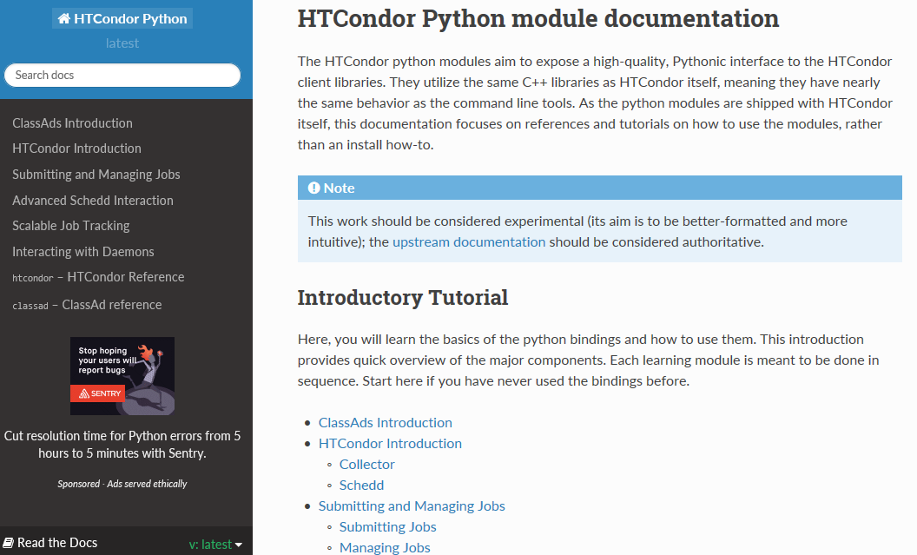
Read the docs
https://htcondor-python.readthedocs.io

Slide 7
Jupyter Tutorials
https://hcc-htcondor-python.unl.edu/
Login in to JupyterHub with a university credential
Spawns a docker instance with a private HTCondor
Will soon put these tutorials into Docker Hub as well so you can run them locally

Slide 8
Python Packages
The primary Python Bindings packages
import classad
import htcondor
Additional higher-level packages built on-top of the bindings
import chip
import htmap
More to come…

Slide 9
ClassAd Package import classad

Slide 10
ClassAds
import classad
Provides the ClassAd and ExprTree classes
Many HTCondor methods return ClassAds
A ClassAd behaves a lot like a python dictionary: {key : value, key2 : value2, …}
Values are of type ExprTree which can be
a simple value (int, real, bool, string)
a special value (Undefined, Error)
an expression which evaluates to one of the above

Slide 11
ExprTree
ExprTree is a ClassAd expression
Literals (int, real, bool, string) are automatically converted to python types
Undefined and Error have no python equivalent
Evaluated lazily, only when explicitly asked
When eval() method of ExprTree is called
returns a Literal (or Undefined/Error)

Slide 12
Evaluate in ClassAd context
ad = classad.ClassAd('[a=1; b=4; tot=a+b]')
print ad['a']
print ad['tot']
print ad['tot'].eval()
1 a + b
5
print ad.eval('tot')
5

Slide 13
Expressions vs Literals
Many classads in HTCondor have values that can be expressions but are usually literals
HTCondor daemons almost always evaluate rather than look-up attributes in ClassAds
You should do the same
Use ad['name'] if you are sure it's a literal
Use ad.eval('name') if you don't know

Slide 14
HTCondor Package import htcondor What classes are in this package?

Slide 15
Job Startup
Central Manager
Negotiator
Collector
Submit Machine
Execute Machine
Schedd
Startd
Starter
Job
Submit
Shadow
Notes:
Steps
1. Startd sends collector ClassAd describing itself. (The Schedd does as well, but it has nothing interesting to say yet.)
2. The user calls condor_submit to submit a job. The job is handed off to the schedd and condor_submit returns.
3. The schedd alerts the collector that it now has a job waiting.
4. The negotiator asks the collector for a list machines able to run jobs and schedd queues with waiting jobs.
5. The negotiator contacts the schedd to learn about the waiting job.
6. The negotiator matches the waiting job with the waiting machine.
7. The negotiator alerts the schedd and the startd that there is a match.
8. The schedd contacts the startd to claim the match.
9. The schedd starts a shadow to monitor the job.
10. The startd starts a starter to start the job.
11. The starter and the shadow contact each other.
11. The starter starts the job.
12. If the job is using the Condor syscall library (typically through being condor_compiled), it will contact the shadow to access necessary files.

Slide 16
Central Manager
Negotiator
Collector
Submit Machine
Execute Machine
Schedd
Startd
Starter
Job
Submit
Shadow
Notes:
Steps
1. Startd sends collector ClassAd describing itself. (The Schedd does as well, but it has nothing interesting to say yet.)
2. The user calls condor_submit to submit a job. The job is handed off to the schedd and condor_submit returns.
3. The schedd alerts the collector that it now has a job waiting.
4. The negotiator asks the collector for a list machines able to run jobs and schedd queues with waiting jobs.
5. The negotiator contacts the schedd to learn about the waiting job.
6. The negotiator matches the waiting job with the waiting machine.
7. The negotiator alerts the schedd and the startd that there is a match.
8. The schedd contacts the startd to claim the match.
9. The schedd starts a shadow to monitor the job.
10. The startd starts a starter to start the job.
11. The starter and the shadow contact each other.
11. The starter starts the job.
12. If the job is using the Condor syscall library (typically through being condor_compiled), it will contact the shadow to access necessary files.

Slide 17
Bindings for the Collector
htcondor.Collector() common methods:
query(), advertise()
condor_status, condor_advertise

Slide 18
Bindings for the Schedd
htcondor.Schedd()
query, xquery, history : look at jobs
act, edit : change jobs
transaction, spool, retrieve : submit jobs
negotiate, reschedule : specialized users only

Slide 19
Example: Query jobs from a Schedd
schedd = htcondor.Schedd() # get the local schedd
jobs = schedd.query('ClusterId=23', ['JobStatus'], limit=2)
for job in jobs : print job.__repr__()
[MyType="Job", JobStatus=5, ClusterId=23, ProcId=0] [MyType="Job", JobStatus=5, ClusterId=23, ProcId=1]
ads = schedd.query(opts=htcondor.QueryOpts.SummaryOnly)
print(ads[0])
[
AllUsesrIdle = 0;
AllUsersHeld = 2;
...

Slide 20
Submit object
htcondor.Submit()
queue, queue_with_itemdata
Converts an HTCondor submit file into a job classads
Then have the Submit() objects send the ads to the schedd in a transaction
Examples…

Slide 21
Using the Submit Class
# Example One: submit via JDL string
import htcondor
schedd = htcondor.Schedd()
sub = htcondor.Submit('''
Executable = ExampleOne.exe
Hold = True
+SubmitExample = True
queue Arguments matching files *
''')
with schedd.transaction() as txn:
sub.queue(txn)

Slide 22
Using the Submit Class, cont
# Example Two: submit one job per item
# from a Python iterator
import htcondor
import os
schedd = htcondor.Schedd()
sub = htcondor.Submit()
sub['Executable']='ExampleThree.exe'
sub['Hold']='True'
sub['+SubmitExample']='True’
files=[{'Arguments':f} for f in os.listdir('.') if os.path.isfile(f)]
with schedd.transaction() as txn:
sub.queue_with_itemdata(txn,1,iter(files))
Notes:
The HTCondor Submit() JDL is able to submit a bag of jobs of a size specified by an interger, or it can submit a job per file, per directory, or per line in a file. But perhaps you want to submit one job per something else? The queue_with_itemdata() method allows you to pass in an arbitrary Python iterator, where each item returned by the iterator should be a dictionary consisting of key/value pairs. Each item returned by the iterator will result in a job submission with that items key/values inserted. In the below example, instead of having HTCondor scan the directory for files, we create a Python iterator that will return a {'Arguments' : filename} item for each file in the current directory, and use this custom iterator to create the jobs.

Slide 23
Less commonly used bindings…
htcondor.Startd()
drainJobs(), cancelDrainJobs()
Similar to command-line tool condor_drain
htcondor.Negotiator()
setPriority, setFactor, resetUsage, ...
Similar to command-line tool condor_user_prio
Bindings to submit DAGs, read job event logs, …

Slide 24
Less common, cont.
htcondor.version()
get the HTCondor version
similar to condor_version
htcondor.param['knob']
get the expanded value of the config knob
similar to condor_config_val
htcondor.reload_config()
reread the HTCondor config files
similar to condor_reconfig

Slide 25
Higher Level Python Abstractions
HTCondor Bindings (import htcondor) are steeped in the HTCondor ecosystem
Exposed to concepts like Schedds, Collectors, ClassAds, jobs, transactions to the Schedd, etc
Working on a new package (e.g. import htcondor_ez … ? Name suggestions? )
More approachable by Python addicts
No HTCondor concepts to learn, just extensions of natural and familiar Python functionality
Targeting iPython users as well (aka Jupyter)
Written on top of htcondor bindings
Also working on HTMap package

Slide 26
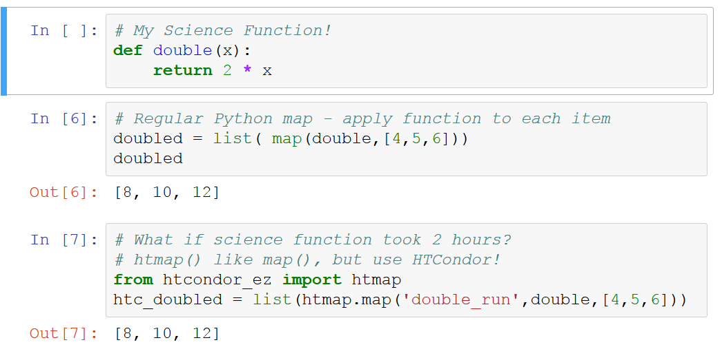
Example: y = f(x)
See https://github.com/htcondor/htmap

Slide 27
Thank you!

