Slide 1
E-Science Activity in Indonesia 2019
Basuki Suhardiman
basuki@itb.ac.id
Insitut Teknologi Bandung
ISGC 2019, Academia Sinica, Taipei, Taiwan
31 March – 5 April 2019

Slide 2
Outline
Building the Infrastructure for E-Science Activity
IDREN
NREN via Asi@Connect
Activity in E-Science
Indonesia Institute of Science (LIPI)
ITB facilities for weather prediction model
Enviroment monitoring
Firewatch activites
Collaboration
DMCC+ , EOSC

Slide 3
Infrastructure Initiatives
IDREN
Initiated by several Universities members 2015 , as continues program of INHERENT
ITB (as TEIN representative in Indonesia
University of Indonesia (Jakarta)
University of Gajahmada (Jogjakarta)
University of Brawijaya (Malang)
Suraya Institute of Technology ( Surabaya)
Approved by Ministry of Science Technology
Directorate General of Learning and Student Affairs (Higher Education)
Funding for the Link via ITB
Number of member institutions(connected to your REN) :
80 – 100 Institution , mostly University and several Research Agency (LIPI and LAPAN)
Backbone :
International Backbone from Bandung to Singapore ,1 Gbps
Domestic Backbone 1 Gbps – 2 Gbps

Slide 4
IDREN Development
Build on Co-operation with Telco’s Provider (Sharing cost)
Multihoming and Multi ASN
AS 64302 (Telkom)
AS138826 (Indosat)

Slide 5
NREN Backbone @java Island
To Sumatra Link
Telco’s Clound Network Infrastructure
Multi connection Multi operator
To Sulawesi Island
UI
1 Gbps (existing)
Undip
ITS
ITB
Plan : another Link (10 Gbps)
UGM
SG/TEIN
UB
AS 138826
AS 64302
Map source:http://www.openstreetmap.org/directions#map=7/-7.368/109.094

Slide 6
Network Infrastructure, IDREN( Indonesia Research and Education Network)
Network Infrastructure Connect to Global REN via Asi@connect Connectivity (TEIN) to Singapore
1 Gbps
http://tein.asia/sub/?mc=2030

Slide 7
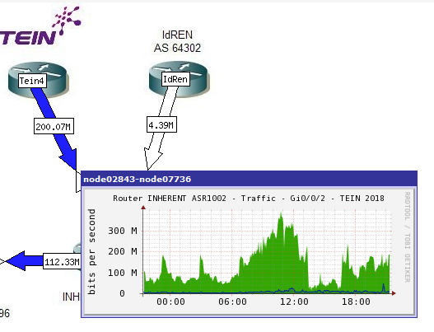
Traffic
More than 200 Mbps from ITB ( Weather Modelling )
Alice Connection to Cibinong
ITB

Slide 8
National Institute of Science (LIPI=Lembaga Ilmu Pengetahuan Indonesia)
Managed by Research Center for Informatics
16 Nodes
8 core Intel Xeon E5-2609 2.4 GHz
8 GB RAM
175 GB /scratch
10 GB CVMFS
CentOS 6.9
100 job slots
Connect to ALICE
https://indico.cern.ch/event/638971/contributions/2633823/attachments/1538560/2411618/2017-IndonesianReport.pdf

Slide 9
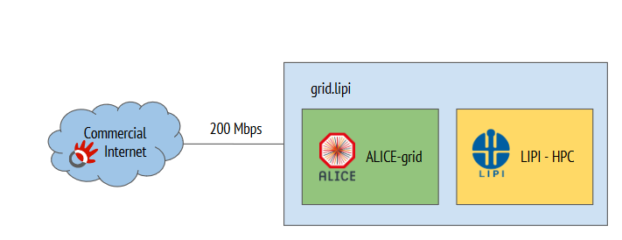
Topology
https://indico.cern.ch/event/638971/contributions/2633823/attachments/1538560/2411618/2017-IndonesianReport.pdf

Slide 10
Application Running
Regional model : REGCM4
Dynamic moleculler : Quantum Expresso
Machine Learning : Keras
Tensor Flow
http://alimonitor.cern.ch/map.jsp

Slide 11
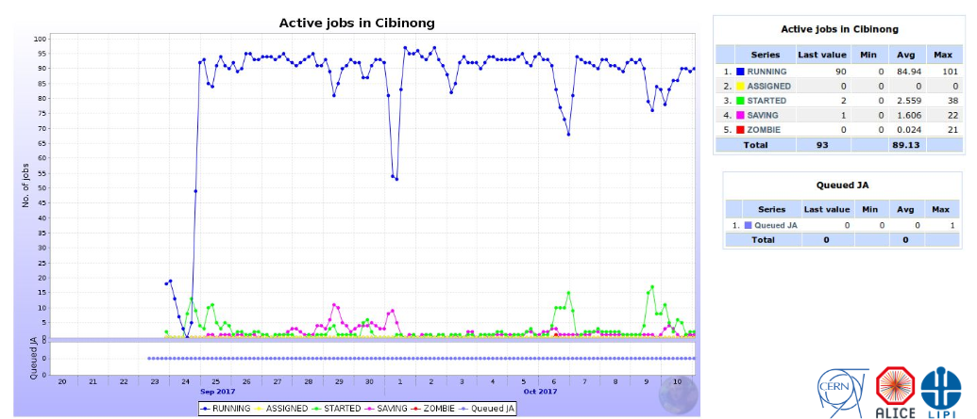
Activity
https://indico.cern.ch/event/638971/contributions/2633823/attachments/1538560/2411618/2017-IndonesianReport.pdf

Slide 12
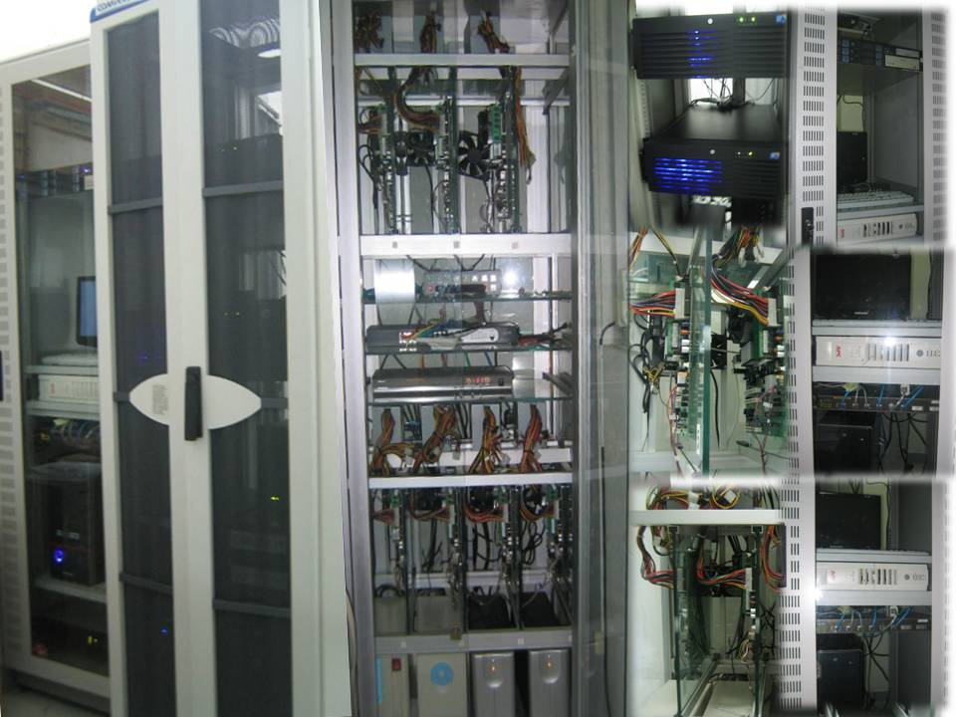
ITB Support for Science
Weather Prediction Model Labolatory
Build 4 (2 cluster ) GPU
2 Machine with GPU 4000 core
2 machine with GPU 2000 core
2 machine running on Redhat 6 Entreprises
2 Machine running on Linux Suse 11
50 Tbytes storage
Release prediction model for weather every 3 hours
New Facilities for HPC/Cluster (2019)
40 Machine (with 56 Core/machine)
Build public and priavte cloud
Build base on Openstack
http://weather.meteo.itb.ac.id/observasi.html

Slide 13
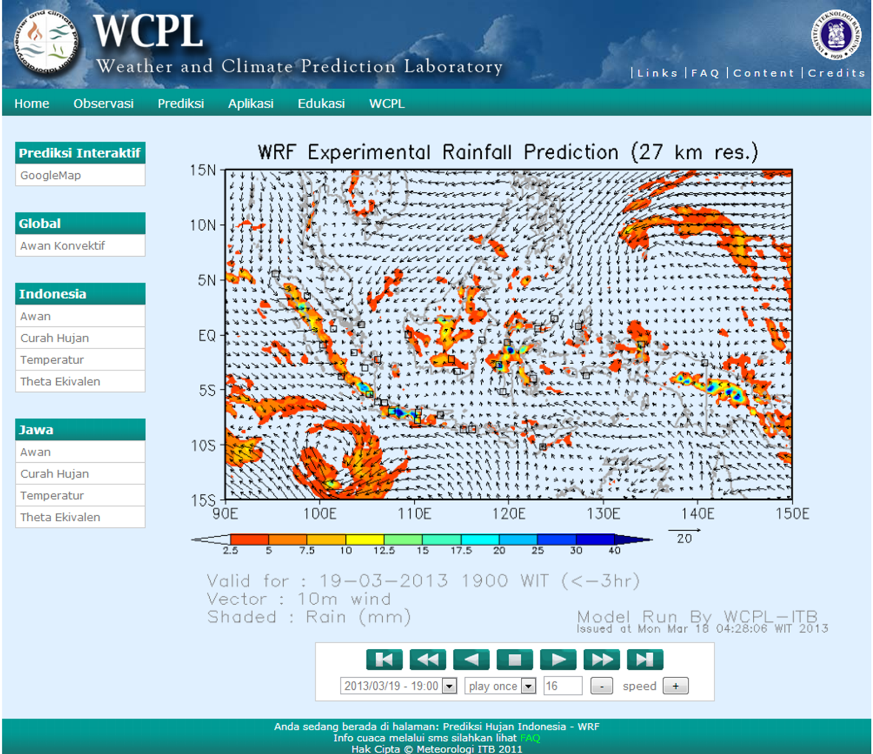
Weather Prediction http://weather.meteo.itb.ac.id
Modifying the resolution of the data input
Before: 1º (interval prediction every 6 hours)
Now: 0.5º (interval prediction every 3 hours)
That is larger download volume but with (roughly) the same latency → Bandwidth utilization
Computing Power

Slide 14
If we have the computing power
Research Center for Weather and Climate Impacts in South East Asia
Org-1
Global Numerical Weather Prediction Model (NOAA, JMA, etc.)
More meaningful information (e.g., more accurate early warning of hydro-meteorological disaster) for the society
Downscaled ensemble middle-range weather prediction for SEA region
Weather/climate impacts prediction: flood, drought, land-slide, etc.
Org-2
Org-3
The research center will operate like UCAR-NCAR in the USA, but mainly serving the community in SEA region

Slide 15
Firewatch Initiatives
Ministry of Forestry and LAND-gate Australia
MODIS-Data from NASA
Collaboration Ministry Forestry with Ministry of Education (2010) for delivering the Hotspot information (Fire) through the Inherent (University of Palangkaraya and University of Riau )
In 2015, ITB initiatives again for firewatch
Data Analysis through satellite
Sosialize the environment impact through the social media (Facebook/twitter)
Prevent air filter system solution in classroom
In 2016
Prevent initiatives for building the near realtime model with Authomatic Weather System and Environment Sensor
In 2017
Build the Prototype AWS + Sensor
In 2018
Running the Prototype , operational test
Collaboration with SeaHazemon (Interlab AIT) deploy 3 sensor

Slide 16
Globalfires report on March 2019
http://fires.globalforestwatch.org/report/index.html#aoitype=GLOBAL&reporttype=globalcountryreport&country=Indonesia&dates=fYear-2019!fMonth-3!fDay-18!tYear-2019!tMonth-3!tDay-25

Slide 17
Prototype 1.0 (2017)
Forestry (School)
GSM/GPRS Modul
TCP/IP
ITB
Web Server
For collecting data
And
Portal
Arduinno
Microcontroller
GPS modul
USB /Storage
AWS
-Wind Direction
-Wind speed
-Temperature
Humidity
Rain fall
CO sensor
And other sensors
Middle Ware
Network of Science Community
NASA/NOAA web server ,etc

Slide 18
Last capture data
10 variables, captures per minutes data (on Bandung Location)

Slide 19
Sea-Hazemon Sensor
3 Sensor node
PM 2.5 microgrm/m3
Temperature
Relative Humidity (RH)
Wifi enable
1 sensor put in Bandung
2 sensor put in Sumatra’s Area
Palembang
Jambi

Slide 20
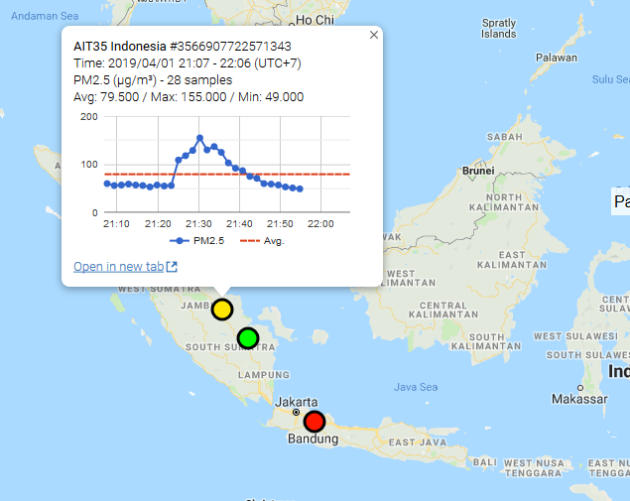
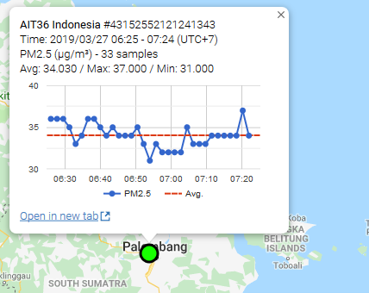
Status of Sensors
AIT 34 Sensor located in Bandung
AIT 35 Located in Palembang ( Sumatra)
Palembang & Jambi
https://canarin.net/seahazemon/map.html

Slide 21
Future Work For SeaHazemon
AIT with support from TEINCC will provide 50 sensors next year to Indonesia
Discuss about the location
Discuss about the possible problems
Telecommunication obstacle
Internet Obstacle
Sensor availability
Accuracy of the data
Discuss the format of the raw data
Discuss the repository server
Operational Issues on the sensor network
Reliability and availability of the sensor
Calibration method, and verification of the data

Slide 22
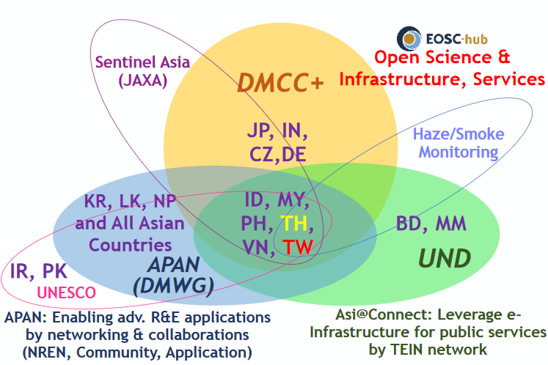
Disaster Mitigation Competence Center (DMCC)
Focus on Case Study for Simulation on Dust Transportation around Indonesia
Provide some data
Dissemination on education and research community
Tsunami Impact analysis using iCOMCOT portal

Slide 23
Future (Next) works
Build the webbase enable and repository data
Development with Sea-hazemon project for deployment sensor around Indonesia for Air Quality monitoring (PM 2.5)
Development and deploy AWS(Protype 1.0) for delivering data and build model with Ministry of Forestry and Environment
Build the case study with DMCC (facilitate for I-Comcot Tsunami and WRF-chem Simulation) → DMCC and EOSC-Hub

Slide 24
Summary
E-infractures has been develop in Indonesia
Network Infrastructure
Clustering Computing facilities
Some specific application (environment sensors)
Need more collaboration amongs the research community
Open the data for public or research community
Sharing the knowledge , resources and data within the countries
Growth up the community of research with the limitation of the Country (Indonesia)

