Slide 1
Big Earth Data
Cloud Service Platform：Architecture & Service
Xuebin CHI（chi@sccas.cn）
Computer Network Information Center
Chinese Academy of Sciences
ISGC2019, 2019-04-04

Slide 2
Outline
Background
Computing Facilities & Storage System
Data Management and Data Infrastructure
Computing Engines & Data Analysis Services
Cloud Service Catalog and Portal
Conclusion

Slide 3
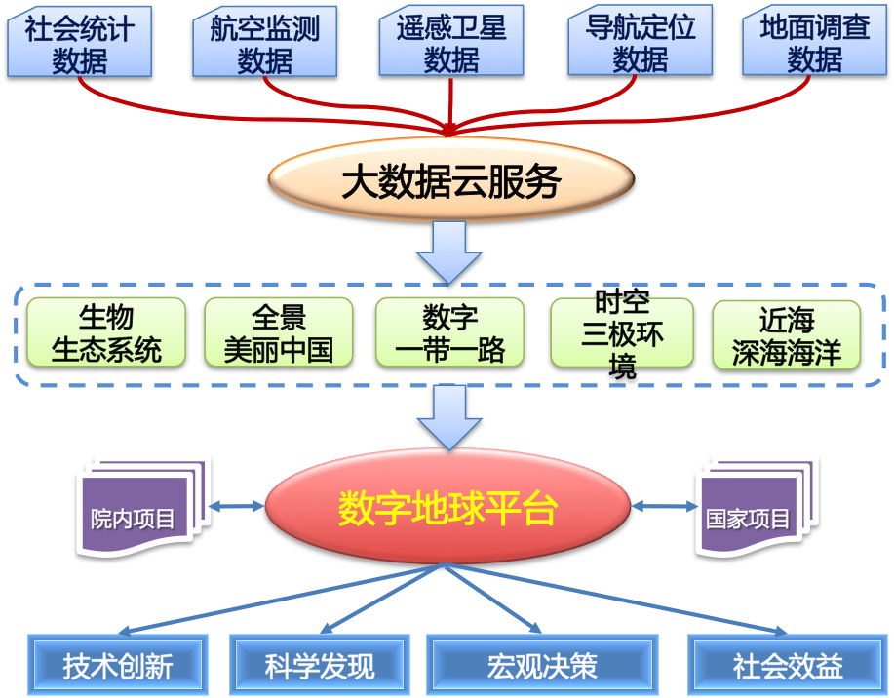
CASEarth Program
A CAS Strategic Pioneer Research and Development Program
  Total investment is almost 1.8 billion RMB (almost 250 million euro) for 5 years (2018-2022)
  CASEarth Satellite, CASEarth Cloud platform, Digital Earth platform
Aims to build the International Big Earth data Science Center
  Building the leading edge big earth data infrastructure
  Accelerating Big data driven science discovery
  Providing decision supporting services for government
Census data
Aviation data
Remote-sensing data
Navigation
data
Monitoring
data
Big Earth data Cloud
BioOne
Beautiful China
DBAR
Tri-poles
Ocean
CAS Projects
Digital Earth
National Projects
Technical Innovation
Scientific Discovery
Macro Decision
Social benefits

Slide 4

A lot of Legacy edge systems
Multi-discipline data and applications
Edge computing + Cloud computing
…
Data can be transfered and shared on demand
Computing capacity can be shared on demand
Data analysis methods and algorithms can be shared
Cross disciplinary discovery can be supported
…
Digital Earth
Big Earth Data
Cloud Service Platform
…
Bio
diversity
BioONE
Ocean
DeBar
Bio
diversity
sequences
…
Eco
system
…
…
sequences
…
…

Slide 5
Big Challenges
How to make data findable, accessible and usable?
  Flowing from the source to target applications automatically
  Heterogeneous data integrating and processing
How to make cyber infrastructure and computing facilities be easily shared by multiple applications and users
  Software defined deployment for specific applications
  Autonomous and elastic scaling out
  Invisible for scientists
How to share scientific models, big data analysis methods and algorithms
  e.g pre-trained machine learning algorithm can be used by multiple applications
…

Slide 6





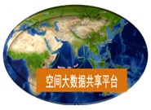

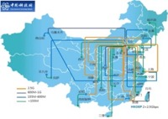


High-level architecture of Cloud Service Platform
Digital earth
Cloud service
Portal
Computing service
Storage service
Data access service
Analysis service
Subject-oriented service
……
Middle ware & software
Big earth data software stacks
Data management
Computing engines
Analysis Engines
Visualization
社会统计数据
专题数据产品
Research data
Earth data Pool
卫星遥感数据
导航定位数据
地面调查数据
航空监测数据
Infrastructure
Network
High-performance computing
High-Throughput computing
Massive storage system

Slide 7
Outline
Background
Computing Facilities & Storage System
Data Management and Data Infrastructure
Computing Engines & Data Analysis Services
Cloud Service Catalog and Portal
Conclusion

Slide 8

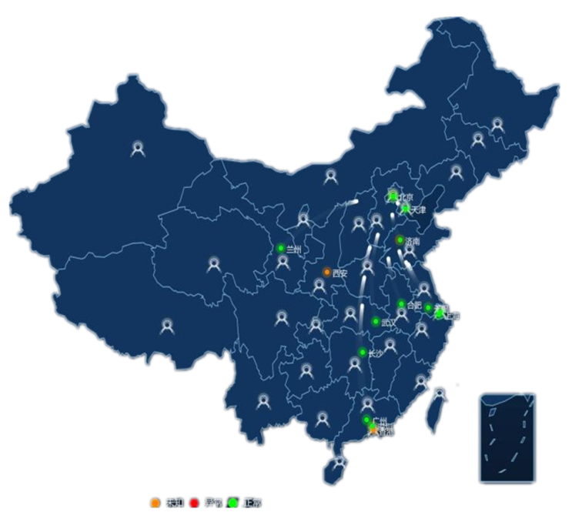
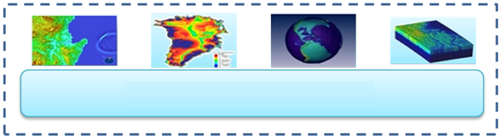

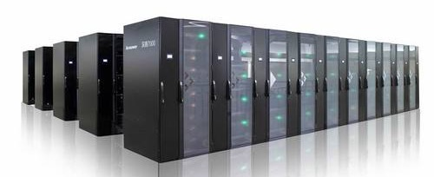
Hybrid Solution
Cloud service platform
Special-purpose computing system for big earth data
China National High Performance Computing Environment

Slide 9
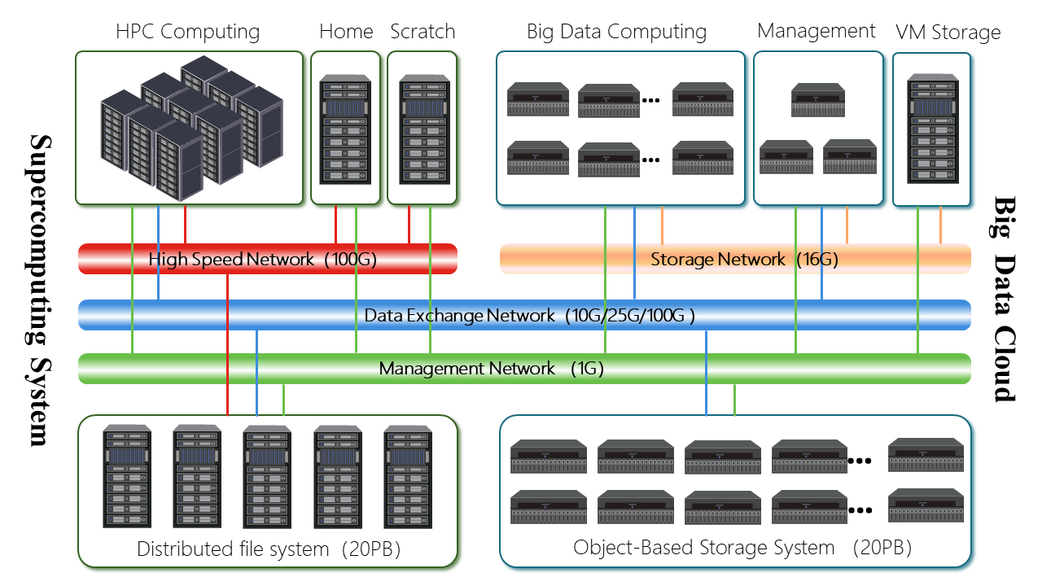
A special-purpose computing system for big Earth data
Integrating HPC/Big Data/Cloud Computing
Hybrid architecture
1Pflops HPC
≥10000 CPU cores support 10000 VMs
≥ 35PB available storage space
High speed data exchange network
GPU acceleration
Unified authentication, administration, portal

Slide 10
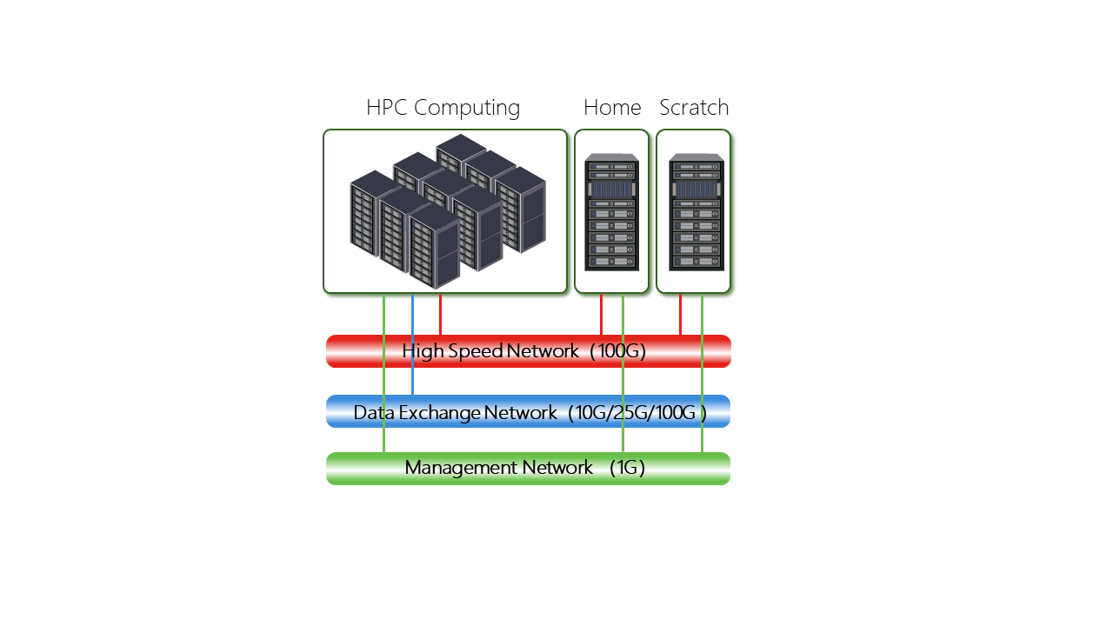
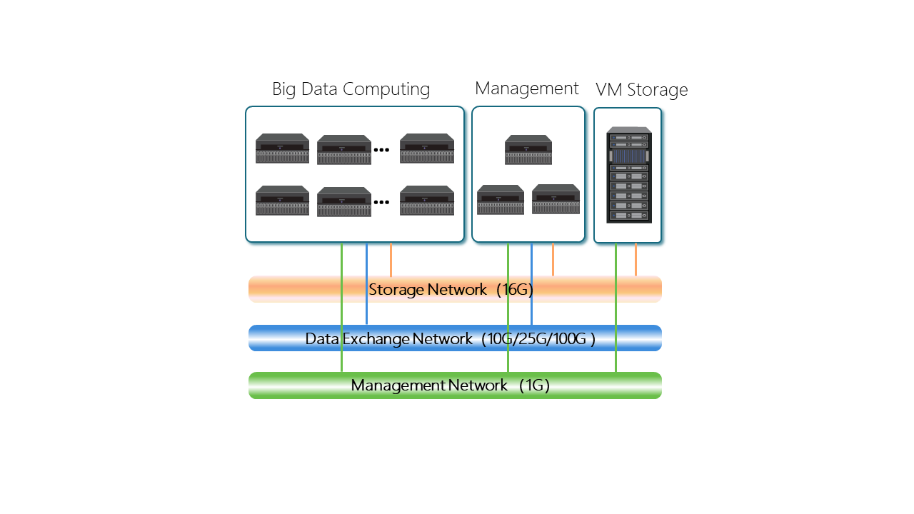
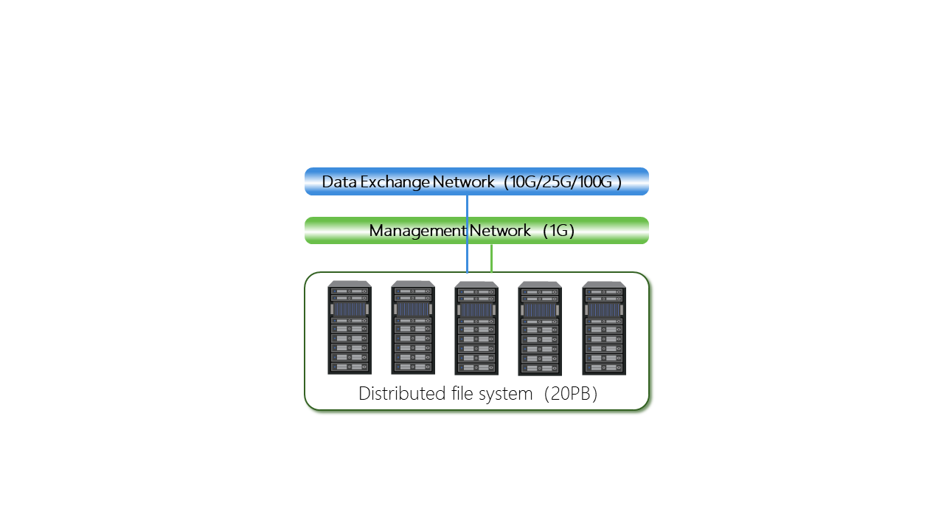
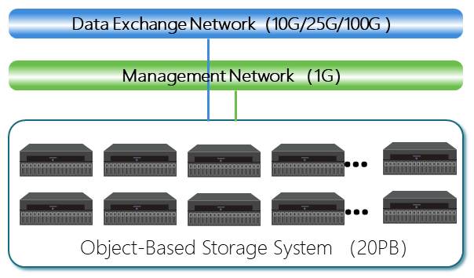
Data Flow Path
Supercomputing
Cloud Computing
File storage system
Object storage system

Slide 11
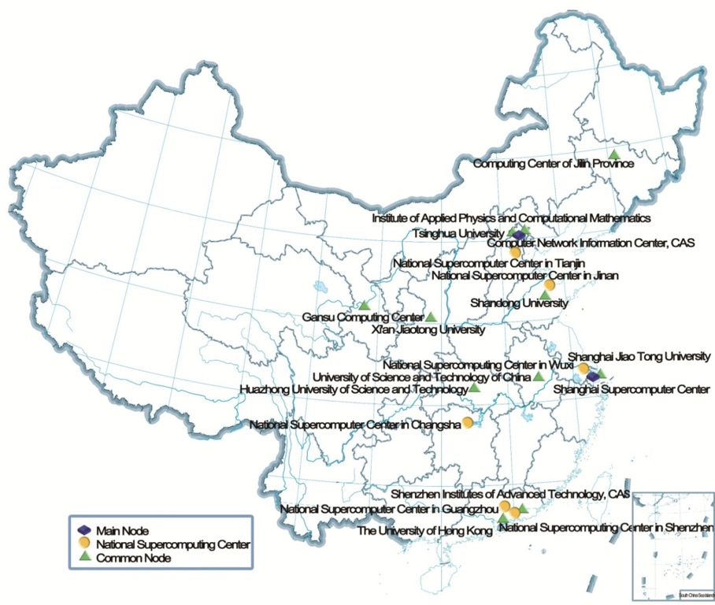
China National High Performance Computing Environment
2 Operating Centers
( Beijing / Hefei )
19 Sites
Portal with Micro-Service
Architecture
Application Oriented
Global Scheduling & Predicting
Resource Evaluation Standard &
Comprehensive Evaluation Index

Slide 12
Outline
Background
Computing Facilities & Storage System
Data Management and Data Infrastructure
Computing Engines & Data Analysis Services
Cloud Service Catalog and Portal
Conclusion

Slide 13
Key Components of Data Infrastructure
Data Portal
Unified data access interface
Finable, Accessible, Usable
Data Bank
Remote sensing data pool
on-demand computing and analysis
Data Fabric
Distributed data sources
dynamic aggregating accessing
Data Repository
Online data publishing & sharing
citable, evaluable
Data Box
Analysis-oriented Remote sensing data management
DataStor
Object storage, SQL, NoSQL, File system

Slide 14
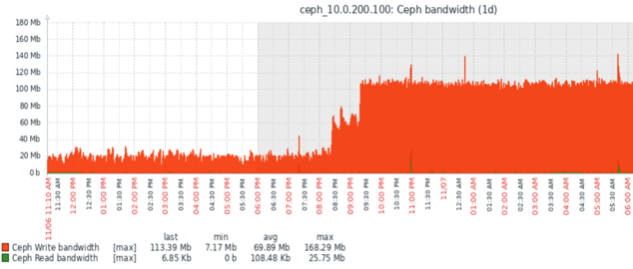
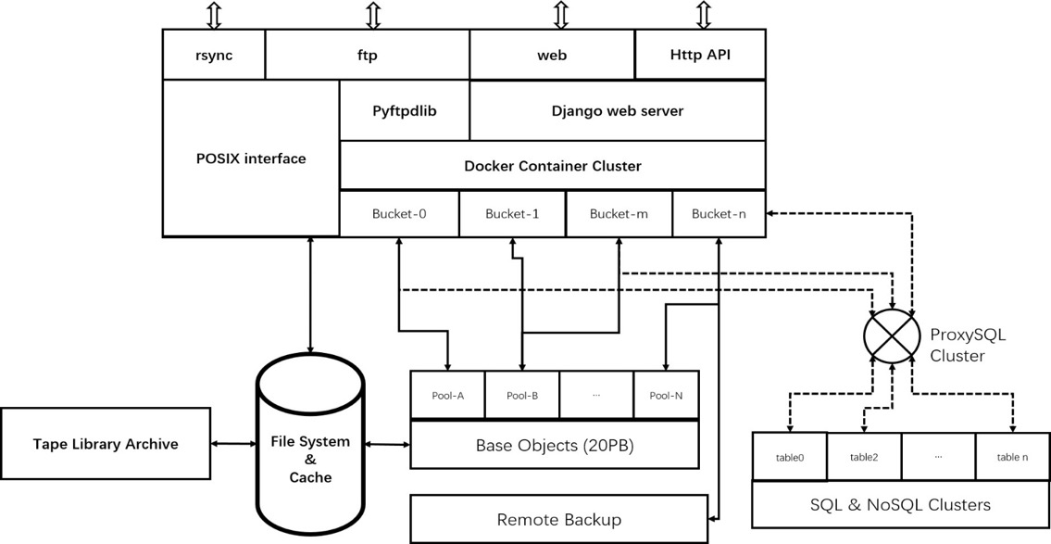
DataStore
Multi-mode Storage
  Object + SQL + NoSQL + Filesystem
  Object storage system architecture & pressure test

Slide 15
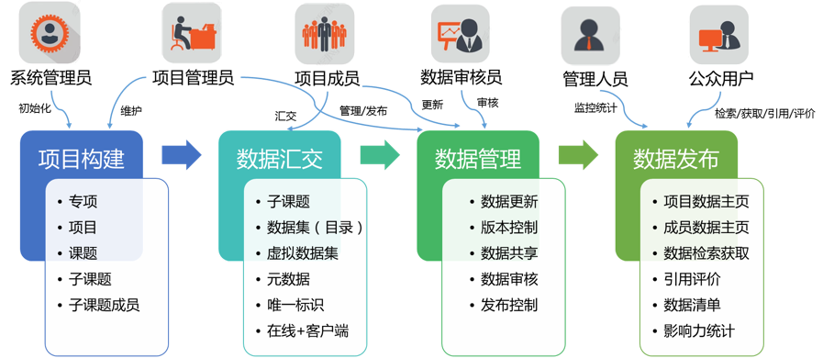
Data Repository
Research data long-term storing, sharing and discovering
  Uploading data online
  Self-management, publish on demand
  Unique identification, citable, evaluable
Store&
Manage
Create
Upload
Publish

Slide 16
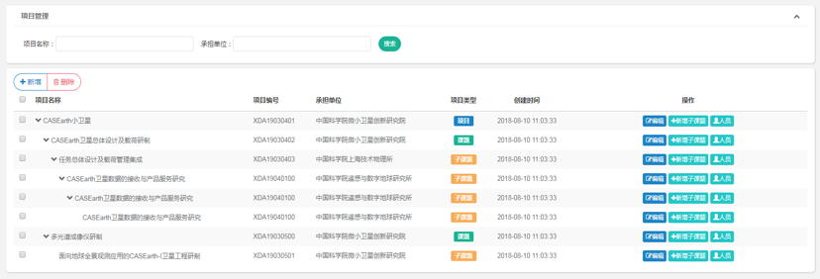
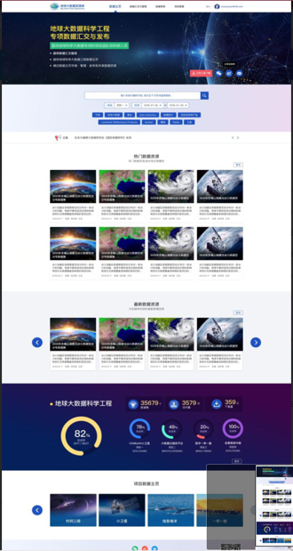
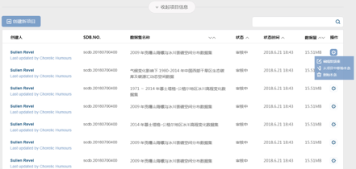
Data Management for Research projects
data management cloud service for data produced by research projects
  Covering data life cycle, from data management plan, data upload, data curation and publish

Slide 17
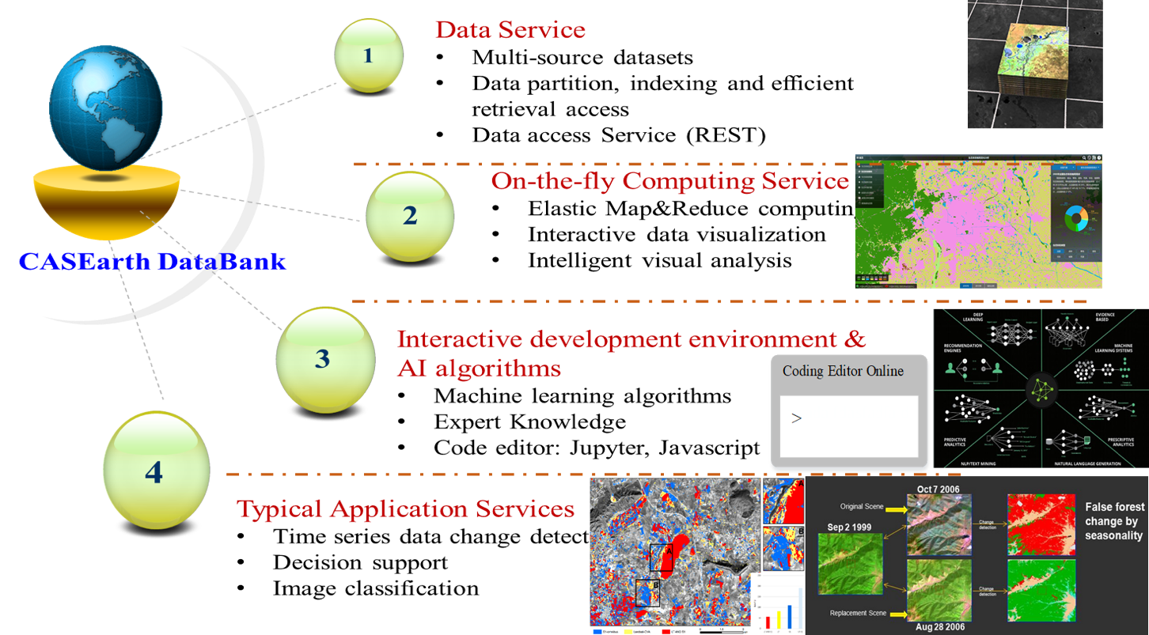
DataBox & DataBank
Efficient search and access for PB-scale RS data

Slide 18
Databox: a spatio-temporal data management engine
reduces processing time of traditional image analysis by calibrating, pre-computing known extents, pixel alignment and storing metadata in a cell lattice structure, makes data analysis ready
DboxStorage：IO Middleware
DBoxDataset：GDALDriver
DBoxMapServer：map serve engine
DBoxCache：distribute cache
DBoxMR：real-time scheduling
DBoxTaskServd
DBoxMapServd
DBoxWebServd
DBoxMR
GDAL & DBoxDataset
DBoxCache
Python3
Dboxio API
Task Queue
Local
Cache
DboxStorage
mongos
Workers
Ceph cluster
Mongodb cluster

Slide 19
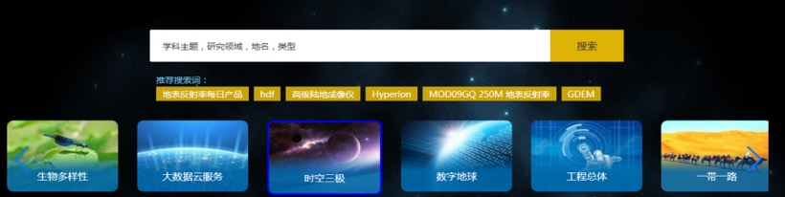
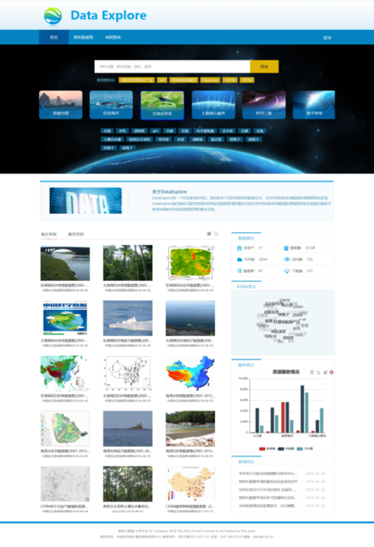
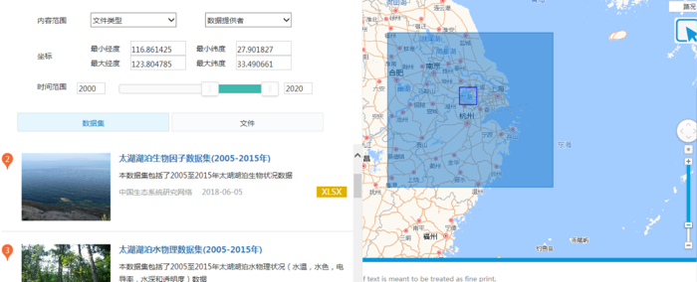
Data Portal
To Browse, Search, Access, Download, and Visualize
Data linking & data recommendation
Search by keywords & categories
Hybrid search by keywords and geographical coverage

Slide 20
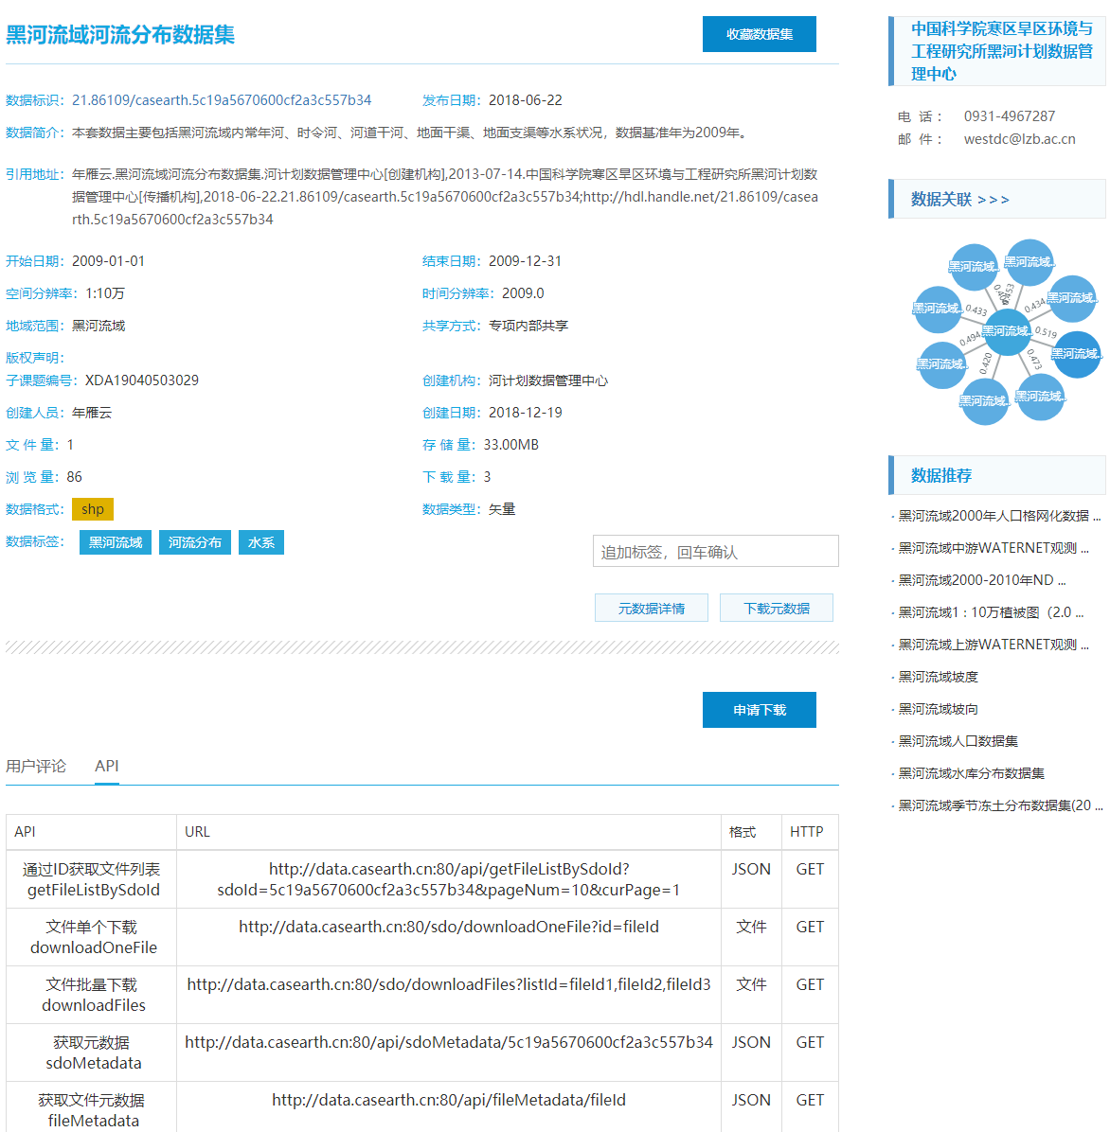
Fair Data
Make each data set Findable, Accessible, Interoperable and Reusable
PID
Citation
Citation
Data linkage
Data Recommendation
APIs for Machine

Slide 21
Outline
Background
Computing Facilities & Storage System
Data Management and Data Infrastructure
Computing Engines & Data Analysis Services
Cloud Service Catalog and Portal
Conclusion

Slide 22
Multiple Data Process Engines based on Virtualization and Caching Technology
CE for Images
Utilizing Container and Virtualization Technology pack-up Computing Engine Logic for rapid deployment and hybrid deployment
The Distributed Cache can solve data persistent issue and enhance the performance of mass data process as well
CE for Multi- Dimensional Spatial Data
Computing Engine for Time-Series Data
MPP DB with Spatial Computing Extension
MPP DB for PostGIS
MPP DB on Cloud
Parallel Spatial Aggregation Functions
Centralized Storage
Index for Spatial Objs
Multi-Tenancy
Distributed Hierarchical Cache
DHC
Apache HAWQ（PostgreSQL 8.2）
KV, File System and Object Interfaces
APIs
RMDA over IB
Data Mgmt. for Local Cache
Local Cache
Distributed In-Memory KV Cache
IM Cache
Data persistency based on Local File System (SSD+HD)
Local FS
Persistent Storage (HDFS， S3， Swift， Ceph， Luster，NFS， etc.)

Slide 23
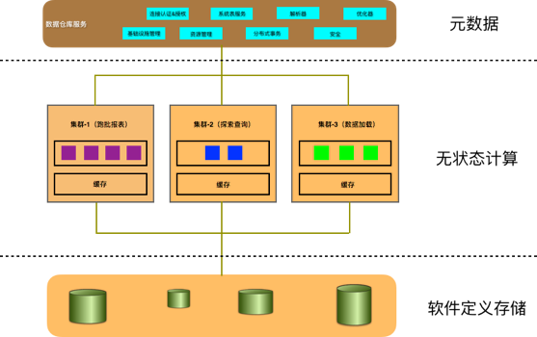
MPP DB with Spatial Computing Extension
Performance test
Output format: netCDF
Start date: 2015-01-15 00:00
End date: 2018-05-24 12:00
Parameter(s):
Temperature
Vertical level(s):
Ground or water surface
Product(s):
3-hour Forecast
Link:https://rda.ucar.edu/#dsrqst/JIAN295398/index.html
4.1GB netcdf compressed data
13GB netcdf
12GB Tiff
23GB loaded database
 | original | splitted
Records | 14845 | 2116206
Size pre record | 253x205 | 20x20
Query time | 109.5 s | 112.8 s
Optimized query time | 109.5 s | 4.3s
Query：
SELECT avg(ST_Value(rast, ST_Point(103.23087483, 24.531609336))) from test
SELECT avg(ST_Value(rast, ST_Point(103.23087483, 24.531609336))) as value from test_tile
where ST_Intersects(ST_Point(103.23087483, 24.531609336), bounding ) =true
Optimized performance speed up by 23 times

Slide 24
Computing Engine for Time-Series Data
Second-level task distribution and startup
Container enabled
Average delay, mirror volume, and startup time are better than Apache Spark & Apache Flink
系统名称 | 平均延迟(ms) | 镜像体积 | 启动时间(s)
Spark Streaming(KVM) | 351.90 | 5GB | ~60s
Spark Streaming(Docker) | 416.76 | 1.2G | ~6s
Flink(KVM) | 129.83 | 5GB | ~60s
Flink(Docker) | 35.57 | 800MB | ~6s
Computing Engine for Time-Series Data | 28.42 | 100MB | ~2s
Architecture

Slide 25
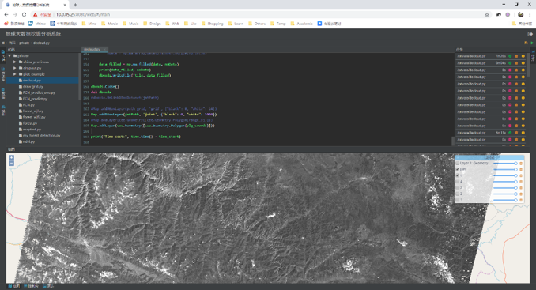
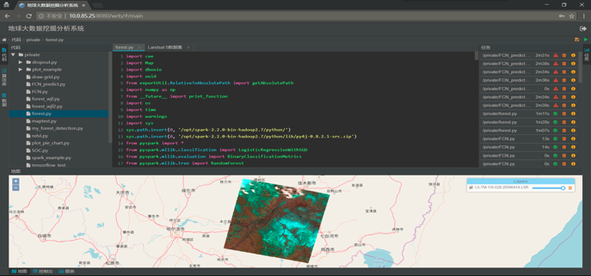
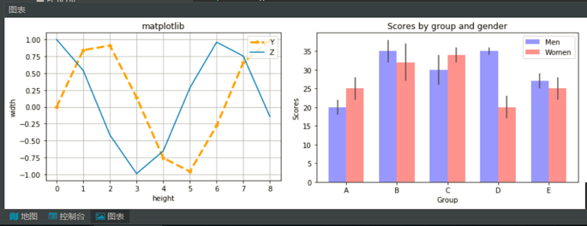
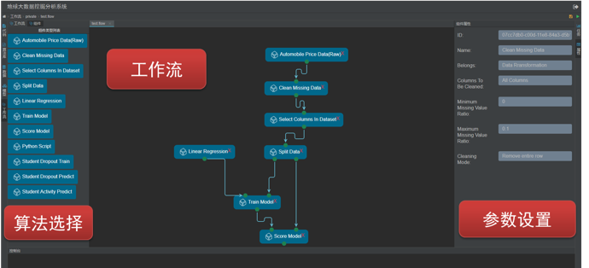
EarthDataMiner
Online interactive data analysis environment
  Using the data processing and analysis function API provided by the system, writing mining analysis code (Python)

Slide 26
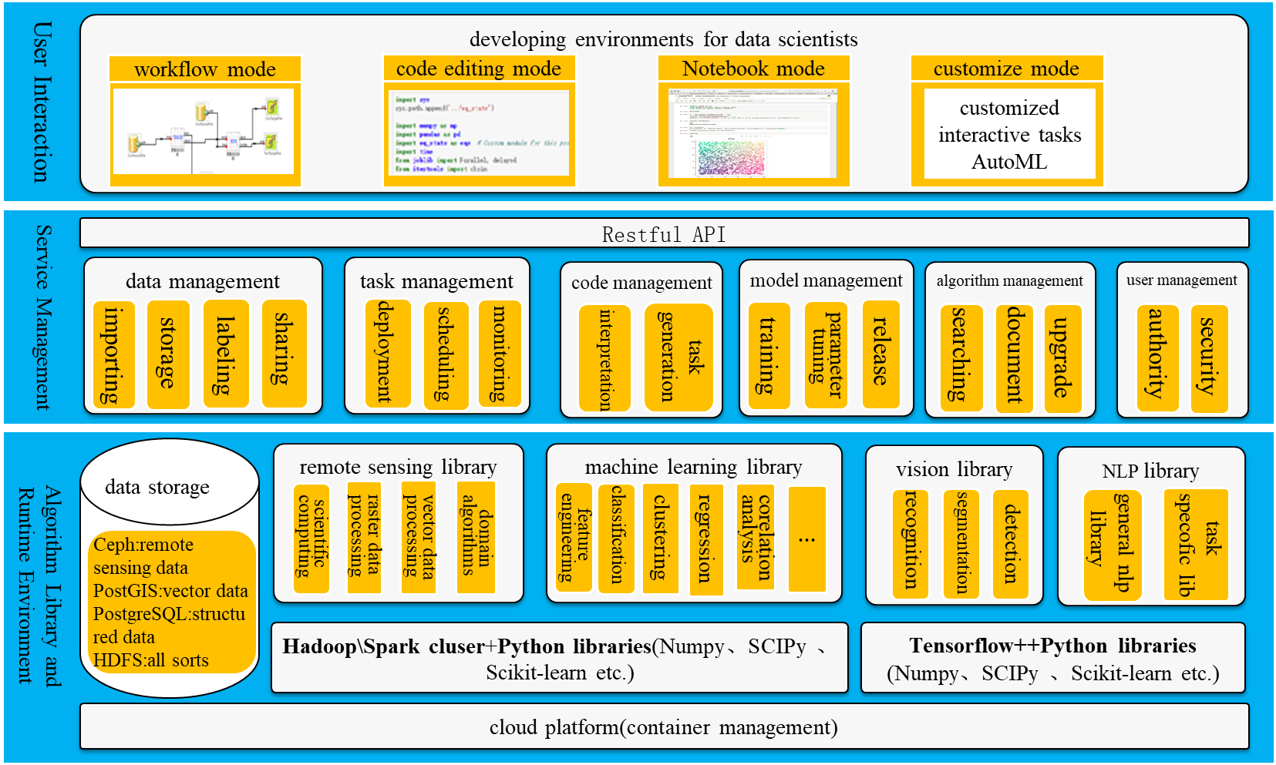
Architecture of EarthDataMiner

Slide 27
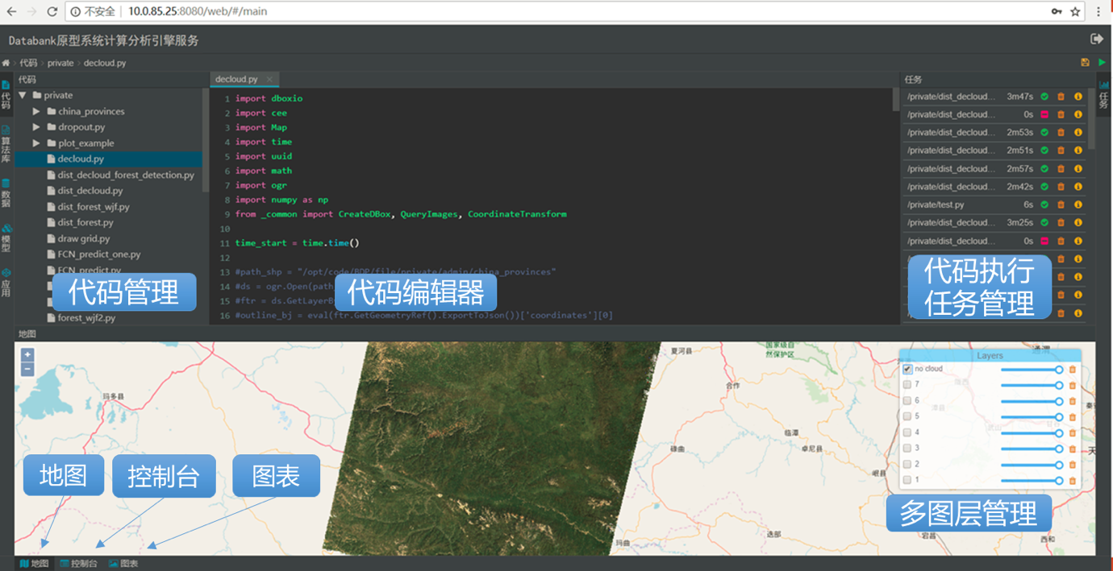
Web IDE for EarthDataMiner
A prototype been developed, Supporting users to write data analysis code (Python) online, providing a batch of basic data processing and analysis function API

Slide 28
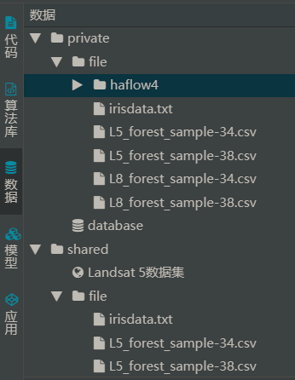
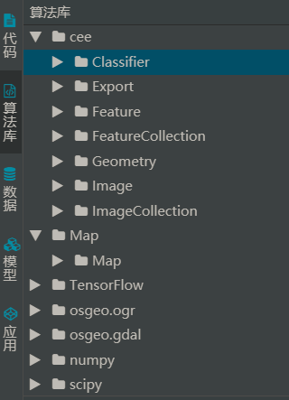
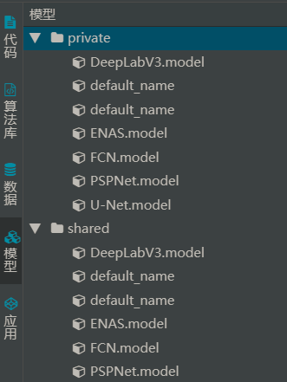
Algorithm & Model Library
More than 20 algorithm developed and provide cloud service: FAAS(Function As A Service)
Data
Algorithm
Model

Slide 29
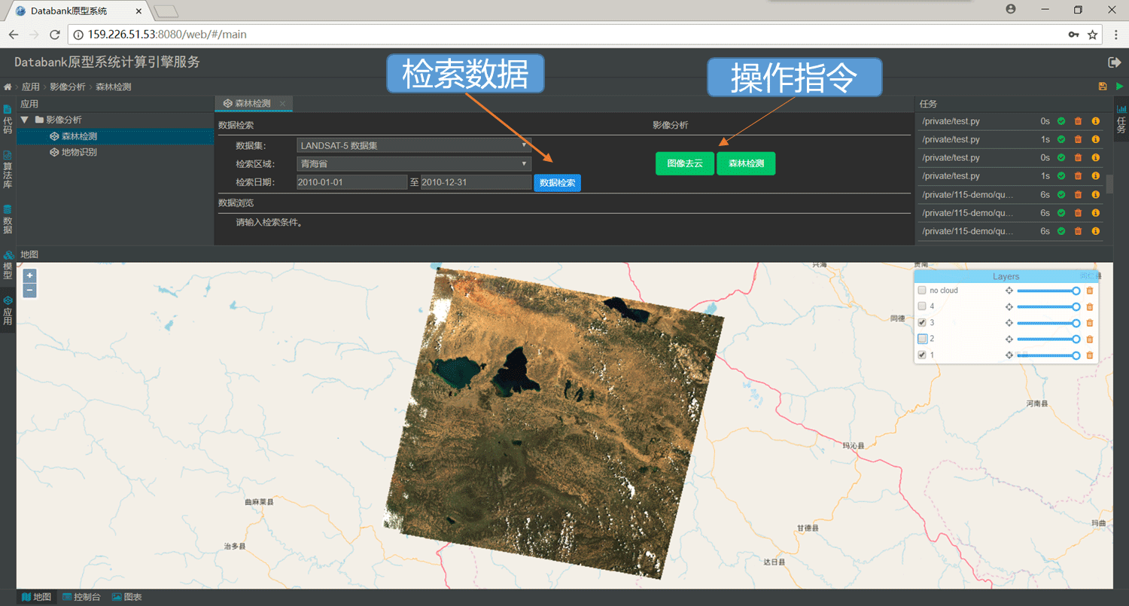
Integrated with DataBank
Upload models, select data, and process data products through instruction operations

Slide 30
Outline
Background
Computing Facilities & Storage System
Data Management and Data Infrastructure
Computing Engines & Data Analysis Services
Cloud Service Catalog and Portal
Conclusion

Slide 31
Cloud Service: Category
Infrastructure as a Service
Compute, Storage, Networking
HPC, EMR, ECS, etc.
Data Management & Sharing
Publishing, Integration, Discovery, Accessing, Sharing
Processing & Analysis
Applications
Service Registration & Sharing
Processing Engines for CASEarth
Online Big Earth Data Analysis
Domain Research Achievements
Specialized Application Services
Open Registration for Services
Universal Discovery of Services

Slide 32
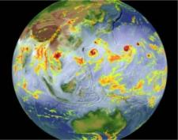
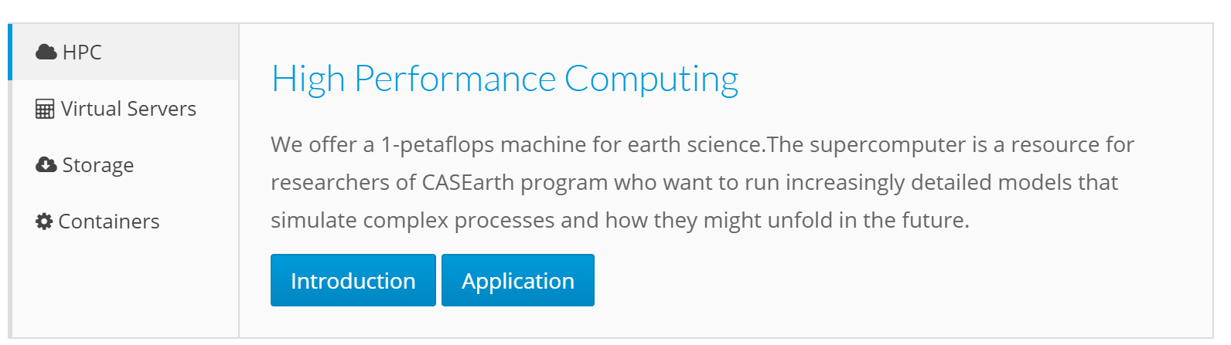
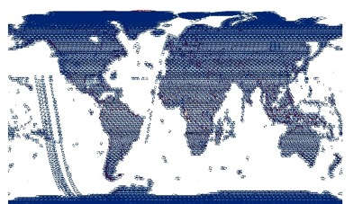
Cloud Service：
Infrastructure as a Service
Integrating HPC, Cloud Computing, Cloud Storage as a Unity
Online Application & On-demand Rapid Deployment
atmospheric circulation simulation
Remote Sensing Image Processing

Slide 33
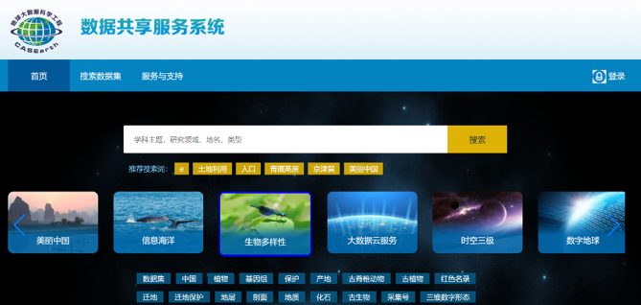
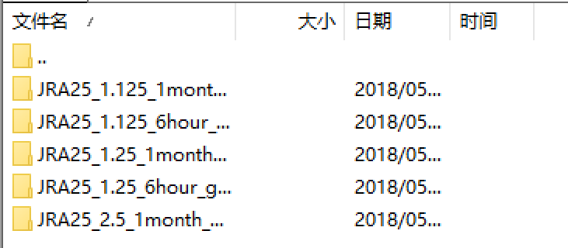
Cloud Service：
Data Management & Sharing
Data Discovery & Accessing
  Both for Web Users & Shell Users
  Data Reproduction Supported
Data Publish & Publication Online
  Hybrid integration mode: Centralized & Distributed
  Unique Identification, Intelligible
Shell data access for workspace

Slide 34
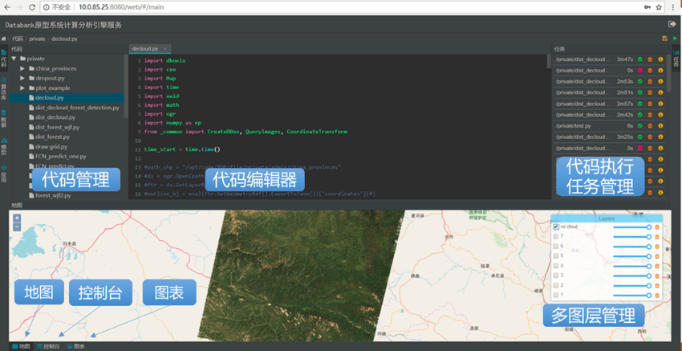
Cloud Service:
Processing & Analysis
Specialized processing engines and analysis platform for Earth study
  Processing engines are applied and used online
  Accelerating querying and computing of remote sensing data
EarthDataMiner:
Online code editing
Code management
Task management
Map Service

Slide 35
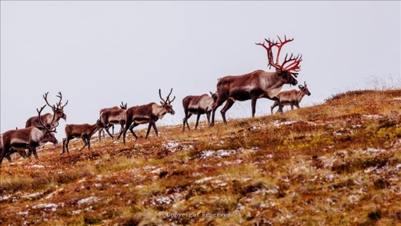
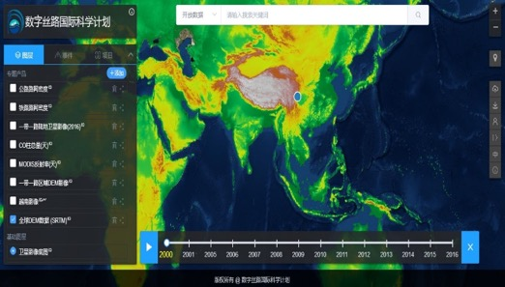
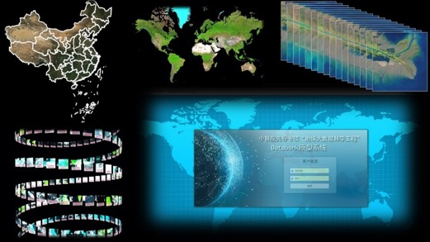
Cloud Service：Applications
BioONE
Integrating Research Achievement of CASEarth projects
  BioONE(Biodiversity), One Belt One Road, Tri-polar, Ocean
DataBank
  A Specialized Application Service for CASEarth
  Ready to Use Remote Sensing Image Data
  High-efficiency RS Data Engine
    Querying, Accessing, Computing
DBAR
DataBank

Slide 36
Conclusion
A integrated environment based on super-computing and cloud computing technology is crucial for Big earth data driven discovery and decision supporting
The Big Earth Data Cloud Service Project will be a good exploration on how to integrate computing power, algorithms and data to accelerate science discovery
  Just beginning, long way to go

Slide 37
Thank You very much
for Your Attention!
Thank my colleagues
Jianhui Li, Yining Zhao, etc.

