Slide 1
e-Science Activities in China
Gang Chen
Institute of High Energy Physics, CAS
ISGC2019
April 4, 2019

Slide 2
Outlines
National HPC and BD programs
Computing for HEP at IHEP

Slide 3
National HPC and BD programs

Slide 4
Efforts of national R&D programs
Supported by
Ministry of Science and Technology (MoST),
Nature Science Foundation of China (NSFC)
 | MoST - ’863’ program | MoST - ’973’ program | MoST- Key R&D program | R&D Mega- Program | NSFC
HPC | 3 key projects | 3 projects | 1 Key project |  | 1 key initiative
BD |  | 6 projects | 1 key project | Mega-project on BD to be launched | 10+ major projects

Slide 5
Past HPC key projects
2002-2005：High Performance Computer and Core Software
  China National Grid (CNGrid) testbed
  Grid-enabled applications in selected areas
  TeraFlops computers
2006-2010：High Productivity Computer and Grid Service Environment
  High productivity
    Application performance
    Efficiency in program development
    Portability of programs
    Robust of the system
  Service features of the HPC environment
  PetaFlops computers
2010-2016：High Productivity Computer and Application Service Environment
  100PF computers
  large scale HPC applications
  Upgrading CNGird

Slide 6
Current HPC projects
Key R&D project: “High Performance Computing” (2016-2020)
  Next generation supercomputer development
  HPC applications development
  CNGrid upgrading and transformation
NSFC key initiative: “Basic Algorithms and Computable Modeling for High Performance Scientific Computing” (2011-2019)
  Computable modeling methods
  Innovative basic algorithms
  Domain applications for demonstration
NSFC/Guangdong province joint program on supercomputing
  Supporting Tianhe-2 users in the form of CPU hours
  600+ projects supported

Slide 7
Current BD projects
Cloud computing and Big Data, key project
  Software-defined cloud computing
  Cloud OS
  Big data storage technologies and platforms
  Domain-specific big data management system
  Dataflow-based big data analysis system
  Big data analytics applications
  …
NSFC/Guangdong province joint project on Big Data Science Center
  5-year program, 300 million RMB
  Supporting about 10 projects

Slide 8
Application-related R&D under the HPC projects
Application enabling techniques
  Modeling methods and optimized algorithms for exascale computing
  Parallel algorithms & libraries for exascale computing
  Parallel programming framework
  HPC application development platform and tools
Domain application software
  Numerical devices
  Domain HPC application software
CNGrid-based service systems
  Integrated business platforms
  Application villages
  HPC education practice platform

Slide 9
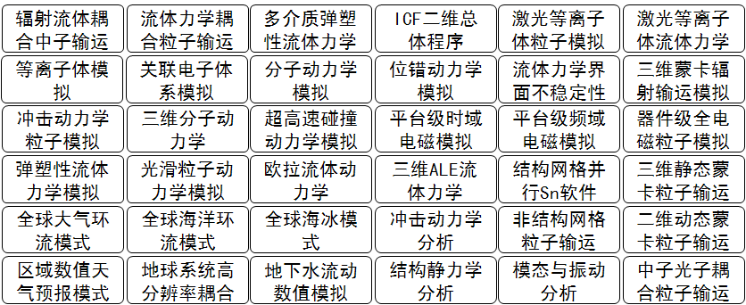
Parallel Programming framework
Supporting development of 40 application software
Application achievements
Original innovation
Structured mesh
JASMIN
PHG
Unstructured mesh
Fram- work
parallel efficiency 30% at 2 million core
Mesh-free combinatory geometry
JAUMIN
GRAPHINE
Finite element
JCOGIN
Technical innovation
Graph computing
high-efficient implementation scheme
parallel appl. software dev. method
Notes:
9
为了应对两个挑战，我们确定四项研究内容
从这些研究内容提出三个核心的科学问题

Slide 10
Numerical devices
Numerical device refers to a set of software supporting simulation in a specific application domain
Four numerical devices are being supported
  numerical aircraft
  numerical earth system
  numerical reactor
  numerical engine

Slide 11
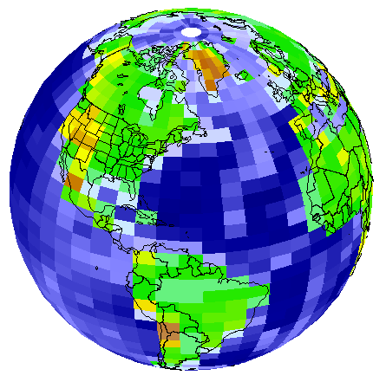
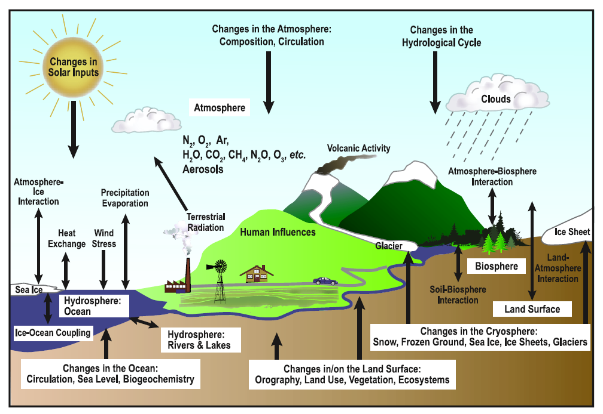
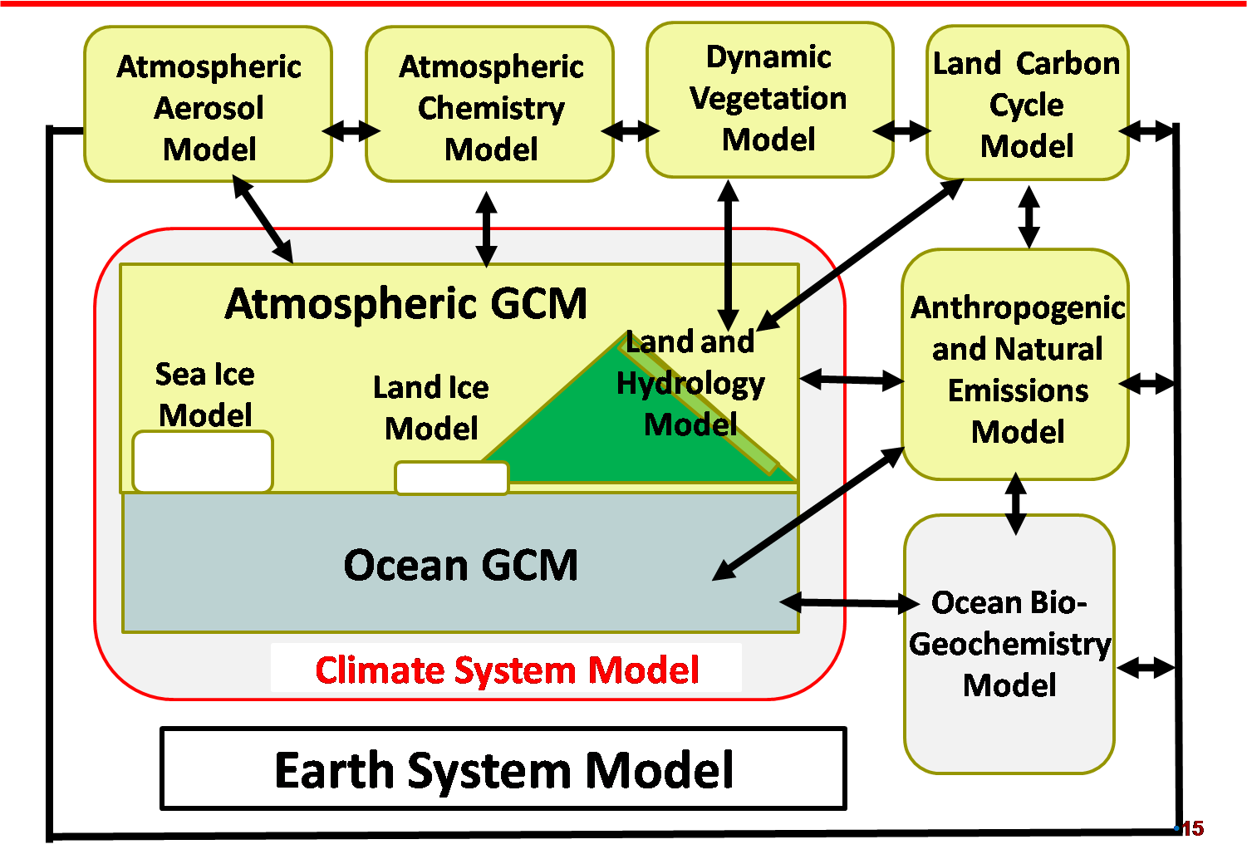
Numerical Earth System
Earth system modeling for studying climate change
Non-linear coupling of multi-physical and chemical processes covering atmosphere, ocean, land, and sea ice
Component Models of the CAS-ESM
Notes:
This slide uses the atmospheric general circulation model (AGCM) in the Chinese Academy of Sciences (CAS) Earth System Model (ESM) as an example to describe the computations. The computations in the atmospheric model include solving the geophysical dynamical equations of the rotating atmosphere (as described by the subset of equations in the figure), and physical parameterizations of atmospheric radiative transfer, turbulence, convection, cloud microphysics etc (as described by the schematic figure). The left bottom panel shows the various component models of the CAS-ESM. These component models are coupled together to simulate climate and earth environmental changes.
这张图用大气环流模式为例，介绍模式的计算内容，包括求解旋转地球流体动力学方程和物理过程参数化（辐射传输、湍流、对流、云维物理等）的计算。右下图描述中科院地球系统模式（CAS-ESM）包含的分系统模式，大气环流模式是其中的一个分量模式。

Slide 12


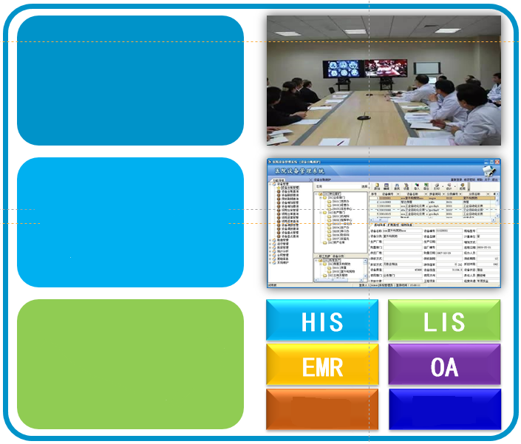
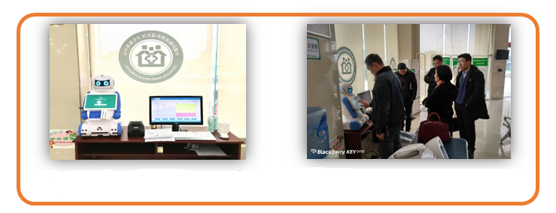
New drug discovery
Misdiagnosis rate :Decreased
more than 20%
Diagnostic accuracy: Increased more than 30%
The duration of treatment: Reduced more than 80%
‘AI Doctor’ On Tianhe Supercomputer
Medical Big Data
AI
Super
computer
Hierarchical medical system
Diagnose Evaluation
Screening
Prediction
Heterogeneous Integration Platform of Medical Data
Science 02 Feb 2018:
Vol. 359, Issue 6375, pp. 598
Existing Medical System(Data Source)
HI
OTHERS
AI doctor deployed in dozens of hospitals in China
Notes:
Several medical applications, such as Artificial Intelligence Doctors, have been well used in Tianhe Supercomputers. Recently we have also made good progress in artificial intelligence, a paper on the joint application of artificial intelligence and precision medicine has been published in Science.
一些医学上的应用已在天河超级计算机上取得很好应用， 比如人工智能医生。近期我们在人工智能方面也获得不错的进展，一篇关于人工智能和精准医学联合应用的论文已发表在Science上。

Slide 13
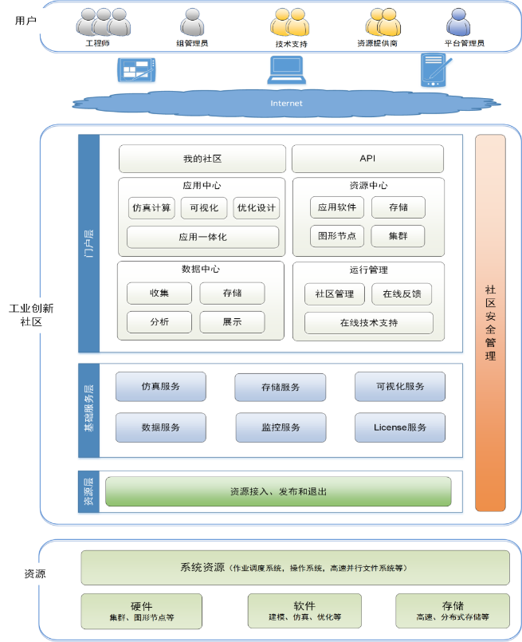
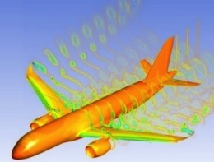
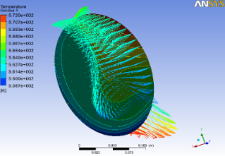
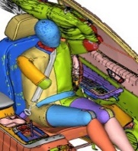
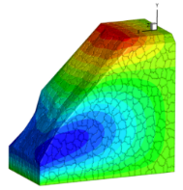
CNGrid-based application village:
Industrial innovation
  Application community based on CNGrid, combining grid and cloud technologies
  Providing professional services for simulation and production design optimization
  Exploring new business model and mechanism for HPC applications
Notes:
这张图需要重新画

Slide 14
Perspectives of BD & AI applications
Pay more attention to emerging BD and AI applications requiring HPC capability
  Treat BD and AI as the first-class citizen
BigData applications
  Much broader scope of applications
  Much higher investment
  Major industry involvement
  Require different software stacks and architectural support
AI applications
  Very hot topic
  Potential large investment
  Require algorithms and novel architecture support
HPC must embrace the new opportunity brought by BD and AI applications
  Major supercomputer developers in China are seriously considering support to BD and AI

Slide 15
Computing for HEP at IHEP

Slide 16
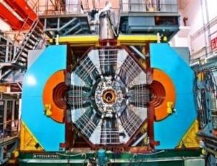
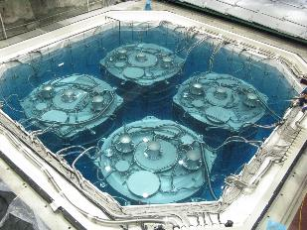
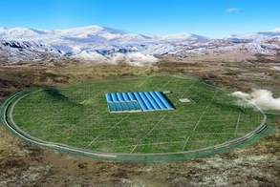
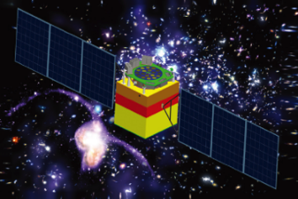
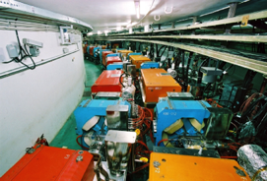
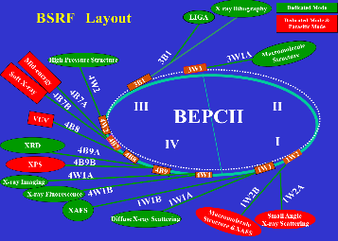
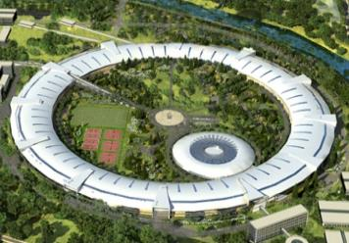
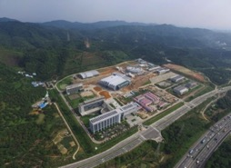
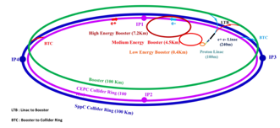
IHEP in Brief
Employee: ~ 1400
Students： ~ 600
Visitors: ~ 400
Budget：~ 1.4 B RMB/year
Theoretical Physics
Spallation Neutron Source (Dongguan)
Computing Center
Applied Tech. Center
BESIII DYB Neutrino LHAASO HXMT
Experimental Physics
Astro-particle physics
BEPCII CEPC/SppC BSRF HEPS CSNS
Accelerator Physics
Multi-discipline research

Slide 17
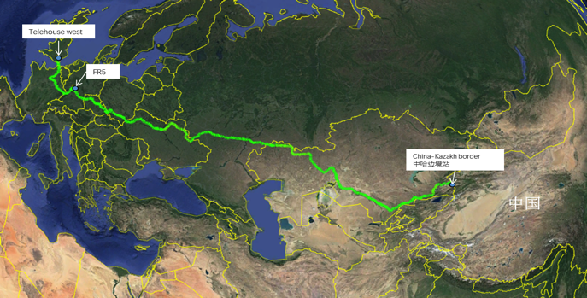
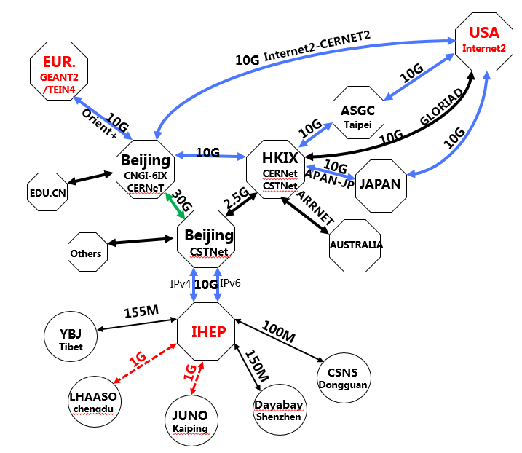
Network connectivities of IHEP
IHEP—USA
  IHEP-CSTNet-CERNet-Internet2/esnet 10Gbps
IHEP—EUR.
  IHEP-CSTNet-CERNet-GEANT(UK)-Europe 10Gbps
  New link from CSTNet to GEANT(DE)-Europe 10Gbps
    RTT: 120ms POP to POP
    China – Kazakhstan - Russia - Ukraine - Poland - Czech - Germany
IHEP—Asia-Pacific
  IHEP-CSTNet-HKIX(Hong Kong Internet exchange) 2.5Gbps
IHEP—domestic
  IHEP-CSTNet-CERNet-EDU
  depends on the network access bandwidth of each university
New link to EUR.
China Education and
Research Network
China Science and
Technology Network

Slide 18
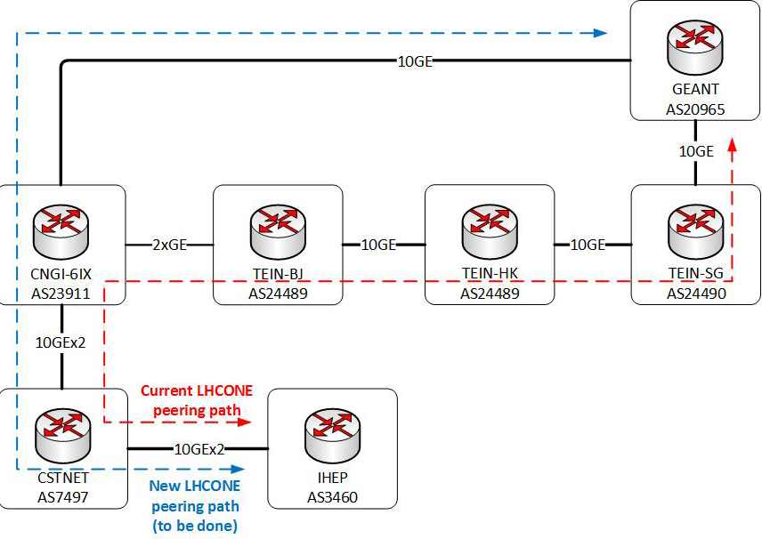
LHCONE in China
R&E network services provided in China
  CSTNet for Chinese Academy of Sciences and other institutions
  CERNET/CERNER2 for universities
VRF Peering has been set up (Peering between CNGI-6IX and TEIN in Beijing)
VRF Peering between CSTNet and GEANT will be set up soon

Slide 19
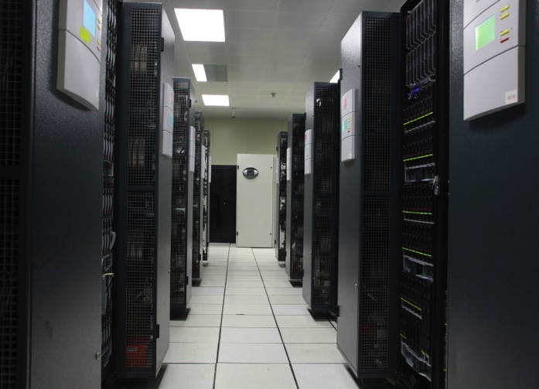
Computing Resources
HTCondor clusters
    HTC jobs: series jobs
    ~13,400 CPU cores
HPC （Slurm） clusters
    HPC jobs: parallel jobs+GPU jobs
    3,384 CPU cores
    80 GPU cards
Grid site (WLCG)
    Tier 2 site
    ~1,900 CPU cores
  Hadoop cluster
    Focus on dedicated model
The BESIII DIRAC-based distributed computing system
    ~ 3,500 CPU cores
IHEPCloud based on Openstack
    ~ 2,000 CPU cores

Slide 20







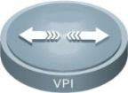





HPC+HTC Architecture
Job
Job
Users
Job
Job
Job
Job
HEP Job Tool
Job
Job
Job
Job
Job
Login Farm
IB Switch
MCS 7520
MetroX 6100
Ethernet core switch
10PB Storage
10Gb Ethernet
EDR InfiniBand
80 GPU Cards
3384 worknode
700 TB Storage
HPC Cluster
123,000 HTC cpu cores
HTC Cluster

Slide 21
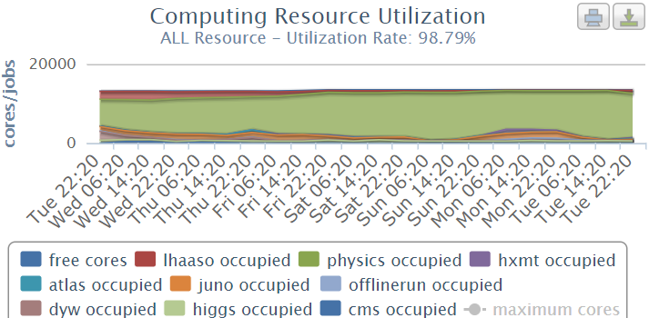
HTCondor Cluster
HTCondor is upgraded from 8.4.11 to 8.6.11
Partially resource sharing → Full-scale resource sharing
  ~13500 CPU cores are completely shared between 14 groups
  Group quota with surplus is used to ensure fairness
A small ratio of resources accept long time (30days) jobs
To provide services to HEP
neutrino, land- and
space-based astroparticle
applications
The overall job slots utilization keeps up to 95%+

Slide 22
HPC Cluster
Created in 2017
    2 master nodes
    2 accounting & monitoring node
    164 worker nodes: 3920 CPU cores + 88 GPU cards
    80 GPU cards will be added in 2019
  Focus on lattice QCD, partial wave analysis, deep learning etc.

Slide 23
BEIJING-LCG2 Tier2 Resources
CPU: 1896 cores
  Intel Golden 6140 1008 Cores
  Intel E5-2680V3: 696 Cores
  Intel X5650 192 Cores
Batch: Torque 4.2.10
VOs: ATLAS, CMS, LHCb
DPM: 775TB
  4TB * 24slots with Raid 6, 5 Array boxes
  DELL MD3860 8TB*60
dCache: 540TB
  4TB * 24slots with Raid 6, 8 Array boxes
  3TB * 24slots with Raid 6, 1 Array box
The Site keeps a good reliability at most of the time

Slide 24
BEIJING-LCG2 Tier2 Operations in 2018
Became LHCb Tier 2 site in 2018.
  Resource for LHCb : 1008 CPU cores and 360TB disks.
Joint LHCONE and enable ipv6 for data transfer.
Upgraded servers and work nodes to Centos7
  Developed UMD4 auto installation and configuration modules for Centos7.
  Upgraded DPM storage element to new version.
Testing new computing element and Batch system.
  Cream CE → HT-Condor-CE or ARC-CE
  PBS → HTCondor
Tier2 site auto deployment (puppet modules)
  https://github.com/yyxfei/emiconfig
Notes:
UMD4 is the latest version of EGI middleware

Slide 25
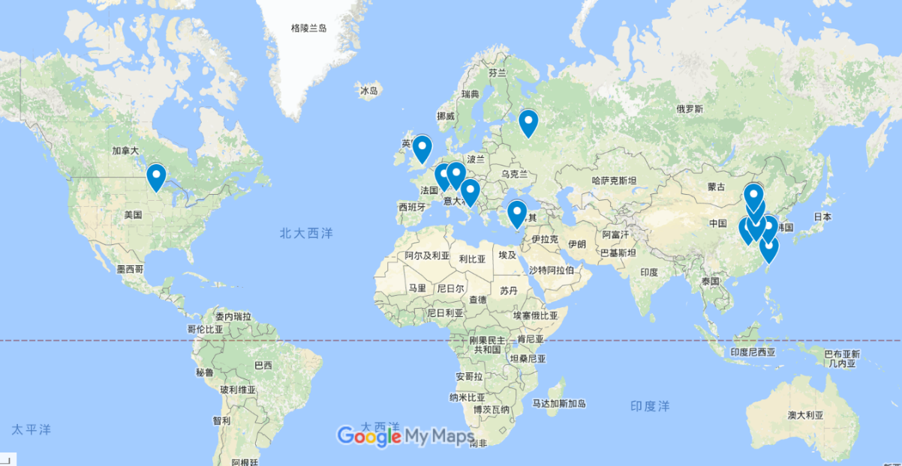
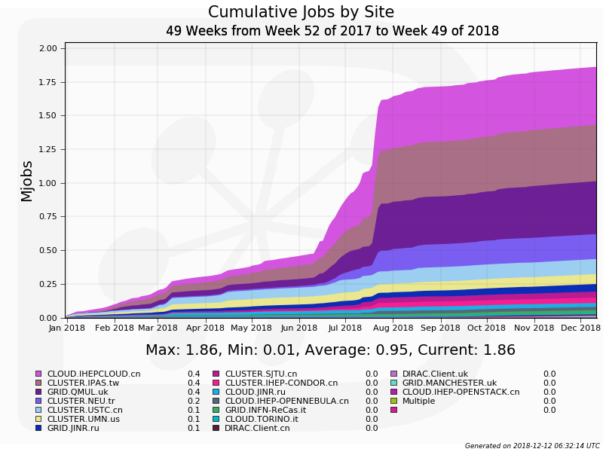
Distributed Computing
IHEP distributed computing based on DIRAC is to integrate and share resources globally
  Site: 15 from USA, UK, Italy, Russia, Turkey, Taiwan, China Universities
  resource type includes cloud, cluster and grid
Network: 10Gb/s to USA and Europe, 10 Gb/s to Taipei
  Joined LHCONE last year
Resource: ~4500 CPU cores, ~1PB storage
About 1.86M jobs running in 2018

Slide 26
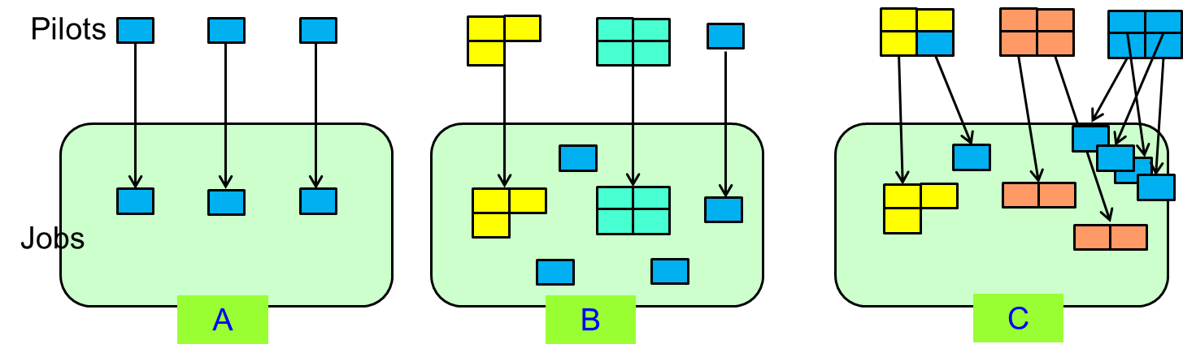
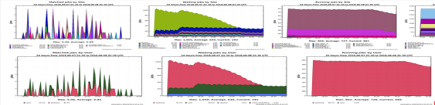
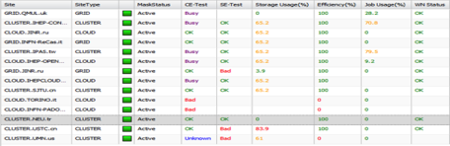
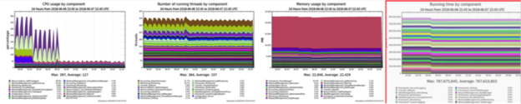
Distributed Computing Recent Effort
Become a common infrastructure for multi-experiments in IHEP
  BESIII, JUNO, CEPC
Extend current pilot infrastructure to enable multi-core scheduling for the support of parallelized experiment software
Introduce lightweight containers (singularity) into the system so that sites can choose its linux version different from the one experiments required
  Already in production for the UK sites
Establish 3 layers monitoring infrastructure with ElasticSearch+Kibana
Join the DOMA working group in the study of future transfer protocols and authentication models
Job
Site
single-core pilot -> multi-core pilot
system

Slide 27
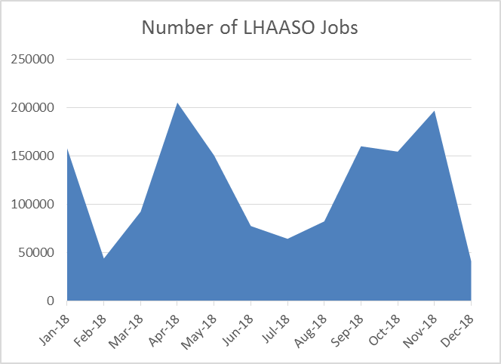
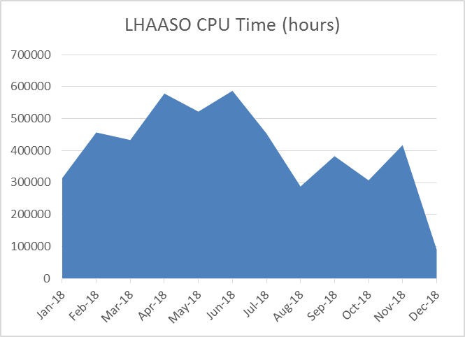
Cloud Computing
IHEPCloud upgrades and runs smoothly
  Add new resources for HXMT experiment to provide a fast and flexible data analysis environment
  Add cloud disk service for users by integrating Ceph storage with Openstack
  User increased from 216 to 356, resource utilization is above 70%
Improve the use of virtual computing clusters and provide a good support for LHAASO experiment
  Provide unified user job submission command for users and integrate the virtualized computing resource into the local physical clusters seamlessly
  In 2018, total number of jobs completed：1,425,181，occupancy CPU hours：48,33,227 CPU hours

Slide 28
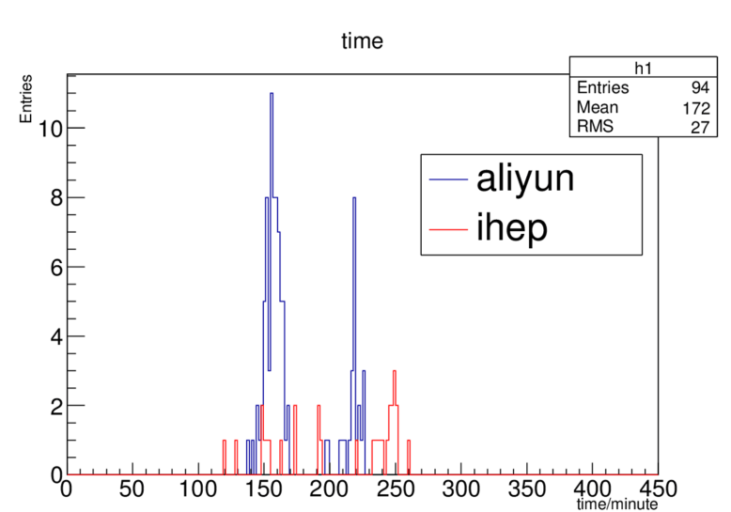
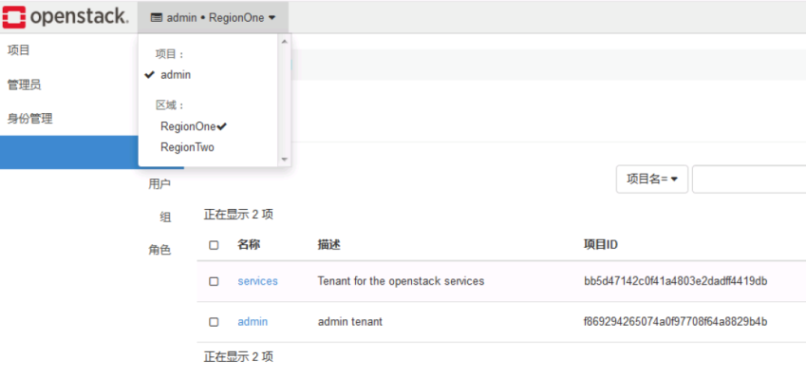
Cloud Computing
Construct the virtualized computing cluster in Daocheng for LHAASO
  Based on Openstack and Kubernetes to significantly reduce the cost of maintenance and improve the system availability in Daocheng
Integrate the computing resources cross regions to expand computing scale for LHAASO
  Using Openstack multi-region and HTCondor to provide a unified resource management and schedule job to remote sites transparently
  A prototype is located in Beijing, Chengdu and Dongguang
  Some commercial cloud(Alibaba Cloud and CDS Cloud) is being evaluated to ease computing resource pressure , especially peak demand
    The tests of submitting LHAASO simulation jobs to Alibaba Cloud have been done

Slide 29
Comments and Acknowledgement
HPC, AI, BD have been developed rapidly in the last years.
More new resources and services deployed at IHEP to support applications
Special thanks to
  Depei Qian, BUAA
  Jingyan Shi, IHEP
  Fazhi Qi, IHEP

Slide 30
Thank you

