Slide 1

eScience Activities in Japan
On-demand Cloud Configuration to Support R&D Utilizing Clouds
ISGC 2019
Center for Cloud Research and Development
National Institute of Informatics
Kento Aida

Slide 2
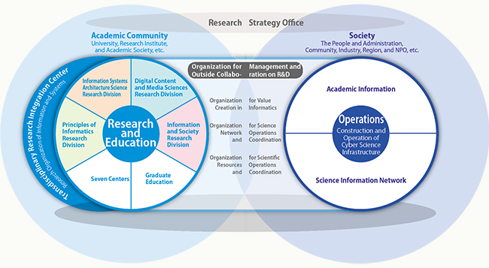
National Institute of Informatics (NII)
The National Institute of Informatics (NII) seeks to advance integrated research and development activities in information-related fields, including networking, software, and content. NII also promotes the creation of a state-of-the-art academic-information infrastructure.

Slide 3






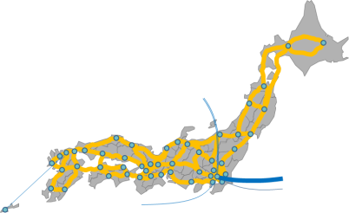
Academic Infrastructure with SINET5
Collaboration and Promotion in Research and Education
Resource
Federation
Promotion of academic information circulation and open access
Collaborative promotion of institutional repository expansion
Collaborative enhancement of authentication between universities
GakuNin
Federation
Cloud
Security
Flow Analysis
enhancement of research and education environment by tailored cloud services
Dramatic cost reduction
Network flow analysis and dynamic control
Raise of security level for SINET users
GakuNin-Cloud
Direct Connection
VPN
Network
Nationwide 100-Gbps backbone network and scalable network expansion
High-speed direct international lines to USA, Europe, and Asia
Introduction of new technologies such as SDN in response to user needs

Slide 4








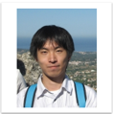


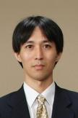
Center for Cloud Research and Development (CCRD)
The center aims at establishment of the national advanced R&E infrastructure taking advantage of clouds. We research and develop advanced cloud infrastructure technologies such as inter-cloud, which utilizes multiple cloud platforms in a federated manner.
  Research and development of infrastructure technologies such as cloud architecture and middleware.
  Establishment of inter-cloud testbed in cooperation with researchers in universities.
  Research and development of inter-cloud application software in cooperation with researchers in universities.

Slide 5


Cloud Promotions Office
The office supports universities/research institutes for adopting/using cloud.
use
procurement
planning
Direct Connection to SINET5
Cloud Adoption Support
Cloud Gateway
On-demand Cloud Configuration
Experiments, PoC

Slide 6


Cloud Service Adoption Support
NII supports cloud service adoption in Japanese academic communities.
make spec.
procurement
Gakunin Cloud
Adoption Support Service
offer cloud services for academics
universities/
research institutes
cloud providers
seminar
startup guideline
checklist
reference to evaluation results using the checklist
consulting
user meeting, workshop, etc.
evaluation of cloud services using the checklist
publish evaluation results in participants (univ./research inst.)
share needs of cloud services in participants (univ./research inst.)
user meeting, workshop, etc.
services for registered organizations

Slide 7
Examples in Checklist
  reliability
  data/log
SLA | Is service level agreement published? the published value
data durability | Is data durability is published? the published value
scheduled maintenance | Is scheduled maintenance planned? the frequency and the average down time
notification of maintenance | Is the procedure for notifying maintenance information published?
data redundancy | Are data redundantly stored? methods for data redundancy
access control (file) | Can the user configure access control for files? methods of access control
encryption | Are stored data encrypted? methods for encryption
log | Can the user access log files (e.g. a system log, a security log, an access log) ? a list of log files

Slide 8
Examples in Checklist (cont'd)
  data location
  contracts
  misc.
data location | Is a country that hosts user data published? the name of country
data location | Can the user designate a country or a region of datacenter to use?
governing law | Is the contract governed by and interpreted in accordance with the laws of Japan? the name of country (if it is governed by a foreign law)
jurisdiction | Is a court with jurisdiction determined? the name of the court
SINET connection | Are DCs directly connected to SINET?
SAML | Authentication via SAML? Gakunin ready?
Interoperability | Does the service provide APIs that have interoperability to other cloud services?

Slide 9
PoC for Using Clouds for R&E
NII offers cloud testbed that allows researchers/educators to run PoC for their R&E systems.
  2 IaaS providers (AWS and Azure) joined the experiment through the public tender.
  13 academic groups joined the experiment through reviewing process.
Participants shared best practices of using clouds for R&E.
  software deployment
  performance study
  resource planning and management

Slide 10
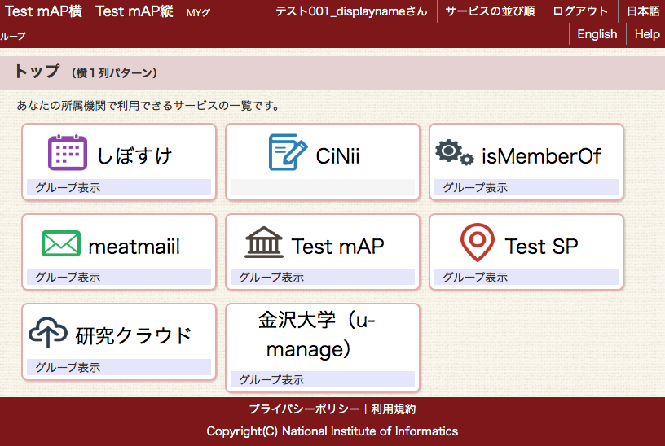
Cloud Gateway
portal system enabling to access cloud service in one-stop manner
University users can access cloud services (contracted by the university/user) through the service menu.
University administrators can configure the service menu for the users.
  avoiding shadow IT
  localization for the university (API)
single sign-on with GAKUNIN
cloud
services
Admins
register cloud services contracted with the university
Users（staff/students）
Takeshi Nishimura, "Design and Implementation of Portal System for Subscribed Cloud Services in Identity Federation", ISGC2017
access the registered cloud services
register cloud services contracted by the user

Slide 11




Direct Connection to SINET5
NII has prepared a framework in which providers offering cloud services (e-mail, storage, remote access, etc.) can directly connect to SINET. SINET users can build private clouds and use these services.
HOTnet
Sakura Internet
Cloud Datacenters
NTT EAST
Direct Connection
L2VPN
Selectable
NTT EAST
CTC
Universities
MITANI
FUJITSU
UQ
NTT-SmC
NTT DATA
FUJITSU
MN
NTT Communications
SiDC
NHN TECHORUS
佐賀
福岡2
AWS
MITANI
NJC
K-OPT
Sakura Internet
CTC
NTT-SmC
NTT WEST
NEC
NIFTY Cloud
IIJ
GMO INTERNET
Dec. 2017
nekojarashi
Microsoft

Slide 12
On-demand Cloud Configuration Service

Slide 13

On-demand Cloud Configuration Service
Technical support for building cloud platforms for R&D and Education
  tools to automatically build cloud platforms in on-demand manner
  high-speed and secure communication utilizing SINET5 L2VPN
configure cloud platform
configure inter-cloud platform
(2)
launch VM
software deployment
(2)
(2)
template
SINET5
L2VPN
テンプレート
SINET5
L2VPN
template
テンプレート
Users can configure customized platforms on clouds by choosing templates (or editing templates).
university
university

Slide 14


Virtual Cloud Provider (VCP)
middleware to automatically build user-customized data analysis platforms (virtual clouds) on Inter-Cloud with reproducibility
cloud platforms
データベース
計算機・ストレージ
計算機・ストレージ
データベース
計算機・ストレージ
virtual cloud
resources selection
VM/BM control (Terraform)
base container deployment (Docker)
network setup (IPSec, SINET5 VPN)
monitoring (Fluentd, Elasticsearch, Kibana)
dynamic resource reconfiguration
VCP
containers collection with app communities
configuration template (Jupyter Notebook)
user

Slide 15

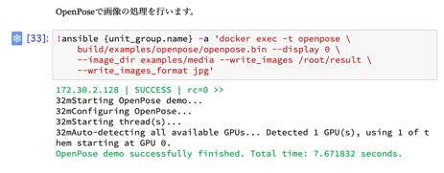

Video Analysis
Building a computing system for video analysis
  deployment of OS image and container for GPU server
  detection of key-points using OpenPose
    https://github.com/CMU-Perceptual-Computing-Lab/openpose
OpenPose
NVIDIA
Docker
Compt. server
GPU server

Slide 16
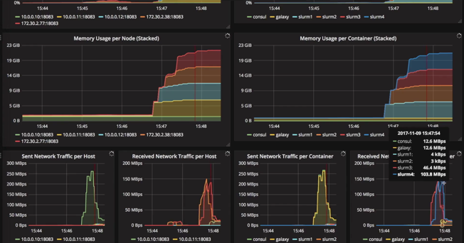
Genome Sequencing
Building a computer cluster for Genome Sequencing
  deployment of Galaxy Workflow Tool, NFS file server, SLUM Cluster (batch scheduler)
  Job submission from Galaxy, Monitoring computing resources
Visualization of resource usage (Grafana)

Slide 17
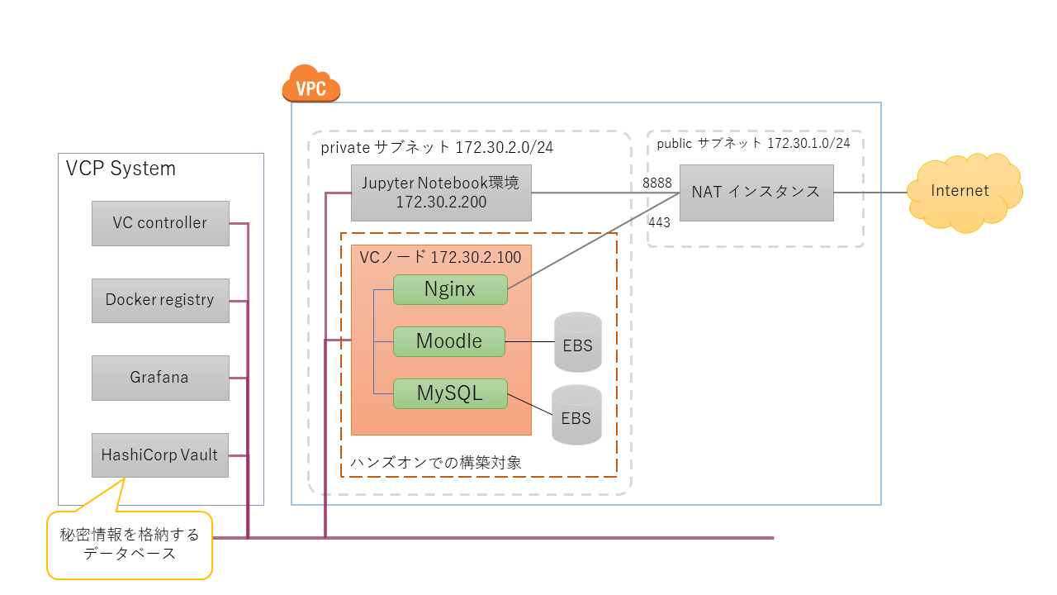
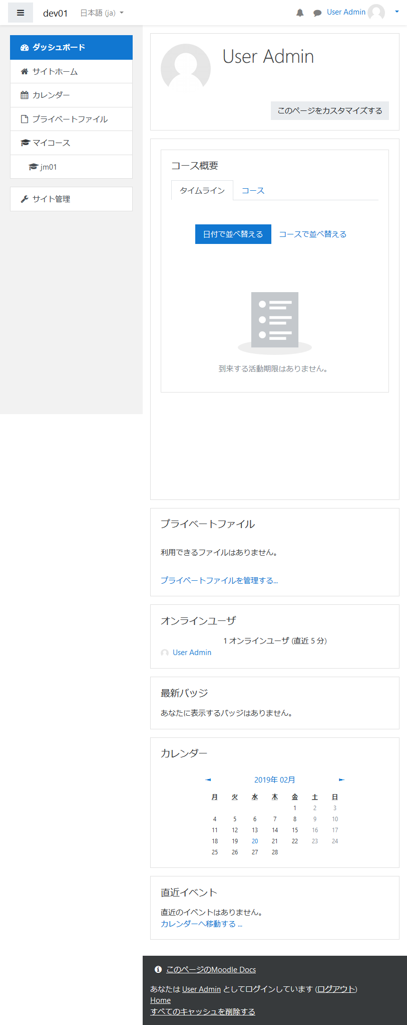
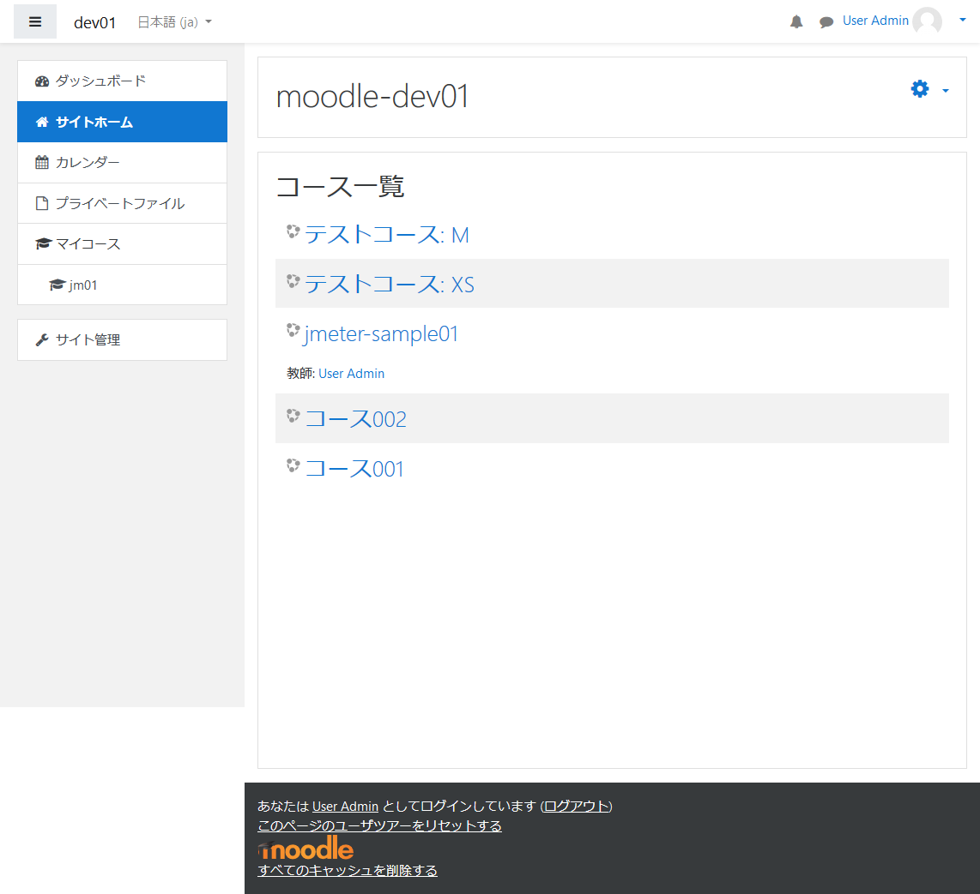
Leaning Management System
Building Learning Management System
  deployment of Moodle, MySQL and Nginx

Slide 18
Virtual Desktop Interface for Class/Exercise
Building VDI environment customized for class/exercise
  deployment of a web-based virtual desktop interface (Guacamole) and virtual servers
built by VCP

Slide 19


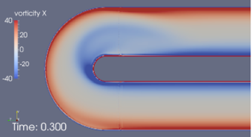
Application Centric Overlay Cloud with Inter-cloud
infrastructure
data store/access method on inter-cloud
cloud/supercomputer federation
  automatically building data analysis platforms optimized for applications on inter-cloud with reproducibility
  creation and advancement of infrastructure technology accelerate use of big data
計算機・ストレージ
データベース
Jitsumoto@Tokyo Tech.
compt
data
計算機・ストレージ
Internet
compt
データベース
platform customized for app B
data
platform customized for app A
データベース
optimal resource selection
select the optimal set of resources (computers, network, storages) that fulfill application requirements
data
middleware
automatically and quickly build data analysis platforms optimized for applications
dynamically reconfigure resources
計算機・ストレージ
compt
Munetomo@Hokkaido U.
Aida@NII
Ogasawara@NIG
application
Genome sequencing
Fluid Acoustic Analysis
user
user
Ono@Kyushu U.
app A
app B

Slide 20


Dynamic Resource Reconfiguration and Runtime Metrics Collection
  We improve our runtime metrics collection system to make the metrics format compatible with the system by Ogasawara group.
    It enables us to develop more fine-grained resource selection algorithms using execution results in both systems.
  We developed a visualization tool to compare execution time and monetary cost of several workflow executions.
Metrics
CPU usage, memory usage
Monetary cost for each step
Starting time, finishing time
…
Metrics server
Workflow engine with reconfiguration algorithm
Runtime Metrics Collection
for Common Workflow Language
by Ogasawara group
Tomoya Tanjo, et.al., Dynamic Framework for Reconfiguring Computing Resources in the Inter-cloud and Its Application to Genome Analysis Workflows. IDCS 2018: 160-172
Notes:
主な内容は以下になります。
- 可視化によって、複数のワークフローの実行結果を比較することが容易になった。
- Galaxy ベースのメトリクス収集システムの出力フォーマットに遺伝研グループの cwl-metrics と互換性を持たせることで、
Galaxy+再構成システム と cwltool+cwl-metrics の両方でのワークフローの実行結果を再構成アルゴリズムで利用することが容易になった。
Tomoya Tanjo, Sun Jingtao, Kazushige Saga, Atsuko Takefusa, Kento Aida, Dynamic Reconfiguration Framework of Computing Resources for Inter- Cloud and its Application to Genome Analysis Workflows, The 11th International Conference on Internet and Distributed Computing Systems (IDCS2018), 2018年10月

Slide 21
Summary
NII supports academic communities for establishing advanced academic IT infrastructure utilizing clouds.
  support for cloud adoption and PoC
  tools to utilize clouds
  direct connection to cloud DCs
On-demand Cloud ConfigurationService technically supports researchers/educators in building cloud platforms for R&D and Education.
This work was partly supported by JST CREST Grant Number JPMJCR1501, Japan.

