Slide 1
Case Study of Flooding in Middle Region of Myanmar
Myint Myint Sein

Slide 2
Land Area‎: ‎ 653,500 km^{2 ;} Water Area‎: ‎23,078 km²
Total Area‎: ‎ 676,578km² Population : 54,208,220 (30th March 2019)
Density : 83 peoples per square kilometer.
land borders countries: India, China, Bangladesh, Thailand, Lao

Slide 3
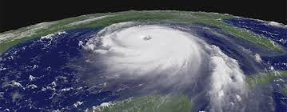
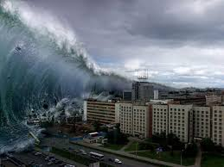
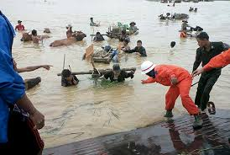
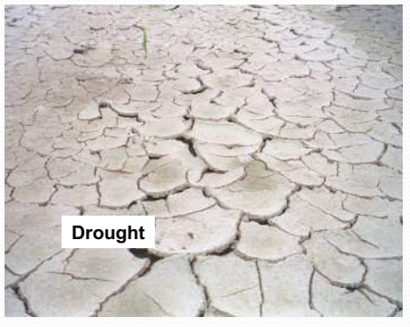
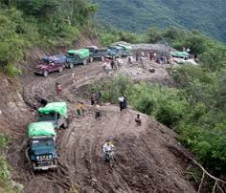
Natural Disaster
Earthquakes
Cyclone,, Hurricanes
iAll over the World
Tsunami
Flood
Landslide

Slide 4
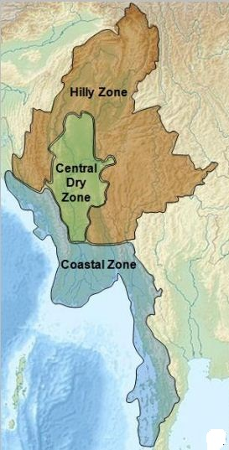
Agro-ecological Zones of Myanmar
There are three agro-ecological zones in Myanmar
Central Dry Zone
Coastal Zone
Hilly Zone
Figure1. Myanmar Agro-ecological Zone

Slide 5
Disaster Area in Myanmar

Slide 6
List of tropical cyclones that affected Myanmar
The Myanmar country is hit by a powerful storm every 1 or 2 years.

Slide 8
Myanmar Hazard Calendar
Hazard | Jan | Feb | Mar | Apr | May | Jun | Jul | Aug | Sep | Oct | Nov | Dec
Cyclone
High Temperature
Low Temperature
Drought
Squalls and Thunderstorm
Flood
Heavy Rain
Monsoon Depression
Hail
Notes:
This slide shows the hazard conditions in Myanmar according to the monthly weather conditions in year.
Cyclone may be occur in April, May, October and November
Heavy rain may occur in May to September.
So flood can occur in Jun to October because cyclone and monsoon rain receive in this period.

Slide 9
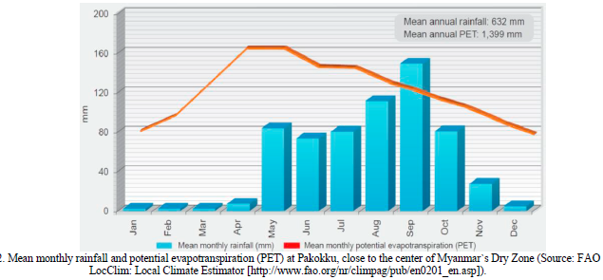

Slide 10
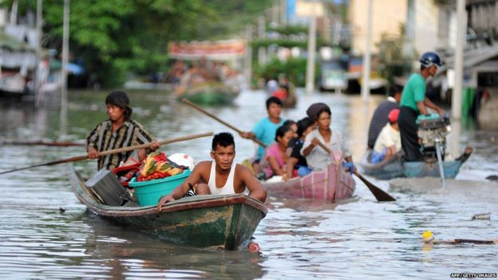
Flooding
Regularly, Myanmar is affected by severe floods comprising
River floods,
Flash floods,
Pluvial floods (Surface Flood) and
Costal floods.
Notes:
Flooding is caused by climate change and rise of water level

Slide 11
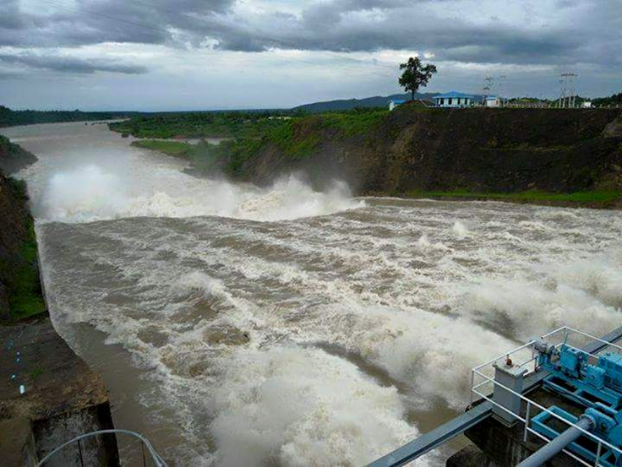
In 2015 and 2016, Myanmar faced flooding in most part of region. The four worst hit regions are
Magway Region,
Sagaing Division,
Chin State and
Rakhine State

Slide 12
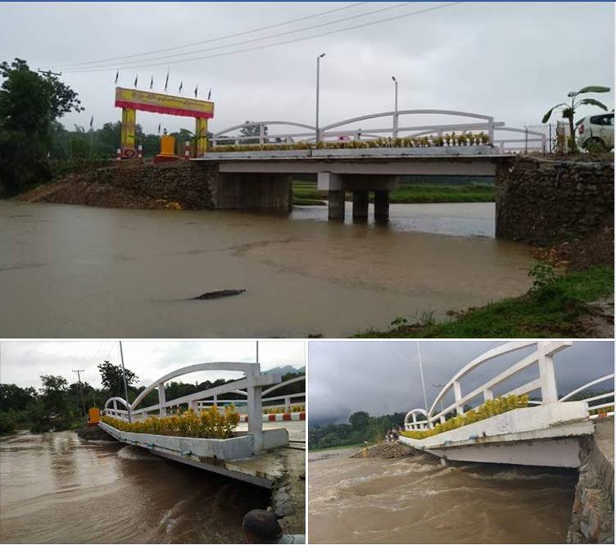
Hlaing Warr Bridge in Hpa-an
31.7.18

Slide 13
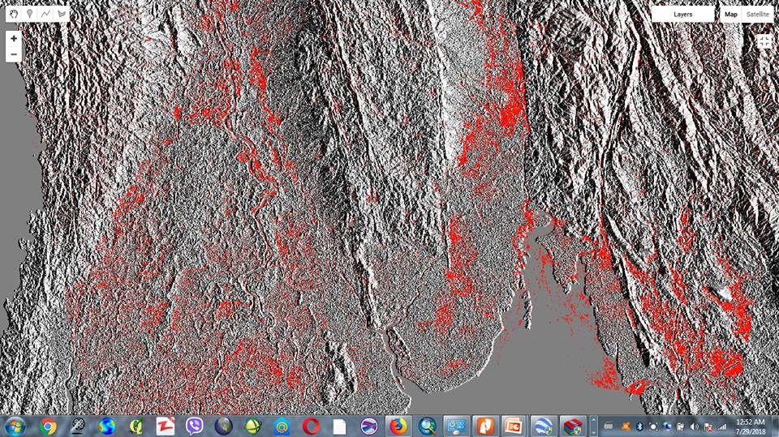
Flood Condition – 29.7.18

Slide 14
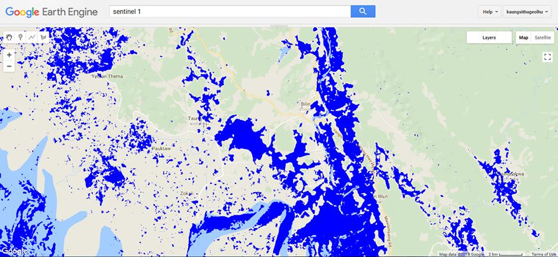
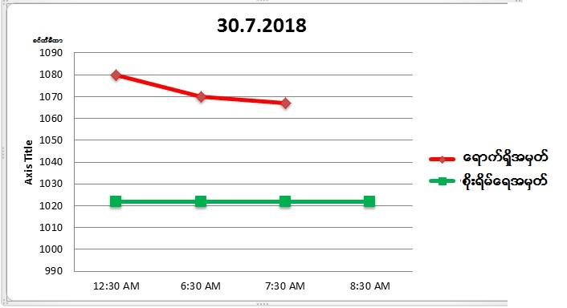
Belin -28.7.18
Belin flood start from 27.7.18 to 30.7.17
Highest Belin River water level - 1099

Slide 15
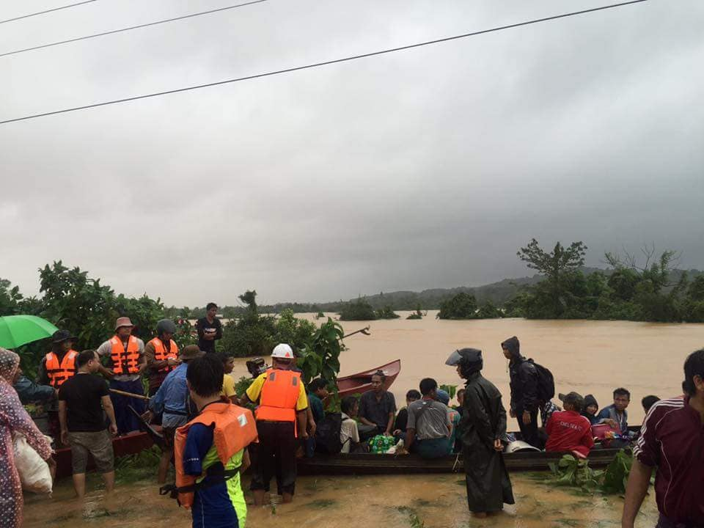
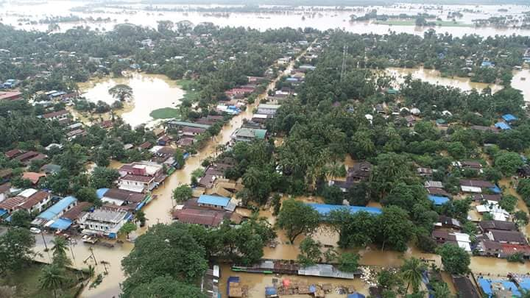
Belin

Slide 16
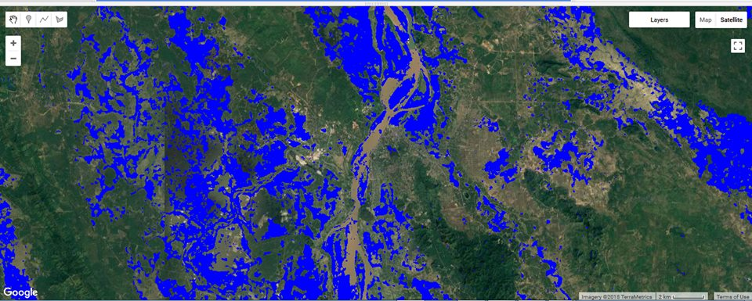
Hpa-an -28.7.18

Slide 17
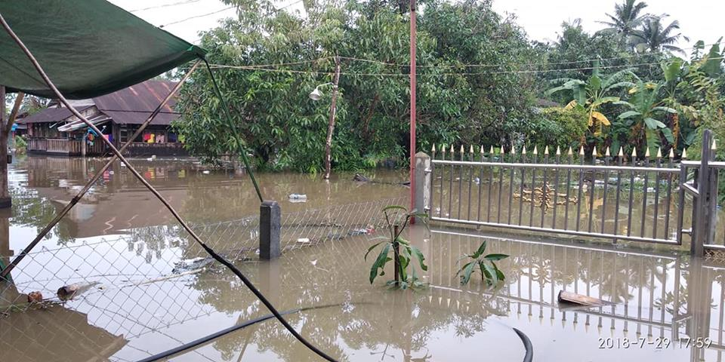
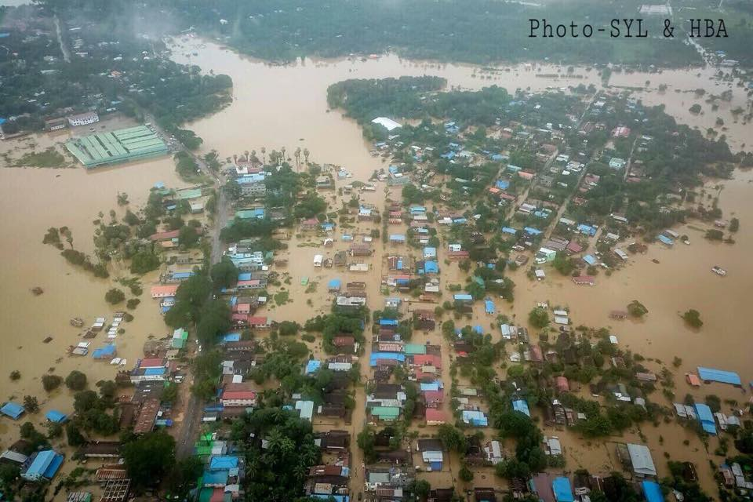
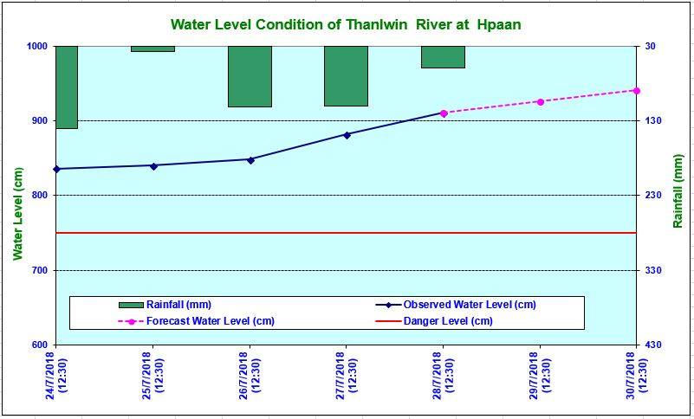
Hpa-an Flood

Slide 18
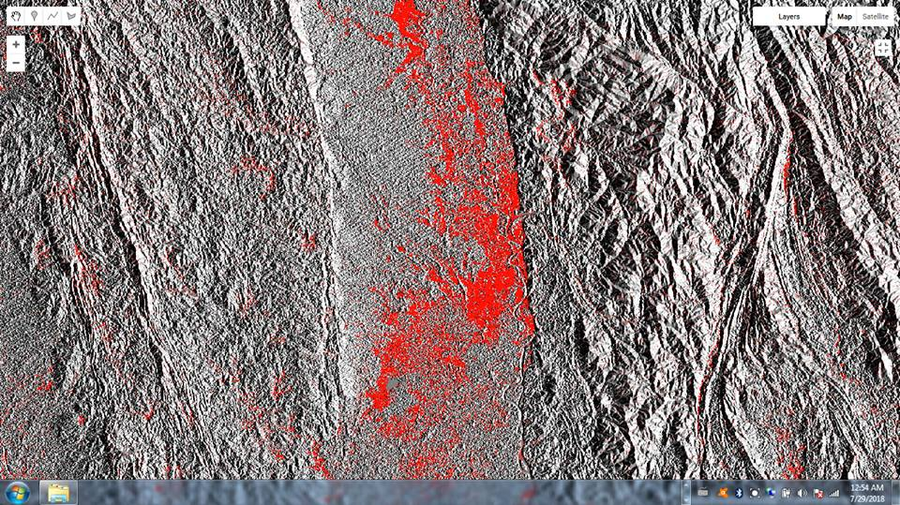
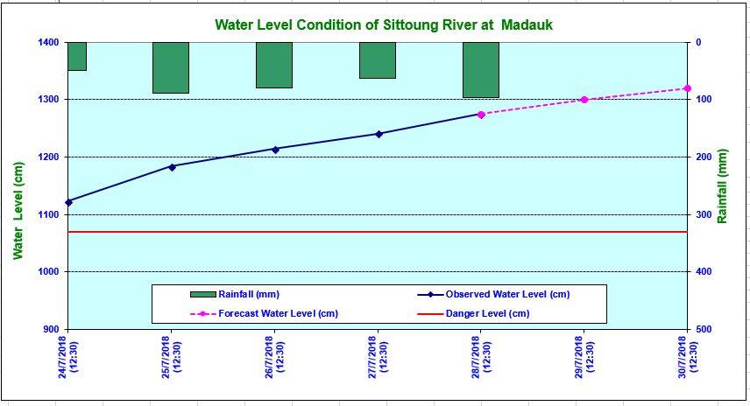
MaDauk -29.7.18

Slide 19
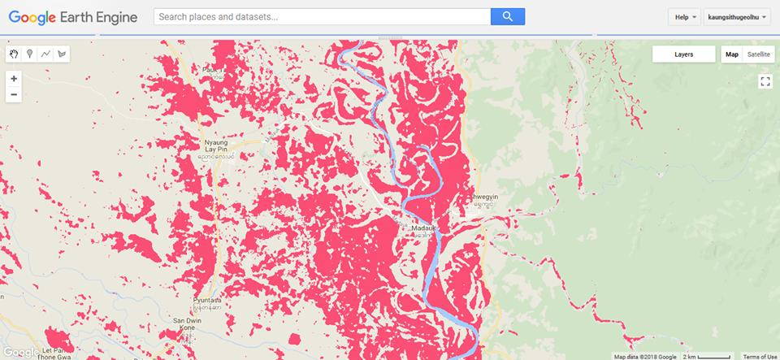
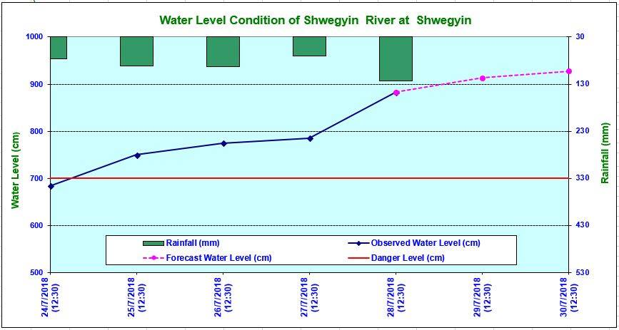
MaDauk, ShweKyin, Nyaung Lay Pin -29.7.18

Slide 20
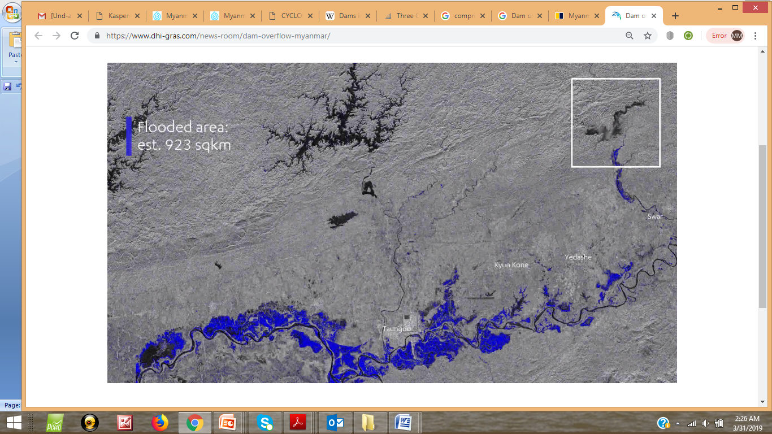

Slide 21
Water Level (28.7.18)
River | Gauge | Alarm Level above 0 level (cm) | 28.7.18 (6:30 am) River Level (cm) | Changes of Surface between 24 hours
Ayeyarwaddy | Hinthada | 1342 | 1282 | -12
 | Zalon | 1160 | 1106 | -12
Sittaung | Taung Goo | 600 | 614* | +35
 | Madauk | 1070 | 1264* | +26
Shwe Kyin | Shwe Kyin | 700 | 830* | +20
Bago | Bago | 880 | 967* | +26
Than Lwin | Hpa-an | 750 | 906* | +32
Nga Won | Ngar Thine Chaung | 1160 | 1146 | -1
 | Thar Paung | 620 | 612 | +2
 | PaThein | 350 | 270 | +12
Toe | Maubin | 720 | 690 | -24

Slide 22
According to figures from Myanmar’s Relief and Resettlement Department, Ministry of Social Welfare, 477,360 people have been affected by flooding in 11 states or regions across the country since the start of June.

Slide 23
Myanmar dam overflow floods 100 villages, displaces thousands
-due to the Swar Chaung dam’s spillway structure

Slide 24
Dams Map in Myanmar
Dams are very useful for our humans’ societies that it provides irrigation water for farms and used for electricity.
Hydroelectric Dams 128
Irrigation Only 4
Total Dams 132

Slide 25
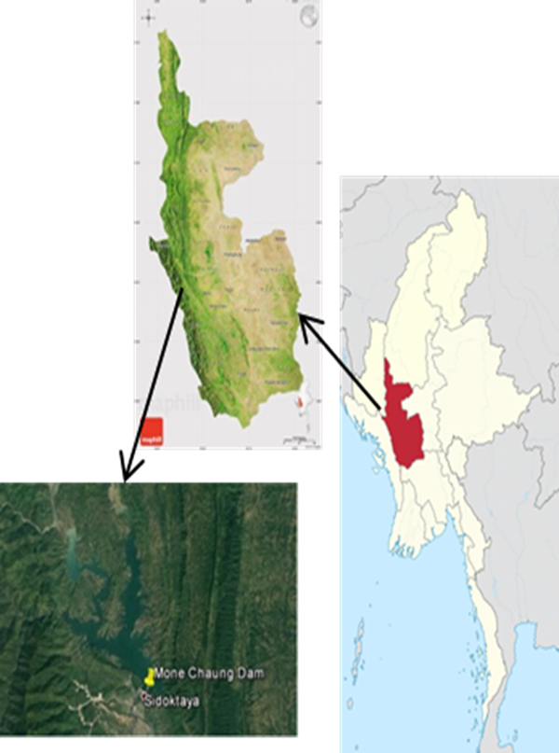
Study Area
This system predict flood conditions for Mone Dam in Magway region which is one of the most affected region of flood damage in Myanmar.
It built across on Mone creek.
Mone creek can be overflow water due to torrential rain from Chin hill and Rakhine hill .
It is an essential fact to develop flood prediction system for Mone dam.
Figure1. Location of Mone Chaung Dam
Notes:
Mone creek can be overflow water due to torrential rain from Chin hill and Rakhine hill.
It is an essential fact to develop alarm system for Mone Chaung dam.

Slide 26
Mone Dam
Northern two miles from Sadoketaya twon.
Situated on Mone Stream
Water catchment area is 1467 sq mile
Rainfall amount 47″
Average height level of water is 125′
Area of Dam - 4320′ (length) × 200′ (height)
Water diversion tunnels - 36′ (diameter) × 3625′ (length)

Slide 27
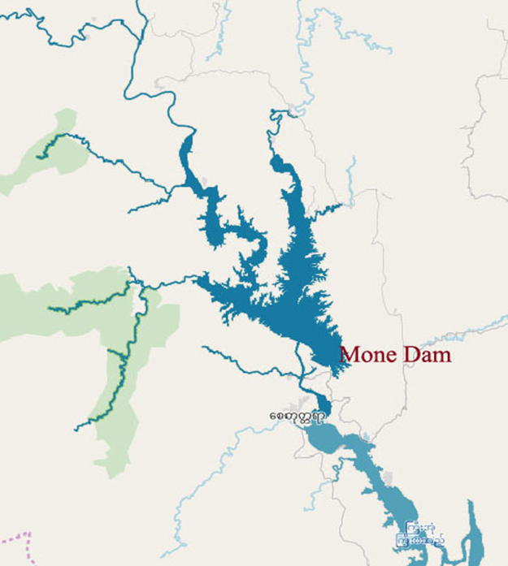
Conditions of Flood in Mone Dam
Heavy Rain in Rakhine Hills and Chin Hills
Causing Storm in Bay-of-Bengal
Dam cannot outlet the water from the spill way when the Ayeyarwaddy River is full of water
Heavy Rain in Bangladesh
Figure2. Inflow water of Mone Dam
Notes:
This slide shows conditions that occurs flood in Mone dam

Slide 28
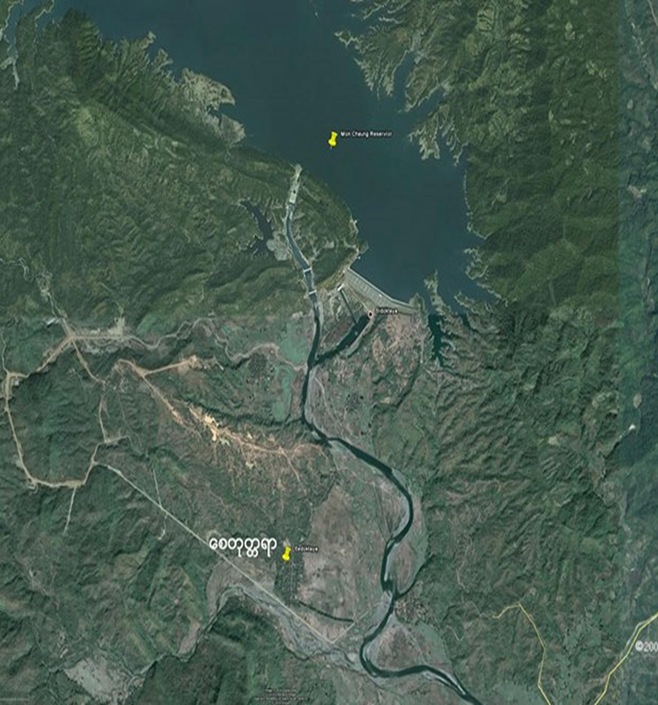
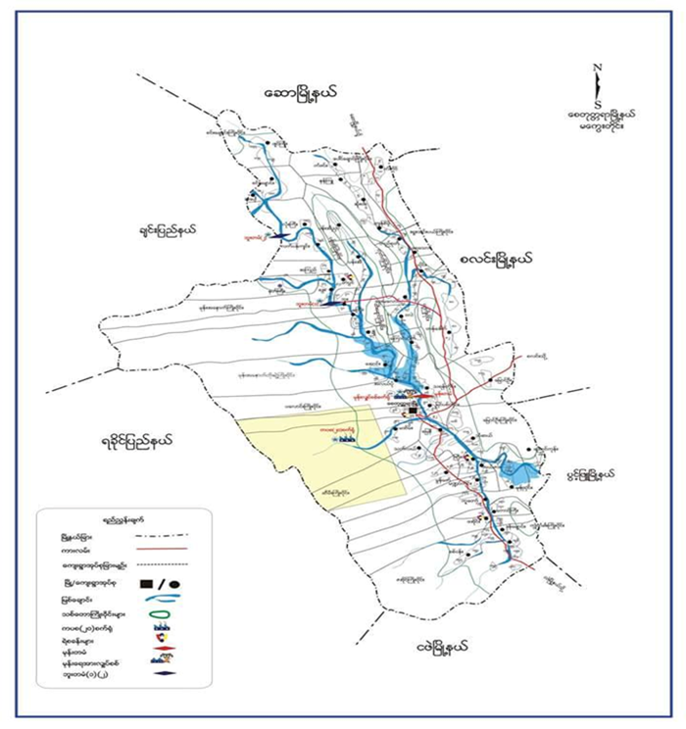
Conditions of Flood in Mone Dam
Figure3.Affected flood region of Mone Dam
Notes:
This slide show the lower region of Mone dam.
When the dam full of water, this region face flood.

Slide 29
Mone Dam
Mone Dam is situated in Magway region and it is very mountainous area.
The other two dams are situated on low lying area and if it will break or overflow water, affect on about 300 villages and two towns in that region.
Its alarm level is 540' and Dam crack level is 560'.
Year | Water Level (ft) | Overflow water (ft) | Overflow Capacity (cu.ft/s)
2010 | RL 540.30 | 20.30 | 99,200
2011 | RL 536.30 | 16.30 | 71,400
2015 | RL 535.90 | 15.90 | 66,800
Table 1. Flood condition of Mone Dam

Slide 30
Weather API
Need to sign up as an authorized user to gain access to the API
Two types of API requests to retrieve the weather
Forecast Request: : returns current weather conditions
Time Machine Request: returns observed in the past or forecast in the future.
Request parameter
key
Latitude
Longitude
Notes:
Forecast Request: returns the current weather conditions a minute-by-minute forecast for the next hour (where available), an hour-by-hour forecast for the next 48 hours, and a day-by-day forecast for the next week.
Time Machine Request : returns the observed (in the past) or forecasted (in the future) hour-by-hour weather and daily weather conditions for a particular date.

Slide 31
Markov Chain
is a random process contains random variables {X₀, X₁… X_{n}}: X_{i} is describe the state of the system at time i.
said to be time invariant if the conditional probability p(x_{n+1}|x_{n}) does not depend on n: for n=1,2,…
the next state only depend upon the current system state
Pr(X_{n+1}=b|X₁=a)=Pr(X₂=b|X₁=x_{a}).
Fig. 4: Markov Chain Process
Notes:
Markov chain is a random process with the Markov property. A random process or often called stochastic property is a mathematical object define as a collection of random variables.
the probability of X_{n+1} only depends on the probability of X_{n}

Slide 32
System Design
This system predict flood condition for Mone dam based on Markov chain model that input as water level and precipitation data to describe the flood level.
First, input water level data to know about the dam conditions.
Second, calculate possible flood condition based on Markov Chain model by combining with dam water level and weather conditions data.
Finally, predict the flood conditions.

Slide 33
System Design (Cont’d)
Start
Water Level
Weather data from weather API
Arrive alarm level?
No
Heavy rain?
No
No flood
Yes
Yes
Calculate Probability by Markov Chain
Show flood conditions
End
Figure 2. System Flow Diagram of Flood Alarm System

Slide 34
Implementation
The water level is computed based on the transition probability matrix with Markov Chain
Date | Water Level (ft) | Threshold Value | Predict | Remark
12.6.18 | RL 512.5 | 0 | No Flood | May still be raining and flood may be occur
13.6.18 | RL 526.7 | 1 | Flood | Warning may still be increase water
14.6.18 | RL 537.9 | 3 | Severe Flood | Should move to safe places
17.6.18 | RL 531.1 | 3 | Severe Flood | Still flood but will reduce water level
Table 2. Overflow Prediction Results

Slide 35
Achievements
1. Phyo Pa Pa Tun and Myint Myint Sein, "Flood Prediction System for Middle Region of Myanmar", 2018 IEEE 7th Global Conference on Consumer Electronics (GCCE 2018), October 9-12, Nara, Japan. DOI: 10.1109/GCCE.2018.8574757
2. Phyo Pa Pa Tun and Myint Myint Sein, "Flood Prediction System by using Markov Chain", Proceeding of International Conference on Future Computer and Communication (ICFCC) 2019, Feb. 27th ~ March 1, 2019, Yangon, Myanmar.

