Slide 1
Authentication and Authorization for RESTful WEB API in Scientific Computing Environment
Cao Rongqiang*, Yangang Wang, Xuebin Chi , Ronghe, Shasha Lu, Xiaoning Wang
Email: caorq@sccas.cn
Computer Network Information Center
Chinese Academy of Science
2019.04.05 ISGC2019

Slide 2
Outline
Introduction
Background and Issues
Architecture and Microservice
Simple Authentication Service
Simple Authorization Service
Typical Scenarios nd Cases
Future work

Slide 3
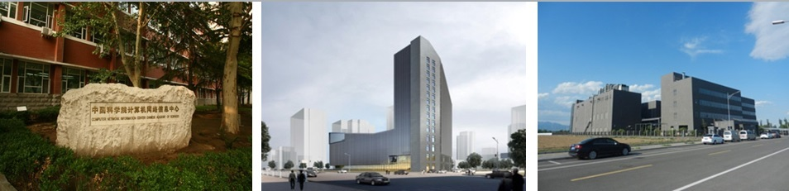
About Us
Based on China National Grid (CNGrid) , build and maintain National High Performance Computing Environment.
Build and maintain China Science and Technology Cloud to provide an integrated and universe platform for computing, data and networks.
Build and maintain Artificial intelligence application and data service platform to provide Virtualized and containerized computing and data sharing services.
Notes:
介绍

Slide 4
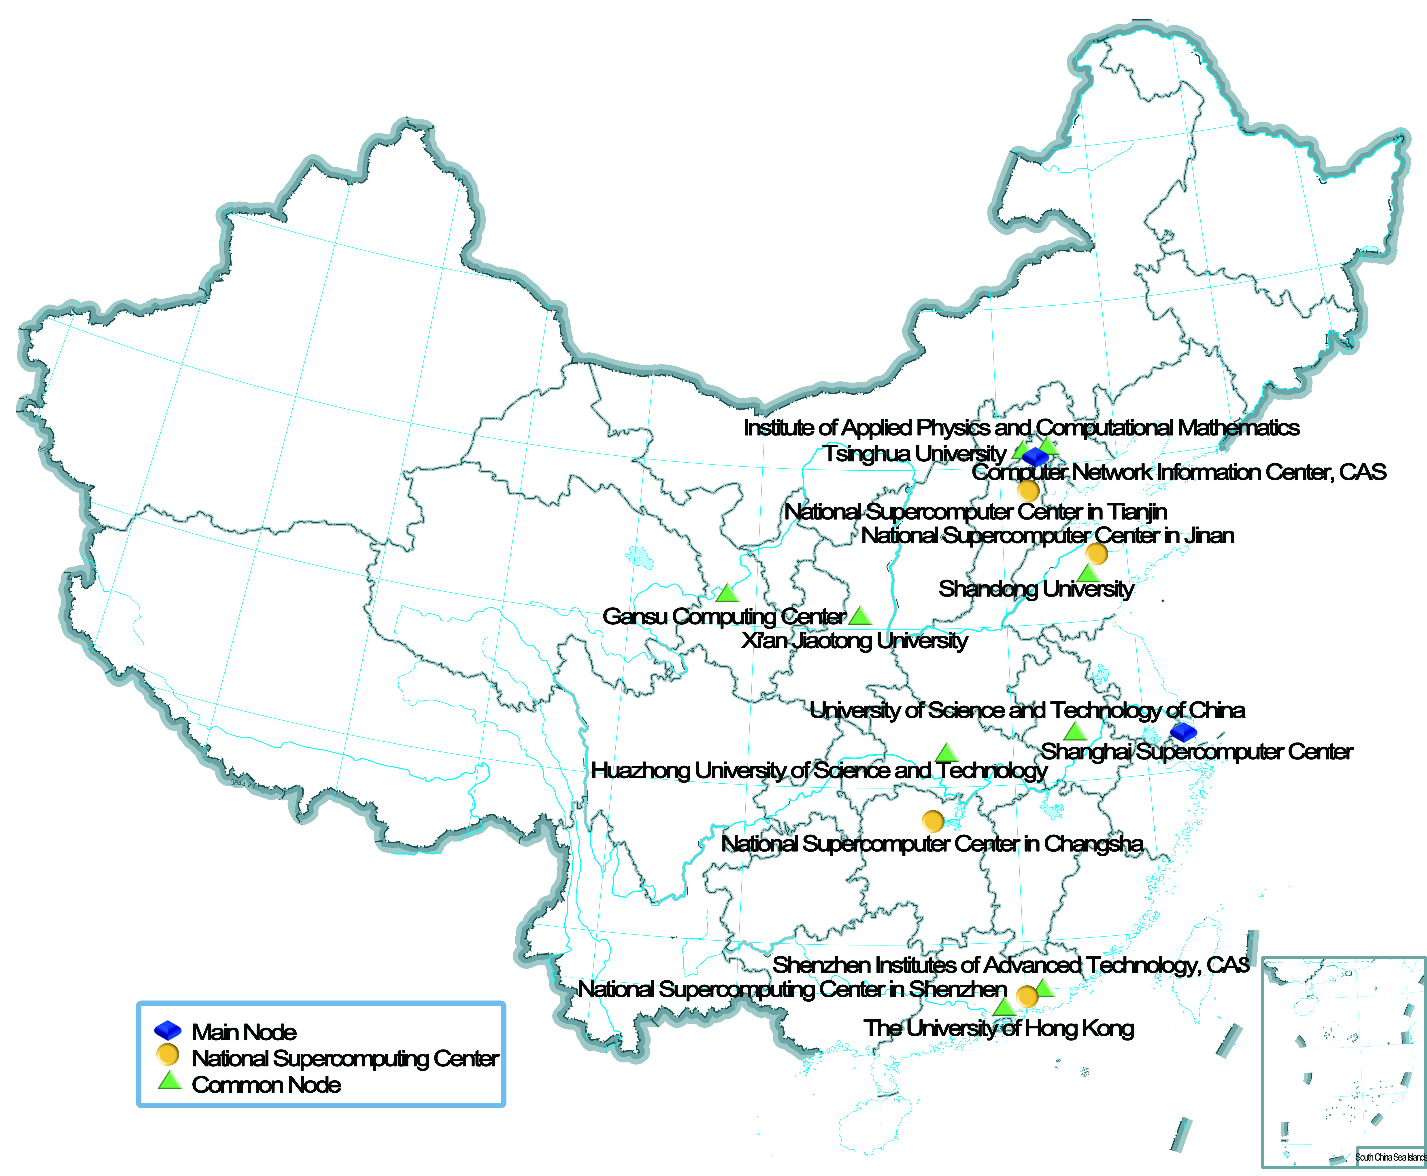
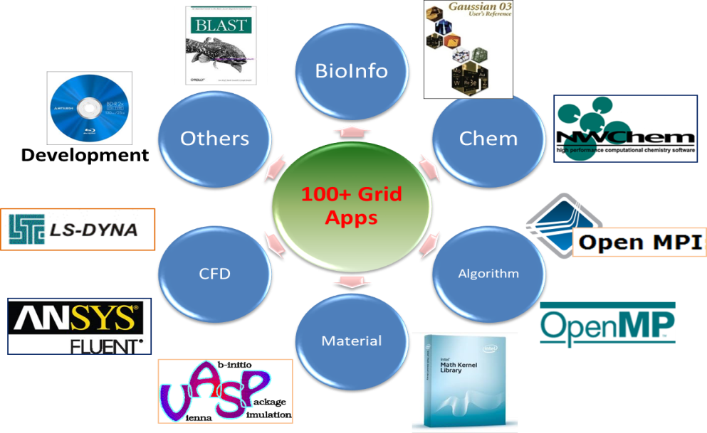
National HPC environment (CNGrid)
integrate heterogeneous computing resources
  19 Nodes, 3 Layers, 200PF Computing Resources, 160PB Storage Resouces
  6 National Supercomputer Centers, Wuxi,Tianjin, Jinan, Changsha, Shenzhen, Guangzhou,
Many kinds of applications for disciplines and fields.
Notes:
资源现状，用户,…

Slide 5
National HPC environment (CNGrid)

Slide 6

China Science&Technology Cloud
Light of Science
Create better future
  Integrate network, big data and computing resources;
  Build professional cloud platform for science and technology;
  enabling computing and data-driven scientific discovery
www.cstcloud.cn
Published at April, 2018
Notes:
Converging and integrating advanced networks, high-performance computing, scientific data, software communities, information resources, building and sharing first-class professional cloud service platforms, supporting technological innovation in the information age, enabling computing and data-driven scientific discovery!

Slide 7
China Science&Technology Cloud
Increase and improve capabilities;
Extend and Integrate massive resources;
1 gateway + 5 resource pools;
  Resource management and self-service gateway;
  High performance computing resource pool;
  Applications and softwares resources pool;
  Information resource pool;
  Big data and cloud computing resources pool;
  Network resource pool
2.0 will be published before November 2019
Notes:
1+5变成一个图。

Slide 8
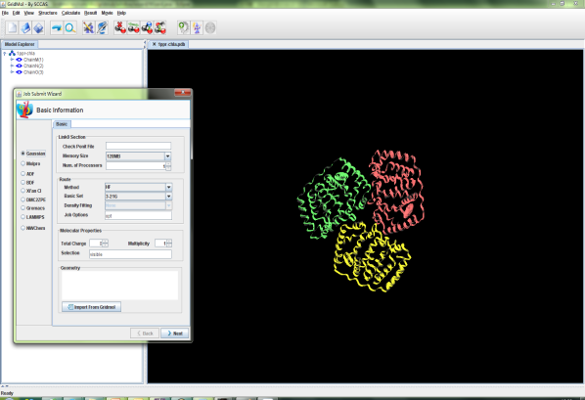
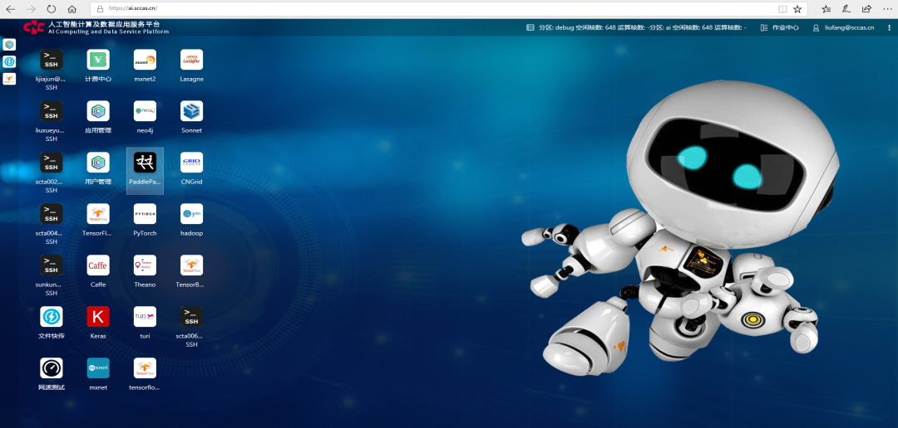
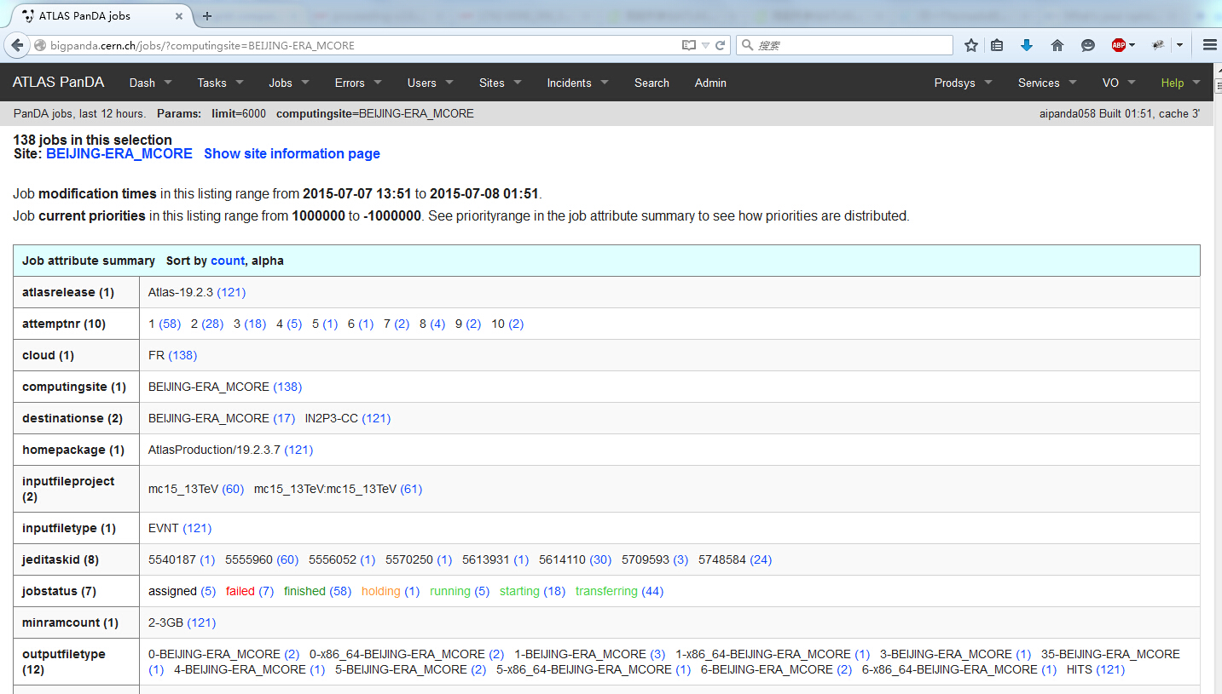
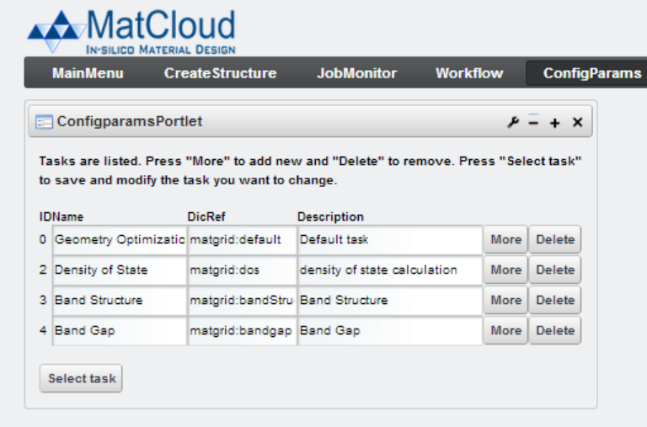
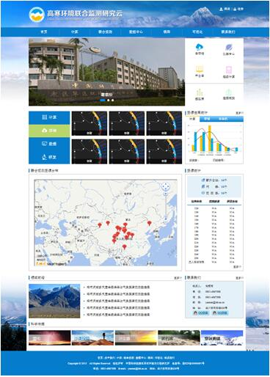
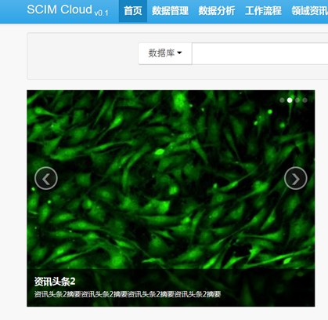
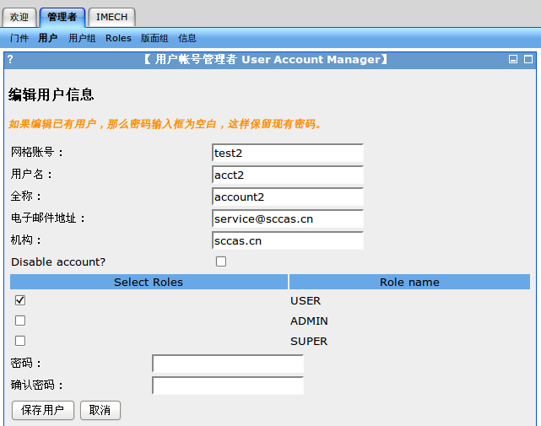
Communities and Gateways

Slide 9
Communities and Gateways
AI Computing and Data Service Platform

Slide 10
Outline
Introduction
Background and Issues
Architecture and Microservice
Simple Authentication Service
Simple Authorization Service
Typical Scenarios and Cases
Future work
Notes:
Authn服务
Authz服务

Slide 11


Background and Issues
  Rest API is a cross-platform and cross-languages way to communicate between different clients and heterogeneous resources.
  Subjects:
    Users
    Administrators
  Objects:
    Clients
    Resources behind API
  Relationships？
    Authn
    Authz
AuthN
AuthZ
Clients
Admin
API Resources
users

Slide 12
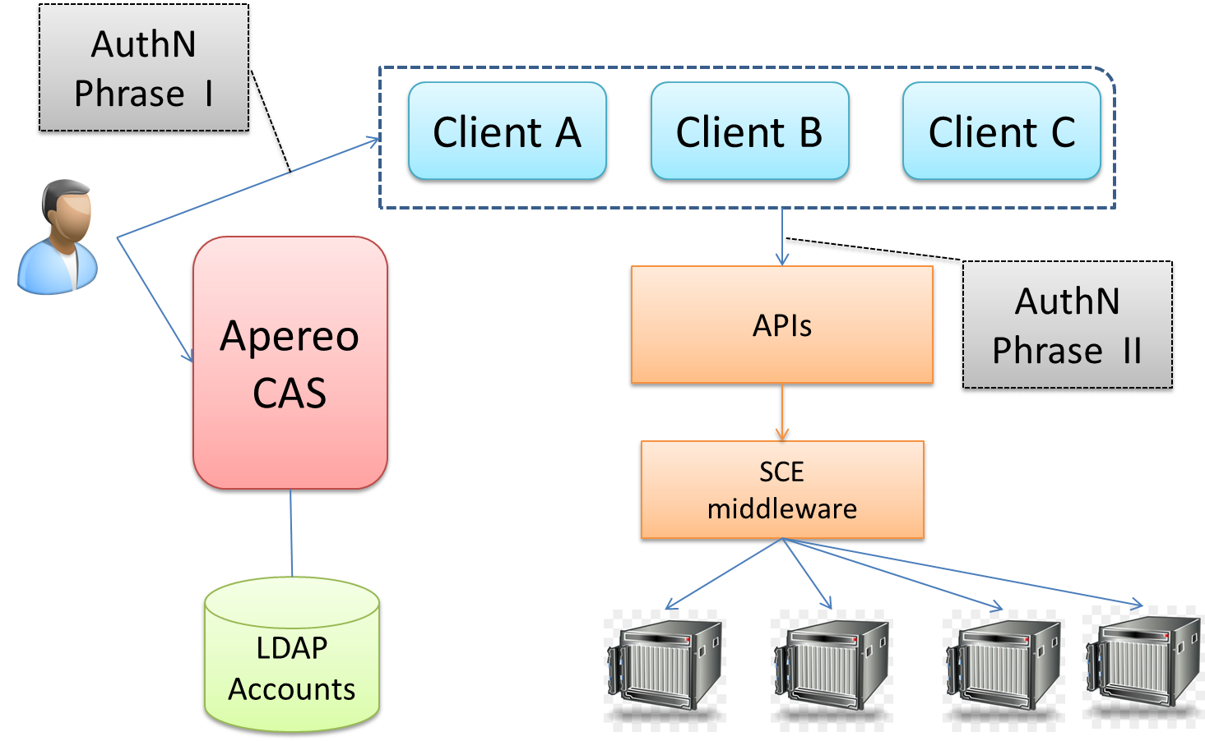
Background and Issues
Pervious AuthN and AuthZ services
  All clients are protected by CAS;
  Each client deals with AuthN and AuthZ issues individually;
  API has only ON/OFF permissions.

Slide 13
Background and Issues
  To design and implement simple AuthN and AuthZ services in distributed HPC environment, we need to take account of issues as following:
    An user how to login different web gateways and mobile apps with only an account of HPC environment?
    An client how to get authorizations from a user and access different resources on behalf of the user?
    An administrator how to organize and manage permissions of APIs for different kinds of clients and massive users?
SSO+OAuth2=API

Slide 14
Outline
Introduction
Background and Issues
Architecture and Microservice
Simple Authentication Service
Simple Authorization Service
Typical Scenarios and Cases
Future work
Notes:
Authn服务
Authz服务

Slide 15
Architecture and Microservice
AuthN and AuthZ Microservices and contexs in CNGrid

Slide 16
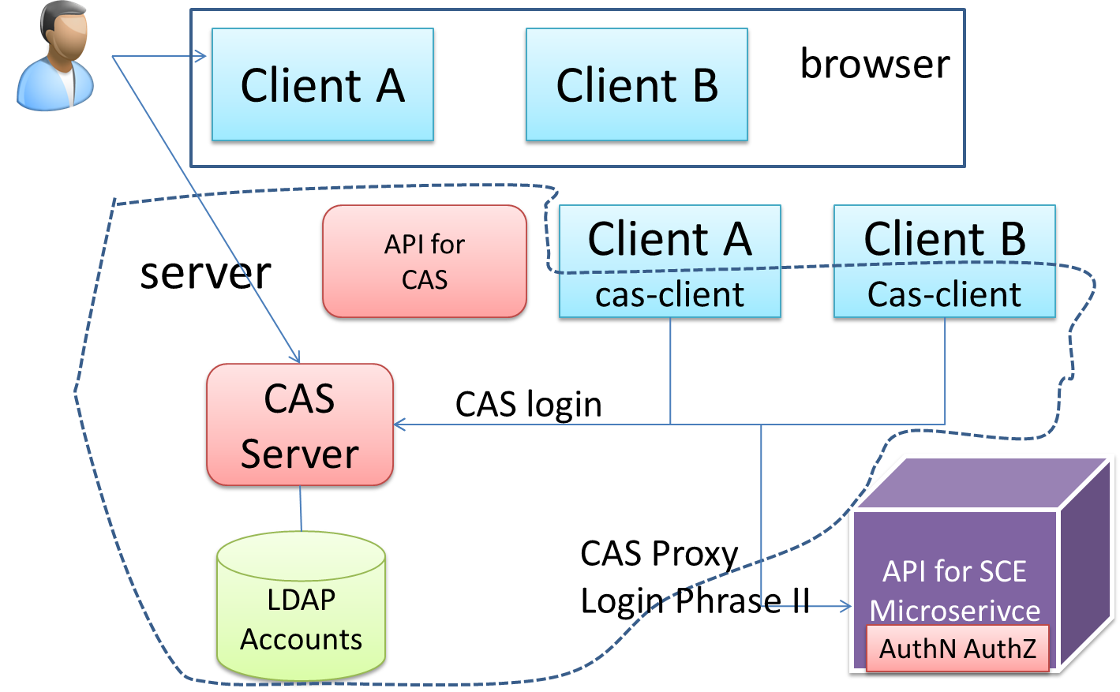
Architecture and Microservice
SSO AuthN Microservice
  Based on Aerepo CAS
  Export authentication abilities to all clients supported by CNGrid
  3rd-party clients use CAS Proxy or OAuth2 token to access API.

Slide 17
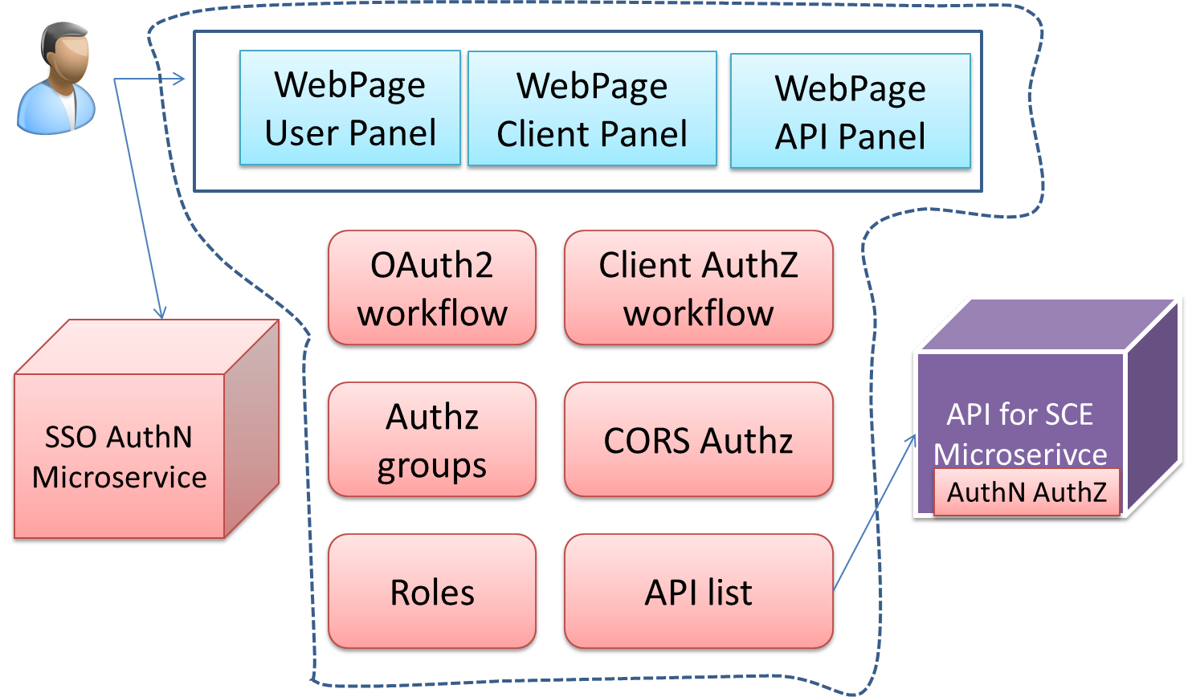
Architecture and Microservice
AuthZ Microservice
  Based on paths of API and role, APIs are put to several groups.
  A client apply permissions and An admin allows/denies.
  OAuth2 flow to authorize a client accessing APIs on behalf of a user.

Slide 18
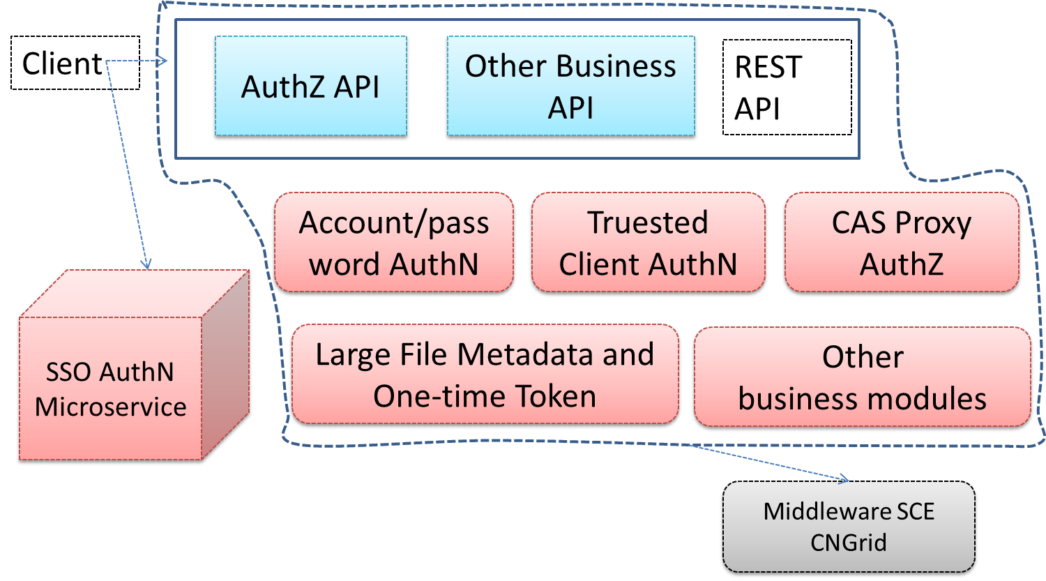
Architecture and Microservice
API for SCE Microservice
  SCE is middleware for CNGrid to integrate disbtributed HPC resources and provide simple and consistent computing services.
  Implement several AuthN ways, includes Oauth2, CAS Proxy, Trusted_Client+Username, …

Slide 19
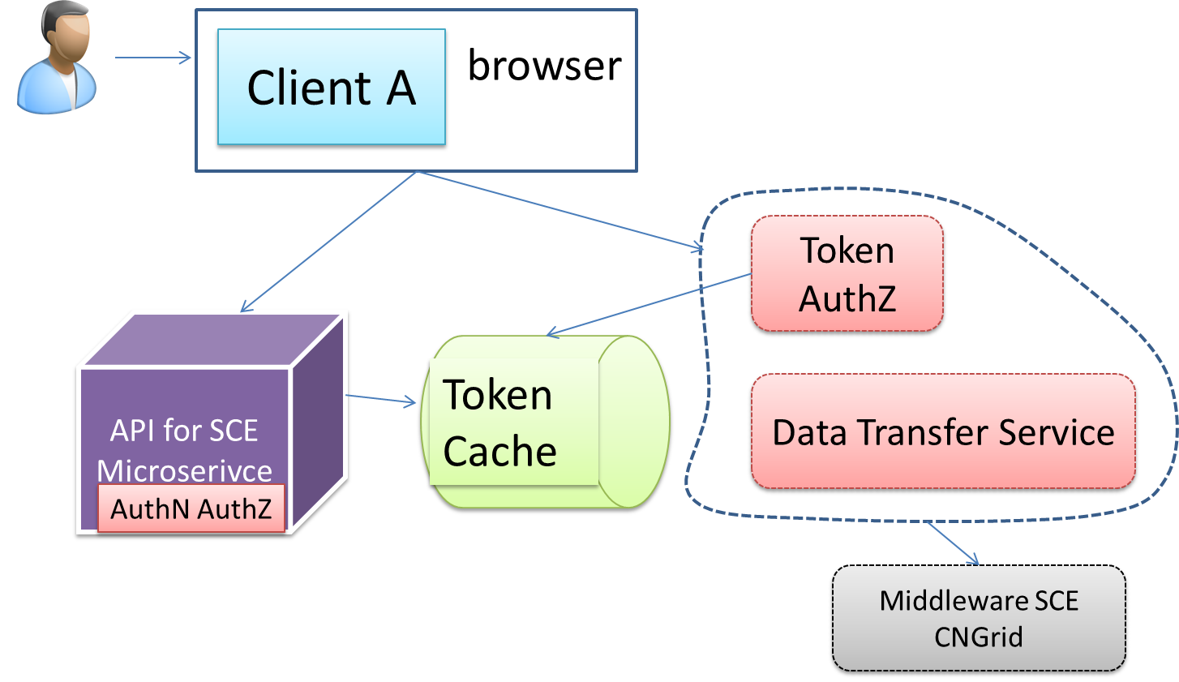
Architecture and Microservice
Large File Transfer Microservice
  An isolated service for transferring large input/output files;
  API Microservice generate a one-time token in a URL attached to meta information of a file.
  The Transfer Microservice accepts the URL, check the token, get information of the file, and transfer data.

Slide 20
Outline
Introduction
Background and Issues
Architecture and Microservice
Simple Authentication Service
Simple Authorization Service
Typical Scenarios and Cases
Future work
Notes:
Authn服务
Authz服务

Slide 21
Simple Authentication Service
4 AuthN ways
Name | Credential | remark
Username\Password | Username, Password, Captcha | A simple but not safe AuthN way. It is used to develop and test.
SSO Proxy | CAS tickets | A simple and popular way. It is recommended in production environment.
Trusted client | Client credentials, Username | Just for trusted clients. A Client needed to login API service firstly with a certificate.
One-time Token | Token | Just for files transferring

Slide 22
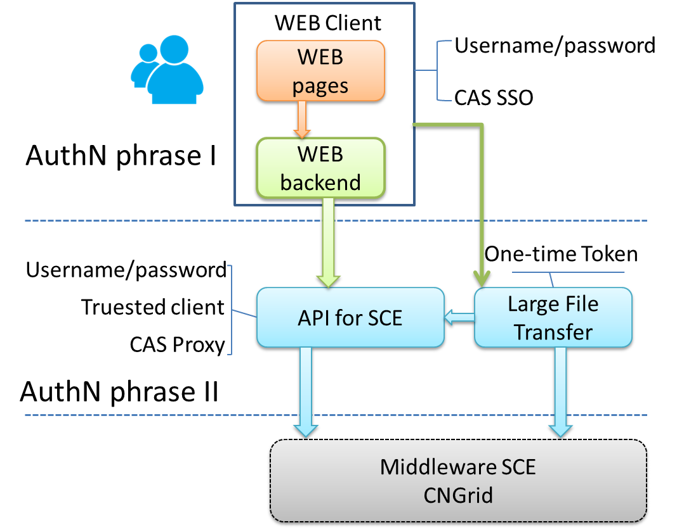
Simple Authentication Service
Two phrases AuthN
  Each AuthN is sufficient and necessary to access certain resources.
  Each phrase has several ways to authenticate a user.
Notes:
加上一个图

Slide 23
Simple Authentication Service
A API list of Simple Authentication Service
 | HTTP | API path | remark
Simple AuthN | POST | /users/login | Username/password
 | POST | /users/login/platform | Trusted client and username
 | GET | /users/logout | logout
SSO | POST | /casv4-service/v1/ticket | authN and return aTGT
 | POST | /casv4-service/v1/ticket/{TGT} | TGT changes to ST
 | GET | /{3rd-client}/?ticket=ST-* | Access a 3rd-party client
 | DELETE | /casv4-service/v1/ticket/{TGT} | Logout SSO
Notes:
加入认证API的表格

Slide 24
Outline
Introduction
Background and Issues
Architecture and Microservice
Simple Authentication Service
Simple Authorization Service
Typical Scenarios and Cases
Future work
Notes:
Authn服务
Authz服务

Slide 25
Simple Authorization Service
Initialization for AuthZ
  General permission and Super permission
  APIs are put to different groups according different functions, eg, job, acccount, cluster, data and …
  Define user roles, such as jobAdmin, clusterAdmin, and …
User
Job
Application
Data
Cluster
Account
Monitor
Statistics
…
General
Super
xxxGeneral
xxxAdmin
xxxAnon
…
API
groups
Roles
Client

Slide 26
Simple Authorization Service
3rd-party client getting AuthZ
  A client registers and applies before online;
  A user authorizes the client when login firstly via a standard OAuth2 workflow.
Request information for a client
Response for a client
URL: homepage, CAS callback, OAuth2 callback;
permissions;
name;
introduction;
contacts;
team;
…
Negotiate?
Approve?
client ID;
secret key;
permissions;
…
Notes:
The secret key could be changed in future.

Slide 27
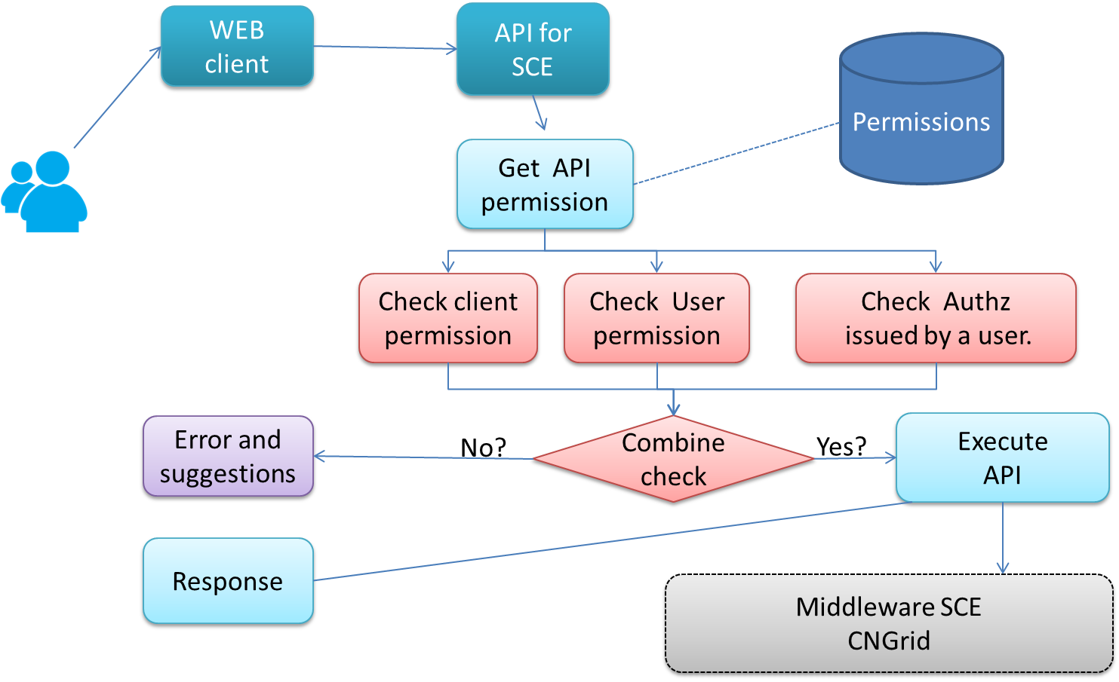
Simple Authorization Service
AuthZ workflow
  Preconditions: A client has got permissions, and A user has authorized the client.

Slide 28
Outline
Introduction
Background and Issues
Architecture and Microservice
Simple Authentication Service
Simple Authorization Service
Typical Scenarios and Cases
Future work
Notes:
Authn服务
Authz服务

Slide 29
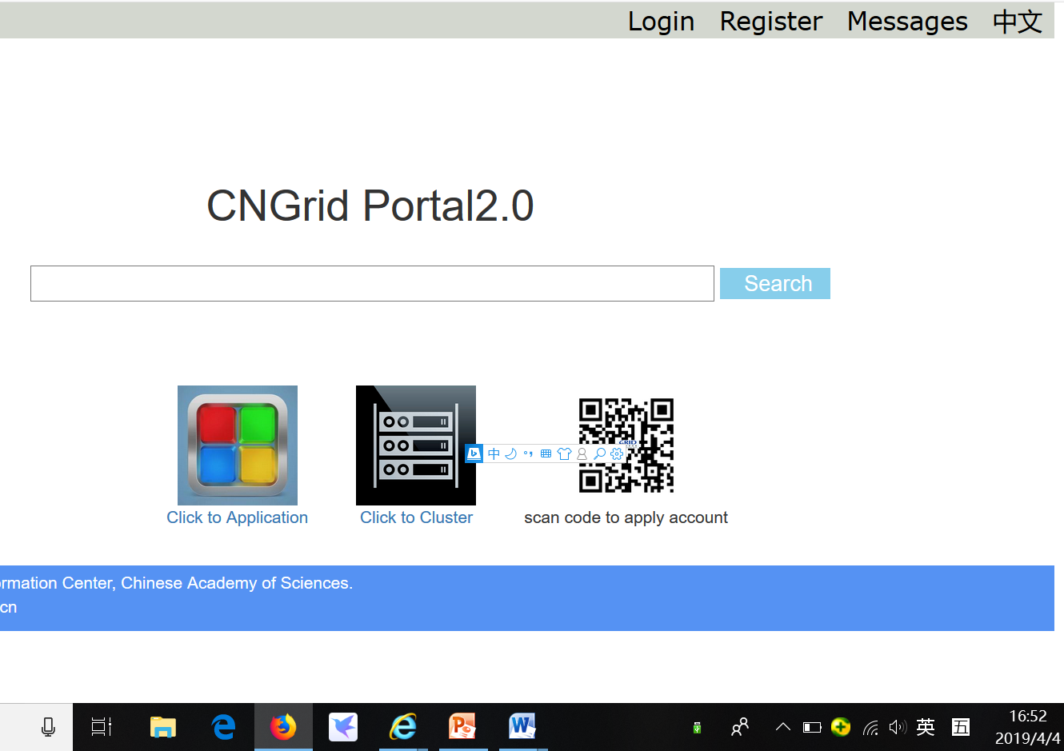
Typical Scenarios and Cases
Portal2.0
  AuthN Phrase 1: CAS; AuthN Pharse II: Trusted client;
  AuthZ: jobGeneral

Slide 30
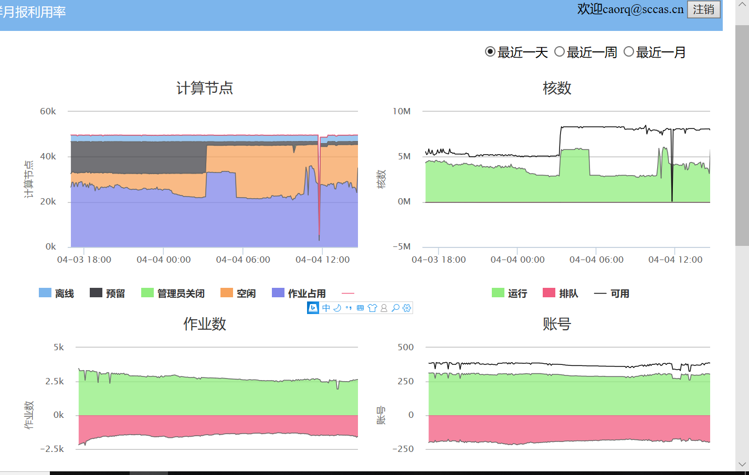
Typical Scenarios and Cases
Monitor Portal of CNGrid
  AuthN Phrase 1: CSTNET paasport; AuthN Pharse II: Trusted client; API calls from JavaScript in browser.
  AuthZ: QueryGeneral

Slide 31
Outline
Introduction
Background and Issues
Architecture and Microservice
Simple Authentication Service
Simple Authorization Service
Typical Scenarios and Cases
Future work
Notes:
Authn服务
Authz服务

Slide 32
Future work
federated Authz Service
  Package SSH authentication from multiply nodes based on the OAuth2 protocol；
  Account mapping service, many to one, one to many
Notes:
未来的工作，联合认证是一个方向；CAS+PAC4J，支持多种协议，统一平台映射。
联合授权，shiro，基于资源+动态+角色的授权,这次不说了。
还要画一个图，放到这个地方。

Slide 33
Thank you!

