Slide 1
自动标点系统的新功能
New functions of the automatic punctuation system

Slide 2
我们升级了自动标点网站（http://gj.cool），加入了新的功能：
We have upgraded the automatic punctuation site (http://gj.cool) and added new functions:

Slide 3
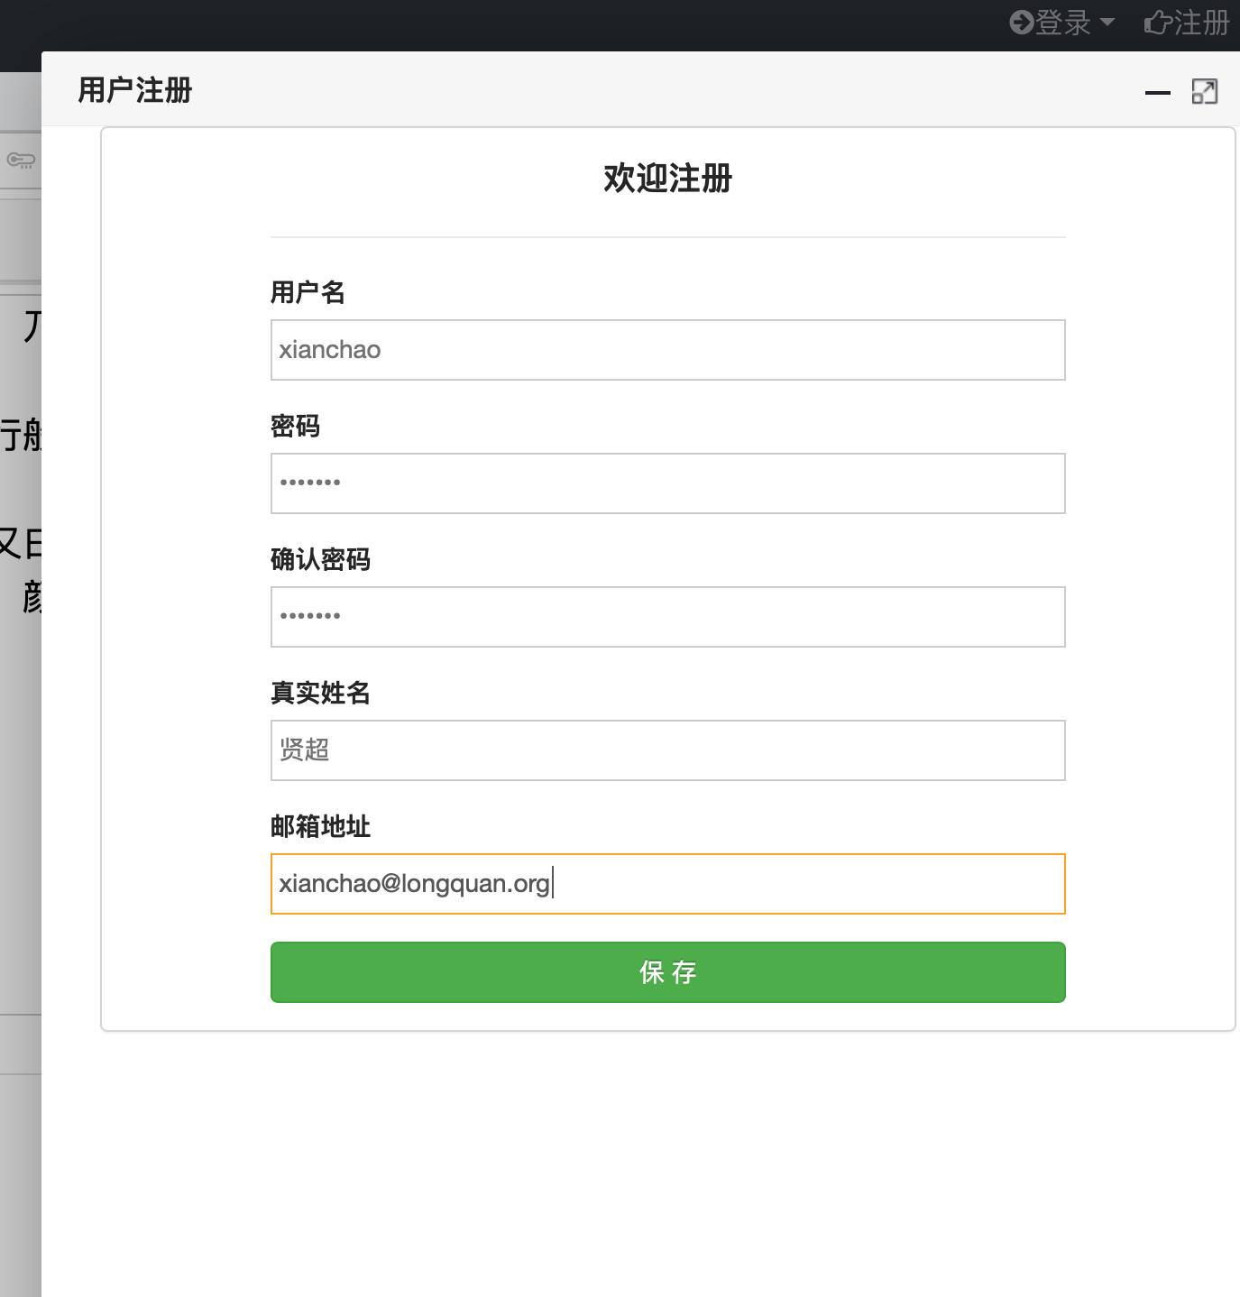
1. 账号 Account
现在，用户可以在网站注册账号。
Now, users can register an account on the website.

Slide 4
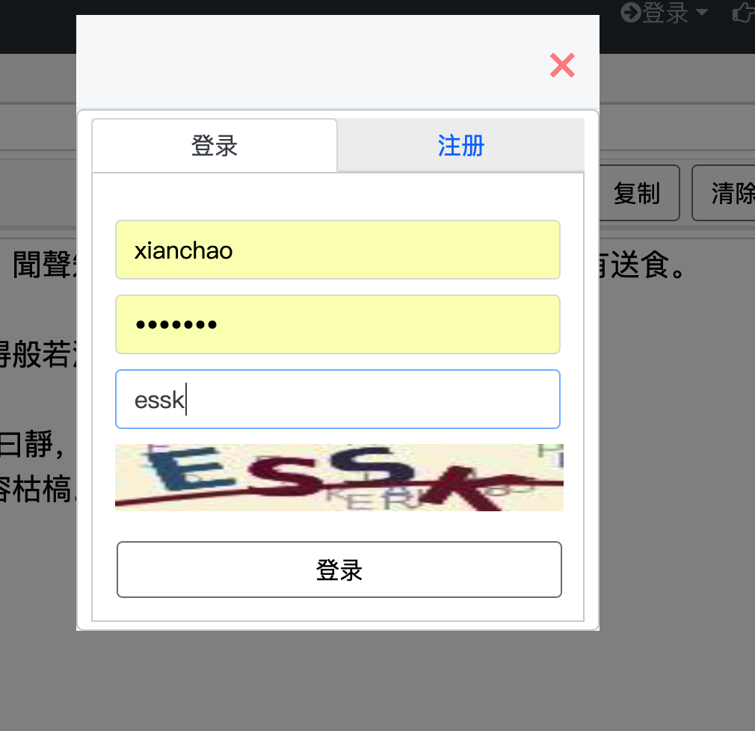
登录账号后，用户就可以使用“保存标点”等新功能。
After logging in, the user can use new functions such as "Save Punctuation".

Slide 5
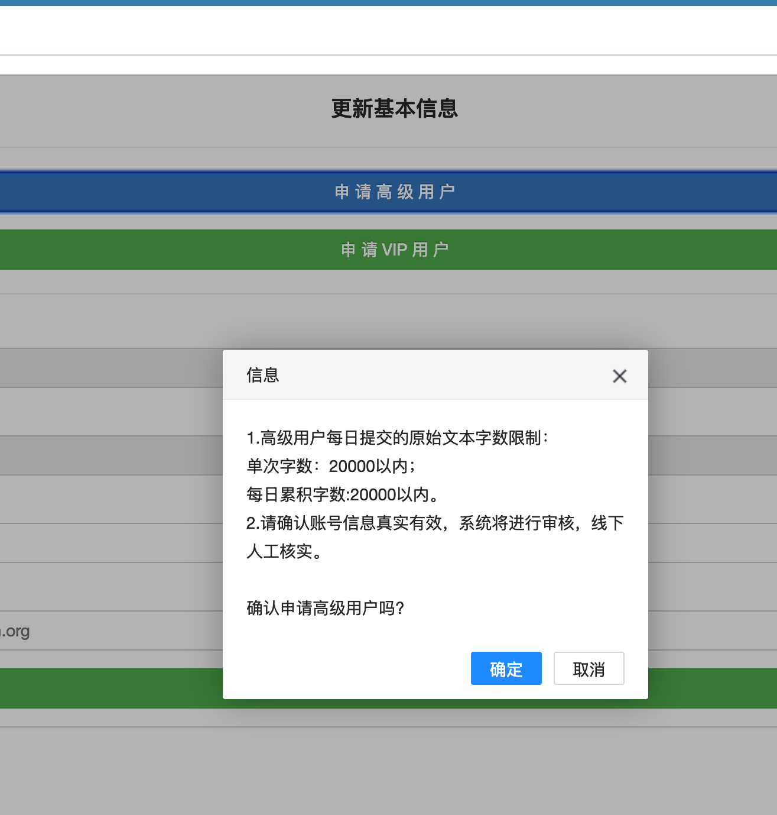
用户还可以申请成为高级用户，提升单次或者每日的使用量。
Users can also apply to become an advanced member and increase their application amount each time or per day.

Slide 7
用户也可以申请成为VIP用户，这样就可以获得API的访问授权。
Users can also apply for VIP, so that they can obtain access authorization for the API.

Slide 9
2. 保存标点 Save Punctuation
在前台页面多了一个“保存标点”的按钮。它的作用是把在线编辑标点的结果保存下来，以便下次可以在网站上面继续编辑。这样的话，整个标点过程可以全部在线完成，只需使用鼠标，而不需要拷贝到word。这样有一个显而易见的好处，就是可以减少键盘按键的磨损。
There is a button for “Save Punctuation” on the front page. Its purpose is to save the results of online punctuation-editing, so that you can continue to do the same job on the website next time. In this case, the entire punctuation process can be done online, using the mouse, no need to copy the documents to Word. Its obvious advantage is the reducing of wear on the keys of the keyboard.

Slide 11
用户可以在后台的任务列表中找到上次保存的任务。
The user can find the job saved last time in the task-list in the background.

Slide 12
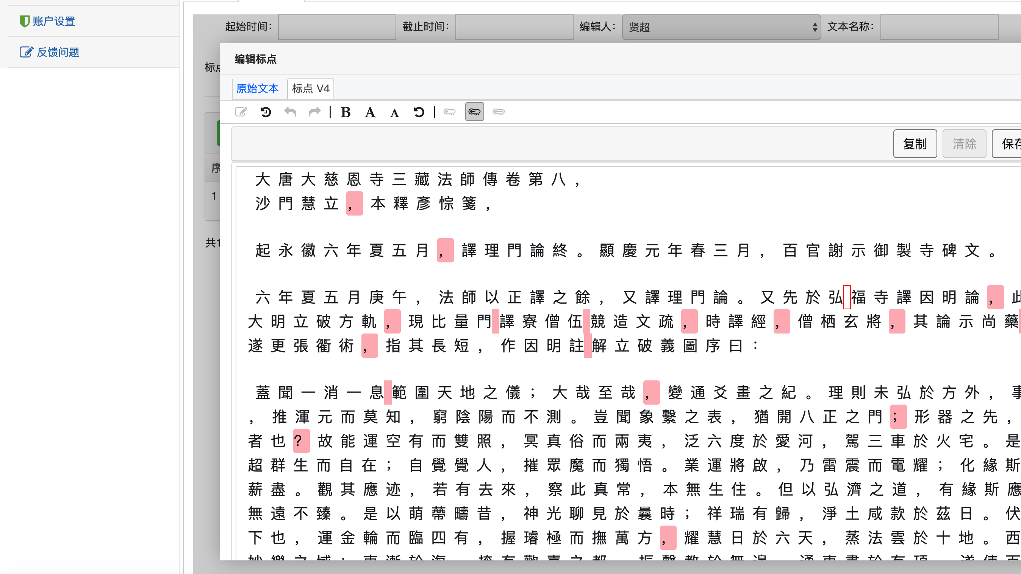
上次的任务可以再次打开，继续编辑。编辑结束的时候，可以再次保存。
The last job can be opened again and editing can be continued. You can save it again when the editing is finished.

Slide 13
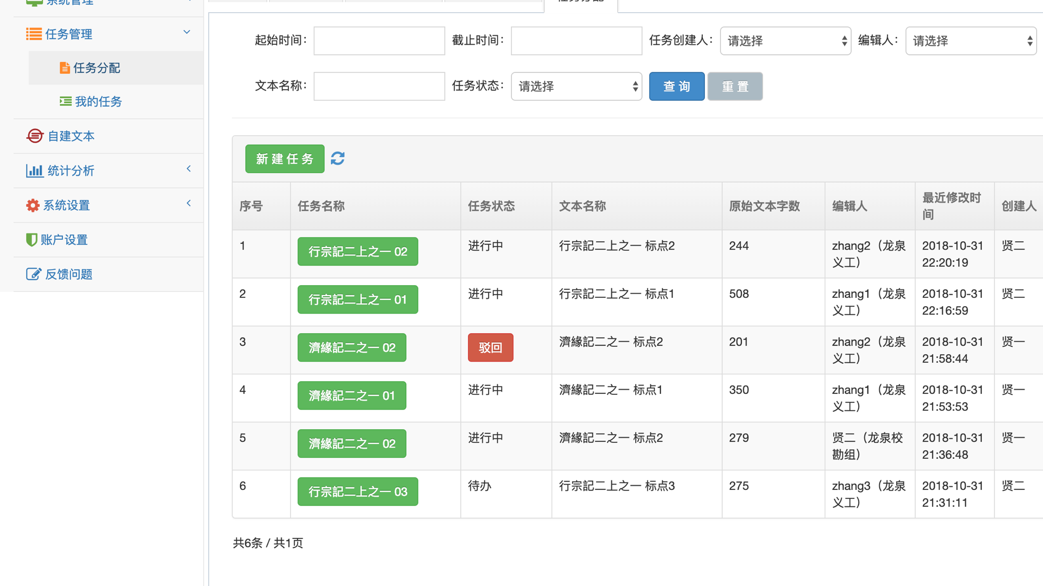
3．任务分配 Task Assignment
新系统可以为指定的用户分配标点任务，实现网络协作。
The new system can assign punctuation tasks to designated users for network collaboration.

Slide 14
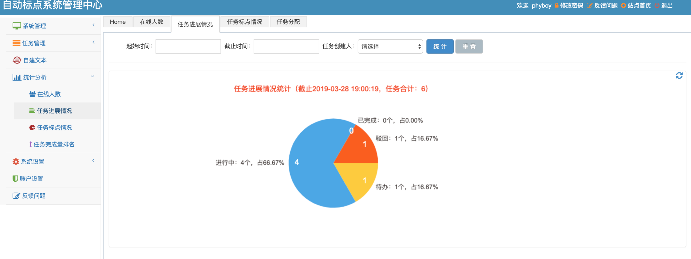
4．统计 Statistics
新系统可以对任务的完成情况、字数、参与人员进行统计，并以图表形式展现。
The new system can count the tasks completed, the number of words, the participants, and display them in graphical form.

Slide 15
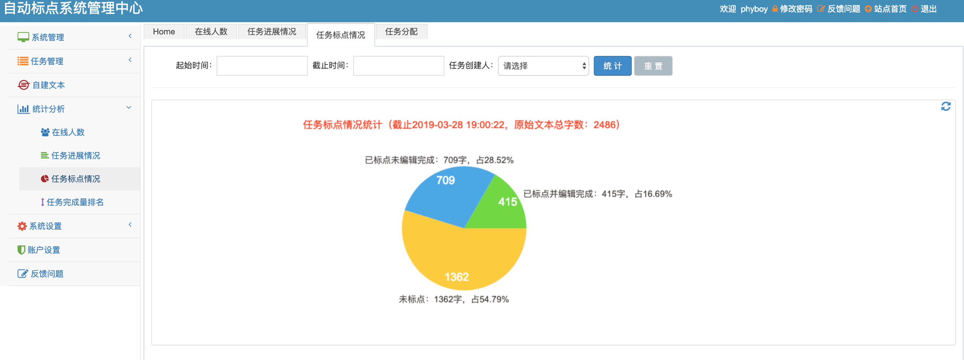
字数统计
Number of words

Slide 16
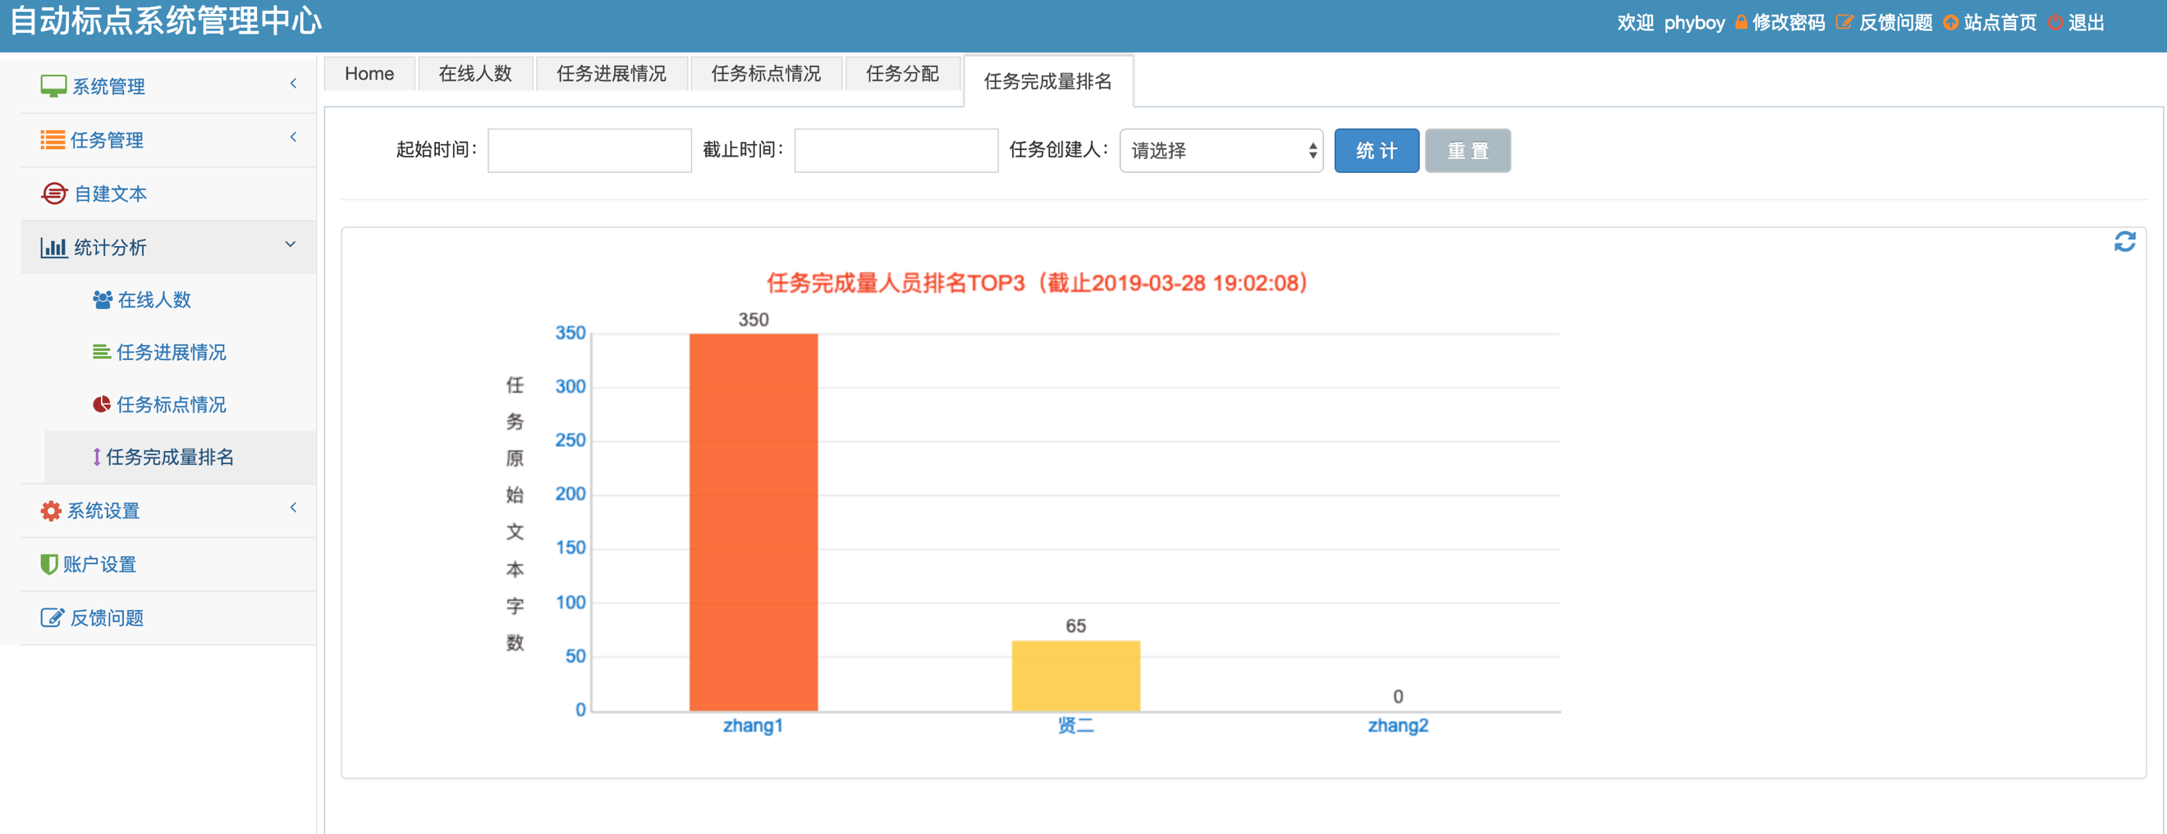
参与人员
Participants

Slide 17
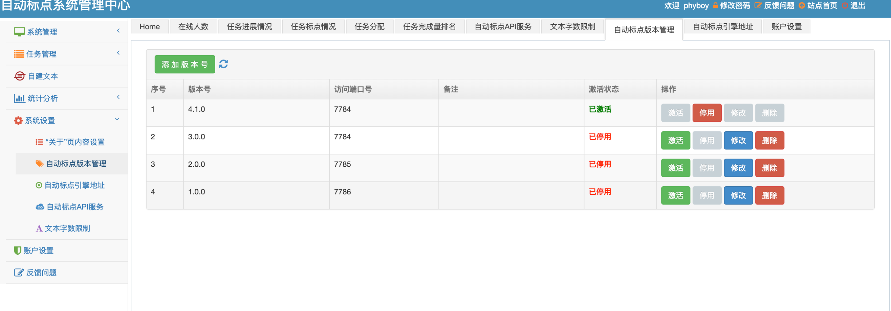
5．参数调整Parameter adjustment
新系统可以对自动标点引擎的设置进行调整。
The new system can adjust the settings of the automatic punctuation engine.

Slide 19
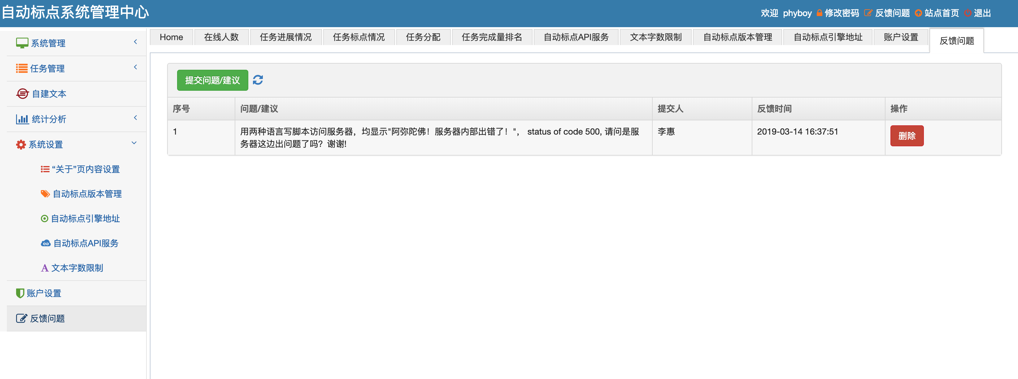
6．问题反馈 Problem feedback
用户可以反馈使用中出现的问题，提醒我们改进。
Users can feedback the problems that arise in use and remind us to improve.

Slide 20
7．动态网页接口Dynamic web interface
这是刚刚实现的新功能，具有非常重要意义，就是我们开发了动态网页接口。通过调用这个动态网页接口，我们的网站可以把任意字符串当成一段古文，标点之后展示出来。这样的话，各种古籍全文类网站都可以为网站添加自动标点功能。CBETA Online已经准备实现这个功能。
This is a new function that has just been implemented, and it is very important that we have developed a dynamic web interface. By calling this dynamic web interface, our website can treat any character string as a piece of ancient text, and display it after punctuation. In this case, various ancient text-based websites can add automatic punctuation to their website. CBETA Online is ready to implement this function.

Slide 21
调用示例如下：
The example is as follows:
http://www.gj.cool/gjcool/index?wd=僧問沙門奚事。曰事道。事道孰為本。曰德行為本。僧云。甚矣。子之固也。利以慧入。鈍以福修。沙門者取慧焉足矣。德行奚為。予曰。先民有言。德行本也。

Slide 22
注意事项 Precautions
1. 调用这个接口的时候，不需要预先将字符串原有的标点去除，因为我们的网站会自动将它们去掉，然后重新标点。
1. When calling this interface, you don't need to remove the original punctuation of the character string in advance, because our website will automatically remove them and then punctuate it.

Slide 23
2.另外，字符串中不能包括某些特殊符号，比如[ ] { } \ | ^ ·。否则，接口将无法返回结果。
2.In addition, some special symbols, such as [ ] { } \ | ^ ·, cannot be included in a string. Otherwise, the interface will not be able to return results.

Slide 24
3.字符串不能太长，否则也是不会返回结果的。
3. The character string cannot be too long (less than 823 characters), otherwise it will not return the result.

