Slide 1
A Resource-saving Job Monitoring System of High-Performance Computing using Parent and Child Process
Kajornsak Piyoungkorn,
Phithak Thaenkaew, Chalee Vorakulpipat NECTEC, Thailand

Slide 2
Introduction
High Performance Computing or (HPC), is the application of "supercomputers" to computational problems that are either too large for standard computers.
HPC technology focuses on developing parallel processing algorithms and systems by incorporating both administration and parallel computational techniques.
A HPC system is essentially a network of nodes, each of which contains one or more processing chips, as well as its own memory.
In Thailand, the National e-Science Infrastructure Consortium was established to create an HPC infrastructure to support Thai scientists to increase their potential and achievements in research.

Slide 3
HPC @NECTEC e-Science in Thailand
The National e-Science Infrastructure Consortium is a non-profit organization operated by the government, that provides free HPC service to Academia and Research Institutions in Thailand.
The users of the National e-Science Infrastructure Consortium are experts from a variety of fields such as High Particle Physics, Chemistry, Biology, Nanotechnology, Pharmacy, and many more.
Each day, the HPC resources have to execute many jobs to produce productivity in scientific research. Normal job requests have to specify requirements such as number of CPU Core processors per compute node, number of compute nodes, Type of Queue (running length)

Slide 4
HPC @NECTEC e-Science in Thailand
A solution in this study is to maximize efficiency when using the resources of the computer which involves the processing power of the processor (CPU-Core)
For example, a user requests computing resources that does not match the actual usage. Resource requests are calculated in high numbers for maximum processing speed that does not correspond to actual usage, resulting in resource wasting. Thus, a negative effect will go to the hardware system and it will be a hindrance to other users who have to lose an opportunity to use it.

Slide 5
Problem of ineffective job
The users have to wait longer for their job to execute.
The administrator needs to check the HPC resources repeatedly.
The machine gets worn out faster than its life expectancy.
The hardware needs to run for long hours continuously to complete executing the job.
The hardware overheating problem, cooling facilities, the electricity bill charges also increase.

Slide 6
Job Management System
The Job Scheduler is responsible for managing jobs that are submitted to the HPC by users.
The Job Scheduler usually provides four main functions, such as Job Submission, Schedules, Control, and Monitor
HPC resources are managed by a Job Management System (JMS)
The JMS works to manage the CPU resources of the HPC according to the jobs requested in the PBS script

Slide 7
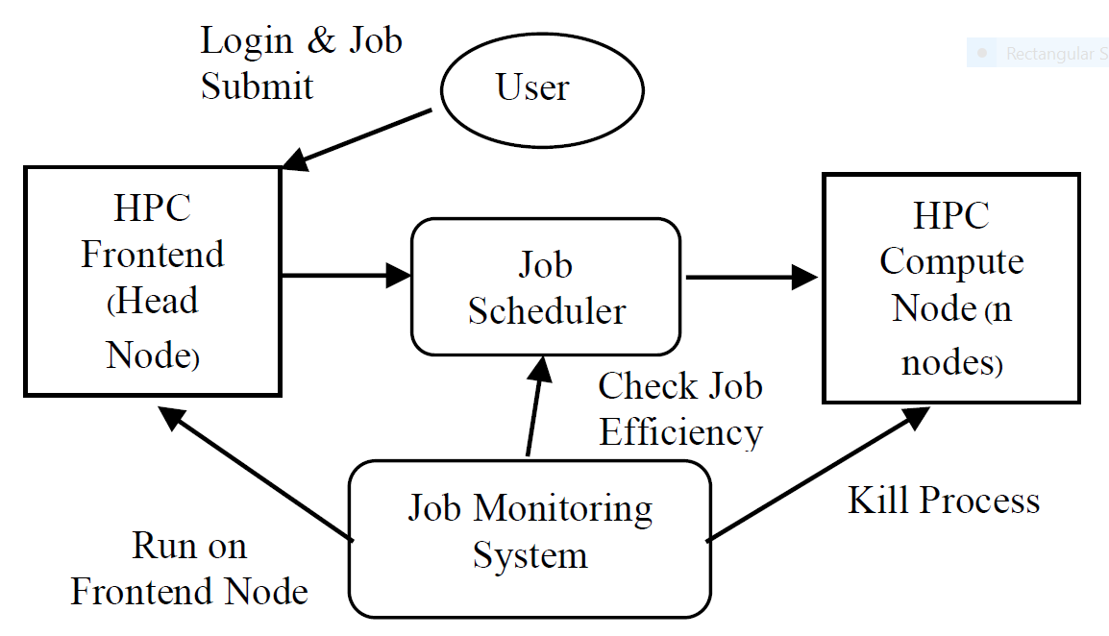
HPC architecture on JMS (Previous study)
Notes:
In our previous study, we start checking all running jobs in the system from number Job ID. The CPU-Load that represents the CPU utilization is over or not 100%. Process ID is then analyzed by the Job ID. Displays user details of how many CPU-Core requests are made. Then, it compares with the current CPU-Load that works exactly as requested. We use the tolerance of 20%. If the current resource has a CPU-Load greater than 120% or less than 80%, it will be assumed that the work is running, and the CPU-Core request does not match the actual use. It means that the use of resources is not effective. The system alerts users via email or eliminates the process. However, using this mechanism, the CPU-Load is not correctly analyzed because some software uses unstable CPU- Core. As a result, the decision of the system is wrong.

Slide 8
Example PBS script from users to request resources
The actual engagement of the HPC resources involves two compute nodes of four processors per node for 18 hours. Hence, the HPC resources are lost for six hours without productivity. As a consequence, the queues waiting for their job execution increase continually, while the booked HPC resources are idle
#### PBS Part ####
#PBS -N example
#PBS -l nodes=4:ppn=8
#PBS -q short (running length)
#### End Part ####

Slide 9
HPC (Cluster test) Specification
Frontend node (JMS system) : CPU 2 cores
Compute nodes : CPU 16 cores x 5 nodes = 80 cores
OS : Linux CentOS 7
Cluster Management : Beowulf Cluster
Job Management : PBS/Torque Scheduler
Scientific applications : Gaussion 09, Quantum Espresso 5, Gromac 5

Slide 10
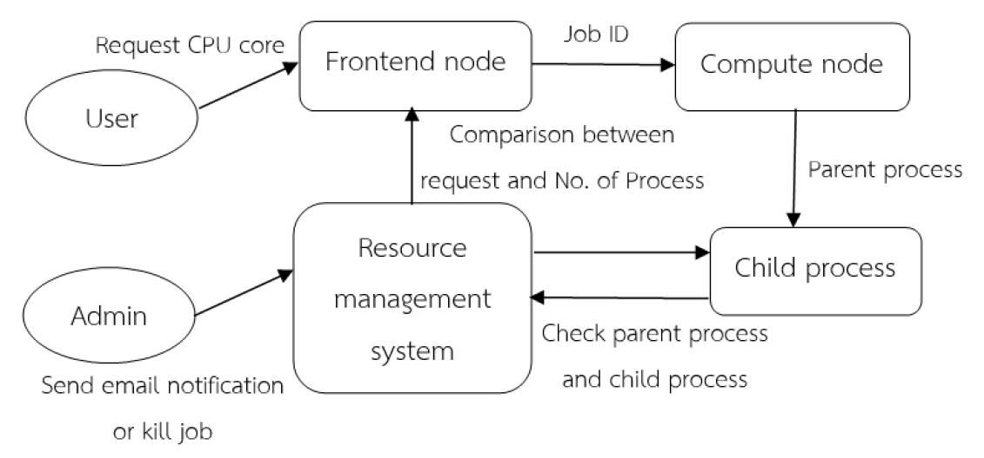
HPC job execution via Job Monitoring System
Notes:
In this study, the analysis of the run in the system uses a technique of parent and child process to determine how many CPU- Threads to be compared to the Job ID number. Based on the preliminary results of the same experiment, it was found that the accuracy was increased from the original method to 20%. This method is more accurate than the original method, since the CPU Thread counts the number of CPU-Cores from the compute node currently in use, regardless of the CPU-load that is the variance of the number. And consistent with the CPU-Core value that the user requested is numbered in integer format, such as CPU-Threads 4 and CPU-Cores 4. The new approach can determine whether the number of CPU-Threads and CPU-Cores are equal or not. In other word, it can answer if the request or usage of the resources is efficient, and finally it can automatically send alert to the user through email and terminate process if the user agrees.

Slide 11
Pseudo code of check job inefficiency
1: Get value JobID runtime over 5 Mins. as string
2: Calculate Resource Usage from JobID detail (SessionID)
3: Determine PBS script from JobID (CPU, Memory)
4: While not end of last JobID do
5: Compare Resource Usage and PBS Script Request;
6: if CPU cores & Threads = PBS Script Request then
7: go back to the beginning of current section;
8: else
9: Send notifications through email or terminate process
10:end while
11: finish

Slide 12
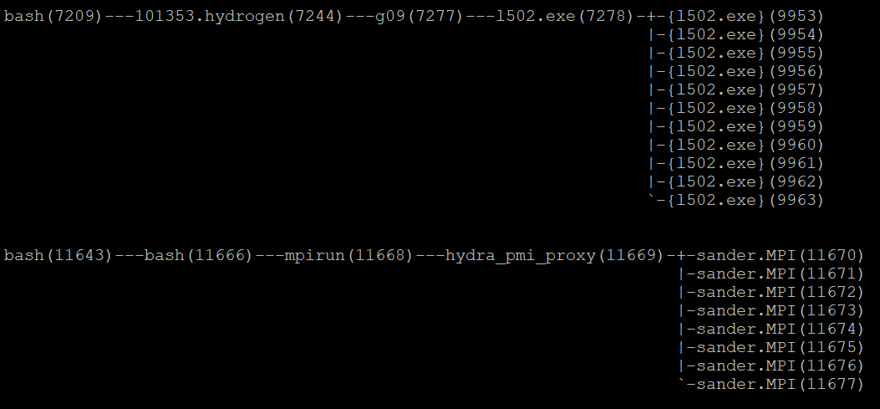
Parent and Child process method
Notes:
This picture show the structure of the process that is running at that moment, how the parent process and the child process are stacked. Then add the two processes together and compare it with the pbs script that the user requested.

Slide 13
The accuracy test of the JMS between Utilization and process
Software Application | Utilization method | Process method | Summary
 | Accuracy / No. of jobs | Accuracy / No. of jobs | Accuracy / No. of jobs
Gaussian 09 | 8/10 | 10/10 | 18/20
Quantum Espresso 5.4.0 | 7/10 | 9/10 | 16/20
Gromac 5.0.4 | 6/10 | 8/10 | 14/20
Total | 21/30 (68%) | 27/30 (95%) | 48/60 (80%)
Notes:
We measure the performance based on r eal use case scenarios. The preliminary studies are defined by the software application installed on the HPC. The studies were carried out by submitting 30 jobs to the system of each software application. Those submitted jobs are divided into categories of 10 jobs each.The studies show that the accuracy of the JMS process method is 20% more accurate than Utilization method

Slide 14
The results before and after use of JMS
Compute Nodes | CPU Cores (Max/Use) | % CPU Load | Result
cp-00 | 16/16 | 8.00 | Inefficiency
cp-01 | 16/16 | 14.00 | Inefficiency
cp-02 | 16/16 | 4.00 | Inefficiency
cp-03 | 16/16 | 12.00 | Inefficiency
cp-04 | 16/16 | 16.00 | Good efficiency
Total | 80/80 | 80/54 | Resource Usage 68%
Compute Nodes | CPU Cores (Max/Use) | % CPU Load | Result
cp-00 | 16/16 | 16.00 | Good efficiency
cp-01 | 16/16 | 16.00 | Good efficiency
cp-02 | 16/16 | 18.00 | Inefficiency
cp-03 | 16/16 | 14.00 | Inefficiency
cp-04 | 16/16 | 16.00 | Good efficiency
Total | 80/80 | 80/76 | Resource Usage 95%
(Utilization method: Schedule for 10 Jobs) (Process method: Schedule for 10 Job)
Notes:
This table present the results when the system deals with 20 jobs sent. The results show that the computational resource using JMS process method can identify the requested jobs that do not rely on or are less than the real use. This leads to a situation other jobs in the queue can be processed earlier. Also, parallel jobs have more opportunities to process in the system. The process method has more accuracy than the utilization method.

Slide 15
Relation of a %CPU Load and Temperature
CPU Cores Usage | % CPU Load | CPU Temperature ( °C) | Note
8/16 | 8.00 | 40 - 50 | Normal
16/16 | 16.00 | 50 - 60 | Full Load
16/16 | 32.00 | 60 - 70 | Overload
Notes:
This Table shows the relation between %CPU load and CPU temperature. When different jobs running in the system, the requested jobs that do not rely on or are less than the real use will result in that %CPU load is overload. The increase of temperature creates the burden and causes lowering the hardware lifetime, eventually leading to the system crash.

Slide 16
The comparison of temperature between before and after use of JMS in one week
Notes:
The results show that the average of temperature at the cluster decreases from 61.42 °C to 52.74 °C. This is because %CPU load is relative to the real use.

Slide 17
Conclusions
The resource-saving JMS is one method that can improve the performance of HPCs in conditions with a heavy load of job requests
The method aims to attenuate the work of the system administrator and encourage users to check their job status and HPC resources to increase system efficiency and productivity
It is expected to promote ecosystem HPC among the HPC consortium in Thailand

Slide 18
Thank you

