Slide 1
ESCAPE: a multi-science data infrastructure for the 2020s
Simone Campana, Patrick Fuhrmann, Giovanni Lamanna
ISGC, Taipei, Taiwan
4 April 2019

Slide 2
Disclaimer
Project just started. No results yet.

Slide 3
About the call
H2020-INFRAEOSC-04-2018 call
Clusters to ensure the connection of the ESFRI RIs with EOSC (and the construction of EOSC)
What is
ESFRI ?
EOSC ?
Cluster ?

Slide 4
ESFRI: Strategy Forum for RI’s
ESFRI's mandate
to support a coherent and strategy-led approach to policy making on research infrastructures in Europe
to facilitate multilateral initiatives leading to a better use and development of research infrastructures
to establish a European Roadmap for research infrastructures (new and major upgrades, pan-European interest) for the next 10-20 years, stimulate the implementation of these facilities, and update the roadmap as needed
to follow-up on implementation of ongoing ESFRI projects after a comprehensive assessment, as well as the prioritisation of infrastructure projects listed in the ESFRI Roadmap
The 2016 roadmap contains details of 21 ESFRI Projects — including six new projects, and 29 ESFRI landmarks. These landmarks are RIs that reached the implementation phase before the end of 2015.

Slide 5
About EOSC

Slide 6
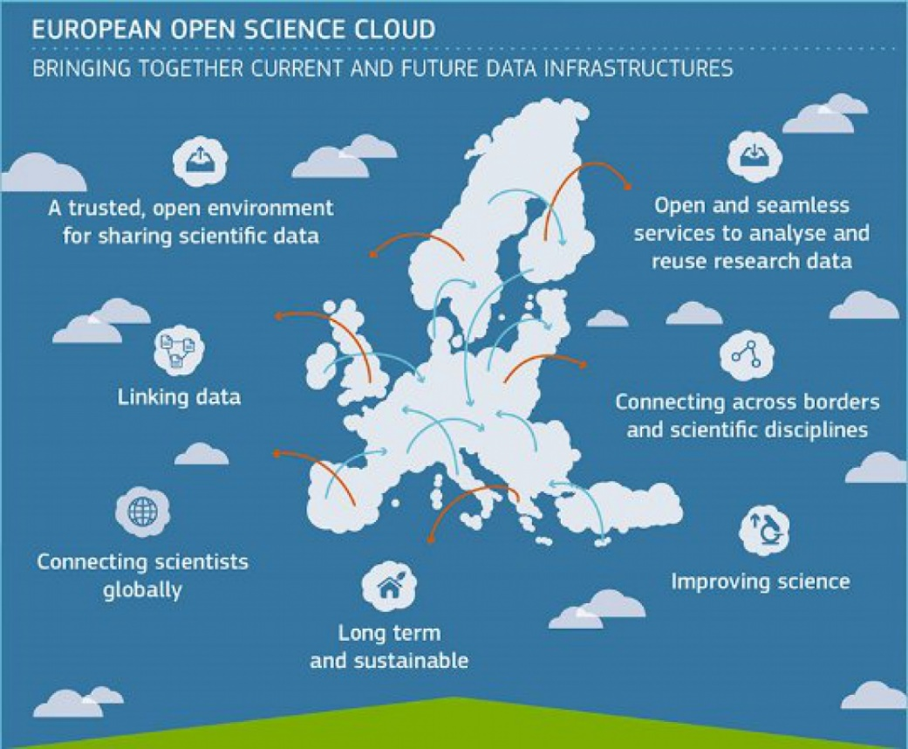
About EOSC
Bridging todays fragmented and ad-hoc solutions, towards a federation of data infrastructures
FAIR data and services for data storage, management, analysis and re-use across borders and disciplines
Added value for data-driven science, reproducible science, interdisciplinary research, digital innovation
6

Slide 7



About EOSC
Some readings…
EOSC Summit of 12 June 2017
  FAIR Data Expert Group
https://ec.europa.eu/research/openscience/pdf/eosc_declaration.pdf
  2nd HLEG on EOSC
  https://doi.org/10.2777/1524
  https://ec.europa.eu/info/events/2nd-eosc-summit-2018-jun-11_en
7

Slide 8
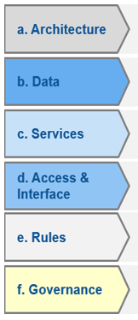
Timeline of EOSC
European
Cloud initiative
Implementation Roadmap
Council conclusions
H2020 – WP 2018-20
2016
Vision for the European Open Science Cloud
2017
INFRAEOSC 2018-2019 Calls
Federated model with 6 action lines
2018
Set up of EOSC governance framework by end 2018
8

Slide 9
EOSC Governance Structure
Governance Board
(MS/AC + EC)
  EOSC Board of MS/AC and EC representatives to ensure effective supervision of EOSC implementation
  Executive Board of stakeholder representatives to help ensure proper EOSC implementation and accountability
    Commission expert group
  Stakeholder Forum to provide input from a wide range of actors
    Self-organised with EC support
CLUSTERS
Oversight – strategic orientation
Coordination
structure
(CSA)
Support
Executive Board (representatives of stakeholders)
Steering implementation
WG
WG
WG
Stakeholders Forum
WG
WG
WG
Users, RIs, Service providers, public sector, industry, SME,…
Advice
Advice
IMPLEMENTATION
Realising the federating core: EOSCHub, eINfraCentral, …
eInfrastructures
Research communities / Research Infrastructures
International Inittiatives
National Initiatives
Coalition of Doers…

Slide 10

Impact of the call
Expected impact:
Improve access to data and tools leading to new insights and innovation
Facilitate access of researchers to data and resources for data driven science.
Create a cross-border open innovation environment.
Rise the efficiency and productivity of researchers through open data services and infrastructures for discovering, accessing, and reusing data.
Foster the establishment of global standards.
Develop synergies and complementarity between involved research infrastructures.
Adopt common approaches to the data management for economies of scale.

Slide 11
About Clusters

Slide 12
EOSC for big science
A cluster action of Big-Science ESFRI RIs for setting up EOSC,
implies technical and policy challenges.
(As per the European Commission “EOSC Declaration”)
  EOSC as a data infrastructure commons serving the needs of scientists, providing functions delegated to community level, federating resources.
  Researchers should contribute to define the main common functionalities needed by their own community.
  A continuous dialogue to build trust and agreements among funders, scientists and service providers is necessary for sustainability.
  Data Sharing and Data Stewardship are critical issues for the next generation ESCAPE RIs

Slide 13
Five EOSC Clusters
EOSC-LIFE: Life science RIs
  Providing an open collaborative space for digital biology in Europe.
  EOSC, Biological Medical Research Infrastructures, BMS RI, ESFR, Cloud, Data Resources, GDPR EOSC-Life brings together the 13 Biological and Medical ESFRI research infrastructures (BMS RIs) to create an open collaborative space for digital biology.
ENVRI-FAIR: Environmental RIs
  ENVironmental Research Infrastructures building Fair services Accessible for society, Innovation and Research.
PANOSC: Photon and Neutron sources Ris
  PaNOSC will contribute to the construction and development of the EOSC, an ecosystem allowing universal and cross disciplinary open access to data through a single access point, for researchers in all scientific fields. The project will work closely with the national photon and neutron sources in Europe in order to develop common policies, strategies, and solutions in the area of FAIR data policy, data management and data services.
SSHOC: Social Sciences and Humanities
  The project aims to provide a full-fledged Social Sciences and Humanities Open Cloud (SSHOC) where data, tools, and training are available and accessible for users of SSH data.
ESCAPE: Hep and Astronomy
  See below
13

Slide 14


Slide 15
ESCAPE in a nutshell
ESCAPE convenes a large scientific community
31 partners (including 2 SMEs)
7 ESFRI projects & landmarks: CTA, ELT, EST, FAIR, HL-LHC, KM3NeT, SKA
2 pan-European International Organizations: CERN, ESO (with their world-class established infrastructures, experiments and observatories).
4 supporting ERA-NET initiatives: HEP (CERN), NuPECC, ASTRONET, APPEC
1 involved initiative/infrastructure: EURO-VO (Virtual Observatory)
2 European research infrastructures: EGO and JIVE-ERIC
Budget: 15.98 M€
Started: 1/2/2019
Duration: 42 months (end date 31/7/2022)
Coordinator: CNRS (Centre national de la recherche scientifique)
Home page: https://escape2020.eu ; Twitter: @ESCAPE_EU

Slide 16































16

Slide 17
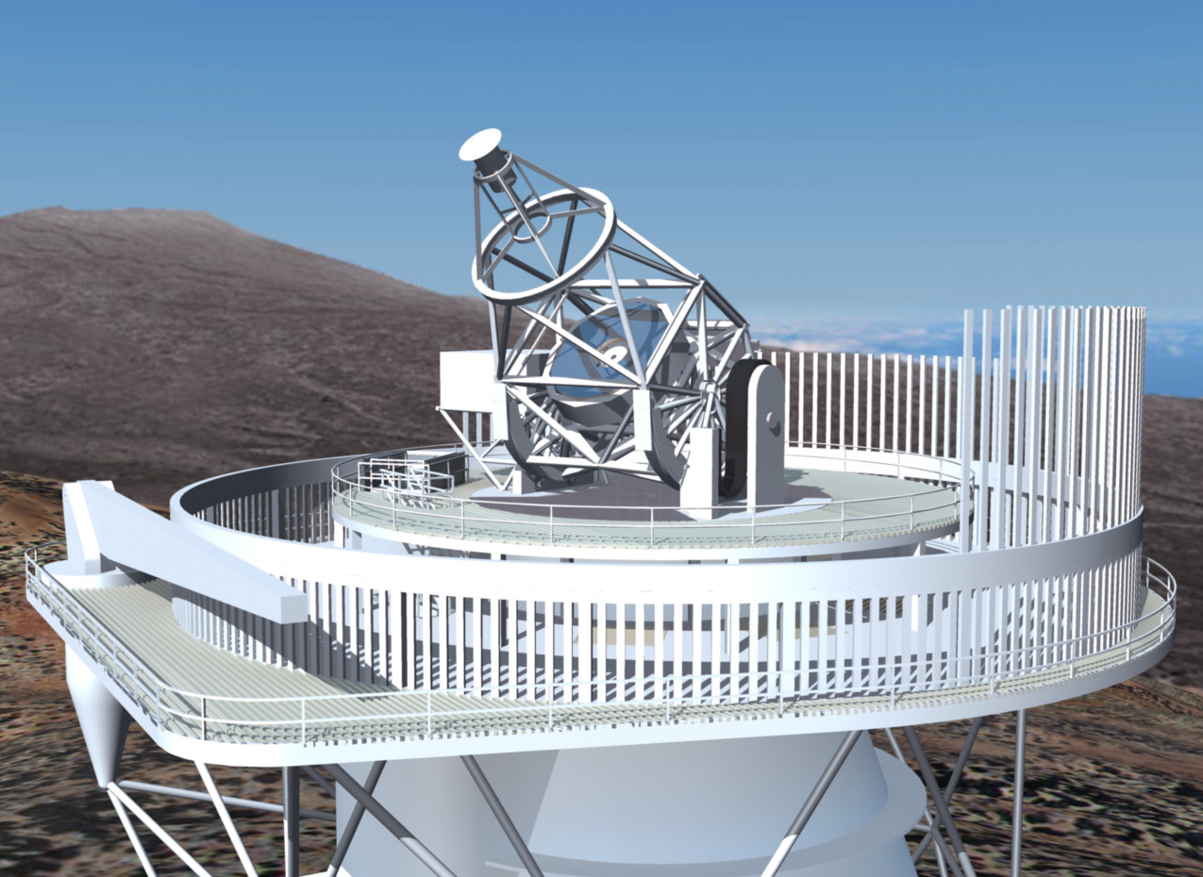
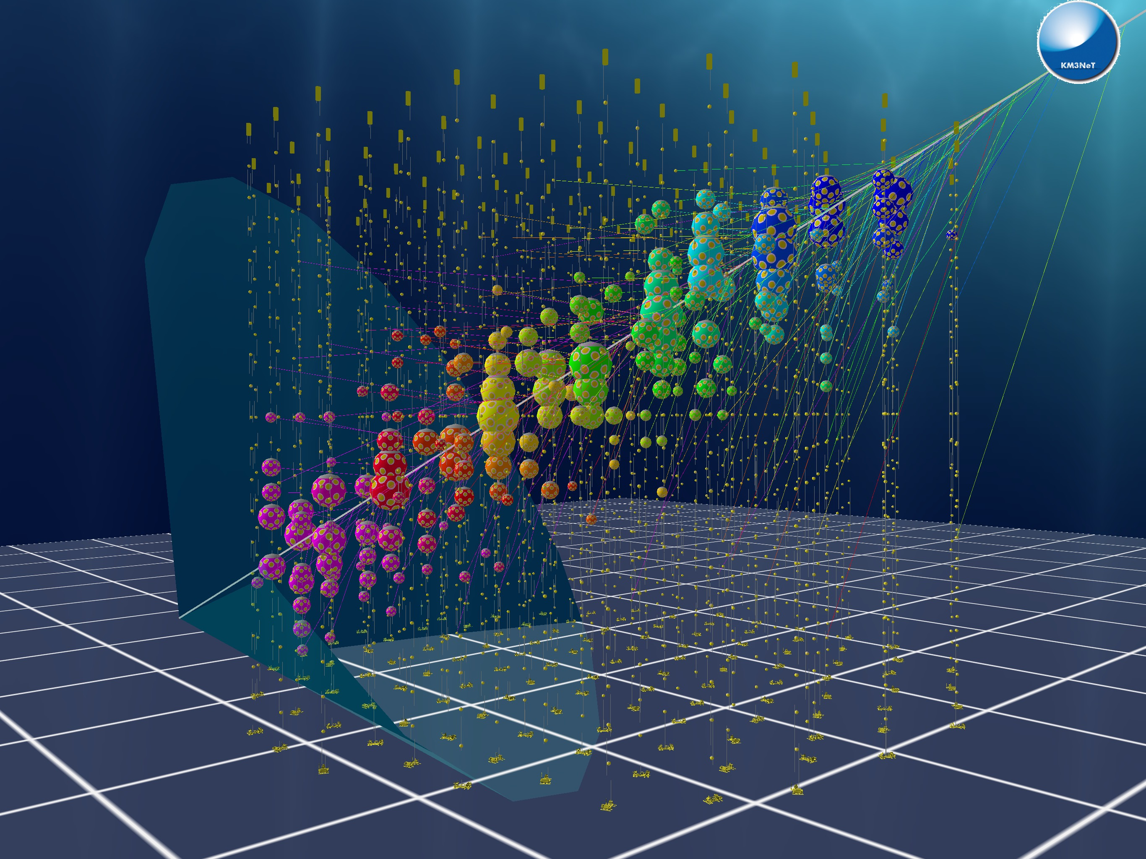
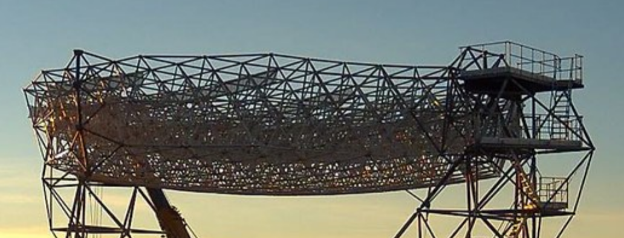
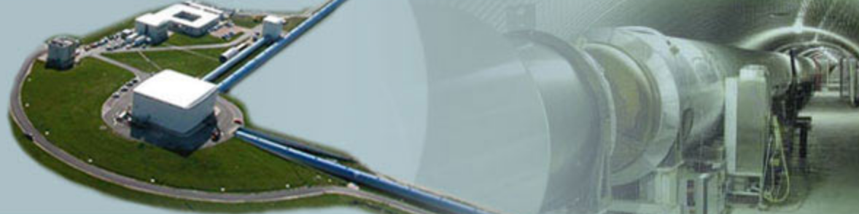
ESCAPE Science
Multi Messenger Astronomy
  Radio
    SKA (Scare Kilometre Array)
    JIVE VLBI (Very large Baseline Instrument)
  Visible Light
    European Extreme Large Telescope (ELT)
    European Solar Telescope (EST)
  Gamma Rays
    CTA
  Cosmic Rays: Neutrinos
    KM3Net
  Gravitational Waves
    EGO-VIRGO
High Energy Physics
  HL-LHC
    High Energy Particle
  FAIR
    High density exotic matter physics

Slide 18
The work package structure
WP1 MIND. Leader: Giovanni Lamanna, LAPP-CNRS
  Management and policy
WP2 DIOS. Leader: Simone Campana, CERN
  Contribute to the federation of global EOSC resources through an implementation of the Data-Lake concept (evolution of WLCG and other ESFRI RIs computing models) to manage extremely large volumes of data up to the multi-exabyte scale
WP3 OSSR. Leader: Kay Graf, FAU
  Support for "scientific software" as a major component of the ESFR-RI “data” to be stored and displayed in EOSC via dedicated community-based catalogues. Implementation of a community-based approach for the continuous development of shared software and for training of researchers and data scientists.
WP4 CEVO. Leader: Mark Allen, CDS-CNRS
  Extend FAIR standards, methods, tools of the Virtual Observatory to a broader scientific context; demonstrate EOSC's ability to include existing platforms.
WP5 ESAP. Leader: Michiel van Haarlem, ASTRON-NOW (Deputy : Zheng Meyer)
  Implementation of scientific analysis platforms enabling EOSC researchers to organize data collections, analyse them, access ESFRI's software tools, and provide their own customized workflows.
WP6 ECO. Leader: Stephen Serjeant, Oxford Open University
  Citizen Science, Open Science et Communication

Slide 19
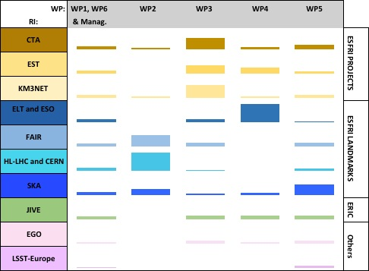
ESCAPE Work Program
An optimal matrix:
Some clear priorities per each RI
RIs’ use-cases in almost all WPs
Sub-sets of RIs driving a WP
All RIs involved in the EOSC support
The allocated staff effort is proportional to the respective boxes’ surface areas.
19

Slide 20
Stepping to WP2 :
Data Infrastructure for Open Science (DIOS)

Slide 21
Data Infrastructure for Open Science (DIOS)
Goal: design, implement and operate a cloud of data services for open access and open science at the Exabyte scale
The backbone of the Data Lake are well experienced large national data centers supporting the ESFRIs in ESCAPE
The data lake will serve as underlying data infrastructure to manage and serve data to the user communities
This solution will be proposed as key component of the future EOSC framework, supporting FAIR principles

Slide 22
Involved sciences and supporting RI
Supported by

Slide 23
WP2- specific objectives
Prototype a reliable and scalable federated data infrastructure. Mapping FAI(R)
Stores and organizes scientific data (Findable) and enables the provisioning of data processing (Accessible)
Enables sciences to build open data repositories (Interoperable)
In general, supports the world-leading data challenges of the Research Infrastructures in ESCAPE

Slide 24
WP2- specific objectives
Ensure long term data preservation (Reproducible) at the infrastructure level
Archiving of data in certified repositories and capabilities to retrieve the data in the long term
Complementing other work packages dealing with software, environment and provenance

Slide 25
WP2- specific objectives
The Data Lake development leverages collaboration with and integrates the work from previous and ongoing frameworks
EU projects such as EOSC-hub and XDC
Initiatives at the Research Infrastructures
Ongoing work from e.g. GEANT, PRACE

Slide 26
WP2- specific objectives
Computing Interface and Scalability
Computing capacity available inside and outside the data lake (Grid, Cloud, HPC, volunteer computing)
Need to integrate compute (and data) resources which are not part of the lake
Compute-data locality not guaranteed. Need to offer a reliable content-delivery service

Slide 27
WP2- specific objectives
Industrial and Commercial involvement
Commercial storage can be added to the data lake as cache or for resiliency
Commercial computing can be integrated with the data lake as extra processing capacity
In the data lake model, for both compute and storage there is no lock-in to the vendor
WP2 will validate the use of commercial cloud to store and process scientific data

Slide 28
WP2 objective
Create a cloud of data services, often referred to as a “Data Lake” by building on and integrating existing work from a variety of areas:
Research Infrastructures
previous EU projects, INDIGO, DEEP, XDC,...
state of the art solutions in the appropriate areas
Collaborates with ongoing work from GEANT, PRACE, and other proposed H2020 projects specifically addressing the European Open Science Cloud

Slide 29
Structure of ESCAPE WP2
Task 2.1 Data Lake Infrastructure and Federation Services. CERN (Xavier Espinal)
Task 2.2 Data Lake orchestration service. DESY (Patrick Fuhrmann)
Task 2.3 Integration with Compute Services. NOW-I-ASTRON
Task 2.4 Networking. SKAO (Rosie Bolton)
Task 2.5 Authentication and Authorization. INFN (Andrea Ceccanti)
Task 2.2 Content Delivering and Caching
Task 2.2
Storage Orchestration
Task 2.3
Efficient Access to Compute
Task 2.4 Networking
HTC/Grid
HPC
Task 2.1 Storage Services
Task 2.5 AAI
Cloud/
Commercial
Task 2.1 Data Transfer Services
Citizen

Slide 30
Data Lake strawman
Storage Orchestration Services
Storage
Asynchronous
Data Transfer
Services
Storage
Data (Lake)
Infrastructure
Distributed Storage
Storage
Storage
Volatile
Storage
Storage
Content Delivering and Caching Services
Data Center
Data Center
Grid Compute
Grid Compute
Cloud Compute
HPC
Compute
@HOME
Grid Compute
Compute
Infrastructure
Compute Provisioning

Slide 31
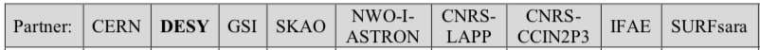
Task 2.2: Orchestration Service
Implement a system managing scientific user policies while optimizing the service provider costs.
Replication policies, access policies
QoS: optimization between redundancy, performance and cost
Data lifetimes and lifecycles: dynamic replication, deletion, change of QoS
Storage Orchestration Services
Storage
Asynchronous
Data Transfer
Services
Storage
Data (Lake)
Infrastructure
Distributed Storage
Storage
Storage
Volatile
Storage
Storage
Content Delivering and Caching Services
Data Center
Data Center
Compute
Infrastructure
Grid Compute
Grid Compute
Cloud Compute
HPC
Compute
@HOME
Grid Compute
Compute Provisioning

Slide 32

Task 2.3: Integration with Compute
Does not focus of provisioning compute resources.
Focuses instead on serving data to large scale processing centers Processing capacity might be not co-located with data.
Processing capacity might be not co-located with data
Data Transfer Services
Caching and latency hiding services (Content Deliver Network)
Compute services will be heterogeneous: Grid, HPC, Cloud (including commercial)
Storage Orchestration Services
Storage
Asynchronous
Data Transfer
Services
Storage
Data (Lake)
Infrastructure
Distributed Storage
Storage
Storage
Volatile
Storage
Storage
Content Delivering and Caching Services
Data Center
Data Center
Compute
Infrastructure
Grid Compute
Grid Compute
Cloud Compute
HPC
Compute
@HOME
Grid Compute
Compute Provisioning

Slide 33

Task 2.4: Networking
Wide Area Network is a key component in the Data Lake model
Task 2.4 develops the capability to provide high capacity networking between data centers to enable traffic management
Leverages work done in WLCG and GEANT.
Applies to all scenarios in Task 2.3:
Asynchronous Data Transfer of large data volumes
Content Deliver Network for processing
Integration of commercial compute resources
Storage Orchestration Services
Storage
Asynchronous
Data Transfer
Services
Storage
Data (Lake)
Infrastructure
Distributed Storage
Storage
Storage
Volatile
Storage
Storage
Content Delivering and Caching Services
Data Center
Data Center
Compute
Infrastructure
Grid Compute
Grid Compute
Cloud Compute
HPC
Compute
@HOME
Grid Compute
Compute Provisioning

Slide 34

Task 2.5: Authentication and Authorization
Integrates solutions from different projects/activities to build a federated storage infrastructure
provide the appropriate level of granularity of authentication and access control to manage and protect data
provide the means by which to enable open access once data is released to the broader community
Heterogeneous authentication mechanisms, management of memberships and policies, controlled delegation, leverage off-the-shelf libraries and components

Slide 35

Task 2.1 puts all this together
Builds the prototype which federates the storage of several of the data centers that support the main science communities in the project
Store scientific data of the Research Infrastructures with the policies by them defined
Provide the needed monitoring and analytics tools
Certifies the data centers for bit preservation
Storage Orchestration Services
Storage
Asynchronous
Data Transfer
Services
Storage
Data (Lake)
Infrastructure
Distributed Storage
Storage
Storage
Volatile
Storage
Storage
Content Delivering and Caching Services
Data Center
Data Center
Compute
Infrastructure
Grid Compute
Grid Compute
Cloud Compute
HPC
Compute
@HOME
Grid Compute
Compute Provisioning

Slide 36
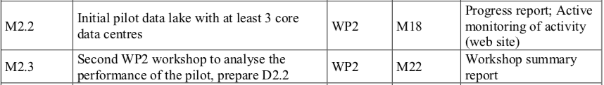
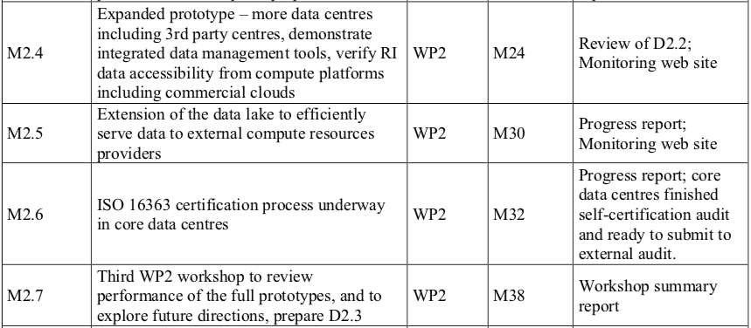
Milestones and Deliverables
1 Aug 2019
1 Oct 2019
1 Aug 2020
1 Dec 2020
1 Feb 2021
1 Feb 2021
1 Aug 2021
1 Oct 2021
1 Apr 2022
1 Jun 2022

Slide 37
Deliverables
Oct 2019:
  Implementation plan and the design of the of the pilot
Aug 2020 (Milestone)
  Initial Data Lake with at least 3 centers.
Feb 2021:
  Analysis and assessment of the first version of the pilot data lake.
Feb 2021:
  Extended prototype with more centers and tools
1 Jun 2022:
  Final analysis and assessment of the full prototype.

Slide 38
First practical steps
Focus on our first milestone (and deliverable): discuss and design the first implementation of the data lake
Evolve the strawman into an architecture
Which components to focus on in the initial phase
Sciences drive the needs (and needs drive the design)
This will be an initial design. Flexibility (both in design and components) is one key aspect

Slide 39
END

