Slide 1
Why such a theme?
Educators’ Mission
Raising the future generation in the safe global society
Global Communication Skill to Build Trust
Not giving pre-fabricated knowledge and values (but Critical Thinking Skill)
Giving students chances to grow transcendent mindset to lead to new values (Creative Thinking Skill)

Slide 2
Outline
(i) Rationale
(ii) Sense Making: Curriculum Development

Slide 3
(i) Rationale
Reasons for the global curriculum proposal
The future of our students?
Paradigm Shift in Education enhanced with ICT is just around the corner!

Slide 4
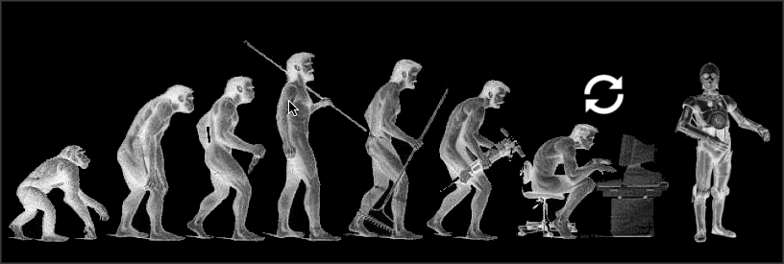
Job Market Dynamics
Singularity (2045) → New Job Market?
How old will your students be in 2045?
https://joneljuste.files.wordpress.com/2015/04/singularity-c3po.jpg

Slide 5
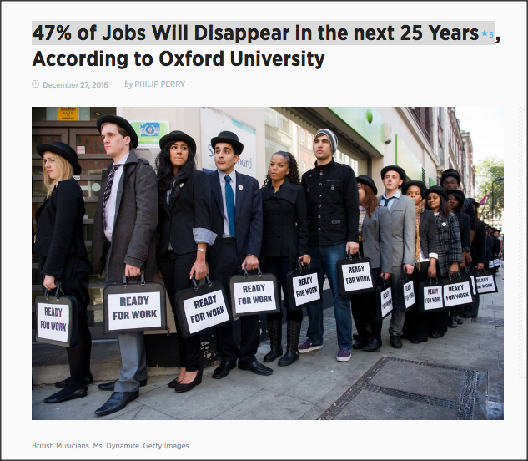
Disappearing Jobs
http://bigthink.com/philip-perry/47-of-jobs-in-the-next-25-years-will-disappear-according-to-oxford-university

Slide 6
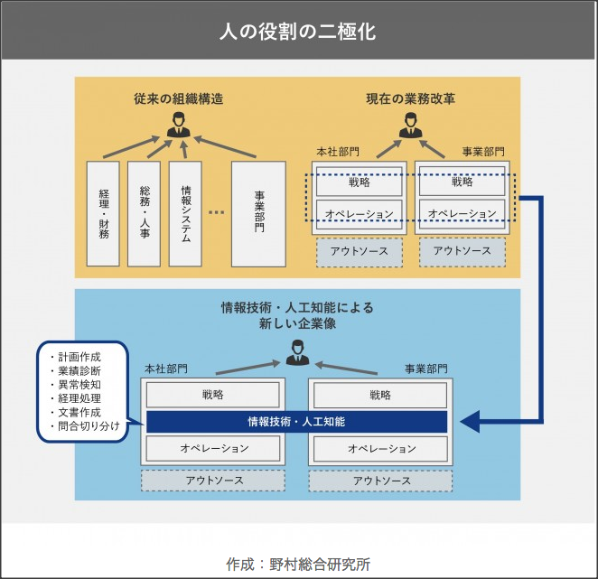
Two-Tier Structure
Routine jobs ➔ AI and Robots
https://mirai.doda.jp/series/interview/tomota-terada-part1/

Slide 7
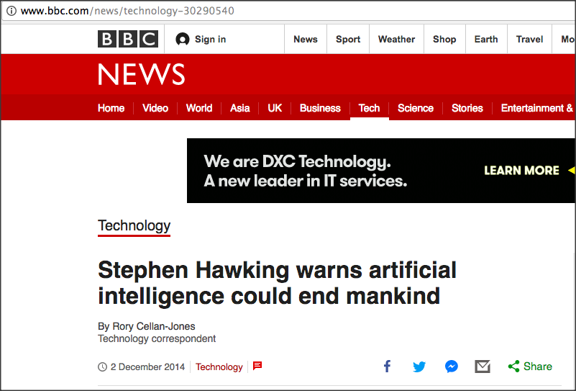
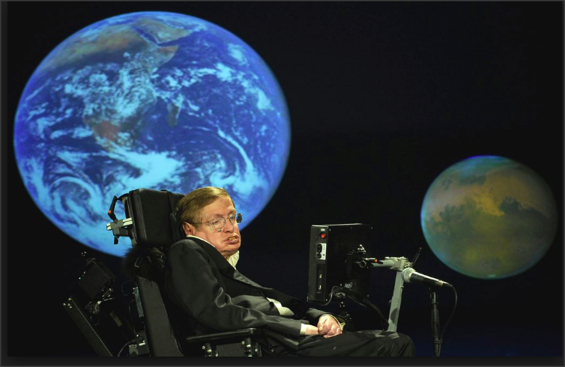
JOB MARKET IN THE FUTURE
In fact, the biggest threat facing mankind is one that has in some ways only just been discovered: artificial intelligence (AI). The physicist Stephen Hawking has said that AI could become ‘a real danger’ in the ‘not-too-distant’ future. Hawking added that ‘the risk is that computers develop intelligence and take over. Humans, who are limited by slow biological evolution, couldn’t compete, and would be superseded.’
http://www.bbc.com/news/technology-30290540
http://www.spiked-online.com/newsite/article/the-robots-are-not-taking-over/16299#.WgJmDmKCzdc

Slide 8
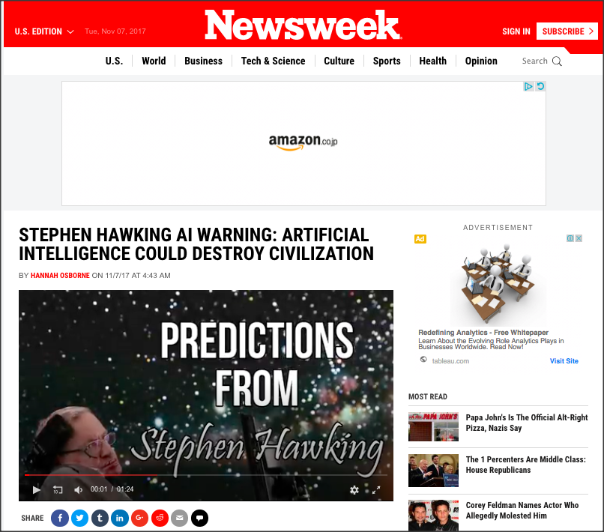
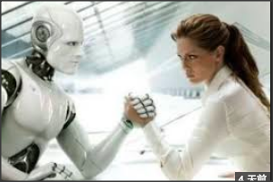
Stephen Hawking
http://www.newsweek.com/stephen-hawking-artificial-intelligence-warning-destroy-civilization-703630

Slide 9
Stephen Hawking
http://www.newsweek.com/stephen-hawking-artificial-intelligence-warning-destroy-civilization-703630
Singularity is just a beginning!
Will our students be ready to face the reality?

Slide 10
(ii) Curriculum Development
Education ready for the Singularity Era

Slide 11
The Role of University: Gas Station for life? Filling the knowledge tank in the students’ brain for the life-long career?
Notes:
consensus

Slide 13
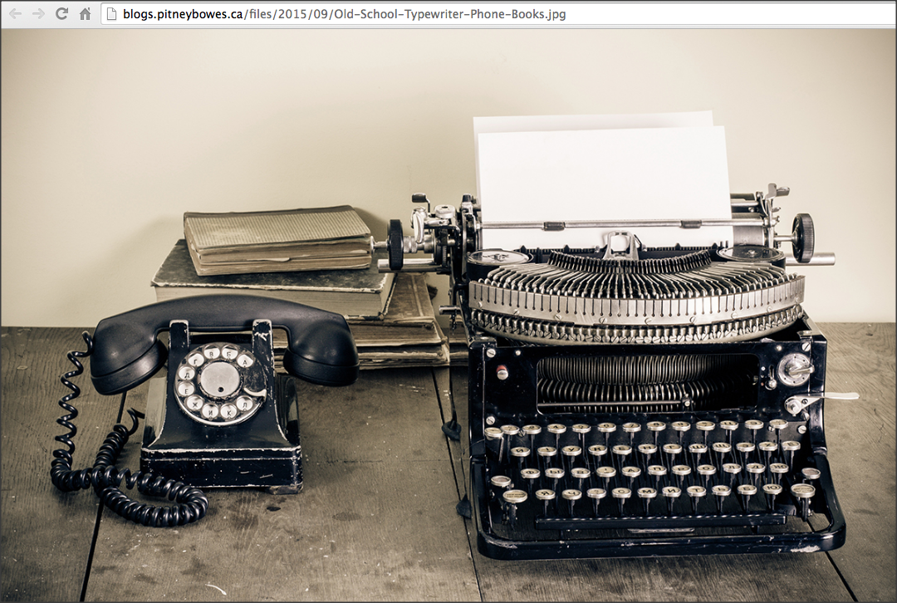
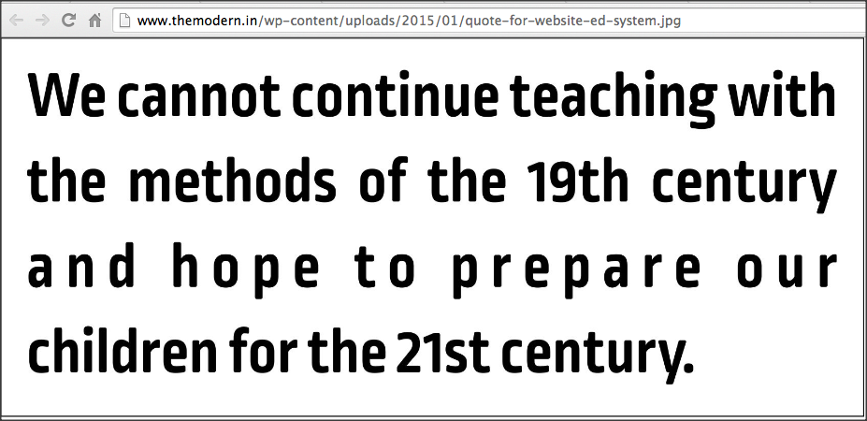
How do we educate the future generation?
Traditional Education Paradigm has seen the handwriting on the wall!
A Paradigm Shift in Education is a must.
New educational philosophy
New educational model: New learning environment

Slide 14
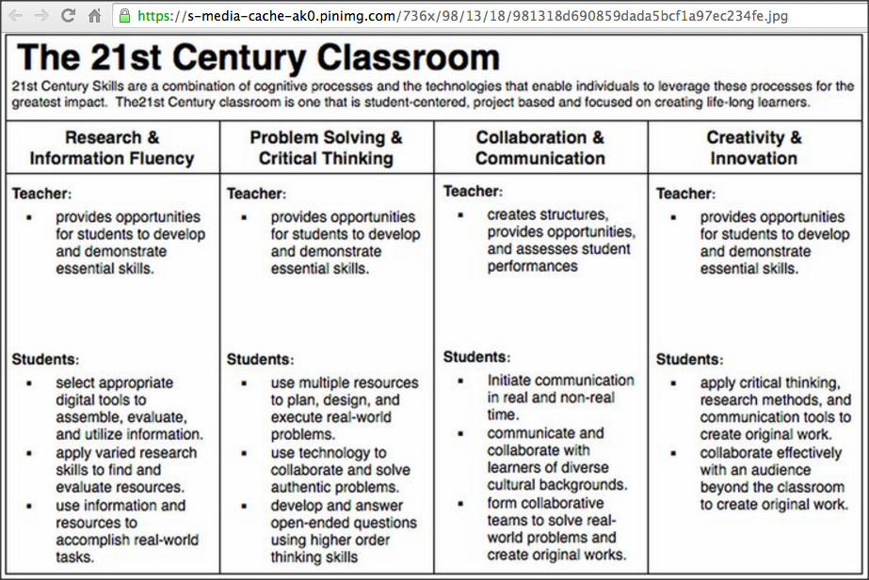
A Quote: From Horizon 2020 Proposal
We can not educate 21st century citizens using only 19th century methodologies.
the vision of … Collaborative Education is that without doubt the largest impact on our society will be obtained by addressing the needs of our children to get personalized education: (1) motivating teachers to motivate students, (2) addressing their creativity, and (3) getting them in contact with their equals and the rest of the society to share their needs and motivations, thus closing the circle.

Slide 15
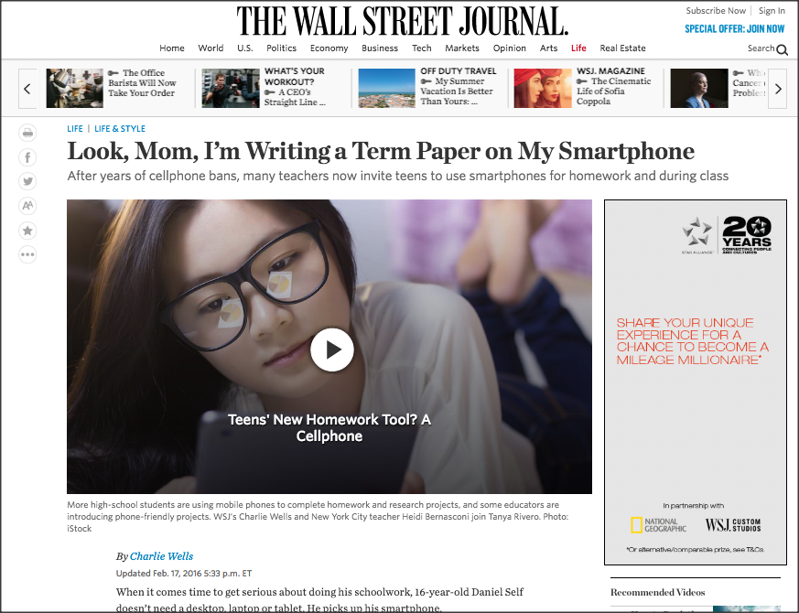
This is happening now!
ttps://www.wsj.com/articles/look-mom-im-writing-a-term-paper-on-my-smartphone-1455729046?mod=rss_Education
https://www.wsj.com/articles/look-mom-im-writing-a-term-paper-on-my-smartphone-1455729046

Slide 16
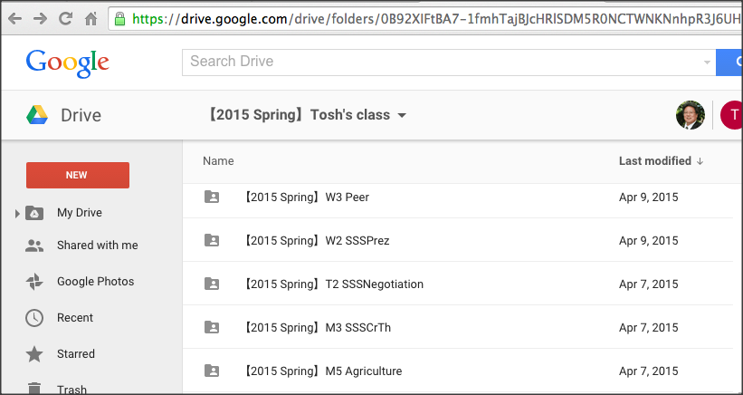
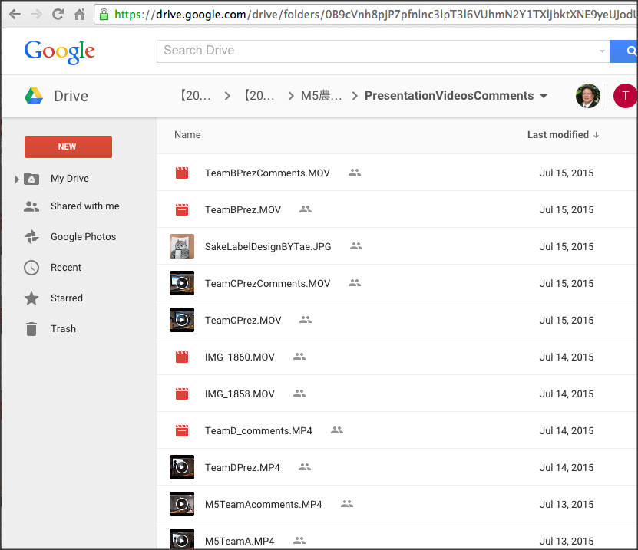
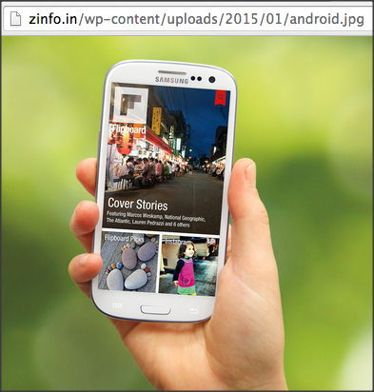
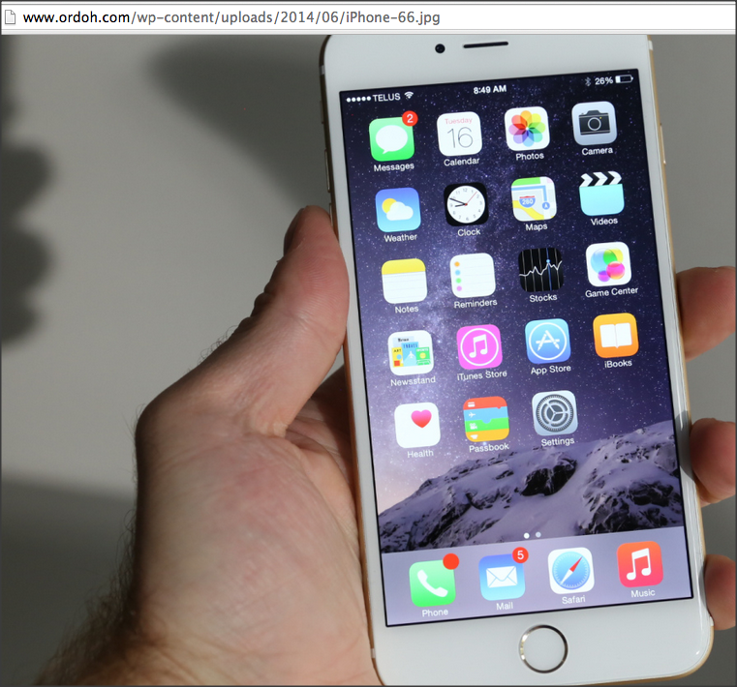
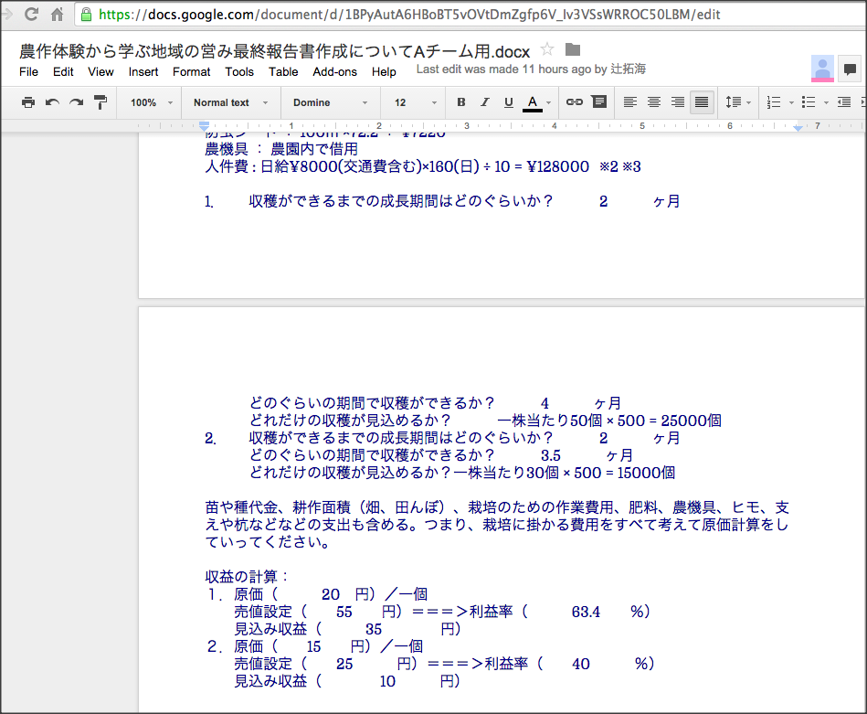
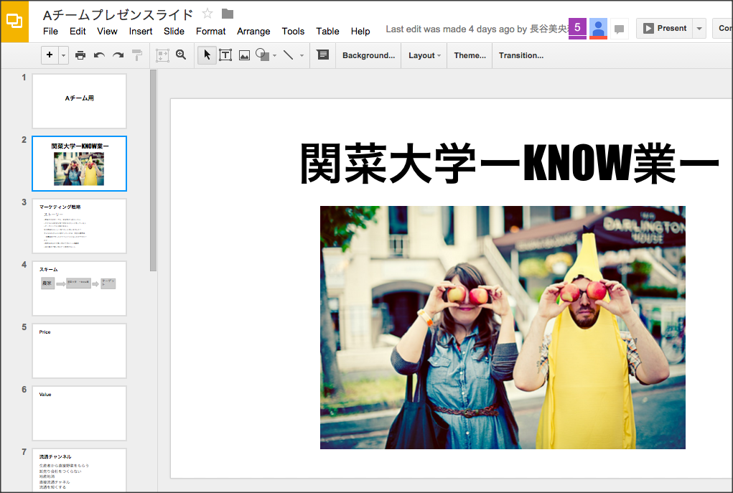
Google Drive Share/Edit/PBL with Team Members!
Team presentation videos
comments
Gurantees 24/7 team learning environment
All linked with TEAM LINE
All linked with TEAM LINE
All linked with TEAM LINE
Team presentation slides
All can edit online
Team Reports
All can edit online.

Slide 17
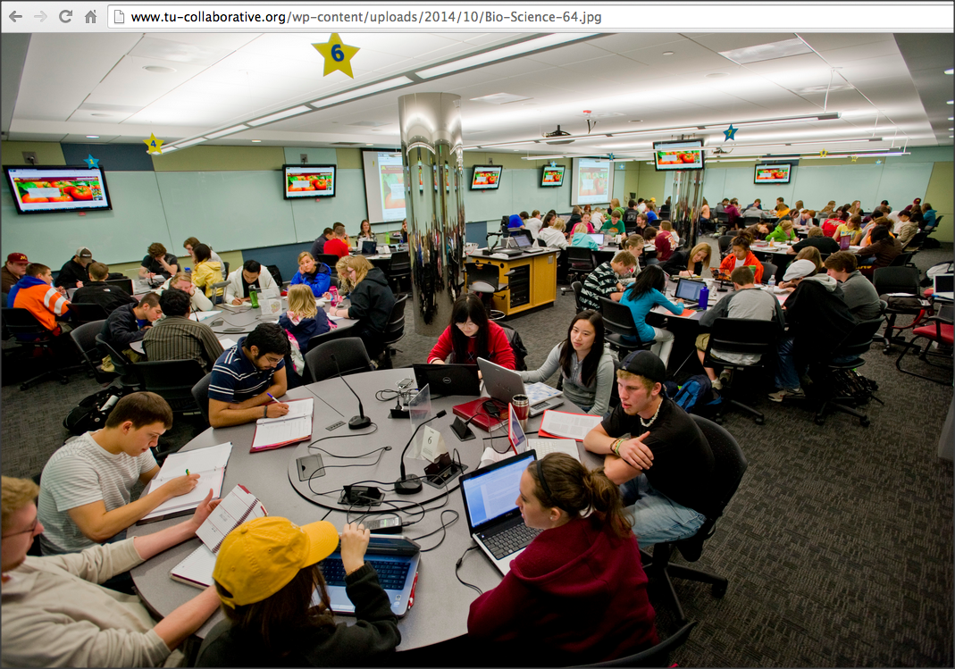
Active Learning is essential!
For the future education,
Social Constructivism Model of Education will be everywhere!
FROM: Face-to-Face
In-Class Learning

Slide 18
Active Learning is essential!
With ICT, this situation can be realized in ONLINE classes!!
Teacher’s role is to facilitate students’ learning. --- control of learning chaos in the online classroom

Slide 19
(ii) Sense Making: ICT and Communication
Communication Skills: Needs for communication with students from other cultures and values.
Long-Lasting Trust Building
Problem Solving Skills: Common issues in our society
Project Management Skills: Working in Teams: International/Global Teams
Consensus Building through TBL
Go Global !

Slide 20
The Future,
Better Life,
Transcendency
http://www.iftf.org/uploads/media/IFTF_FutureWorkSkillsSummary_01.gif
Notes:
http://www.iftf.org/uploads/media/IFTF_FutureWorkSkillsSummary_01.gif

Slide 21
10 Needs for Future Education
The Future,
Better Life,
Transcendency
http://www.forbes.com/sites/sap/2014/05/12/are-you-ready-here-are-the-top-10-skills-for-the-future/2/
Sense Making
Social Intelligence
Novel & Adaptive Thinking
Cross-Cultural Competencies
Computational Thinking
New Media Literacy
Transdisciplinarity
Design Mindset
Cognitive Load Management
Virtual Collaboration
Notes:
Sensemaking
Social Intelligence
Novel & Adaptive Thinking
Cross-Cultural Competencies
Computational Thinking
New Media Literacy
Transdisciplinarity
Design Mindset
Cognitive Load Management
Virtual Collaboration

Slide 22
A Quote: From Horizon 2020 Proposal
We can not educate 21st century citizens using only 19th century methodologies.
the vision of … Collaborative Education is that without doubt the largest impact on our society will be obtained by addressing the needs of our children to get personalized education: (1) motivating teachers to motivate students, (2) addressing their creativity, and (3) getting them in contact with their equals and the rest of the society to share their needs and motivations, thus closing the circle.
Active Learning
Social Constructivism
PBL through TBL!
Global Learning is a must!

Slide 23
Proposing an ICT-Enhanced Learning Environment
Our Sense-Making
the Future Skills ⬅ ➔ the Requirements for Learning Environment

Slide 24
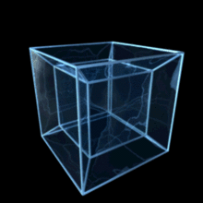
Tesseractive Learning
Tesseract https://en.wikipedia.org/wiki/Tesseract
Spatial & Temporal Perspectivve
（Past ➔ Present ・・＞ Future）
Tesseract + ive = Time-line-wise & 3 Dimensional Perspective

Slide 25
Curriculum Development for the Future Design
Requirements
Global Society as the Realm of Learning
Students from different campuses in different countries
Students learn in the same learning space in global teams!
Critical Thinking/Creative Thinking Enhanced!
Future Scenario Planning (Tesseractive Learning)
Realm of Learning ➔ Global Issues (SDGs)
Win-Win Relationship (Empathy-Building and Maintenance)
Not! Leading to a battle or war – Goal is Global Happiness
Learning In Global Teams!

Slide 26
Curriculum Development for the Future Design
Overcoming Difficulties
Distance (Time Difference)
Mindset Differences
Cultural Values ➔ influences on decision making
➔ communication patterns or thinking processes
“On the Same Page”
Accessible to the Learning Environment ➔24/7
Team Level
Class Level (Can watch other teams’ progresses anytime!

Slide 27
Let’s Get Engaged!
Design your own future education
Curriculum or Course
Sense Making of what we have with Requirements & Overcoming Difficulties!

