Slide 1
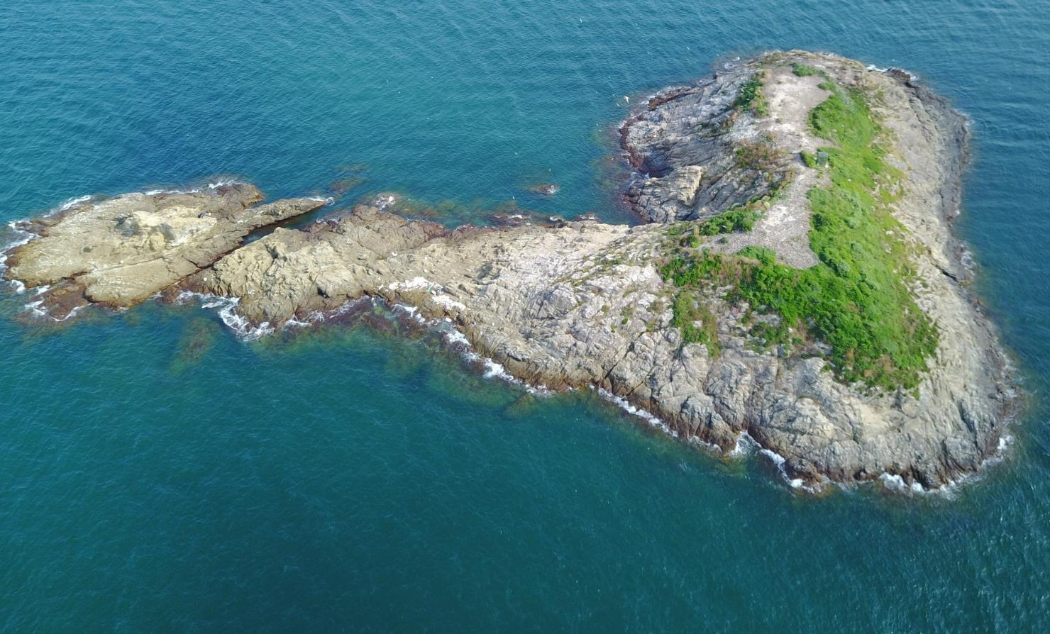
Use of acoustic recorders in monitoring and management of seabird breeding colony in Matsu archipelagos, Taiwan
1. National Taiwan University
2. Japan Agency for Marine-Earth Science and Technology
Chung-Hang, Hung¹,
Tzu-Hao, Lin², Kung-Kuo, Chiang¹³ , Le-Ning, Chang¹, Hsiao-Wei, Yuan¹
3. Wild Bird Society of Taipei

Slide 2
Greater Crested Tern
(Thalasseus bergii)
590 – 4600 idv. in Matsu
15,000 –150,000 idv. worldwide
Chinese Crested Tern
(Thalasseus bernsteini )
2 –16 idv. in Matsu
< 100 idv. worldwide
(BirdLife international, 2017; Hung et al., 2019)
Notes:
In this study, we focus on these two seabird species. The GCT was the most abundance terns among china cost line and the CCT was the most critically endangered seabird in china.
The two species looks very similar but you tell the different between their bill color and wing color
According our observation in Matsu since 2000. The CCT always nest within GCT colony, and the fluctuation of their population also shown a strong positive correlation.

Slide 3
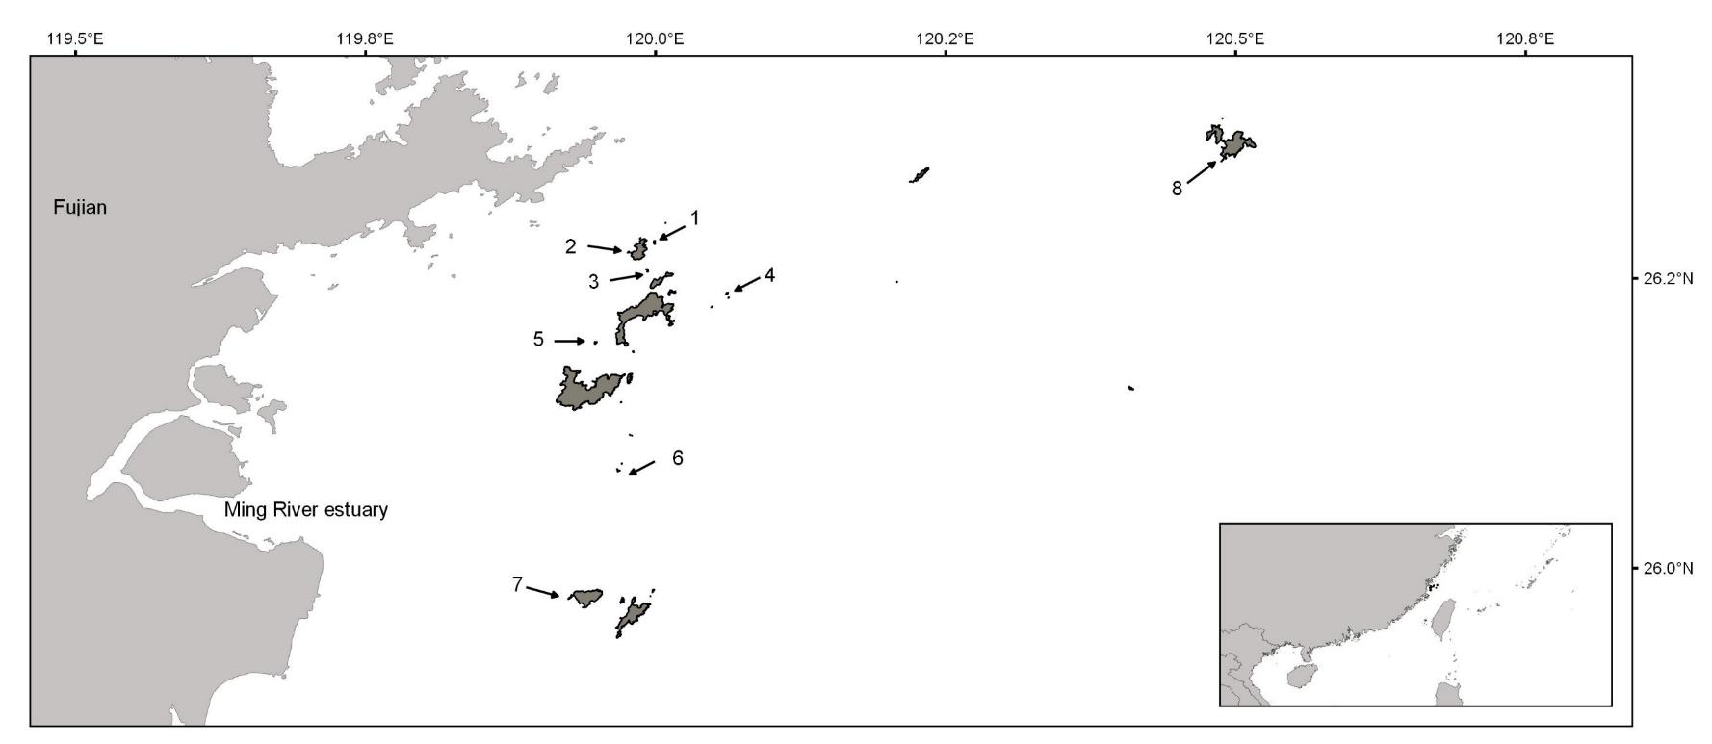
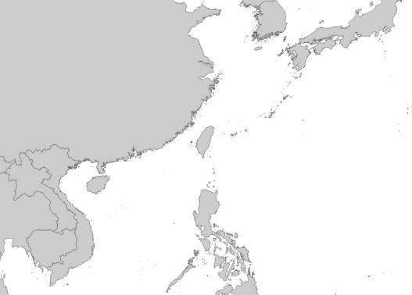
Matsu Islands Tern Refuge
Baimao (1.88 ha)
Twins (1.74 ha)
Tiejien (1.29 ha)
Zhongdao (2.02 ha)
Sanlianyu (1.39 ha)
Jinyu (3.12 ha)
China
Liuquanjiao (1.09 ha)
Matsu
Taiwan
Sheshan (3.16 ha)
Notes:
In this map you can see the location of out study site: Matsu Archipelagos, it locate at north-west side of Taiwan and were very close to Fujian.
In 2000, the Lienchiang County Government of Taiwan designated eight islands of the archipelago as the Matsu Islands Tern Refuge (MITR) to protect breeding colonies of terns. As you can see the area of these island, it all very small islands.
For the past decades, NTU cooperated wild bird society of Taipei to monitor all these island which had various kind of seabirds breed colony

Slide 4
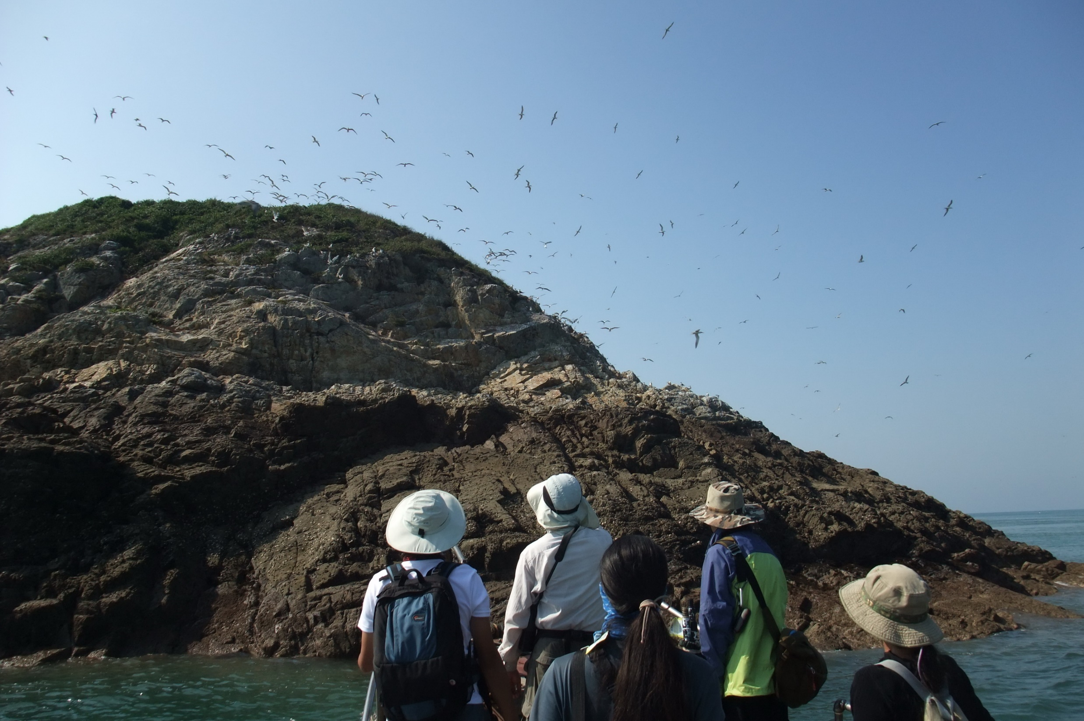
Notes:
This is the way we do the routine seabird survey in the past decade. We use binocular on a fishing boat and to count all the bird flying around the island
As you can imagine, the data was unreliable because most of the seabird breeding at the top of the island where we cant see it.

Slide 5
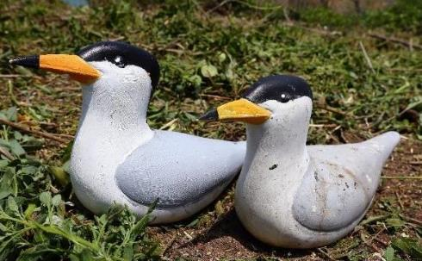
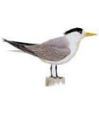
Colony shifts and Social Attraction
The breeding colonies of GCT and CCT shift annually
We used decoys to lure terns to breed on island with habitat management since 2011
Social Attraction
Notes:
Whatever.
Based on previous data, we found that the breeding colonies of GCT and CCT shift among the 7 islands between years, the different color means different island they used. This nomadic behavior made use hard to monitor and mange the breeding colony under very limiting resources. So, We used social attraction technique since 2011
to lure tern to breed on islands with habitat management

Slide 6
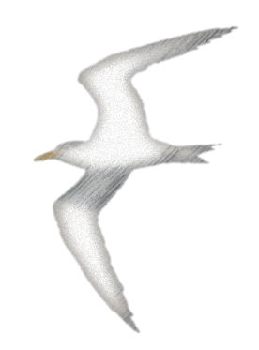
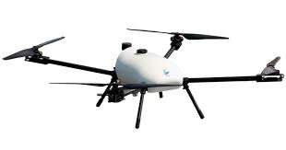
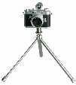
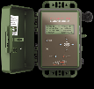
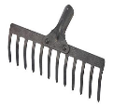
Conservation strategy for CCT and GCT
Social Attraction
UAV
Auto-cameras
Song meter
Audio playback
Decoy
Habitat management
Notes:
Our Conservation strategy for CCT and GCT was removed the overgrown vegetation and small rodent before breeding season, then we set up decoy and audio playback system for the social attraction to lure terns to breed on Tiejien island.
Tiejien is a very small island, we don’t want to made any disturbance to the tern colony, so the ground counting for nest was unable to conducted. So this is why we use song meter and auto cameras to help use to monitoring the colony
The aerial images collected by UAV could be used to generated geometrical data of the island. These information will be very useful for our habitat management plan.

Slide 7
Notes:
And this is how the tern’s colony look like from the UAV in year 2017, we have about 1000 GCT and 10 CCT in this area
If look this aerial photo very carefully, you can see that 3 or 4 CCT stick together at the comer

Slide 8
Notes:
This is

Slide 9
Objectives
Use acoustic recorders to monitor terns’ colony
Arrival
Departure
Colony size
Colony status
Notes:
Our objectives were very simple,

Slide 10
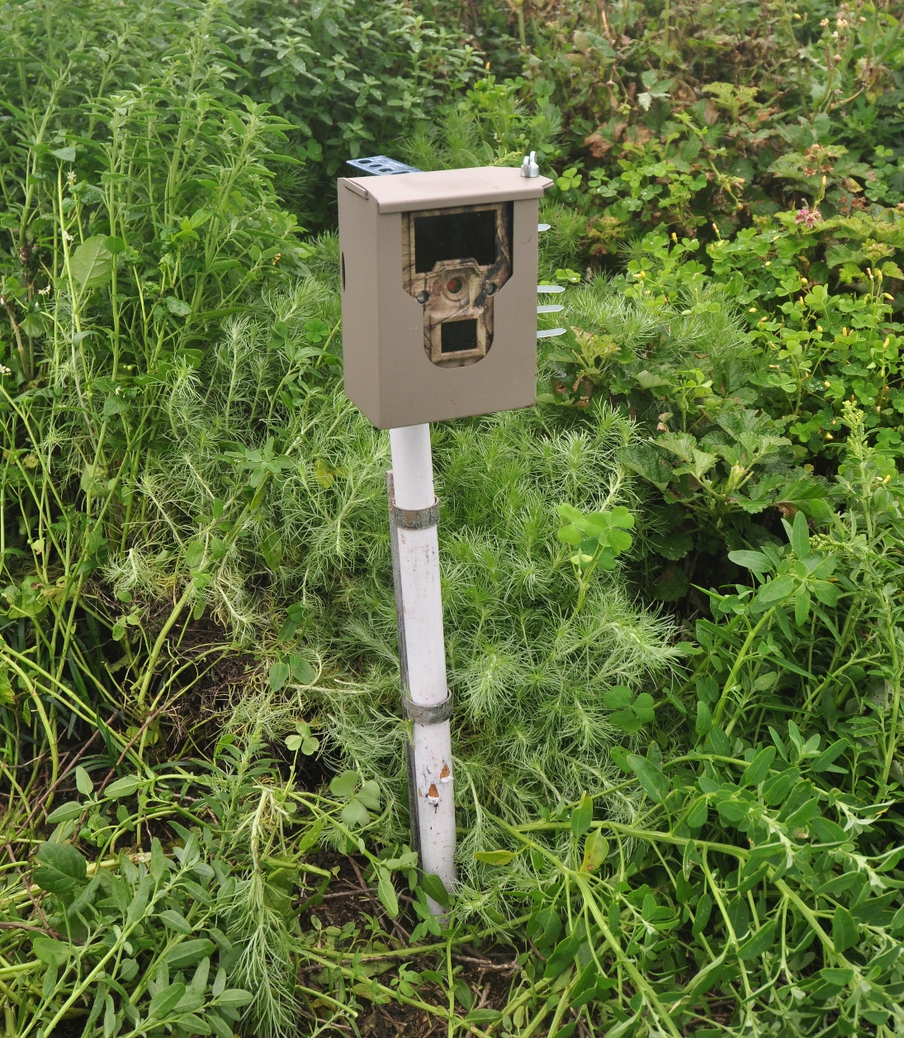
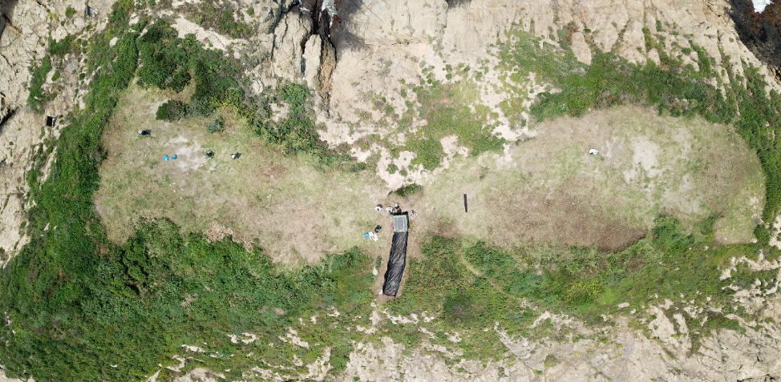
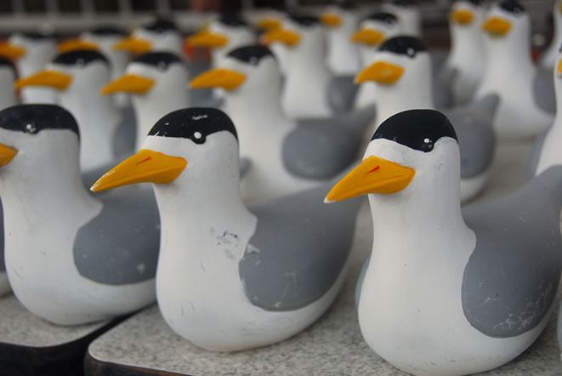
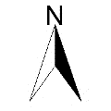
Auto cameras and decoys
32 decoys
6-8 Auto cameras with time lapse mode (1 photo every hour)
Auto cameras
Decoys
Decoys
Bird blind
Song meter
Notes:
This aerial photo shows how we deploy our equipment on the island , we put 32 decoy at the north and south side of the island and set up 6-8 auto camera around the decoys

Slide 11
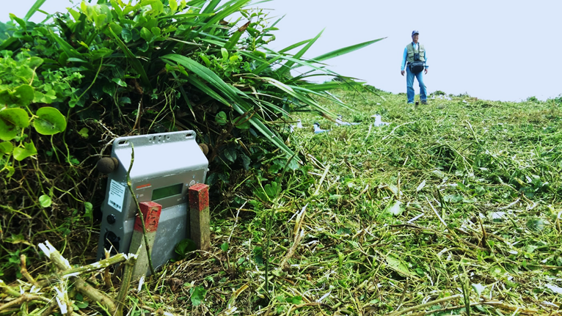
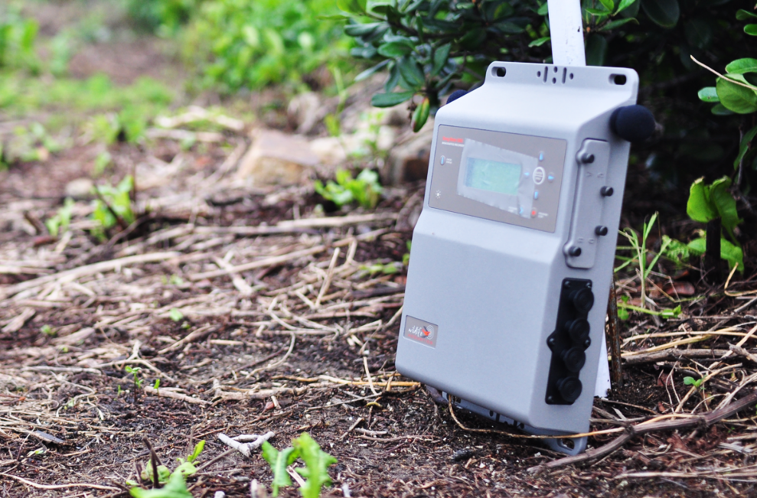
Acoustic recorders
Song meter 3 (Wildlife Acoustics Inc.)
2015-2016: May-August, 5:00 to 18:00, 1min every hour
2017: May-August, 24 hours, 1min every hour

Slide 12
Call characteristics
The sound frequency of GCTs and CCTs were between 1.5 – 8 kHz
CCT: tonal structure with multiple harmonics
GCT: strong pulse structure but some tonality when multiple calls are overlapped

Slide 13
Average sound pressure level in 2015
Average sound pressure level (dB ref 20 µPa) between 1.5-8kHz
GCT & CCT arrived Tiejien at May 25
Notes:
Thank to Dr. Lin in helping us to analyze these acoustic data from song meter.
This figure show the average sound pressure level change over time in year 2015, red color means the environment became more noisy
unfortunately, the song meter were dead before june, the data did not cover the whole breeding season

Slide 14
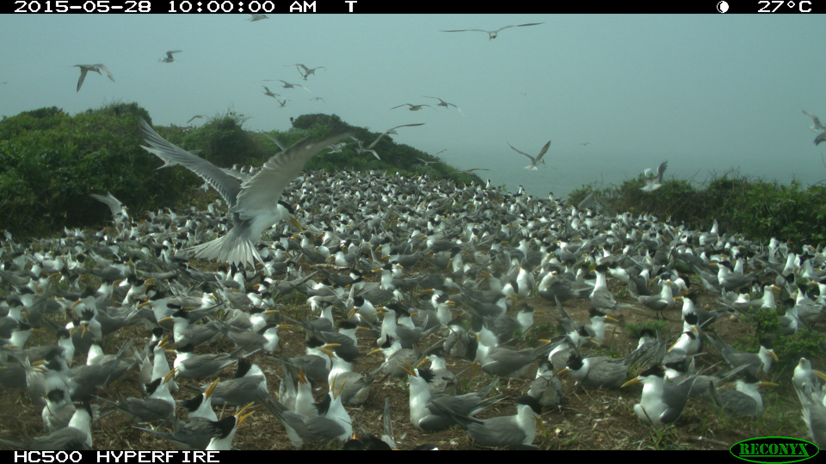
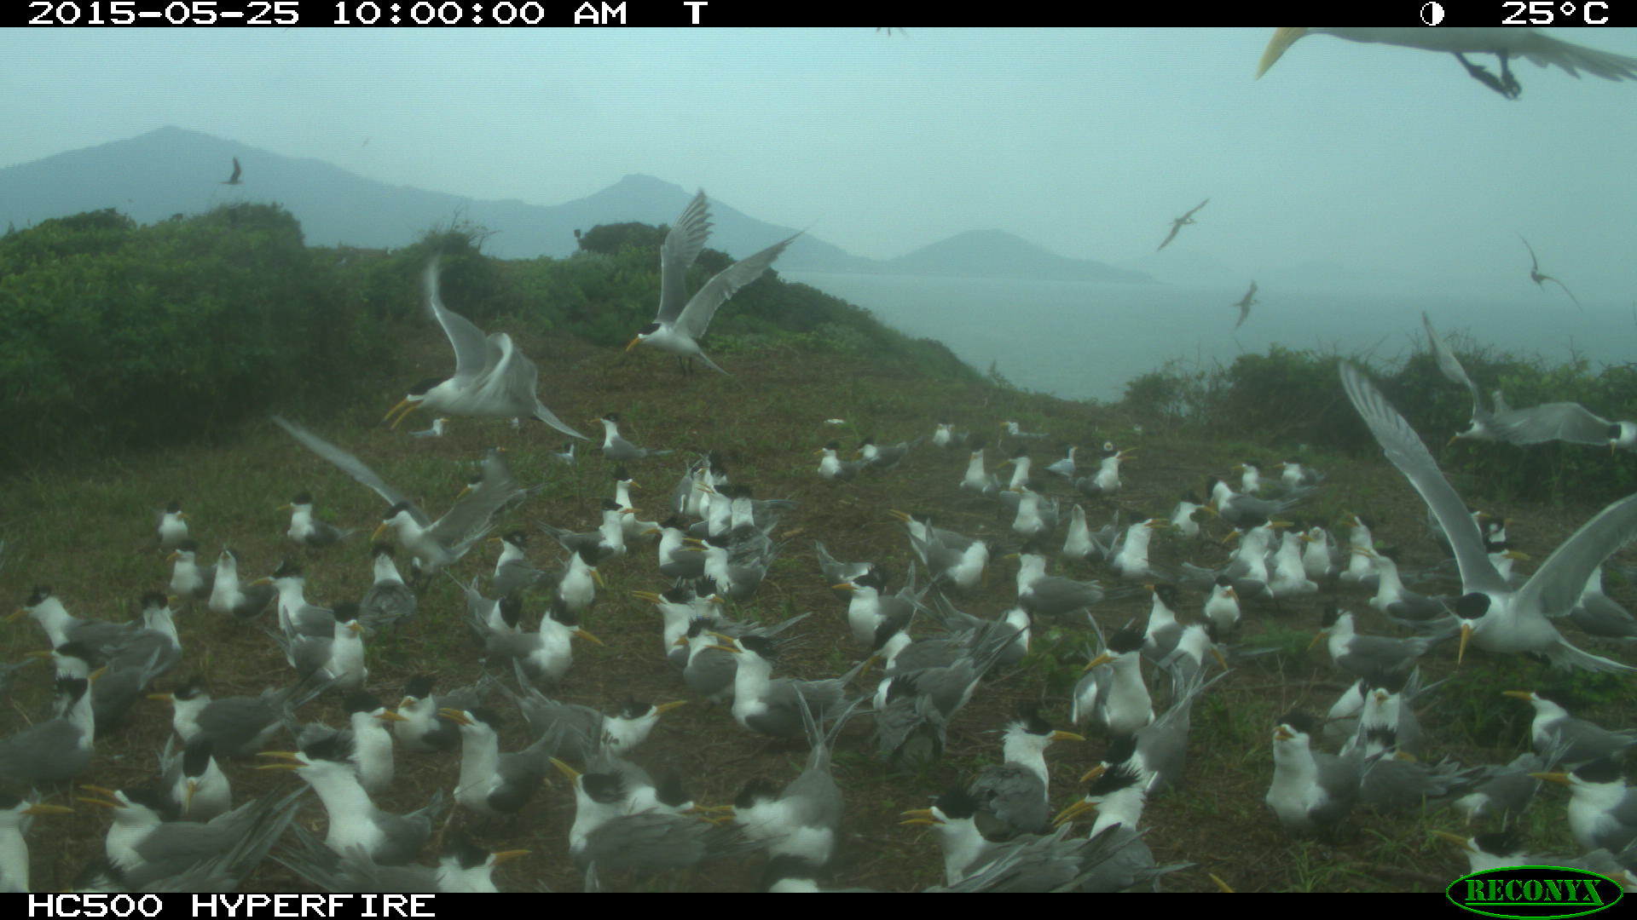
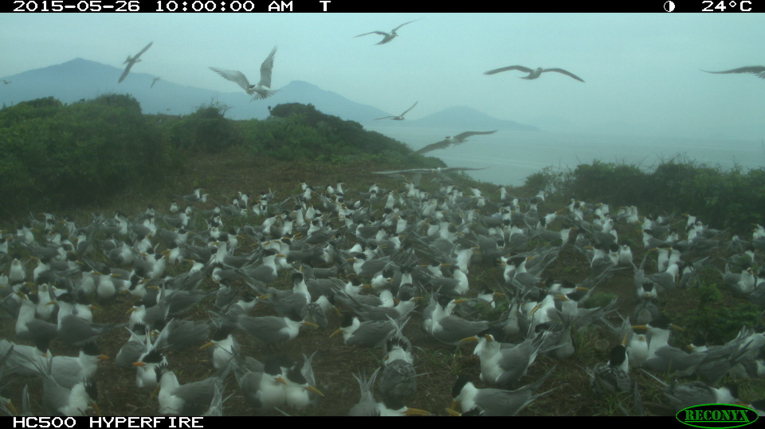
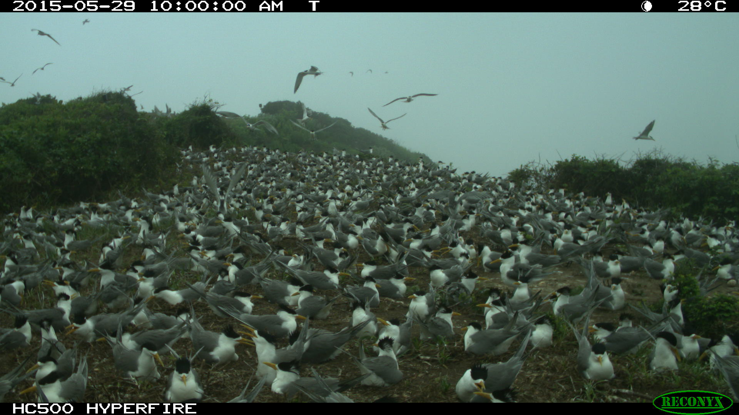
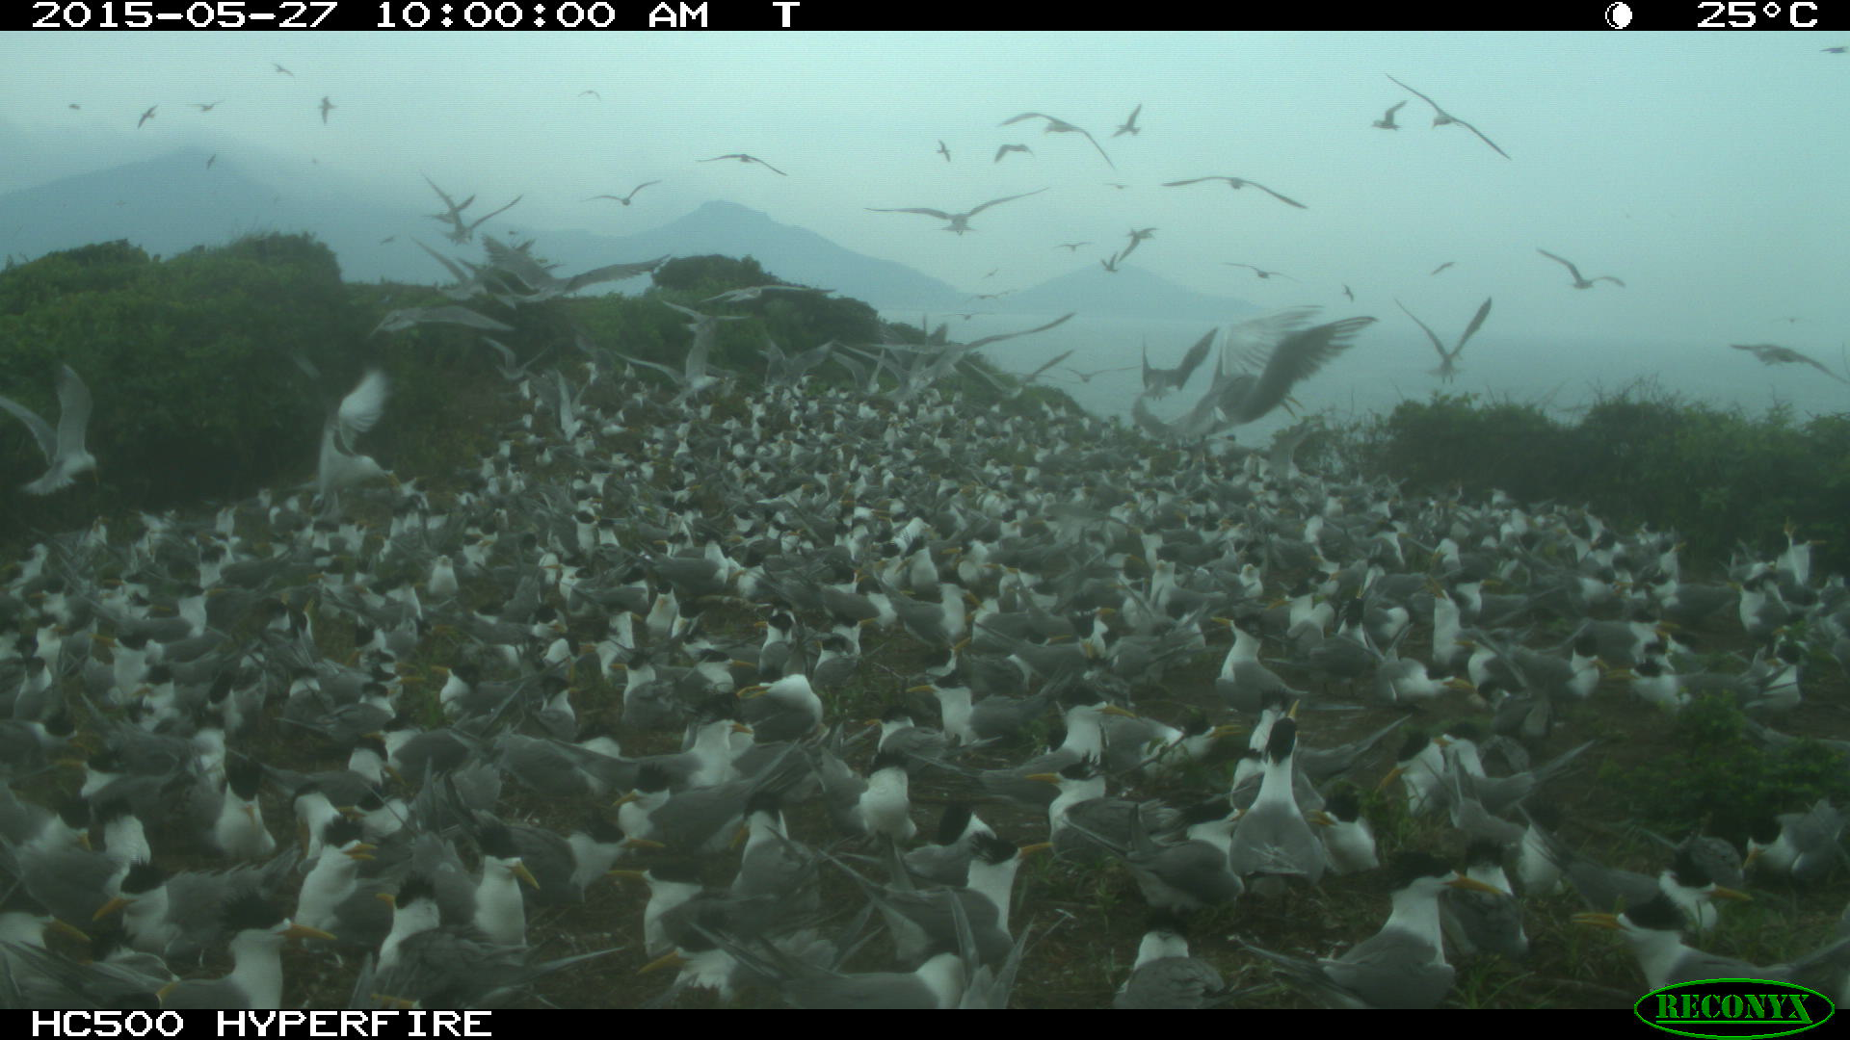
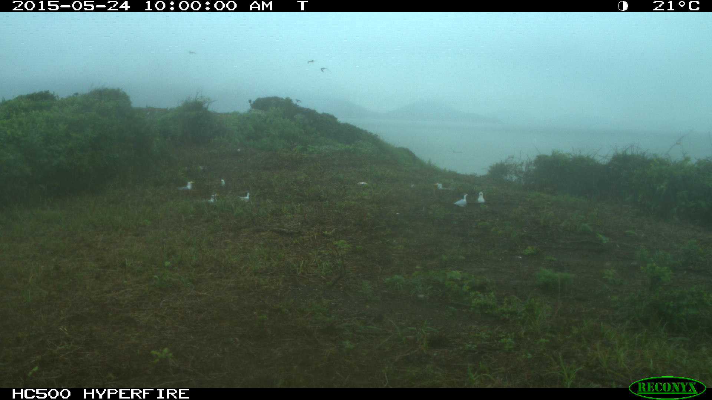
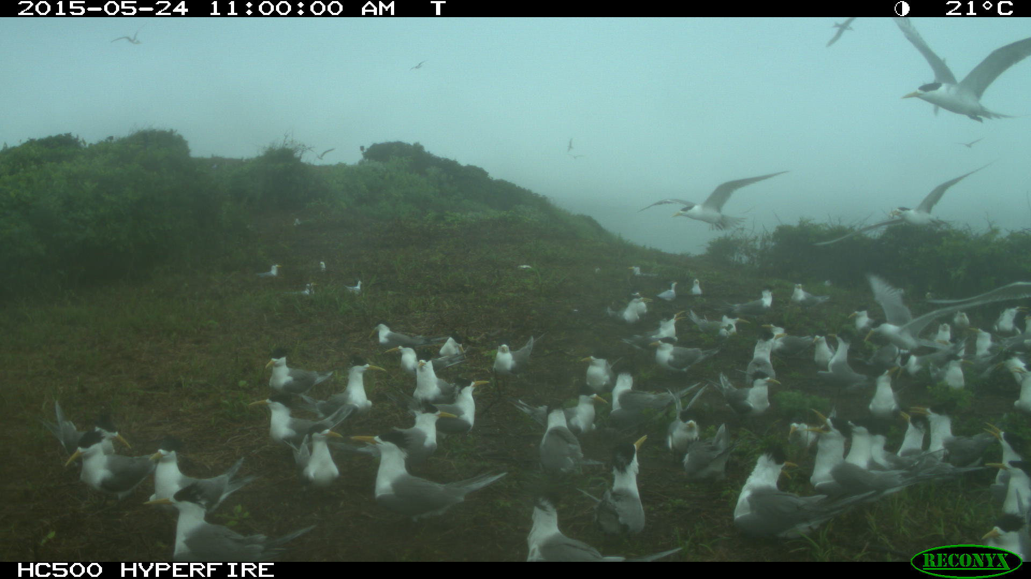
Notes:
05/24抵達鐵尖，05/25確認繁殖

Slide 15
Average sound pressure level in 2016
Average sound pressure level (dB ref 20 µPa) between 1.5-8kHz
GCT & CCT arrived Tiejien at June 4, left the colony at July4
Notes:
In year 2016, The terns arrived tiejien island in June 4 , but we found these tern left the colony in the mid of the breeding season, in normal situation, they usually stay at the colony until late july or august.

Slide 16
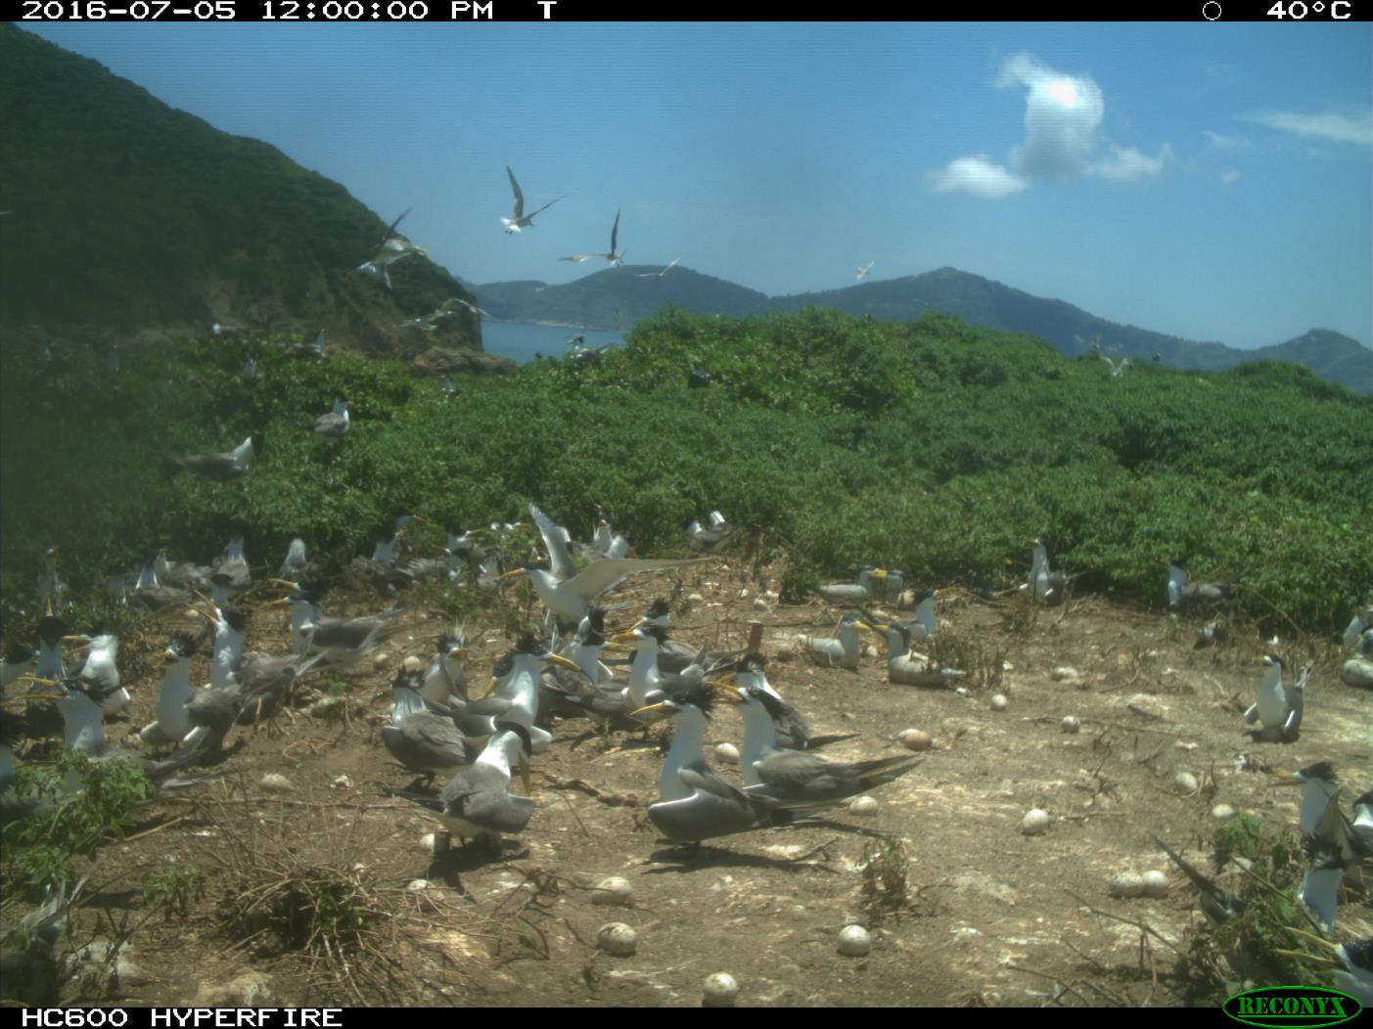
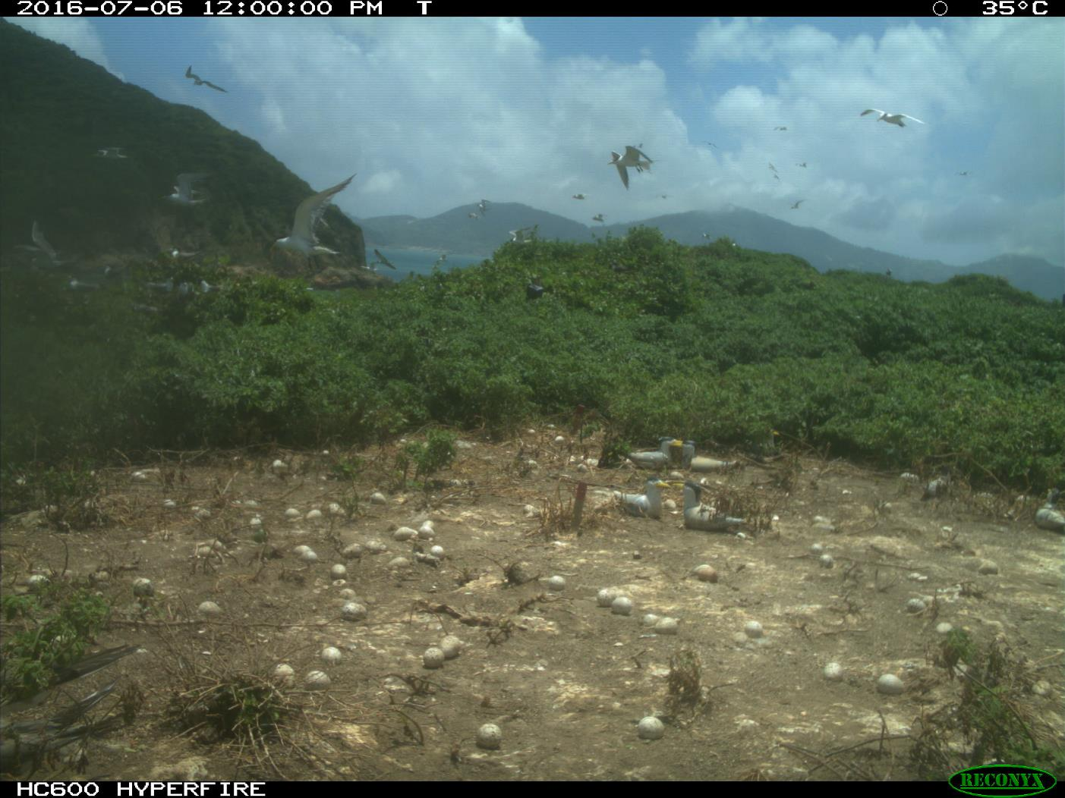
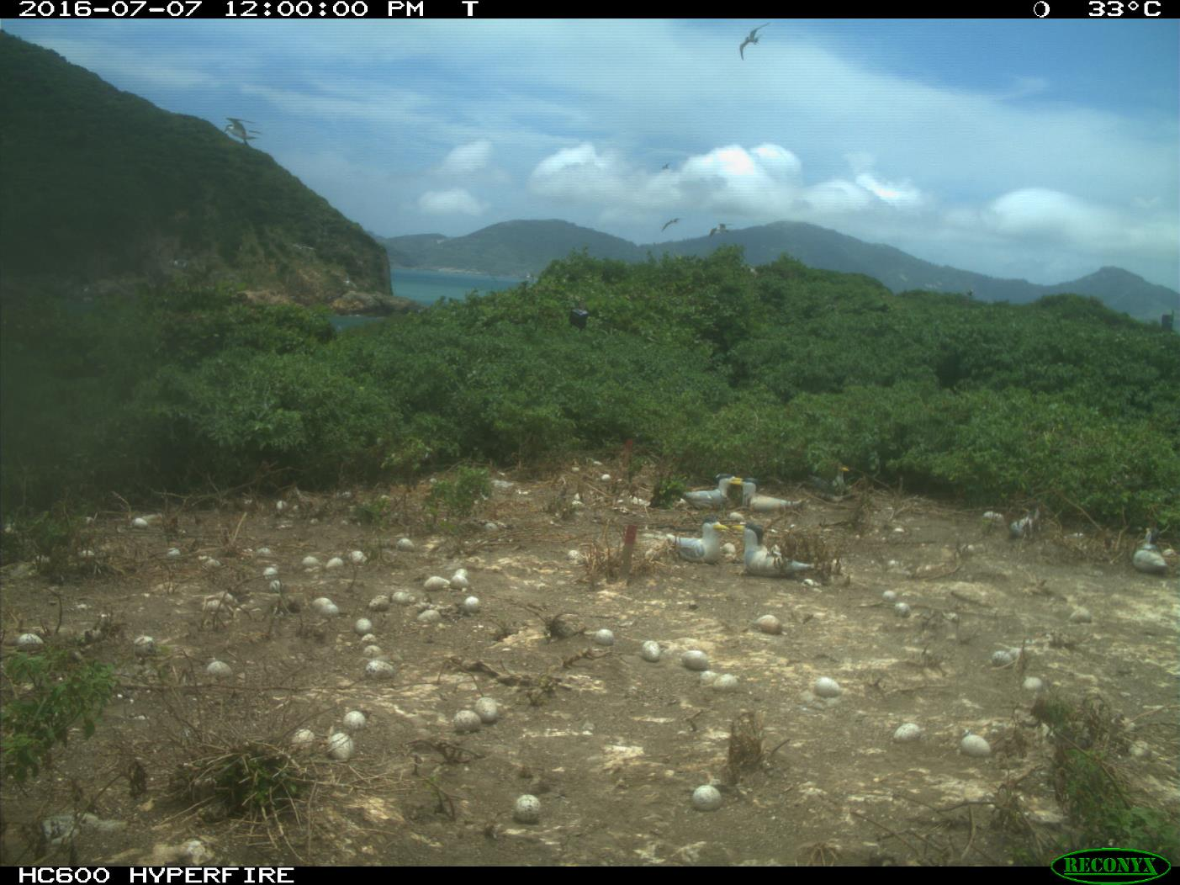
Notes:
So we check the auto camera, and we found that most of the tern abandon their eggs at july 5

Slide 17
Average sound pressure level in 2017
Rainfall (mm)
Notes:
In year 2017, we found several interesting thing, first, I notice the sound pressure level decrease at some period, than I checked the rainfall data and it was match with the silent period.
Second, we found the tern became silent at night in July

Slide 18
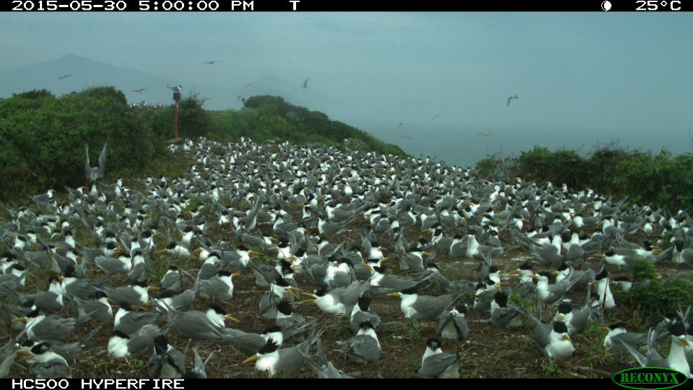
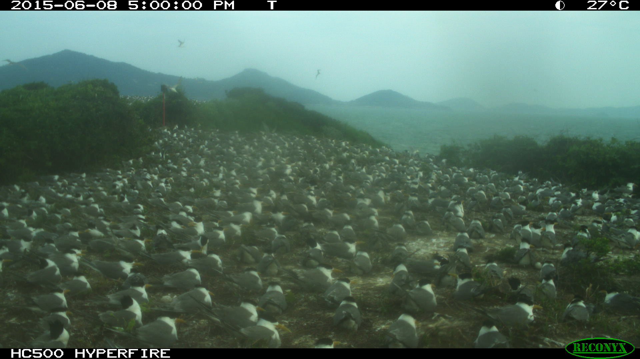
Weather condition
Raining and windy

Slide 19
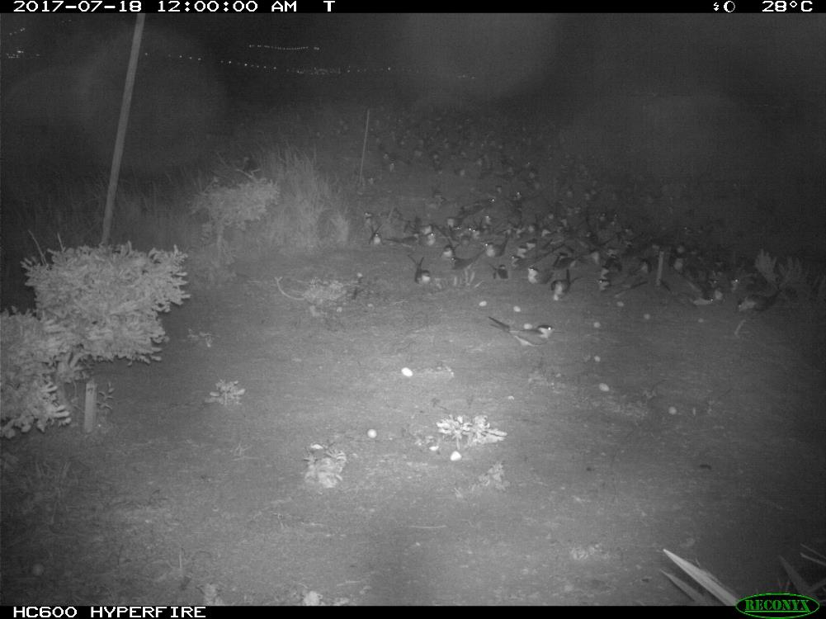
Night desertion

Slide 20
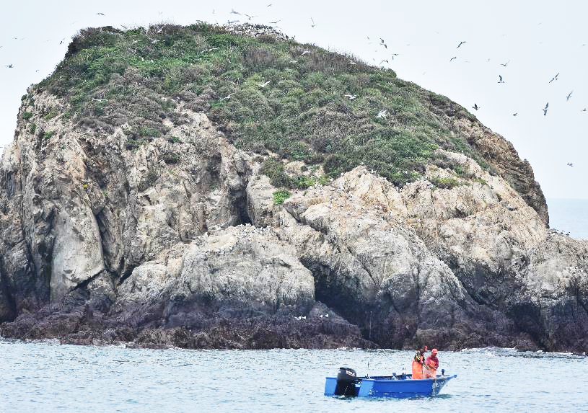
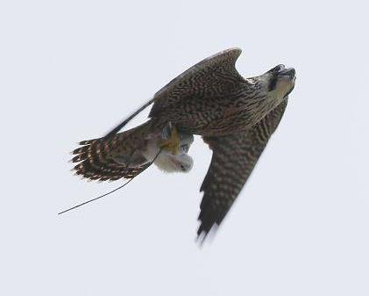
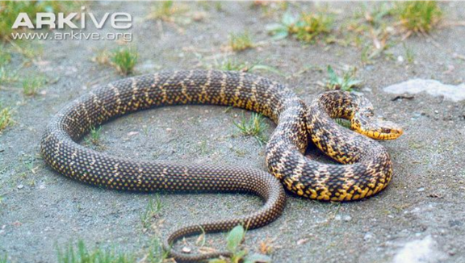
Why do terns abandon their eggs?
Human disturbance?
Predators?

Slide 21
Behavior and acoustic data
Compared tern’s fighting behavior with sound pressure level
2015
sound pressure level
Raining
Counts
p < 0.001
Notes:
We want to understand if the acoustic data really reflect the behavior of terns, so we

Slide 22
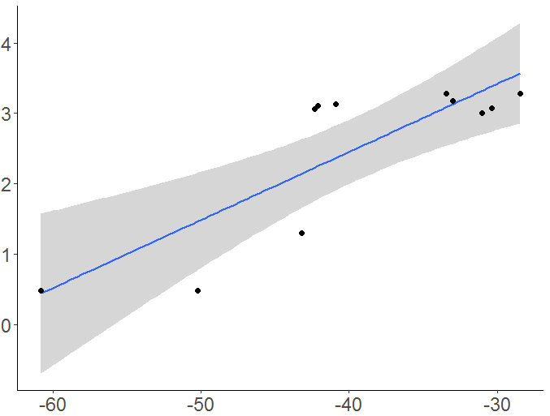
Colony size and acoustic data
Compared ship-based survey GCT data (log) with daily average sound pressure value
Sound pressure values were positively correlated with GCTs colony size
GCTs number (log)
Adjusted R-squared: 0.6547
p-value: 0.001
Daily average sound pressure level (dB)

Slide 23
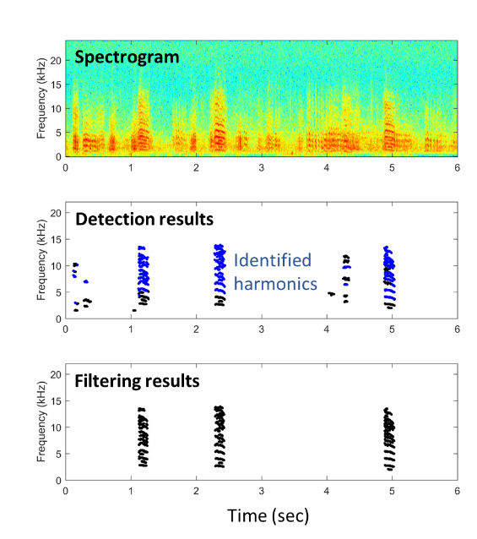
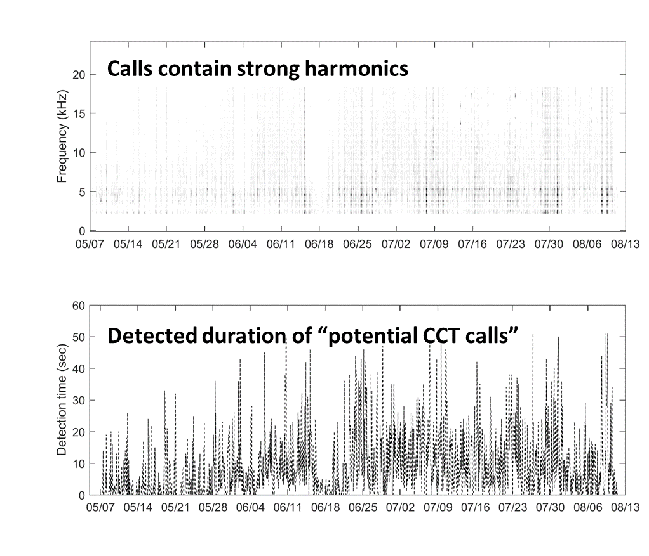
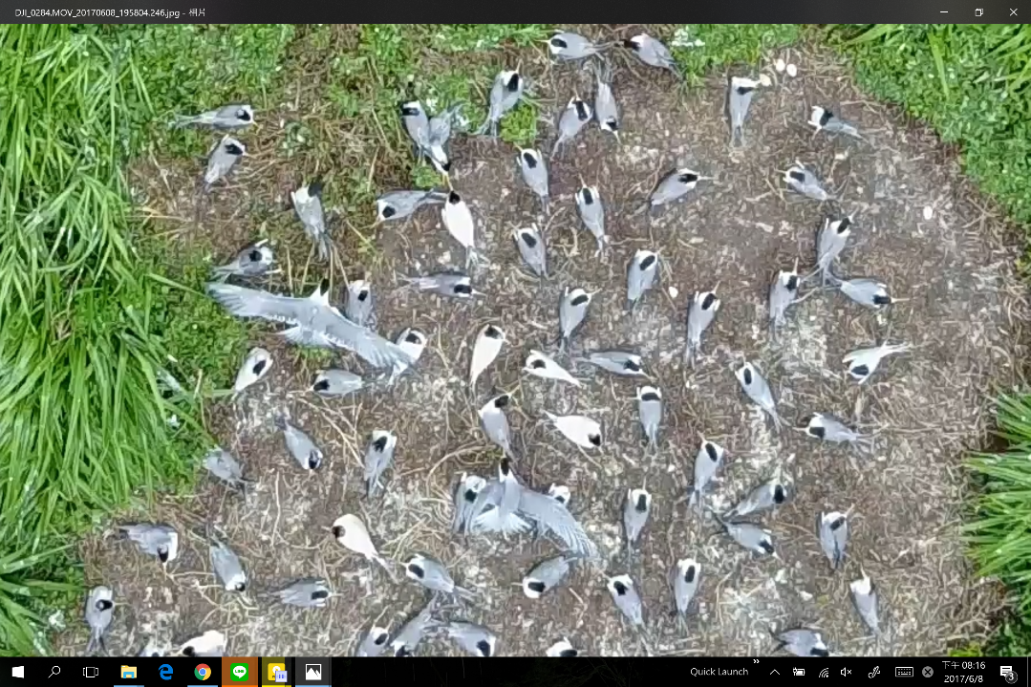
CCT sound detection
Overlapping with GCT sound cause a lot false alarms
Need more training data

Slide 24
Conclusions
Acoustic recorders provide effective information (colony size and status) for the monitoring of seabird breeding communities on remote islands such as Matsu archipelagos
Future research will focus on developing CCT sound recognition system and c

Slide 25
Thank you!
25

