Slide 1
Deep Mapping, Federated Data, Crowd Sourcing, and Digital Encyclopedias David Bodenhamer The Polis Center at IUPUI
International Symposium on Grids & Clouds
Academia Sinica, Taipei
April 2019

Slide 2
Spatial Humanities
An explicit recognition of the reciprocal influence of geographic and constructed/symbolic space on culture and society.
Fuses traditional focus on nuance, voice, experience, text, and image with the systematic approaches of spatial science, computer modeling, and virtual reality.
Links time, space, and culture dynamically (deep mapping).

Slide 3
Deep Mapping
Deep maps (platform, process, and product):
Links time and space (chronotope)
Operates across multiple scales (time and space)
Embodies multiple agents, multiple perspectives
Open to new information and non-expert contributions
Fosters dynamic context (movement, linkage)
Evokes emotional and experiential (visual and
immersive; an affective geography)

Slide 4
Design Requirements
Deep maps are:
Flexible, inviting exploration
User-centric, supporting differing views
Path-traceable, supporting narration
Open, admitting new material
Immersive, evoking experience

Slide 5
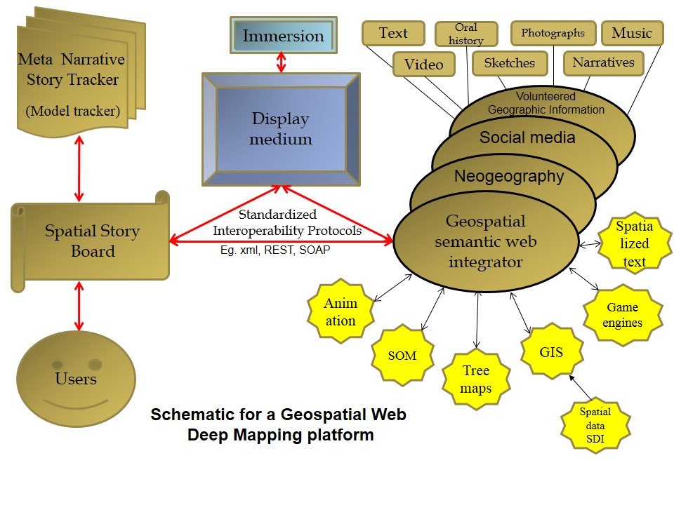
Technical Schema

Slide 6
New Approaches (alt.GIS)
Neogeography
Participatory GIS
Volunteered Geographic Information (VGI)
Google Earth, virtual globes
APIs, mash-ups
Story maps
Gazetteers, spatial semantics, text-to-GIS

Slide 7
Deep Maps Typology
Five categories
1.Archival: spatially and temporally enabled open repository that allows map-based access to quantitative, qualitative, and image data (WorldMap, Valley of Shadow)
2.Descriptive: densely layered map of a place with information drawn from multiple sources; designed to describe context or theme (Salem Witch Trials, Literary Atlas of Europe)
3.Exploratory: dynamically constructed, path-traceable maps of places and place-based themes (Pelagios Commons, Republic of Letters)
4.Narrative: structured view of spatially and temporally located data; designed to facilitate or make a scholarly argument within a rich spatio-temporal (mapped) environment (Enchanting the Desert)
5.Immersive/Experiential: focus on presence, a sense of reality, with its contextual awareness of past actions and embedded contingencies; seeks to place user within a spatially and temporally sensitive environment as a way of reifying context; fosters an aesthetic and emotional experience with place (Virtual Wheeling, Virtual Plasencia)

Slide 8
Visible Past: A Participatory GIS

Slide 9
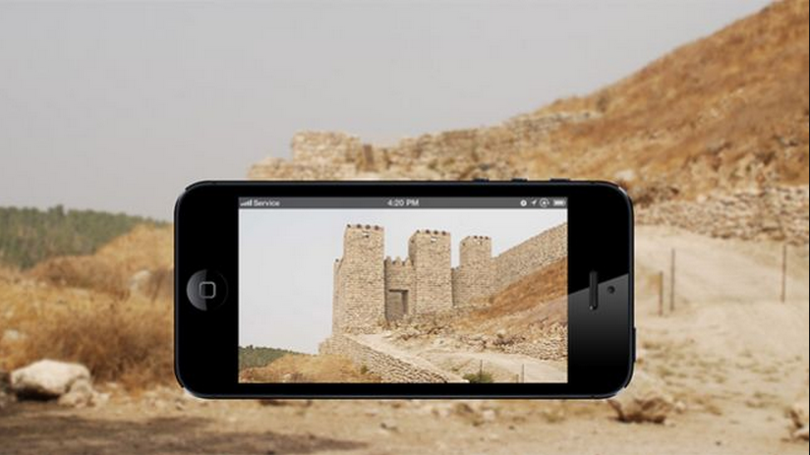
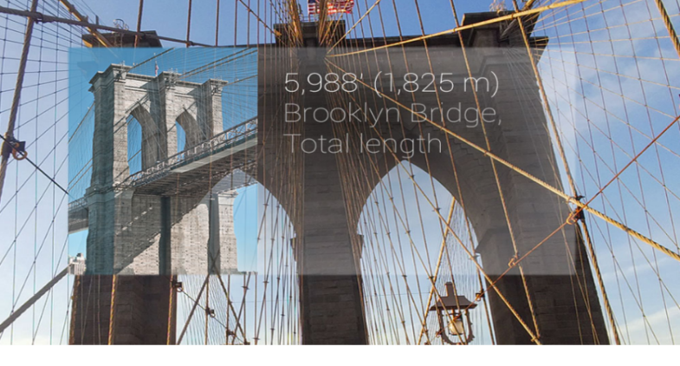
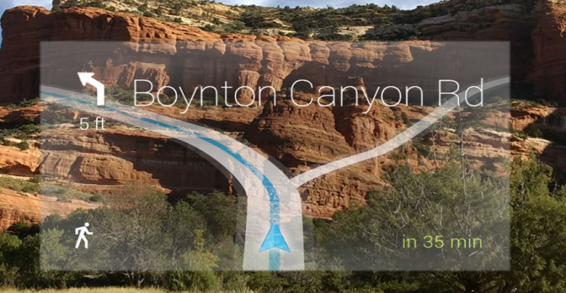
Augmented Reality
Synthesis of real and
digital space (e.g., Architip)
Wearable technology,
e.g., Google Glass

Slide 10
Virtual Place-Making

Slide 11
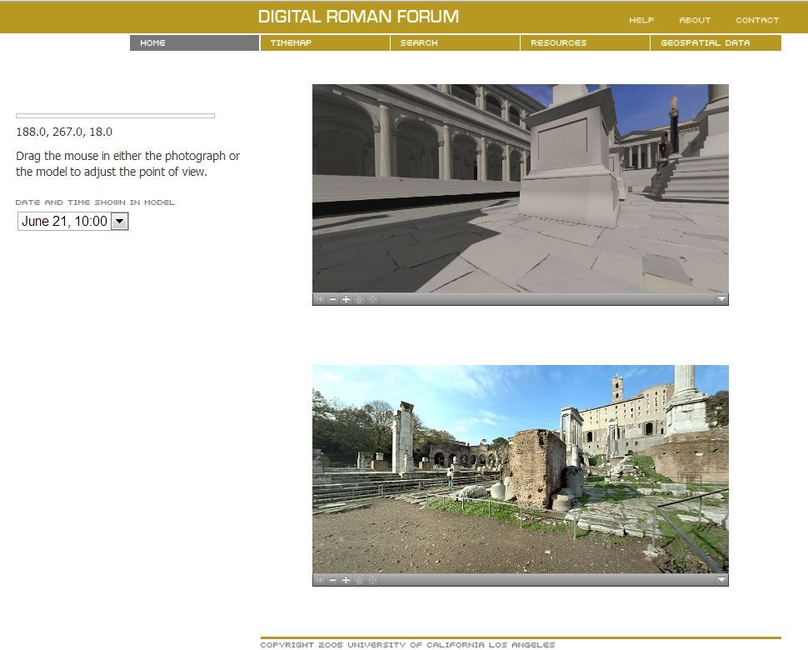
Spatial VR

Slide 12
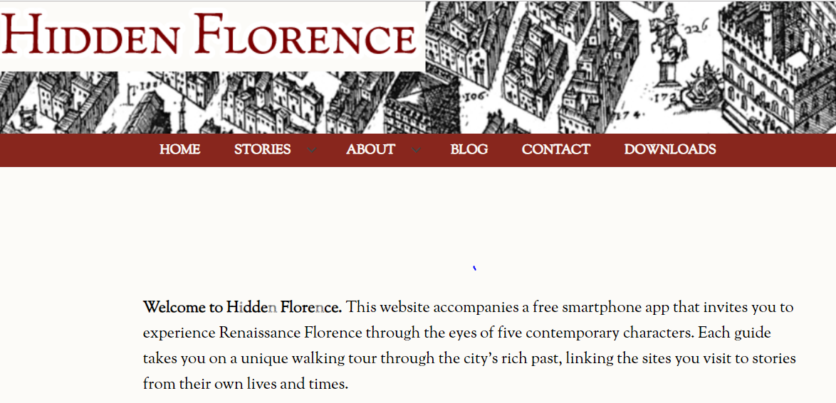
Temporal Ubiquity

Slide 13
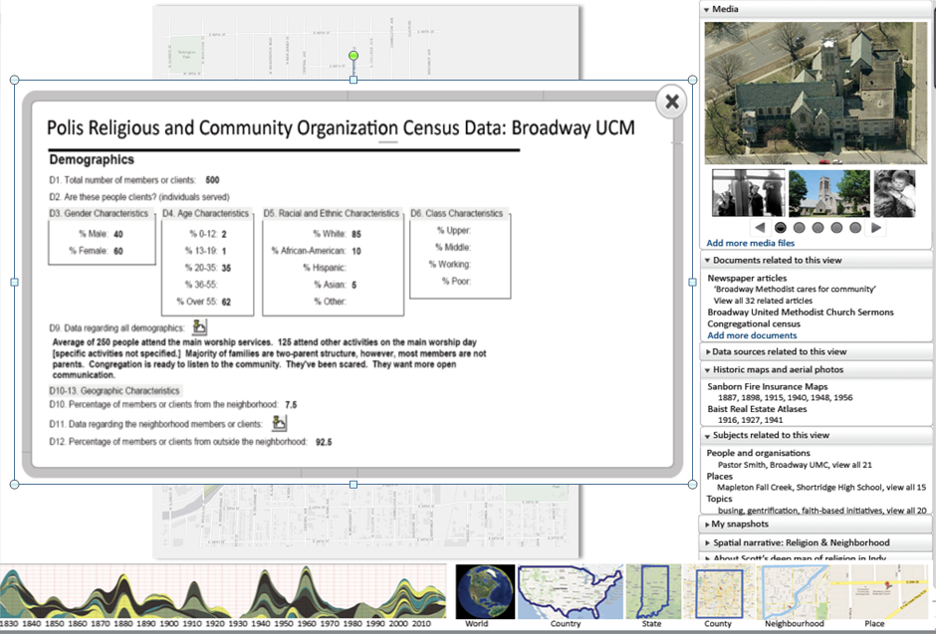
Faceted Browsing

Slide 14
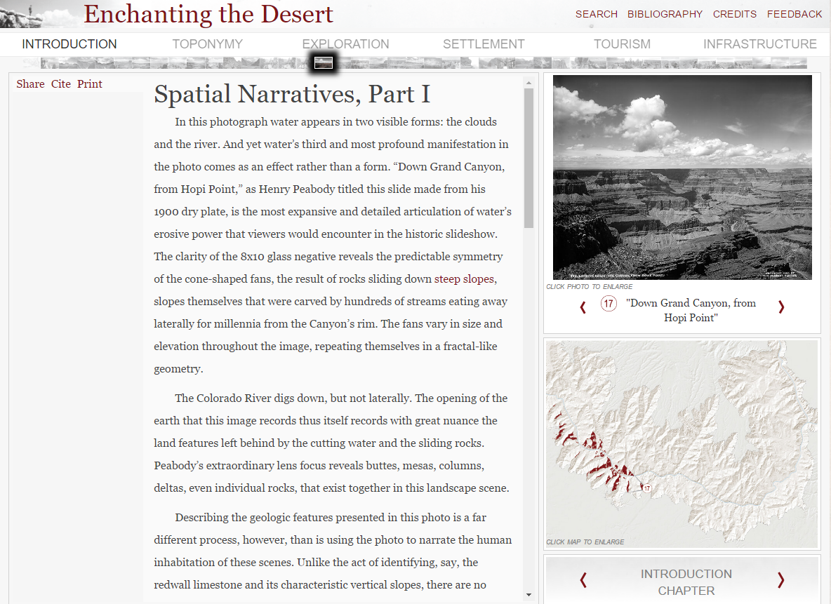
Enhanced e-Books

Slide 15
Immersive VR

Slide 16
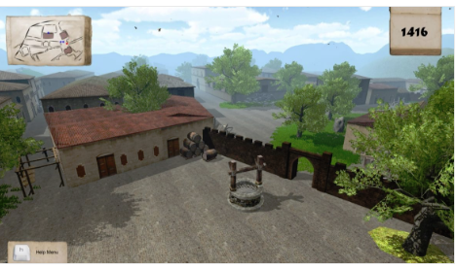
Gaming Engines

Slide 17
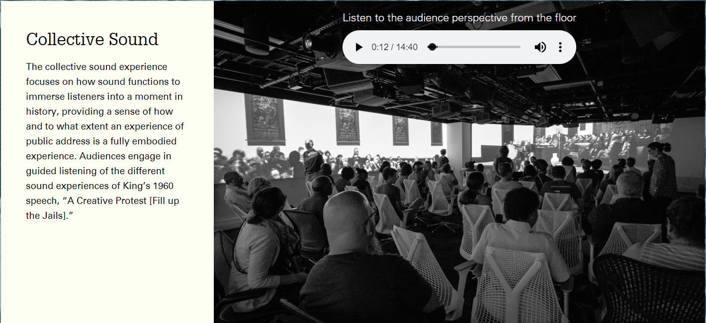
Soundscapes

Slide 18
Print Encyclopedias
Strengths:
Compendium of existing knowledge
Useful for quick reference
Weaknesses:
Static
Dated
How do we transform a centuries-old tool into a
sustainable modern resource?

Slide 19
Challenges
New models, e.g., wikipedia
Emergence of digital repositories
Shift to mobile platforms
Demand for citizen engagement
Skepticism of experts
Rapid changes in technology
Limited funding/sustainability

Slide 20
Digital Encyclopedia of Indianapolis
Goals
Update the Encyclopedia of Indianapolis (1994) as a knowledge platform to serve as a sustainable, dynamic, and reliable source of information about the metropolitan area.
Develop a collaborative framework among the city’s major heritage and culture institutions to support the continued growth of the DEOI.
Involve residents in creating information for the DEOI.
Make the DEOI an innovative technical product, with deep mapping capabilities.

Slide 21
Federated Data
Collaborating partners include state and local libraries and archives, centers, universities, historical societies.
All have active programs to create digital resources.
Key aim is to federate these resources, allowing the DEOI to serve as a hub for their exchange.

Slide 22
DEOI as Knowledge Platform
Discover
Timelines: animated and basic
Basic maps
Explore
Simple simulations (user adjusts parameters to view scenarios)
Learn
Faceted browsing (multiple views of data)
Exploratory Spatial Data Analysis
Spatial narratives, cultural narratives
Story telling – includes narrative
Online exhibits (e.g., photos, art)
Data catalog
Visualize
Search feature: find data and content by geo x time x topic
Contribute
Citizen science
Perceptions, memories, unstructured observations
Experimental Areas:
Virtual Reality, Immersive Environments
Augmented reality

Slide 23
Design Principles
1. Flexible
Data preparation, ingestion, transformation, and delivery is continuous
Accommodates changes in technology
2. Scalable
Both horizontally and vertically in response to demands and complexities of data
3. Performance
Technology choice is made to reach/optimize highest performance
4. Distributed
Bridges and integrates distributed data
Sustainable
Supportable as a distributed system

Slide 24
Structural Design Principles
1. Mobile first
Location aware
Voice assistive
4. Deep both temporally and spatially
5. Connectivity based on friend of a friend (FOAF) that can be associated with relevant objects
6. SEO Rich
7. Accessible

Slide 25
Interface Design Principles
Focus on clarity and readability.
Create connections internally and to partner sites.
Optimize for causal users and researchers.
Encourage user contributions/volunteered content.
Differentiate between authoritative and non-authoritative content.
Aim for simplicity and currency.

Slide 26
System Architecture

Slide 27
Technology Stack
Servers
1. Multimodal database such as MongoDB
2. MySQL, SQL Server, Hadoop, Polybase,
and file systems
3. Web server Windows IIS and Nginx
4. Windows and Linux Operating Systems
Geospatial Platform
1. ESRI ArcGIS Enterprise
Cached service
Feature service
Geocoding service
Geodata service
Geometry service
Geoprocessing service
Image service
2. GeoNode and GeoServer for geo-spatial
Content Management Module
Programming
1. .net core and Go
2. JavaScript Libraries (jQuery, Vue.js,
d3.js, leaflet.js etc.)
3. CSS3 or CSS4, bootstrap
4. HTML5
5. Excel, Word
6. ArcGIS Online, CartoDB
7. Python and R
8. Drupal CMS

Slide 28
Editorial Modules and Work Flow

Slide 29
DEOI Modules and Content Flow

Slide 30
User-Driven Change
ID Needs
Develop Require-ments
Build prototype
User Testing
Final Build
Responsive to the needs of existing and potential users
Work with the user community regularly
Continual user feedback

Slide 31
Conceptual Design: Homepage

Slide 32
Linked Data

Slide 33
Mutimodal Format

Slide 34
