Slide 1
Proposing an ICT-enhanced curriculum for global learning environment for Social Entrepreneurship for universities in Asia
Tosh Yamamoto, CTL-KU
Benson Ong, Business Management, NPY
Chris Pang, Business Management, NPY
Maki Okunuki, CTL-KU, Hands-on LC-Kwansei U

Slide 2
Proposing an ICT-enhanced curriculum for global learning environment for Social Entrepreneurship for universities in Asia
This paper presents a curriculum development endeavor for Social Entrepreneurship including the simulation of preparing for a startup or venture business to the Mezzanine stage.
It must be emphasized that the curriculum is not limited to business majors but also for all university students of various majors. In such a curriculum, Creative/Creative Thinking in the global team was the focus.
The curriculum has been pilot-tested on the Kansai University campus for five years with Japanese, Korean, Chinese, Taiwanese, Vietnamese, English, Dutch, German, and French students. The students formed international teams and developed their own brand/product after market research and planned and designed their dream project to come true.
The teams with global team members considered target consumers, the fund for initiating a business, and the plan to bring the project to the Mezzanine stage. The course was enhanced with the state-of-the-art ICT making the entire class, as well as all the team members, be on the same page of the learning process throughout the course. Such ICT tools for globally collaborative learning are show-cased in the presentation.

Slide 3
Outline
Rationale behind the new Educational Paradigm
Building/Sense Making: Curriculum Development
Pilot Curriculum: Social Entrepreneurship in Action

Slide 4
Rationale
Why ? (The following will be discussed in this section.)
Reasons for the global curriculum proposal
The future of our students?
Paradigm Shift in Education enhanced with ICT is just around the corner!

Slide 5
Rationale
Educators’ Mission
Raising the future generation
Global Communication Skill to Build Trust
Not giving pre-fabricated knowledge and values (but Critical Thinking Skill)
Giving students chances to grow transcendent mindset to lead to new values (Creative Thinking Skill)

Slide 6
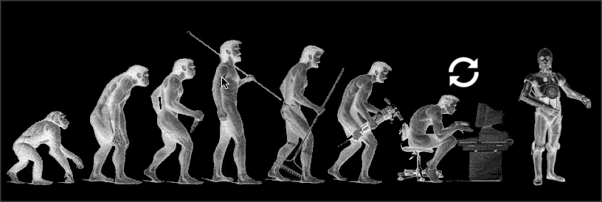
Job Market Dynamics
Singularity (2045) → New Job Market?
How old will your students be in 2045?
https://joneljuste.files.wordpress.com/2015/04/singularity-c3po.jpg

Slide 7
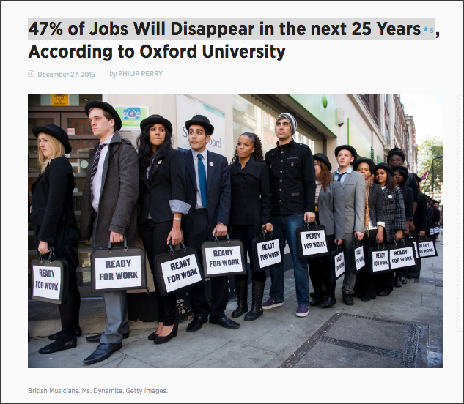
Disappearing Jobs
http://bigthink.com/philip-perry/47-of-jobs-in-the-next-25-years-will-disappear-according-to-oxford-university

Slide 8
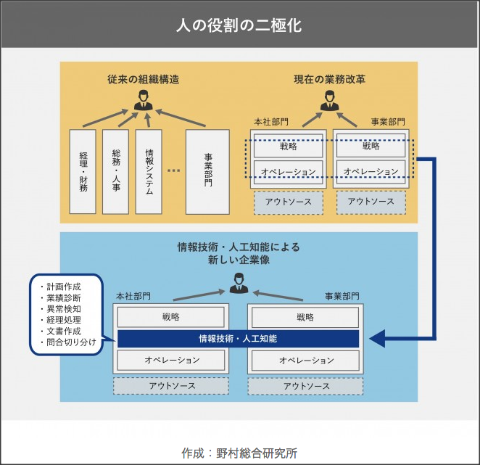
Two-Tier Structure
Routine jobs ➔ AI and Robots
https://mirai.doda.jp/series/interview/tomota-terada-part1/

Slide 9
Surgical Robots
Human doctor vs. robot
Routine jobs ➔ AI and Robots

Slide 10
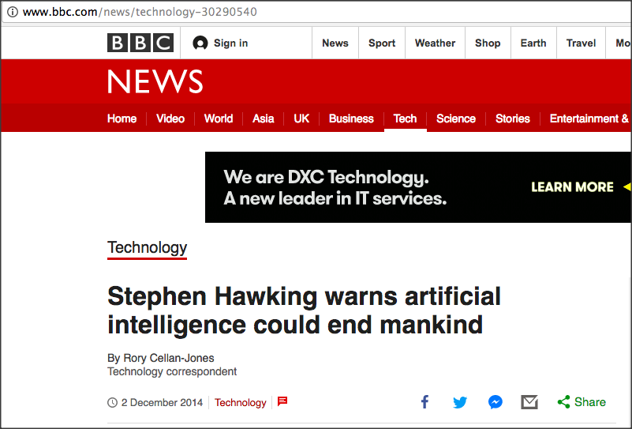
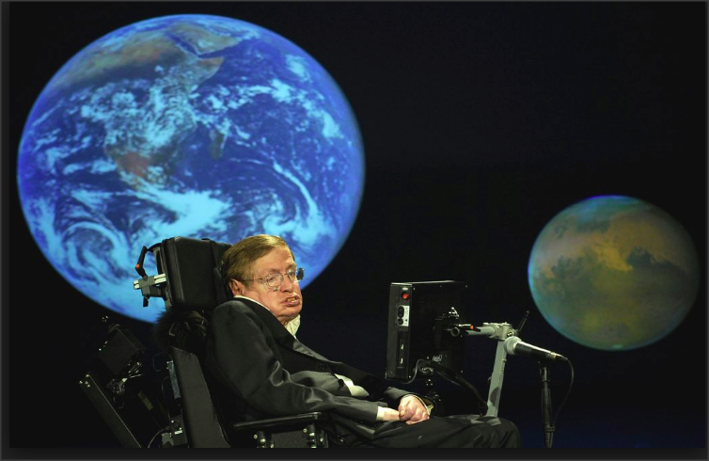
JOB MARKET IN THE FUTURE
In fact, the biggest threat facing mankind is one that has in some ways only just been discovered: artificial intelligence (AI). The physicist Stephen Hawking has said that AI could become ‘a real danger’ in the ‘not-too-distant’ future. Hawking added that ‘the risk is that computers develop intelligence and take over. Humans, who are limited by slow biological evolution, couldn’t compete, and would be superseded.’
http://www.bbc.com/news/technology-30290540
http://www.spiked-online.com/newsite/article/the-robots-are-not-taking-over/16299#.WgJmDmKCzdc

Slide 11
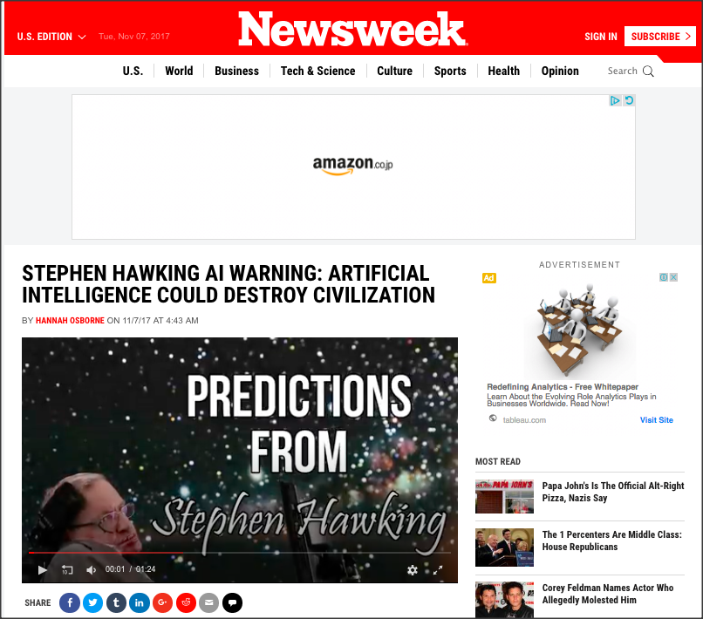
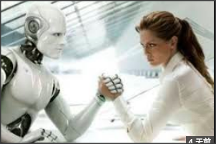
Stephen Hawking
http://www.newsweek.com/stephen-hawking-artificial-intelligence-warning-destroy-civilization-703630

Slide 12
Stephen Hawking
http://www.newsweek.com/stephen-hawking-artificial-intelligence-warning-destroy-civilization-703630
Singularity is just a beginning!
Will our students be ready to face the reality?

Slide 13
Curriculum Development
Education ready for the Singularity Era

Slide 14
The Role of University: Gas Station for life? Filling the knowledge tank in the students’ brain for the life-long career?
Singularity
Notes:
consensus

Slide 16
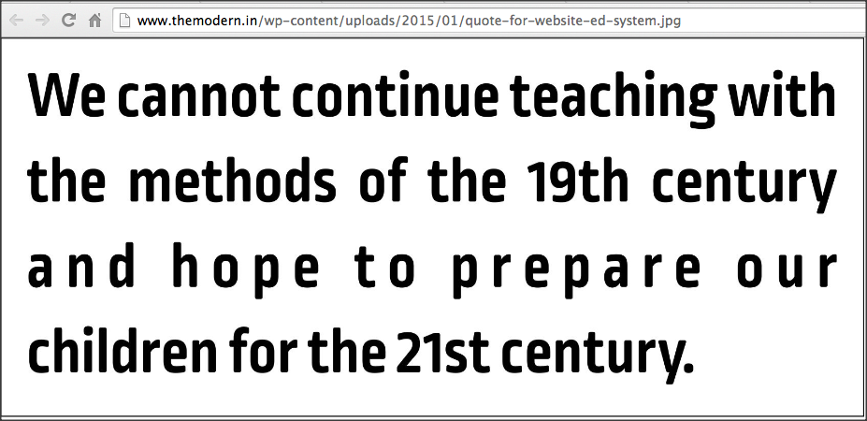
How do we educate the future generation?
Traditional Education Paradigm has seen the handwriting on the wall!
A Paradigm Shift in Education is a must.
New educational philosophy
New educational model: New learning environment

Slide 17
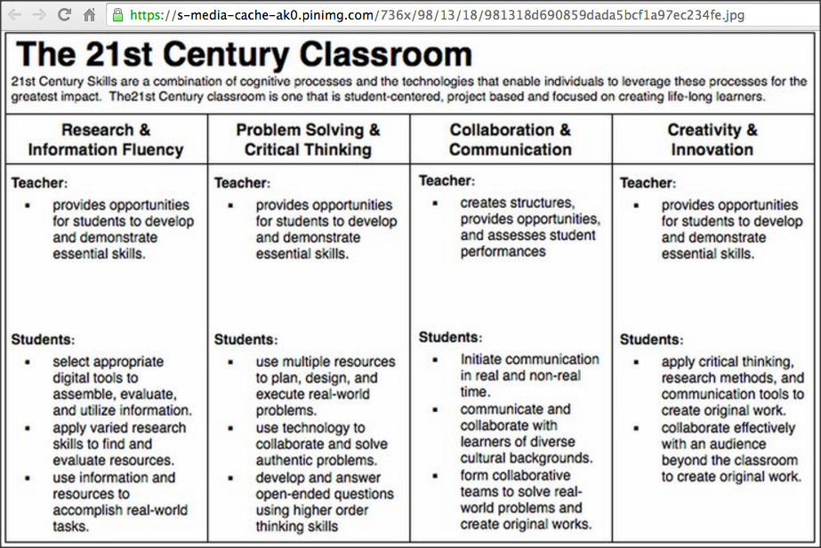
A Quote: From Horizon 2020 Proposal
We can not educate 21st century citizens using only 19th century methodologies.
the vision of … Collaborative Education is that without doubt the largest impact on our society will be obtained by addressing the needs of our children to get personalized education: (1) motivating teachers to motivate students, (2) addressing their creativity, and (3) getting them in contact with their equals and the rest of the society to share their needs and motivations, thus closing the circle.

Slide 18
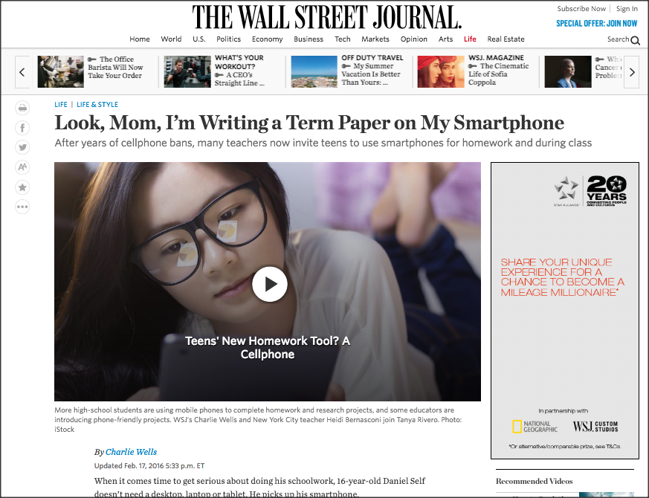
This is happening now!
ICT
In
Edu
ttps://www.wsj.com/articles/look-mom-im-writing-a-term-paper-on-my-smartphone-1455729046?mod=rss_Education
https://www.wsj.com/articles/look-mom-im-writing-a-term-paper-on-my-smartphone-1455729046

Slide 19
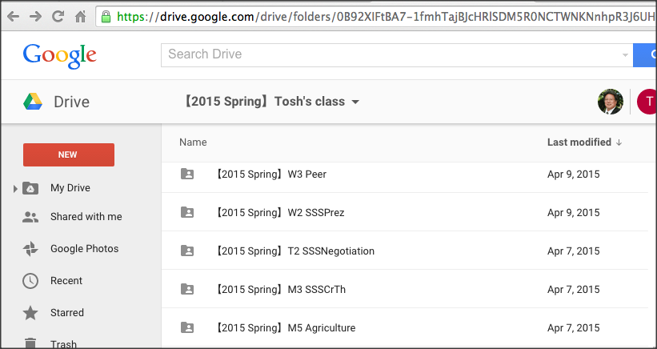
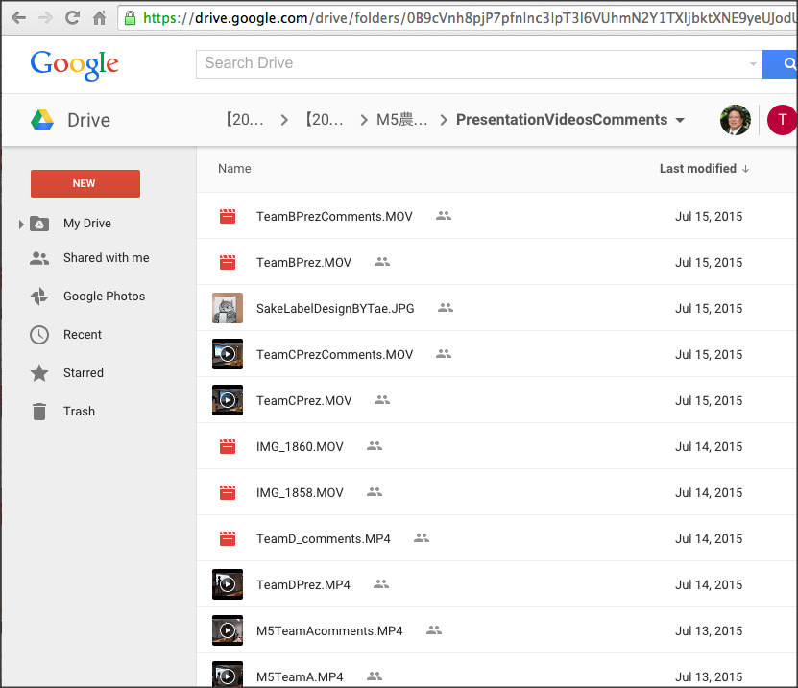
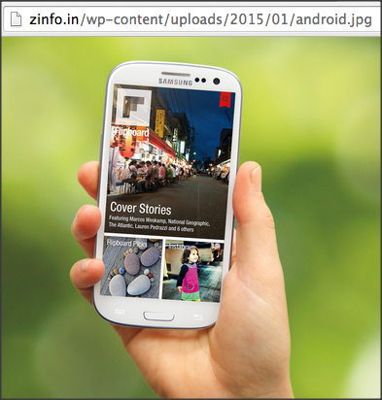
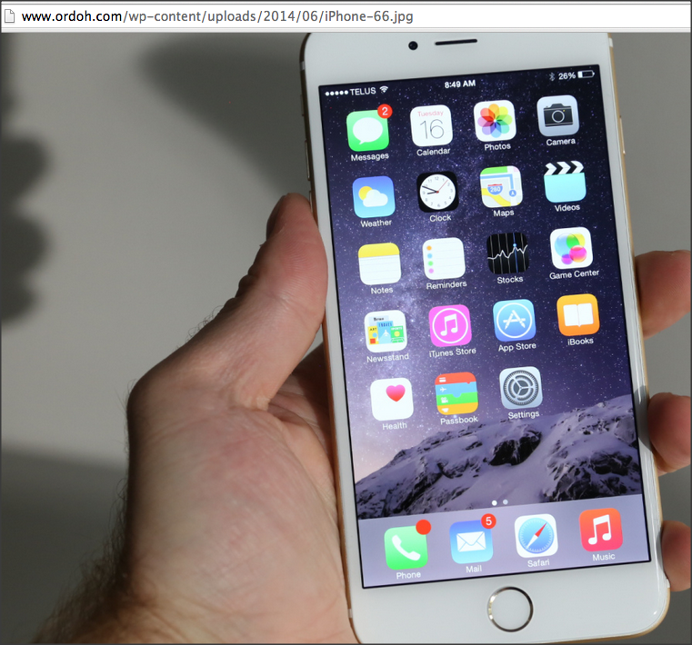
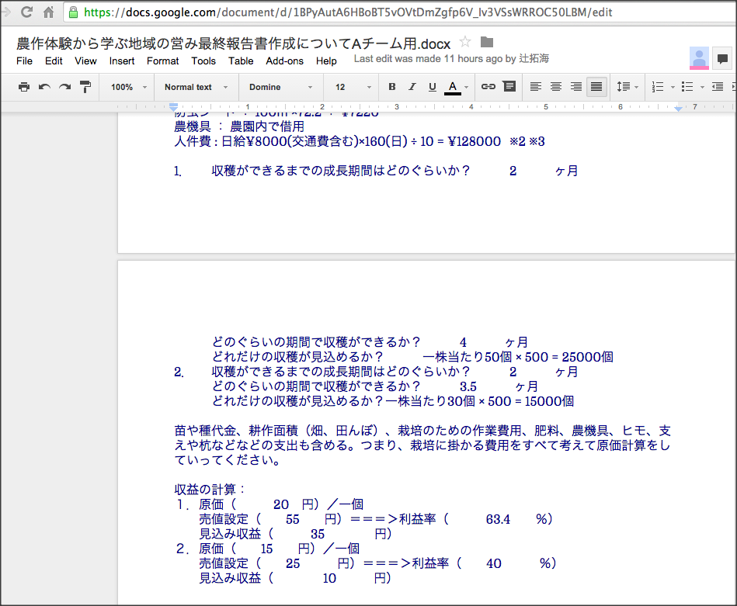
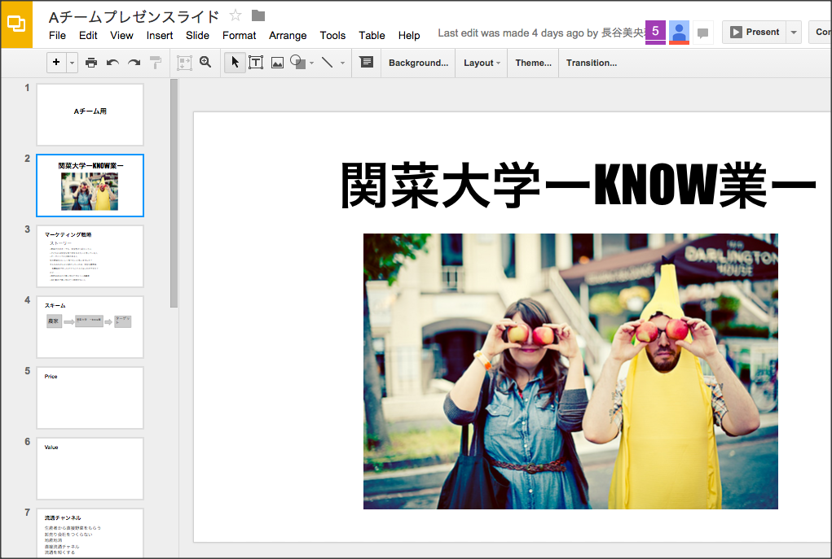
With Google Drive, You can Share/Edit/PBL with Team Members!
Team presentation videos
comments
Gurantees 24/7 team learning environment
All linked with TEAM LINE
All linked with TEAM LINE
All linked with TEAM LINE
Team presentation slides
All can edit online
Team Reports
All can edit online.

Slide 20
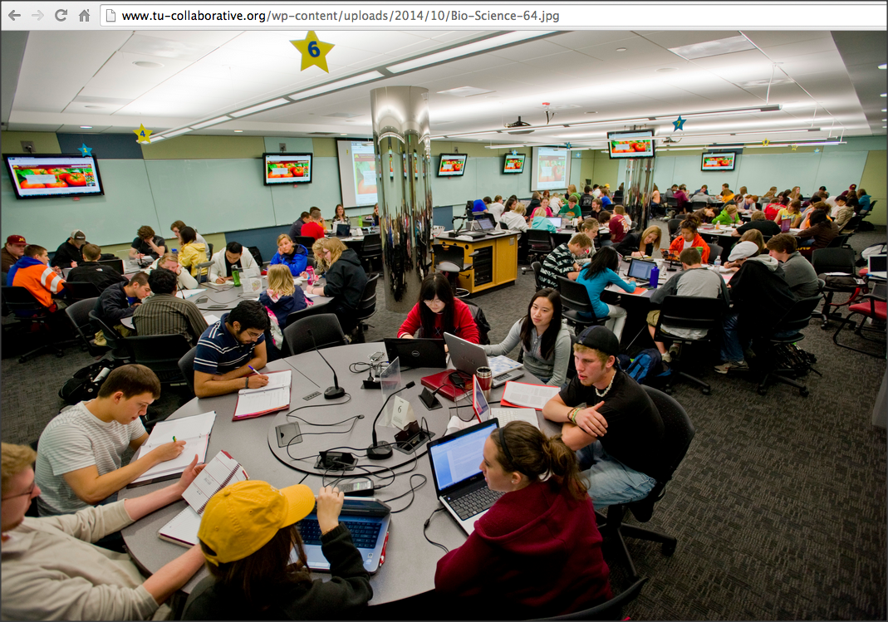
Active Learning is essential!
For the future education,
Social Constructivism Model of Education will be everywhere!
FROM: Face-to-Face
In-Class Learning

Slide 21
Active Learning is essential!
With ICT, this situation can be realized in ONLINE classes!!
Teacher’s role is to facilitate students’ learning. --- control of learning chaos in the online classroom

Slide 22
Bloom’s Taxonomy Matrix

Slide 23
Sense Making: ICT and Communication
Communication Skills: Needs for communication with students from other cultures and values.
Long-Lasting Trust Building
Problem Solving Skills: Common issues in our society
Project Management Skills: Working in Teams: International/Global Teams
Consensus Building through TBL
Go Global !

Slide 24
The Future,
Better Life,
Transcendency
http://www.iftf.org/uploads/media/IFTF_FutureWorkSkillsSummary_01.gif
Notes:
http://www.iftf.org/uploads/media/IFTF_FutureWorkSkillsSummary_01.gif

Slide 25
10 Needs for Future Education
The Future,
Better Life,
Transcendency
http://www.forbes.com/sites/sap/2014/05/12/are-you-ready-here-are-the-top-10-skills-for-the-future/2/
Sense Making
Social Intelligence
Novel & Adaptive Thinking
Cross-Cultural Competencies
Computational Thinking
New Media Literacy
Transdisciplinarity
Design Mindset
Cognitive Load Management
Virtual Collaboration
Notes:
Sensemaking
Social Intelligence
Novel & Adaptive Thinking
Cross-Cultural Competencies
Computational Thinking
New Media Literacy
Transdisciplinarity
Design Mindset
Cognitive Load Management
Virtual Collaboration

Slide 26
A Quote: From Horizon 2020 Proposal
We can not educate 21st century citizens using only 19th century methodologies.
the vision of … Collaborative Education is that without doubt the largest impact on our society will be obtained by addressing the needs of our children to get personalized education: (1) motivating teachers to motivate students, (2) addressing their creativity, and (3) getting them in contact with their equals and the rest of the society to share their needs and motivations, thus closing the circle.
Active Learning
Social Constructivism
PBL through TBL!
Global Learning is a must!

Slide 27
Proposing an ICT-Enhanced Learning Environment
Our Sense-Making
the Future Skills ⬅ ➔ the Requirements for Learning Environment

Slide 28
Requirements for ICT-Enhanced Global Learning Environment
On the same page of learning . . .
Attention and Care to Individual Students in class
Each Team Member in the Global Team
All Global Teams in the course
Learning – Not limited to a course in a semester i.e. Life-Long/Life-Wide !
Global Learning (Beyond the border of campus)

Slide 29
Curriculum Development for the Future Design
Requirements
Global Society as the Realm of Learning
Students from different campuses in different countries
Students learn in the same learning space in global teams!
Critical Thinking/Creative Thinking Enhanced!
Future Scenario Planning (Tesseractive Learning)
Realm of Learning ➔ Global Issues (SDGs)
Win-Win Relationship (Empathy-Building and Maintenance)
Not! Leading to a battle or war – Goal is Global Happiness
Learning In Global Teams!

Slide 30
Curriculum Development for the Future Design
Overcoming Difficulties
Distance (Time Difference)
Mindset Differences
Cultural Values ➔ influences on decision making
➔ communication patterns or thinking processes
“On the Same Page”
Accessible to the Learning Environment ➔24/7
Team Level
Class Level (Can watch other teams’ progresses anytime!

Slide 31
SOLUTION
Our Solution: Show Case: Curriculum in Action

Slide 32
Collaborative Online Global Learning
PBL ➔ Social Entrepreneurship
Careful Planning – one mistake will destroy the entire program
From Google

Slide 33
PBL ➔ Social Entrepreneurship
A new Phase of Global Collaborative Learning
KU-Students: Dept of Foreign Languages
+
NanYang Polytechnic: Business School

Slide 34
Team Building/Project Management Forged by ICT ( Flipgrid & Padlet)
Team Building with Empathy/Trust
Each Team sets their own theme for CT
All members & the entire class to be “on the same page” of Learning!
Team Activity Report in Rich Media
View Presentations by Other Teams & Give Constructive Comments
Reflection session => SWOT Analysis => Goal Setting for the Future Learning (in writing/video)

Slide 35
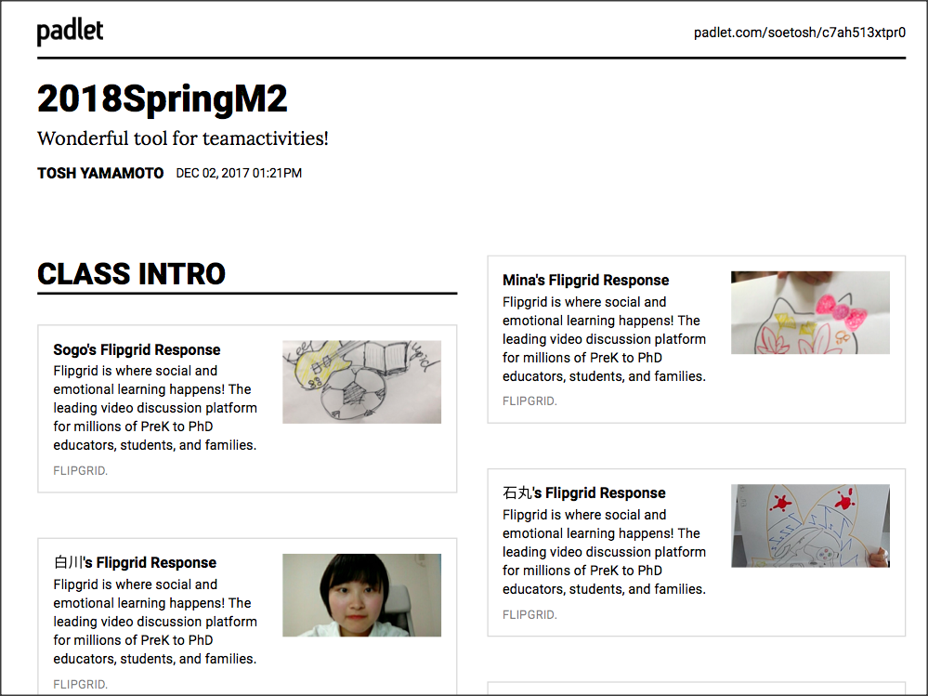
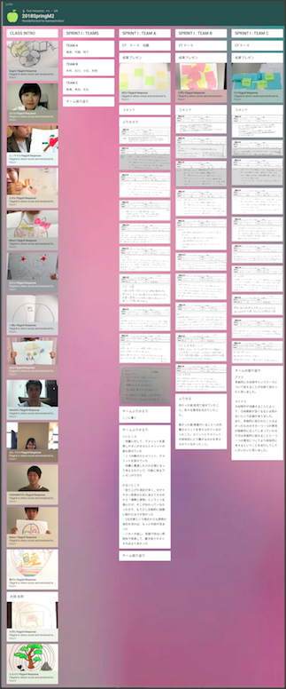
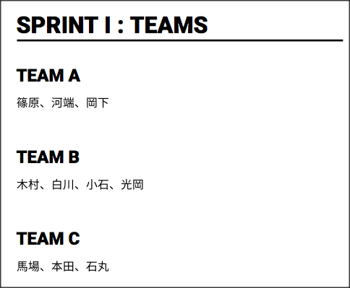
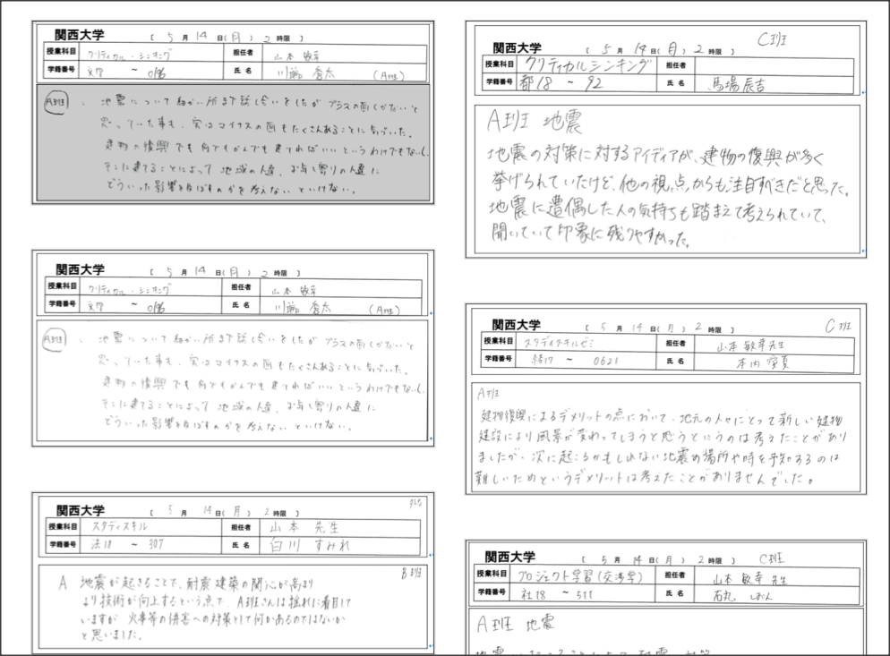
e.g. Flipgrid & Padlet
Team Building with Empathy/Trust
All members to be “on the same page” of Learning!

Slide 36
KU-NanYang Polytechnic School of Business Management

Slide 37
Quality of Learning enhanced throughout the Course
Quality Assurance in Learning
ICT – Leanstack !
Quality Assurance in Assessment
ICT– FINCODA, Rubric, Reflective Writing

Slide 38
KU-NanYang Polytechnic School of Business Management

Slide 39
KU-NanYang Polytechnic School of Business Management

Slide 40
Leanstack canvas Model
Go to Leanstack Slides

Slide 41
Quality of Learning enhanced throughout the Course
Quality Assurance in Learning
ICT – Leanstack !
Quality Assurance in Assessment
ICT– FINCODA, Rubric, Reflective Writing

Slide 42
FINCODA
Go to FINCODA Slides

Slide 43
Course Final reflection

Slide 44
Advantages
Students have learned to :
communicate/discuss in the virtual learning environment
set the pace of team learning.
plan their own team learning.
share their discoveries with all the class (followed by their constructive comments)
reflect the entire learning process (meta cognition)
work in teams (situational leadership in action!)
use the language skill for productive ways.
appreciate global diversity in learning.
new values found by the actively engaged learners
to name a few . . .

Slide 45
Proposing an ICT-enhanced curriculum for global learning environment for Social Entrepreneurship for universities in Asia
Thank you very much!
Tosh Yamamoto, CTL-KU
Benson Ong, Business Management, NPY
Chris Pang, Business Management, NPY
Maki Okunuki, CTL-KU, Hands-on LC-Kwansei U

