Slide 1

Lean
Business
Model
Canvas

Slide 2
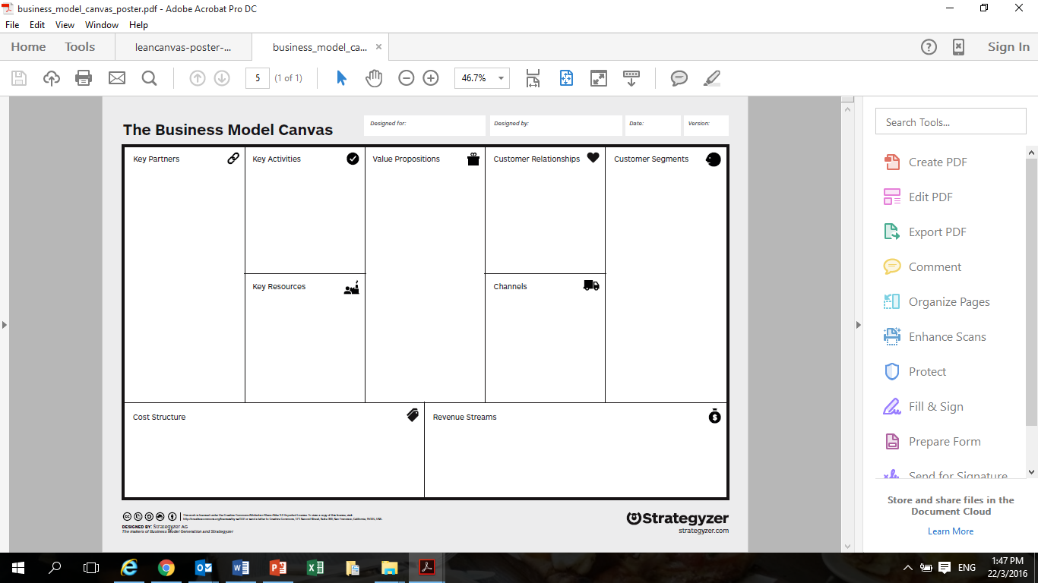
The Original Business Model Canvas

Slide 3
The LEAN Business Model Canvas
Modified from the Business Model Canvas
As the name implies “LEAN”
  Focus on the 2 main factors – Problems and Customers
  Time is of the essence – no time for detailed business plans
  Allows for flexibility in planning the appropriate strategies

Slide 4
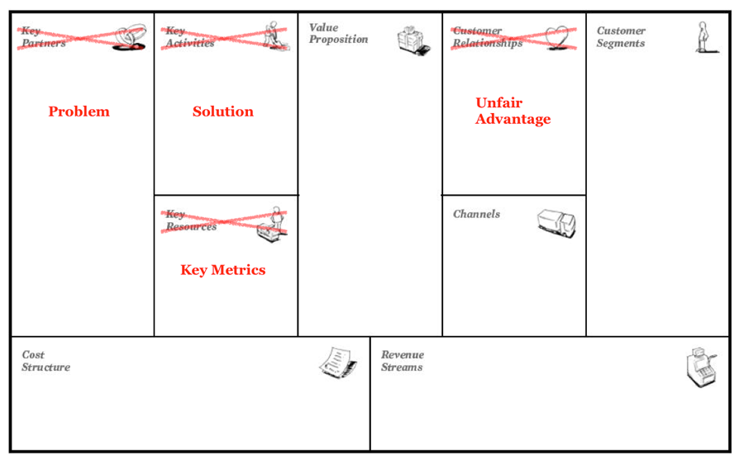
The LEAN Business Model Canvas

Slide 5
Lean Business Model Canvas (LBMC)

Slide 7
Welcome back
Benson Ong
    M: 9711-1964
    P: 6550-1180
    E: benson_ong@nyp.edu.sg

Slide 8
Activity #2 – Potato chips love affair
Worksheet
Potato Chips Love Affair
  Sample
  Evaluate
Time: 15 minutes
Mode: Individual

Slide 9
Activity #2 – Potato chips love affair
Discussion
Why did you buy potato chips?
For the same purpose, what else would you buy?
Out of the 3 samples, which is your preference?
List 3 main reasons for their preference.
List the reasons for not liking the other 2 samples.

Slide 10
Activity #2 – Potato chips love affair
Price
  Sample A:
  Sample B:
  Sample C:
  Would you still buy the same?
  Why?.

Slide 11
Reasons for Activity #2
To illustrate
  Customers purchase with a purpose.
  Customers have many choices.
  Customers are caught by product which is ‘interesting’.
  Customers look beyond features of the product.
  Some customers are quick to try new products
  Price may not influence the purchase decision

Slide 12
Why Product Fails?
Idea owners focus wrongly on product.
Customers don’t care about product, they only want to solve their problems.
Investors don’t care about the product. They care about sales and tractions which determine the profitability.

Slide 13
Planning To Reduce Risk
Building a successful product is fundamentally about risk mitigation.
The biggest risk for most business idea is building something no body wants.
The next risk is building a business model that cannot scale.

Slide 14

Planning – 1st of 3 Stages
Problem-Solution Fit
Key Questions: Do I have a problem worth solving?
    Can it be solved? (feasible)
    Is it something customers want? (must have)
    Will they pay for it? If not, who will? (viable)

Slide 15

Planning – 2nd of 3 Stages
Product-Market Fit
Key Question: Have I built something people want?
    What can I use to test traction?

Slide 16

Planning – 3rd of 3 Stages
Scale
Key Questions: How do I accelerate growth?

Slide 17
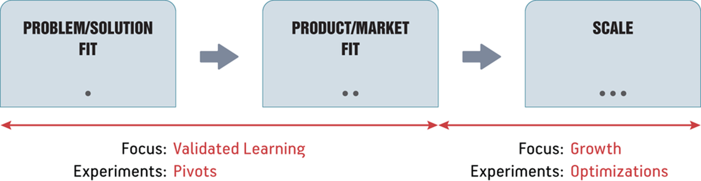
Planning –3 Stages
Sources: Running Lean

Slide 18
Business Planning
Lean Business Model Canvas
    A tool to help you plan your business quickly.
    Web Solution: www.leanstack.com

Slide 19
The Business Model Canvas
Original: Alex Osterwalder’s Business Model Canvas
It allows user to describe, design, challenge, invent, and pivot his business model.
Structured into 9 components, the user can clearly identify and develop the business model for their ideas

Slide 20
The Original Business Model Canvas

Slide 21
The LEAN Business Model Canvas
Modified from the Business Model Canvas
As the name implies “LEAN”
  Focus on the 2 main factors – Problems and Customers
  Time is of the essence – no time for detailed business plans
  Allows for flexibility in planning the appropriate strategies

Slide 22
The LEAN Business Model Canvas

Slide 23
Lean Business Model Canvas (LBMC)

Slide 24
Lean Business Model Canvas
Outcome:
    A tool for brainstorming business models, prioritising where to start.
    Increase competence in self-directed research and collaborative learning.

Slide 25
Lean Business Model Canvas
Fast
    Creating it takes little time.
Concise
    Forces you to pick your words carefully and get to the points.

Slide 26
Lean Business Model Canvas
Portable
    Easily shared with others for comments and suggestions.
    Frequently updated.

Slide 27
Set Up Your Own Canvas
Web Solution: www.leanstack.com
    Quick business planning – anywhere, any time.
    Better collaboration

Slide 28
Back to activity #2 – group Discussion
Can you recall what we have discussed during Activity #2?
If you are a new potato chip producers, complete the following elements in the Lean Business Model Canvas
  Problems
  Customers Segment
  Unique Value Proposition
  Solutions

Slide 29
Lean Business model canvas
Problems
3 high priority problems that your Customer Segments have.
Existing alternatives used to solve these problems.

Slide 30
Lean Business model canvas
Customer Segments
Potential market segments
Early adopters.

Slide 31
Lean Business model canvas
Unique Value Proposition
A promise of value to be delivered.
Why are you different?
Why should your Customer Segments buy/invest time in you?

Slide 32
Lean Business Model Canvas
Solutions
3 Features of your product/service that solve the 3 problems.
“Go Out The Building”.

Slide 33
Presentation #1

Slide 34
Channel & key metrics

Slide 35

Lean business model canvas
Channels
ways for you to reach your Customer Segments.

Slide 36
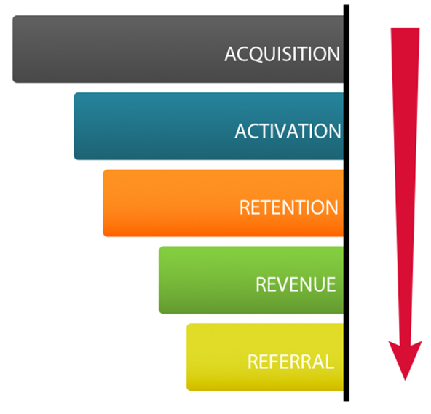
Lean business model canvas
Key Metrics
used to monitor performance.
Analytics through
Acquisition
Activation
Retention
Revenue
Referral

Slide 37
Channels & Key metrics
Video: Banking 2020 – Technology Disruption Banking
Discuss:
    New Banking Channels
    Analytics

Slide 38
Revenue &
Cost structure

Slide 39
Lean business model canvas
Revenue Streams
01
Depending on the type of business model.
Liquidity or Profitability
Cost Structure
02
Fixed
Variable
Burnt Rate

Slide 40
Unfair advantage

Slide 41
Lean business model canvas
Unfair Advantage
What you have that no one else can buy.
“The only real competitive advantage is that which cannot be copied and cannot be bought.” – Jason Cohen.
insider information;
a dream team;
getting expert endorsements;
exclusivity;
existing customers etc.

Slide 42
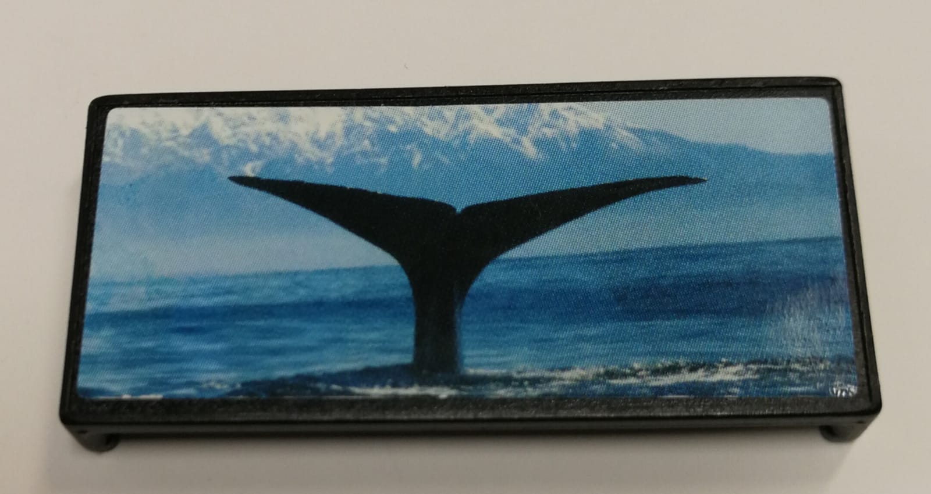
Reinforcement
What is this?
What problem does it solve?
What is the feature that solve this problem?
What is its UVP?
Notes:
The object will be shown to the participants. It is a clip for squeezing toothpaste from the bottom of the tube. More information: http://tubemate.com/

Slide 43
Your First canvas

Slide 44
LBMC – The Meta Principles
The usage of LBMC involves the following 3 steps:
    Document Your Plan A.
    Identify the Riskiest Part of Your Plan
    Systematically Test Your Plan

Slide 45
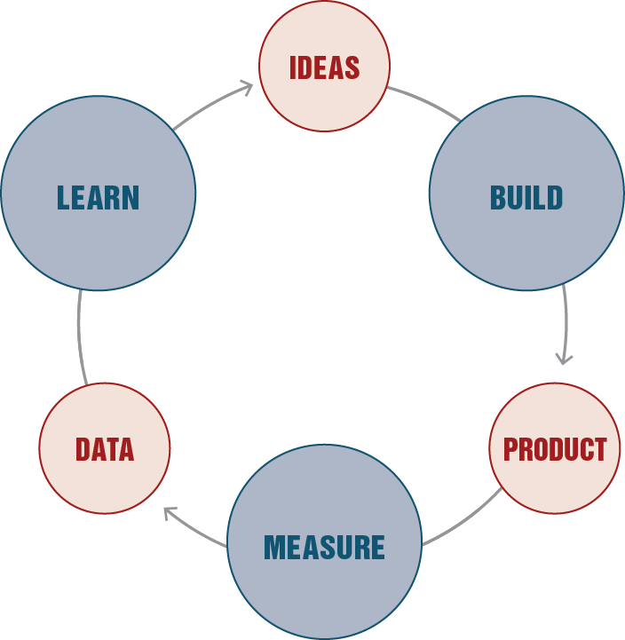
The 3 Smart Ways for Viable Business Idea

Slide 46
LBMC – Test
Qualitative
Quantitative

Slide 47
TIPS

Slide 48
The first canvas - TIP
Customer Segment & Problems
    How do you validate?
    Can you validate with some friends who are in your customer segments by using WhatsApp or other social media?

Slide 49
The first canvas - TIP
Customer Segments
Customers/Users
Early Adopters

Slide 50
The first canvas - TIP
Problems
Roots cause of the problems
3 main problems
Existing Alternatives

Slide 51
The first canvas - TIP
Unique Value Proposition
Why you are different and worth buying?
What is the value your product is uniquely delivering to the buyer?

Slide 52
The first canvas - TIP
Solutions
    Brainstorm for ideas to solve the problems.
    What are the 3 main features of your solution?
    Prototype it!

Slide 53
Group Discussion
Solutions Verification
    How can you verify your solution?
    Can you use Carousel, Gumtree and other e-commerce sites or other apps to verify?
    What is the price they are willing to pay?

Slide 54
The first canvas - TIP
Solutions
3 features to solve the 3 problems.
The concepts of
    Must-have
    Performance Benefits
    Delighters
Minimum Viable Product (MVP) – Prototype

Slide 55
The first canvas - TIP
Key Metrics
The key numbers that tells you how your product is doing in real time, before you get the sales report.
The key numbers are used to
  Measure progress
  Identify hot spots in your customers’ preference.

Slide 56

Key Metrics
Dave McClure’s Start-up Metrics

Slide 57
The first canvas - TIP
  Revenue Streams and Cost Structure
  What are the revenue streams?
  What are the cost?
  Revenue = Price x Quantity
  Profit = Revenue – Cost

Slide 58
The first canvas - TIP
  Channels
  How can the Customer Segments gain access to
    Product/service
    information

Slide 59
The first canvas - TIP
  Unfair Advantage
  How can you raise the barrier of entry?

Slide 60
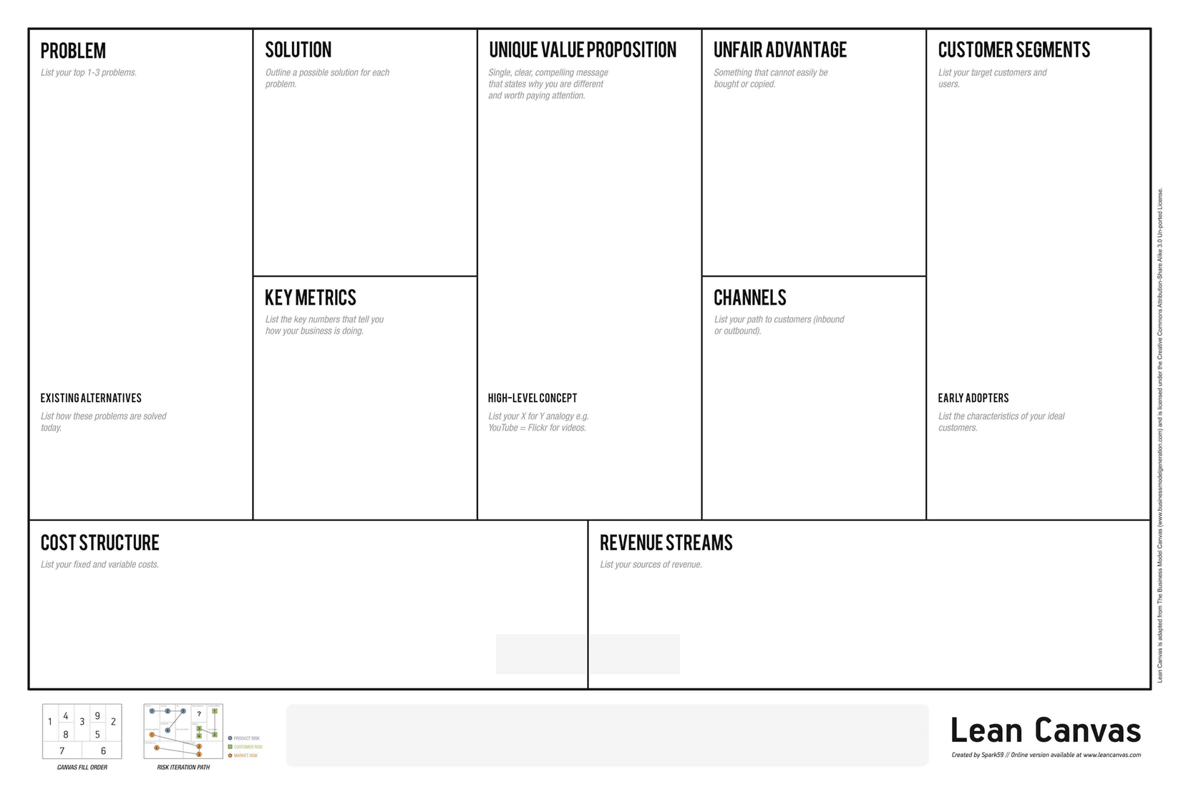
Revision - LBMC
Must-Have
Benefits
Delighters
Prevent
Copycats
Get them interested
Purpose
Customer Profile/
Persona
Performance
Measurements
Tell and Sell
Competitors
Easy Target
Expense List
Sources of Revenue

Slide 61
The 3 Smart Ways for Viable Business Idea

Slide 62
presentation

Slide 63
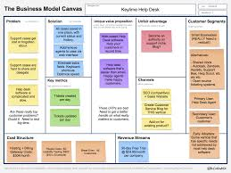

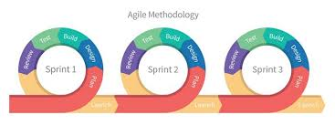
Agile – Experimental mindset – lean business model canvas
The tool
attitude
The Way

Slide 64
Questions?

Slide 65
Reflection- Wish & Like

Slide 66
Always pleased to hear from you.
Benson Ong
    M: 9711-1964
    P: 6550-1180
    E: benson_ong@nyp.edu.sg

