Slide 1
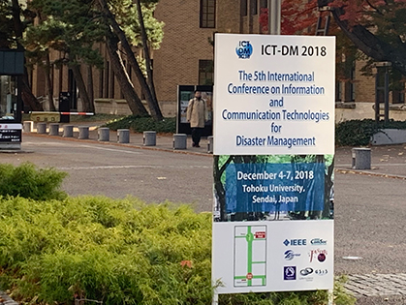
Event Report of ICT-DM2018 Conference
Hideaki Sone Cyberscience Center, Tohoku University
Environmental Computing Workshop and DMCC+/UND Project Meeting at ISGC2019

Slide 3
ICT-DM 2018 in Sendai
The 5th International Conference on Information and Communication Technologies for Disaster Management
Emergency services, ad hoc planning, disaster recovery, etc. Together academics and practitioners
To learn about the latest research developments, share experiences and information
International collaborations
First time in Asia - Past four meetings were held in Europe
Sendai city had the great earthquake and tsunami in 2011

Slide 4
Local Organizing Committee
Hideaki Sone, Tohoku University, Japan
Yusheng Ji, National Institute of Informatics, Japan
Shigeki Yamada, National Institute of Informatics, Japan
Kiyoshi Takano, University of Tokyo, Japan
Takuo Suganuma, Tohoku University, Japan
Celimuge Wu, University of Electro-Communications, Japan
Osamu Uchida, Tokai University, Japan
Keisuke Utsu, Tokai University, Japan

Slide 5
Organizing Committee
General Co-chairs Hideaki Sone, Tohoku University, Japan Soufiene Djahel, Manchester Metropolitan University, UK Yusheng Ji, National Institute of Informatics, Japan
Advisory Board Shigeki Yamada, National Institute of Informatics, Japan Kiyoshi Takano, University of Tokyo, Japan Takuo Suganuma, Tohoku University, Japan
TPC Co-chairs Celimuge Wu, University of Electro-Communications, Japan Said Yahiaoui, CERIST, Algeria Carlos T. Calafate, Technical University of Valencia, Spain
Publication Co-chairs Guohui Zhang, University of Hawaii, USA Imane Horiya Brahmi, Tyndall National Institute, Ireland Zhi Liu, Shizuoka University, Japan
Publicity Co-chairs Cong Chen, University of South Florida, USA Nafaa Jabeur, German University of Technology in Oman, Sultanate of Oman
Kun Wang, Nanjing University of Posts and Telecommunications, China Adam Widera, University of Muenster, Germany
Poster & Demo Co-chairs Osamu Uchida, Tokai University, Japan Keisuke Utsu, Tokai University, Japan
Steering Committee – Steering committee co-chairs –
Nadia Nouali-Taboudjemat, CERIST, Algeria Yassine Hadjadj-Aoul, University of Rennes 1, France
– Steering committee members – Ahcène Bendjoudi, CERIST, Algeria Aris M. Ouksel, University of Illinois at Chicago, USA Ivan Gojmerac, AIT Austrian Institute of Technology, Austria Nadjib Badache, CERIST, Algeria Omar Nouali, CERIST, Algeria Soufiène Djahel, Manchester Metropolitan University, UK
TPC 65 members

Slide 6
Sponsors and financial supporters
IEEE Explore
Steering Committee
Cooperation
Tohoku University
Financial Support

Slide 7
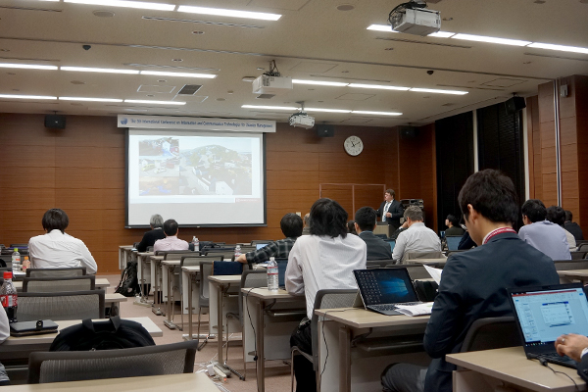
Submission
Submissions: 51 full papers and 25 short papers
Review by TPC, and acceptance: 18 full papers and 10 short papers = Accept rate36.8% (Condition < 40%, 2 withdrawal) - Published on IEEE Xplore
Poster & Demo session: Planned for young researchers and practitioners 35 presentations

Slide 8
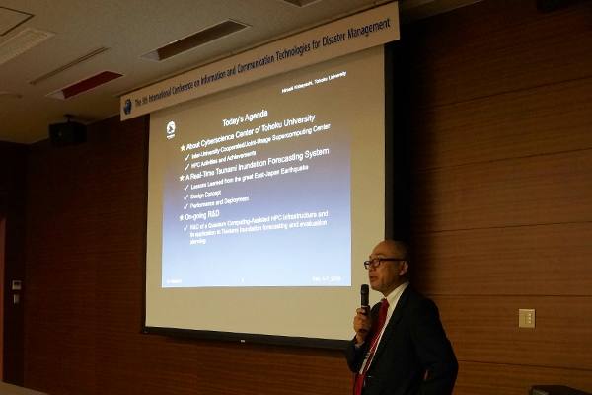
Keynotes
Building Robust Wireless Networks with Relay Node Placement Guoliang Xue, Arizona State University, USA
Application of numerical model on extreme weather and regional climate changes studies Dr. Chuan-Yao Lin, Academia Sinica, Taiwan
A Real-Time Tsunami Inundation Forecasting System for Disaster Mitigation and Prevention ~Lessons learned from the 2011 East-Japan Great Earthquake ~ Hiroaki Kobayashi, Tohoku University, Japan

Slide 9
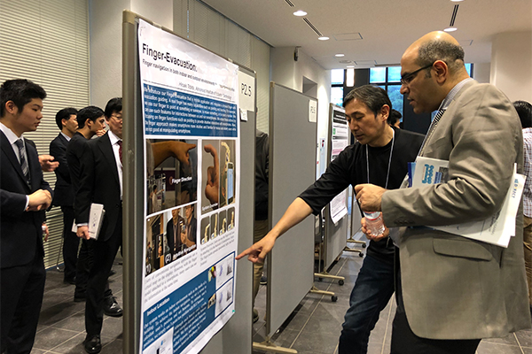
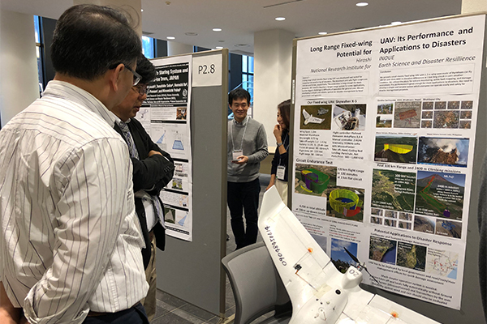
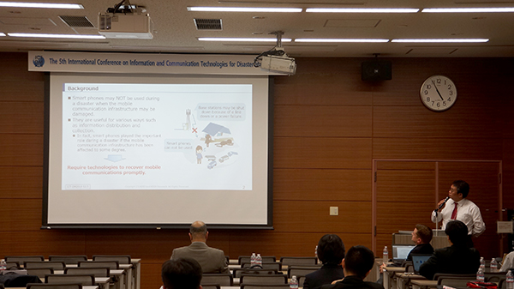
Program
Day 1 – Tue, Dec 4
Opening, Keynote
1. AI (4 presentations)
2. Communications (5)
Reception
Day 2 – Wed, Dec 5
Keynote
3. Architeture and platform (5)
Poster & Demo (18)
4. Flood management (4)
Banquet
Day 3 – Thu, Dec 6
Keynote
5. Issues and algorithms (5)
Poster & Demo (17)
6. Social media (5)
Closing
Day 4 – Fri, Dec 7
Excursion

Slide 10
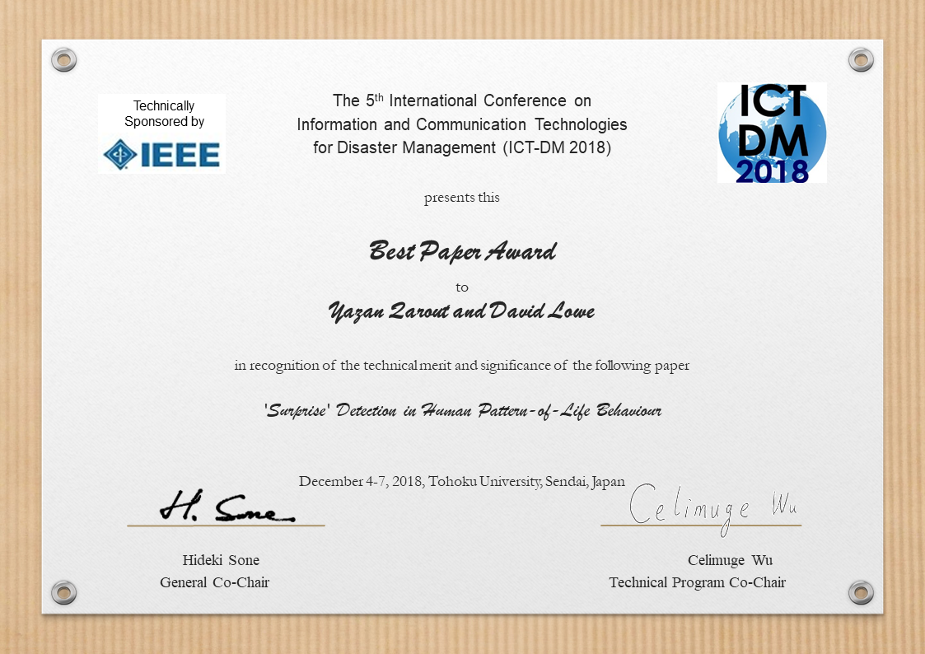
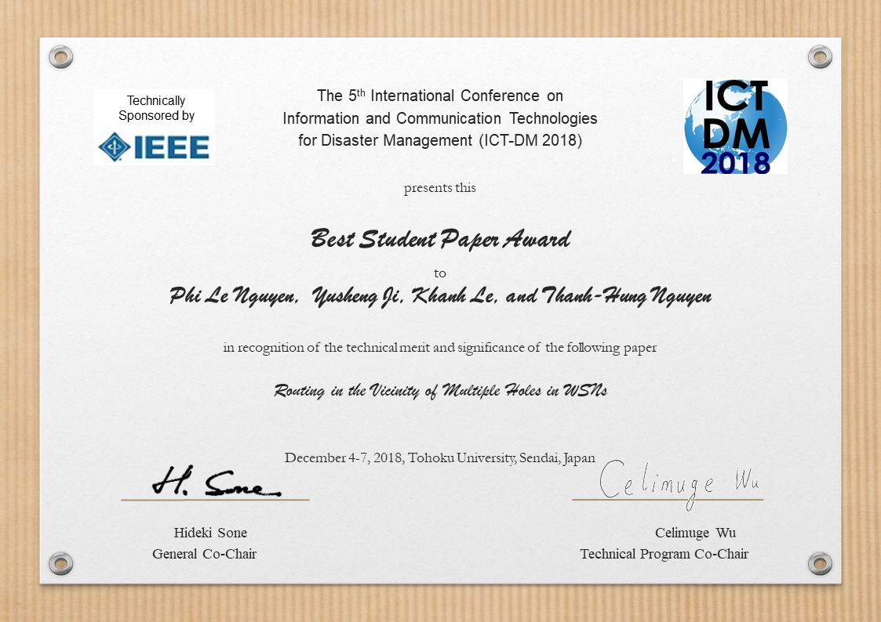
Awards
Best Paper Award
Yazan Qarout and David Lowe
Aston University, UK
'Surprise' Detection in Human Pattern-of-Life Behaviour
Best Student Paper Award
Phi Le Nguyen, Yusheng Ji, Khanh Le, and Thanh-Hung Nguyen
National Institute of Informatics, and SOKENDAI (The Graduate University for Advanced Studies), Japan
Routing in the Vicinity of Multiple Holes in WSNs

Slide 11
International Participants
Australia | 1
Austria | 2
China | 3
Germany | 5
India | 2
Indonesia | 1
Italy | 1
Japan | 52
Norway | 4
Philippines | 1
Qatar | 1
Taiwan | 3
United Kingdom | 3
United States of America | 1
Total | 80
14 countries/areas
Many from Asia for the first time
(numbers based on contact address)

Slide 12
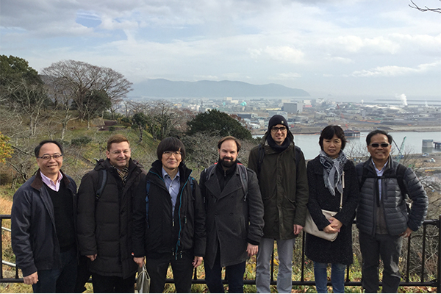
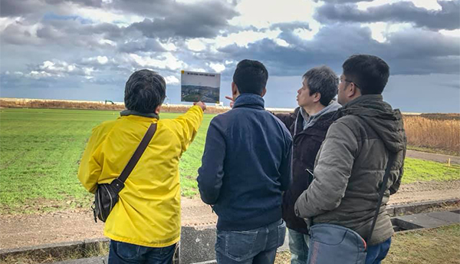
Excursion
Plan 1: Ishinomaki (and Onagawa)
Time: 1-hour train + 30 min (slope) walk
View: Landscape from Hiyoriyama Park Hill
Visit: Information exchange hall (Small exhibition)
Lunch and shopping: Local market, or shops on streets
Other: Manga museum
Extension: Onagawa
Plan 2: Yamamoto
Time: 40 min train + bus trip
View: Totally redeveloped town, railway, farms, and former town and ruin of former rail station
Visit: Former Yamashita Station and MINNANO SHASHINKAN (small exhibition)
Visit: Former Nakahama Elementary School
Visit and lunch: ICHIGO WORLD Strawberry Farm GRA
Visit: Hidamari Hall (Exhibition)

Slide 13
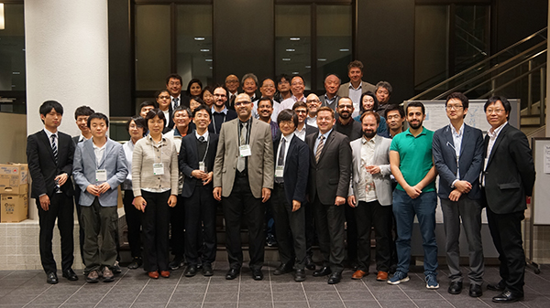
Future ICT-DM
Not yet announced
Steering Committee will …?

