Slide 1
Combined Assurance Model
David Kelsey
AARC2 Community Engagement/Policy and Best Practice Harmonisation
STFC – UK Research and Innovation
IGTF All Hands Meeting, ISGC2019, Taipei
1 April 2019

Slide 2
Outline
Quick reminder on Assurance in R&E Federated Identity Management
IGTF Assurance - Relying Party - EGI policy
Combined Assurance
Assessment/accreditation
A use case – LIGO
Next steps

Slide 3
Reminder: Assurance in R&E Federated Identity

Slide 4
IGTF Assurance Profiles https://www.igtf.net/ap/authn-assurance/

Slide 5
IOTA/DOGWOOD Profile
End-entity, subscriber and user identity validation
Credentials issued must be bound to an act of identity vetting.
Authorities are only required to collect the data that are necessary for fulfilling the uniqueness requirements. Credentials issued by authorities under this LoA are not required to provide sufficient information to independently trace individual subscribers. Traceability of the credential is provided only in a cooperative way jointly with other parties that provide other elements of identity-related data. Credentials issued by authorities operating under this LoA should be used primarily in conjunction with vetting and authentication data collected by the relying parties or service providers.
Validation of the credential application establishes the permanent binding between the end-entity, the owner, and the subject name. The authority must describe how it can reasonably verify identity information and trace this information back to a physical person (or for non-human credentials to a named group) at the time of credential issuance.

Slide 6
REFEDS Assurance Framework https://refeds.org/assurance
To manage risks related to the access control of their services, the Relying Parties of the research and education federations need to make decisions on how much to trust the assertions made by the Identity Providers and their back-end Credential Service Providers (CSP)
This framework splits assurance into the following orthogonal components:
the identifier uniqueness;
the identity assurance;
the attribute assurance
Assurance profile Cappuccino for low-risk research use cases ($PREFIX$/profile/cappuccino)
Assurance profile Espresso for use cases requiring verified identity ($PREFIX$/profile/espresso)
The assurance of authentication is not covered by this specification
Single Factor Authentication https://refeds.org/profile/sfa
requirements that an authentication event must meet in order to communicate the usage of SFA
Multi Factor Authentication https://refeds.org/profile/mfa
at least two of something you know, something you have, something you are, something you do

Slide 7
REFEDS Identity proofing and credential issuance, renewal and replacement
Value | Description
$PREFIX$/IAP/low | Identity proofing and credential issuance, renewal, and replacement qualify to any of sections 5.1.2-5.1.2.9 and section 5.1.3 of Kantara assurance level 1 [Kantara SAC] IGTF level DOGWOOD [IGTF] IGTF level ASPEN [IGTF] Example: self-asserted identity together with verified e-mail address, following sections sections 5.1.2-5.1.2.9 and section 5.1.3 of [Kantara SAC].
$PREFIX$/IAP/medium | Identity proofing and credential issuance, renewal, and replacement qualify to any of sections 5.2.2-5.2.2.9, section 5.2.2.12 and section 5.2.3 of Kantara assurance level 2 [Kantara SAC] IGTF level BIRCH [IGTF] IGTF level CEDAR [IGTF] section 2.1.2, section 2.2.2 and section 2.2.4 of eIDAS assurance level low [eIDAS LoA] Example: the person has sent a copy of their government issued photo-ID to the CSP and the CSP has had a remote live video conversation with them, as defined by [IGTF].

Slide 8
Kantara & eIDAS
Kantara Initiative
https://kantarainitiative.org/confluence/display/LC/Identity+Assurance+Framework
Four Assurance Levels
1- Little or no confidence in the asserted identity’s validity
2 - Some confidence in the asserted identity’s validity
3 - High confidence in the asserted identity’s validity
4 - Very high confidence in the asserted identity’s validity
eIDAS
http://eur-lex.europa.eu/legal-content/EN/TXT/?uri=OJ:JOL_2015_235_R_0002
Regulation (EU) 2015/1502 of 8 September 2015 on setting out minimum technical specifications and procedures for assurance levels for electronic identification means pursuant to Article 8(3) of Regulation (EU) No 910/2014 of the European Parliament and of the Council on electronic identification and trust services for electronic transactions in the internal market

Slide 9
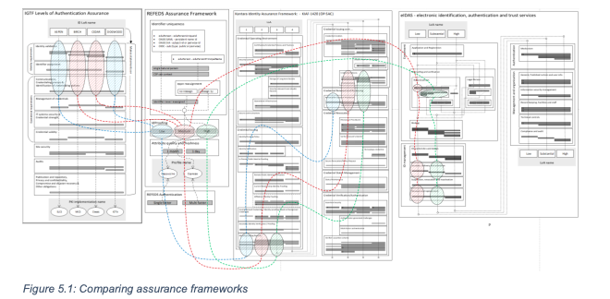
Mapping Assurance Frameworks to each other (Ian Neilson & D Groep)
AARC-I050 Comparison Guide to Identity Assurance Mappings for Infrastructures
Read this document carefully to fully understand all (“breadcrumbs” & “grains of rice” get lost along the way!)
https://wiki.geant.org/download/attachments/114935014/AARC-I050-ComparisonGuidetoAssuranceMapping.pdf

Slide 10
IGTF Assurance
Relying Party (EGI) policy

Slide 11
EGI Policy - Policy on Acceptable Authentication Assurance
https://documents.egi.eu/document/2930
Authentication and identification is considered adequate if the combined assurance level provided by the Issuing Authority, the e-Infrastructure registration service, and the VO registration service, for each User authorised to access Services, meets or exceeds the requirements of the following approved IGTF authentication assurance profiles:
a) IGTF Assurance Profile ASPEN (urn:oid:1.2.840.113612.5.2.5.1)
b) IGTF Assurance Profile BIRCH (urn:oid:1.2.840.113612.5.2.5.2)
c) IGTF Assurance Profile CEDAR (urn:oid:1.2.840.113612.5.2.5.3)
Unless either the VO or e-infrastructure registration service can demonstrate that - for the Users it authorises to use Services - it meets one of the approved assurance profiles, the IGTF accredited issuing authority MUST provide this level of assurance.

Slide 12
Combined Assurance - assessment

Slide 13
Combined assurance – policy/procedure – Are we seeking IGTF approval?
https://wiki.egi.eu/wiki/SPG:Drafts:Assessment_Community_IDvetting_adequacy
Authentication and identification is considered adequate, for each User authorised to access Services, if the combined assurance level provided by the end-user credential issuing authority, and either the e-Infrastructure registration service and/or the Community registration service, meets or exceeds the requirements of the approved IGTF authentication assurance profiles [AAP]. This is conventionally assured through a vetting process during user credential issuance at their identity provider.
The Community or e-Infrastructure wishing to prove the adequacy of its identity vetting, in order to use its members' credentials in conjunction with the IGTF Assurance Profile DOGWOOD, and substantiate their compliance with the Snctfi membership management requirements, must submit a request for assessment by the designated Security Policy Groups (SPG) by way of Infrastructure Operations.

Slide 14
Combined Assurance (2)
The request shall include the following information:
a statement of their compliance with the Community Membership Management Policy
a statement of their compliance with the Community Operations Security Policy
a documented description of the membership life cycle process and practices meeting the requirements of the IGTF BIRCH, CEDAR (or ASPEN) assurance level, in which
the credential of the user is the membership registration data and community-issued assertions
the Issuing Authority is the collection of membership management and assertion-issuing systems and services
the credential life time corresponds to the renewal periods as defined in the Community Membership Management Policy
a description of the method of binding between the membership information and the DOGWOOD user credential (identifier)

Slide 15
Combined Assurance (3)
Based on this information, the SPG shall advise the Infrastructure Operations with respect to suitability of the Community or e-Infrastructure for such combined adequacy in accordance with the Policy on Acceptable Authentication Assurance.
The SPG may make available an evaluation matrix. Applicant communities are welcome to use the assurance evaluation matrix to prepare the requisite documents, bearing in mind the evaluation Method and the Persistent registry (community membership) implementation and assessment hints. The most relevant community assurance profiles for the joint adequacy purpose are BIRCH and CEDAR. Registries and membership services at ASPEN level are strongly discouraged. The credential (registration) life time of 11 days necessitates re-registering members with this frequency, and re-validating their eligibility. This model is likely to both confuse and upset members.

Slide 16
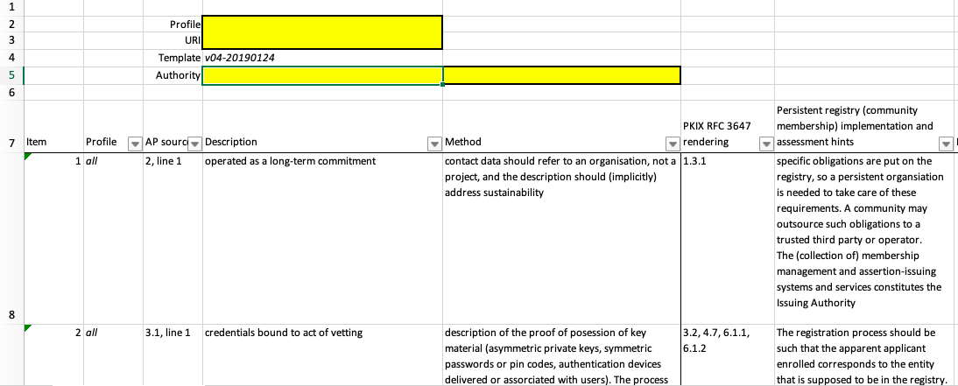
Evaluation/Assessment spreadsheet
AssuranceAssessment-v04-20190124
Show spreadsheet and discuss?

Slide 17
A use case - LIGO

Slide 18
LIGO – request for assessment of combined assurance
19 March 2019 (email to David Groep)
> When enabling the use of /cvmfs/ligo.osgstorage.org at NIKHEF we came across an issue, as you are aware, that many LIGO users get their user certificates from CILogon Basic CA, and at first cvmfs on the NIKHEF worker nodes rejected them. The problem has been solved at NIKHEF, but I am still concerned about the bigger issue of access to this repository at more sites throughout Europe and I want to discuss with you about how to solve that problem.
Response from DavidG included:
Since LIGO as of yet had not requested assessment for the combined assurance model under EGI, they are not (at Nikhef, nor anywhere else AFAIK) in the set of whitelisted communities for the combined assurance model.
The 'ca-policy-egi-cam' trust anchors add, on top of the core set:
ca_RCauth-Pilot-ICA-G1
ca_cilogon-basic
ca_CERN-LCG-IOTA-CA
which are equivalent in terms of their assurance level

Slide 19
LIGO (2)
Jim B: once LIGO has written down the membership vetting process - actually the LSC members in the LIGO VO all qualify already for a higher assurance level for their identity.
All vetted members meet the REFEDS "Cappuccino" assurance level, which is equivalent in vetting to the IGTF BIRCH level.
And - by going through the LIGO proxy on CILogon itself - they all qualify for CILogon Silver!
In that way, all LSC users in LIGO immediately get back to the old trust level they had from the OSC CA, but now through the federated mechanism.
Draft of membership vetting now been provided – EGI SPG analysis can soon start

Slide 20
Next steps
Work with LIGO on assessment of their request to be trusted
As a result of this work, may need to
Modify assessment methods/spreadsheet
Review policy/procedure for Assurance assessment
Who owns the Combined Assurance Assessment Policy/procedure?
Role of IGTF?

Slide 21
David.Kelsey@stfc.ac.uk

