Slide 1
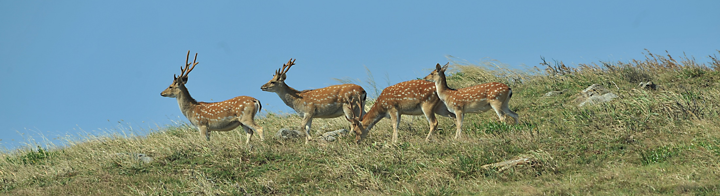
An application of using acoustic and visual information to monitor activities of sika deer
Shih-Ching Yen¹, Tzu-Hao Lin², Pei-Jen Lee Shaner³
¹ Center for General Education, National Tsing Hua University
² Department of Marine Biodiversity Research, Japan Agency for Marine-Earth Science and Technology
³ Department of Life Science, National Taiwan Normal University
Notes:
Good morning everyone. I am yen s c. Thanks dr. lin and dr. tuanmu for inviting me. it is my great honor to be here today. Actually, I am very nervous now, because I am not really familiar with the field of soundscape research. I am a wildlife biologist. We usually study large mammals by line transect, radio-telemetry, or camera trap. It’s my first try using soundscape technique. This is a preliminary study. We use both camera trap and acoustic recorders to monitor a wild sika deer population. The results are simple. But what we really want to do is explore the possible application of soundscape monitoring on large mammals in the future.

Slide 2
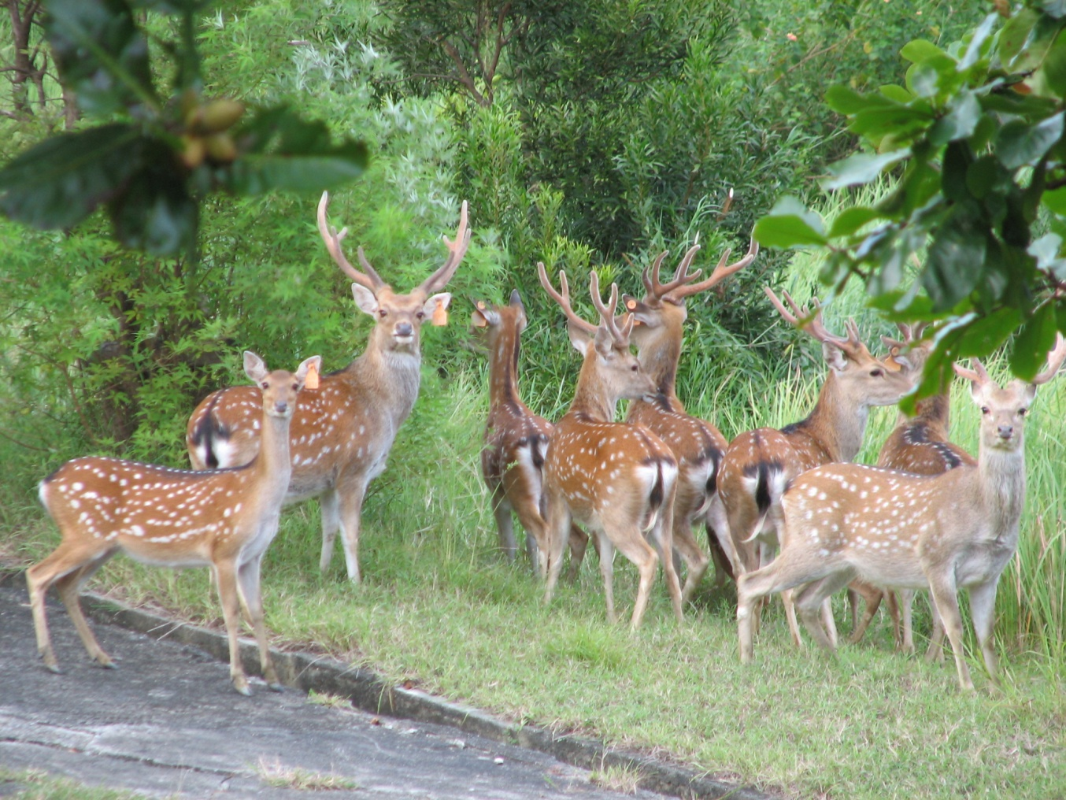
Sika deer
Notes:
Sika deer is social animal, males are usually solitary, females live in groups. They are sexual dimorphic. Males are larger in body size. Their mating system is polygyny. The males have to compete with each other for the opportunities of mating. Therefore they fight with their antlers. But fighting is so fierce that may lead to hurt or death. So they evolve another gentler behavior. They compete by their vocal behavior. That is the key behavior in this study. I will introduce it later.

Slide 3
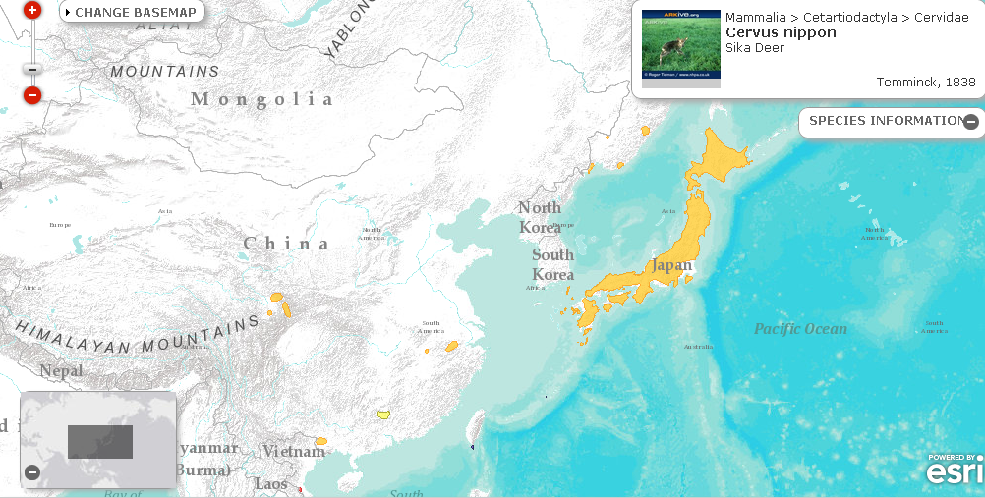
Distribution
Notes:
The sika deer is distributed in East Asia. It is very abundant in Japan, but is rare in other parts of its native range. Taiwan is here.

Slide 4
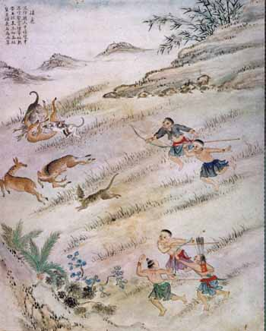
Sika deer
had been widespread in low-elevation areas in Taiwan
is highly valuable for aboriginal people
番社采風圖
Notes:
In the past, sika deer had been widespread in low-elevation areas of Taiwan. It is highly valuable for aboriginal people. They hunt deer and collect deer meats, skins, velvets, bones. Almost all parts of a deer are valuable. Then they trade with fishers from china. After that, dutch ruled Taiwan during 17 century. At the same time, japan was under civil war and need a large amount of military supplies. Lots of deer skins were imported for the materials of armors and boots. Thus people in Taiwan hunt much more deer and exported them to japan . The deer population decreased dramatically during those years.

Slide 5
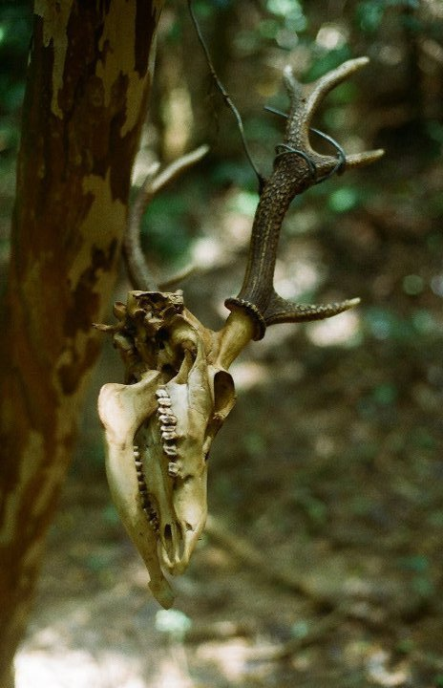
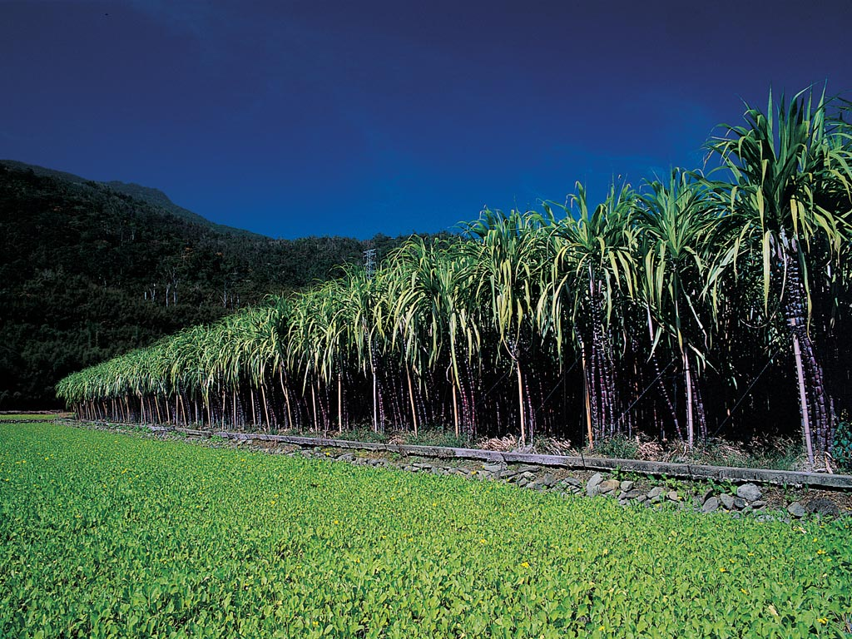
Extinct in the wild in 1969, because of :
Hunting
Habitat destruction
Notes:
Besides hunting, habitat destruction also threatened sika deer. Nature vegetation in low elevation areas of taiwan were transformed to agriculture areas, particularly for rice and canes. Following was the rapid urbanization. Suitable habitats for sika deer became very rare. The deer population declined year by year. Finally, the sika deer was extinct in the wild in 1969. The final record was a fawn captured by a trap in Taitung.

Slide 6
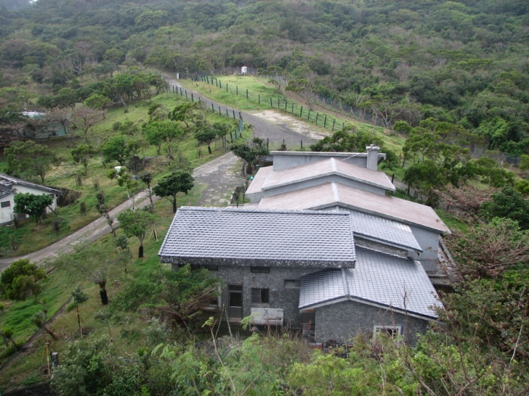
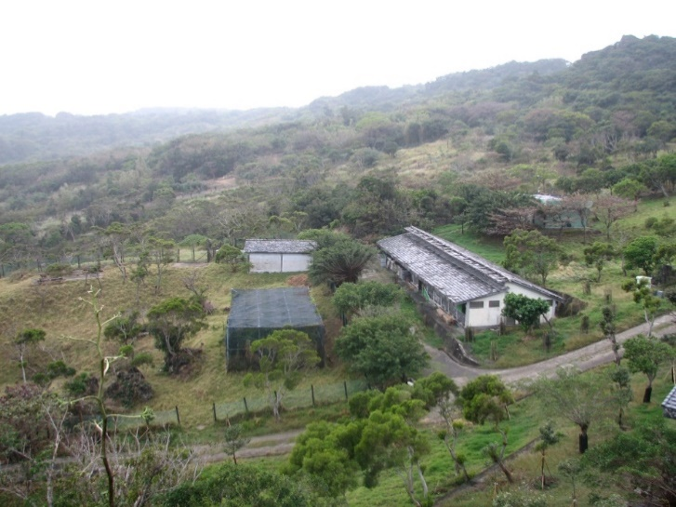
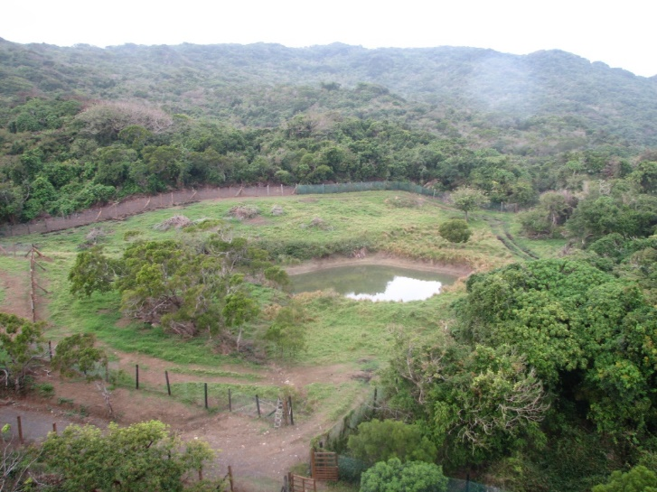
Restoration program in Kenting National Park (KTNP)
1969
Extinct in the wild
1984
Beginning of restoration program
1988
Rewilding period
1994
Reintroduction to the wild
Notes:
Kenting national park is at the southmost tip of Taiwan. It placed a restoration program for sika deer since 1984. Several sika deer individuals were introduced from Taipei zoo to sheding restoration center. The deer were raised in sheding and rewild in neighboring areas since 1988. From 1994, the deer were reintroduce to the wild and successfully established a wild population in hengchun penisular.

Slide 7
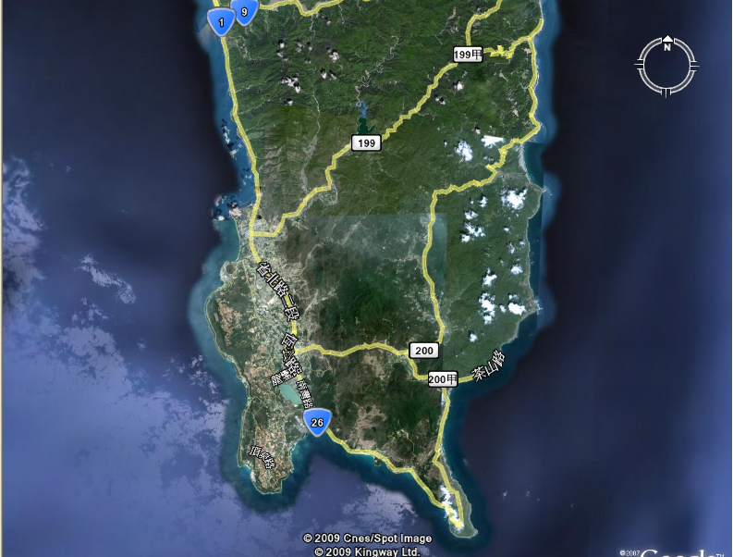
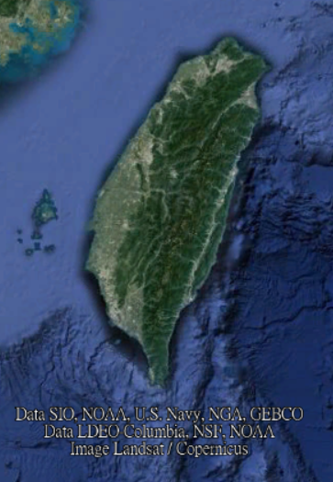
Approximately 200 deer were reintroduced to the wild between 1994-2009.
An estimation of 1500 wild deer are living within and around KTNP.
Mudan village
Jioupeng military base
Kenting National Park
Notes:
During 1994-2009, about 200 deer were reintroduced to the wild. After then, the action of reintroduction stopped, because the population size and density seems too high in the wild. Natural vegetation and crops were damaged the deer. At present, an estimation of 1500 wild deer are living within and around KTNP. Nevertheless, to evaluate the effectiveness of the restoration program, and to make management plans, the population status of wild sika deer, including their distribution, expansion, population size and density, should be monitored.

Slide 8
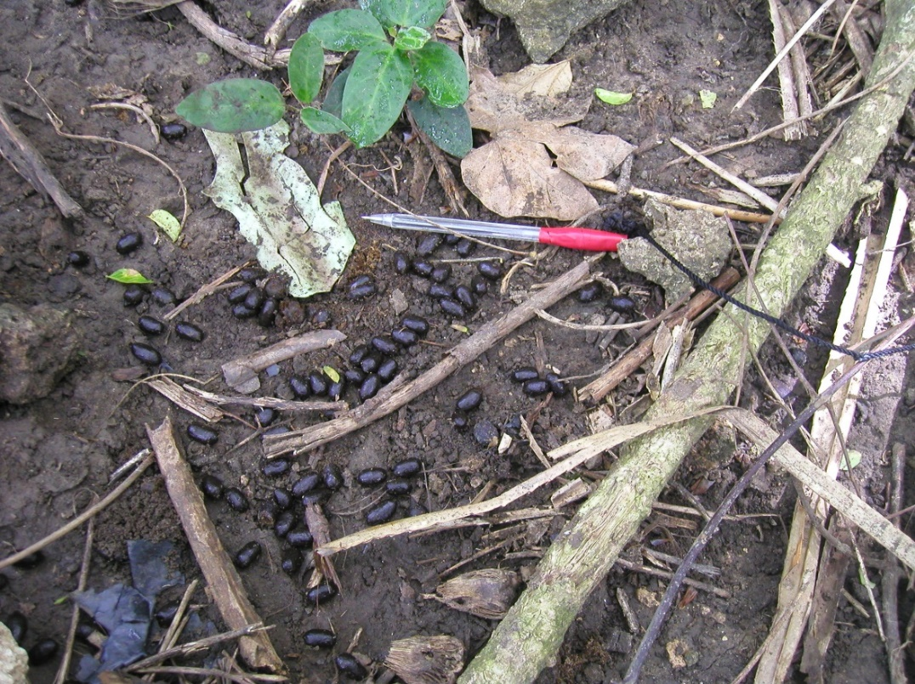
Line transects
Notes:
I participated the field survey of wild sika deer during 2006-2010. We carried out line transects to record all signs and tracks of sika deer. It was a hard work because kenting is located in the tropical area. The temperature during daytime was super high. The vegetation was dense and barbed. In addition, there were lots of ants, wasps, mosquitos, and other unknown insects. It’s a harsh environment for field work.

Slide 9
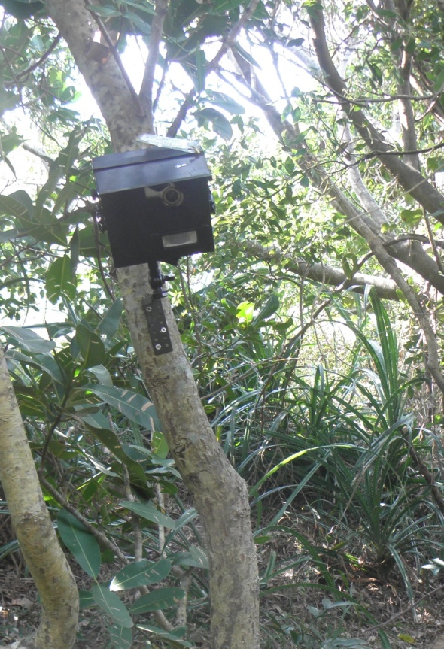
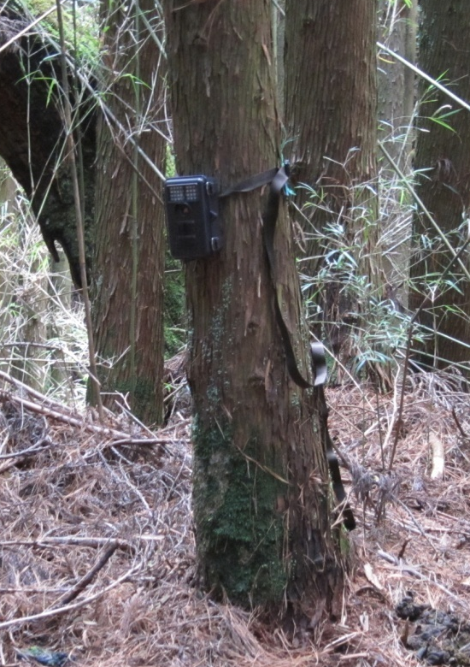
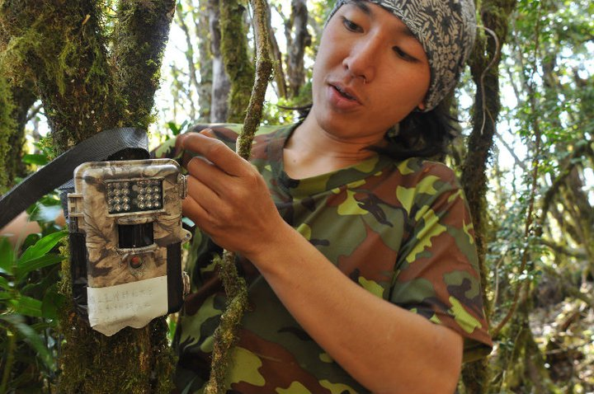
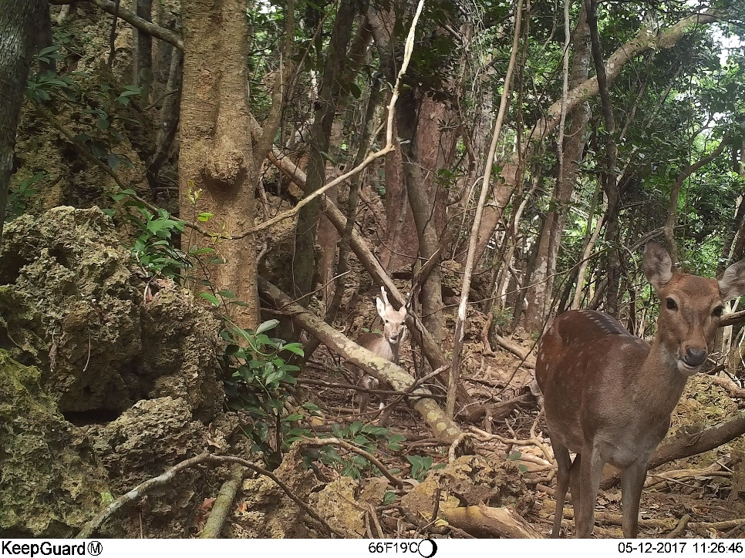
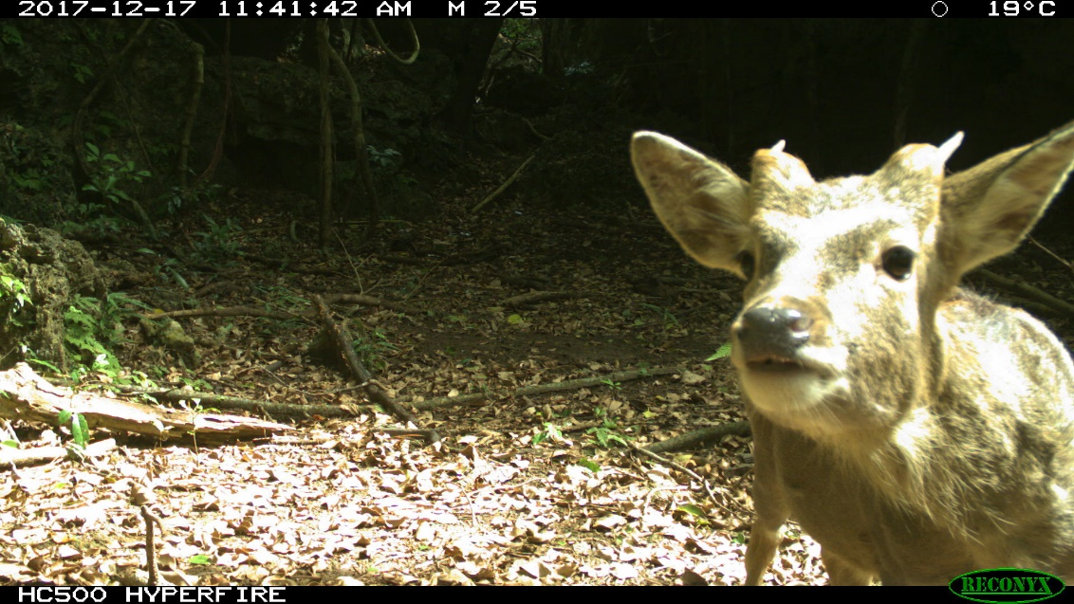
Camera trap
Notes:
We also used camera traps to monitor the sika deer. It’s a useful tool. But some shortcomings still exist. For example, its detection zone is very small, comparing to the whole study area. Its case forms a good shelter and became a nest for many animals, like lizards, geckos, spiders, cockroaches, and ants.

Slide 10
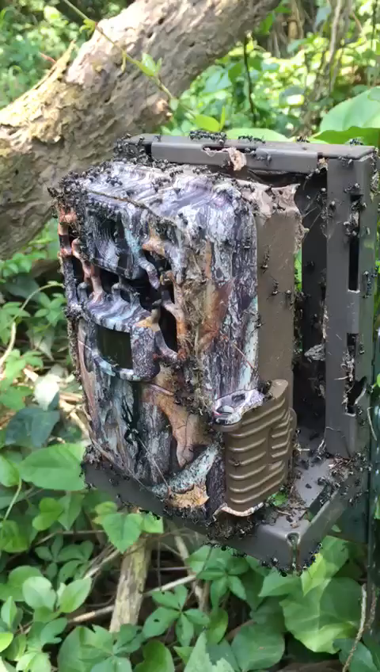

Slide 11

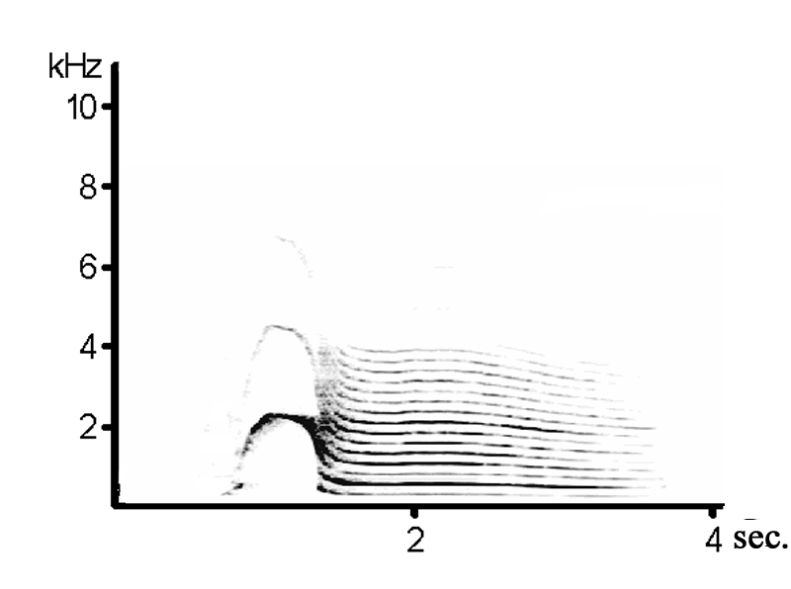
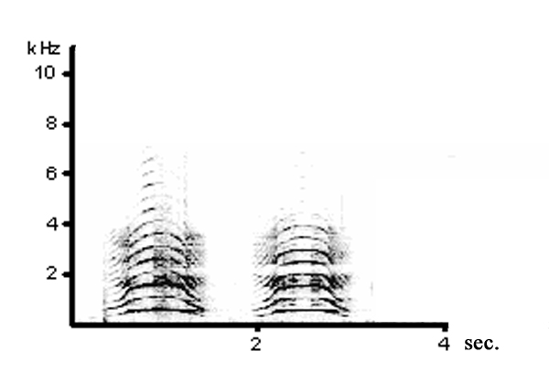
Rutting vocalizations
moan howl
Part I
duration
Part II
duration
74.5% of the first portion of moan, 65.3% of the second portion of moan, and 64.2% of howl could be identified on an individual basis. (Yen et al. 2013)
Notes:
Since the field work is difficult, I wonder if there is any other method to monitor the wild sika deer. Utilizing its rutting vocalization is a possible direction. During the rutting season, the male sika deer emit two types of rutting vocalizations: moan and howl. By the behavior observation in a captive population, the function of moan is more likely to advertise its existing and location, while howl is more likely a direct competition between male individuals. In this former study, we also found that the males had individuality in their vocalizations. By analyzing the sound spectrum, the sounds could be accurately assigned to the right individuals.

Slide 12
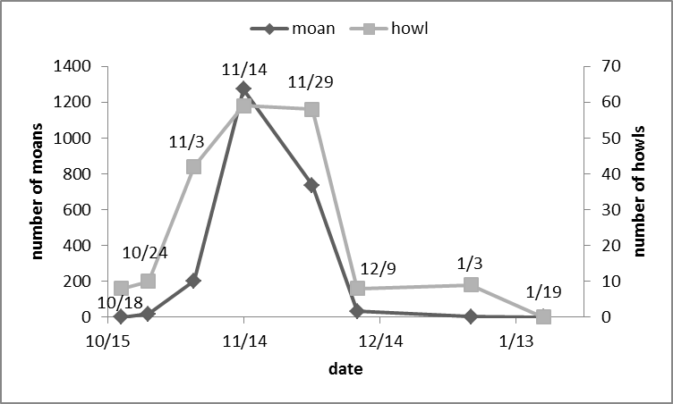
Breeding season
Notes:
These sounds are loud, and could be heard in a distance of several hundred meters. We recorded the number of rutting vocalizations during a breeding season in the field. The occurrence of rutting vocalizations started from the mid October, then rose rapidly during November, decreased dramatically in December, and ended in the mid January.

Slide 13
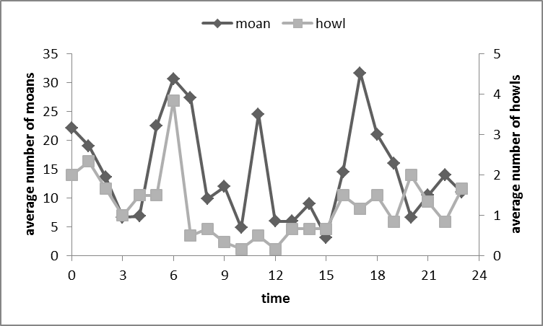
Daily pattern of rutting vocalizations
Notes:
This figure shows the daily pattern of occurrence of rutting vocalizations. The deer emitted the sounds all day, but peaked at dawn and dusk, and had two minor peaks at noon and midnight.

Slide 14
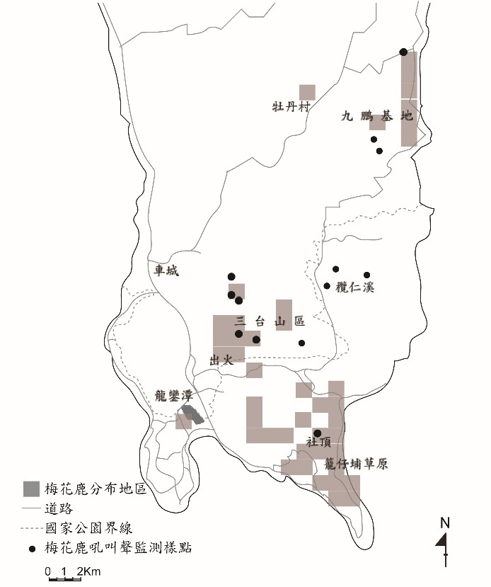
Monitoring population distribution by observation of rutting vocalizations
Survey of sika deer distribution during breeding season (Yen et al. 2010)
Notes:
We have tried to monitor the distribution of the wild sika deer population by utilizing its vocalizations. According to the timing of vocal activity, we went to several vantage points before sunrise and after sunset to observe their vocalizations. Some points with known distribution were selected for control. Finally, we confirmed the presence or absence of sika deer at several points in the edge of its distribution. This method is still hard because we have to arrived the vantage points very early, and left there very late. It was just a try. I was wondering if there is any other better method.

Slide 15
Aim
Developing a novel method to investigate the activities of sika deer by soundscape monitoring
Notes:
Fortunately, soundscape monitoring techniques and machines developed quickly in recent years. It’s time to establish a novel monitoring method. In this study, we used acoustic recorders to monitor the wild sika deer, and developed a method for analysis. We not only collected the acoustic information, but also visual information by deploying camera traps for comparison.

Slide 16
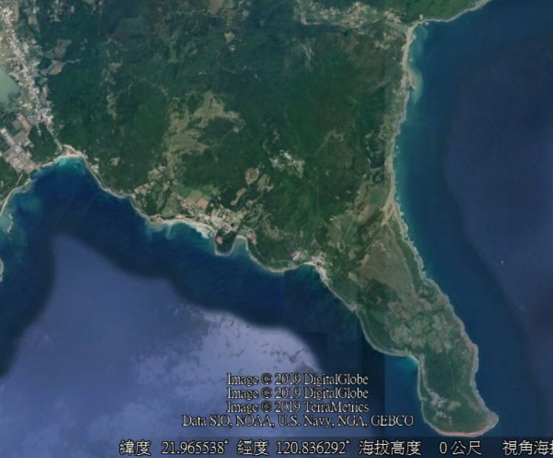
Study area
- Kenting Uplifted Karst Nature Reserve
Neighbor to Sheding Sika Deer Restoration Center
With a high-density sika deer population
Notes:
We carried out this study in Kenting uplifted karst nature reserve, which is neighbor to sheding restoration center. This area had the highest density of wild sika deer.

Slide 17
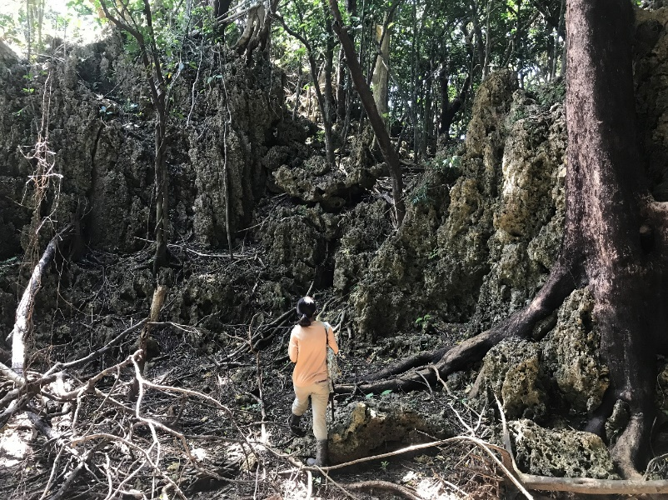
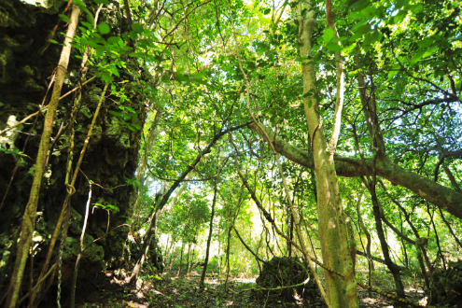
Study area
- Kenting Uplifted Karst Nature Reserve
Evergreen broad-leaved forest
Tropical climate
Windy during October-April
Few precipitations during November-May
Notes:
The environment was covered by evergreen broad-leaved forest. It is located in tropical zone, so the climate is warm all year long. Its very windy during October-April, but receives few precipitation in this period. Therefore, the work of sound recording may be disturbed by wind but not rain.

Slide 18
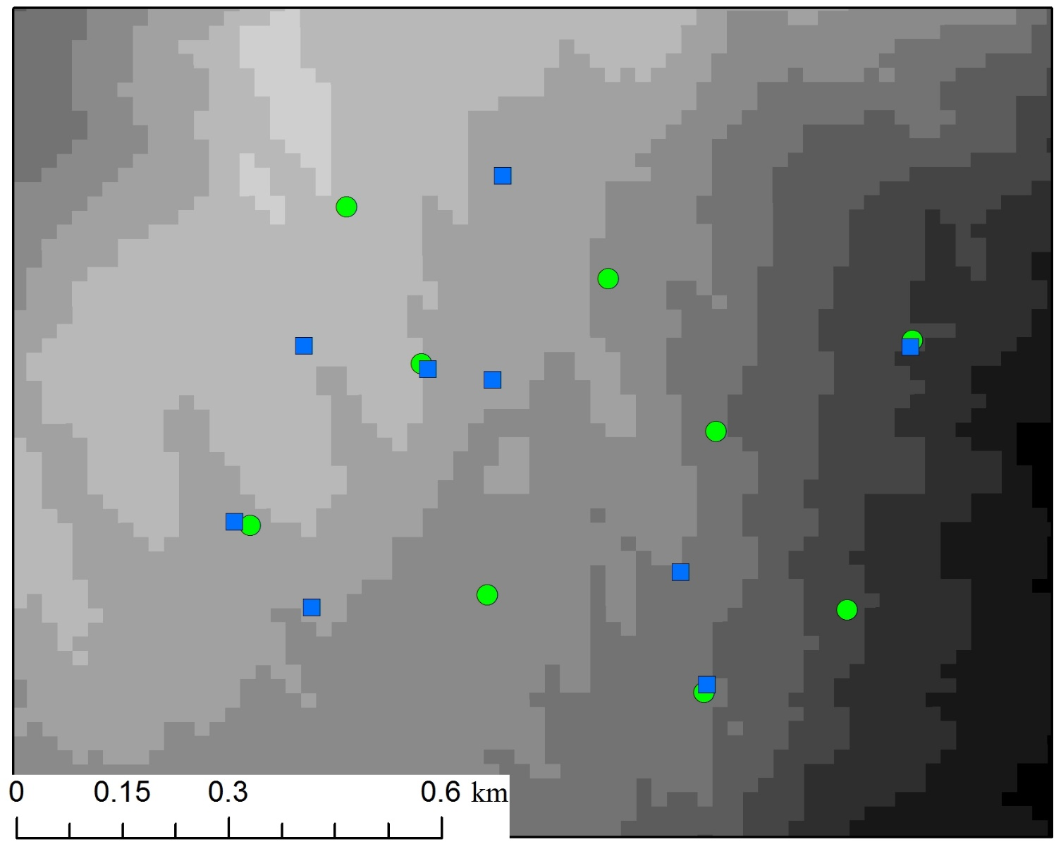
9 acoustic recorders
9 camera traps
deployed during November 7th to December 21th, 2017
Notes:
In the nature reserve, we deployed 9 acoustic recorders and 9 camera traps with an interval of 200 m, during the sika deer breeding season in 2017. In general, the terrain was higher in the northwest and lower in the southeast. In fact, it’s rugged because of the uplifted coral reefs.

Slide 19
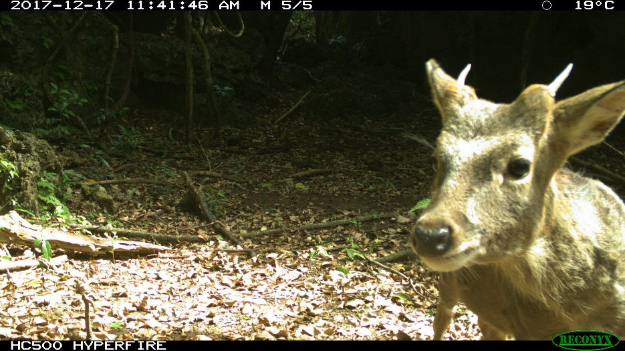
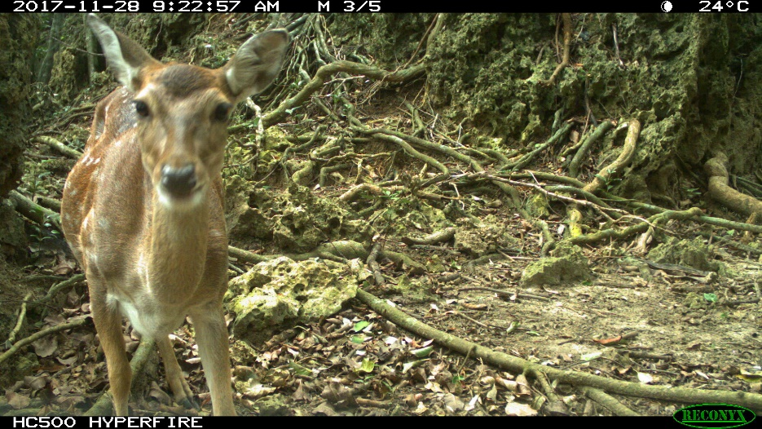
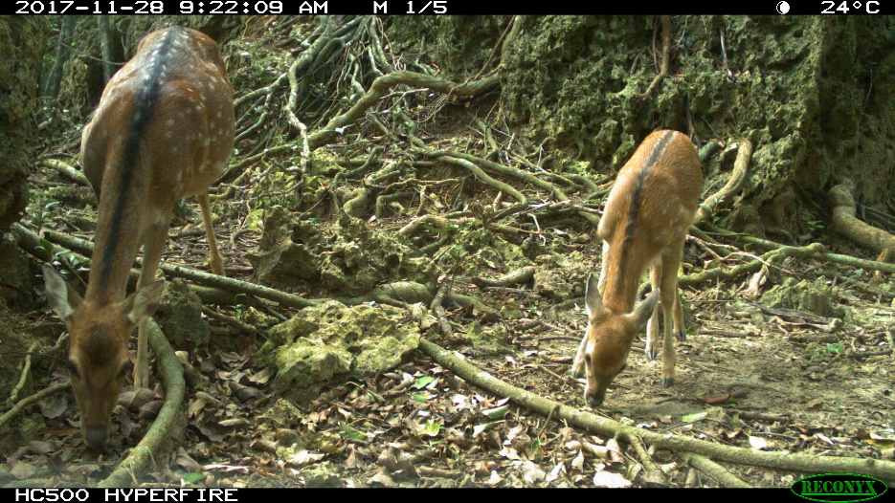
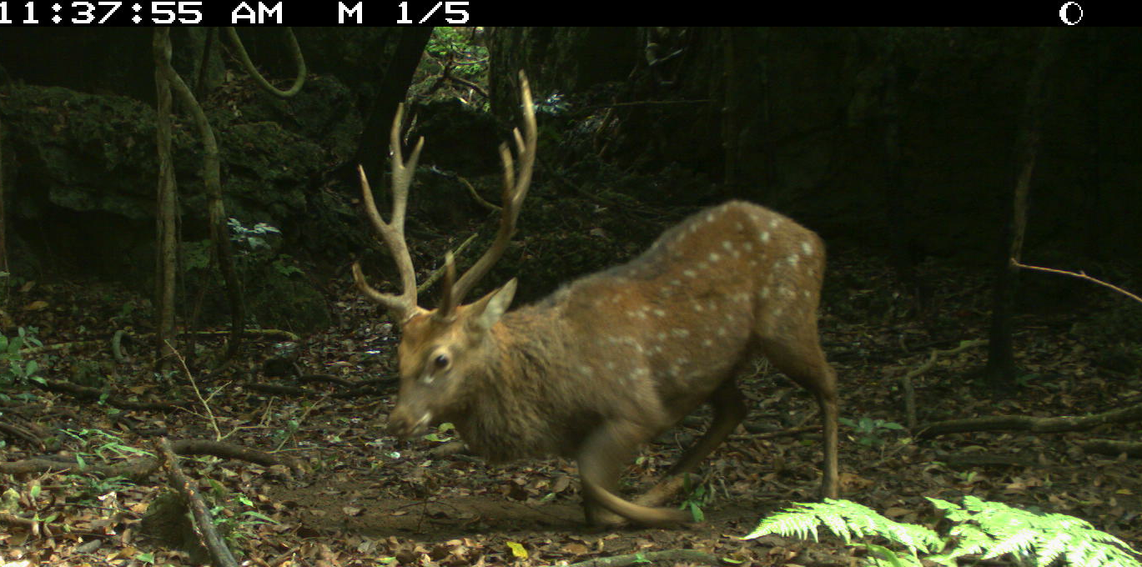
Camera trapping
Trap nights : 392
Independent photographs of sika deer: 924 (506 males)
Notes:
The 9 camera traps totally work 392 days, collected 924 photographs of sika deer, including 506 males.

Slide 20
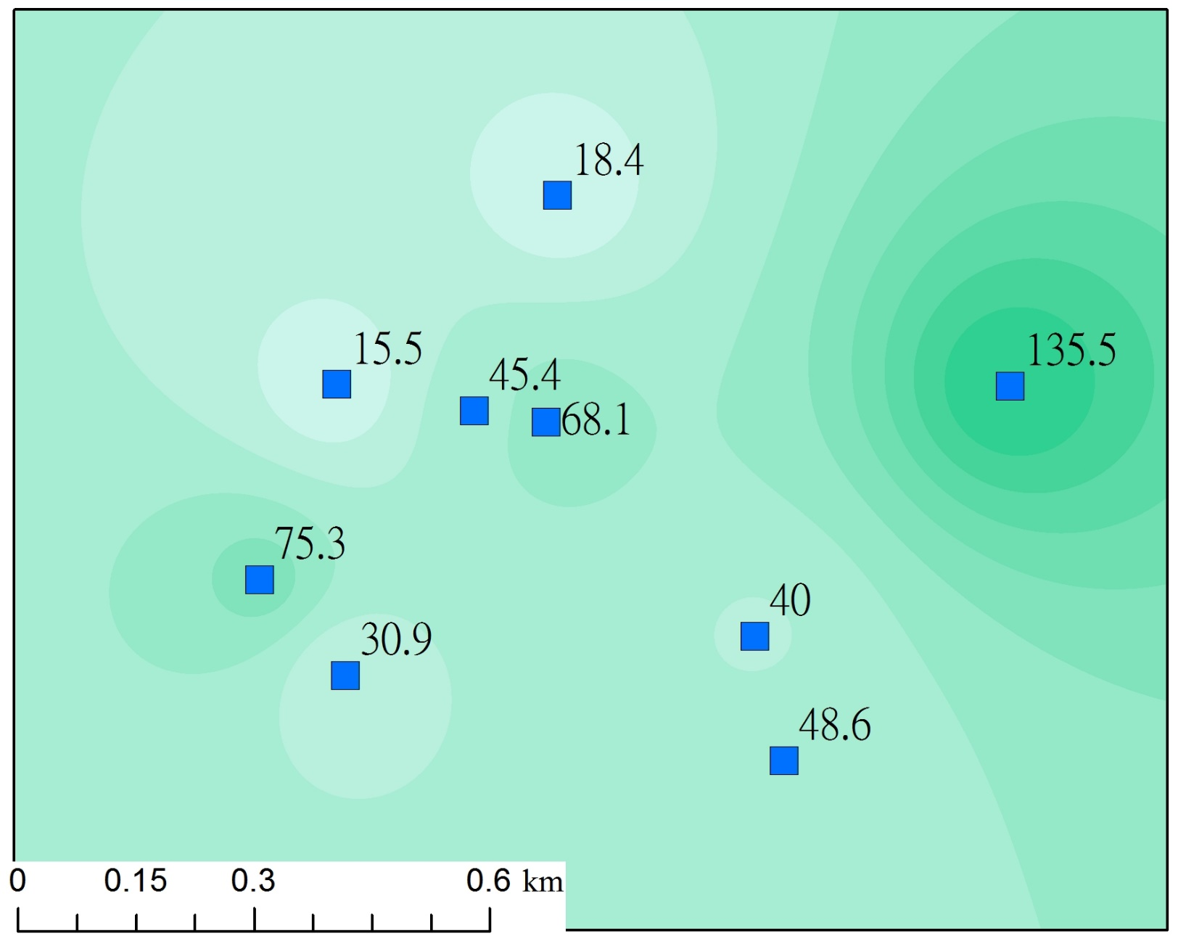
Relative activity level (number of photos per 100 trap nights) of male sika deer in each camera trap
Notes:
Two basic application of camera trap data are to estimate the activity level of animals in a spatial extent, and to estimate their temporal variation of activity, whether seasonal or daily.
We evaluated the relative activity level of male deer for each camera trap. The relative activity level was the number of independent photos which is standardized by 100 trap nights. The larger number represents the higher activity level of deer. This figure suggest that the deer was most active in the east part, and less active in the northwest part, where is close to a recreation area.

Slide 21
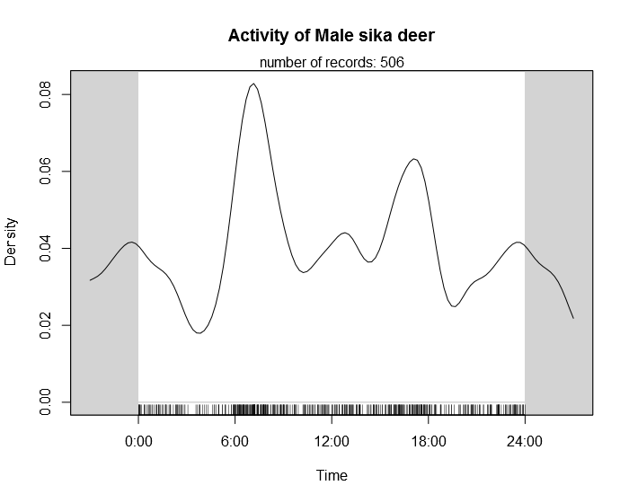
Diel activity pattern kernel density estimation
Notes:
A time period with more photo captures may represent that the deer is more active at that time. We thus applied a kernel density estimation on circular data to evaluate the diel activity pattern of male sika deer. This figure shows the activity of males peaked at dawn and dust, and had another two minor peaks at noon and midnight. It is very similar with the daily pattern of rutting vocalizations.

Slide 22
Field recordings of rutting vocalizations
Spectral hump at frequencies below 5kHz
Emphasized by the difference between the mean and median PSDs
Notes:
From the field recordings, we identified two types of rutting vocalizations, which most of the acoustic energy were at frequencies less than 5 kHz. We divided the recording into 10 second clips. During our analysis, the median spectrum of the clips did not display the acoustic energy of rutting vocalizations because they are transient calls. But, if we measure the difference between mean and median spectra in each clip, the rutting vocalizations can be easily emphasized due to its high amplitude.

Slide 23
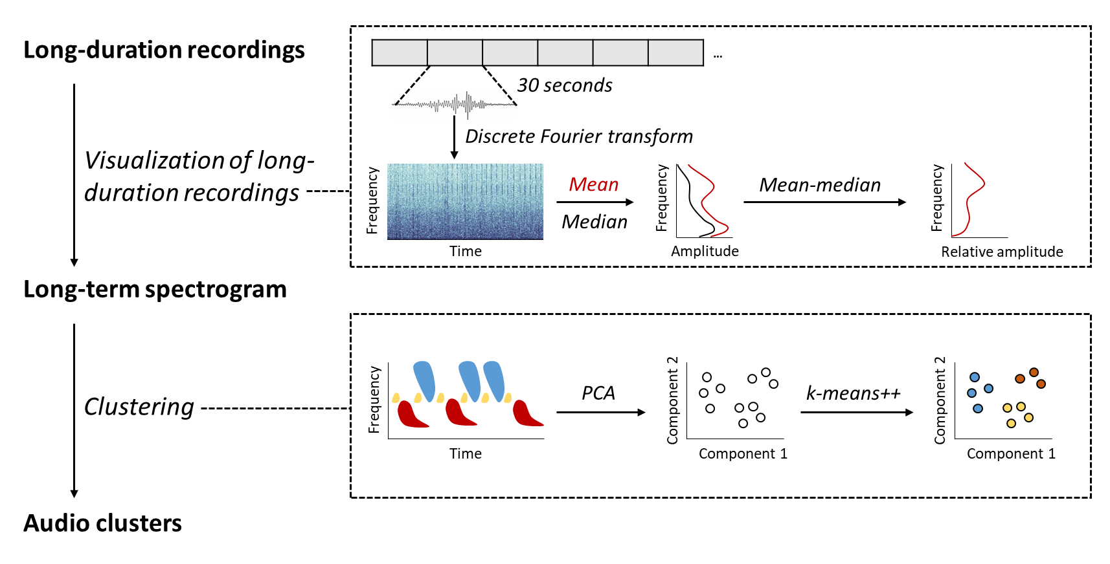
Information retrieval of soundscape
Unsupervised identification of rutting vocalizations of sika deer
Event identification
Notes:
Here illustrates our procedures to identify the rutting vocalizations. At first, we calculate the difference between mean and median spectra in each 10 second clips. Then, we use k-means clustering algorithm to identify audio clusters which display similar spectral shape on the long-term spectrogram. By using the unsupervised learning approach, it is possible to identify rutting vocalizations of sika deer without extensive coding for sound detection and noise reduction.

Slide 24
Spatiotemporal change of soundscapes
Mean-based LTS: noisy soundscapes consisted of rutting vocalizations, bird calls, insect chorus, and wind noise
Notes:
These figures show the one-day long-term spectra average at each recording station. X-axis is the recording time, and the y-axis is frequency. Various sound sources could be summarized in mean-based spectra, therefore, you can see the spatiotemporal changing pattern of soundscapes is quite complicated. Despite that, you can still see many rutting vocalizations at the frequencies below 5 kHz at the Station 1 and 8.

Slide 25
Visualization of long-duration recordings
A mixture of various environmental and biological sounds
Suppress environmental sounds and emphasize the presence of transient calls
Dominate by environmental sounds and insect chorus
Notes:
Here is a closer look for the visualization of soundscape. You can see many rutting vocalizations on the mean-based LTS in the frequency range below 5 kHz. However, these signals are invisible if you use median-based LTS, because the median spectra can only capture the change of background noise and biological chorus. If we take the difference between mean and median spectra, you can see that rutting vocalizations are emphasized.

Slide 26
Spectral features of different audio clusters
Seven clusters (explained 90% of variation) were identified from 9 recording stations
Two clusters were highly associated to spectral peaks of rutting vocalizations
Notes:
In total, there are 7 audio clusters which display unique spectral shapes from the recordings. After a manual identification, we found two clusters were highly associated to rutting vocalizations. Their prominent spectral humped at the frequencies between 1 to 5 kHz.

Slide 27
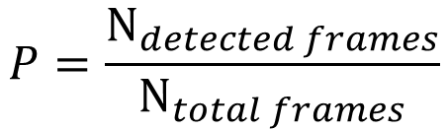
Spatiotemporal change of detection probabilities
$$P=\frac{N_{detected frames}}{N_{total frames}}$$
Heterogeneity in spatial distribution
Prominent crepuscular and diurnal activity
Notes:
By dividing the number of frames identified as rutting vocalizations to the total number of recording frames, we can investigate the spatiotemporal change of detection probabilities. It could be seemed as an index for relative activity level. According to the audio data, the heterogeneity in spatial distribution is high, most of the acoustic activities were recorded at Station 1 and 8.

Slide 28
Changes of acoustic activities during breeding season
Prominent seasonal changes were only observed in the acoustical hot spots
Peaked at late November
Notes:
We downscale the former figure to display the change of acoustic activities during breeding season. The two hot spots, station one and eight, shows the change of acoustic activities peaked at late November, then decreased gradually until the late December.

Slide 29
Diel pattern of acoustic activities
Modeling by spline
Bimodal distribution in detection rates
Daytime recordings will be sufficient for monitoring the variation of acoustic activities
Mean
Confidence interval
Notes:
This figure also derives from the former figure at two slides before. In this figure we can see the diel pattern of acoustic activity more clearly. The acoustic activity peaked at dawn and dusk, which is highly similar with the result we obtained from camera traps.

Slide 30
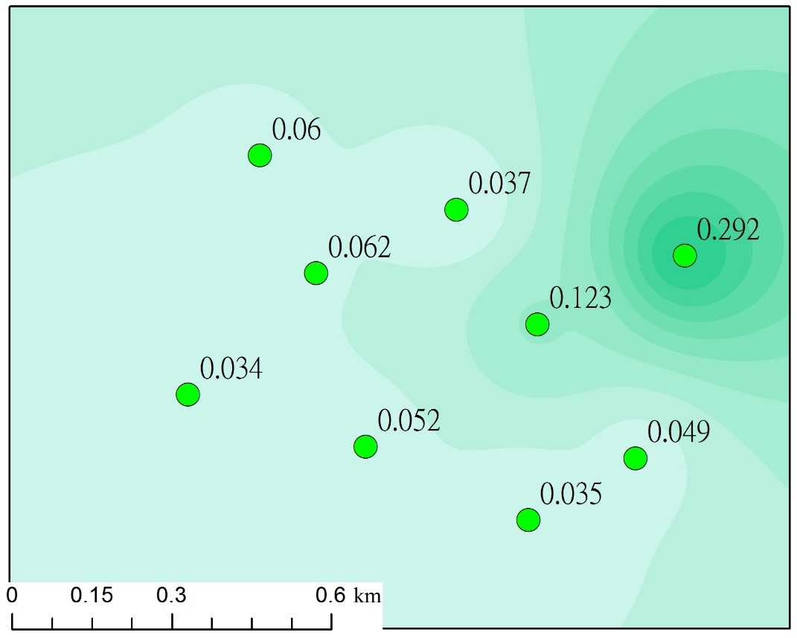
Relative activity level (detection probability) of male sika deer in each recorder
Notes:
We used the detection probability of each recorder as an index of relative activity level and project into the map. The figure suggest the sika deer were more active in the east part and less active in the west part.

Slide 31

Camera trap
Distribution of relative activity level
Recorder
Notes:
Comparing the two maps derived from camera trap data and recorder data. We suggest they are similar. Therefore, the acoustic recorders successfully provided data for two main functions of camera trap, the estimation of diel activity pattern and spatial distribution of relative activity level. Here, I am not talking that the acoustic recorder can replace camera trap. I just wanna display its potential.

Slide 32
Soundscape: a platform for observing various vocalizing animals
Notes:
In addition, the sounds were categorized into 7 clusters. Two are associated with sika deer. Others are likely associated with other sound-producing animals. This figure shows the intensity of this type of sound occurred in a matrix of date and time. By selecting different clusters, we can see how the sound changed across different time and location.

Slide 33
Future applications
Monitoring of distribution
Estimation of population size (minimum size)
Estimation of population size (capture-recapture method)
Recognition of hybrid (sika x red deer)
Monitoring other sound-producing mammals (muntjac, macaque, squirrel…etc)
Notes:
Above is our preliminary study on vocalizations of sika deer. Now I am going to talk about the possible future applications. We have talked about the function of monitoring distribution of animals.

Slide 34
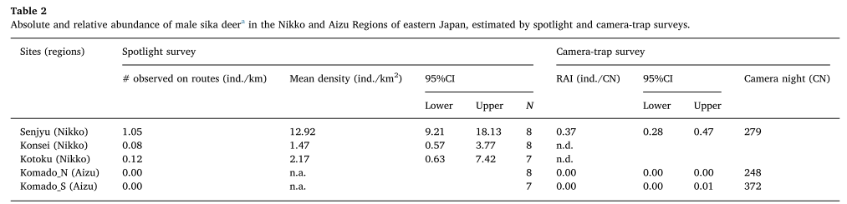
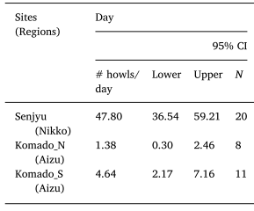
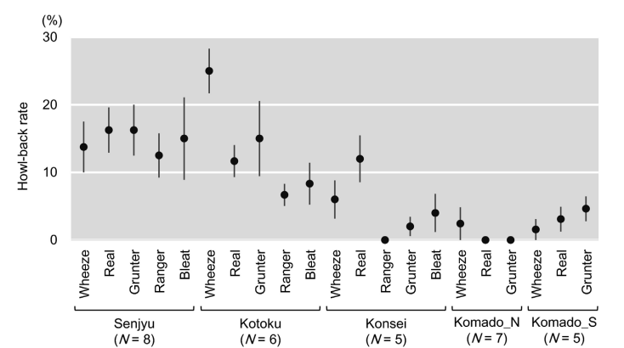
Feasibility assessment of active and passive acoustic monitoring of sika deer populations (Enari et al. 2017)
Notes:
Actually, this idea was completed and published by some scientists. Enari et al. 2017 applied spotlight survey, camera trap, and passive acoustic recorders to monitor sika deer populations at several sites. Spotlight and camera trap were failed to detect sika deer. However, the passive acoustic recorders successfully detected the howls of sika deer, which suggest the outstanding detection ability of acoustic recorder in areas where the deer density are very low. Moreover, they broadcast playback of deer vocalizations to elicit the deer to howl back. This method may also improve the detection probability when using acoustic recorders.

Slide 35
Future applications
Monitoring of distribution
Estimation of population size (minimum size)
Estimation of population size (capture-recapture method)
Recognition of hybrid (sika x red deer)
Monitoring other sound-producing mammals (muntjac, macaque, squirrel…etc)
Notes:
Another topic I am interested in is using sound monitoring to estimate the population size of sika deer. As I mentioned before, the vocalizations of male deer had individuality. Therefore, if we record the soundscape in a certain area, and then extract the vocalizations from sika deer. We can analyze the sound spectrum of the vocalizations, and use statistical method to calculate how many individuals exist. That would be the minimum population size of male deer. Furthermore, we can apply a capture recapture method to estimate the total population size. There are still many technical difficulties to overcome. We will try to solve these problems in the future.
Another application of soundscape monitoring on deer is to recognize the hybrids in the field.

Slide 36
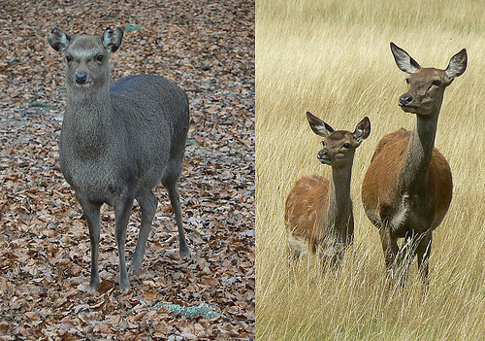
Notes:
Although it’s not the case of Taiwan, Sika deer have caused problem in UK. Sika deer is an alien species to UK, however, they hybridize with the native red deer in the wild, forming red x sika hybrids. It pollute the gene pool of native red deer.

Slide 37
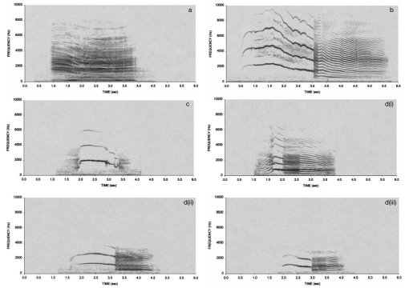
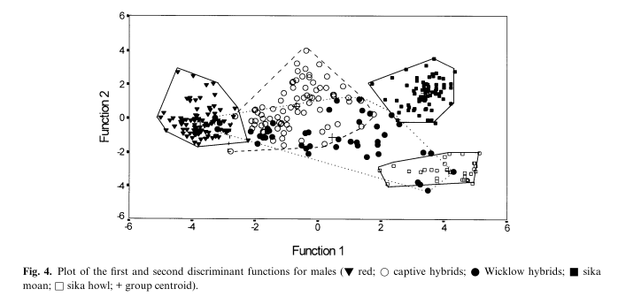
Vocalizations in red deer, sika deer, and red x sika hybrids (Long et al. 1998)
Red deer
Sika deer
Sika deer
Hybrid
Hybrid
Hybrid
Notes:
Both sika deer and red deer, the males emit rutting vocalizations during breeding season. By analyzing the frequencies of those vocalizations, and apply a pca and discriminant analysis, those vocalizations could be correctly categorized into different groups, while the vocalizations of hybrids located between those of sika deer and red deer. Therefore, to detect the presence of hybrids, one may apply a soundscape monitoring, and extract the vocalizations of deer for advanced analysis.

Slide 38
Future applications
Monitoring of distribution
Estimation of population size (minimum size)
Estimation of population size (capture-recapture method)
Recognition of hybrid (sika x red deer)
Monitoring other sound-producing mammals (muntjac, macaque, squirrel…etc)
Notes:
Finally, we suggest all sound-producing animals can be monitored by this tool. In Taiwan, the sound-producing large mammals includes muntjac, Formosan macaque, several species of squirrels.

Slide 39
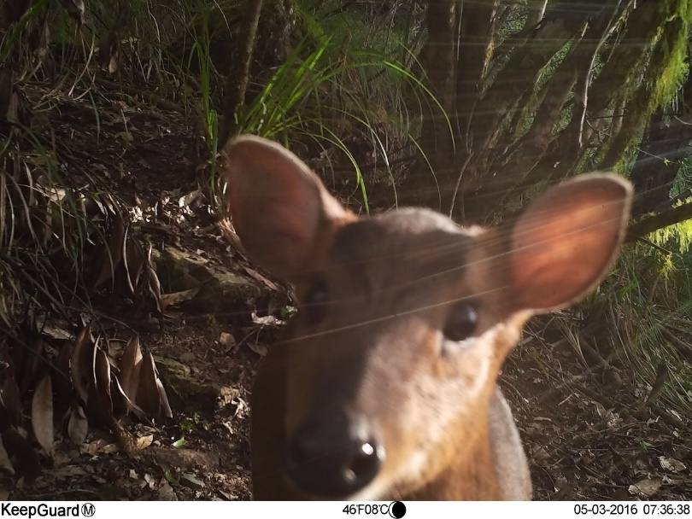
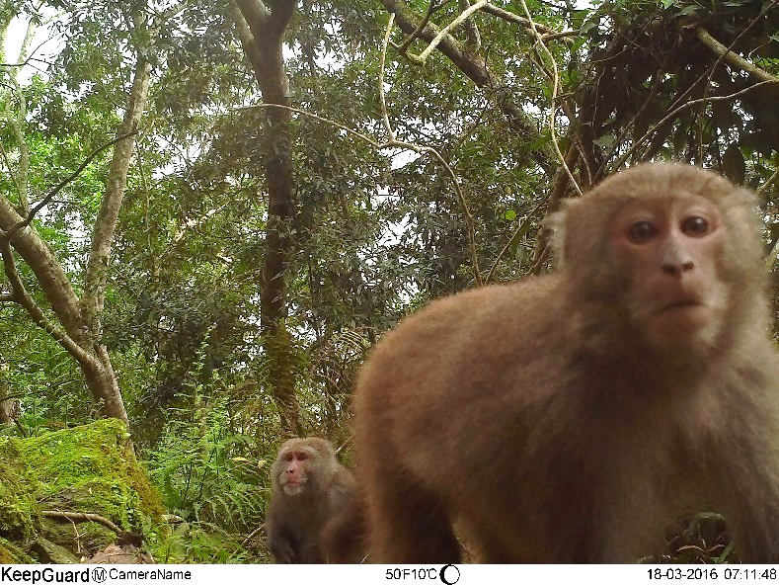
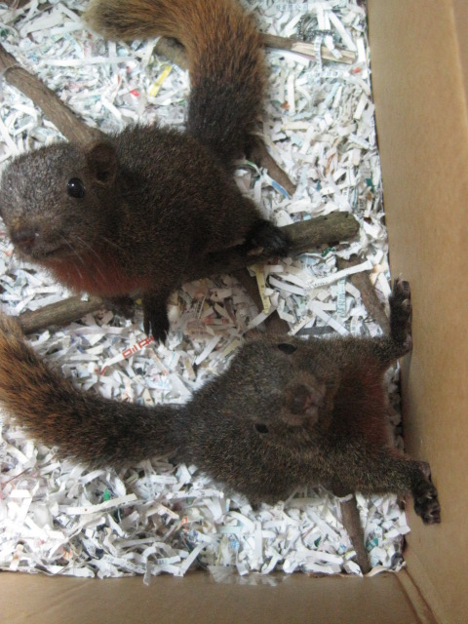
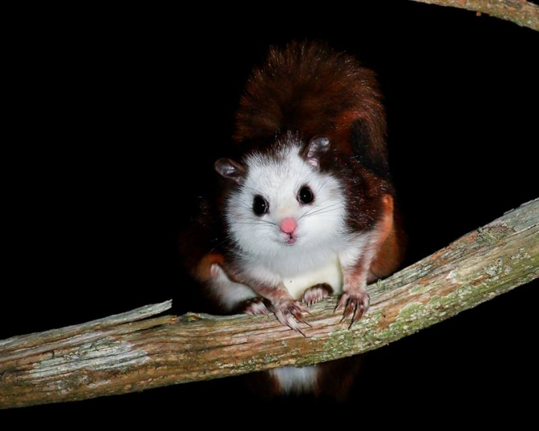
Reeves’s muntjac
Formosan macaque
Red-bellied squirrel
White-faced flying squirrel
Notes:
These species produce sounds very frequently. For example, the muntjac produce loud sounds to advertise their territory. The muntjac and the flying squirrel are game species. They are valuable for some people and are thus under hunting pressure. So long term monitoring on their populations is required. I consider soundscape monitoring can become a tool to monitor them.

Slide 40
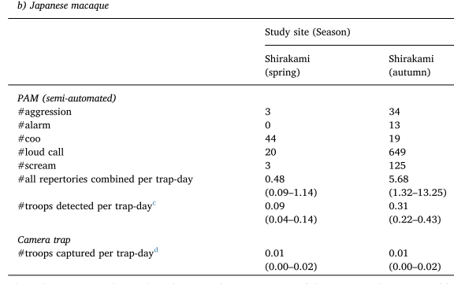
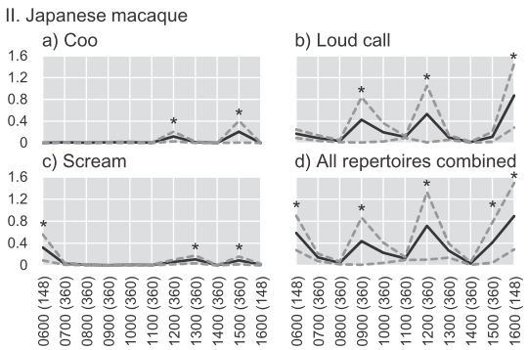
An evaluation of the eﬃciency of passive acoustic monitoring in detecting deer and primates in comparison with camera traps. (Enari et al. 2019)
Notes:
Actually, this idea wad done by those scientists again. In that article, they not only use passive acoustic recorder to monitor sika deer, but also for Japanese macaque. The detection probability of recorder was somehow higher than that of camera traps. Their results also showed the daily and seasonal change of the macaque’s activities.

Slide 41
Combination of camera traps and acoustic recorders provides insight into interaction across multiple trophic levels and taxa
Camera traps | Acoustic recorders
High accuracy on identifications of species, morphology, behavior | Wider detection range
Discover rare or cryptic species | Able to detect arboreal mammals, birds, insects
Focus on medium-large mammals | Target on community or higher level
Understand landscape dynamics | Able to detect human activity
Notes:
Finally, I have to emphasize that we are not saying that the recorders are able to replace camera traps. We suggest that they have their own pons and cons. A combination of these two tools can provide deeper insight into multiple trophic levels and taxa and their interactions. The benefit of camera trap is its high accuracy to identify species, and maybe their morphology and behavior. It’s also helpful to find rare or cryptic animals. But its detection zone is small, only a small area in front of the camera. In comparison, the acoustic recorder has a wider detection range, which maybe in a distance of 100 m or so. It’s also able to detect a wider range of taxa, such as arboreal mammals, birds, and insects. So the study using acoustic recorders can target on animal community or higher level of biodiversity. In addition, camera traps helps to understand landscape dynamics, such as the changes of vegetation type. And the sound recorder is able to detect human activities, such as hunting, logging, or noise pollution. Therefore, we look forward to seeing the combination of these two tools.

Slide 42
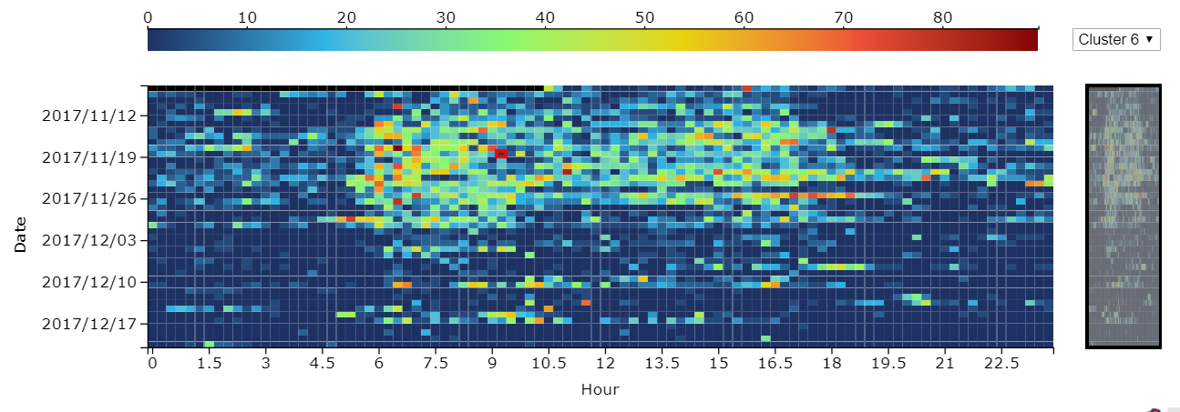
Spatiotemporal change of detection probabilities
Notes:
We have already put these results on our webpage. Let me show you a brief demonstration.

Slide 43
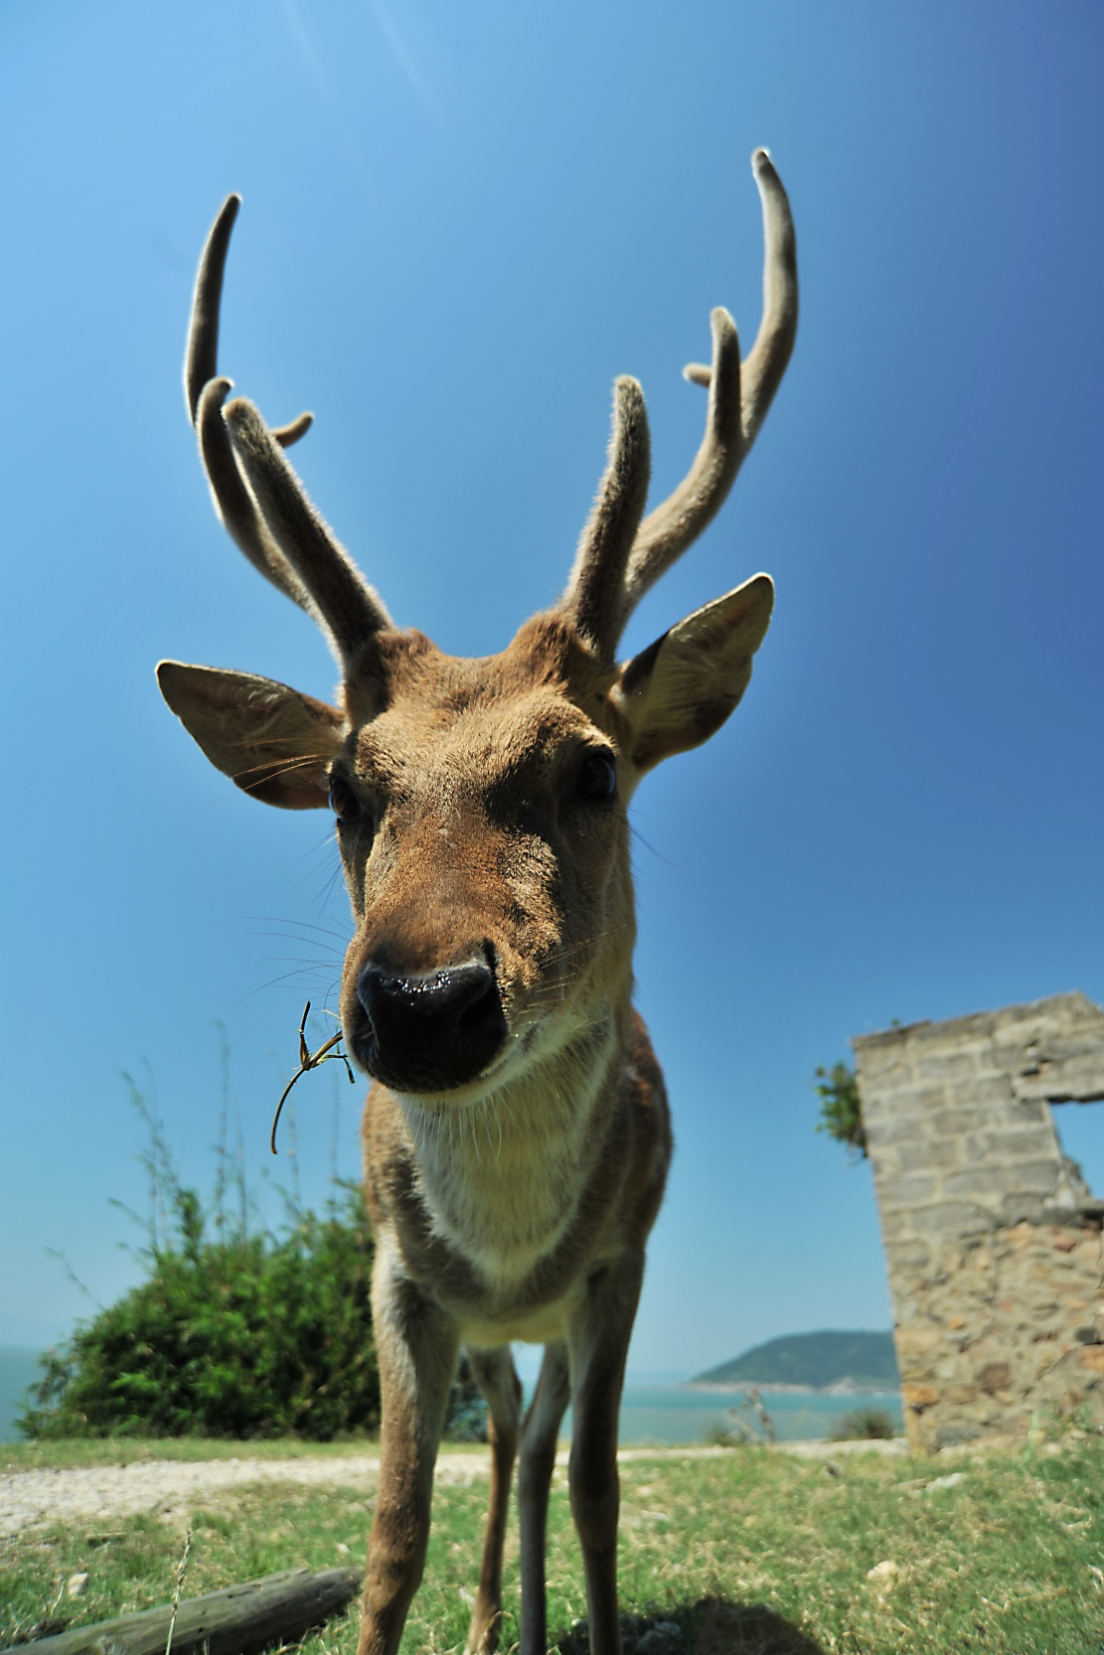
Thanks for your attention

