Slide 1
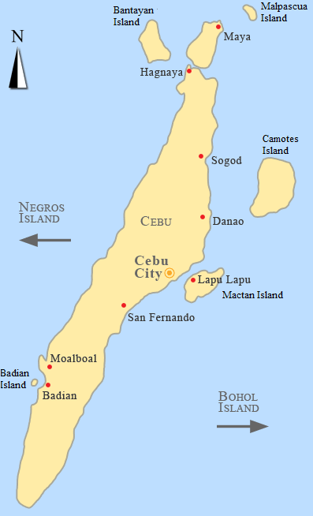
Coral Soundscapes of Cebu, Philippines:
Initial Results and Future Directions
Florence C. Evacitas¹ and Tzu-Hao Lin²
¹University of the Philippines Cebu, Cebu City, Philippines
²Japan Agency for Marine-Earth Science and Technology, Yokosuka City, Kanagawa, Japan

Slide 2
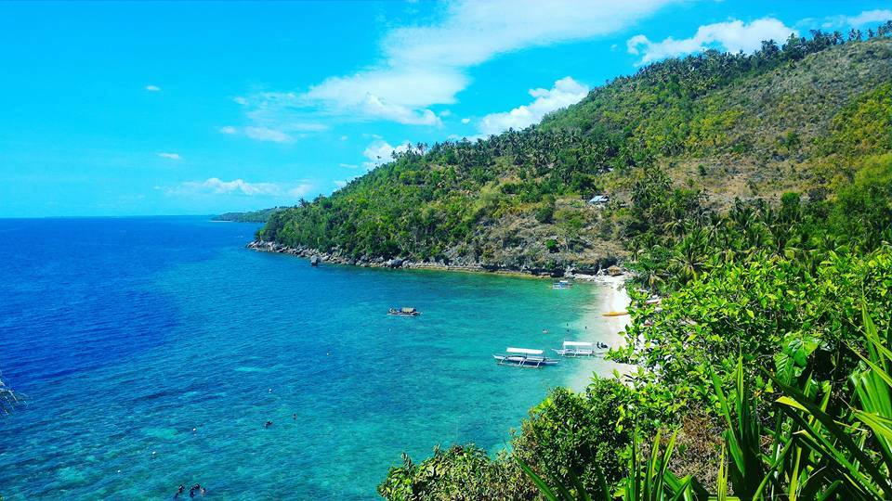
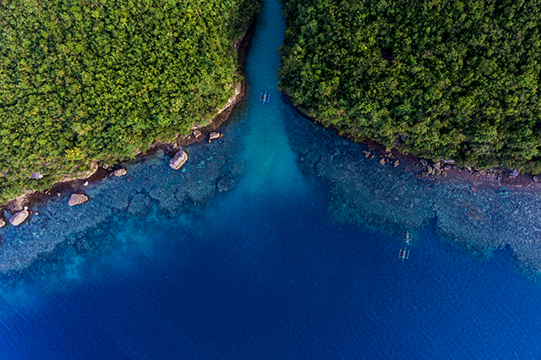
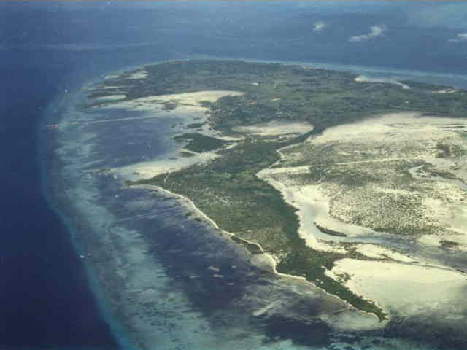
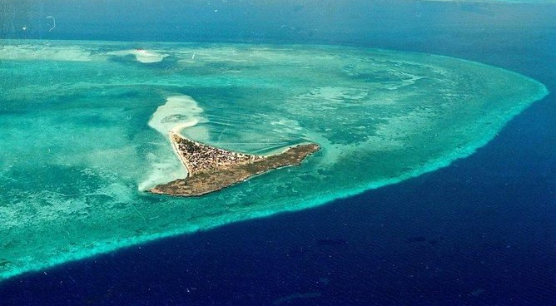
Diversity of coastal ecosystems in Cebu
Photo by Jomar Lipon https://www.driftstories.com/philippine-scenery-capture-with-zenfone
http://www.lloyedvalenzuela.com
http://www.malapascua.de/Cebu/Olango_Island/olango_island.html
https://www.mylittleadventure.se/best-things/cebu-city 2016 - 2019 © MyLittleAdventure

Slide 3
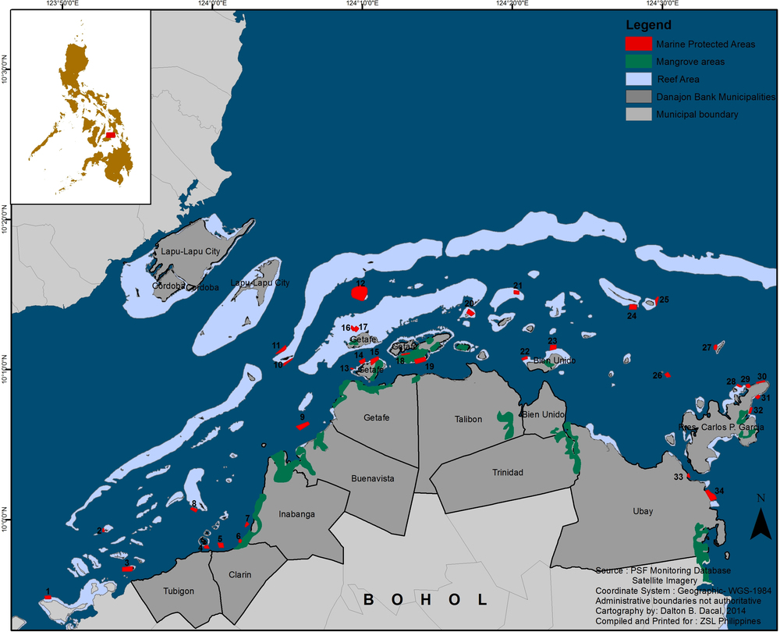
Danajon Bank (double barrier reef)
http://www.projectseahorse.org/action-marine-protected-areas

Slide 4
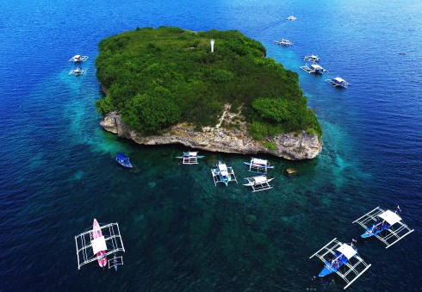
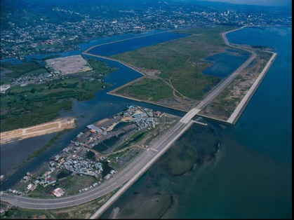
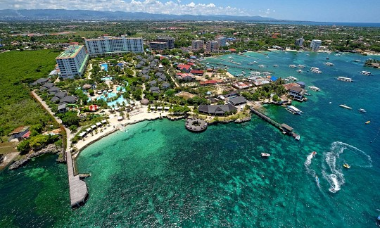
Diversity of uses
Tripadvisor/moalboal/pescador
Tripadvisor/moalboal/pescador

Slide 5
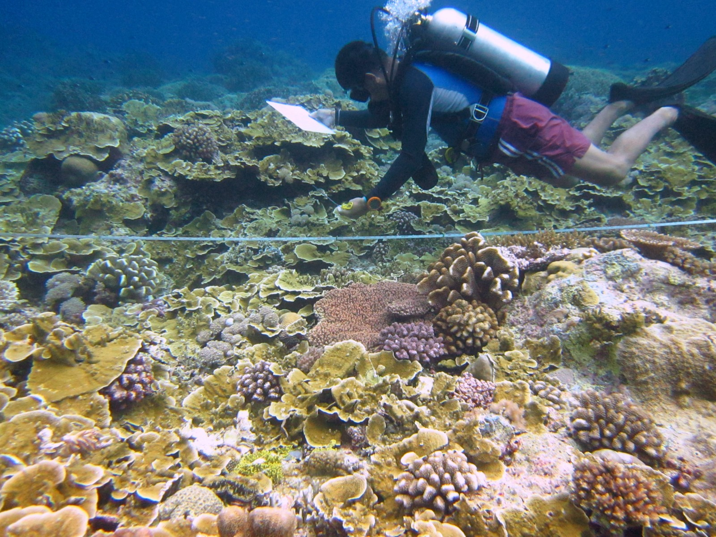
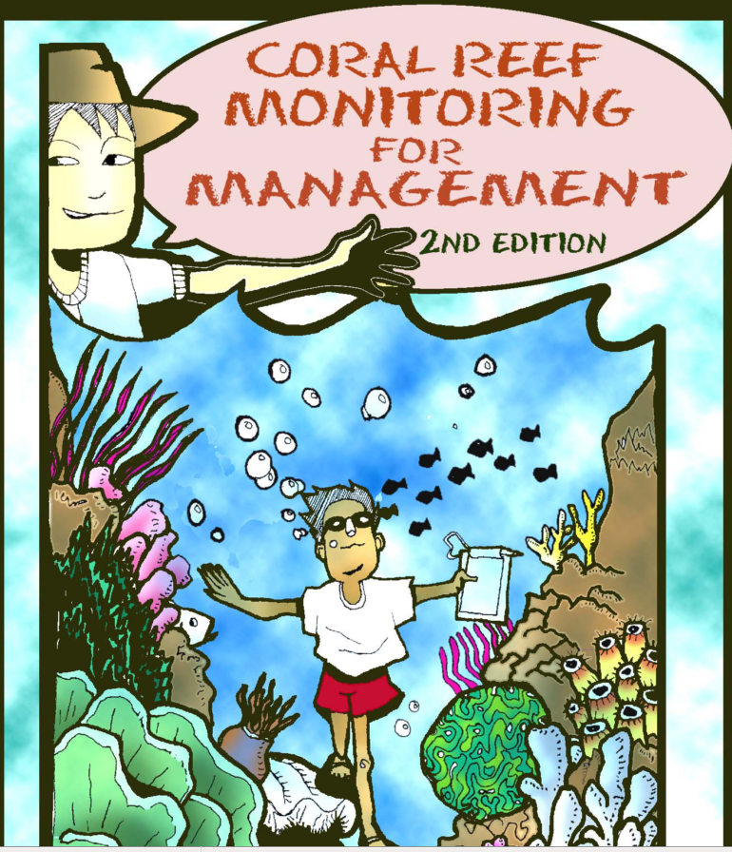
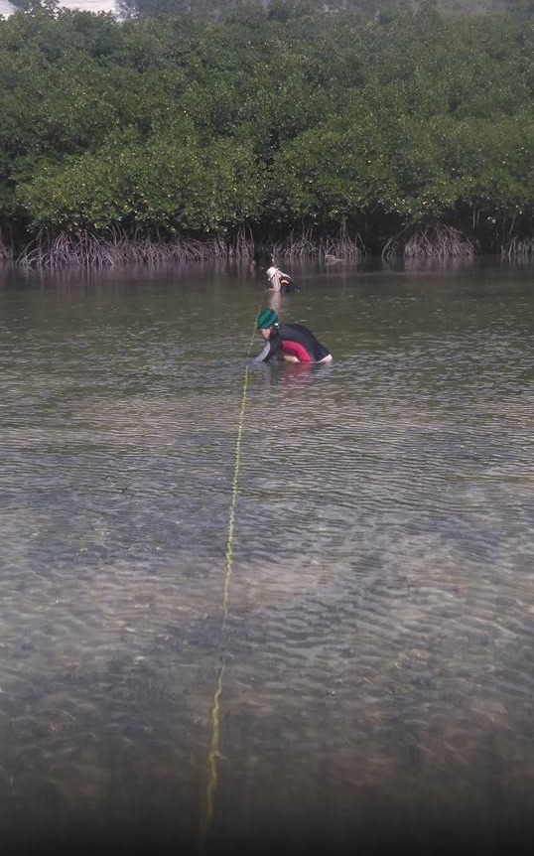
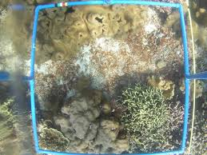
Monitoring is mostly done visually
http://thecoraltriangle.com/stories/take-your-diving-to-the-next-level-with-reef-checks-eco-diver-training
bmb.gov.ph

Slide 6
Indicators of reef health
% Cover of live corals
Non-MPA
Non-MPA

Slide 7
Count and estimated biomass of fishes
Fish Density (indiv/m³)
stock status
recruitment
habitat health
MPA
Non-MPA
Fish Biomass (g/m³)
MPA
Non-MPA

Slide 8
Main goal
To characterize the spatiotemporal soundscape patterns of different marine ecosystems
  factors that may influence such patterns
Ecosystem type
Location
Tidal cycle
Use pattern
Level of Protection
Environmental gradient

Slide 9
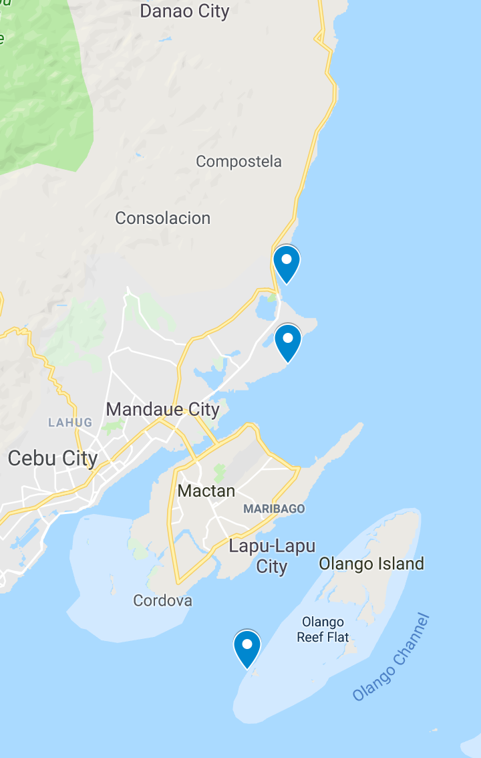
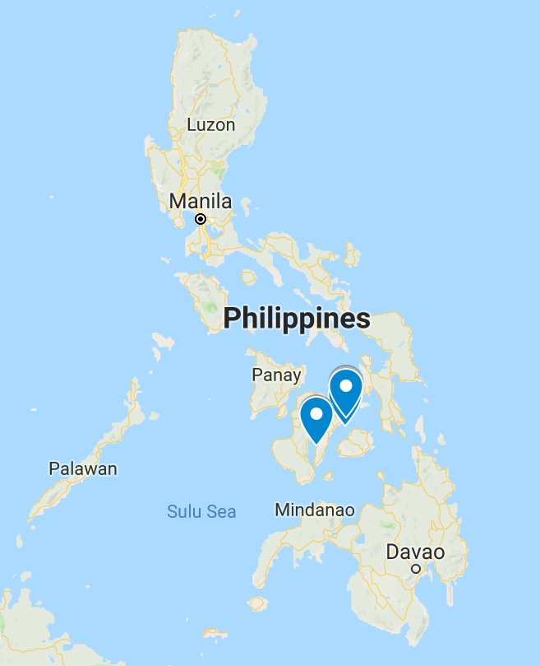
Current progress in Cebu
Current progress in Cebu
Field works since Dec 31, 2018
Feasibility test @ Badian
Long-term monitoring sites:
Guilutongan (Reef Edge)
Liloan (Reef)
Liloan (Seagrass)
Liloan (Reef)
Liloan (Seagrass)
Guilutongan (Reef Edge)

Slide 10
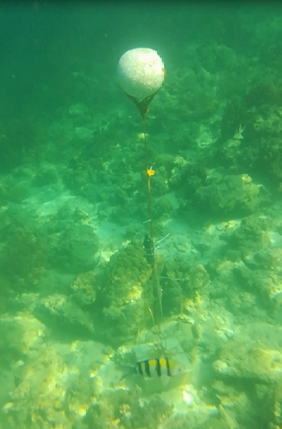
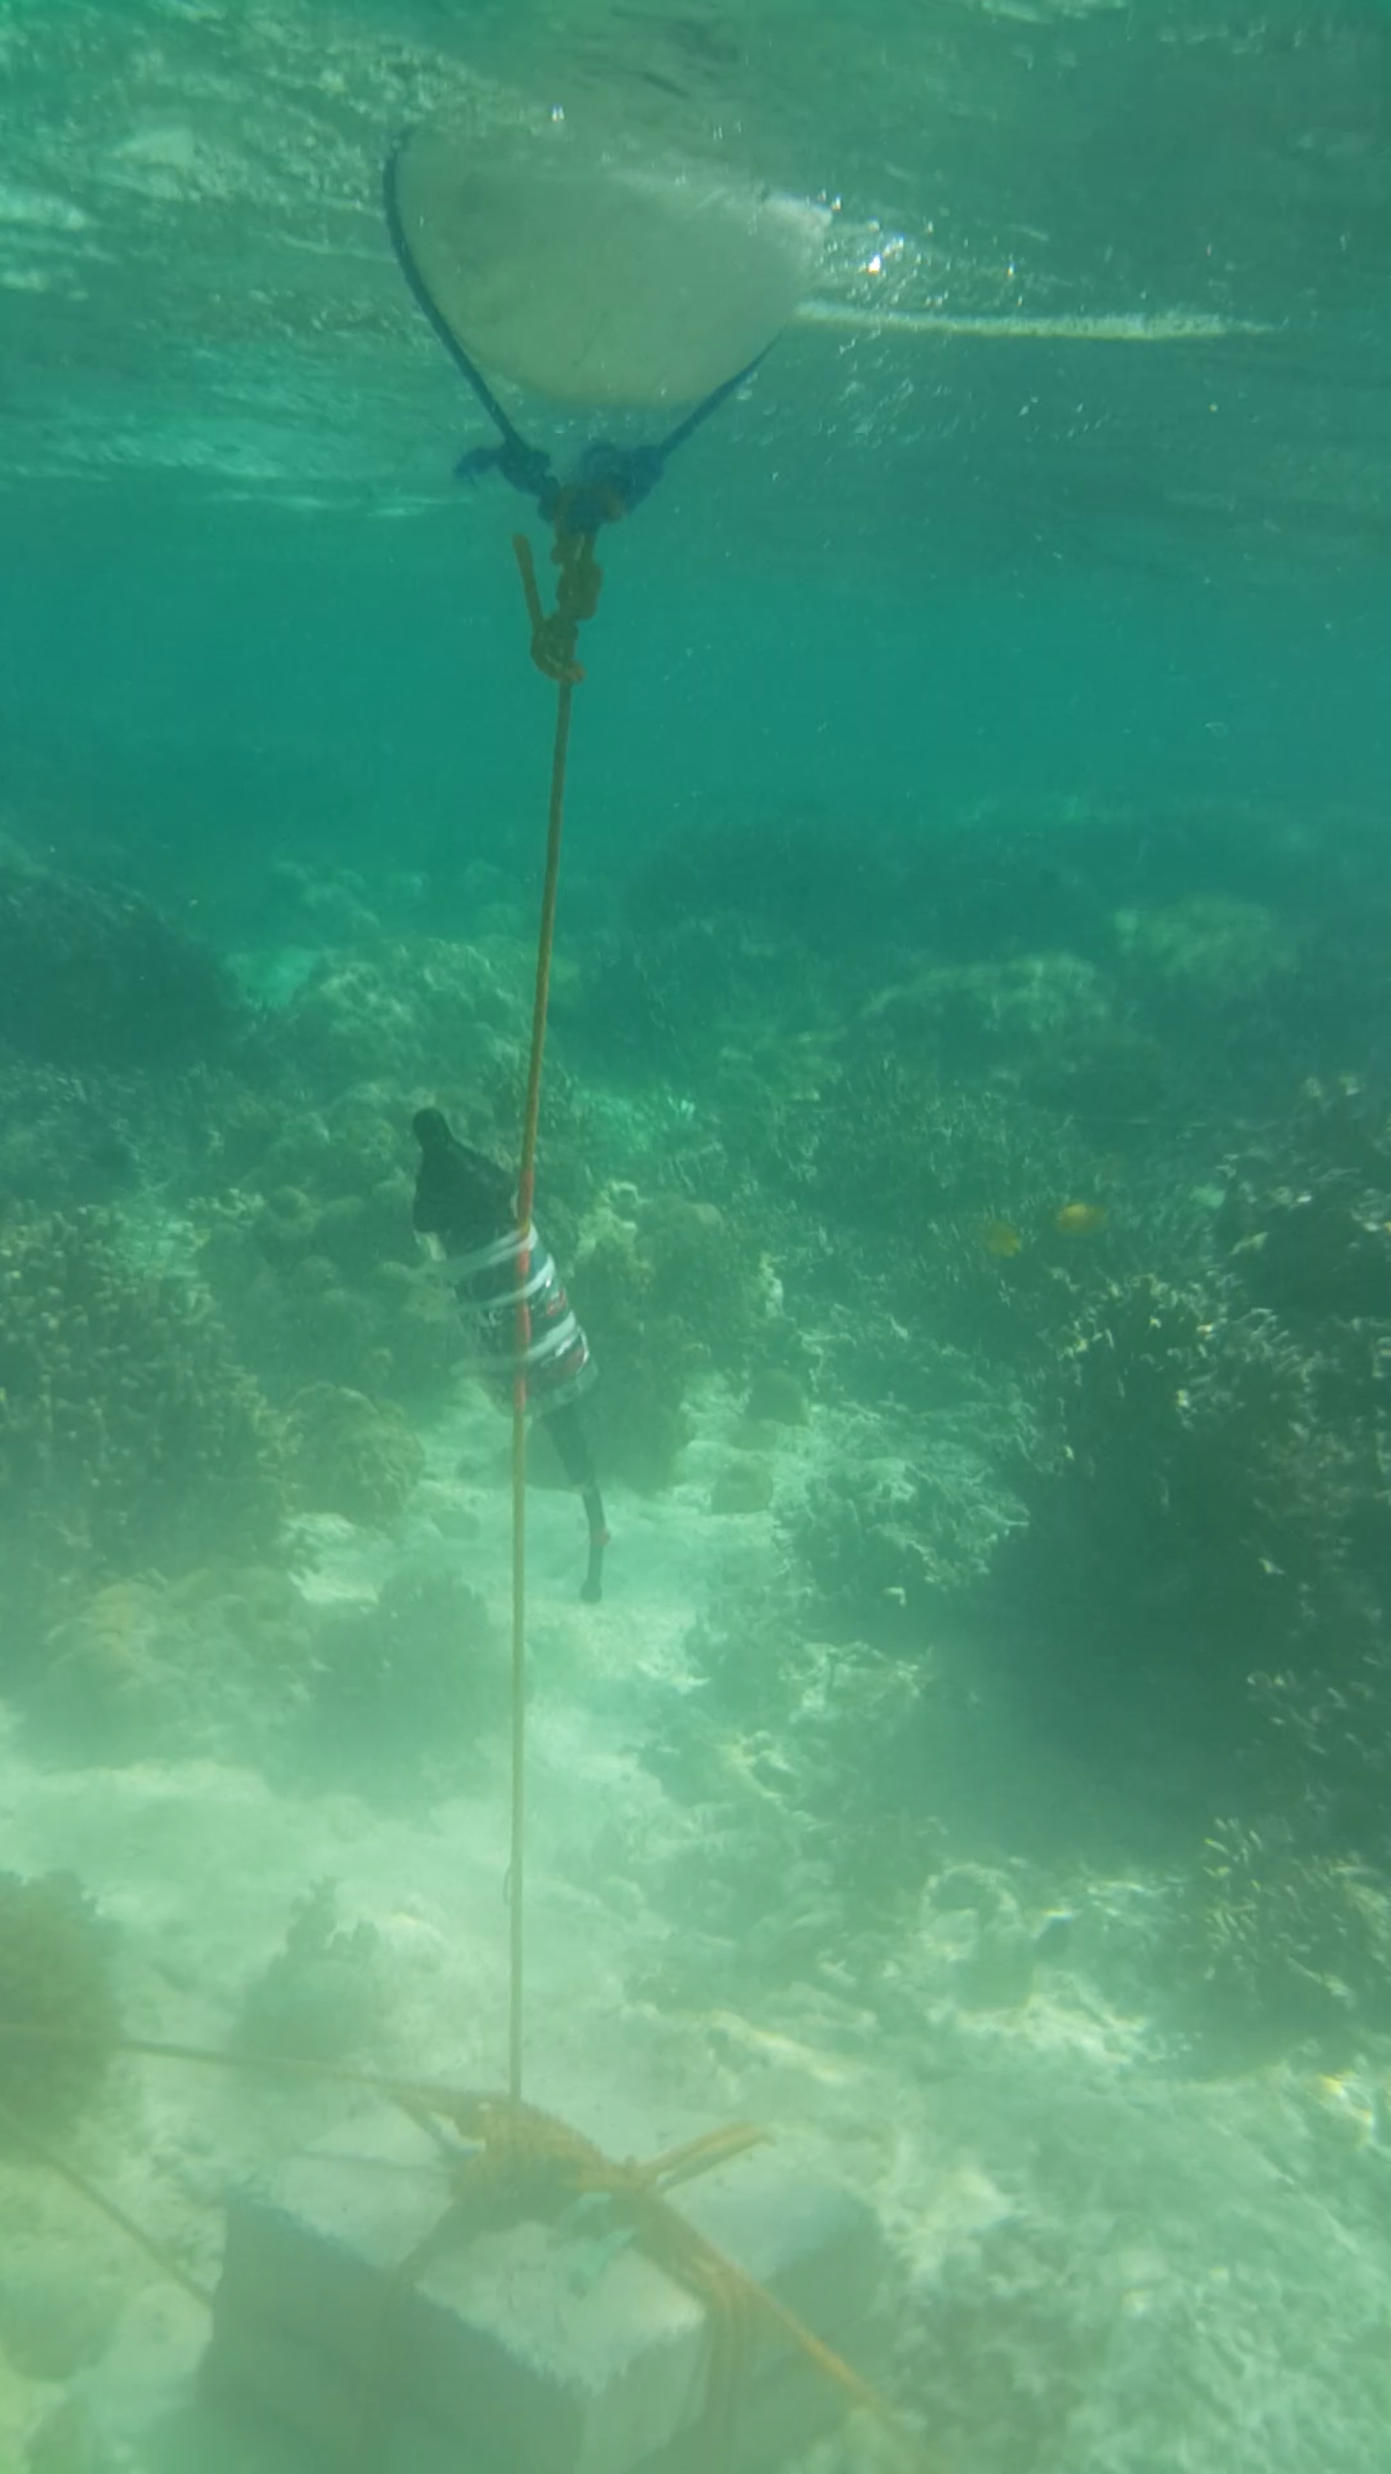
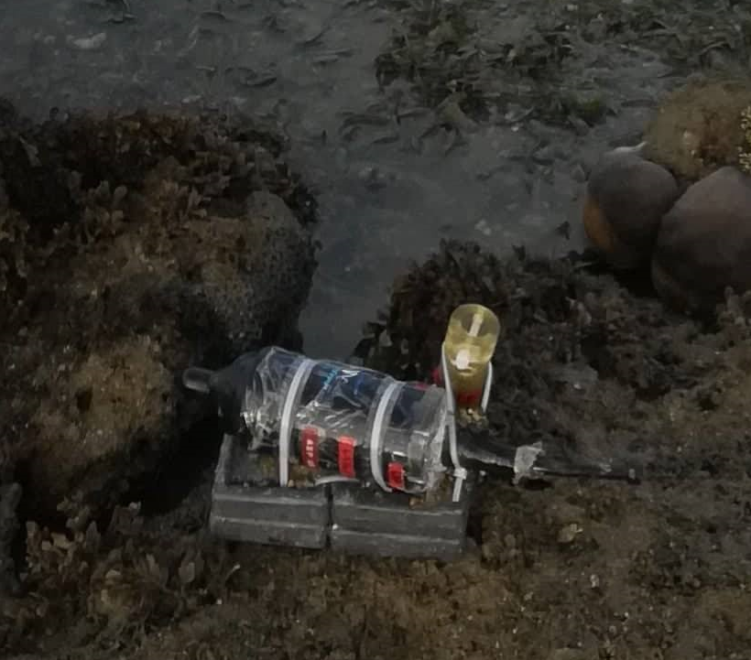
Recorder deployment
Reefs
Seagrass
Depth at spring tide:
1.0 m
0.5 m
3.2 m

Slide 11
Acoustic analysis procedures
Noise

Slide 12
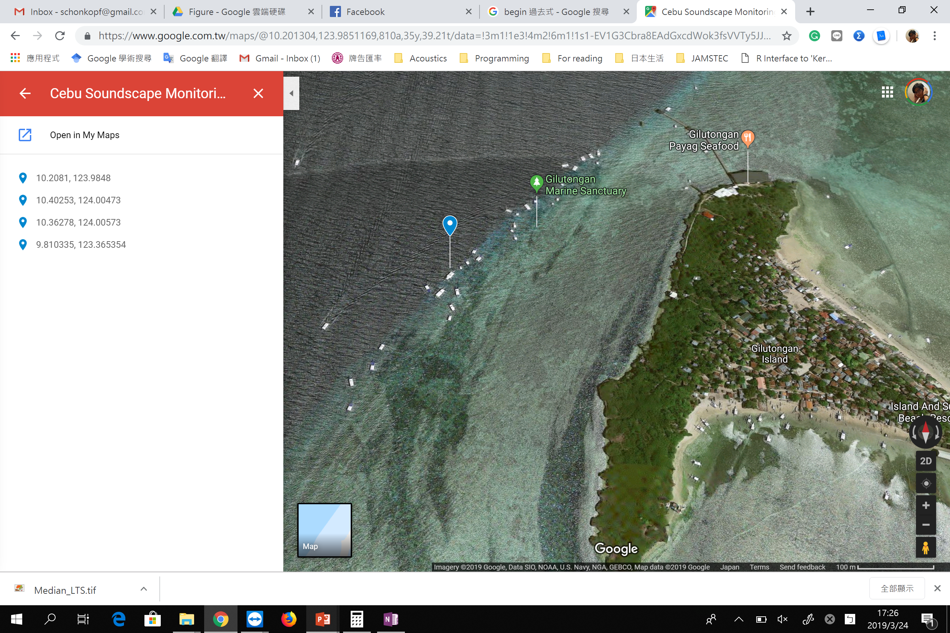
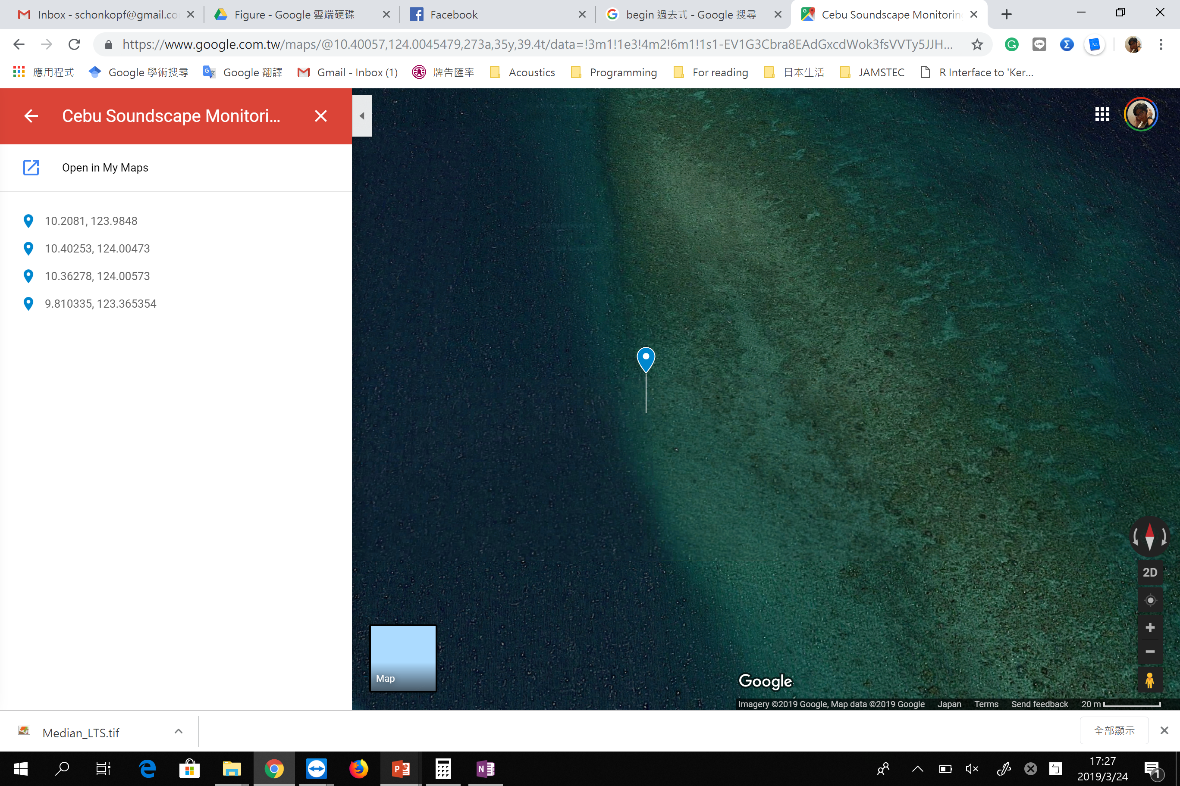
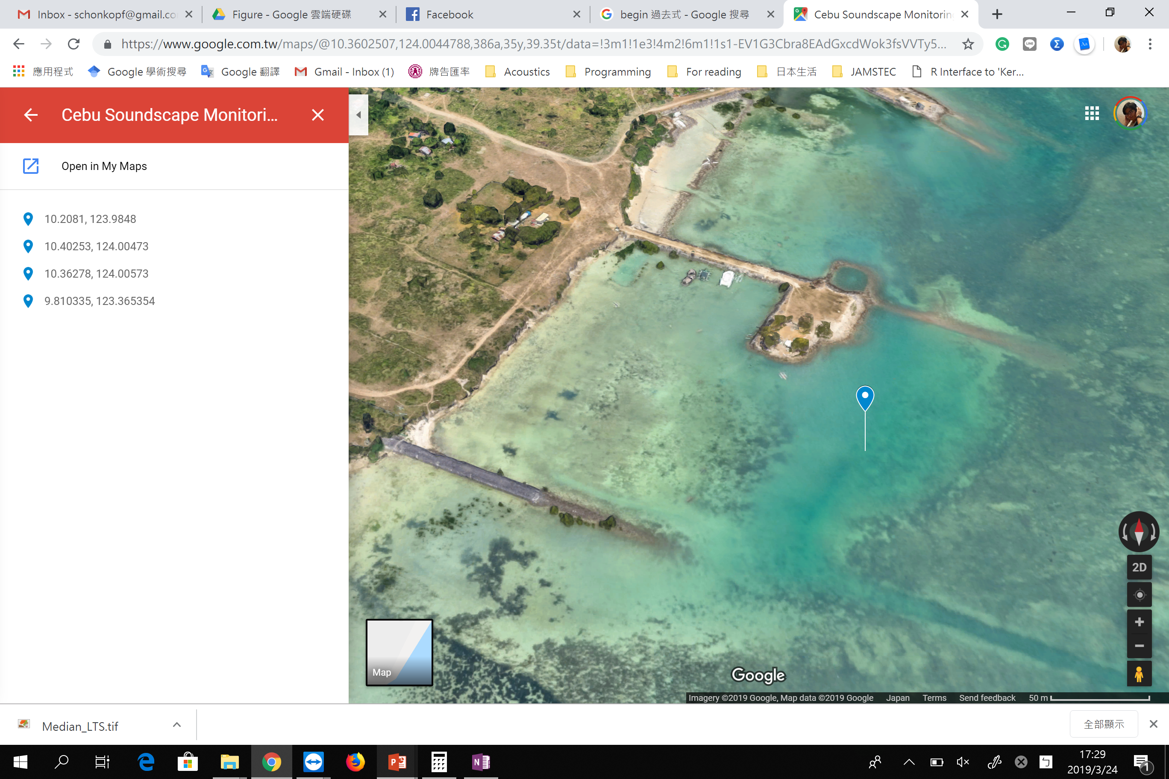
Reef Edge
Reef
Seagrass
Dive site
No fishing activities
Strict protection
Protected area
Limited recreational activities

Slide 13
Reef edge soundscape
@ Guilutongan
Long-term spectral median
Sounds of snapping shrimps
Fish choruses
Noise

Slide 14
Reef edge soundscape @ Guilutongan
Nocturnal behavior of biological sounds vs. daytime utilization of recreational activities
Interactions between boat noise and biological sounds?

Slide 15
Reef soundscape @ Liloan
Long-term spectral median
Biological chorus
Noise

Slide 16
Reef soundscape @ Liloan
Diurnal and tidal driven activities of biological choruses
Noise mostly from surface waves and tidal waves

Slide 17
Seagrass soundscape @ Liloan
Long-term spectral median
Biological chorus
Noise

Slide 18
Seagrass soundscape @ Liloan
Diurnal and tidal driven activities of biological choruses
Shipping activities (0.5-1 min) mostly occurred in the daytime

Slide 19
Soundscape specific to individual marine ecosystem/habitat
Guilutongan (Reef Edge)
Seagrass: Lower level of biological chorus
Reefs: Higher level of biological chorus
  Liloan: environmental noise
  (higher mean level but lower variation)
  Guilutongan: anthropogenic noise
  (lower mean level but higher variation)
Liloan (Reef)
Liloan (Seagrass)
Mean
STD
Mean

Slide 20
More sounds to explore…
Reef Edge
Reef
Seagrass
Mean spectra can visualize the acoustic contribution of transient signals, such as fish calls and other sounds of marine animals (also noise)
Diversity of transient signals may be another important acoustic cue for the marine biodiversity
Combining soundscape with other survey techniques to investigate the spatiotemporal change of marine biodiversity
Soundscape heterogeneity at microhabitat scale

Slide 21
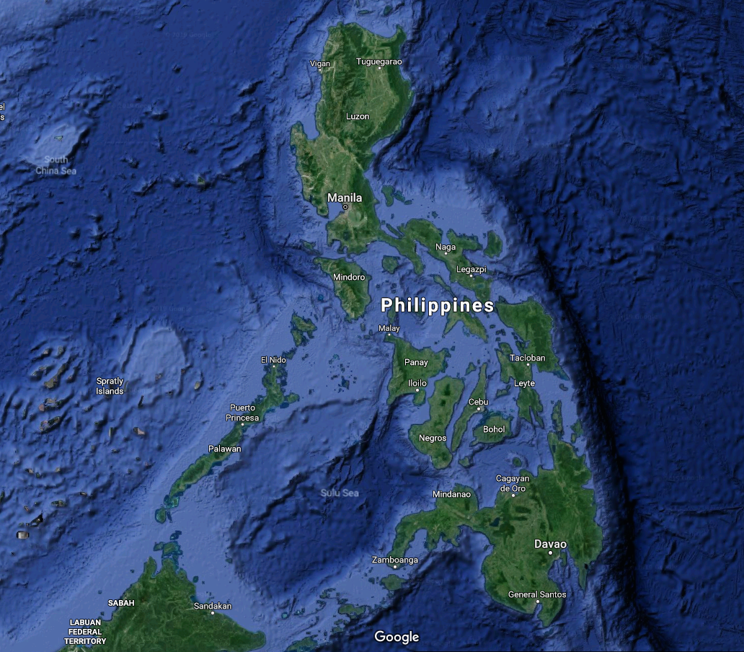

More sites to explore …
Benham Bank
(May 2019)
Liloan Reef
(April - December 2019)
Tubbataha Reefs
(April 2019)
Imagery ©2019 Data SIO, NASA, U.S. Navy, NGA, GEBCO, Landsat / Copernicus, Data LDEO-Columbia, NSF, NOAA, Map data ©2019 Google

Slide 22
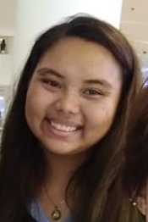
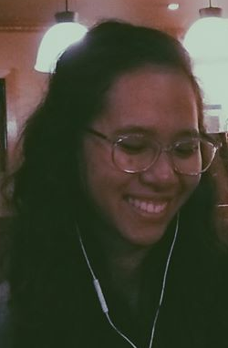
We thank …
Asi@Connect
Local Government Units of Liloan and Cordova, Cebu
Protected Area wardens
Jhoanna
Pia
Claire

